Slide 1
Readiness of the FOS monitor for DESY’s thermo-mechanical mock-up. Kloster Seeon, May 19th DEPFET Workshop
D. Moya, I. Vila, A. L. Virto., J.González
Instituto de Física de Cantabria (CSIC-UC)
G. Carrión, M. Frövel.
Instituto Nacional de Técnica Aeronautica (INTA)

Slide 2
Outline
Status and issues concerning the FOS integration in DESY’s thermo-mechanical mock-up.

Slide 3
Fiber cables and sensors for the mock-up
Four cables with four sensors
Additional FOS with not specific support (see next table)

Slide 4
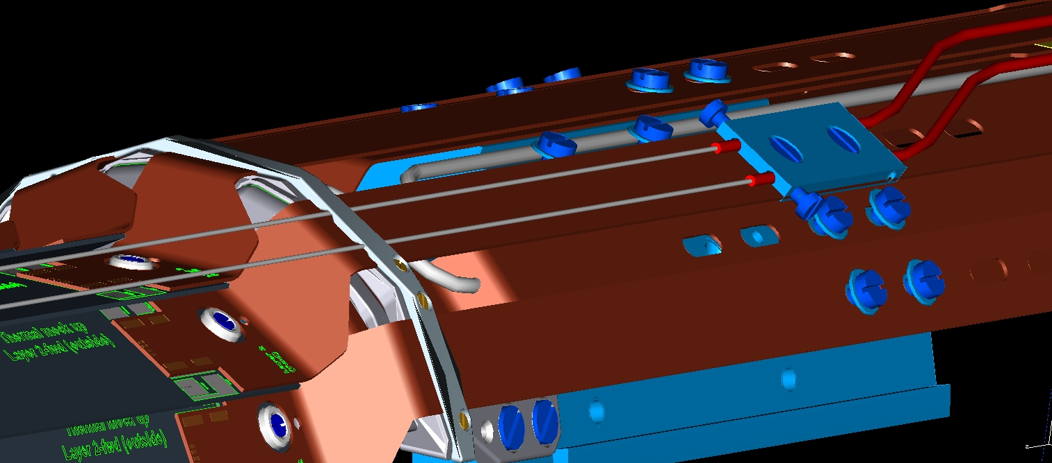
Mock-up Fibers routing
For humidity fibers the routing will be the same as for the final solution
Teflon protected fibers( temperature) routed above the ring (The diameter is not small enough)

Slide 5
FOS at DESY test beam
Fibres for PXD thermal set-up
Fibre Nº | Nº of sensors | position | protection | parameter
51 | 4 | On top of PXD on air | Teflon | Temperature
52 | 4 | On top of PXD on air | Teflon | Temperature
53 | 4 | On top of PXD on air | Teflon | Temperature
37 | 2 | On top of PXD on air | - | broken
38 | 4 | On top of PXD on air | - | Temperature + humidity
OS-4210 | 1 | To be defined | metal | Temperature
sensor 1 | 1 | To be define | Teflon | Temperature
Fibre 1 polyimida | 2 | To be define | - | Temperature + humidity
Fibre 2 polyimida | 2 | To be define | - | Temperature + humidity
SN89356/0003 | 1 | To be defined | metal | Temperature
 | New sensors
 | January 2015 Test Beam sensors

Slide 6
Mock-up: Basic Fiber layout
Three fibers mounted inside a sealed Teflon tubing (0.9 mm ext. diameter) to prevent humidity sensitivity of the FBG sensors.
Additional fiber sensible to humidity partially inside a Teflon or steel tubing outside the sensitive volume.
Temperature sensitivity of the FBGs in the fibers from calibrations
The strain-induced temperature offsets to be determined just after the fiber fixation in the mock-up (requires precise temperature and humidity measurement at the fixation time using reference sensors).

Slide 7
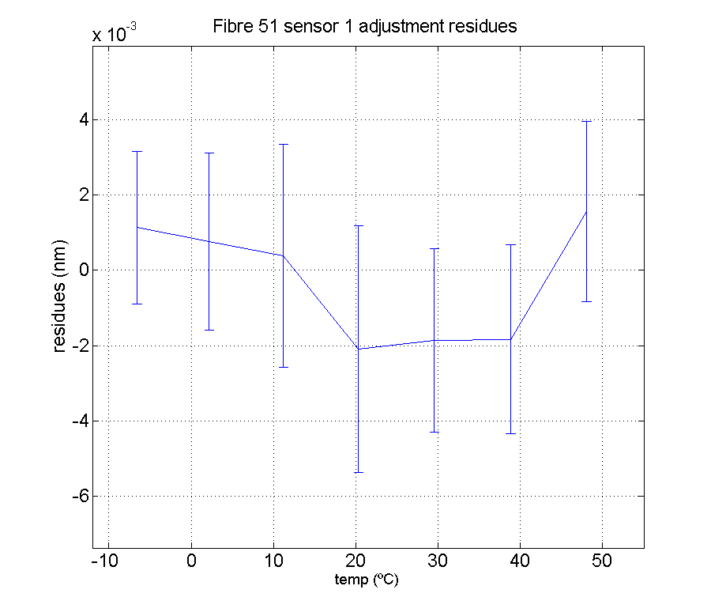
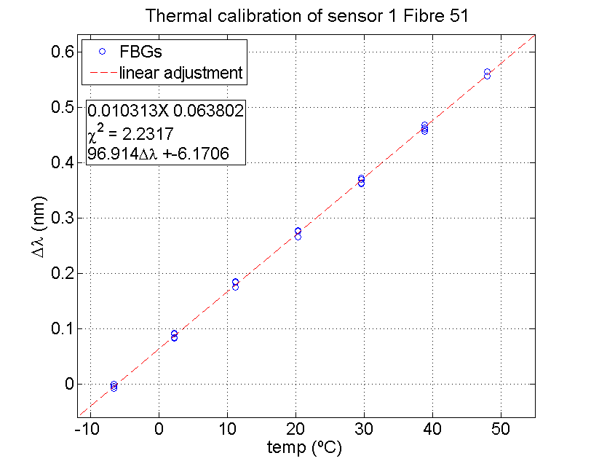
Protected fibers thermal calibration
Test beam fibers: same calibration parameters used
All the new fibers calibrated with temperature and the temperature sensitivity have been obtained.(σ < 10 pm ( 1ºC) for almost all sensors)

Slide 8
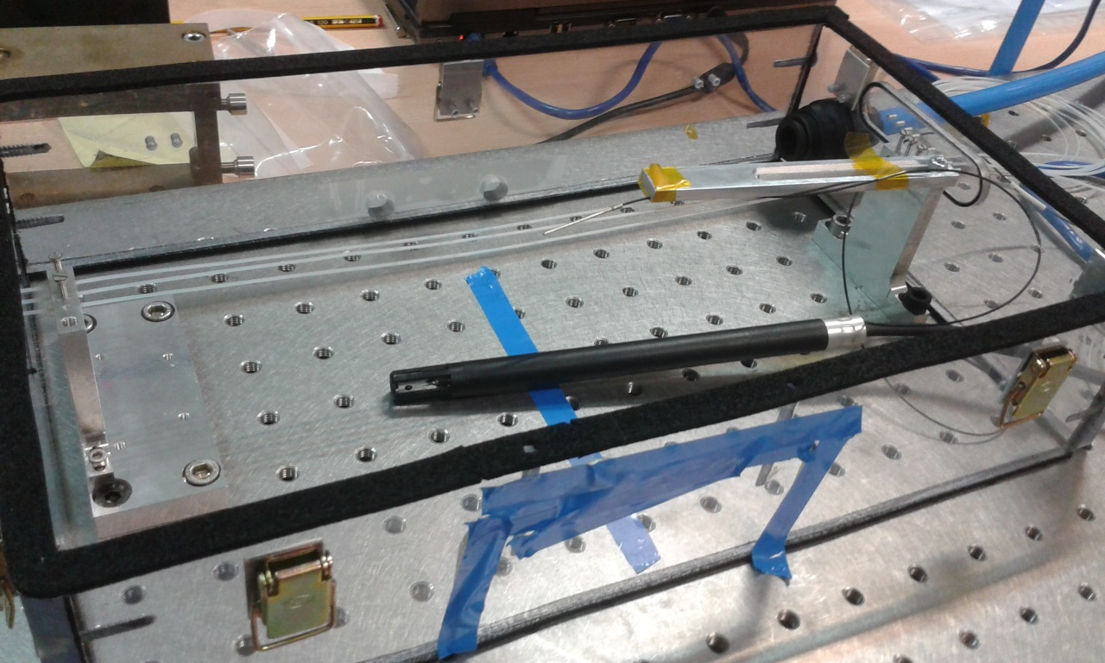
Strain reproducibility test
Check the repeteability of the FBG sensors readout during several fibre fixing test (3 times) .
Teflon protected fibers
Temperature reference sensor
Fibers locking points
Thermohygrometer

Slide 9
Strain reproducibility test results
Very good repeteability ( σ < 5 pm)
 |  | Mean ofset (nm) | σ (pm)
Fibra 51 | F51-S1 | 1530,0027 | 3,4
 | F51-S2 | 1540,1130 | 1,4
 | F51-S3 | 1549,8907 | 3,2
 | F51-S4 | 1559,8850 | 4,8
Fibra 52 | F52-S1 | 1529,9430 | 3,9
 | F52-S2 | 1540,0732 | 2,3
 | F52-S3 | 1549,9356 | 2,7
 | F52-S4 | 1559,6151 | 1,3
Fibra 53 | F53-S1 | 1529,9510 | 4,8
 | F53-S2 | 1540,1448 | 1,0
 | F53-S3 | 1549,9159 | 2,0
 | F53-S4 | 1559,9192 | 2,1

Slide 10
R/O of the fibers
For PXD mock-up DAQ ready: Readout integrated in epics similar to the test beam ( it is expected to be integrated smoothly)
The SVD fiber monitor will use the same interrogating unit. How should be proceed with the read integration ?

Slide 11
Plans
Next week: final check on the kind of tubing to be used for the humidly fibers (Teflon or steel)
Assuming installation of fibers in the PXD mock-up during the first half of June

