Slide 1




PXD9 Pilot run
Analysis of transfer characteristics from W35 of PXD-9-6
Paola Avella, Daniel Klose, Christian Koffmane, Jelena Ninkovic, Rainer H. Richter
for the MPP/HLL team

Slide 2


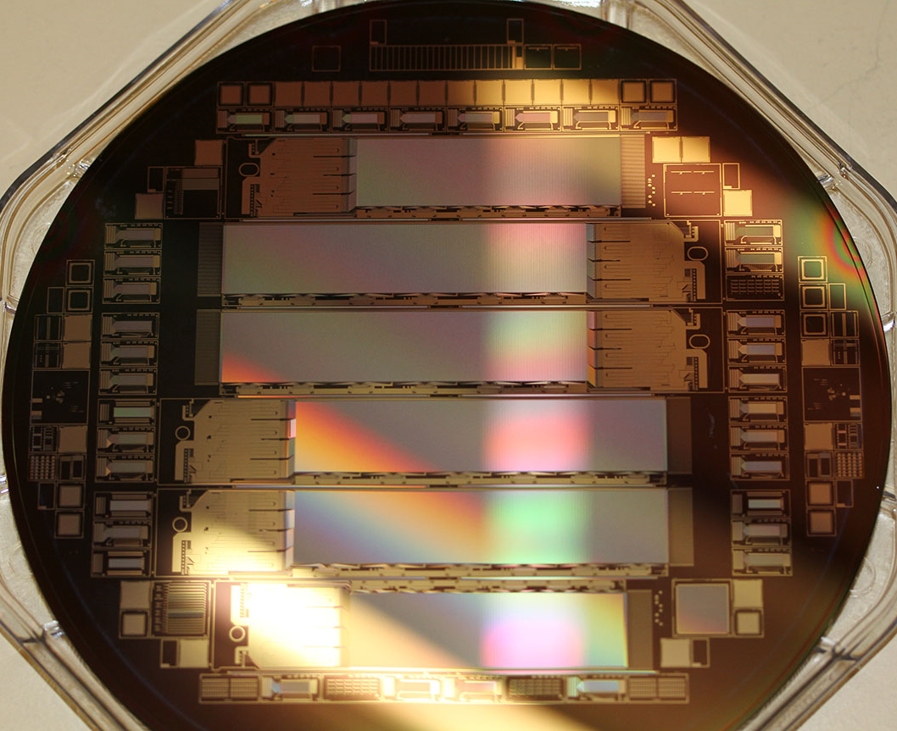
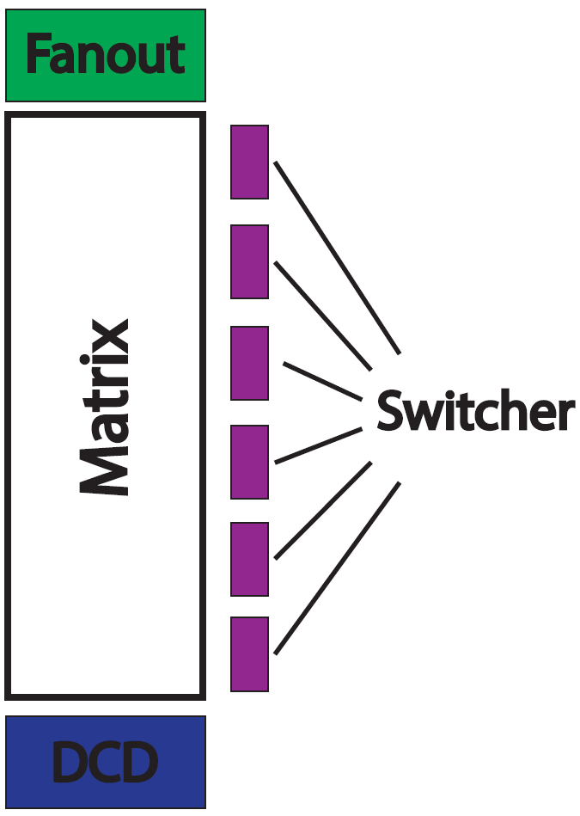
Wafer and chip layout
The pilot run consists of three wafers from PXD-9-III (renamed PXD-9-6):
W30 and W36 → currently undergoing further processing
W35 → on hold to allow setup optimization and precision measurements

Slide 3
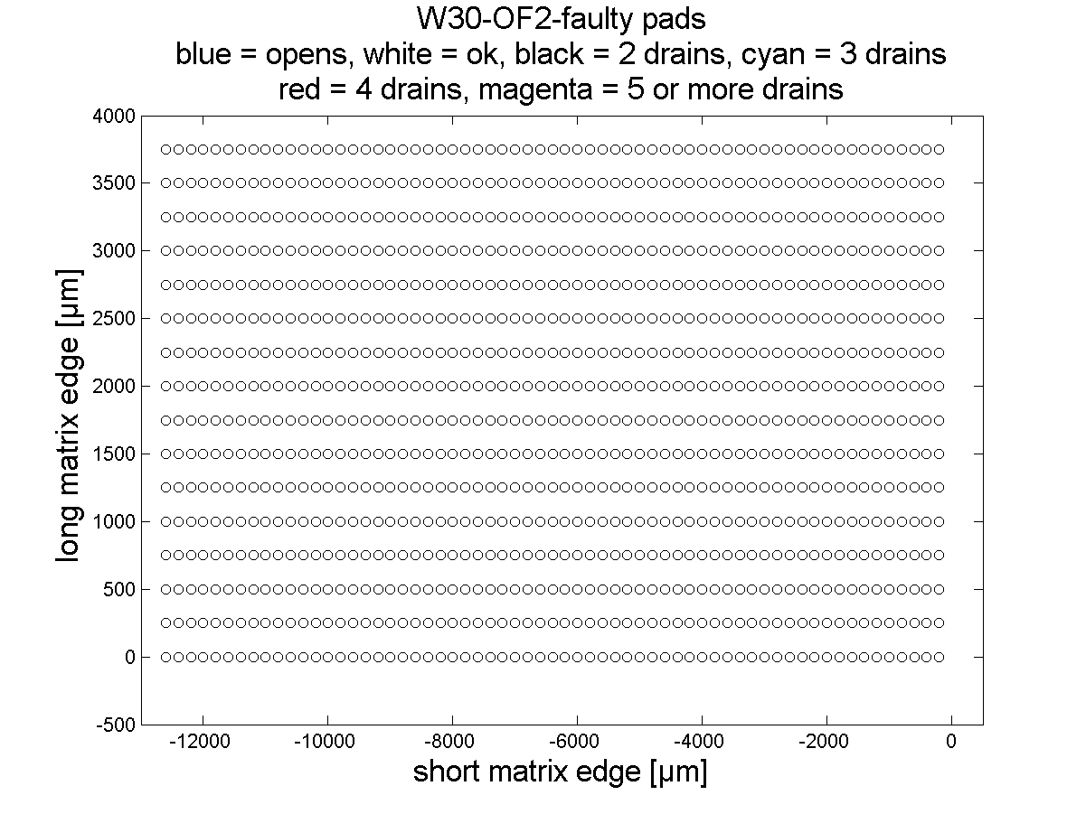
Drain Groups, mapping, probing
chuck
step #8
SMUb2
DG7 2612 #2
SMUa2
DG6 2612 #2
SMUb1
DG5 2612 #1
SMUa1
DG 4
2612 #1
SMU8
DG 3
4200
SMU7
DG 2
4200
SMU6
DG 1
4200
chuck
step #1

Slide 4
Fan-out types
Type A: IF, OB1, OB2
Type B: IB, OF1, OF2
Clear Gate
Source
All Clear
All Clear
Drain pads
All Gates
All Gates
Drain pads
Source
Clear Gate
4
3
Static voltage
2
1
4
3
Static voltage
2
1
Configuration #1:
SMU2 = All Clear (15V – static voltage 1)
SMU3 = All Gates (2V – static voltage 2)
SMU4 = Clear Gate (5V – static voltage 3)
SMU5 = Source (0V – static voltage 4)
Configuration #2:
SMU2 = Source (0V – static voltage 1)
SMU3 = Clear Gate (5V – static voltage 2)
SMU4 = All Gates (2V – static voltage 3)
SMU5 = All Clear (15V – static voltage 4)
+ automatic probehead PH510 for the voltage sweep [-3 V to 2 V] at the external gate
Notes:
Current compliance and range for ALL the SMUs is 1 mA
7 SMUs are switched on ALMOST in parallel → total current expected in the source is still < 1 mA

Slide 5
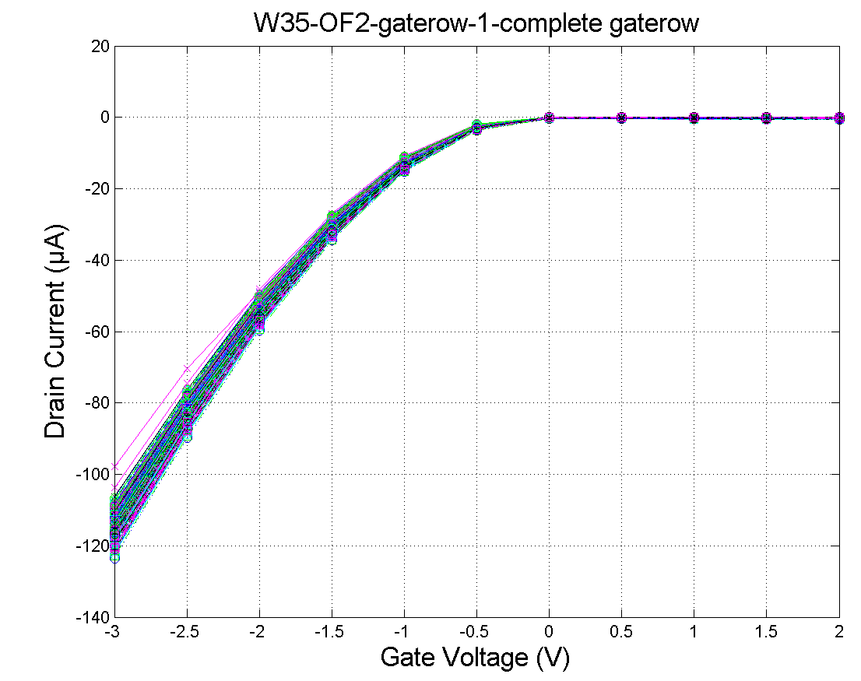
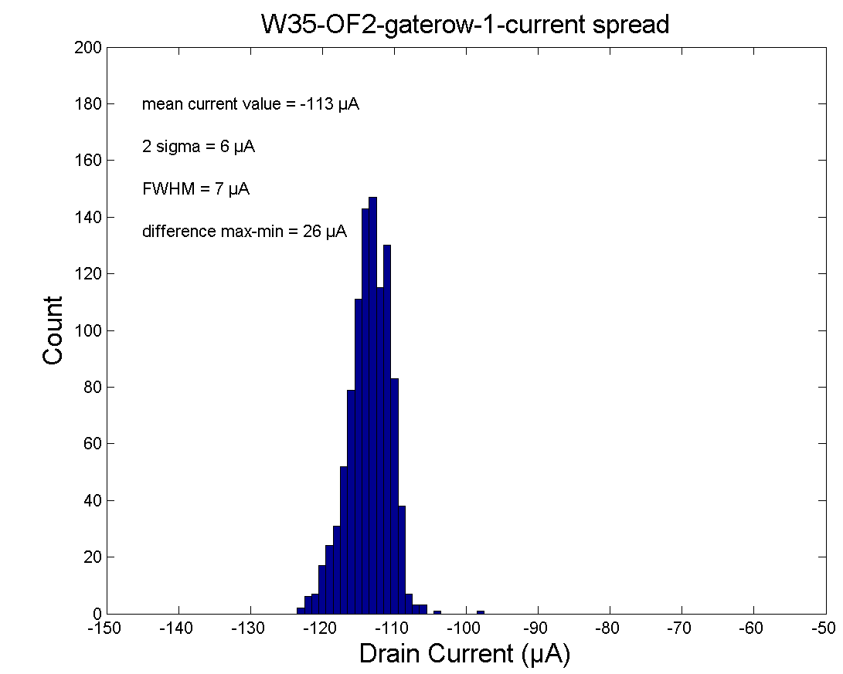
1st gate row test with remote sensing
Planarised chuck
Upgraded software (2612B’s SMUs always ON during test – no speed settings yet)
Remote sensing for the Source (now on SMU3)
Full fan-out test
Keithley 4200 default integration time = 200 μs.
Keithley 2612B default integration time = 20 ms.
No settling time

Slide 6
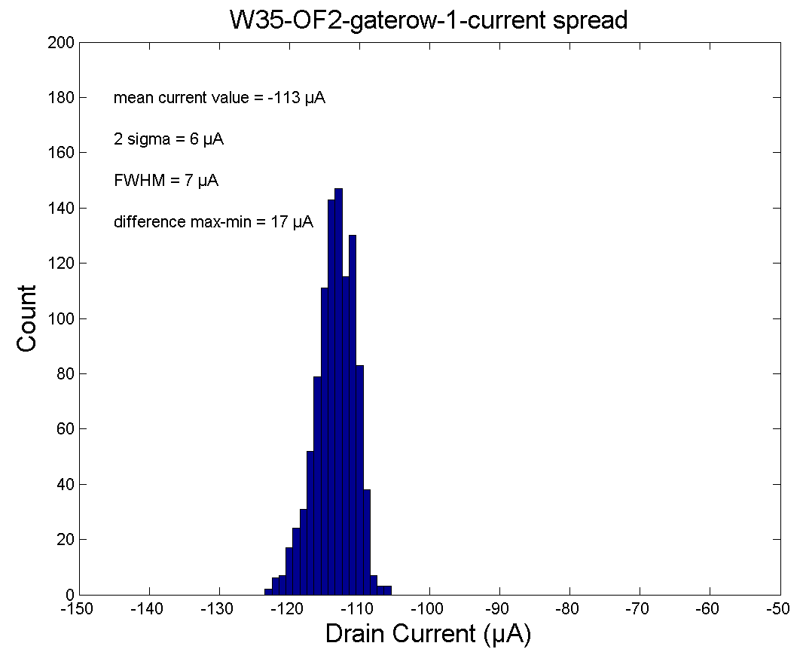
1st gate row test with remote sensing
Planarised chuck
Upgraded software (2612B’s SMUs always ON during test – no speed settings yet)
Remote sensing for the Source (now on SMU3)
Full fan-out test
Keithley 4200 default integration time = 200 μs.
Keithley 2612B default integration time = 20 ms.
No settling time

Slide 7
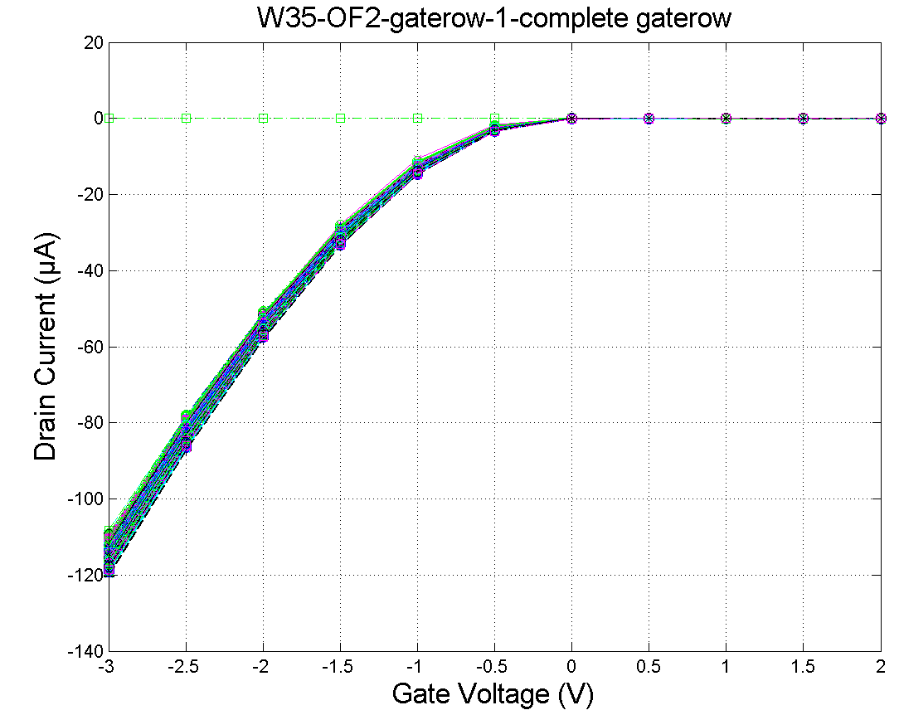
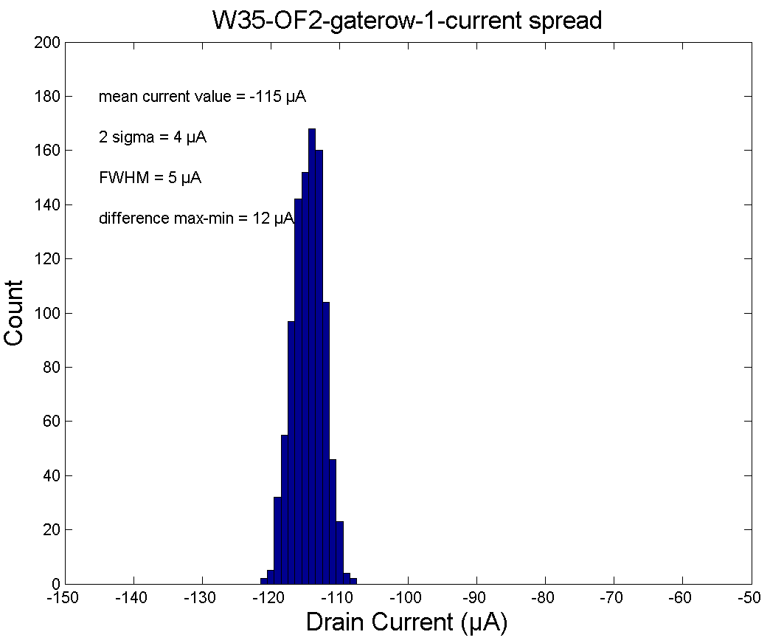
1st gate row test with remote sensing @ site 8
8 consecutive measurements at the same chuck position
First measurement
Upgraded software (no speed settings yet).
Keithley 4200 default integration time = 200 μs.
Keithley 2612B default integration time = 20 ms.
No settling time

Slide 8
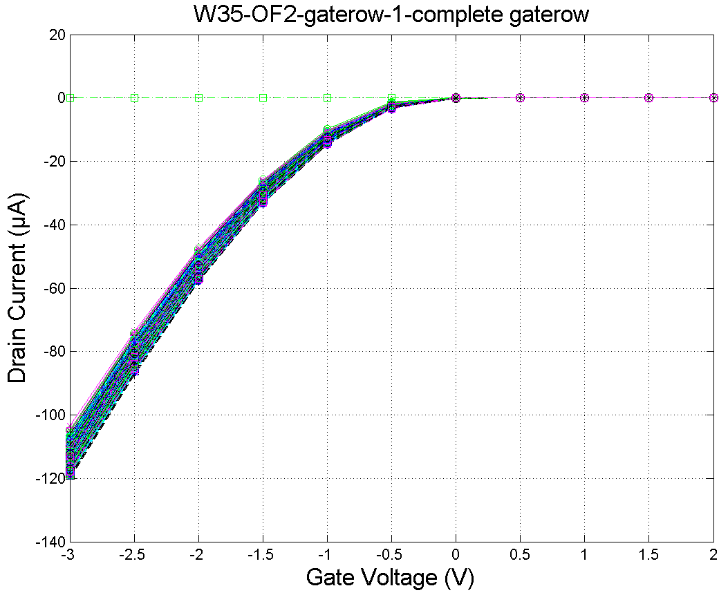
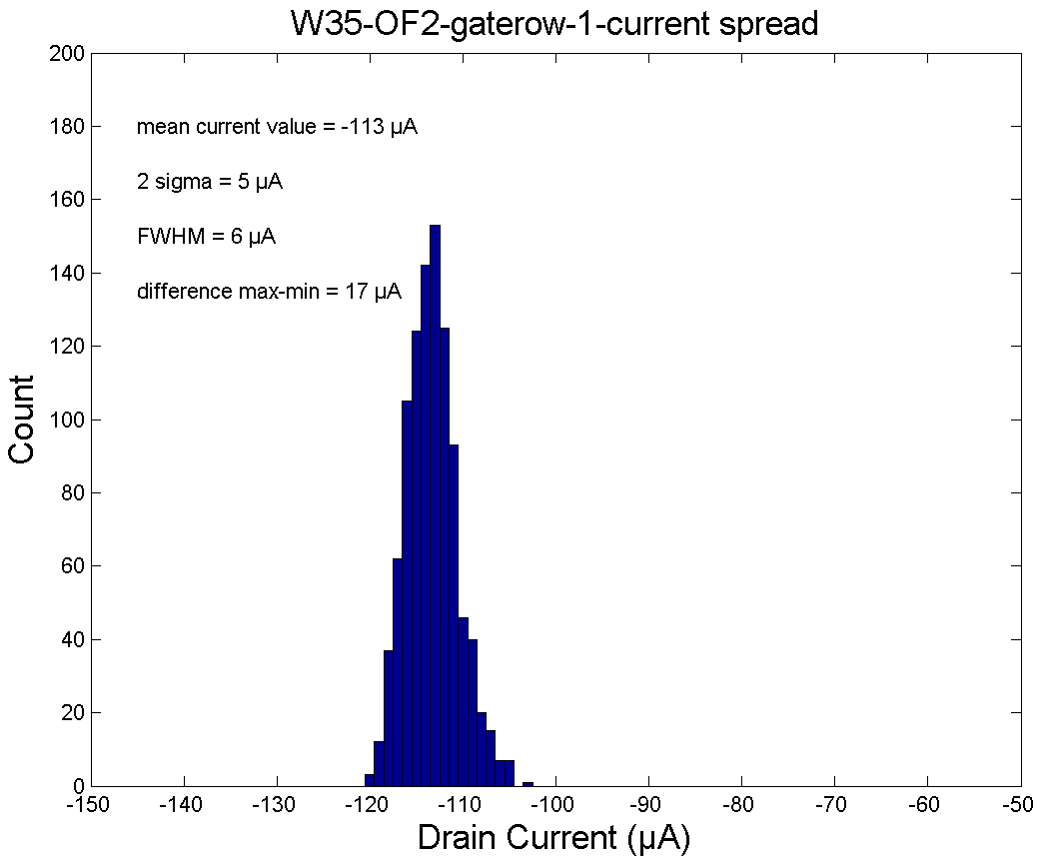
1st gate row test with remote sensing @ site 8
8 consecutive measurements at the same chuck position
Changed speed settings.
Second measurement
Upgraded software (with speed settings!).
Keithley 4200 set integration time = 20 ms.
Keithley 2612B set integration time = 20 ms.
Settling time = 100 ms

Slide 9
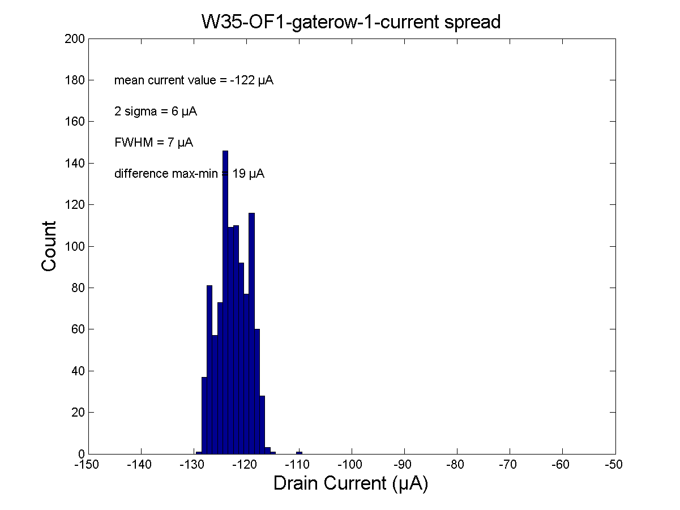
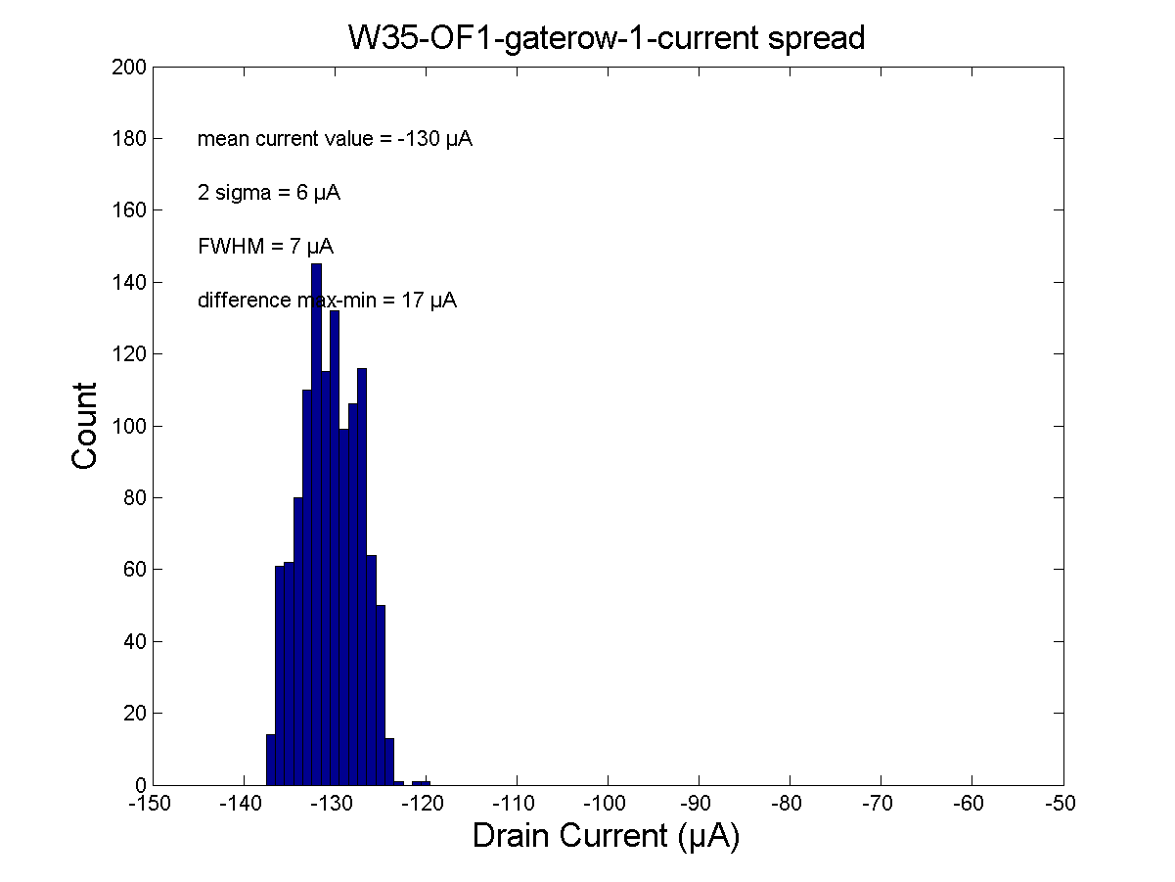
1st gate row test with local sensing @ site 8
Local sensing with lower mean current value than the remote sensing
Local sensing
Remote sensing
Upgraded software (with speed settings!).
Keithley 4200 set integration time = 20 ms.
Keithley 2612B set integration time = 20 ms.
Settling time = 100 ms

Slide 10
Rough matrix scan - Outline
Overview
Average current value distribution
Pedestral spread
Source-Gate effect
Tilt / Flip effect
Threshold voltage

Slide 11
Rough matrix scan
Test on the transfer characteristics on:
first & second gaterow
of each switcher
Rough scan since each test takes about 75min
=> Full test would take more than 240h (40 days) and fully consume the Fanout pads

Slide 12
Average current value distribution
Average current values [-µA] | OF1 | OF2
switcher1 gaterow1 | 121 | 114
switcher1 gaterow2 | 119 | 113
switcher2 gaterow1 | 127 | 122
switcher2 gaterow2 | 126 | 123
switcher3 gaterow1 | 119 | 123
switcher3 gaterow2 | 120 | 123
switcher4 gaterow1 | 125 | 124
switcher4 gaterow2 | 124 | 124
switcher5 gaterow1 | 122 | 120
switcher5 gaterow2 | 122 | 120
switcher6 gaterow1 | 122 | 120
switcher6 gaterow2 | 120 | 120
Average of those gate rows | 122.25 | 120.50

Slide 13
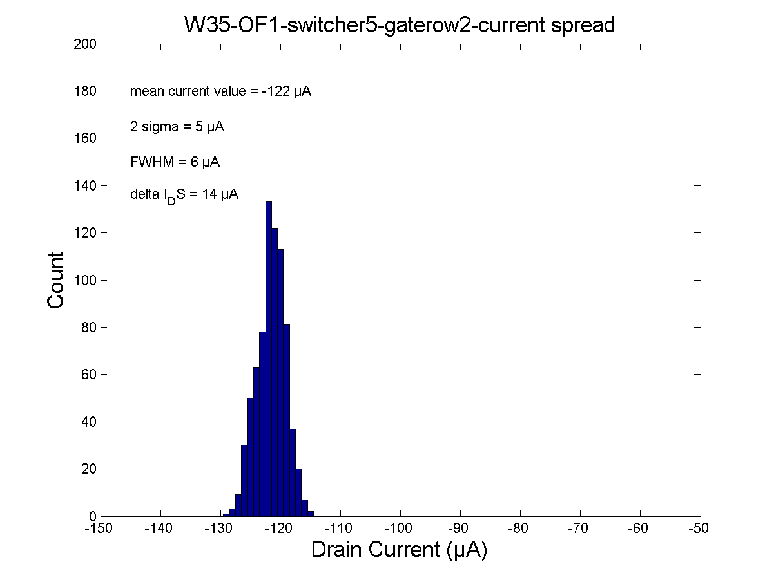

Pedestal spread
$Pedestal spread ∆I = I_{max}⁡– I_{min}$

Slide 14

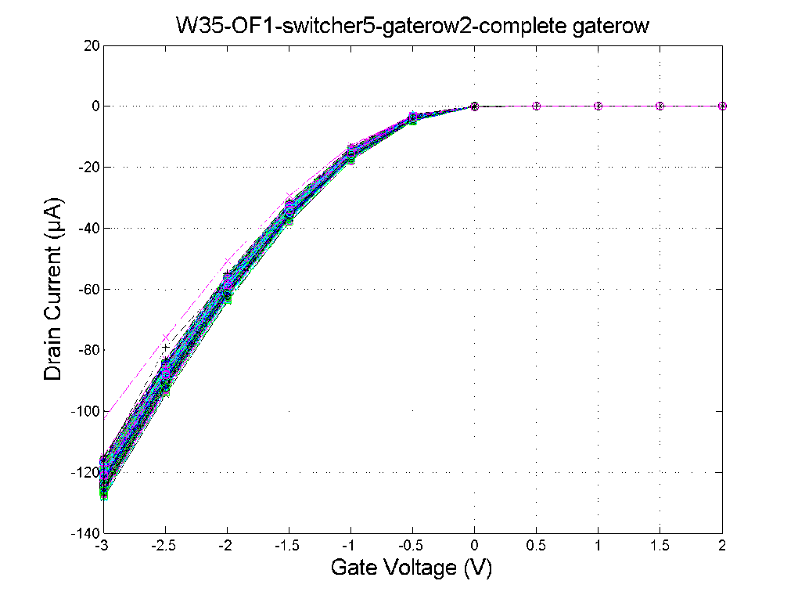
Pedestal spread
Low drain currents result from bad contact of the needles and are not an intrinsic value of the matrix.
=> Can be excluded from the analysis, since they disappears after retest

Slide 15

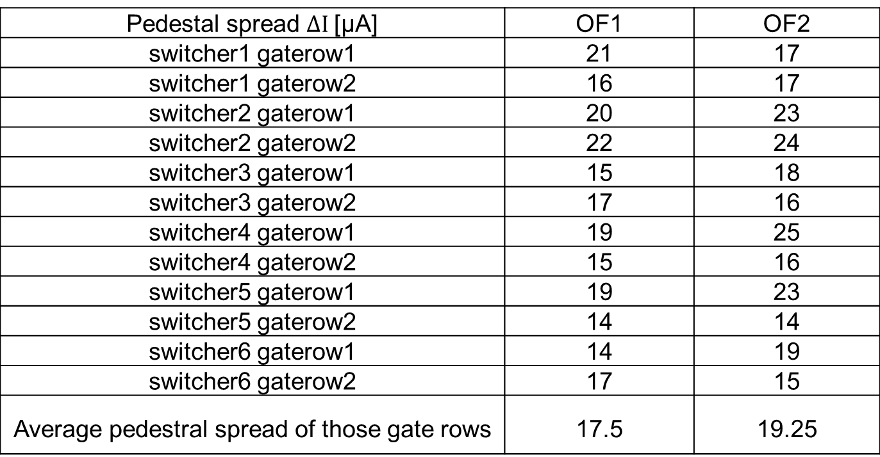
Pedestal spread
$Pedestal spread ∆I = I_{max}⁡– I_{min}$
Pedestal spread $∆I$[µA] | OF1 | OF2
switcher1 gaterow1 | 21 | 17
switcher1 gaterow2 | 16 | 17
switcher2 gaterow1 | 20 | 23
switcher2 gaterow2 | 22 | 24
switcher3 gaterow1 | 15 | 18
switcher3 gaterow2 | 17 | 16
switcher4 gaterow1 | 19 | 25
switcher4 gaterow2 | 15 | 16
switcher5 gaterow1 | 19 | 23
switcher5 gaterow2 | 14 | 14
switcher6 gaterow1 | 14 | 19
switcher6 gaterow2 | 17 | 15
Average pedestral spread of those gate rows | 17.5 | 19.25

Slide 16
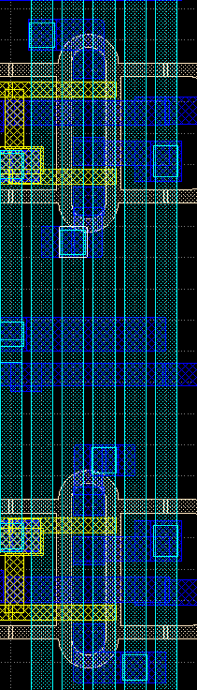
Source-Gate effect (far - near)
The picture on the left side shows one gate row = four physical rows.
The Source-Gate contact distance is different for the Gates (far & near).
(far Gate)
Source
(near Gate)
4
far
3
near
(near Gate)
2
Source
(far Gate)
1
far

Slide 17
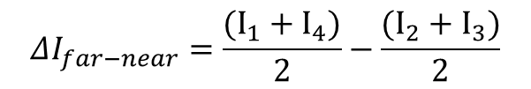
Source-Gate effect (far - near)
far
near
$$ΔI_{far−near}=\frac{(I_{1}+I_{4})}{2}−\frac{(I_{2}+I_{3})}{2}$$
4
far
3
Remember: Drain currents are all negative
A negative result means that the far Gates dominate
A positive result means that the near Gates dominate
near
2
1
far

Slide 18
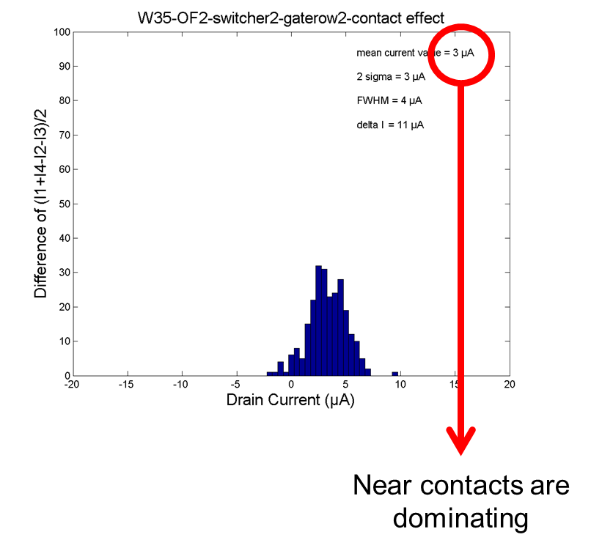
Source-Gate effect (far - near)
far
near
$$ΔI_{far−near}=\frac{(I_{1}+I_{4})}{2}−\frac{(I_{2}+I_{3})}{2}$$
Remember: Drain currents are all negative
A negative result means that the far Gates dominate
A positive result means that the near Gates dominate
Near Gates are dominating

Slide 19
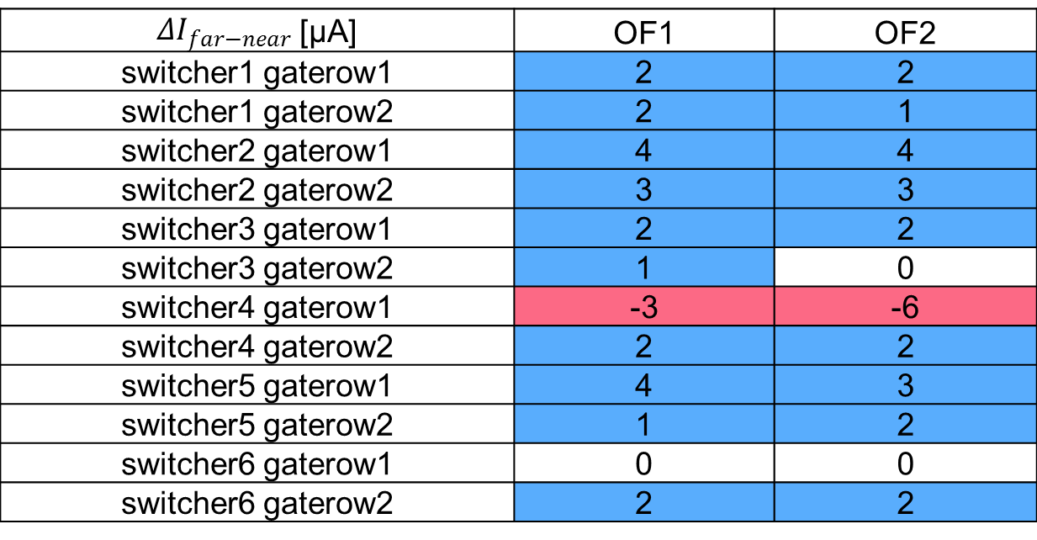
Source-Gate effect (far - near)
$ΔI_{far−near}$ [µA] | OF1 | OF2
switcher1 gaterow1 | 2 | 2
switcher1 gaterow2 | 2 | 1
switcher2 gaterow1 | 4 | 4
switcher2 gaterow2 | 3 | 3
switcher3 gaterow1 | 2 | 2
switcher3 gaterow2 | 1 | 0
switcher4 gaterow1 | -3 | -6
switcher4 gaterow2 | 2 | 2
switcher5 gaterow1 | 4 | 3
switcher5 gaterow2 | 1 | 2
switcher6 gaterow1 | 0 | 0
switcher6 gaterow2 | 2 | 2
=> mostly the near Source-Gate distances dominate

Slide 20
Tilt / Flip effect (odd - even)
The pixel rows of Drain1 & Drain2 are mirror images to the pixel rows of Drain3 & Drain4 (flipped).
Due to tilt of the ion beam during implantation the source doping concentration is not perfectly homogeneous in the region between two gates.
Gate 4 has the higher conentration
3 & 4
Gate 2 has the higher conentration
1 & 2

Slide 21
Tilt / Flip effect (odd - even)
The pixel rows of Drain1 & Drain2 are mirror images to the pixel rows of Drain3 & Drain4 (flipped).
Due to tilt of the ion beam during implantation the source doping concentration is not perfectly homogeneous in the region between two gates.
Gate 3 has the higher conentration
3 & 4
Gate 1 has the higher conentration
1 & 2

Slide 22
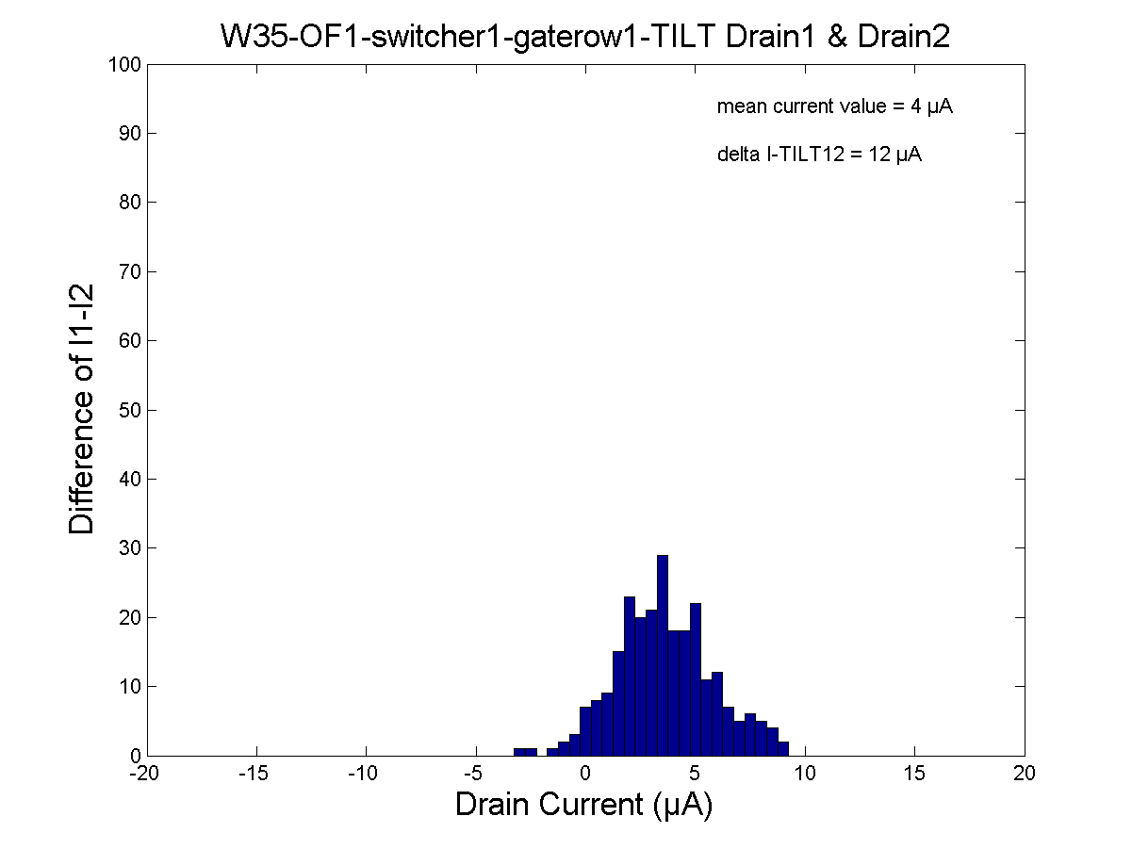
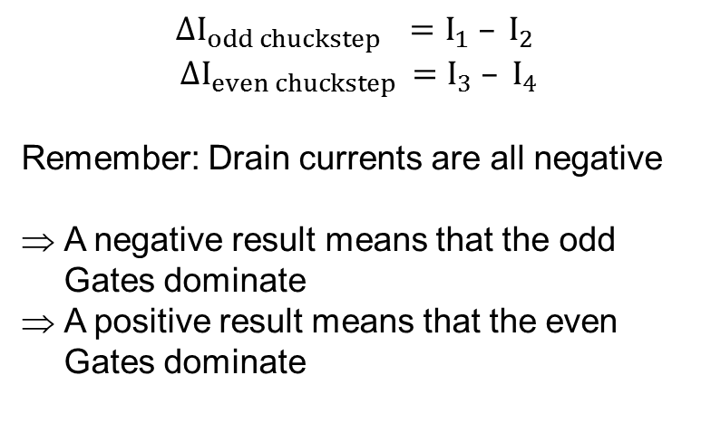
Tilt / Flip effect (odd - even)
$$ΔI_{odd chuckstep }{ =I}_{1} – I_{2}$$
$$ΔI_{even chuckstep }{=I}_{3} – I_{4}$$
Remember: Drain currents are all negative
A negative result means that the odd Gates dominate
A positive result means that the even Gates dominate
3 & 4
1 & 2

Slide 23
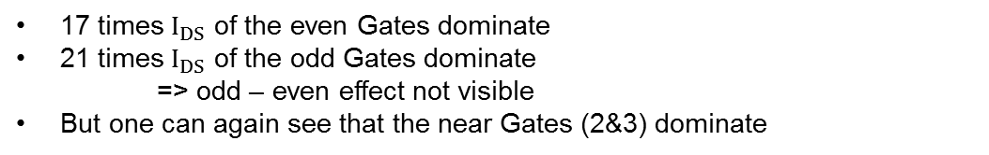
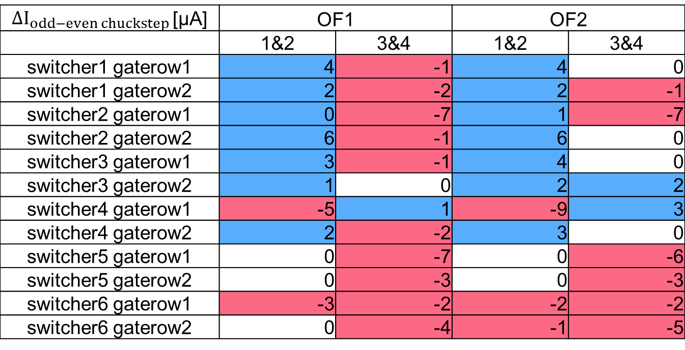
Tilt / Flip effect (odd - even)
$ΔI_{odd−even chuckstep }$[µA] | OF1 |  | OF2
 | 1&2 | 3&4 | 1&2 | 3&4
switcher1 gaterow1 | 4 | -1 | 4 | 0
switcher1 gaterow2 | 2 | -2 | 2 | -1
switcher2 gaterow1 | 0 | -7 | 1 | -7
switcher2 gaterow2 | 6 | -1 | 6 | 0
switcher3 gaterow1 | 3 | -1 | 4 | 0
switcher3 gaterow2 | 1 | 0 | 2 | 2
switcher4 gaterow1 | -5 | 1 | -9 | 3
switcher4 gaterow2 | 2 | -2 | 3 | 0
switcher5 gaterow1 | 0 | -7 | 0 | -6
switcher5 gaterow2 | 0 | -3 | 0 | -3
switcher6 gaterow1 | -3 | -2 | -2 | -2
switcher6 gaterow2 | 0 | -4 | -1 | -5
17 times $I_{DS}$ of the even Gates dominate
21 times $I_{DS}$ of the odd Gates dominate
=> odd – even effect not visible
But one can again see that the near Gates (2&3) dominate

Slide 24
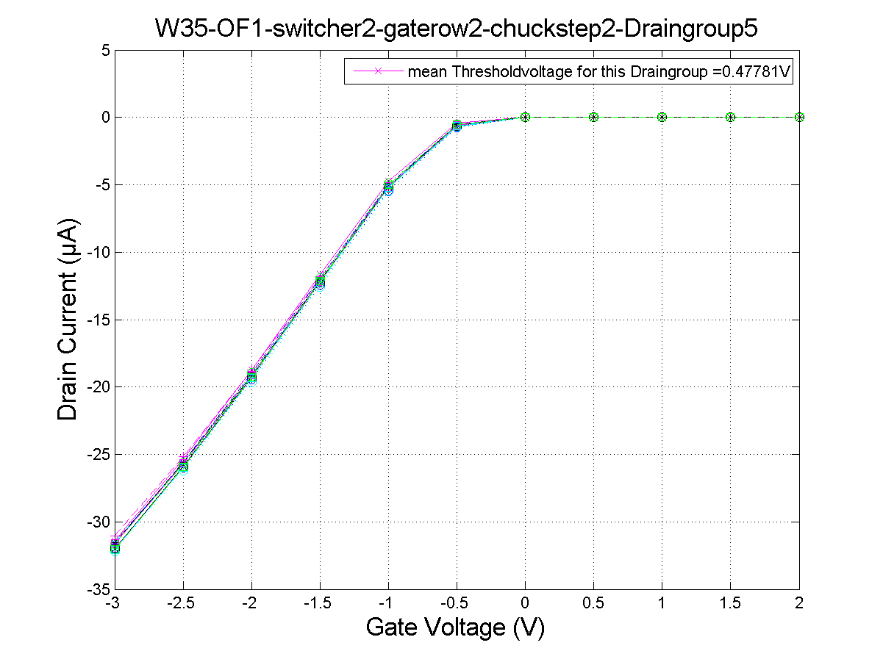
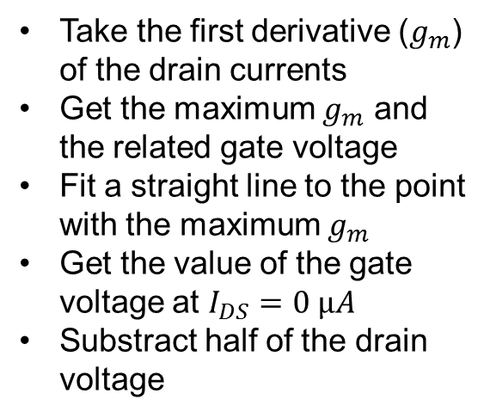
Threshold voltage – Linear ($V_{DS}=−0.5 V$)
Threshold calculation according to:
Dieter K. Schroder: Semiconductor material and device characterisation. Arizona State University (2006), p.223.
Take the first derivative ($g_{m}$) of the drain currents
Get the maximum $g_{m}$ and the related gate voltage
Fit a straight line to the point with the maximum $g_{m}$
Get the value of the gate voltage at $I_{DS}=0 µA$
Substract half of the drain voltage
Threshold voltage around -0.5V

Slide 25
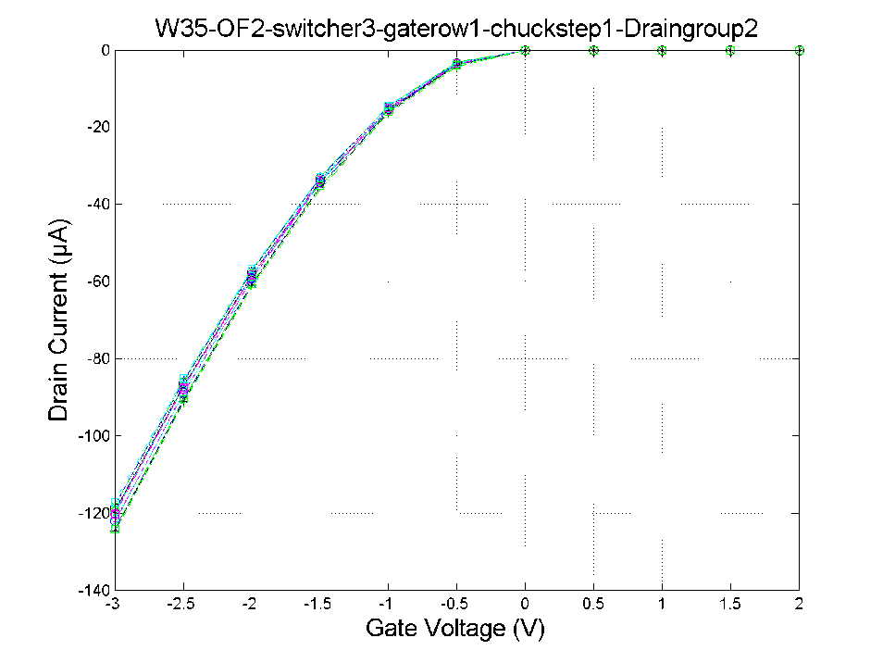
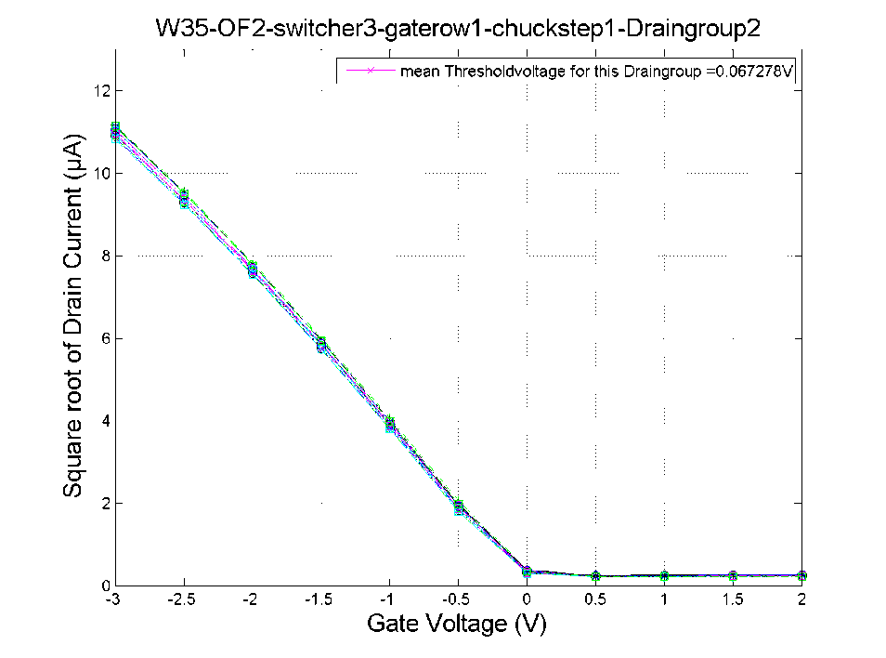
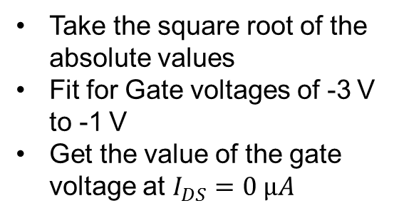
Threshold voltage – Saturation ($V_{DS}=−5 V$)
Threshold calculation according to:
Dieter K. Schroder: Semiconductor material and device characterisation. Arizona State University (2006), p.225.
Take the square root of the absolute values
Fit for Gate voltages of -3 V to -1 V
Get the value of the gate voltage at $I_{DS}=0 µA$
Threshold voltage mostly around +0.08V

Slide 26
Conclusions and future plans
Some modifications are already implemented:
  Planarization of the chuck
  Software upgrade (external SMUs always ON during measurement, user control on integration time, additional delays)
  Introduction of a sense line (possible for first static voltage)
Analysis of the Threshold voltages
Measurements of Output characteristics and Clear characteristics on half ladders
Calculation of Internal Gate potential and Channel length modulation factor
Further tests on test structures and small matrices
Thank you for your attention!

Slide 27
BACKUP SLIDES

Slide 28
Pedestral spread
pedestral spread [µA] | OF1 | OF2
switcher1 gaterow1 | 21 | 17
switcher1 gaterow2 | 16 | 17
switcher2 gaterow1 | 20-34 | 23
switcher2 gaterow2 | 22 | 24
switcher3 gaterow1 | 15-23 | 18
switcher3 gaterow2 | 17 | 16-21
switcher4 gaterow1 | 19 | 29
switcher4 gaterow2 | 15 | 16
switcher5 gaterow1 | 19-27 | 23
switcher5 gaterow2 | 14 | 14
switcher6 gaterow1 | 15-24 | 19
switcher6 gaterow2 | 17-19 | 15-24
Average of the averages | 17,5 | 19,25

Slide 29
Threshold voltage for Saturation region
Threshold voltage [V] | OF1 | OF2
switcher1 gaterow1 | 0,051 | -0,016
switcher1 gaterow2 | 0,039 | -0,020
switcher2 gaterow1 | 0,093 | 0,055
switcher2 gaterow2 | 0,098 | 0,061
switcher3 gaterow1 | 0,025 | 0,059
switcher3 gaterow2 | 0,029 | 0,057
switcher4 gaterow1 | 0,102 | 0,081
switcher4 gaterow2 | 0,095 | 0,085
switcher5 gaterow1 | 0,090 | 0,097
switcher5 gaterow2 | 0,087 | 0,061
switcher6 gaterow1 | 0,074 | 0,055
switcher6 gaterow2 | 0,058 | 0,050
Average of the averages | 0,070 | 0,052

Slide 30
System issues/failures
(from last SeeVogh meeting – 31.03.15)
Chuck not planar →
  Bad probing in the right hand side of the fan-out (source in conf #2) – (E/W tilt)
  Bad contacts (higher contact resistance ➔ smaller I_{ds}) for higher chuck steps (N/S tilt)
  NOW SOLVED:
    Chuck planarized
    Use of sense line at source contact (currently possible only for conf #2)
Electrical failures (due to contact problem in SMU2 preamp of Keithley 4200) →
  System freeze
  Bad characteristics due to wrong applied voltage (AC/conf #1 or S/conf #2 – critical)
  → Need investigation – currently on hold (temporary solution: SMU2 and SMU3 swapped)
Electrical failures (in Keithley 2612) →
  System freeze
  Possibly due to a timeout error in the communication between KITE (Keithley GUI) and the instruments:
    Software upgrade seems to solve the problem via the introduction of time delays (or settling time) and keeping the SMUs in the ON state for the whole duration of the measurement (under investigation!)
Software failures (fully understood) →
  KITE (DAQ software) crash
  System freeze if data folder remotely accessed

Slide 31
Yield considerations of the metal system
Yield (%)
 | W30 | W35 | W36
IF | 75.0 | 100.0 | 100.0
OF1 | 100.0 | 100.0 | 100.0
OF2 | 100.0 | 100.0 | 100.0
OB1 | 99.8 | 99.4 | 100.0
OB2 | 99.6 | 99.5 | 99.8
IB | 100.0 | 0 | 100.0
Yield calculated taking into account the following equation:
With D the total number of drain lines (1000) and D_{s} the number of drain lines involved in the short.
Rainer’s Yield Criteria
 | W30 | W35 | W36
IF | 3 | 0 | 0
OF1 | 0 | 0 | 0
OF2 | 0 | 0 | 0
OB1 | 1 | 1 | 0
OB2 | 1 | 5 | 1
IB | 0 | 4 | 0
Rainer’s criteria for yield calculation:
0: no faults
1: pixel or column* (drain line) level faults
2: row level faults
3: high impact faults
4: lethal faults
5: to be clarified
* Column level faults in Al2 can be repaired by rework (grade 1 → 0).

Slide 32
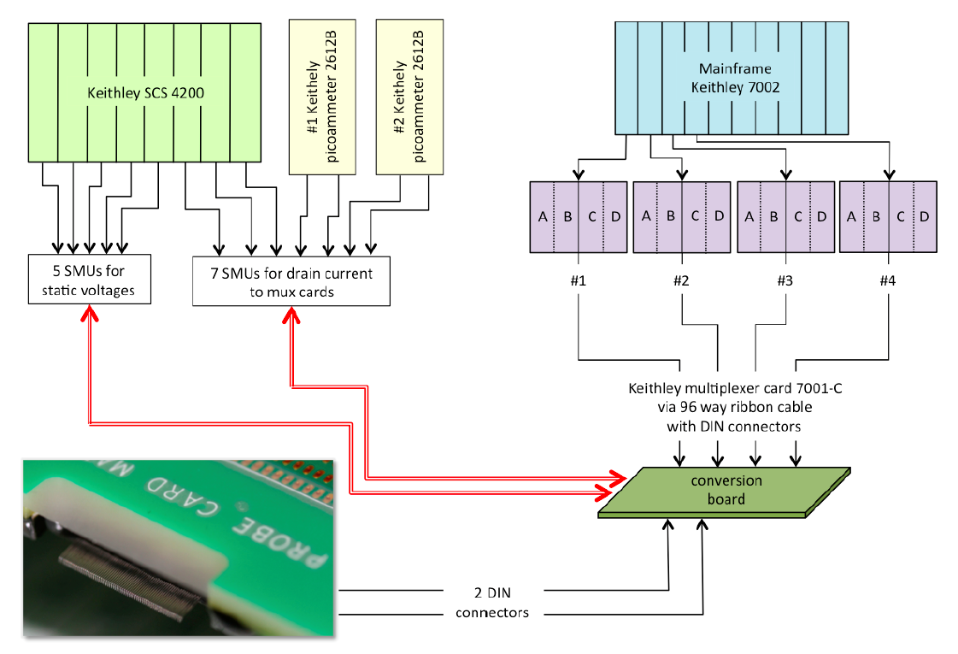
Switch system

Slide 33
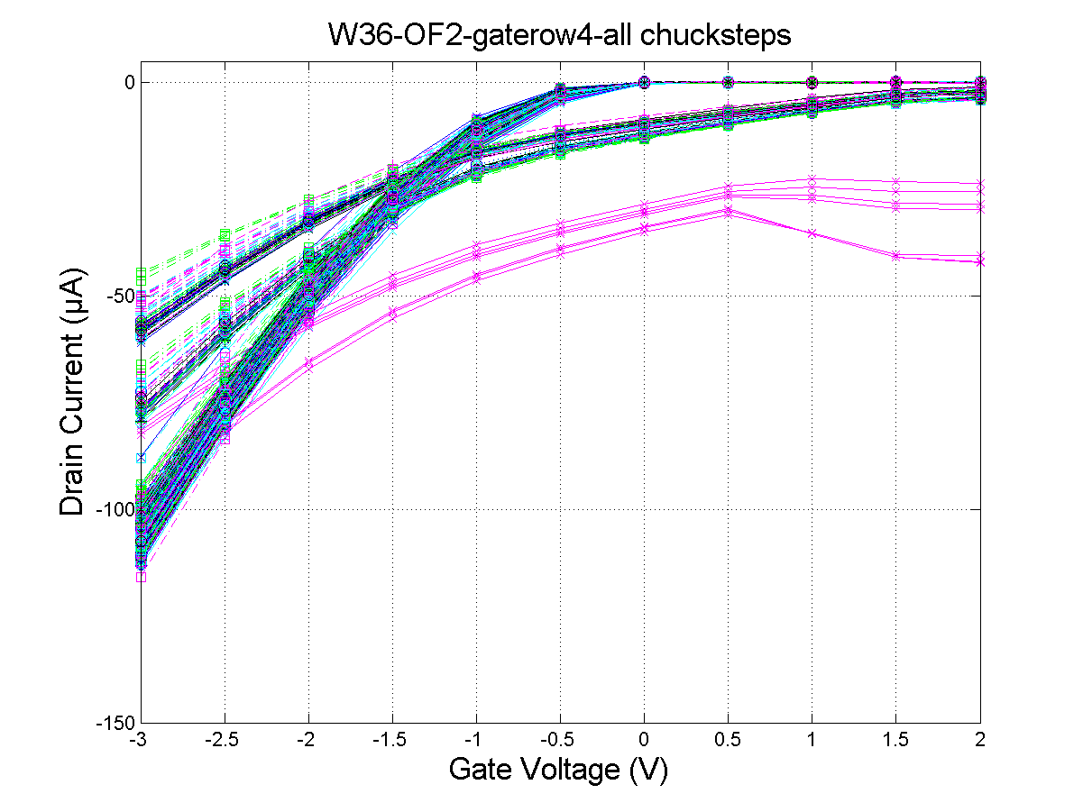
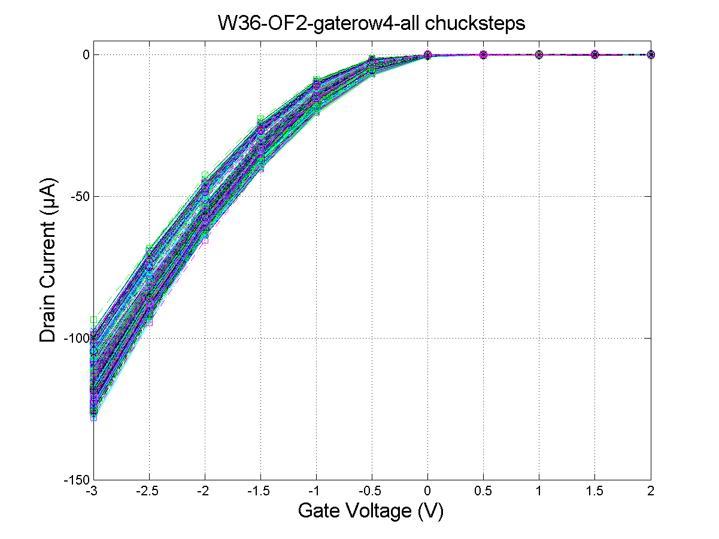
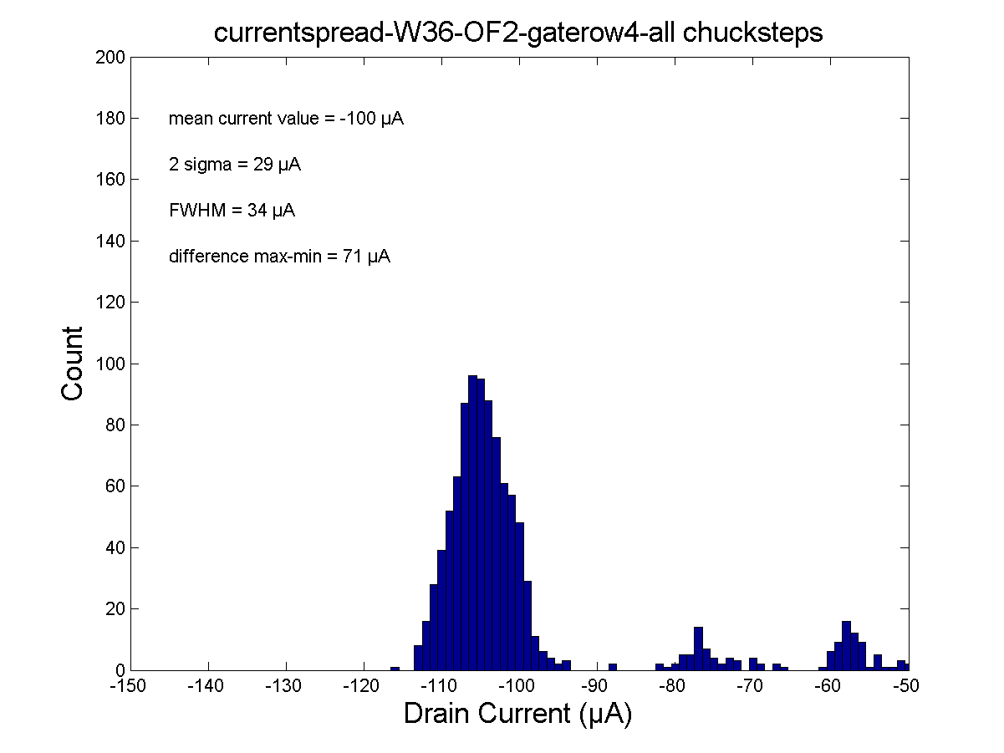
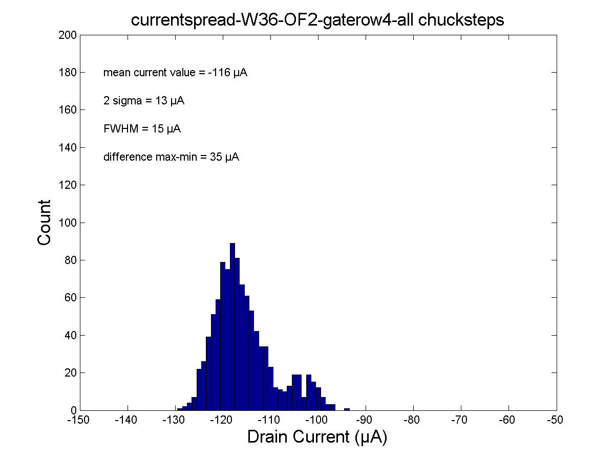
System failures
Bad contacting
Good contacting
measurement
→
repeated

Slide 34
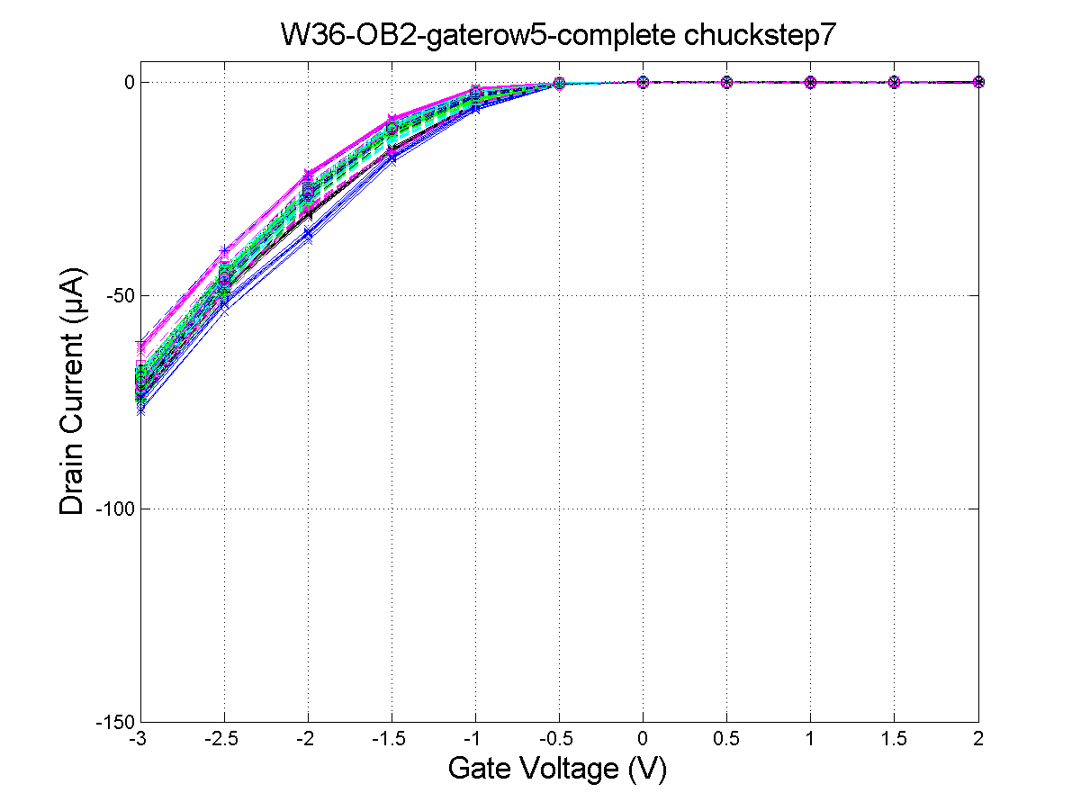
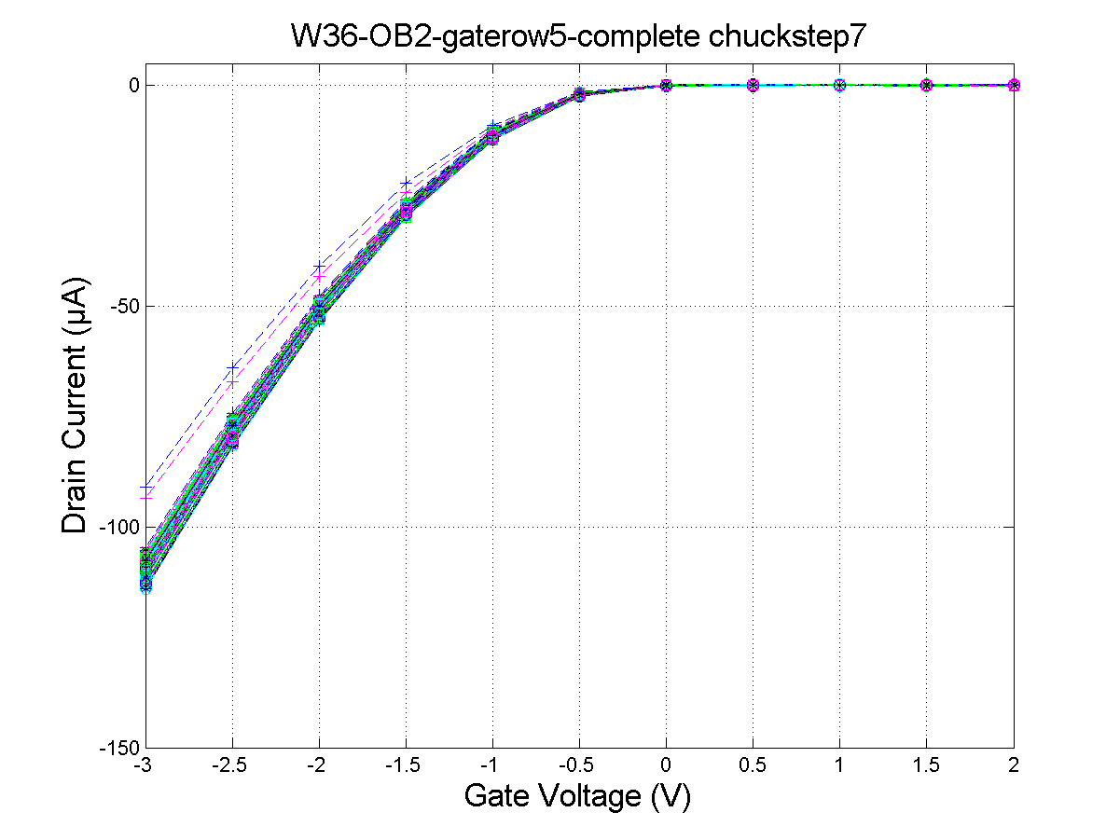
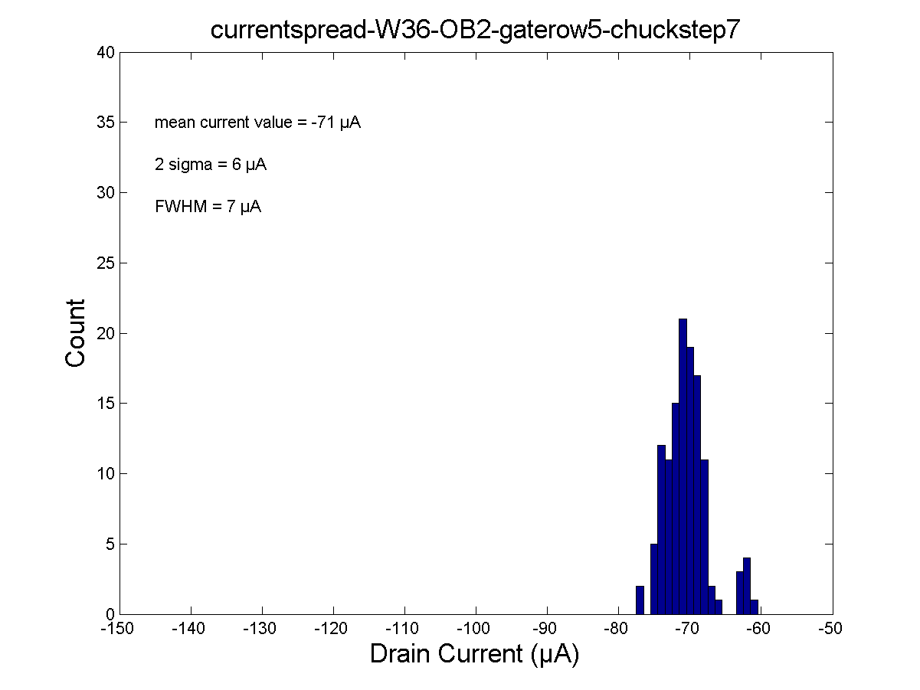
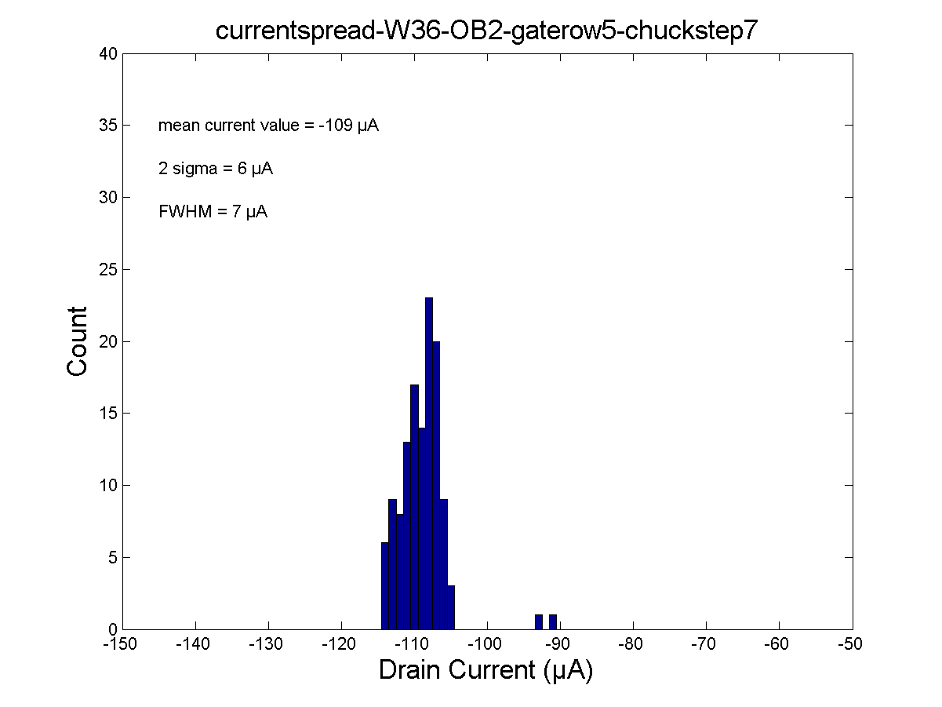
System failures
(from last SeeVogh meeting – 31.03.15)
Bad contacting
Better contacting
measurement
→
repeated

Slide 35
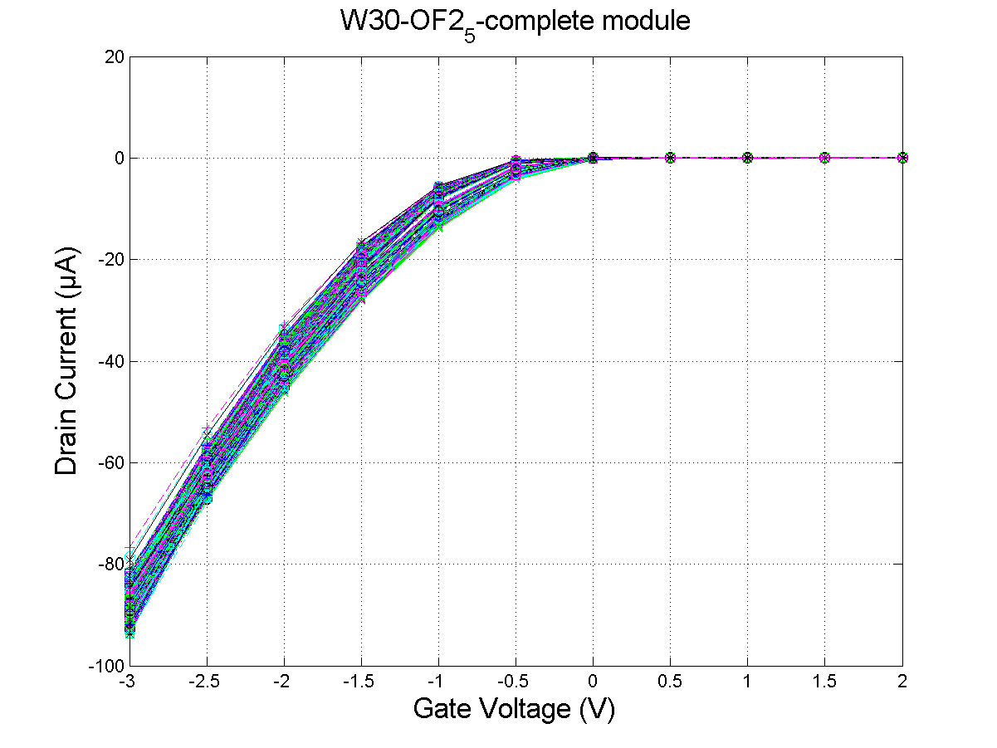
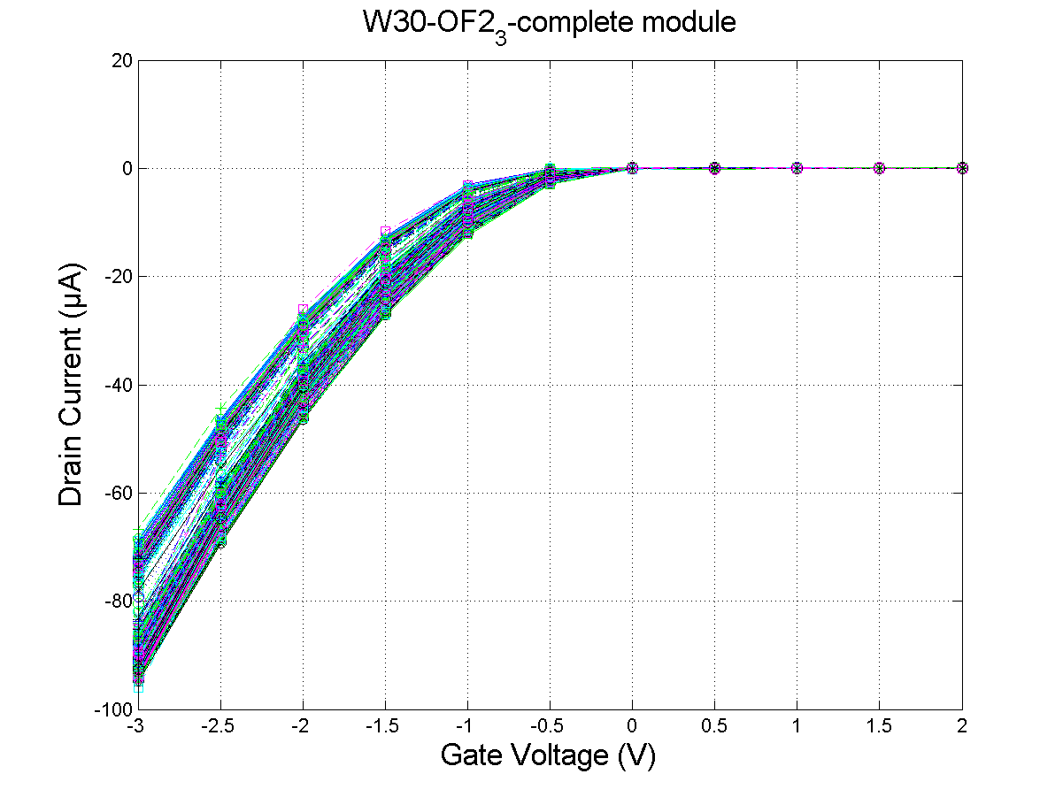
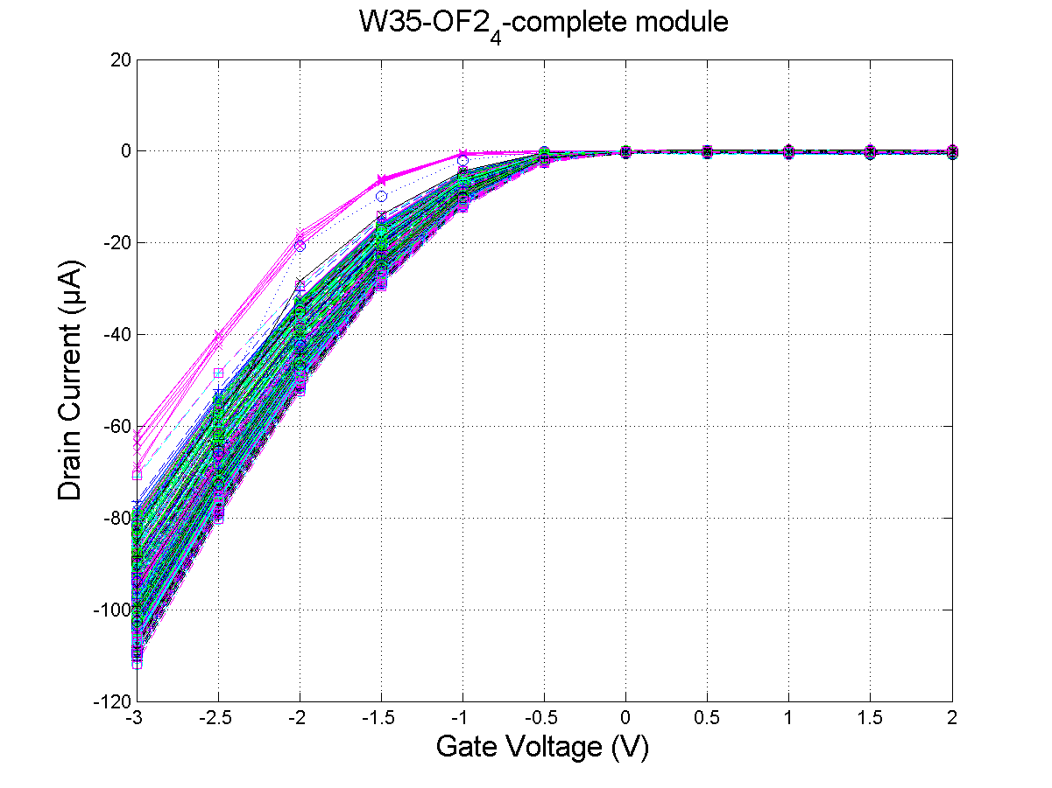
Examples (from last SeeVogh meeting – 31.03.15)

