Slide 1
DCD submission plan
Changes in design (present status):
Change sampling of TDI for global and pixel register to positive edge
Add fast parallel sampling mode for easier needle card tests (maybe)
Improve test DAC resolution (?) by adding additional DAC
Programmable LVDS output current (or just larger)
Check protection diodes should be on VDDD for digital
Investigate power up problem
Add transmission switch to monitor (now only PMOS)
Check the voltage drop on power rail – connect gate of the NMOS sources only in one point
Reduce RefIn current
Try to connect DAC Dump and SF VDDA to RefIn
Separated bias DACs for up and down bias
Spare ADCs
Current through bias line (Hans)
Redo protection diode, current drain/split nwell
Ipdac 60uAfull range
SubIn 4 times or additional DAC
Introduce 15k Feedback resistor setting – low gain mode
Variable digital test patterns (?)

Slide 2
DCD submission plan
Simulations:
ADC full/CMC+Comparator corner, mismatch, drop
Measurements:
RefIn/ALow vary whole chip
Current mismatch
Repeat after irradiation

Slide 3
JTAG and slow controll
Pixel Register
PixelSel
P_Shift, P_Rb, P_Ld
PixelSel
ShiftDR, CaptureDR, UpdateDR
Address
Global Register
GlobalSel
G_Shift, G_Rb, G_Ld
Digital Block
GlobalSel
State M.
ShiftDR, CaptureDR, UpdateDR
TDO
PreLoad
TMS
CaptureIn
DO0(7:0),DI0(1:0),…,DI3(1:0),SYNC_RES,CLK,RetCLK,TestInjEn,DO4(7:0),…,DI7(1:0)
LatchOut
Data Register
In
Out
CaptureIn
ExtTest OR PreLoad
Cont. Signals
LatchOut
ShiftDR, CaptureDR, UpdateDR
ExtTest
Commands
Instruction Register
FF
i
Pads
o
i
Bitck
Res
ShiftIR
The other if not ShiftIR
ShiftIR, CaptureIR, UpdateIR
Res!
TestMode
TestMode
TDI
ID Register
FF
TestPads
IDSel
ShiftDR&IDSel
Readout Reg
Readout
CaptureIn
CaptureIn
FF
FF
TCK
Full custom latches
Bypass
Ld
o
3

Slide 4
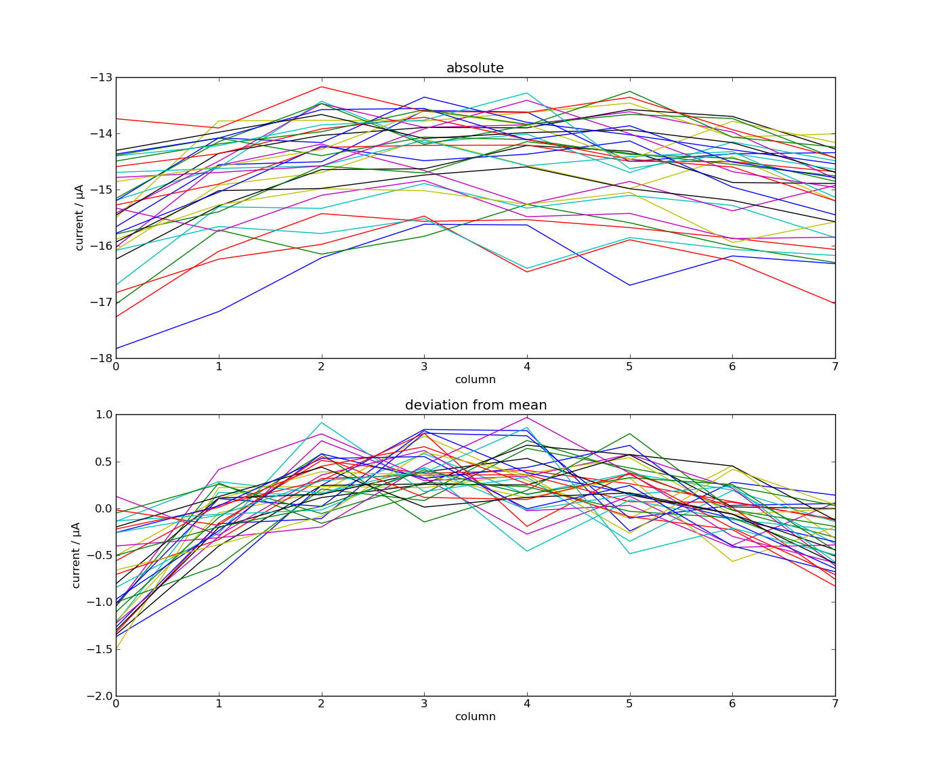
DCD Measurements
…

Slide 5
DCD Measurements
….

Slide 6
DCD submission plan
…
VDDA
VDDA
This makes current GNDA constant always
Source
~300uA
AmpInCM
RefIn
AmpIn
RefIn Current isn‘t constant
SF
AmpOut
This makes NMOS scs independent on GNDA noise
~60uA
RefIn
VDDA
240uA max
Source
GNDA
Gate
RefIn
RefIn

Slide 7
DCD submission plan
…
DAC
Mirror
d
d

Slide 8
DCD submission plan
…
DAC
DAC

Slide 9
Origin of offset
Possibility: transistor mismatch – fix in the next chip: make the layout in a better way e.g. the transistors bigger
Additionally, there may be a systematic offset in comparator that adds to the mismatch
Notice also: two output nodes are not on perfectly same potential
Original UI converter connected to amplifier input, copy UI converter to RefIn – this explains RefIn dependence
Reduce RefIn voltage drop!
Low
PFB
PFB
24u
24u
RefFB
RefFB
RefIn
RefIn
TooLow
24u
24u
24u
26u
Sc2
Sc2
Sc2
Sc2

Slide 10
SWITCHER Status
SWITCHER
Irradiation of latest SWITCHER has been done at KIT (dose 31 MRad)
The chip works after the irradiation
Bumping: bumping so far done in HD-lab, this works well for prototyping but is slow for production
Bumping with the required pitch (150 μm) is not offered by the vendor (AMS/IBM)
Solution: Company Pactec can place underbump metallization (ENIG) and solder bumps on single dies
SWITCHER submission planned for end of May 2015
Improvements: faster clear driver
Separated control of the termination resistance for serial input (should be always on) and for the other fast inputs

Slide 11
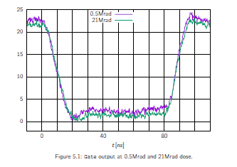
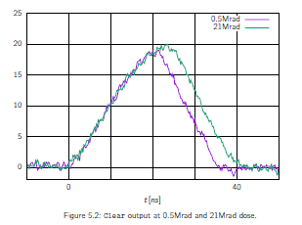
Rise Time Measurements – irradiated chip
Irradiation to 21MRad – 150pF load
We need to increase size of the power transistors
Can be done, but the chip size will increase by 100um

Slide 12
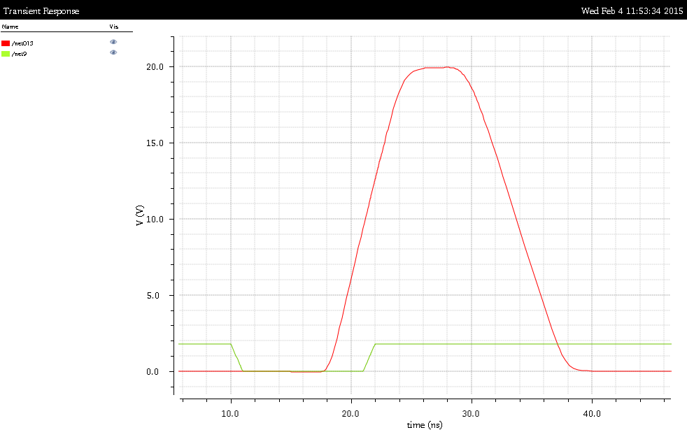
Simulation
Simulation of clear pulse with 150pF load
Output transistors 3 time wider
20ns

Slide 13
Backup Slides

Slide 14
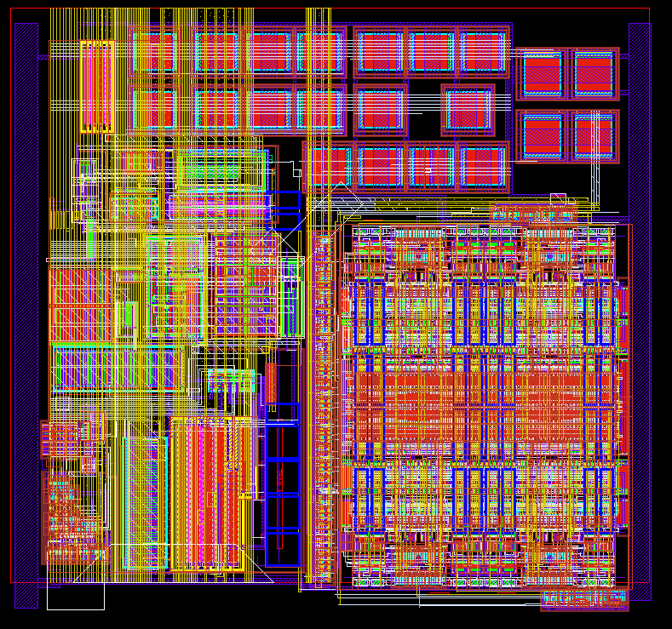
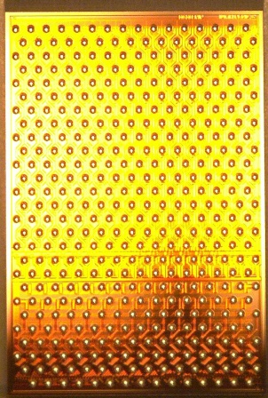
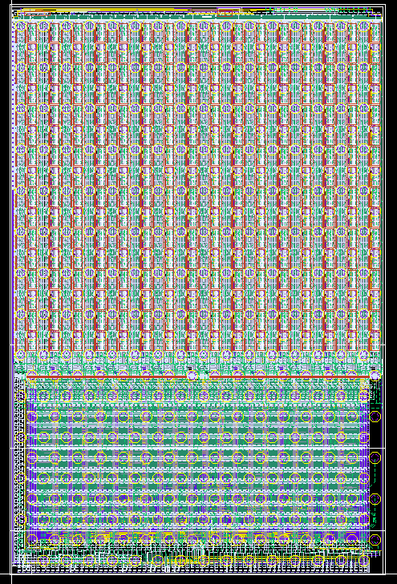
DCDBPip
TIA
ADC
200 µm
5 mm

Slide 15
ASICs
Ivan Peric

Slide 16
DCD

Slide 17
KIT
The development/production of DCD and SWITCHER chips will be done from middle of 2015 at KIT
ASIC and detector laboratory (ADL) at the Institute for Data Processing and Electronics (IPE)

Slide 18
DCDBPip
TIA
ADC
200 µm
5 mm

Slide 19
DCD
DCD chip contains 256 channels, each channel has a DEPFET current receiver (trans-impedance amplifier) and an eight bit ADC
DCD specifications:
  Required number of channels (256)
  Sampling rate of about 100ns
  Radiation tolerance up to a dose of about 20MRad
  Noise which should allow good detection efficiency (~ 200e – SNR ~ 25)
  Power consumption not too high, current consumption ~ 1A
Resolution 10 bits (2-bit offset correction DAC and 8-bit ADC)
Dynamic range of up to 90uA (low gain mode 115nA/LSB) which should be enough to cope with DEPFET current that has signal and mismatch part
Non-standard fabrication process. After fabrication of standard layers (FEOL, BEOL) the chips are sent to another company which adds one extra layer, bump pads and bumps.

Slide 20
DCD
Testing of these single dies is difficult
Due to space constrains if was not possible to implement standard differential pads – the chip’s IOs are not compatible with FPGA
Since the chip does not have wire bonds, it must be mounted onto adapter
Another ASIC must be used to convert DCD IO format to the standard one
Difficult characterization

Slide 21
DCD
Different tests setups
DCD
Tests on probe station
Test with DEPFET or with test signal sources
DCD
DCDRO
Sensor
To FPGA
adapter
PCB
Tests on hybrid4 with DCDRO

Slide 22
DCD
Different tests setups
Test with DEPFET or with test signal sources
Irradiation tests
DCD
DHP
Sensor
adapter
PCB
Tests on hybrid5 with DHP

Slide 23
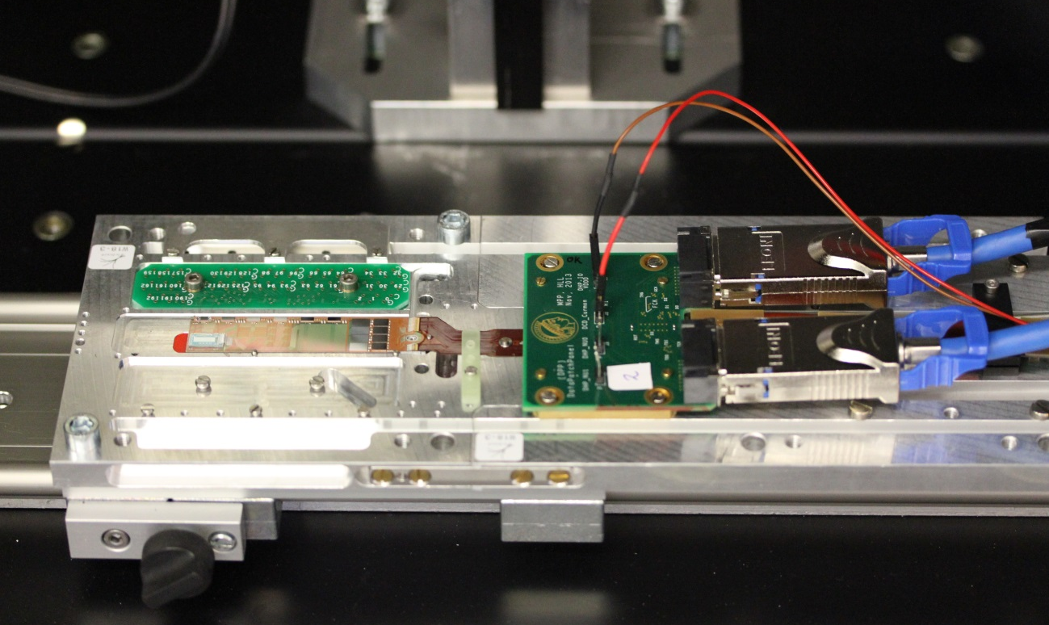
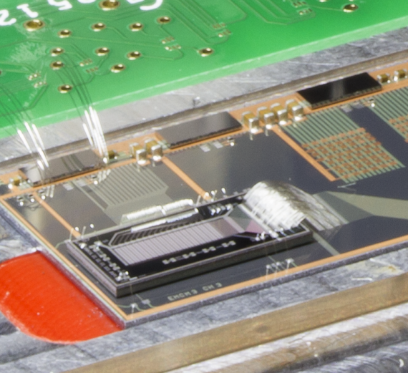
DCD
EMCM

Slide 24
DCD tests on single chip PCB

Slide 25
Chip #1 Test all ADCs

Slide 26
Chip #1 Test all ADCs
…
ADC characteristics
Noise of the first ADC
Deviation from mean for every input
DNL: code difference for two consecutive inputs
(first ADC)
INL of the first ADC
Deviation from linear fit for every input
INL (peak to peak for all inputs)
Gain (nA/LSB)
Average noise (LSB)
DNL (peak to peak for all inputs)
All ADCs:
Noise vs. ADC position
INL vs. ADC position
DNL vs. ADC position
Gain vs. ADC position

Slide 27
Chip #1 Test all ADCs
Several ADCs show higher noise (out of 128 tested)
Bad ADCs

Slide 28
Chip #1 Test all ADCs
…
Noise of the ADC: ~1.3LSB (210e @ gq 450pA/e)
ADC gain 73nA/LSB
INL the „bad“ ADC: ~5.3LSB
Noise floor: ~0.58LSB (92e @ gq 450pA/e)
3LSBs
3LSB

Slide 29
Chip #2 test all ADCs – fit (-100 to 125)
…

Slide 30
Chip #2 Test all ADCs
Another chip: no bad ADCs – probably due to more careful optimization of bias parameters
ADC gain 72nA/LSB
Noise: ~0.55LSB
2.5LSB

Slide 31
DCD tests on EMCM

Slide 32
DCD
EMCM
All ASICs can be configured and read out, Switcher outputs ok
Small PXD6 matrix connected to DCDPipeline

Slide 33
EMCM Tests
Digital test pattern has been used to tests the digital blocks and the communication DCD - DHP
Test pattern
ADCs
bit | 29 | 30 | 31 | 0 | 1 | 2 | 3
7 | 0 | 0 | 0 | 1 | 0 | 0 | 0
6 | 1 | 1 | 0 | 0 | 0 | 1 | 1
5 | 1 | 1 | 0 | 0 | 0 | 1 | 1
4 | 1 | 1 | 0 | 0 | 0 | 1 | 1
3 | 1 | 1 | 0 | 0 | 0 | 1 | 1
2 | 1 | 1 | 0 | 0 | 0 | 1 | 1
1 | 1 | 1 | 0 | 0 | 0 | 1 | 1
0 | 1 | 1 | 0 | 1 | 0 | 1 | 1
mux
DCD digital block
DHP

Slide 34
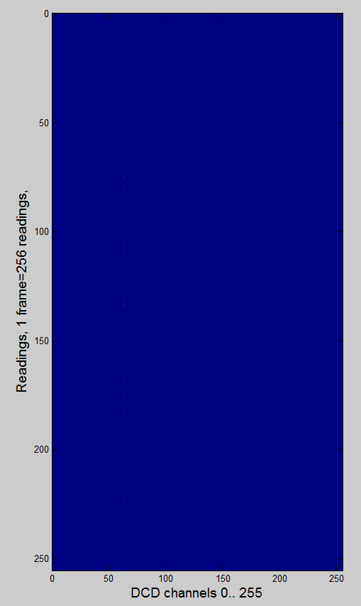
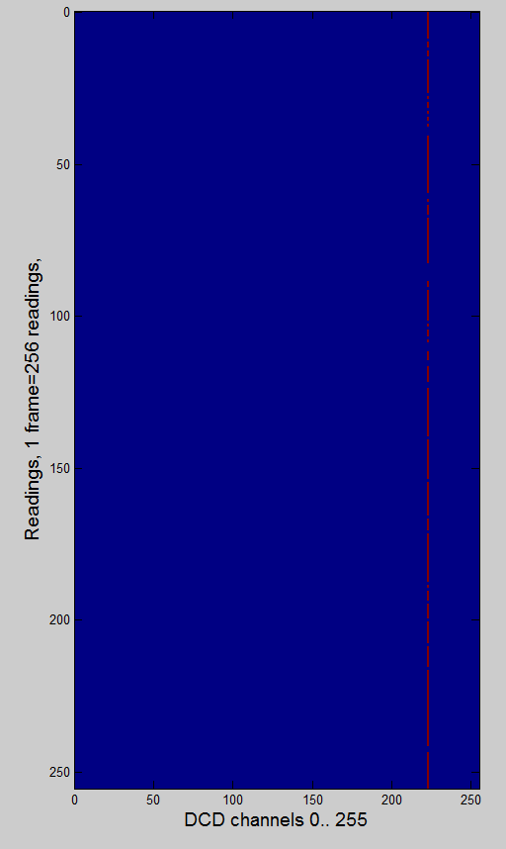
EMCM Tests
Digital test pattern has been used to tests the digital blocks and the communication DCD - DHP
250MHz, DCD1, VDDD=1.8V
305MHz, DCD1, VDDD=1.8V
~/TIMING/15_12_22_DCDpp0_1/test_pattern_of_dhpdcd0_bit61_SLDY_0.pdf
~/TIMING/15_12_22_DCDpp0_3/test_pattern_of_dhpdcd0_bit15_SLDY_0.pdf
column 223
(128ADU 160ADU)

Slide 35
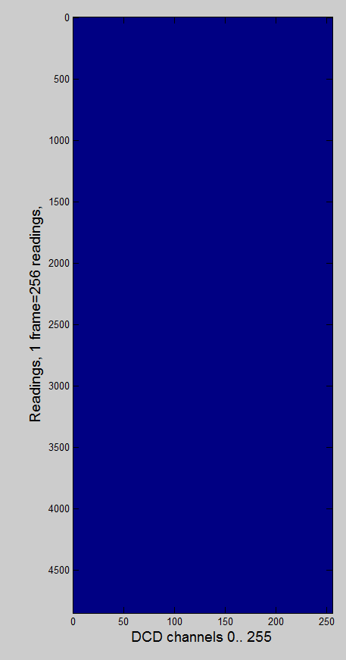
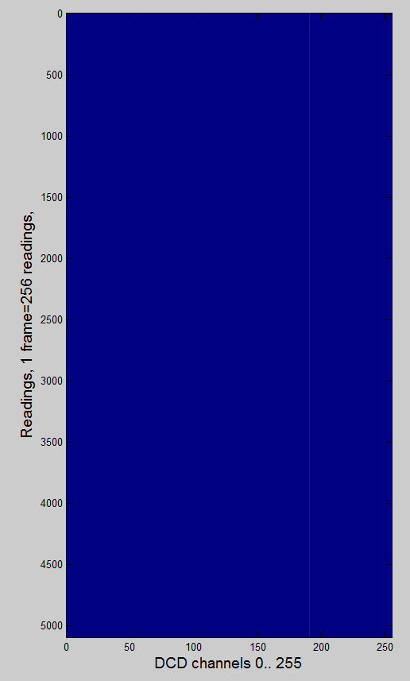
EMCM Tests
Digital test pattern has been used to tests the digital blocks and the communication DCD - DHP
305MHz, DCD1, VDDD=1.9V
305MHz, DCD4, VDDD=1.9V
PLL_SER_
CLK_DLY=1
~/TIMING/15_01_08_DCDpp3_2/test_pattern_of_dhpdcd3_dcd_cmos_clk_dly_0_pll_ser_clk_dly_1.pdf
~/TIMING/15_01_07_DCDpp0_1/test_pattern_of_dhpdcd0_bit0_SLDY_0.pdf
✔
column 191
(128ADU 132ADU)

Slide 36
DCD Measurements
Test pattern
bit | 29 | 30 | 31 | 0 | 1 | 2 | 3
7 | 0 | 0 | 0 | 1 | 0 | 0 | 0
6 | 1 | 1 | 0 | 0 | 0 | 1 | 1
5 | 1 | 1 | 0 | 0 | 0 | 1 | 1
4 | 1 | 1 | 0 | 0 | 0 | 1 | 1
3 | 1 | 1 | 0 | 0 | 0 | 1 | 1
2 | 1 | 1 | 0 | 0 | 0 | 1 | 1
1 | 1 | 1 | 0 | 0 | 0 | 1 | 1
0 | 1 | 1 | 0 | 1 | 0 | 1 | 1
Channel 191

Slide 37
DCD Measurements
Test pattern
DCD
DCD digital block
VDD
Channel 191
Bias block
DCD ck
DCD data
Seen by DHP
Duty cycle
DCD ck
Delayed data DHP
DHP
Synchronized by DHP

Slide 38
DCD Measurements
Digital communication works for ~ 99.5% channels
Can be improved (next submissions) by slight resizing of bias currents, delay elements in DHP and DCD
RLC models of DEPFET needed
Ideal
bit | 29 | 30 | 31 | 0 | 1 | 2 | 3
7 | 0 | 0 | 0 | 1 | 0 | 0 | 0
6 | 1 | 1 | 0 | 0 | 0 | 1 | 1
5 | 1 | 1 | 0 | 0 | 0 | 1 | 1
4 | 1 | 1 | 0 | 0 | 0 | 1 | 1
3 | 1 | 1 | 0 | 0 | 0 | 1 | 1
2 | 1 | 1 | 0 | 0 | 0 | 1 | 1
1 | 1 | 1 | 0 | 0 | 0 | 1 | 1
0 | 1 | 1 | 0 | 1 | 0 | 1 | 1
127
0
-127
0
127
Realistic
Channel 191
127
0
-127
0
127
In DHP - CMOS
Reduced sampling window

Slide 39
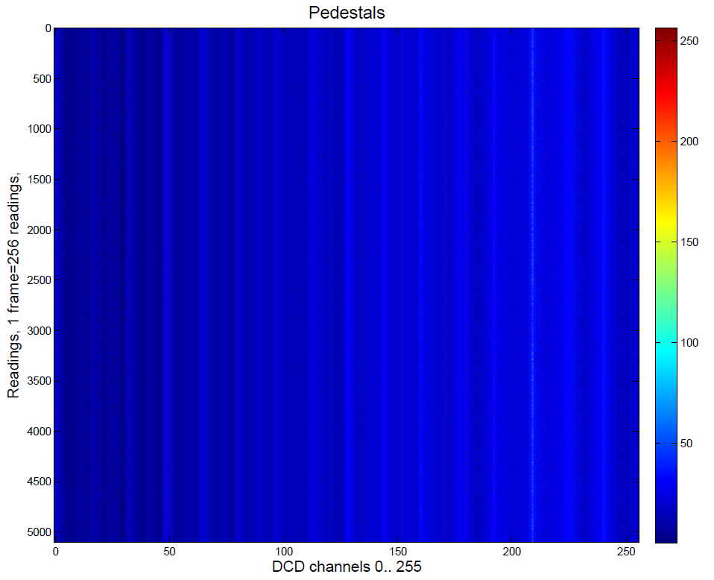
EMCM Tests
ADC readout – only one channel has unstable bit 6 (64) (digital problem?)
305MHz, DCD1, VDDD=1.9V
Column 209
ADU: 30, 31, 32, 33 & 63

Slide 40
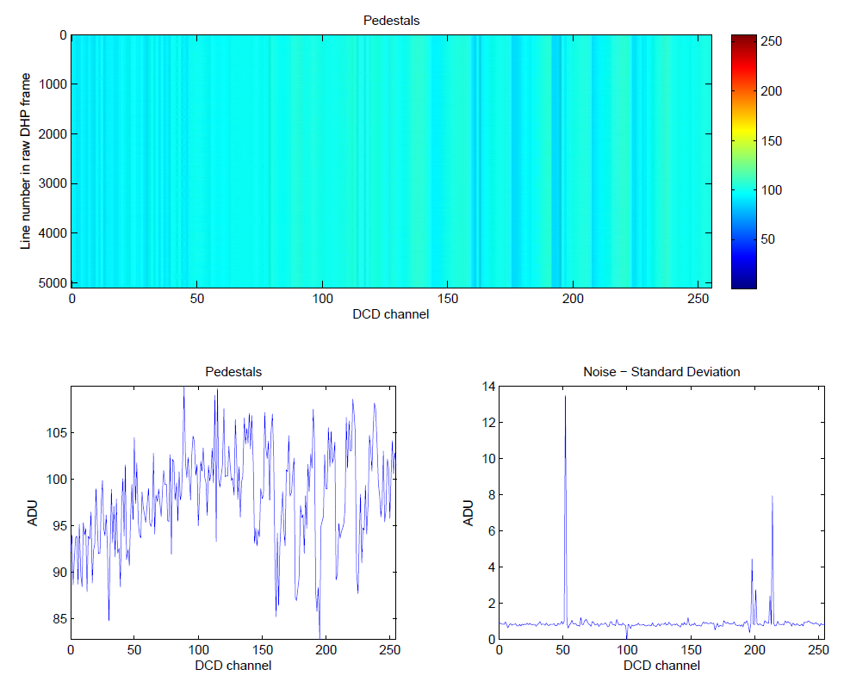
EMCM Tests
ADC characterization
ADCs have been measured using internal- and DHE current source
Only 3 ADCs with slightly higher noise – unstable bit (e.g. bit 5)
Column 52
ADU: 94, 95, 96, 126, 127

Slide 41
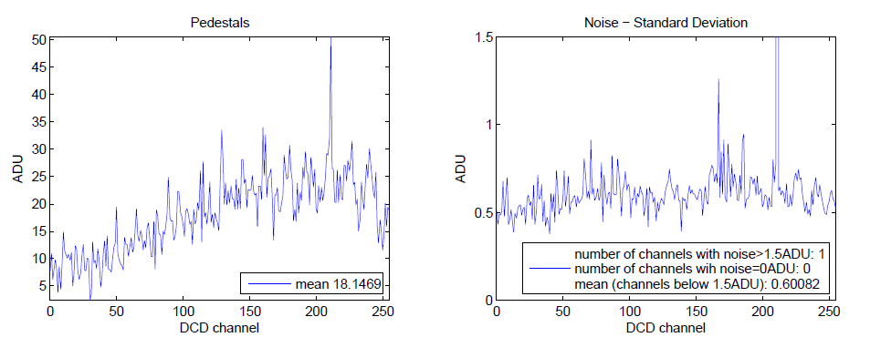
EMCM Tests
ADC characterization
Noise measurement with LMU power supply on EMCN
Noise 0.5LSB < 100e
Only one ADC with noise ~ 1.5 LSB
4 DCDs on
daciampbias = 66
dacifbpbias = 80
dacipsource = 88
dacipsource2 = 77

Slide 42
EMCM Tests
ADC characterization
ThHi
ThLo
Cmp1
Cmp2
C_{f}
SF
Rd
Logic
En
VAmpPBias
WrB*
A
Sw1
Wr*
3
DAC
1
RefNWELL
Sub
Add
2
AmpLow
I_{in}
WrB
VPSource
Sw2
24 μA
VFBPBias
NotRd AND Not Wr
VPSourceCasc
RefIn
Sw5
4
VFBNCasc
NotWr
Sw3
RefIn
RefFB
12 μA
NotRd
VFBNBias (VPSource2)
24 μA
TC
Sw4
To Next Cell
RefIn

Slide 43
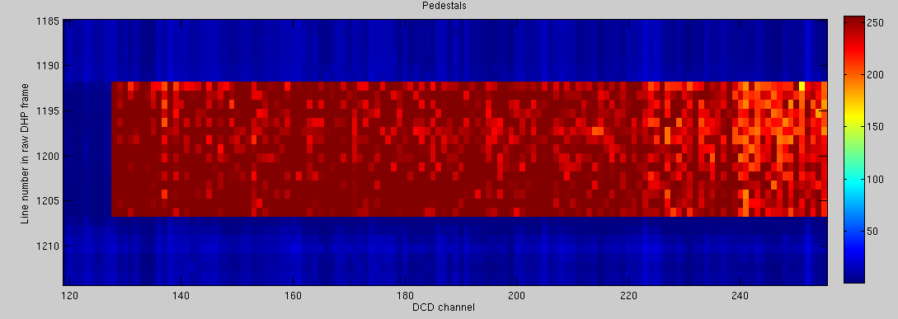
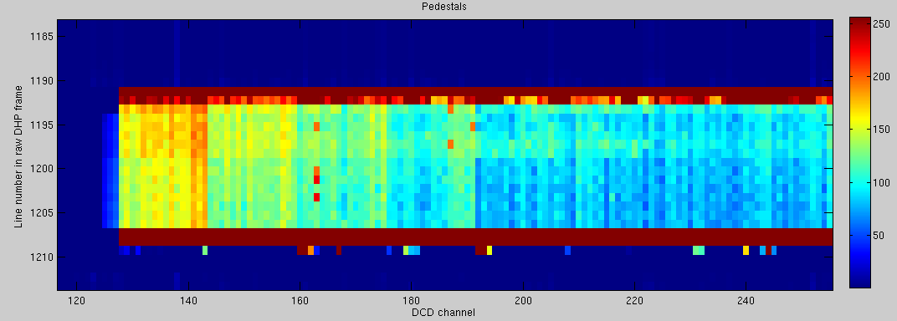
Operation of Matrix
Light sensitive
Still not optimized
14 rows
/home/hybrid5/ADC_curves/DCD_noise/15_01_15_parser_DCD3_70th/dcdpp_3_dacvnsubin_7
18 rows
/home/hybrid5/ADC_curves/DCD_noise/15_01_19_parser_DCD3_71th/dcdpp_3_dacvnsubin_7

Slide 44
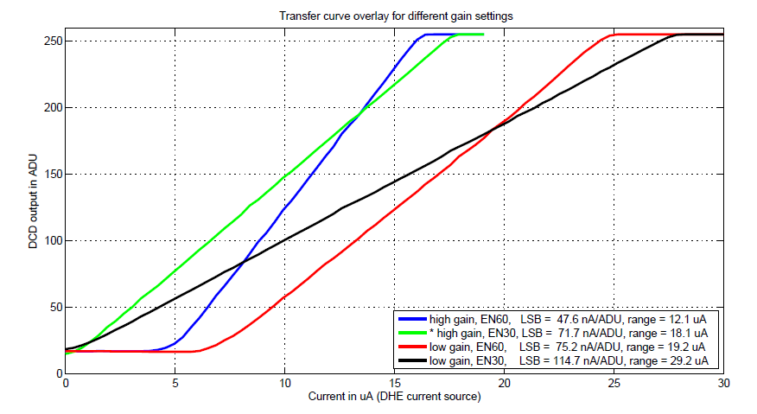
EMCM Tests
Different gain settings

Slide 45
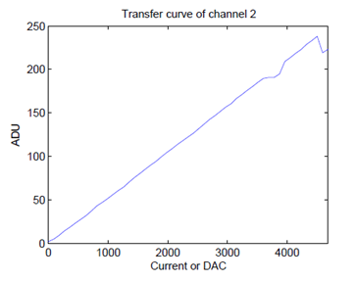
EMCM Tests
Missing code
„missing code“

Slide 46
Missing Codes

Slide 47
ADC unit-cell
The ADC-unit has two current-memory cells based on two U-I converters A and B
Depending on the input current amplitude (too low or too high), a reference current (4 μA per cell) will be added or subtracted
The comparison is done in the following way:
Two copies of the current stored in A are made – this is done with the two, layout-identical, UI converters CL and CH that are connected to the same voltage as A
The goal of this preprocessing is “to compress” the input signal so that it occupies 2x smaller range.
14u
CL
TooLow
12u+/-4u
10u
A
CH
TooHi
12u+/-4u
B

Slide 48
Unit-cell characteristics
The purpose of the comparators is to assure that the reference currents are subtracted/added in the way so that the result current occupies two times smaller range
Only so, the error in algorithm is small
IOut
-8u
-4u
-2u
IIn
8u

Slide 49
Unit-cell characteristics with offset
Imagine now that the ThHi threshold is shifted by Ref/4 (2uA) +Delta.
Imagine also that the signal is about Ref/2 (=64) In this case the result of the first comparison is zero. The result of all other comparisons is TooHigh. This leads to the binary code 64.
Imagine now that signals are within range Ref/2 and Ref/2+Delta. Obviously the binary code are always 64. This leads to the long code 64.
IOut
-8u
-4u
-2u
IIn
8u

Slide 50
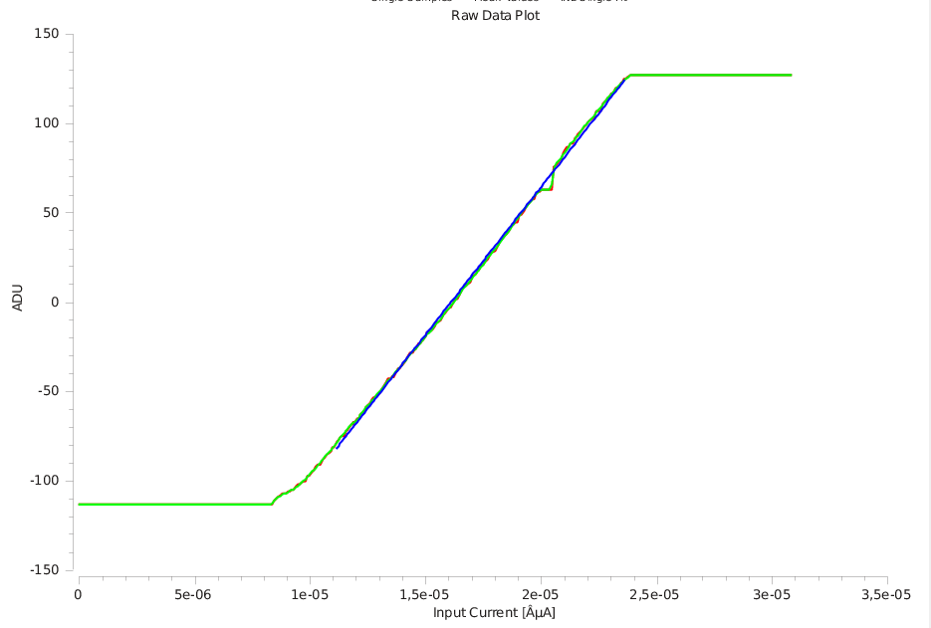
Bad characteristics causes missing codes
Missing codes around 64
IOut
-8u
-4u
-2u
IIn
8u

Slide 51
Origin of offset
Why does the current offset happen?
Possibility: transistor mismatch – fix in the next chip: make the layout in a better way e.g. the transistors bigger
Additionally, there may be a systematic offset in comparator that adds to the mismatch
Notice also: two output nodes are not on perfectly same potential
Original UI converter connected to amplifier input, copy UI converter to RefIn – this explains RefIn dependence
We will verify our theory by measurements of the transistor currents. It is possible to access the output of one transconductor in every channel from outside.
Low
PFB
PFB
24u
24u
RefFB
RefFB
RefIn
RefIn
TooLow
24u
24u
24u
26u
Sc2
Sc2
Sc2
Sc2

Slide 52
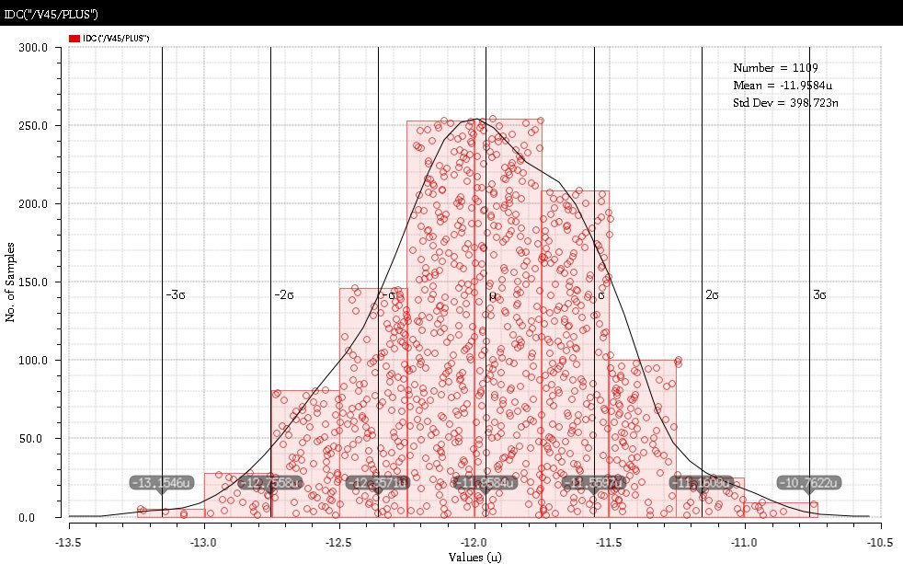
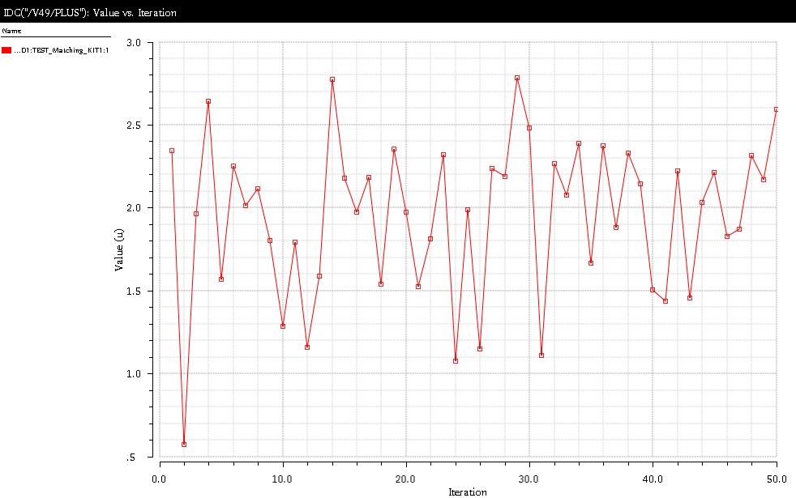
Monte-Carlo Simulation
We have started Monte Carlo simulations – according to first simulations mismatch is up to 1.5uA – which is still smaller than 2uA which produces missing codes.
However, the use of enclosed gates and mirroring can make the models not accurate.
Comparator input current for current memory cell current of 4uA (code 64)
If less than 0 we have a long code

Slide 53
Unit-cell characteristics
The purpose of the comparators is to assure that the reference currents are subtracted/added in the way so that the result current occupies two times smaller range
Only so, the error in algorithm is small
IOut
-8u
-4u
-2u
IIn
8u

Slide 54
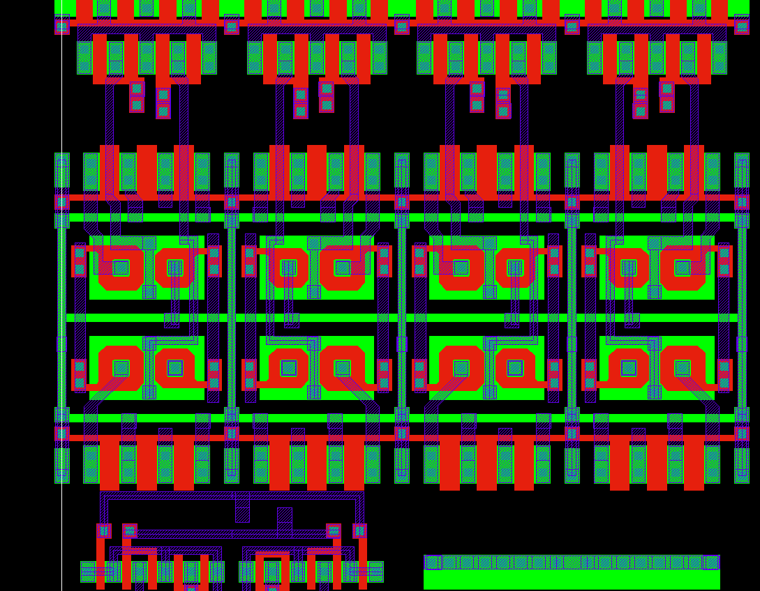
Layout
The NMOS current source has a complicated structure
It is based on enclosed NMOS and a PMOS that should compensate for voltage drops (the simple version with only NMOS behaved worse on DCD1)
The layout is dense
TooHigh
TooLow
Original cell

Slide 55
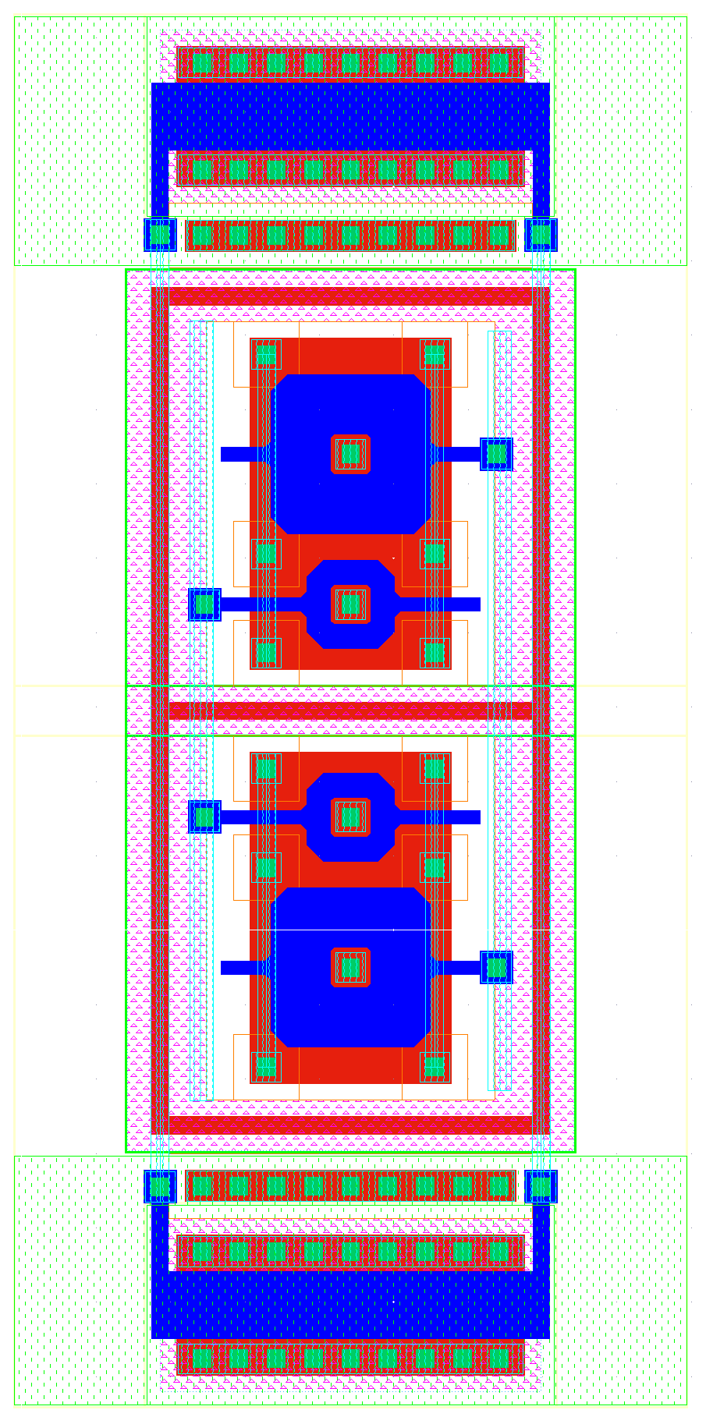
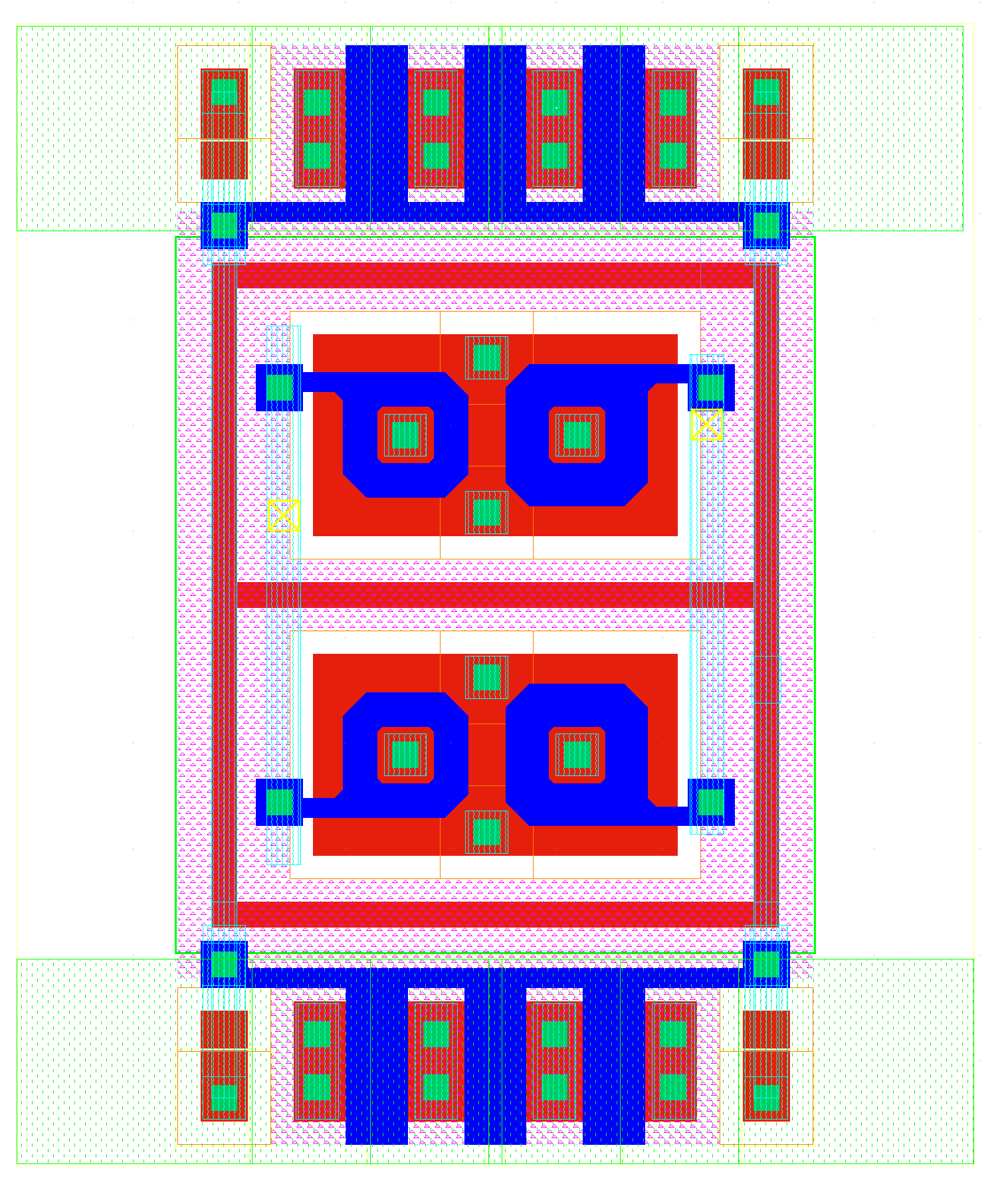
Layout
…
Old
New
11u
18u

Slide 56
Layout
TIA
ADC
200 µm

Slide 57
Missing codes
The problem can be solved by changing of layout, which can be done within one-two weeks.
Question: Is the long code problem worth of this effort
It reduces dynamic range by ¾
Dynamic range is still 20u which should be ok
„missing code“
20uA

Slide 58
DCD submission plan
UMC run on 18. May
Changes in design (present status):
Resize of several transistors in ADC to fix the problem of missing codes
Change sampling of TDI for global and pixel register to positive edge
Add fast parallel sampling mode for easier needle card tests
Improve test DAC resolution
Programmable LVDS output current
Add transmission switch to monitor
Check the voltage drop on power rail – connect gate of the SubIn source only in one point
Try to connect DAC Dump and SF VDDA to RefIn
Separated bias dacs for up and down bias
VDDA
VDDA
This makes current GNDA constant always
Source
~300uA
AmpInCM
RefIn
AmpIn
RefIn Current isn‘t constant
SF
AmpOut
This makes NMOS scs independent on GNDA noise
~60uA
RefIn
VDDA
240uA max
Source
GNDA
Gate

Slide 59
DCD submission plan
UMC run on 18. May
Changes in design (present status):
Resize of several transistors in ADC to fix the problem of missing codes
Change sampling of TDI for global and pixel register to positive edge
Add fast parallel sampling mode for easier needle card tests
Improve test DAC resolution
Programmable LVDS output current
Add transmission switch to monitor
Check the voltage drop on power rail – connect gate of the SubIn source only in one point
Try to connect DAC Dump and SF VDDA to RefIn
Separated bias dacs for up and down bias
VDDA
VDDA
This makes current GNDA constant always
Source
~300uA
AmpInCM
RefIn
AmpIn
RefIn Current isn‘t constant
SF
AmpOut
This makes NMOS scs independent on GNDA noise
~60uA
RefIn
VDDA
240uA max
Source
GNDA
Gate

Slide 60
DCD Conclusions
DCD has been testes in various ways
All circuits have been tested
Probably the only problem is that usually some number of ADCs have a long code (mostly +64 but can be -64 or zero).
Our measurements are not consistent - measurements in Heidelberg show no long codes after optimization, measurements in Munich several channels from 256 affected
Question: is the long-lode issue critical? (It only reduces the dynamic range by 25% in some channels.) Can the present chip be used for production?
The fix for the long code problem is probably easy – resize of several transistors.
All other issues that we encountered during measurements are to my opinion either not related to DCD itself or fixed in the DCD pipeline design.
The problems in some channels (unstable bits, wrong digital patterns) are probably the issue of data transfer from DCD to DHP – large capacitances, not optimized delays, slow digital IOs

Slide 61
DCD
Do we already have enough measurement results?
☹ We still did not test a properly working DEPFET module with DCDs…
☺ Measurements with EMCM show very low noise
☺ Configuration of all ASICs works well
☹ The DCD-DHP communication has been tested at somewhat reduced speed. Tests at full speed are not possible due to PLL/VCO/Delay element issue
We do not have many measurements with long DEPFET lines (and capacitances) on DCD inputs, however additional capacitance, according to simulation, does not introduce noise; it is just making the amplifier slower. Notice, a slower amplifier is not critical, since it equally reduces noise and signal. Signal to noise ratio is the same.
We have performed irradiations of DCD2 and DCDBv2. DCDBPipeline uses exactly the same circuits, just arranged in different way.
SEU tolerance of 180nm technology with 1.8V power supply is better than the SEU tolerance of 65nm technology.
The only issue could be the NMOS leakage current in the DCD digital part for the does range 1-5MRad. We will investigate this
Analog CMC has been tested on modular hybrid

Slide 62
SWITCHER

Slide 63
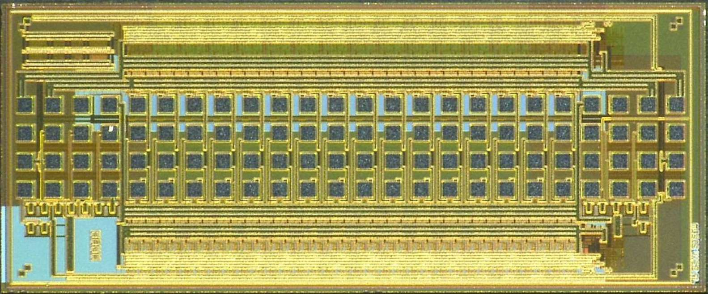
SWITCHER
SWITCEHR chips generate fast high-voltage pulses of up to 20 V amplitude to activate gate rows and to clear the internal DEPFET gates.
SWITCHER is implemented in HV AMS 180nm technology.
32 channels with a clear- and a gate-driver each.
SWITCHER in 180nm AMS

Slide 64
DHP

Slide 65
Thank you!

Slide 66
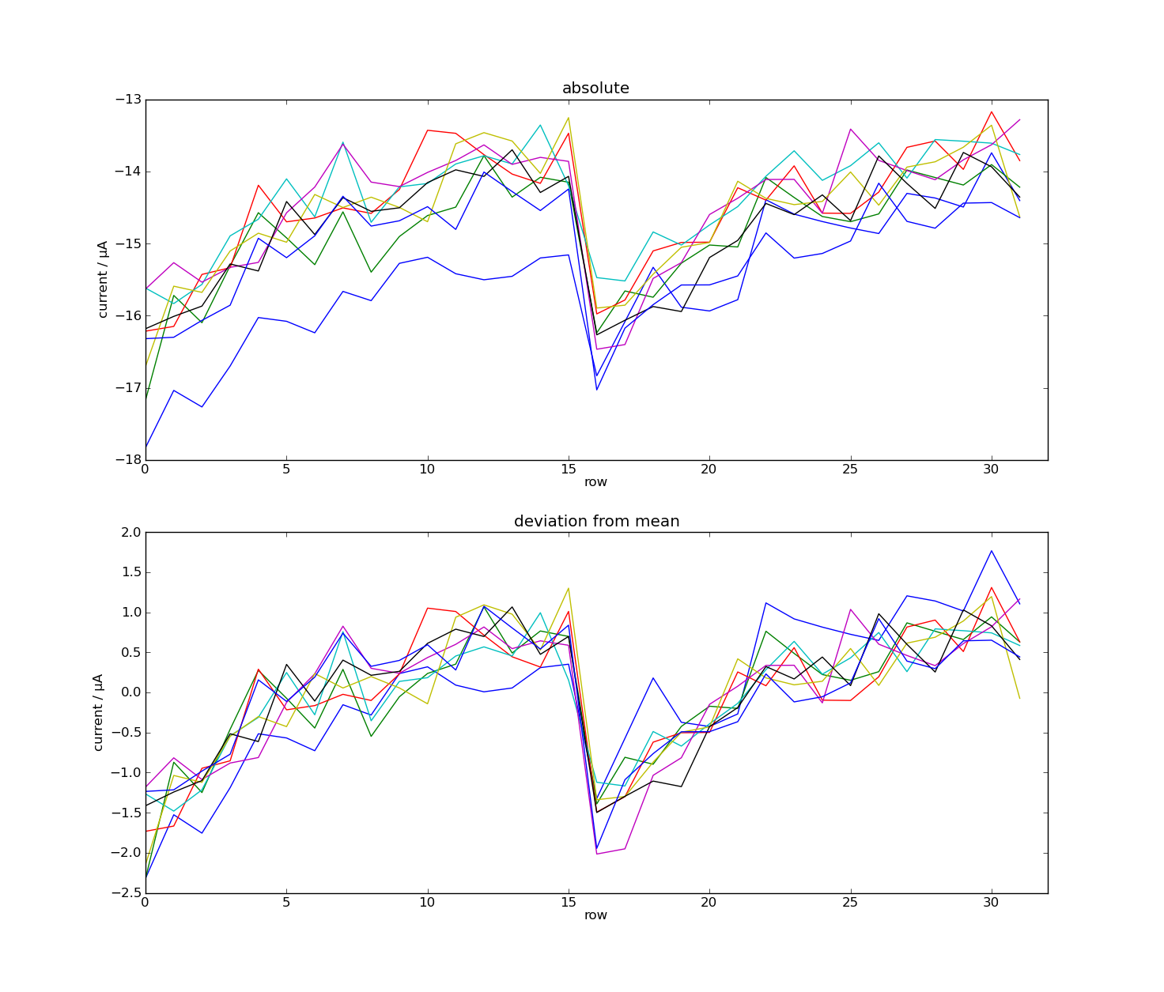
DCD Measurements
Measure

Slide 67
DCD Measurements
Measure

Slide 68
DCD Measurements
Noise vs. Code
RC
Bias V.
ADC

Slide 69
Problem of low ADC end
Problem of low ADC end
M1 current too weak
Resistance Sw too high
Out too low (Amplifier A saturates)
Low VT of PMOS not produced or bad corner – do corner simulation
Try
Increase Sc2
Decrease NMWELL voltage
Increase RefFB voltage
Decrease AmpLow (better Out_low), but increase IPAmp for higher in
In next chip – increase W/L of differential PMOS
Out
PFB
24u
RefFB
Sw
RefIn
24u
24u
Sc2
M1
Sc2

