Slide 1
Topics to be discussed
:- Where do we stand with pilot run preps?
:- ASIC testing/re-design/submission
:- Preparations for installation/commissioning → Shuji..
:- AOB

Slide 2
Preparations for Pilot Assembly and Test
Sensors - Rainer, Laci:
Production cycle in CR done, now in thinning and backend
:- first full PXD9 dummy etched (☺)
:- finish next week hot wafers
:- hope to finish Cu, BCBN, cutting by ……………….. end June
DHP tests - Carlos M./Hans
Tested chips available …………………………………………. done
DCD tests - Christian Kreidl/Ivan
Still issues with probe card …………………………………………. ????
SWB bumping – Laci
Under way, delayed because of PacTech problems…………. end May

Slide 3
Preps pilot, cont.
SWB tests - Christian Kreidl/Ivan
Ready, waiting for bumped chips …………………………………. ?????
Flip-Chip – Laci
IZM contacted, 4 weeks lead time (incl. jigs) ………………….. mid July
SMD - Carlos L./Laci
Both places to be ready ……………………………………………… end June
Probecard testing (if needed) - Christian Koffmane
??? …………………………….. July

Slide 4
Preps pilot, cont.
Kapton availability – Stefan
…………. end July
Kapton attach and wire bond - Hans-Guenther
…………. end July
Assembly jigs and test fixtures - Hans-Guenther
Need transport and SMD jigs for practicing at NTC …….. beg. June
Testsystems - Christian Koffmane ……………….. ~August??
:- test fixtures/patch panels …
:- Hybrid7

Slide 5
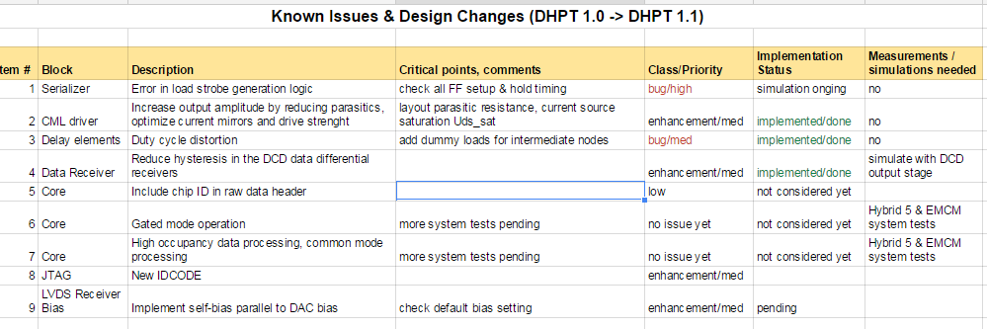
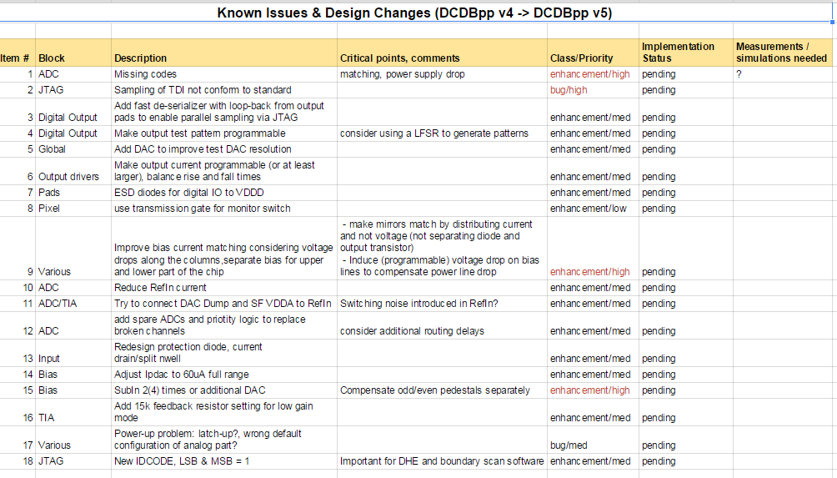
ASICs testing/re-design/submission
Hans made a google docs spreadsheetfor DCD/DHP/SWB
https://docs.google.com/spreadsheets/d/1OVASA4uVWEmoNZSZnSXNDR2uCe2bCWhkqrnfIKvhg_g/edit#gid=0

