Slide 1
FANGS for BEAST
J. Dingfelder, A. Eyring, Laura Mari,
C. Marinas, D. Pohl
University of Bonn

Slide 2
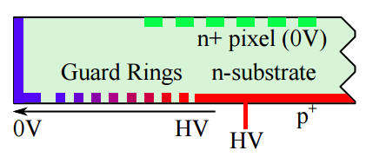
FANGS: FE-I4 ATLAS Near Gamma Sensors
FE-I4 read out chip
High hit rates and radiation hard
IBM 130 nm CMOS process
Provides read out for 80x336 pixels
Thickness=150 µm
Physical size=21x19 mm²
Bump bonded to Si sensor
Sensor:
n-in-n planar
Pitch=50x250 µm²
Thickness=200 µm
Physical size=19x20 mm²
HV=60 V
Power=1.2 W
Background radiation measurements in Phase 2:
Sensitive to low keV X-rays (6 keV to 60 keV)
Particle rates (25 ns)
2
Notes:
Reasonable power consumption.

Slide 3
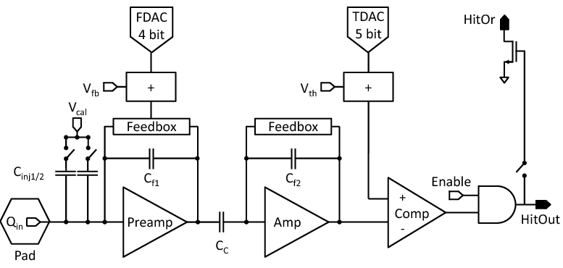
TDC Method
V(Q)
t2
t1
Vth
TOT
Time
TOT Clock signal
TDC Clock signal
Two stage amplifier → Discriminator with adjustable threshold.
Time over threshold (TOT) with externally supplied 40 MHz clock.
Time to digital converter (TDC) uses 640 MHz FPGA clock.
Output of each pixel is ORed.
Internal charge injection circuit for threshold tuning and calibration
→ Both, high speed and adequate energy resolution achieved at the same time
Notes:
40MHz is the bunch crossing rate at ATLAS
Voltage across the capacitors allows internal charge injection useful for threshold tuning and TOT/TDC calibration.

Slide 4
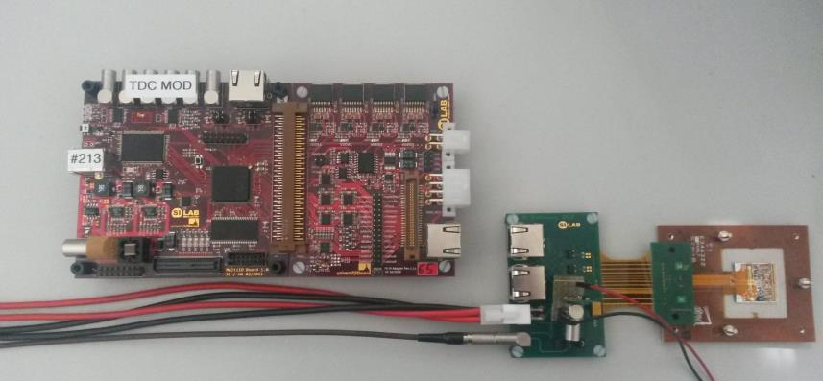
Experimental Setup
Hit-or
FPGA
Production module Adapter
Data
FE-I4
Multi IO Board
Adapter card
Open drain Buffer
HV
USBpix used for readout and pyBAR for analysis.
Open drain buffer amplifies HitOr signal on long cables (Ο(30 m)).
New USBPix3 readout system being tested at the moment (8 FE at a time).
Software allows to monitor multiple FE in parallel.

Slide 5
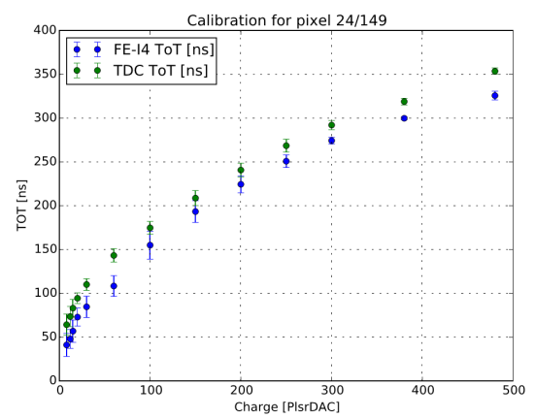
Pixel-per-pixel Calibration
Threshold tuning noise based
Vth and TDC as a function of charge different for each pixel.
Per pixel calibration needed.
Internal charge injection in units of PlsrDAC ~ 55 electrons
5
Notes:
Threshold tuning is done in two loops. Global threshold (gdac) set to high value and decreased at each loop. Pixel threshold set to lowest value and increased for each noisy pixel

Slide 6
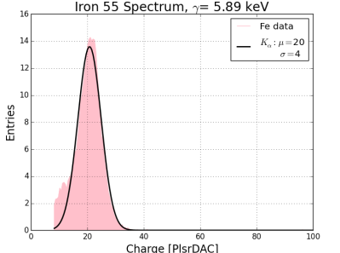
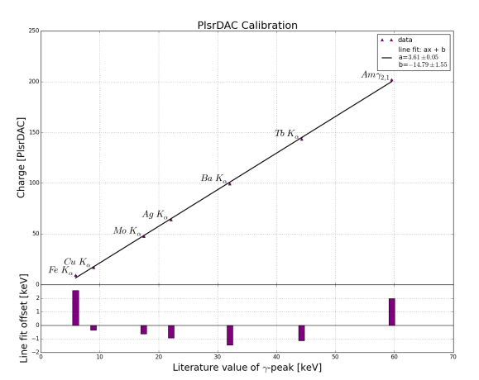
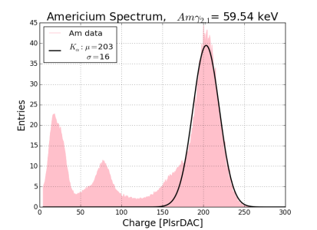
Calibration and Dynamic Range
Wide dynamic range covered (wider also possible)
Lowest measured plsrDAC value ~ 7
Threshold of ~1000 electrons feasible
Notes:
5.9 keV~ 1600 electrons.

Slide 7
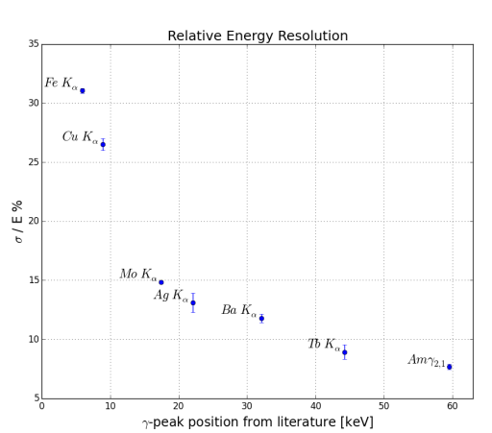
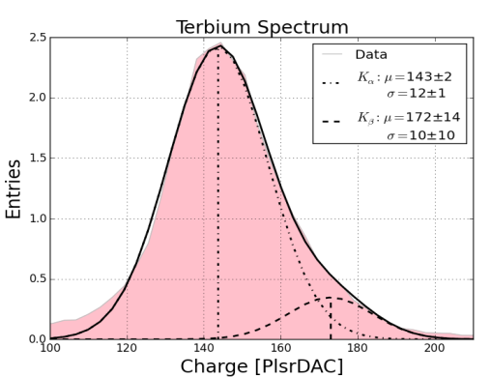
Energy Resolution
3D sensor
Terbium Kα=44.23keV, Kβ =50.65 keV
ΔE = 6.42 keV
Adequate energy resolution
Better than 15 % above 10 keV

Slide 8
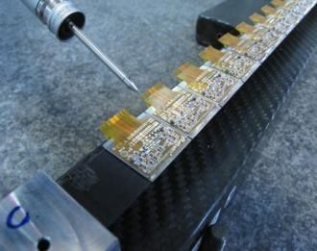
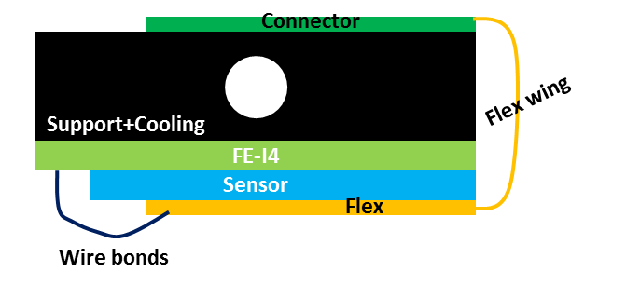
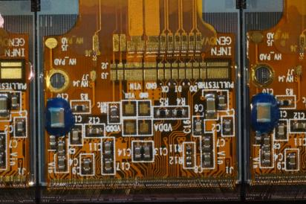
Initial Design Concept for Beast II
Stave structure similar to ATLAS IBL.
90 µm thick flex attached on top of sensor for read out.
↘ BUT: High absorption probability in the low keV range → Forced a design change

Slide 9
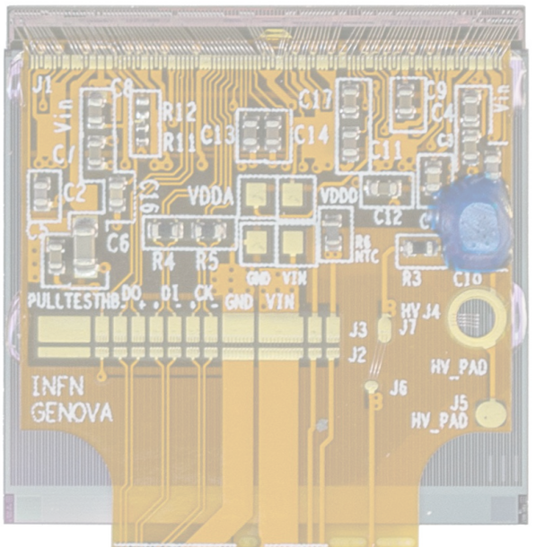
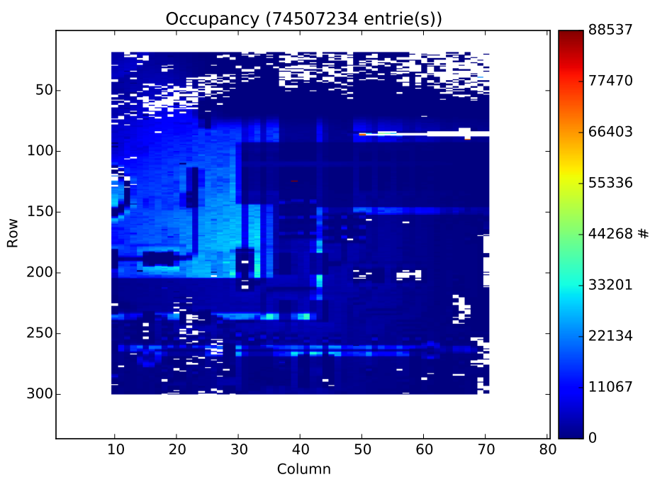
Flex Radiography
9
Notes:
Effect of Flex using , scanned over a period of 2 hours and effect of absorption of flex is seen.

Slide 10
FANGS Stave: Design Evolution
Connector
How to mount few single chips in Phase 2?
(Reusing existing infrastructure)
Flex wing
Support+Cooling
FE-I4
Sensor
Flex
Wire bonds
Move the flex to one side. No material in front!
Support+Cooling
Flex
FE-I4
Sensor
Wire bonds
Thinner support. Make use of PXD cooling
Support+Cooling
Flex
FE-I4
Sensor
Wire bonds

Slide 11
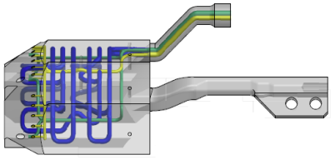
Mechanical Arrangement
SIDE
TOP
Al
FRONT
Glue
Flex
FE-I4
Solder
Sensor
Wire bonds

Slide 12
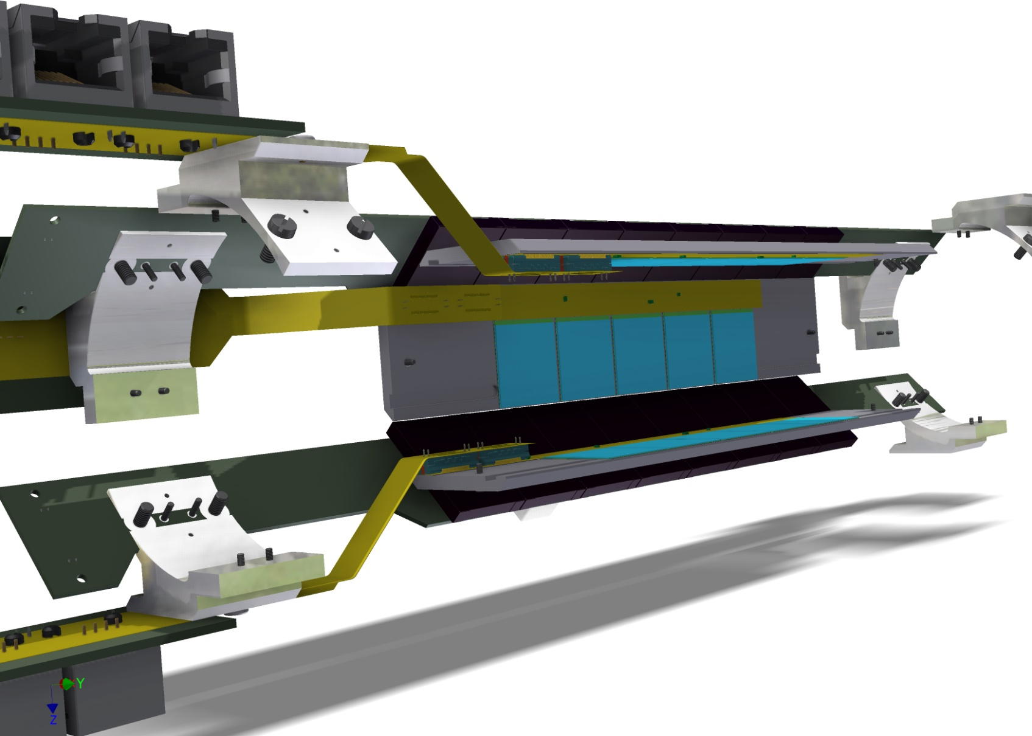
FANGS and CLAWS Integration
CLAWS
FANGS
Final configuration under discussion
Established regular Bonn-MPI meetings
CAD integration by K. Ackermann (MPI)
BASF2 implementation M. Ritter (KEK-MPI)

Slide 13
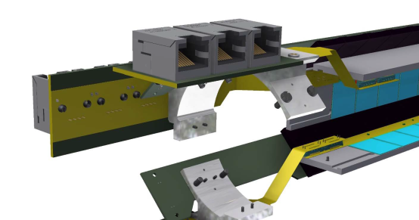
Flex Concept
Design still evolving:
8 mm wide Kapton
2 x 40 pin connector on backward side
Short intermediate Kapton connecting to a PCB attached to SVD ring
4 Ethernet and 1 power connectors on PCB

Slide 14
Aluminum Stave Material Budget
Support:
3 mm thick Aluminum → 3.4%X₀
Epoxy:
50 µm thick → 0.014%X₀
FE-I4
150 µm thick → 0.16%X₀
Sensor:
200 µm thick → 0.21%X₀
Solder balls
SnAg → 0.17%X₀ (3.3% of the area)
Flex (or 500 µm PCB)
66 µm thick polymide → 0.023%X₀
24 µm Cu (2 layers) → 0.17%X₀
Aluminum
Glue
Flex
FE-I4
Solder
Sensor
Wire bonds
3.1% X₀
3.9% X₀
Low and flat material budget distribution
No impact in outer detectors
Reminder: PXD+SVD contribute with ~4.0% X₀

Slide 15
FEA of a FANGS (Al-based) Stave
Maximum temperature = -4 ºC
Maximum ΔT within one sensor = 4 ºC
Power = 1.2 W each FE
Cooling block = -15 ºC
Environment = 20 ºC at 2 m/s
Proper heat handling
Low and flat temperature profile

Slide 16
Conclusion
FANGS is rapidly evolving into a final detector system for background (energy and rates) measurements at BEAST Phase 2
All the aspects related to the design, characterization, integration are in good progress
30 hybrids (FE-I4 and planar sensor) have been prepared (twice what is needed)
Front end has been tuned to cover the expected energy range with proper resolution
Multiple-FE DAQ with long cables is being tested with a new readout system
Kapton flex and intermediate boards are being designed
Mechanical concept and cooling management are well in progress

Slide 17
Thank you

Slide 18
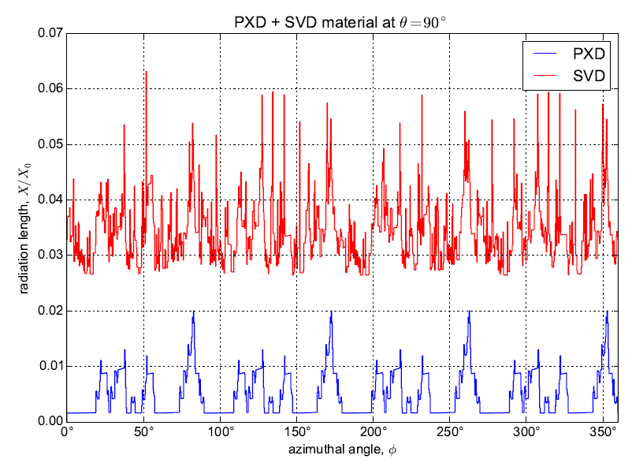
VXD Material Budget
How much material budget is allowed for BEAST Phase 2 systems?
i.e. maximum material budget that do not impact the commissioning of the outer detectors
~4.5% X₀
M. Ritter

Slide 19
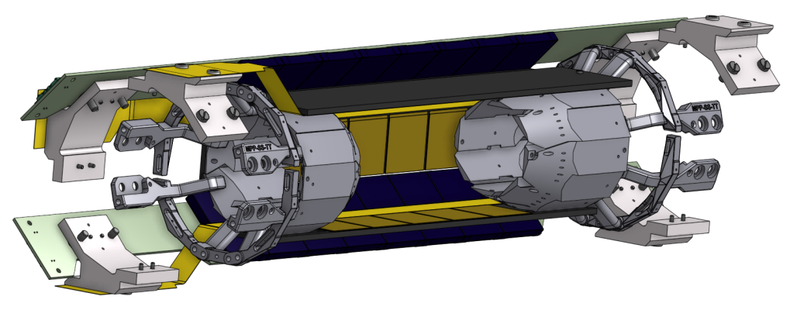
Fully Equipped FANGS and CLAWS

Slide 20
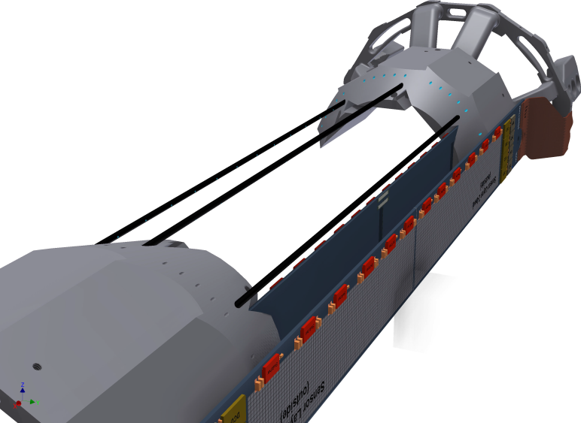
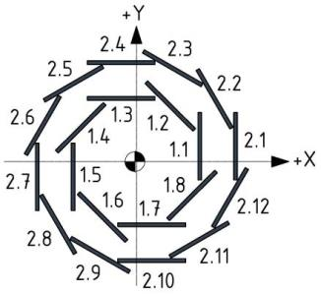
Phase 2 PXD
Instrument parts of the solid angle:
FE-I4 based pixel detectors
Backgrounds and timing
1.1
2.1

Slide 21
Al-based FANGS Stave Dimensions
17 cm
2 mm spacer
2 cm
2.8 cm
1.1 cm
CB
CB
2.5 cm
2 cm
0.3 cm
2.8 cm
Kapton/PCB missing in this drawing
13 mm wide and 500 µm thick (+ wire bonding)
Where to place the connectors (power and data)?

