Slide 1
Module/Ladder Assembly
Receive module from flip chip, inspection
SMD assembly in base jig
Tests (needle card)
Kapton assembly (soldering, wire bonding)
Full test & characterisation
Glue two modules to a ladder
Test
Need jigs and tooling for each step
Module fixation for handling
Storage and transport
Tests (cooling)
Tooling

Slide 2
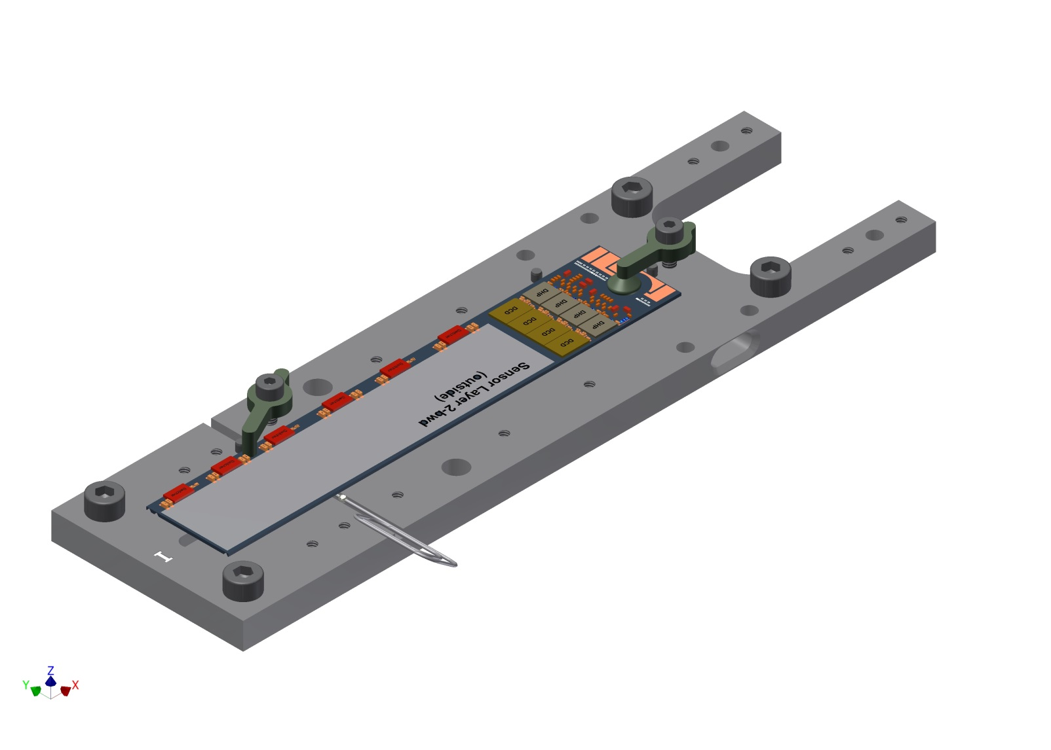
Base jig sensor
For transport and bonding
Fits on NTC stage (vacuum)

Slide 3
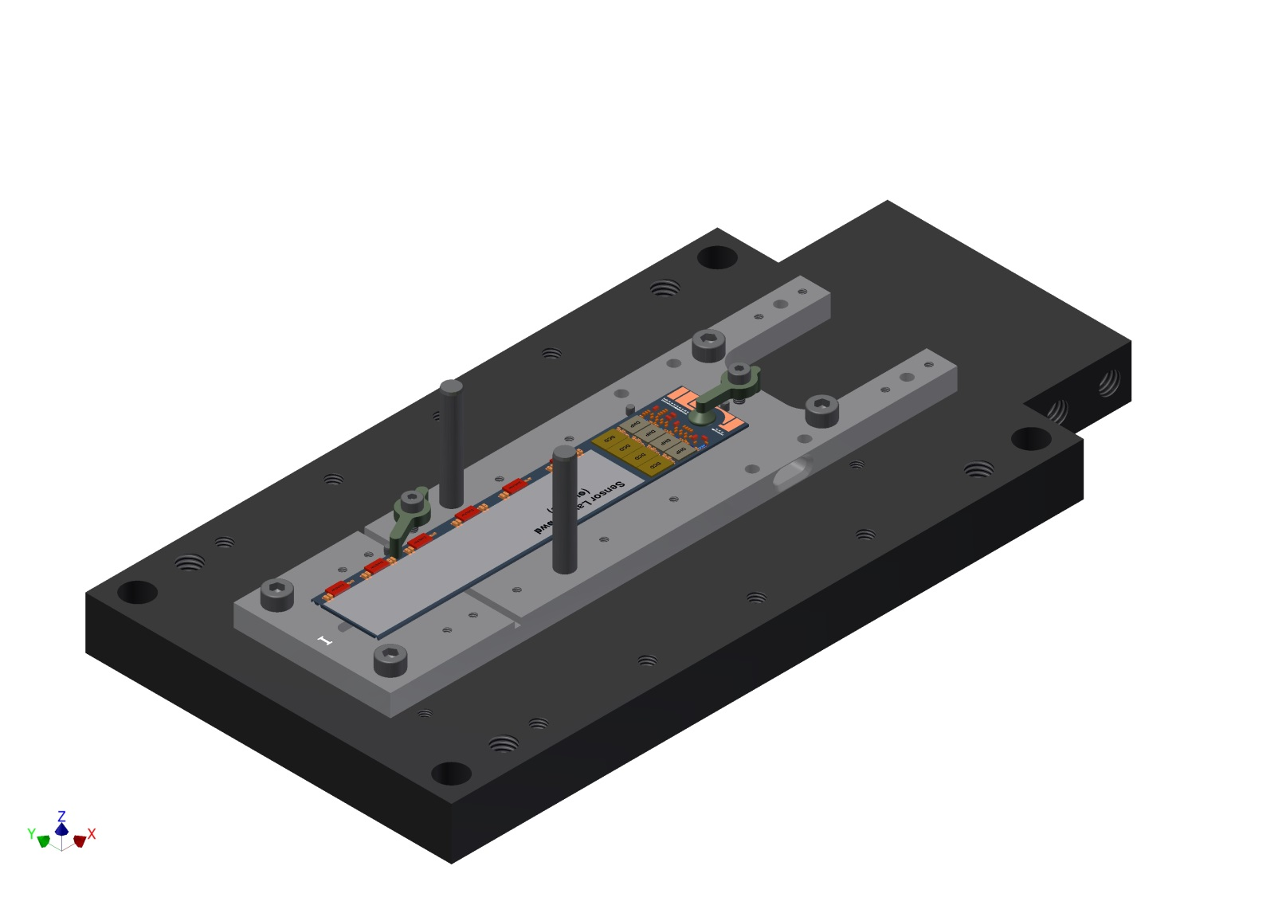
Transport base
For transport and storage

Slide 4
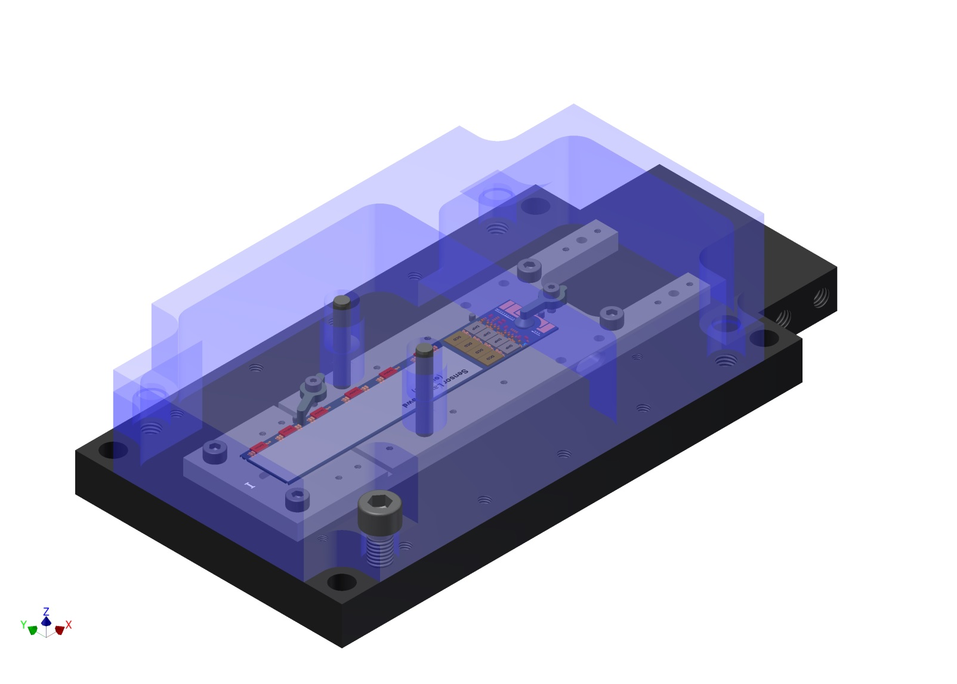
Transport cover, sensor

Slide 5
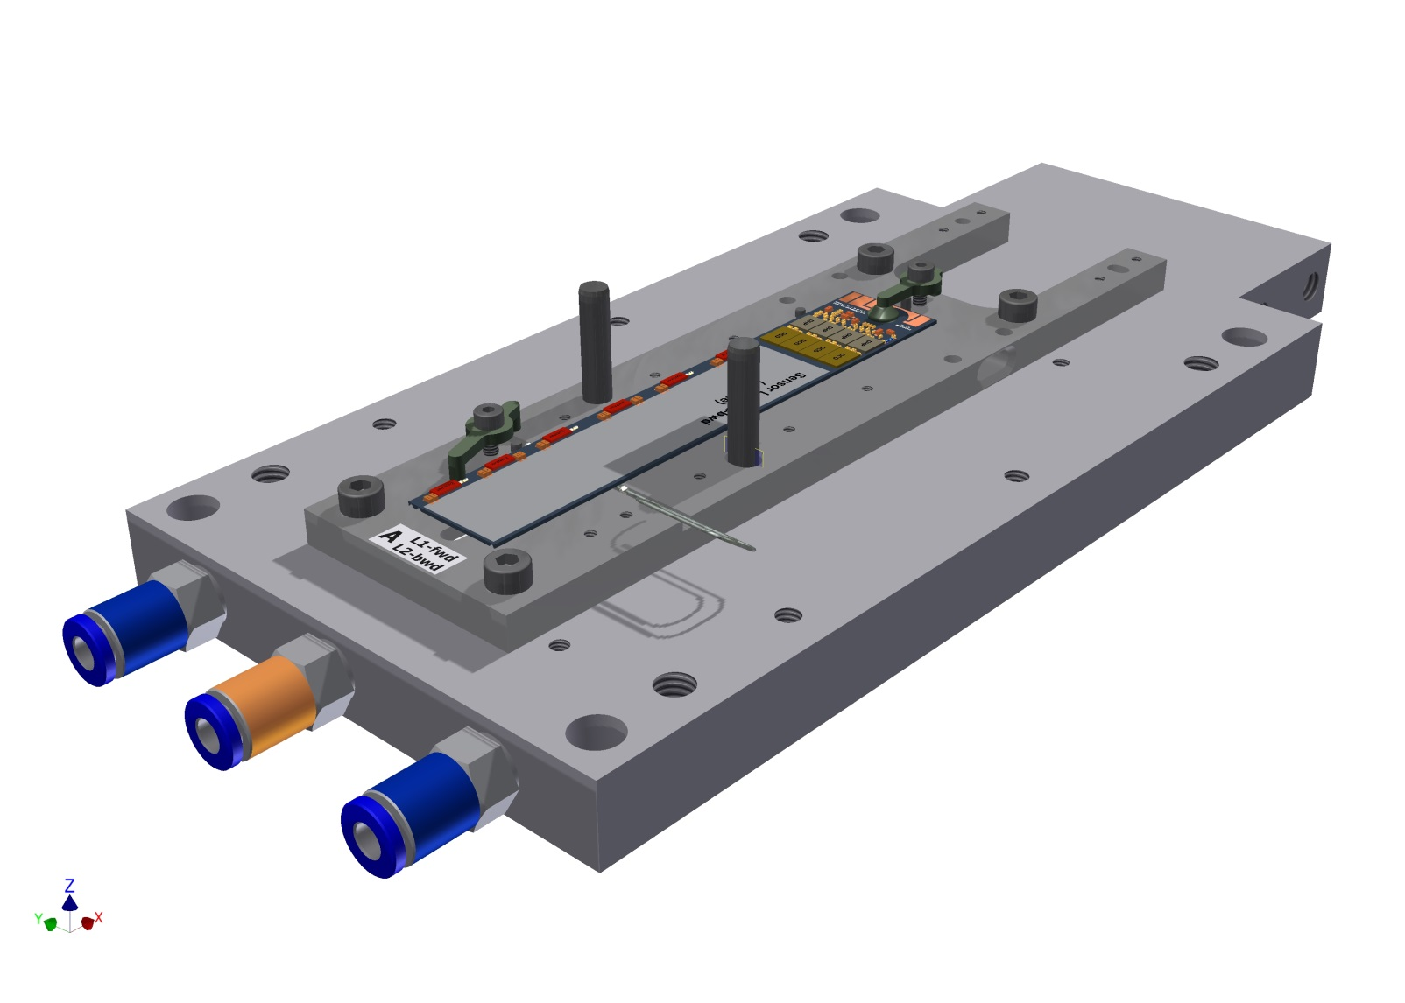
Cooling plate
(for tests)

Slide 6
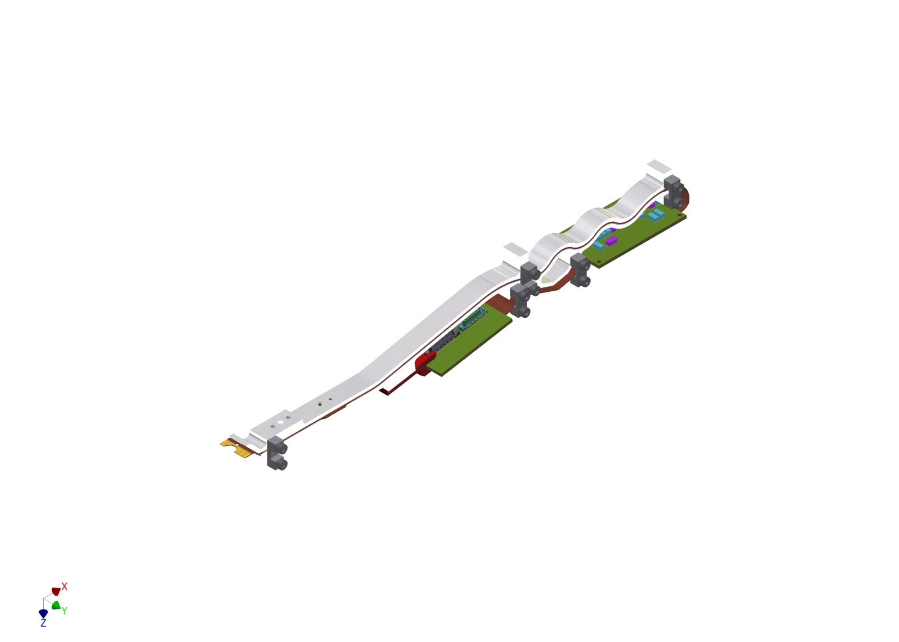
Kapton jig
- shaped, to keep bending

Slide 7
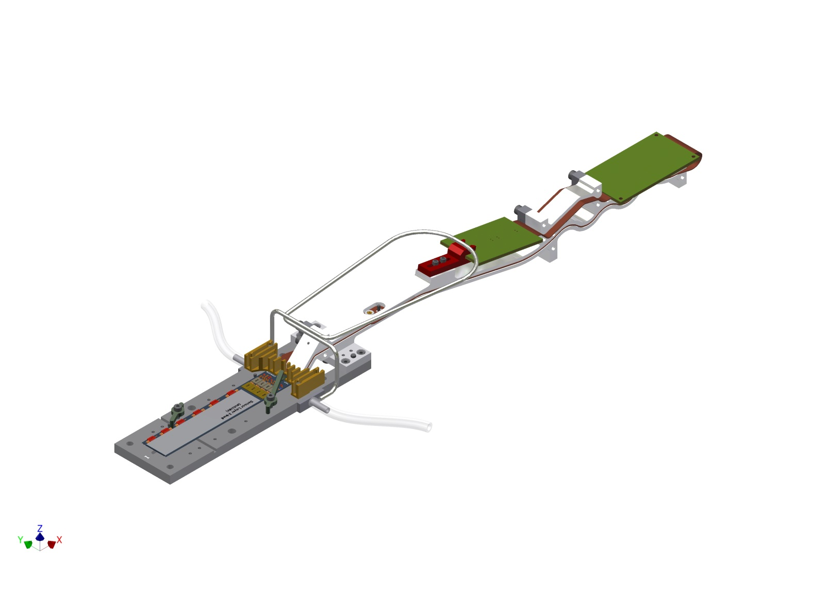
Kapton jig fitted to base jig
Including cooling for solder joint

Slide 8
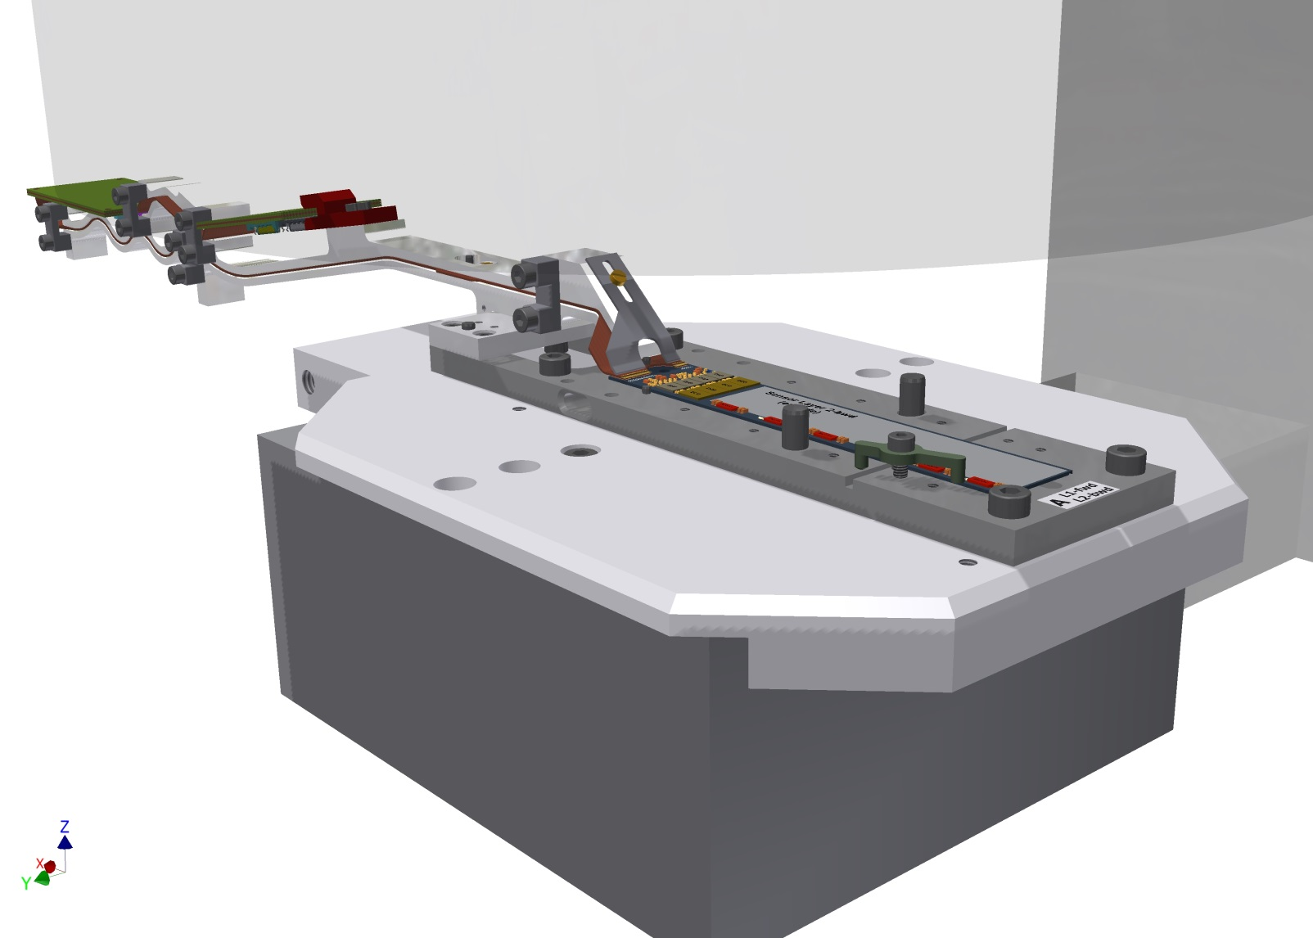
wire bonding

Slide 9
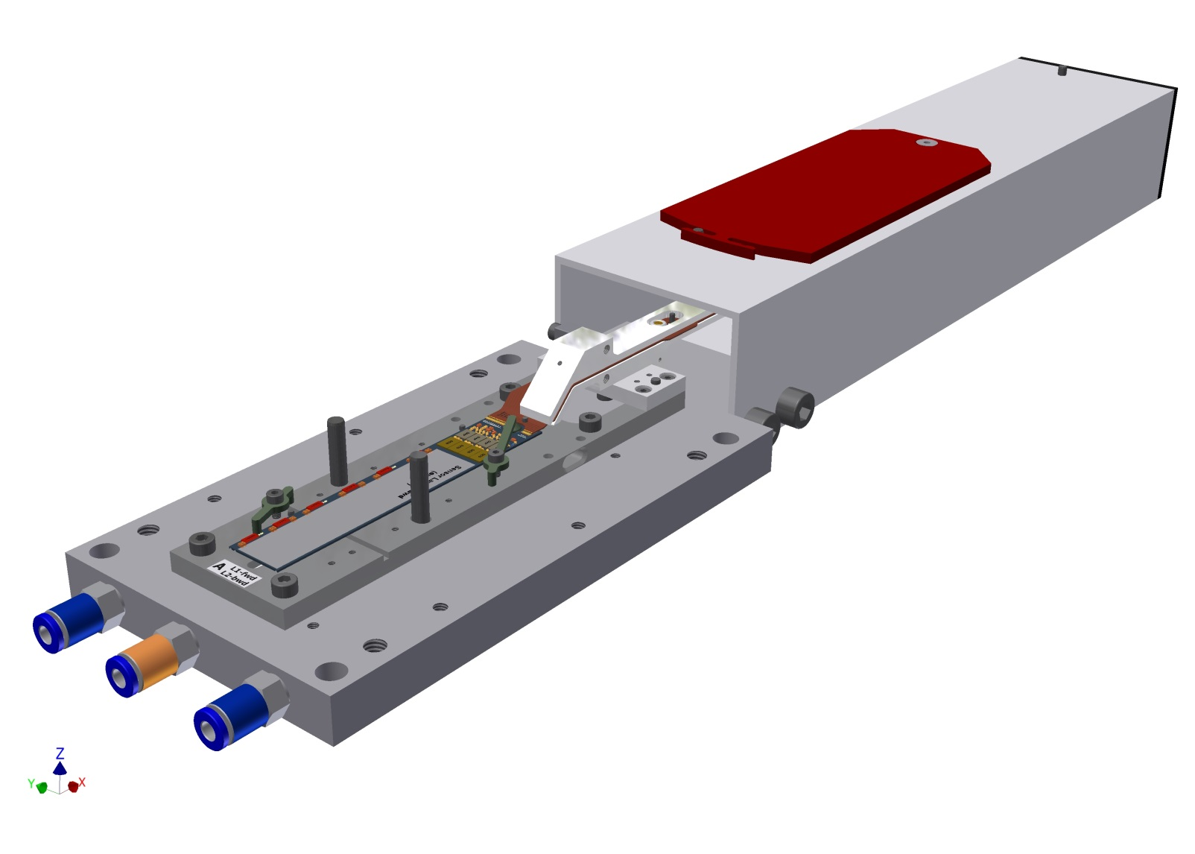
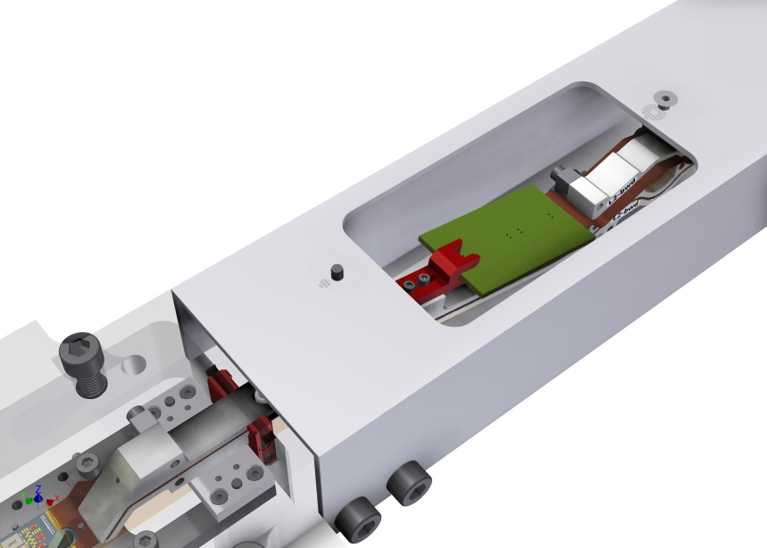
Finished module
Ready for testing
Lid can be opened to access Kapton

Slide 10
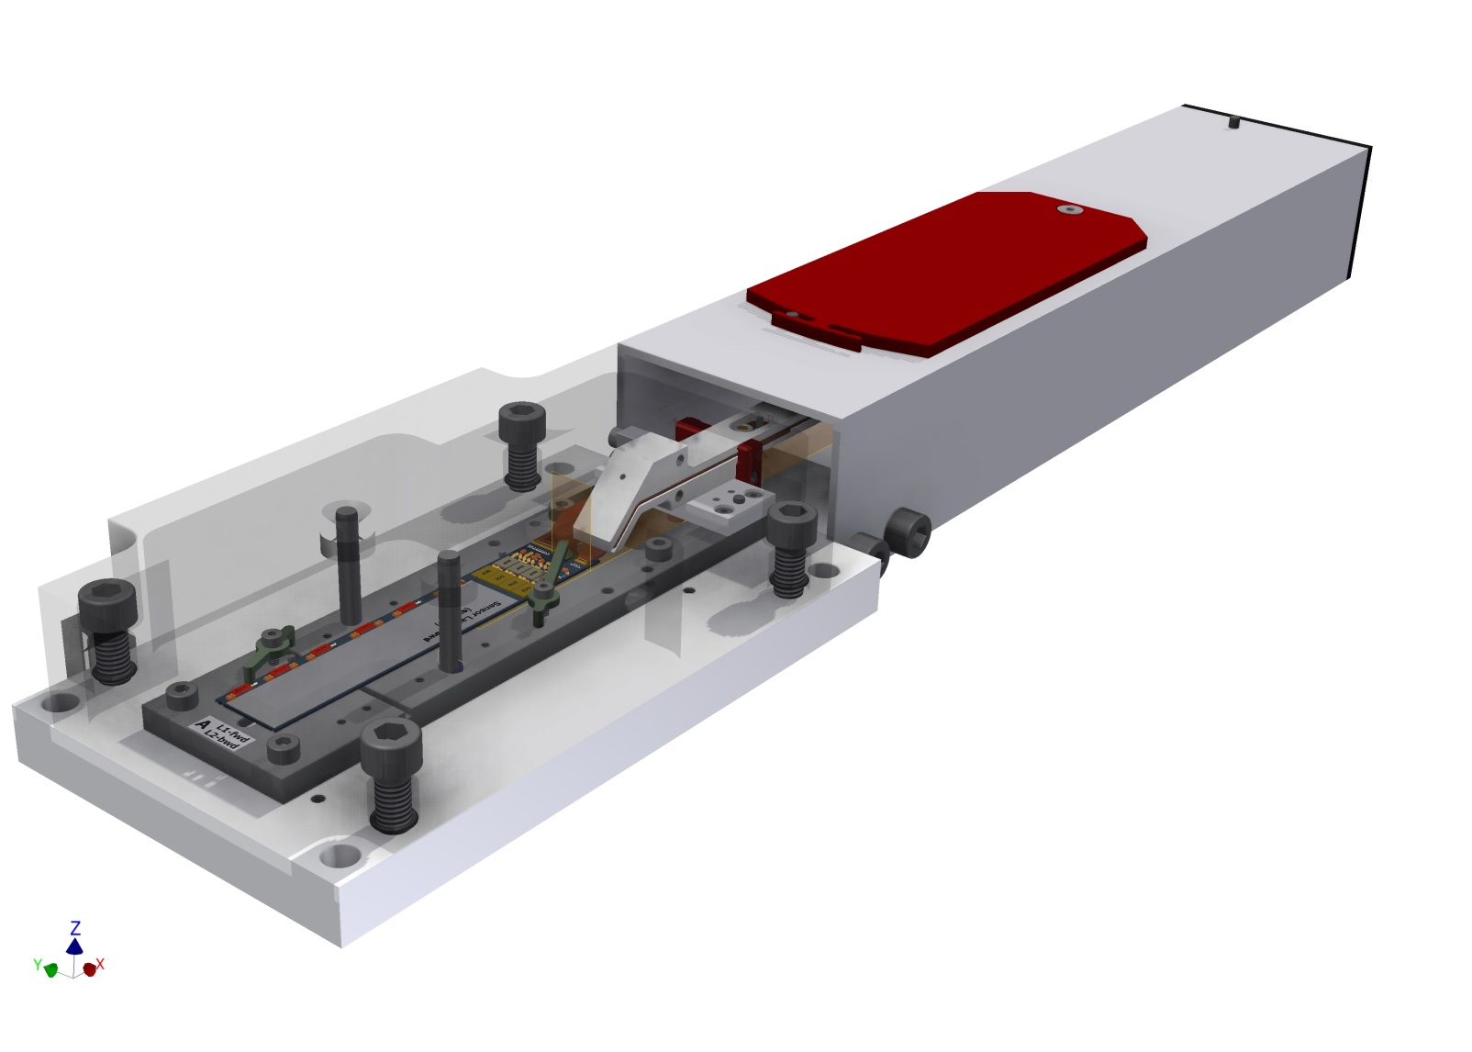
With protective cover for transport and storage
All components show so far are in work
(7 base jigs are ready)

Slide 11
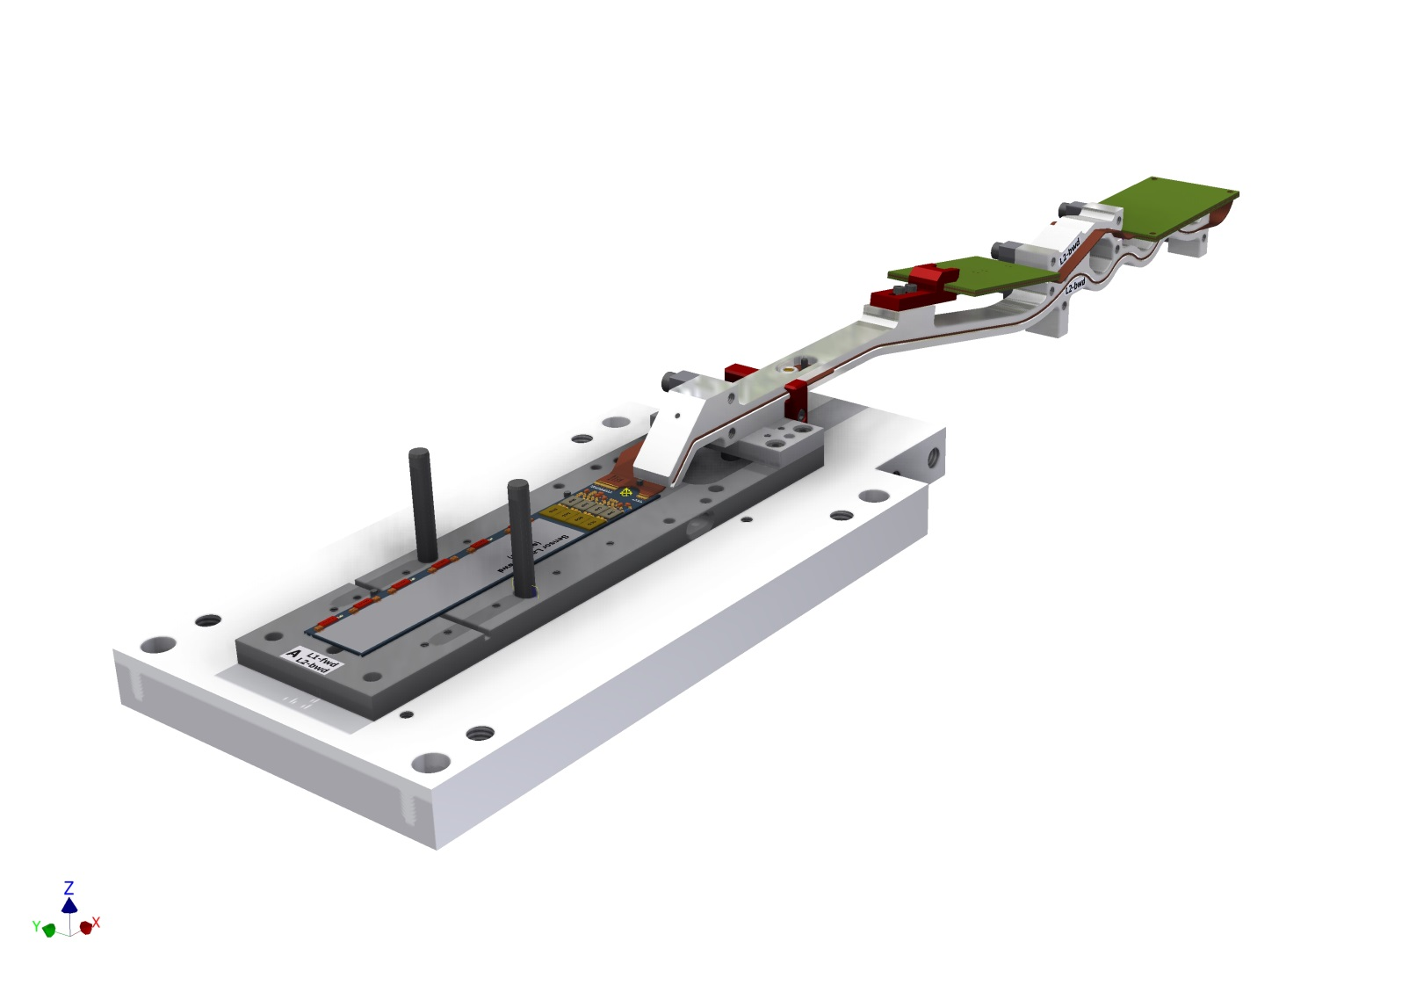
Prepare for ladder gluing
open
Vacuum jig for turning and ladder gluing
Fits on top side (cut outs for switcher)
Mode from microporous plate (gentle vacuum on sensor top side)

Slide 12
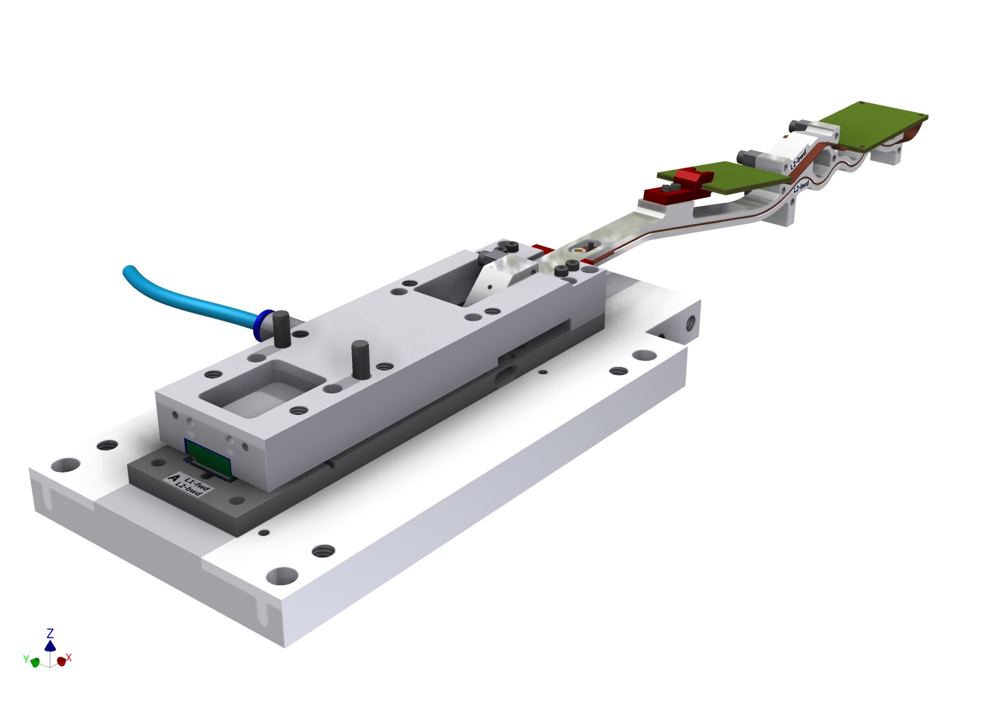
Vacuum jig on sensor
Connect kapton extension to vacuum jig
Disconnect base jig

Slide 13
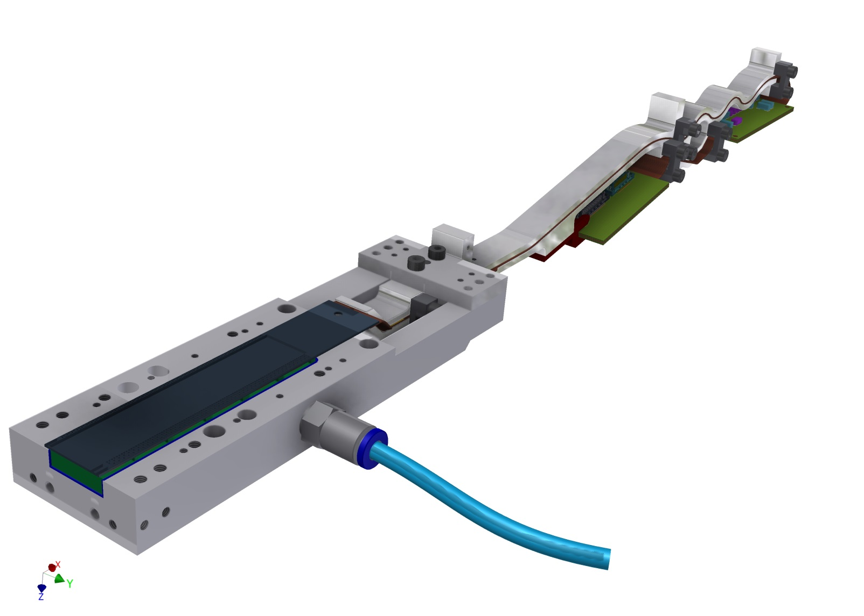
Lift off from base jig and turn over

Slide 14
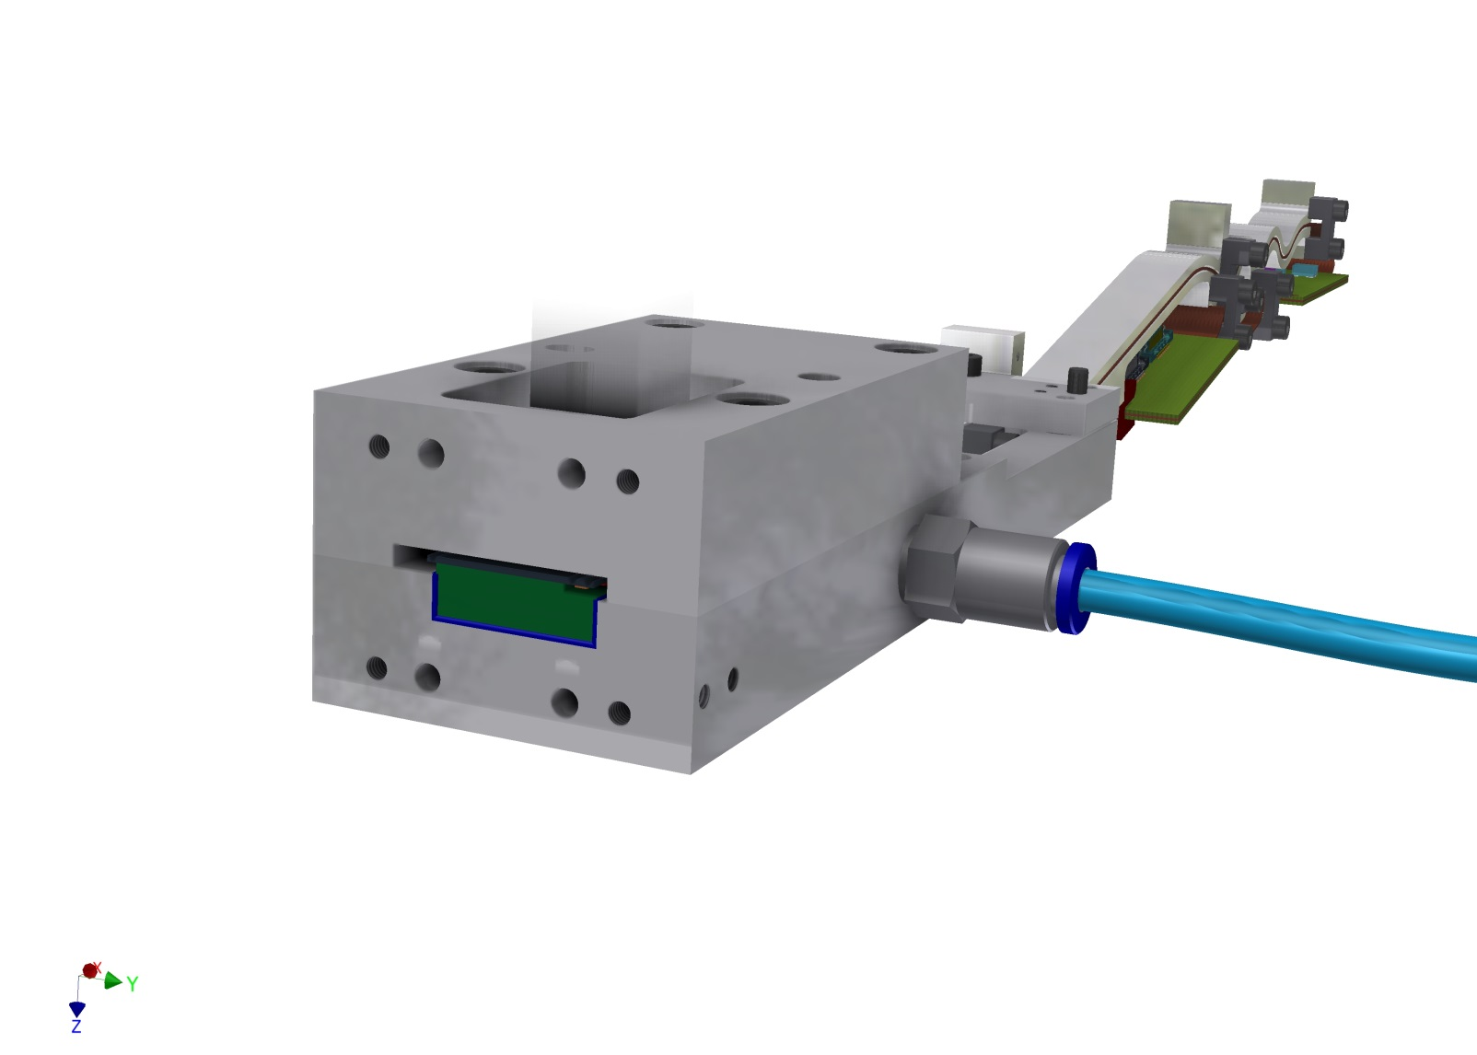
Add cover

Slide 15
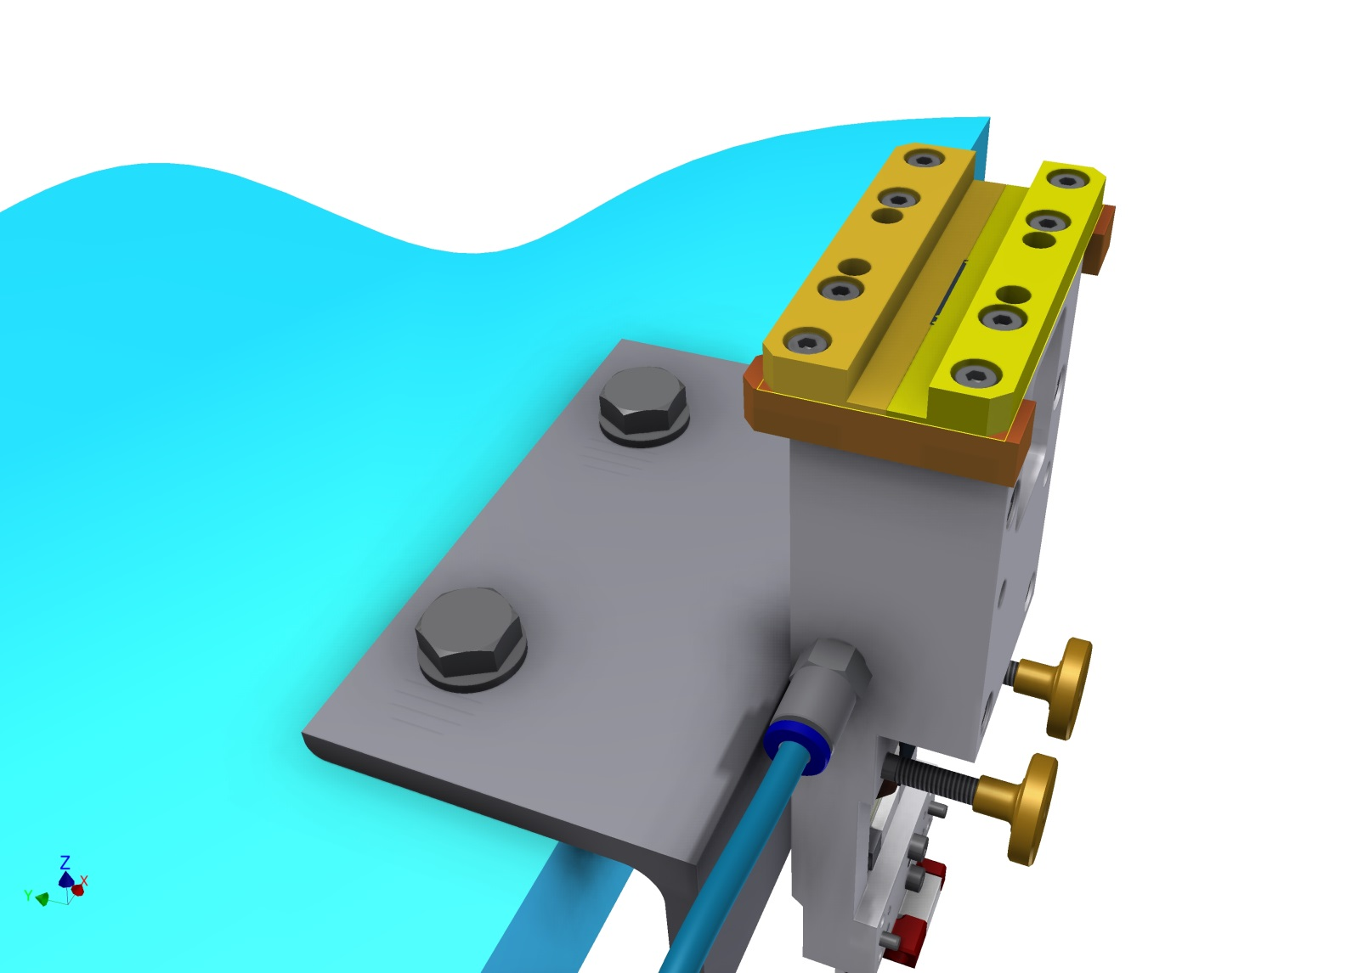
Mask for applying the glue
In order to ensure a well defined glue thickness: use shims to adjust height
Needs tests!

Slide 16
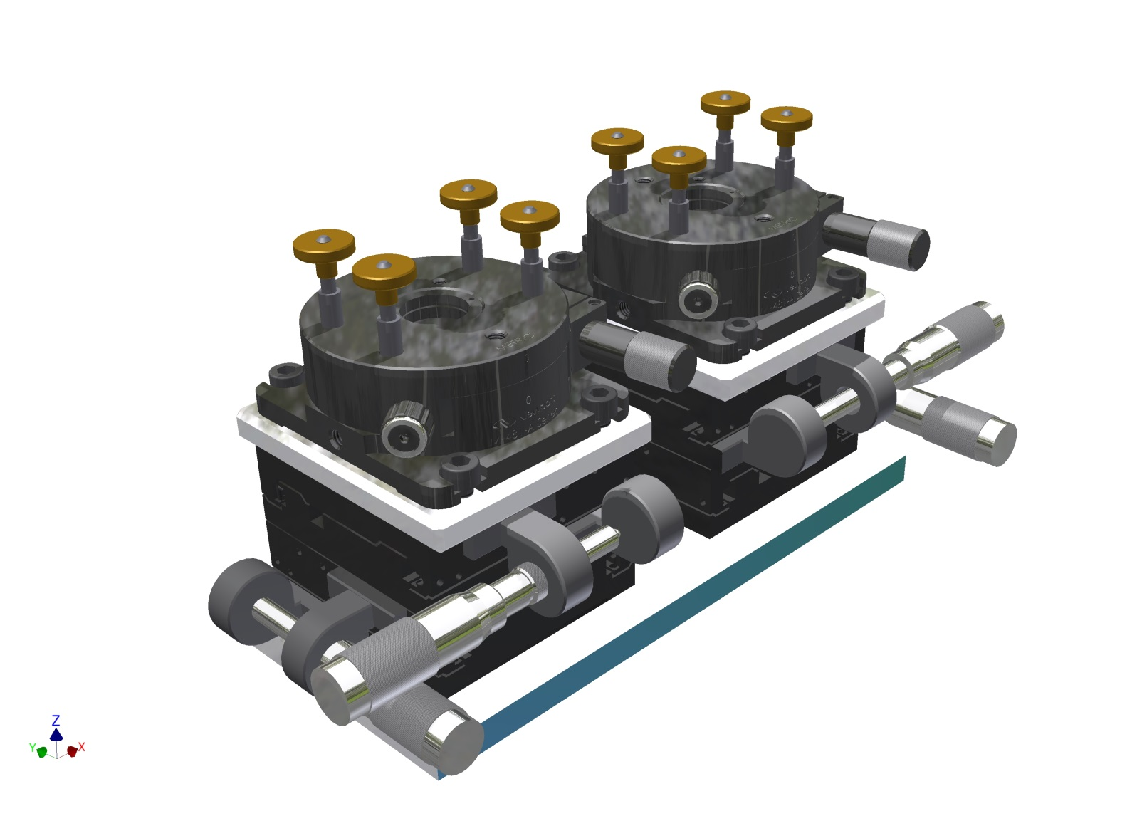
Alignment stage

Slide 17
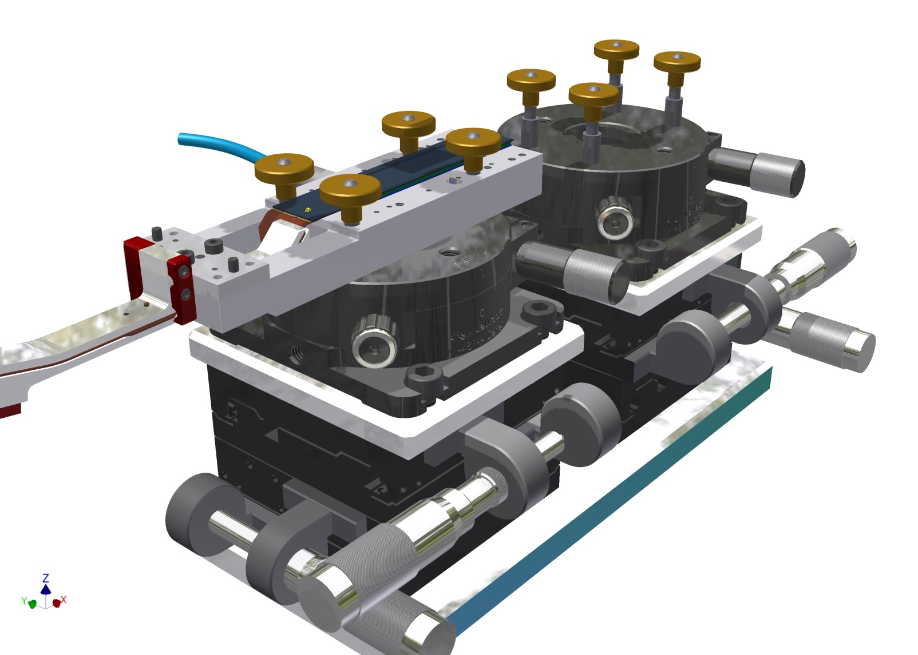
Attach one module…..

Slide 18
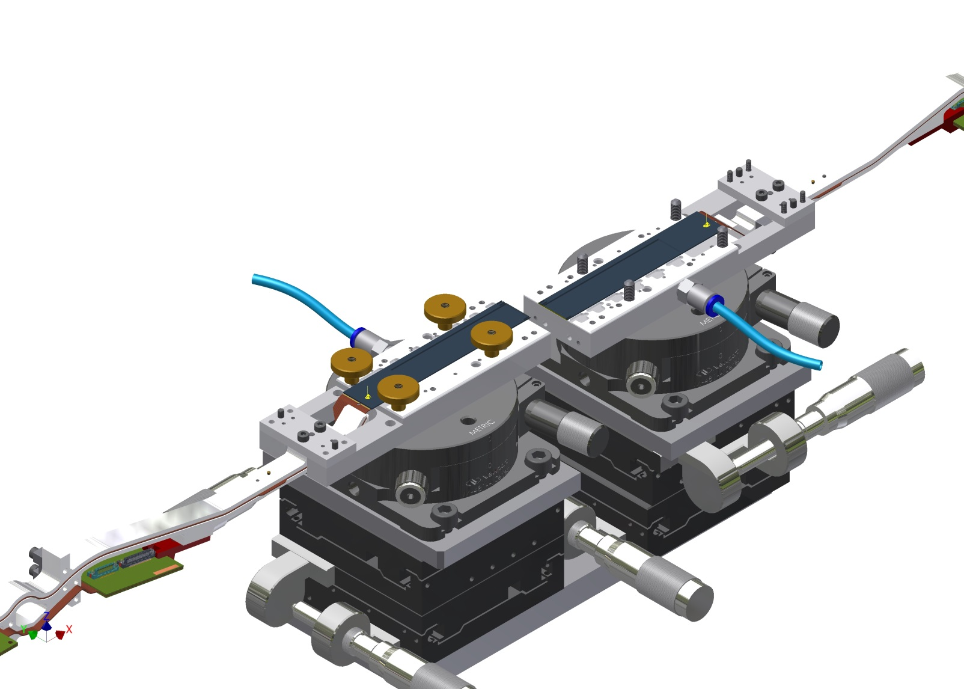
And the 2nd one
Old drawing: alignment screws are in wrong position

Slide 19
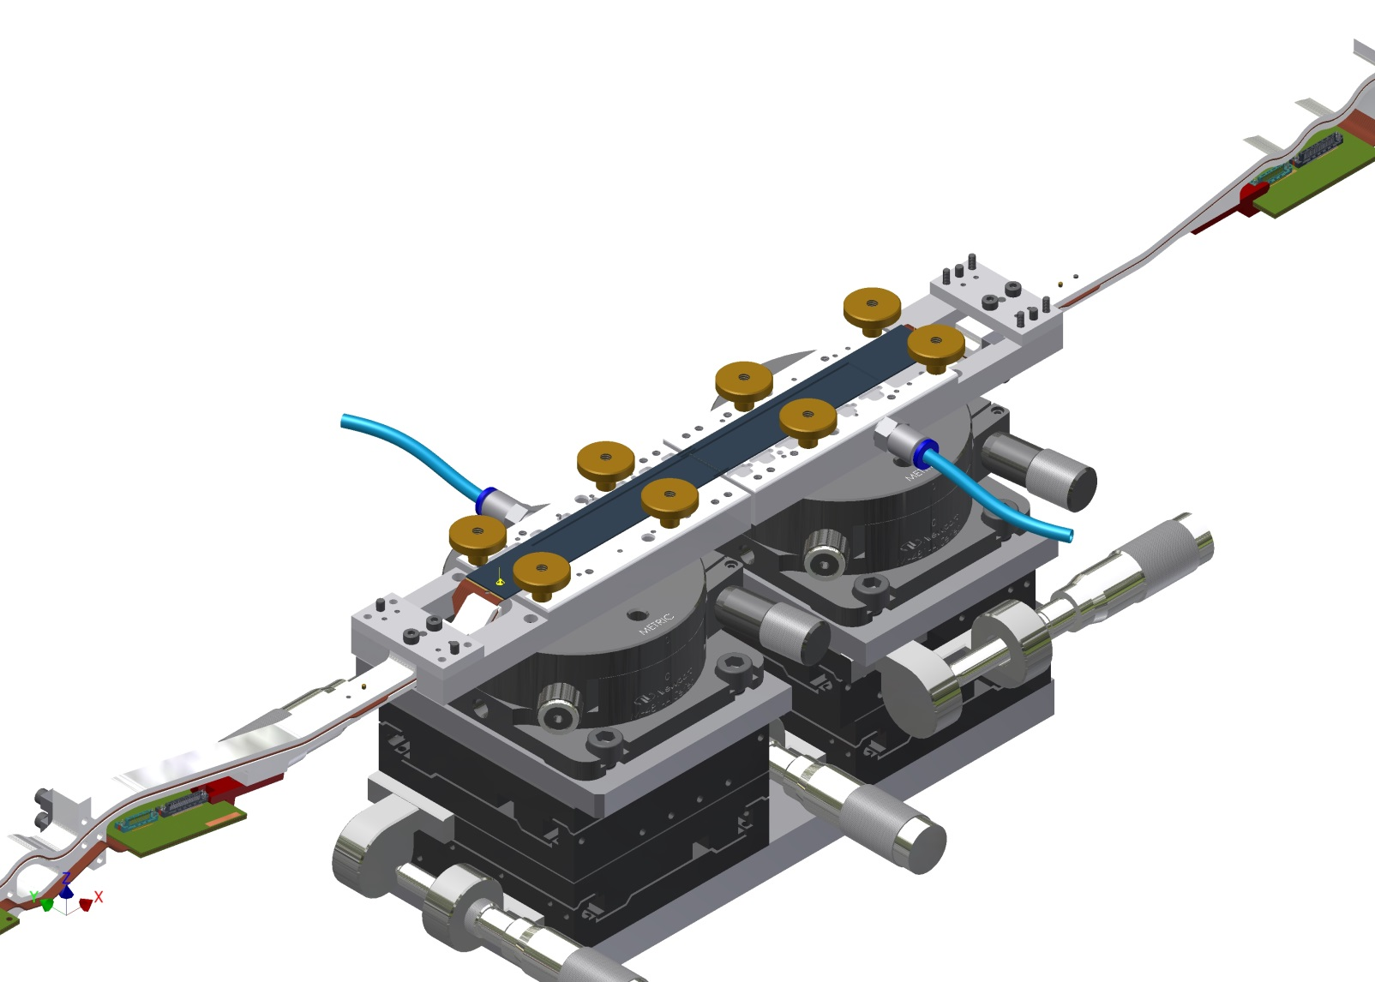
Align, push together & cure

Slide 20
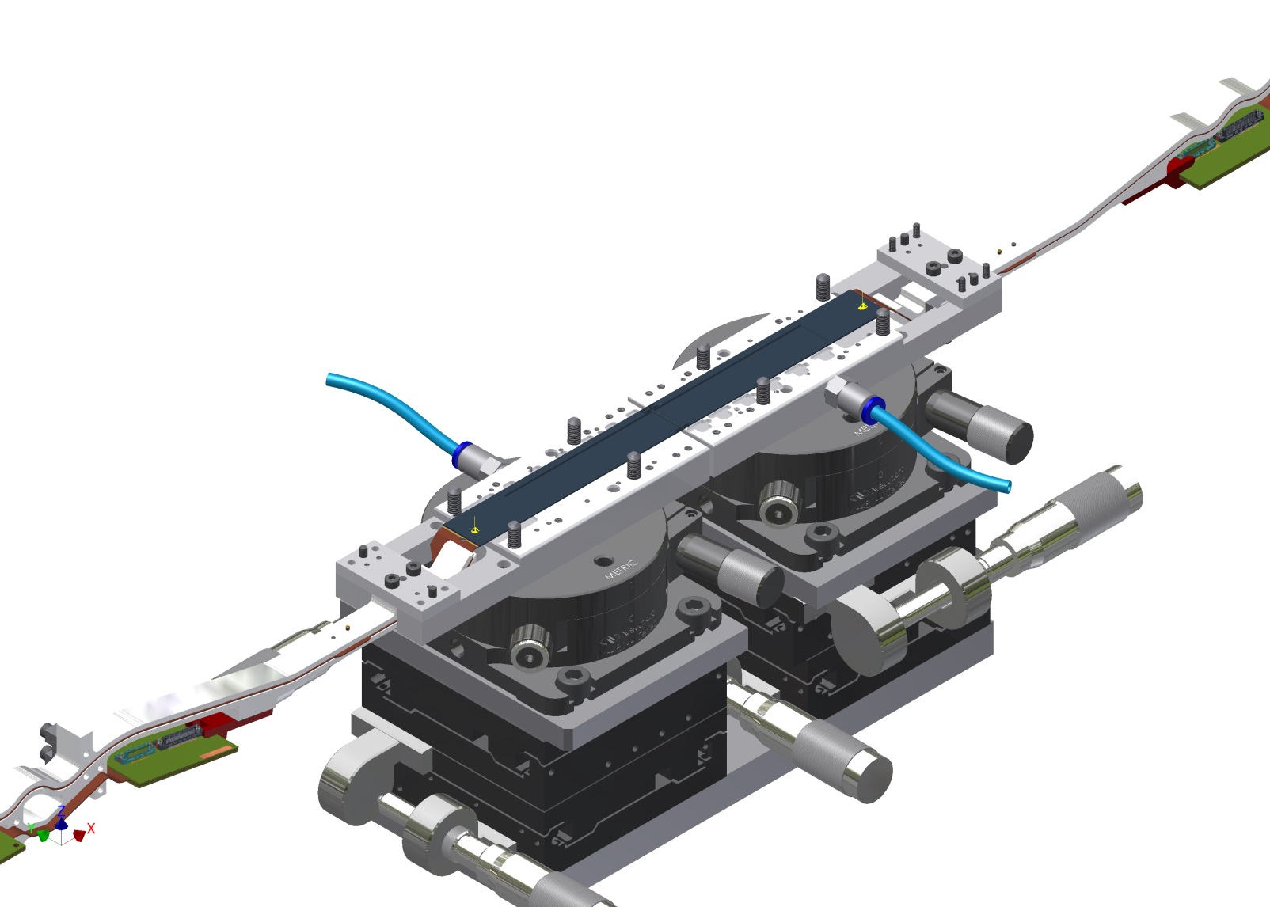
Remove fixations

Slide 21
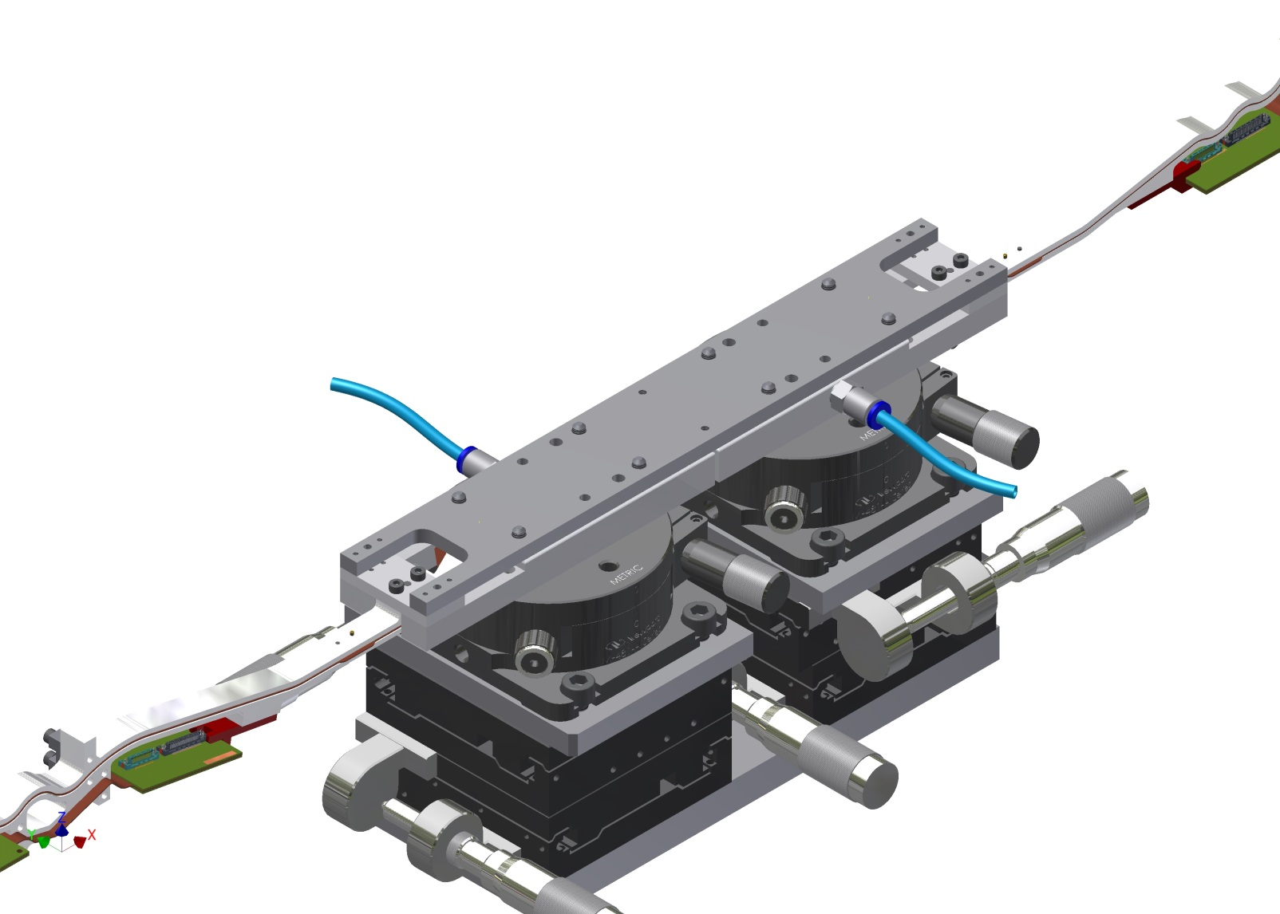
Add base jig, ladder

Slide 22
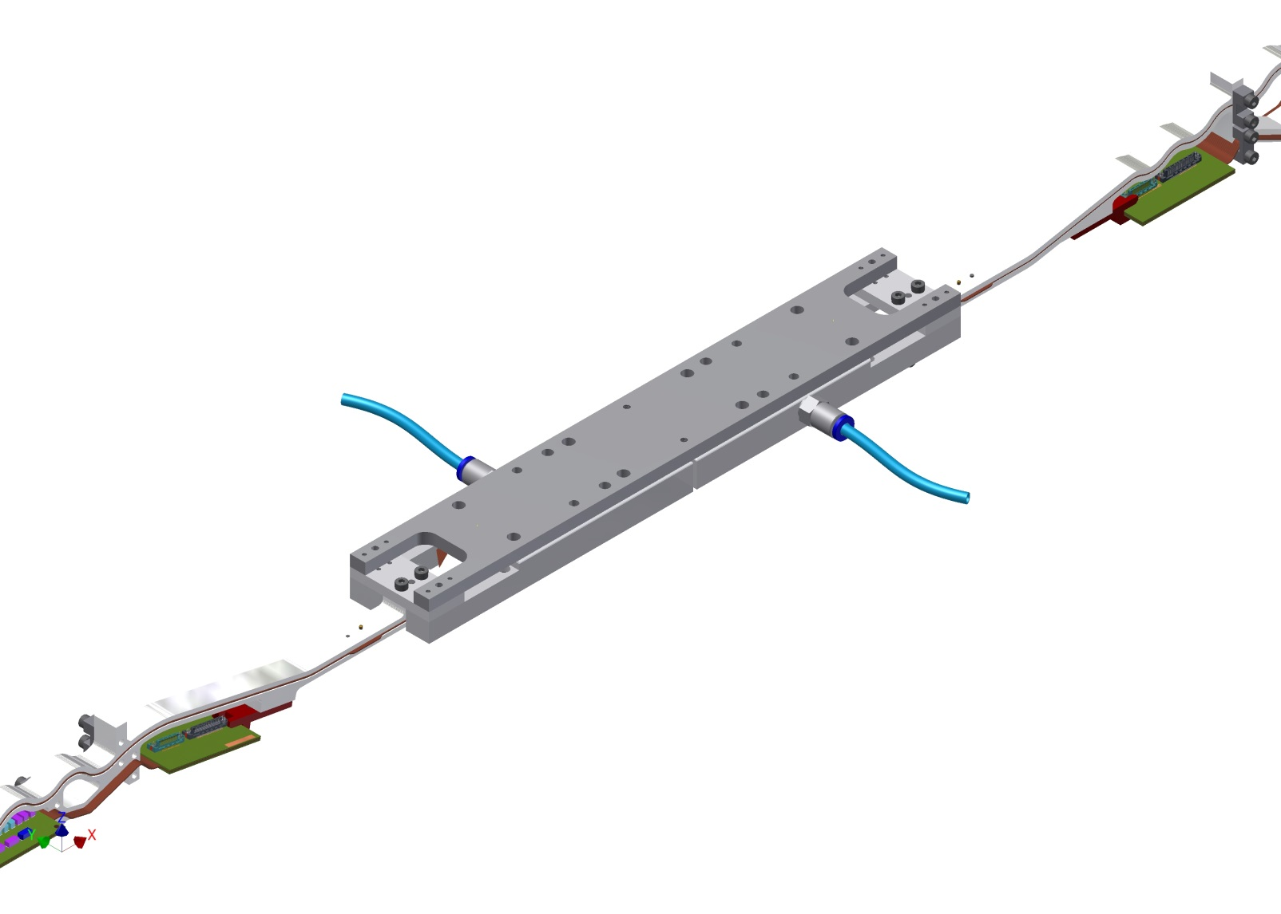
Take off from alignment stage

Slide 23
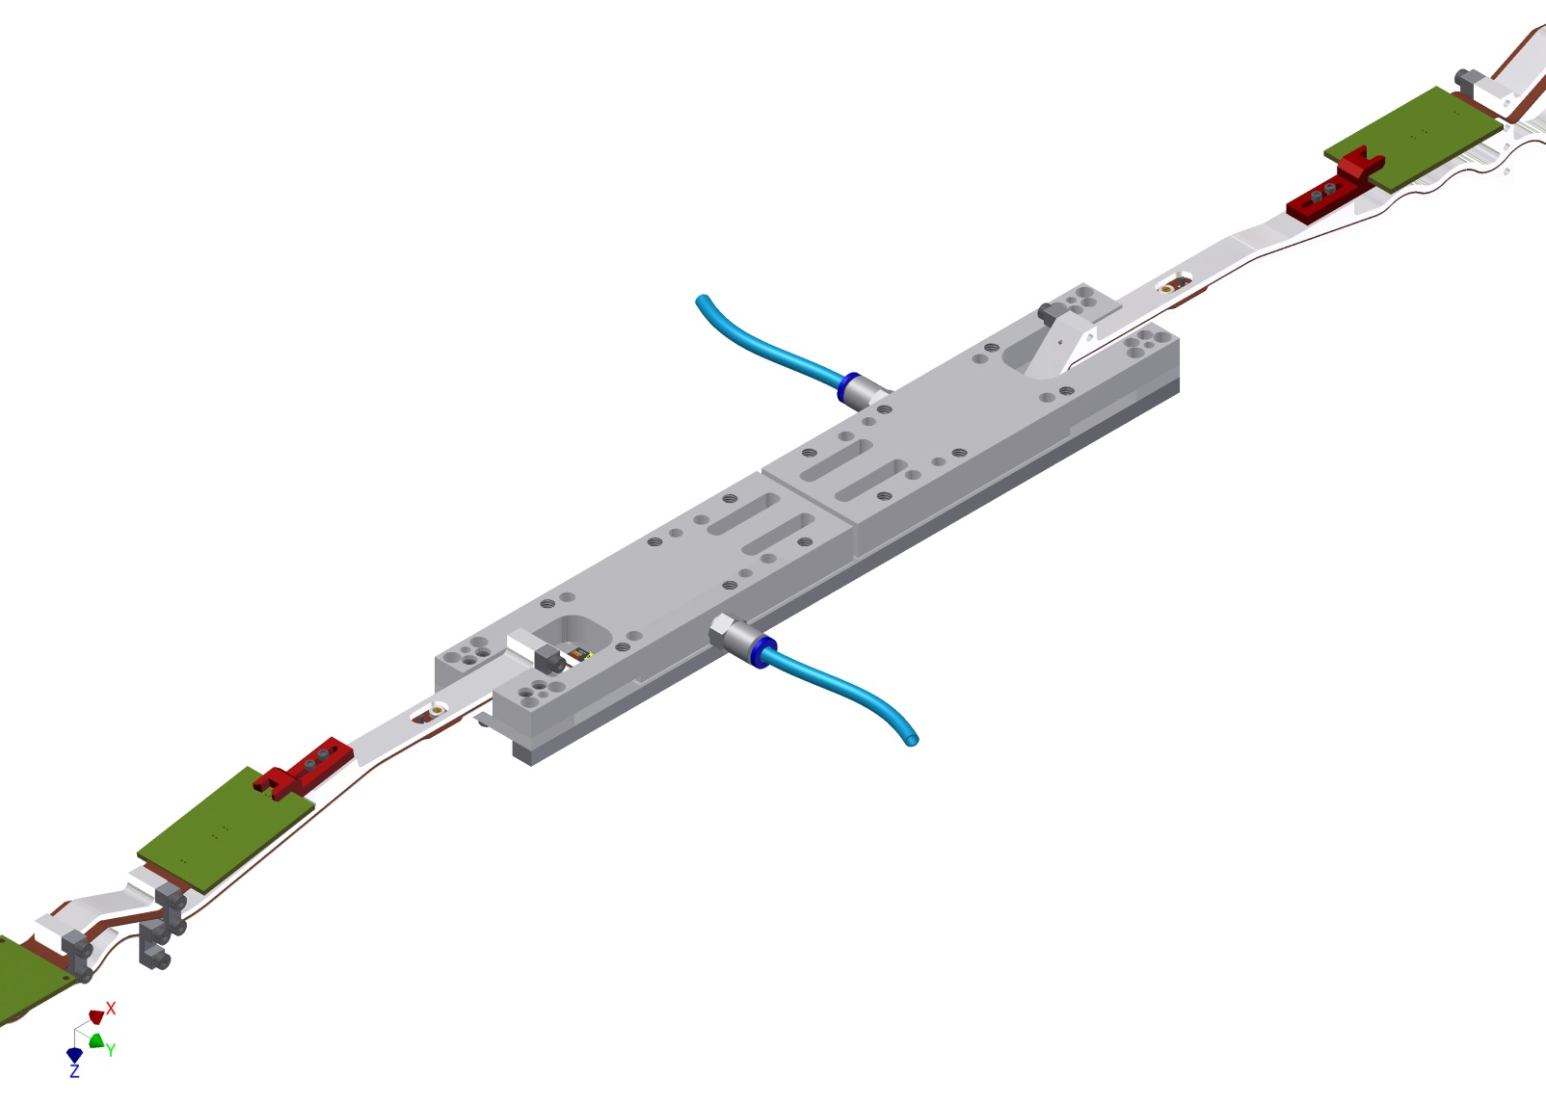
turn over

Slide 24
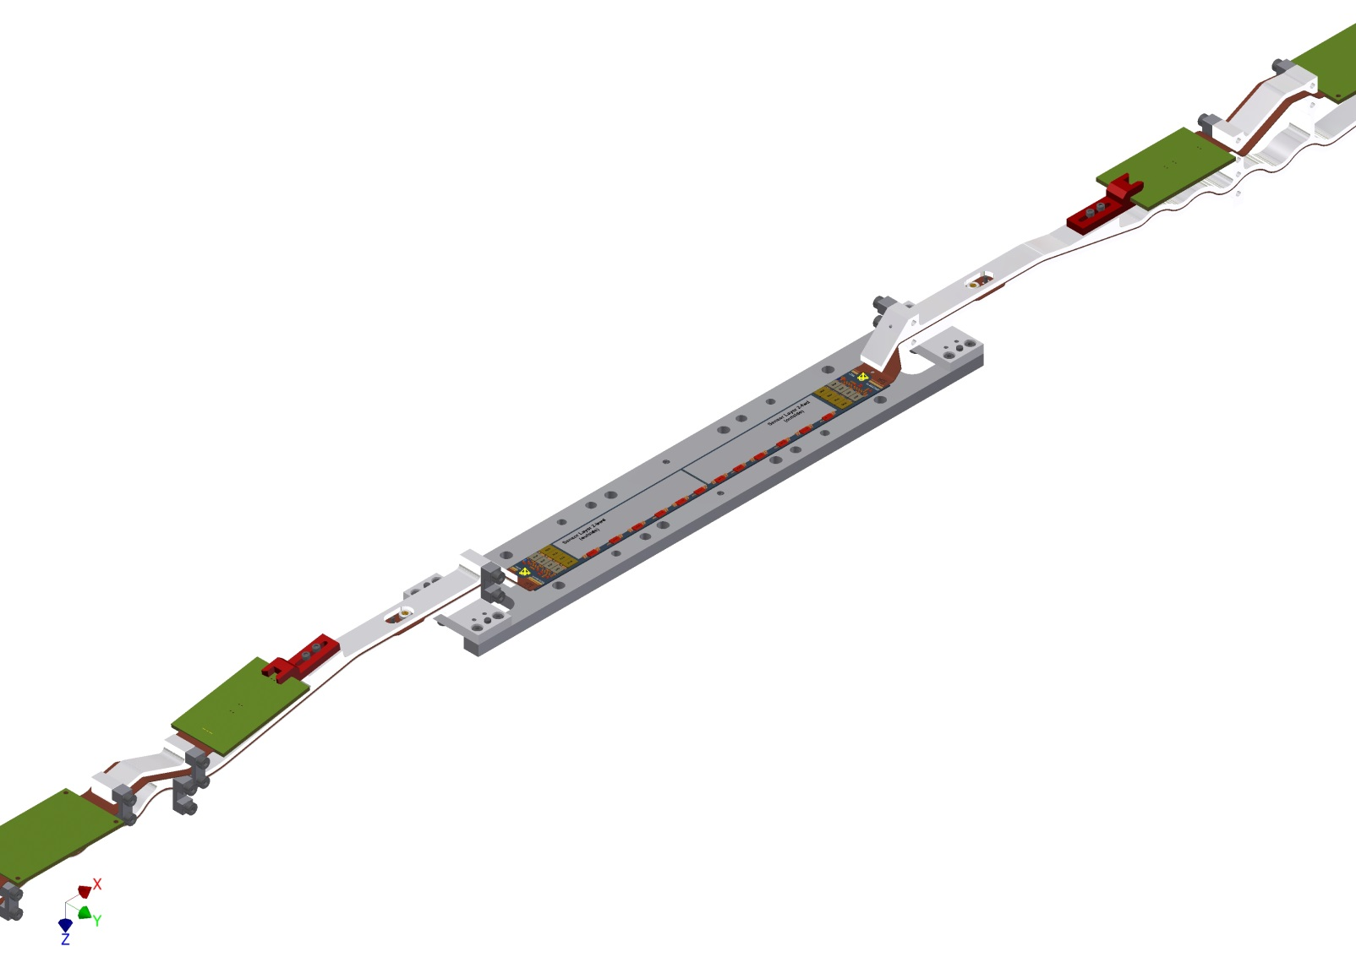
Remove gluing jigs

Slide 25
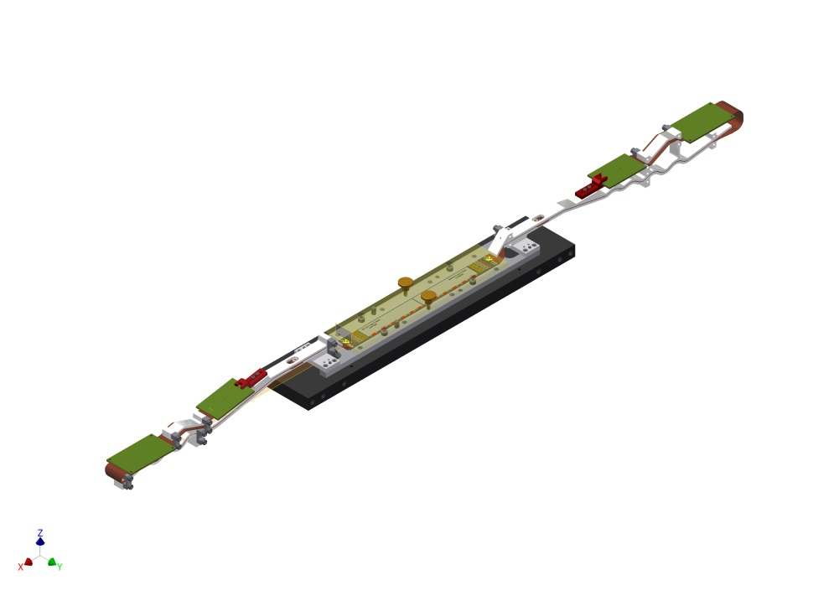
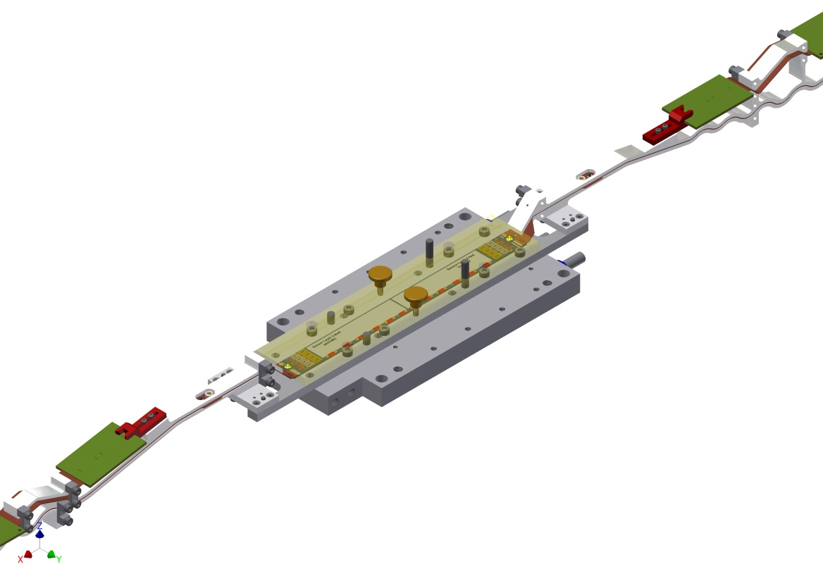
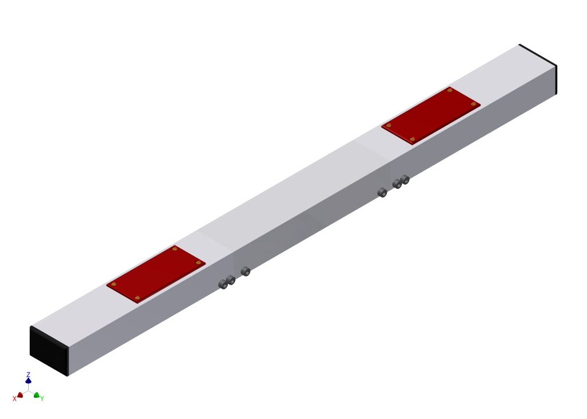
Transport and storage
Base plate for tests (cooling)

Slide 26
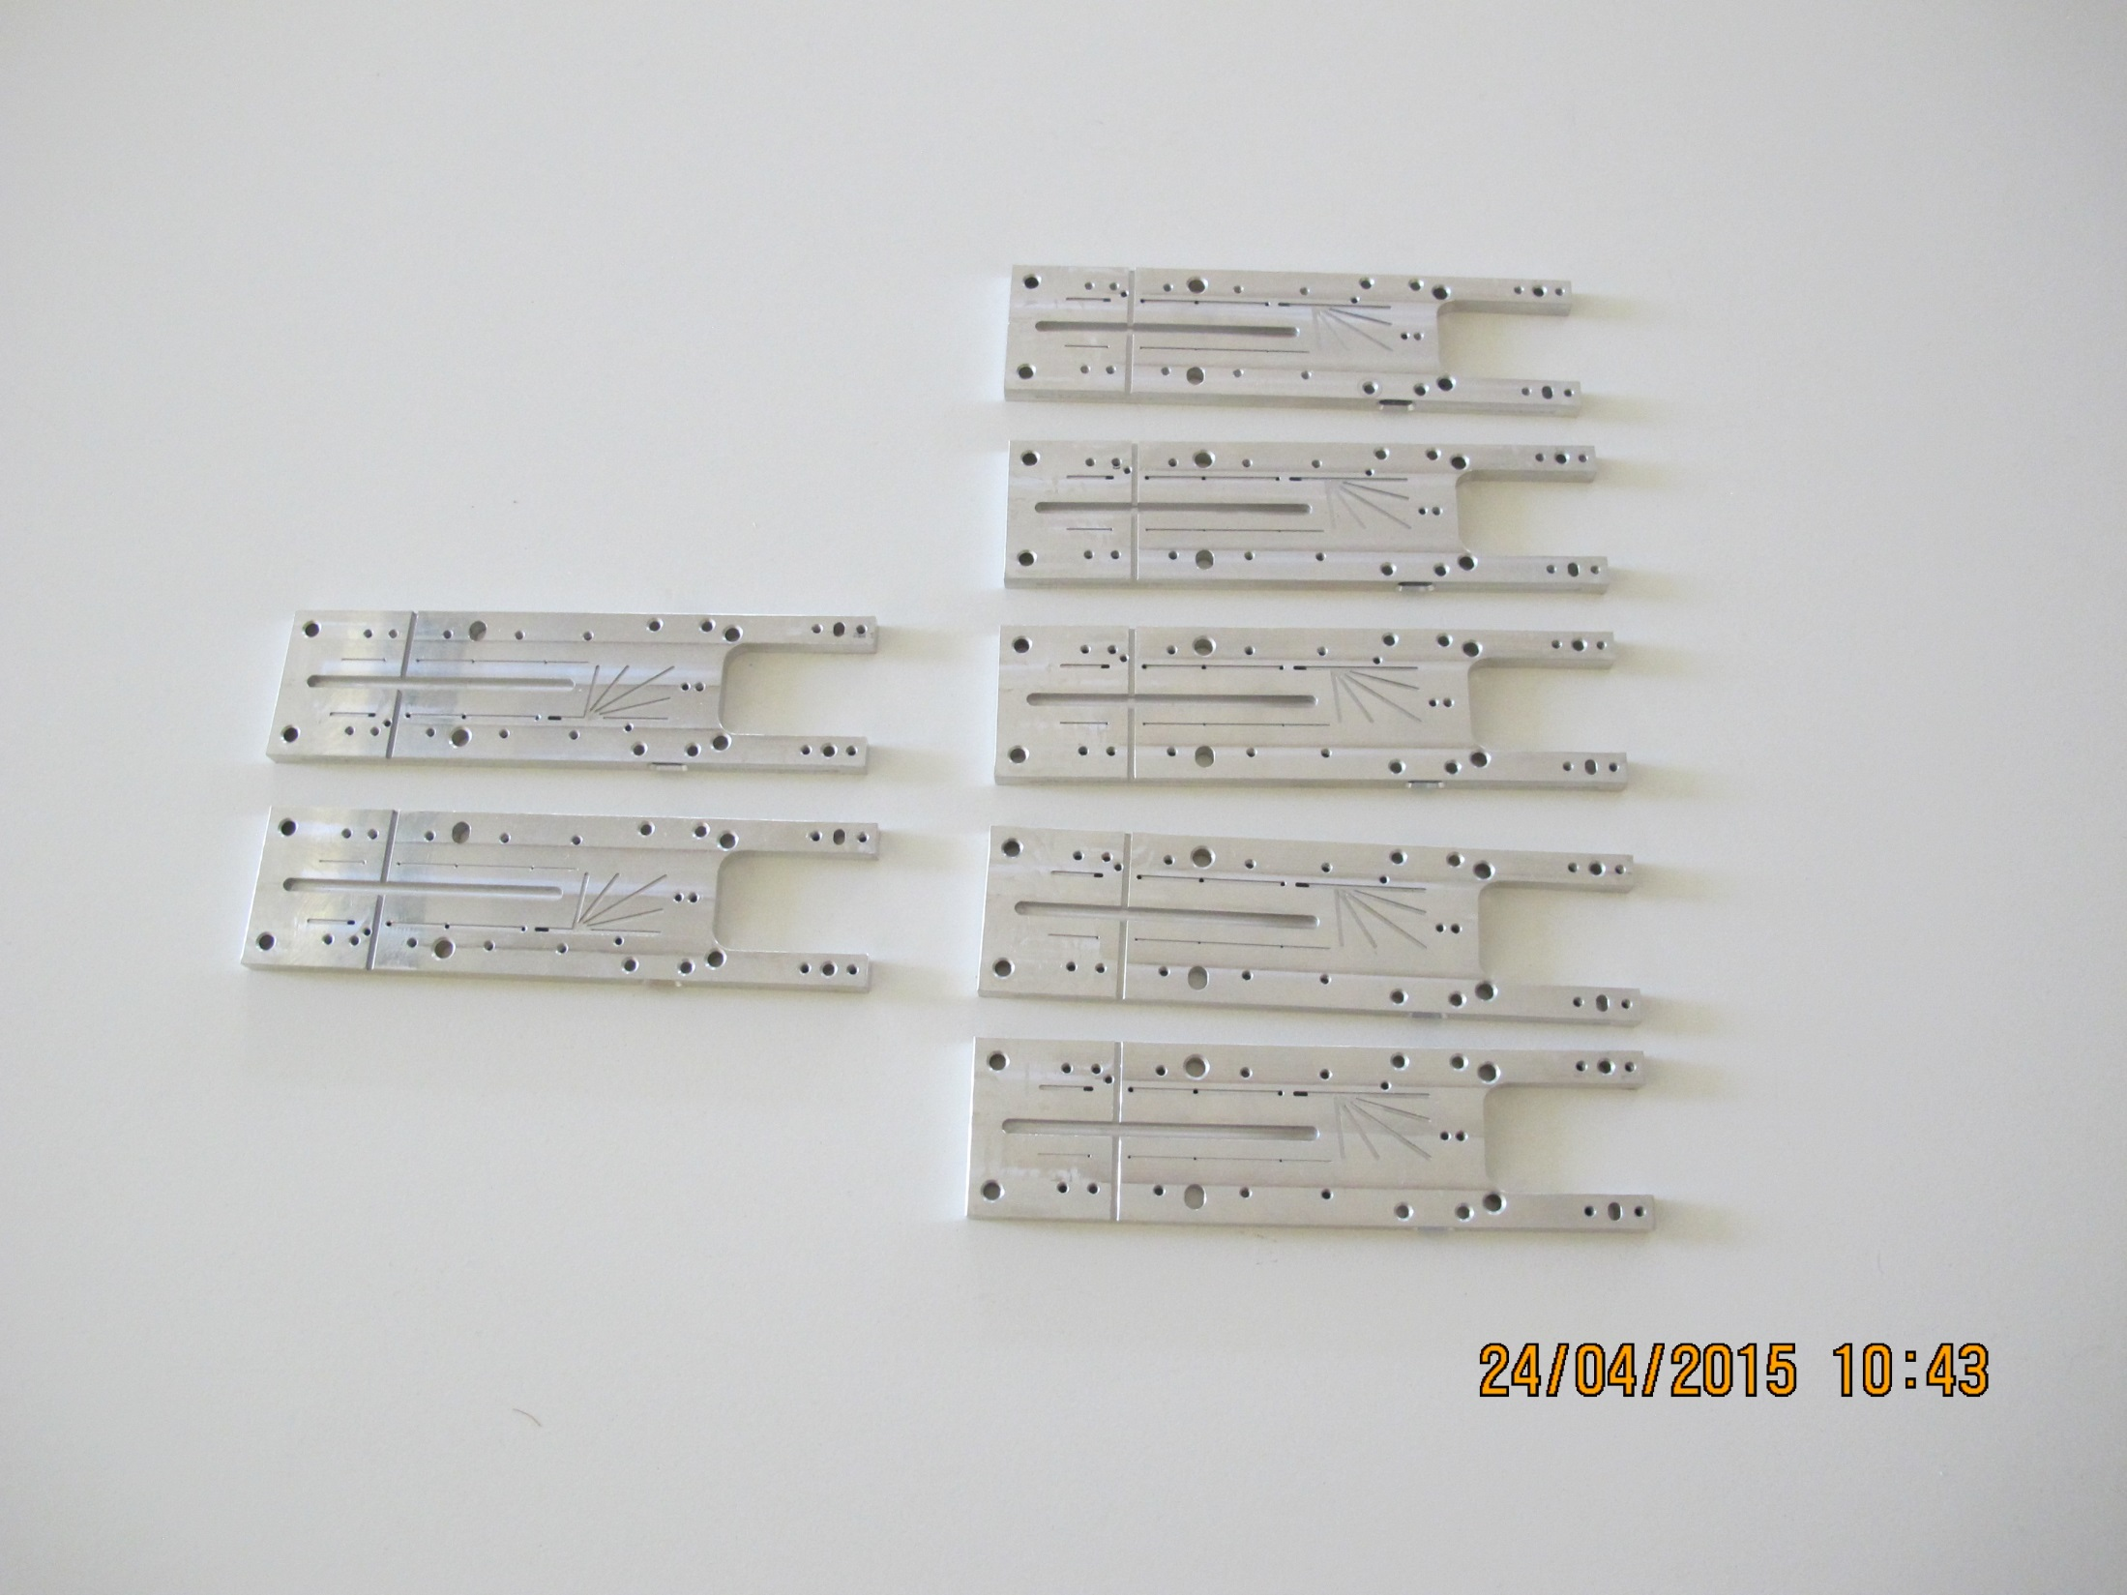
Basic jigs already produced (for pilot run)
5 outer backward
2 outer forward
(2 jigs will be anodized)
Other components (up to gluing jig) are in work
Stages for alignment station delivered

