Slide 1
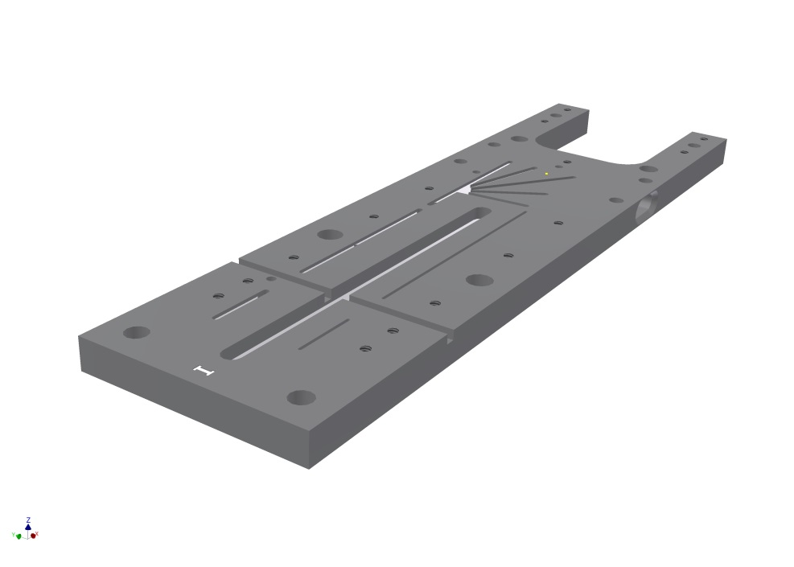
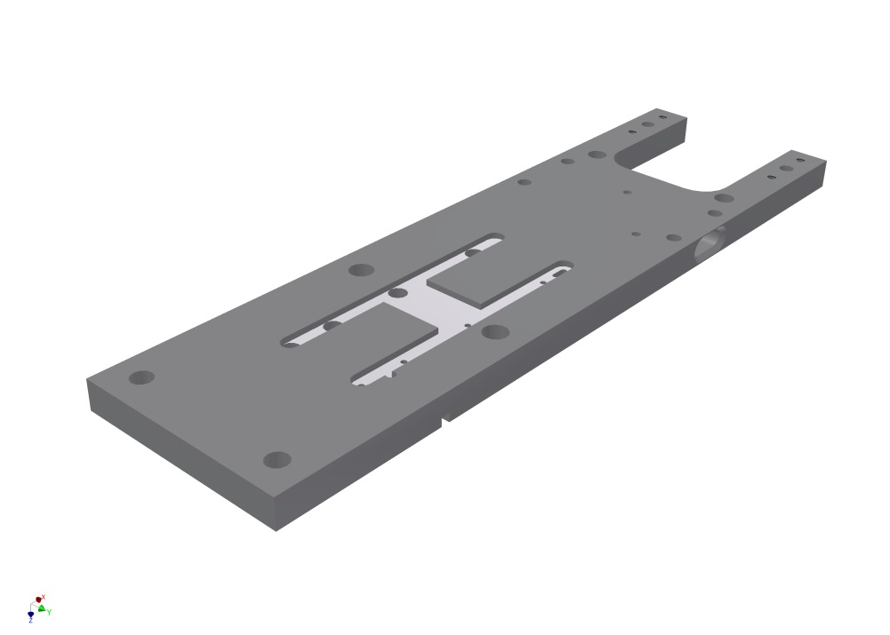
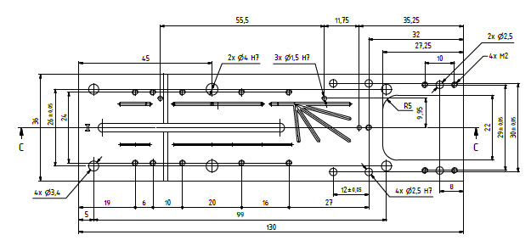
Assembly Jig
Module universal jig
Transport
SMD assembly
Cooling plate
Both are designed
Release end of this week
(need to check compatibility with
Kapton extension)

