Slide 1


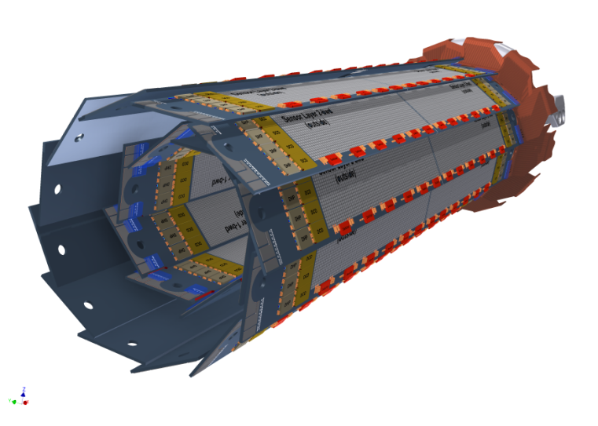
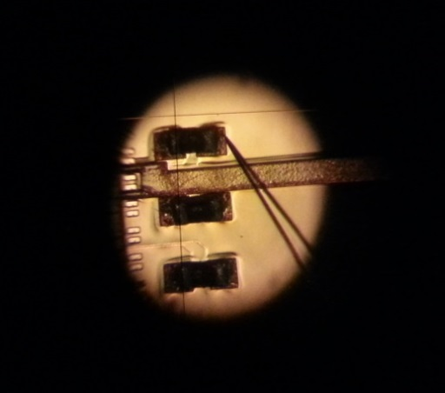
The Belle II Vertex Pixel Detector (PXD)
Felix Müller

Slide 2
Outline
SuperKEKB and Belle II
Vertex Detector (VXD)
Pixel Detector (PXD) and its characteristics
DEPFET technology and working principle
The readout electronics
Gated Mode Operation
Summary and future plans

Slide 3
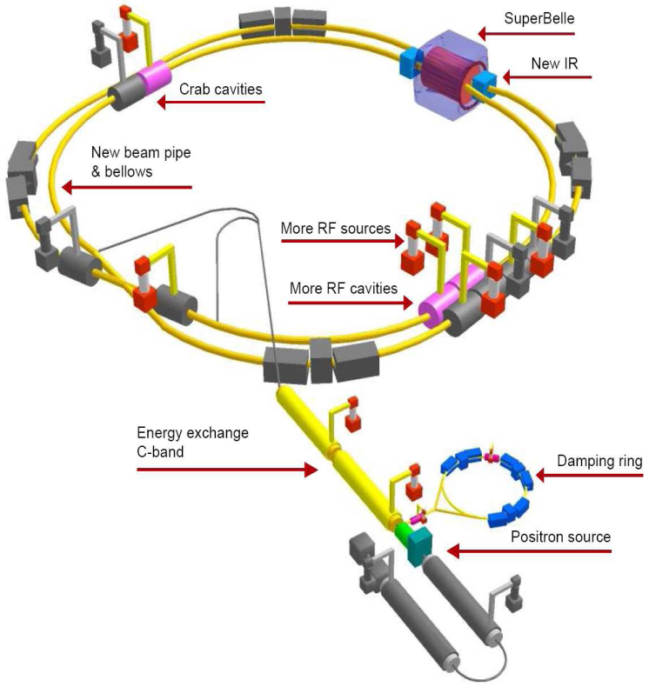
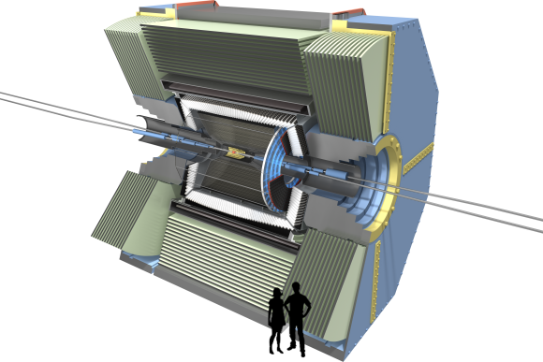
SuperKEKB upgrade
Belle II
Nano beam scheme → smaller beam size (~nm) & increased beam currents (x2)
L = 8 x 10³⁵ cm⁻² s⁻¹ (40x larger than in KEKB)
E_{e-} = 7 (8) GeV & E_{e+} = 4 (3.5) GeV
(βγ = 0.42 (KEK) → 0.28 (SuperKEK))
E_{cm} = 10.58 GeV - Y(4S)
Changes involving the Vertex Detector (VXD):
Four layers of Double Sided Si-Strip Detector (DSSD) with a larger radius
Two layers of DEPFET pixel detector (PXD)

Slide 4
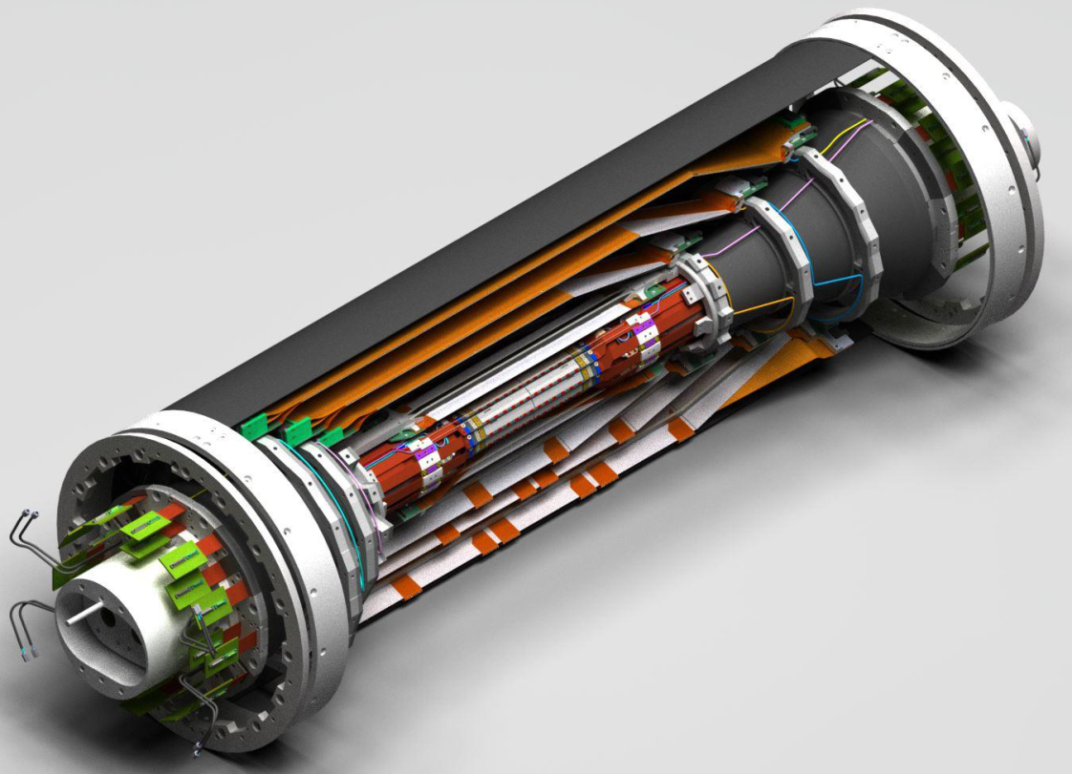
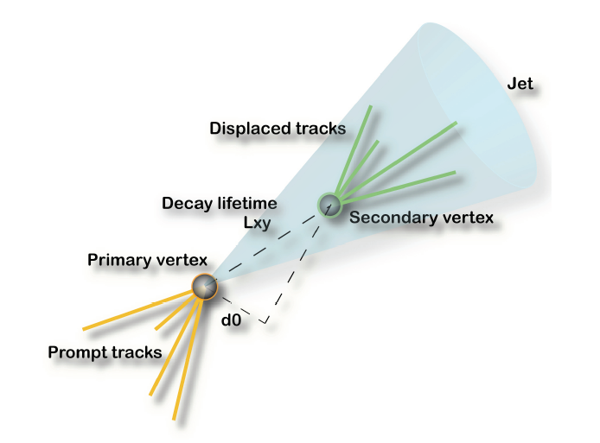
Vertex Detector (VXD)
Tasks of the vertex detector:
Reconstruction of primary, secondary, … vertices of short-lived particles
  Decay of particles is typical in the order of 100 µm from the IP
Detect tracks of low momentum particles (in high B field) which cannot make it to the main tracker
  Innermost detector system as close as possible to IP
  highly granular pixel sensors; provide most accurate 2D position information
  should be massless and still provide a large enough S/N
  Design and specifications to a larger extent driven by machine/beam characteristics
    Beam background, radiation
    damage, occupancy …
BELLE PHYSICS II (Friday 11-12)

Slide 5
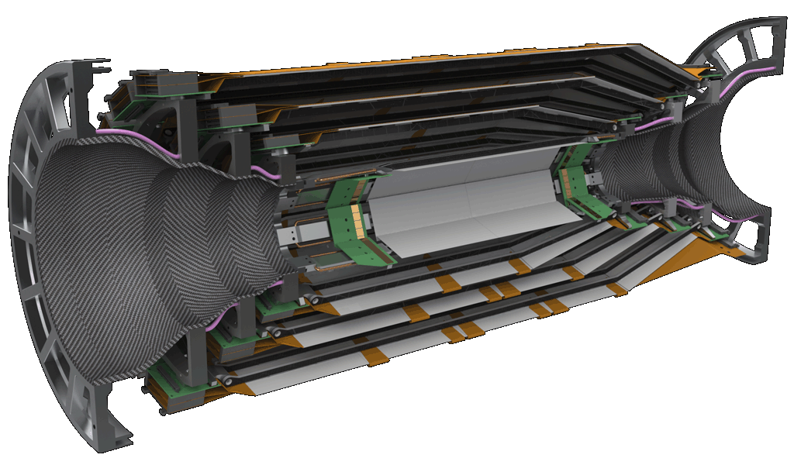
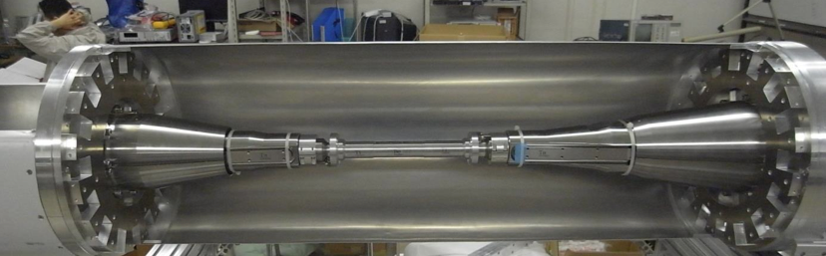
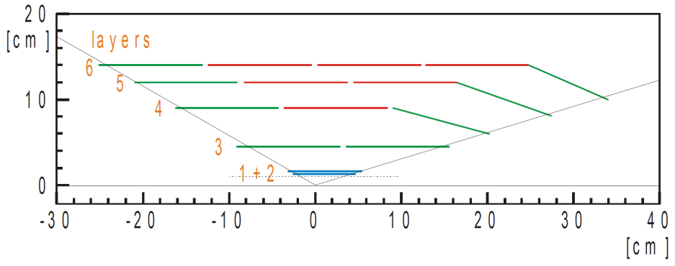
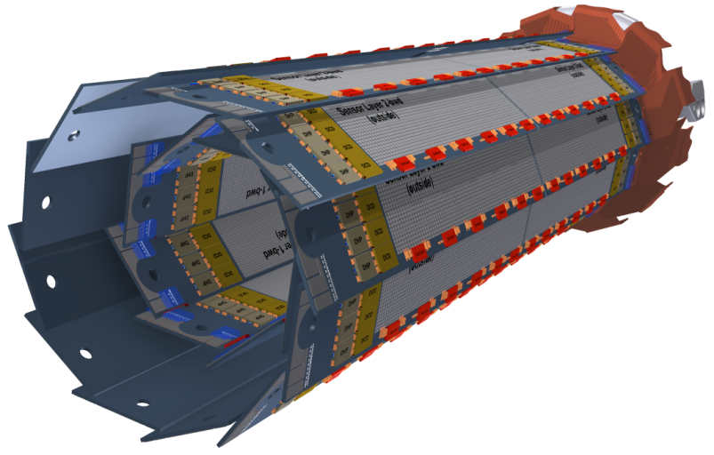
Vertex Detector (VXD)
Silicon Vertex Detector (SVD)
4 layers of double sided silicon strip detector
R= 3.8 cm, 8.0 cm, 11.5 cm, 14 cm
Pixel Detector (PXD)
2 layers of DEPFET pixels
R = 1.4 cm, 2.2 cm

Slide 6
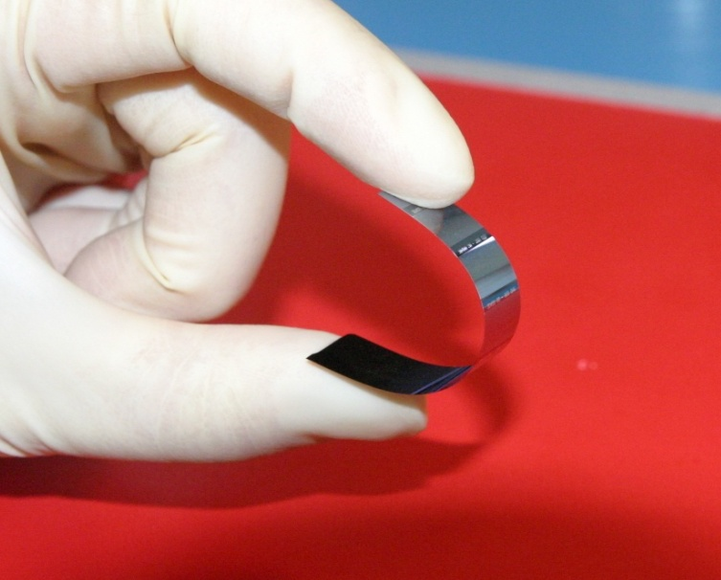
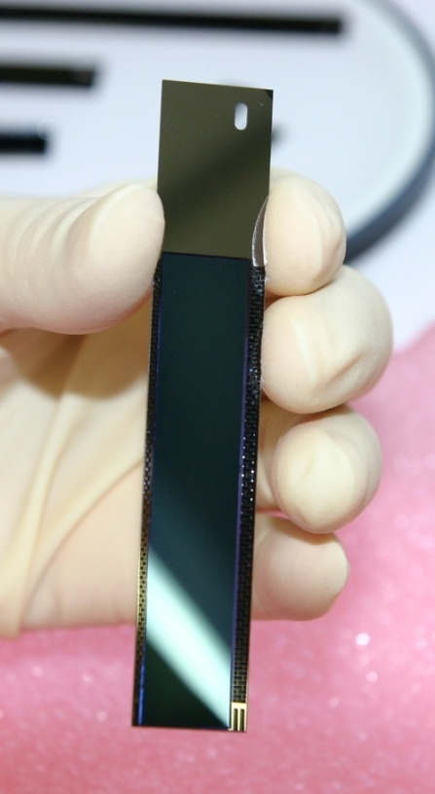
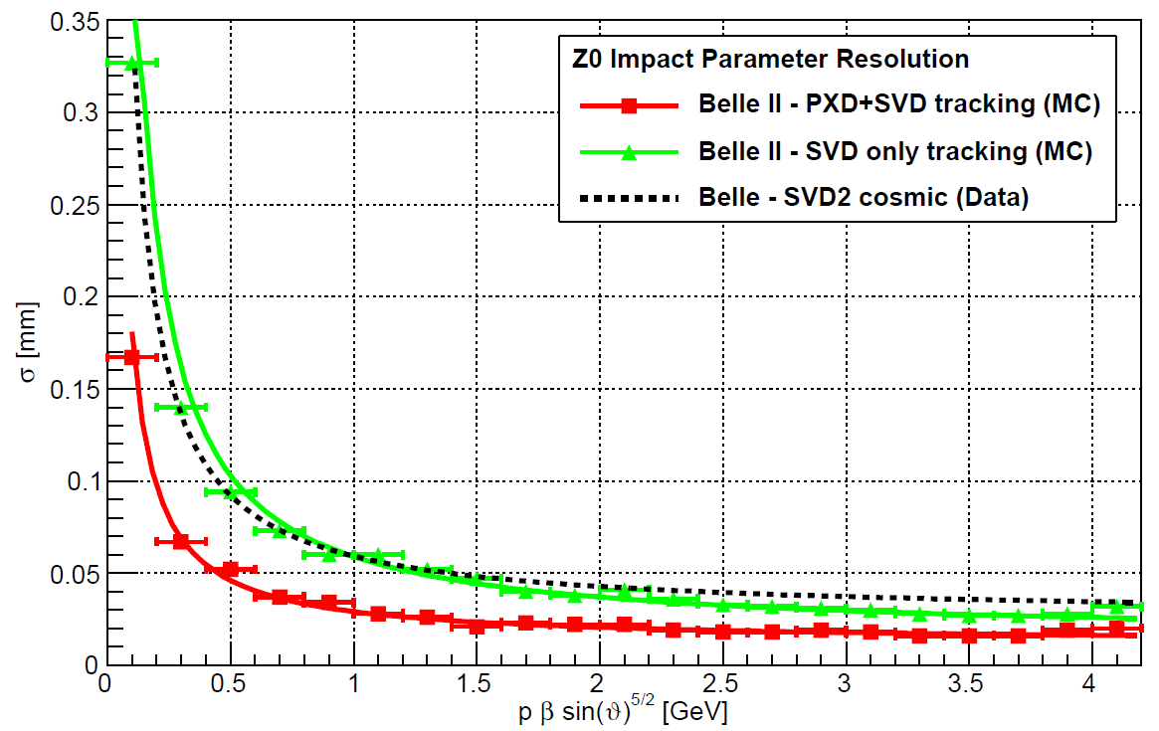
PXD detector requirements
Occupancy | 0.1 hits/µm²/s
Frame time | 20µs (rolling shutter mode)
Momentum range | Low momentum (<1GeV)
Acceptance | 17°-150°
Radiation | ~20 kGy/year, 1·10¹⁰ n/ab⁻¹cm²
Belle II is dominated by low momentum tracks
Modest intrinsic resolution (15 μm), dominated by multiple scattering → Moderate pixel size (50 x 75 μm²)
Lowest possible material budget (0.2% X₀/layer) [including ASICs]
Due to higher background (20x-40x): Radiation damage and occupancy, fake hits and pile-up noise
10x higher event rate => higher trigger rate
Replace inner layers of SVD with PXD

Slide 7
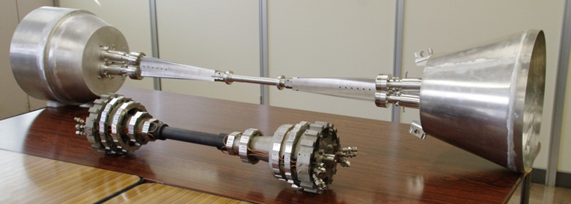
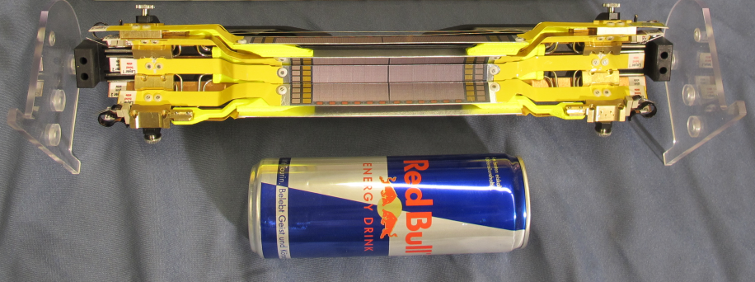
Mockup of the Belle II PXD Detector
Beam pipe radius:
10 mm (inner), 12.5 mm (outer)
Half Ladder

Slide 8
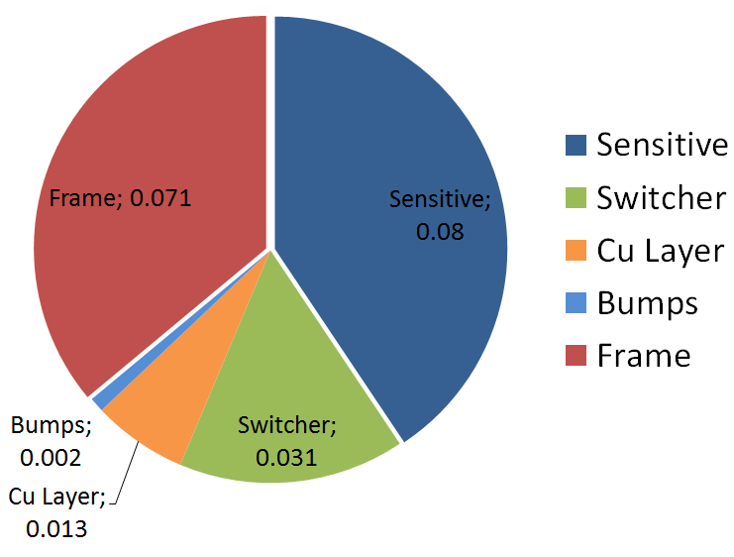
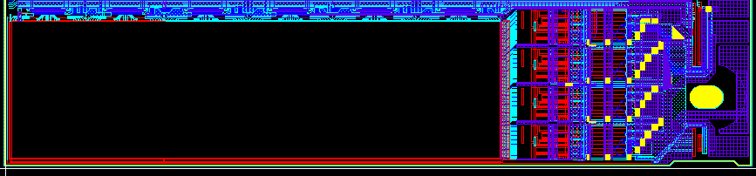
Half Ladder of DEPFET PXD
 | Inner Layer (L1) | Outer Layer (L2)
# Modules | 8 | 12
Distance from IP (cm) | 1.4 | 2.2
Thickness (µm) | 75 | 75
Total # pixels | 3.072 x 10⁶ | 4.608 x 10⁶
Pixel size (µm²) | 55, 60 x 50 | 70, 85 x 50
Sensitive area (mm²) | 44.8 x 12.5 | 61.44 x 12.5
Sensor length (mm) | 90 | 123
Frame/Row rate | 50 kHz / 10MHz | 50 kHz / 10 MHz
~0.2%X₀ per layer
256 x 250 pixels
55 x 50 µm² (L1)
70 x 50 µm² (L2)
512 x 250 pixels
60 x 50 µm² (L1)
85 x 50 µm² (L2)

Slide 9
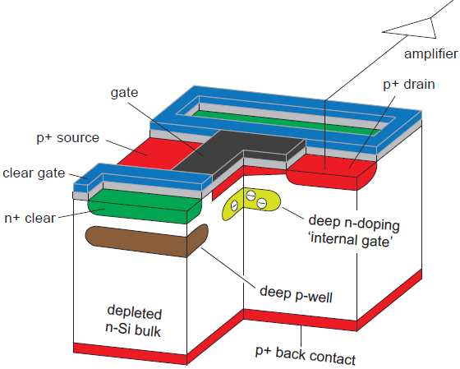
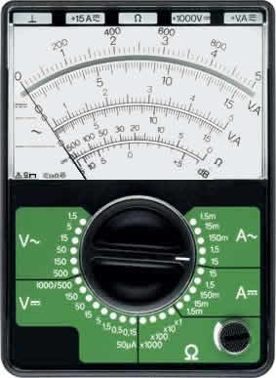
DEPFET (Depleted p-channel Field Effect Transistor)
Turn on DEPFET
impinging
particle
Gate
source
Clear

Slide 10
DEPFET (DEPleted p-channel Field Effect Transistor)
Cross-section of a DEPFET
internal amplification:
g_{q}≈0.5 nA/e⁻
A DEPFET is a MOSFET onto a sideward depleted silicon bulk
90 steps fabrication process
9 Implantations
19 Lithographies
2 Polysilicon layers
2 Aluminum layers
1 Copper layer
Back side processing
Impinging
particle
→ Low noise
→ Low power
→ High signal/noise-ratio
→ Non-destructive readout

Slide 11
Rolling Shutter Mode
row1 (on/off)
Clear
Source
row1 (on/off)
Gate
row2 (on/off)
Clear
row2 (on/off)
Gate
row3 (on/off)
Clear
row3 (on/off)
Gate
row4 (on/off)
Clear
row4 (on/off)
Gate
row5 (on/off)
Clear
row5 (on/off)
Gate
Drain1
DCD

Slide 12
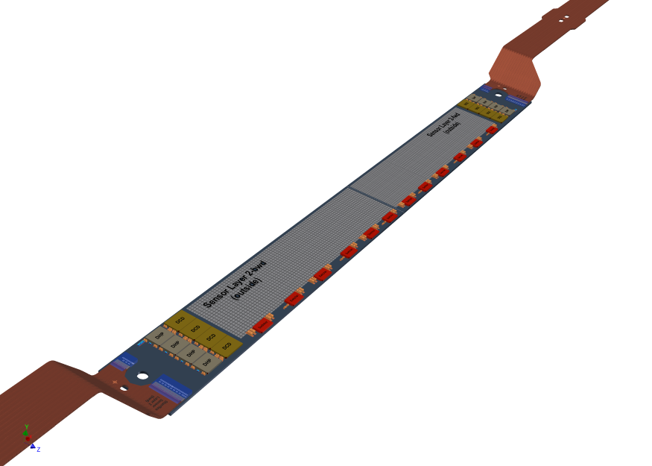
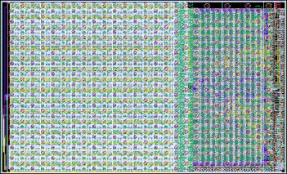
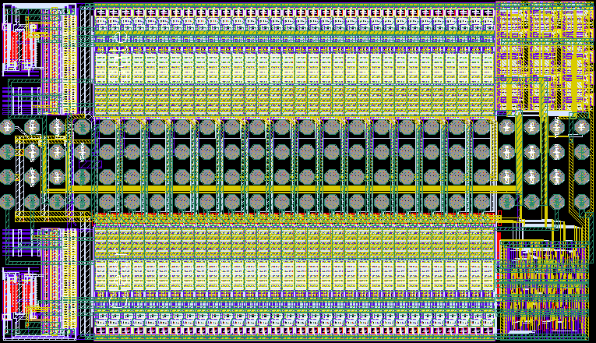
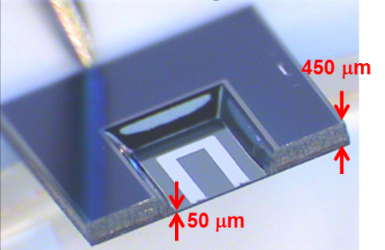
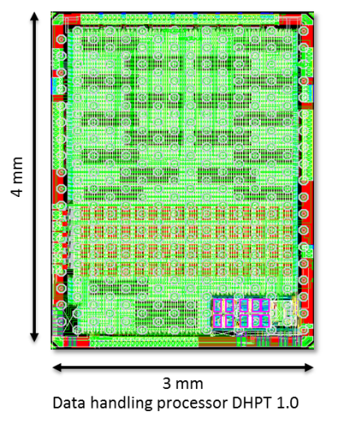
Control and readout electronics
Drain Current Digitizer (DCD)
Keeps the columns line potential constant
8 bit ADCs
Compensates for pedestal current variation (2bit DAC)
Programmable gain and BW
256 input channels (4 per module)
DEPFET
SWITCHER
Fast voltage pulses up to 20 V to activate gate rows and to clear the internal gate
JTAG for interconnectivity tests
64 output drivers for both gate and clear channels → address 32 matrix segments
768 rows → 192 electrical rows → 6 ASICs needed per module
Data Handling Processor (DHP)
Pedestal correction
Common mode correction
Data reduction using the zero suppression
Triggered readout scheme introduces
further data reduction
Controls the Switcher sequence
Kapton Flex cable
Power Supply via soldered contacts and bond wires
Data transmission via bond wires
4 layers, 48 cm

Slide 13
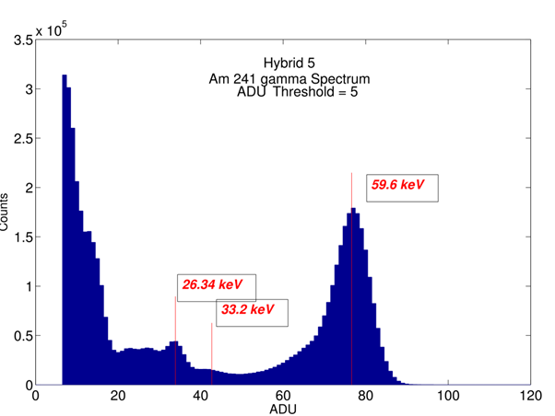
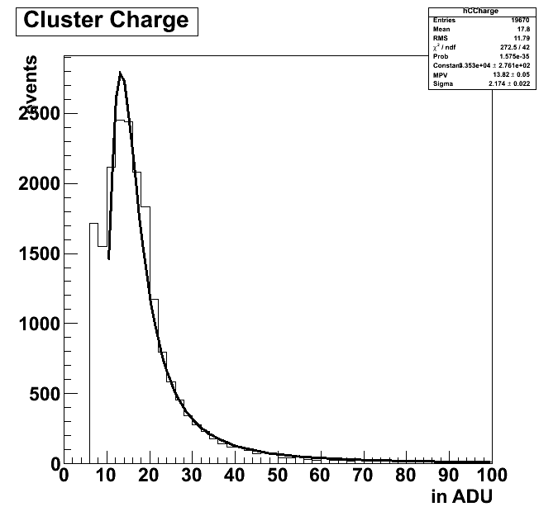
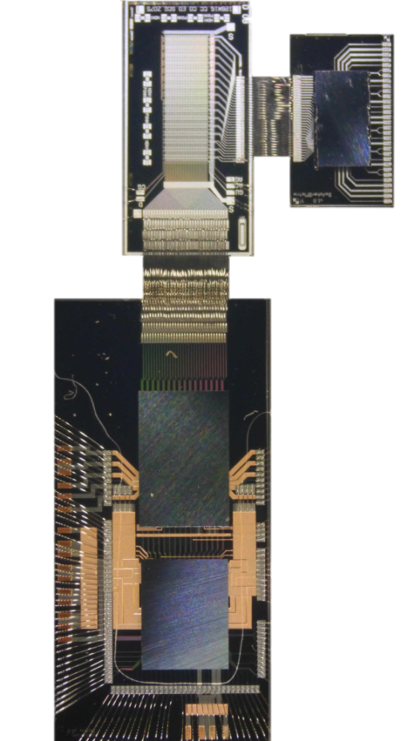
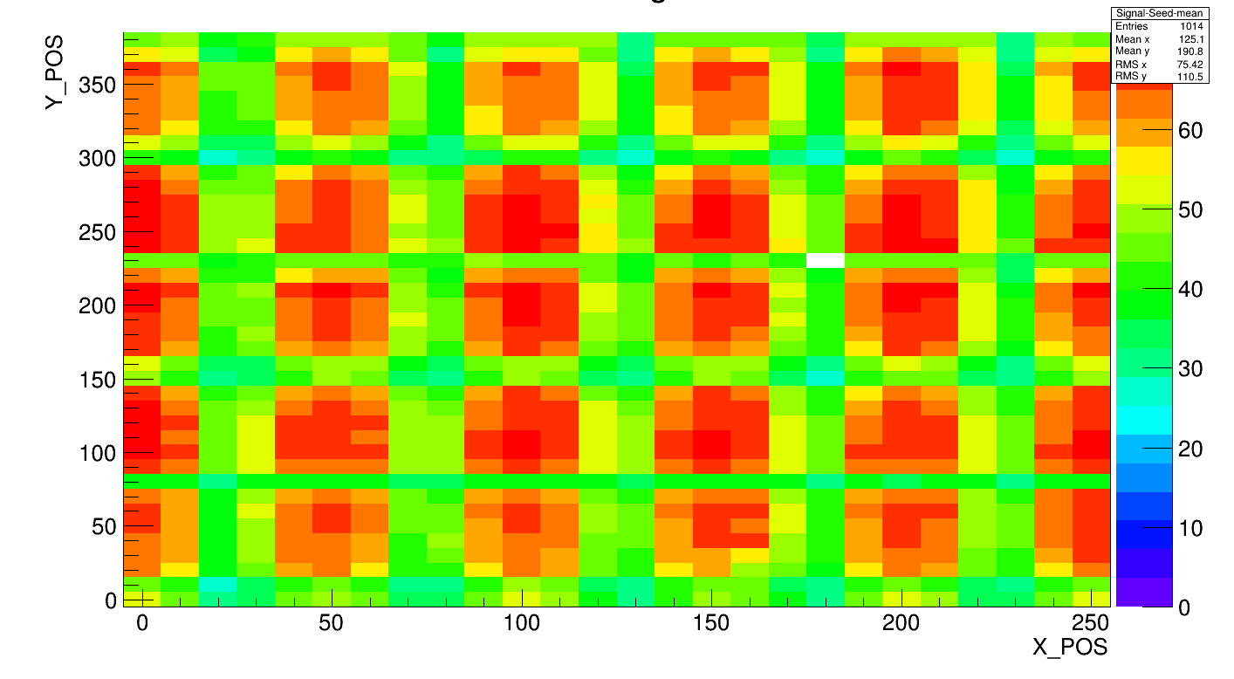
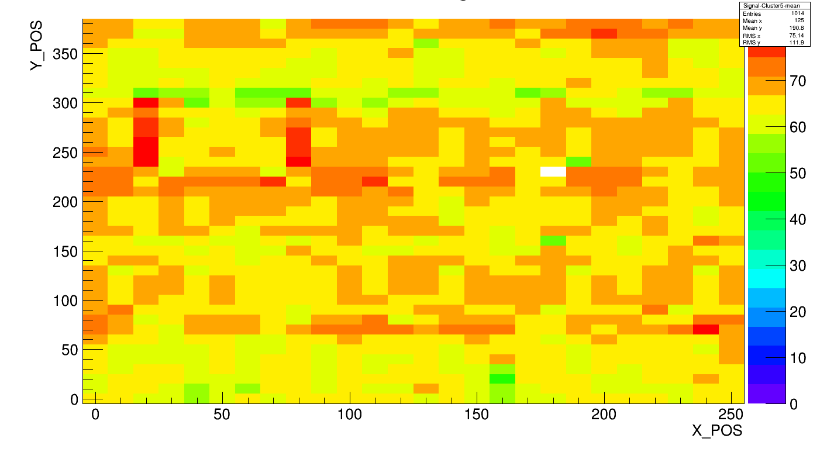
Lab Measurements and Beam Test
PXD6
50x75µm²
50µm
Switcher
B-18v1.0
g_{q} ~ 450 pA/e⁻
Test Beam,
2013
DCDBv2
DHP0.2
seed charge
Laser scan 5x6 pixels
cluster charge
Laser scan 5x6 pixels
Homogeneous charge collection

Slide 14
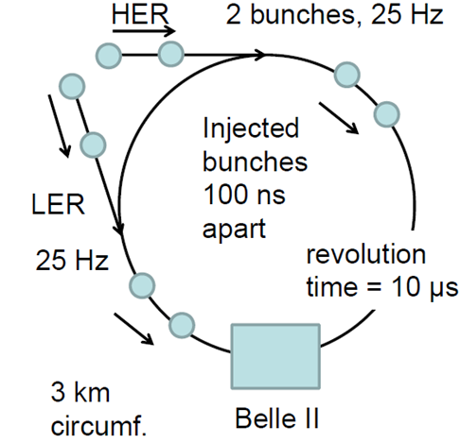
Injection Scheme of SuperKEKB
continuous injection every 20 ms
„noisy bunches“ create (junk) electrons within the Pixel Detector (PXD)
mask noisy bunches → PXD deadtime = 20%
best solution: gate the DEPFET during the passage of the noisy bunches
Make detector „blind“
Intensity of particle beam decreasing, cooling down takes 4ms (worst case throw away all noisy recordings) → again intriguing property of DEPFET detector
Applying appropriate voltages to Clear and Gate one can apply an electronic shutter:
    Clear pulse to all pixels during the noisy bunch injection
    Keep the Gate in the off state
Two questions for our Test-Set-up:
Can we protect charge in the internal Gate from being cleared?
How much of the junk charge will arrive in the internal Gate?

Slide 15
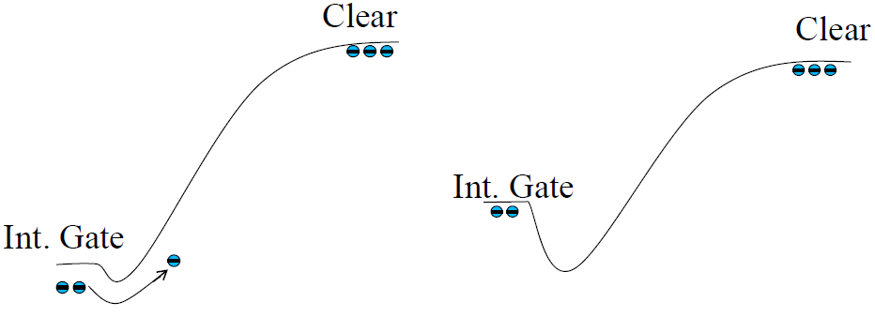
Selectivity of the Clear Process
Real Clear
External Gate in on state
Suppressed Clear
External Gate in off state
Electrons can overcome the
small potential barrier (<0.5V)
by thermionic emission
external gate shifts the potential of the internal gate by capacitive coupling → e⁻ stay in internal gate
The difference is due to the applied voltage at the external gate

Slide 16
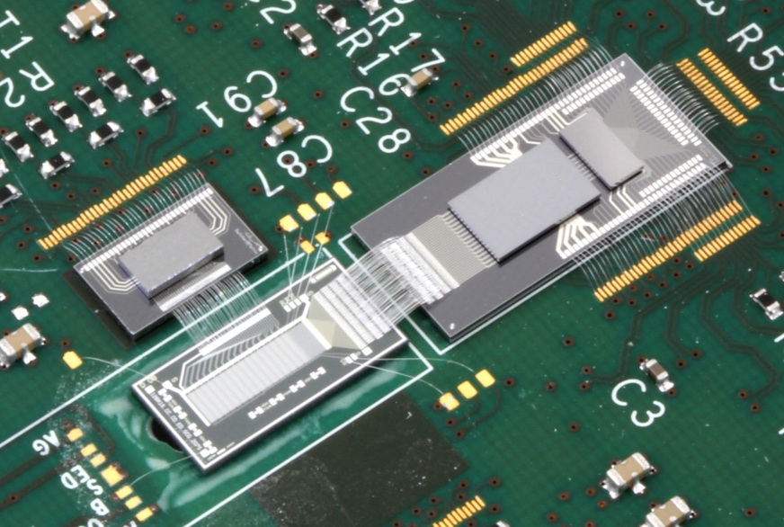
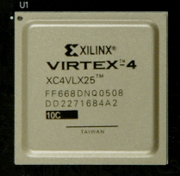
Hybrid 4 Setup – ASICs supporting GatedMode
Read-Out with DCDBpipeline
FPGA
SwitcherB18v2
PXD6 Matrix
Laser impinges from backside due to metal layers
Lab Setup: small matrix, i.e. 64 rows, 32 columns
(Experiment: large matrix, i.e. 768rows, 250columns)

Slide 17

Signal Charge Restore
Frame # | Frame 1 | Frame 2 | Frame 3 | Frame 4 | Frame 5 | Frame 6 | Frame 7 | Frame 8
Normal sequence | Read No reset | Read No reset | Laser Read No Reset | Read No Reset | Gated Mode | Gated Mode | Read No Reset | Read Reset/Clear
Frame 1 2 3 4 5 6 7 8
Lab Setup: small matrix, i.e. 64 rows, 32 columns
(Experiment: large matrix, i.e. 768rows, 250columns)

Slide 18

Gated Mode w/o Readout
Impinge Laser
Charge is generated
Charge is collected
Read
rolling shutter mode
1,6ms
Gated Mode
Gated Mode
Read

Slide 19
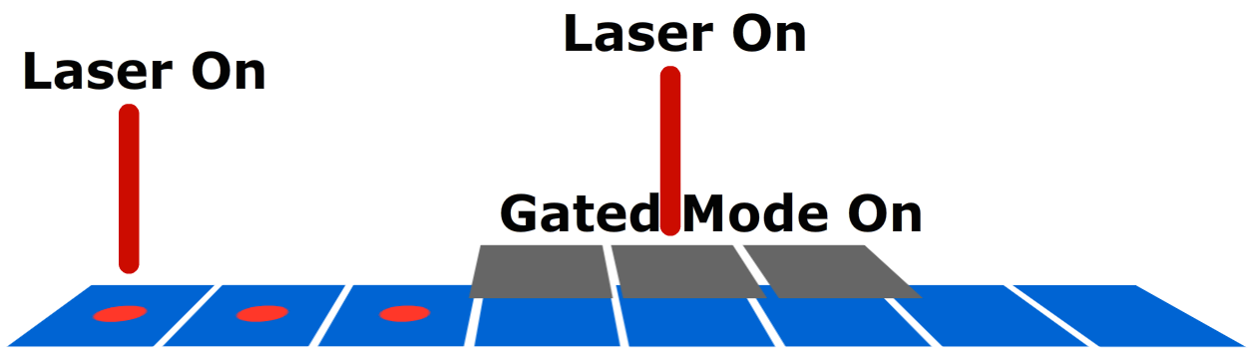
Junk Charge Generation
Frame # | Frame 1 | Frame 2 | Frame 3 | Frame 4 | Frame 5 | Frame 6 | Frame 7 | Frame 8
Normal sequence | Laser Read No Reset | Read No reset | Read Reset/Clear | Gated Mode | Gated Mode | Gated Mode | Read No Reset | Read No Reset
Lab Setup: small matrix, i.e. 64 rows, 32 columns
(Experiment: large matrix, i.e. 768rows, 250columns)

Slide 20
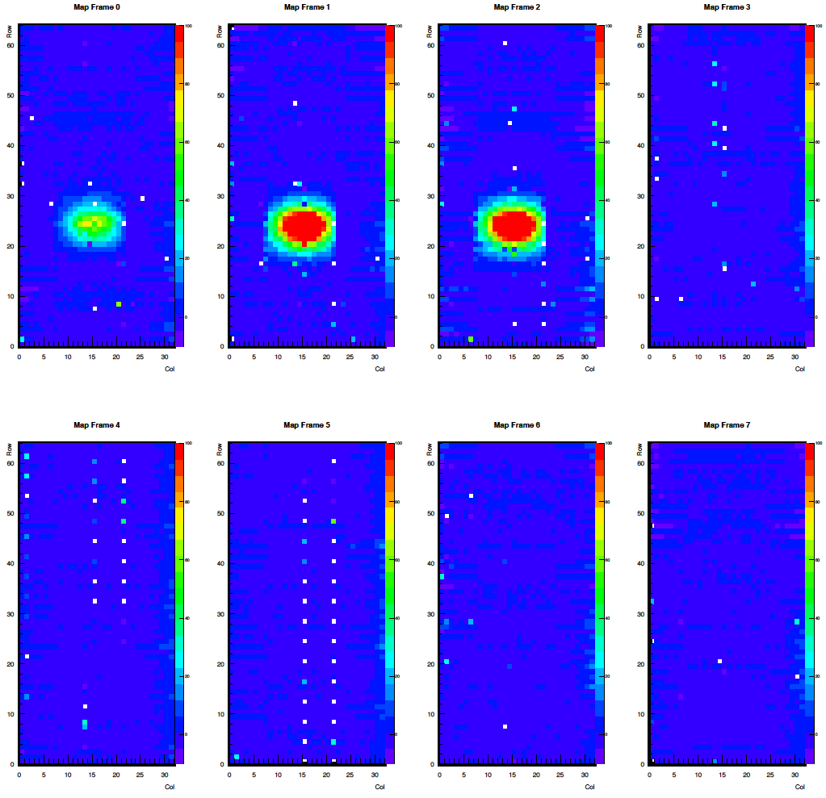
Gated Mode w/o ReadOut – Junk Charge Generation
ReadnoClear
+ Laser
ReadnoClear
Read&Clear
Gated &
Readout
Gated & Laser & Readout
Gated & Readout
ReadnoClear
ReadnoClear

Slide 21
Gated Mode with ReadOut – Junk Charge Generation
ReadnoClear
+ Laser
ReadnoClear
Read&Clear
Gated
Gated
+Laser
Gated
ReadnoClear
ReadnoClear
rows sensitive for 100ns

Slide 22

Summary and Outlook
Measurements with small matrix and one set of ASIC pair
Many beam tests to study performance
Proof of GatedMode operation to „noisy“ bunches
Future plans:
Use silicon substrate as supporting structure for ASICs and Sensor (-> next talk by Jakob Haidl)
Operate system in an experimental environment (14 ASICs, small capacitors, no surrounding PCB)
Next months: large prototype sensor („pilot-run“) equipped with latest generation of ASICs: characterization of ASICs / operation of matrix

