Slide 1
Using the HEPHY CO₂ plant in B1 room
18 August 2015
4 Sept. 2015 (revised)
T. Tsuboyama (KEK)

Slide 2
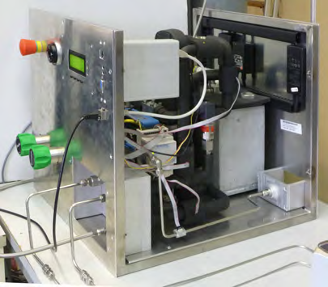
The CO₂ plant
Integrated in a 46cm (H) x 46cm (W) x 55cm (D) chassis and can be put on a working table.
Low temperature parts are wrapped with heat-insulating rubber to avoid dew.
KEK and HEPHY people discuss that safety valves should be added. This can be done
either in HEPHY or in KEK.

Slide 3
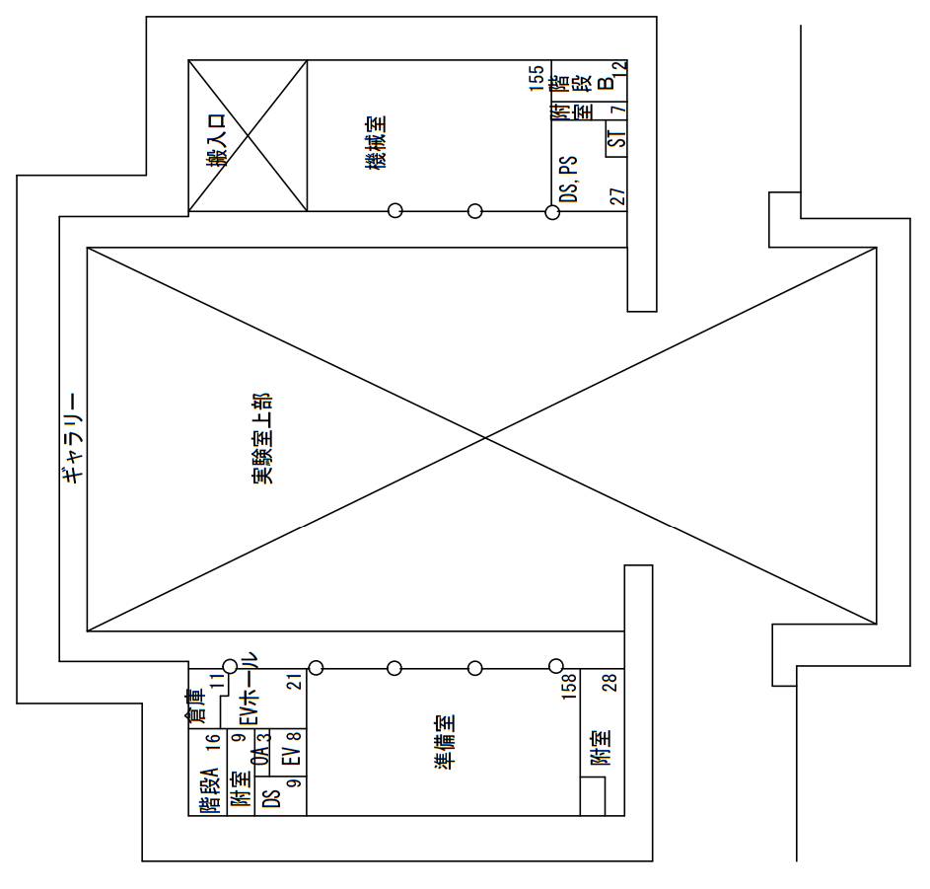
Location of CO2 usage
Tsukuba experiment hall. B1 level.
SVD/PXD preparation room

Slide 4
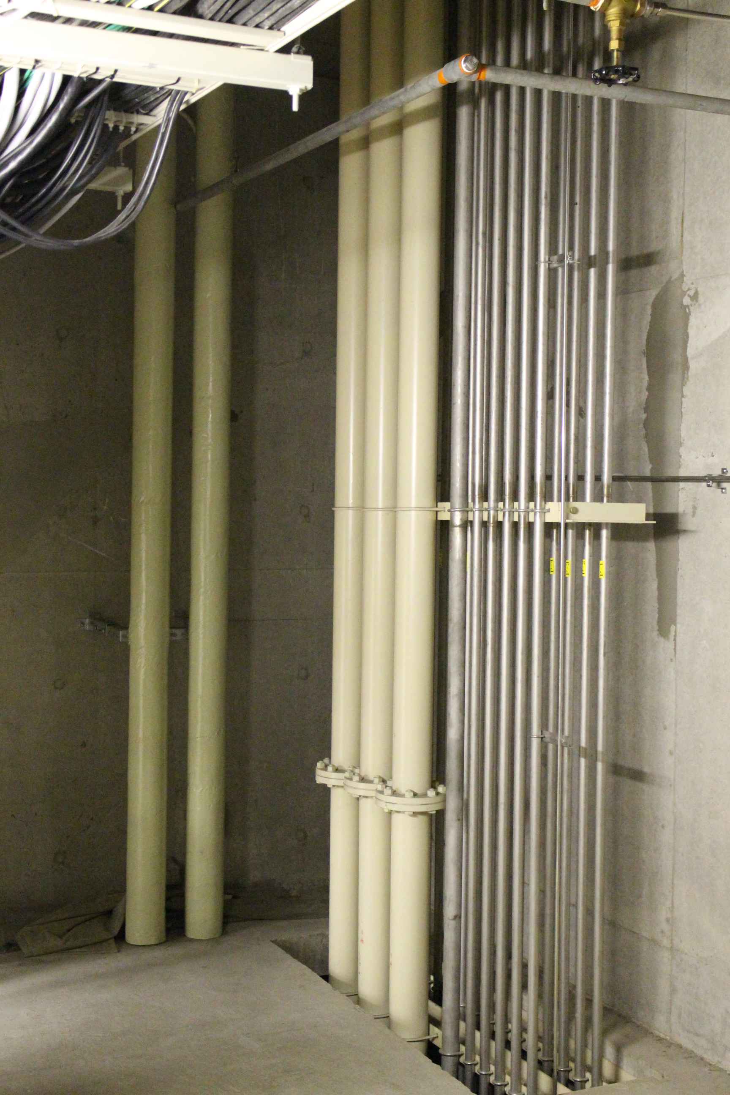
Location of the CO₂ plant
path through
the ceiling of B1 room
Tsukuba B1 room
CO₂
Cylinders
(up to 2)
HEPHY
CO₂
Plant
⌀100
exhaust
pipes
VXD assembly tent
Dark room (5 m x 5m)

Slide 5
Exhaust pipes
A thick tube will be used in order to reduce conductivity, for safety.
Outside
15 m long, ⌀100mm
exhaust tube
F1 room
CO2 plant
exhaust
(∅50 tube?)
B1 room

Slide 6
Usage of CO₂ cooling plant in KEK
We should clear two laws concerning the CO₂ plant.
Working environment and health law 労働安全衛生法
High pressure gas safety act 高圧ガス安全法
However, I need to negotiate the managers of 1 and 2 as this is first practical utilization of CO₂ in KEK.
The CO₂ plant should be acknowledged in KEK.
I did not like it is treated in governmental regulations, in which huge efforts are necessary to get the license.
License is not given if we are not lucky.

Slide 7
Working environment and health law
I first have discussed with Prof. Furukawa, the working environment health law manager of IPNS, and with a 3rd party safety consultant company. We agreed the following conditions should be established before they admit our CO₂ plant.
Number of CO₂ cylinders is up to 2 in the B1 room to secure the Oxygen concentration >15 % after an CO₂ gas leak accident.
CO₂ should be exhausted outside of the Tsukuba building.
We should equip enough number of monitors and alarms.
The alarm should be displayed outside of doors.
In case of significant CO₂ leak, B1 room must be extinguished and wait until the CO₂ level decreases.
Information and necessary education:
CO₂ system manual
Safety manual
Instruction lecture to every worker.

Slide 8
High pressure gas safety act
Then I discussed with Prof. Nakai, the high-pressure gas safety manager of KEK. He concluded that the plant is not subject to the governmental license. He admitted that KEK accepts the CO₂ plant under following conditions:
Definite acceptance test condition should be defined.
Intense inspection and examination is done every year.
Daily inspection shift: inspection is performed even the plant is not operated, as accidents can happen even when idle. You can finish the inspection when you decide the plant is no more used.
Documents describing everything: Operation principles, detail design, structure, parts list (certification information), operation, safety system, failure cases.
Emergency contact network.

Slide 9
Summary
I cleared the first two steps.
Working environmental safety low
High-pressure gas safety act
The managers allow us to utilize the CO₂ system if conditions are met.
I now can ask HEPHY people to start the process of CO₂ plant shipping to KEK.
If you prepare a shipping idea, schedule or documents, I will discuss with Ms. Nomura to start the receiving procedure. I will also ask comments of environmental /high-pressure safety professors.

