Slide 1
SVD Sensors Update
Luciano Bosisio, Irina Rashevskaya
INFN - Trieste
8th Belle II VXD Workshop
Trieste, September 9-11, 2015

Slide 2
Retesting of Scratched Micron Sensors
36 scratched sensors sent to Trieste end of June for retesting the P-side metal (AC) strips
Standard AC strip scan on P-side
Total sensor I-V characteristic for a quick check of possible (but not likely) damage to junctions
Retesting completed by mid-July
Metal shorts due to scratches separated in the first week of August
91 out of 99 shorted strips separated
of the remaining 8:
4 in a sensor sent to Pisa in July
4 non-separable (shorted by poly residue)

Slide 3
Retesting of Scratched Micron Sensors
Priority | Sensor | Tested | Broken AC | Metal Shorts | Seen in Previous test | MetalShorts After Separation | Nr. of AC Defective Strips P-side | AC Defect %
1+ | 3077-15_Wedge | Vienna | 4 | 4 | 1 of 4 Broken AC | 4 | 8 | 1.0%
1+ | 3084-20_Wedge | Vienna | 0 | 0 | ? | 0 | 0 | 0.0%
1 | 3077-25_Wedge | Vienna | 6 | 6 | 3 of 6 Broken AC | 0 | 6 | 0.8%
1 | 3066-16_Wedge | Vienna | 5 | 0 | 4 of 5 Broken AC | 0 | 5 | 0.7%
1 | 3077-6_Wedge | Vienna | 5 | 2 | 1 of 5 Broken AC |  | 5 | 0.7%
1 | 3066-10_Wedge | Vienna | 0 | 2 | ? | 0 | 0 | 0.0%
1 | 3077-10_Wedge | Vienna | 10 | 0 | 2 of 10 Broken AC | 0 | 10 | 1.3%
1 | 3083-12_Wedge | Vienna | 2 | 0 | ? | 0 | 2 | 0.3%
1 | 3049-20_Wedge | Vienna | 10 | 3 | ? | 0 | 10 | 1.3%
1 | 3077-5_Wedge | Vienna | 5 | 3 | 5 of 5 Broken AC | 0 | 5 | 0.7%
1 | 3084-14_Wedge | Vienna | 1 | 2 | 1 of 1 Broken AC | 0 | 1 | 0.1%
1 | 3067-4_Wedge | Vienna | 1 | 2 | 1 of 1 Broken AC | 0 | 1 | 0.1%

Slide 4
Retesting of Scratched Micron Sensors
Priority | Sensor | Tested | Broken AC | Metal Shorts | Seen in Previous test | MetalShorts After Separation | Nr. of AC Defective Strips P-side | AC Defect %
2 | 3084-5_Wedge | Vienna | 2 | 2 |  | 2 | 4 | 0.5%
2 | 3066-8_Wedge | TS | 1 | 0 | No Added Defects | 0 | 1 | 0.1%
2 | 3084-12A_Wedge | TS | 4 | 0 | 1 new Broken AC | 0 | 4 | 0.5%
2 | 3067-10_Wedge | TS | 3 | 2 | No Added Defects | 2 | 5 | 0.7%
2 | 3083-1_Wedge | TS | 2 | 0 | No Added Defects | 0 | 2 | 0.3%
2 | 3084-7_Wedge | TS | 1 | 0 | No Added Defects | 0 | 1 | 0.1%
2 | 3084-6_Wedge | TS | 1 | 0 | No Added Defects | 0 | 1 | 0.1%
2 | 3067-7_Wedge | TS | 5 | 0 | No Added Defects | 0 | 5 | 0.7%
2 | 3078-10_Wedge | Vienna | 2 | 15 | 0 Broken AC , 0 ALShorts | 0 | 2 | 0.3%
2 | 3078-6_Wedge | Vienna | 1 | 8 | 0 Broken AC , 0 ALShorts | 0 | 1 | 0.1%
3 | 3084-8_Wedge | TS | 1 | 0 | No Added Defects | 0 | 1 | 0.1%
3 | 3078-13_Wedge | TS | 1 | 0 | No Added Defects | 0 | 1 | 0.1%
3 | 3066-20_Wedge | TS | 1 | 0 | No Added Defects | 0 | 1 | 0.1%
3 | 3083-10_Wedge | TS | 6 | 0 | No Added Defects | 0 | 6 | 0.8%
3 | 3084-17_Wedge | TS | 1 | 0 | No Added Defects | 0 | 1 | 0.1%

Slide 5
Retesting of Scratched Micron Sensors
Priority | Sensor | Tested | Broken AC | Metal Shorts | Seen in Previous test | MetalShorts After Separation | Nr. of AC Defective Strips P-side | AC Defect %
3 | 3084-19_Wedge | Vienna | 4 | 0 | 4 of 4 Broken AC | 0 | 4 | 0.5%
3 | 3083-15_Wedge | Vienna | 7 | 2 | 7 of 7 Broken AC | 0 | 7 | 0.9%
3 | 3067-20_Wedge | TS | 1 | 0 | No Added Defects | 0 | 1 | 0.1%
3 | 3048-3_Wedge | Vienna | 15 | 2 | ? | 0 | 15 | 2.0%
3 | 3049-3_Wedge | Vienna | 12 | 3 | ? | 0 | 12 | 1.6%
3 | 3067-16_Wedge | Vienna | 5 | 9 | ? | 0 | 5 | 0.7%
3 | 3067-25_Wedge | Vienna | 6 | 26 | ? | 0 | 6 | 0.8%
3 | 3077-13_Wedge | Vienna | 4 | 4 | ? | 2 | 6 | 0.8%
3 | 3077-16_Wedge | Vienna | 3 | 2 | ? | 0 | 3 | 0.4%

Slide 6
Sensor measurements at HEPHY
(Manfred Valentan)
No probecard
instead three needles and stepping the table
Switching matrix to connect measurement devices
Electromenter, SMUs, LCR-Meter
Automated measurement procedure
LabView

Slide 7
Quality Test Center (QTC)
(Manfred Valentan)

Slide 8
(Manfred Valentan)

Slide 9
Analysis of HEPHY Sensor Test Data
(Manfred Valentan)
Written in Python
Input: raw data file from the QTC
Output: csv file with list of defective strips, compatible with HephyDB
Combination of absolute and relative thresholds
Absolute: e.g. current through dielectric -> pinhole
Relative: e.g. doubled current (inside a certain deadband) -> implant short
Robust least-median-of-squares fit
To find the expected value of a measurement outlier

Slide 10
Example: pinholes
(Manfred Valentan)

Slide 11
Example: implant short
(Manfred Valentan)

Slide 12
Analysis: Status and outlook
(Manfred Valentan)
Progressing to final version
The specifics of the measurement procedure are understood
The thresholds are reasonable
The analysis procedures are sophisticated
To do
Understand a few special cases which are not caught by the present analysis procedure, but being pragmatic...
Run the analysis over the data of all sensors

Slide 13
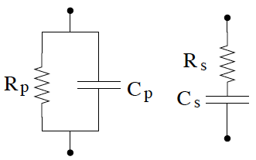
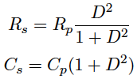
P-side contact problem effect on C_{AC} measurement
P-side of Wedge sensors affected by poor metal-implant contacts
=> high effective series R_{series} in Vienna measurement of C_{AC}
=> the parallel R-C model underestimates C
admittance: Y = 1/Z
Trieste measurement of C_{AC} not affected by this problem, because the DC pad is not used.

Slide 14
Metal to p-implant contact
∆V
Forward-bias I-V between p-strip and n-bulk, contacted by n-side Bias Ring
Likely some oxide present on the contact area: ‘burned’ by forcing 10 mA
The V-drop ∆V through the contact can be estimated from the curve shift

Slide 15
Contact influence on AC-coupling cap. measurement
Measurement of C_{AC} versus f at different test voltages V_{osc.}
(performed in Trieste on a sample strip)
↑
Vienna test f (100 Hz, V_{osc.} = 0.5 V)
Even at 100 Hz and V_{osc.} = 0.5 V the parallel model underestimates C_{AC}
The effect can be higher on other strips or sensors

Slide 16
Contact influence on AC-coupling cap. measurement
Micron Sensor 3084-20 – Vienna test data
C_{P}
C_{S}
This is a rather extreme case, with very high contact resistance on the last strips
_{Triested measurement}

Slide 17
Contact influence on AC-coupling cap. measurement
Micron Sensor 3066-10 – Vienna test data
On most sensors the series model improves the quality of the C_{AC} measurement

Slide 18
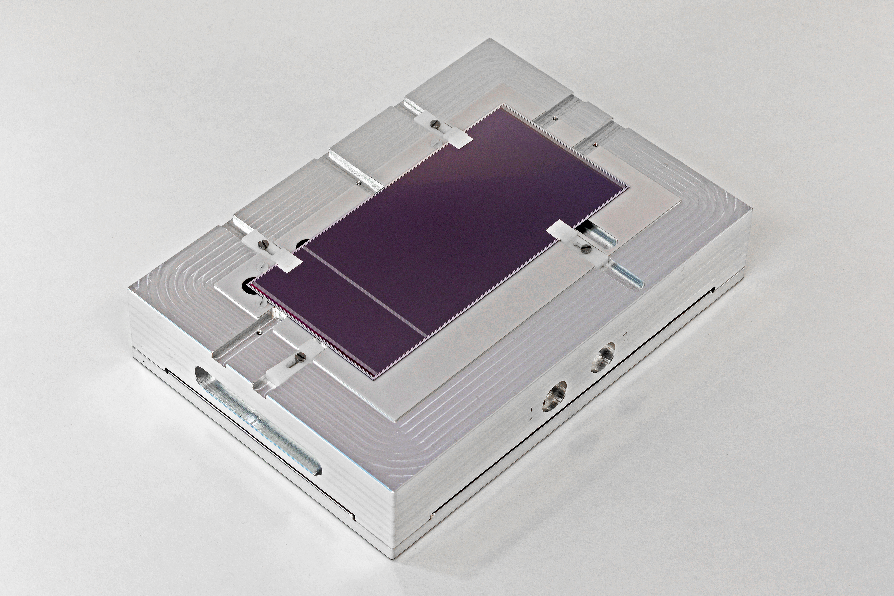
Test of a Large HPK Sensor
Front-side Rings are bonded to these traces
Sensor # 83 (not classified) recently tested in Trieste

Slide 19
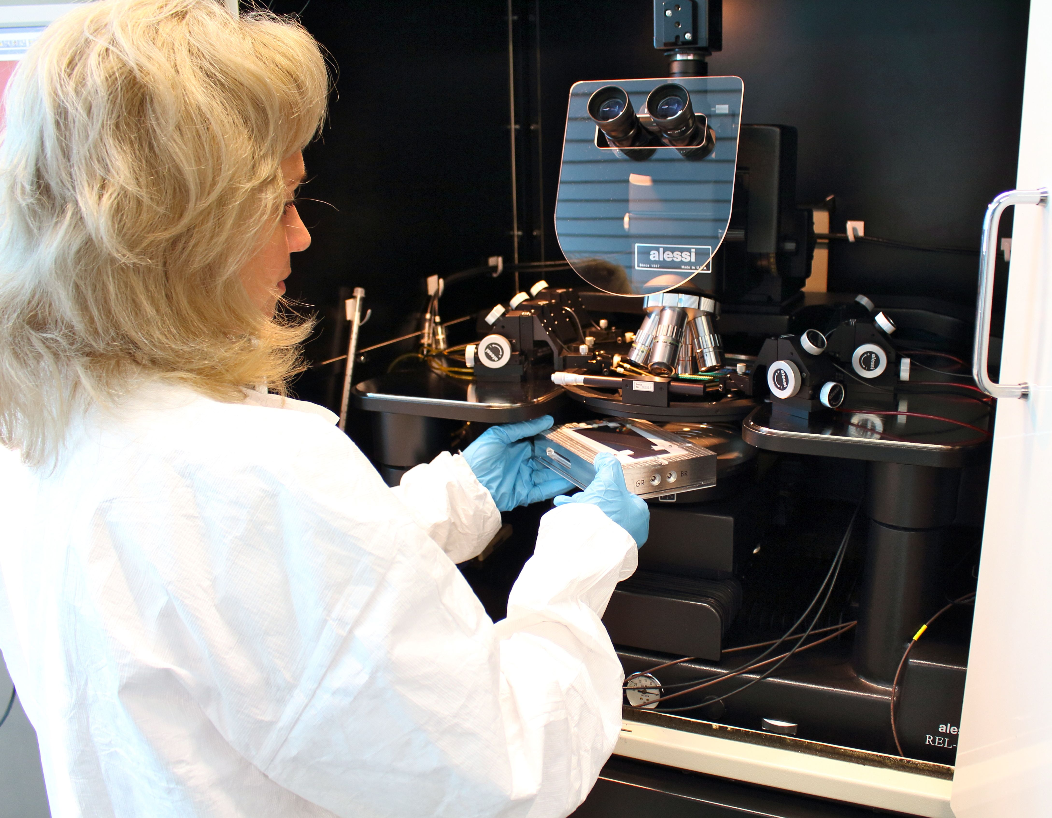
Sensor testing set-up

Slide 20
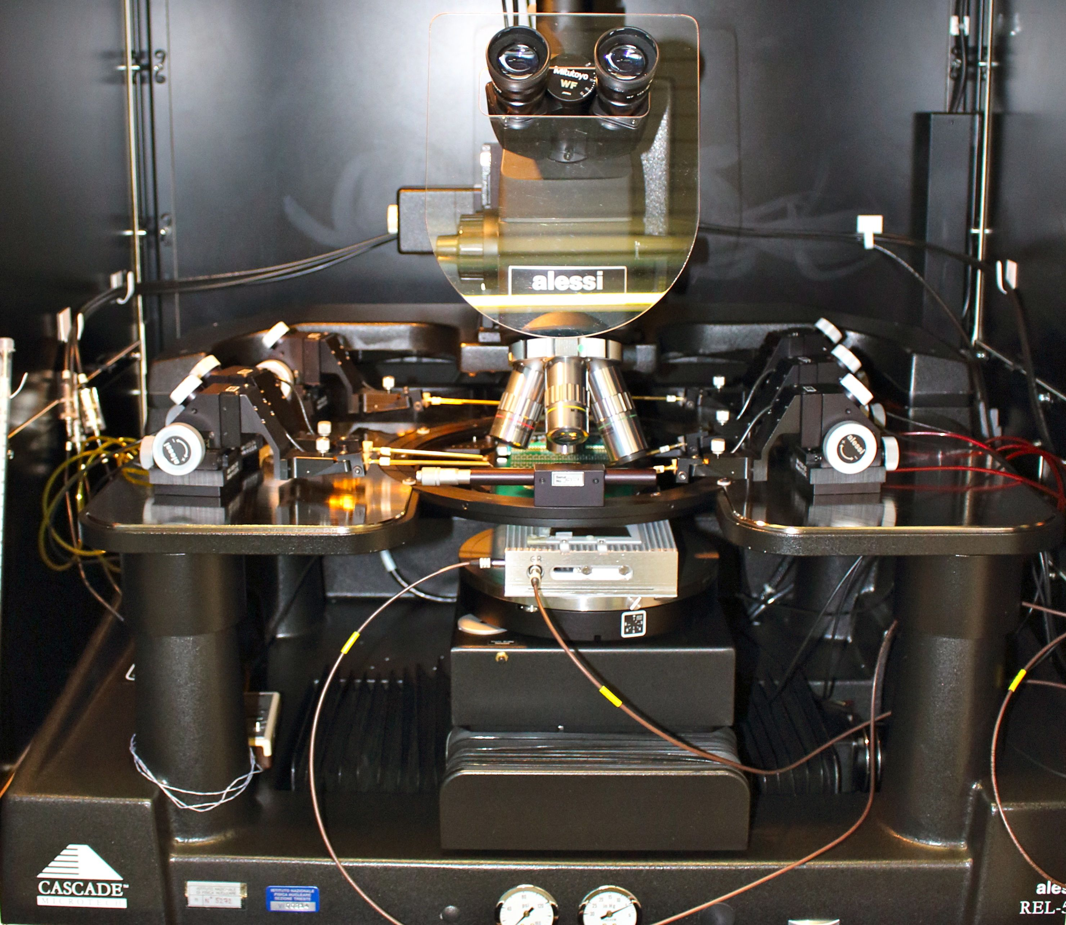
Sensor testing set-up
Front and Back-side Rings are connected through cables
Strips are contacted by a 40-needle Probe Card

Slide 21
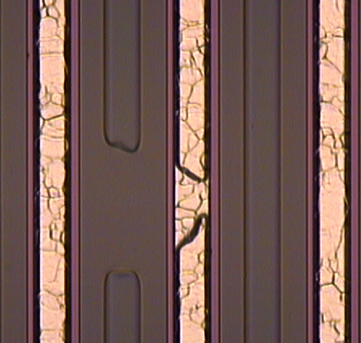
Test results on Large HPK Sensor
P-side:
1 AC defect (pinhole)
2 (adjacent) high-current strips (0.53 µA, 0.71 µA)
4 implant opens (verified at the microscope)
1 implant short to adjacent non-readout strip
N-side:
No AC defects
1 high-current strip (0.75 µA)
24 implant opens (verified at the microscope)
=> Consider as Class A ?
We can test some more if available

