Slide 1
Introduction Issues of the Meeting
Christoph Schwanda
VXD Trieste, September 10, 2015

Slide 2
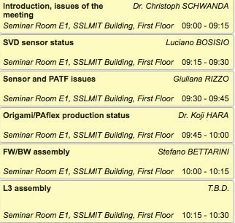
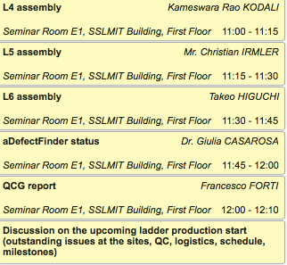
SVD parallel session agenda Thursday morning

Slide 3
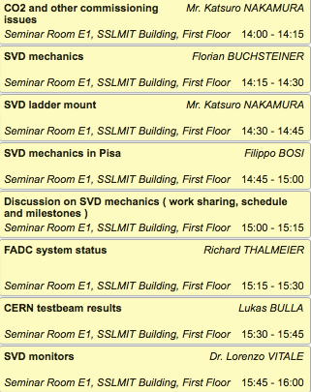
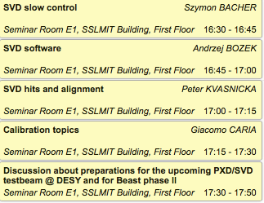
SVD parallel session agenda Thursday afternoon

Slide 4
Planned discussions
Ladder production
outstanding issues, logistics, milestones
Ladder mount
responsibilities, schedule, milestones
Test beam preparations
Goals ( participating subsystems )
Organization ( subgroup contacts, overall SVD contact )

Slide 5
Most important items
Preparations for BPAC review in October
Agenda
Update of schedule ( detailed schedule for all production sites? )
DESY VXD test beam
Define contact persons, set up organization

