Slide 1


SVD Overview
Christoph Schwanda
Institute of High Energy Physics
Austrian Academy of Sciences
8th Belle II VXD Workshop
September 9-11, 2015
Trieste, ITALY

Slide 2
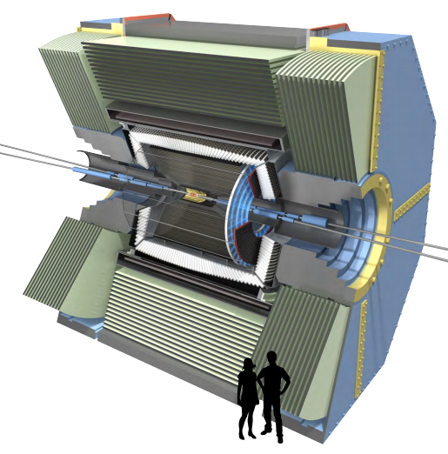
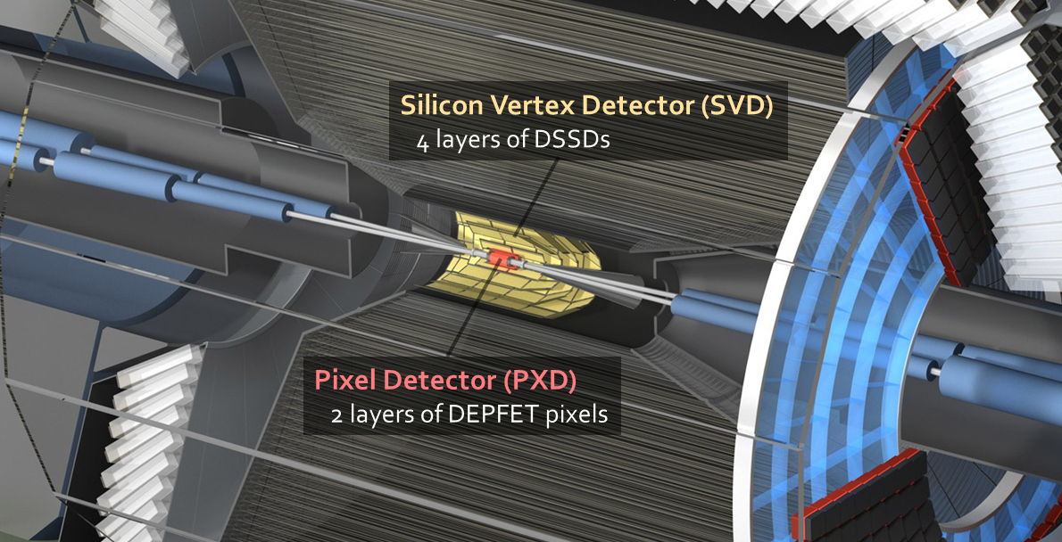
Belle II Vertex Detectors
PiXel Detector (PXD)
  Based on DEPFET pixels –
  see previous talk
Silicon Vertex Detector (SVD)
  Double-sided silicon strip detectors (DSSDs)
VXD requirements
Fast – to operate in high background environment
Better resolution at IP – to compensate reduction of boost wrt. Belle I
Radiation hard (up to 100 kGy)
Self-tracking capable – to track particles down to 50 MeV in p_{T}
SVD
PXD

Slide 3
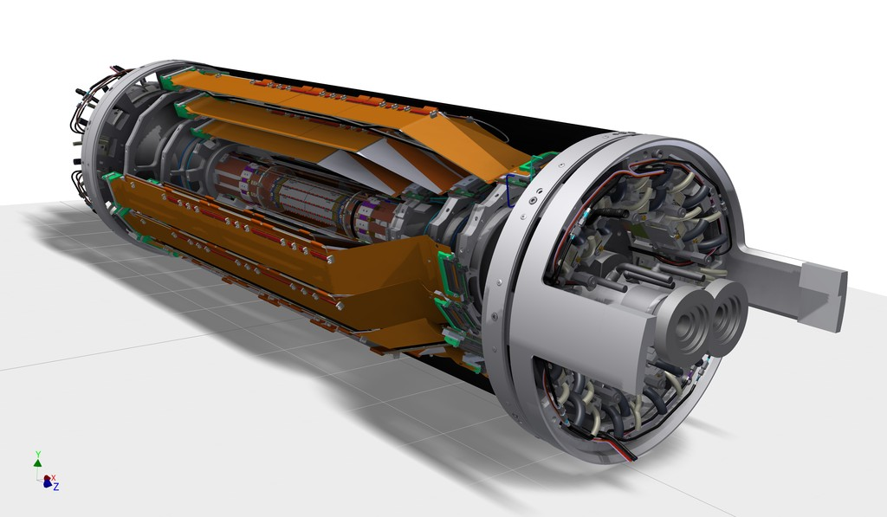
Belle II SVD Components
Carbon fiber
(CF) cone
Outer CF shell
End flange
End rings
Ladders
Beam pipe
PXD
(inside SVD → individual sub-detector)
4 Layers double sided silicon strip detectors
2,3,4 or 5 sensors per ladder

Slide 4
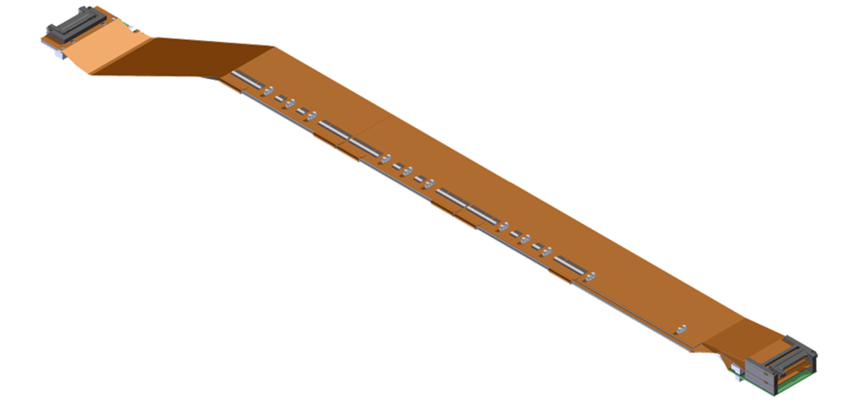
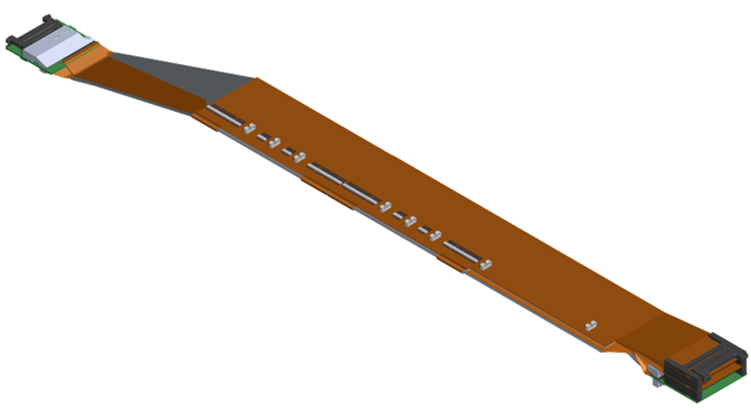
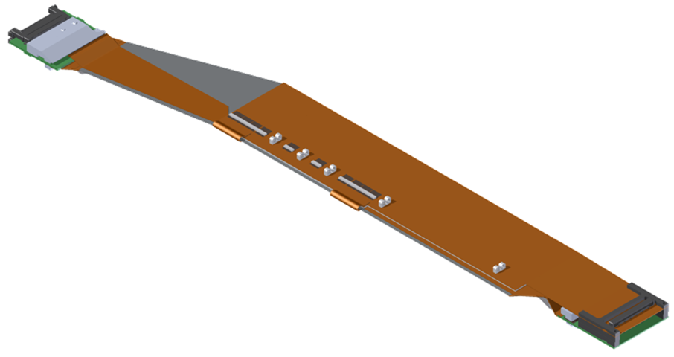
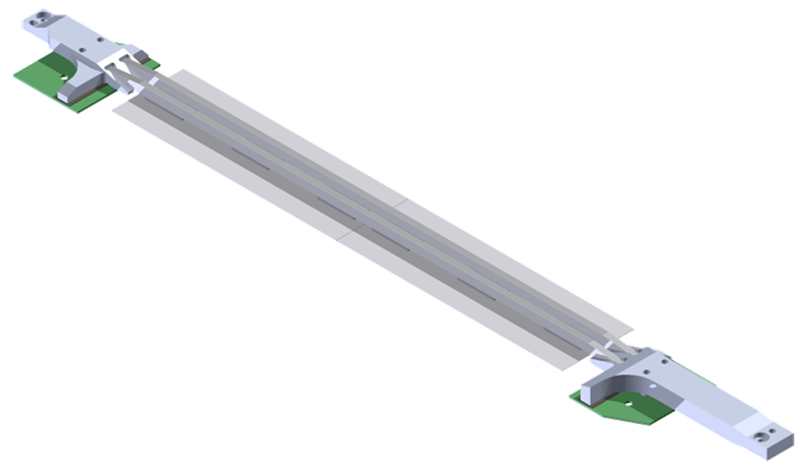
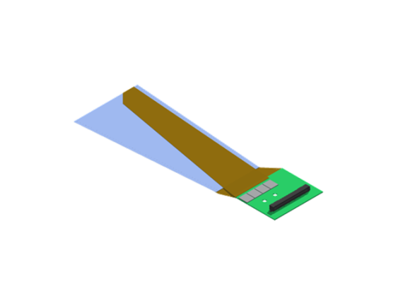
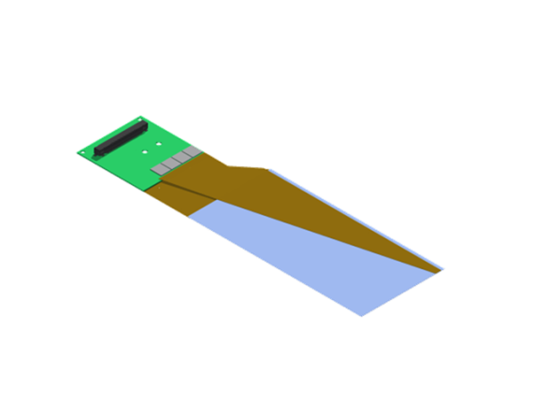
SVD ladders
Layer | Ladders | Sensors / Ladder
6 | 16 | 5
5 | 12 | 4
4 | 10 | 3
3 | 7 | 2
L6 Ladder
(Kavli IPMU)
FWD module
FWD
Origami +z
L5 Ladder
(HEPHY)
Origami ce
BWD
Origami -z
L4 Ladder
(TIFR)
BWD module
L3 Ladder
(Melbourne)
Cooling pipe
FWD module
(Pisa)
Cooling pipe
BWD module
(Pisa)
Cooling pipe

Slide 5
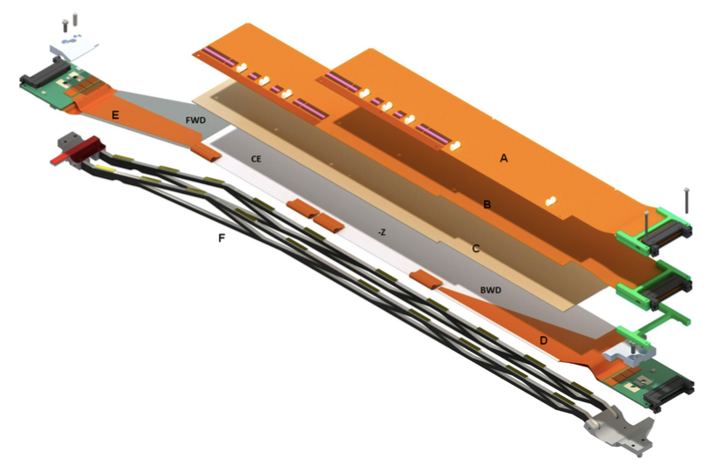
Ladder anatomy (L5)
Origami hybrids
(with APV frontend readout chips)
Airex sheet (insulator)
Sensors
Carbon fiber sandwich ribs

Slide 6
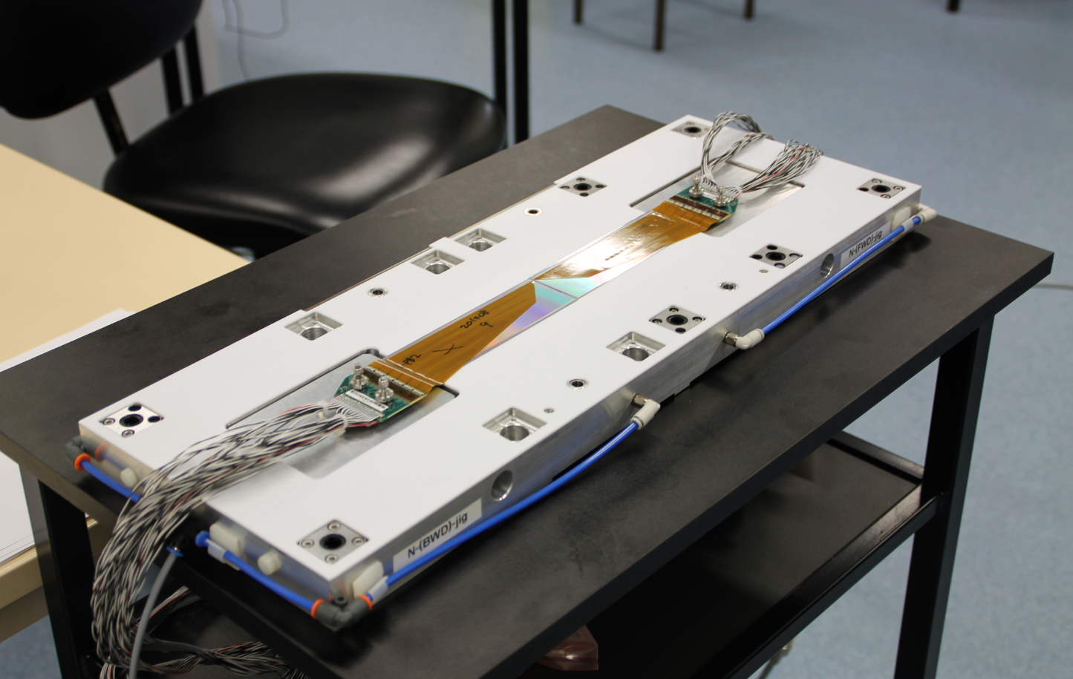
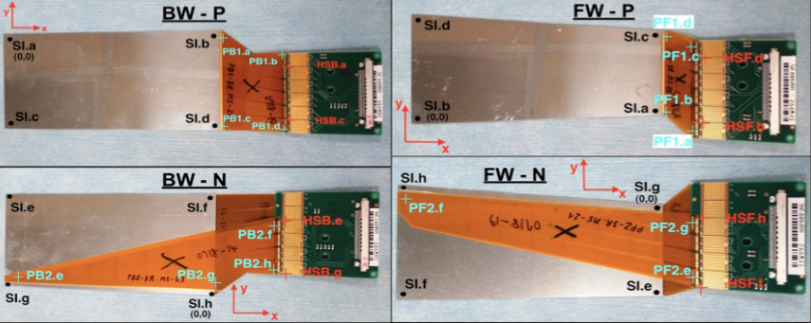
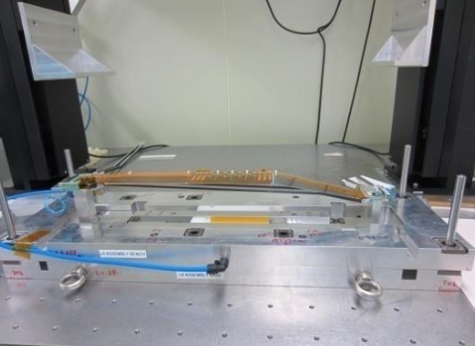
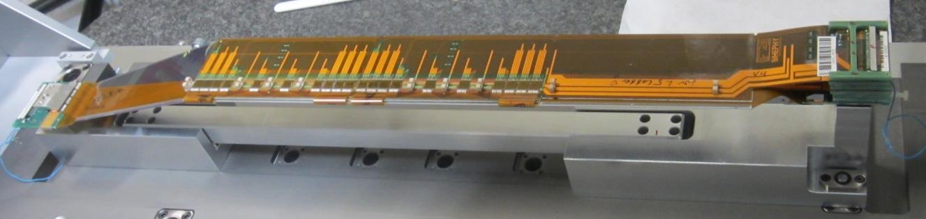
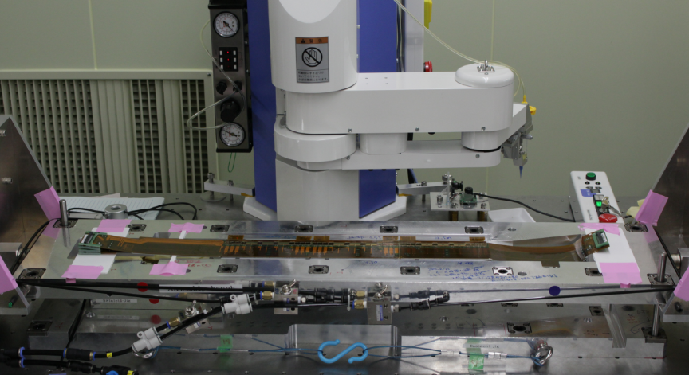
FW/BW (Pisa)
L3 (Melbourne)
L5 (HEPHY)
L4 (TIFR)
L6 (Kavli IPMU)
All sites have successfully assembled SVD ladders with the final components

Slide 7
Status at the assembly sites
FW/BW (Pisa)
  Site passed final qualification review on May 29 and is now in production mode
L3 (Melbourne)
  Site assembled two class C ladders (L3.902 and L3.903) and is now moving to the first electrically working ladder (class B)
L5 (HEPHY Vienna)
  Site passed final qualification review on Aug 6
  Very recently completed first production-grade ladder (L5.001) → origami evaluation
L4 (TIFR)/L6 (Kavli IMPU)
  Both assembled class C and B ladders, close to production readiness
  Main outstanding issue: shift of FW sensor

Slide 8
Results class C L3 survey

Slide 9
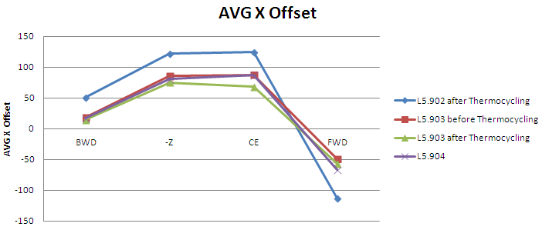
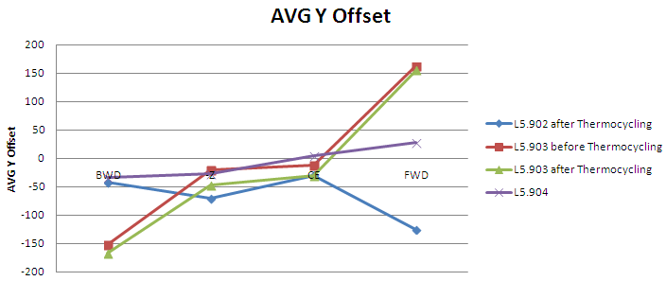
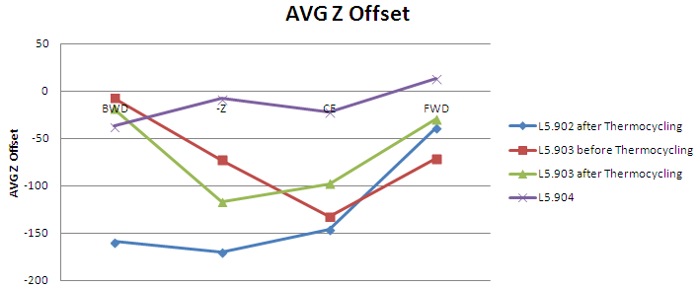
Ladder survey
Results class C L5 survey
Overview of average offsets of each Ladder [µm]

Slide 10
Results class C L4 survey

Slide 11
Results L6 survey

Slide 13
Ladder parts availability
Sensors
  Three types of DSSD sensors: Micron (trapezoidal), small and large HPK (rectangular)
  After a detailed inventory and sensor grading revision, we conclude that sensors are in hand to produce the detector including 2 spares/layer with a safety factor (~20%)
  Only 5 small HPK sensors for L3 need to be reproduced (available ~end 2015)
Origami
  In autumn 2014 we lost the origami mass production due to cracks in the PA0 lines
  PA0 redesign, origami pre-production, requalification

Slide 14
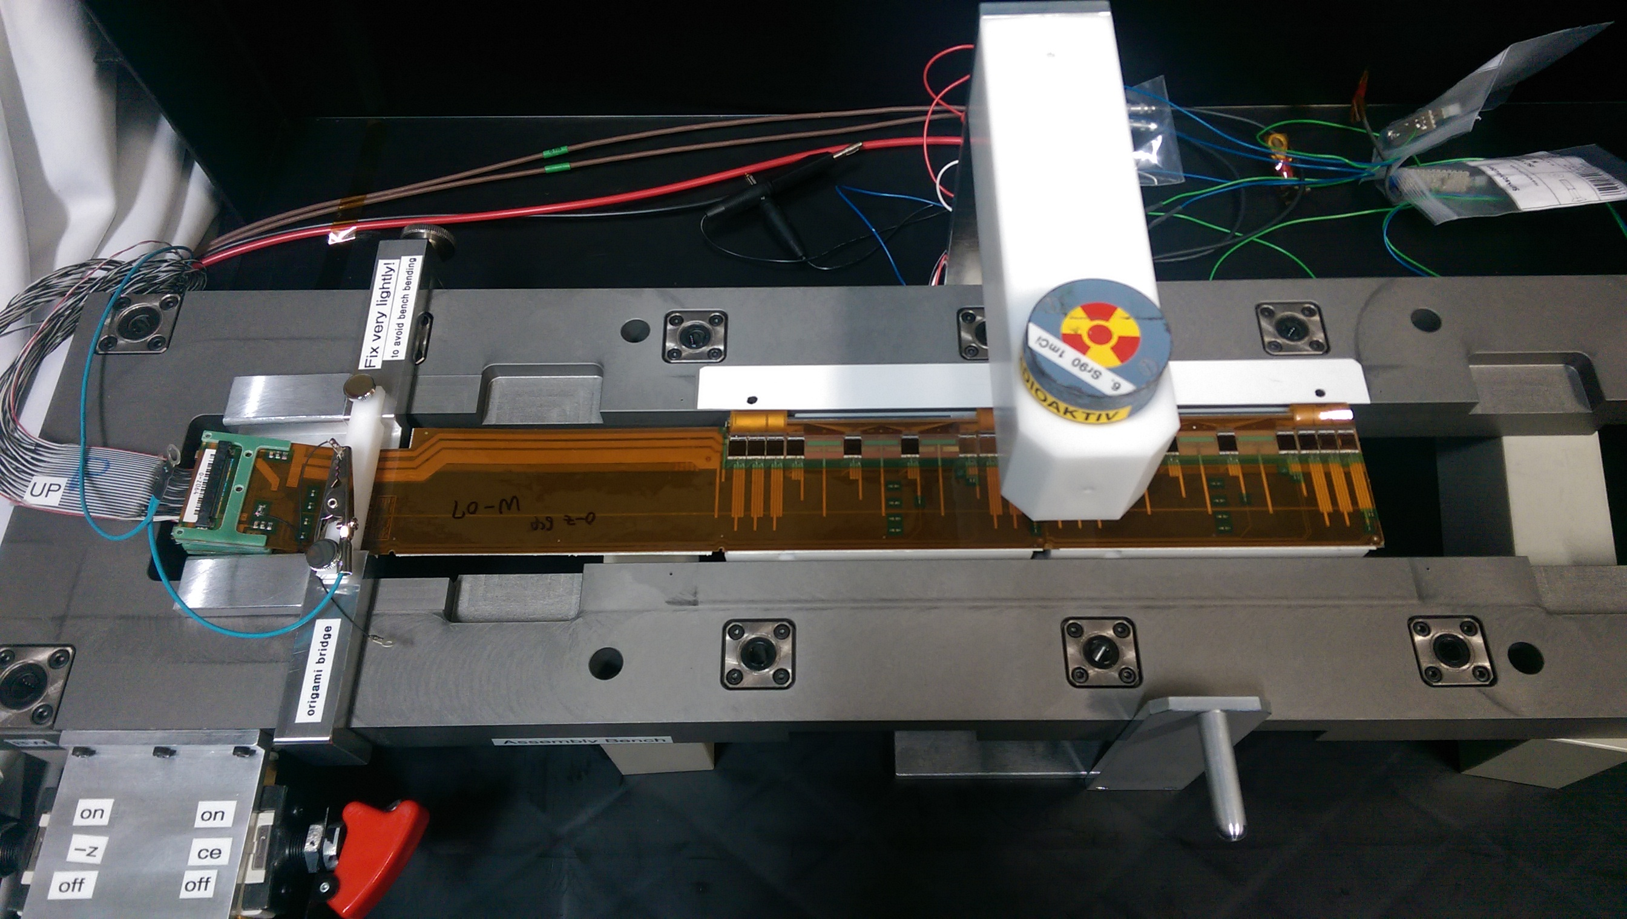
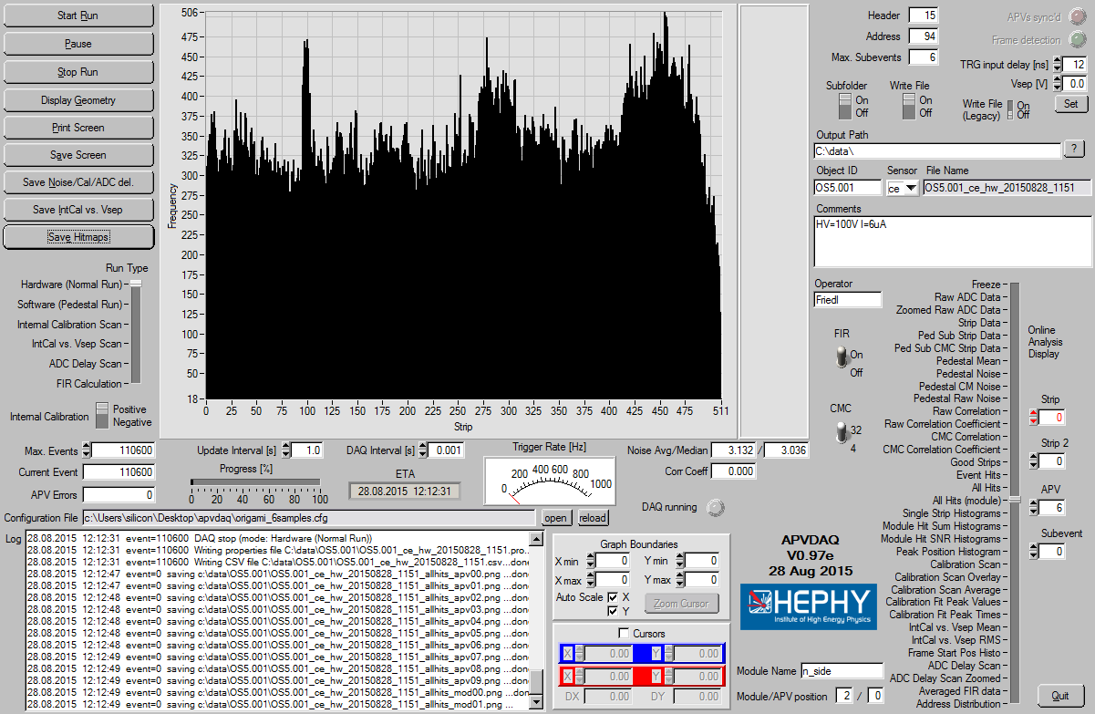
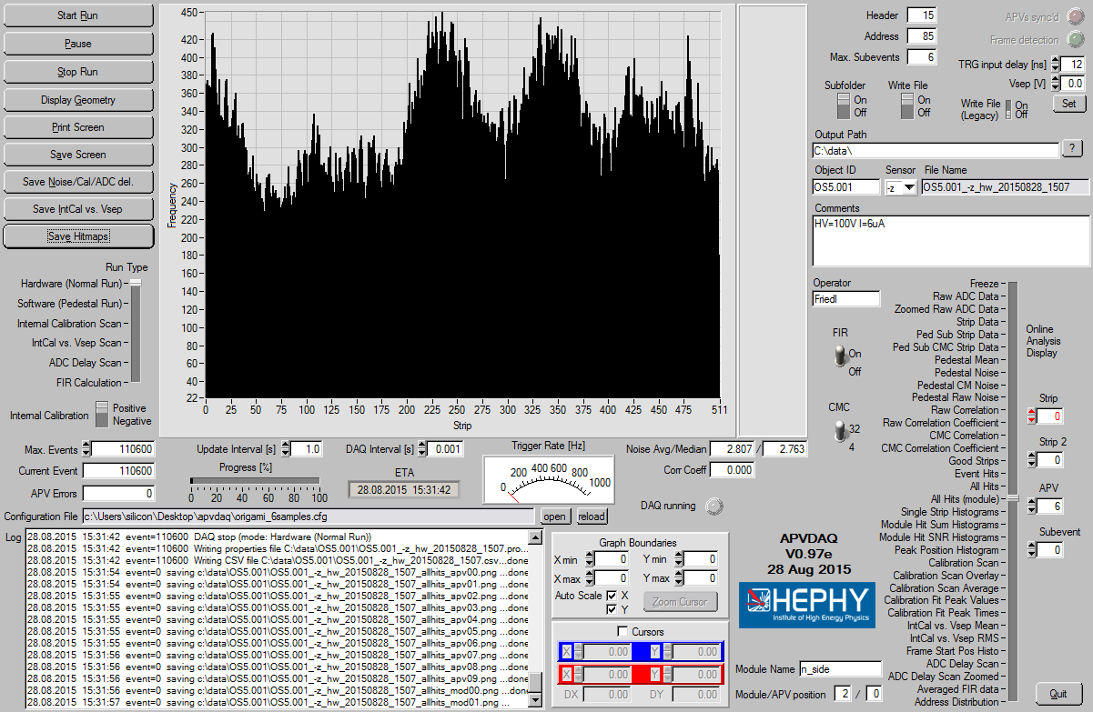
Source run with pre-production origami (Aug 28)
Electric functionality of new origami confirmed!

Slide 15
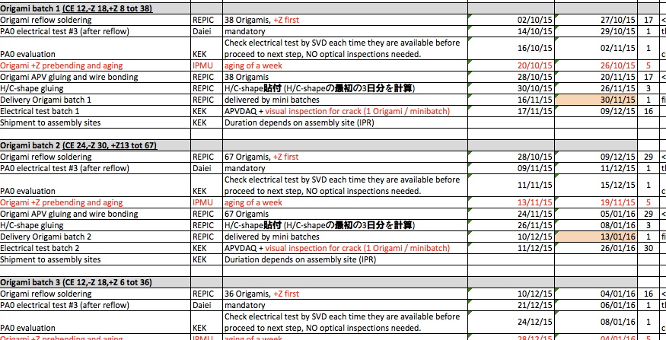
First samples from the origami mass production expect for the second half of November

Slide 16
Other issues to follow-up
Ladder mount procedure
  Decision on the concept at the June B2GM (ladder mount from the side)
  But many details to work out (ladder mount adapter – keep or remove, gluing of FOS fibers and NTC sensors, CO2 pipe attachment, …)
Read-out electronics
  Redesign of the FADC board layout
  Trigger latency issue
    Does the L1 trigger arrive within 5 μs to the APV

Slide 17
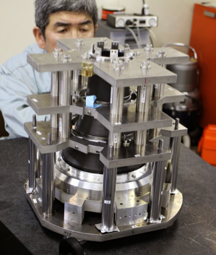
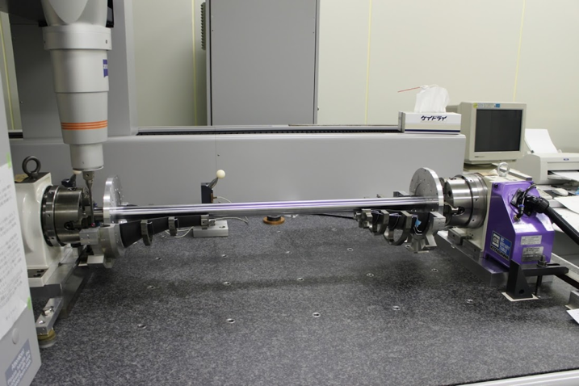
Support structure assembly
CMM measurement of assembled FWD-BWD structure (v1): Inoue-san
  will be done in Sep (after VXD meeting). I will show the data as soon as possible.
Second trial of endring+endflange assembly (v2): Katsuro
  Order of modified jigs for FWD was taken place.
  They will appear the middle of Sep.
  We will try to assemble FWD half endrings in Nov.
Support-rod reproduction: Suzuki-san
  We will employ ETP bushings for the new rod. But they will appear the end of Oct.
    Easy to achieve co-axis and squareness, and easy to adjust position in Z.
  Production: by the begin of Nov.

Slide 18
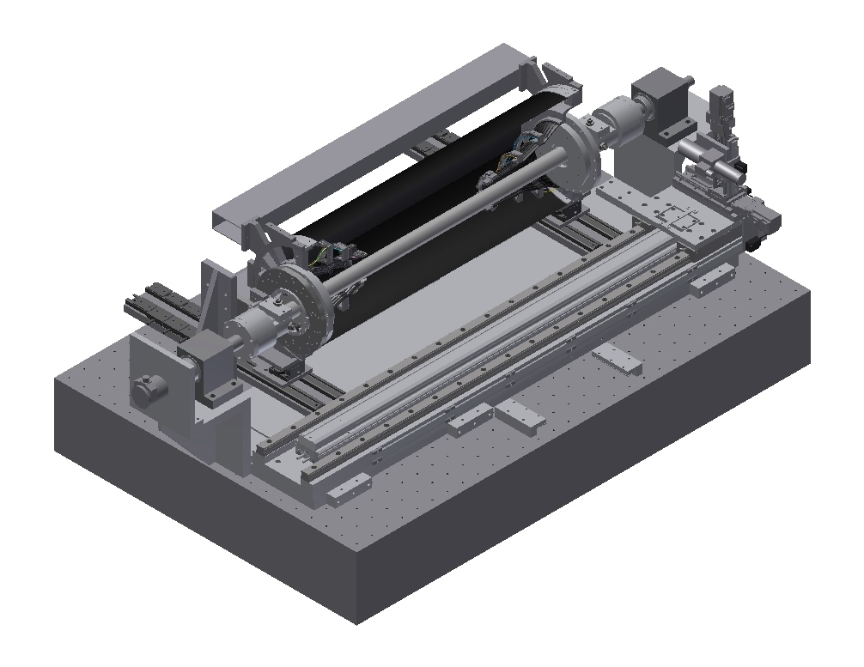
Ladder Mount Table
Index plate
  Considering cable routing, optimize index plate and fixation mechanism.
  by Oct. B2GM
3D measurement system
  change the stroke of movable stages.
  by Oct. B2GM
Division of half-structure
  Setup rails on table
  Division test
  Storages of half-structure (Toru)
  by Oct. B2GM
Above tasks are managed by Suzuki-san and Maki-san.
Division
Tool
Index Plate
Coordinate
Measurement
System

Slide 19
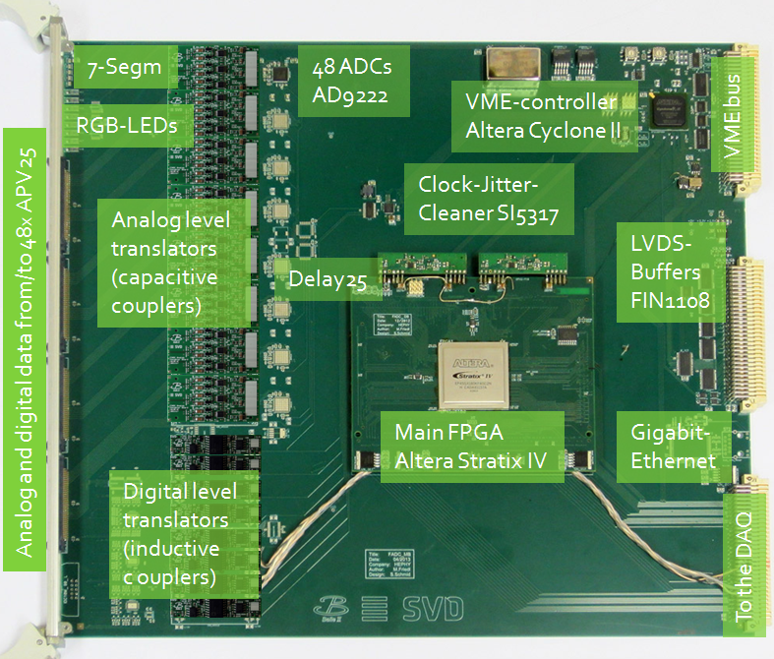
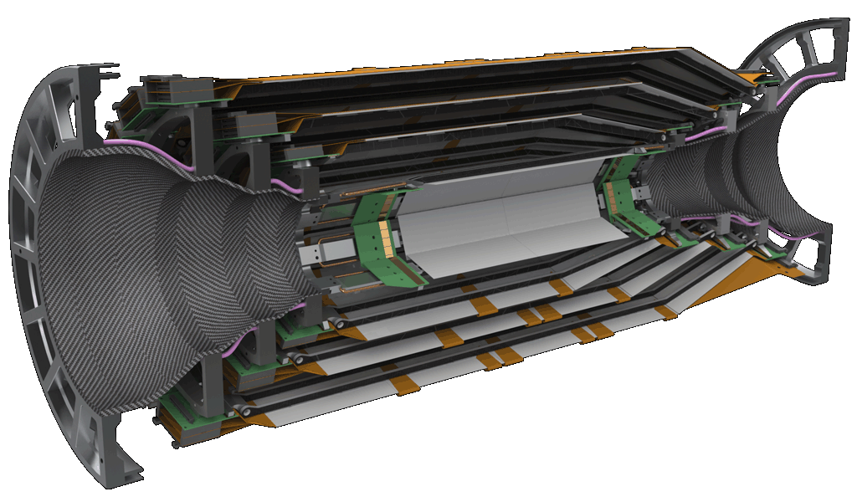
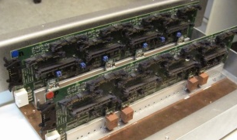
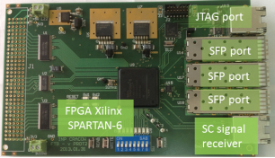
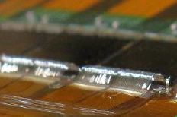
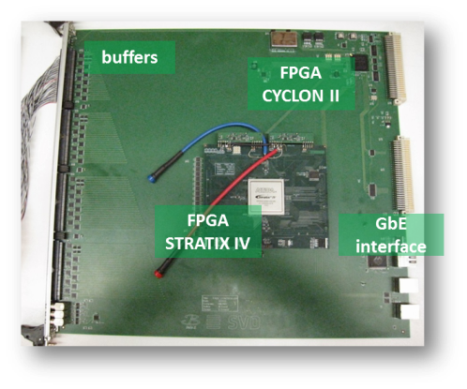
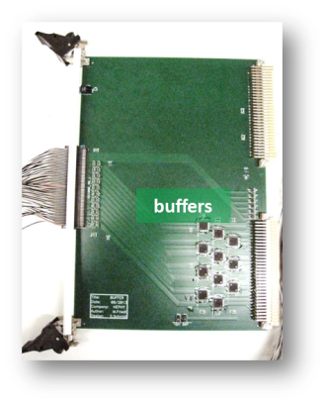
FADC Readout System
“COPPER” board
x48 FADC
RX
Data stream
CPU
SVD
FADC
Zero supp.
Formatter
Repeater
to HLT
~2m
~10m
belle2link
TX
x1748
APV25s
Aurora link
TRG/CLK signals
VME
PXD region of
interest gen
x4 buffer
to PXD
Data size reduction
Cu cable
FADC Ctrl
APV trig gen
Decoder
Trigger/
timing
distributor
Central
TRG
FADC-Ctrl
SVD readout system
Central DAQ
Prototypes of all components have been developed.

Slide 21
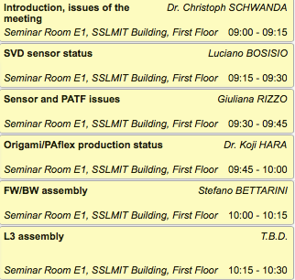
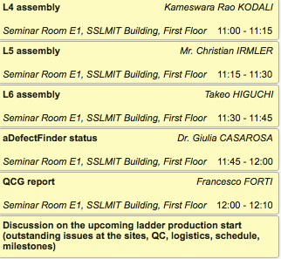
SVD parallel session agenda
Thursday morning

Slide 22
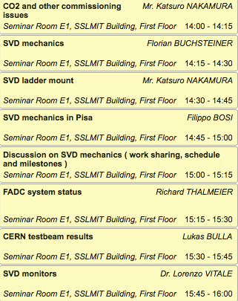
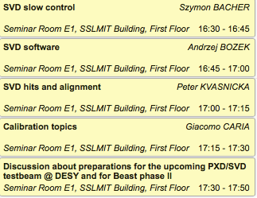
SVD parallel session agenda
Thursday afternoon

Slide 23
Discussion items at this meeting
Discussion time is foreseen during this meeting for a number of items, both in the plenary and in the parallel
Most pressing item: organization of the March/April 2016 combined testbeam at DESY
  date/schedule
  goals and participating sub-systems
  sub-system contact persons and organization
The idea behind the agenda is to discuss these items first within PXD/SVD separately (Thu) and then have a combined discussion (Fri)

Slide 24
Summary
The SVD ladder production has started although not all assembly sites have been fully qualified
  L5.001 assembled, surveyed and electrically tested
  The origami pre-production has been successful – first mass production samples are expected for the second half of November
The next challenge will be to fully develop and qualify the ladder mount
At this meeting, we need to clearly define what we expect for the DESY testbeam Mar/Apr 2016 and set up the organisation

Slide 25
backup

Slide 26
The Belle II detector
CsI(Tl) EM calorimeter: waveform sampling electronics, pure
CsI for endcaps
RPC μ & K_{L} counter: scintillator + Si-PM for end-caps
4 layers DS Si vertex detector → 2 layers PXD (DEPFET) + 4 layers DSSD
Time-of-Flight, Aerogel Cherenkov Counter → Time-of-Propagation (barrel), prox. focusing Aerogel RICH (forward)
Central Drift Chamber: smaller cell size, long lever arm

Slide 27
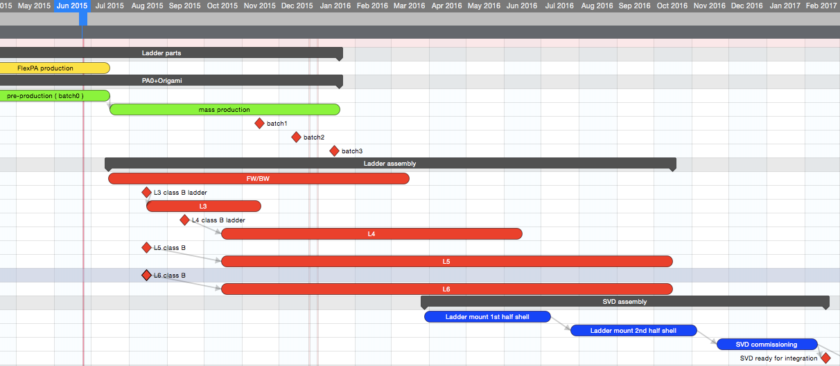
SVD schedule
Ladder Production schedule still consistent
with a start of ladder mount in April 2016

Slide 28
VXD ( PXD + SVD ) Schedule
High level milestones
First mass production ladder (L4-L6) | Oct. 2015
2nd beam test | Jan.-Feb. 2016
Start of ladder mount to support structure | Apr. 2016
SVD readiness in KEK | Feb. 2017
PXD readiness in KEK | Apr. 2017
PXD+SVD integration | Jun. 2017
PXD+SVD combined cosmic ray test | Jun. 2017
PXD+SVD installation | Apr. 2018
Start of physics run | 4Q 2018

