Slide 1
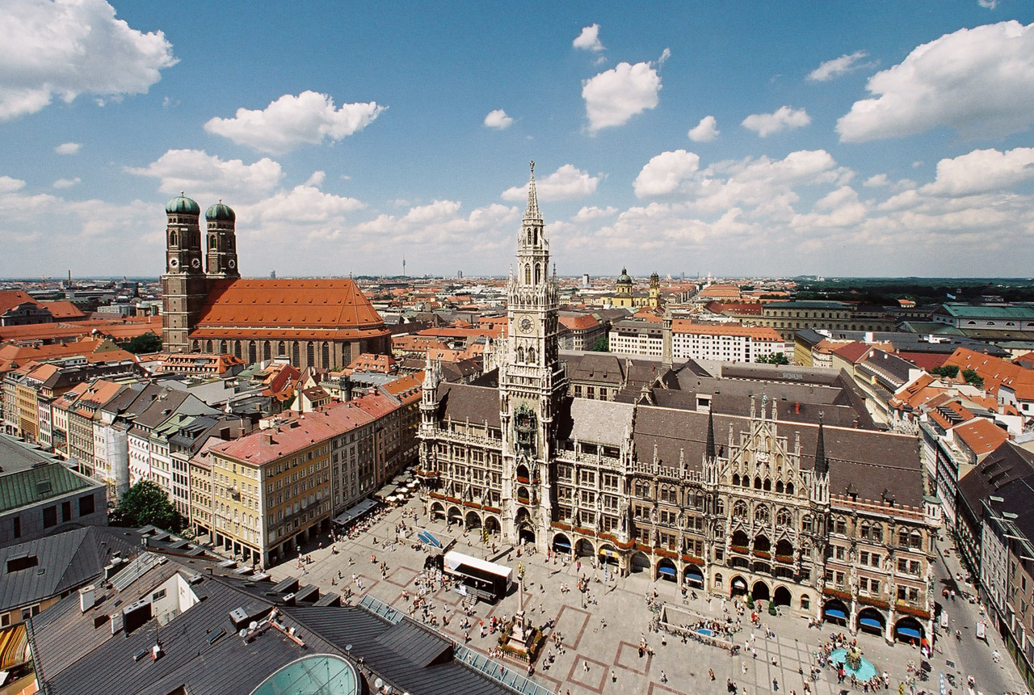
9 September 2015
VXD Mechanics Summary
Markus Friedl (HEPHY Vienna)

Slide 2
Contents
Highlights of the recent VXD mechanics meeting
(Munich, 7–8 September)
Actually, all PXD (and some general) topics are covered by speakers today
Thus, I will focus on these presentations:
  SVD Mechanics (Florian Buchsteiner)
  SVD Assembly and Plan (Katsuro Nakamura)
  Service Installation Around DOCK Area (Markus Friedl)

Slide 3
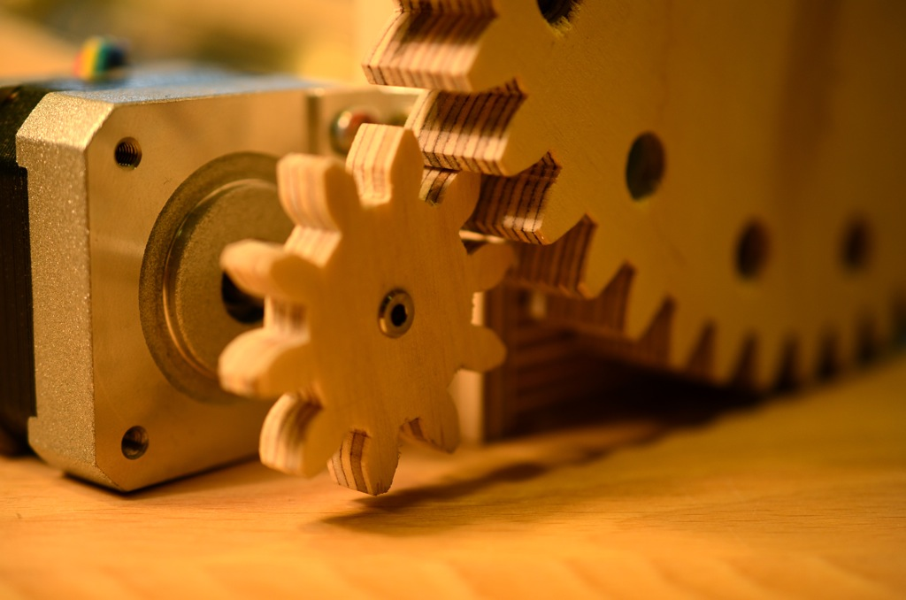
Mechanics Status
VXD Mechanics Meeting

Slide 4
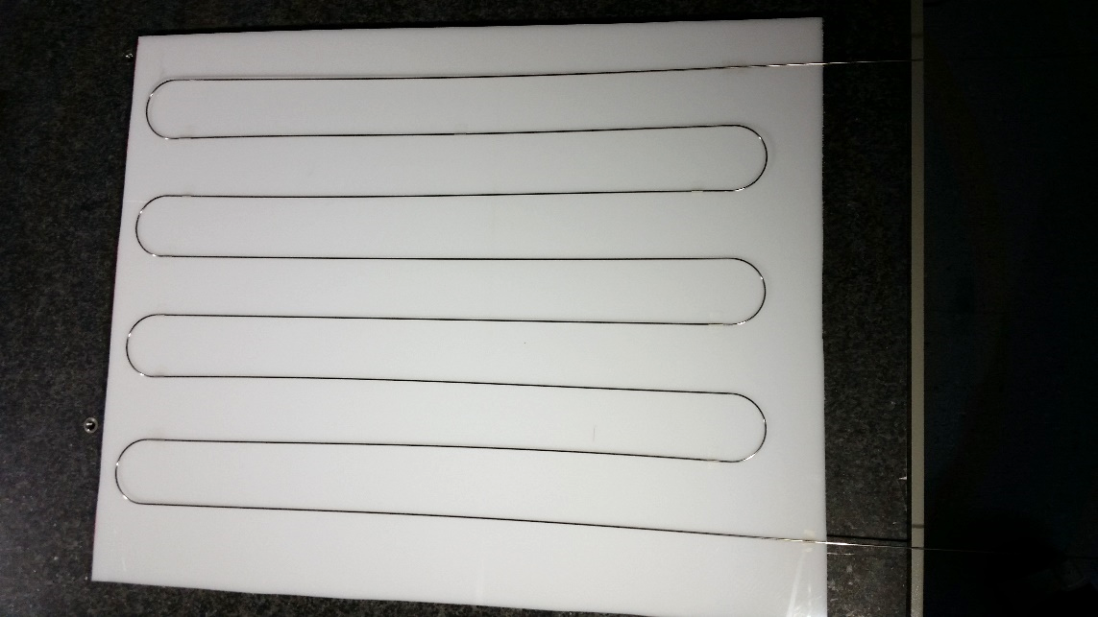
Result Bending Part 1

Slide 5
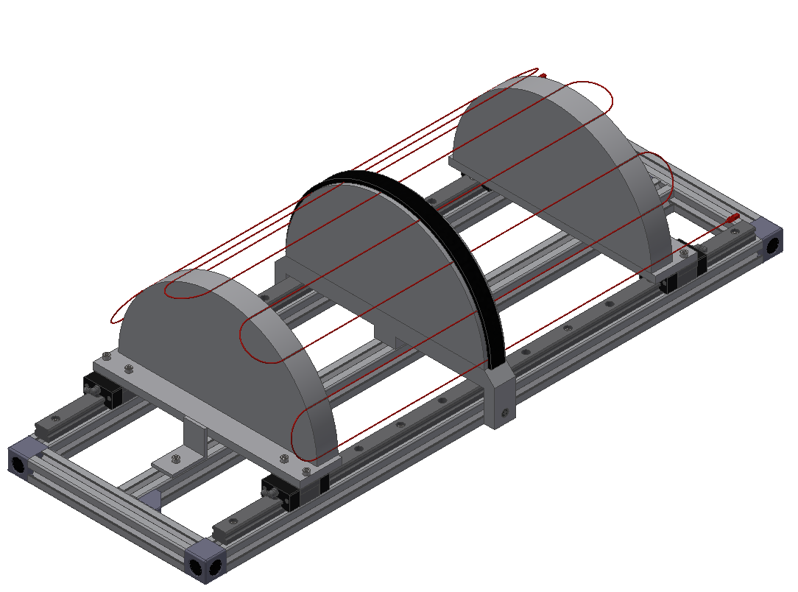
L6 Origami Tool Modification
Moveable Parts
Origami pipe
Linear guides
EPDM pipe fixation (schema)
In this position we can check the shape of the Origami pipe

Slide 6
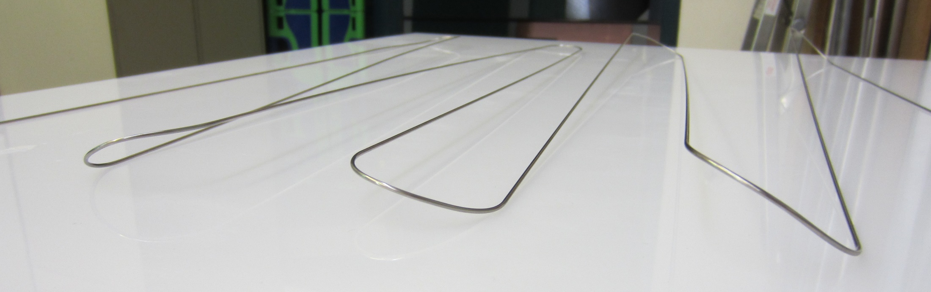
Result L6 Origami Cooling Pipe
3D bending attempts resulted in erratic tension and deformations

Slide 7
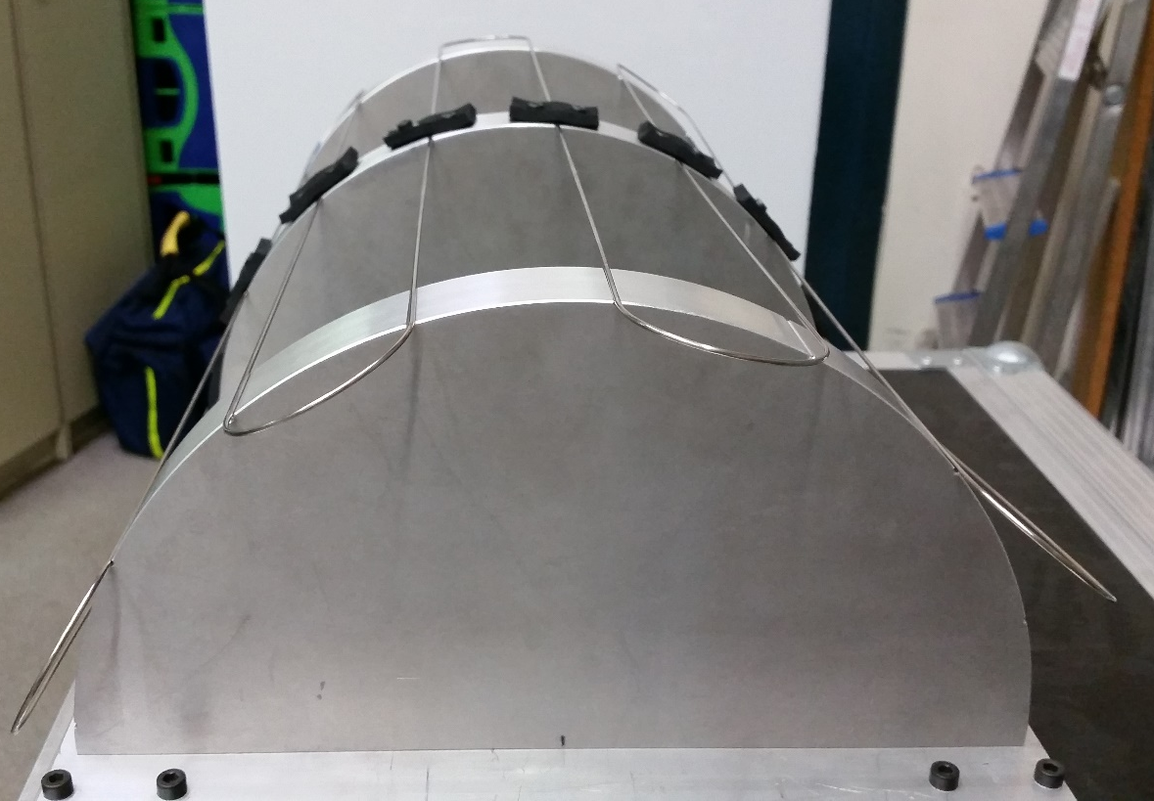
Option 1
Pipe is so soft that it follows 3D shape almost by itself
How much force is needed to bring the pipe into the correct position?
We tested this

Slide 8
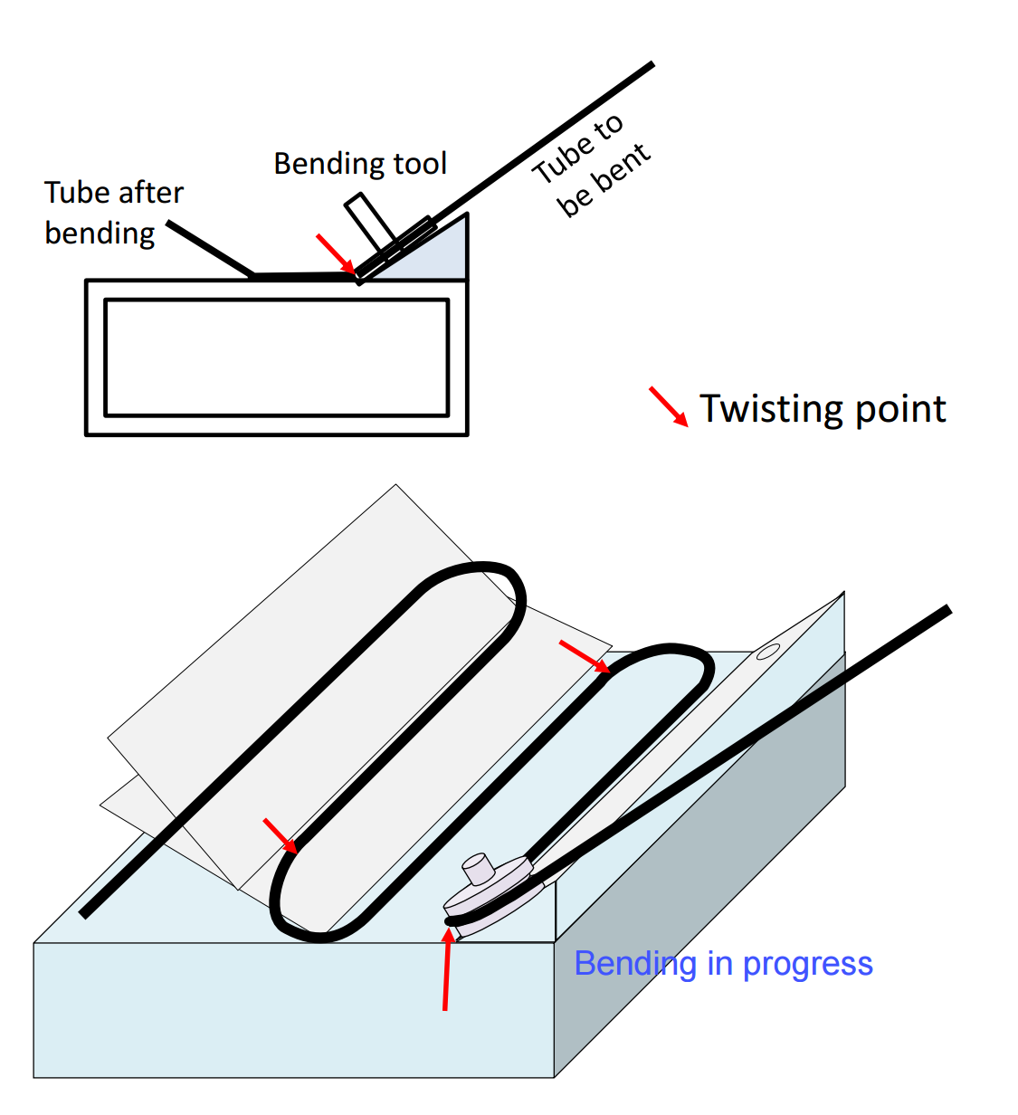
Option 2
Idea brought up by Toru
Modify the tool for the flat part bending such that we can bend the 3D shape in one step
We have some ideas and we made first test with dummy support structure → looks good
It needs 2 weeks to modify the tool and 1 week for fine adjustment → hard to finish before B2GM (flat Origami pipe will be sent to KEK after Trieste)

Slide 9
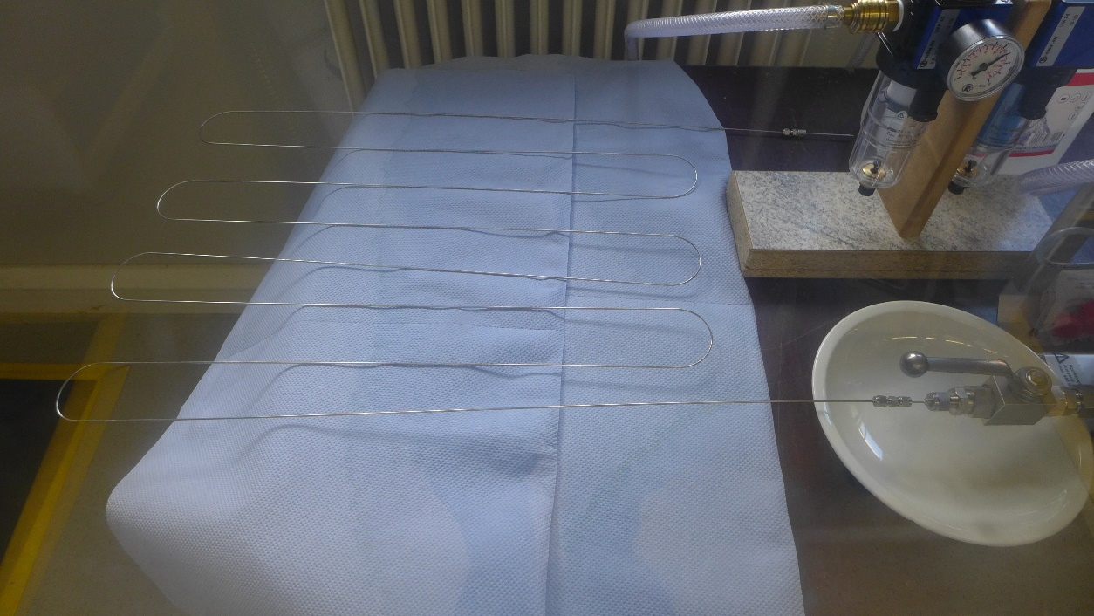
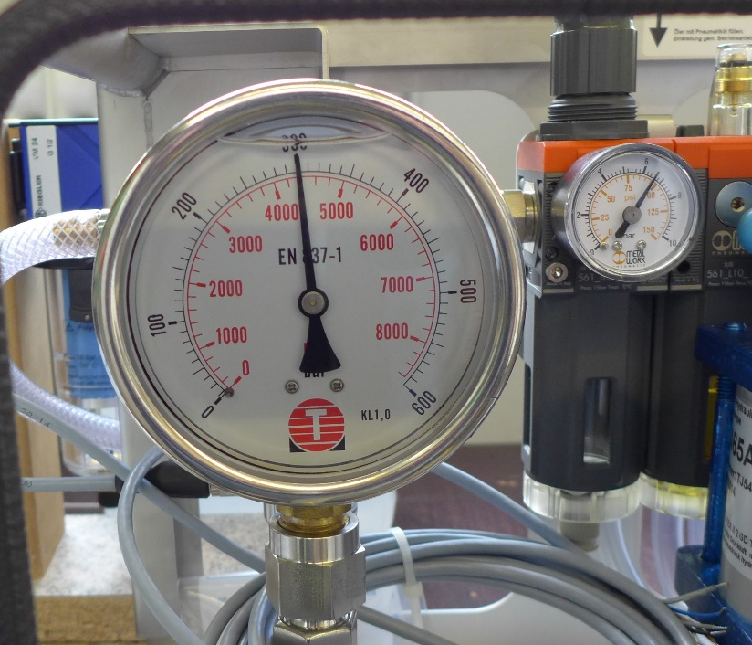
L6 Origami Pressure Test
We attached one end to the water high pressure system and closed the other side
Increased pressure gradually from 0 to 300 bar
  No movement of pipe could be seen
We waited 15 minutes and nothing happened
Finally pressure was taken away
SUCCESS!

Slide 10
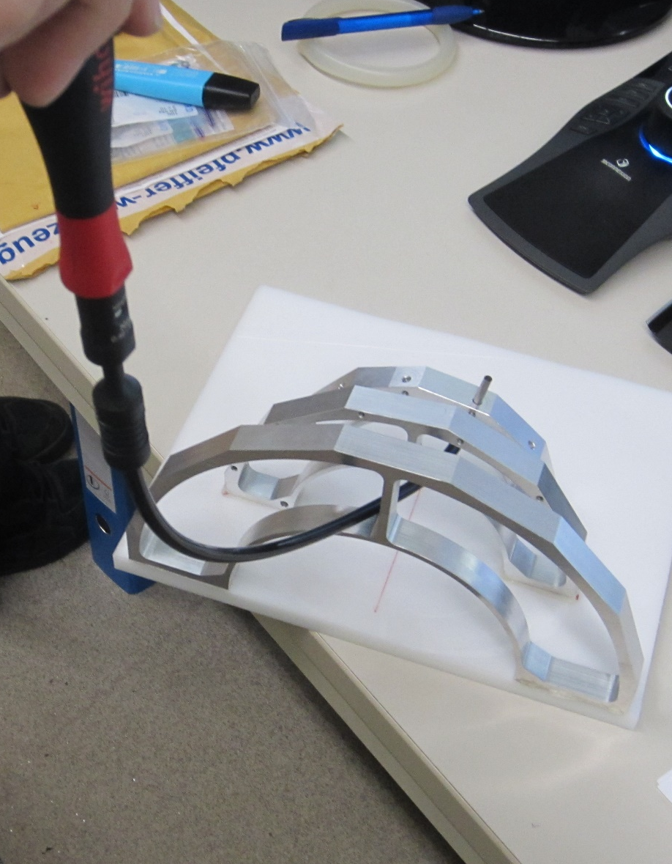
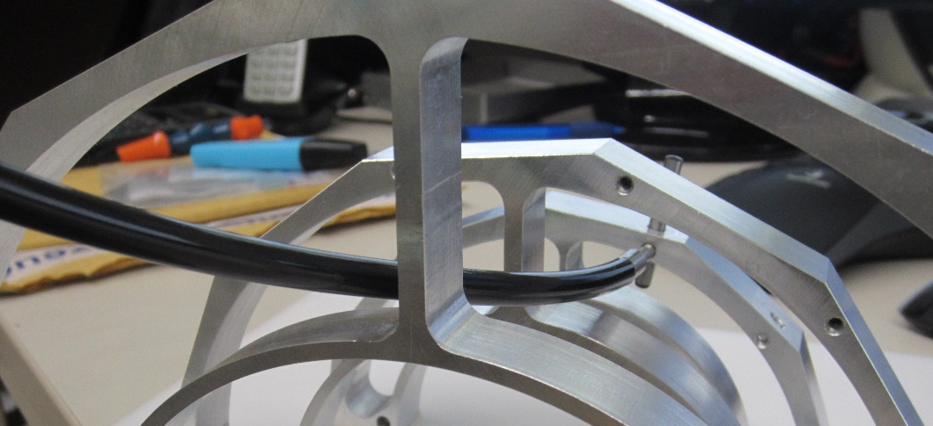
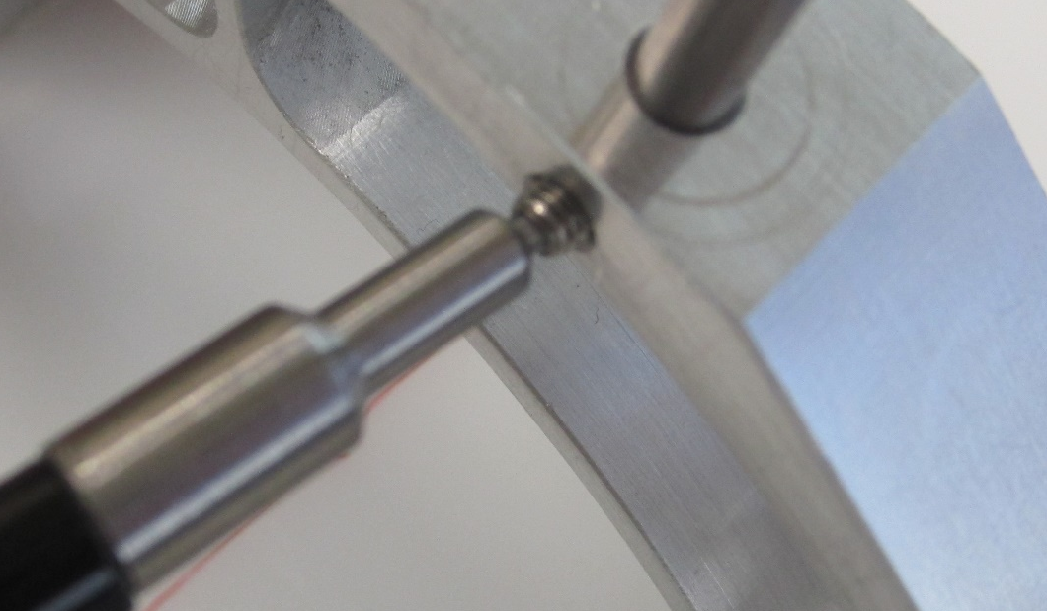
Set Screw Fixation Tool

Slide 11
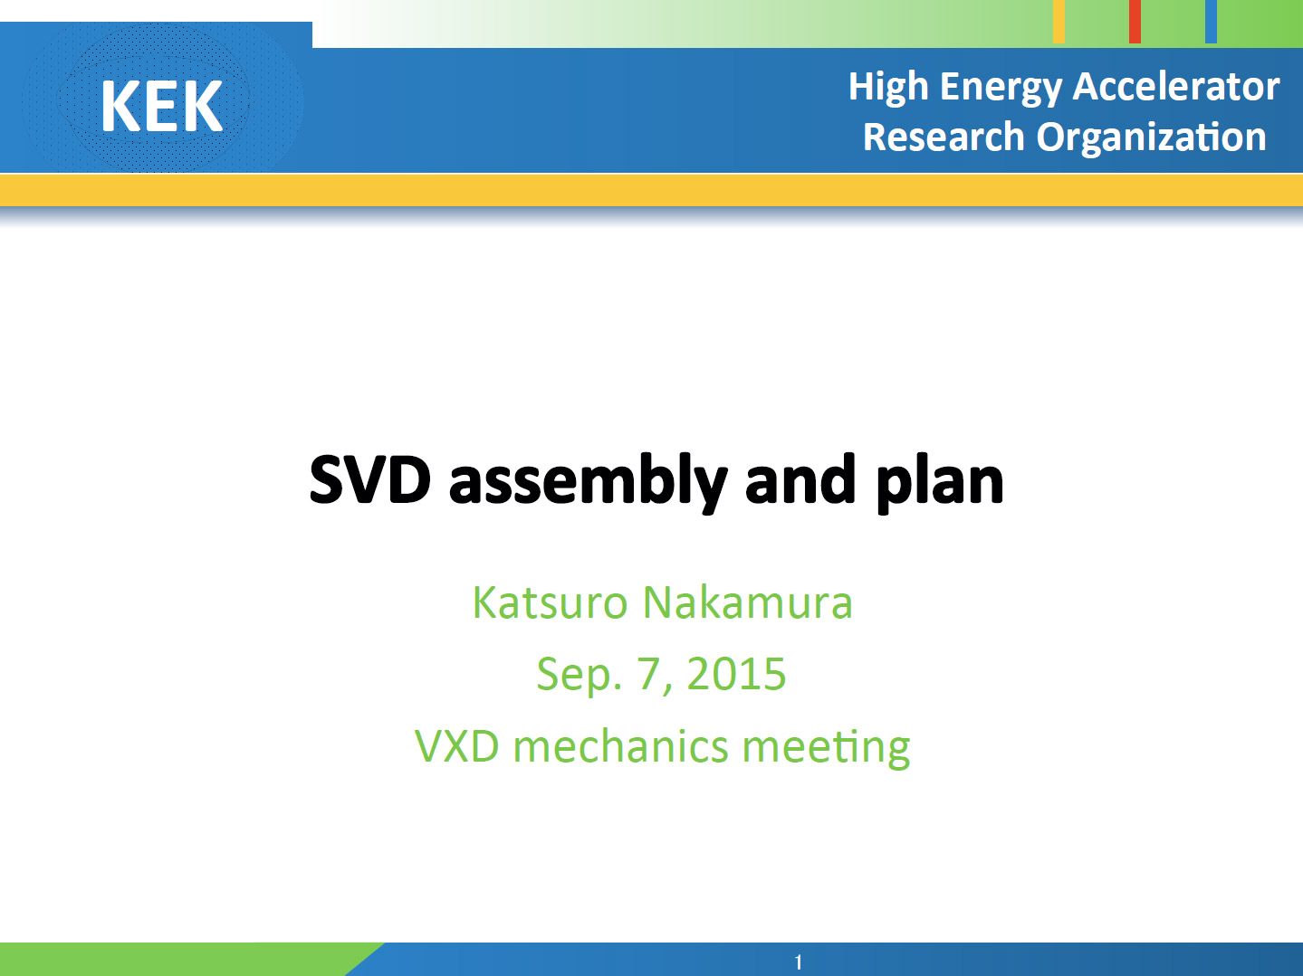

Slide 12
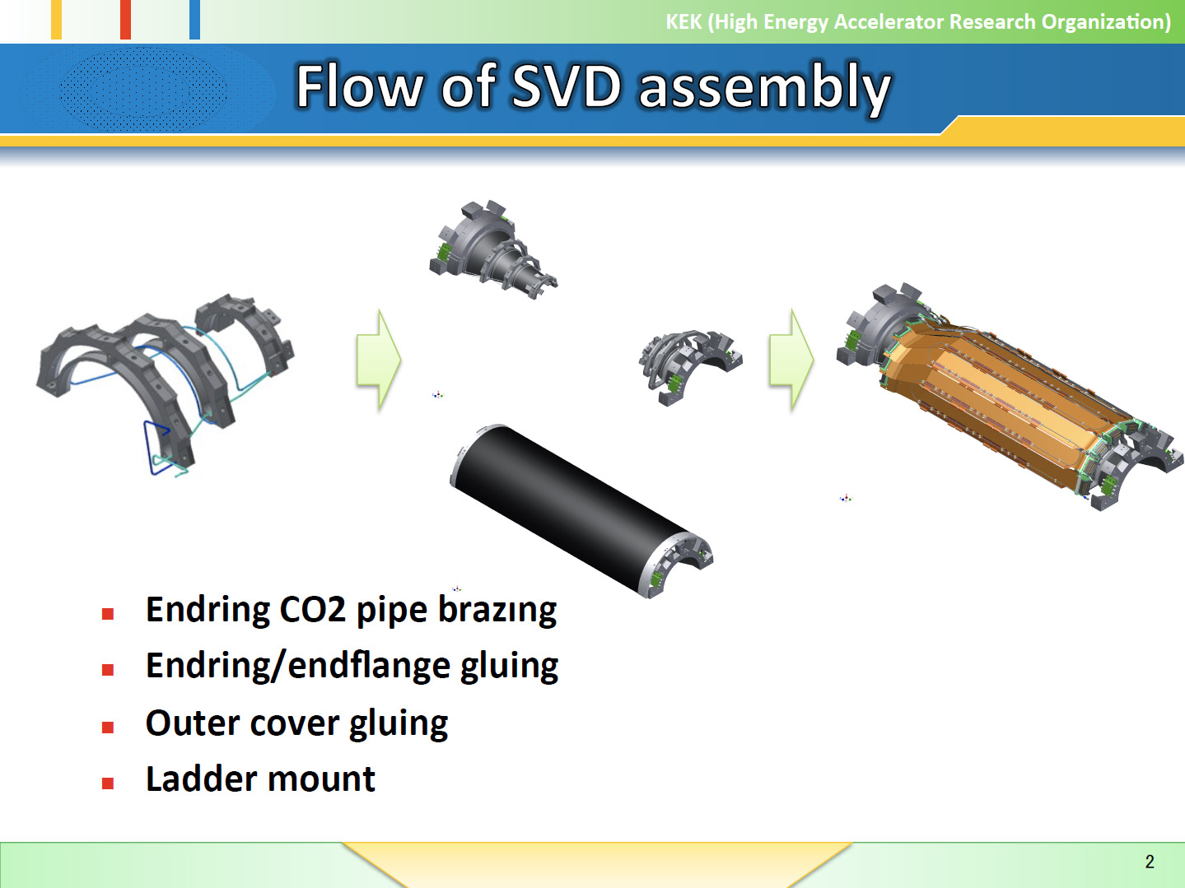

Slide 13
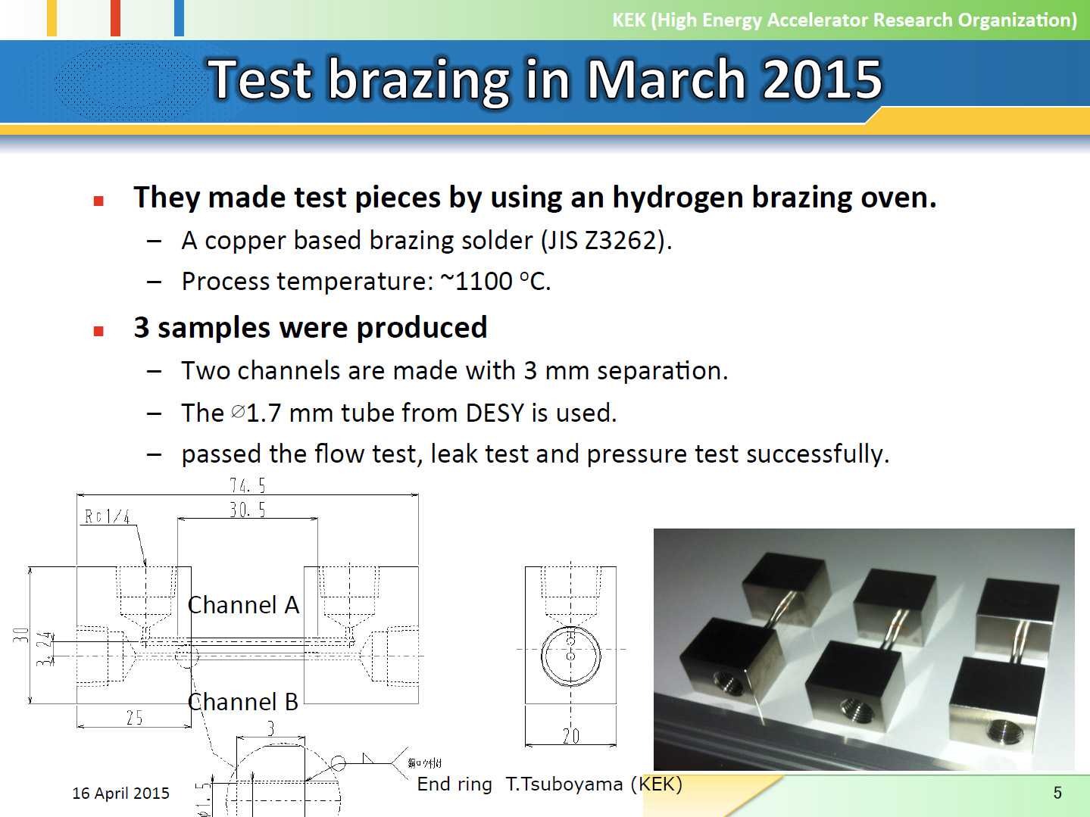

Slide 14
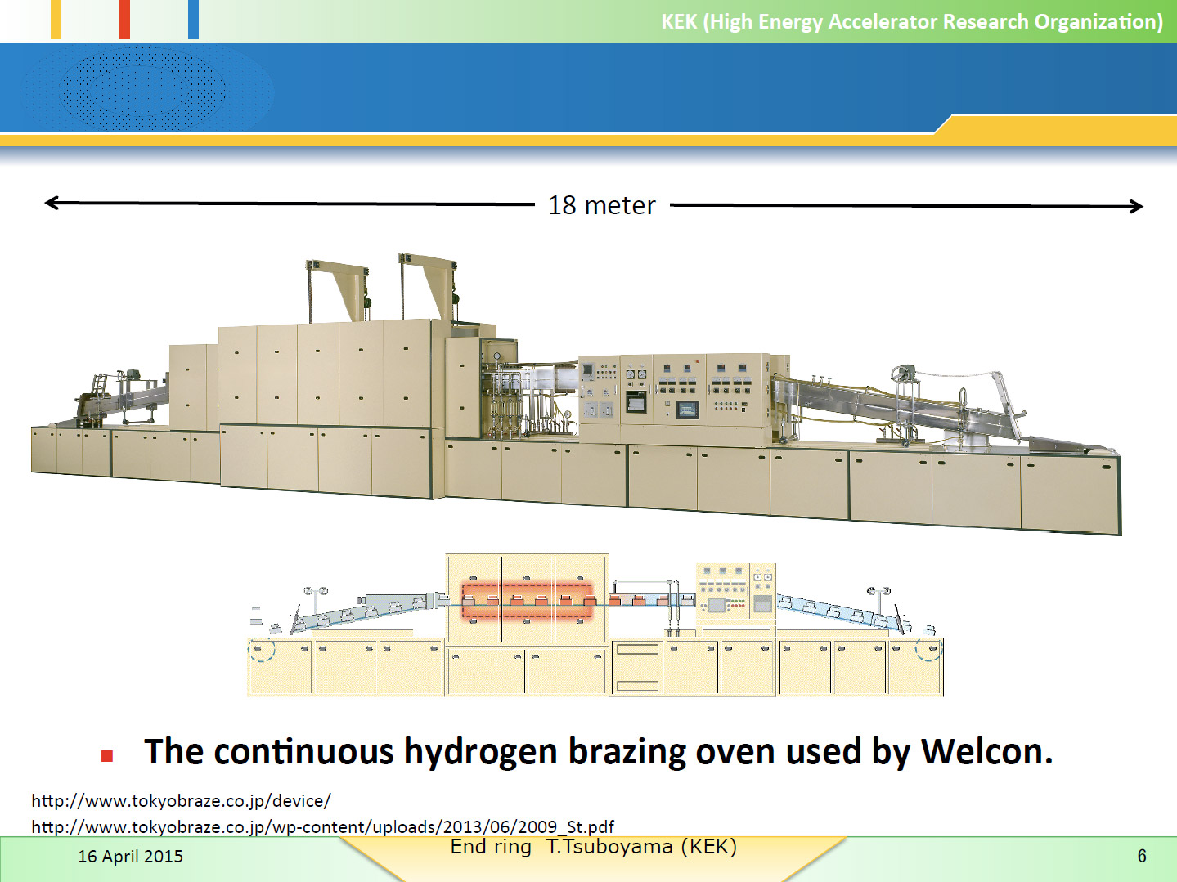

Slide 15
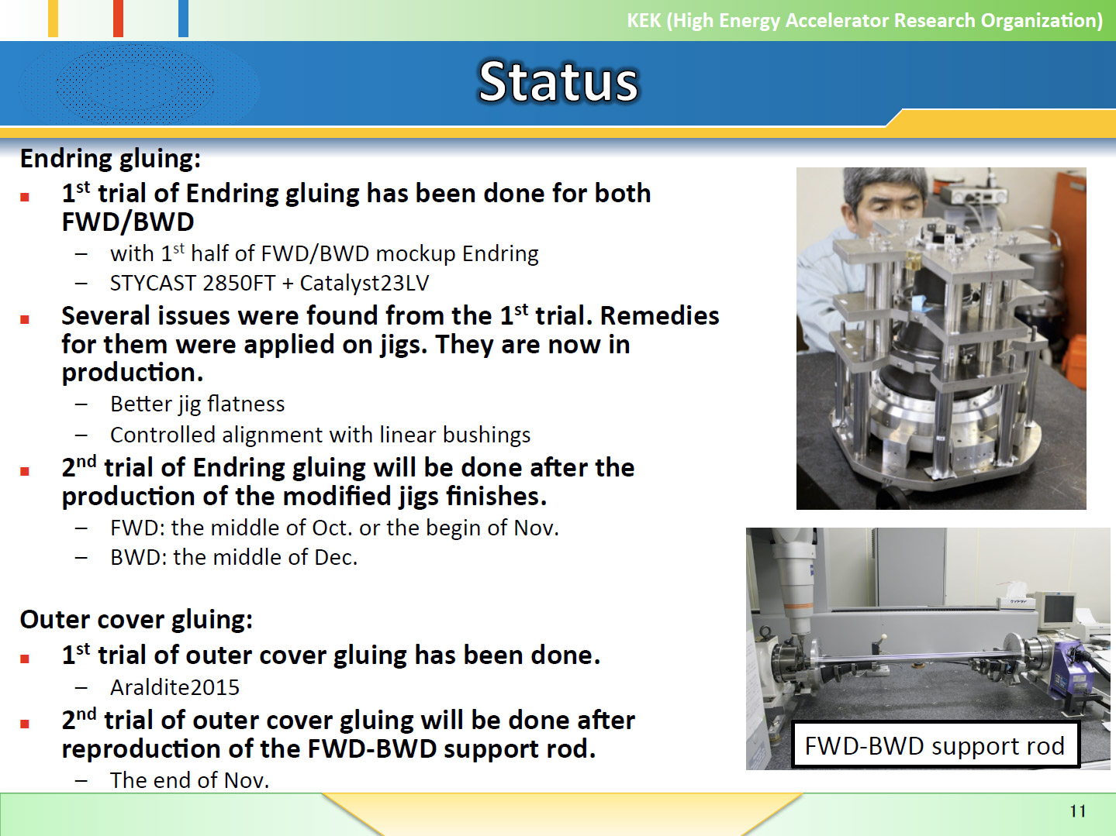

Slide 16
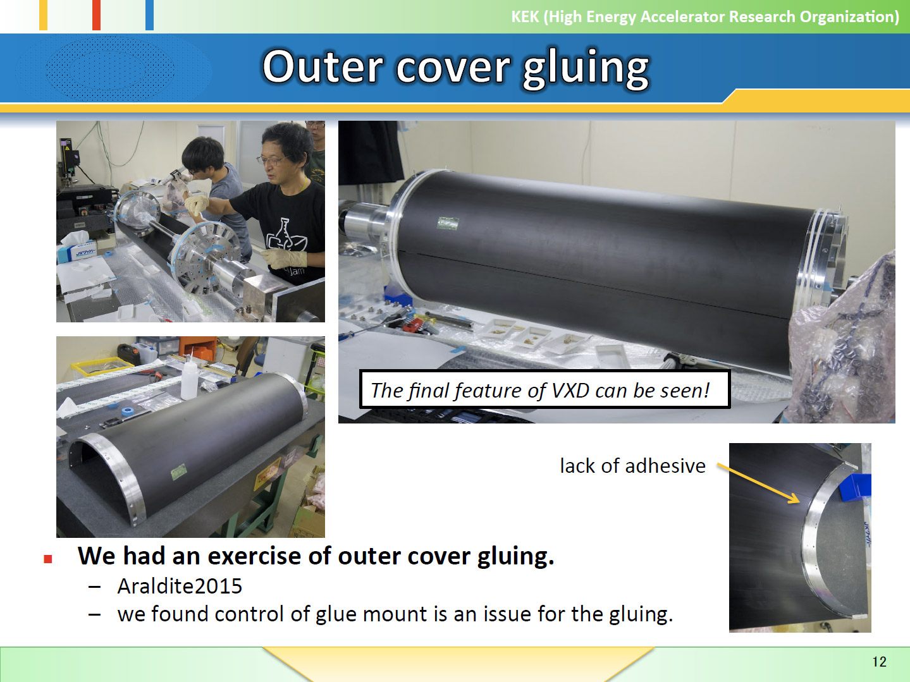

Slide 17
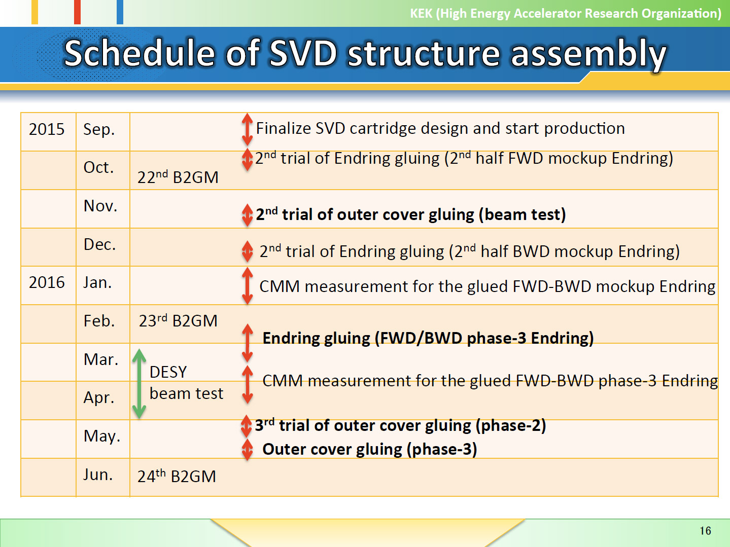

Slide 18
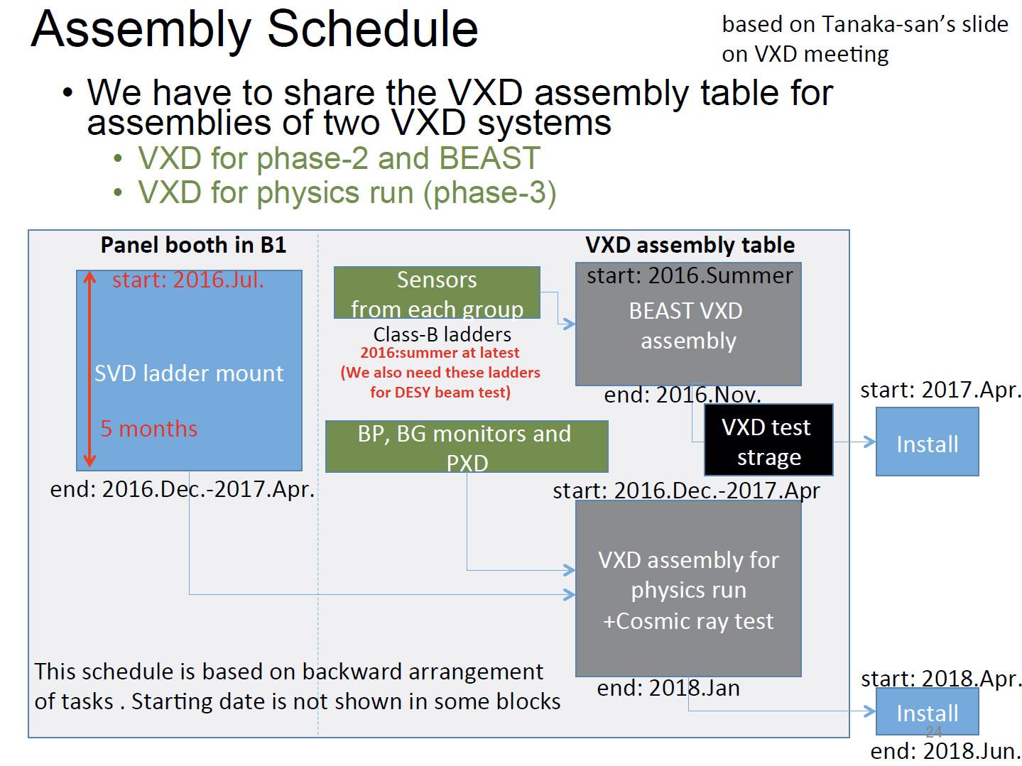

Slide 19
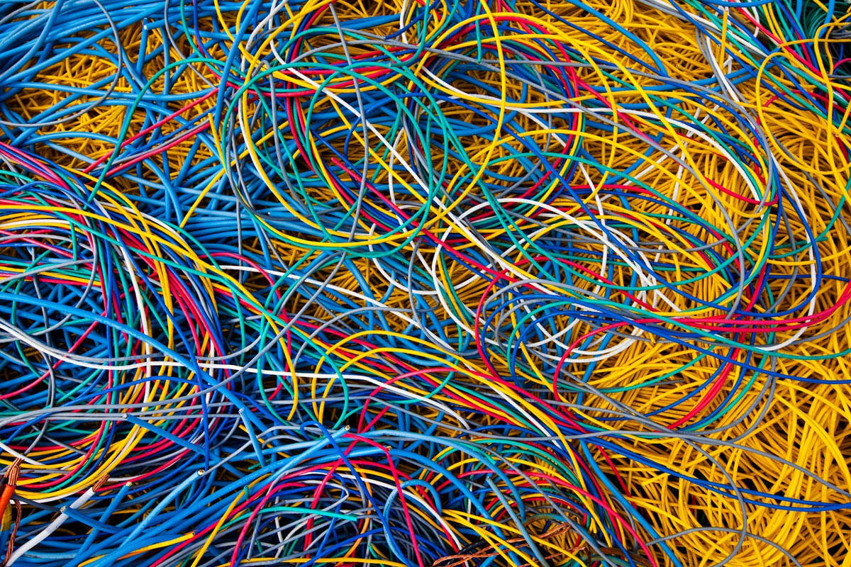
8 September 2015 (updated)
SVD Cables
Markus Friedl (HEPHY Vienna)

Slide 20
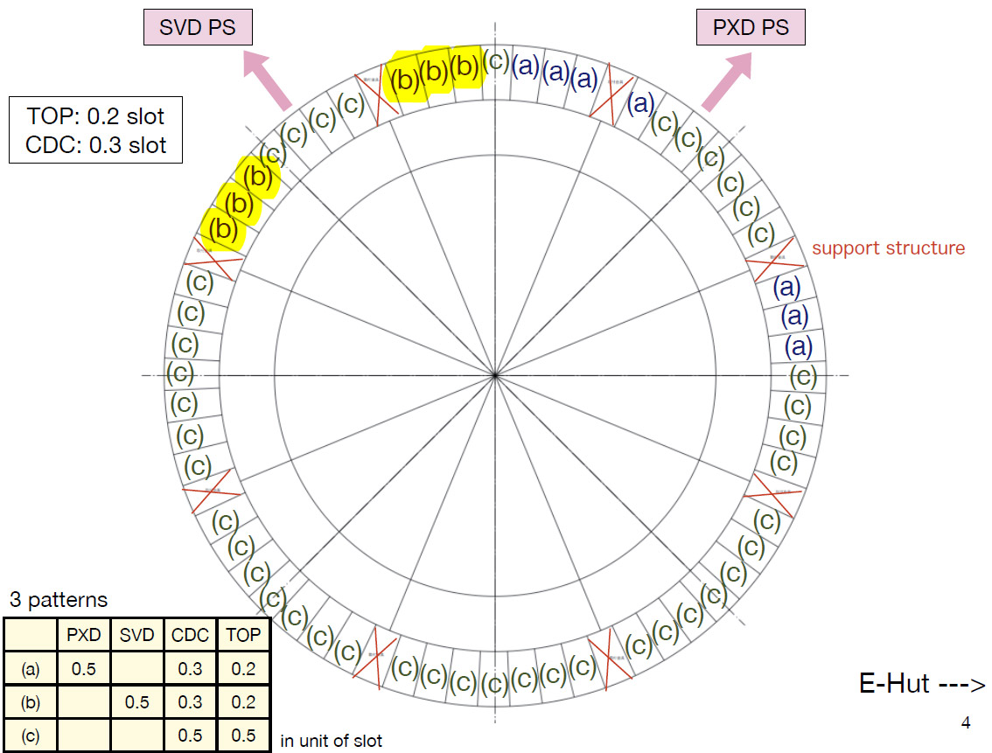
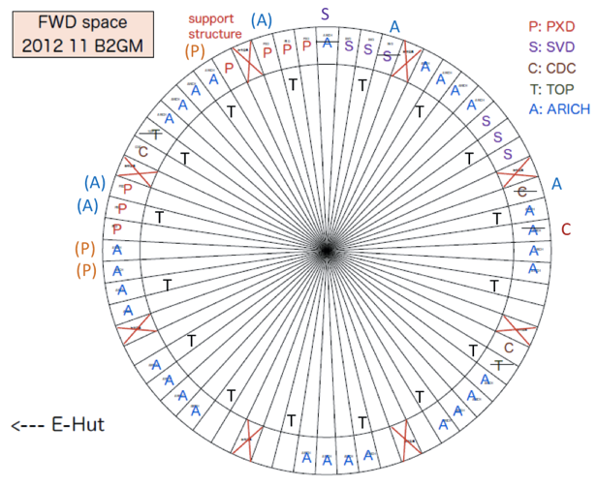
Cable Slot Assignments
16 July 2015
BW: only shared slots
  Labeling very important
FW: minor change
  Slot swapped with ARICH

Slide 21
CDC End Wall Routing Considerations
Cable placement (design & actual cabling work) in descending order of bulkiness/rigidity:
  Cooling pipes (h=18mm)
  PXD power + data (h=12.6mm)
  SVD power (h=12.5mm)
  SVD data (h=6mm)
  Monitoring (h=6.5mm)
Available gap is 20mm
  No crossing with cooling pipes
  Crossing of SVD data & monitoring with PXD & SVD power OK

Slide 22
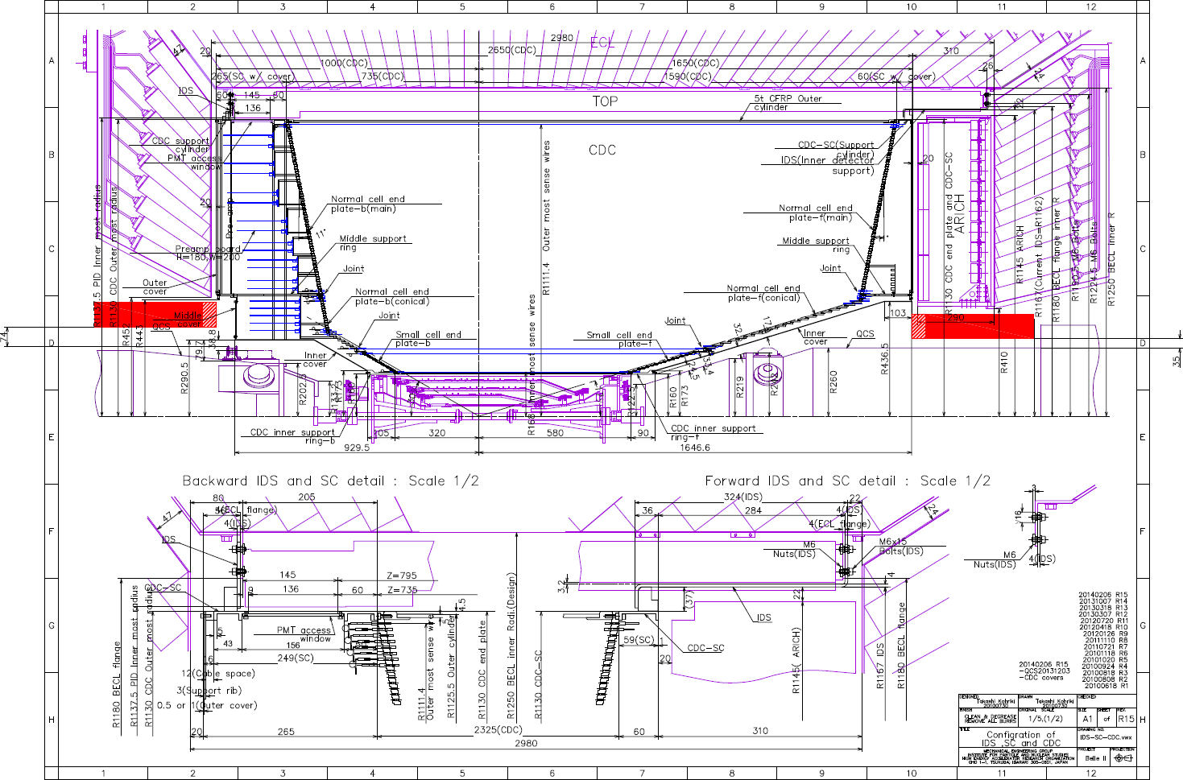

Slide 23
Space Underneath DOCK Boxes (Grey Area)
BW
FW
Claimed for:
Excess cable storage
Cable routing
Claimed for:
Excess cable storage
Safety margin of 10mm towards QCS is requested

Slide 24
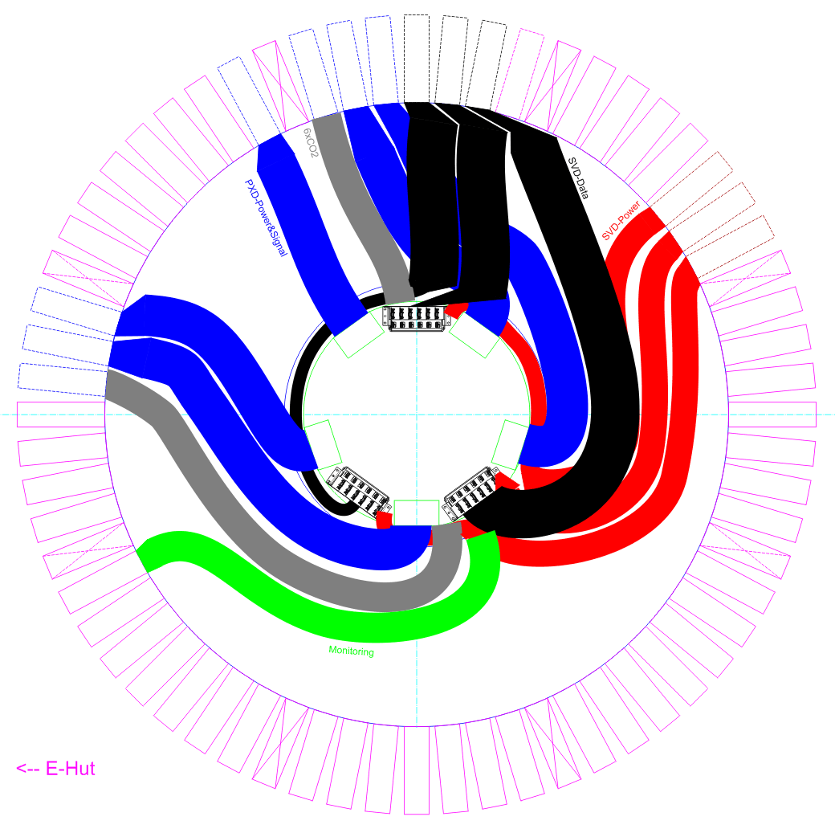
FWD Cable Routing
Cooling pipes
PXD power + data
SVD power
SVD data
Monitoring
Using triangular space behind DOCK boxes for some SVD cable routing

Slide 25
ECL Slots (left) And CDC End Wall (right)

Slide 26
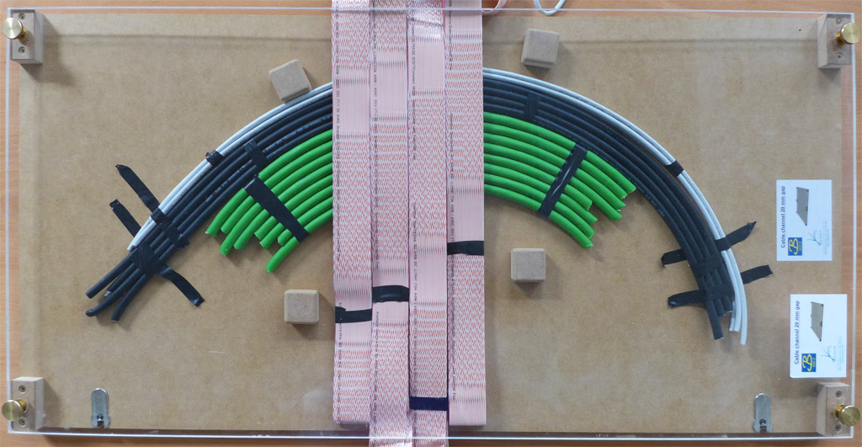
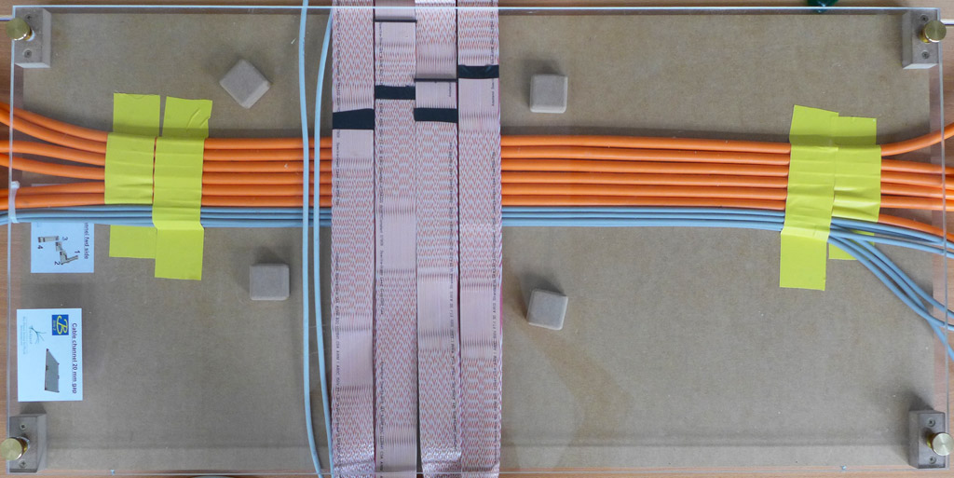
Mockup Crossings
Fits in the 19.2 mm gap of the mockup

Slide 27
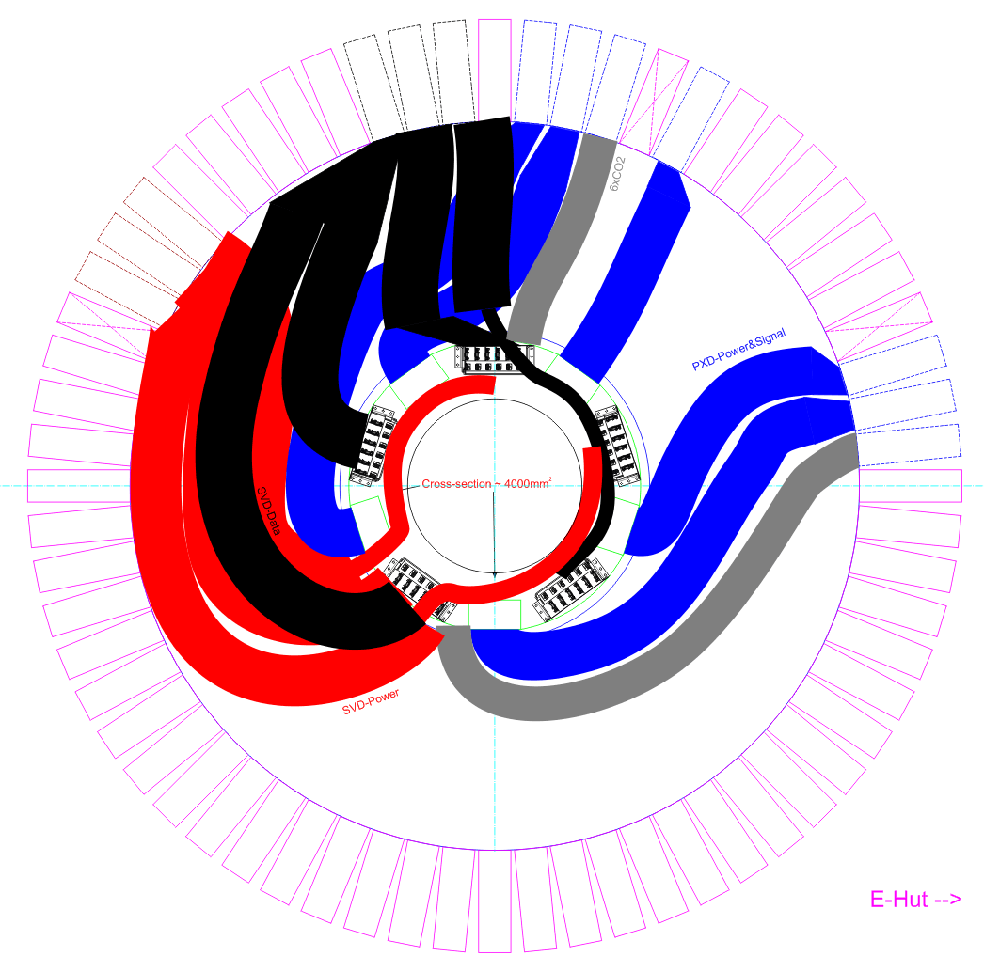
BWD Cable Routing
Cooling pipes
PXD power + data
SVD power
SVD data
Monitoring
Using space under DOCK boxes for some SVD cable routing

Slide 28
ECL Slots (left) And CDC End Wall (right)

Slide 29
Mockup
Known from FW mockup
Known from FW mockup
Situation simulated with mockup
(in 12 o’clock position)
→ Next pages

Slide 30
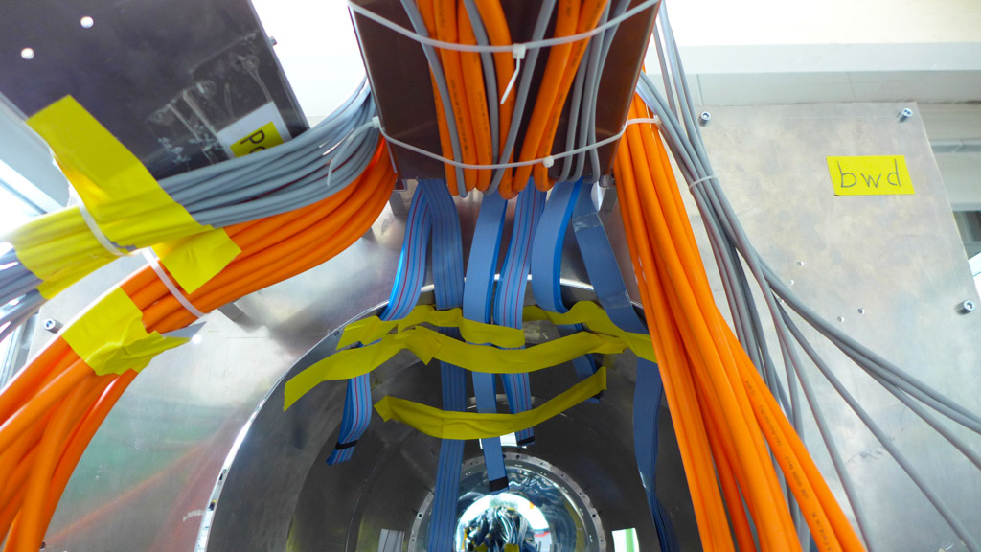
BW Mockup With SVD Cables
Power cables for
this DOCK box
HV Power Cables
LV Power Cables
Hybrid Cables
Cables to next 2 DOCK boxes

Slide 31
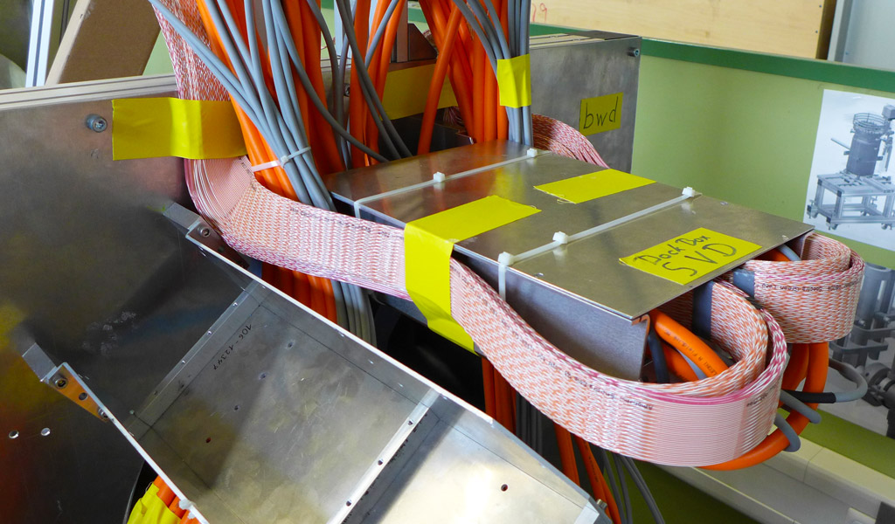
BW Mockup Including SVD Data Cables

Slide 32
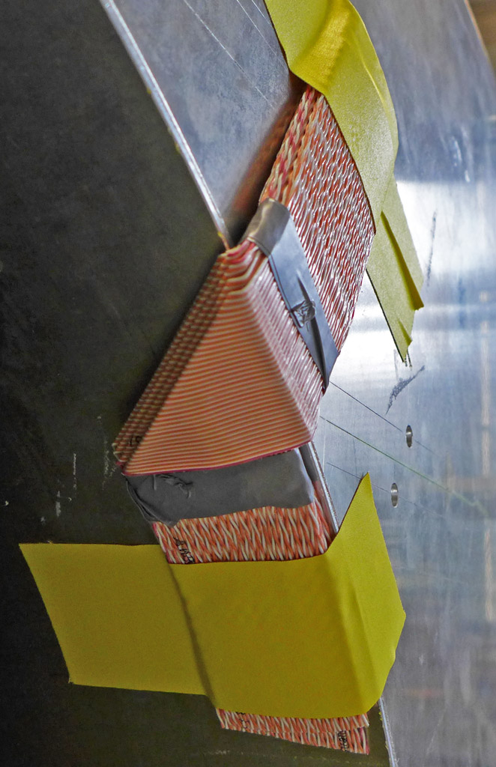
Another Kind of Origami ☺
SVD data cables can easily be folded to follow corners
Arcs cannot be done (as with round cables), but any kind of angles are possible
Thicker at bend (two cable layers)
Bending radius too tight?
  No specs from vendor
  Stranded cables

Slide 33
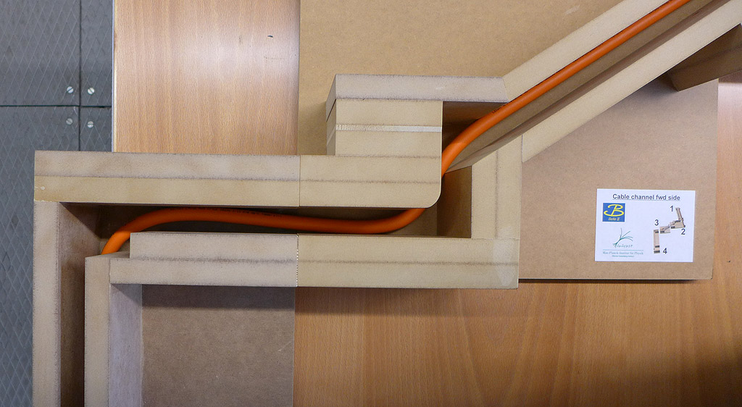
Around IDS: No Problem
We are asked to define screw hole positions for cable brackets.

Slide 34
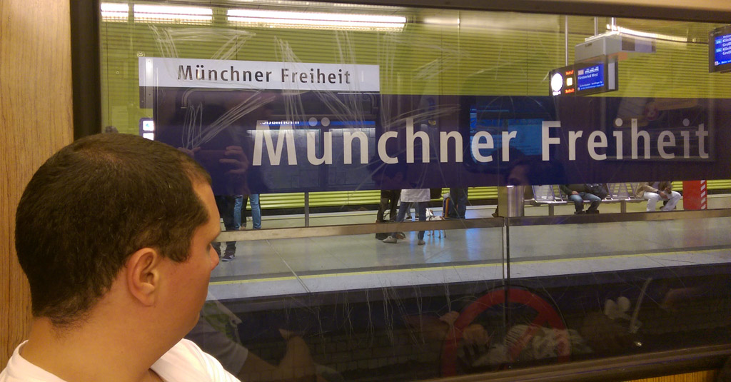
Thank you for your attention!
Literal translation:
“Freedom of Munich”

