Slide 1
SVD QCG Report
F.Forti

Slide 2
Outline
Sites Qualification Reviews
Open issues
https://belle2.cc.kek.jp/~twiki/bin/view/Detector/SVD/SvdQCQAGroup

Slide 3
Site qualification reviews
Site qualification reviews have proven to be a very effective tool to ensure the quality of modules and improve site to site communication.
Quite active summer of update reviews:
May 29, 2015: Pisa qualification update: http://kds.kek.jp/conferenceDisplay.py?confId=18748
Jun 27, 2015: TIFR qualification update: http://kds.kek.jp/conferenceTimeTable.py?confId=18750
Jul 27, 2015: IPMU qualitication update: http://kds.kek.jp/conferenceDisplay.py?confId=19223
Aug 06, 2015: HEPHY qualification update: http://kds.kek.jp/conferenceDisplay.py?confId=18752
Aug 21, 2015: Melbourne qualification update: https://kds.kek.jp/indico/event/19357/
All reports are on the QCG site: https://belle2.cc.kek.jp/~twiki/bin/view/Detector/SVD/SvdQCQAGroup

Slide 4
Review types
Some naming:
(PCCQ) Preliminary class C qualification = review of production procedures, but without a fully qualified and satisfactory class C module
(CCQ) Class C qualification = review a full class C module and authorize production of class B modules
(CBQ) Class B qualification = review a full class B module, and authorize start of mass production with class A modules
(CAM) Class A monitoring = regularly review the production quality of class A modules, especially at the beginning of mass production

Slide 5
Site Qualification current situation (I)
Pisa (SFW-SBW)
Completed full CBQ qualification on May29 → Authorized for class A production
Need to setup the class A monitoring reviews.
Melbourne (L3)
DONE: CCQ (21 August 2015): very good progress and minor issues identified.
Email exchange on-going to finalize issue and start class B production
TODO: CBQ should be held after the first full class B
TIFR (L4)
DONE: CCQ (27 June 2015)
Main issue: shift of the forward assembly, due to vacuum leak accident
Documentation and DB usage
The first class B was produced, but has some issues:
Shift of the forward assembly → probably understood
Electrical problems in APV readout → needs debugging
Need to resolve the issue before proceeding.
TODO: CBQ should be held when a good class B is produced

Slide 6
Site Qualification Current Situation (II)
HEPHY (L5)
DONE: CBQ (6 August 2015) → Authorized for class A production
Fully functional class B module produced
Very good mechanical accuracy achieved: < 100um shifts
TODO: Setup class A monitoring reviews
IPMU (L6)
DONE: CCQ (27 July 2015)
A class B module had also been produced
Main issue: shift of the forward assembly → probably understood
CMM inspection accident → understood
Procedures should be corrected and one class C should be produced
Verification of the class C accuracy before next class B construction
TODO: CBQ should be held after a good class B is produced.

Slide 7
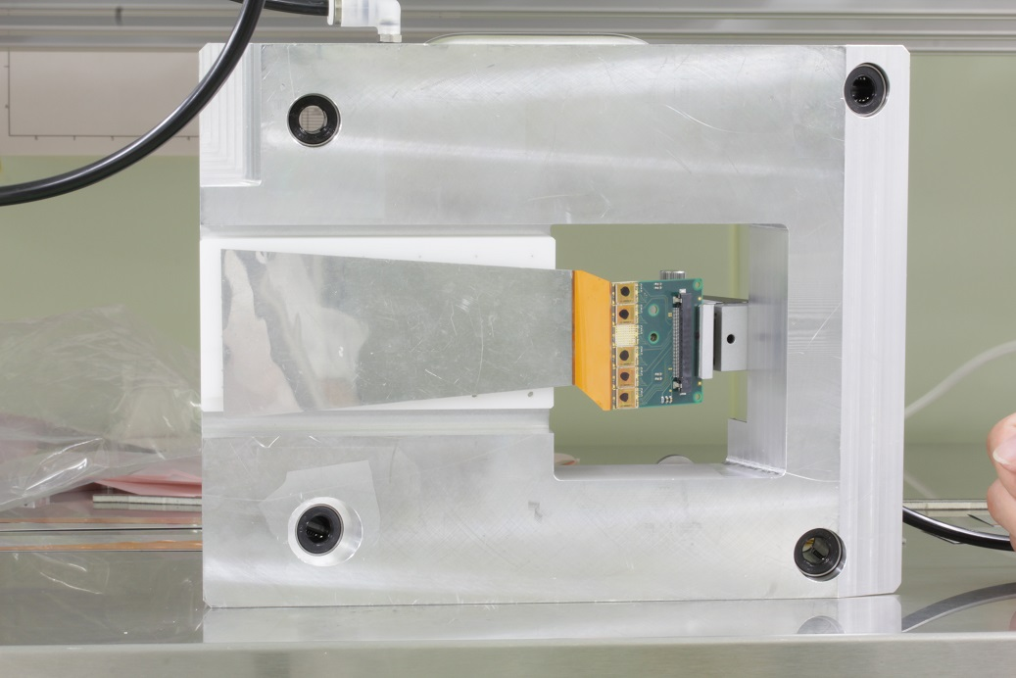
Shift of forward assembly
Very short PA can carry large forces → do not move hybrid after clamping
Can move several mm’s even vacuum chucking.

Slide 8
QCG Open issues
Ladder design
Definition of ladder mechanical tolerances
L5 shown 100um is possible. Probably too tight.
Proposal: 100um in xy, 300um in z ? Needs decision
Verification of thermal (-30 to +60 C) and mechanical properties on ladders (deformations and vibrations)
Tests performed, analysis to be finalized; no major problem.
Verification of possible ladders mechanical interference on rings
Planned for october B2GM

Slide 9
QCG Open issues
Ladder assembly procedures
Clear definition of all coordinate systems and survey points
Done. Need finalization for L3 https://docs.google.com/spreadsheets/d/1_YVu501StrxXufcWm0qn6wgAOasZ15F8WG03tc8utLY/edit?usp=sharing
Finalization of some assembly procedure details
Correction of the Shift in the forward assembly to be fully verified
Streamline the database usage for production checklist and measurements storage and comparison
Definition of the ladder transport container
Detailed definition of production ladder thermal tests
Ideas proposed, but need to be finalized
Detailed definition of electrical QA during production
aDefectFinder is the standard tools

Slide 10
Common comments
The reporting format for the ladder measurements should be standardized for ease of comparison. A uniformly structured spreadsheet should be used
All sites should use the standardized defect finder (aDefectFinder), maybe tuning the cuts for the specifics of the site.
The wire-bonding should be done in full, with a careful visual inspection of each step, but with electrical test only at the end of the wire bonding and prior to gluing.
Modules should be repeatedly inspected throughout the assembly steps to make sure no damage or significant displacements are happening. Pictures should be taken at all steps to document the inspection.
Perform redundant wire bonds for the bias lines.
Common procedures to cut the AIREX should be clarified and finalized, taking into account the needed accuracy for the optical fiber placement and the existing PB2 groove.
Common procedures to glue the SILPAD to the Kokeshi-pin should be clarified and finalized.
The ground wire for the origami needs to be applied by the assembly sites prior to gluing the H-shapes together. The length of the wire should be clearly specified
The electrical functionality of O-Z, OCE, O+Z and SBW and SFW should be verified prior to their usage.
Incoming inspection and tests of received components should be part of the workflow.

Slide 11
QCG Next Steps
Conclude specification documents signoff (Origami/ H-C Shape)
Conclude sites initial qualification
Set up proper quality monitoring of ladder production
Collect statistics on production quality
Spot problems and possibly trigger adjustments of procedures
Start worrying about ladder mount requirements and procedure review

Slide 12
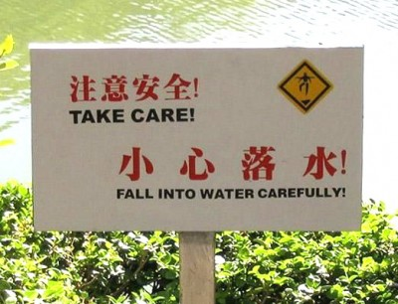
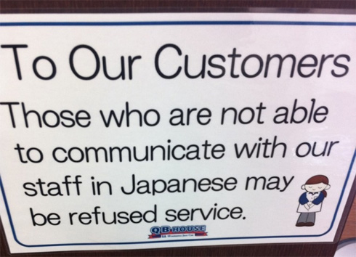
Communication !
Great progress in communication. Still, communication is difficult and we should apply extra care in making sure we understand each other
Use good communication equipment for phone meetings !
Write down conclusions in a clear way !
Stick to the accepted conclusions, or communicate if we need to change something.
Timid man overboard

