Slide 1
Belle II PXD ASIC Review, the 2nd ……..

Slide 2
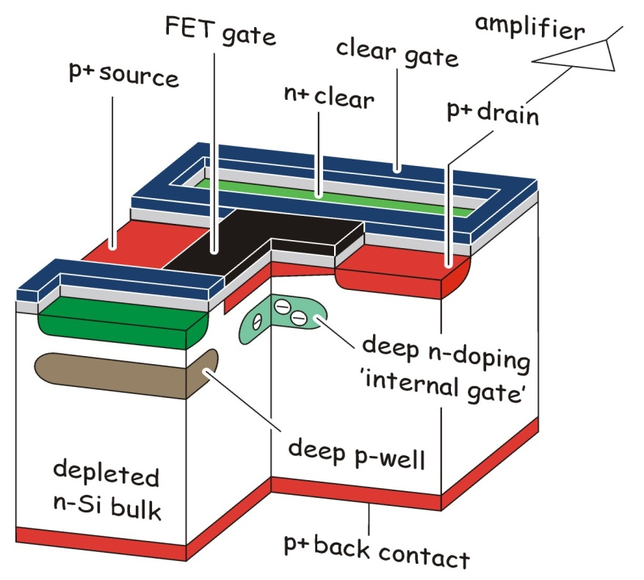
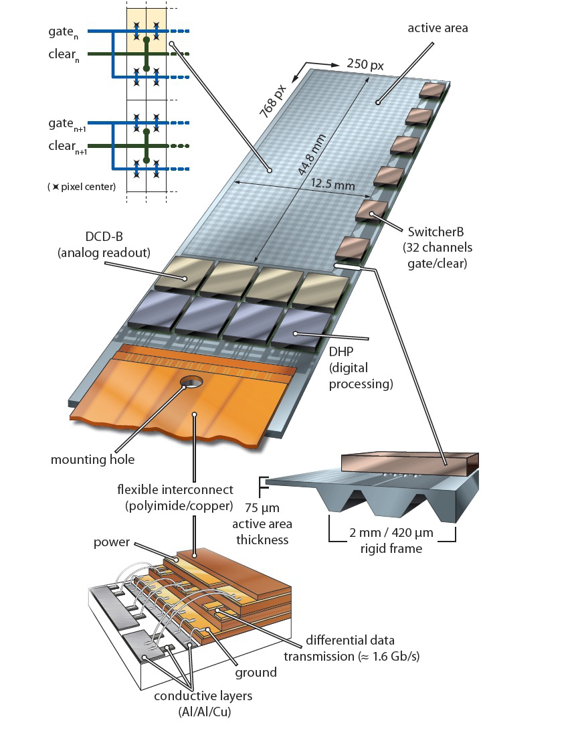
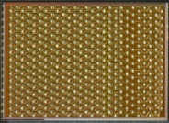

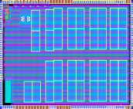
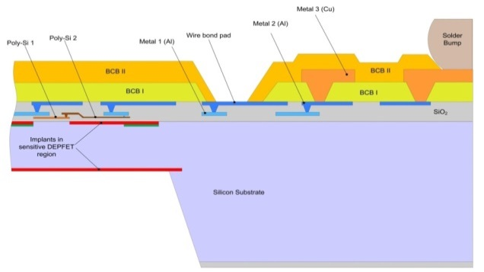
DEPFET all-silicon module
DCDB (Drain Current Digitizer)
  Analog front-end
SwitcherB - Row Control
  AMS/IBM HVCMOS 180 nm
  Size 3.6 × 1.5 mm²
  Gate and Clear signal
  32x2 channels
  Fast HV ramp for Clear
Amplification and digitization of DEPFET signals.
256 input channels
8-bit ADC per channel
92 ns sampling time
new version w/ 50ns sampling time under test
UMC 180 nm
Key to low mass vertex detectors
highest integration!
  Thin sensor area
  EOS for r/o ASICs
  Thin (perforated) frame
  w/ steering ASICs
DHP (Data Handling Processor)
  First data compression
  IBM CMOS 90 nm (TSMC 65 nm)
  Size 4.0 × 3.2 mm²
  Stores raw data and pedestals
  CM and pedestal correction
  Data reduction (zero suppression)
  Timing and trigger control
  Drives data link

Slide 3
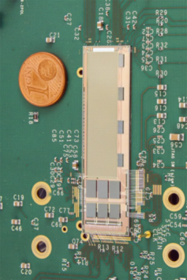
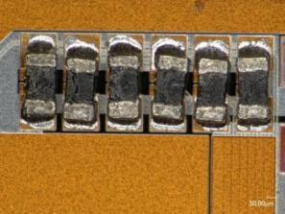
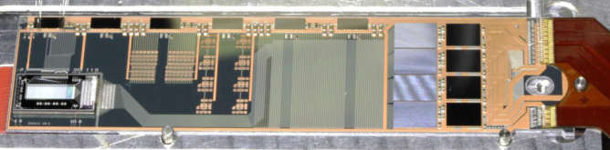
Module Assembly – overview
Flip Chip of ASICs (~240°C):
  Bumped ASICs have the same solder balls (SAC305)
    DHP bumping at TSMC, DCD bumping organized via Europractice
    SWBv2 bumping on chip level at PacTech
    FC at IZM Berlin as for EMCMs
SMD placement (~200°C):
  Passive components (termination resistors, decoupling caps)
  Dispense solder paste/jetting of solder balls, pick, place and reflow
    PbSn 37/63 solder
  For EMCMs solder paste at Finetech in Berlin, no production service possible
    Finetech automated process at HLL (dispense, pick-and-place, reflow)
    SMD placement at IFIC/NTC Valencia as backup, (PacTech solder jetting …)
Kapton attachment (~160°C), wire bonding:
  Solder paste printing on kapton,
    SnBi solder
  Wire-bond, wedge-wedge, 32 µm Al bond wires between kapton and substrate
  EMCM and final at MPP Munich
01005 term. res

Slide 4
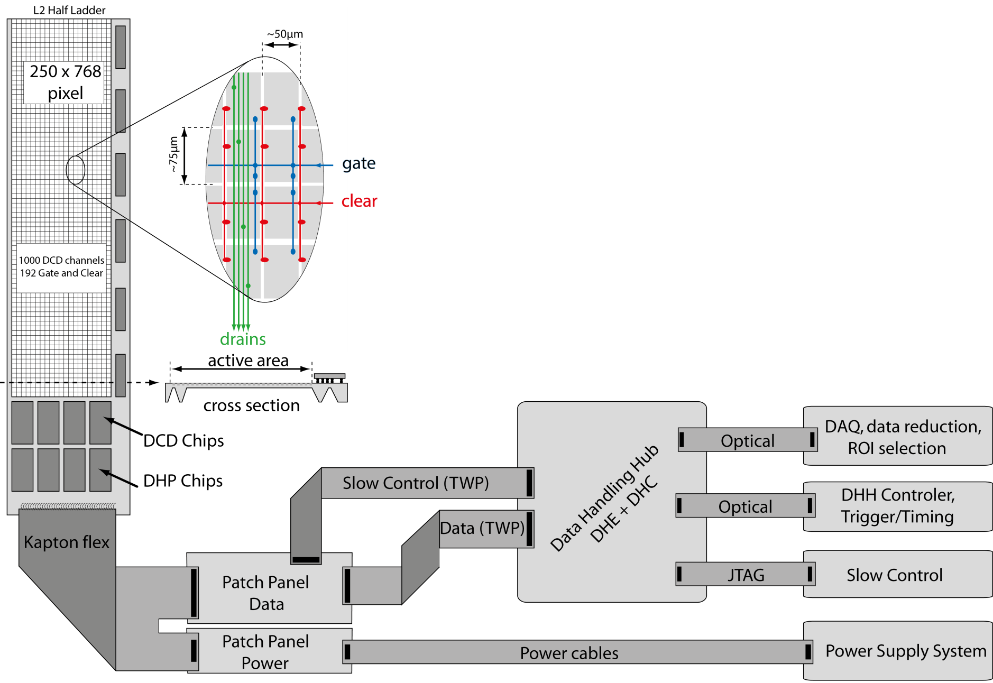
The System
 | L1 | L2
# ladders | 8 | 12
Distance from IP (cm) | 1.4 | 2.2
#DCD/DHPT/SWB | 160/160/240
Sensitive thickness (μm) | 75 | 75
#pixels/module | 768x250
#of addr. and r/o lines per module | 192x1000
Total no. of pixels | 3.072x10⁶ | 4.608x10⁶
Pixel size (μm²) | 55x50 60x50 | 70x50 85x50
Frame/row rate | 50kHz/10MHz
Sensitive Area (mm²) | 44.8x12.5 | 61.44x12.5

Slide 5
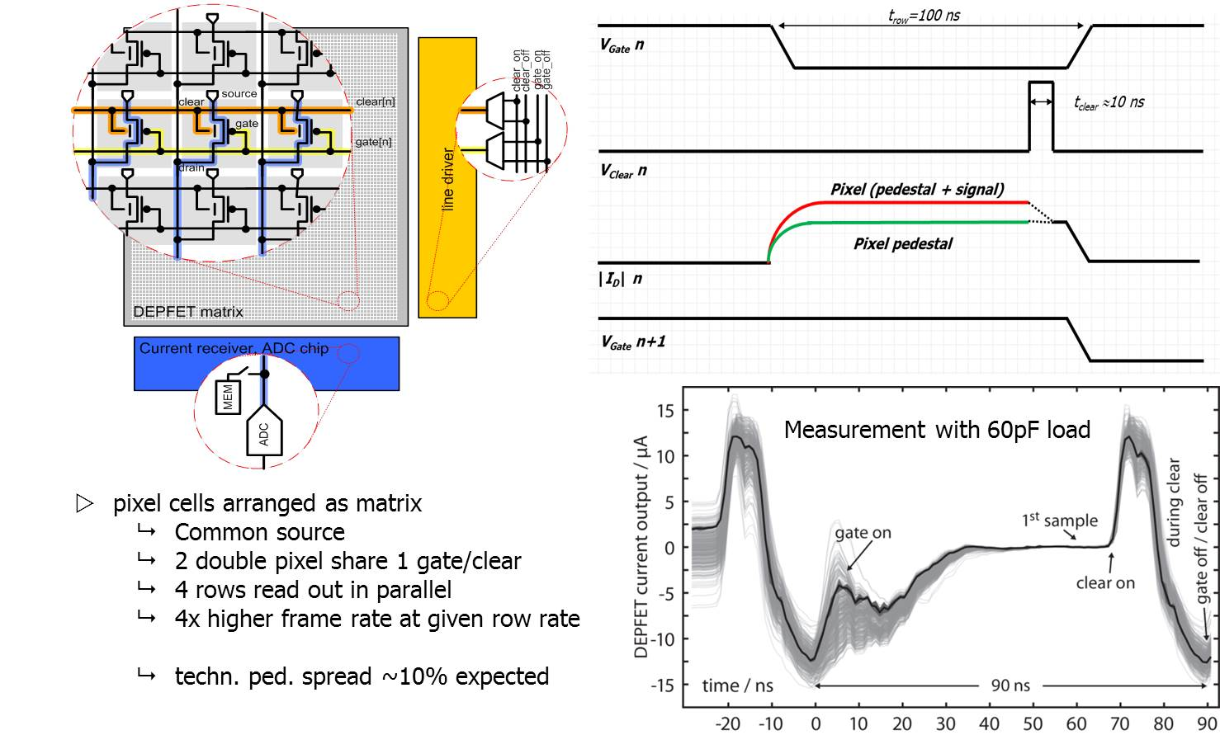
Matrix arrangement and read-out sequence

Slide 6
Top level specs
Top level specs for the supporting ASICs of a DEPFET based Belle II PXD
Expected occupancy: ~1.5%
Rad. Tolerance for 5 years: 10Mrad TiD, 5e13 n_{eq}/cm²
Read-out speed: row rate 10MHz
Capacitive load: DCD input 50pF, SWB Gate and Clear 125pF(tbc)
DEPFET bias: Gate_off 3..5 V
Gate_on -3..-10V
Clear_off 3..5V
Clear_on 15..20V
Max. input signal: ~3 mips ~6µA
Signal/noise: >20 (mip MPV)
Pedestal: 100µA
Pedestal variation within matrix: technol. 10%
after irrad. tbd
General: analogue ped. correction for each pixel
support of the “gated mode”

Slide 7
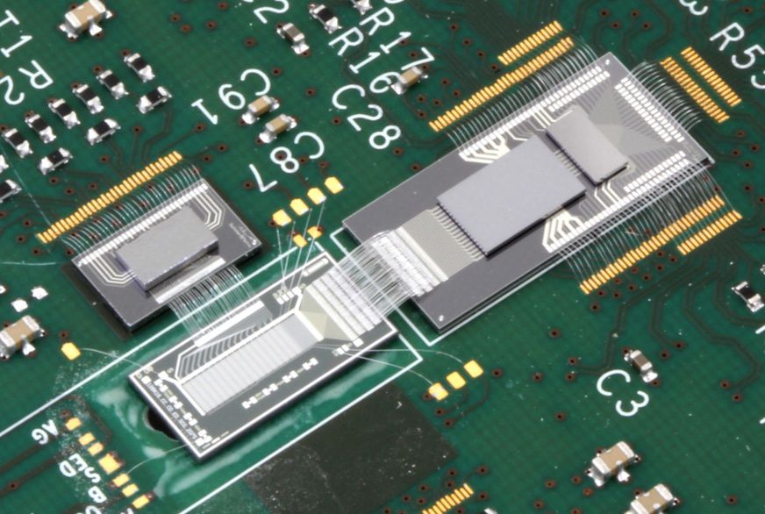
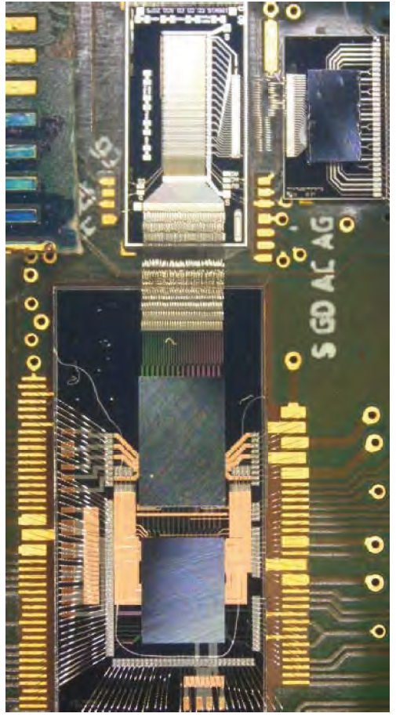
Existing test setups
Hybrid4
Hybrid5
Hybrid6
EMCM

Slide 8
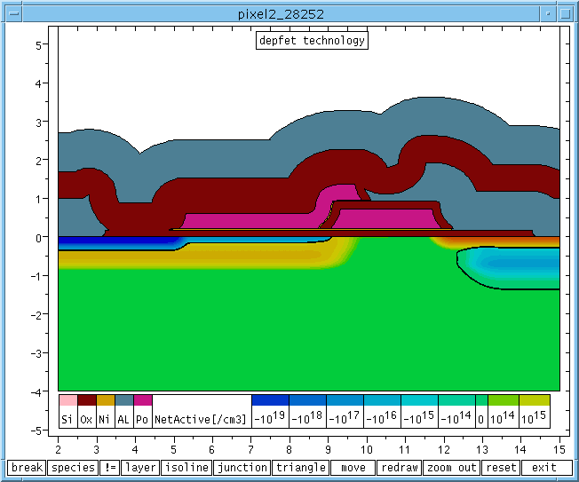
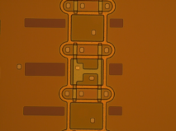
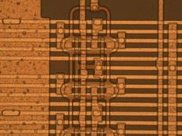
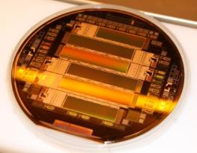
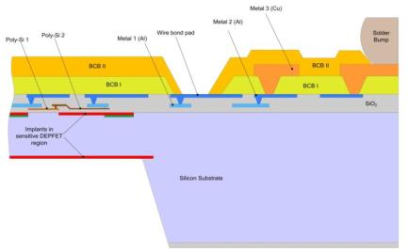
Sensor production phases and where we are
metal_2
oxide
☑
p+
polySi_2
polySi_1
metal_1
Phase I – before metal:
Process module based on PXD6 and simulation
first yield estimate based on optical inspection
deep n
n+
deep p
n bulk
metal_2
☑
Phase II – metal system (al1 and al2):
Qualification parallel to Phase I
Technology development on EMCM batches
oxide
p+
polySi_2
polySi_1
metal_1
deep n
n+
deep p
n bulk
☑
Phase III – Thinning and Cu
Qualification on dummy level
Cu on thick silicon already part of EMCM batches
First test on PXD6 prototype

Slide 9
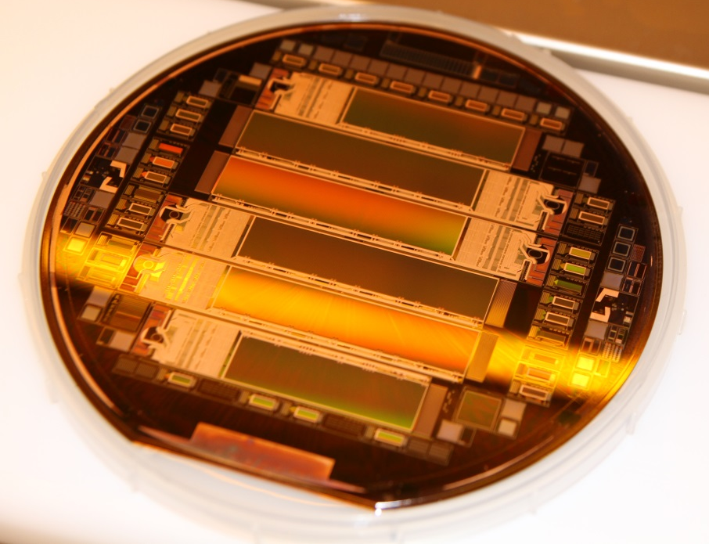
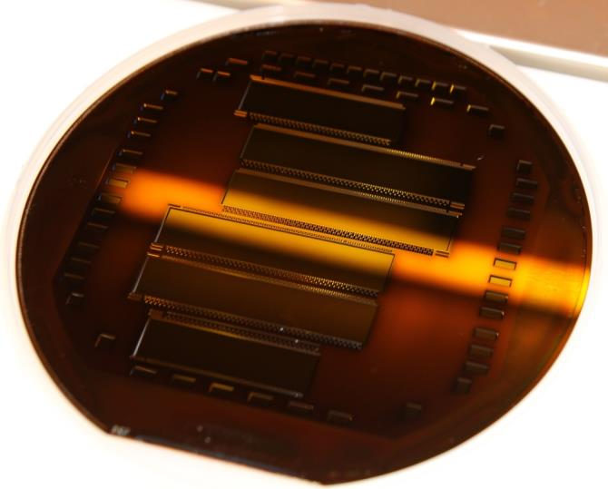
PXD9-6 – the PXD Pilot Production
:- 3/30 “hot” wafers (W30, W35, W36)
:- still a lot of process control, tests, and measurements “on the fly”
:- status today:
:- front side Alu finished on all
:- back side etching finished on W30 & W36, W30 Copper process finished
Expect first modules for flip chip end of July

Slide 10
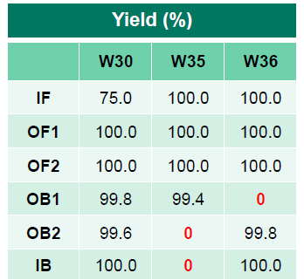
Plans with pilot run modules
:- Wafer level testing
:- I_{D}/V_{th} Dispersion → Rainer’s talk
:- Metal system integrity
:- Module level testing
:- assembly with prototype ASICs
:- electrical verification of periphery
:- assembly with new (final) ASICs
:- test of final ASICs/system in the beam
Assignment of the modules:
:- W30-OB1, W30-OB1, W36-OB2 → assembly with prototype ASICs, kapton interconn.
:- W30-OF1, W30-OF2 → assembly with prototype ASICs, PCB interconnn.
:- W30-IB and W35-IF → L1 ladder for test beam and Beast
:- W35-OF1 and W35-OB1 → L2 ladder for Beast test beam and Beast

Slide 11
Schedule
:- PXD9 pilot run and beyond
:- sensors by July 2015
:- all ASICs (prototypes) are pre-tested and available
:- Assembly (FC+SMD) August 2015
:- tests to understand periphery performance: Sept./Oct./Nov.
:- start phase II and III of sensor production (metal sys.) Dec. 2015
:- ASIC submissions (including bumping, details in the afternoon)
:- DHPT tape out end of August 2015 → December 2015 first 100 dies
:- DCD tape out end of August 2015 → January 2016 first 100 dies
:- SWB tape out end of August 2015 → January 2016 first 40+ dies
:- after test and verification of specs re-order new wafers (within 6 months)
:- ASIC testing Jan/Feb 2016
:- assembly of test beam/Beast modules March 2016
:- VXD combined test beam at DESY April 2016
:- start PXD module production Summer 2016

Slide 12
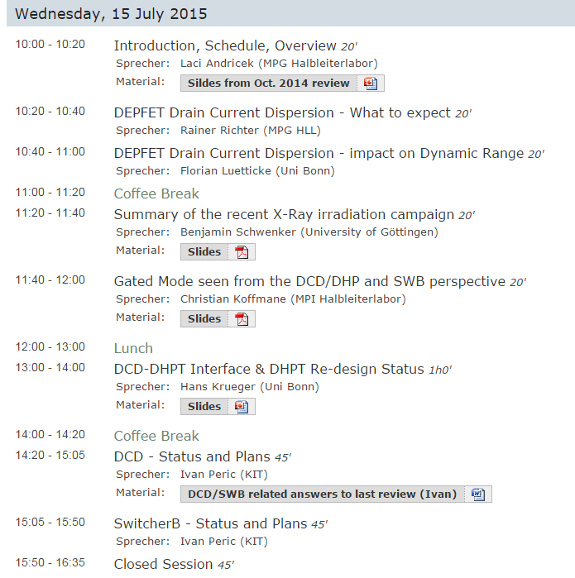
Structure of the review
Interface to the DEPFET
System tests before and after irrad.
Gated mode status
DHPT-DCD interface
Detailed talks by the designers
:- status
:- response to the prev. review
:- submissions plans

Slide 13
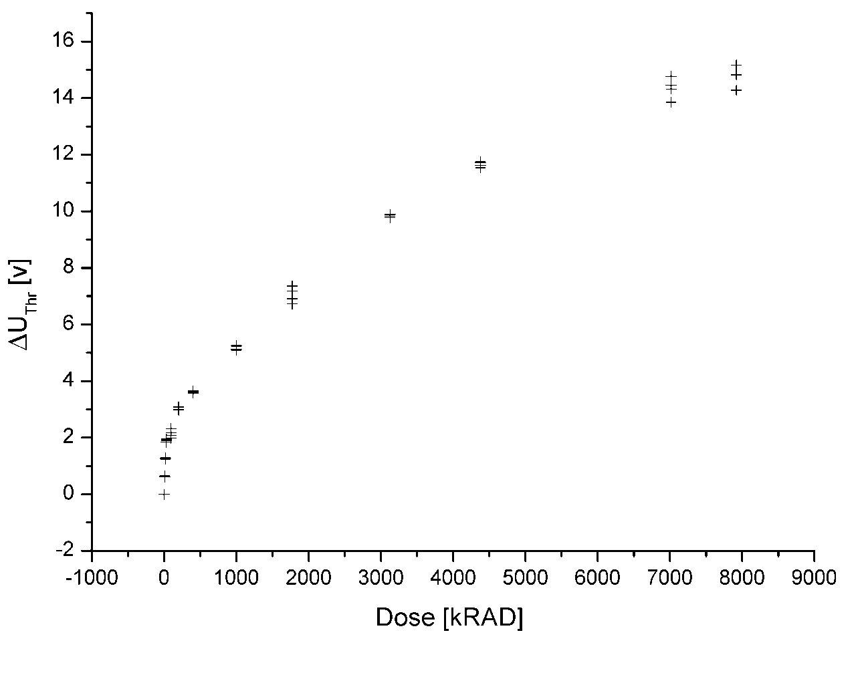
PXD5 Irradiations → to higher TIDs
-: PXD5, Wafer 90, 8x12 mini-matrix, 32x24 µm²
-: irradiation with X-rays photons in Karlsruhe, ~150krad/h
-: entire matrix biased in "off" during irradiation, periodically cleared
-: four pixels selected to measure basic characteristics throughout irradiation
"No" annealing!
x
⁶⁰Co irradiation
S.Rummel

Slide 14
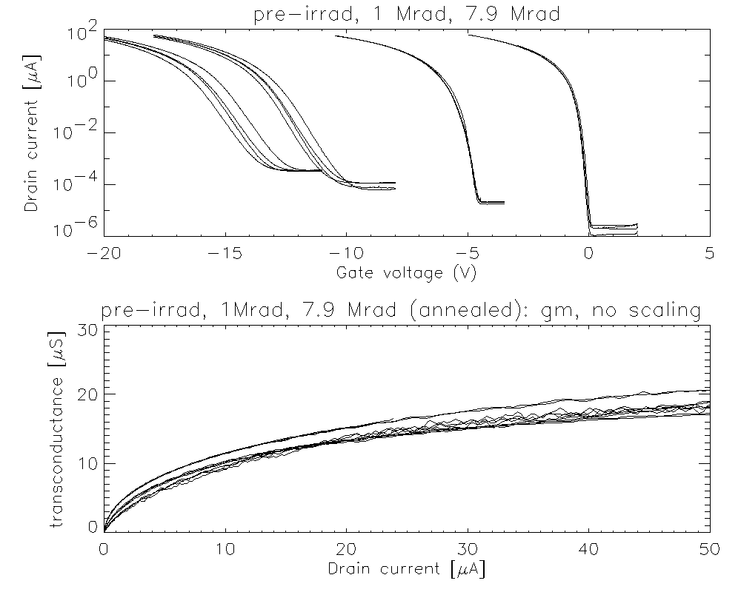
PXD5 Irradiations → first results
1Mrad
pre-irrad
7.9Mrad
5 days ann.
at RT
for 7.9 Mrad:
V_{t}: 0V→-13V
s: 100mV/dec → 650mV/dec
and
~1V V_{t} variation of
identical
DEPFETs
at same TID!

Slide 15
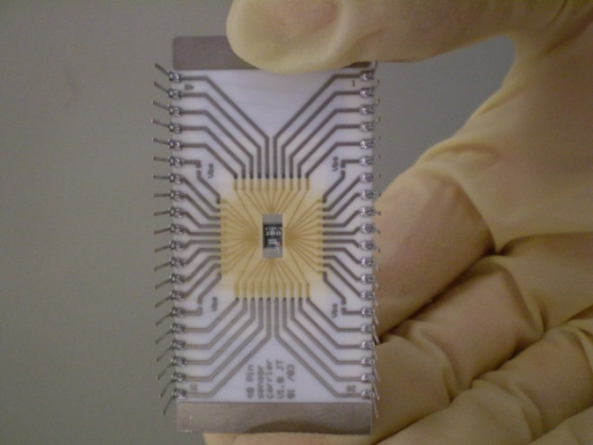
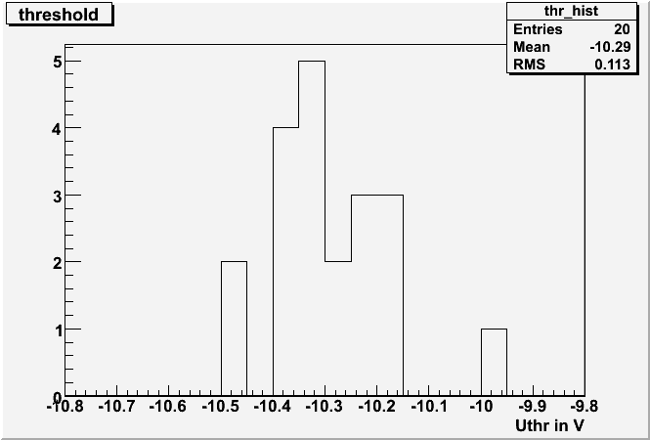
PXD5 Irradiations → threshold dispersion
-: 4 DEPFETS → ∆Vt≈1V after 8 Mrad is an issue!!
-: 8x12 DEPFETs on mini-matrix, so re-bond and measure them all for higher statistic
But then ... due a misunderstanding ...
accidentally(!!!) the structure was annealed for 1/2h @ 110°C
Conclusion: Nice try, but do another irradiation!!!!
But on the other hand, we now know that the dispersion is not the final state and maybe even room temperature annealing will lead to the same results.
So, there is hope....we will keep you informed!

Slide 16
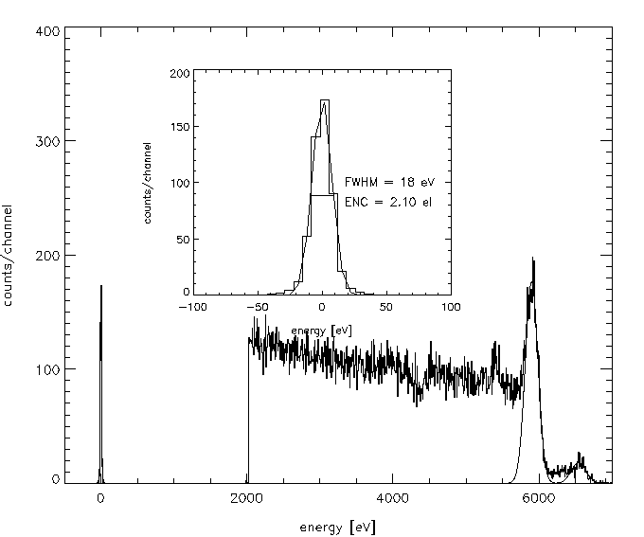
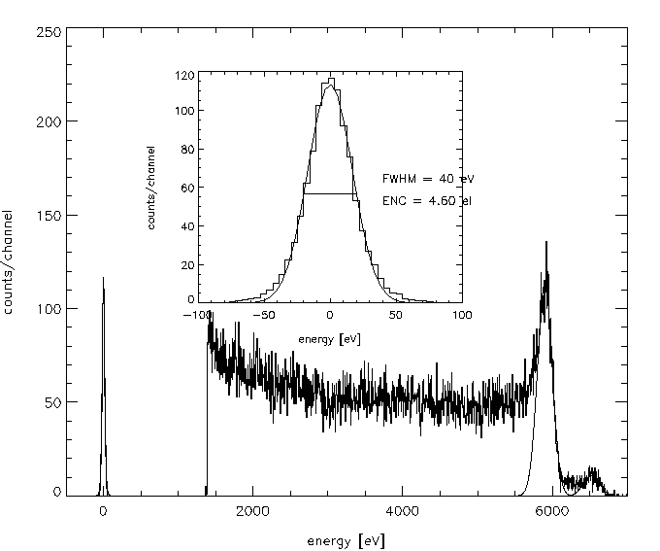
PXD5 Irradiations → first results
S.Rummel
non-irradiated
V_{thresh}≈-0.2V
time cont. shaping τ=10 μs
7.9 Mrad, 10keV X-rays
V_{thresh}≈-13.0V,
time cont. shaping τ=10 μs
Noise ENC=2.1 e⁻ (rms)
at T>23 degC
Noise ENC=4.6 e⁻ (rms)
at T>23 degC

Slide 17
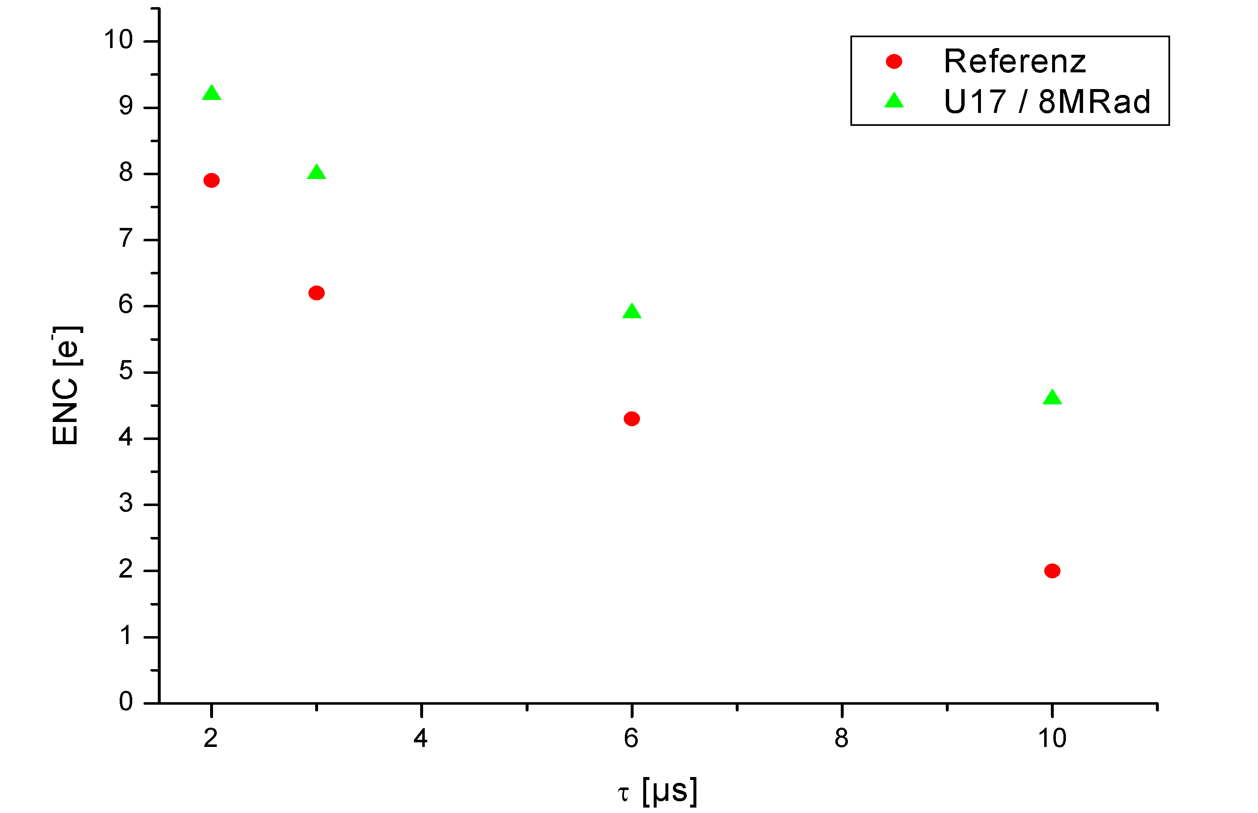
PXD5 Irradiations → noise vs. shaping time
Therm. noise
1/f
I_{L}
-: Leakage current in the pixel @ RT ~40 fA ( 10-22fA unirradiated)‏
-: Noise increase due to 1/f noise which is independent of bandwidth
-: noise increase due to radiation is not factor 2 but only 3 e⁻ ENC

