Slide 1



DCD Gain and Pedestal Spread

Slide 2
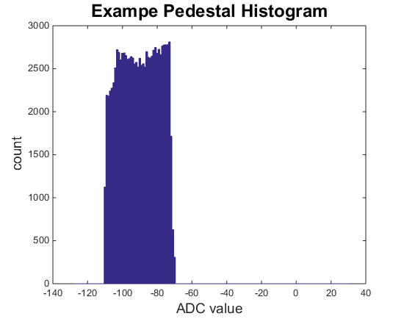
Pedestals and dynamic range
Dynamic range
Pedestals spread after compression,
Pedestal range
Signal range
Min ADC Value
Separation of Pedestals and min ADC value

Slide 3
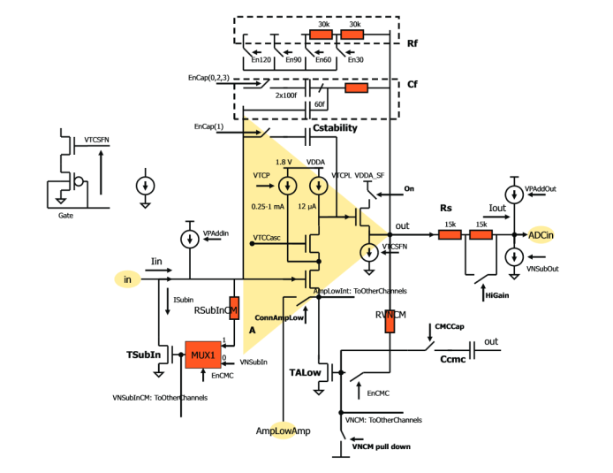
DCD Input stage
Feedback Setting
Setting for High/Low Gain

Slide 4
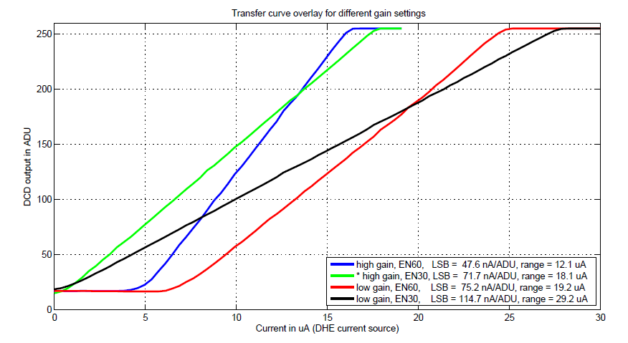
Gain on DCD
Realistic full ADC width: 220 * LSB width
Ideal range: 254 * LSB width
ADCs show reduced range (start not at -127, but at higher values)
Nonlinearities in the edges
Gain spread between different ADCs
Some room between lowest pedestal and minimal ADC code
Dynamic range:
10.4 uA (high gain, en60)
15.8 uA (high gain, en30)
16.5 uA (low gain, en60)
25.2 uA (low gain, en30)
33.0 uA (Assumed 150nA/LSB)

Slide 5
Signal from the matrix
Expected g_{q} from the DEPFET Sensor: 450 pA/e⁻
Expected Charge on Sensor: MIP 7900 e⁻, Slow Pion: 23700 e⁻ (3 x MIP)
Expected current for the DCD: MIP 3.55uA, Slow Pion: 10.67uA
Dynamic range:
10.4 uA (high gain, en60)
15.8 uA (high gain, en30)
16.5 uA (low gain, en60)
25.2 uA (low gain, en30)
33.0 uA (Assumed 150nA/LSB)
MIP corresponds to
75 LSB (high gain, en60)
49 LSB (high gain, en30)
47 LSB (low gain, en60)
31 LSB (low gain, en30)
23 LSB (Assumed 150nA LSB)
Slow Pion corresponds to
224 LSB (high gain, en60)
149 LSB (high gain, en30)
142 LSB (low gain, en60)
93 LSB (low gain, en30)
71 LSB (Assumed 150nA LSB)

Slide 6
Range for pedestals
Expected g_{q} from the DEPFET Sensor: 450 pA/e⁻
Expected Charge on Sensor: MIP 7900e-, slow pion: 23700 (3 x MIP)
Expected current for the DCD: MIP 3.55uA, slow pion: 10.67uA
Pedestal range= dynamic range – expected signal
Dynamic range:
10.4 uA (high gain, en60)
15.8 uA (high gain, en30)
16.5 uA (low gain, en60)
25.2 uA (low gain, en30)
33.0 uA (Assumed 150nA/LSB)
Pedestal range (assuming MIPs)
6.9 uA (high gain, en60)
12.3 uA (high gain, en30)
13.0 uA (low gain, en60)
21.7 uA (low gain, en30)
29.5 uA (Assumed 150nA LSB)
Pedestal range (assuming slow pions)
0 uA (high gain, en60)
5.1 uA (high gain, en30)
5.7 uA (low gain, en60)
14.5 uA (low gain, en30)
22.3 uA (Assumed 150nA LSB)

Slide 7
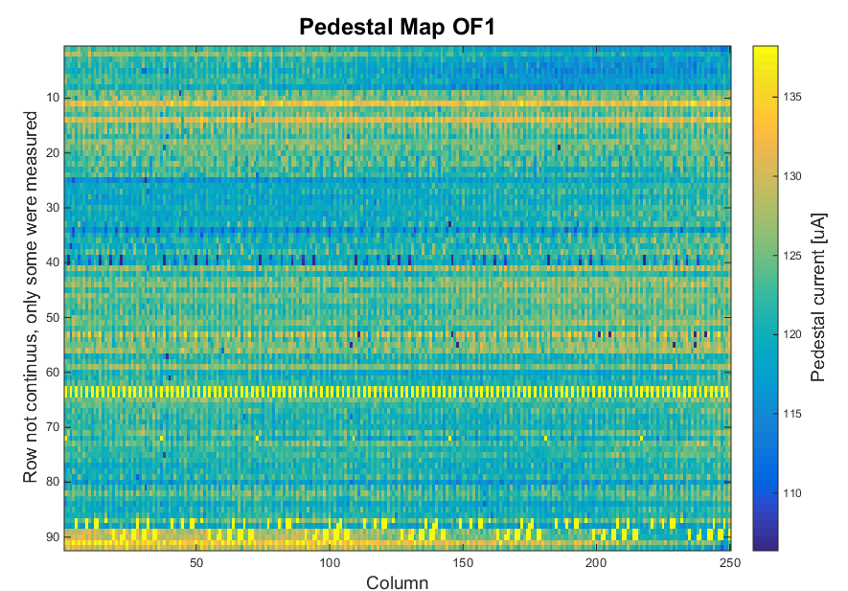
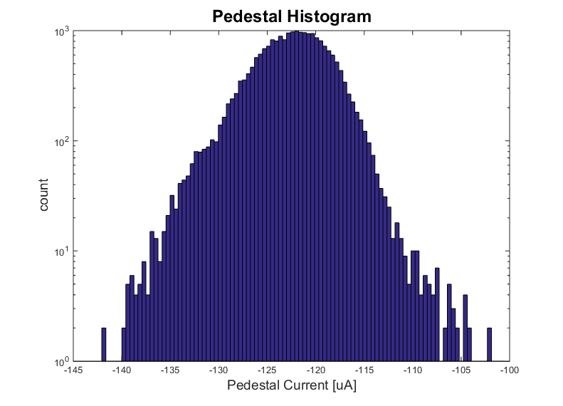
Pedestal spread without common mode correction
Static wafer level measurements of OF1_W35
(cut pixel with bad contact)
Measured two or four gates for every switcher
99.5% of pedestal between 109uA and 137uA
28uA spread on Pedestals
System adds some spread
Offset spread between ADCs -> ~1uA
Current subtraction current source can have spread (5% Spread on ISubIn of 120uA) -> ~6uA
7uA additional current spread
~35uA range for pedestals needed (not irradiated)

Slide 8
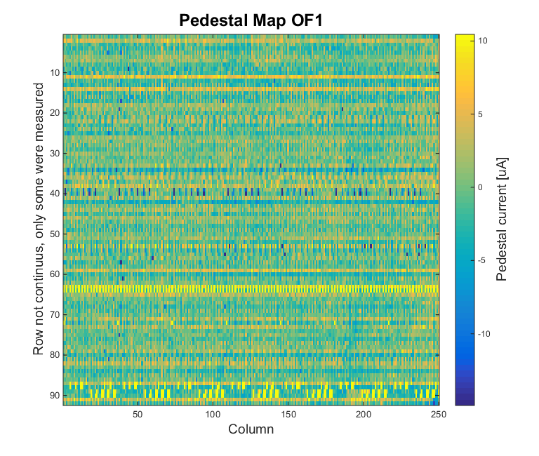
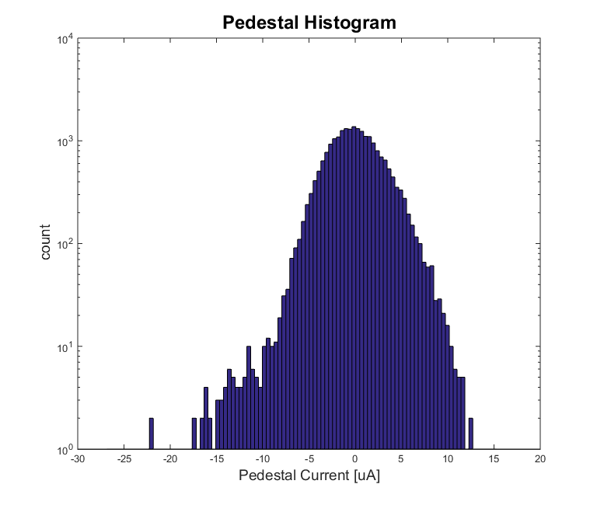
Pedestal spread with DCD common mode correction
Static wafer level measurements of OF1_W35
(cut pixel with bad contact)
Measured two or four rows for every switcher
Assumed perfect CM subtraction
99.5% of pedestal between -12uA and 10uA
21uA Spread on Pedestals
System adds some spread
Offset spread between ADCs -> ~1uA
Current subtraction current source can have spread (5% Spread on ISubIn of 120uA) -> ~6uA
7uA additional current spread
~28uA range for pedestals needed (not irradiated)

Slide 9
Pedestal compression
Dynamic switching current sources can add current to pedestals
2 bit DAC: Add 0, I₀ ,2I₀ , 3I₀ to pedestal
I₀ can be set over DAC
Ideal: Compression by factor 4 but:
  DAC to set I₀ has certain step size. Ideal I₀ can not be set
  I₀ for drain A depends on what other drains get and what drain A got one gate before -> expected values do smear out
  I₀ varies from drain to drain
  2bit DAC not perfectly linear (2I₀ != 2*I₀)
Realistic compression factor: 3 to 3.5. To be on the save side assume compression factor 3
+3I₀
+2I₀
+I₀
+0

Slide 10
Range for pedestals using pedestal compression
Expected g_{q} from the DEPFET Sensor: 450 pA/e⁻
Expected Charge on Sensor: MIP 7900e-, slow pion: 23700 (3 x MIP)
Expected current for the DCD: MIP 3.55uA, slow pion: 10.67uA
Expected pedestal compression factor: 3
Max pedestal spread = (dynamic range – expected signal) x compression factor
Dynamic range:
10.4 uA (high gain, en60)
15.8 uA (high gain, en30)
16.5 uA (low gain, en60)
25.2 uA (low gain, en30)
33.0 uA (Assumed 150nA/LSB)
Max pedestal spread (MIPs only)
20.7 uA (high gain, en60)
36.9 uA (high gain, en30)
39.0 uA (low gain, en60)
65.1 uA (low gain, en30)
88.5 uA (Assumed 150nA LSB)
Max pedestal spread (slow pions)
0 uA (high gain, en60)
15.3 uA (high gain, en30)
17.1 uA (low gain, en60)
43.5 uA (low gain, en30)
66.9 uA (Assumed 150nA LSB)
~35uA pedestal spread
not irradiated
no dynamic effects
no power drop over DCD or module assumed
no common mode correction (with CM: 28uA)

Slide 11
Conclusions
From all the possible gain configurations, only the lowest gain is suited for the experiment (MIPs and Slow Pion rescue) but:
  Pedestal knowledge is limited
  Small headroom
  Irradiation and temperature will add on top
  Any other effects (?)
  A slightly lower gain setting (150nA/LSB, MIP ~ 20 LSB) could be helpful as live saver, if we suffer from high pedestal spread.

Slide 12
Recommendations
Current high gain setting (47nA/LSB) is not usable – can be dropped
Current medium gain (72nA/LSB) should become our new high gain setting
  Matrix characterization, small matrix operation, etc.
Current lowest gain setting (115nA/LSB) should be the baseline and be optimized
  Detector operation
One even lower gain setting (150nA/LSB) as live saver
  Detector operation with inhomogeneous irradiation

Slide 13
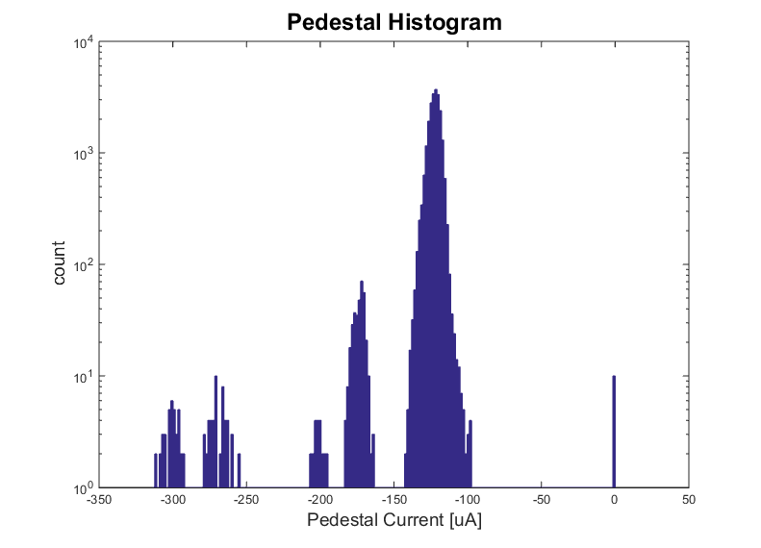
Pedestal Spread, full data
Probably bad needle contact on steering line
Probably bad needle contact on drain line

Slide 14
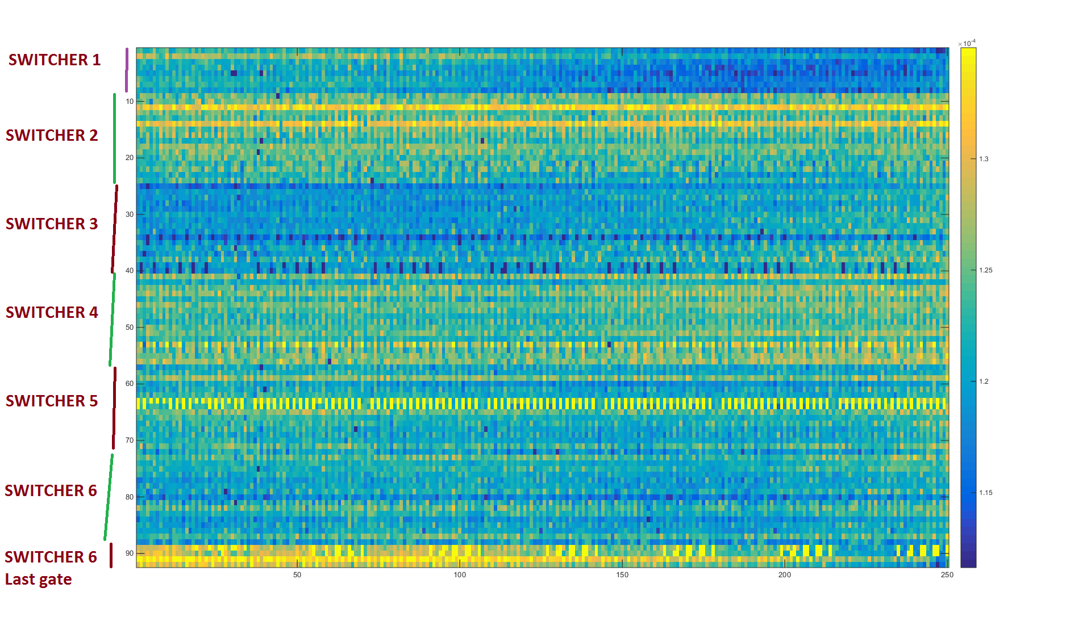
Pedestal Spread - jumps in the distribution
Jumps, when rows are not neighbors
Same colored lines are neighbors

