Slide 1
ASICs: DCD and Switcher

Slide 2
DCD

Slide 3
DCD
Changes in design (present status):
Change sampling of TDI for global and pixel register to positive edge (mandatory)
Add fast parallel sampling mode for easier needle card tests (nice to have)
Improve test DAC resolution by adding additional DAC (nice to have)
Stronger digital output driver current (or improved scheme), radiation hard NMOS (mandatory)
Protection diodes for digital signals should be on VDDD for digital (mandatory)
Add transmission switch to monitor (now only PMOS) (nice to have)
Check the voltage drop on power rail – connect gate of the NMOS sources only in one point (nice to have)
Reduce RefIn current (mandatory)
Try to connect DAC Dump and SF VDDA to RefIn (nice to have)
Separated bias DACs for up and down bias/notice larger drop 0-7 then 8-15, try different grouping (mandatory)
Spare ADCs (nice to have)
Redo protection diode, current drain/split nwell (mandatory)
Ipdac 60uA full range (mandatory)
SubIn 4 times or additional DAC (still not clear)
Introduce 15k Feedback resistor setting – low gain mode (mandatory)
More complex digital test patterns (mandatory)
Improve matching and Rout – wider LV PMOS, same orientation, same NMOS, enlarge Diff PMOS (mandatory)

Slide 4
JTAG and slow controll - Change sampling of TDI
Pixel Register
PixelSel
P_Shift, P_Rb, P_Ld
PixelSel
ShiftDR, CaptureDR, UpdateDR
Address
Global Register
GlobalSel
G_Shift, G_Rb, G_Ld
Digital Block
GlobalSel
State M.
ShiftDR, CaptureDR, UpdateDR
TDO
PreLoad
TMS
CaptureIn
DO0(7:0),DI0(1:0),…,DI3(1:0),SYNC_RES,CLK,RetCLK,TestInjEn,DO4(7:0),…,DI7(1:0)
LatchOut
Data Register
In
Out
CaptureIn
ExtTest OR PreLoad
Cont. Signals
LatchOut
ShiftDR, CaptureDR, UpdateDR
ExtTest
Commands
Instruction Register
FF
i
Pads
o
i
Bitck
Res
ShiftIR
The other if not ShiftIR
ShiftIR, CaptureIR, UpdateIR
Res!
TestMode
TestMode
TDI
ID Register
FF
TestPads
IDSel
ShiftDR&IDSel
Readout Reg
Readout
CaptureIn
CaptureIn
FF
FF
TCK
Full custom latches
Bypass
Ld
o
4

Slide 5
Digital output driver
The ADC signals are compressed and serialized on DCD. The output drivers of DCD sent the data via non-standard single ended current mode links. The structure of these links is shown in figure. Currently the amplitude of the signal is limited to 220 mV and cannot be changed.
DCD
DCD digital block
VDD
Bias block

Slide 6
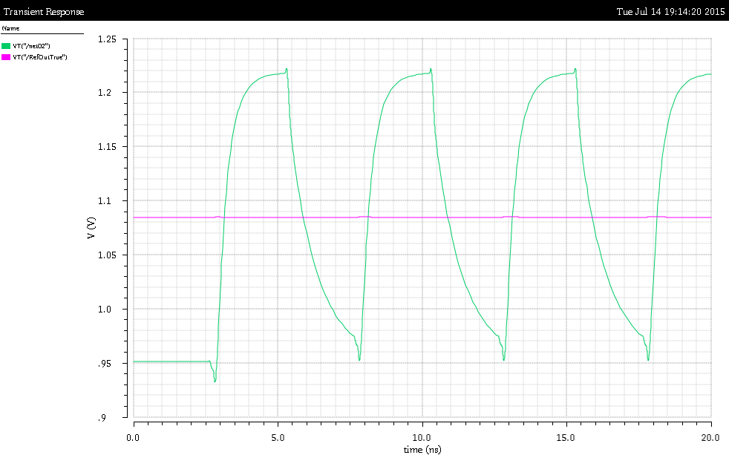
Digital output driver
Stronger digital output driver current (or improved scheme), radiation hard NMOS
InB
In
3pF
In
InB

Slide 7
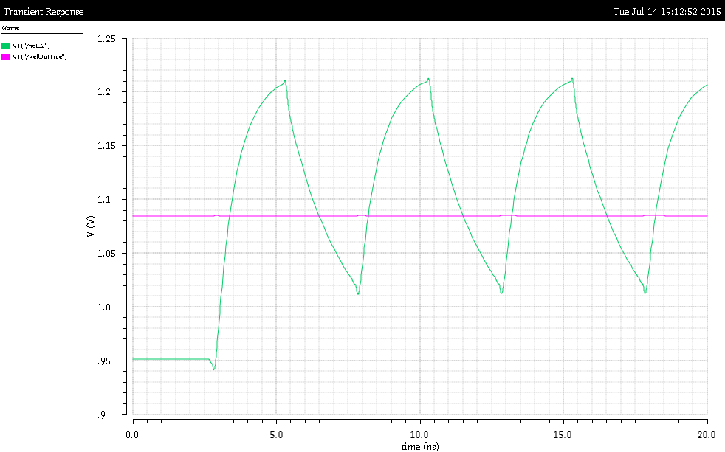
Digital output driver
Stronger digital output driver current (or improved scheme), radiation hard NMOS
InB
In
6pF
In
InB
1.4m

Slide 8
Digital output driver
Stronger digital output driver current (or improved scheme), radiation hard NMOS
vdda
vddd
InB
In
3pF
In
InB
gndd

Slide 9
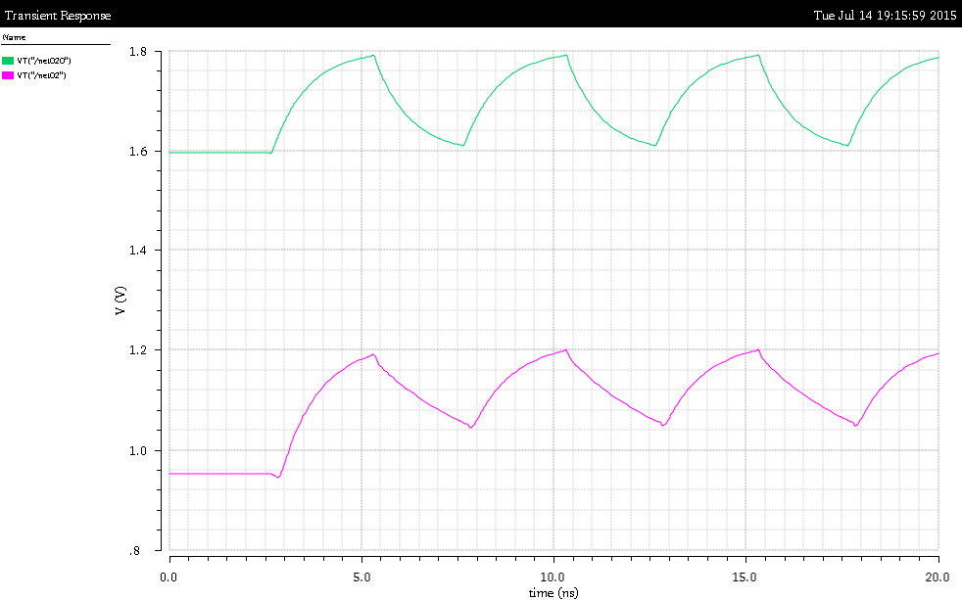
Digital output driver
Stronger digital output driver current (or improved scheme), radiation hard NMOS
In
InB
6pF
1.4m
InB
In
6pF
In
InB
1.4m

Slide 10
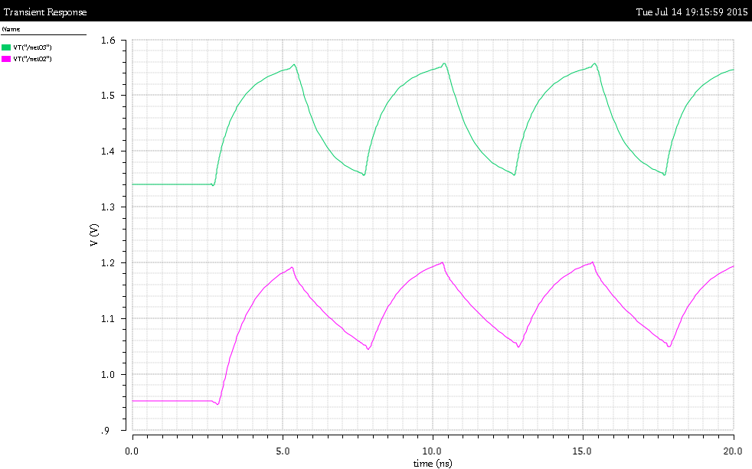
Digital output driver
Stronger digital output driver current (or improved scheme), radiation hard NMOS
In
InB
6pF
350u
350u
InB
In
6pF
In
InB
1.4m

Slide 11
RefIn current
…
VDDA
VDDA
This makes current GNDA constant always
Source
~300uA
AmpInCM
RefIn
AmpIn
RefIn Current isn‘t constant
SF
AmpOut
This makes NMOS scs independent on GNDA noise
~60uA
RefIn
VDDA
240uA max
Source
GNDA
Gate
RefIn
RefIn

Slide 12
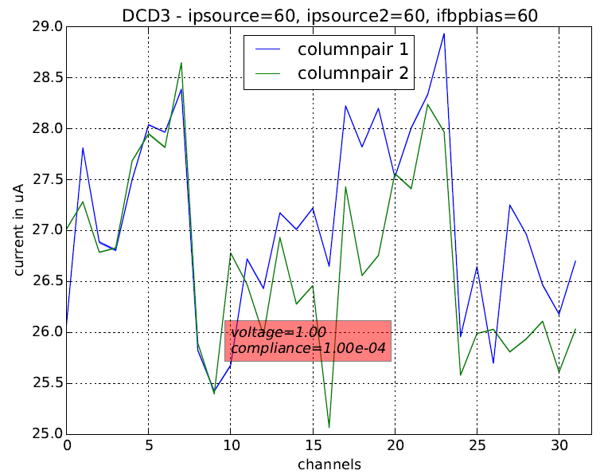
Separated bias DACs
…
DAC
Mirror
d
d
Some measueremnts do not show the effect!

Slide 13
Separated bias DACs
…
DAC
DAC
Or here

Slide 14
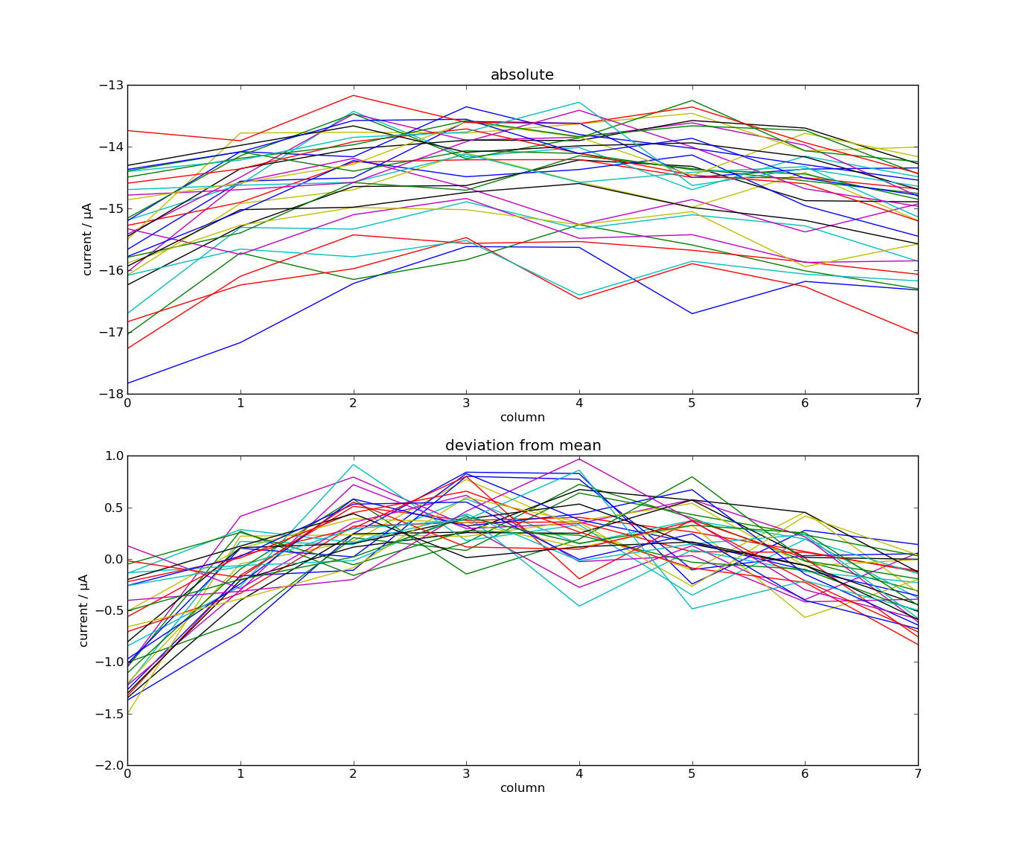
Connect gate of the NMOS sources only in one point
…

Slide 15
Connect gate of the NMOS sources only in one point
….

Slide 16
Long Codes - Simulations

Slide 17
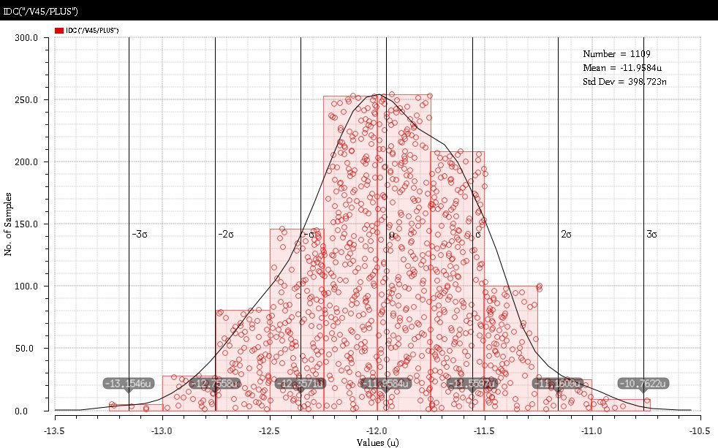
Monte-Carlo Simulation
We have done Monte Carlo simulations – according to first simulations mismatch (6 sigma) is up to ~2.5uA – which is still smaller than 4uA which produces missing codes
(Simulation without thresholds source)
2.5u

Slide 18
ADC unit-cell
The ADC-unit has two current-memory cells based on two U-I converters A and B
Depending on the input current amplitude (too low or too high), a reference current (4 μA per cell) will be added or subtracted
The comparison is done in the following way:
Two copies of the current stored in A are made – this is done with the two, layout-identical, UI converters CL and CH that are connected to the same voltage as A
The goal of this preprocessing is “to compress” the input signal so that it occupies 2x smaller range.
14u
CL
TooLow
12u+/-4u
10u
A
CH
TooHi
12u+/-4u
B

Slide 19
Unit-cell characteristics
The purpose of the comparators is to assure that the reference currents are subtracted/added in the way so that the result current occupies two times smaller range
Only so, the error in algorithm is small
IOut
-8u
-4u
-2u
IIn
8u

Slide 20
Unit-cell characteristics with offset
Imagine now that the ThHi threshold is shifted by Ref/4 (2uA) +Delta.
Imagine also that the signal is about Ref/2 (=64) In this case the result of the first comparison is zero. The result of all other comparisons is TooHigh. This leads to the binary code 64.
Imagine now that signals are within range Ref/2 and Ref/2+Delta. Obviously the binary code are always 64. This leads to the long code 64.
IOut
-8u
-4u
-2u
IIn
8u

Slide 21
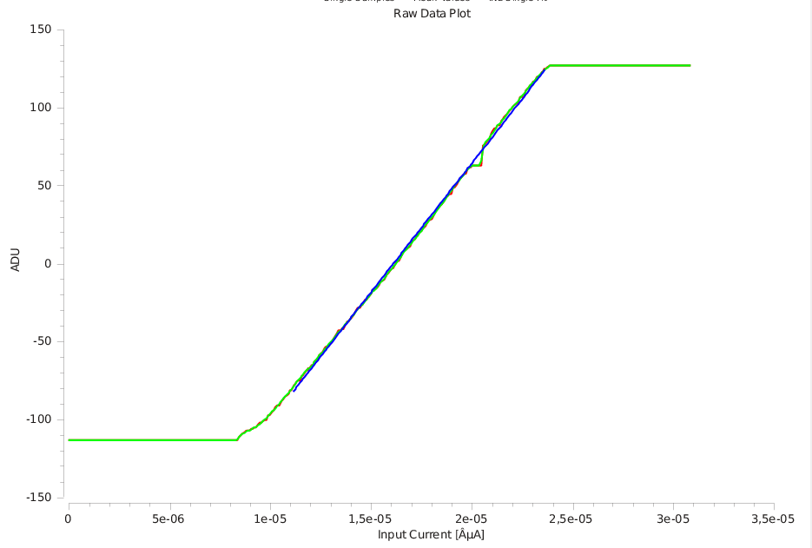
Bad characteristics causes missing codes
Missing codes around 64
IOut
-8u
-4u
-2u
IIn
8u

Slide 22
Origin of offset
Why does the current offset happen?
Possibility: transistor mismatch – fix in the next chip: make the layout in a better way e.g. the transistors bigger
Additionally, there may be a systematic offset in comparator that adds to the mismatch
Notice also: two output nodes are not on perfectly same potential
Original UI converter connected to amplifier input, copy UI converter to RefIn – this explains RefIn dependence
Low
PFB
PFB
24u
24u
RefFB
RefFB
RefIn
RefIn
TooLow
24u
24u
24u
26u
Sc2
Sc2
Sc2
Sc2

Slide 23
Monte-Carlo Simulation
We have done Monte Carlo simulations – according to first simulations mismatch (6 sigma) is up to ~2.5uA – which is still smaller than 4uA which produces missing codes
(Simulation without thresholds source)
2.5u

Slide 24
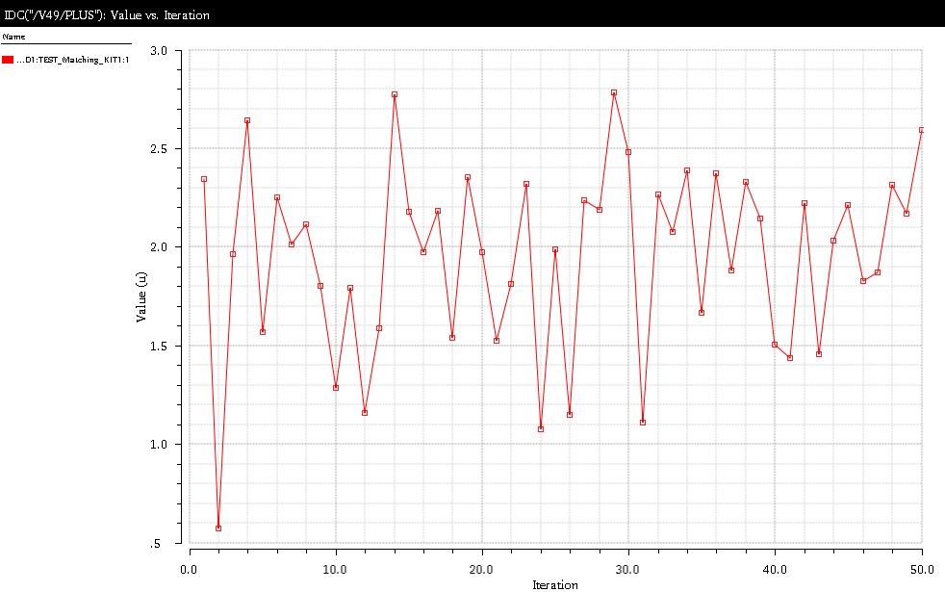
Monte-Carlo Simulation
We have done Monte Carlo simulations – according to first simulations mismatch (6 sigma) is up to ~2.5uA – which is still smaller than 4uA which produces missing codes
(Simulation with thresholds source)
Comparator input current for current memory cell current of 4uA (code 64)
If less than 0 we have a long code
2.3u

Slide 25
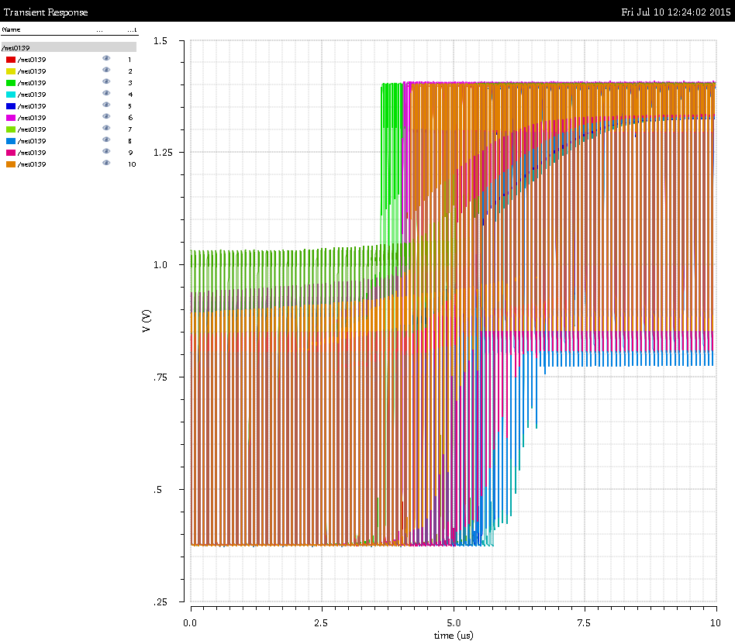
Monte-Carlo Simulation
(Simulation with clocked comparator)
Input current = 1 uA/us
2uA
14u
CL
TooLow
12u+/-4u
10u
A
CH
TooHi

Slide 26
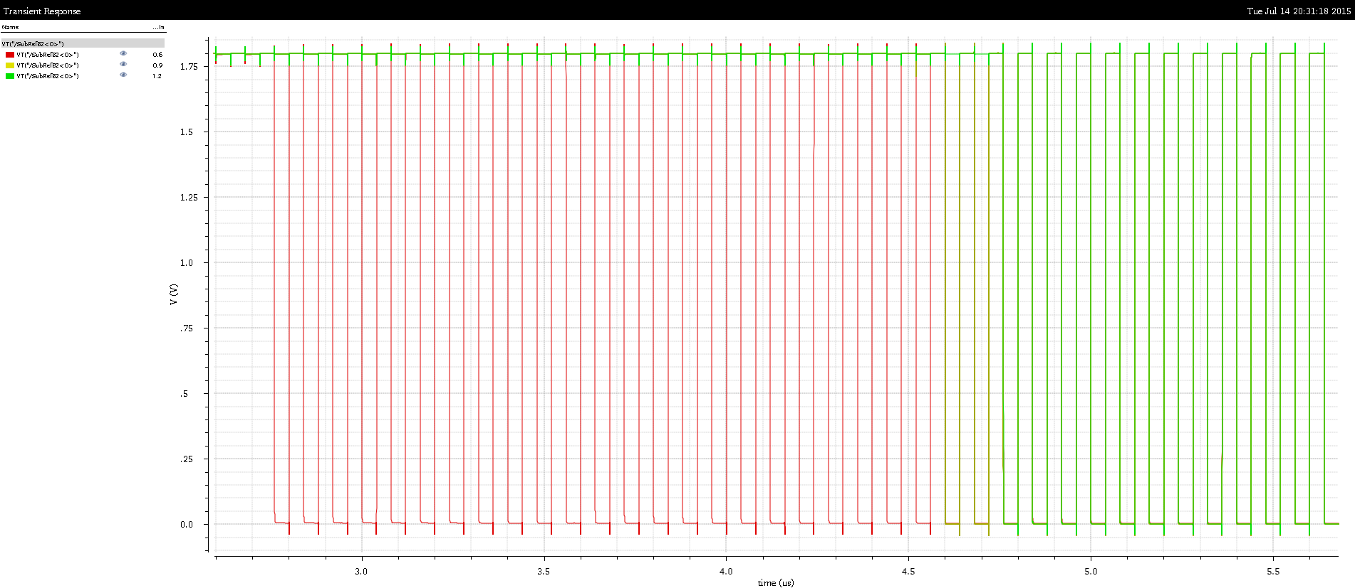
Monte-Carlo Simulation
Systematic offset due to Ref In variations from 600mV to 1.2V
2uA
PFB
24u
RefFB
RefIn
TooLow
24u
26u
Sc2
Sc2

Slide 27
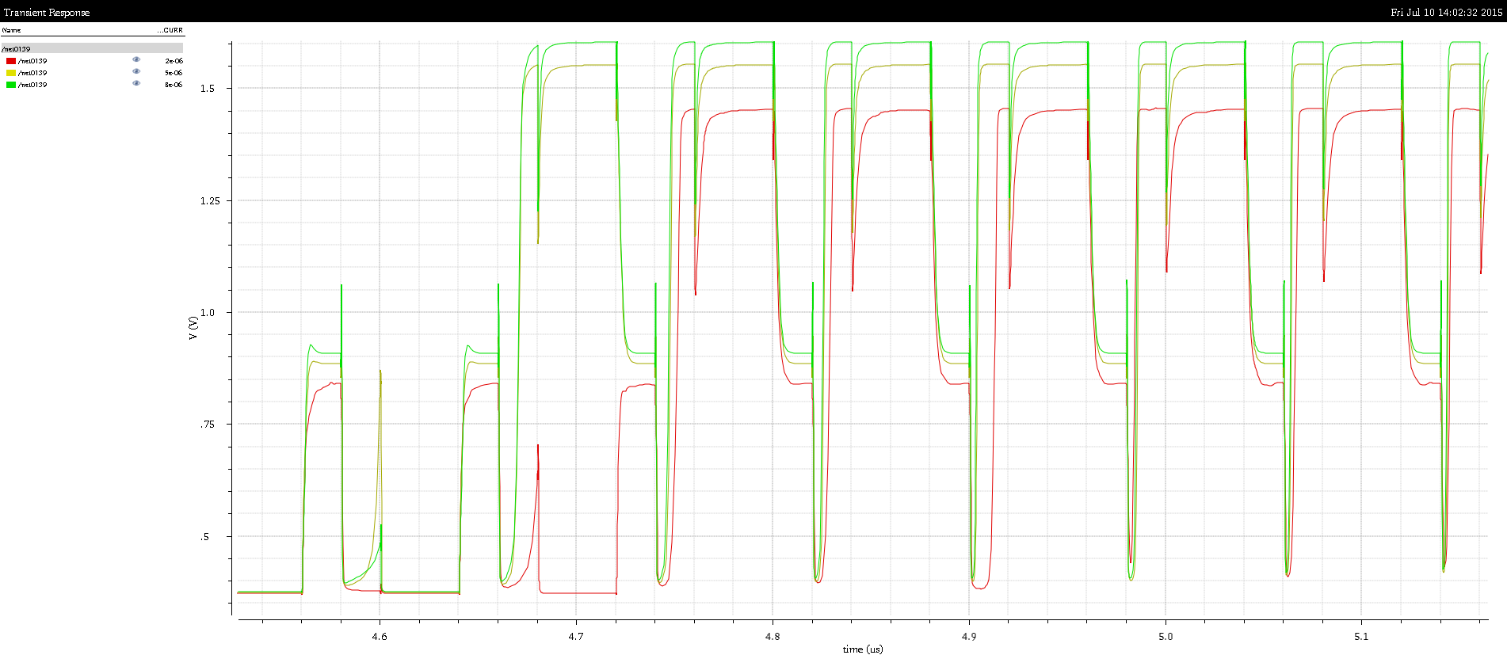
Monte-Carlo Simulation
Small systematic offset due to PMOS Bias variations from 2u to 8uA
0.3uA
PFB
24u
RefFB
RefIn
TooLow
24u
26u
Sc2
Sc2

Slide 28
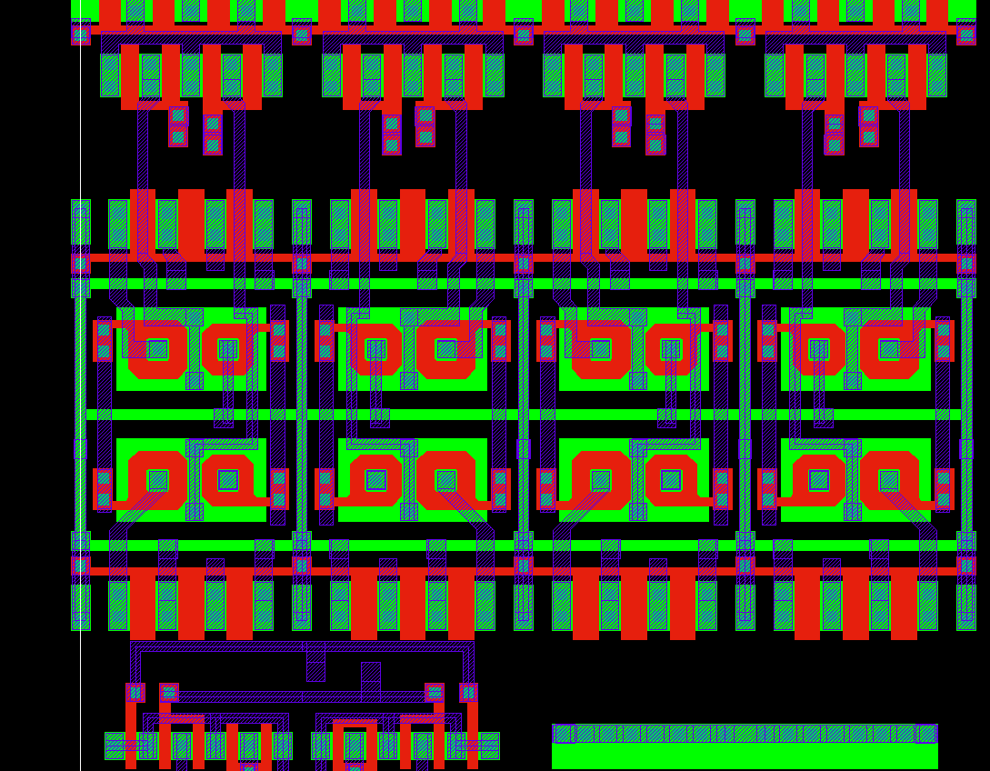
Layout
The NMOS current source has a complicated structure
It is based on enclosed NMOS and a PMOS that should compensate for voltage drops (the simple version with only NMOS behaved worse on DCD1)
The layout is dense
TooHigh
TooLow
Original cell

Slide 29
Layout
Simulations done but not shown:
Mixed mode simulation of the channel with different RedIn and PMOS bias voltages – OK
ADC works well in RefIn range 0.8V – 1.1 V
Comparator simulation with different corners – OK
Comparator simulation with added 5fC coupling capacitance – the coupling capacitance can contribute to systematic offset (5fC – 2uA) – however in reality we expect less capacitance
Simulations to be done:
Mixed mode simulation of the channel combined with mismatch simulation
Mixed mode simulation of the ADC on netlist extracted from layout
Mixed mode simulation of the channel with lower local VDDA level

Slide 30
Mismatch - Measurements

Slide 31
…
14u
CL
TooLow
10u
A
CH
TooHi
A
ADC15
14u
CL
TooLow
10u
A
CH
TooHi
A
ADC1
14u
CL
TooLow
10u
A
CH
TooHi
A
ADC0

Slide 32
…
14u
CL
TooLow
10u
A
CH
TooHi
A
ADC15
14u
CL
TooLow
10u
A
CH
TooHi
A
ADC1
14u
CL
TooLow
10u
A
CH
TooHi
A
ADC0

Slide 33
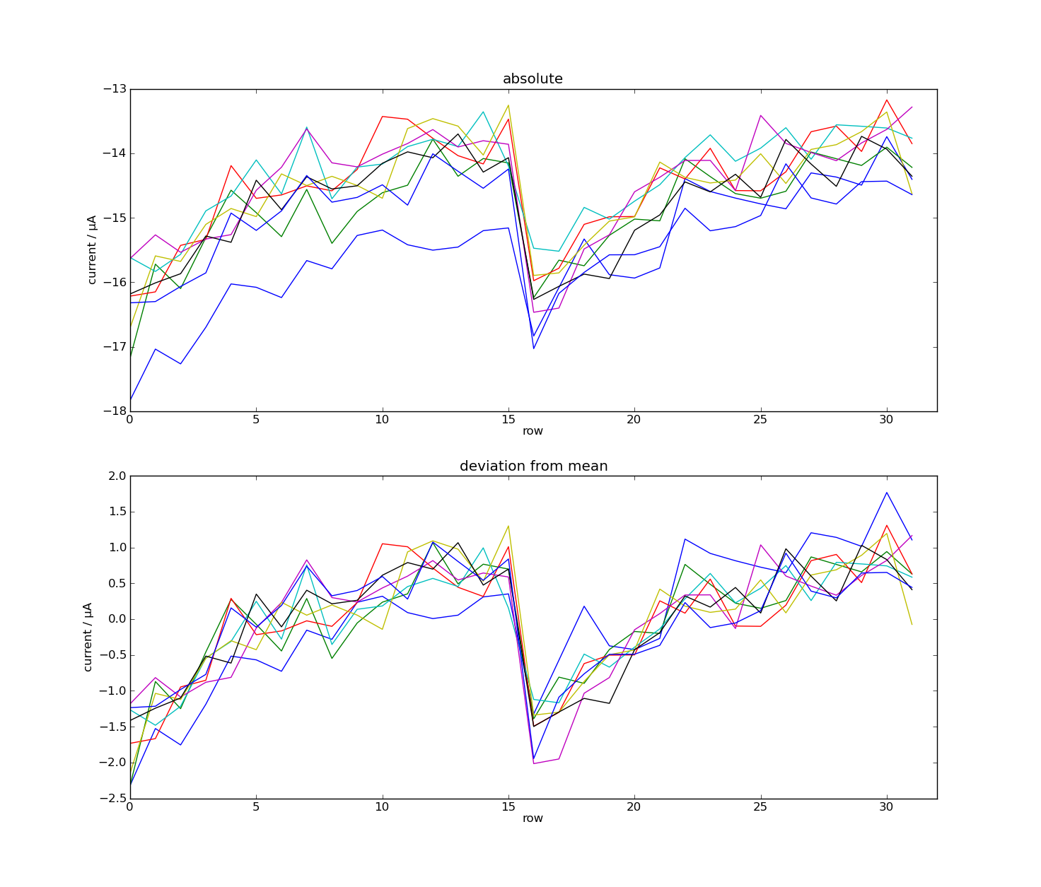
DCD Measurements
+
A

Slide 34
DCD Measurements
+
A
PMOS current varies by 2.8uA (from expected 24uA+48uA)
~1.5u

Slide 35
EMCM Tests
ADC characterization
ThHi
ThLo
Cmp1
Cmp2
C_{f}
SF
Rd=0
Logic
En
VAmpPBias
WrB*
A
Sw1
Wr*
3
DAC
1
RefNWELL
Sub
Add
2
AmpLow
I_{in}
WrB
VPSource
Sw2
24 μA
VFBPBias
NotRd AND Not Wr
VPSourceCasc
RefIn
Sw5
4
VFBNCasc
NotWr
Sw3
RefIn
RefFB
12 μA
NotRd
VFBNBias (VPSource2)
24 μA
TC
Sw4
To Next Cell
RefIn

Slide 36
EMCM Tests
ADC characterization
ThHi
ThLo
Cmp1
Cmp2
C_{f}
SF
Rd=0
Logic
En
VAmpPBias
WrB*
A
2*24μA - 2*24μA - 2*12μA
Sw1
Wr*
3
DAC
1
Sub
Add
2
AmpLow=1
I_{in}
WrB
VPSource
Sw2
2*24 μA
VFBPBias
NotRd AND Not Wr
VPSourceCasc
RefIn
Sw5
4
VFBNCasc
NotWr
Sw3
2*12 μA
RefIn
RefFB
12 μA
NotRd
VFBNBias (VPSource2)
2*24 μA
TC
Sw4
To Next Cell
RefIn

Slide 37
DCD Measurements
+
A
1.5u

Slide 38
…
14u
CL
TooLow
10u
A
CH
TooHi
A
1.5u
ADC15
14u
CL
TooLow
10u
A
CH
TooHi
A
1.5u
ADC15

Slide 39
…
14u
CL
TooLow
10u
A
CH
TooHi
1.5u/sqrt(2)
1.5u/sqrt(2)
ADC15
A
1.5u/sqrt(2)

Slide 40
…
14u
CL
TooLow
10u
A
CH
TooHi
Sqrt(2)*1.5u/sqrt(2)
ADC15
A

Slide 41
…
14u
I+d
TooLow
10u
A
CH
TooHi
I+d
I-d
A
6sigma = 1.5u
ADC15
I-d
IOut
-8u
-4u
-2u
IIn
8u

Slide 42
Summary
Measurements to be done:
VDDA measurement using test multiplexer
Analog CMC measurements on EMCM
Influence of offset DACs on noise
Matching after irradiation (DC measurement)
Noise without TIA (after irradiation)
Noise without input current source (after irradiation)
Measurements of large matrix (pilot run)
Analog EMCM, influence of offset DACs on noise, gated mode

Slide 43
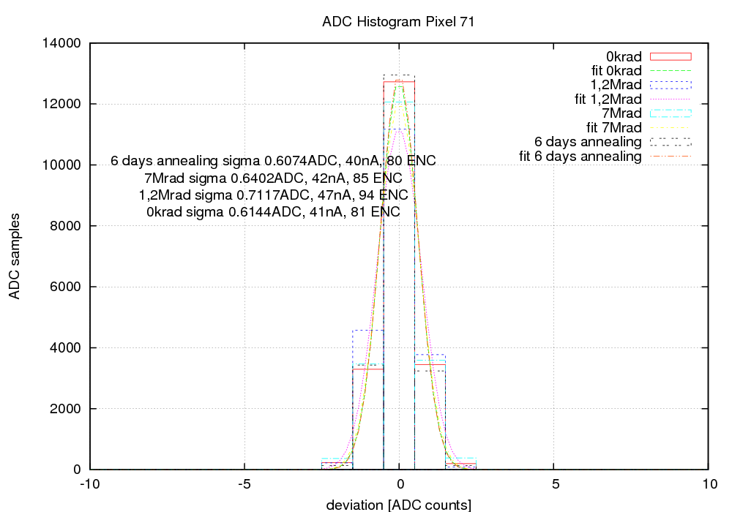
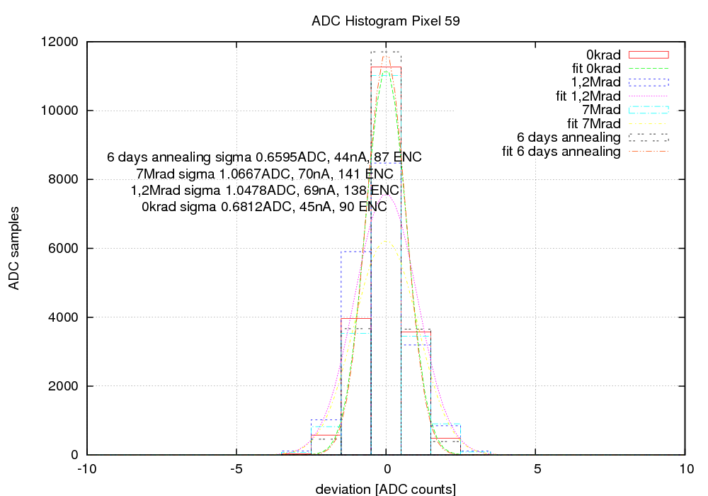
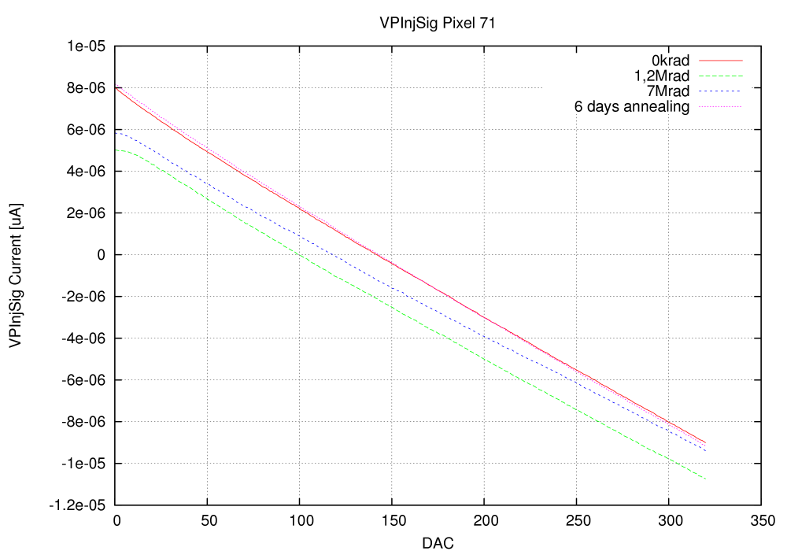
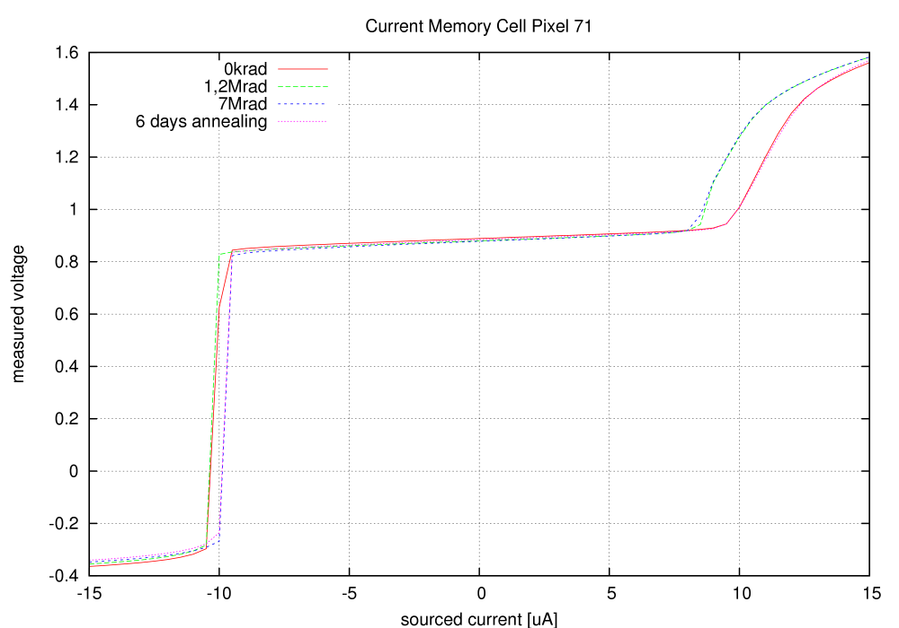
DCD 3 irradiation up to 7 MRad
Noise – channel 1
Noise – channel 2
No significant changes after 7 Mrad and 6 days of annealing
ADC characteristic
Analog characteristic of CSC

Slide 44
Summary
We are planning to submit the final DCD design end of August.
Several improvements:
Digital transmission
Larger output buffer current, adapted scheme, improved radiation tolerance of the output buffer
ADC long code problem
Better layout for better matching
Same orientation in cells
Larger transistors
Reduced voltage drops by distributed bias scheme and reduced RefIn current
Many important measurement results are missing, impossible to have them before the next submission

Slide 45
SWITCHER

Slide 46
SWITCHER
SWITCHER
Irradiation of latest SWITCHER has been done at KIT (dose 21 MRad)
The chip works after the irradiation
Bumping: bumping so far done in HD-lab, this works well for prototyping but is slow for production
Bumping with the required pitch (150 μm) is not offered by the vendor (AMS/IBM)
Solution: Company Pactec can place underbump metallization (ENIG) and solder bumps on single dies
SWITCHER submission planned for end of August 2015
Improvements: faster clear driver, needs larger decoupling capacitors for voltage regulators
Separated control of the termination resistance for serial input (should be always on) and for the other fast inputs
Pad geometry should be adapted

Slide 47
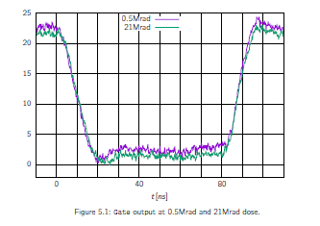
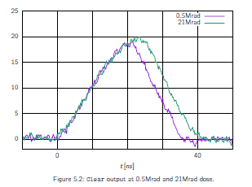
Rise Time Measurements – irradiated chip
Irradiation to 21MRad – 150pF load
We need to increase size of the power transistors
Can be done, but the chip size will increase by 100um

Slide 48
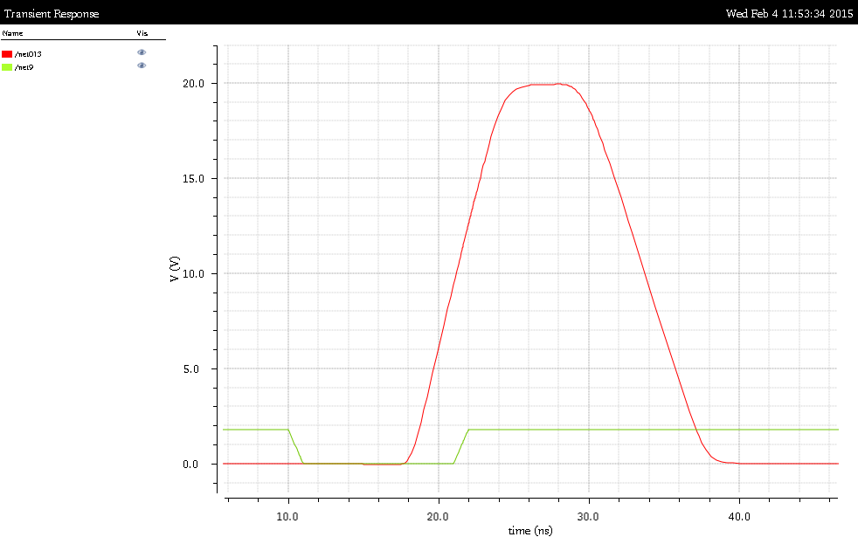
Simulation
Simulation of clear pulse with 150pF load
Output transistors 3 time wider
20ns

Slide 49
DCD – Measurements (2)

Slide 50
DCD tests on single chip PCB

Slide 51
Chip #1 Test all ADCs

Slide 52
Chip #1 Test all ADCs
…
ADC characteristics
Noise of the first ADC
Deviation from mean for every input
DNL: code difference for two consecutive inputs
(first ADC)
INL of the first ADC
Deviation from linear fit for every input
INL (peak to peak for all inputs)
Gain (nA/LSB)
Average noise (LSB)
DNL (peak to peak for all inputs)
All ADCs:
Noise vs. ADC position
INL vs. ADC position
DNL vs. ADC position
Gain vs. ADC position

Slide 53
Chip #1 Test all ADCs
Several ADCs show higher noise (out of 128 tested)
Bad ADCs

Slide 54
Chip #1 Test all ADCs
…
Noise of the ADC: ~1.3LSB (210e @ gq 450pA/e)
ADC gain 73nA/LSB
INL the „bad“ ADC: ~5.3LSB
Noise floor: ~0.58LSB (92e @ gq 450pA/e)
3LSBs
3LSB

Slide 55
Chip #2 test all ADCs – fit (-100 to 125)
…

Slide 56
Chip #2 Test all ADCs
Another chip: no bad ADCs – probably due to more careful optimization of bias parameters
ADC gain 72nA/LSB
Noise: ~0.55LSB
2.5LSB

Slide 57
Irradiations

Slide 58
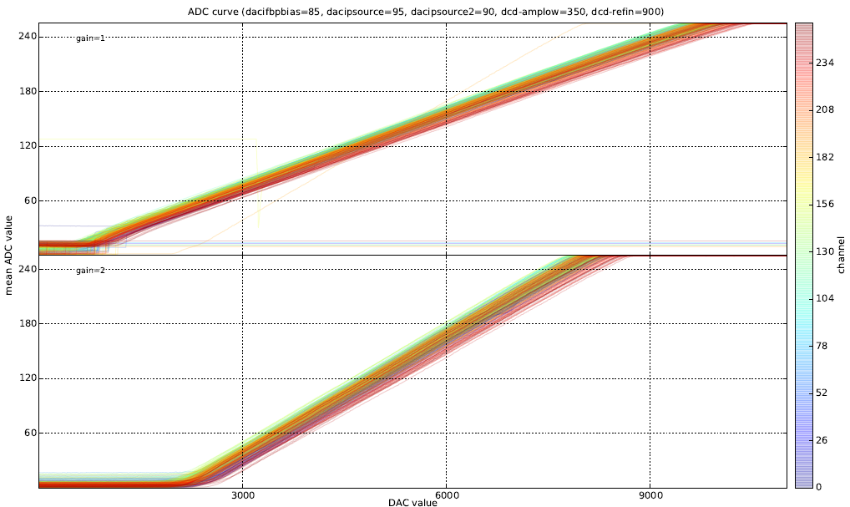
…
Example the measurement of all ADCs on the EMCM performed on the chip irradiated to 3MRad.
All ADC lines for gain 2 setting (output resistance 15kOhm) appear nice.
In the case of gain 1 setting there are several ADC lines which are not good. This is a surprising (“under investigation”), since the only difference between two measurements is the value of the resistor. One explanation can be that first ADC cell works better with an input resistance of 15kOhm. For this setting the bandwidth is lower and the noise is better filtered. In the final design we will use 15kOhm.

Slide 59
…
…

Slide 60
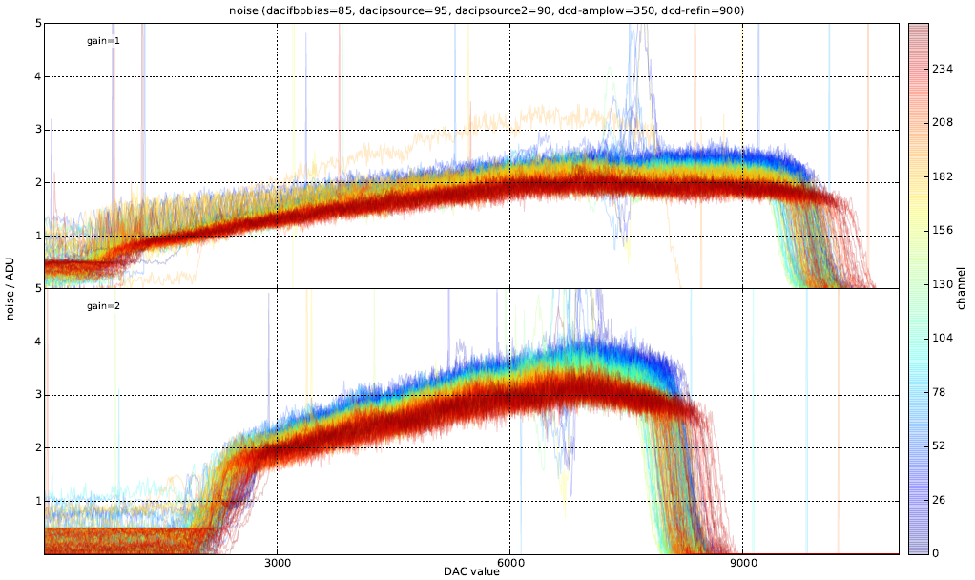
…
…

Slide 61
…
When we look to the lines with gain 2, we can notice that some number of ADCs have a bump (a long code 63)
We have tried to investigate this problem. Our simulations show that if the comparator threshold ThHigh of the first cell is by 2uA (25% of the range) higher than the nominal one, such a problem can occur. The input current is not recognized as too high in the first cell and the current overflows in all subsequent cells.
The resulting code is 63 until the comparator “fires”.

Slide 62
…
It is a statistical problem. It occurs only in small number of cells.
One explanation: mismatch between the mirror and the original cell. The effect of mismatch is probably enhanced by voltage drops.
The current source IPSource2 may be too strong or PMOS currents too weak, making the threshold too high.
Low
PFB
PFB
24u
24u
RefFB
RefFB
RefIn
RefIn
TooLow
24u
24u
24u
26u
Sc2
Sc2
Sc2
Sc2

Slide 63
…
Notice also, that the threshold depends to some extent on RefIn voltage.
We know: Mostly all affected pixels are far away from the power contacts. In this regions IPSource2 is stronger with respect to IPSource and IPFB (a voltage drop effect). (=> ADC range is smaller) Also, Ref is smaller due to voltage drops. We can mitigate the problem by reducing RefIn – however this may cause problems in ADCs where IPSource2 has mismatch in other direction or RefIn is higher.
Solution would be to improve the matching of the mirror- and the original cell by several measures
Larger transistors, equal orientation of the transistors, less local voltage drop (within one ADC), separated bias lines or reduced Refin current for less global voltage drop.
Low
PFB
PFB
24u
24u
RefFB
RefFB
RefIn
RefIn
TooLow
24u
24u
24u
26u
Sc2
Sc2
Sc2
Sc2

Slide 64
…
It is good to increase slightly VPSource (and thus the ADC range) and keep the other bias settings unchanged.
The allowed offset is 25% of the range, so it increases when we increase VSource. If we keep the other settings constant, the mismatch and voltage drop caused offset stays the same.

Slide 65
…
Irradiation results:
The irradiation has been done on EMCM. One DCD/DHP pair has been irradiated.
Before irradiation the chip settings were optimized. We see that it is optimal when IPSource setting is a bit higher than IPSource2/IFB.
In the following measurement, the IPSource2 has been varied. Only a subset of critical ADCs have been measured. The noise plots look fine. The noise is 2 – 2.5 LSBs for gain 2. It is probably caused by the long line between the calibration current source and the ADCs.

Slide 66
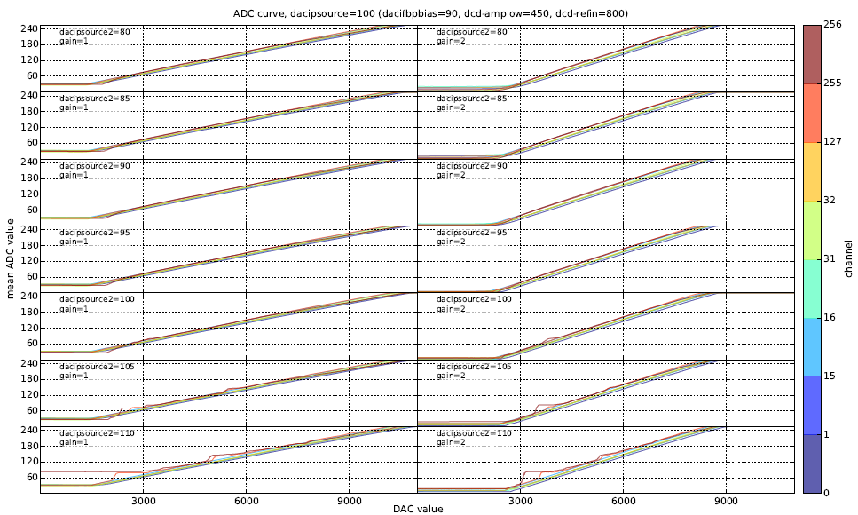
…
Irradiations: Optimization before irradiation

Slide 67
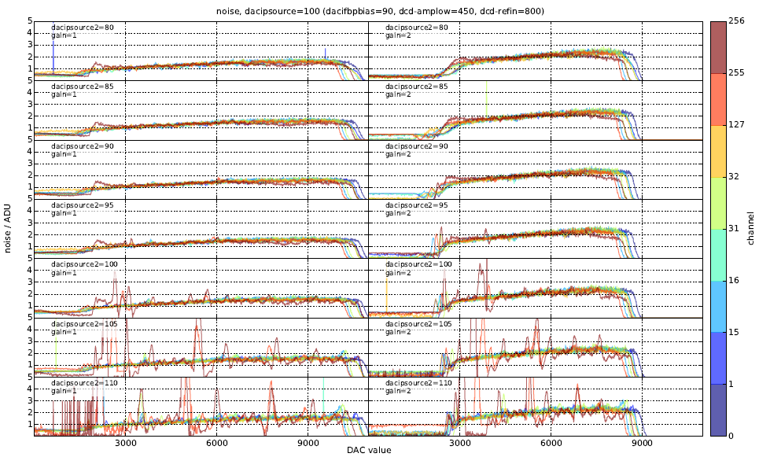
…
Irradiations: Optimization before irradiation

Slide 68
…
Irradiation results:
Every NMOS transistor in the analog part is done with enclosed geometry. We know that enclosed NMOS transistors are radiation tolerant. Transistors are separated by guard rings.
In digital part – NMOSes are not enclosed!
Important results: The digital communication between DCD and DHP is affected by irradiation. This can be seen from the following measurement.
DCD sends a digital test pattern. DHP delay setting is varied until the correct data pattern is received. There are two delay settings - a global one that is of duration of one clock period - 3ns. A local one, that should, ideally, be much finer.
Even before irradiation, there is not much space where a correct data pattern is received.

Slide 69
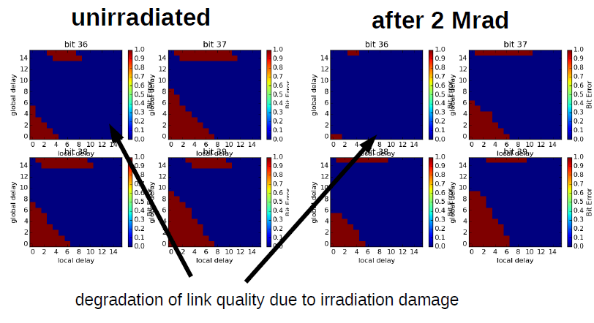
…
Irradiations: digital communication

Slide 70
…
There are many imperfect details.
The digital amplitude produced by DCD is not large – 220mV. The amplitude was chosen such to save the power in output drivers. They operate with 220Ohm termination resistance and 1mA current.
After irradiation (particularly in the dose range ~ 1 MRad) the data links behave worse than initially.
Possible explanation: in this dose range the digital amplitude gets smaller.

Slide 71
…
Irradiations: digital communication

Slide 72
…
After 20MRad and annealing, the DCD works well as before the irradiation.
However, the most critical dose is not the highest one. The effects to NMOS transistors usually show a turnaround. There is a threshold voltage decrease from 0 – several MRad (due to trapped holes) and then again increase. The increase can be addressed to activation of the interface traps (which are usually filled by H atoms who get removed). These traps compensate for the trapped holes. Additionally it may be an effect of annealing.

Slide 73
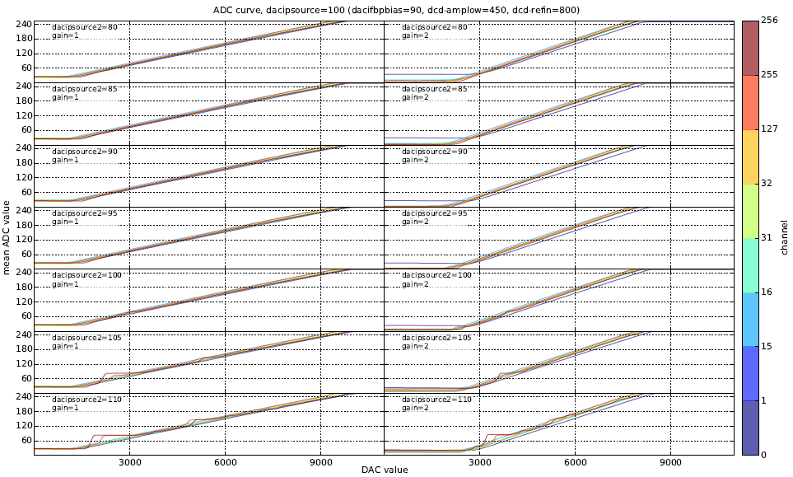
…
Irradiations: after 20MRad and 5 days annealing

Slide 74
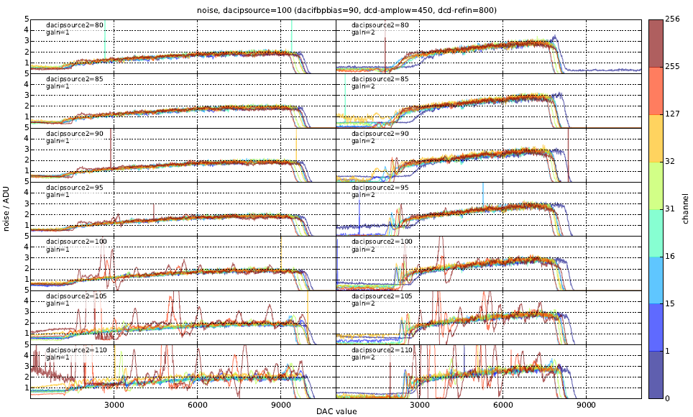
…
Irradiations: after 20MRad and 5 days annealing

Slide 75
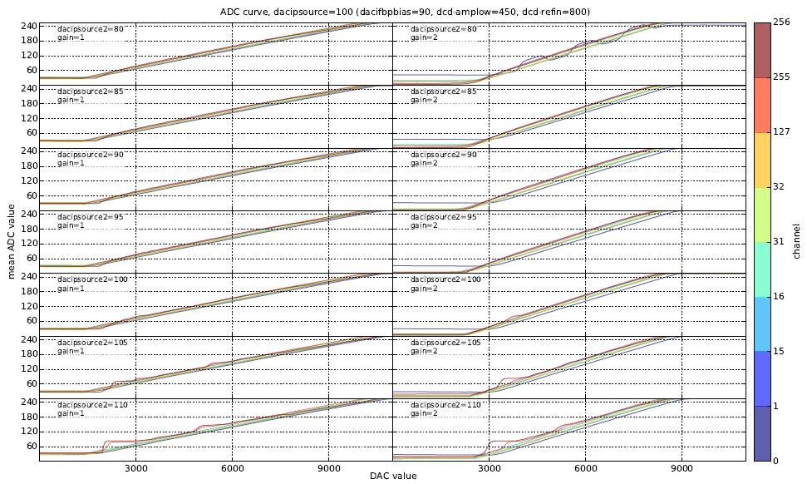
…
ADC curves at 1MRad. Equal setting as for 20 MRad. For low VPSource2 there is a problem in one ADC. It seems that one bit is stuck.
This is still under investigation. Notice that the problem didn’t occur when the same ADC was measured for low gain setting. Most probably it is a problem in digital communication.
With optimized setting the problem vanished.

Slide 76
…
Irradiations: after 1MRad

Slide 77
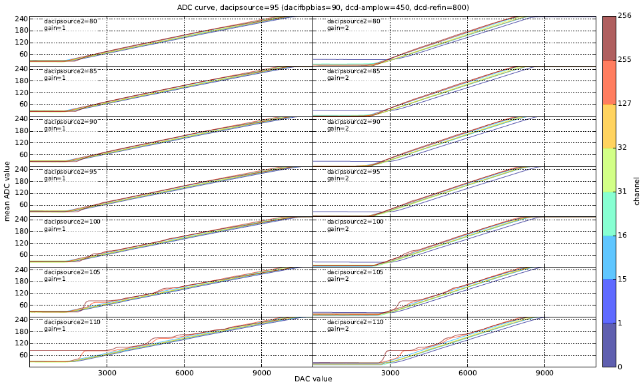
…
Irradiations: after 1MRad

Slide 78
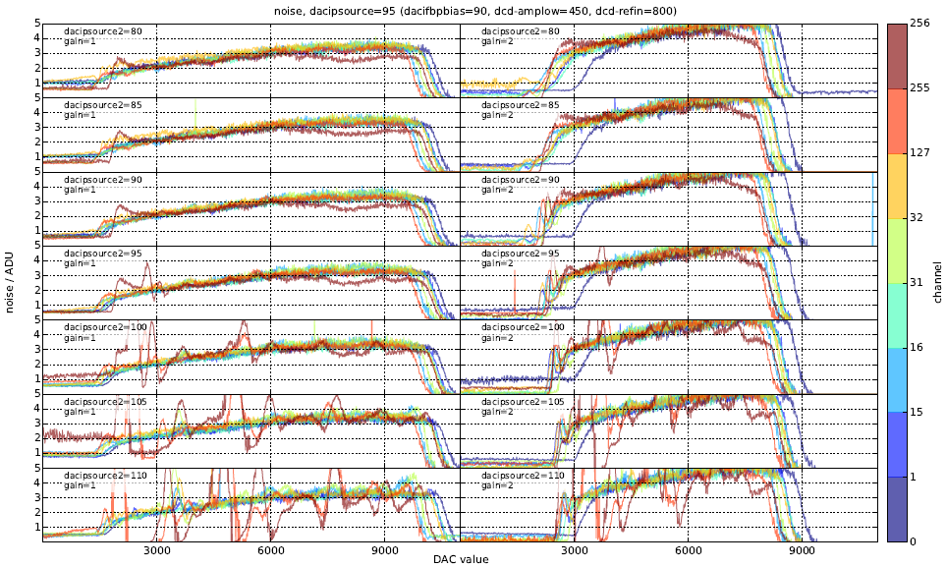
…
Irradiations: after 1MRad

Slide 79
…
The results for 2 and 5 MRad. At 5 MRad the stuck bit problem occurs only at low gain setting. It is difficult to say whether it is caused by wrong data transfer or by ADC itself

Slide 80
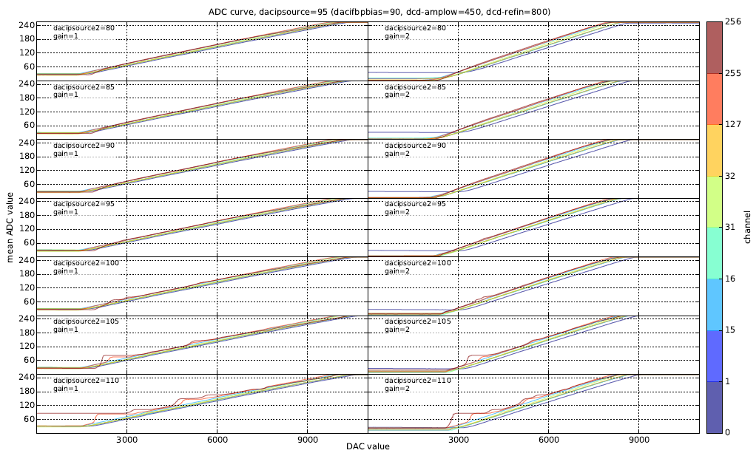
…
Irradiations: after 2MRad

Slide 81
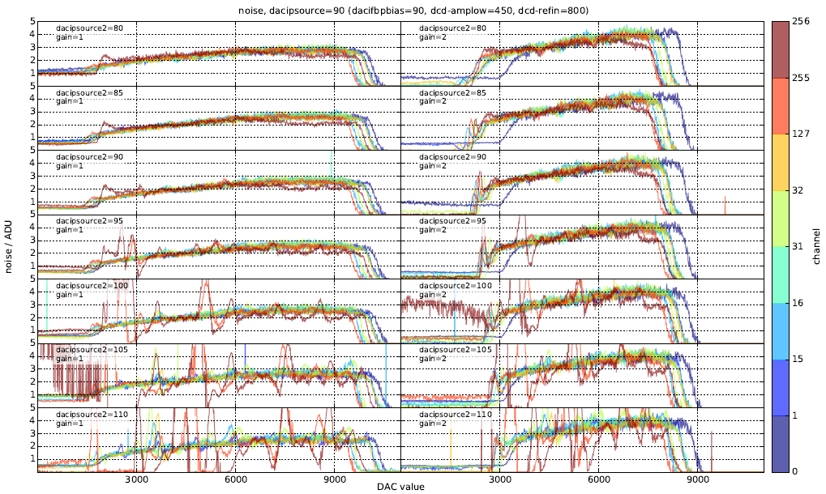
…
Irradiations: after 2MRad

Slide 82
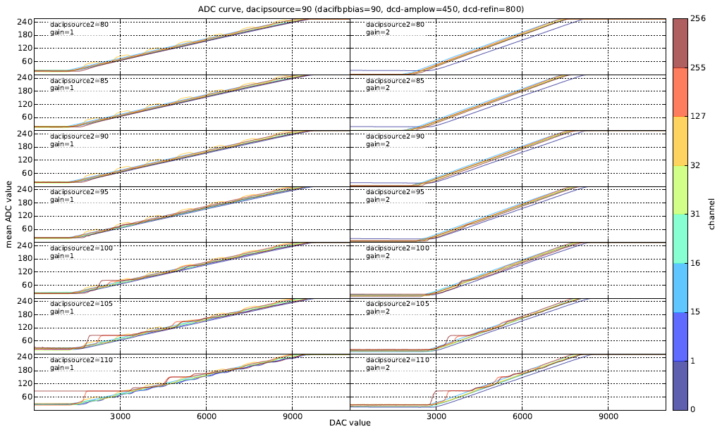
…
Irradiations: after 5MRad

Slide 83
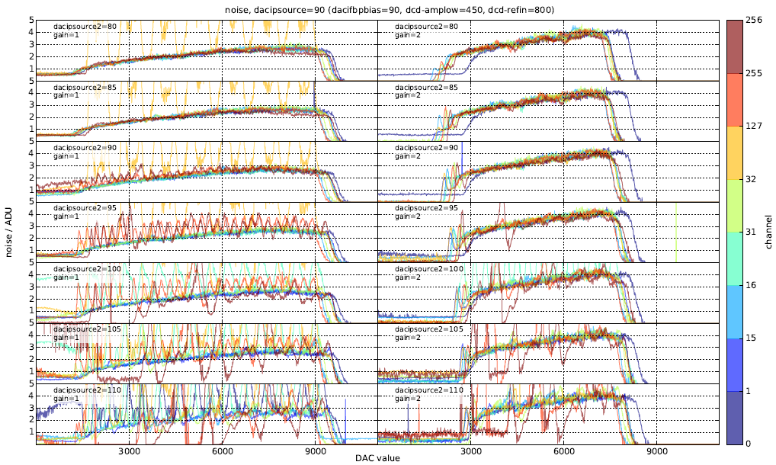
…
Irradiations: after 5MRad

Slide 84
…
Conclusion: for every step in irradiation, we can find a setting for which the ADCs work fine either in low- or in high gain mode.
Digital communication should be made more robust by increasing of the amplitude in DCD’s transmitter and improving the digital receiver/delay cells in DHP. (Better granularity and symmetry.)
Concerning ADC noise, it was 2 LSBs at 0 and 20 MRad as well as 2 and 5 MRad but had a peak at 3.5 LSBs at 1 MRad.
This effect is under investigation
RC
Bias V.
ADC

Slide 85
Backup Slides

Slide 86
DCD tests on EMCM

Slide 87
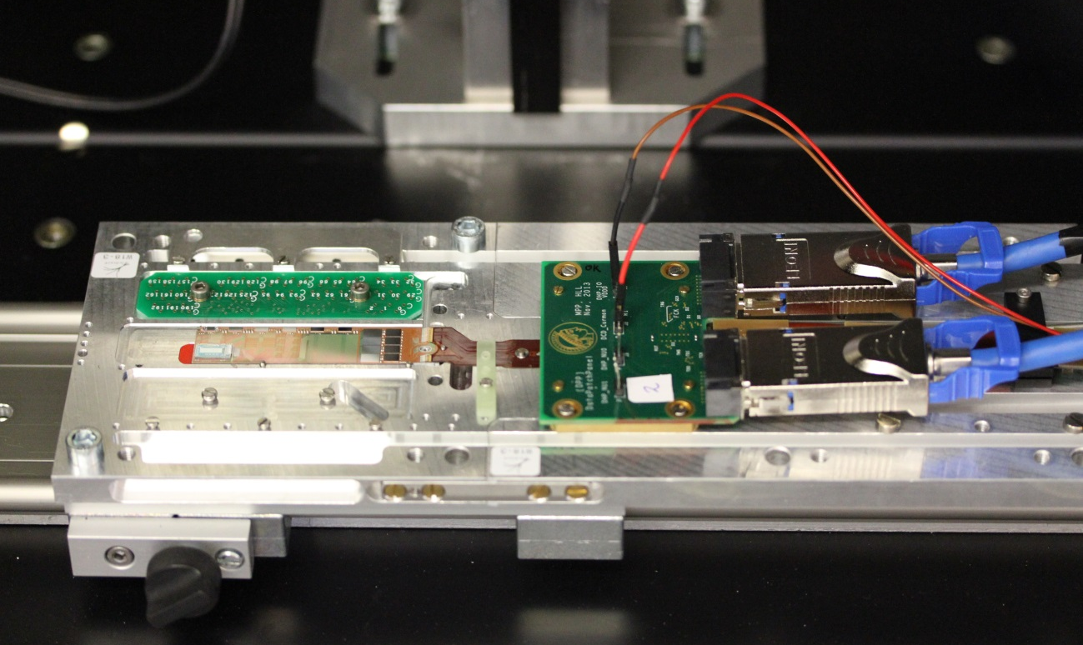
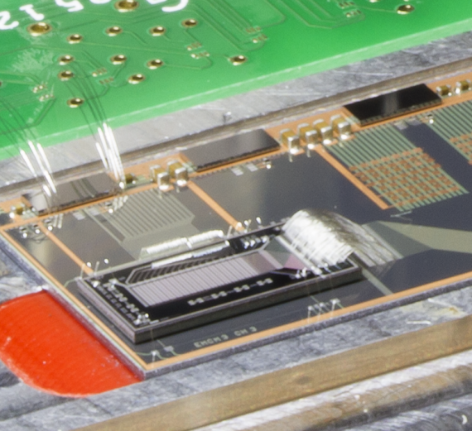
DCD
EMCM
All ASICs can be configured and read out, Switcher outputs ok
Small PXD6 matrix connected to DCDPipeline

Slide 88
EMCM Tests
Digital test pattern has been used to tests the digital blocks and the communication DCD - DHP
Test pattern
ADCs
bit | 29 | 30 | 31 | 0 | 1 | 2 | 3
7 | 0 | 0 | 0 | 1 | 0 | 0 | 0
6 | 1 | 1 | 0 | 0 | 0 | 1 | 1
5 | 1 | 1 | 0 | 0 | 0 | 1 | 1
4 | 1 | 1 | 0 | 0 | 0 | 1 | 1
3 | 1 | 1 | 0 | 0 | 0 | 1 | 1
2 | 1 | 1 | 0 | 0 | 0 | 1 | 1
1 | 1 | 1 | 0 | 0 | 0 | 1 | 1
0 | 1 | 1 | 0 | 1 | 0 | 1 | 1
mux
DCD digital block
DHP

Slide 89
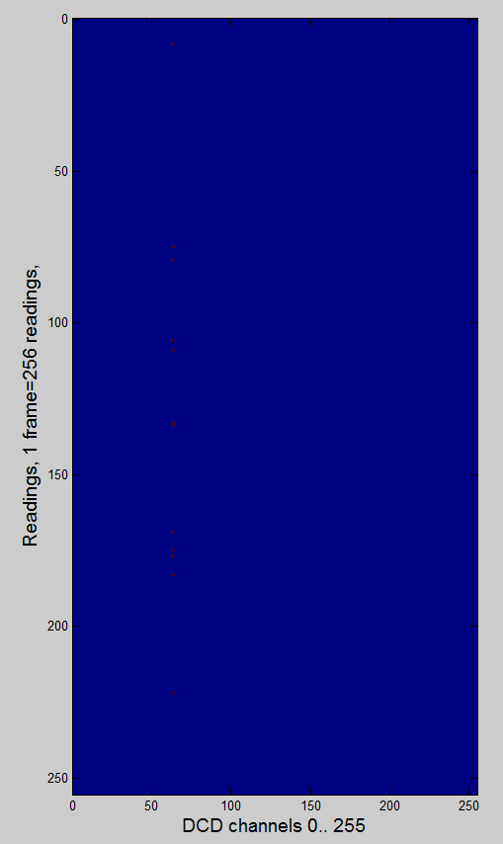
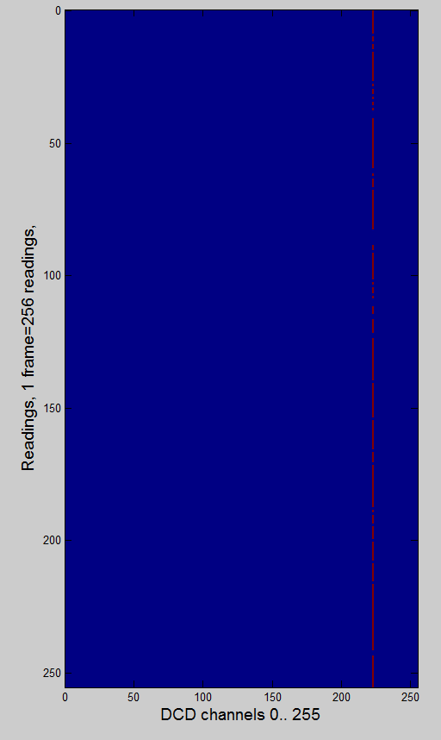
EMCM Tests
Digital test pattern has been used to tests the digital blocks and the communication DCD - DHP
250MHz, DCD1, VDDD=1.8V
305MHz, DCD1, VDDD=1.8V
~/TIMING/15_12_22_DCDpp0_1/test_pattern_of_dhpdcd0_bit61_SLDY_0.pdf
~/TIMING/15_12_22_DCDpp0_3/test_pattern_of_dhpdcd0_bit15_SLDY_0.pdf
column 223
(128ADU 160ADU)

Slide 90
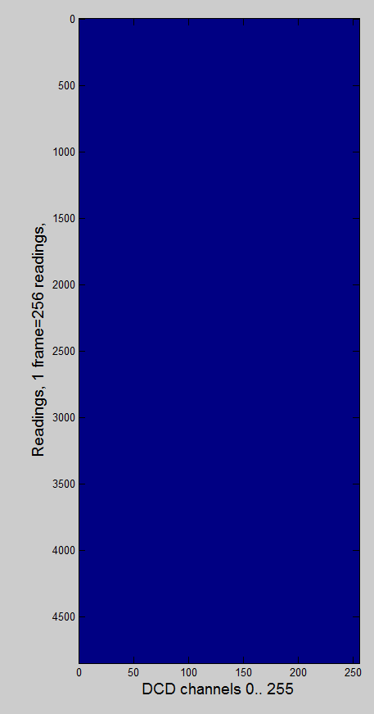
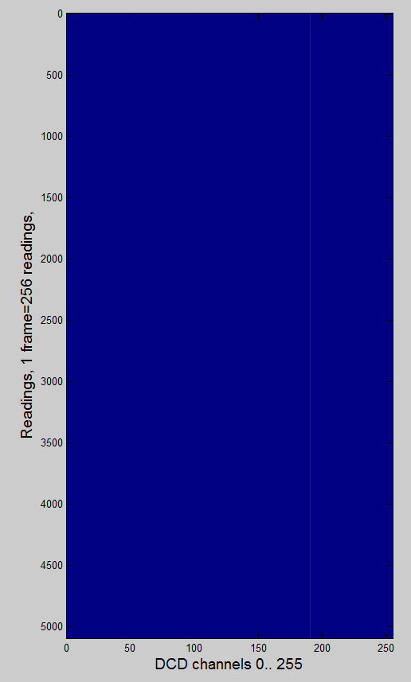
EMCM Tests
Digital test pattern has been used to tests the digital blocks and the communication DCD - DHP
305MHz, DCD1, VDDD=1.9V
305MHz, DCD4, VDDD=1.9V
PLL_SER_
CLK_DLY=1
~/TIMING/15_01_08_DCDpp3_2/test_pattern_of_dhpdcd3_dcd_cmos_clk_dly_0_pll_ser_clk_dly_1.pdf
~/TIMING/15_01_07_DCDpp0_1/test_pattern_of_dhpdcd0_bit0_SLDY_0.pdf
✔
column 191
(128ADU 132ADU)

Slide 91
DCD Measurements
Test pattern
bit | 29 | 30 | 31 | 0 | 1 | 2 | 3
7 | 0 | 0 | 0 | 1 | 0 | 0 | 0
6 | 1 | 1 | 0 | 0 | 0 | 1 | 1
5 | 1 | 1 | 0 | 0 | 0 | 1 | 1
4 | 1 | 1 | 0 | 0 | 0 | 1 | 1
3 | 1 | 1 | 0 | 0 | 0 | 1 | 1
2 | 1 | 1 | 0 | 0 | 0 | 1 | 1
1 | 1 | 1 | 0 | 0 | 0 | 1 | 1
0 | 1 | 1 | 0 | 1 | 0 | 1 | 1
Channel 191

Slide 92
DCD Measurements
Test pattern
DCD
DCD digital block
VDD
Channel 191
Bias block
DCD ck
DCD data
Seen by DHP
Duty cycle
DCD ck
Delayed data DHP
DHP
Synchronized by DHP

Slide 93
DCD Measurements
Digital communication works for ~ 99.5% channels
Can be improved (next submissions) by slight resizing of bias currents, delay elements in DHP and DCD
RLC models of DEPFET needed
Ideal
bit | 29 | 30 | 31 | 0 | 1 | 2 | 3
7 | 0 | 0 | 0 | 1 | 0 | 0 | 0
6 | 1 | 1 | 0 | 0 | 0 | 1 | 1
5 | 1 | 1 | 0 | 0 | 0 | 1 | 1
4 | 1 | 1 | 0 | 0 | 0 | 1 | 1
3 | 1 | 1 | 0 | 0 | 0 | 1 | 1
2 | 1 | 1 | 0 | 0 | 0 | 1 | 1
1 | 1 | 1 | 0 | 0 | 0 | 1 | 1
0 | 1 | 1 | 0 | 1 | 0 | 1 | 1
127
0
-127
0
127
Realistic
Channel 191
127
0
-127
0
127
In DHP - CMOS
Reduced sampling window

Slide 94
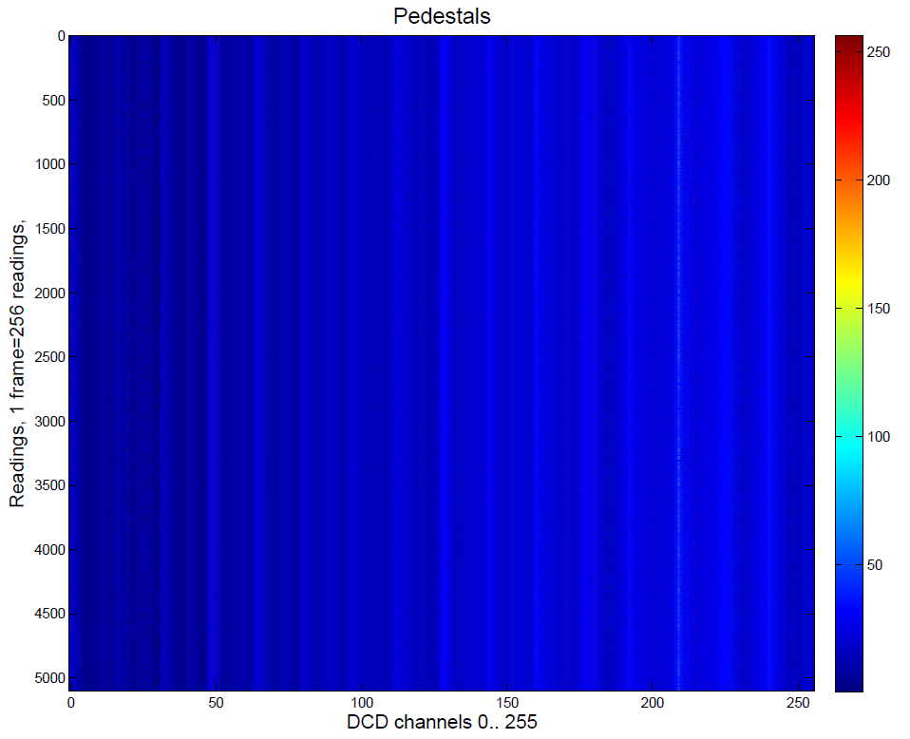
EMCM Tests
ADC readout – only one channel has unstable bit 6 (64) (digital problem?)
305MHz, DCD1, VDDD=1.9V
Column 209
ADU: 30, 31, 32, 33 & 63

Slide 95
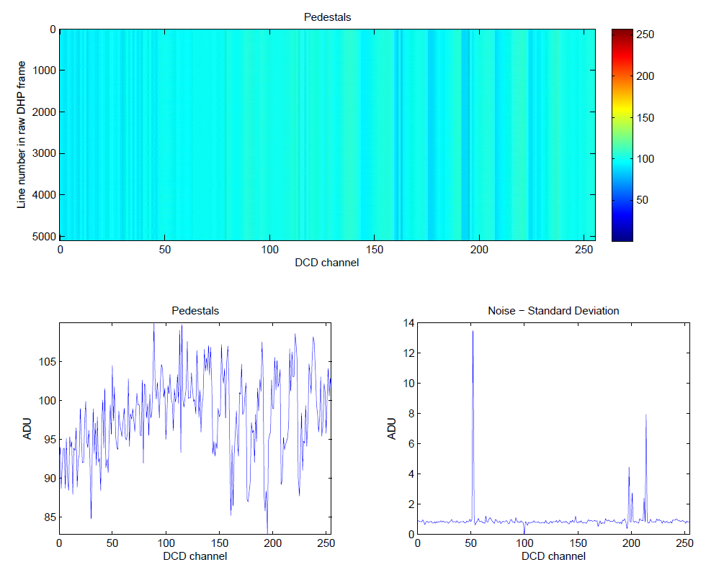
EMCM Tests
ADC characterization
ADCs have been measured using internal- and DHE current source
Only 3 ADCs with slightly higher noise – unstable bit (e.g. bit 5)
Column 52
ADU: 94, 95, 96, 126, 127

Slide 96
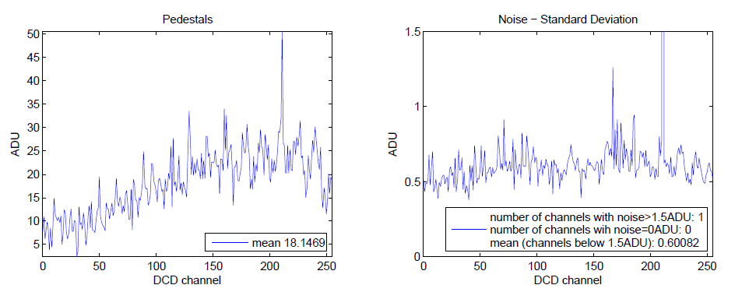
EMCM Tests
ADC characterization
Noise measurement with LMU power supply on EMCN
Noise 0.5LSB < 100e
Only one ADC with noise ~ 1.5 LSB
4 DCDs on
daciampbias = 66
dacifbpbias = 80
dacipsource = 88
dacipsource2 = 77

Slide 97
EMCM Tests
ADC characterization
ThHi
ThLo
Cmp1
Cmp2
C_{f}
SF
Rd
Logic
En
VAmpPBias
WrB*
A
Sw1
Wr*
3
DAC
1
RefNWELL
Sub
Add
2
AmpLow
I_{in}
WrB
VPSource
Sw2
24 μA
VFBPBias
NotRd AND Not Wr
VPSourceCasc
RefIn
Sw5
4
VFBNCasc
NotWr
Sw3
RefIn
RefFB
12 μA
NotRd
VFBNBias (VPSource2)
24 μA
TC
Sw4
To Next Cell
RefIn

Slide 98
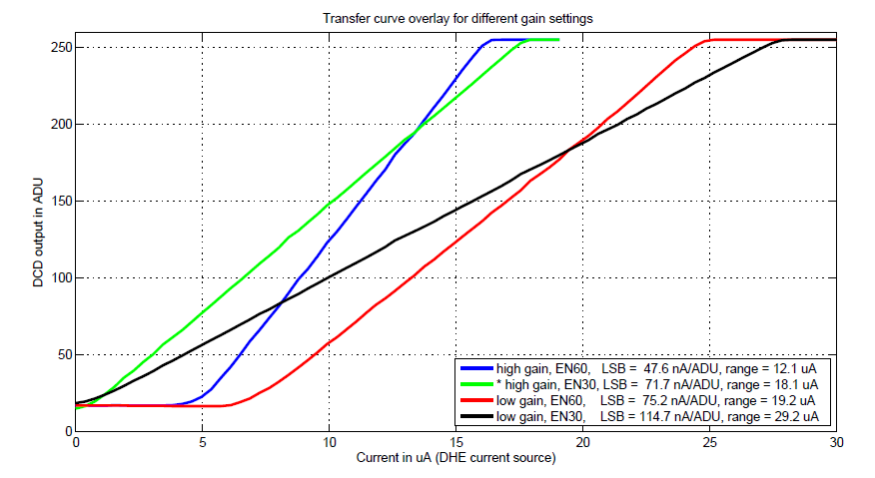
EMCM Tests
Different gain settings

Slide 99
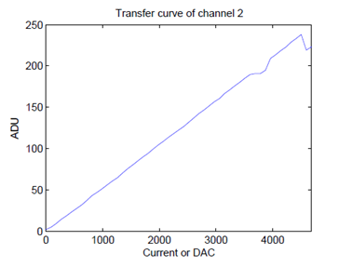
EMCM Tests
Missing code
„missing code“

Slide 100
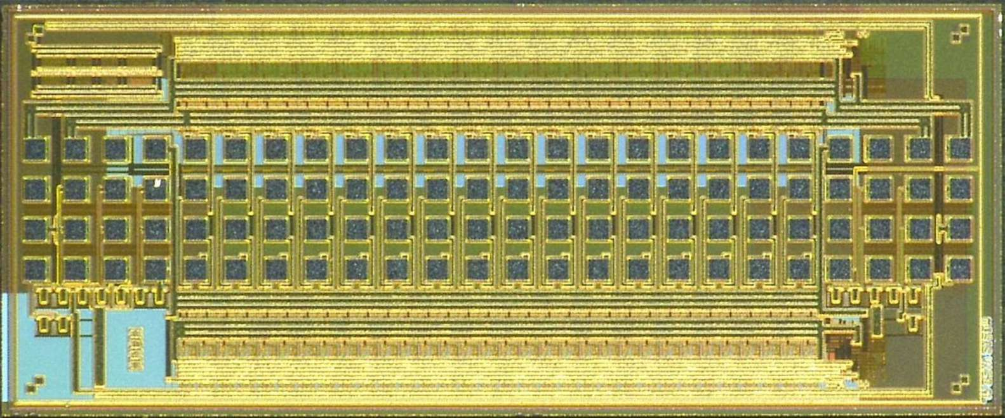
SWITCHER
SWITCEHR chips generate fast high-voltage pulses of up to 20 V amplitude to activate gate rows and to clear the internal DEPFET gates.
SWITCHER is implemented in HV AMS 180nm technology.
32 channels with a clear- and a gate-driver each.
SWITCHER in 180nm AMS

Slide 101
DCD Measurements
Noise vs. Code
RC
Bias V.
ADC

Slide 102
Problem of low ADC end
Problem of low ADC end
M1 current too weak
Resistance Sw too high
Out too low (Amplifier A saturates)
Low VT of PMOS not produced or bad corner – do corner simulation
Try
Increase Sc2
Decrease NMWELL voltage
Increase RefFB voltage
Decrease AmpLow (better Out_low), but increase IPAmp for higher in
In next chip – increase W/L of differential PMOS
Out
PFB
24u
RefFB
Sw
RefIn
24u
24u
Sc2
M1
Sc2

Slide 103
…
DCD is a multi channel ADC chip
The ADCs are of the pipeline type.
This means, for 8-bit resolution we need ~8 cells.
The cell contain or two current mode memory cells, two mirror cells, two comparators.
Algorithm: The input current is stored into both cells. Mirror cells make two copies of the current stored in cell 1. The two copies are compared with the high and low threshold. If the current is higher than the high threshold a reference current (ISource) will be subtracted from the output. If the current is lower than the low threshold, the reference current is added to the output.
14u
CL
TooLow
12u+/-4u
10u
A
CH
TooHi
12u+/-4u
B

Slide 104
…
Why do we need two current memory cells? => the output signal must be the duplicated. We implement the duplication by adding up two stored currents.
The current memory cells are biased by, internally generated, voltages VPSource2 and VPFB. The currents IPSource2 and IPFB should be equal.
The thresholds of the comparators and the reference current are controlled by the bias voltage VPSource.
The reference current and VPSource determine the size of LSB and the ADC range.
For the standard setting (64) the ADC range is 16uA.
IPSource2/IPFB determine the dynamic range of the current memory cell – for standard setting (64) the dynamic range is 24uA.

Slide 105
Missing codes
The problem can be solved by changing of layout, which can be done within one-two weeks.
Question: Is the long code problem worth of this effort
It reduces dynamic range by ¾
Dynamic range is still 20u which should be ok
„missing code“
20uA

