Slide 1
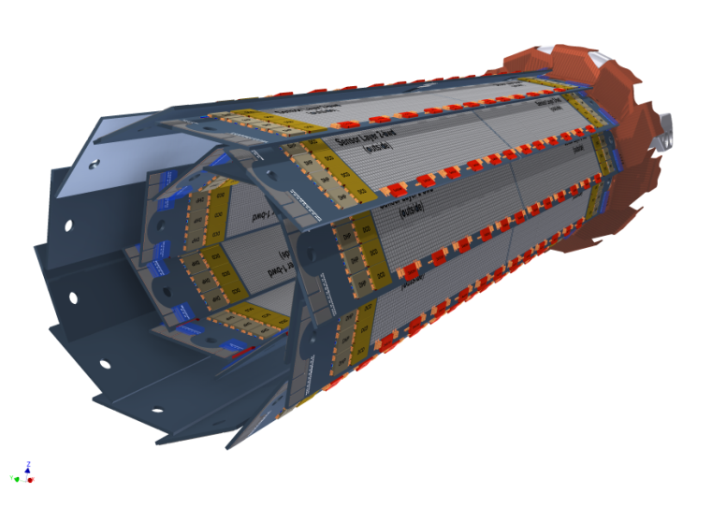
Test Program for the First Pilot Module
Christian Koffmane, Felix Müller, Eduard Prinker, Jakob Haidl

Slide 2
First power up of Pilot Run
# | Task |  | automatic/manual
1 | Power up ASICs |  | automatic
2 | sanity check: voltages and currents |  | manual/automatic
3 | configure JTAG, set termination resistors in Switcher 6 | TO DO: readout of temperature | automatic
4 | sanity check: voltages and currents; DHPT temperature |  | manual
5 | Power Down, Add BoundaryScan Board, Repeat steps 1-4
6 | check boundary scan (incl. DHPT-DCD links) |  | automatic
7 | Power Down, Disconnect BoundaryScan Board, Repeat steps 1-4
8 | scan DHPT link parameters (amplitude, boost, delay) |  | automatic
9 | Set optimal aurora parameters into inifile
10 | PowerCycle of System (ASICs, DHE, EPICS of DHH) - Repeat steps 1,4
11 | digital test pattern, delay scan |  | automatic
12 | program SWB sequence (192 channels) - switch DHPT output still on |  | automatic
13 | increase DCDPP current limit |  | automatic
14 | enable DCDPP analog part: analog CMC off, no pedestal correction |  | automatic
15 | sanity check: voltages and currents |  | manual/automatic
16 | check test pattern again
17 | Manual Delay tuning (raw data read-out => minimize noise)
18 | power up DEPFET voltages | list of voltages - Rainer | automatic

Slide 3
# | Task |  | automatic/manual
19 | sanity check: voltages and currents; |  | manual
20 | raw data read-out, 1 single DHP | Pixel mapping, DCD channel masking | automatic
21 | check: pedestal distribution, noise |  | automatic
22 | check: response on light (laser) |  | manual
23 | set Gate_On to Gate_Off
24 | sampling point scan | TO DO: check sequence - verify with EMCM | automatic
25 | optimization of DEPFET voltages, |  | automatic
26 | store pedestal values for 2-bit DAC offset correction |  | automatic
27 | upload pedestals for zero suppressed readout | memory mapping (timing) | automatic
28 | trigger zero suppressed frames (no data should arrive)
29 | Laser spot (move laser accros the matrix)
30 | Source measurement
31
32 | power down DEPFET voltages | POWER DOWN | automatic
33 | disable DHPT to SWB control signals |  | automatic
34 | disable DCDPP analog part |  | automatic
35 | decrease current limits |  | automatic
36 | power down ASIC voltags |  | automatic

