Slide 1
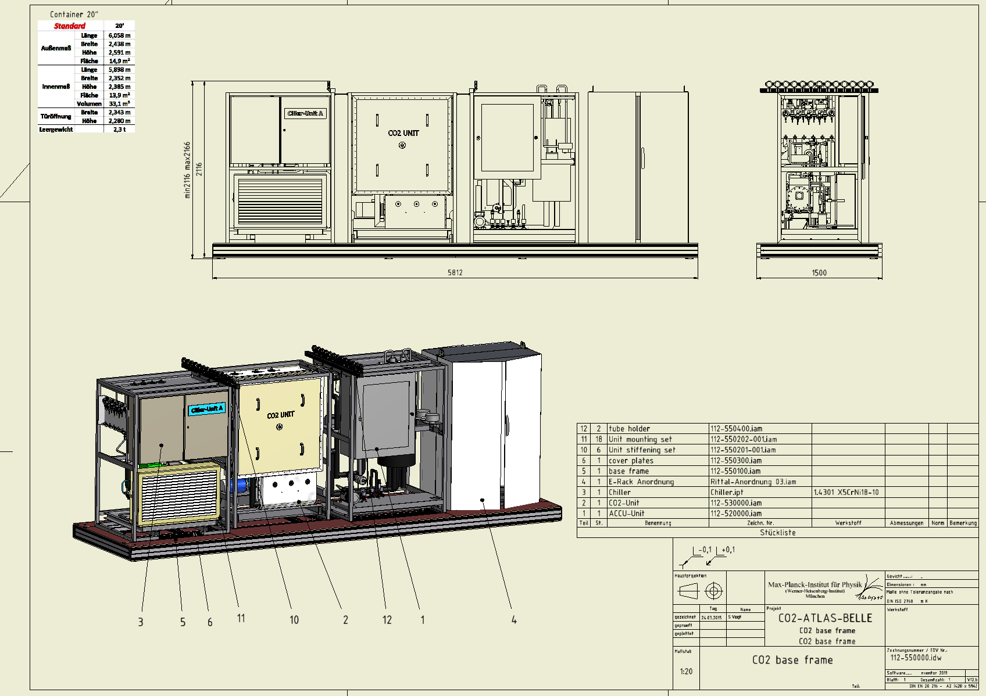
IBBelle for VXD
Use one unit first
Assemble on a platform which fits in a 20’ container
No redundancy
(ATLAS needs 100% up time in order to prevent reverse annealing of irradiated detectors. We don’t)
2nd unit will be added later
(budget available)

Slide 2
Safety Certification
First discussion with TÜV:
We got an offer of ~26000€ for the certification
but this includes ‘operational safety’ (Does the plant satisfy the specs).
We need only to certify the security aspect (Can anybody be harmed?).
Continue discussion on January 19.
Information from Kimura-san:
Under certain conditions no TÜV is needed, KEK can do the certification:
We do tests of components according to KEK standards.
Kimura-san will visit MPP during commissioning of IBBelle.
Conditions:
Maximum working pressure: < 80 bar.
He- leak test.
Dye Penetration Inspection (DPI).
Pressure test (110 bar shortly, 60 bar long term).
Tests were done.
Can we limit the pressure to 80 bar (Present spec: 110 bar)?

Slide 3
Operation Pressure
KEK requires <80bar pressure during operation.
During normal operation the pressure is much lower (10 bar @ -30ºC + 10 bar pressure drop)
However, higher pressure occurs:
during maintenance if all CO₂ is stored in (warm) accumulator.
In case of power failure (Chiller off).
During filling if warm CO₂ is circulated.
Static pressure depends on amount of CO₂ per volume (density)
At 35ºC the critical density is:
420 kg/m³ for 80 bar (KEK)
700 kg/m 3 for 100 bar (CERN)

Slide 4
Operation Pressure
Volume (l)
At 35ºC (max ambient temperature)
Worst case: all CO2 stored in Accu (Maintenance)
With 55l volume (Accu):
420 kg/m³ => 23.1 kg or 20.7 l @ -40ºC (KEK)
700 kg/m³ => 38.5 kg or 34.5 l @ -40ºC (CERN)
Minimum fill level to operate IBBelle: 17.2 l
There is still a reserve of 3.5 l
(However, with two units the total volume becomes 19.8 l, very close to the limit)
However, this is for the extreme case that all CO₂ is in the Accumulator:
IBBelle (W/o Accu) | accu unit | 0,57198977
 | interconnect | 0,24513847
 | pump unit | 1,91918977
 |  |  | 2,73631802
long transfere line |  |  | 8,08177145
Junction Box & Manifolds | JB | 0,16342565
 | manifolds | 0,3268513
 | connection | 0,9805539
 |  |  | 1,47083085
PXD (incl. Service) | PXD | 0,00271434
 | warm/cold | 0,02434734
 | flex | 0,25831227
 |  |  | 0,28537395
SVD (incl. Service) | SVD | 0,0444306
 | warm/cold | 0,0447677
 | flex | 0,51662454
 |  |  | 0,60582284
Grand Total |  |  | 13,18
min. fill in accu |  |  | 4
Liquid volume |  |  | 17,18
Volume | volume (l) | density (kg/cm²3) | p (bar) @ 35 deg | Delta (l) | Delta (kg)
Accu only | 55,00 | 348,60 | 78,7 | 3,52 | 3,93
total volume | 68,18 | 281,21 | 75,7 | 8,48 | 9,46
Accu + trans + detector | 65,44 | 292,97 | 76,4 | 7,45 | 8,31
Accu + IBBelle | 57,74 | 332,08 | 78,1 | 4,55 | 5,08
So, in normal scenarios the margin it quite high!
There is no need to store all CO₂ in the Accu,
we can transfer it a bottle or simply empty part of it and top up afterwards

Slide 5
Warm Operation
For warm operation (with circulating CO₂) we need to add the pump pressure (pressure drop in flex lines) to the vapour pressure.
With Δp ~ 10 bar the maximal temperature for warm operation is 28ºC……
The only possible problem may occur if we fill with CO₂ at high ambient temperature (> 28ºC)
Here we must pre-cool the CO₂ before we start the pumps
We should do that anyway, to avoid CO₂ to be close to the critical temperature (31ºC)
A software control of the pump may be a nice feature, too

Slide 6
Options
Modification of IBBelle for p_{max} = 80 bar: ~4000€
(replacement of burst discs to custom made ones, 200€ piece)
If we can get the certificate from TÜV for a comparable price (and KEK accepts it) we could it!
Advantage: larger operation window for CO₂ level
Disadvantage: depend on TÜV for later upgrades and changes (?)
But, we can work with 80 bar, so we do not need to pay any price

Slide 7
MARCO
MARCO volume: 10.2 l (Accu cannot be sealed off)
Minimum fill level: 2.7 l (1 l in Accu ?, 1.7 l in rest of MARCO)
In case the transfer lines are similar as for IBBelle (34 m, 11 l volume)
R = 718 kg/m², already above the 100 bar limit
If we want to stay below 420 kg/m³
Max volume for detector and transfer: 1.9 l, leaving about 3 m transfer line!
TÜV certification for MARCO
Bring MARCO close to B1 (or B1 close to MARCO)
What are modification costs for p_{max} = 80 bar?

Slide 8
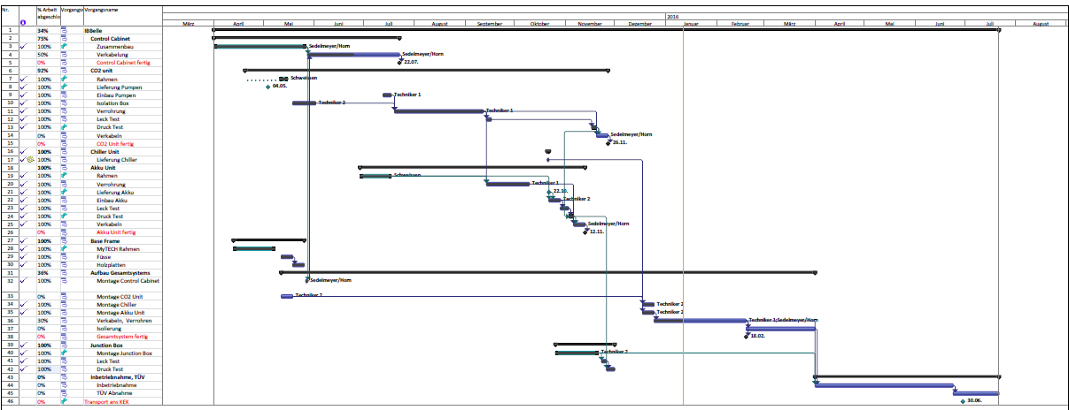
Schedule
Components assembled and pressure tested
Control cabinet, accu unit and chiller mounted on base frame
Next:
Pump unit on frame, interconnection (piping, cables)
Software installation
Basic functionality tests, warm run, safety certification
Foam insulation
Cold commissioning,
Shipping to KEK: June/July 2016

Slide 9
Commissioning
Close collaboration with NIKHEF/CERN team needed
Install and debug software (necessary changes, EPICS!)
Dry run of control software (use standalone PLC as emulator)
Check complete setup (best, if Bart could make an inspection )
all components in place
correctly connected
documentation
dry out
Basic functionality tests (based on low level SCADA instructions or expert modus)
temperature sensors (fan or cold spray)
pressure sensors (pressure with N₂)
pneumatic valves (noise, vibrations)
(or pressurize one section after the other and monitor with pressure sensors)
heaters (can we run them dry)?
vacuum pump (for filling)
Lewa pumps (can they operate dry?)
Pressurize complete system with N₂ and check for tightness
First Ideas

Slide 10
Commissioning II
Fill with liquid CO₂ for warm run
Check level gauges, operate pumps and heaters
Check flow rates, temperature and pressure distributions (reproduce CO₂ phase diagram)
Check pressure regulation with accu
Circulate and heat CO₂ using internal bypass
Adjust Lewa pump
Circulate CO₂ with junction box using dummy load
Repeat with chiller (but main circuit still warm) / Commission chiller according to manufacturer instructions)
Check for leaks
Complete foam insulation
Cool down in steps to expected operation temperature
First: internal bypass
Secondly with junction box dummy heater
Check flow rates, pressure drops and adjust pump power
Exercise all maintenance and emergency scenarios (provoke discharge?)
Long term tests
Response to change of operation conditions (load on/off…)
Monitor flow rates and pressure drops (filter probably need to be changed early)
Need simulations on expected flow rates and pressure drops (in work)
First Ideas

Slide 11
Summary
Construction of IBBelle at MPP runs smoothly
Completed for commissioning: ~ February
After discussion with Kimura-san:
TÜV not needed, KEK can certify IBBelle
However: limit to 80 bar (instead of 110 bar)
=> negociate with TÜV
Develop commissioning scenario (together with NIKHEF/CERN)
Need EPICs software!

