Slide 1
DCD Engineering Run, ASIC Tests at KIT

Slide 2
DCD - Engineering Run
Conservative version
As now with the following changes: larger LVDS bias current, in ADC layout added dummy structures, antenna diodes, new gain settings
Main version 1
Changed sampling TCK edge
Parallel sampling mode for probe tests at full speed via JTAG, needle pads
Programmable LVDS current (2 levels)
Programmable RefLVDS (2 levels, normal and by ~30mV increased)
Defined power up sequence – VDDD should be turned on as first (fixed power up problem – nwell was vdda, source vddd)
Separated bias DACs for up and down (for better LSB uniformity)
IPDAC resized
Gain settings redone
In ADC layout added dummy structures, antenna diodes
Main version 2
As version 1 with larger ADC transistors and uniform orientation for better matching and less missing codes
Main version 3
As version 2 with new digital block – ID-code changed to one with LSB=1, added digital test patterns as proposed by Florian

Slide 3
DCD
New type
As version 3 with capacitive SAR ADC
Also submitted – wire bond bump bond adapter for standalone DCD tests

Slide 4
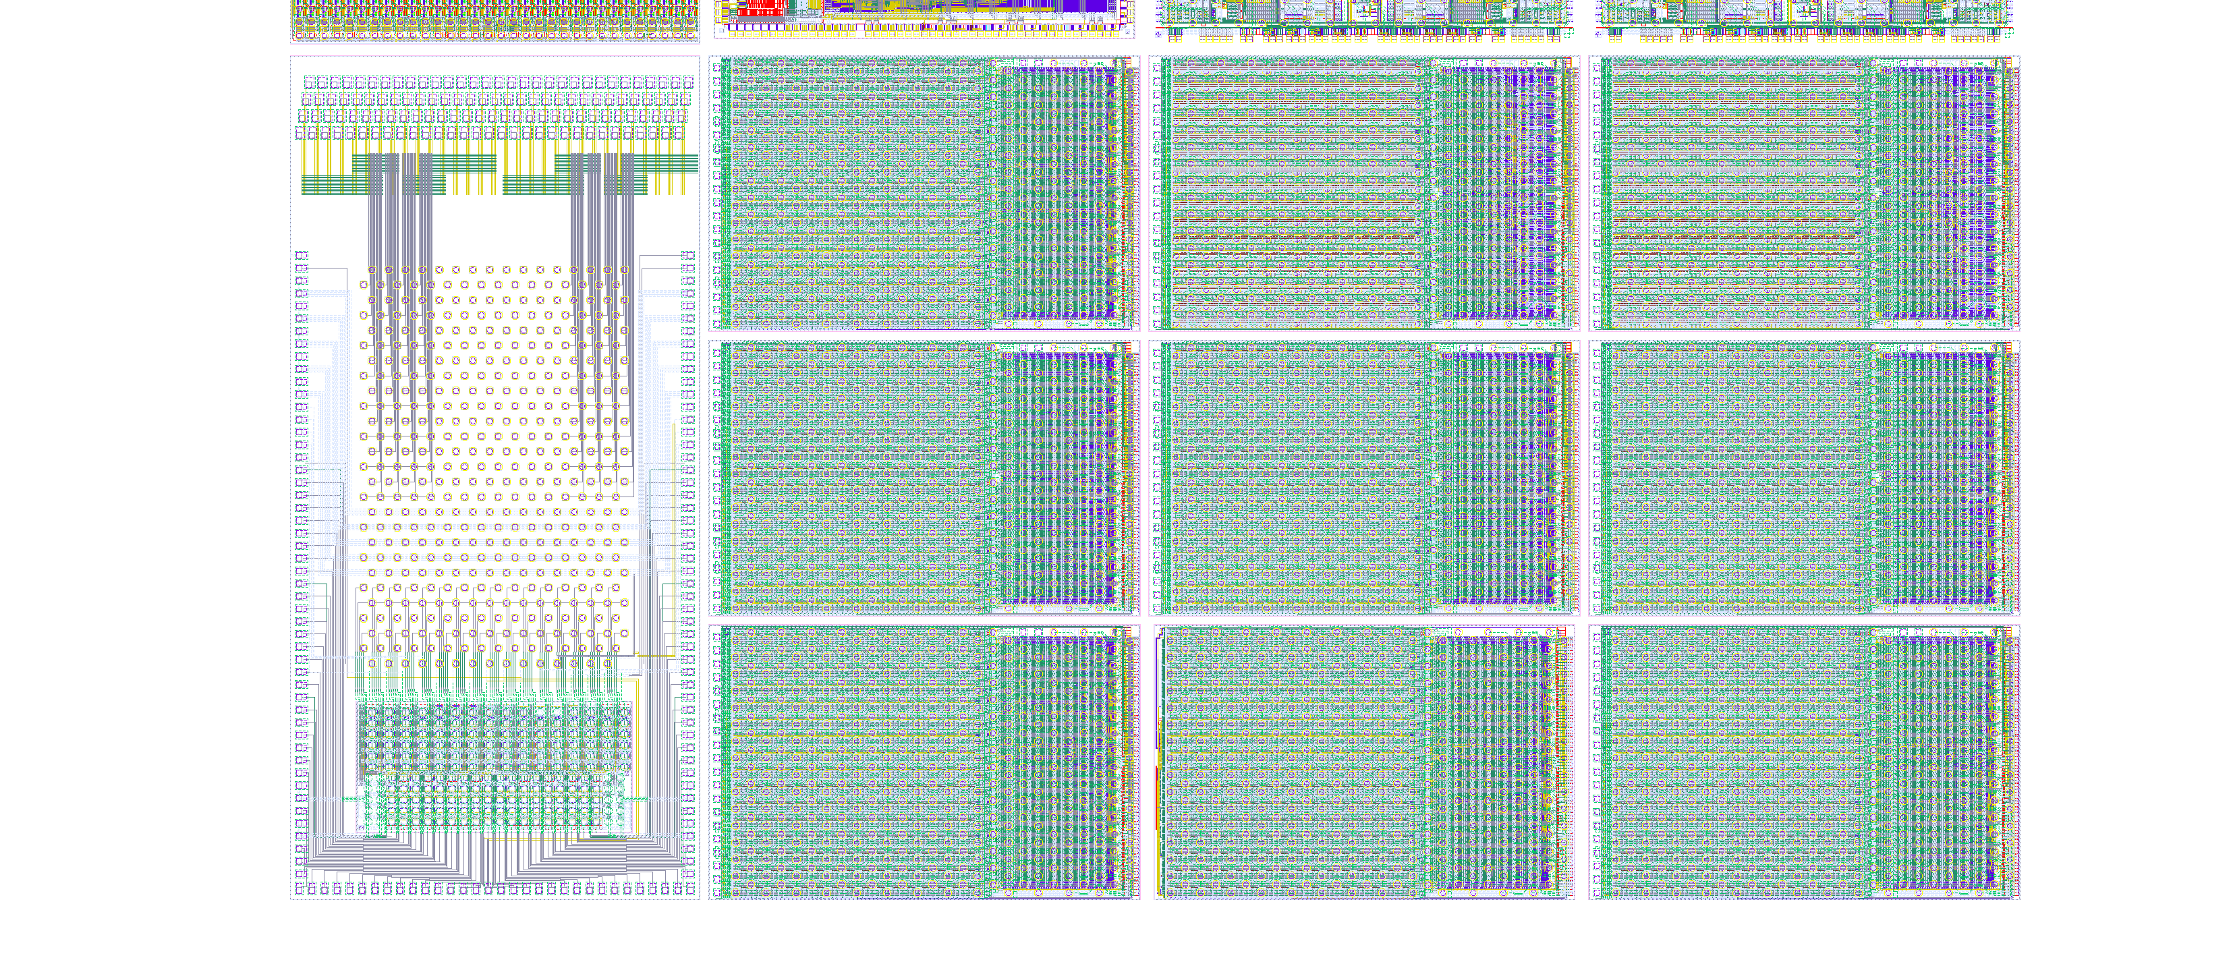
DCD
…

Slide 5
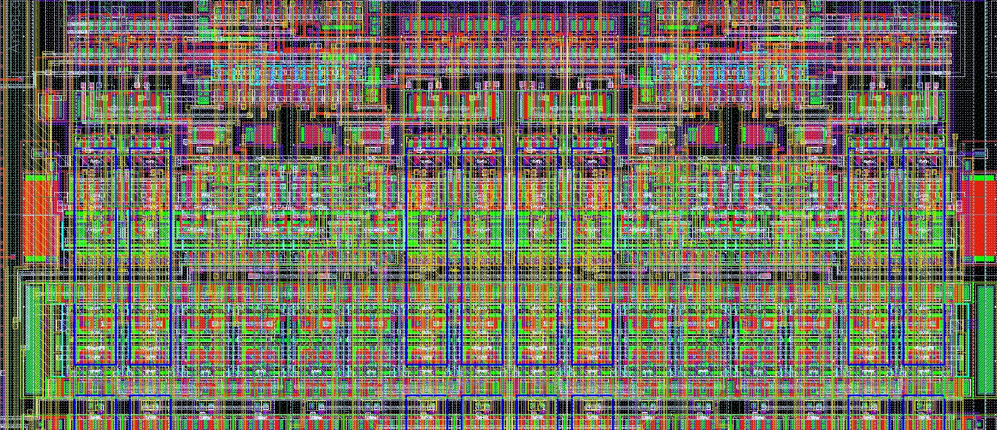
DCD
…

Slide 6
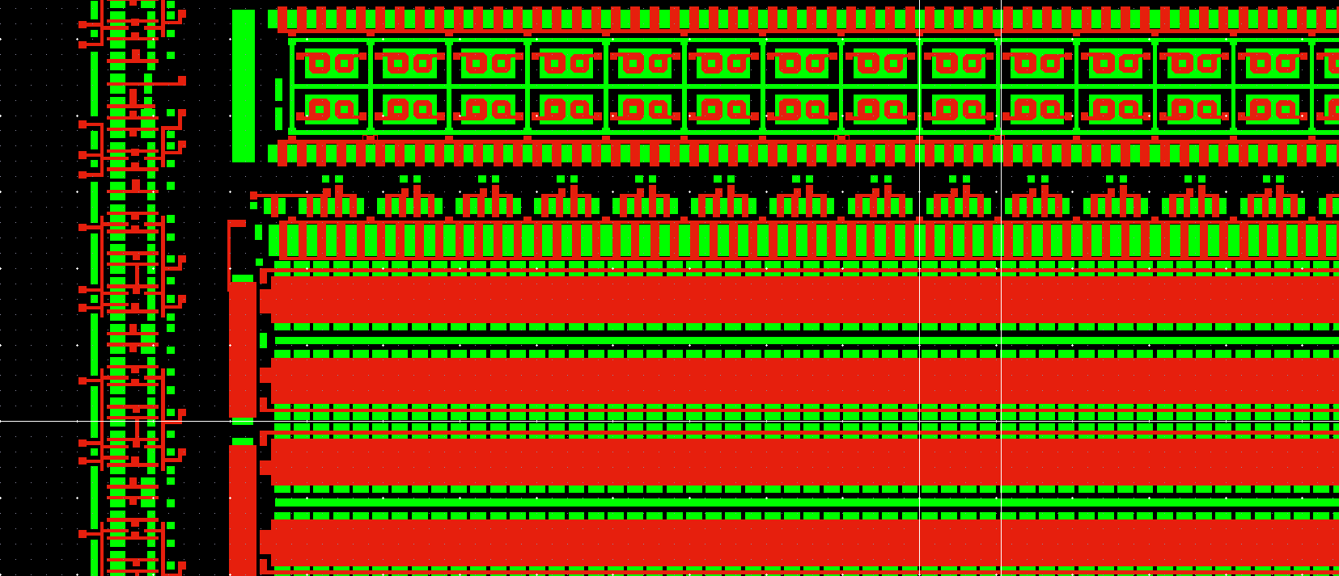
DCD
…

Slide 7
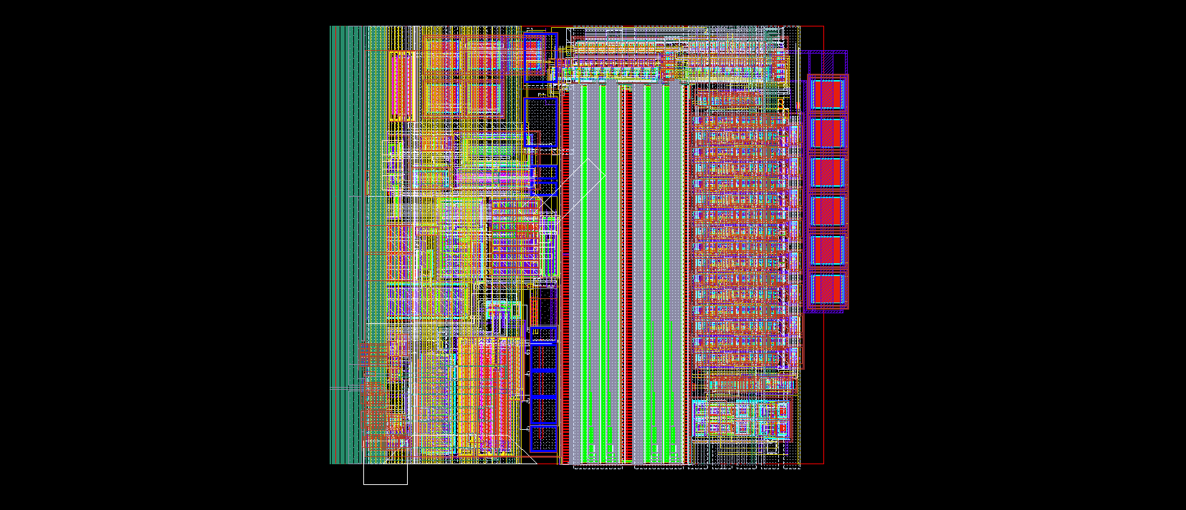
DCD
…

Slide 8
DCD
DCDBv4
IEKP made their small probe available
Heidelberg probe PCBs for switcher and for DCD are at KIT
Software is ready
The adapter plate for the small probe station is in production
Tests on of the old DCDBv4 can start in the second half of January

Slide 9
DCD
DCDv5
Three new probe PCBs and probe cards are in production
Switcher probe card – added HV multiplexer and voltage divider allows (digital) tests of all 64 Switcher output
DCD probe card 1 – can contact all 64 digital outputs and test them by FPGA placed on PCB (spartan 3). The probe card is compatible with all DCD versions
DCD probe card 2 – can use the test multiplexer of the new DCD. Connector to faster FPGA board Nexys Video.
New (self made) probe station (replica of the existing probe station used for CMS module production) will be built in February. We will use it for wafer DCD tests.
New DCD adapter with on chip DCDRO (single ended – LVDS convertor) has been submitted
PCB for the new adapter will be designed, readout with Manuel’s FPGA board or with Nexys
Switcher tests on modular PCB

Slide 10
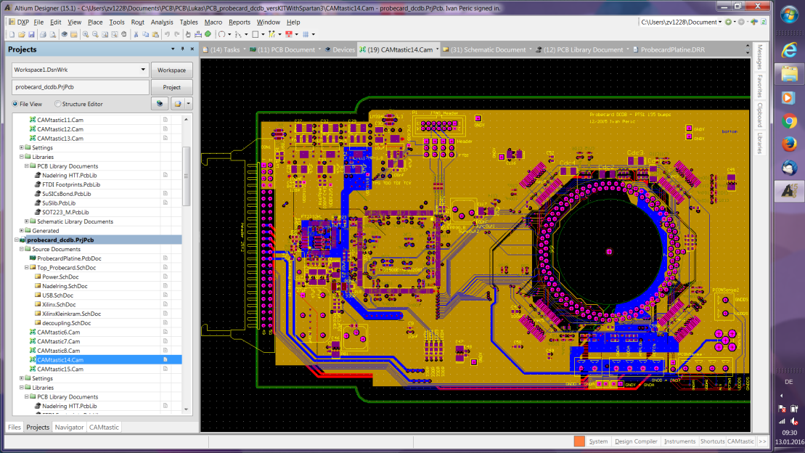
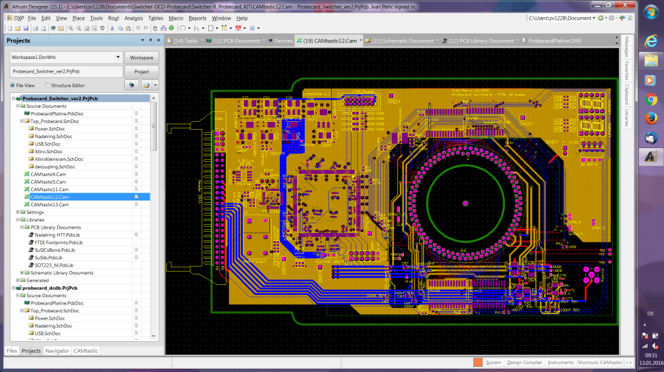
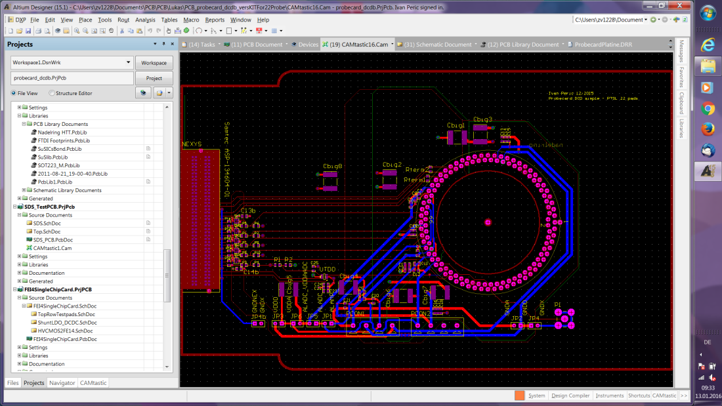
DCD
…

Slide 11
Switcher
Output driver is 2x bigger
Larger decoupling capacitors
Separated termination on/off bit for serial in and for other inputs
100 Switchers ordered, the are sent to PacTech for bumping

