Slide 1
Laser Measurements (as comparison to test beam data)
Florian Lütticke
University of Bonn
9th VXD Belle 2 Workshop Valencia, 14.01.2016

Slide 2
Outline
Measurement Setup
Drift/HV Measurements
CCG/Clear Measurements
Large area scan
Large area scan at low HV
Transistor characteristics of PXD 9
… and sorry for using so much color!

Slide 3
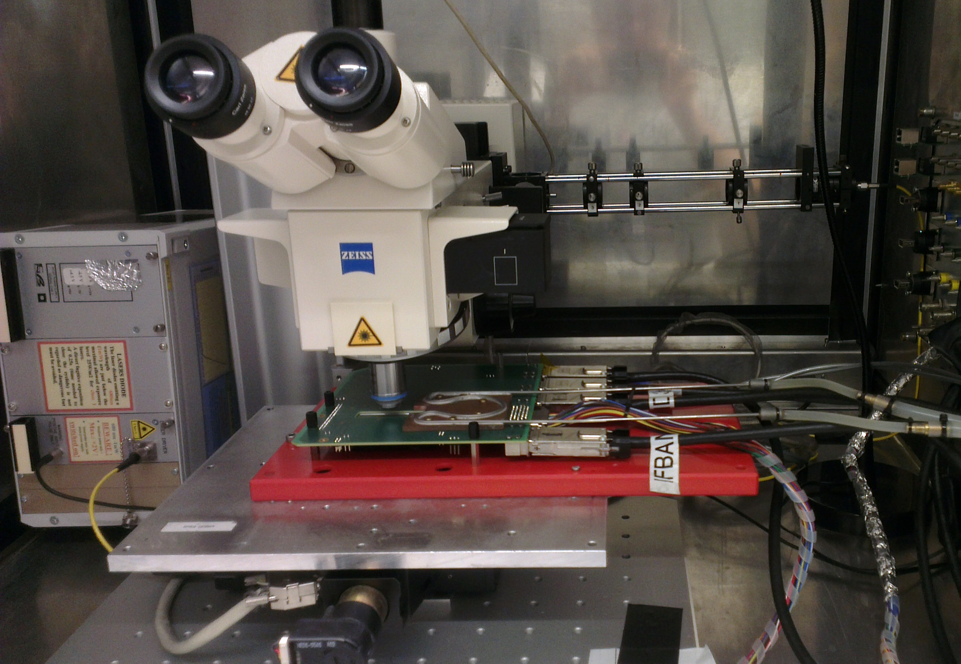
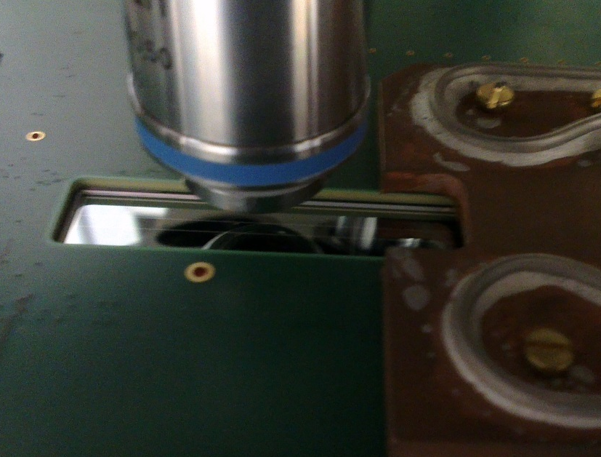
Setup
Reflection of me, taking a picture of the lasersystem
optics
Laser
Hybrid 6
Motor table

Slide 4
Measurement Setup
Probably dust
Measurement:
Move laser over the matrix
At each point take 800 frames
Step width: 5 um in both directions
8*10 pixels from 2 gates
Analysis:
Create mapping between laser position and firing pixel
Using the mapping filter out noise hits
Calculate seed signal, cluster signal, cluster size, etc.. for each position
Caveat:
“high” noise when running at 128ns per gate.
Solution: Read each gate twice, throw away first reading

Slide 5
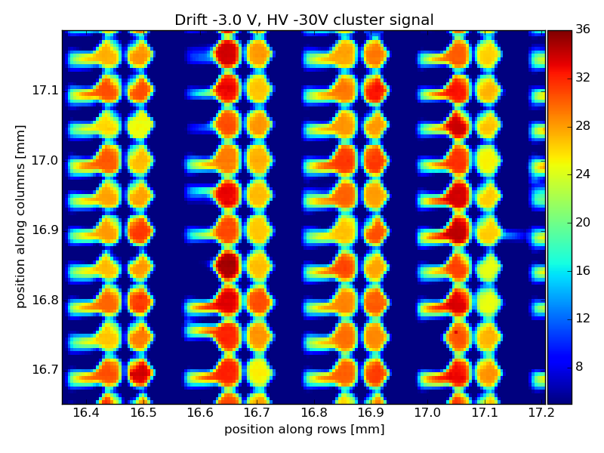
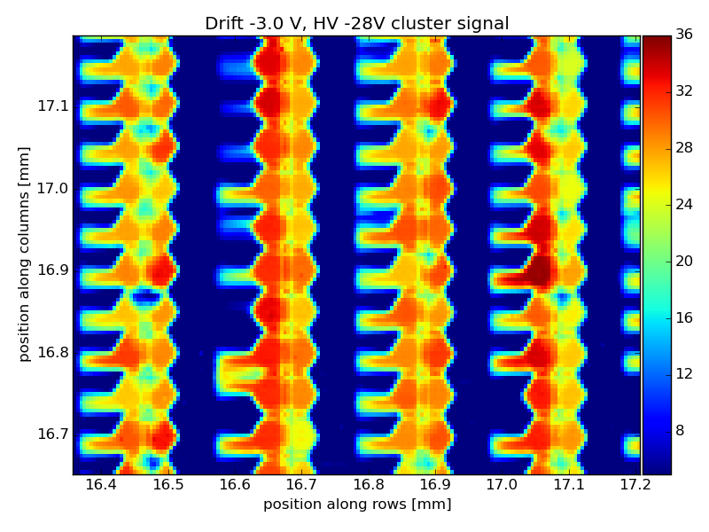
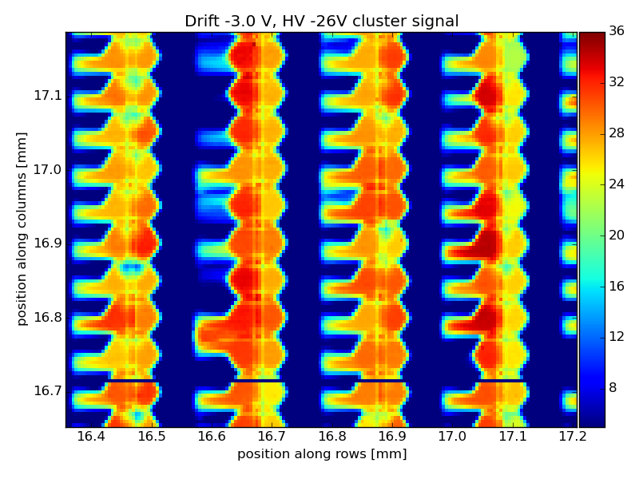
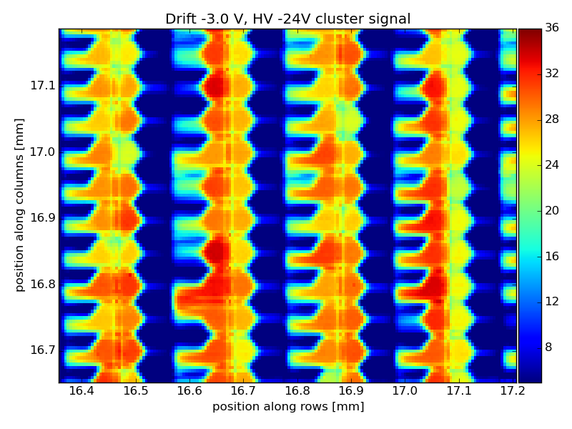
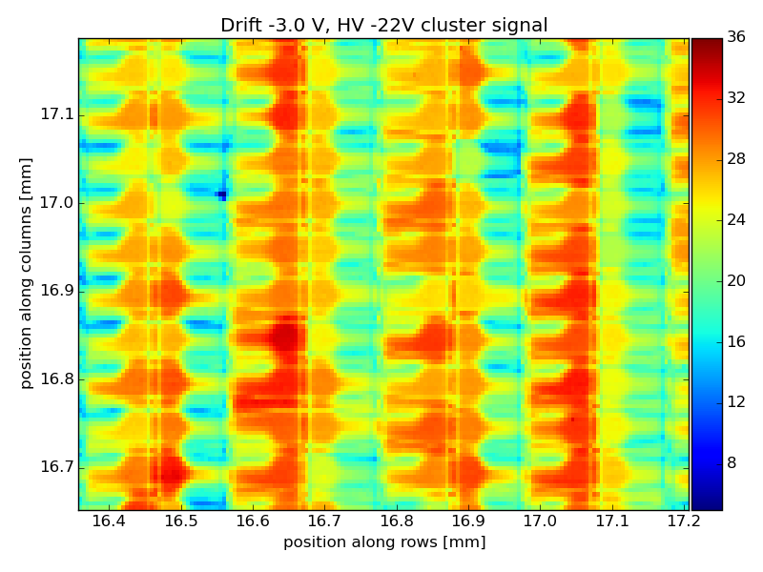
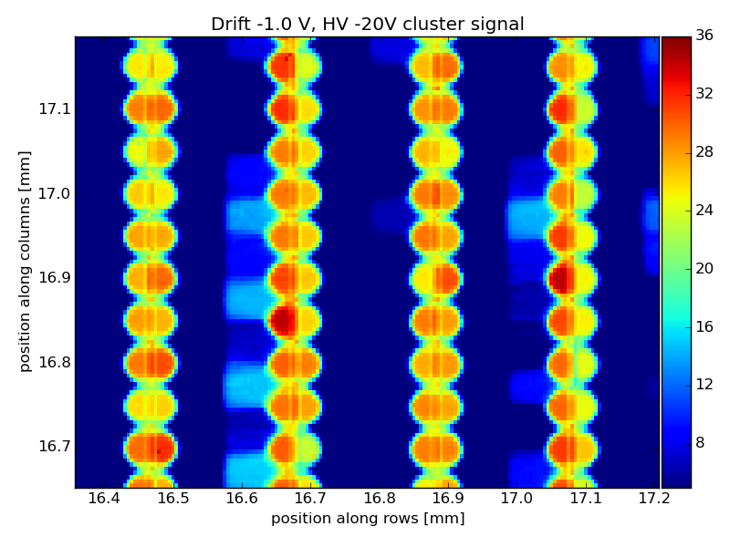
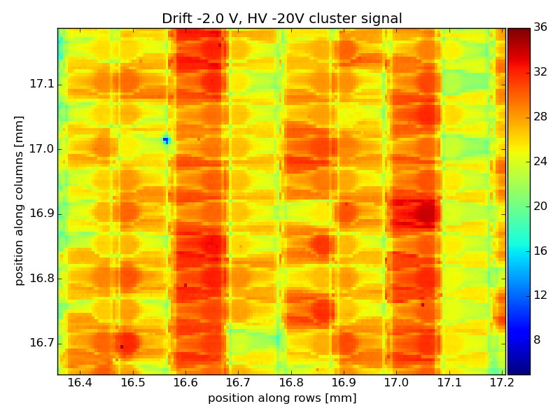
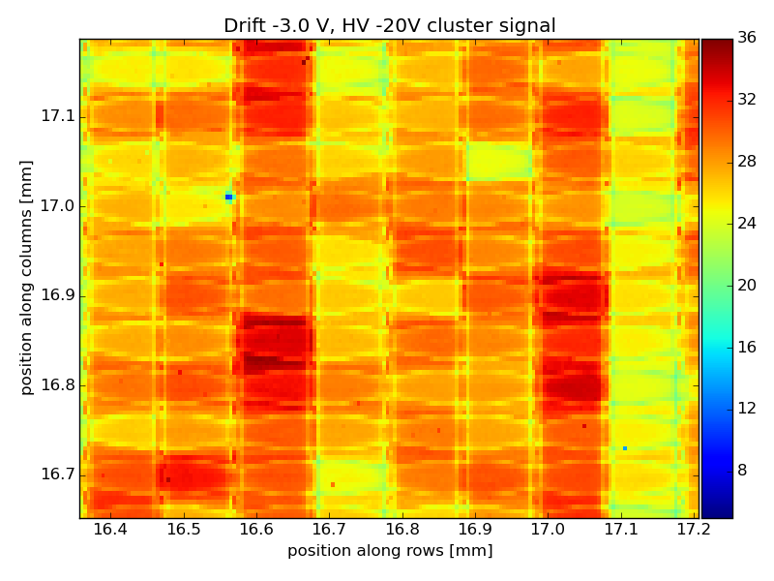
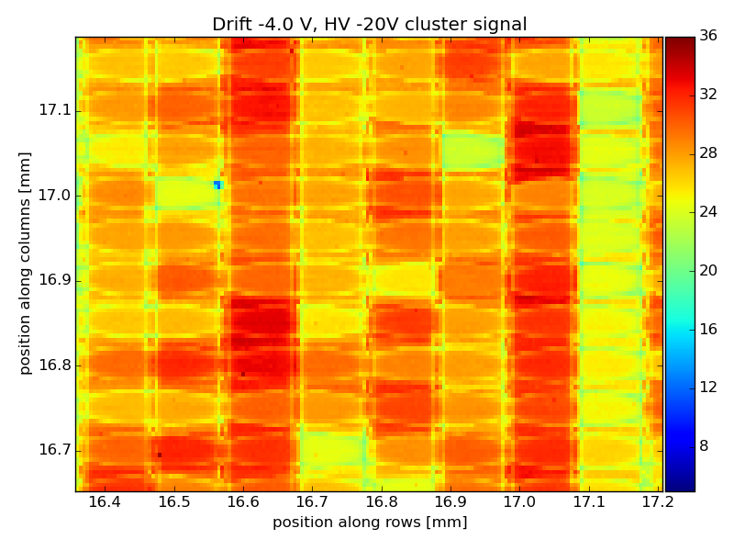
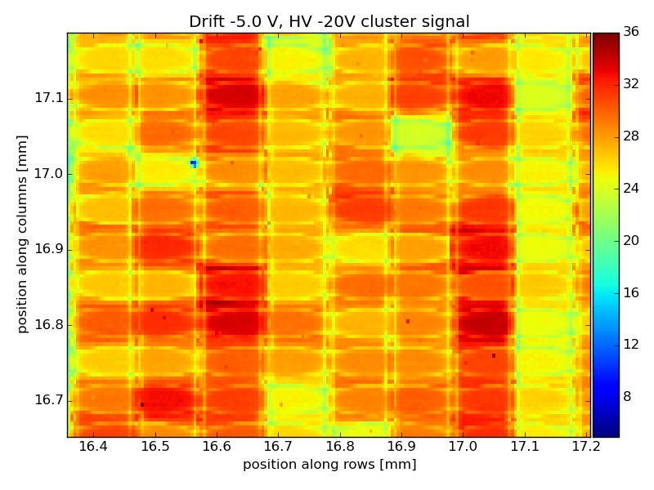
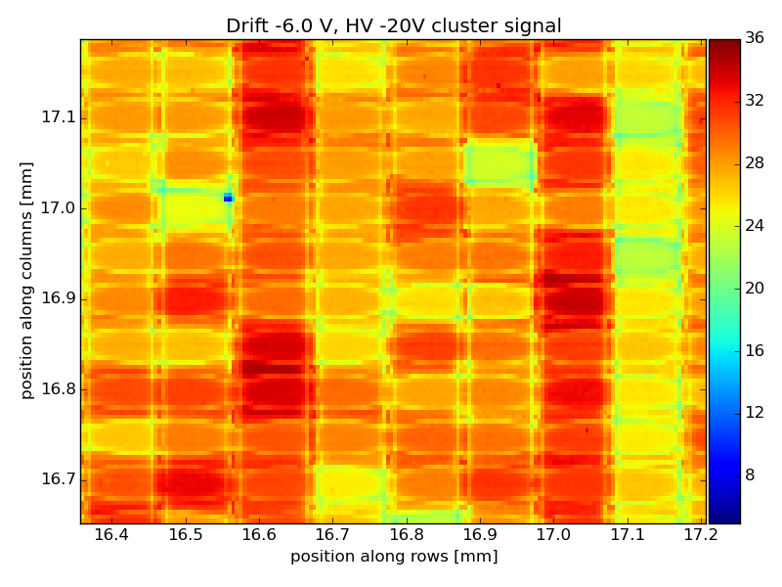
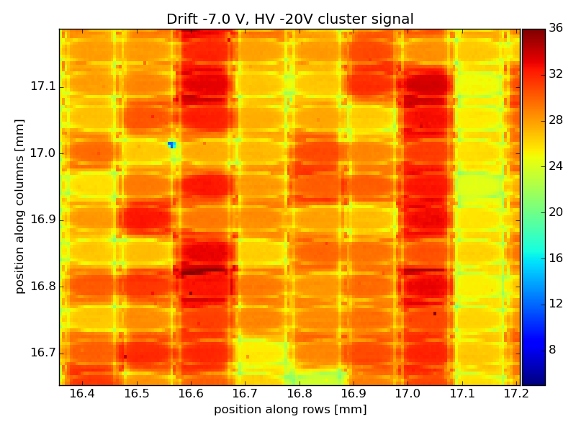
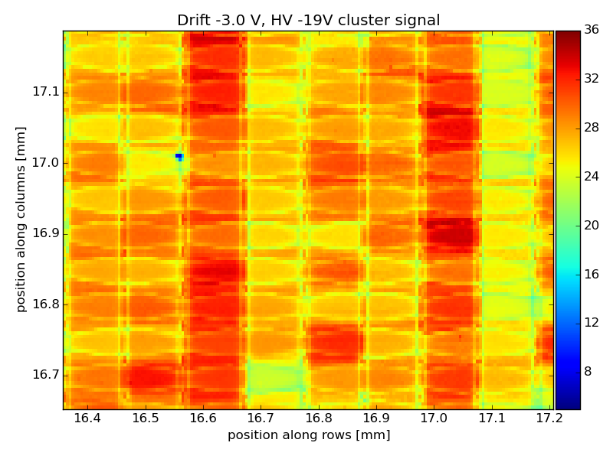
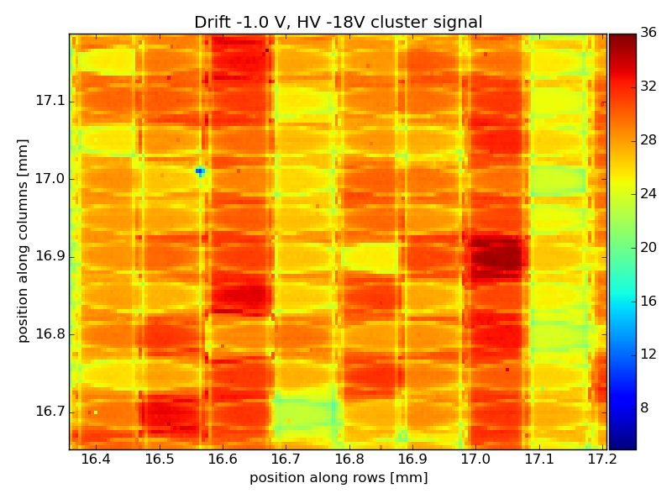
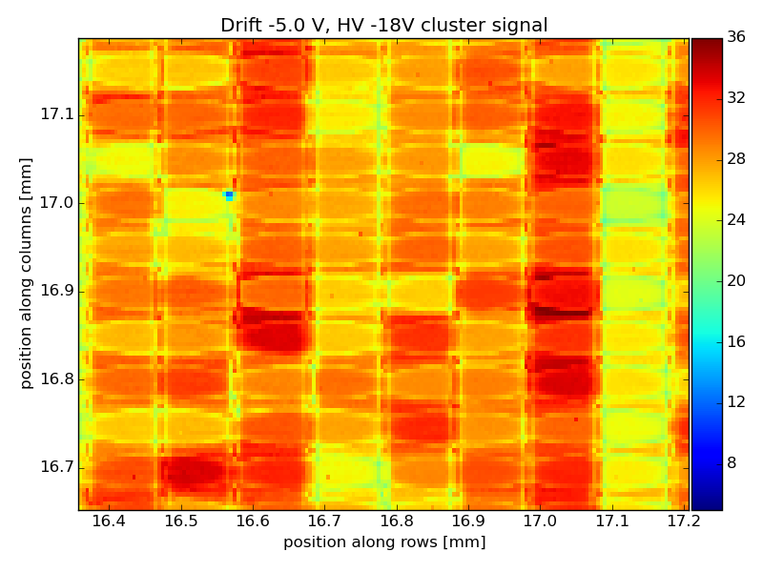
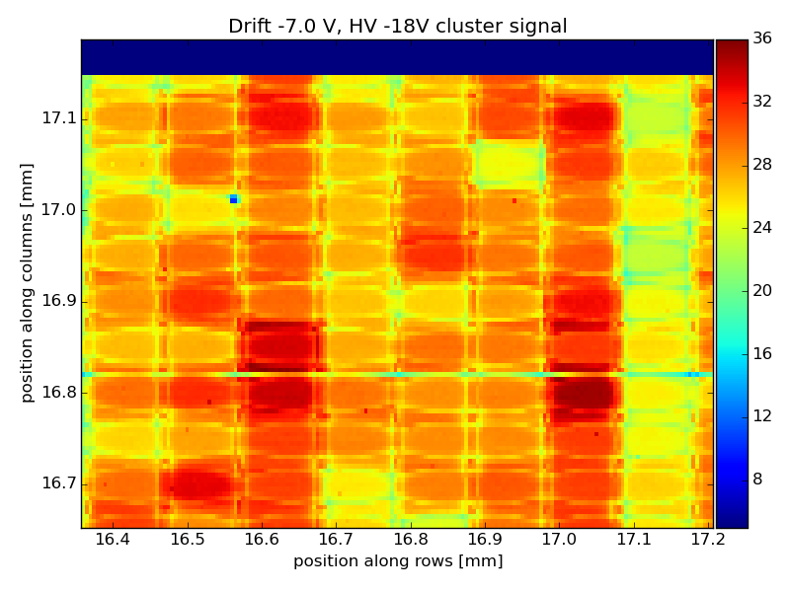
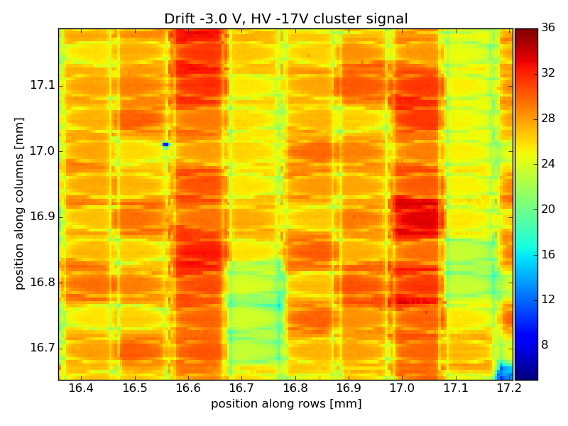
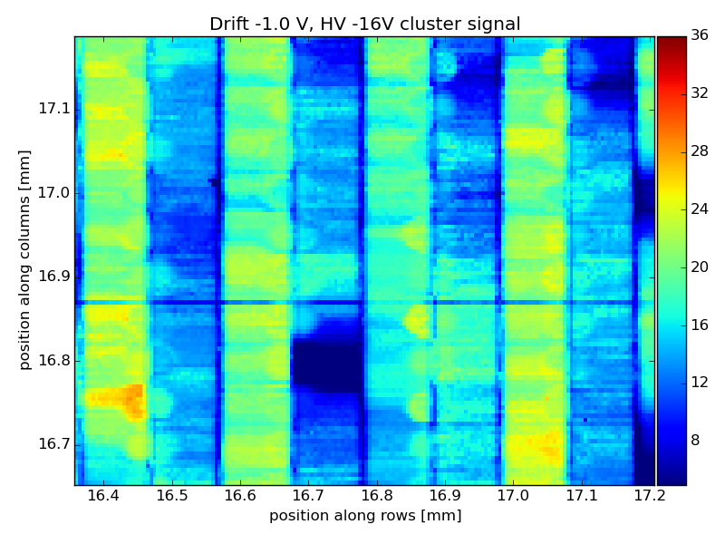
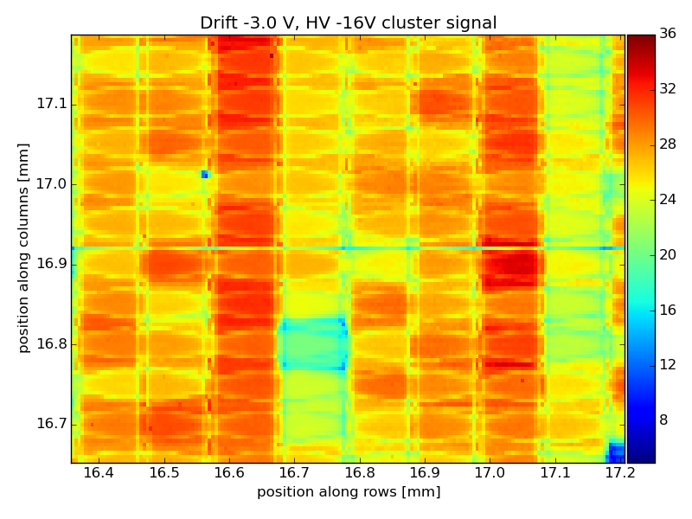
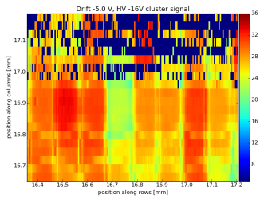
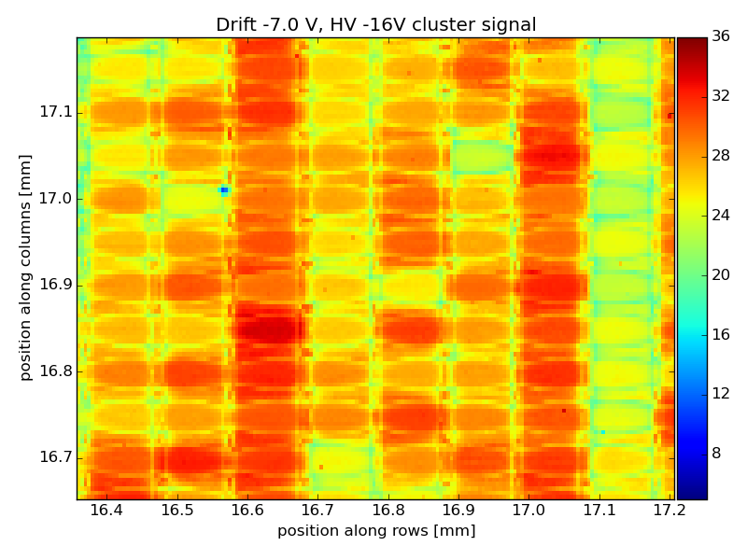
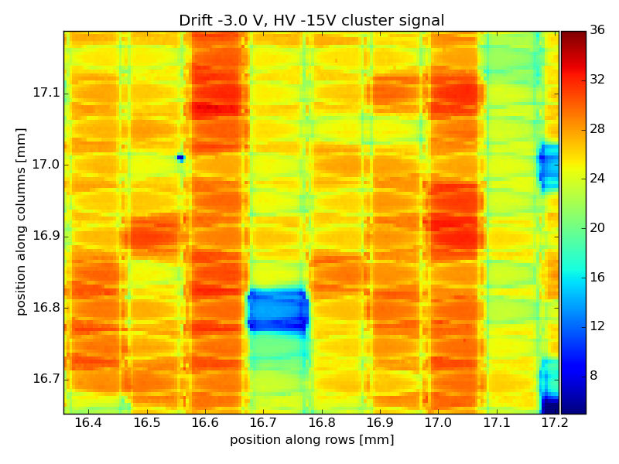
HV -24V
Drift -1V
Drift -2V
Drift -4V
Drift -5V
Drift -6V
Drift -7V
HV -22V
HV -20V
HV -19V
HV -18V
HV -17V
HV -16V

Slide 17
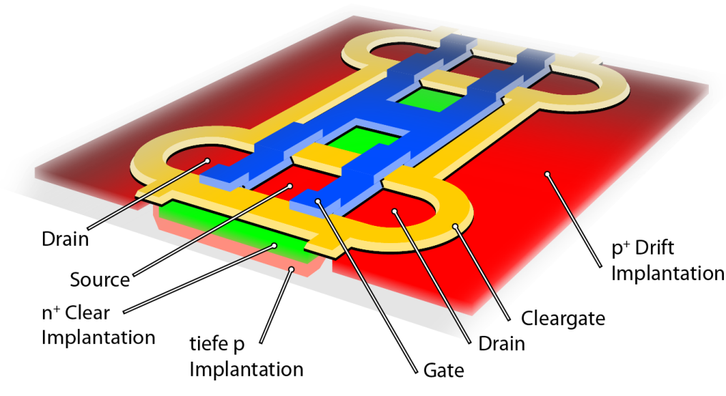
HV too negative:
Charge travels close below drift contact and gets into CCG, (like Rainer said) .
Near the internal gate, this is not a big effect.
If HV very negative, charge seems to be lost between the pixels (below source and below clear contact)

Slide 18
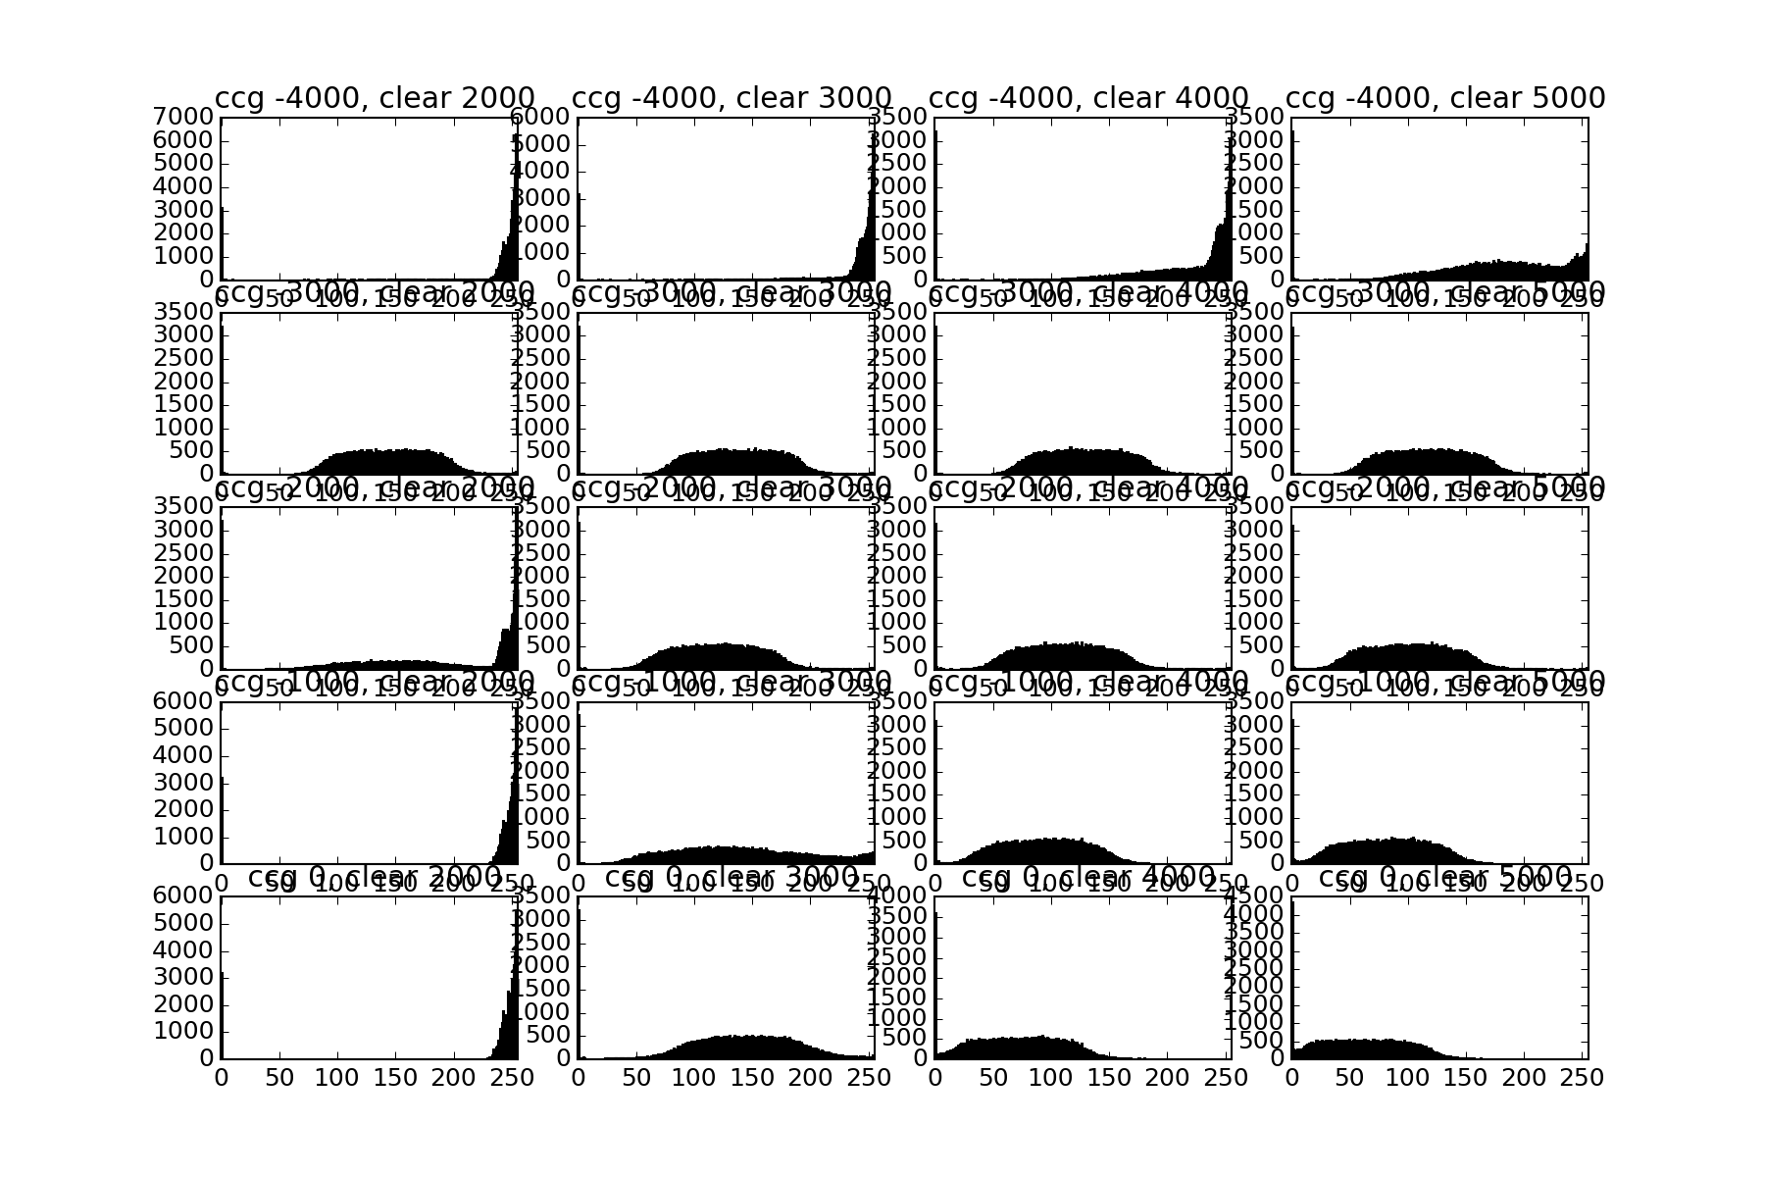
CCG vs Clear voltage Scan
First scan: Pedestals
Find a good range to scan
What can go wrong?
Clear too negative:
Back Emission
Electrons overcome the barrier between clear and internal gate. Electrons from clear contact flood the internal gate.
Can be mitigated by more negative Clear gate.
Clear too positive
Clear is attractive for electrons during charge collection
Charge loss

Slide 19
CCG vs Clear voltage Scan
CCG too negative:
Charge is not able to overcome the CCG Barrier between drift region and internal gate. Stays there long and diffuses -> bigger Clusters in Drift region.
Can be mitigated by high clear
Also: CCG can form a channel between source and drain – high drain currents!
Later effect can be mitigated by positive Clear
CCG too positive
Separation between internal gate and clear does not work anymore
Charge loss

Slide 20
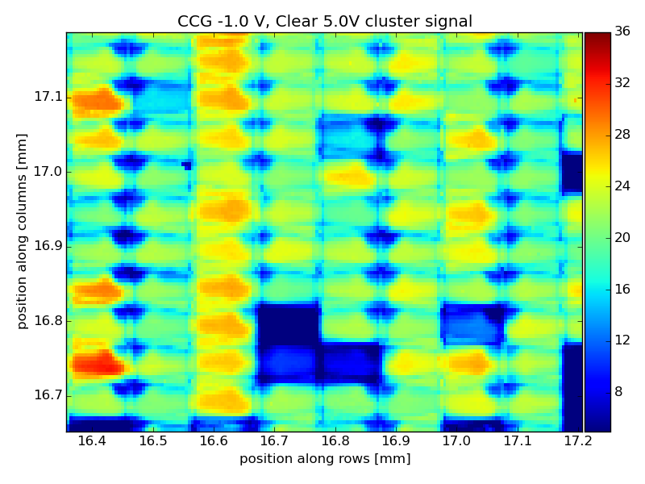
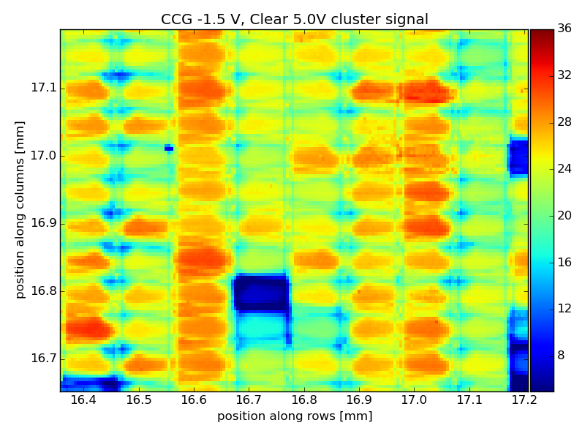
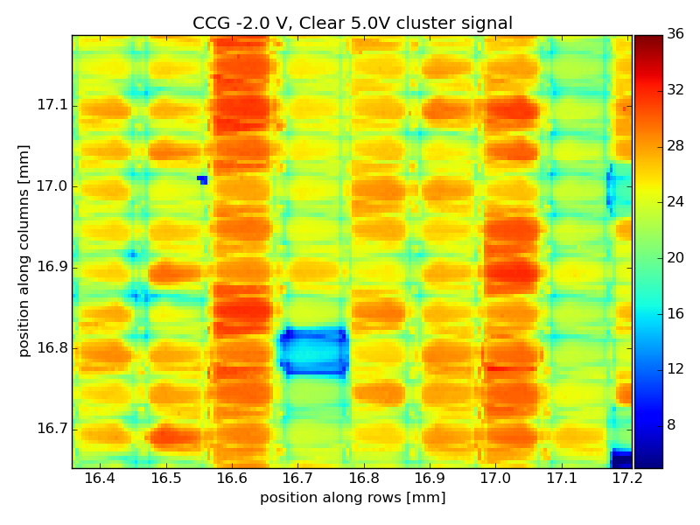
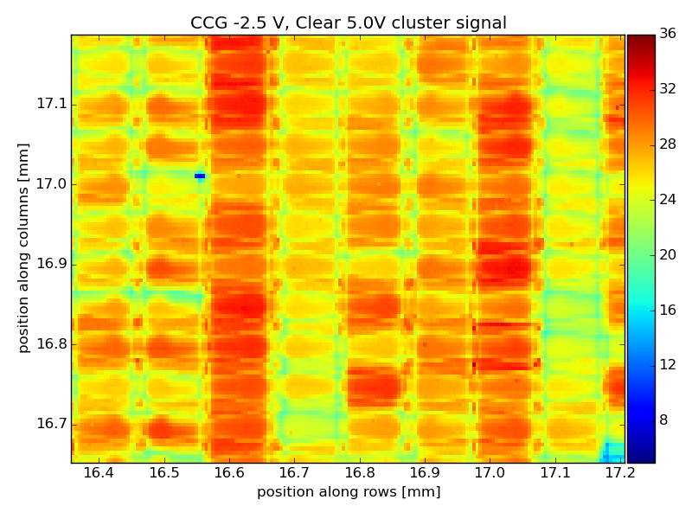
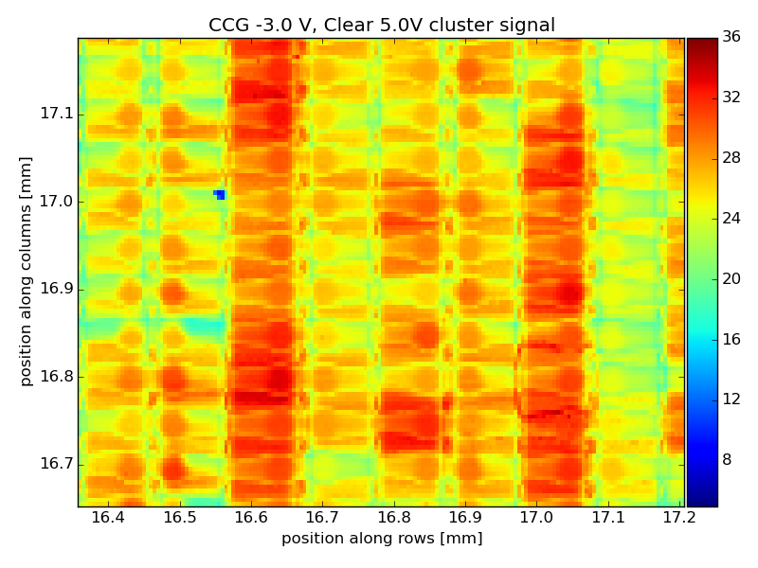
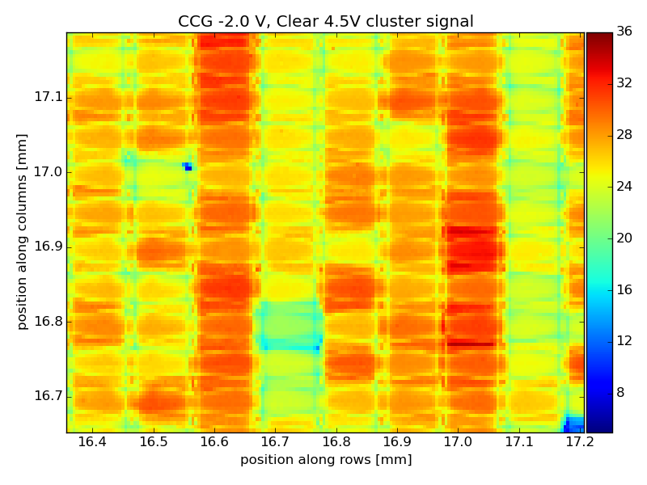
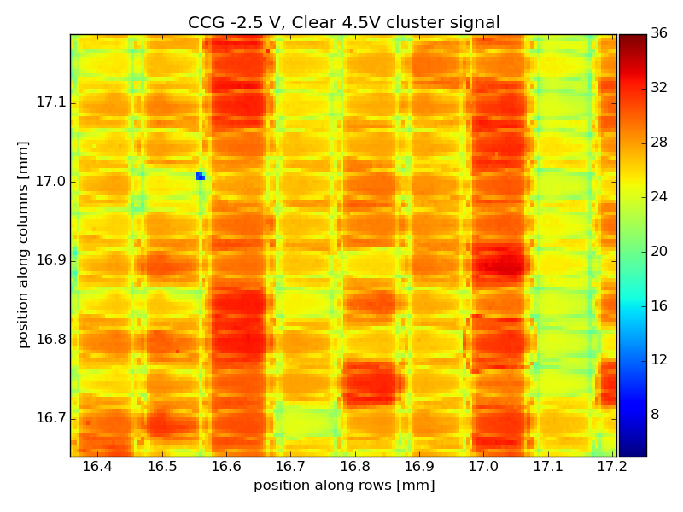
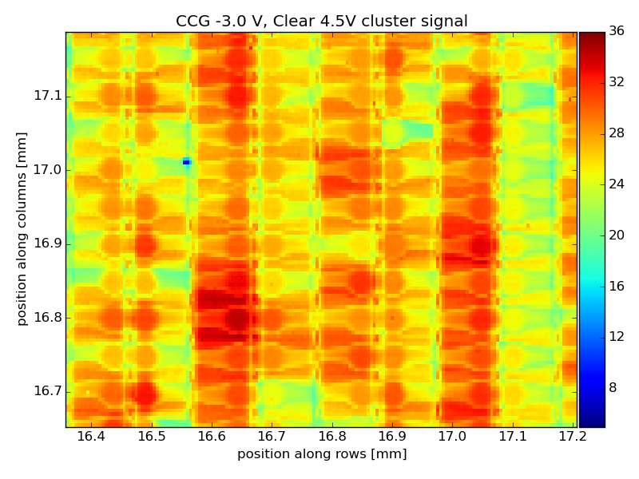
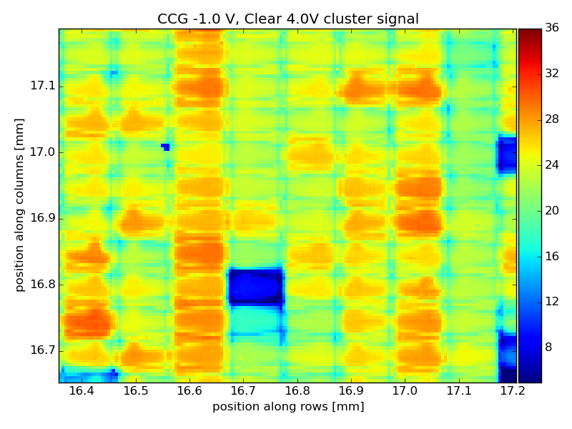
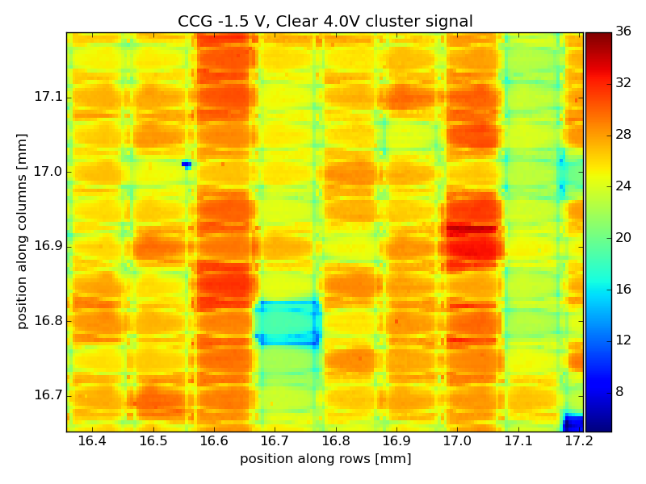
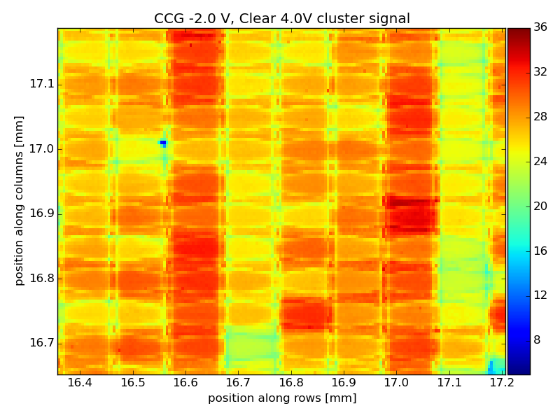
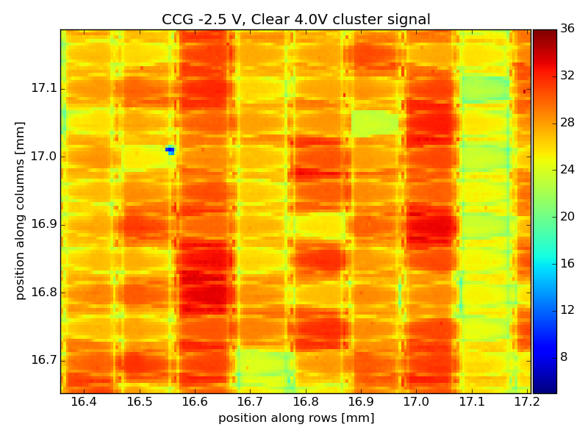
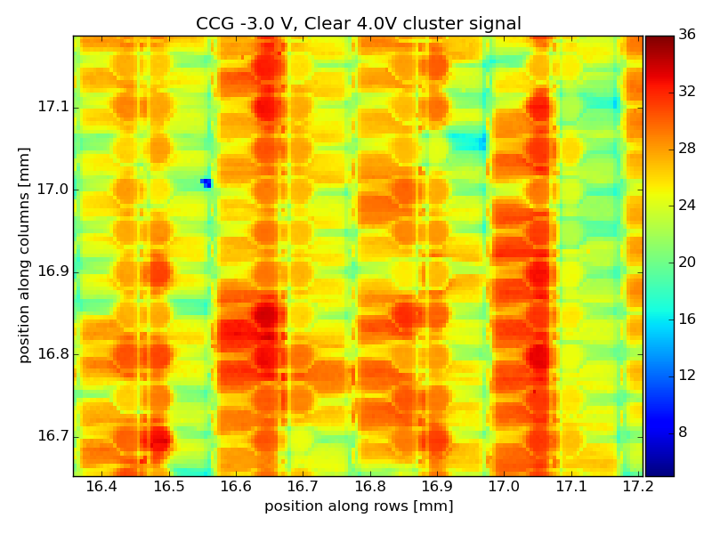
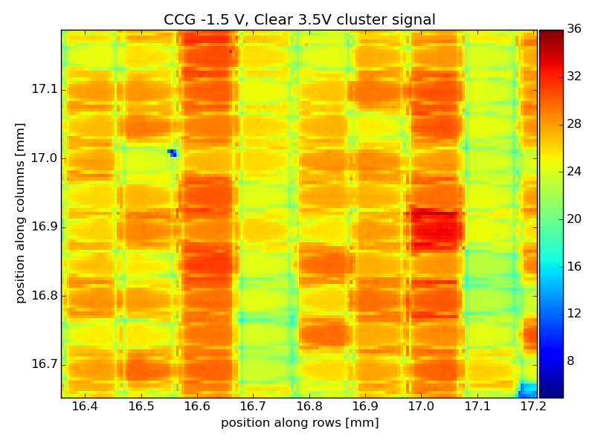
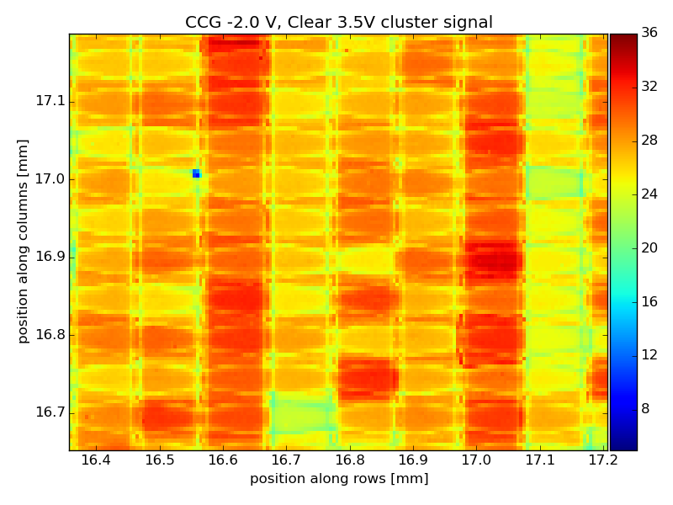
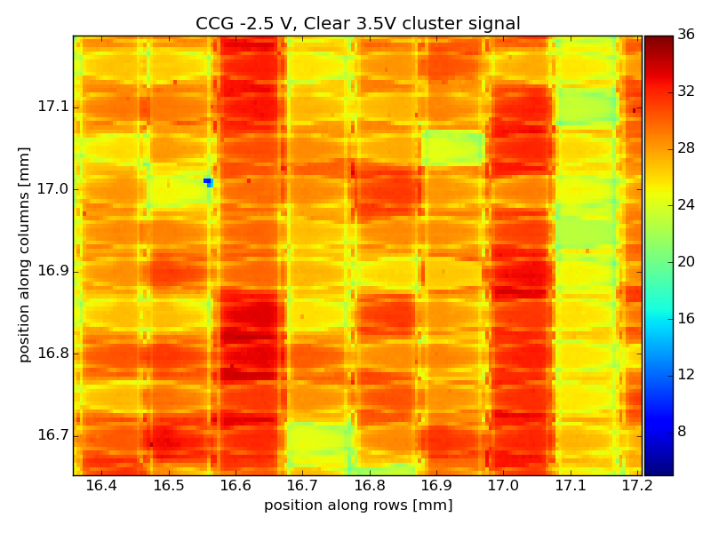
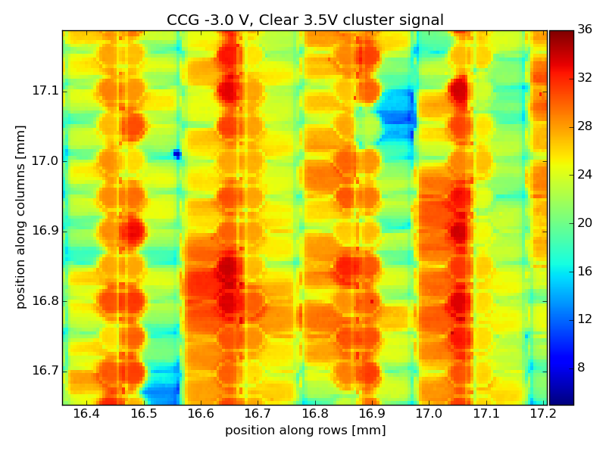
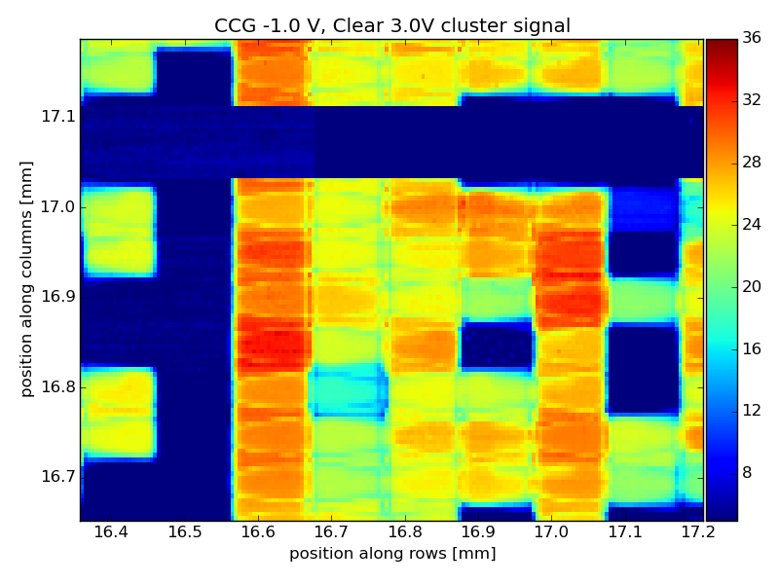
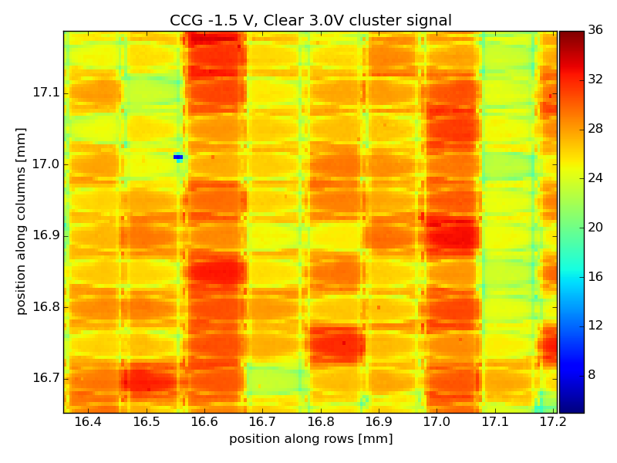
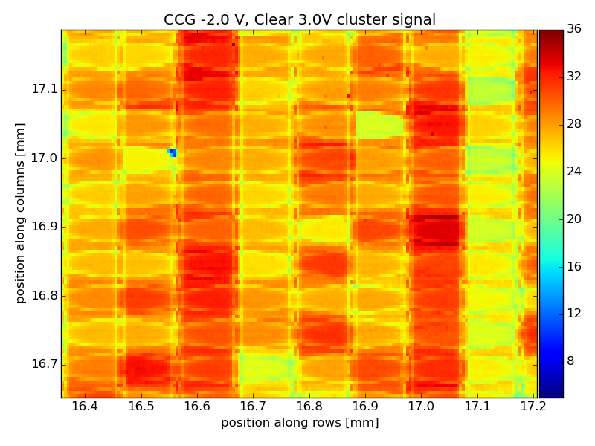
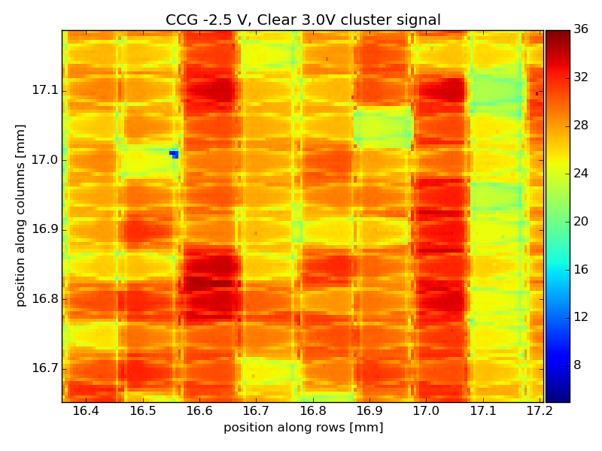
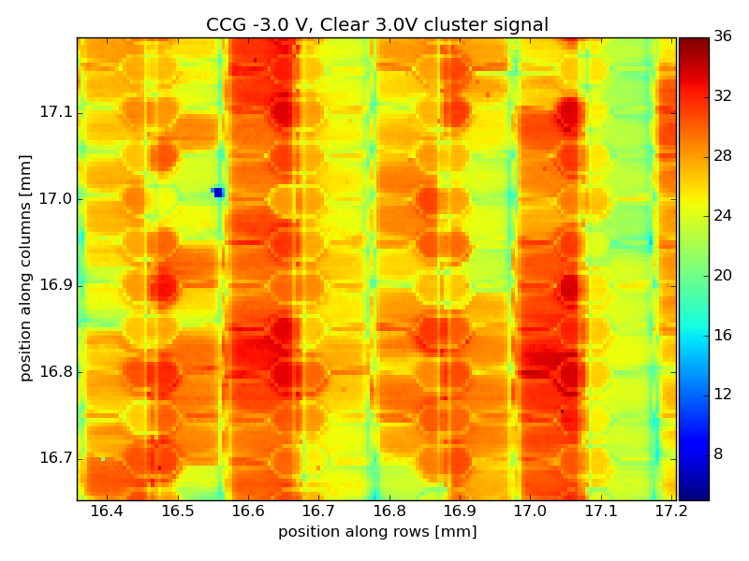
Clear Gate -1V
Clear Gate -2V
Clear Gate -3V
Clearlow
5V
Cluster Signal
Clearlow
4V
Clearlow
3V

Slide 21
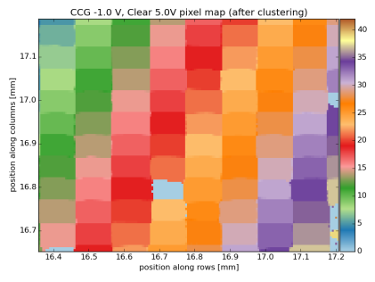
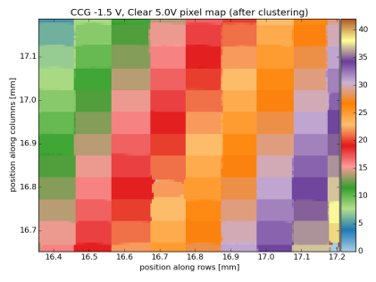
Clear Gate -1V
Clear Gate -2V
Clear Gate -3V
Clearlow
5V
Seed Pixel position
Clearlow
4V
Clearlow
3V

Slide 22
Clear Gate -1V
Clear Gate -2V
Clear Gate -3V
Clearlow
5V
Cluster size
Clearlow
4V
Clearlow
3V

Slide 23
Large Laserscan
Scan most of the matrix with the laser
On each step: move module, trigger system, check data integrity
Roughly I get 2000 laser points per hour (1.6 sec per point)
5 um step size not doable on 153.000.000 um^2 (6 Million points, 4-5 months)
Each ~6000 steps take pedestals
Step size 11um and 22um (Pixel size is 50um x 100 um)
4-5 steps per pixel
Step size does not divide pixel size – can be used to project scans of multiple pixels onto a standard pixel and get better resoultion
Small enough to guarantee to have a laser spot in the center of pixel (gain determination)
Still takes rather long (around two weeks, perfect for )

Slide 24
Uncorrected pedestals
Col
Very low pedestal currents
(way outside of dynamic range)
Row

Slide 25
Corrected pedestals
Area scanned by laser
Col
Very low pedestal currents
(way outside of dynamic range)
Row

Slide 26
Large Laserscan
Col
Row

Slide 27
Large Laserscan

Slide 28
Large Laserscan

Slide 29
Large Laserscan

Slide 30
Large Laserscan @ HV=-14V
Col
Row

Slide 31
Large Laserscan @ HV=-14V
Col
Row

Slide 32
PXD 9 Transistor characteristics

Slide 33
PXD9: Measurement of DEPFET IV curves
Task: Change V_{GS}, measure I_{DS}
Use ADC in DCDBp for current measurement
ADC has limited range:
Measure I_{DS} vs V_{GS}
Increase I_{Sub_In}
Repeat
Assume same V_{GS}, same I_{DS}
Reconstruct I_{Sub_In}
Add I_{Sub_In} to reduce all parts to one curve

Slide 34
Summary
Optimal voltages of large PXD6 Matrix were determined using Laser scans.
Obvious non ideal operation points were also studied.
Module working very nice (though with lower speed)
Comparison to test beam results will be done soon
Large Area scan revealed gain gradient following the pedestal distribution
Expected, due to extreme pedestal distribution
Offset compensation works very nice
At low voltages, stripes (rings?) are observed, similar to PXD9
HV between -15V and -20V work

