Slide 1

Background Measurements During Commissioning Phase 2
(supplementary information for the BPAC)
Prepared by the Belle II Beam Background Group

Slide 2
Contents
Executive summary (p. 3-6)
  Definition of Commissioning Phase 2
  Required Background (BG) Measurements
  Detectors to perform those measurements
More details on the main BG measurements tasks and detectors that will perform them
  VXD BG Measurements (p. 7-23)
  Other Measurements (p. 24-44)

Slide 3
Definition of Commissioning Phase 2
The SuperKEKB accelerator will be operating, for the first time, with QCS magnets
  First operation with focused beams
  First beam collisions
The Belle detector, minus the vertex detectors (VXD), will have rolled into the beam line
The end of Phase 2
  Minimum inst. luminosity of 10³⁴ cm⁻²s⁻¹
  Desire to integrate > 20 fb⁻¹
  Tolerable beam background levels in the vertex detector (VXD)

Slide 4
Mandate of the Beam Background Group
Estimate, measure, mitigate, and protect against beam backgrounds
Background sources
  Touschek effect (Beam size and energy)
  Beam-gas interactions (current, pressure)
  Radiative Bhabha scattering (Lum.)
  4-fermion final state QED process (Lum.)
  Synchrotron radiation
  Injection BG
Can result in instantaneous damage, long term damage, or excess occupancy in Belle II
Want to measure all backgrounds individually
  Validate MC primarily during phase 2
  Use MC to extrapolate to phase 3

Slide 5
Required Measurements & Tasks
Ensure safe BG conditions for VXD
  Both before installation & during operation
Provide real-time BG levels to SuperKEKB control room
Measure individual beam background components (Touschek, beam-gas, Bhabha, 4-fermion final state QED)
  Required to validate phase 3 simulation
Commission BG sensors that will be used for mask adjustment in both phases 2 and 3
Measure specific backgrounds that led to problems in the past (i.e. in Belle, BaBar)
These task numbers are associated with detectors on slide 6, last column of the table

Slide 6
Background Detectors
sensor | contact p. | number | location | DAQ | unique measurement | Tasks
Belle II PXD | C. Marinas | 2 ladders | VXD | Belle II / VXD EPICS | in-situ occupancy, full Belle II tracking, vertexing | 1,2 (3)
Belle II SVD | K. Nakamura | 4 ladders | VXD | Belle II / VXD EPICS
diamond sensors | L. Vitale | 8 diamonds | VXD | Belle II monitor DB & BEAST EPICS | ionizing dose in VXD → BEAM abort | 1,2 (3)
FANGS “LHC style” silicon pixel sensors | C. Marinas | 3 arms 15 chips | VXD | BEAST EPICS | MIPs & x-rays > 10 keV @ 40 MHz → Synchrotron x-ray spectrum | 1,2,5 (3)
CLAWS Scintillators w/ SiPMTs | F. Simon | 2 ladders | VXD | BEAST EPICS | X-rays or track counting w/ 1-ns timing → injection background | 1,2 (3)
PLUME “ILC style” silicon pixels sensor | I. Ripp-Baudot | 2 ladders | VXD | BEAST EPICS | Two-sided silicon pixels → tracklets w/ pointing | 1,2 (3)
Scintillators + PIN diodes | H. Nakayama K. Nakamura | 40+40 | around QCS | BEAST EPICS | X-ray and total loss distribution versus position, → collimator adjustment | 4 (3)
Micro-TPC nuclear recoil detectors | S. Vahsen | 8 | VXD dock | BEAST EPICS | fast neutrons: rate, directional & spectral information | 5 (3)
He-3 tube neutron detectors | S. De Jong | 4 | VXD dock | BEAST EPICS | thermal neutrons: rate | 5 (3)

Slide 7
Ensuring safe BG conditions for VXD

Slide 8
Required VXD measurements
Simulations predict largest particle BGs (from QED) in the +x direction (phi=0). We will install PXD and SVD ladders there, to measure their in-situ occupancies.
  These detectors are part of Belle II DAQ and event building, and will also allow exercising global tracking and event building
Eight diamond sensors monitor dose rate in VXD volume.
  To be calibrated in phase 1 against PIN diodes. In phase 2, diamond output can be compared against PXD / SVD occupancies, to further fine-tune the beam abort threshold.
In other phi directions, detectors to perform critical, specialized measurements and/or increase acceptance/redundancy
  FANGs: measure synchrotron radiation (SR) x-ray background rate, spectrum, and distribution over a large solid angle (In Belle I, SR x-ray destroyed the beam pipe and first SVD)
  CLAWs: measures injection background decay time, to optimize timing of PXD gate signal.
  PLUME: off-the-shelf, self-contained double-sided silicon ladders that can provide tracklets independent of Belle II DAQ

Slide 9
Redundancy
Multiple technologies, some with significantly higher rad-hardness than Belle II detectors will allow VXD volume BG characterization even if PXD/SVD ladders are damaged in phase 2.
CLAWs and PLUME systems kindly contributed by new groups that joined only for that purpose, i.e. they don’t have other Belle II involvement. Hence not a drain on, nor distraction from, VXD production and integration efforts.
Bonn ATLAS group kindly providing help for FANGS.

Slide 10
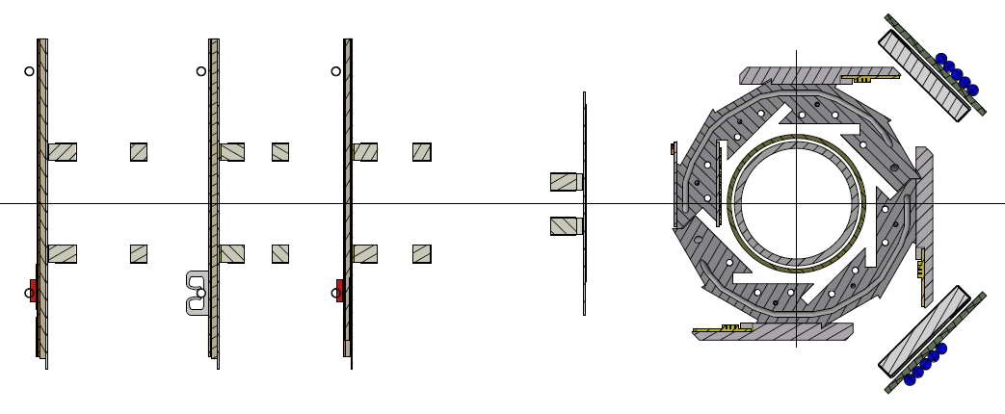
VXD Detector Systems in phase 2
FANGS: Covering 90º , 180º , 270º in φ, full acceptance in θ
CLAWS: Covering 135º , 225º in φ, full acceptance in θ
PLUME: Covering 135º , 225º in φ, partial acceptance in θ
+X
PXD
FANGS
CLAWS
FANGS
FANGS
CLAWS
SVD
cmarinas@uni-bonn.de

Slide 11
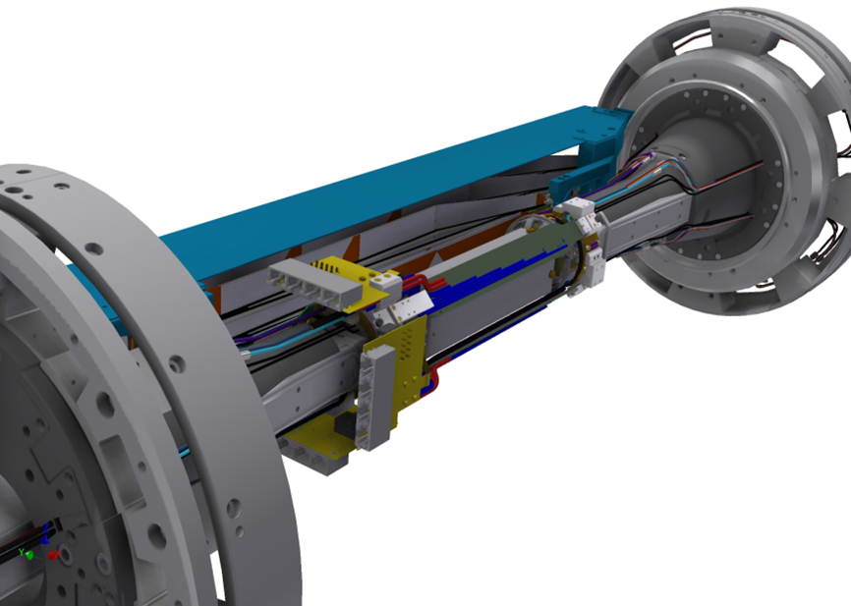
VXD Detector Systems in phase 2
FANGS: Covering 90º , 180º , 270º in φ, full acceptance in θ
CLAWS: Covering 135º , 225º in φ, full acceptance in θ
PLUME: Covering 135º , 225º in φ, partial acceptance in θ
CLAWS
FANGS
cmarinas@uni-bonn.de

Slide 12
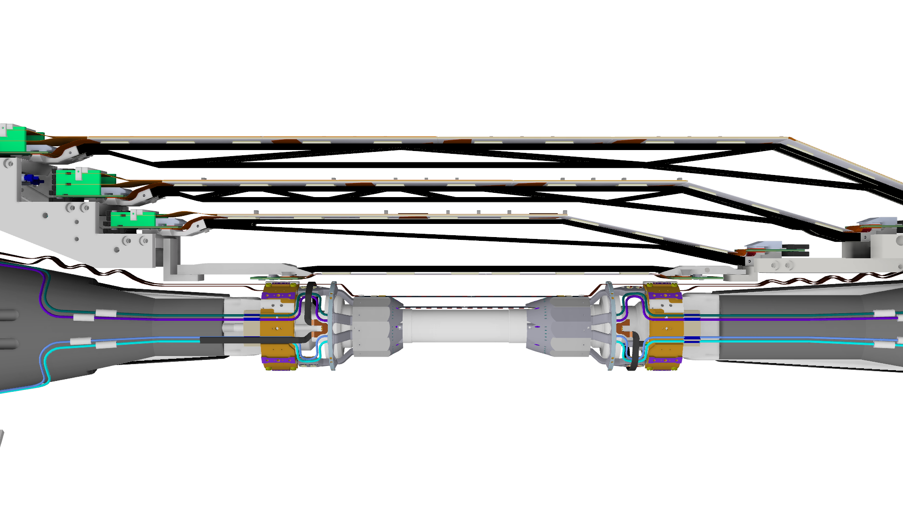
Belle II Detectors in VXD volume
Two PXD and four SVD layers (“final” arrangement for Belle II)
  Horizontal plane for highest background sensitivity (+X direction)
  Fully integrated into the Belle II environment
  Occupancies for different machine scenarios at several radii (1/r²)
  ROI, alignment, tracking, vertexing
+X
cmarinas@uni-bonn.de

Slide 13
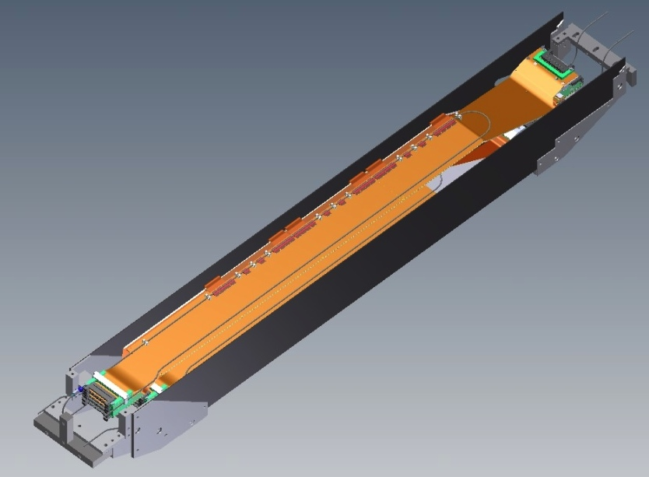
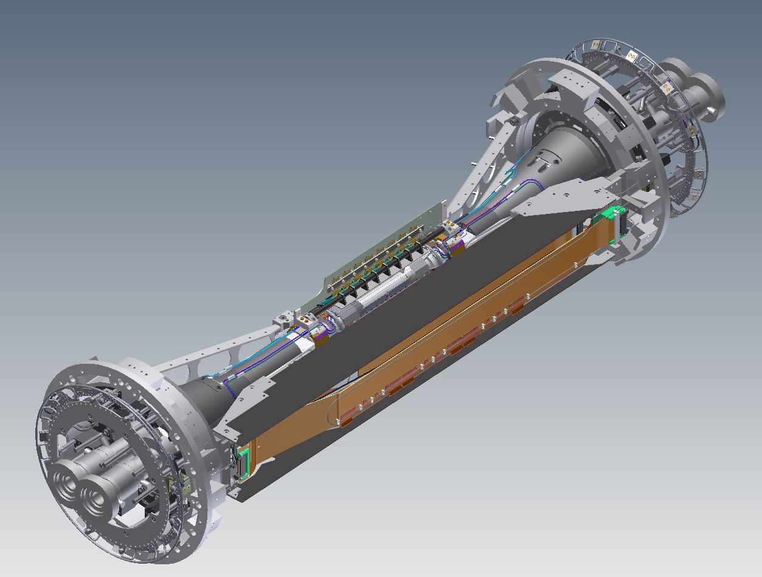
Phase-2 SVD Installation
Concept of phase-2 SVD
SVD Cartridge
Same ladders as phase-3
  B-class ladders before mass production will be used.
1 ladder / 1 layer (L3 - 6)
  4 ladders in total
The installation direction is +X as well as PXD.
CO2 cooling will be performed as a study and practice for phase-3.
Aluminum
blocks
CFRP plate
(1mm thickness)
All 4 ladders are installed
in this cartridge by hands.
SVD cartridge: a support structure for phase-2 SVD
  Since the locations of the ladders are different from phase-3, we are preparing the different support.
  simple structure and low cost
  easily installed in the VXD volume.
SVD cartridge is directory
mounted on End-flanges.

Slide 14
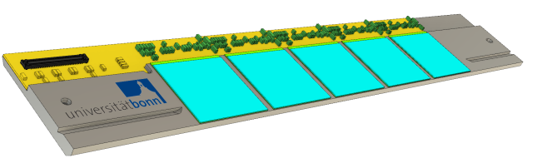
FANGS: Sensor system built on ATLAS IBL Pixels
Background radiation measurements in Phase 2:
  Sensitive to, and adequate energy resolution for low keV X-rays (SR)
  Ability to measure high particle rates
FE-I4 pixel read out chip
  High hit rates (25 ns) and radiation hard (250 Mrad, 10¹⁵ n_{eq}cm⁻²)
  IBM 130 nm CMOS process
  Thickness=150 µm
  Physical size=21x19 mm²
Sensor:
  n-in-n planar
  Pitch=50x250 µm²
  Thickness=200 µm

Slide 15
FANGS
Three compact and portable staves with 5 FE-I4 each
Independent DAQ system and online monitoring (rates and hit maps)
Installation independent of other subsystems: Only PXD SCBs needed
Final geometry and mechanical integration into the PXD SCB ready
Radiation hard, pixelated and fast detectors with energy resolution, covering the volume left by the VXD
FANGS can measure particle rates, angular distributions and background energy spectra for the different accelerator commissioning steps at three positions of the outermost PXD layer, almost covering the solid angle not yet instrumented with PXD/SVD ladders in phase 2

Slide 16
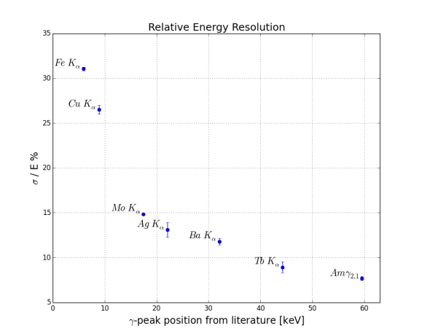
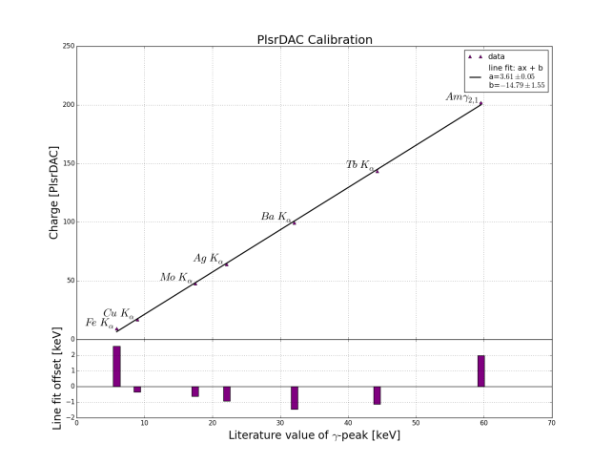
FANGS Synchrotron Radiation Measurements
Adequate photon energy resolution
Better than 15 % above 10 keV
Dynamic range 6-60 keV (wider also possible)
Covering the SR dynamic range expected in Phase 2 (6.6 µm Au)
16
Notes:
5.9 keV~ 1600 electrons.

Slide 17
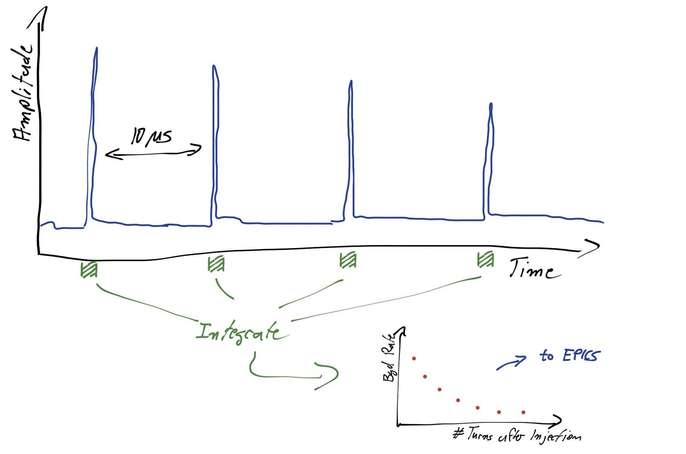
CLAWS Goals & Motivations
CLAWS can measure the time evolution of the injection background in the IP region - Primarily by being sensitive to charged particles
Continuous monitoring of injection cycle (20 ms) with 0.8 ns sampling rate
Single particle time resolution <1 ns → Unambiguous linking of particles to SuperKEKB bunches
Fast feedback for machine background close to IP
Independent DAQ system
Set up to provide fast analysis of injection bunches and other machine backgrounds
PVs transmitted via EPICS
Permanent online display in machine control room
Direct feedback to machine with sub-second delay

Slide 18
CLAWS
CLAWS detector: Concrete sensor layout and design being established
  2 ladders, each with 6-8 scintillator cells read out by SiPMs
    Photon sensor MPPC S13360-1325PE – Radiation hardness of this generation stablished to > 1 Grad (rad hardness of 2 Mrad required)
    Scintillators: Investigating options – PVT – based scintillator available, but radiation hardness most likely ≤ 1 Mrad, at the limit of requirement
    Polystyrene based scintillator can be obtained, with radiation hardness > 1 Mrad, also looking for other alternatives
Size and number of cells depend on expected particle rates – Default size 2 x 2 cm²; easy to modify also relatively late in the design process.
Mechanical support finalized (fixation points established)

Slide 19
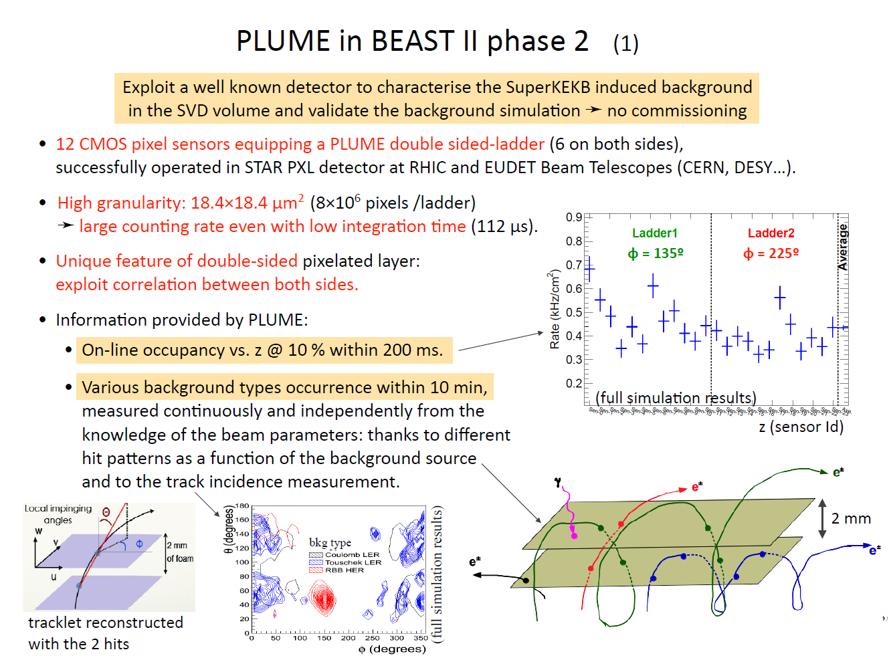

Slide 20
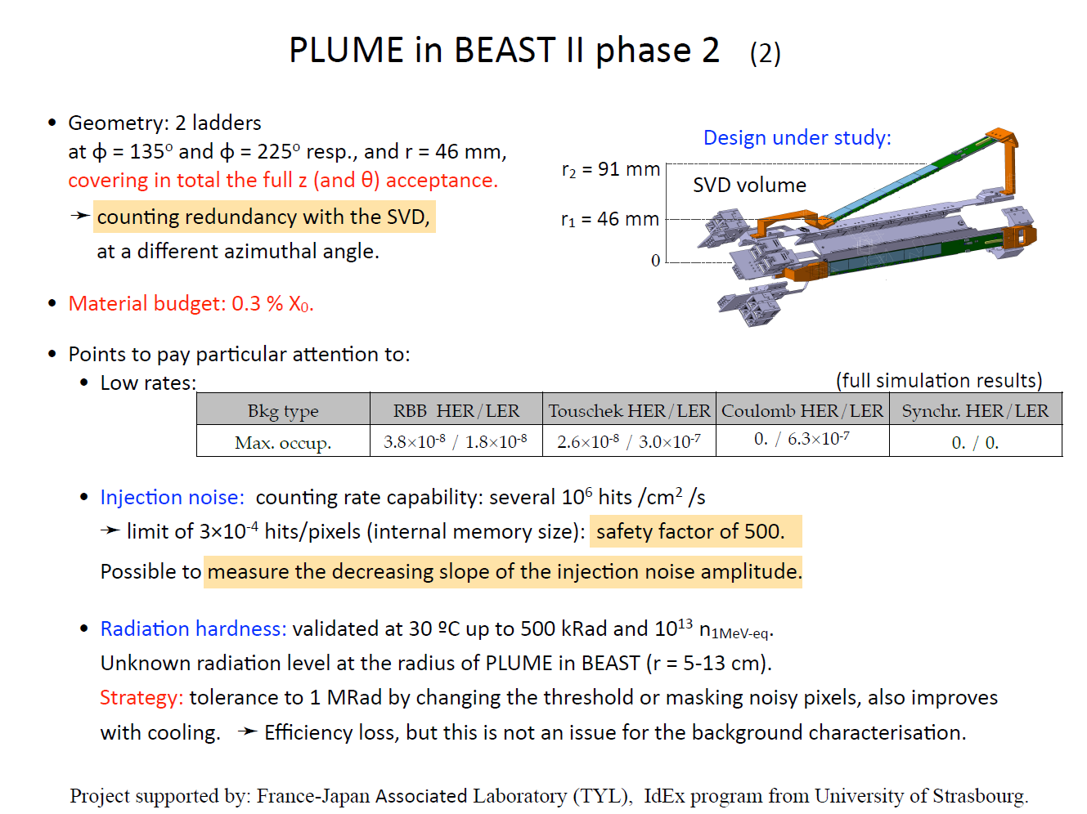
20

Slide 21
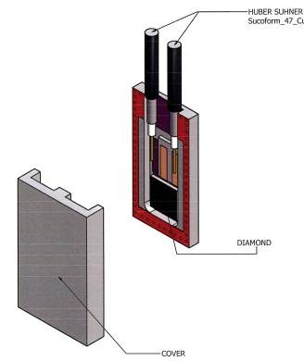
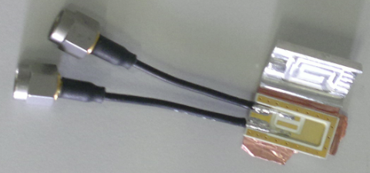
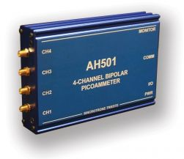
Diamond Sensor – Beam Abort
same sensor arrangement close to the beam pipe as in phase 3
motivation and brief analysis plan
  Instantaneous and accumulated radiation dose
  Interlock system test
  Correlations with PIN diodes
  Correlations with PXD and SVD
what kind of data to be stored on DAQ
  Total ionizing radiation dose normally @ 1-10Hz,
  In case of Beam Abort 600ms buffer @ 10us sampling
designs of sensor/package/support
  ~ 17 x 10 x 3.3 mm³
number and locations
  Phase 2: 8 in PXD volume
  Phase 3: 8 in PXD volume, 12 in VXD volume
cables and space for service
  2 cables for each sensor.
  3m coaxial thin (HS SM47LSFH) from sensors to DOCKs + ~22m HS S_04162-B60, double shield
readout system and DAQ
  AH501 for test readout in phase 1. A new electronics with FPGA will be tested already in phase 1 and the final prototype in phase 2. In E-HUT F2. Data will be stored in Belle II VXD EPICS DB.
21

Slide 22
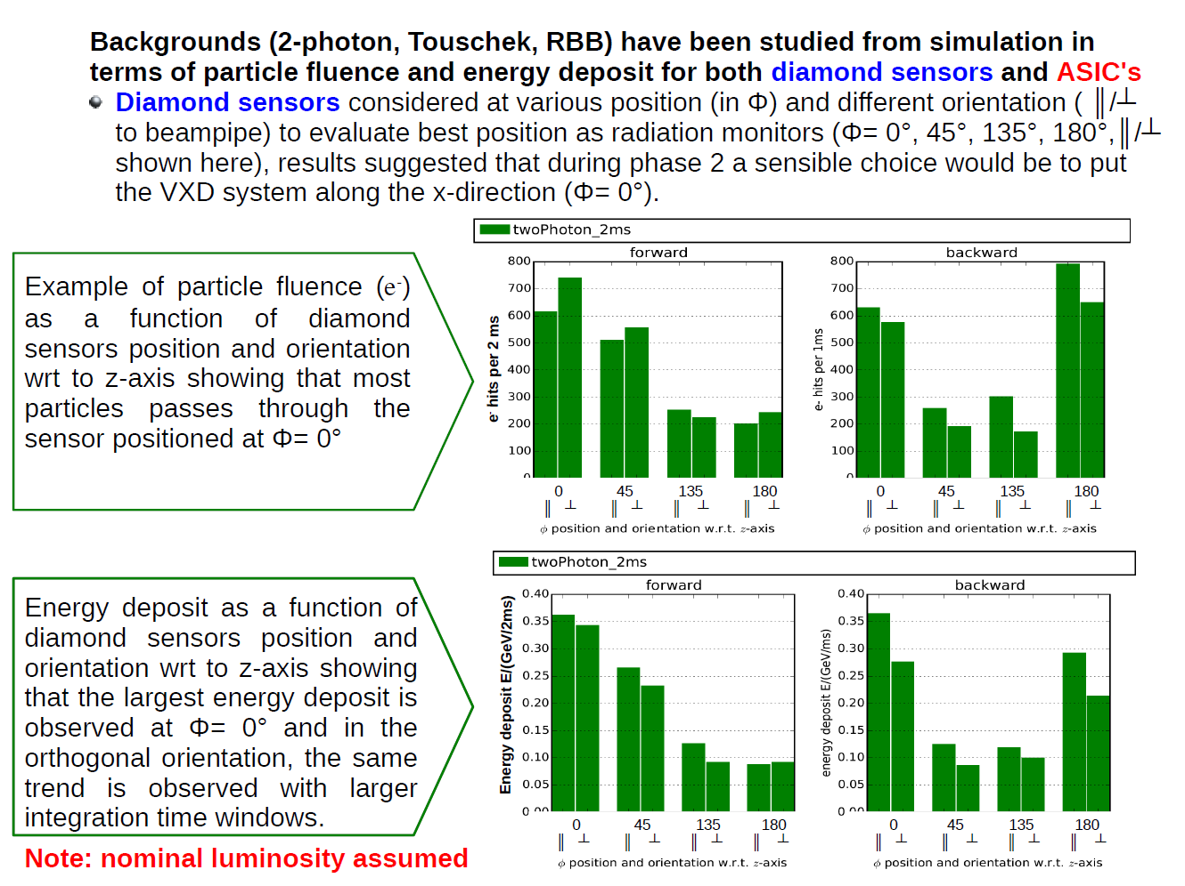
Simulation of VXD BG to optimize abort sensor positions
22

Slide 23
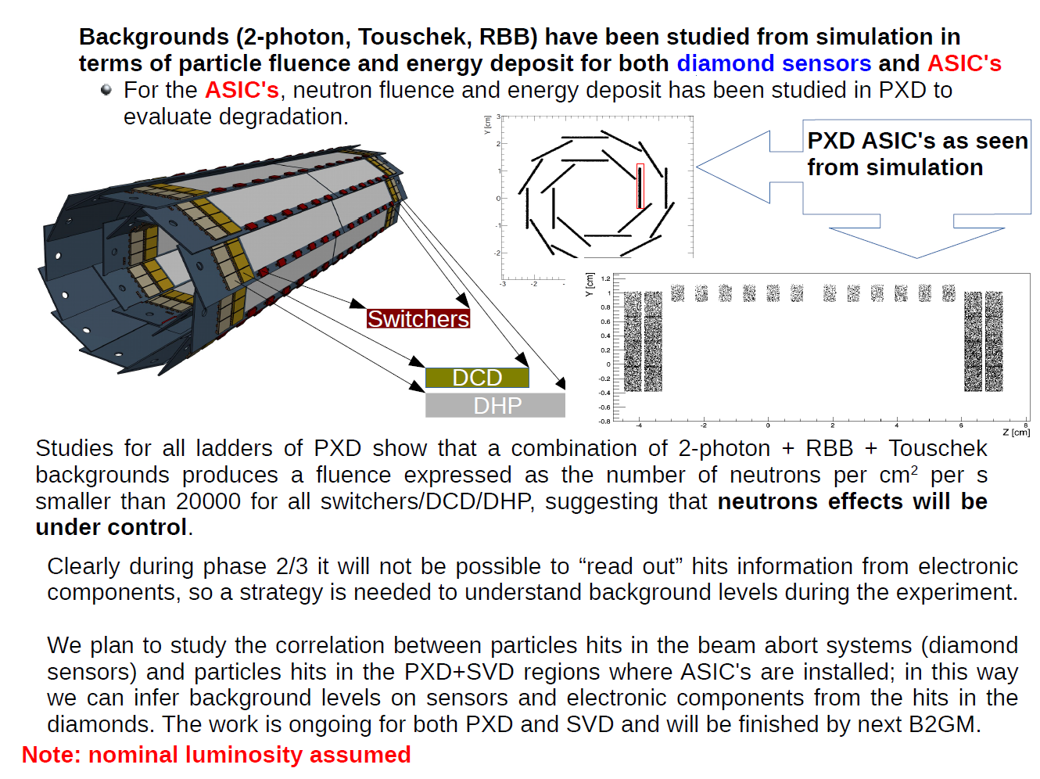
23

Slide 24
Providing real-time BG levels to SuperKEKB control room

Slide 25
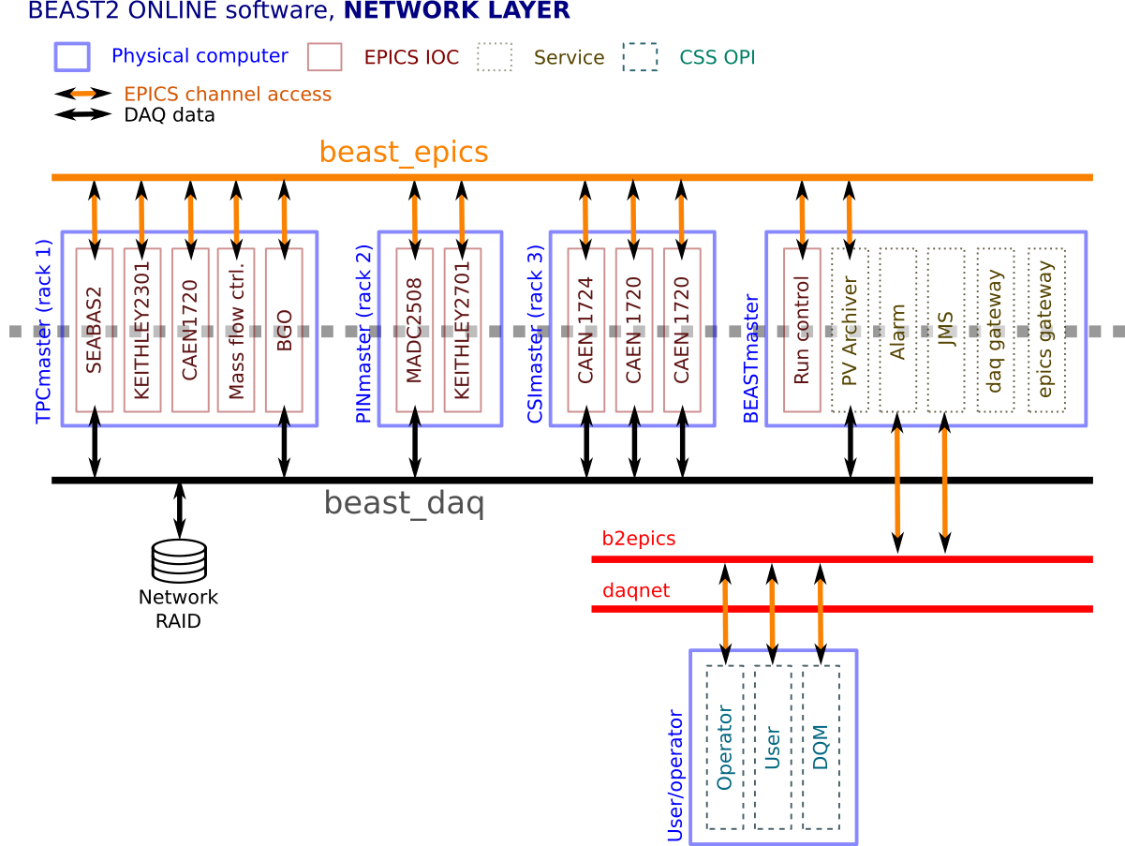
DAQ and communication w/ SuperKEKB
BEAST EPICS scalars (PVs) hosted on a dedicated GigE private network: beast_epics
SuperKEKB PVs hosted on b2epics network
One of the BEAST computers acts as a “channel access” gateway between these two networks
  SuperKEKB PVs and BEAST PVs all accessible from both networks
  Near real-time monitoring (~20Hz) of key BEAST scalars by SuperKEKB group planned (not yet tested)
  EPICs PVs also provided to beam collimator control panel /operator
P. Lewis
All BG sensors that are not part of the final Belle II are controlled by and read out through a dedicated, BEAST II EPICs system
25

Slide 26
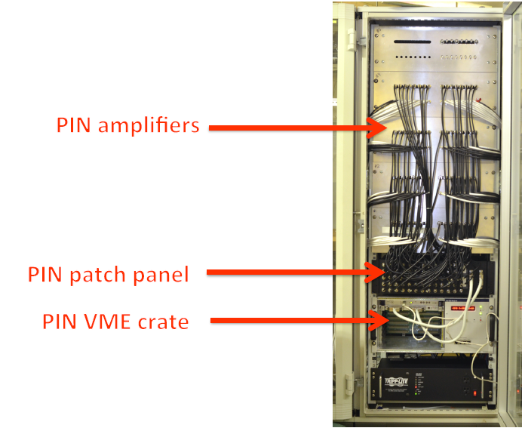
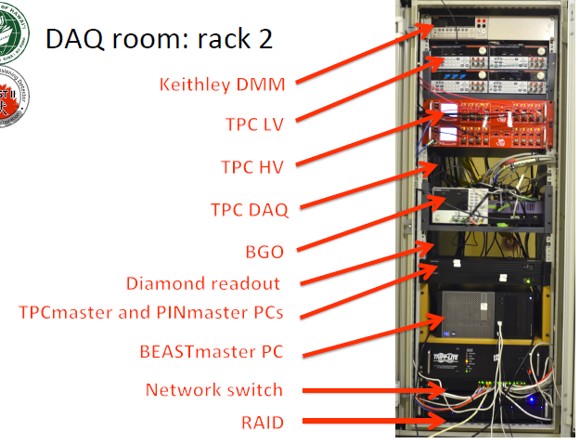
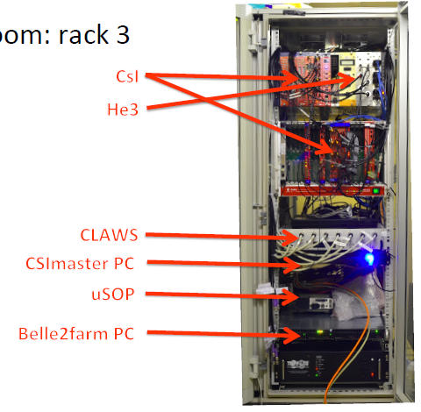
BEAST DAQ Racks (Phase 1)
BEAST EPICs currently being commissioned – also used in phase 1
Phase 1: 3 racks in Tobiyama Room
Phase 2: 4 racks in Belle II electronics hut

Slide 27
BEAST EPICs
Simple: scalars versus timestamp, no event building
Scalars both for real-time monitoring and offline analysis
Accelerator group also uses EPICs, simplifying offline correlation studies between beam parameters and BGs through timestamps
A dedicated screen in the SuperKEKB control room will display scalars of interest for tuning beams (under discussion with accelerator group)
During dedicated background study runs (see later slides), one of the two beam background group shifters will be stationed in SuperKEKB control room
Update frequencies and synchronization:
  write PVs at up to 20Hz (=“real time”), maximum possible. to be determined
  SuperKEKB injection frequency is 50 Hz, revolution time 10 µs, bunch spacing 100 ns. Fast BEAST detectors (e.g. CLAWS – see later slide, w/ GHz sampling) will be synchronized via SuperKEKB-issued injection trigger signal. Multiple-sample sequences and summary data written to disk at each EPICs PV update.
  No direct synchronization between BEAST and Belle II detectors, and no event building with both classes of detectors. During dedicated BG study runs, Belle II will take random trigger data, to be correlated with BEAST detectors via timestamp.

Slide 28
Measuring individual beam background components

Slide 29
Beam BG machine studies
Phase2 is most similar to phase3 full-lumi, but still different
  1. “Detuned” optics with smaller IR beta functions (less SR, Toucheck)
  2. Worse vacuum level (more Beam-gas)
  3. Smaller luminosity (less RBB/2-photon)
  4. Phi=0: VXD. Phi ≠ 0: covered by FANGS, CLAWS, PLUME
We need some extrapolation
  For 1, simulation/measurement comparison at detuned optics tells us how much we can believe simulation at final optics
    Collimator secondary shower effect can be measured at phase2.
  For 2. and 3. extrapolation is rather straightforward.
  For 4, BEAST sensor (FANGS, CLAWS, PLUME) measurements important.
It is important to disentangle each BG source
  Vary beam size , vacuum level , luminosity, and beam current to measure Touschek, BeamGas, RBB and 2photon separately (same approach as 2010 BG study)
  Validate simulation results with measurement

Slide 30
Example: Studying BGs from Touschek LER
At KEKB, 2010
 | Beam size Max(4.3μm) | 3.5μm | 2.8μm | 2.2μm | Beam size Min(1.3μm)
Current Max (1450mA)
1100mA
750mA
Current Min (~300mA)
⓪
Optimize
Mask
② （Mask V close）
③ （Mask OPEN）
④ （Mask H close）
⑧
vary ξ_{y}
⑦ （Mask both open, varyN_{bunch} ）
3点だけ取った
①
Mask
OPEN
⑥ （Mask OPEN）
1.6μmも取った
⑤ （Mask OPEN）
1.6μmも取った
Beam size sweep by changing isizeBump
When we varied beam current, beam size also changed accordingly
~30 minutes for each run
Notes:
First, We took the data of size sweep at max current for three mask condition.
Then change current andd took data for mask open.

Slide 31
Collimator studies
In this study, we measure following data with several collimator settings:
  acc. loss monitor rates placed along the ring
  BEAST sensors
  Belle outer detectors (phase2)
To confirm simulation
  tip-scattering on collimator head is very difficult to simulate
  We observed BG increase when we closed some collimators at KEKB
To confirm collimator control system
  EPICS controls, GUIs, BPMs, backlash, etc..
  Semi-automatic (fail-safe) control using BELLE/BEAST BG info
To develop collimator optimization strategy
  Vertical collimators are especially sensitive and difficult to optimize

Slide 32
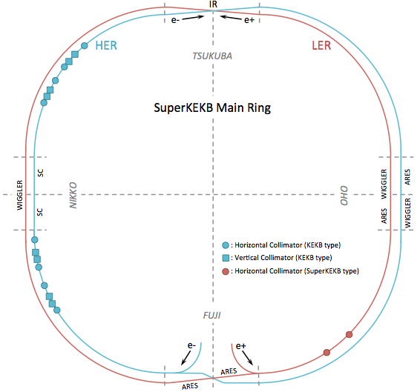
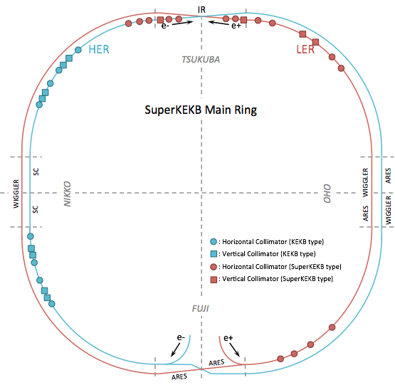
Collimator Installation schedule
Plan and Location
  Phase-I : 2 new models (horizontal type) for LER. (Conventional collimators are reused in HER.)
  Phase-II : Only install 3 more for LER and 3 more for HER (due to budgetary limitation)
  Phase-III : more collimators for LER and HER (how many to be decided)
Phase-I
HER
D01: H1, H2, H3, H4, H5
V1
Phase-II
LER
D02: H1, H2, H3, H4
V1
x
x
x
x
x
x
x
LER
D03: H1, H2
V1, V2
D01
D02
D01
D02
x
x
D12
D03
D12
New in phase2
D03
HER
D12: H1, H2, H3, H4
V1, V2, V3, V4
HER
D12: H1, H2, H3, H4
V1, V2, V3, V4
D11
D04
D11
D04
D10
D05
D10
D05
D09
D06
D09
D06
D08
D07
New in phase1
D08
D07
HER
D09: H1, H2, H3, H4
V1, V2, V3, V4
HER
D09: H1, H2, H3, H4
V1, V2, V3, V4
x
x
LER
D06: H3, H4
LER
D06: H1, H2, H3, H4

Slide 33
Machine time request in phase2
For these machine studies, we have requested 2-3 week in total.
  For example, 3days x 4~5 times with 1 week intervals
  We prefer closer to the end of phase2
  Which do accelerator group prefer, day or night?
 | SuperKEKB | Belle DAQ
Collimator study | Allow us to lose beam by playing with collimator (for ~1 week in total) | Please take data with random trigger
BG machine study (Touschek/Coulomb/Luminosity term) | Please change machine parameters for our study (3 days x 4~5) | Please take data with random trigger
Injection BG measurement | Need few days to work together for machine tuning with better injection BG? | No special requests to outer detectors
If physics need non-Y(4S) run, it should not overlap with BG machine studies and collimator study.

Slide 34
Commissioning BG sensors that will be used for mask adjustment in both phases 2 and 3

Slide 35
Motivation for BG monitors around QCS
BG monitor for VXD is only installed around IP
It is useful to install other BG monitors at |z|>60cm, around QCS surface, to see BG distribution in broader area
BG loss distributions are different for each BG sources
  Next page, you can find hit distributions on beam pipe
  Note that BG distributions are more smeared at QCS surface
With these sensors, it might be possible to distinguish which BG source is responsible when BG level increases. Once you know which BG source, you know which movable collimator to adjust.

Slide 36
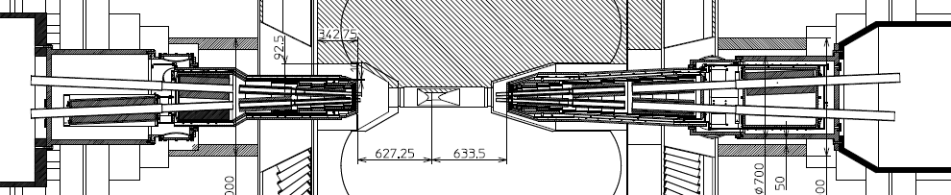
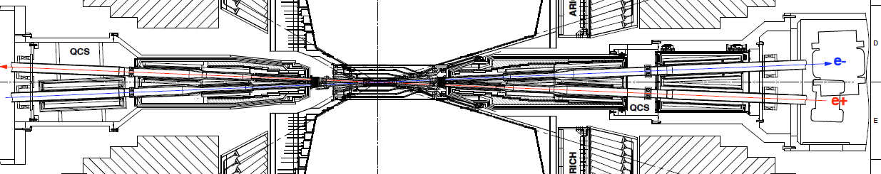
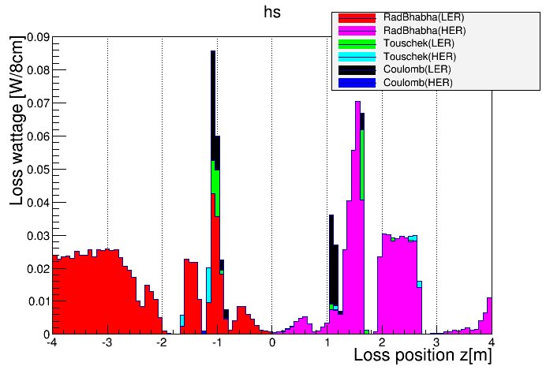
BG loss distribution
Ver. 2015.1.30
(11th campaign)
Loss wattage
= loss rate
* energy of loss particle
HER
(e-)
LER(e+)
1GeV ,1GHz
= 0.16W
 | LER (4GeV e+) | HER (7GeV e-)
Rad. Bhabha | 0.74 W (eff. 1.2GHz) | 0.59W (eff. 0.52GHz)
Touschek | 0.05 W (0.08GHz) | 0.02 W (0.02 GHz)
Coulomb | 0.10 W (0.16GHz) | 0.001W (0.001GHz)

Slide 37
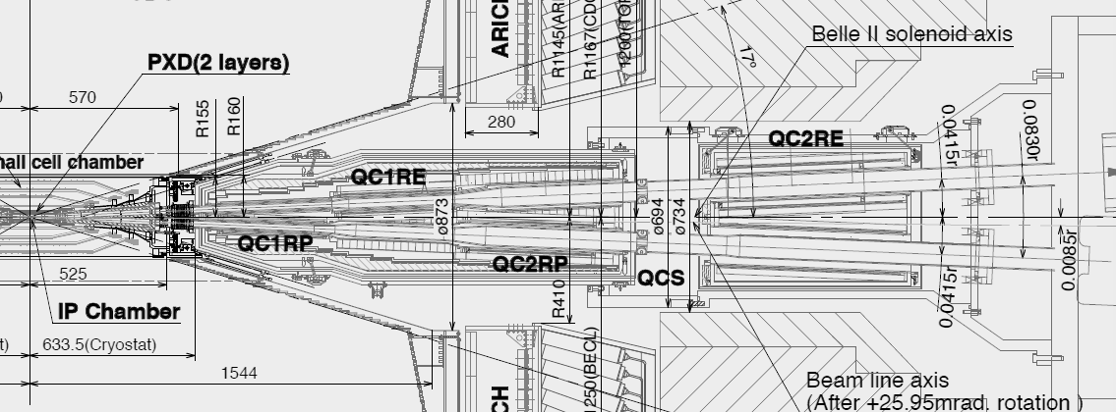
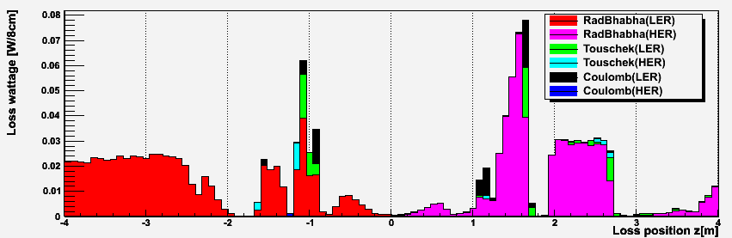
_{Sensor locations}
This is R-side picture, but we also put sensors on L-side
At least 4 sensors in phi
(hopefully 8 sensors)
10 z positions （L-side x5、R-side x5）, 4 phi positions at each z position

Slide 38
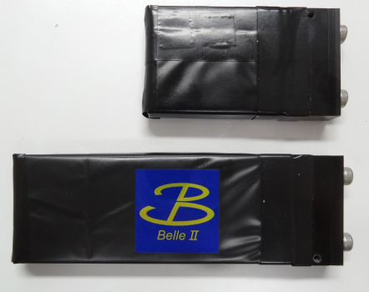
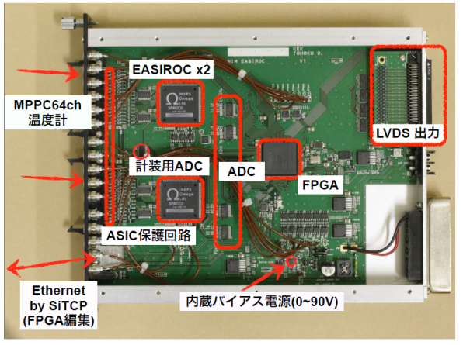
Sensor R&D
β(Sr-90)
Plastic scintillator + WLS fibers (x40)
  Rate measurement
  WLS fibers and MPPC（3mm□、S12572-025C）
  EASIROC module （bias supply + readout for 64 ch/module）
PIN diodes (x40)
  Current measurement
  No real activity yet, plan to reuse phase1 PIN diode system for phase2/3
  Still need to consider: readout, cable space, grounding, packaging, etc..
5cm or 10cm
4cm
MPPC
1cm

Slide 39
Measuring specific backgrounds that led to problems in the past (i.e. in Belle, BaBar)

Slide 40
SR X-rays and Neutrons
Not well measured during Belle I commissioning
  Unexpected, large synchrotron radiation (SR) flux
    hole in the first Belle beam pipe
    radiation damage to the initial Belle SVD, necessitating early replacement
  neutrons led to unexpectedly large backgrounds in the Belle KLM
  neutrons also an important, unexpected background in the BaBar DIRC
  neutrons fluxes and spectra are notoriously difficult to simulate and measure accurately
Synchrotron x-ray rates will be measured with shielded/unshielded PIN diode pairs in BEAST phase 1 (not covered here), and in more detail with the FANGs detector (see earlier slides) in phase 2
We plan to measure neutrons in the VXD dock space, where there is space for additional instrumentation in phase 2.
  The dock space is a good location, as the beam-loss distribution peaks in the QCS magnets just inside of the dock space, leading to a large flux of neutrons through the dock and into the Belle II ECL and KLM.

Slide 41
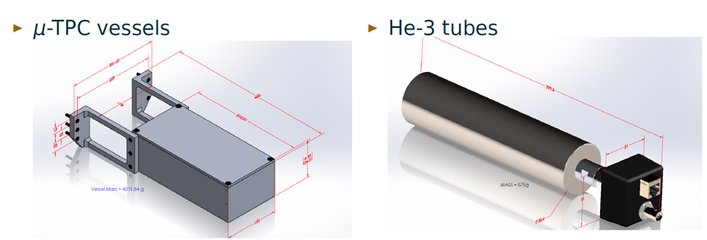
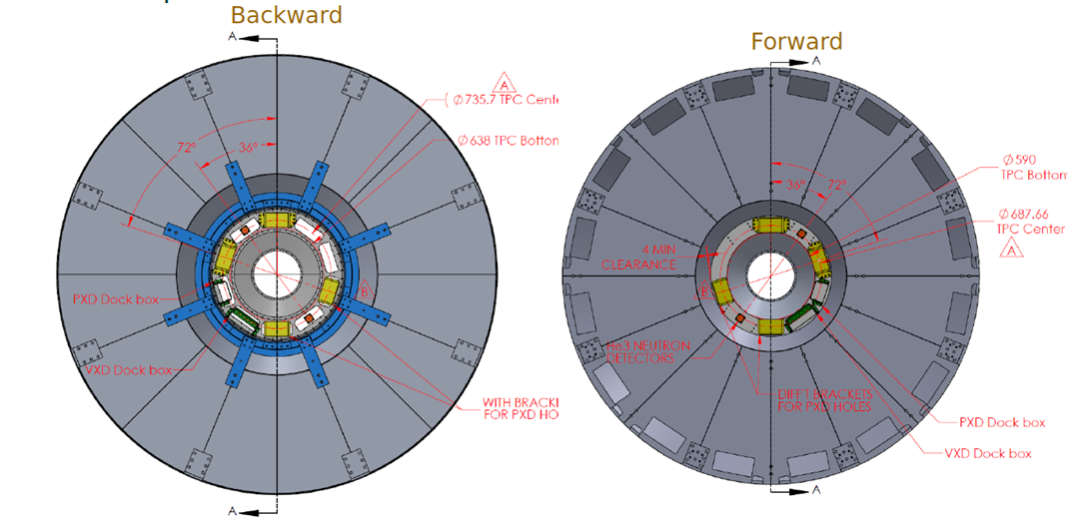
Phase-2 Neutron Detectors
TPC fast neutron detector
He-3 thermal neutron detectors
Fast and thermal neutron detectors in dock space will provide complimentary information.

Slide 42
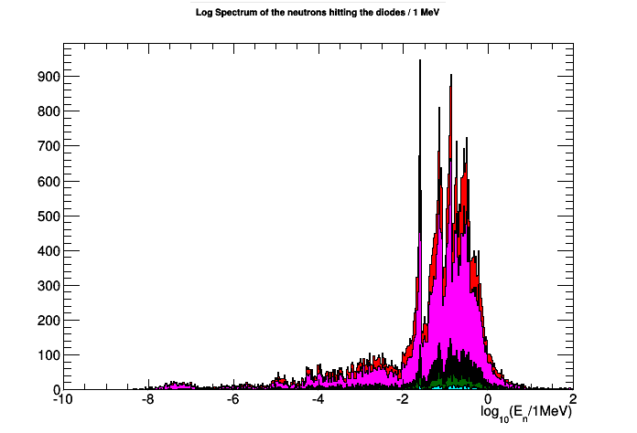
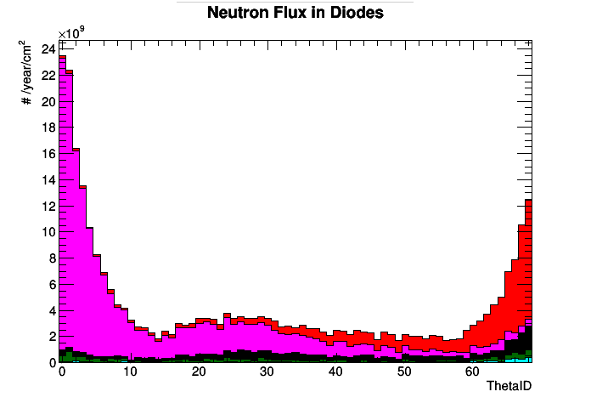
He-3 Tube
Contact Person: Sam de Jong (Victoria) Number of Channels: 4 in phase 1 and 2
Space allocation for services: four NIM slots, two VME slots in BEAST DAQ rack
Data output:
  BEAST DAQ: pulse height from each tube, tube #, timestamp
  KEKB control room: Running histogram of number of hits vs time in each tube
  Belle II control room: same
Required Input: Injection time, timestamp
The He-3 tubes will measure the thermal neutron flux at their location
The data will be used to verify the robustness of the Monte Carlo simulations
He3tubes will be near ECL endcaps – Shown here is data from 11th background campaign ECL studies
  No phase II simulation on He3tubes has been done yet
Neutron spectrum in ECL
Neutron flux in ECL diodes
Forward endcap
Backward endcap
Thermal Neutrons
42
42

Slide 43
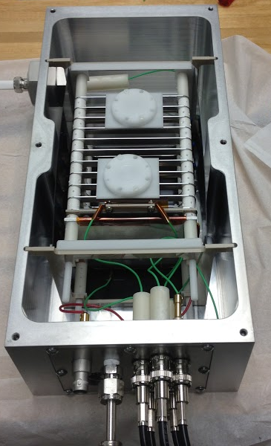
Micro-TPC fast neutron detectors
contact person
  S. Vahsen (Hawaii)
motivation and brief analysis plan
  Measure fast neutron rate for K_{n}> ~500 keV
  Use neutron recoil direction to
    identify neutrons originating from beam pipe
    dis-entangle different types of beam backgrounds
  Also sensitive to
    neutron energy spectrum
    total ionization dose
    x-rays and charged tracks
what kind of data to be stored on DAQ
  Nuclear recoils, self-triggered events
  Summary information on neutron flux versus phi, theta for each TPC
designs of sensor/package/support
  completed
readout system and DAQ
  FEI4 → LVDS → USBPix3 DAQ → BEAST EPICS
request for Belle II clock, trigger, injection timing?
  No requests
  Not planning careful timing calibration of this system
  Will benefit from Belle II random trigger data to analyze Belle II hit correlation with TPC neutron flux
any other requests
  Need CDC endplate holes in all dock space positions
Final TPC
(without lid)

Slide 44
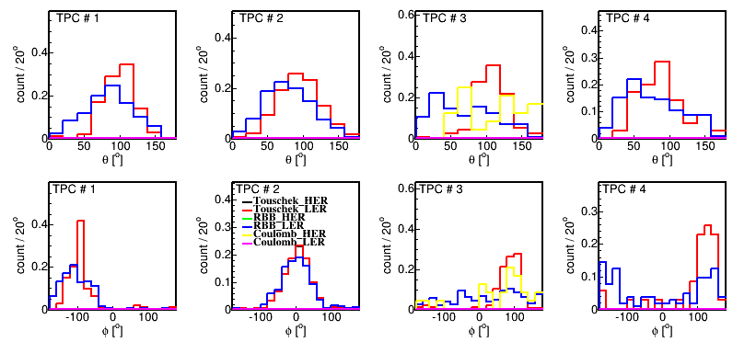
Measuring Individual Neutron BGs w/ TPCs
Directional detection
motivation
Isolate neutrons coming directly from beam lines (rather than re-scattered)
Measure neutron flux versus polar angle (beam line position) → validate/tune simulation
I. Jaegle (Hawaii)
nominal beams:
RBB HER dominates
  → measure
Run single beams
  no RBB
  measure
  Touchek
  vacuum bump
  → measure
  Coulomb
(note: Distributions normalized to same area)
1/20/2015
Sven Vahsen, Strasbourg Workshop
44

Slide 45
Conclusion
A set of dedicated “BEAST” detectors in the VXD volume, VXD dock space, and around the QCS will provide BG measurements in phase 2
Each detector contributes a unique measurement or capability
Multiple technologies, some with significantly higher rad-hardness than Belle II detectors will allow VXD volume BG characterization even if PXD/SVD ladders are damaged in phase 2.

