Slide 1



CLAWS Phase 1 Status,
Phase 2 Motivation
Frank Simon
Max-Planck-Institute for Physics
January 14, 2016

Slide 2
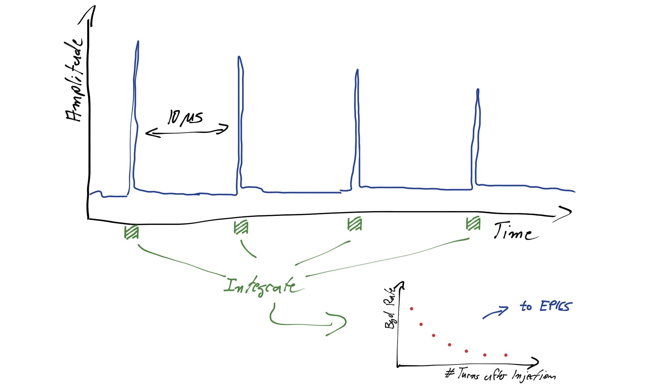
CLAWS Goals & Motivation
Measure the time evolution of the injection background in the IP region - Primarily by being sensitive to charged particles
Continuous monitoring of injection cycle (20 ms) with 0.8 ns sampling rate
Single particle time resolution < 1 ns => Unambiguous linking of particles to SuperKEKB bunches
Fast feedback for machine background close to IP
Independent DAQ system
Set up to provide fast analysis of injection bunches and other machine backgrounds
PVs transmitted via EPICS
Permanent online display in machine control room
Direct feedback to machine with sub-second delay

Slide 3
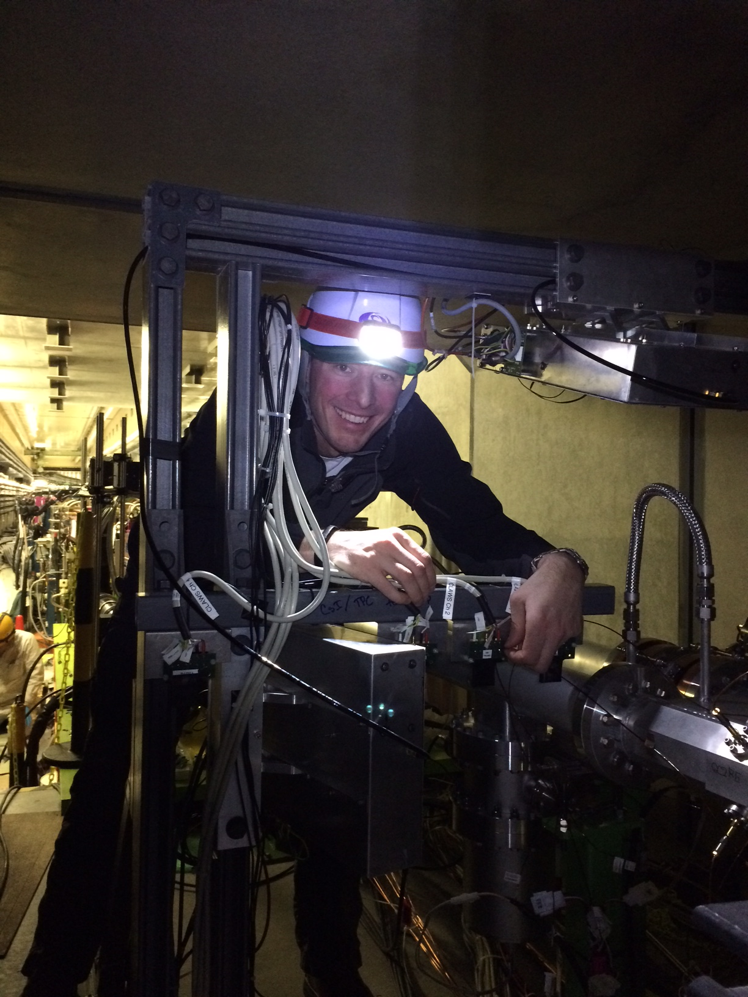
CLAWS Phase 1: Installed & Upgraded
Phase 1 system installed – total of 8 independent sensors on both sides of the IP
Currently installing “upgrade”: Better SiPMs, rad-hard PS scintillator
Commissioning & DAQ integration ongoing

Slide 4
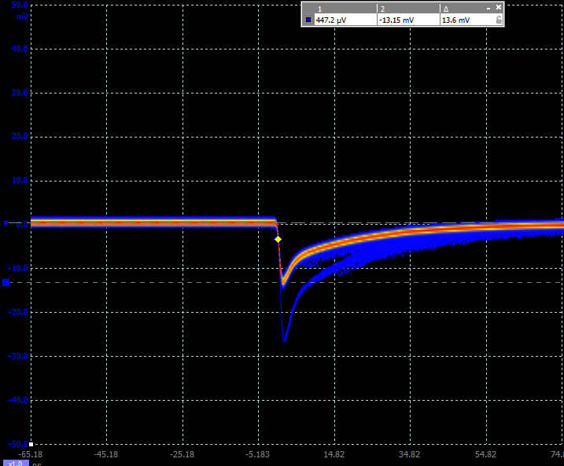
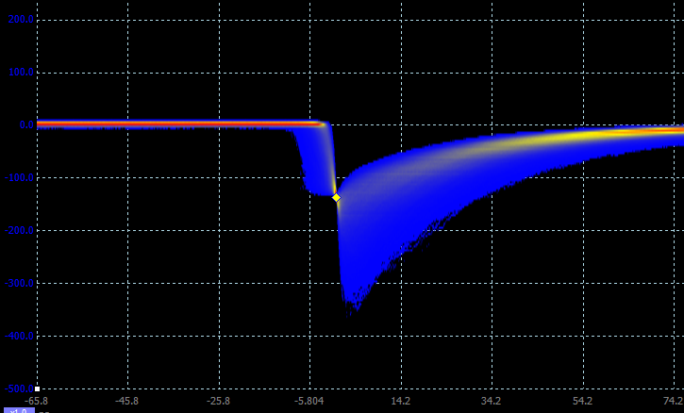
CLAWS Phase 1:First Signals
Very low noise of new sensors – almost no signals higher than 1 p.e., no noise beyond 2 p.e.
Successful test with ⁹⁰Sr source: good signals with trigger at 10 p.e. (expect ~ 18 p.e. for a MIP)

Slide 5
CLAWS Phase 1: First Signals
Overall very good uniformity of gain of detectors when all are operated with identical bias voltage:
  5% spread, measurement accuracy probably ~ 3 %

Slide 6
CLAWS Phase 2
CLAWS Detector: Concrete sensor layout and design being established
  2 ladders, each with 6 - 8 scintillator cells read out by SiPMs
    Photon Sensor: MPPC S13360-1325PE
    Scintillators: Investigating options - PVT- based scintillator available, but radiation hardness most likely < ~ 1 MRad -> at the limit of requirement
    Polystyrene based scintillator used for Phase 1, with radiation hardness > 1 MRad, also looking into other alternatives, expecting first results in coming months
  Size and number of cells depend on expected particle rates -
  Default size 2 x 2 cm², easy to modify also
  relatively late in the design process
  Mechanical support essentilly
  finalized, fixation points established

Slide 7
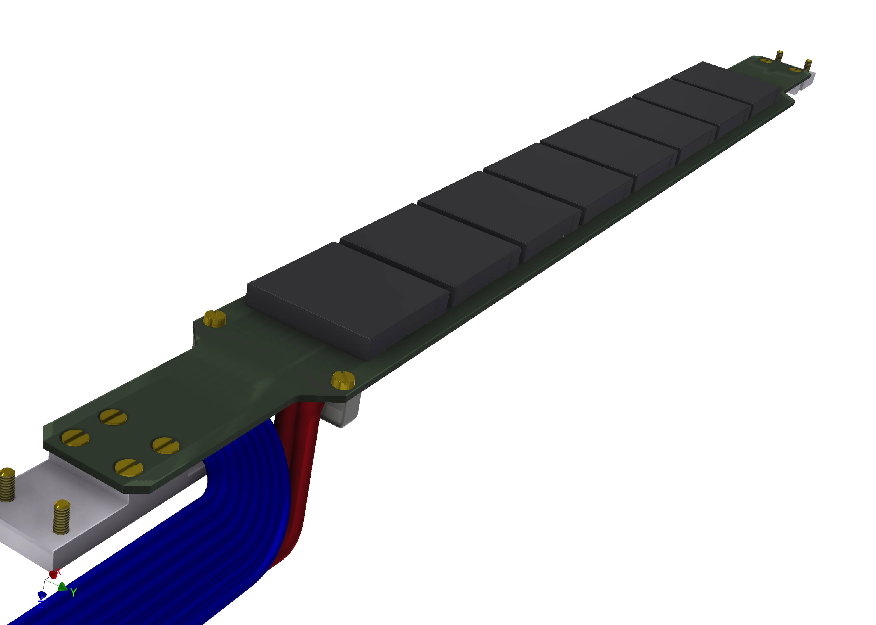
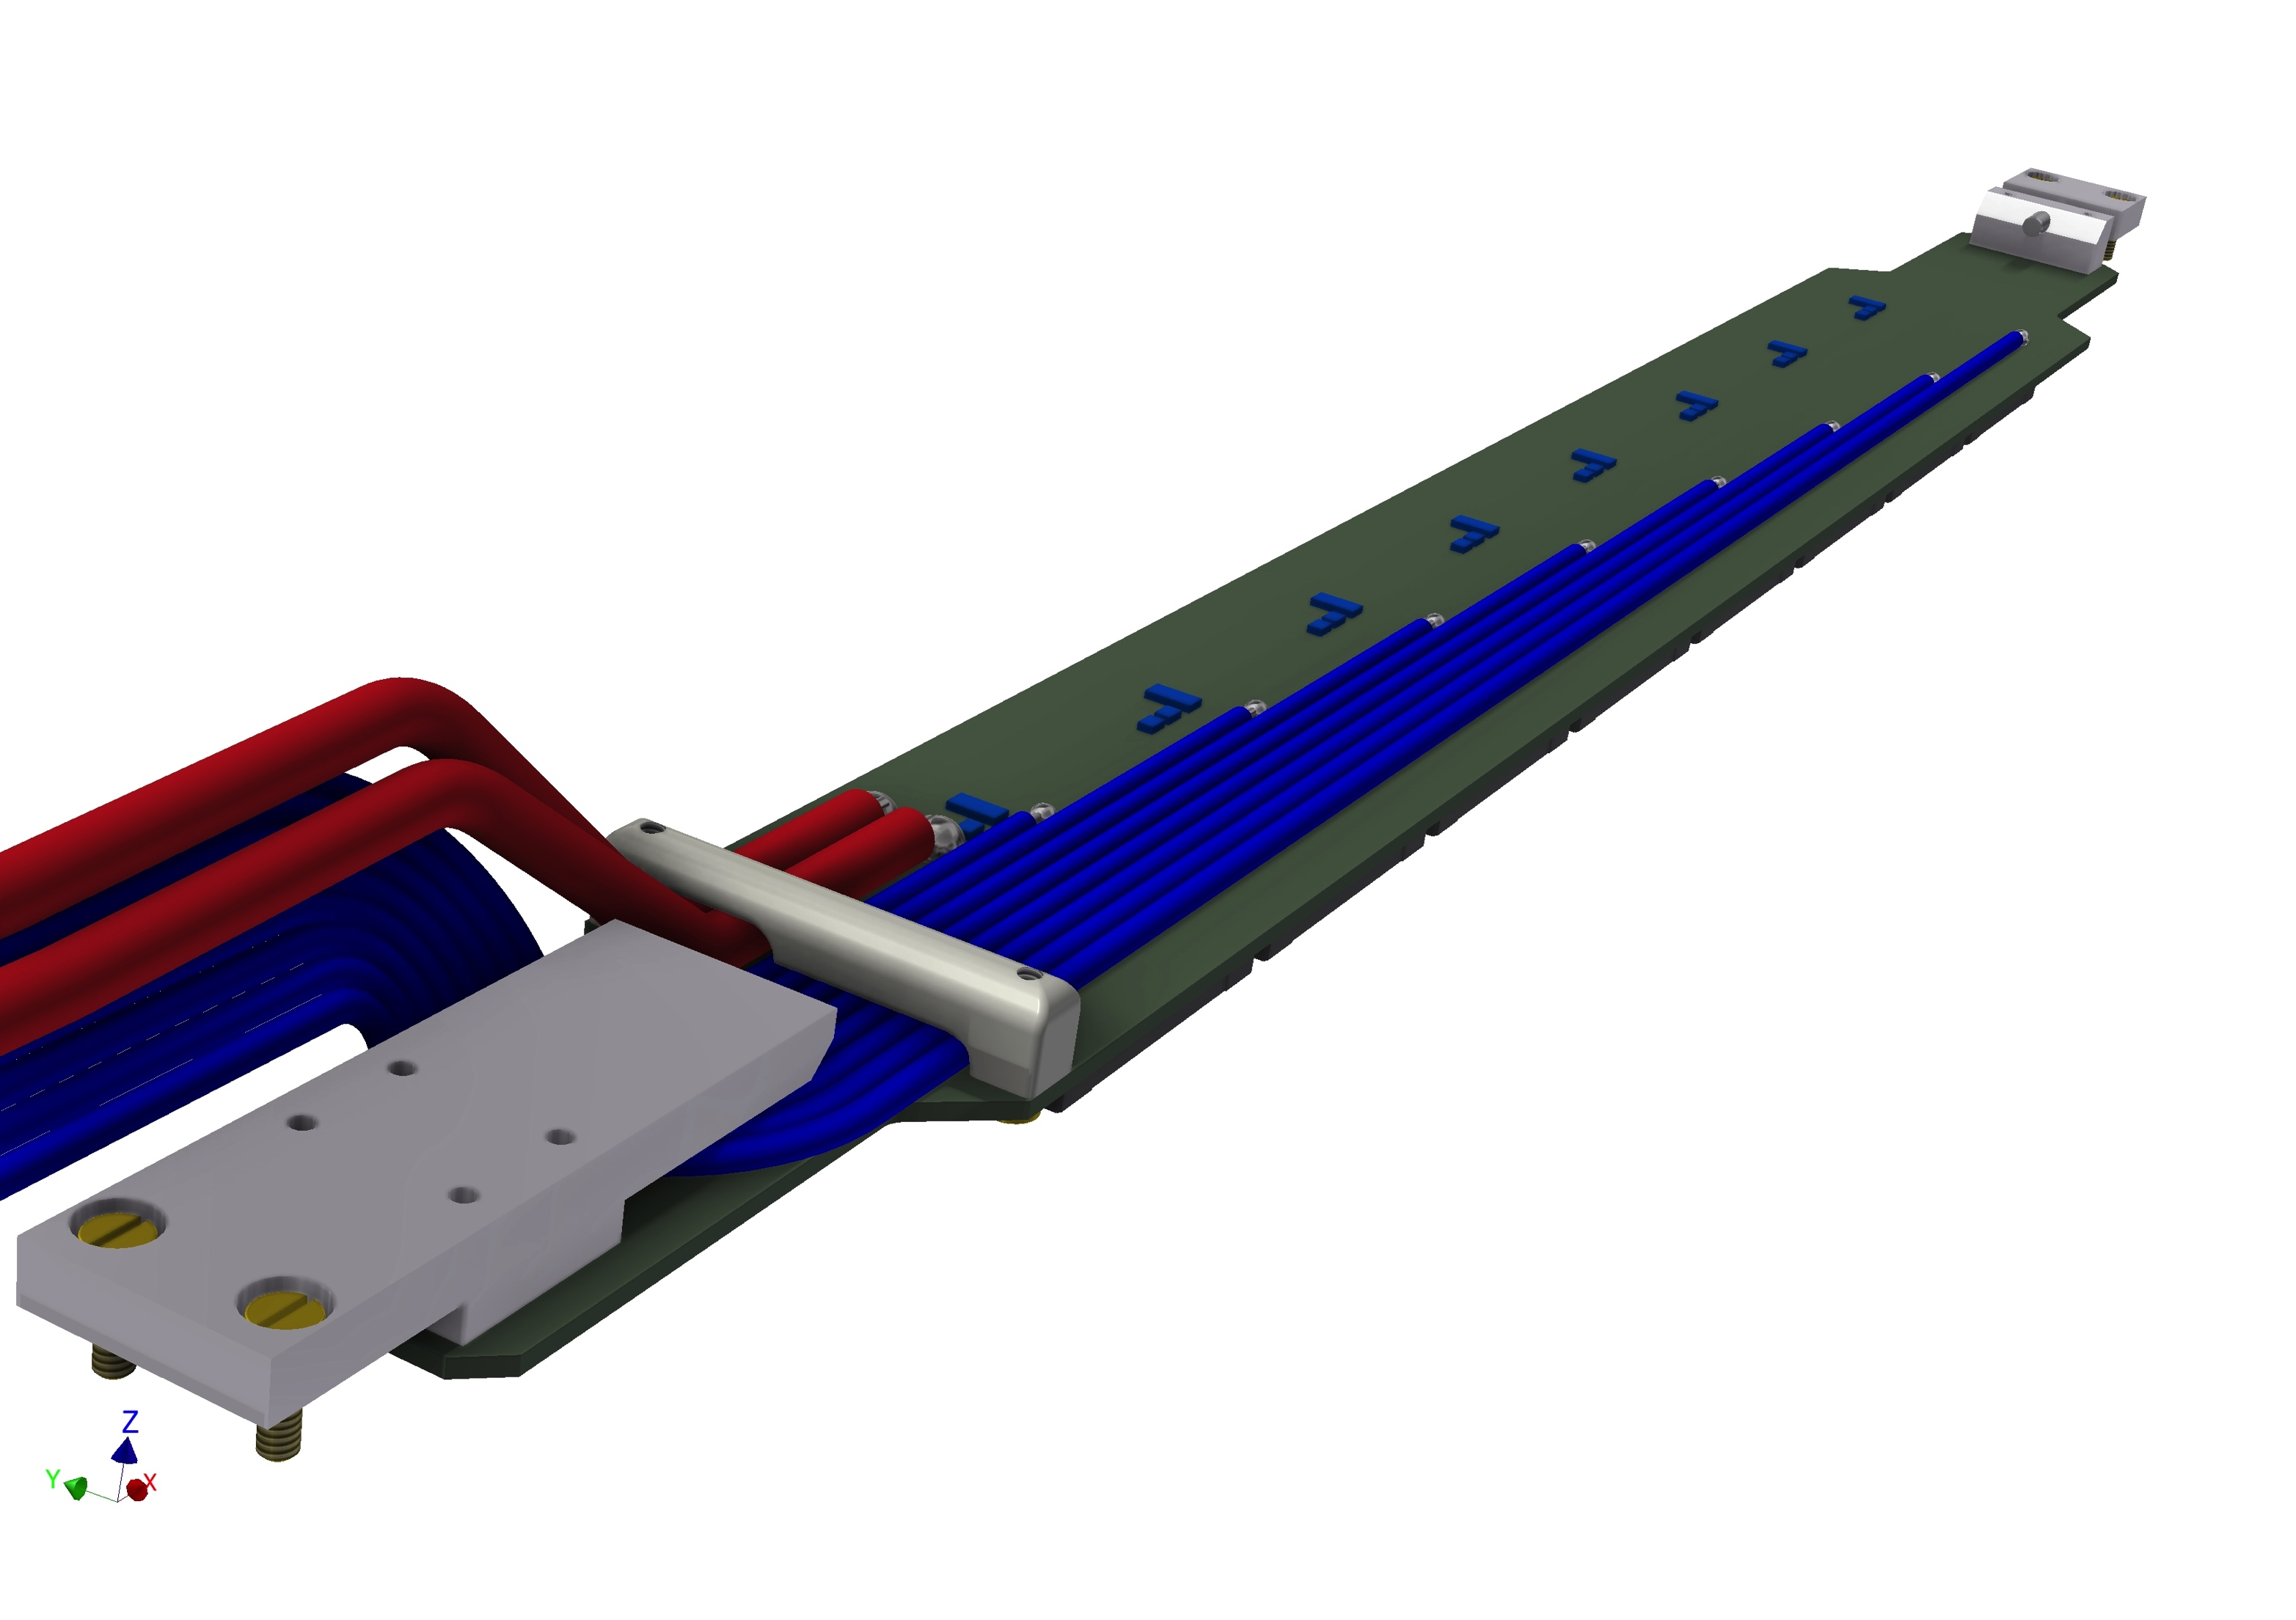
CLAWS Phase 2 Mechanical Design
2 cm x 2 cm x 3 mm scintillator tiles: ladder a bit wider than 20 mm
8 signal cables: 1.5 mm diameter coax
2 power cables: expect ~
3 mm diameter

Slide 8
Summary
CLAWS Phase 1 making good progess
  System installed
  All sensors alive
  Currently working out triggering scheme
  Next up: Integration into global BEAST DAQ
CLAWS Phase 2 essentially defined – finalize at next B2GM, then start production

