Slide 1
Next steps
For metal-1:
:- fully speed operation of OB seems to be shown
:- take source data at reduced speed as far as possible
:- → before B2GM …
:- Open issues
:- common mode noise? Grounding??
:- → operate 2nd OB …
:- testing of OF (Hybrid7)
Finally:
:- gated mode
:- first on Hybrid5 (Bonn?)
:- then on OB and OF-Hybrid7(?)

Slide 2
OB – OF comparison
OB
OF
:- different in the direction of the rolling shutter
:- different in the topology of the JTAG chain
:- some differences in the routing of lines …
What is actually the difference in metal 1??
IF (EMCM)
IB

Slide 3
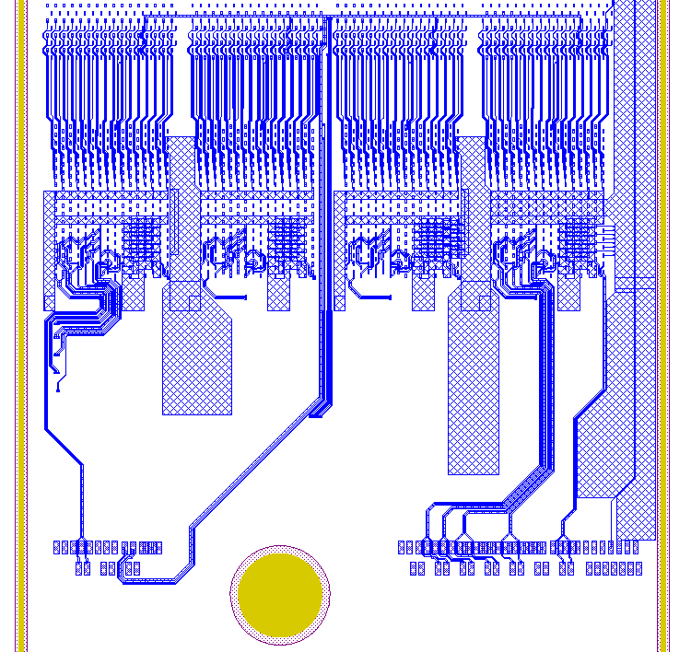
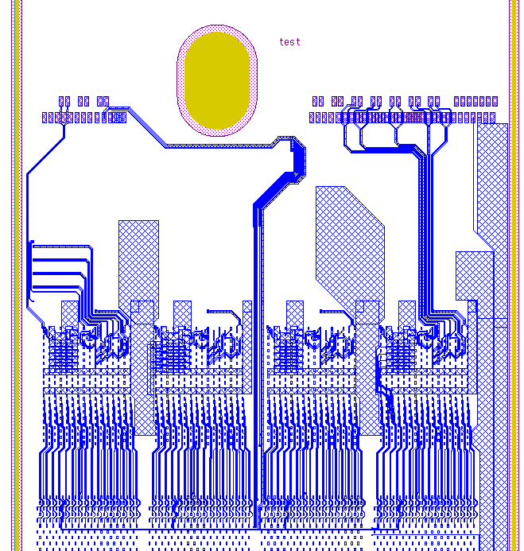
The EOS
OB
OF
TMS, TCK, GCK, TRG, TDO
DCD Monitor and bias sense lines, various JTAG

Slide 4
The EOS
SWB Strobes and clk ..
OB
OF
TMS, TCK, GCK, TRG, TDO
DCD Monitor and bias sense lines, various JTAG

Slide 5
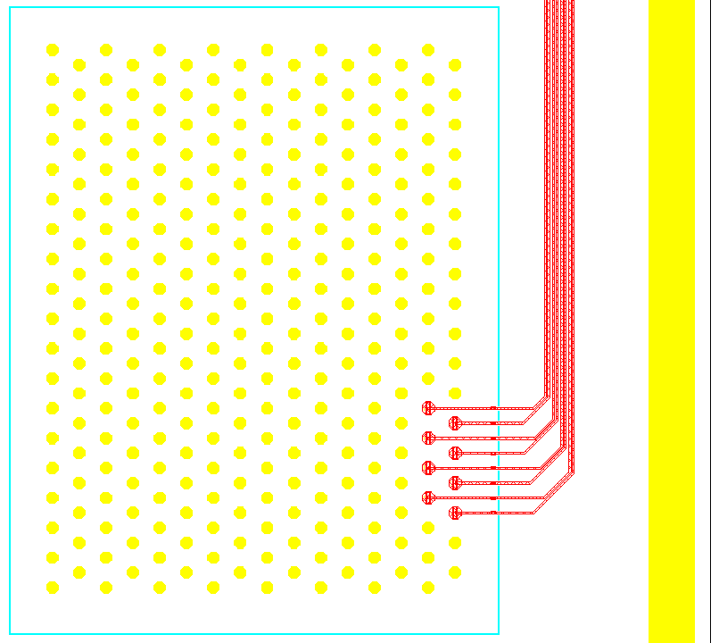
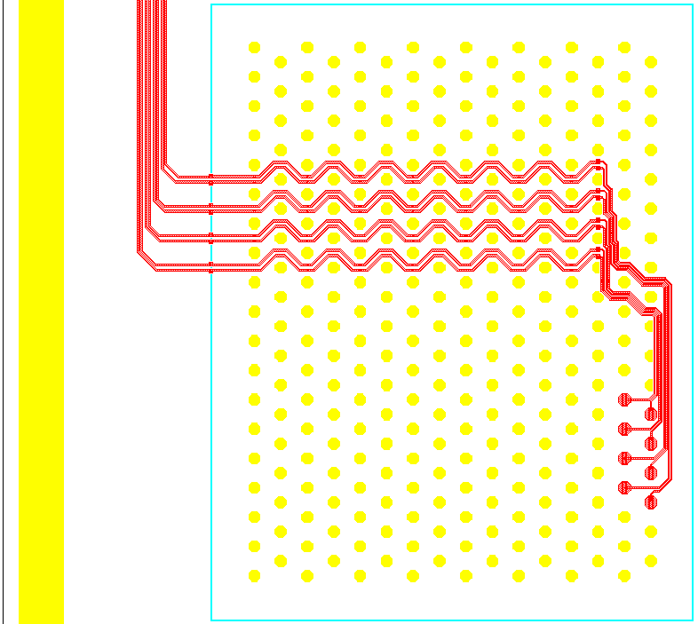
OB – OF strobe lines
SerIn
OB in Al1/Al2
OF in Al1/Al2/Cu
In addition from DHPT:
:- SerIn goes all the way up to last SWB at the end of OF
:- SerIn starts on SWB close to DHP on OB
Routing on balcony basically the same
SerIn

