Slide 1

9th Belle II VXD Workshop
IFIC-VALENCIA-SPAIN, 13-15 January 2016
NOISE IMMUNITY TESTSTAND AT ZARAGOZA
Fernando Arteche, Mateo Iglesias & Iván Echeverría

Slide 2
OUTLINE
1. Introduction
2. RF susceptibility test set-up
  Auxiliary equipment
3. Equipment Under Test
  Power lines
  Beam pipe radiation
4. Discussion …..
9 th Belle II VXD Workshop
13-15 January 2016, IFIC, Spain
2 de 19

Slide 3
1. Introduction
Susceptibility test is the most useful test of the EMC plan.
  However it is much more complex than emission test
It tries to evaluate the effect of noise current and transients present in a system
The susceptibility test can be divided into two big groups:
  Immunity to RF noise
  Immunity to transient perturbation
Test results need some data processing.
  It may require long analysis (several months)
It is crucial to define the EMC unit - Unit under test
9 th Belle II VXD Workshop
13-15 January 2016, IFIC, Spain
3 de 19

Slide 4
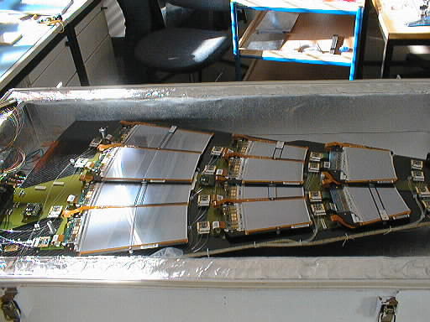
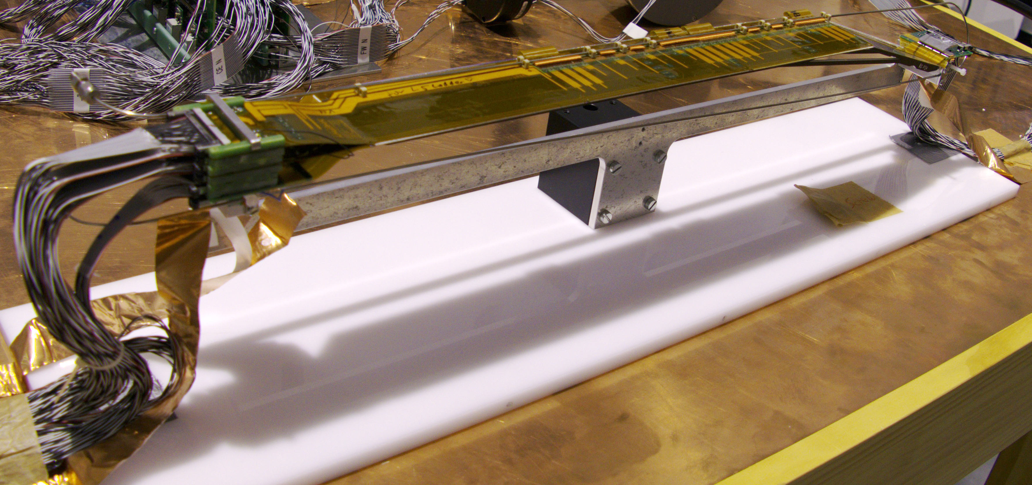
1. Introduction
Test layout (EMC unit) as similar as possible to the final configuration
What is an EMC unit? – Something that represents the system under study .
CMS- TEC FEE unit – 1 Petal
  Petal divided into
    Rings & Modules (16)
  ICB- Inter Circuit Board
Belle II-SVD EMC unit – 1 Ladder
  L5 – 8 sensors
    ≈ 5000 channels
9 th Belle II VXD Workshop
13-15 January 2016, IFIC, Spain
4 de 19

Slide 5
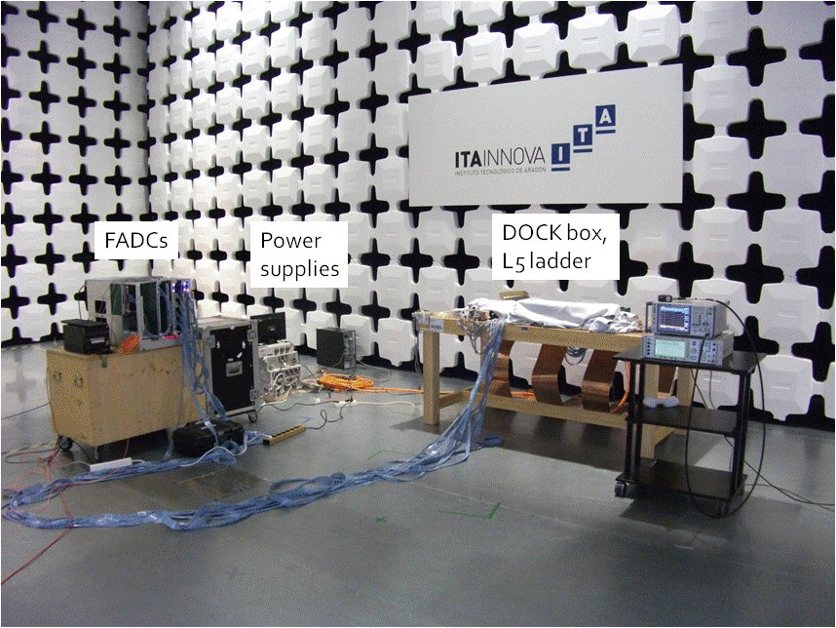
1. Introduction
EMC unit test
EMC test set-up ( Belle II - SVD sub-detector)

Slide 6
1. Introduction
The test injects a perturbing signal into the FEE and evaluates the FEE performance
  Several frequencies
  Several amplitudes (the system should be perturbed)
FEE
FEE
FEE
Diagnosis & Sensitive areas - Belle II - SVD
9 th Belle II VXD Workshop
13-15 January 2016, IFIC, Spain
6 de 19

Slide 7
1. Introduction
Frequency response (Compare designs & systems)
  It is the noise transfer function (TF) of FEE – Vout / Inoise
    To quantify the sensitivity of the FEE to noise currents
Icm
External Noise
TF
Vout (RMS)
SVD –TF (average)
SVD -TF
9 th Belle II VXD Workshop
13-15 January 2016, IFIC, Spain
7 de 19

Slide 8
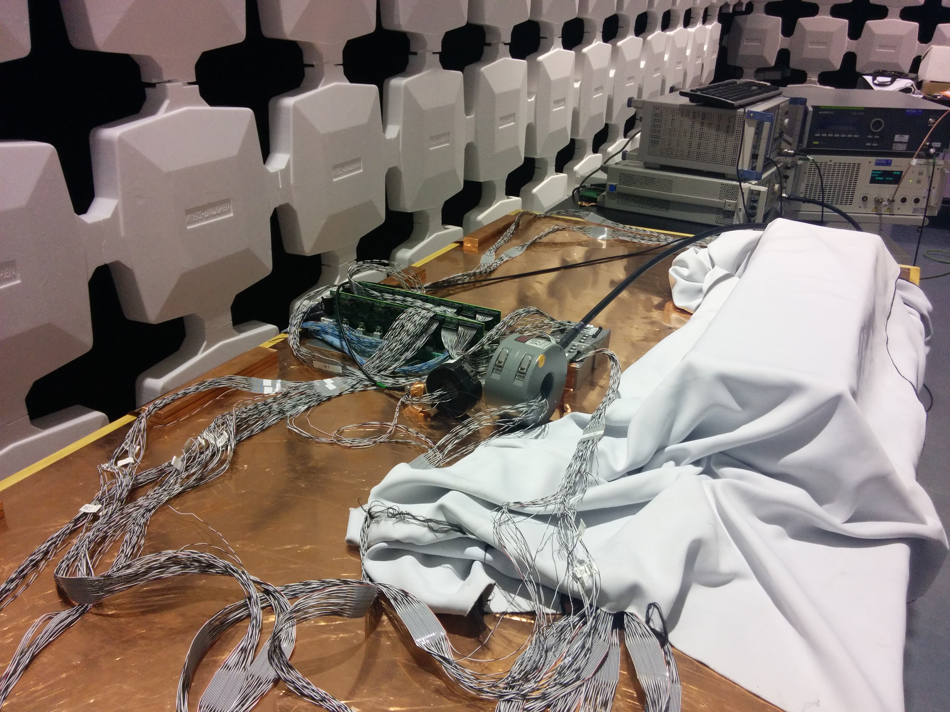
2. RF susceptibility test set-up
Decoupling impedance
Copper plane
BCI probe
Current probe
Ladder 5
Test equipment & Set-up – SVD EMC test
9 th Belle II VXD Workshop
13-15 January 2016, IFIC, Spain
8 de 19

Slide 9
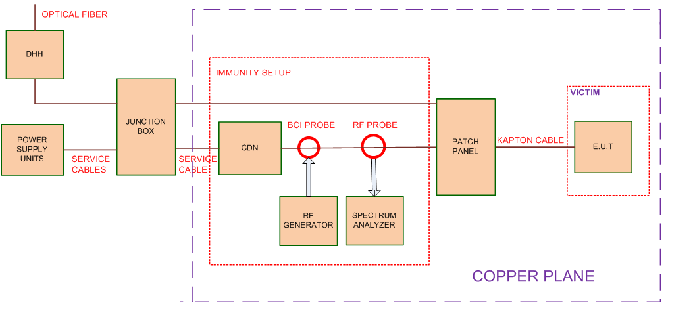
2. RF susceptibility test set-up
EUT
Possible PXD set-up
9 th Belle II VXD Workshop
13-15 January 2016, IFIC, Spain
9 de 19

Slide 10
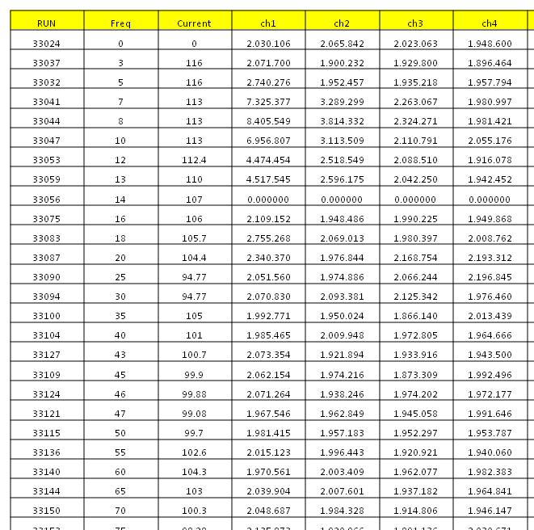
2. RF susceptibility test set-up
The evaluation of the PXD system is via RMS
The RMS value of each channel is stored:
  The RMS value (calculated based on 2000 events ) of each run is stored.
File has to be prepared for future analysis
  A file per test / module / chip
  It should be discussed
CM noise test – Line 1
9 th Belle II VXD Workshop
13-15 January 2016, IFIC, Spain
10 de 19

Slide 11
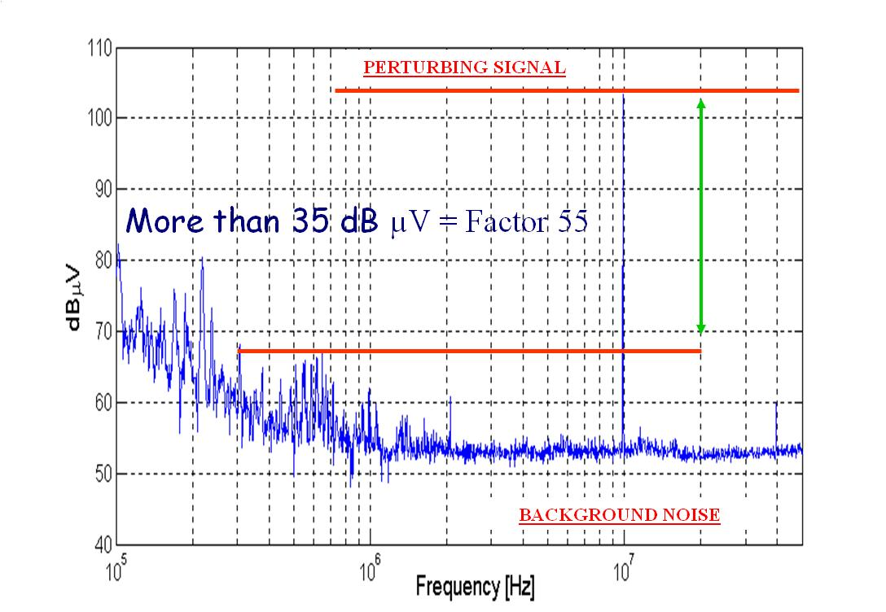
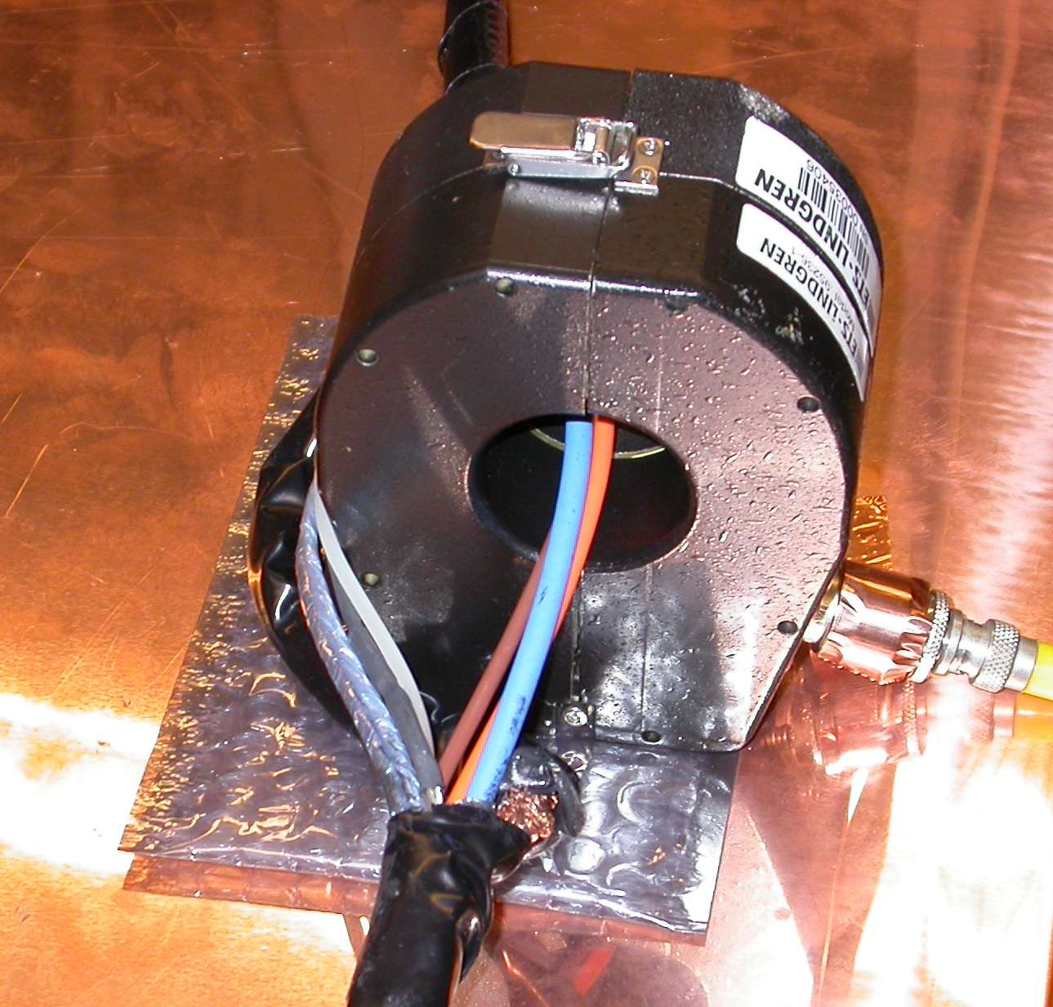
2.1 RF susceptibility test set-up:
Auxiliary equipment
Noise injection – HF current probes
  High ratio – perturbing / background signal
Special cable should be prepared.
9 th Belle II VXD Workshop
13-15 January 2016, IFIC, Spain
11 de 19

Slide 12
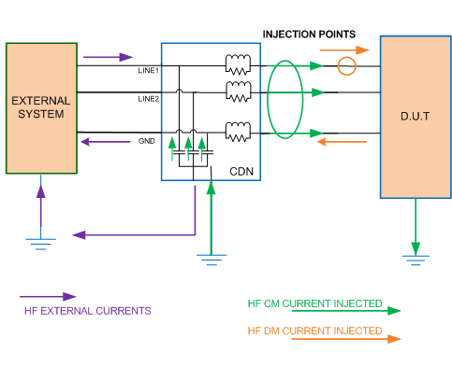
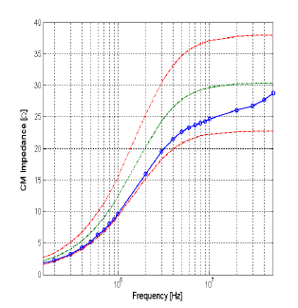
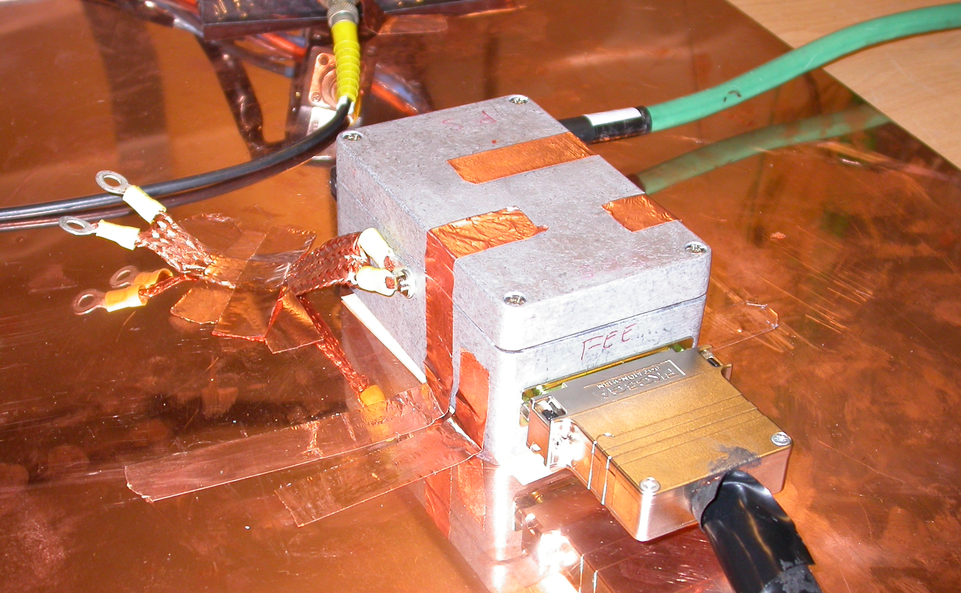
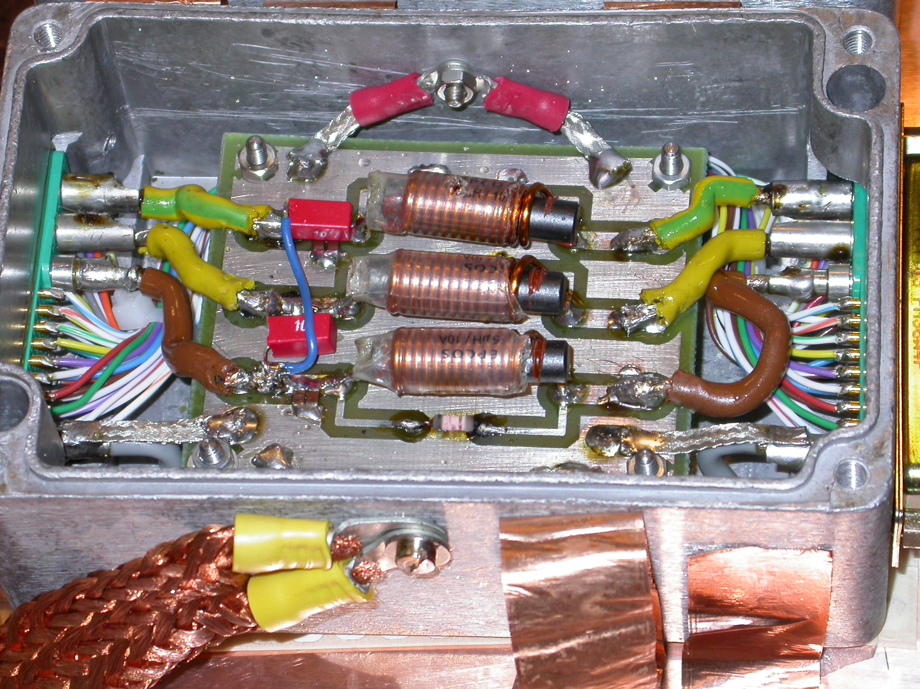
Aux equipment: CDN (Common Impedance)
2.1 RF susceptibility test set-up:
Auxiliary equipment
Coupling/Decoupling Network
  Return path to noise
  Isolate from auxiliary equipment
  It shows a uniform impedance
CDN – CMS - SiT
9 th Belle II VXD Workshop
13-15 January 2016, IFIC, Spain
12 de 19

Slide 13
3. Equipment under test
We need to define the system we want to test
  Which one ?
The PXD is very complex
  Services cable (many voltages)
  Data transmission cable
We suggest to perform two sets of susceptibility test:
  Power supply lines
    Low impedance lines (more susceptible lines in HEP)
  Radiation noise from the beam pipe
9 th Belle II VXD Workshop
13-15 January 2016, IFIC, Spain
13 de 19

Slide 14
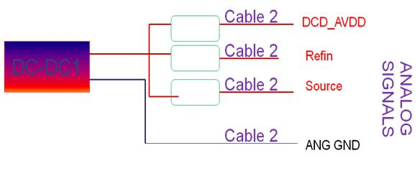
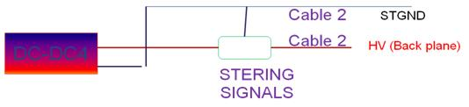
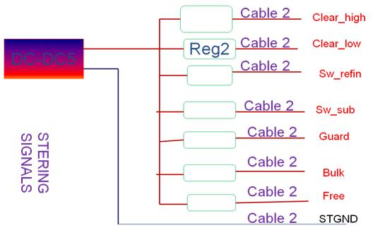
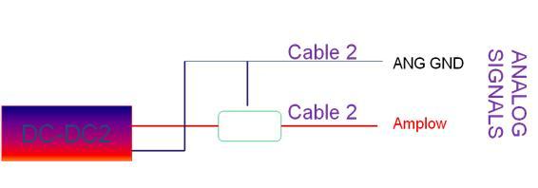
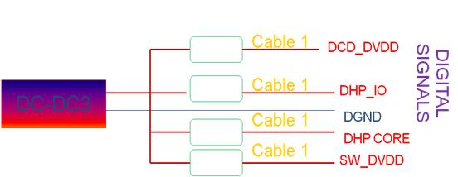
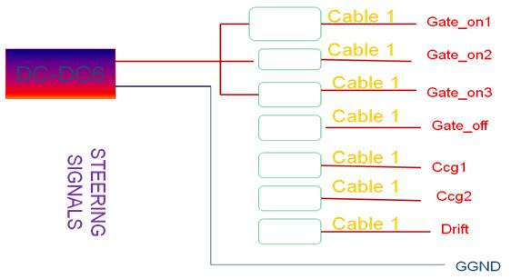
3.1 EUT: Power lines
Which lines are we going to test ? (practical)
  CM & DM associated to these lines ( Coord. PS test)
Cable 1
Cable under study
Cable 2
9 th Belle II VXD Workshop
13-15 January 2016, IFIC, Spain
14 de 19

Slide 15
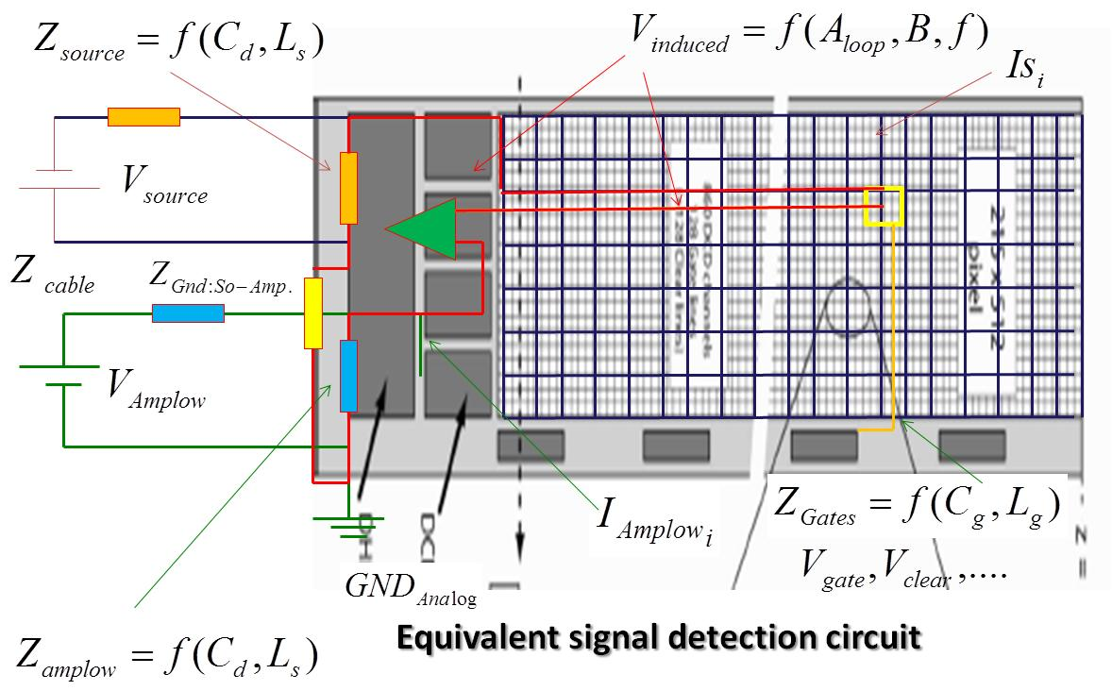
3.1 EUT: Power lines
9 th Belle II VXD Workshop
13-15 January 2016, IFIC, Spain
15 de 19

Slide 16
3.2 EUT: Beam pipe radiation
The PXD is going to be placed very close to the beam pipe
The beam pipe may radiate noise
  PXD is not a PCB with a nice ground plane ( there are traces)
Beam pipe is part of the accelerator and it may have noise currents in the external face of the pipe (H field)
  Pumps
  Auxiliary electronics (BM)
  Power converters
This noise does not come from the beam
  The EM wave associated to the beam is very well confined (skin-depth)
9 th Belle II VXD Workshop
13-15 January 2016, IFIC, Spain
16 de 19

Slide 17
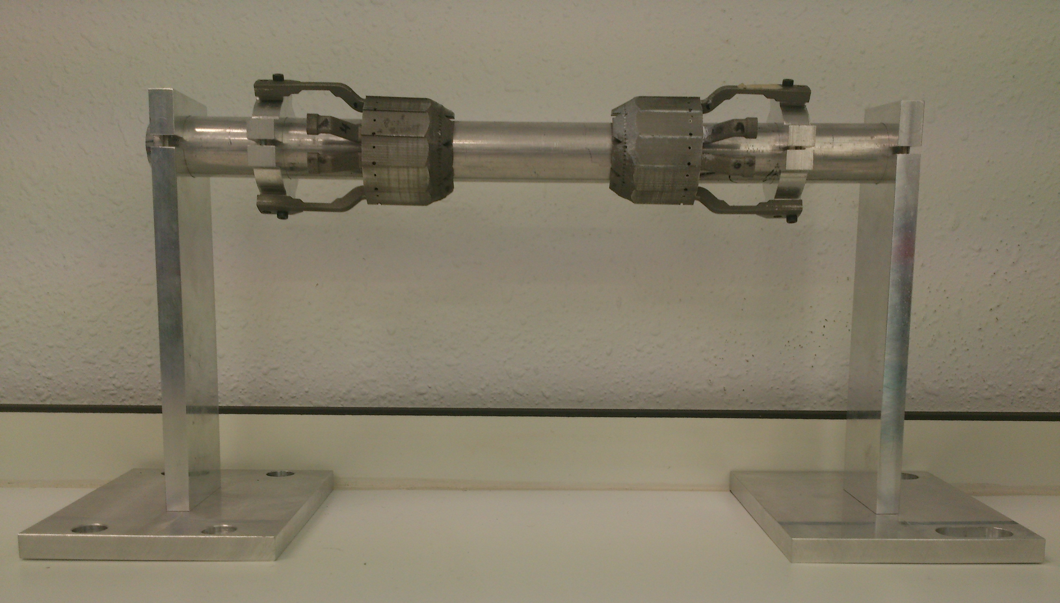
3.2 EUT: Beam pipe radiation
The susceptibility of the PXD system may be measured (depends on EUT)
We have this structure at Zaragoza (IFIC - IFCA)
Ip
V
9 th Belle II VXD Workshop
13-15 January 2016, IFIC, Spain
17 de 19

Slide 18
4. Discussions…
Which system are we going to test ?
  PXD9 / EMCM / other ?
Which test are we going to perform ?
  Which lines?
When should this test be carried out ?
Who is going to be involved ? Personnel support?
  Who is going to operate the PXD ? How ?
  Some extra funding (trips, hotel, allowances, etc ) through AIDA2020
farteche@itainnova.es
9 th Belle II VXD Workshop
13-15 January 2016, IFIC, Spain
18 de 19

Slide 19
4. Discussions
Who is going to prepare the aux. equipment ?
  CDN / Cables /
    It should be tested before sending anything to Zaragoza
  PS units/ Cooling / DAQ ?
SVD EMC test was planned as a “kind “ of test beam (similar approach to the PXD is suggested)
  It was very useful / several discussions in advance
This set of tests is quite long
  We spent 12 hours per day during 2 weeks in order to perform SVD EMC test.
It is a quite delicate test - Things may be wrong …..
farteche@itainnova.es
9 th Belle II VXD Workshop
13-15 January 2016, IFIC, Spain
19 de 19

