Slide 1
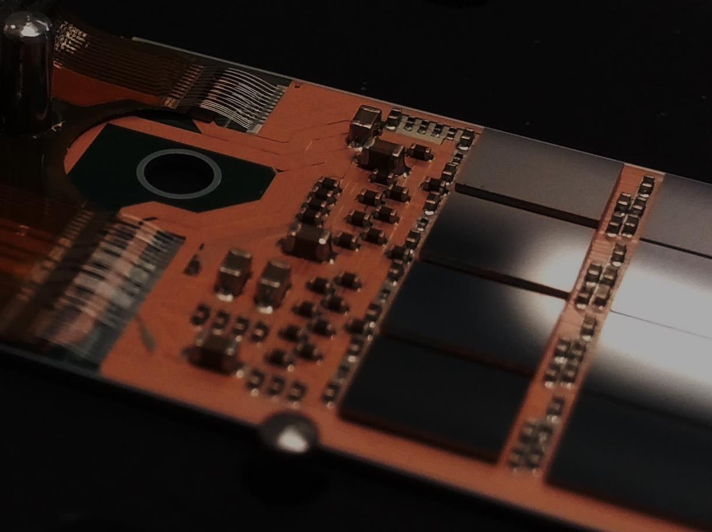
pilot module assembly
- lessons learned -

Slide 2
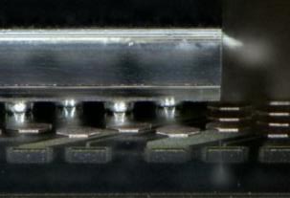
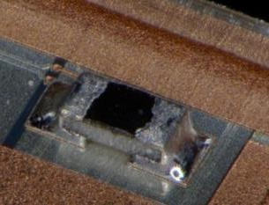
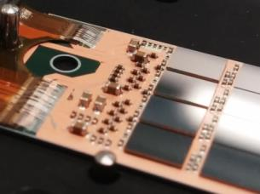
Module Assembly – overview
Flip Chip of ASICs (~240°C):
Bumped ASICs have the same solder balls (SAC305)
DHP bumping at TSMC, DCD bumping via Europractice
So far SWB bumping on chip level at PacTech
@ IZM Berlin
SMD placement (~200°C):
Passive components (termination resistors, decoupling caps)
Dispense solder paste/jetting of solder balls, pick, place and reflow
PbSn 37/63 solder
@ HLL, backup at IFIC
Kapton attachment (~170°C), wire bonding:
Solder paste printing on kapton,
SnBi solder
Wire-bond, wedge-wedge, 32 µm Al bond wires
@ MPP Munich
Link to Google sheet: List of observed issues to be followed up

Slide 3
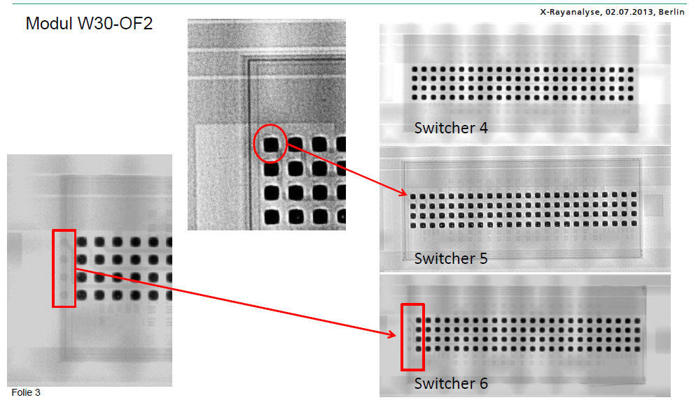
Flip Chip at IZM
IZM experience
First flip chip on EMCMs 2013
10 EMCMs, two modules showed problems after FC, cause not completely clear
4 PXD9 modules: 3 perfect, one had issues with SWB FC
W30-OF2 somehow “cursed”
IZM used manual equipment instead of automatic → bad soldering!
Trials to repair, shipment → module broke

Slide 4
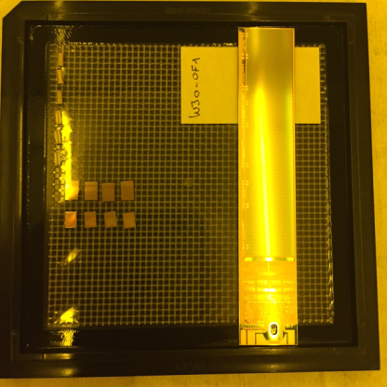
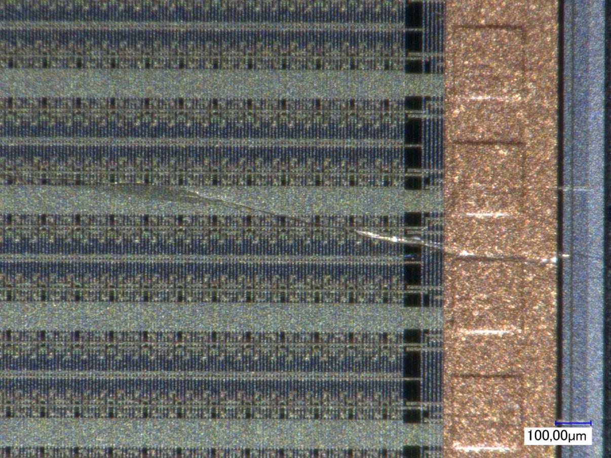
W30-OF2

Slide 5
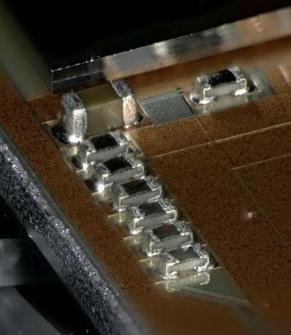
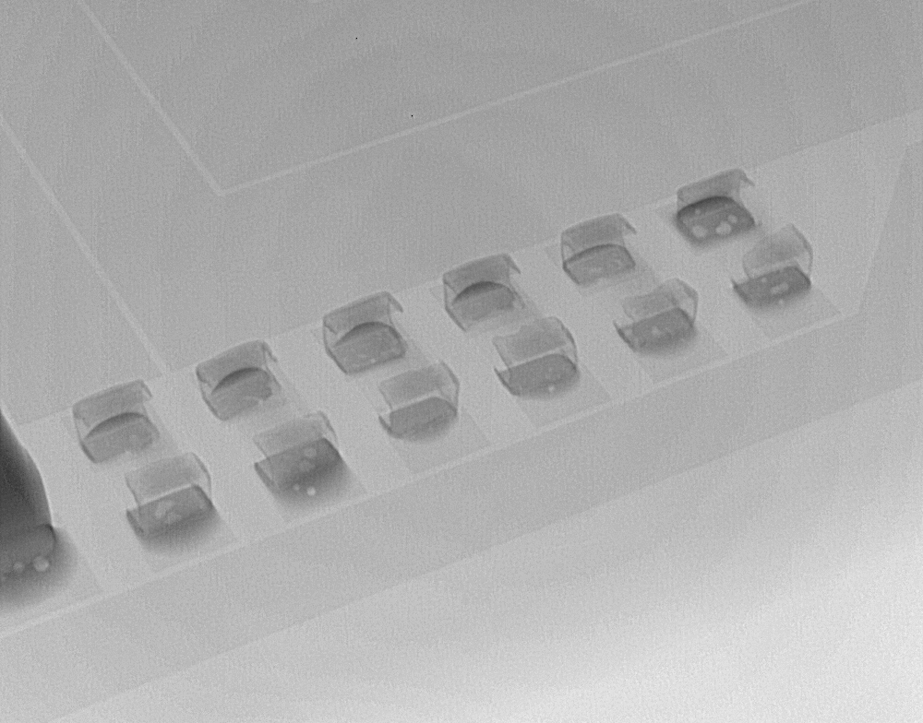
SMD: Status as of today
Tooling and process installed at HLL
Two EMCMs successfully assembled
With special adapter plates assembly of pilot modules done
EMCM Qualification

Slide 6
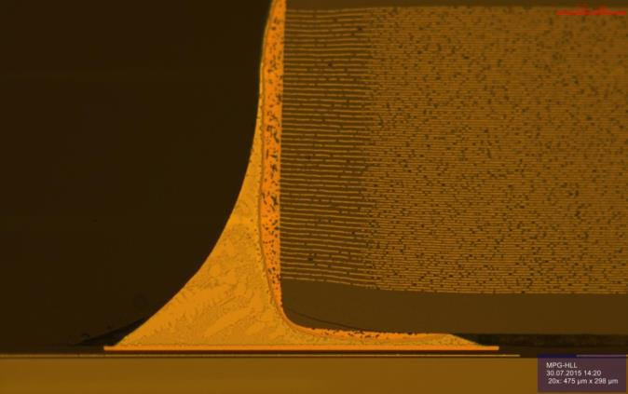
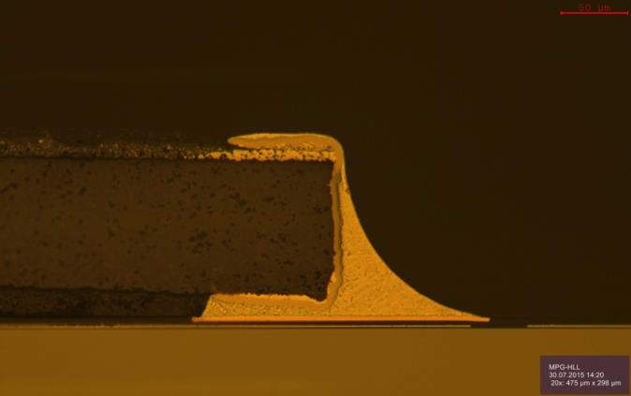
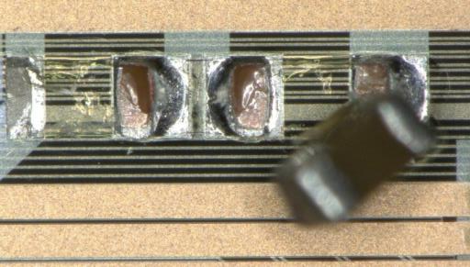
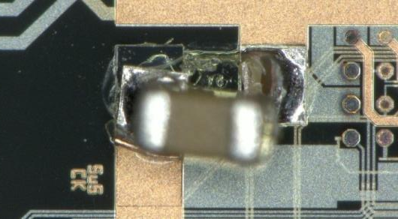
SMD: Qualification of the process
Shear tests of SMDs → okay (350g to 470g for 0201 cap)
Cross sections → okay
Thermal cycling → okay (-50°/+50°, no effect on shear strength)

Slide 7
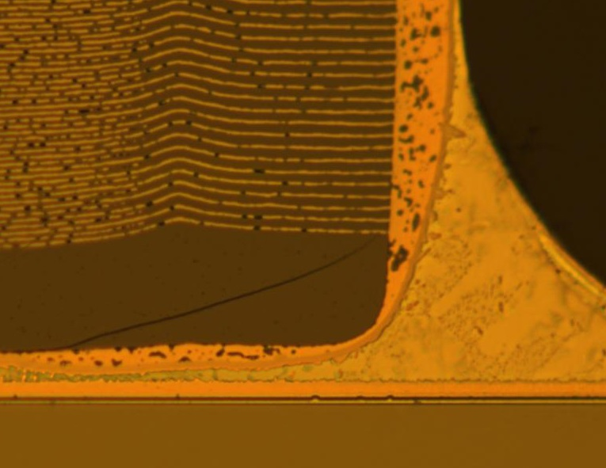
SMD: Qualification of the process
Optimization, fine tuning, reliability … → need higher quality SMDs
Crack in SMD cap. ceramics

Slide 8
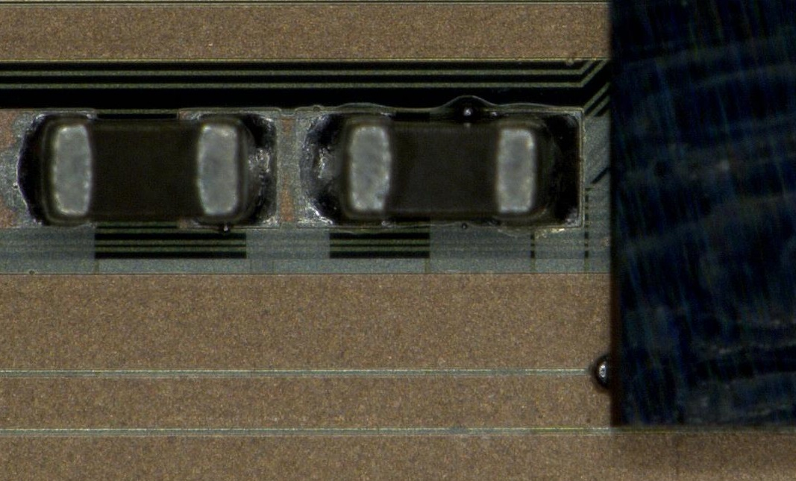
SMD: Qualification of the process
Optimization, fine tuning, reliability … → reduce solder paste volume
“Side balls”

Slide 9
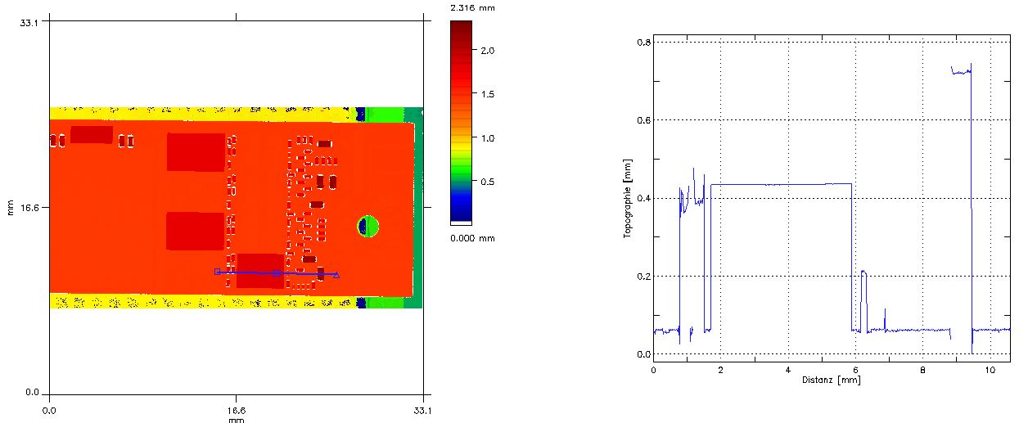
SMD Profile
10µF 0401 SMD on EOS are too high!

Slide 10
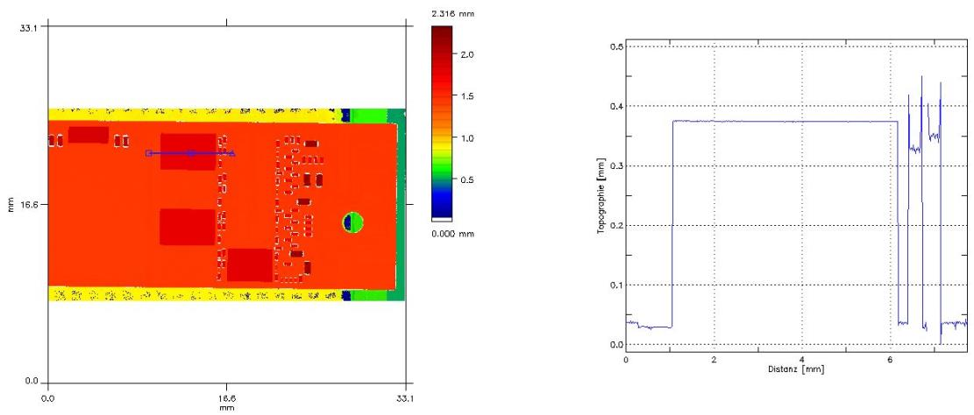
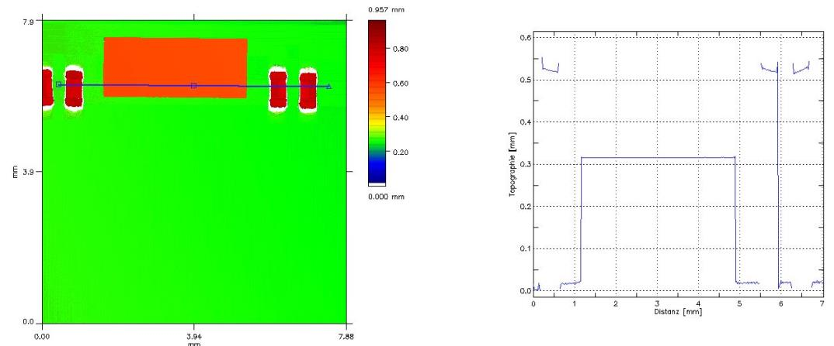
SMD Profile
DCD, SWB@Balcony okay?

Slide 11
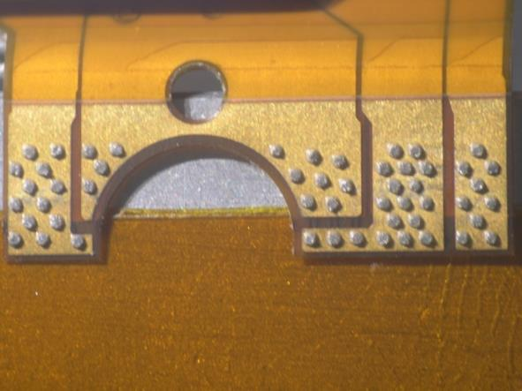
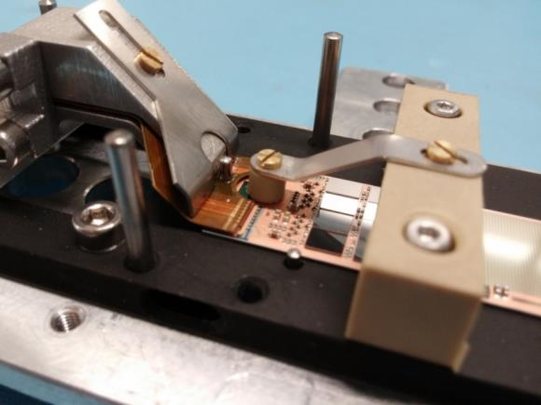
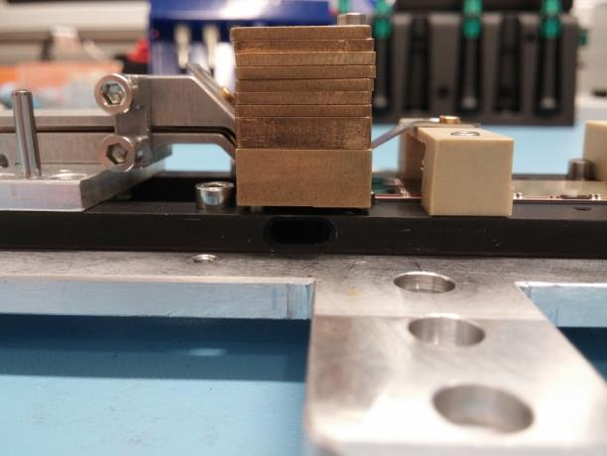
Kapton attachment
Screen printing of solder: Bi58/Sn42
Solder stop on kapton too wide
Possible contact to cutting edge
→ short to bulk

Slide 12
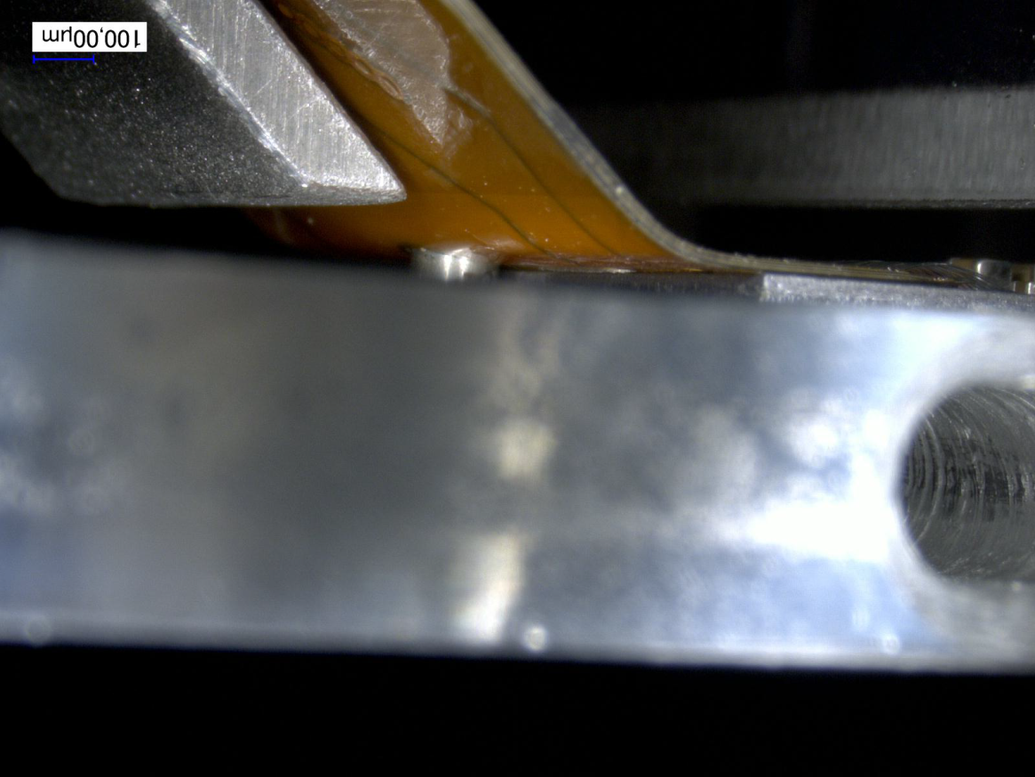
W30-OB2

Slide 13
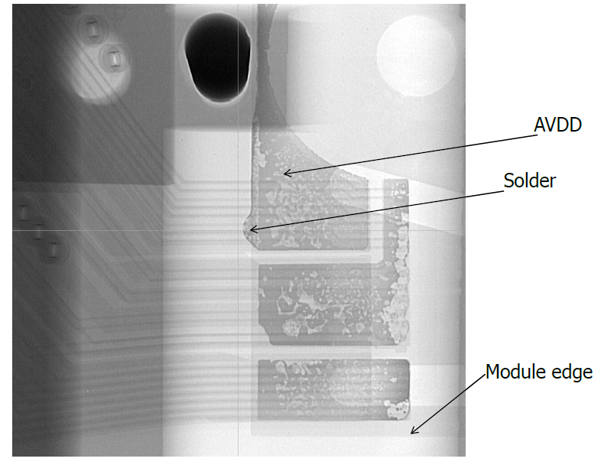
W30-OB2

Slide 14
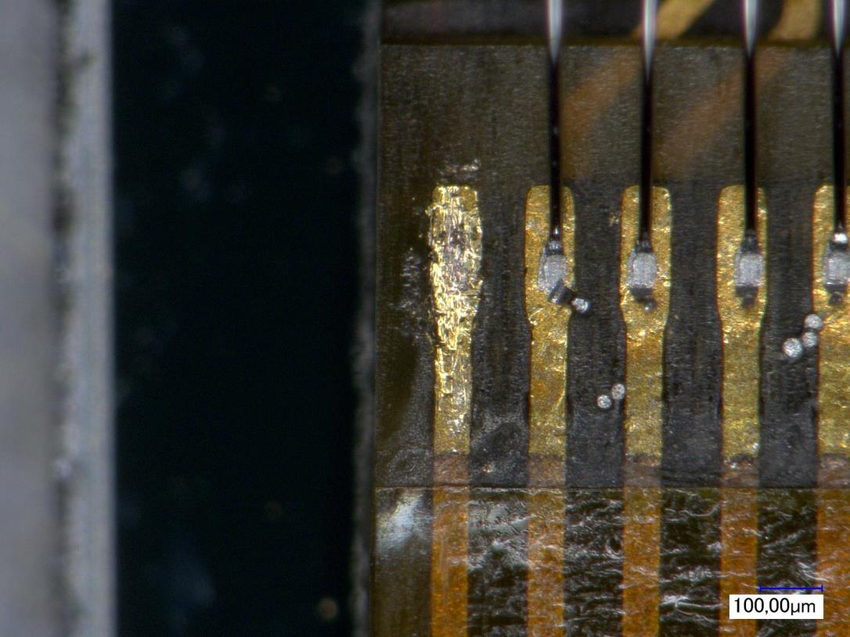
Wire bonding to kapton
Non-standard parameters, difficult wire bonding to kapton pads
dummy

Slide 15
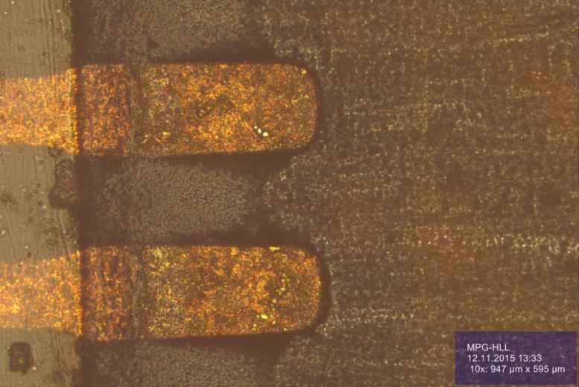
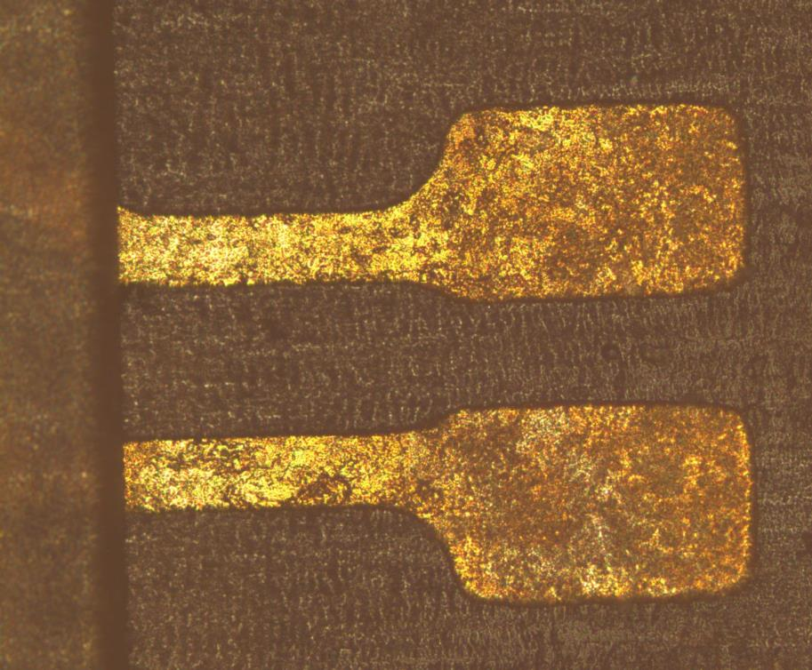
Wire bond pads on kapton

Slide 16
Metal system on kapton

Slide 17
Metal system on kapton

Slide 18
Summary
:- pilot run was also the first hot assembly!
:- many lessons learned
:- flip-chip basically okay, need more care for shipment
:- a bit of optimization in SMD, find smaller caps (!), quality of caps …
:- isolate kapton/module edge to avoid shorts
:- improve metal system on Taiyo kapton
:- more complete list:
:- on google docs: link

