Slide 1
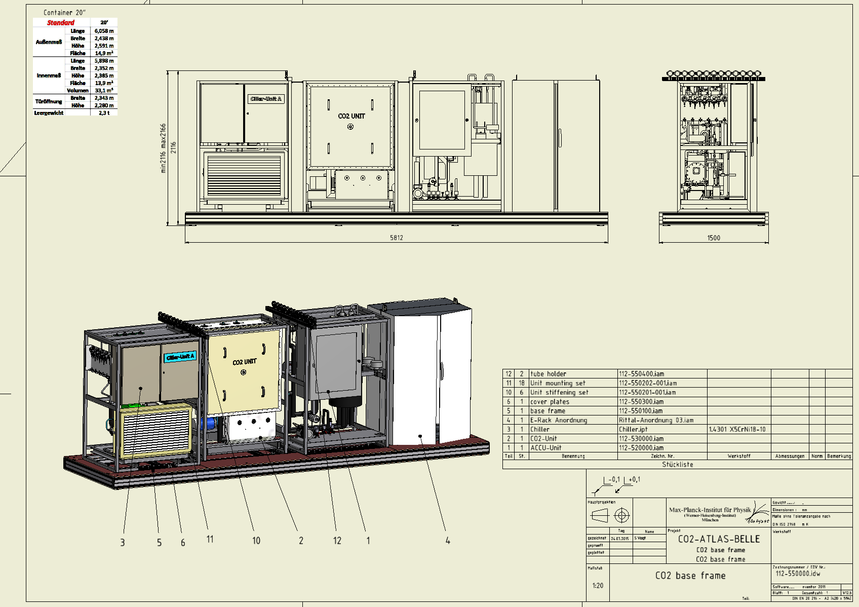
IBBelle for VXD
Use one unit first
Assemble on a platform which fits in a 20’ container
No redundancy
(ATLAS needs 100% up time in order to prevent reverse annealing of irradiated detectors. We don’t)
2nd unit will be added later
(budget available)

Slide 2
Safety Certification
Discussion with Kimura-san
No TÜV needed
KEK will do certification:
We do tests of components according to KEK standards
Kimura-san will visit MPP during commissioning of IBBelle
Conditions:
Maximum working pressure: < 80 bar
He- leak test
Dye Penetration Inspection (DPI)
Pressure test (110 bar shortly, 60 bar long term)

Slide 3
Operation Pressure
KEK requires <80bar pressure during operation
During normal operation the pressure is much lower (10 bar @ -30ºC + 10 bar pressure drop)
However, higher pressure occurs during maintenance if all CO₂ is stored in (warm) accumulator
Pressure depends on amount of CO₂ per volume (density)
At 35ºC (max ambient temperature)
The pressure reaches 80 bar at 420 kg/m³
With 55l volume (Accu):
22.5 kg or 18 l @ -40ºC
CERN calculates with 700 kg/m³ (100 bar!)
This corresponds to 38 kg (32 kg filled)
However, our unit is smaller, we need only 13.4 l,
Which is safe
A second requirement comes from warm operation during filling:
Vapor pressure at 20ºC: 60 bar + 10 bar Δp
(ok till 27ºC, then one needs to pre-cool
Question to Kimura-san:
do we need to adapt bust disks, discharge valves and pump control ?
Accu | Pipes: 0.6 l (Accu: 50 l) | 0.6 l
Interconnection | 3 m | 0.24 l
Pump Unit | Pipes: 0.6 l Heat exchanger (large) 0.95l Heat exchanger (small) 0.15l Pump: 0.5 l | 2.2 l
Transfer Line | 40 m: 8 l | 8 l
Junction Box | 0.1 l | 0.1 l
JB – Transfer line | 1l | 1 l
Manifold | 2 x 0.1l | 0.2 l
Flex lines | PXD (4x): 0.26l SVD (8x) : 0.52l 2 x (L6, L5+L4, FWD & BWD Endring) | 0.77 l
PXD | 4 x 0.0007 l | 0.003 l
SVD | 0.031 + 0.013 l (2 x L4,L5,L6 Origami + Endrings) | 0.044 l
Warm/cold Volume | 12 lines in, 12 out (4 PXD, 8 SVD) | 0.15 l
Total |  | 13.3 l

Slide 4
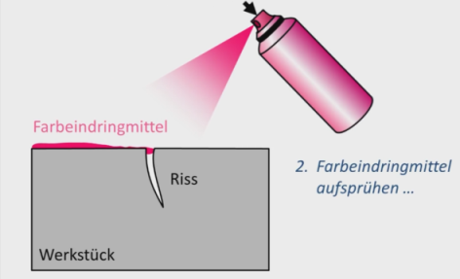
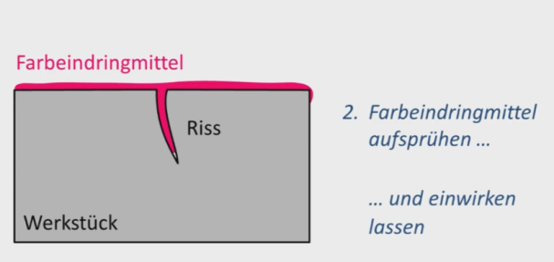
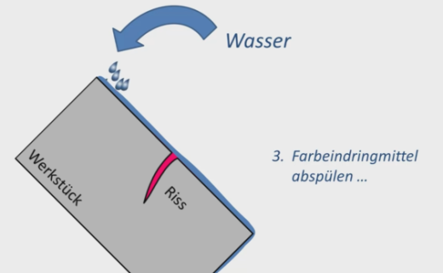
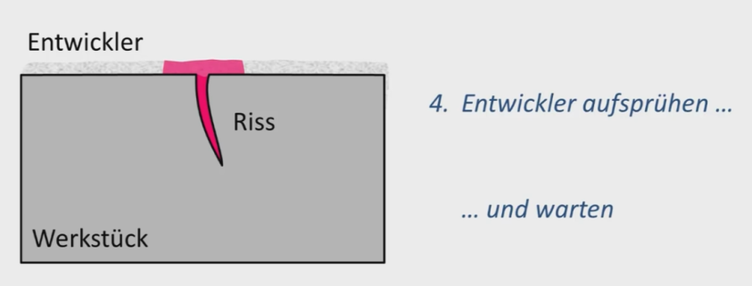
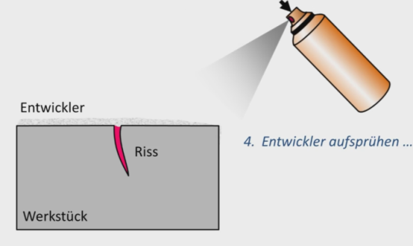
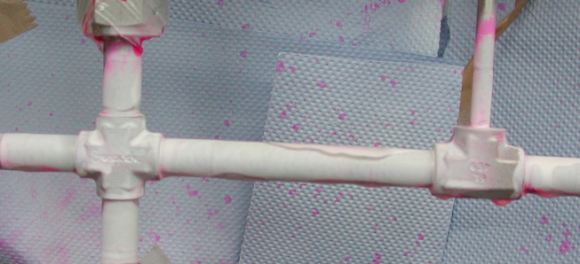
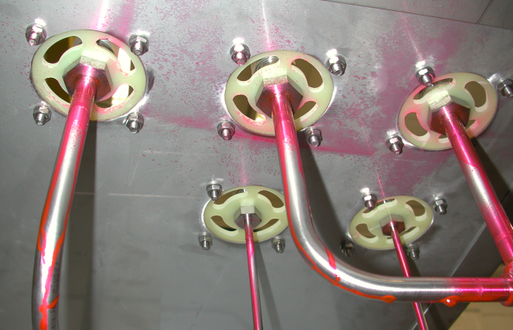
DYE Penetration Inspection
Excludes small fissures in welded joints

Slide 5
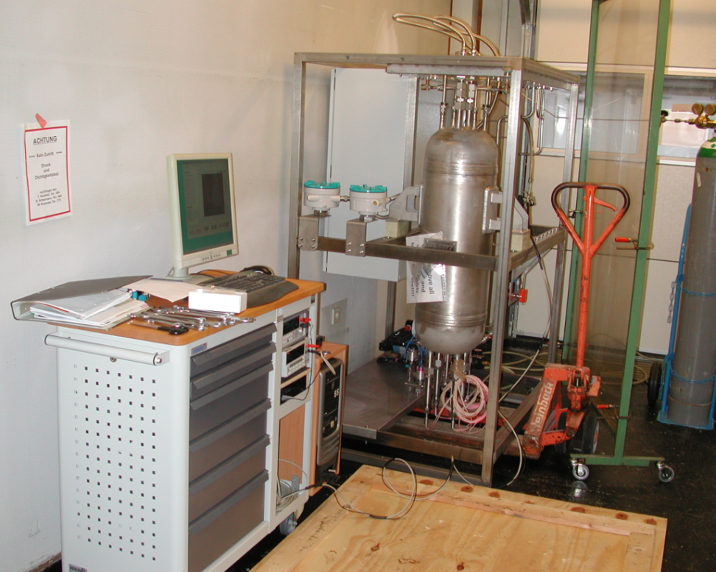
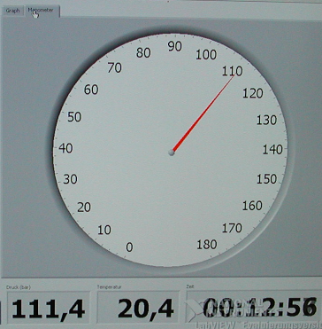
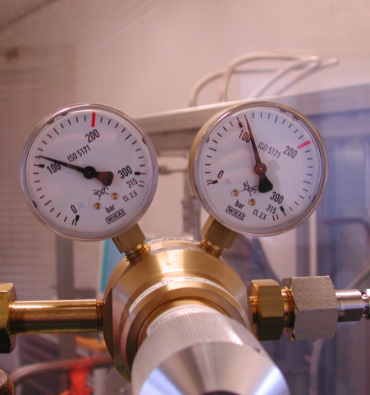
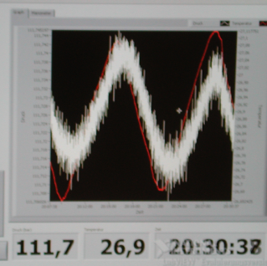
Pressure tests
55 bar: Check for deformations
Increasse in steps to 110 bar
keep for 30 min, check for deformations
- Increase in steps to 160 bar
- Keep for 2h
- Reduce to 110 bar, for 24 h
- Reduce to 60 bar, for 24
Protocols and pictures
KEK requirements

Slide 6
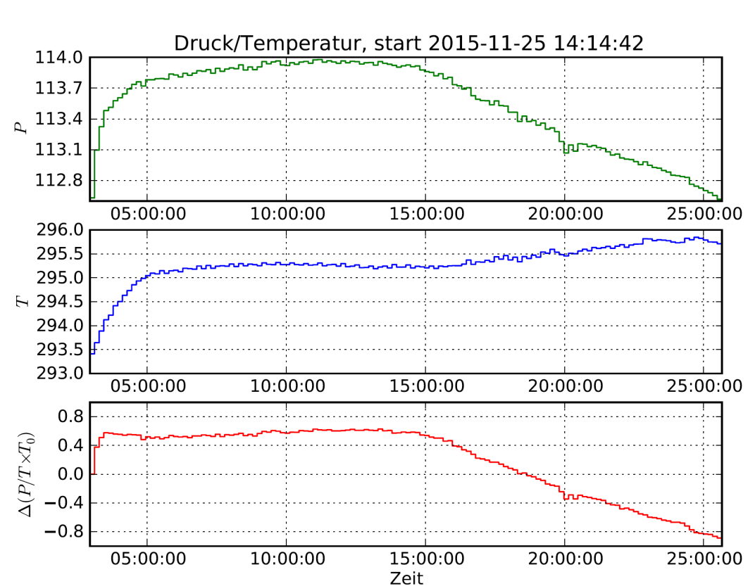
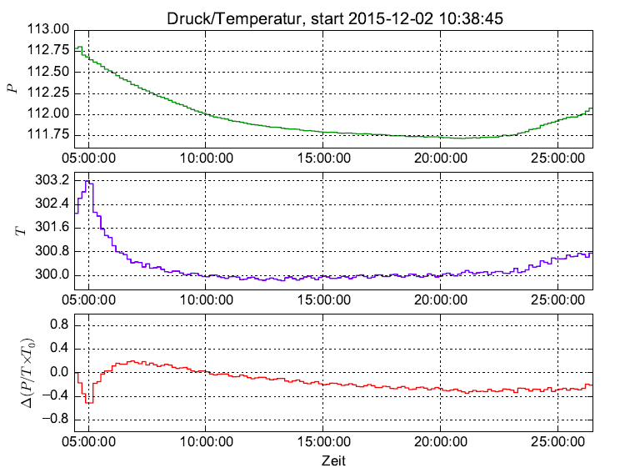
Leak Detection
The test of the Accu unit showed a leak in the long term test (110 bar) and later 60 bar
Traced to a faulty valve in the test setup.
Leak developed after 15h
Second test with new valve ok. Just residual temperature
Effects
(only one PT100 probe, temperature gradient in room)

Slide 7
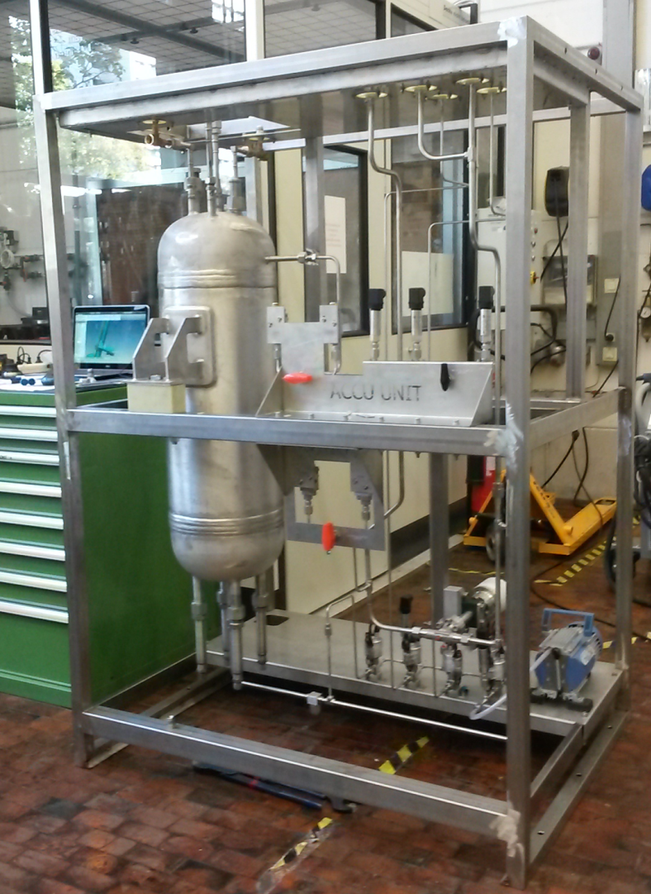
Accumulator Unit
Frame produced
Accumulator was cleaned, ok now
Assembled, piping finished
He-leak test ok
DPI ok
High pressure test ok (long term test needs to be repeated)

Slide 8
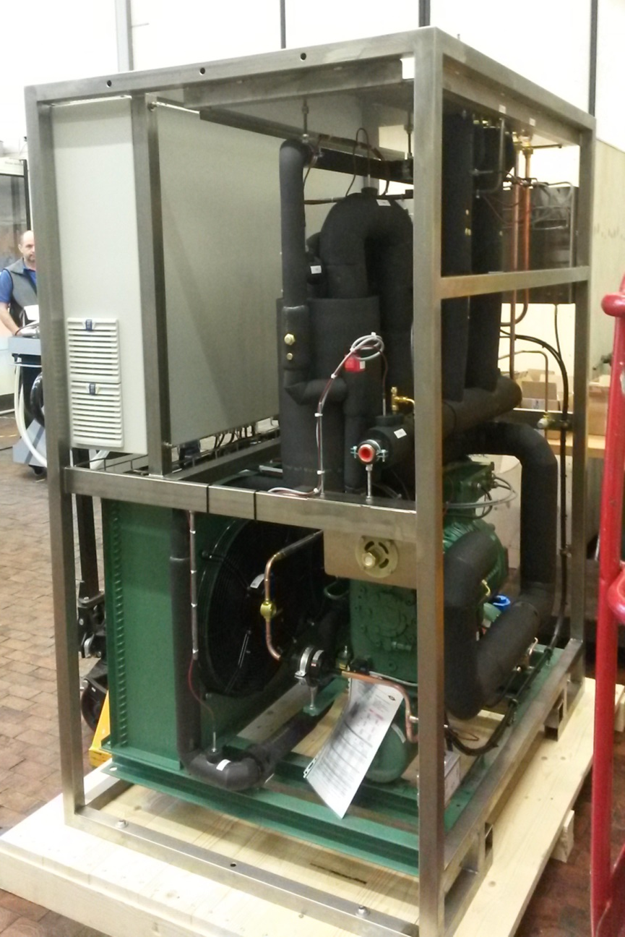
Chiller Unit
Chiller was manufactured by a company (2 units)
Delivered October 22
Uses 12 kg of R404a (per chiller)
EU: restrictions since 2015
banned from 2020
12 kg R404a = 48 t CO₂
However: exemption for chillers < 50C (ours has -55C)
Will there be similar laws in Japan?

Slide 9
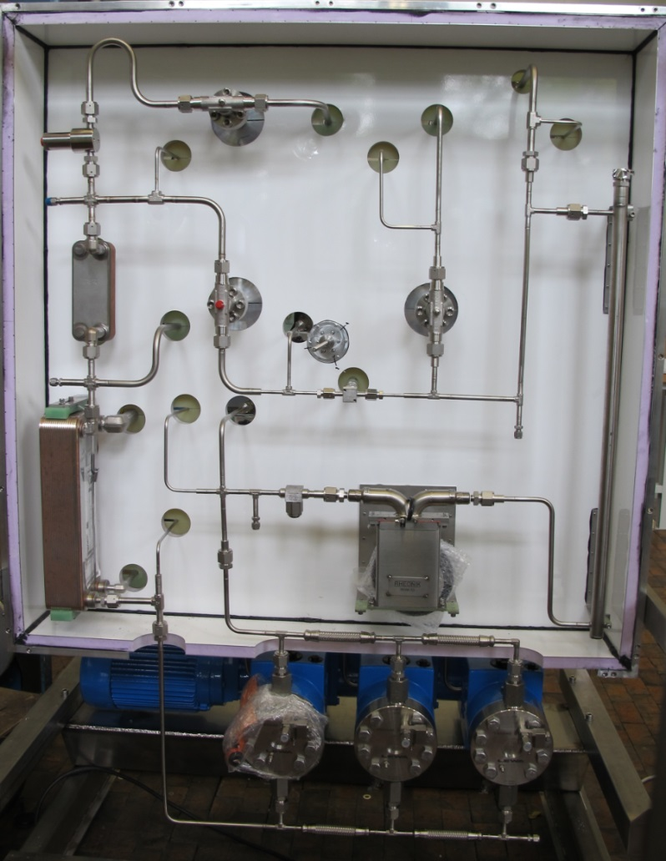
CO₂ Unit
All parts delivered
Piping completed
He-leak test ok
DPI ok
Pressure test ok

Slide 10
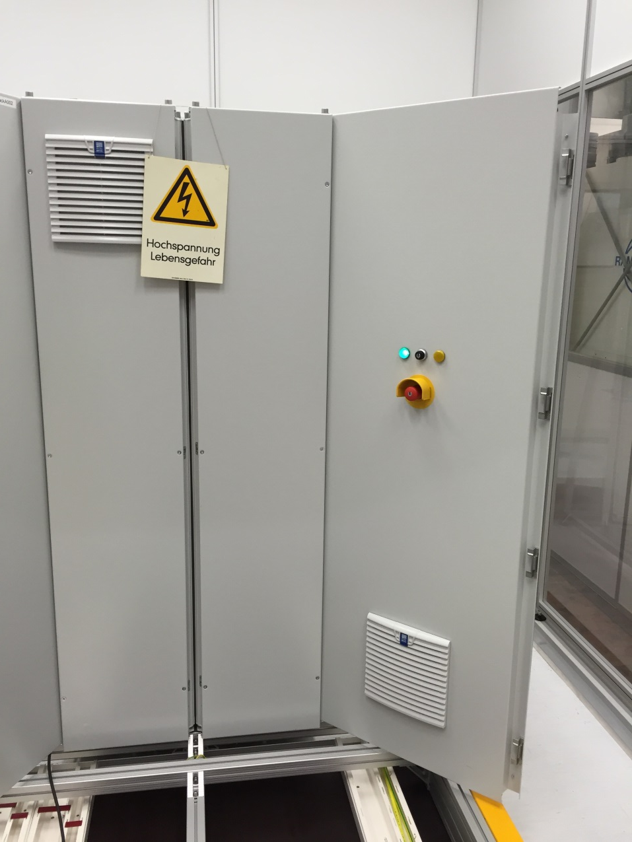
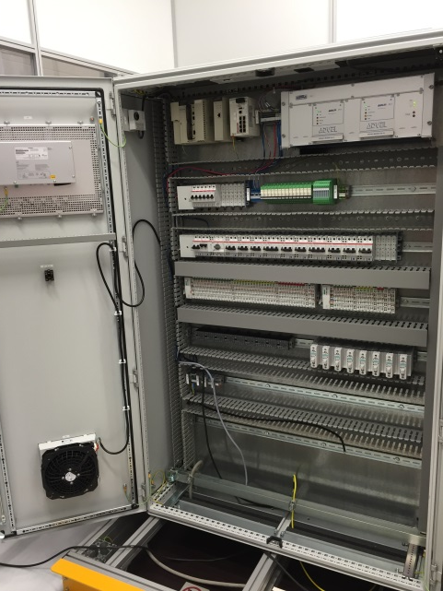
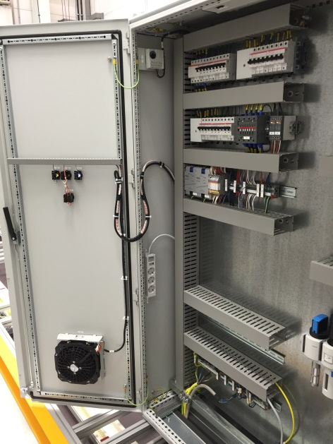
Control Cabinet
Cabinet ready
Cabling of power distribution part completed
(already powered)

Slide 11
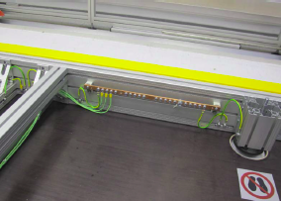
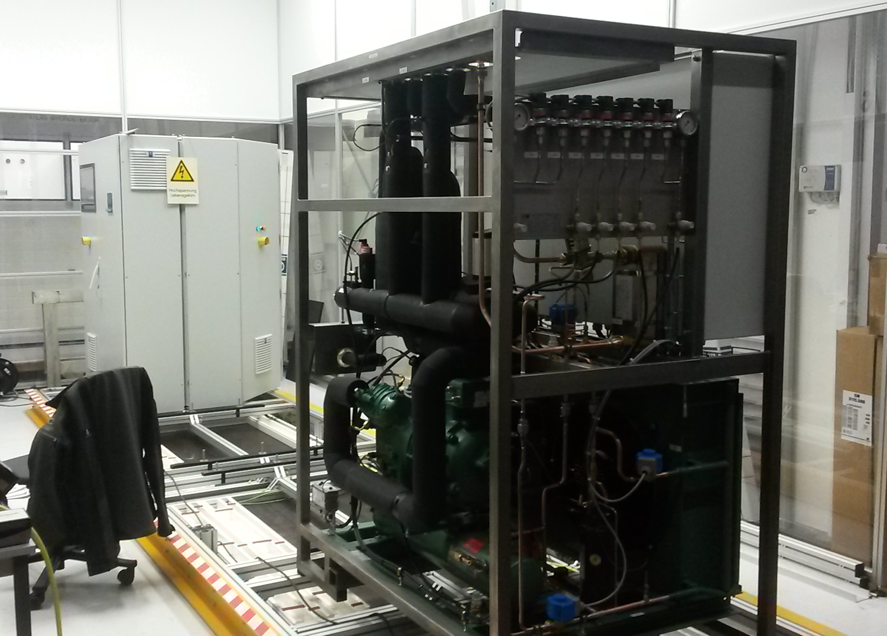
IBBelle frame
Frame assembled
Control cabinet mounted
Chiller unit mounted
Cabling started (e.g. grounding)

Slide 12
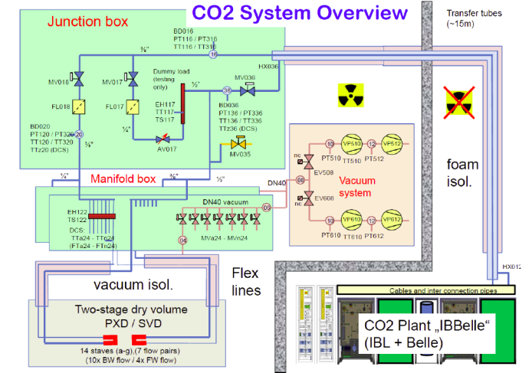
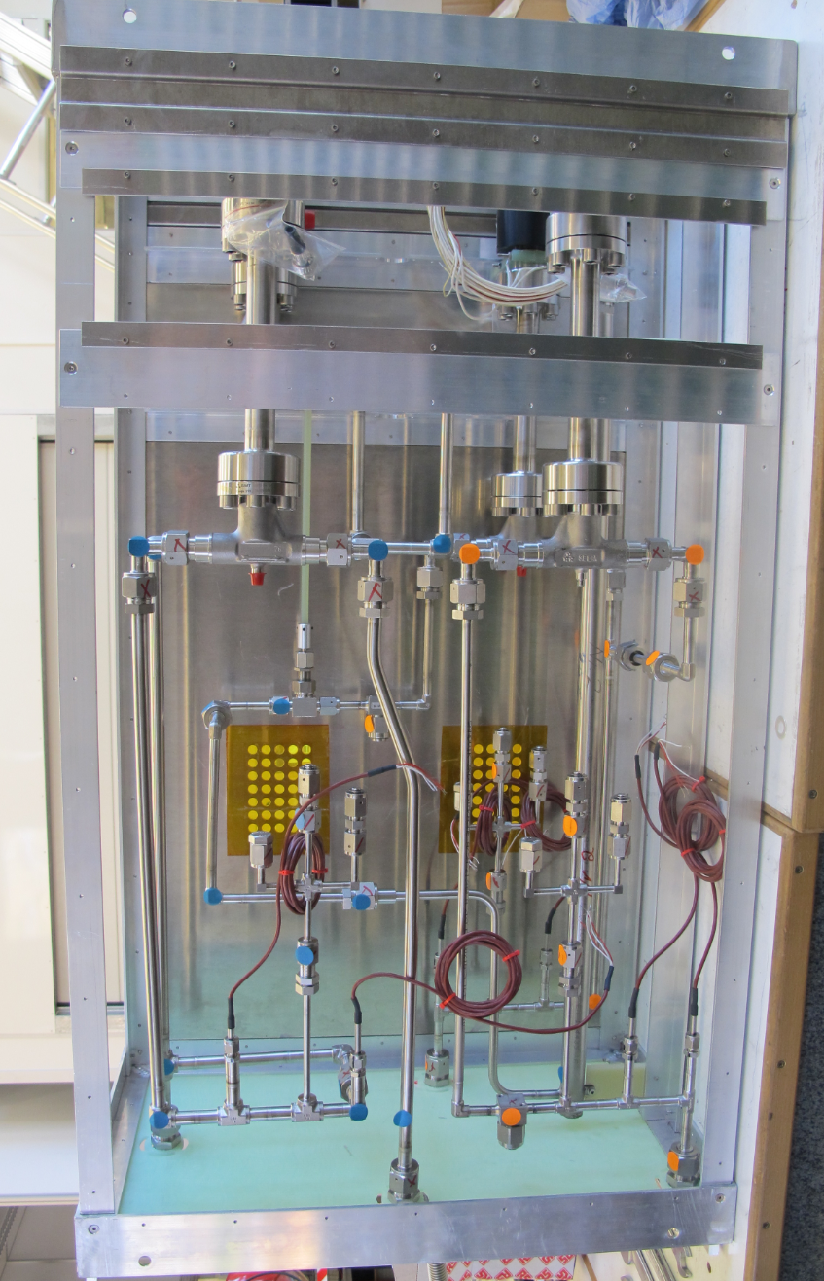
Junction Box
Assembled
He-leak test ok
DPI test

Slide 13
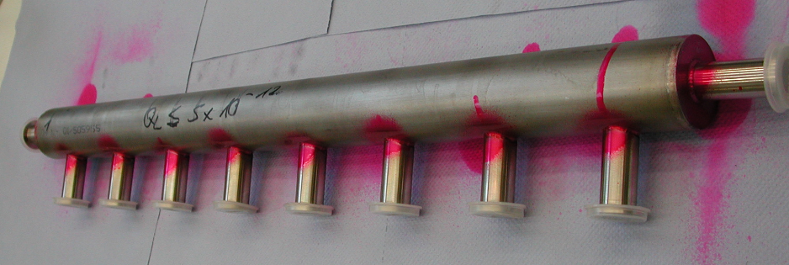
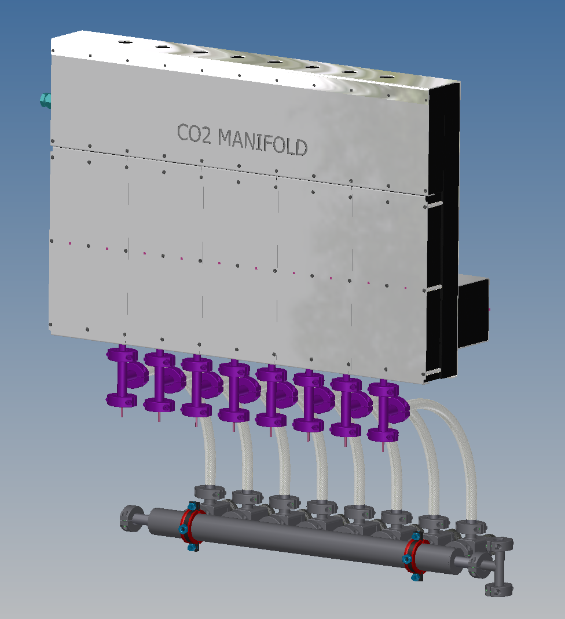
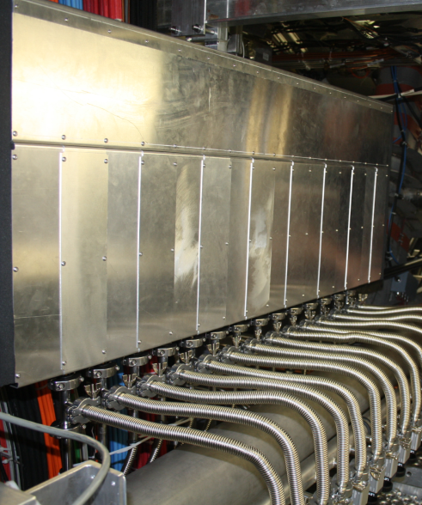
Manifold Boxes (2x)
2 needed to service 16 CO₂ branches
Parts produced
He-leak test ok
DPI test ok

Slide 14
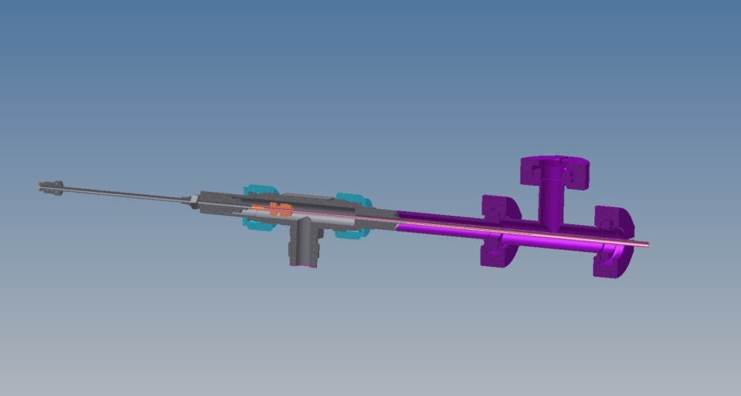
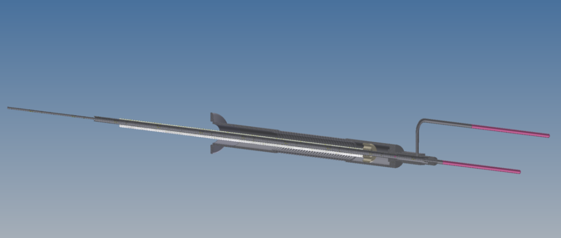
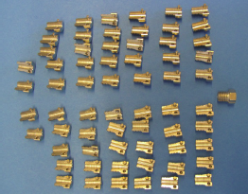
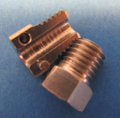
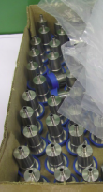
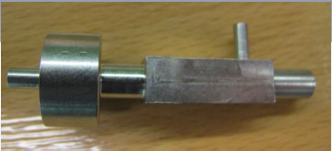
Flex Tubes
Dismountable & rotatable concentric joint (at manifold)
- Parts produced
Split (in-flow and return) at Belle side
- Parts produced
Flex tubes to be produced at DESY
Components already in production at MPP
(like for ATLAS)

Slide 15
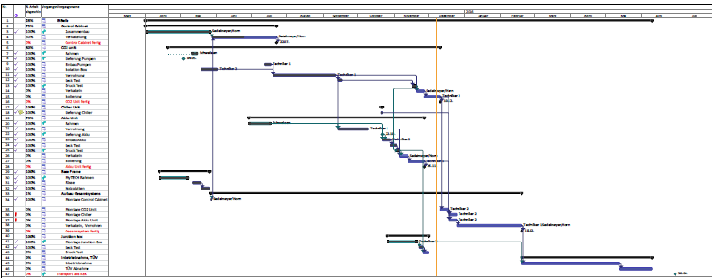
Schedule
Almost in Schedule (~ 2-3 weeks late)
Components assembled and tested
Next:
mounting on frame, interconnection, cabling, insulation
commissioning, safety certification: byJune 2016
shipping to KEK: June/July 2016

Slide 16
Summary
Construction of IBBelle at MPP runs smoothly
Delivery to KEK in July 2016
After discussion with Kimura-san: TÜV not needed, KEK can certify IBBelle
Need to start manufacturing of flex lines ( @ DESY): length?

