Slide 1





FCC-ee
technology, timelines, analysis highlights
Frank Zimmermann, CERN
KET Strategy Workshop, Munich, 2 May 2016
on behalf of the FCC global design study team
Work supported by the European Commission under Capacities 7th Framework Programme project EuCARD-2, grant agreement 312453, and the HORIZON 2020 project EuroCirCol, grant agreement 654305

Slide 2

Future Circular Collider Study
GOAL: CDR and cost review for the next ESU (2019)
International FCC collaboration (CERN as host lab) to study:
pp-collider O(100) TeV (FCC-hh) → main emphasis, defining infrastructure requirements
80-100 km tunnel infrastructure in Geneva area
e⁺e⁻ collider (FCC-ee) as a possible first step
p-e (FCC-he) option
HE-LHC with FCC-hh technology
~16 T ⇒ 100 TeV pp in 100 km
M. Benedikt

Slide 3

CERN Circular Colliders and FCC
1980
1985
1990
1995
2000
2005
2010
2015
2020
2025
2030
2035
Constr.
Physics
LEP
Design
Proto
Construction
Physics
LHC
Design
Construction
Physics
HL-LHC
20 years
FCC
Design
Proto
Construction
Physics
M. Benedikt
Now is the right time to plan for the period 2035 – 2040
Goal of phase 1: CDR by end 2018 for next update of European Strategy

Slide 4
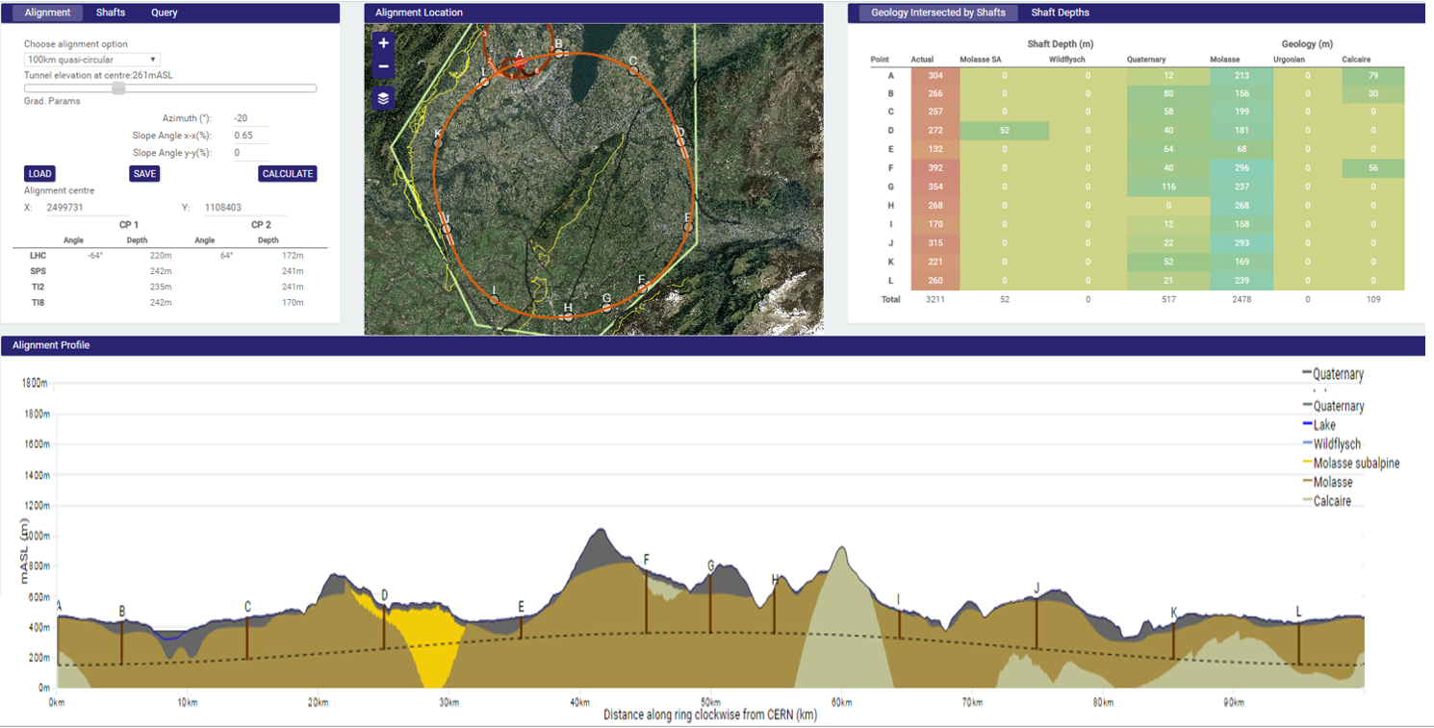
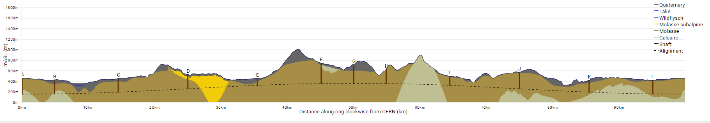
progress on site investigations
90 – 100 km fits geological situation well
LHC suitable as potential injector
The 100 km version, intersecting LHC, is now being studied in more detail
J. Osborne, C. Cook
Notes:
Use the latest slides from John/Charlie.
100 km machines, possibly with both versions intersecting and non-intersecting?

Slide 5
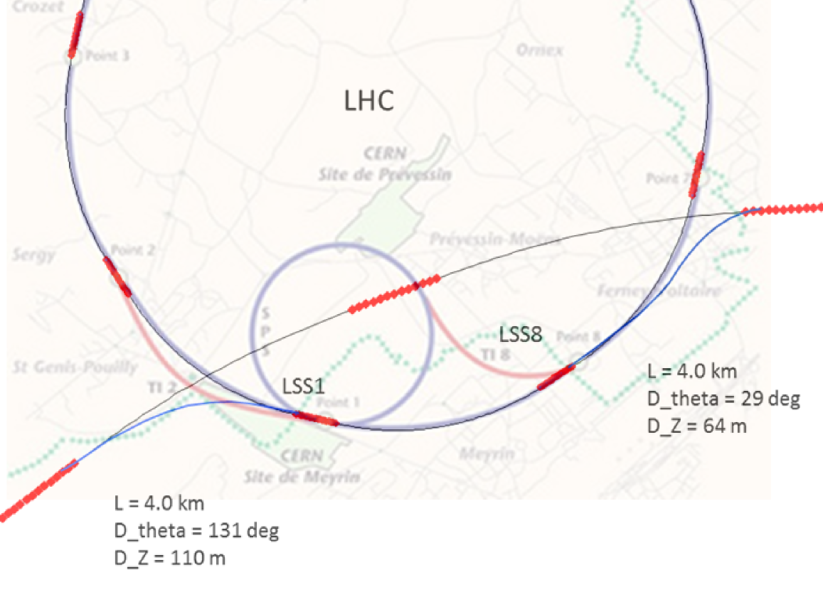
FCC-hh injector studies
injector options:
SPS → LHC → FCC
SPS/SPS_{upgrade} → FCC
SPS -> FCC booster
→ FCC
100 km FCC
intersecting version
SPS
FCC
current baseline is to fully re-use the existing CERN accelerator complex
injection energy 3.3 TeV from LHC
B. Goddard
Notes:
See talk of Oliver on injection energy
Several options, present baseline is 3.3 GeV
Ínjection at 1.5 TeV studied as alternative, potentially compatible with SPS upgrade

Slide 6
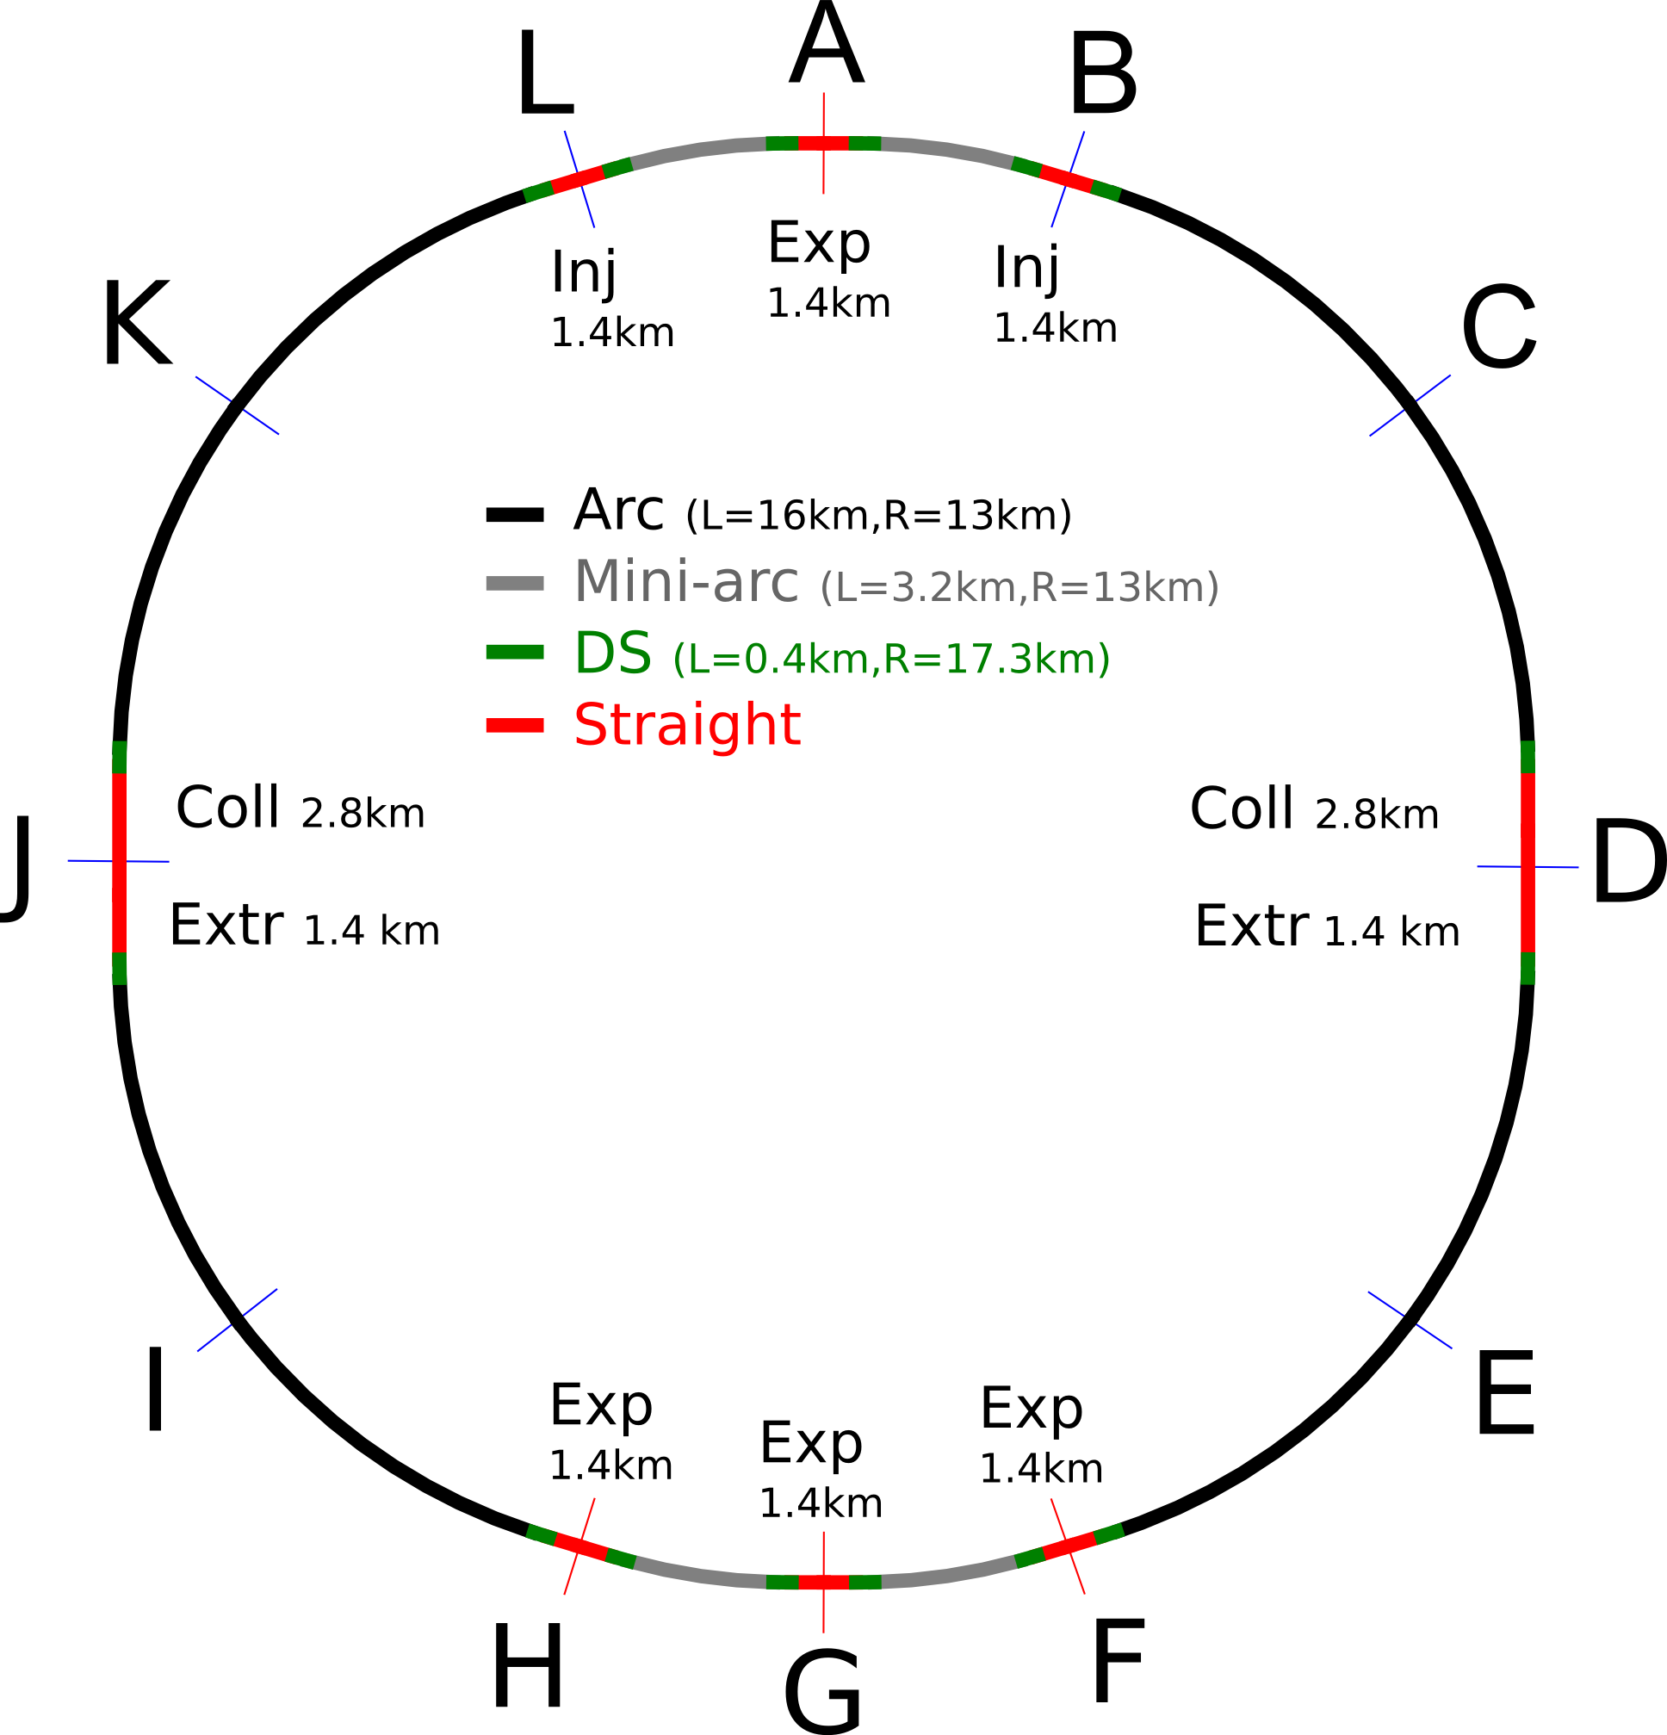
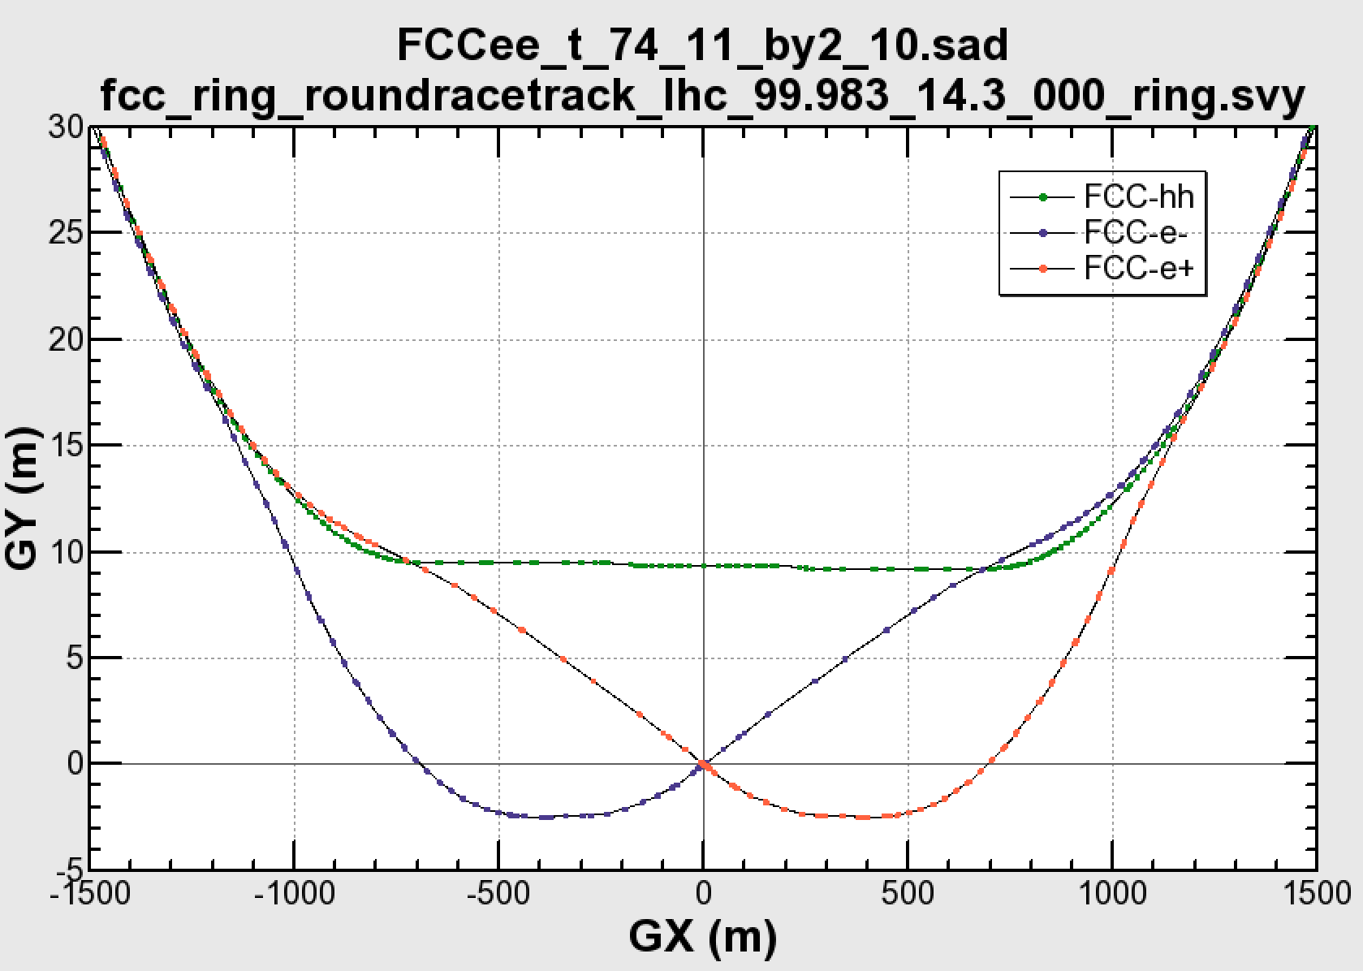

common layouts for hh & ee
FCC-ee 1, FCC-ee 2,
FCC-ee booster (FCC-hh footprint)
11.9 m
IP
30 mrad
FCC-hh/
ee Booster
9.4 m
0.6 m
Lepton beams must cross over through the common RF to enter the IP from inside.
Only a half of each ring is filled with bunches.
FCC-hh
layout
Common
RF (tt)
Common
RF (tt)
Max. separation of 3(4) rings is about 12 m:
wider tunnel or two tunnels are necessary around the IPs, for ±1.2 km.
2 main IPs in A, G for both machines
asymmetric IR optic/geometry for ee to limit synchrotron radiation to detector
IP
K. Oide, D. Schulte,
A. Bogomyagkov,
B. Holzer, et al.
Notes:
Check with Katsunobu to have latest layout.
Check with detector people if 9 m offset is acceptable for ee detector

Slide 7
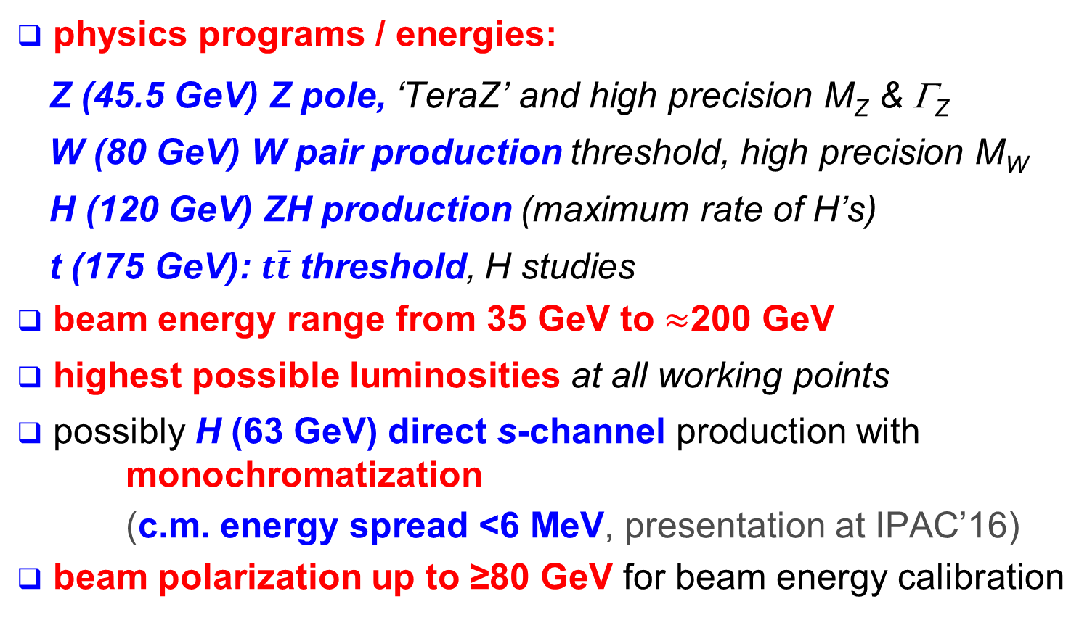
FCC–ee physics requirements
A. Blondel, J. Ellis, C. Grojean, P. Janot
physics programs / energies:
  Z (45.5 GeV) Z pole, ‘TeraZ’ and high precision M_{Z} & Γ_{Z}
  W (80 GeV) W pair production threshold, high precision M_{W}
  H (120 GeV) ZH production (maximum rate of H’s)
  t (175 GeV): $t\overline{t}$threshold, H studies
beam energy range from 35 GeV to $≈$200 GeV
highest possible luminosities at all working points
possibly H (63 GeV) direct s-channel production with monochromatization
  (c.m. energy spread <6 MeV, presentation at IPAC’16)
beam polarization up to ≥80 GeV for beam energy calibration

Slide 8
lepton collider parameters
parameter | FCC-ee |  |  |  |  | LEP2
physics working point | Z |  | WW | ZH | tt_{bar}
energy/beam [GeV] | 45.6 |  | 80 | 120 | 175 | 105
bunches/beam | 30180 | 91500 | 5260 | 780 | 81 | 4
bunch spacing [ns] | 7.5 | 2.5 | 50 | 400 | 4000 | 22000
bunch population [10¹¹] | 1.0 | 0.33 | 0.6 | 0.8 | 1.7 | 4.2
beam current [mA] | 1450 | 1450 | 152 | 30 | 6.6 | 3
luminosity/IP x 10³⁴cm⁻²s⁻¹ | 210 | 90 | 19 | 5.1 | 1.3 | 0.0012
energy loss/turn [GeV] | 0.03 | 0.03 | 0.33 | 1.67 | 7.55 | 3.34
synchrotron power [MW] | 100 |  |  |  |  | 22
RF voltage [GV] | 0.4 | 0.2 | 0.8 | 3.0 | 10 | 3.5
rms cm E spread SR [%] | 0.03 | 0.03 | 0.05 | 0.07 | 0.10 | 0.11
rms cm E spread SR+BS [%] | 0.15 | 0.06 | 0.07 | 0.08 | 0.12 | 0.11

Slide 9
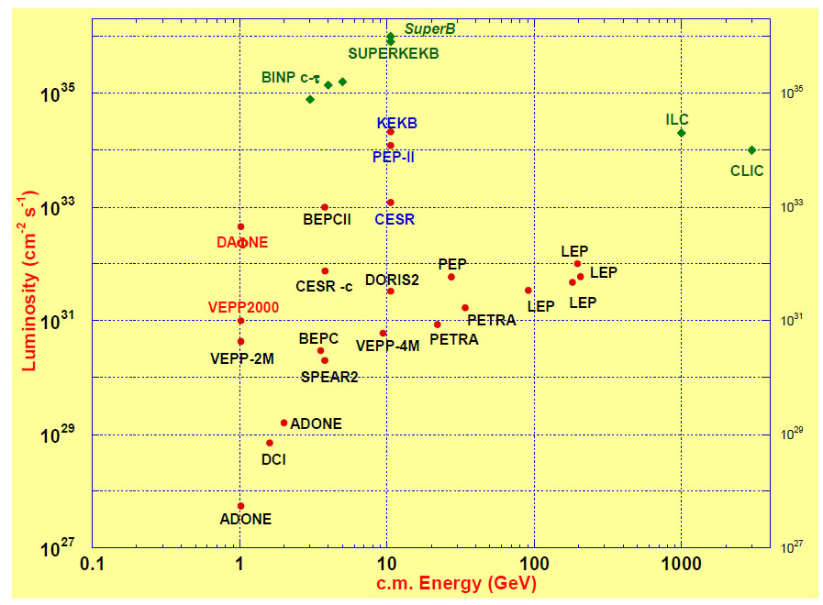
FCC-ee exploits lessons & recipes from past e⁺e⁻ and pp colliders
LEP:
high energy
SR effects
B-factories:
KEKB & PEP-II:
high beam
currents
top-up injection
DAFNE: crab waist
Super B-factories
S-KEKB: low β_{y}*
KEKB: e⁺ source
HERA, LEP, RHIC:
spin
gymnastics
FCC-ee
DAΦNE
VEPP2000
combining successful ingredients of recent colliders → extremely high luminosity at high energies
Barry Barish
13 January 2011

Slide 10
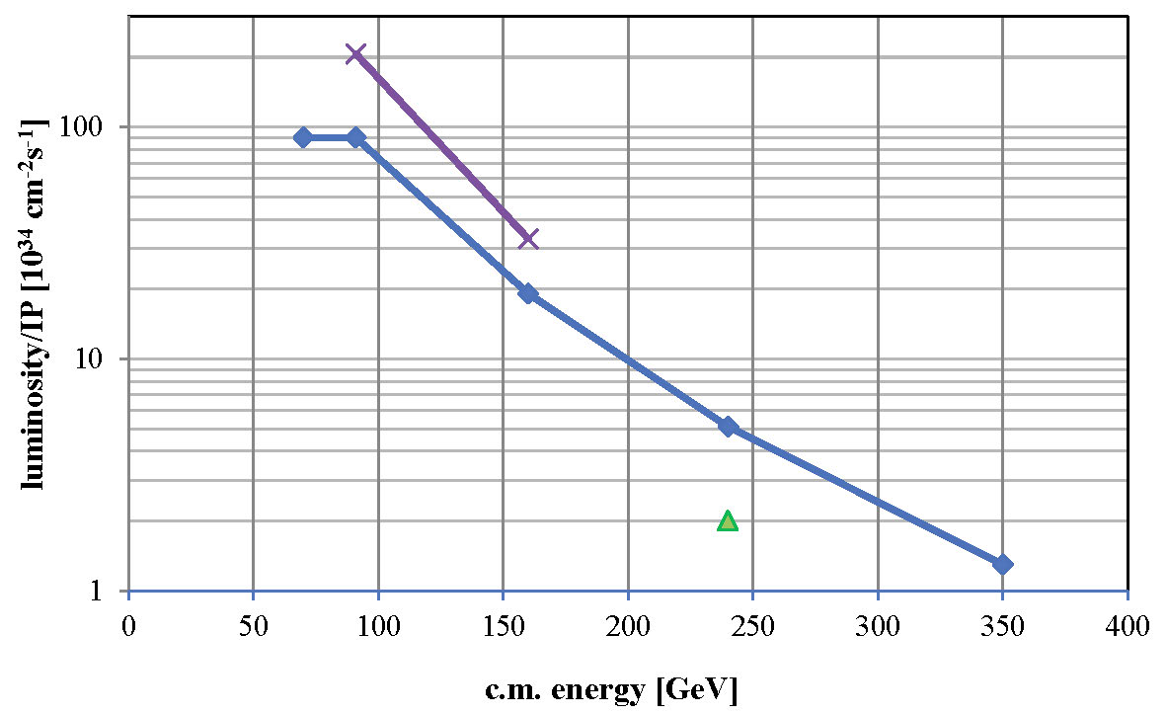

FCC-ee luminosity per IP
further increase with squeeze to β_{y}*=1 mm, β_{x}*=0.5 m
mono-chromati-zation?
new baseline 2016, crab waist w 2 IPs
β_{y}*=2 mm, β_{x}*=1 m
α_{QED}
Z
H?
WW
HZ
$$t\overline{t}$$
?
conservative baseline with functioning optics, space for improvement, esp. at Z and W
CEPC

Slide 11
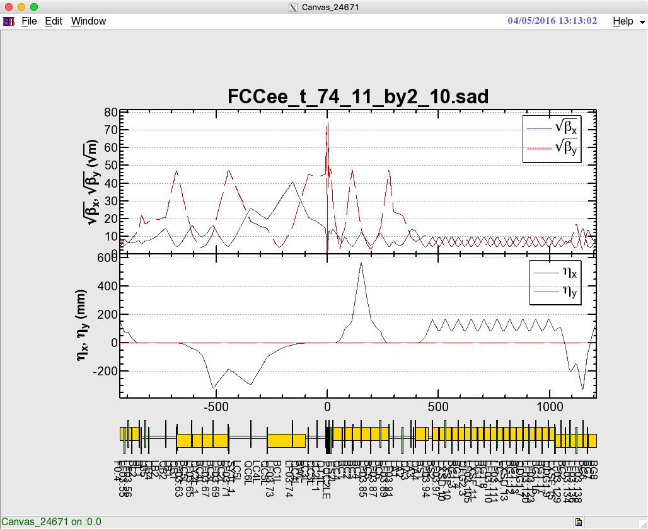

FCC-ee optics design
Optics design for all working points achieving baseline performance
Interaction region: asymmetric optics design
Synchrotron radiation from upstream dipoles <100 keV up to 450 m from IP
Dynamic aperture & momentum acceptance requirements fulfilled at all WPs
Local chromaticity correction
+ crab waist sextupoles
Local chromaticity correction
+ crab waist sextupoles
IP
Beam
K. Oide
Notes:
New slide from Katsunobu on converged optics, final focus and ring optics
Sufficient dynamic aperture and momentum
Injection details missing

Slide 12
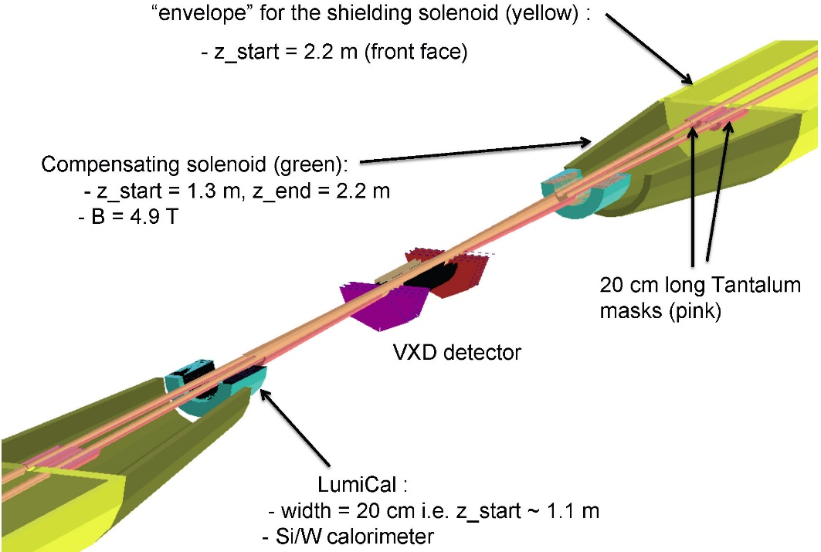
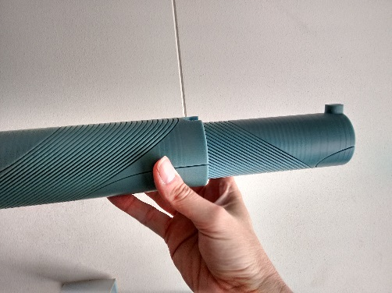
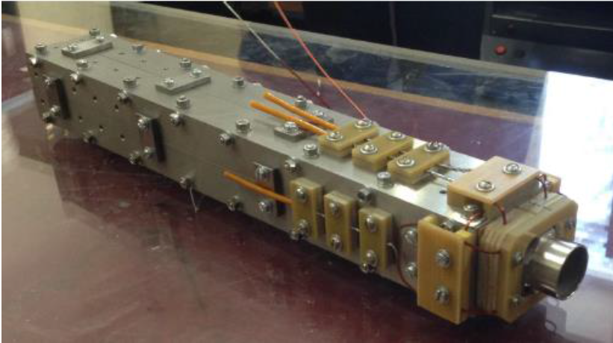
FCC-ee MDI optimisation
M. Sullivan, E. Perez, M. Boscolo, H. Burkhardt, M. Koratzinos, E. Levichev,…
MDI work focused on optimization of
l*, IR quadrupole design
compensation & shielding solenoid
SR masking and chamber layout
CERN model of
CCT IR quadrupole
BINP prototype IR quadr.
2 cm aperture, 100 T/m
Notes:
New slide on MDI optimisation, L*, solenoid compensation, lumi monitoring, etc.
Slide from Mike Sullivan talk, synchrotron radiation IR, masking?
Possibly one slide on magnet design of Attilio?

Slide 13
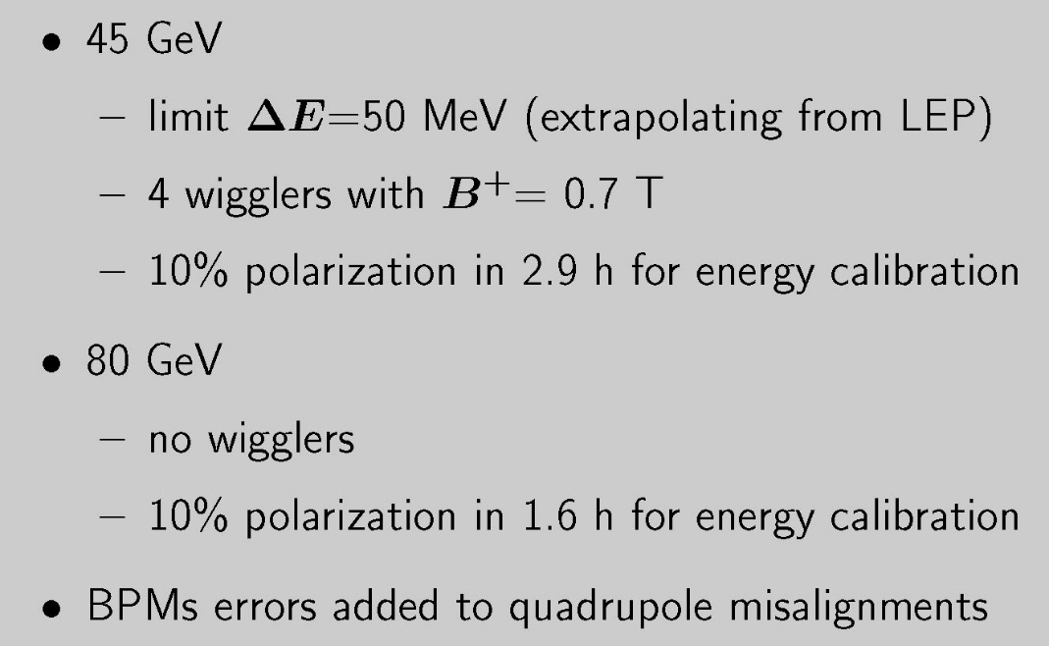
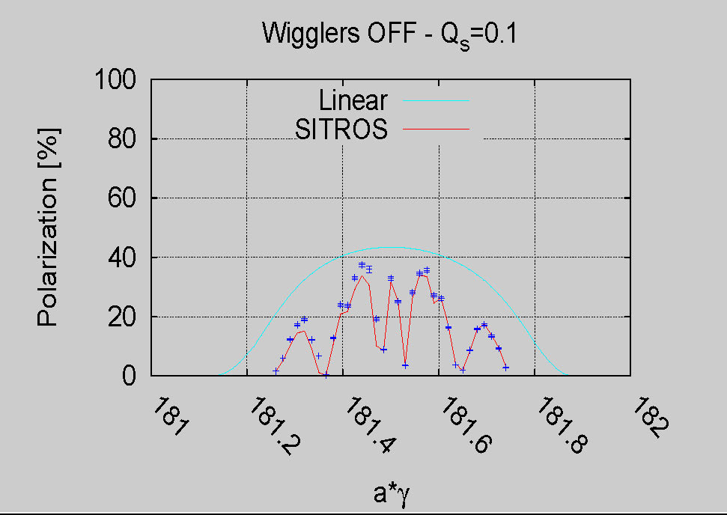
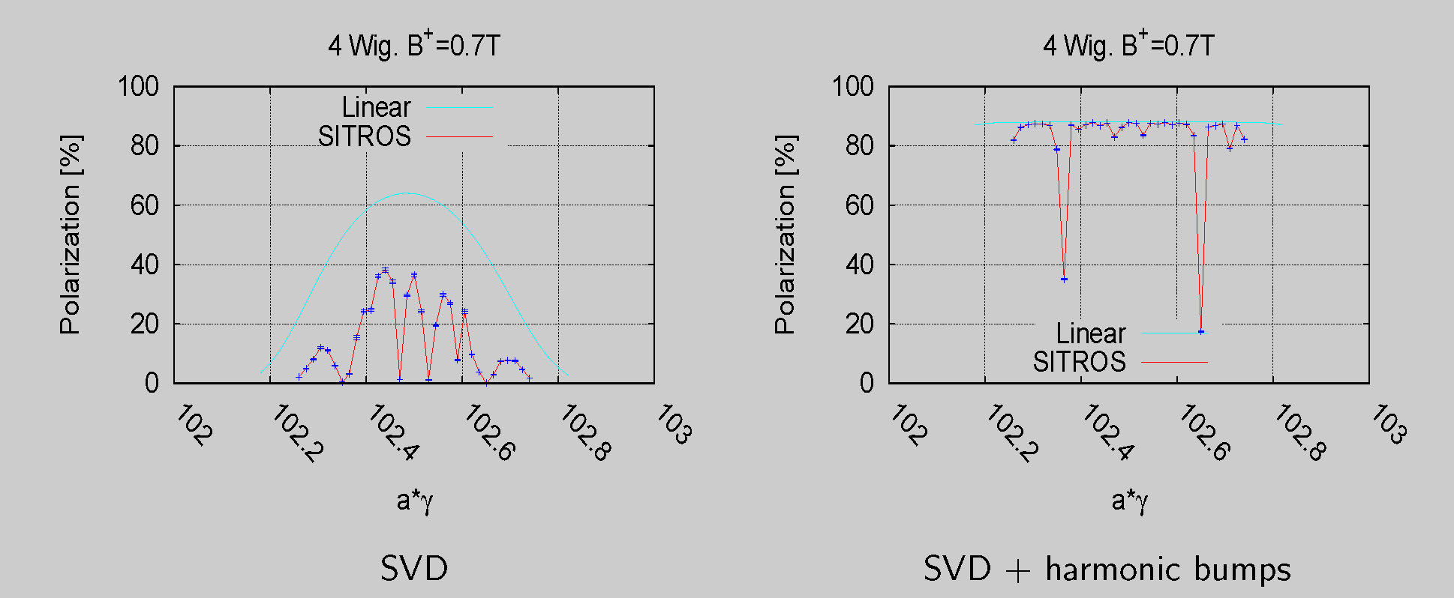
FCC-ee self polarization allows precise E calibration
80 GeV
- goal E_CM calibration: 100 keV
45 GeV
E. Gianfelice-Wendt

Slide 14
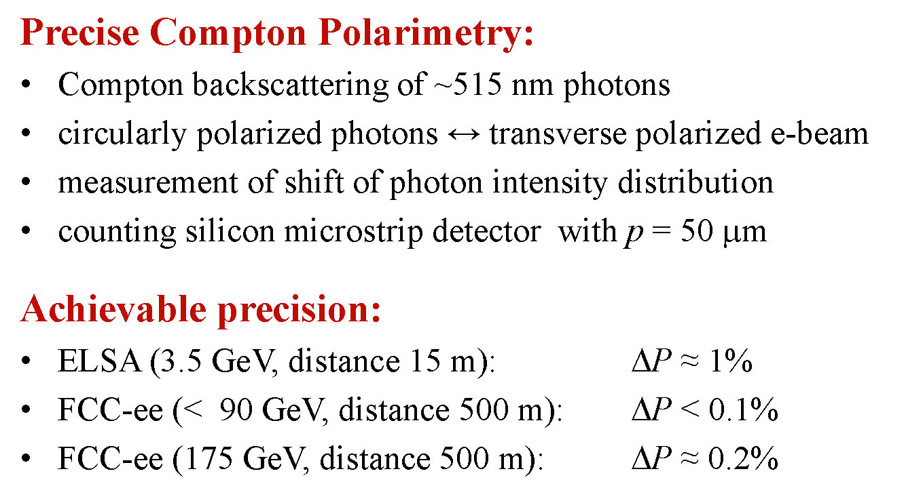
polarimetry: from ELSA to FCC-ee
(bunch by bunch, turn by turn)
using conventional high power laser
W. Hillert

Slide 15
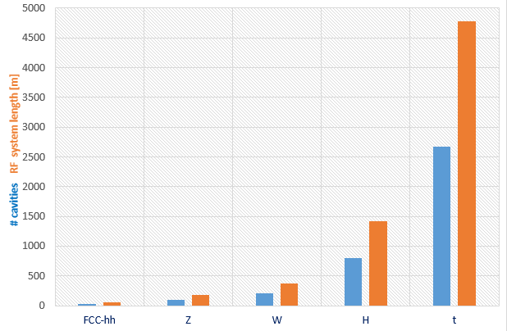

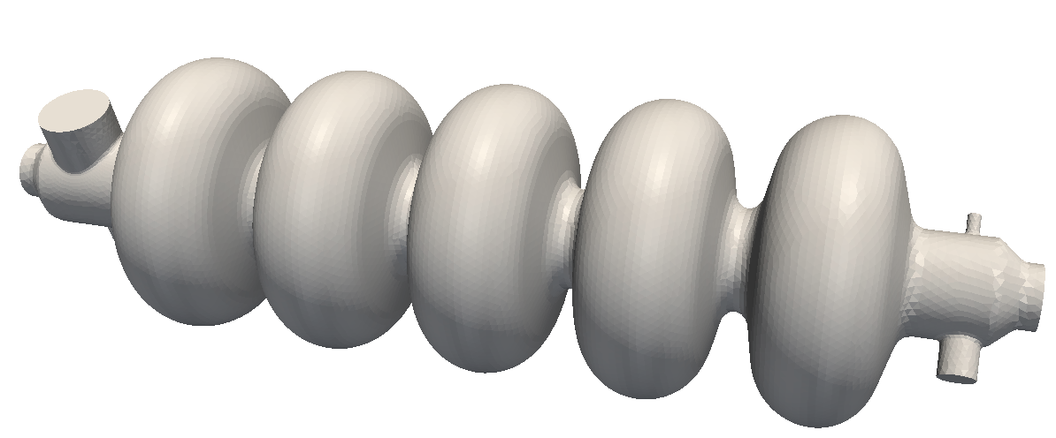
RF system requirements
Very large range of operation parameters
“Ampere-class” machines
Naive scale up from an hh system
 | V_{total} GV | n_{bunches} | I_{beam} mA | ΔE/turn GeV
FCC-hh | 0.032 |  | 500
Z | 0.4/0.2 | 30000/90000 | 1450 | 0.034
W | 0.8 | 5162 | 152 | 0.33
H | 5.5 | 770 | 30 | 1.67
t | 10 | 78 | 6.6 | 7.55
x6
x12
≈ 16 x 1 cell 400MHz,
“high gradient” machines
Voltage and beam current ranges span more than factor > 10²
No well-adapted single RF system solution satisfying requirements
O. Brunner, A. Butterworth, R. Calaga,…
Notes:
New slide from Olivier
Common design for hadron and lepton low energy-high currecnt system
Synergies HL-LHC, HE LHC, FCC-hh, FCC-ee Z pole

Slide 16
RF system R&D lines
400 MHz single-cell cavities preferred for hh and ee-Z (few MeV/m)
Baseline Nb/Cu @4.5 K, development with synergies to HL-LHC, HE-LHC
R&D: power coupling 1 MW/cell, HOM power handling (damper, cryomodule)
hh
Z
W
≈ 16 cells per beam
≈ 100 per beam
(+ 100 for booster ring)
≈ 210 per beam
(+ 210 for booster ring)
400 or 800 MHz multi-cell cavities preferred for ee-H, ee-tt and ee-W
Baseline options 400 MHz Nb/Cu @4.5 K, ◄▬► 800 MHz bulk Nb system @2K
R&D: High Q₀ cavities, coating, long-term: Nb₃Sn like components
W
H
t
≈ 200 per beam
(+ 200 for booster)
≈ 800 per beam
(+ 800 for booster)
≈ common 2600 cells for both beams
(+ 2600 for booster)
O. Brunner, A. Butterworth, R. Calaga
Notes:
New slide from Olivier
Common design for hadron and lepton low energy-high currecnt system
Synergies HL-LHC, HE LHC, FCC-hh, FCC-ee Z pole

Slide 17
FCC RF & cryo power
 | Z | W | ZH | ttbar
total voltage / beam [GV] | 0.2 | 0.8 | 3 | 10
no. cavities / beam | 75 | 150 | 400 | 670
RF frequency [MHz] | 400
cells / cavity | 1 | 2
cavity length [m] | 0.38 | 0.75 | 0.75 | 0.75
Q₀ [10⁹] | 3 | 3 | 3 | 3
material & temperature | Nb/Cu at 4.5 K
gradient [MV/m] | 7.0 | 7.1 | 10 | 10
voltage / cavity [MV] | 2.7 | 5.3 | 7.5 | 7.5
input power / cavity [MW] | 0.67 | 0.33 | 0.125 | 0.075
R/Q [Ω] linac | 87 | 169
matched Q_{L} | 1.3x10⁵ | 5.0x10⁵ | 2.7x10⁶ | 4.4x10⁶
HOM loss / cavity [kW] | 3.1 | 1.2 | 0.3 | 0.3
dynamic/static cryo power | 1, 1 | 4, 1 | 20, 3 | 33, 6
total cryo power [MW] | 2 | 5 | 23 | 39

Slide 18
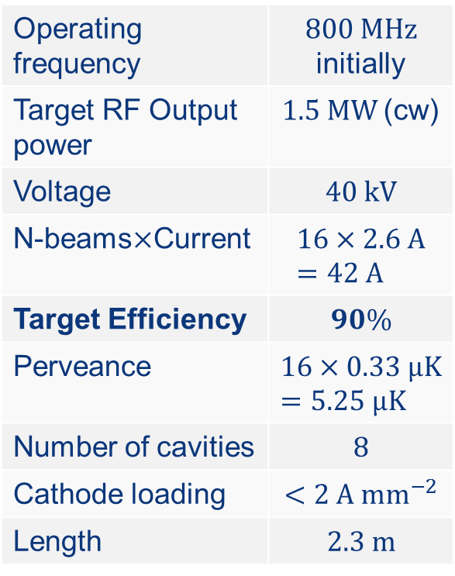
highly efficient RF power sources
2014 breakthrough in klystron theory:
–”congregated bunch” V.A. Kochetova, 1981] (later electrons faster when entering the output cavity)
- “bunch core oscillations” [A. Yu. Baikov, et al.: “Simulation of conditions for the maximal efficiency of decimeter-wave klystrons”, Technical Physics, 2014](controlled periodic velocity modulation)
- “BAC” method [I.A. Guzilov, O.Yu. Maslennikov, A.V. Konnov, “A way to increase the efficiency of klystrons”, IVEC 2013] (Bunch, Align velocities, Collect outsiders)
These three methods together promise a klystron efficiency ~90%
An international collaboration “HEIKA” (CERN, ESS, SLAC, CEA, MFUA, Lancaster U, Thales, L3, CPI, VDBT) is now designing, building and testing prototypes at several places around the world. Simulations and first hardware tests extremely encouraging.
FCC klystron prototype - initial target parameters
Operating frequency | $800 MHz$ initially
Target RF Output power | $1.5 MW$(cw)
Voltage | $$40 kV$$
N-beams$×$Current | $$16×2.6 A=42 A$$
Target Efficiency | $$90\%$$
Perveance | $$16×0.33 μK=5.25 μK$$
Number of cavities | $$8$$
Cathode loading | $$<2 A mm^{−2}$$
Length | $$2.3 m$$
work in progress
E. Jensen, I. Syratchev, C. Lingwood

Slide 19
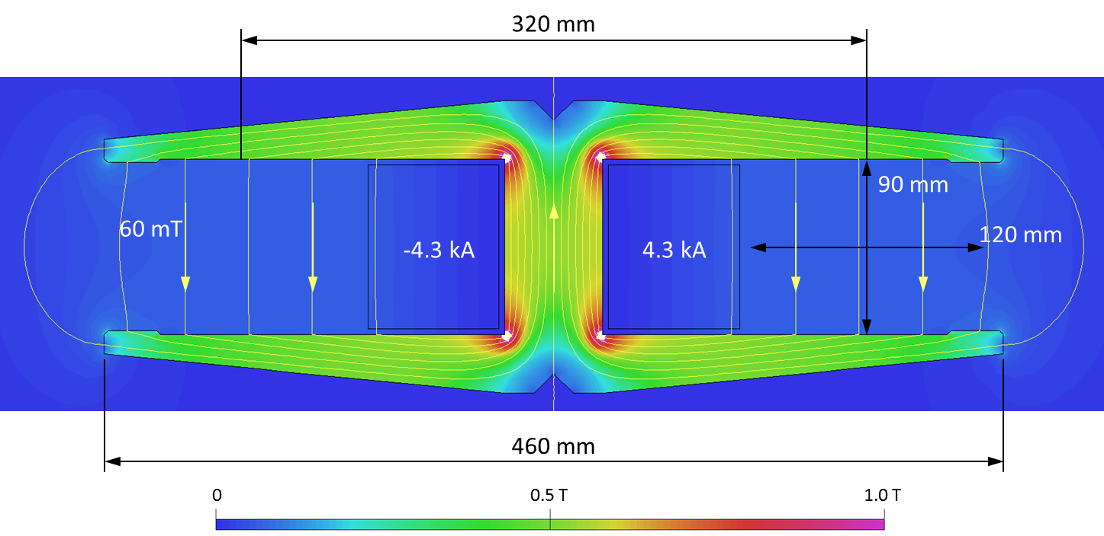
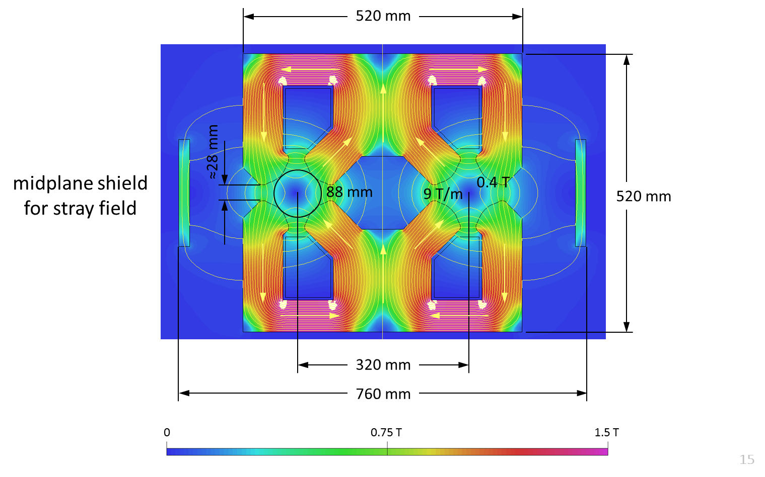
efficient 2-in-1 arc magnets
dipole based on
twin aperture yoke
and single busbars as coils
A. Milanese
twin 2-in-1 quadrupole
the novel arrangements of the magnetic circuit allow for considerable savings in Ampere-turns and power consumption,
less units to manufacture, transport, install, align, remove,…

Slide 20
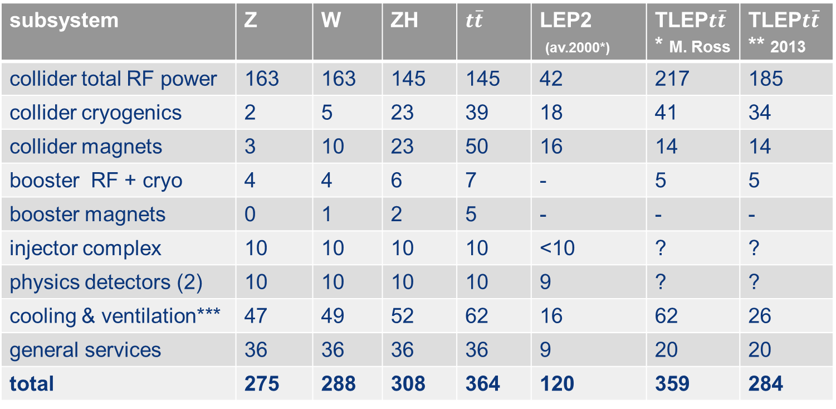

FCC-ee total power
subsystem | Z | W | ZH | $$t\overline{t}$$ | LEP2 (av.2000*) | TLEP$t\overline{t}$* M. Ross | TLEP$t\overline{t}$** 2013
collider total RF power | 163 | 163 | 145 | 145 | 42 | 217 | 185
collider cryogenics | 2 | 5 | 23 | 39 | 18 | 41 | 34
collider magnets | 3 | 10 | 23 | 50 | 16 | 14 | 14
booster RF + cryo | 4 | 4 | 6 | 7 | - | 5 | 5
booster magnets | 0 | 1 | 2 | 5 | - | - | -
injector complex | 10 | 10 | 10 | 10 | <10 | ? | ?
physics detectors (2) | 10 | 10 | 10 | 10 | 9 | ? | ?
cooling & ventilation*** | 47 | 49 | 52 | 62 | 16 | 62 | 26
general services | 36 | 36 | 36 | 36 | 9 | 20 | 20
total | 275 | 288 | 308 | 364 | 120 | 359 | 284
power roughly $∝$ luminosity
for comparison, total CERN complex in 1998 used up to 237 MW
*M. Ross, ``Wall-Plug (AC) Power Consumption of a Very High Energy e+/e- Storage Ring Collider,'‘ 3 August 2013, http://arxiv.org/pdf/1308.0735.pdf ; **M. Koratzinos et al., ``TLEP: A High-Performance Circular e+e- Collider to Study the Higgs Boson'',
Proc. IPAC2013 Shanghai, 12--17 May 2013, {http://arxiv.org/pdf/1305.6498.pdf 2013,
*** private discussions with M. Nonis
presentation at IPAC’16
*dividing total energy used by 200 days

Slide 21
annual energy consumption
my (unofficial) estimate
consider 200 days of running / year
160 days of which in physics
→ 300 MW x 200 x 24 h ~ 1400 GWh
very similar to LHC / HL-LHC

Slide 22
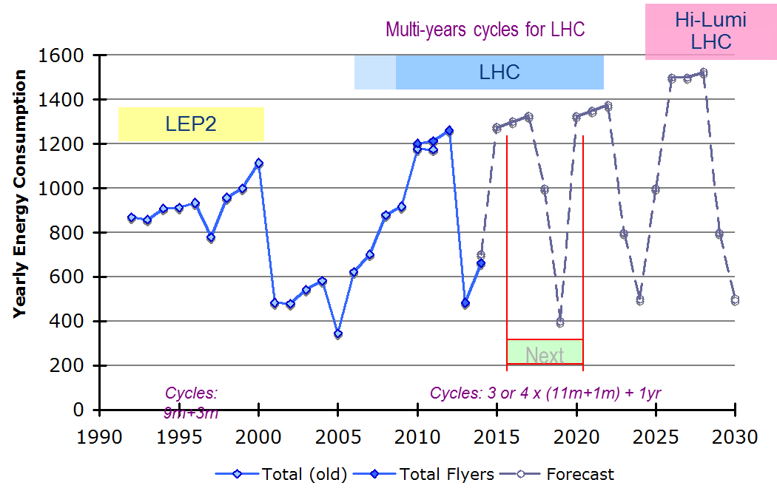
CERN energy consumption
[GWh]
FCC-ee
estimate

Slide 23
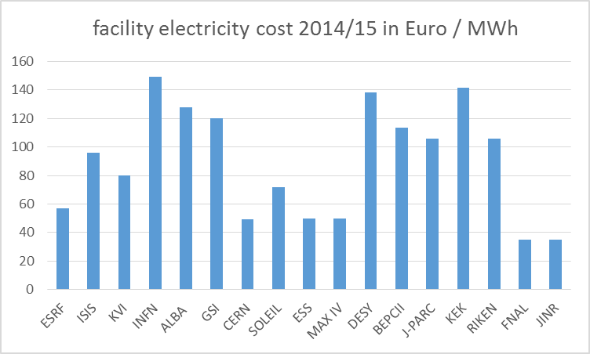
electricity cost
Courtesy: M. Seidel, EuCARD-2, V. Shiltsev, K. Oide, Q. Qin, G. Trubnikov, and others
1400 GWh / yr → ~70 MEuro / yr

Slide 24
tentative preliminary time line for
FCC-ee construction
physics start
years
-14
-12
-10
-8
-6
-4
-2
0
inj. complex construction
injector commissioning
access shafts & caverns
tunneling
<12 years from
construction start
to first physics
technical infrastruct.
machine installation
hardw. & beam commissioning

Slide 25
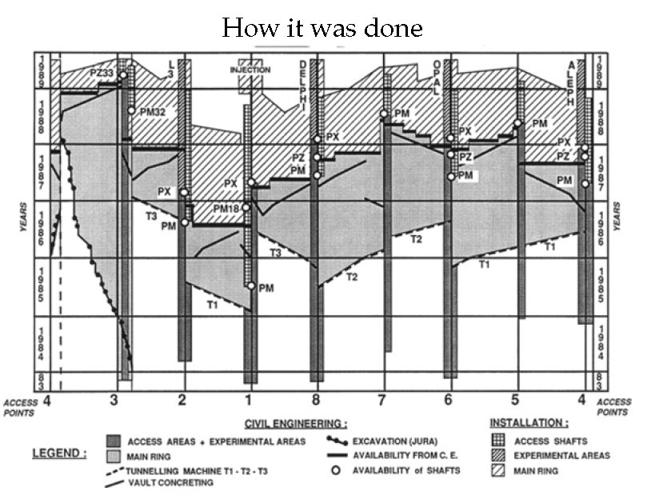
recall the construction of LEP
1989
<6 years from
zero
to physics
1988
1987
1986
1985
1984
E. Picasso
H. Schopper

Slide 26
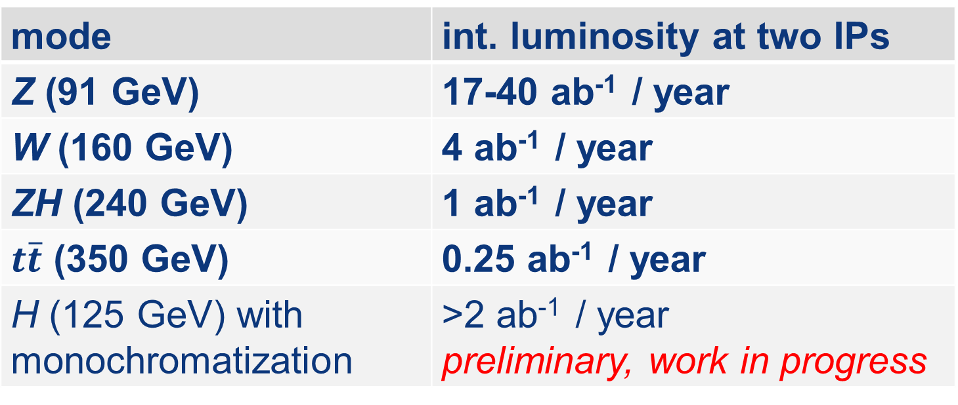
estimated annual luminosity
assumptions:
160 days of physics per year
two interaction points,
“Hübner factor”=0.65 w top up inj. (KEKB, PEP-II)
mode | int. luminosity at two IPs
Z (91 GeV) | 17-40 ab⁻¹ / year
W (160 GeV) | 4 ab⁻¹ / year
ZH (240 GeV) | 1 ab⁻¹ / year
$t\overline{t}$ (350 GeV) | 0.25 ab⁻¹ / year
H (125 GeV) with monochromatization | >2 ab⁻¹ / year preliminary, work in progress

Slide 27
FCC-ee discovery potential
of course discovery depends on the goodwill of nature;
a few things that FCC-ee could do and discover (if they exist):
EXPLORE 10 TeV energy scale (and beyond) with Precision Measurements
~20-50 fold improved precision on many EW quantities
(equivalent to factor 5-7 in mass)
m_{Z,} m_{W}, m_{top} , sin² θ_{w}^{eff} , R_{b} , α_{QED} (m_{z}), α_{s} (m_{z}), Higgs and top couplings
DISCOVER a violation of flavour conservation
- ex FCNC (Z → μτ , eτ) in 5 10¹² Z decays.
+ flavour physics (10¹² bb events!)
DISCOVER dark matter as «invisible decay» of H or Z
DISCOVER very weakly coupled particle in 5-100 GeV energy scale
such as: right-handed neutrinos, dark photons etc…
…..
also see
M. Bicer et al.,
“First Look at the
Physics Case of TLEP,”
JHEP01 (2014) 164
A. Blondel

Slide 28
typical running scenario
Z pole: 1-2 10³⁶/cm²/s/IP → 2.5 10¹² Z events (per experiment) 3-5 years
+ Z scan 1 year
WW threshold: 3.5 10³⁵/cm²/s/IP 1 year
m_{Z} , Γ_{Z} (100 KeV), m_{W} (500 keV), sin² θ_{w}^{eff} (<10⁻⁵ from asymmetries & tau polar.),
R_{b} , α_{QED} (m_{z}) (3 10⁻⁵), α_{s} (m_{z}) (O(10⁻⁴) from B_{zh} & B_{wh}), N_{v} from Zγ (0.0004) etc…
ZH threshold : 5 10³⁴/cm²/s/IP : >500’000 Higgs / exp 4 years
tt (E_{CM} 350-365 GeV) 1.3 10³⁴/cm²/s/IP 4 years
Higgs width (<1%), invisible width (<0.2%), HZZ (<0.1%) etc. etc.
Top quark mass (O(10 MeV)) and top couplings from top cross-section and polarization
above luminosities according to March 2016 baseline (with room for improvement);
optimization will continue as luminosity figures evolve; there is no pile-up at FCC-ee!
in addition possible run at e+e- → H (125.2 GeV)
A. Blondel

Slide 29
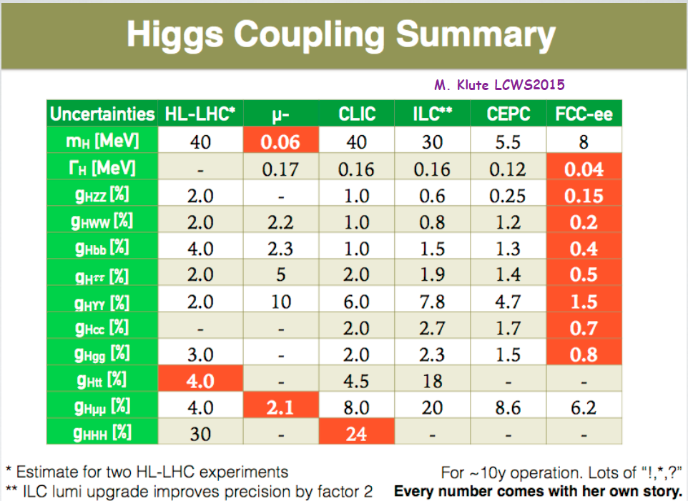
Higgs coupling summary
FCC-hh
1
1
5
the combination of FCC-ee and FCC-hh is «invincible»
M. Klute

Slide 30
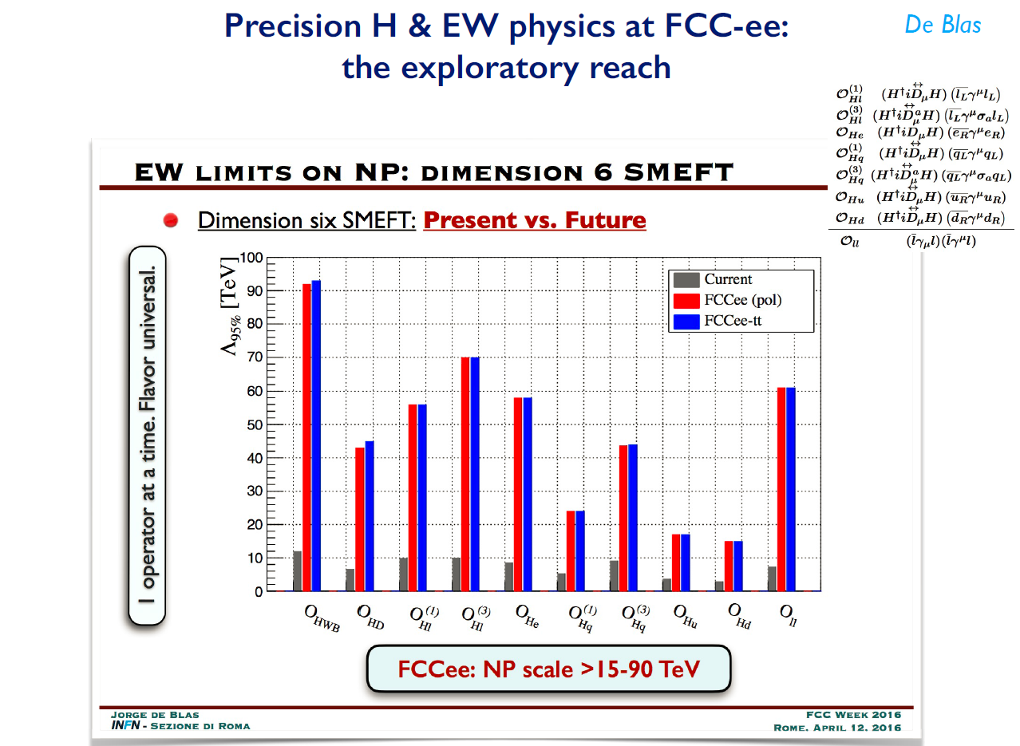
precision H & EW physics at FCC-ee: exploratory each
J. de Blas
Notes:
Michelangelo taking seriously the ee machine (not a small feast)

Slide 31
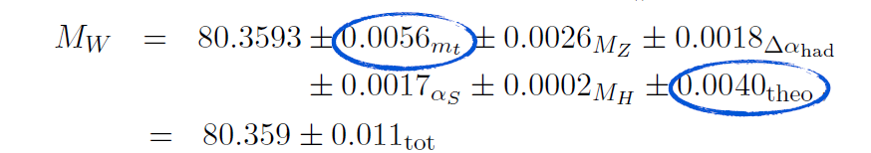
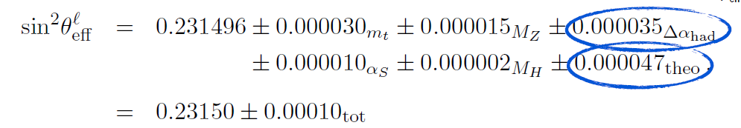
theoretical limitations
R. Kogler, Moriond EW 2013
FCC-ee
SM predictions (using other input)
0.0002
0.0001
0.0003
0.0005
0.0001
0.0000
0.0000015
0.000001
0.00001
0.00001
0.0000014
0.000000
Experimental errors at FCC-ee will be 20-100 x smaller than present errors.
BUT can be typically 10 -30 times smaller than present level of theory errors.
Will require significant theoretical effort and additional measurements!
Radiative correction workshop 13-14 July 2015 stressed need for 3 loop calculations for the future!
Suggestion to include manpower for theoretical calculations in the project cost.
A. Blondel

Slide 32
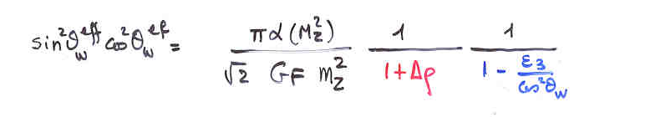
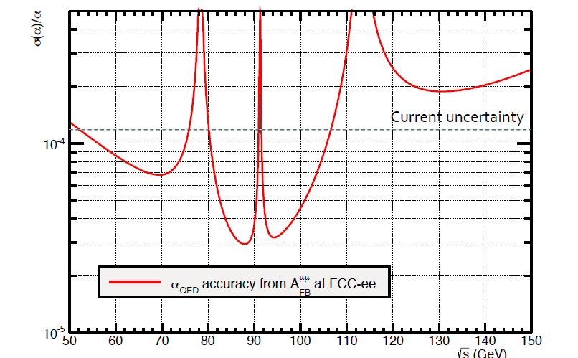
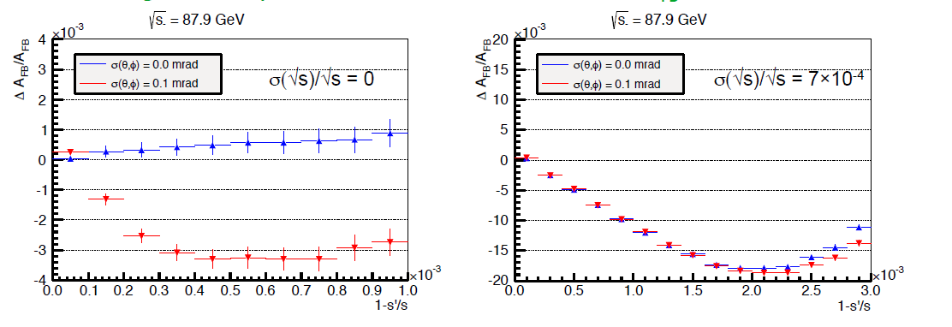
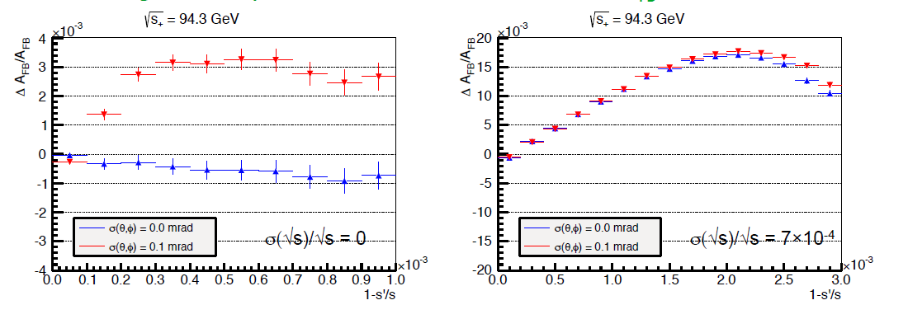
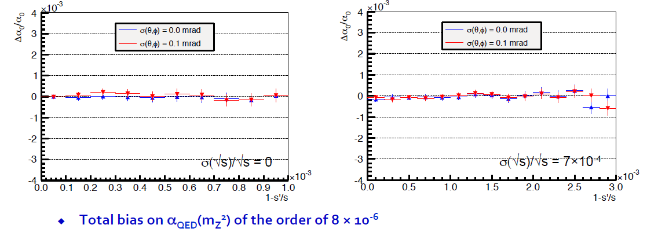
A. Blondel
Unwanted error
Physics discoveries
BREAKTHROUGH
P. Janot discovered that one can measure Δα_{QED}(m_{z}) from measuring A_{FB}^{μμ} at +- 3 GeV
from the Z peak (nice Z lineshape scan).
Further studies with S. Jadach show
error cancellation of +3 vs -3 points.

Slide 33
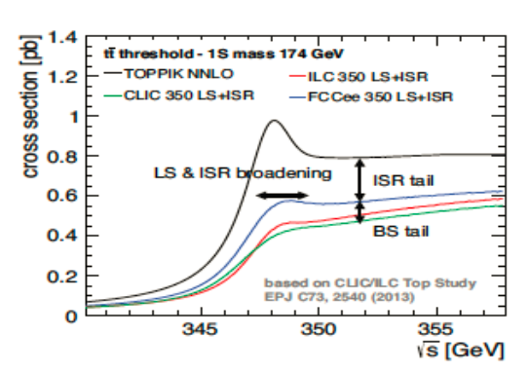
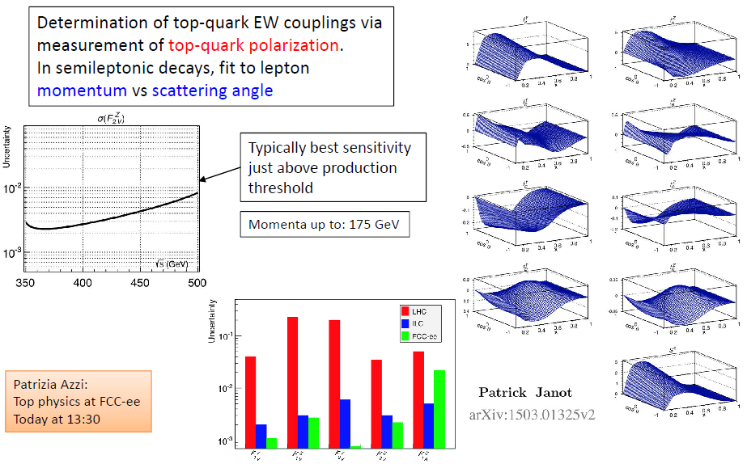
top physics
top mass measured to O(10 MeV);
beam energy calibration from WW, γZ, ZZ + reduced error on α_{S} by measurements@FCC-ee
top beam energy
needed ~185 GeV
Also:
CKM measurements
FCNC decays down to 10⁻⁶
All luminosity can be used!
A. Blondel

Slide 34
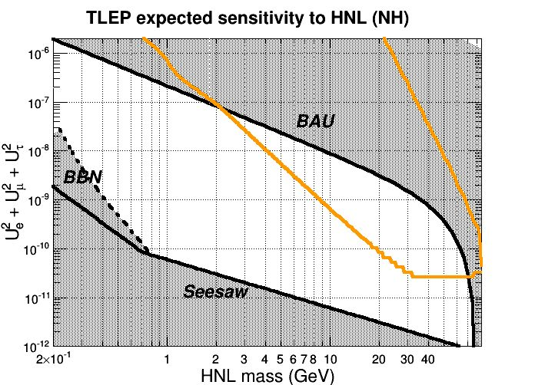
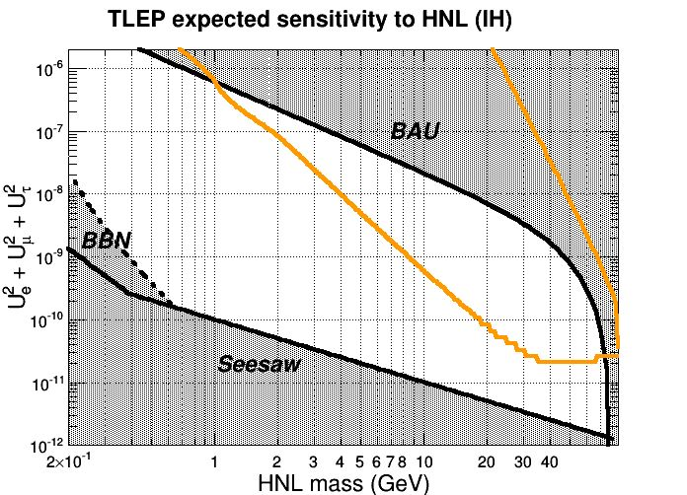
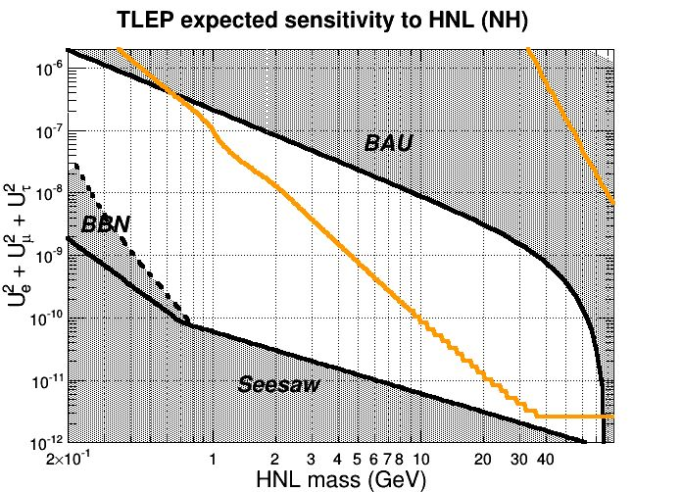
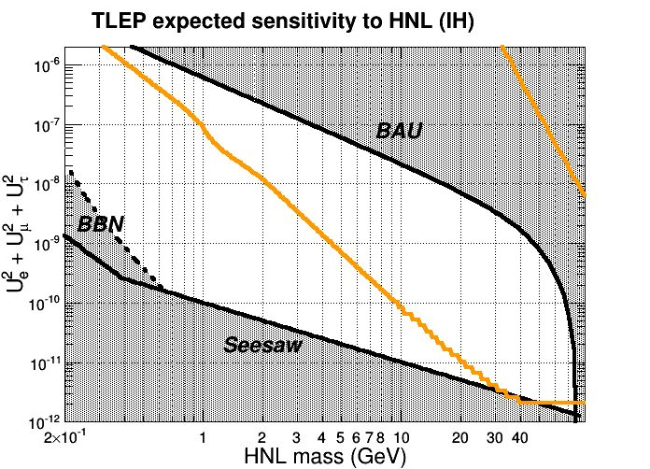

FCC-ee expected sensitivity to heavy RH neutrinos
SHIP
FCC-ee expected sensitivity to Heavy RH neutrino
μ⁺
N
W⁻→qq
ν
N_{Z} = 10¹³ 100$m$ <L<5m
region of interest
FCC-ee sensitivity
NB: very large detector caverns for FCC-hh may allow for very large FCC-ee detector (R=15 m?)
leading to improved reach at lower masses
A. Blondel

Slide 35
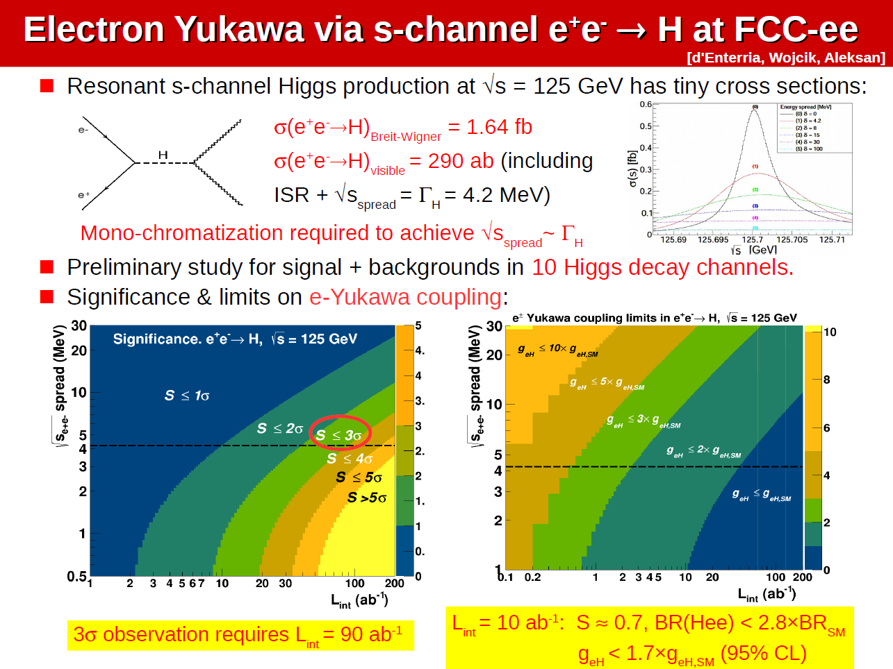
work in progress

Slide 36
FCC-ee and linear colliders
significant synergies (detectors) and real complementarities (physics)
between FCC-ee and the linear collider projects (ILC and CLIC)
- FCC-ee offers high luminosities and discovery potential at Z, W and ZH threshold
→ these features will remain if LC gets built
- linear e+e- colliders can reach energies beyond 500 GeV
→ this advantage will remain if FCC-ee is built
physics absolutely needs an e+e- collider at the EW scale and above
and can very much profit from having two (different) ones
in practical terms:
if LC is built, FCC-ee probably may not need to run at the top energies,
thus saving some RF cavities and running time,
while remaining a real discovery machine
and
if FCC-ee gets build the LC can concentrate on energies ≥350 GeV
A. Blondel

Slide 37
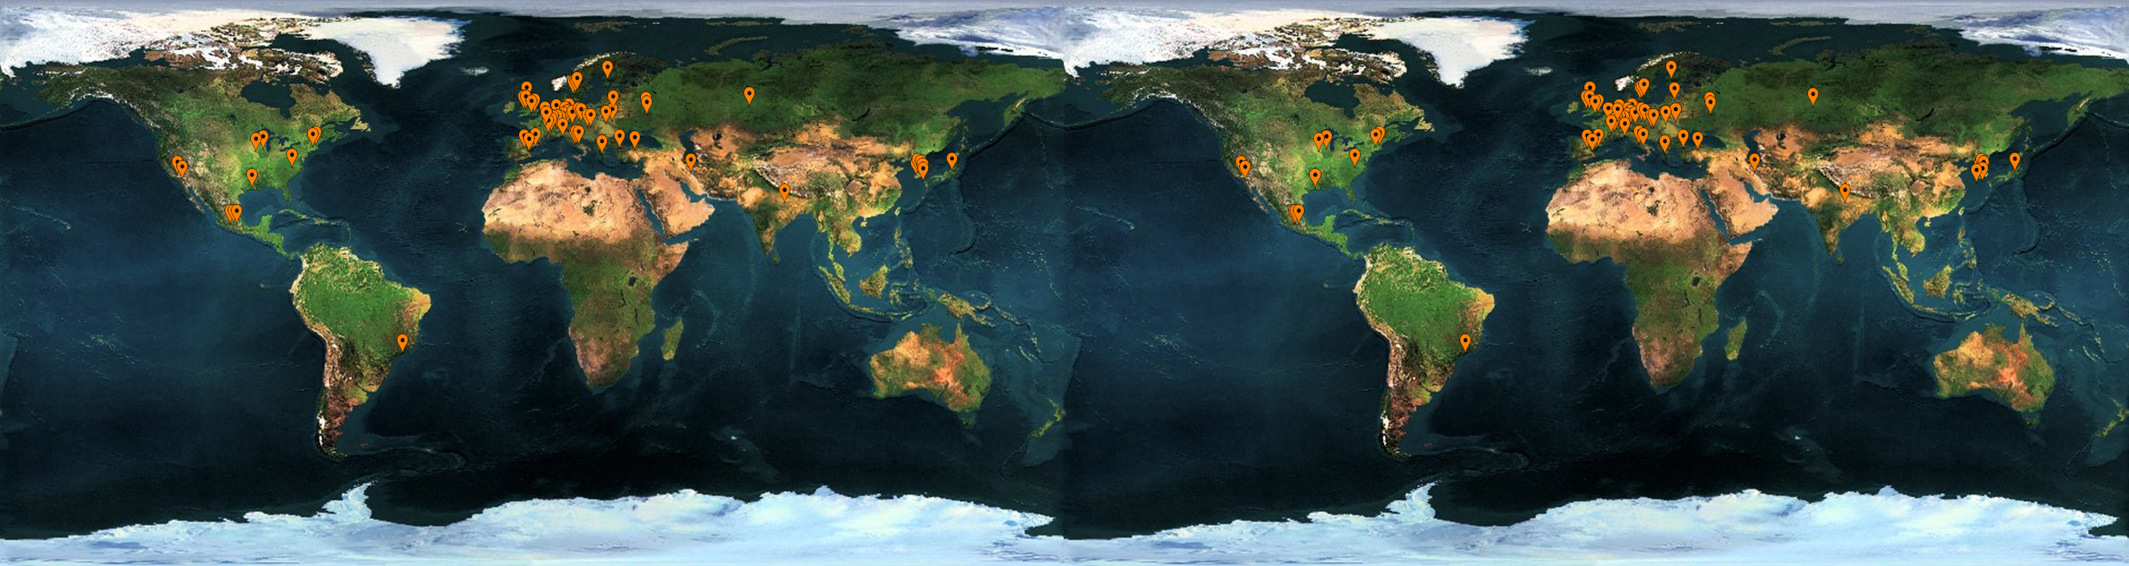



























FCC International Collaboration
75 institutes
26 countries + EC
Status: 17 April, 2016

Slide 38
FCC Collaboration Status
75 collaboration members & CERN as host institute, 17 April 2016
UT Enschede, Netherlands
U Geneva, Switzerland
Goethe U Frankfurt, Germany
GSI, Germany
GWNU, Korea
U. Guanajuato, Mexico
Hellenic Open U, Greece
HEPHY, Austria
U Houston, USA
IIT Kanpur, India
IFJ PAN Krakow, Poland
INFN, Italy
INP Minsk, Belarus
U Iowa, USA
IPM, Iran
UC Irvine, USA
Istanbul Aydin U., Turkey
JAI, UK
JINR Dubna, Russia
Jefferson Lab, USA
FZ Jülich, Germany
KAIST, Korea
KEK, Japan
KIAS, Korea
King’s College London, UK
ALBA/CELLS, Spain
Ankara U., Turkey
U Belgrade, Serbia
U Bern, Switzerland
BINP, Russia
CASE (SUNY/BNL), USA
CBPF, Brazil
CEA Grenoble, France
CEA Saclay, France
CIEMAT, Spain
CINVESTAV, Mexico
CNRS, France
CNR-SPIN, Italy
Cockcroft Institute, UK
U Colima, Mexico
UCPH Copenhagen, Denmark
CSIC/IFIC, Spain
TU Darmstadt, Germany
TU Delft, Netherlands
DESY, Germany
DOE, Washington, USA
ESS, Lund, Sweden
TU Dresden, Germany
Duke U, USA
EPFL, Switzerland
KIT Karlsruhe, Germany
KU, Seoul, Korea
Korea U Sejong, Korea
U Liverpool, UK
U Lund, Sweden
MAX IV, Lund, Sweden
MEPhI, Russia
UNIMI, Milan, Italy
MIT, USA
Northern Illinois U, USA
NC PHEP Minsk, Belarus
U Oxford, UK
PSI, Switzerland
U Rostock, Germany
RTU, Riga, Latvia
UC Santa Barbara, USA
Sapienza/Roma, Italy
U Siegen, Germany
U Silesia, Poland
TU Tampere, Finland
TOBB, Turkey
U Twente, Netherlands
TU Vienna, Austria
Wigner RCP, Budapest, Hungary
Wroclaw UT, Poland

Slide 39
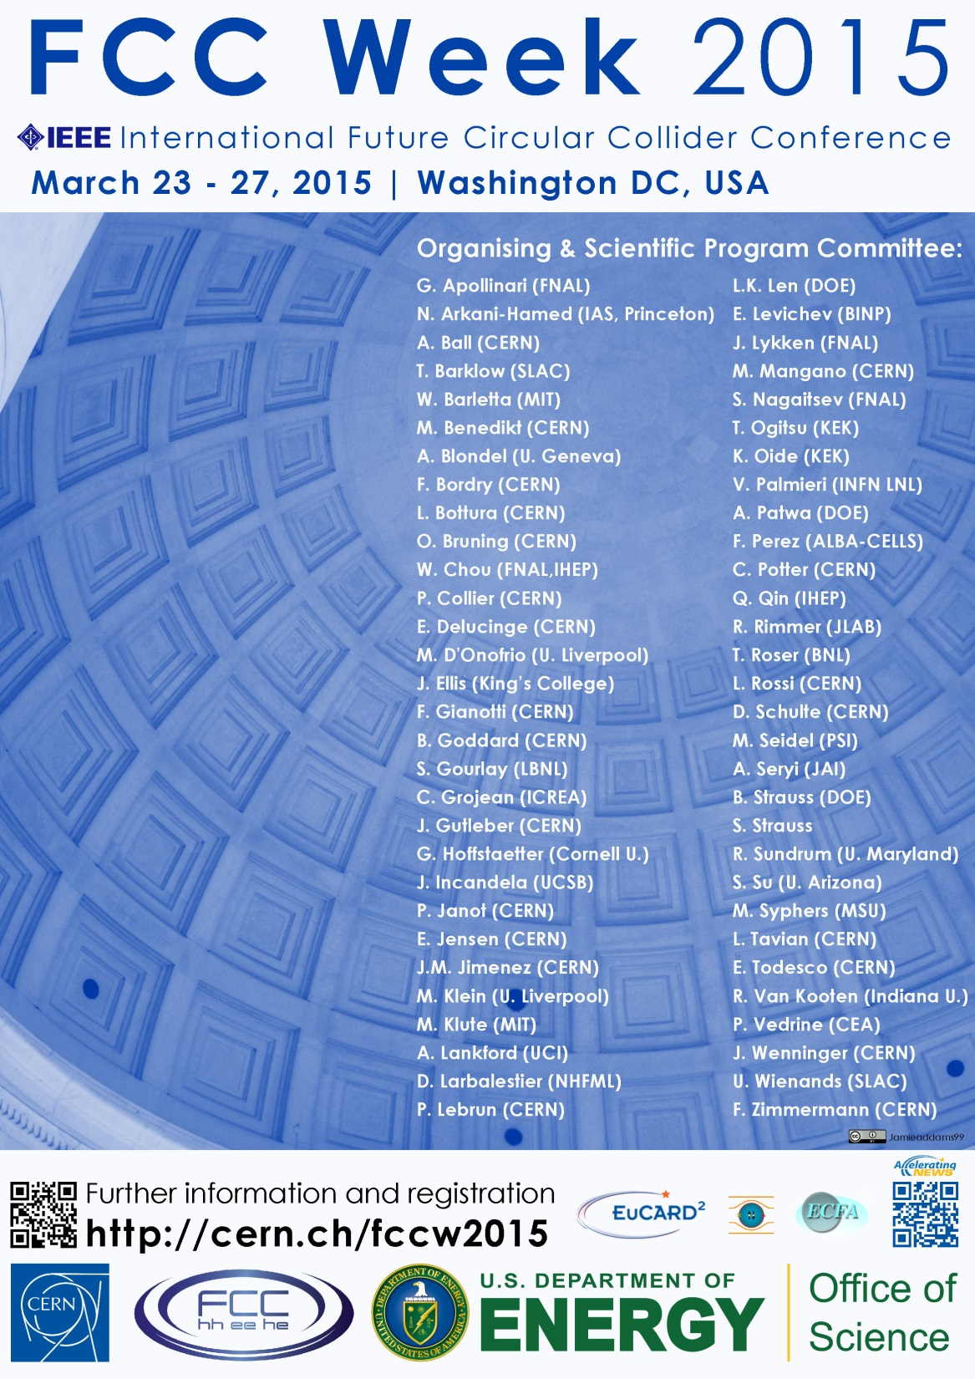
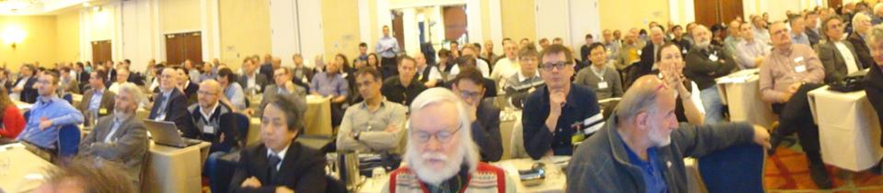
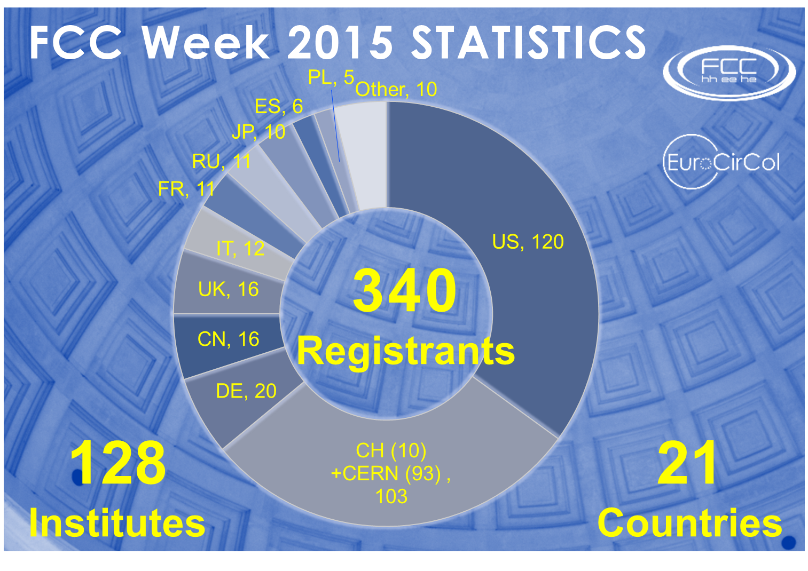
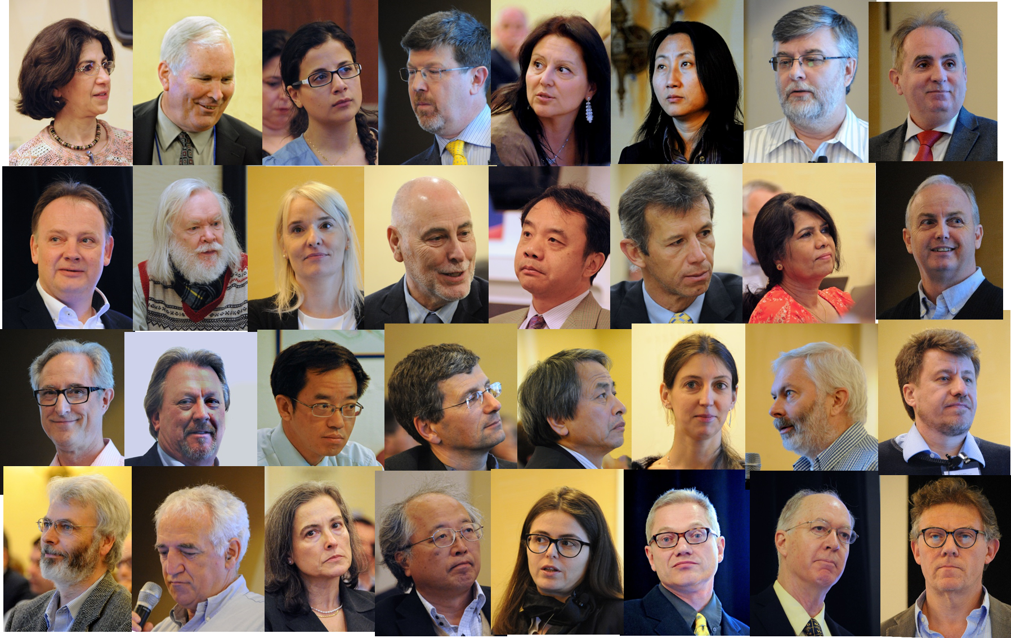
First FCC Week
Conference
Washington DC
23-27 March 2015
http://cern.ch/fccw2015
“head shots” from Bob Palmer (BNL)

Slide 40
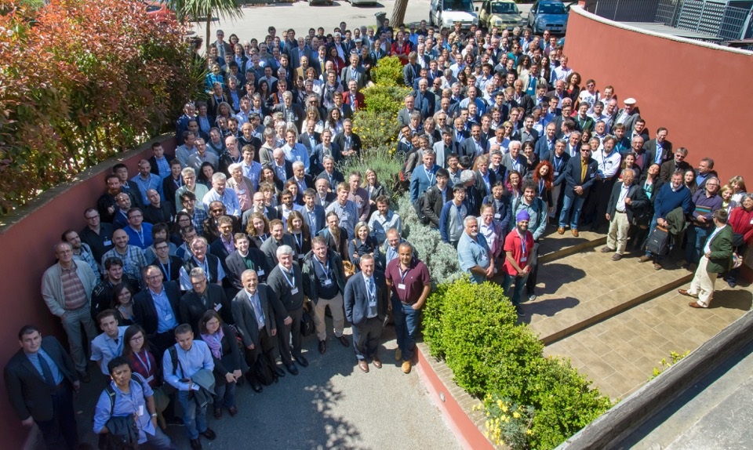
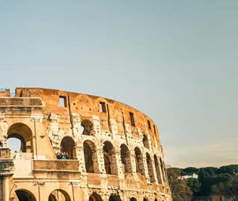
First FCC Week
Conference
Washington DC
23-27 March 2015
http://cern.ch/fccw2016
468
Participants
168
Institutes
http://cern.ch/fccw2015
24
Countries

Slide 41
Summary
FCC-ee combines several new concepts invented and successfully demonstrated during the last 20 years
FCC-ee offers extremely high luminosities in the energy range from Z to ttbar; combined w. precise energy calibration at Z & W
FCC-ee may serve as spring board for the FCC-hh 100 TeV pp collider, bringing a large tunnel, infastructure, cryogenics, time, addt‘l physics motivations + performance goals for FCC-hh
FCC-ee technology is ready; ongoing R&D aims at further increasing efficiency, making FCC-ee a truly „green accelerator“
optics fulfils all requirements, matched to FCC-hh footprint, baseline luminosity performance is predicted with confidence
FCC-ee would provide superb discovery potential & a great first step towards 100 TeV; FCC-ee/hh = powerful combination at EF

Slide 42
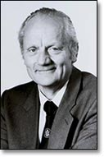
is 100 km too big?
“Of course, it should not be the size of an accelerator, but its costs which must be minimized.”*
Gustav-Adolf Voss,
builder of PETRA,
† 5. October 2013
*G.-A. Voss, ”A Personal Perspective of High Energy Accelerators”,
Proc. 1995 PAC & Int’l HEACC Conference, Dallas, pp. 27-29

Slide 43



FCC Week 2017
29 May – 2 June 2017
Berlin, Germany

