Slide 1
DHPT Timing Reference
T. Hemperek

Slide 2
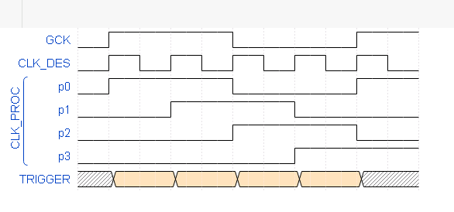
Synchronization
different startup conditions

Slide 3
Consequnces
The acceptance window for recognizing correctly the commands is ~3ns comparing to 12ns before
The sampling point can change after power up between the chips by ~9ns
-> requires tuning after every power-up
This is present since DHP01(2010)

Slide 4
Design solution
SYNC
Solution (easiest?): Provide GCK based synchronization (SYNC) to the divider
Consequences:
- redo the digital part + better PLL characterization (for SYNC) - it will take time (at the moment I do not know how much will investigate this)
- there is a limited risk something goes wrong

Slide 5
Other solutions
PROGRAM.
DELAY
SYNC
Does not require changing/charactering PLL
Possibly need some calibration once (like DCD delays) to avoid hold/setup problems since the relationship between GCK and CLK_DES is unknown at this point

Slide 6
Other solutions
The acceptance window for recognizing correctly the commands is ~3ns comparing to 12ns before
Does not require changing/charactering PLL

