Slide 1
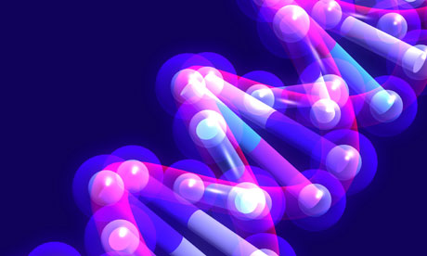
Ultra fast electron detectors – Edet_80k for the molecular movie –
Sascha Epp

Slide 2
EDET team
Acknowlegements
HLL ► Ladislaw Andricek ● Martin Hensel ● Christian Koffmane ● Jelena Ninkovic ●Gerhard Schaller ● Martina Schnecke ● Florian Schopper ● Thomas Selle ● Andreas Wassatsch ● Christian Zirr
KIT ► Ivan Peric
USI ► Klaus Gärtner
MPSD ► Ibrahym Dourki ● Djordje Gitaric ● Sascha Epp ● R. J. Dwayne Miller ● Fabian Westermeier

Slide 3
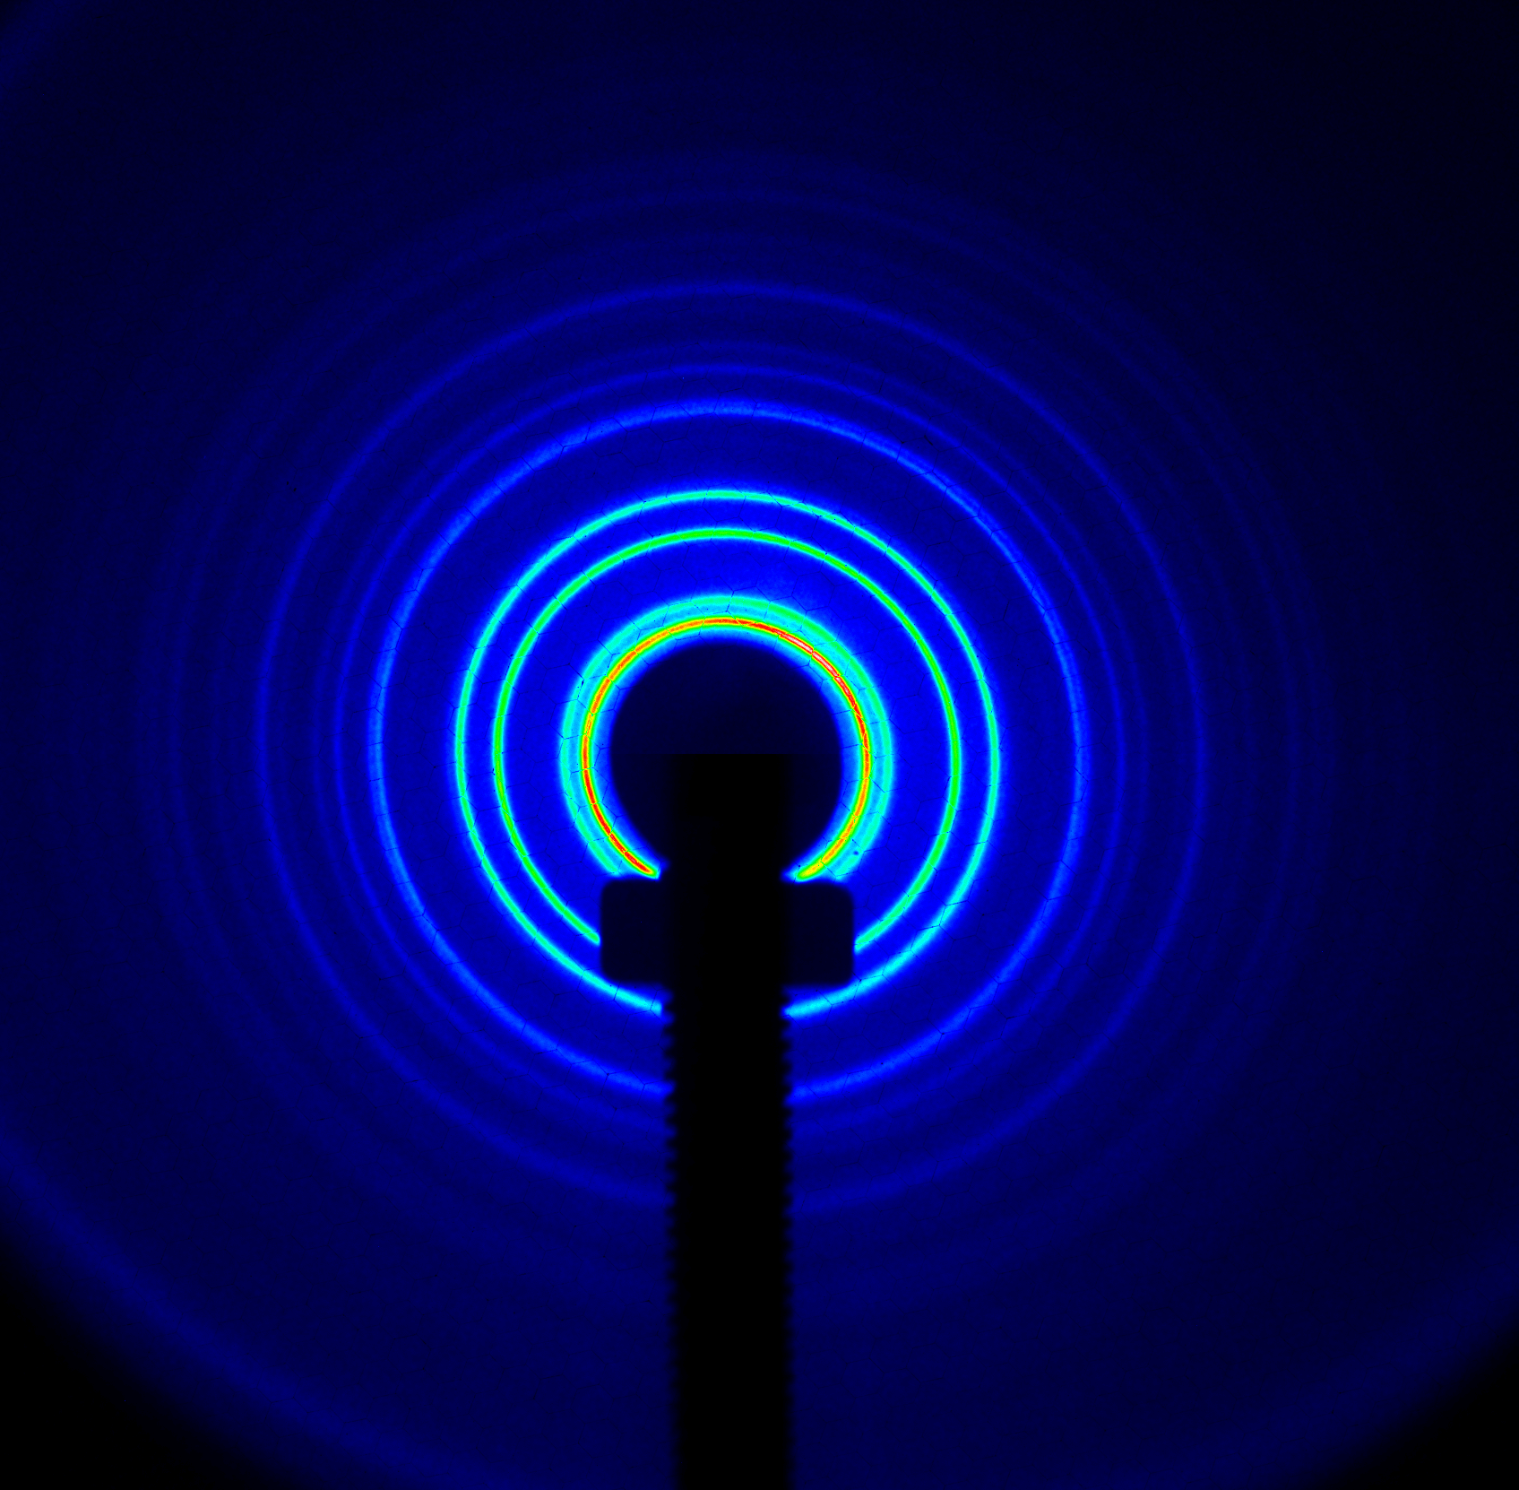
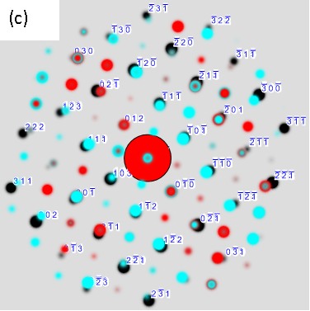
Electron diffraction
$${E_{kin}}_{}^{2}$$
The wave-particle duality of particle beams
► We exploit the wave nature of the electron
► Need to detect electrons (sig.-to-noise)
● direct-hit detector
● in-direct hit detector
► scientist can do is 24/7
► cross section -> 1e6 times larger
► mass & charge -> penetration depth
${\text{l}}_{dB}$ $=\frac{hc}{\sqrt{2E_{kin}E_{0}+{E_{kin}}^{2}}}$ < 0.1 $\dot{A}$
► 0.1 A corresponds to 100 keV X-rays
Diffraction out to less than 0.2Å!

Slide 4
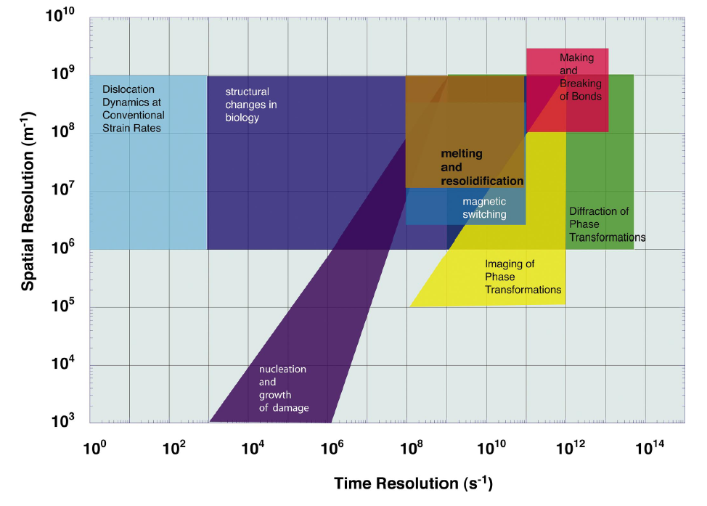
Static & Dynamic
Time scales

Slide 5
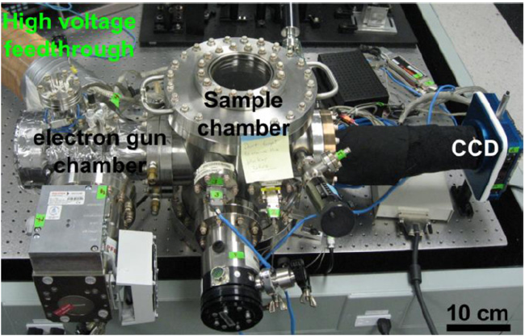
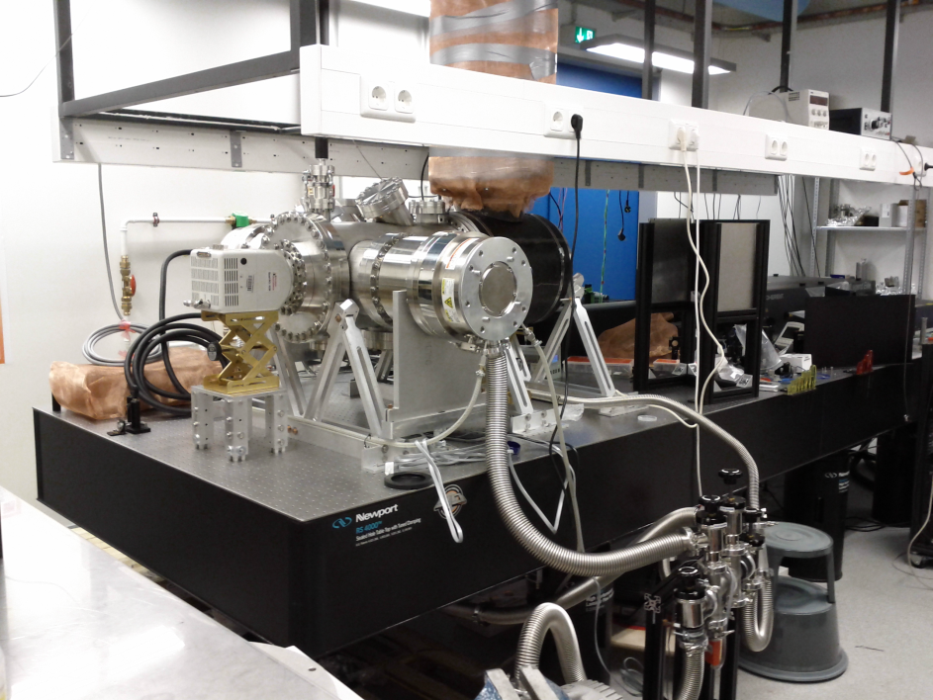
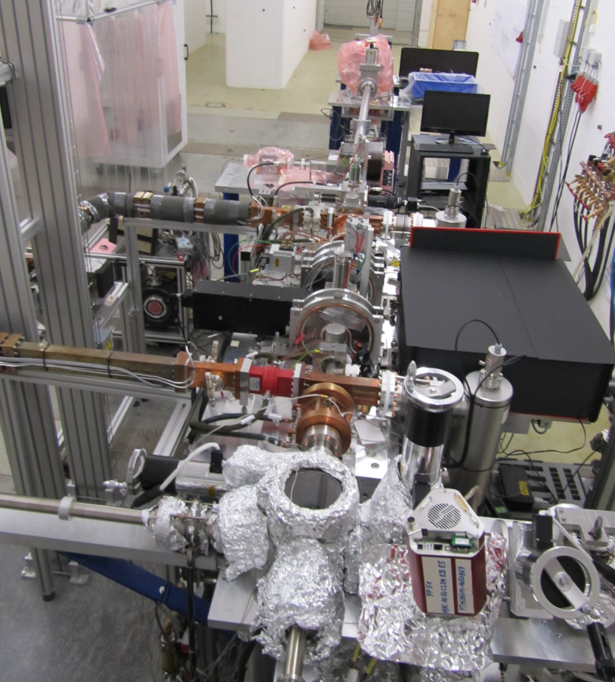
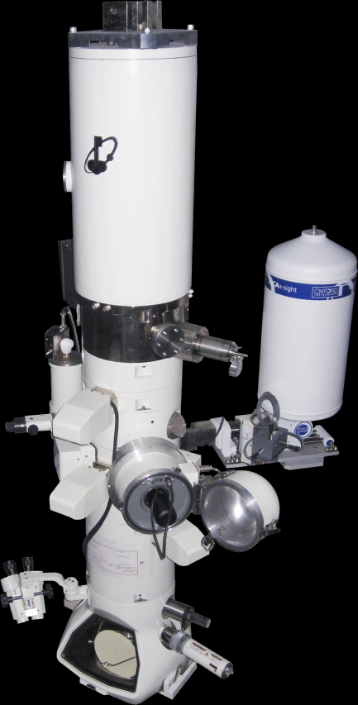
REGAE 7 MeV
Experiments
Small scale & with e-
keV FED – solid state
keV FED – liquid phase
keV FED – gas phase
REGAE Diffraction
keV time-resolved TEM
REGAE Dynamic RTEM

Slide 6
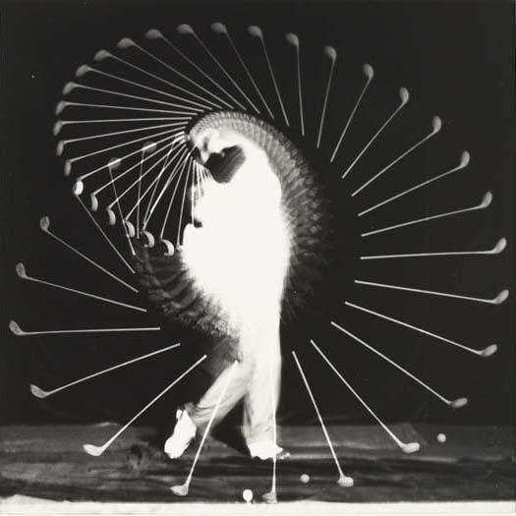
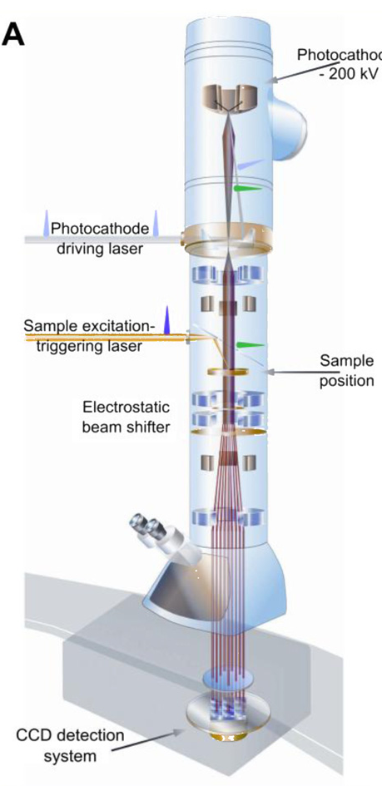
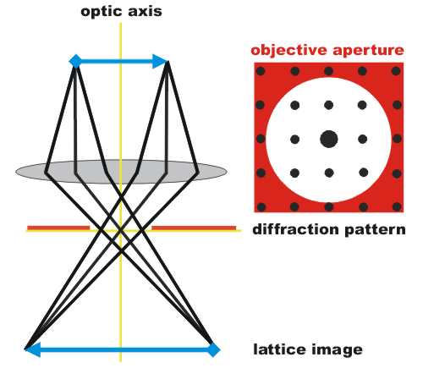
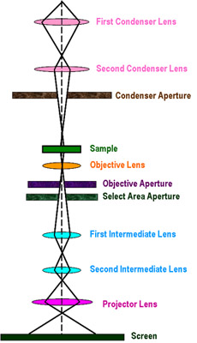
TEM real space imaging
A movie like in cinema
1
2
3
4
3
1
4
2
Source: https://www-pls.llnl.gov

Slide 7
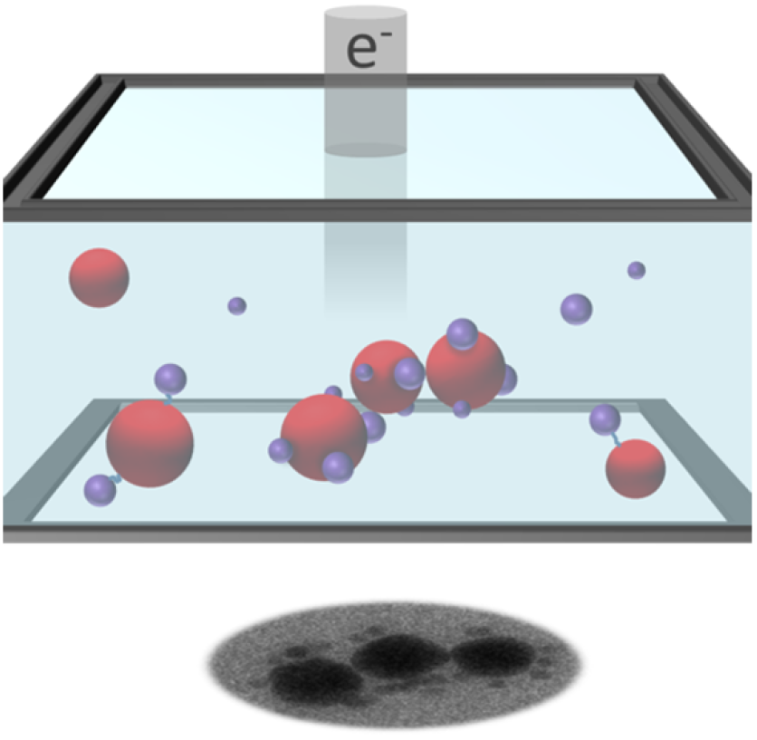
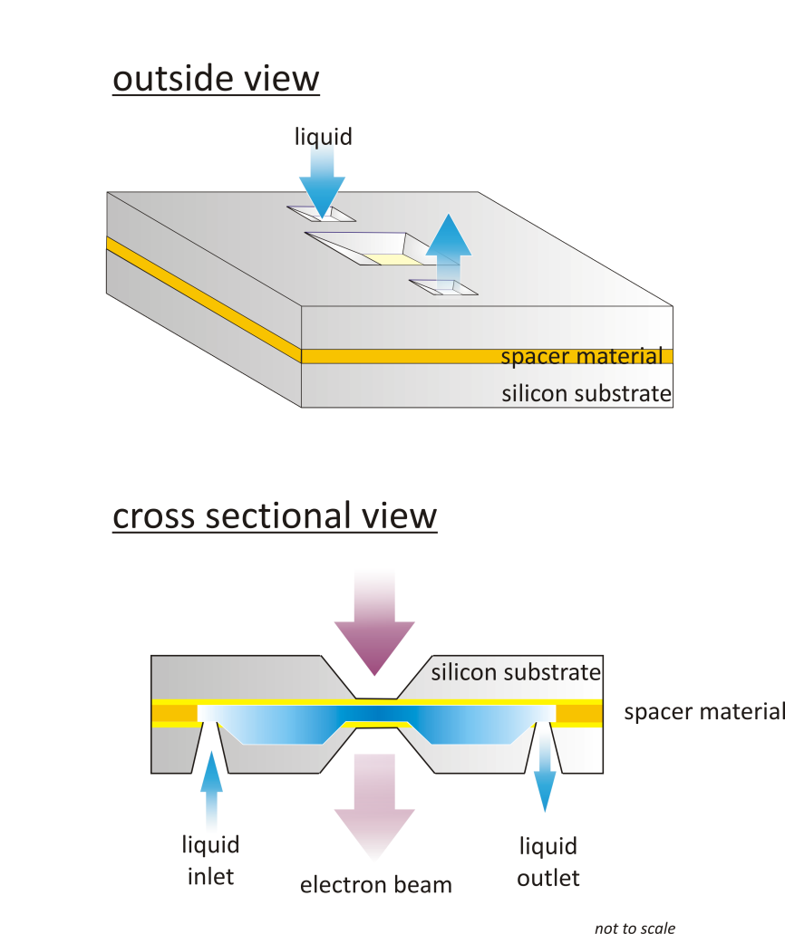
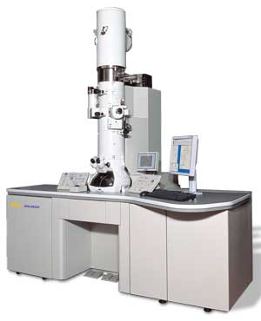
Further Evolution in atom gazing: ……Solution Phase Dynamics
TEM nanocell with flow!
30 nm SiN membrane
H₂0 ->->->
100-1000 nm
Christina Müller: U Toronto
Sercan Kescin, Stephanie Manz: MPSD

Slide 8
Static & Dynamic
base-pairing dynamics and ubiquitous nature of DNA interactions
- 200 nm
► DNA origami
► Drug delivery
► DNA based electonic dev.
Keskin et al. J. Phys. Chem. Lett. 2015, 6, 4487−4492

Slide 9
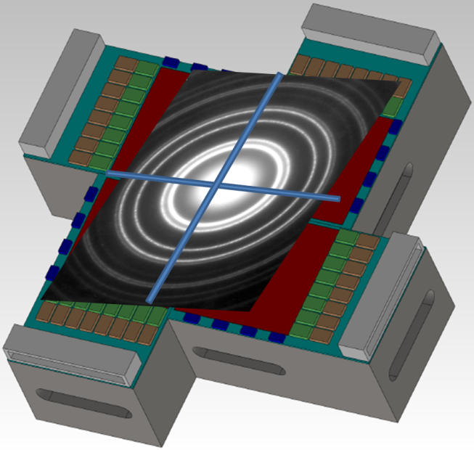
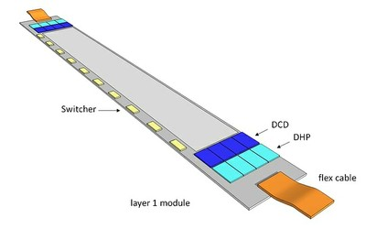
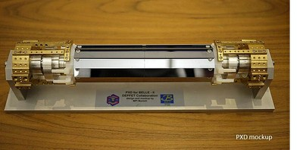
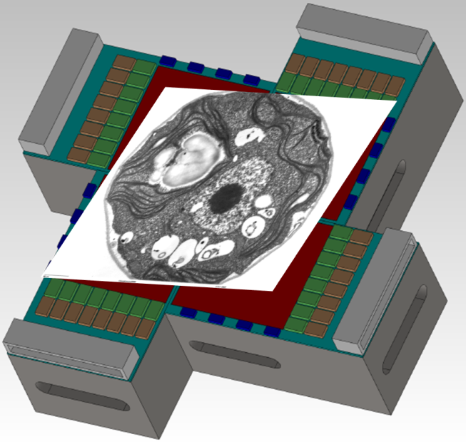
From Belle PXD to EDet
► Development basis
posponed
Work on ► ASCIS, pixel design, system design, thermal design, mechanical design, radiation hardness
Edet_1k
Sensors in Aug.
Work on ► ASICS: switcher, DCD, DMC (DHP)
Sensor & pixel design: thickness, size, charge handling System design: making the sum of components a useful unit , thermal design, Geant4 simulations of sensor response mechanical design
Edet_80k

Slide 10
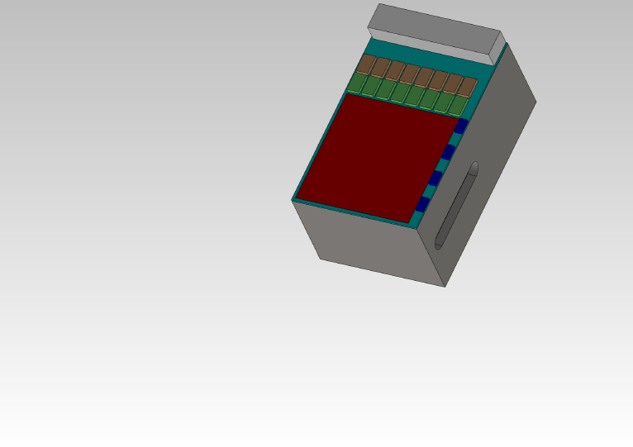
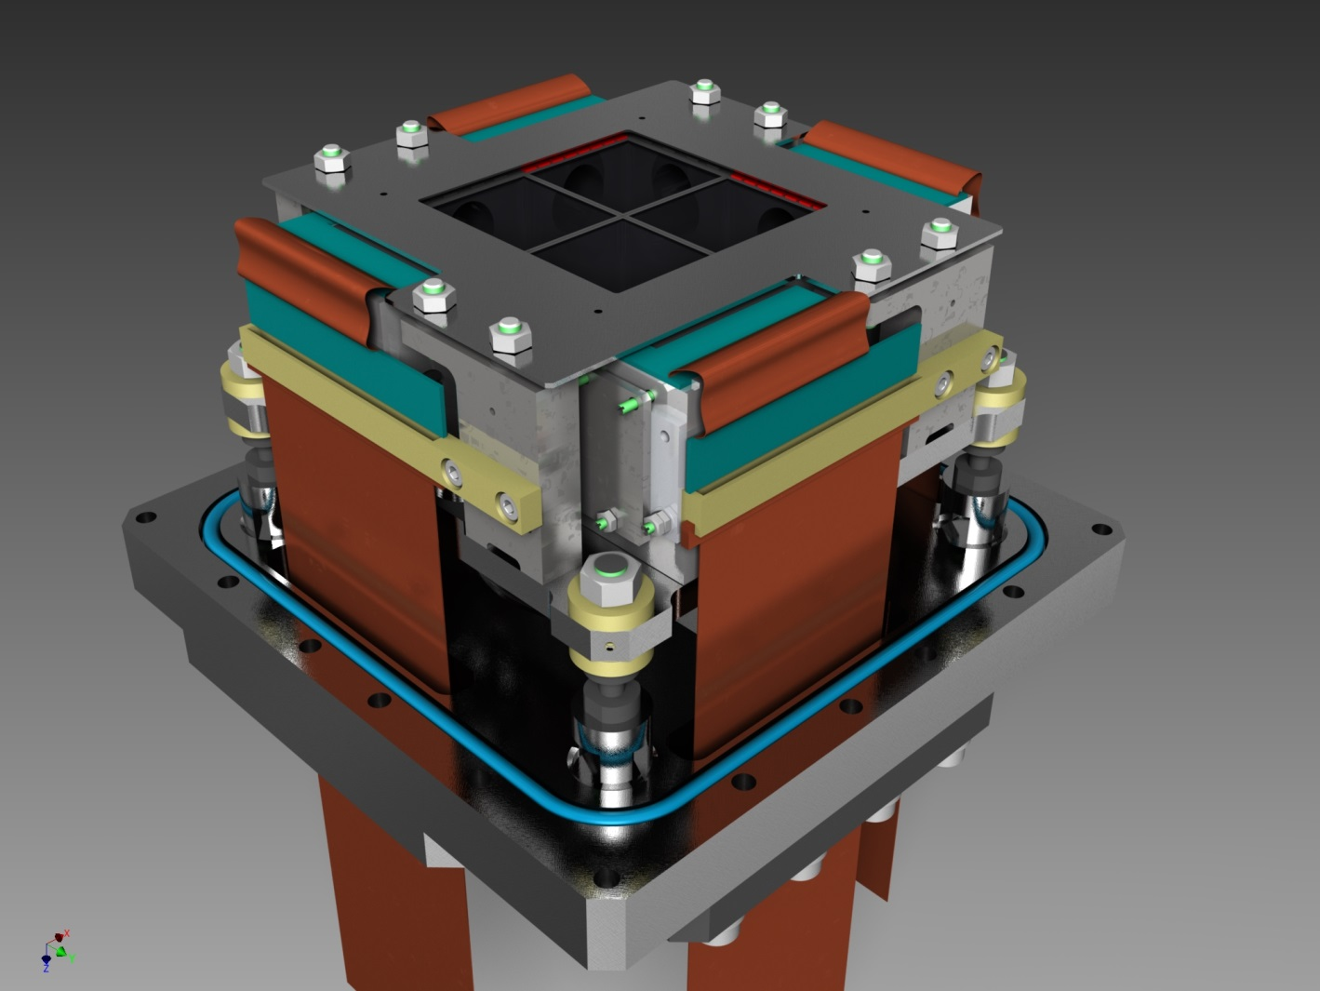
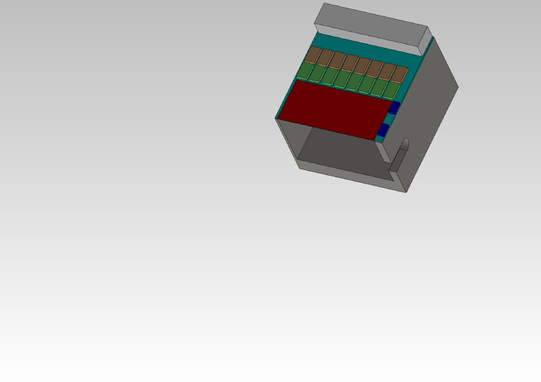
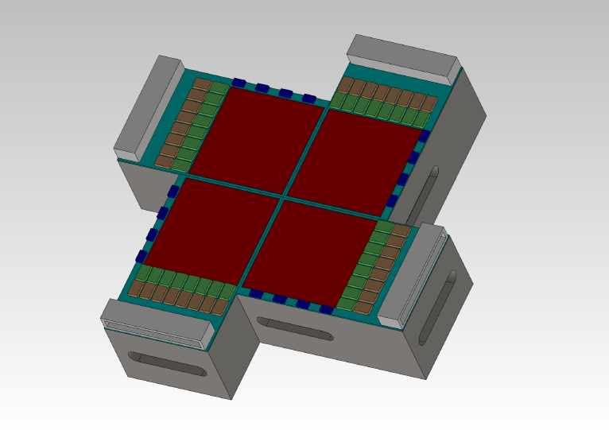
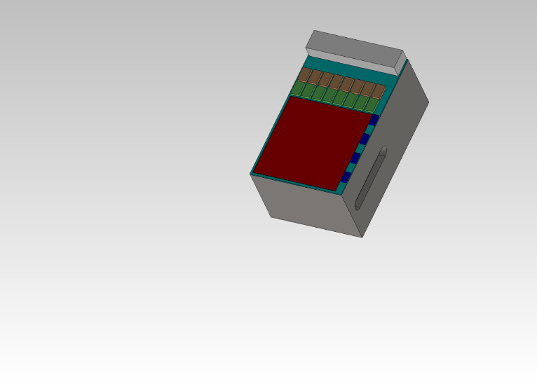
EDet_80k
DEPFET direct hit
► direct electron detection
► 60 x 60 mm² active area
► Thickness 50µm (30 µm)
512 x 512
► 1000 x 1000 px (4 chips)
2 mm
512 x 512
► pixel size: 60 x 60 µm²
► full frame recording at 80kHz (for 100 frames) by 4-fold rolling shutter mode
512 x 512
512 x 512
► > 200 primaries of 300keV per pixel
► dead joining region < 2 mm

Slide 11
Timeline
revised
Last Milestone ► Switcher and Edet DCD (1st gen) are delivered from engin. run (April ’16)
Next important step ► end of sensor production in August 2016 (10 wafers)
Mid 2016 ► 1st stage mechanical design prototype at hand
End 2016 ► submission of DMC chip (the DHP of Edet_80k)
End 2016 ► Dynamic measurement on small det. structures
End 2016 ► First large matrix assembly by Nov 2016 – system test with DHP
June 2017 ► Module 0 assembly
End 2017 ► Full quadrant assembly
March 2016 ► DEPFET production start (DH1k) (Phase III)
March 2016 ► Completion of sensor production (DH80k) (Phase IV)
July 2017 ► Completion of DH80k detector system (Phase VI)
Dec. 2017 ► Completion of sensor production (DH1k) (Phase V)
2018 ► Completion of DH1k detector system (Phase VII)

Slide 12
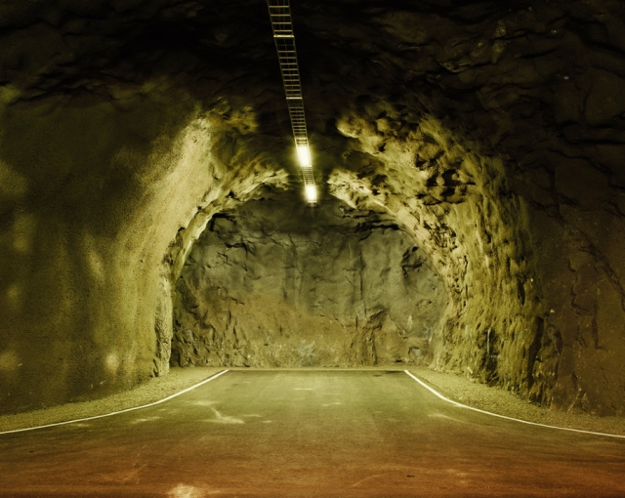
Thank you !!!

Slide 13
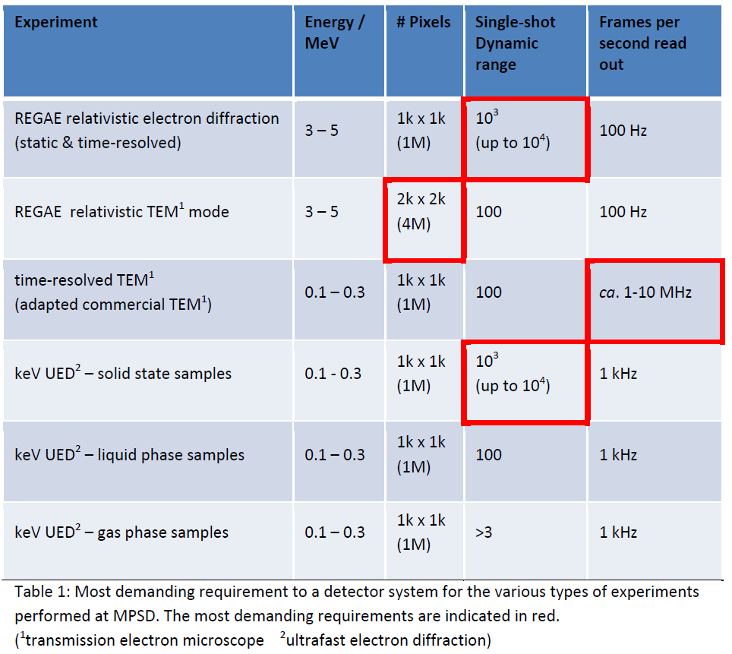
Detector requirements
► Want fast detector…
as reasonably possible
► Excellent signal to noise
(single primary e- detection)
Can one single system serve all requirements?
Principally yes, but we make two different (similar) systems!

Slide 16
Upcoming talks
revised
Last Milestone ► Sensor production of wafer has started at HLL (Oct. 2014)
► around 10 wafers are in processing (for 50µm and 30 µm thick det.)
Next important step ► ASICSs: DCD, Movie Chip
March 2016 ► DEPFET production start (DH1k) (Phase III)
March 2016 ► Completion of sensor production (DH80k) (Phase IV)
July 2017 ► Completion of DH80k detector system (Phase VI)
Dec. 2017 ► Completion of sensor production (DH1k) (Phase V)
2018 ► Completion of DH1k detector system (Phase VII)

