Slide 1
Detector Housing: Simulation and Design
Ibrahym Dourki
12.05.2016
20th International Workshop on DEPFET Detectors and Applications
11-14 May 2016, Kloster Seeon ( Tagungsraum )
Ibrahym Dourki, PhD Student
Max Planck Institute for Structure and Dynamics of Matter, Center for Free Electron Laser Science (CFEL) Luruper Chausee 149 D-22761 Hamburg (Germany)

Slide 2
Outline
Motivation
Sensor Thickness and Support
Detector Housing Simulation
Spatial Resolution: MTF Calculation
Mechanical Design of Detector

Slide 3
Motivation
Supporting the detector sensitive area:
Provides high mechanical stability for the detector (robustness)
Is needed to integrate an efficient cooling system
BUT!
Support layer increases the noise signal produced by backscattered electrons and thus degrades the detector performance.
A concept of the new design is presented by taking into account the thermo- and mechanical stability of the detector without degrading the detector performance.
Monte Carlo Simulation is used to optimize the detector geometry

Slide 4
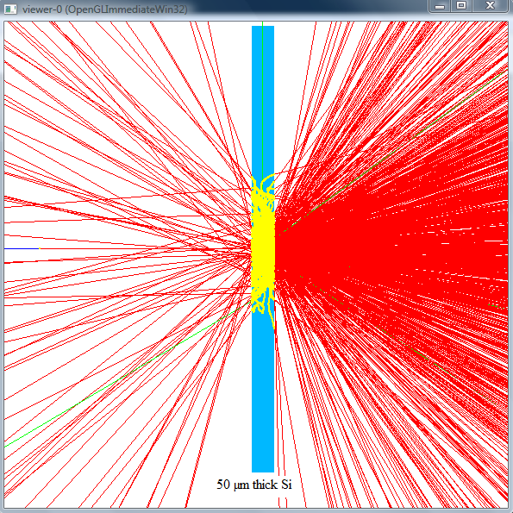
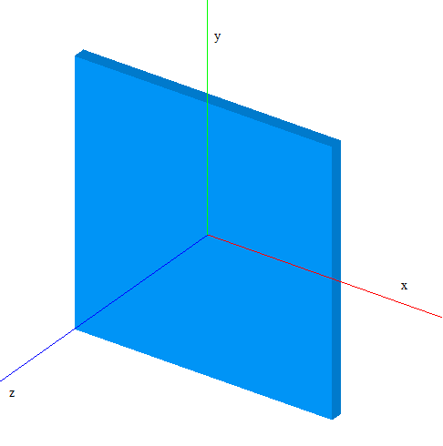
Sensor Thickness and Support
Radiation Source: Electron beam of E_{e}=300 keV normally incident on the Silicon layer
Thickness of Silicon layer: 50 µm thick
Simulation of 1 mm x 1 mm x 50 um Si layer with Geant4

Slide 5
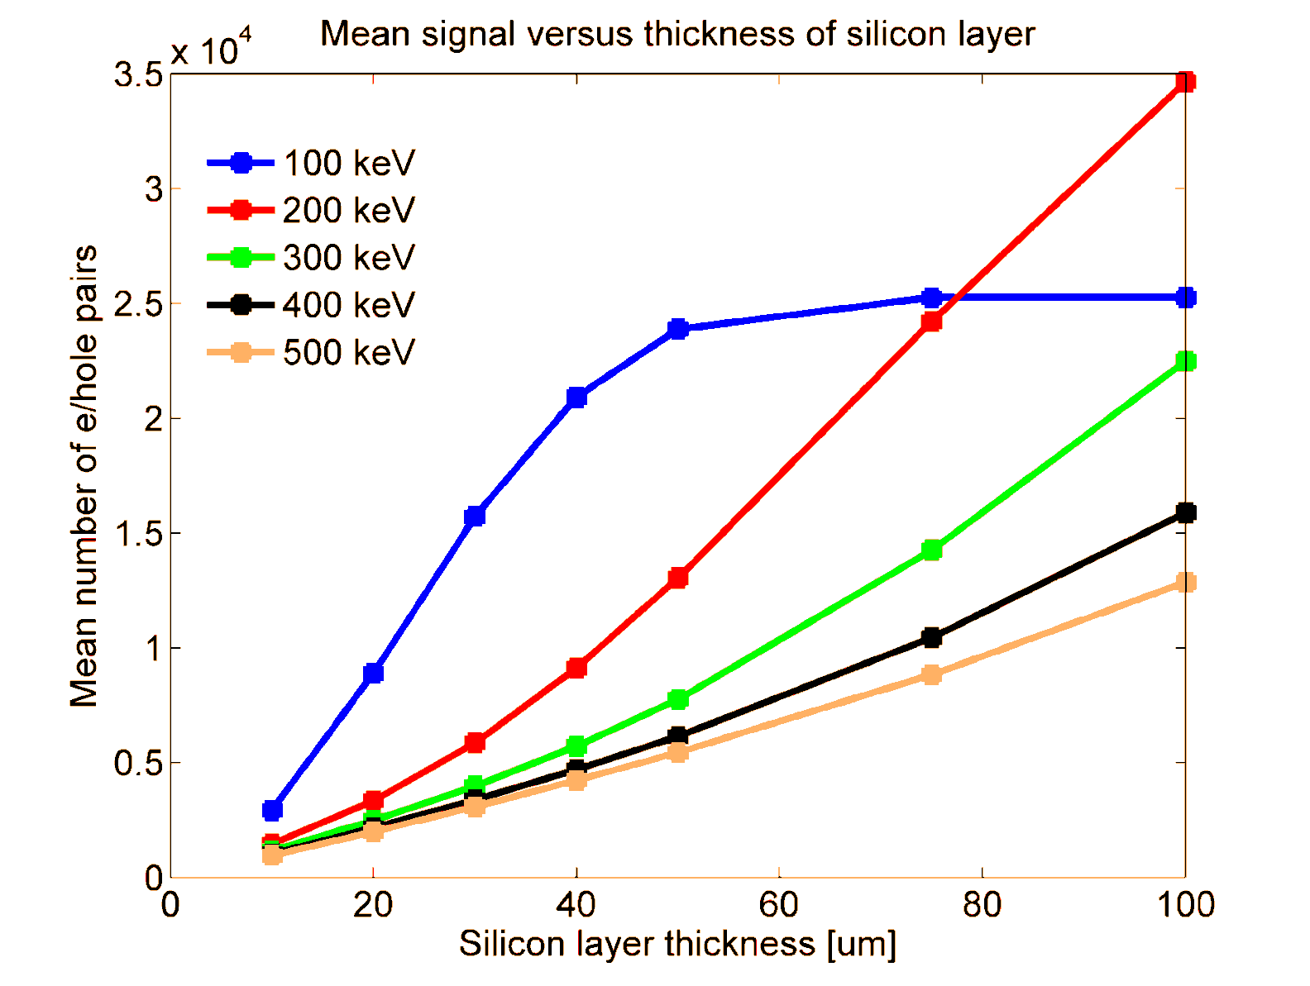
Signal Versus Thickness and Energy
50µm Si sensitive layer has high DQE and can detect a single electron

Slide 6
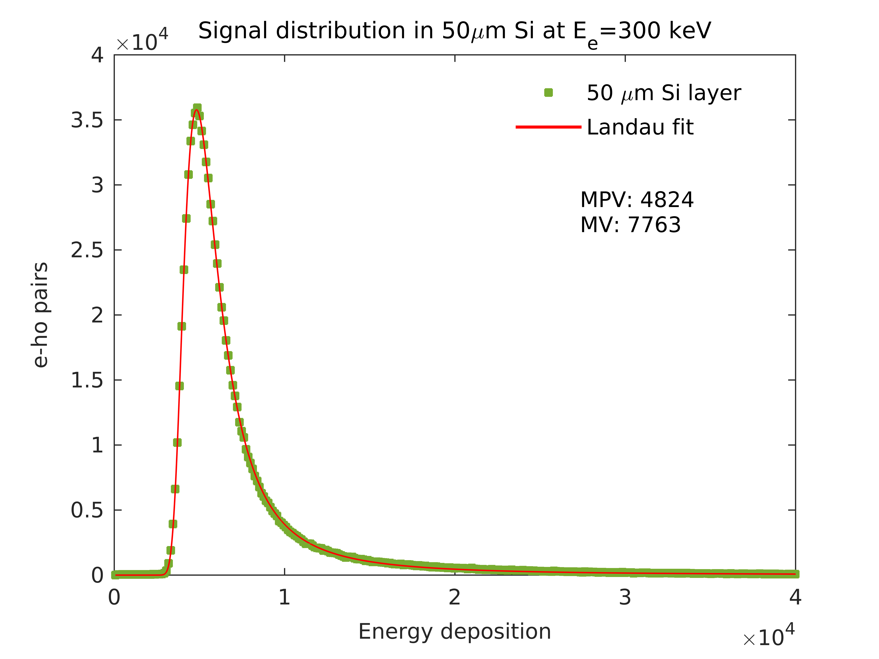
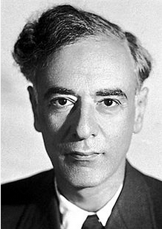
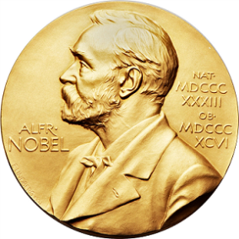
Signal Distribution: Landau Distribution
Counts
Theory: MPV_{theo} = 4600 e- Simulation: MPV_{s} = 4824 e-
Lev Davidovich Landau 22.01.1908-1.04.1968
https://fr.wikipedia.org/wiki/Lev_Landau
Nobel Prize: 1962
e-hole pairs
- Asymmetric distribution ⇒ MPV≠MV
Long tail extending to high values: Originatingfrom high energy transfer
Most interactions involve little energy deposition

Slide 7
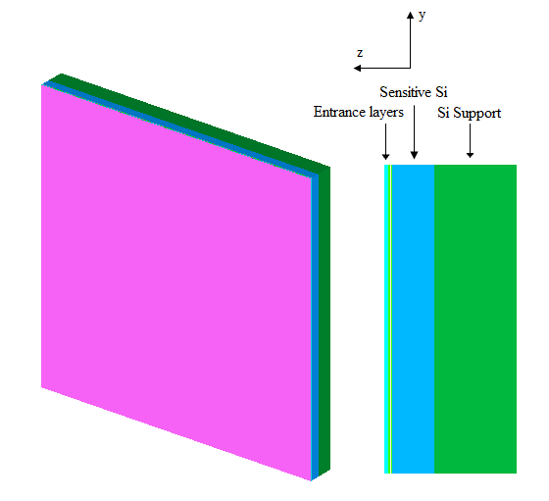
Electron Backscattering Investigation
Support layer is needed:
Cooling
Mechnanical stability
An example of detector beeing simulated

Slide 8
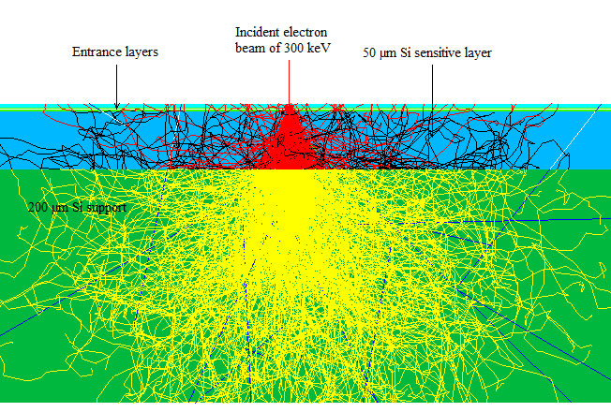
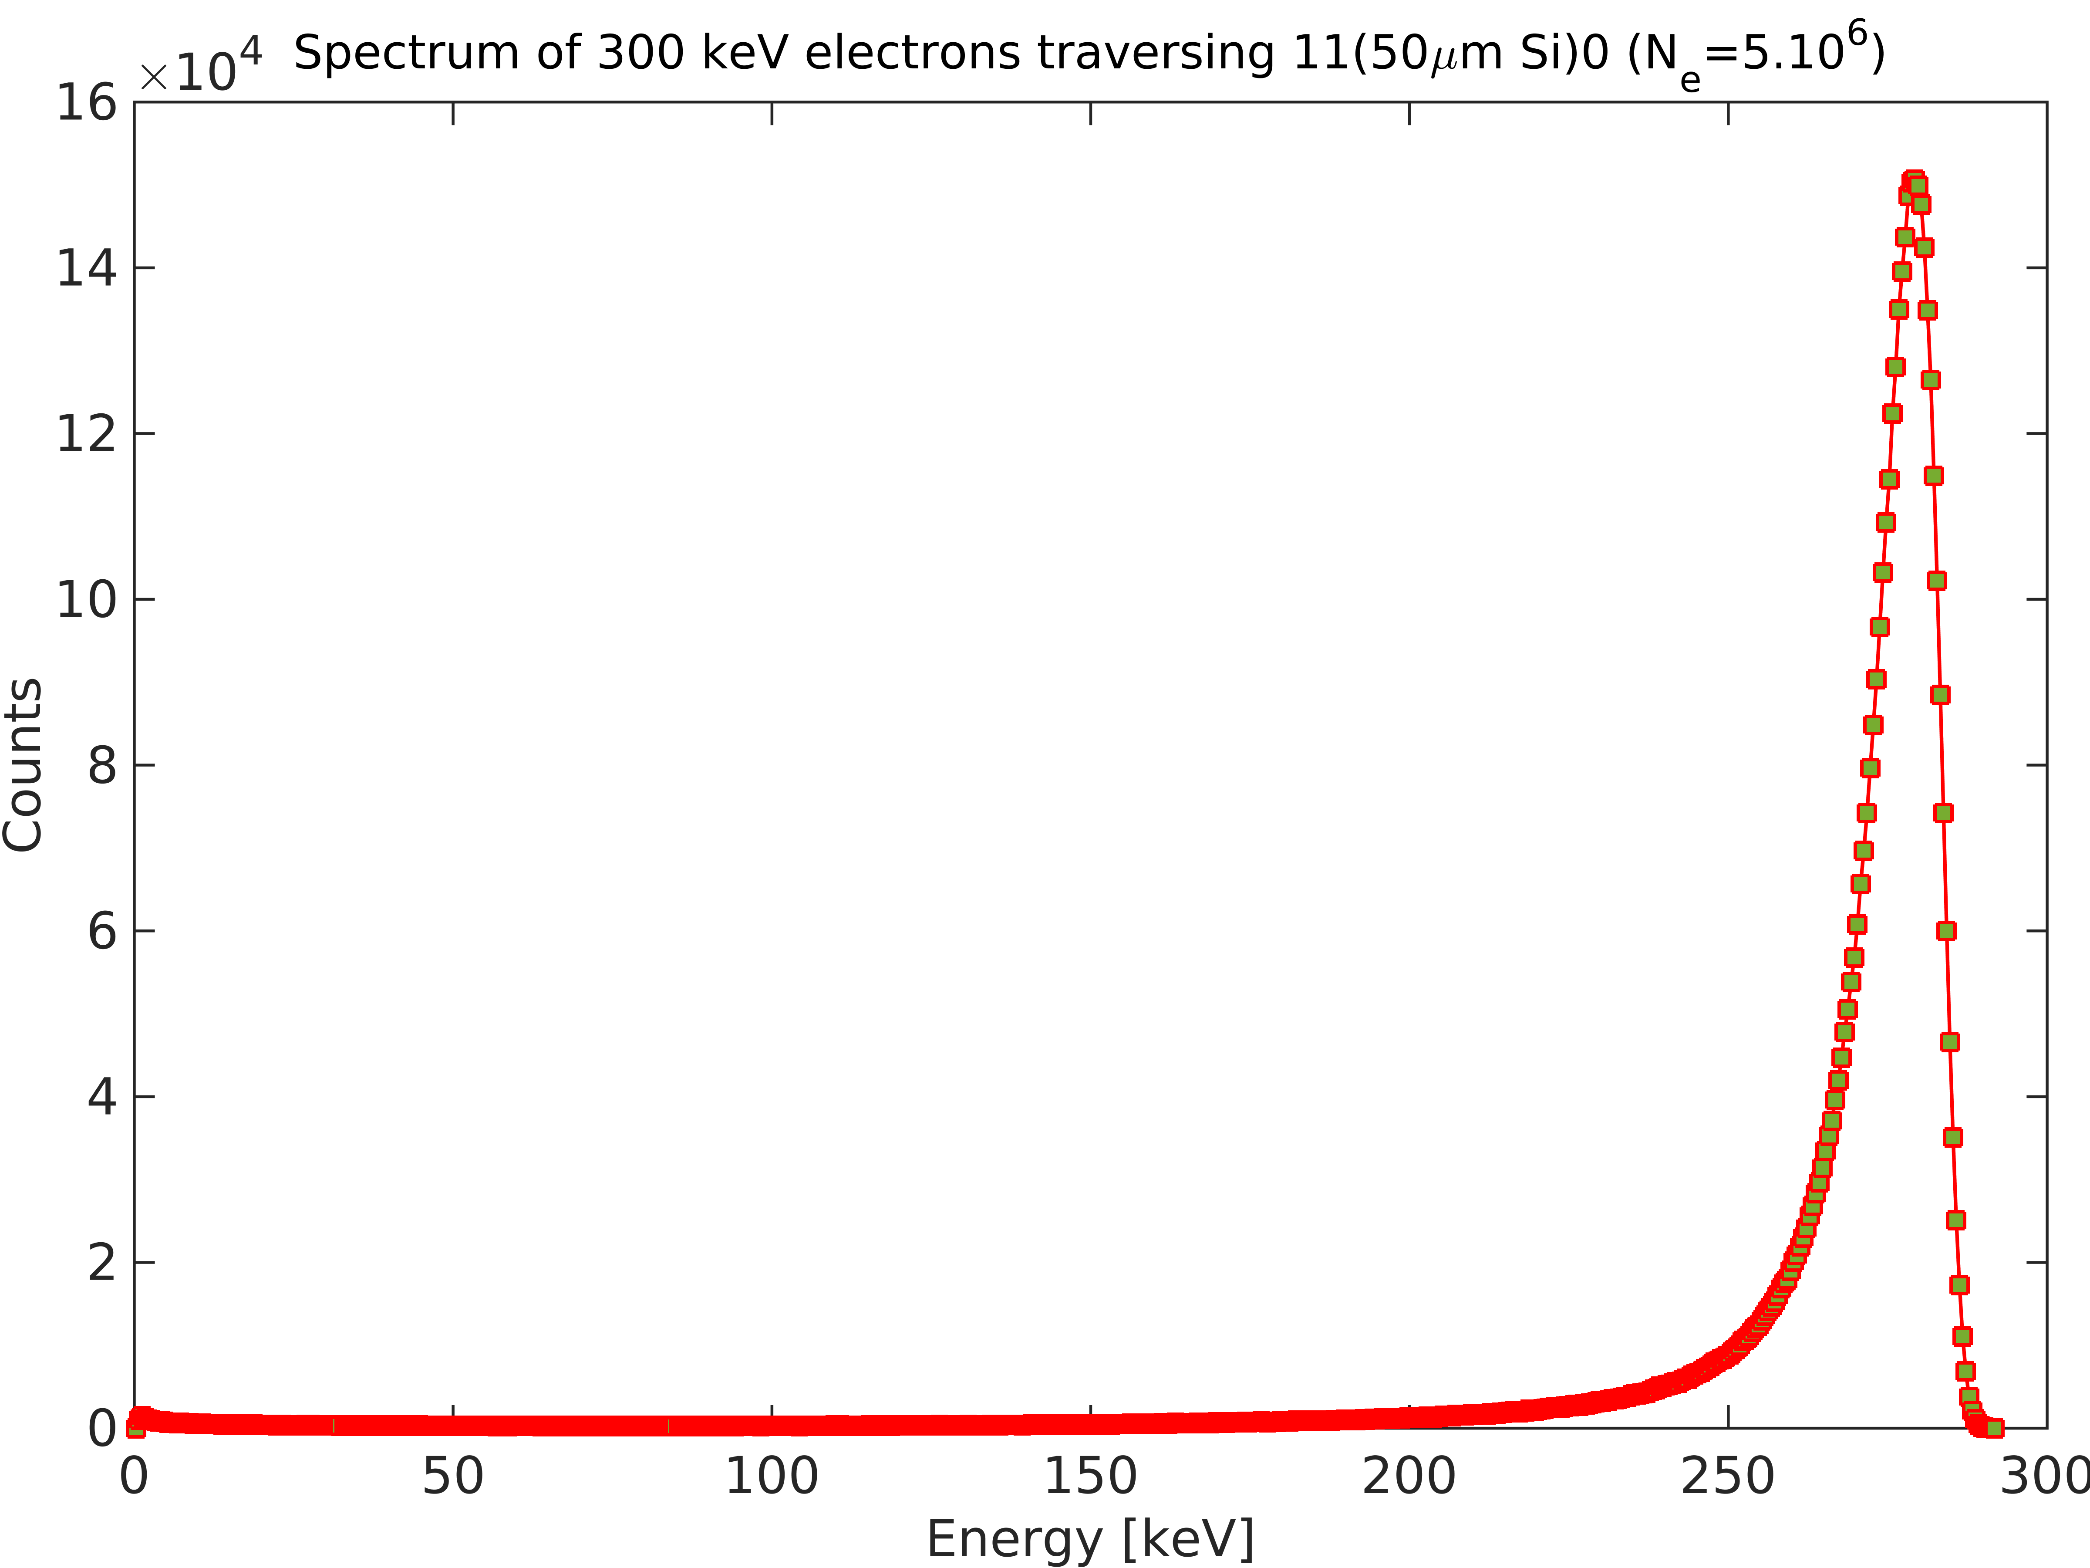
Qualitative description of electron backscattering
MV= 265.73 keV
MPV=276.35 keV
Simulation of the tracks of 500 electrons
of 300 keV in the detector layers.
For 50 µm Si and Ee=300 keV → only 10 % of the electron energy is deposited
Signal generated by backscattered electrons must be reduced as low as possible

Slide 9
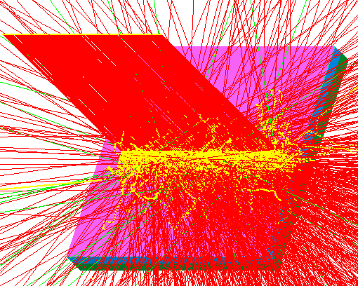
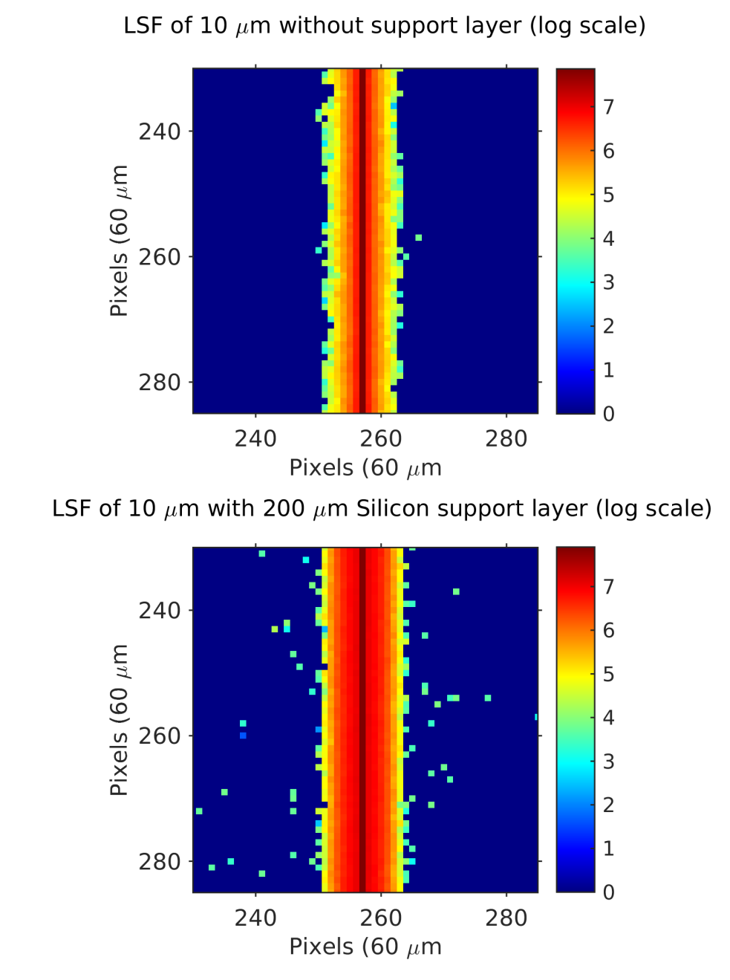
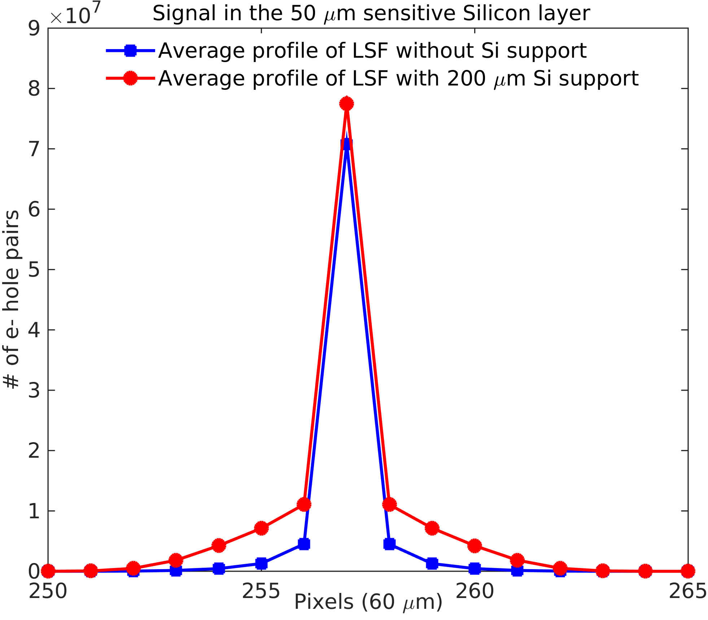
Effet of the backscattering on the signal quality

Slide 10
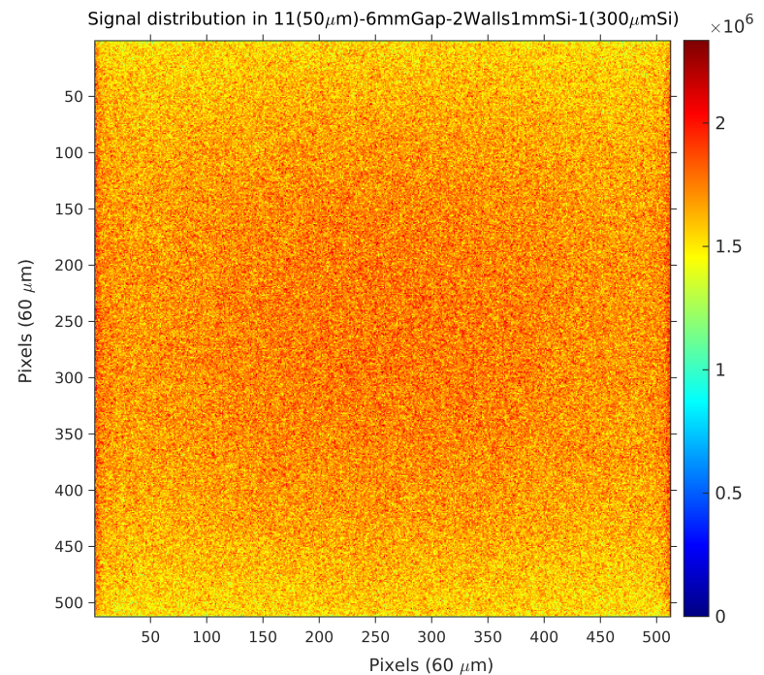
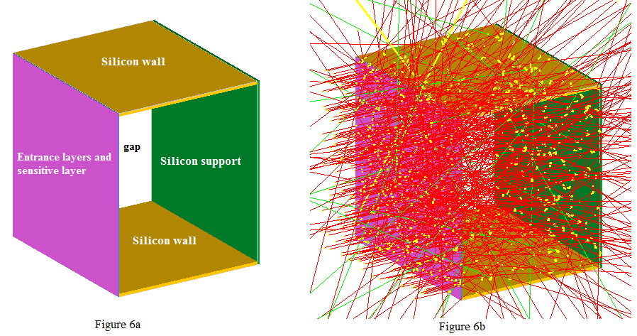
Detector Optimization: Vacuum Gap
Introducing a gap allows to direct the scattered electrons away from the sensitive layer
Substantial improvement in the detector performance.

Slide 11
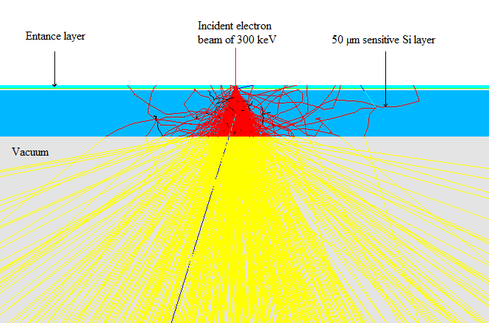
Simulation of the tracks of 500 electrons of 300 keV in the detector layers
20 mm vacuum gap
Black tracks label backscattered and secondary electrons emitted from the support layer.
Vacuum gap between sensitive silicon area and Si support

Slide 12
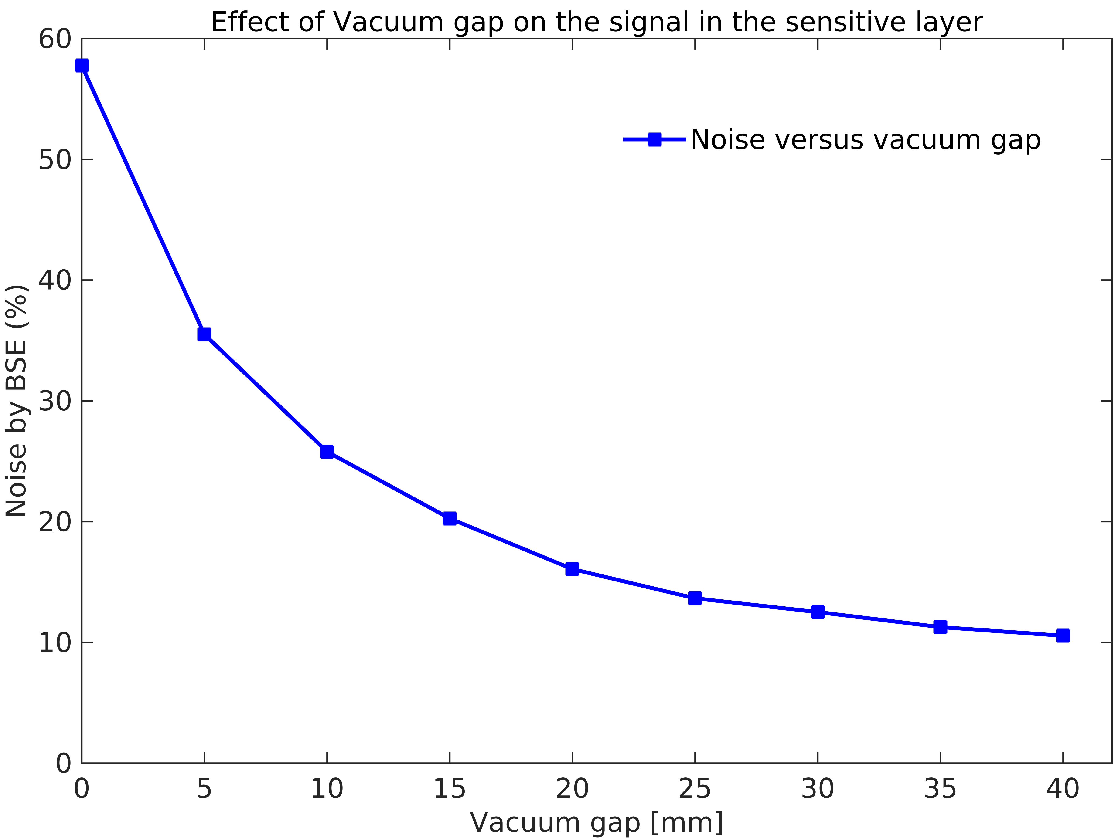
16% noise at 20 mm gap

Slide 13
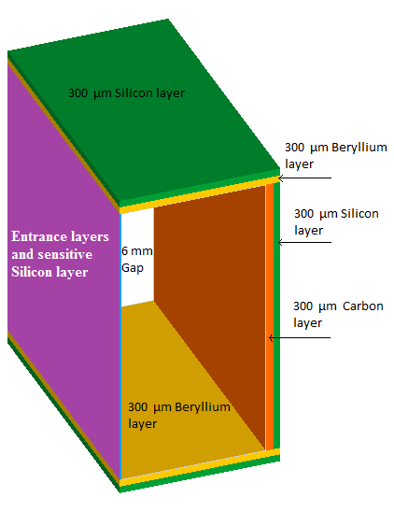
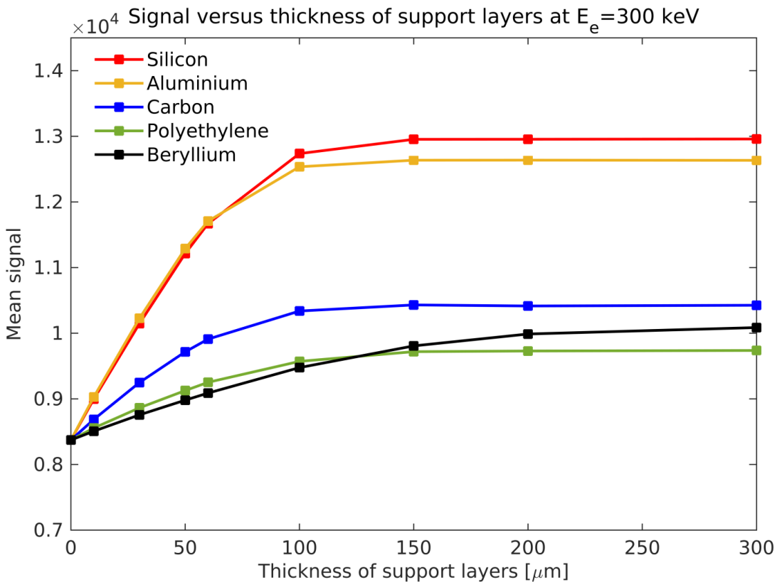
Coating the Detector Geometry with Low Z Material
20 mm vacuum gap + extra cavity : Detector stabitiy

Slide 14
Cross Section of Almost Final Detector Geometry
Entrance layers
50 µm sensitive Si layer
2.5 mm
900 µm Si
450 µm
2.02 mm
60 µm
500 µm
340 µm
140 µm (600 µm)
20 mm gap
200 µm Carbon layer
4.02 mm Si
2.5 mm Si
Extra Cavity (15 mm)
4.02 mm Si
2.5 mm Si
3 mm Si
Notes:
140 µm insensitive layer must be optimized

Slide 15
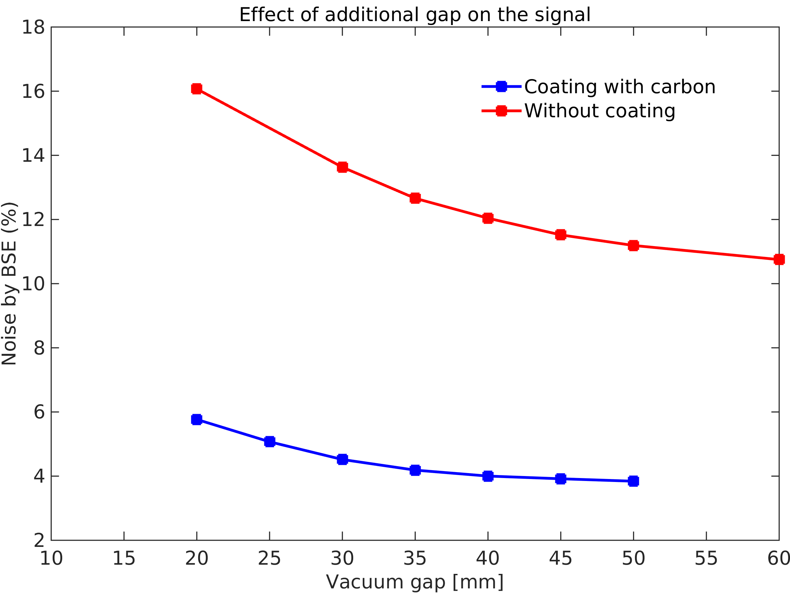
≃13 %
≃4.2 %
Without gap and without coating: ≃ 58 % noise caused by BSE
With vacuum gap and carbon coating: only ≃ 4.2 % noise

Slide 16
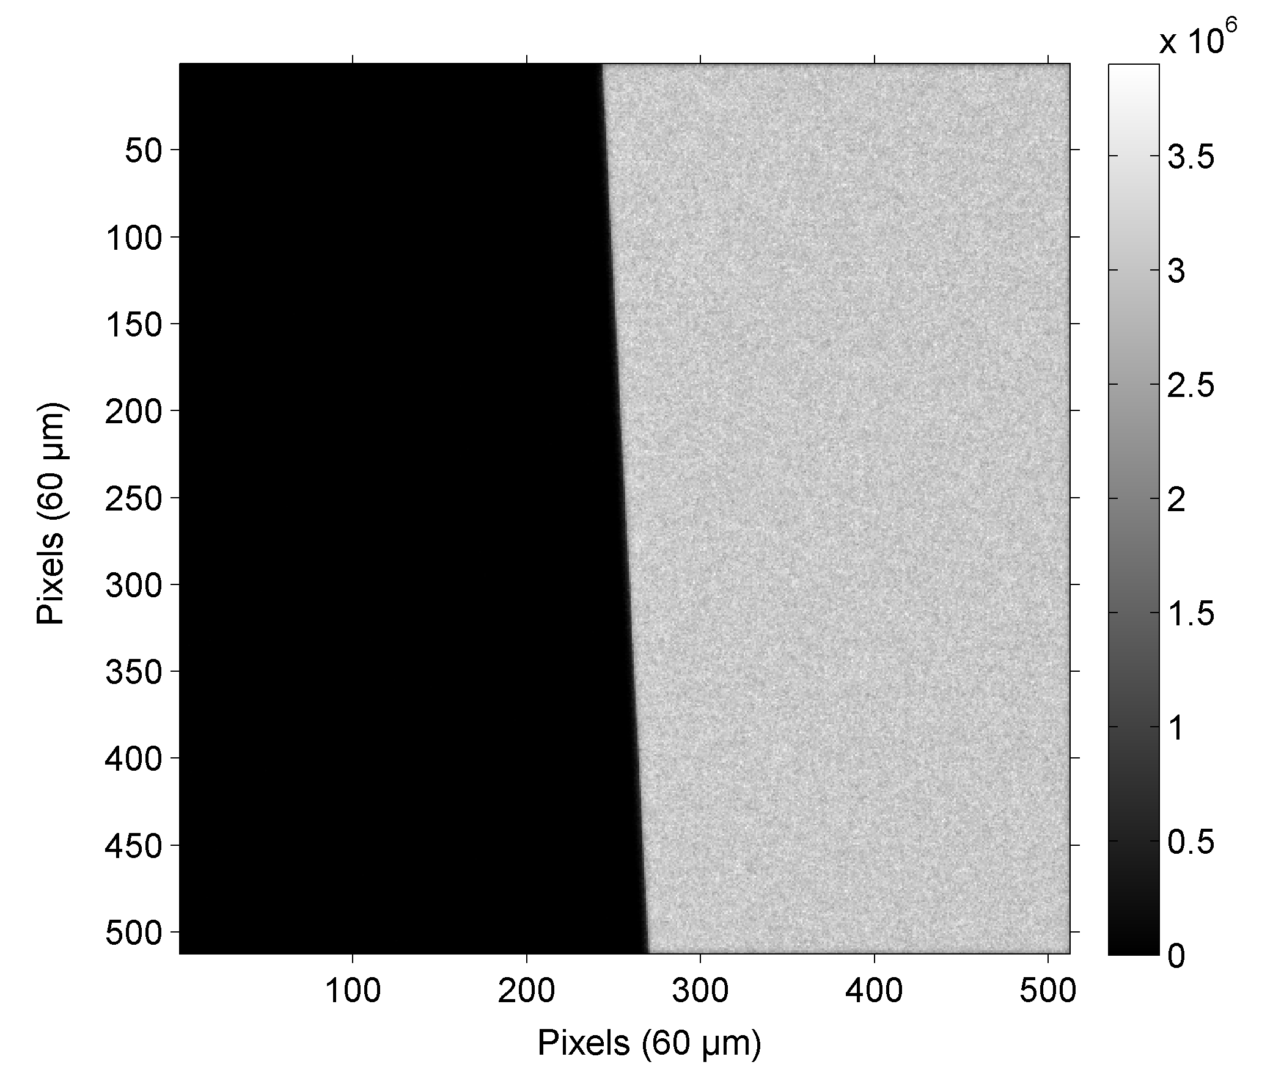
Spatial Resolution: MTF Calculation
Modulation Transfer Function (MTF) measures how well a detector is able to transfer signals of various frequencies from the input to the output.
1 lp/mm
3 lp/mm
10 lp/mm
Object A
Object B
Object C
Input Signal: S_{in}
Detector
Output Signal: S_{out}
1 lp/mm
3 lp/mm
10 lp/mm
Slanted edge method is used to calculate the MTF
Object A
MTF=90 %
Object B
MTF=50 %
Object C
MTF=0 %

Slide 17
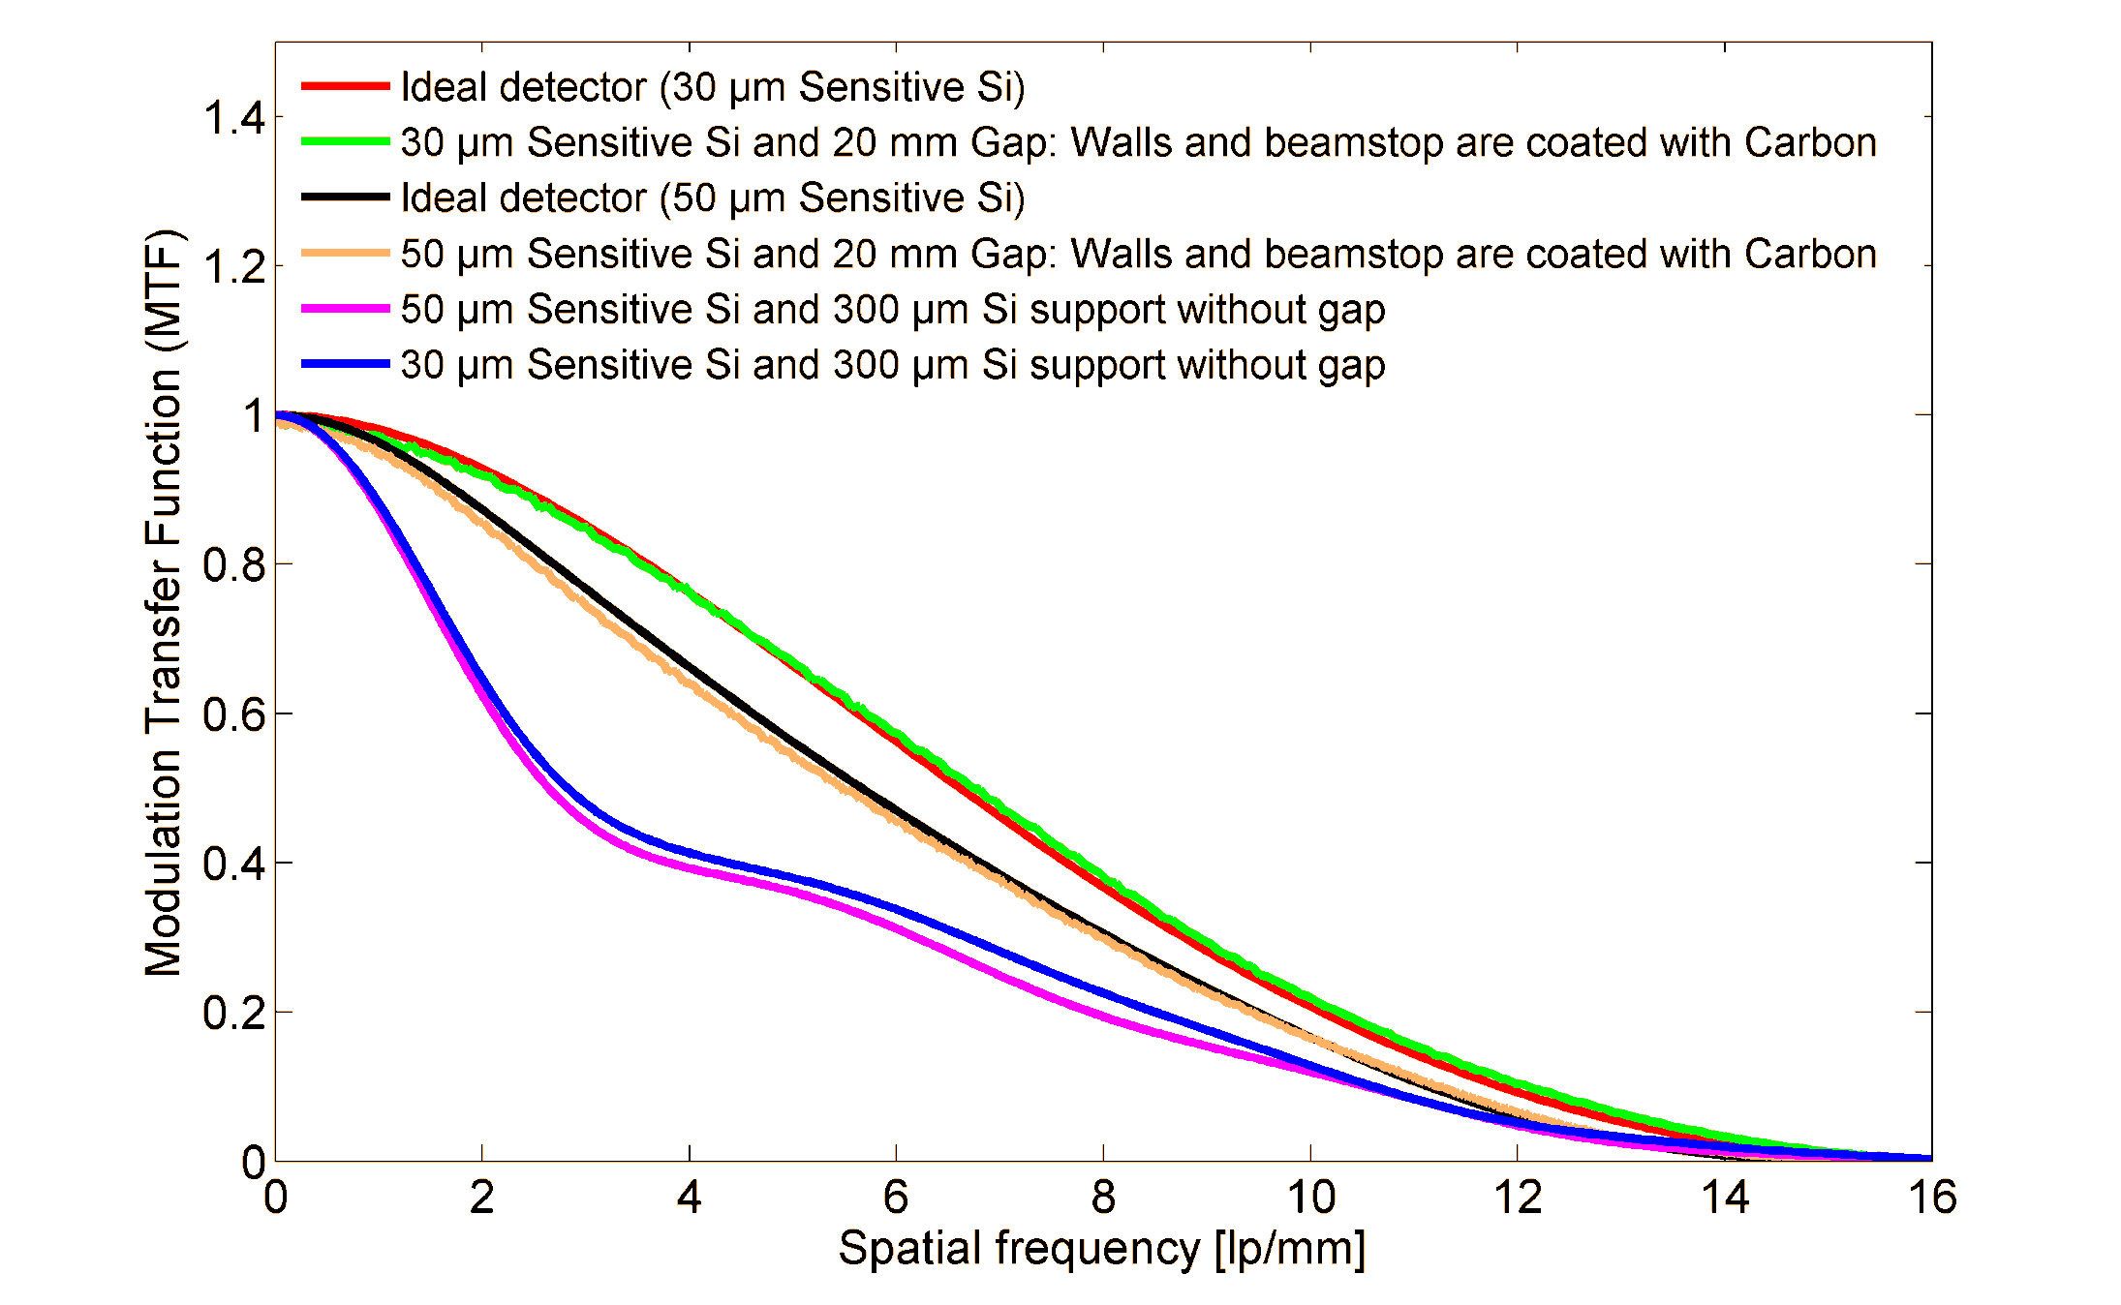

Slide 18
Example: Imaging of gold and carbon rings (2 line pairs per mm (2lp/mm)
Electron source
Width=20.8 nm
Thickness= 2 µm
SF=2lp/mm
FOD
Object
Magnification:
M=FDD/FOD
Resolution in TEM:
R=pixel size/M
For M=12000 and FOD=20 µm
FDD=240 mm
FDD
Gold rings
20.8 nm
2 µm
Detector
Cross sectional view
of gold rings

Slide 19
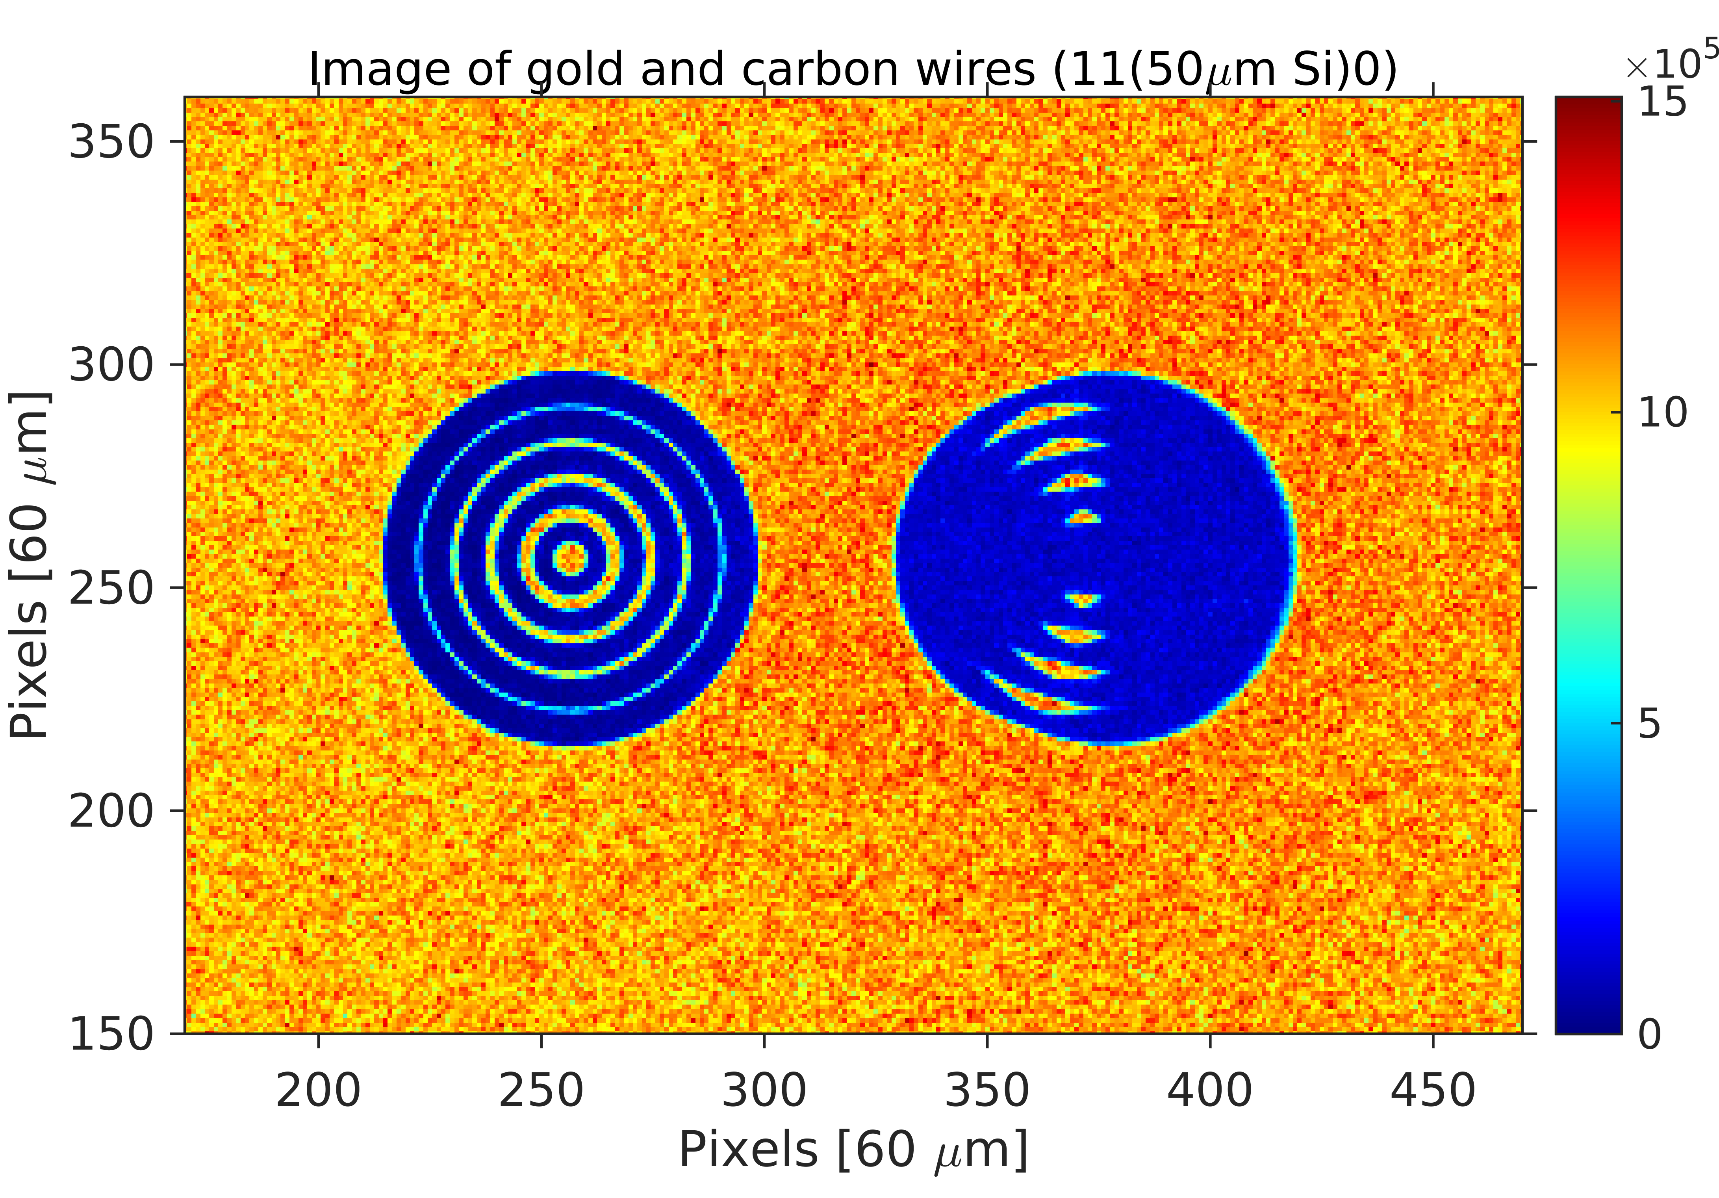
Gold
Carbon
Less electrons reaching the detector

Slide 20
Gold
Carbon
More electrons reaching the detector

Slide 21
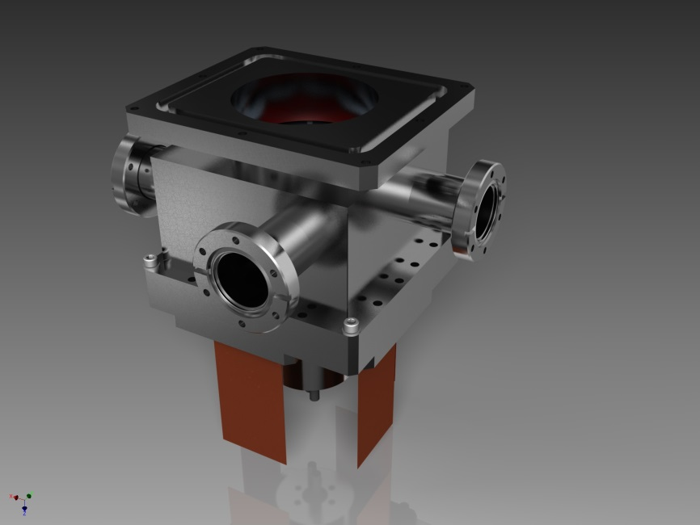
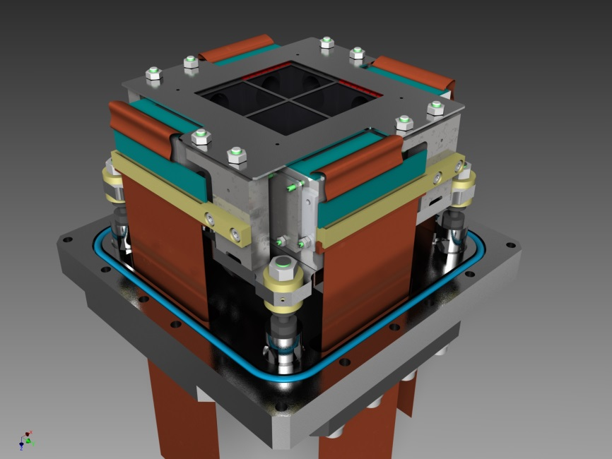
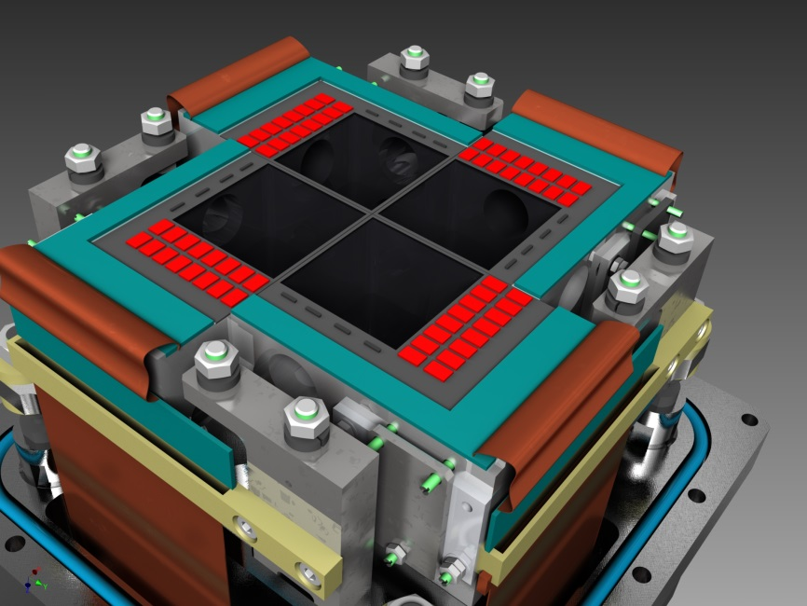
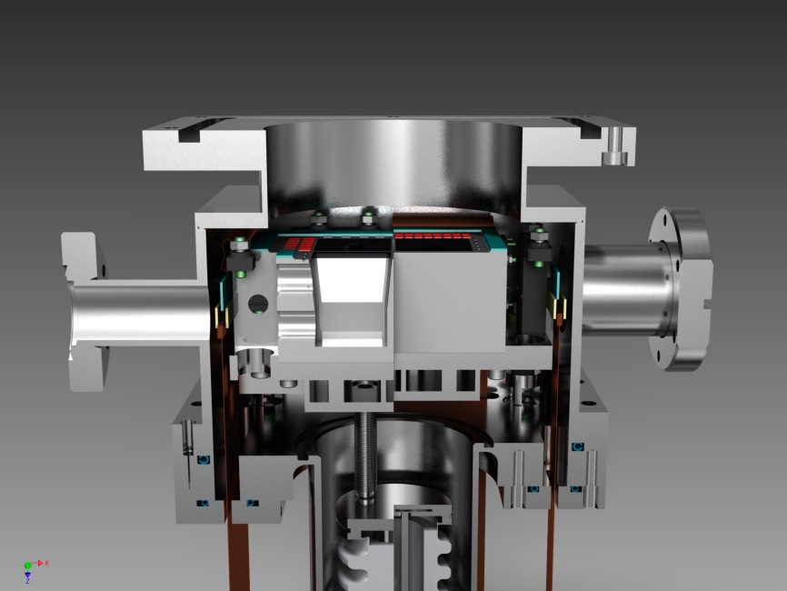
Mechanical Design of Detector
shielding
150 mm
PCB inter-
connects
Wide and short flex leeds
170 mm
Cooling plate
very compact design
e-
Poly-Si block
Cavity
Colling
channels
Cryo liquid cooling > -40°C
CAD design (Djordje Gitaric)

Slide 22
EDET Team: Acknowlegements
HLL ► Ladislaw Andricek ● Martin Hensel ● Christian Koffmane ● Jelena Ninkovic ● Gerhard Schaller ● Martina Schnecke ● Florian Schopper ● Andreas Wassatsch ● Christian Zirr
KIT ► Ivan Peric
USI ► Klaus Gärtner
MPSD ► Ibrahym Dourki ● Sascha Epp ● R. J. Dwayne Miller ● Fabian Westermeier
● Djordje Gitaric

Slide 23
Summary
Detailed detector simulation studies were perfomed.
The unwanted signal generated by backscatering in the sensitive
layer is reduced by a factor of 13.
A new detector design has been developed
The detailed engineering design has just started

Slide 24
Thank you for your attention

