Slide 1
DePFET Development for the ATHENA Wide Field Imager
P. Lechner, R. Lehmann, J. Ninkovic,
R. Richter, G. Schaller, J. Treis
MPG Halbleiterlabor
A. Bähr, N. Meidinger, J. Müller-Seidlitz,
W. Treberspurg
MPI für extraterrestrische Physik
20th International Workshop on DEPFET Detectors and Applications, Kloster Seeon, 12.05.2016

Slide 2
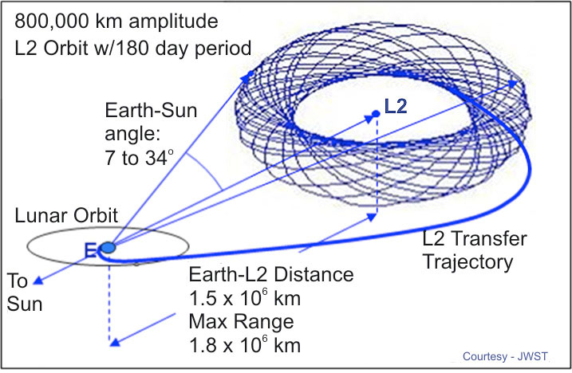
ATHENA Mission (Advanced Telescope for High ENergy Astrophysics)
ESA mission
next large X-ray observatory
ESA's Cosmic Vision 2015–25 plan
2nd of three L-class missions
science targets
theme 'The Hot & Energetic Universe'
formation of large scale structures
evolution of black holes
scenario
launch ~ 2028
Ariane 5 carrier
halo orbit around Lagrange point L2
design life time 5 y (+5 y)
300 observations per year
status
phase A (feasibilty study)
ATHENA spacecraft
artist's impression, ESA

Slide 3
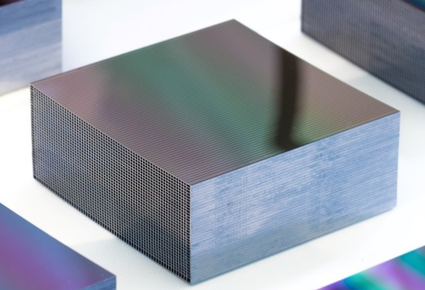
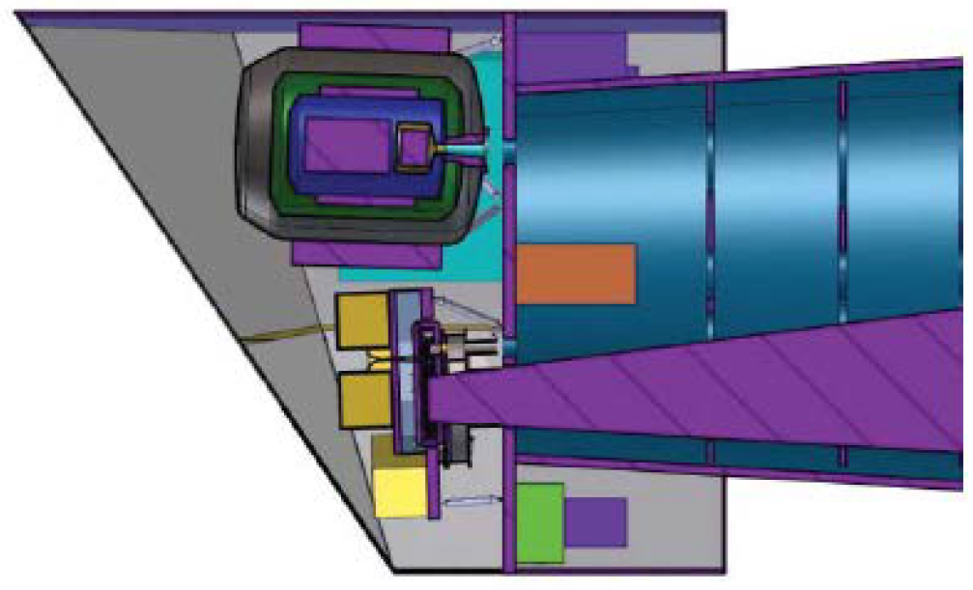
Spacecraft
optics module
Wolter-I Si pore optics
effective area 2 m² @ 1 keV
field of view 40 arcmin
angular resolution 5 arcsec HEW
focal length 12 m
instrument module
moveable platform
X-ray Integral Field Unit (X-IFU)
cryogenic transition edge sensor
highest resolution (2.5 eV @ 6 keV)
field of view 5 arcmin
pixels 3840 x (250 µm ◻)
energy range 0.3 … 10 keV
temperature < 100 mK
Wide Field Imager (WFI)
X-IFU
WFI

Slide 4
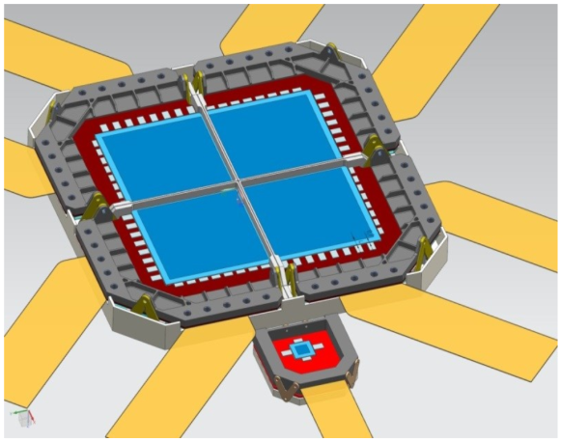
ATHENA Wide Field Imager
X-ray imaging spectrometer with spectral, position and time resolution
science drivers
specifications
WFI parameters
point source
sensitivity
angular resolution
≤ 5 arcsec
< 0.3 mm
pixel size
130 µm □
combination of
large-area detector
high-rate detector
survey power
field of view
≥ 40 arcmin
≥ 14 cm Ø
pile-up limit
format
1024 x 1024 pixels
14 x 14 cm²
row / frame time
≤ 10 µsec / 5 msec
line spectroscopy
energy resolution
150 keV @ 6 keV
low electronic noise
≤ 10 el. ENC
quantum
efficiency
energy range
0.1 … 15 keV
thin entrance window
thickness 450 µm
light-curve of bright
point sources
transients
rate capability (1 Crab*)
throughput > 90 %
pile-up < 1 %
time resolution
position out of focus
~ 35 mm
4 mm PSF
frame time
≤ 80 µsec
* 1 Crab ≈ 10⁵ cps

Slide 5
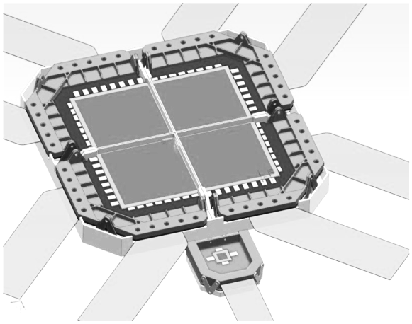
Large Area Detector

Slide 6
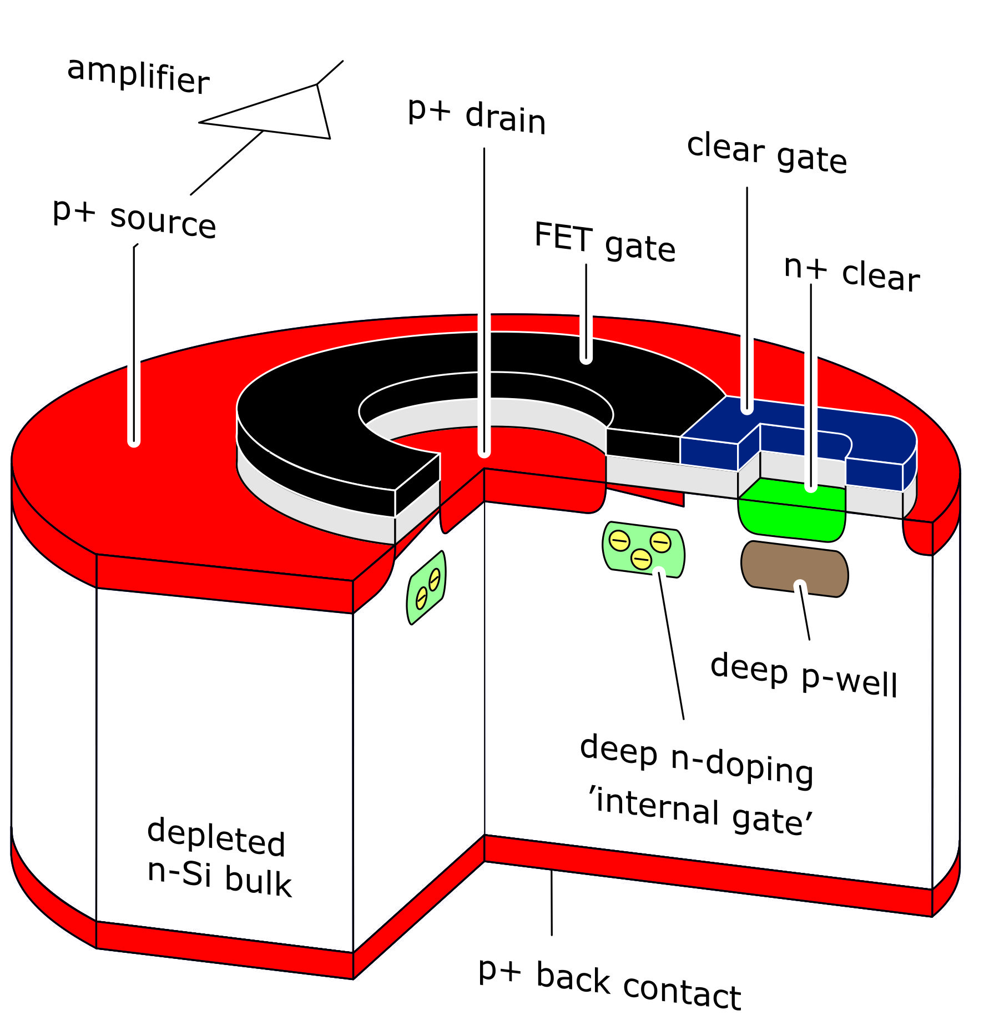
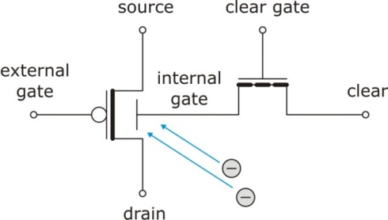
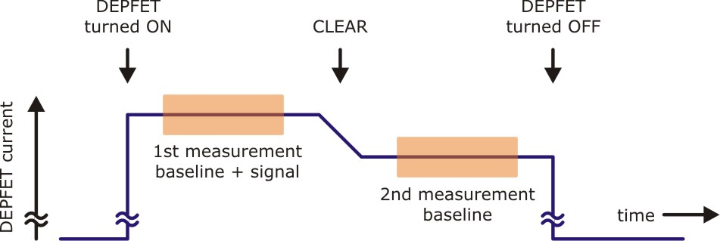
DePFET
Depleted P-channel
Field Effect Transistor
Depleted P-channel Field Effect Transistor
principle
p-FET on depleted n-bulk
signal charge collected in potential minimum below FET channel
transistor current modulation (~ 300 pA/el.)
unit cell of an Active Pixel Sensor
X-ray imaging spectroscopy
combined function of sensor & amplifier
low capacitance (20 fF) and noise
signal = full – empty internal gate
charge storage capability
non-destructive readout
backside illuminated, fully depleted
DePFET equivalent circuit
DePFET readout sequence

Slide 7
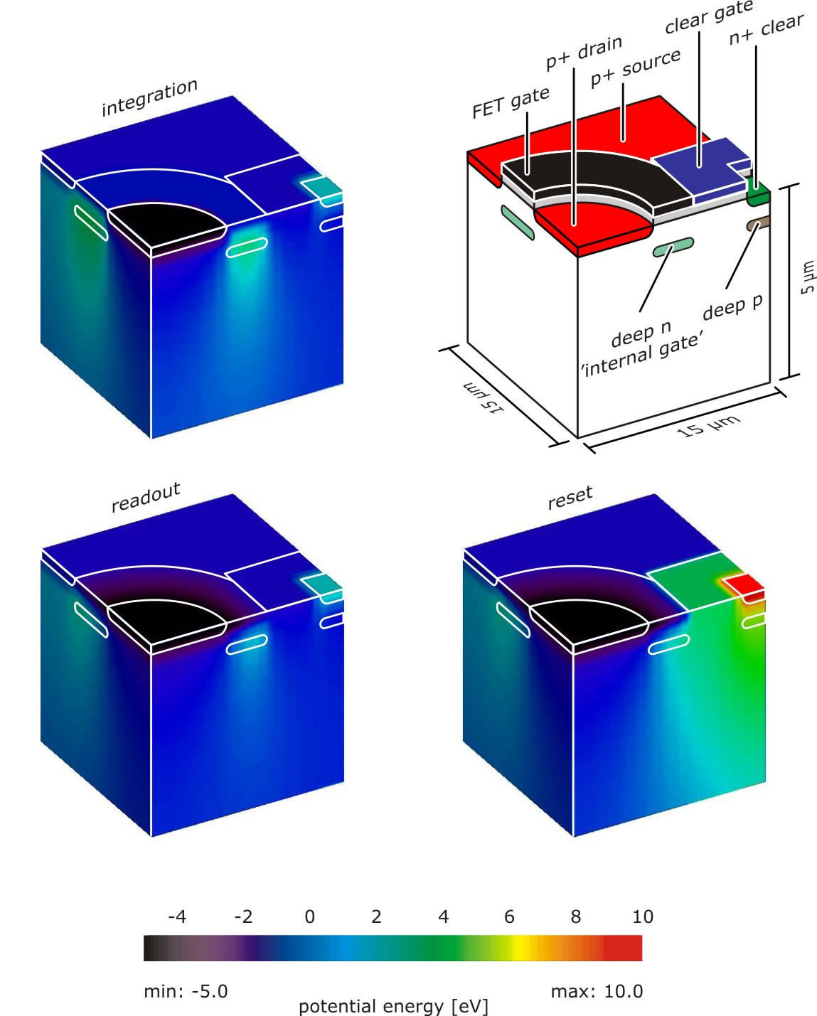
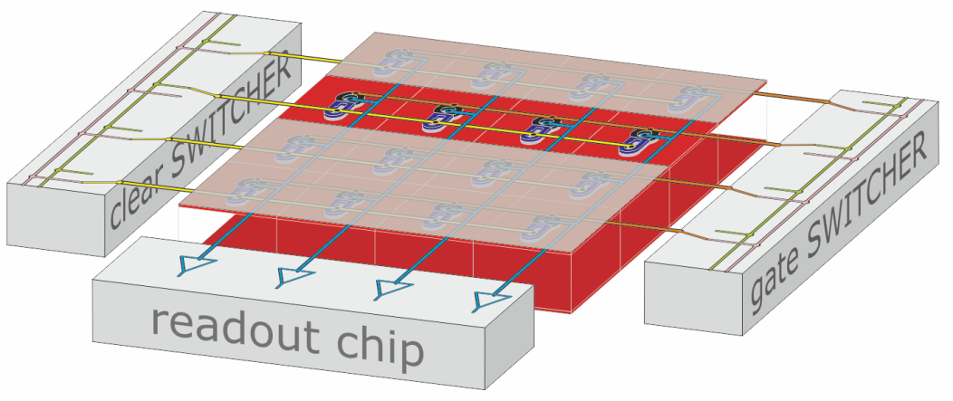
DePFET
Depleted P-channel
Field Effect Transistor
Depleted P-channel Field Effect Transistor
3D device simulation (POSEIDON)
integration  DePFET current off
readout  DePFET current on
reset  clear structure active
matrix organisation
common bulk & back contact
 thin homogeneous entrance window
 fill factor 100 %
row connection of gate, clear, cleargate
column connection of r/o nodes (drain/source)
 individually addressable pixels
 windowing option
rolling shutter operation
one active row
all other pixels turned off
 minimum power consumption
column parallel processing

Slide 8
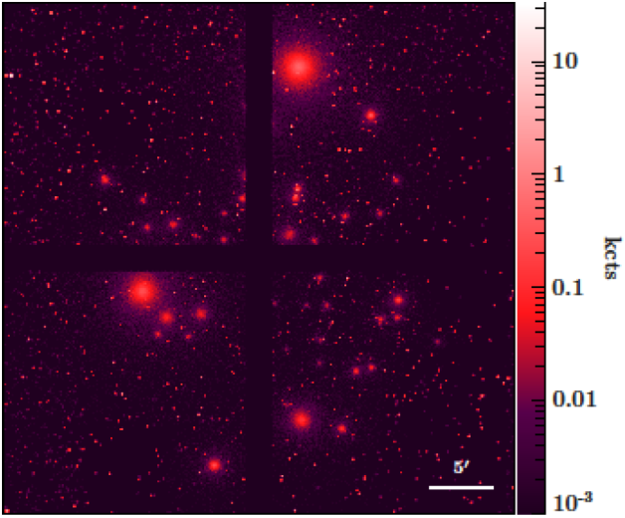
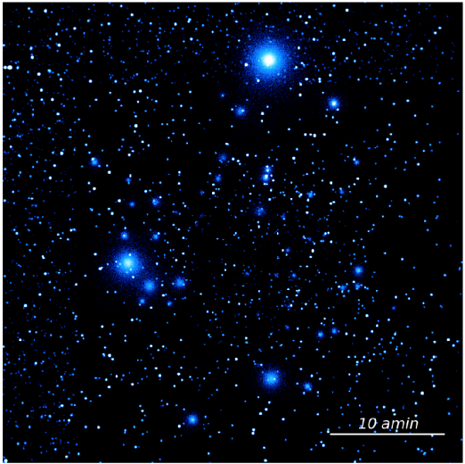
Focal Plane
4 independent & identical quadrants
format 4 x 512 x 512
pixel size 130 µm ◻
sensitive area 4 x (6.7 cm)²
two-side buttable DePFET-APS
front-end electronics
new SWITCHER-A (3 ports/channel)
VERITAS readout ASIC
thermal decoupling
DePFET @ -60 … -80 °C
front-end @ -20 °C
support structure  ~ 7 mm insensitive gap
observation mode
gap compensation
Lissajous dithering pattern
5 arcmin amplitude
simulation by MPE

Slide 9
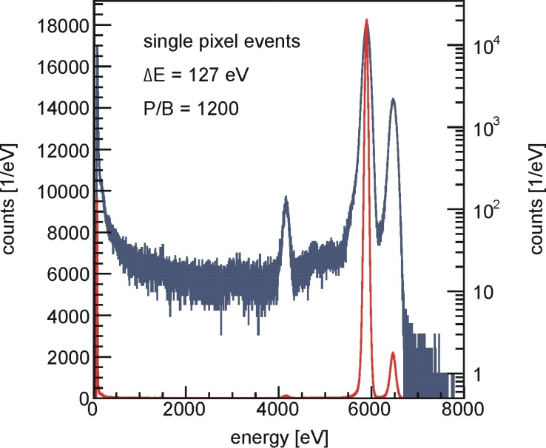
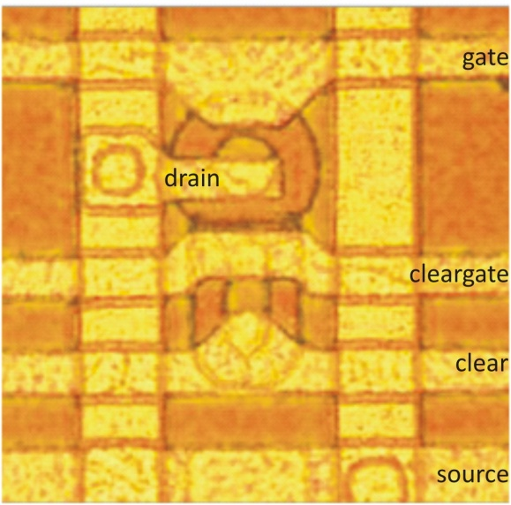
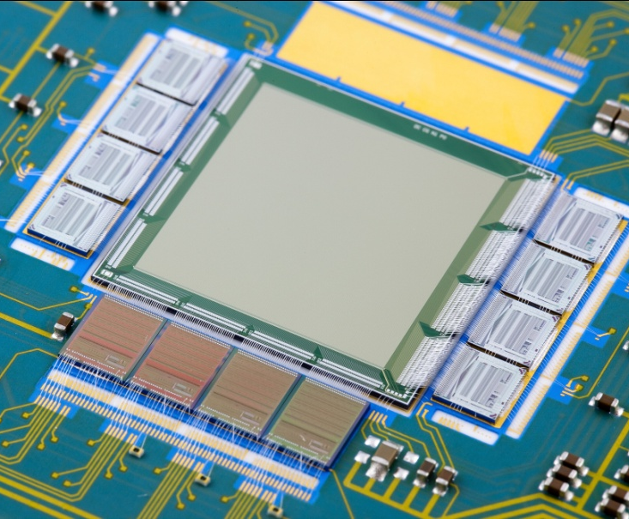
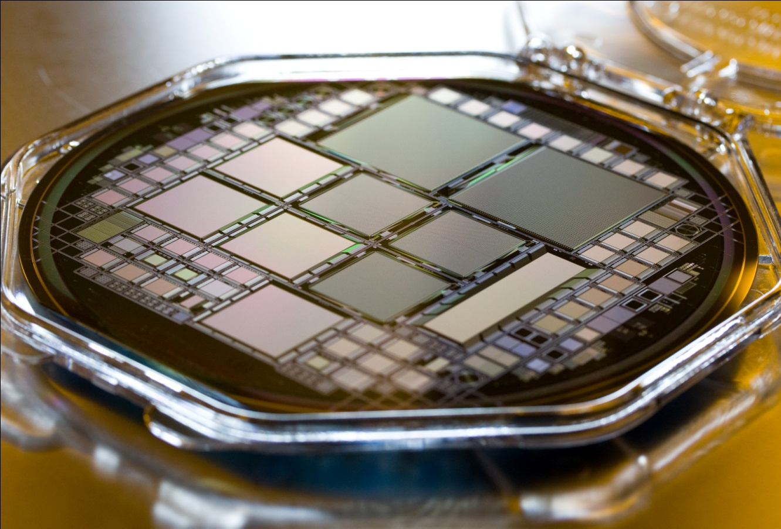
XEUS & IXO Wide Field Imager Prototypes
Depleted P-channel
Field Effect Transistor
prototype test
format 256 x 256 pixels
area 1.92 x 1.92 cm²
pixel 75 µm 
readout 6 µsec / row
1.5 msec /frame
temp -5 °C (!)
resolution 127 eV (singles)
140 eV (all)
σ (gain, noise, offset) ~ %
shadow image,
measurement by
Aline Meuris

Slide 10
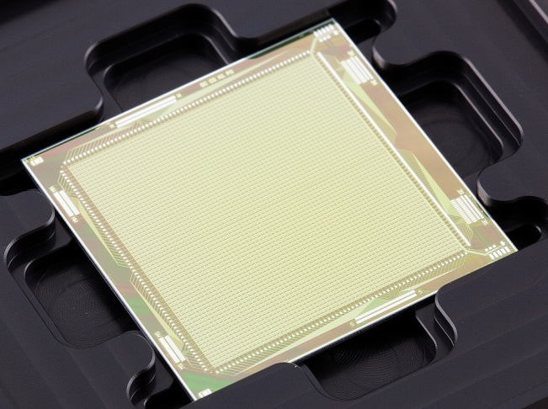
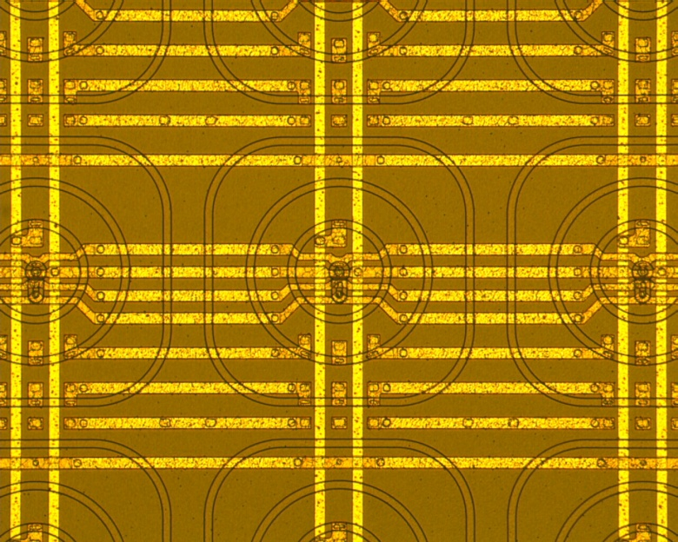
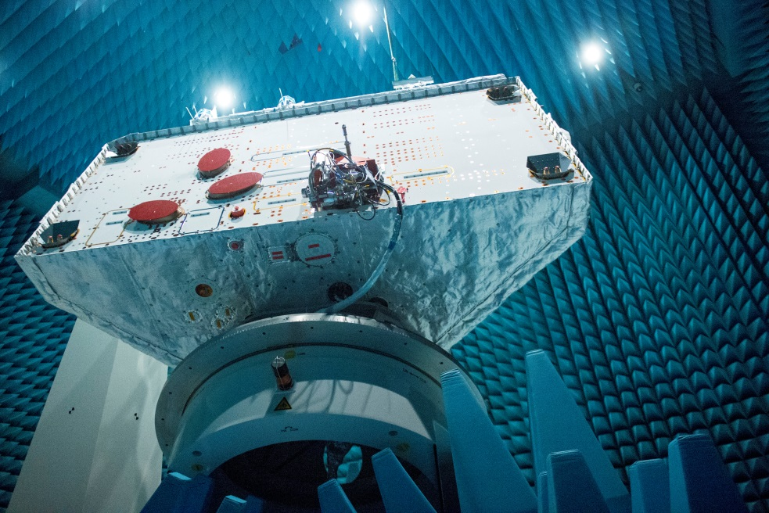
BepiColombo MIXS
Depleted P-channel
Field Effect Transistor
Mercury Imaging X-ray Spectrometer
Macro Pixel Sensor
DePFET + Si Drift Detector
area 1.92 x 1.92 cm²
pixel 300 µm 
split frame readout
source follower (ASTEROID)
2 instruments:
MIXS-C (Collimator)
 wide field (5°)
MIXS-T (Telescope)
 precision mapping < 500 m
status
fully space qualified
spacecraft integration
jan17 launch
jan24 Mercury orbit
mission lifetime 1 (+ 1) year
1.92 cm
300 µm
MIXS sensor die
microphotograph of pixel structure
planetary orbiter in electromagnetic test facility @ ESTEC

Slide 11
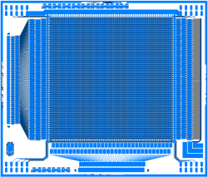
1st Prototype Production
2 objectives
operation of large-scale pixel detectors
 formats representative for flight devices
 homogeneity over large area
 effect of long signal and supply lines
DePFET evolution
64 x 64 test vehicle
 variations in layout
 variations in technology
 variations in readout
full width
512 x 64
quarter
256 x 256
full height
128 x 512
prototype
64 x 64

Slide 12
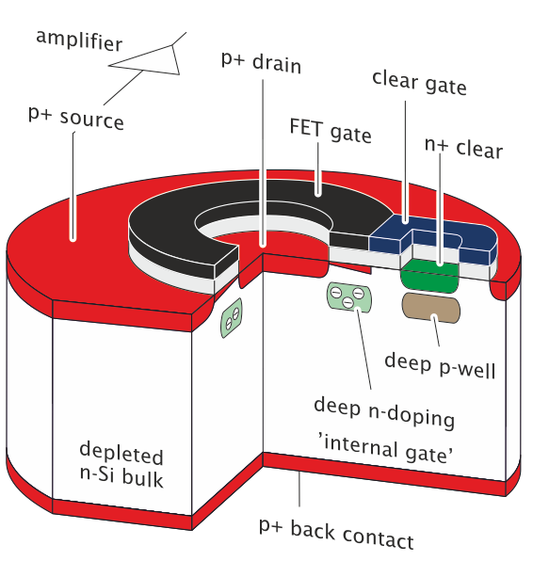
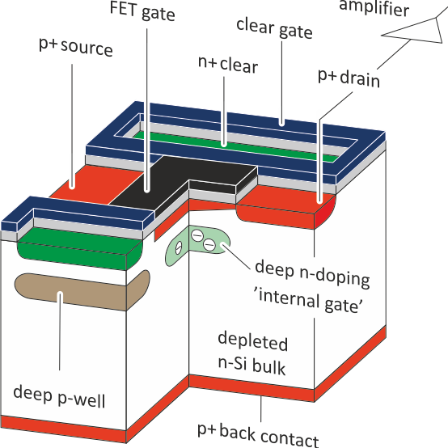
Layout Variation
gate shape
circular, closed
 standard spectroscopy device so far
 compact design, minimum polySi1/2 overlap
 gate geometry not scalable
 long clear time
50/50 share of both versions
many flavours with modified details, based on 64 x 64 format
linear, open
 small gate dimensions possible
 efficient double-sided clear
 less experience in spectroscopy
 complex on-chip wiring

Slide 13
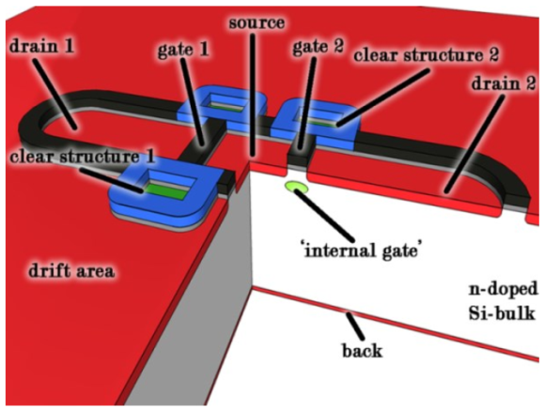
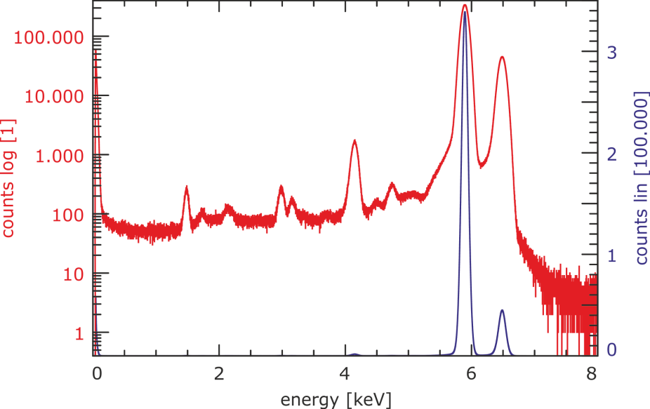
Layout Variation
DePFET with internal storage (InfiniPix)
design similarity to linear gate DePFET
measured performance
32 x 32 prototype matrix
energy resolution (FWHM @ 5.9 keV)
124 eV (single pixel events)
128 eV (all valid patterns)
peak / background ratio
6500
A. Bähr
measurement by
J. Müller-Seidlitz / MPE

Slide 14
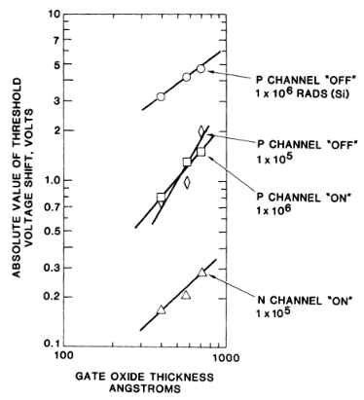
Technology Variation
gate oxide thickness
 heritage, standard so far
XEUS, Simbol-X, IXO, BepiColombo MIXS
 amplification
according to basic DePFET model
confirmed by experiment
50/50 share of wafers
 convenient process technology
all implantations self-aligned w.r.t. polySi
 freedom in choice of operation parameters
 radiation hardness
thick gate oxide
thin gate oxide ~ 50 %
$$g_{q, sat}= \frac{∂I_{D}}{∂Q_{sig}} ≅ \sqrt{\frac{−2 μ_{p} I_{D, sat}}{W L^{3 }\acute{C_{ox}}}}$$
e.g. Nordstrom & Gibbon, 1981

Slide 15
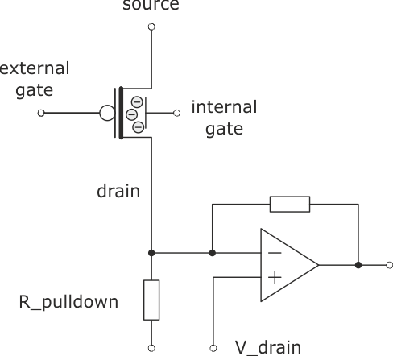
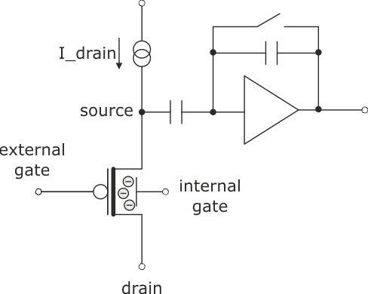
Readout Modes
VERITAS readout ASIC  2 input stages
source follower
standard so far
charging of line stray capacitance
 long time constants (~ µsec),
especially for large area devices
drain current readout
commmon operation voltage
 requires homogeneity of DePFETs
favorised, but insufficient experience
 50/50 split of 1st production
C_stray

Slide 16
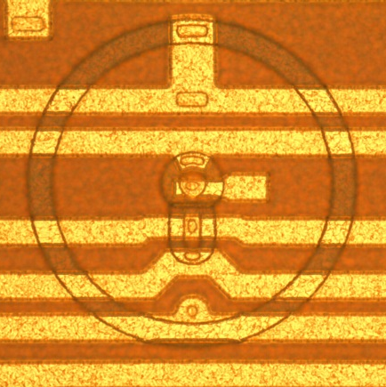
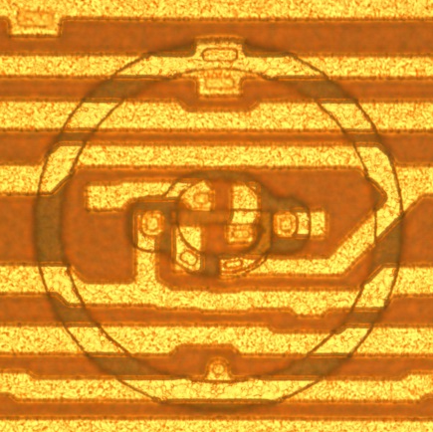
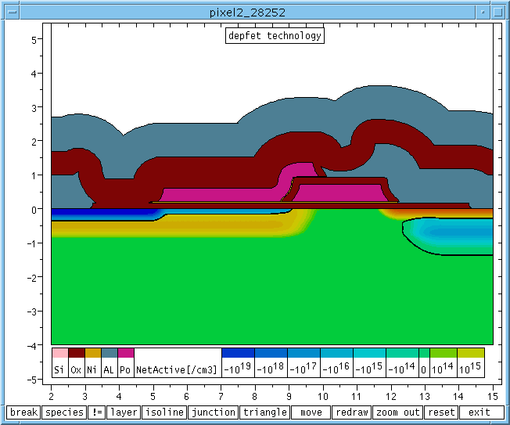
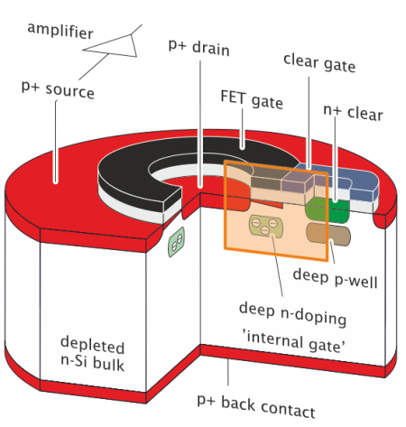
1st Production Status
production start may15
today
to do
2nd metal layer top side
metal layers back side
passivation
wafer level test
dicing
estimated time of arrival sep16
pre-flight production mid17
 final format 512 x 512
microphotographs
of ATHENA DePFET
pixels
round gate
linear gate

Slide 17
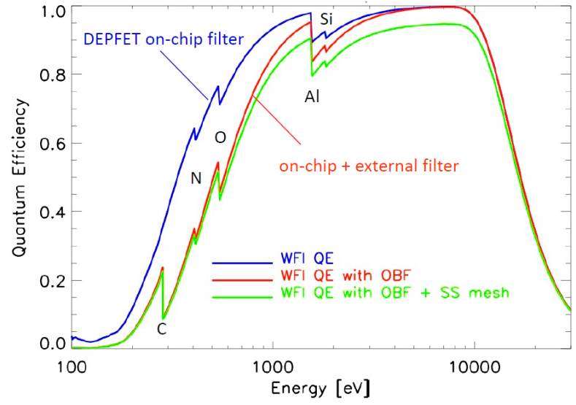
Entrance Window
tradeoff
quantum efficiency
vs.
optical & UV stray light
transmittance ≤ 1.e-6 @ 100 nm Al

Slide 18
High Rate Detector

Slide 19
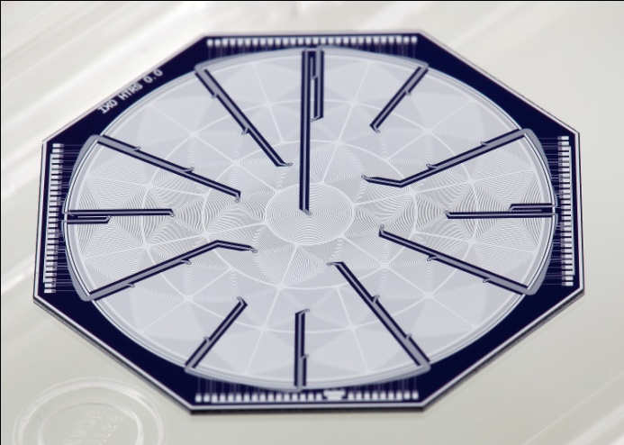
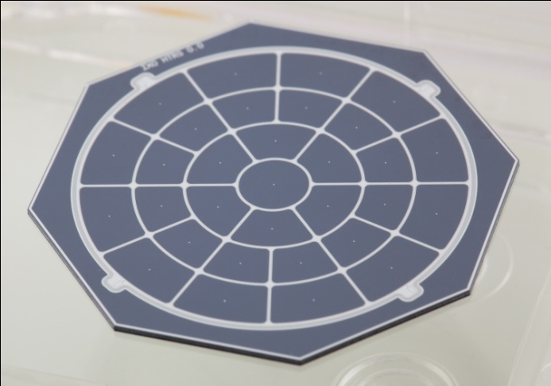
Option1: IXO HTRS
High Time Resolution Spectrometer
multi-channel Si Drift Detector
format 31 cells
overall area 4.5 cm², 24 mm Ø
out-of-focus distance 11.3 cm
predicted performance
time resolution 10 µsec
energy resolution 150 eV (BoL)
300 eV (EoL)
count rate capability > 10 Crab (170 kcts/sec)
deadtime & pile-up < 2 % @ 1 Crab
system development
self-triggering analog readout ASIC SFERA
(Politecnico di Milano & XGLab)
alternative digital filtering system
(CESR Toulouse)
detector board
DAQ system
mechanical/thermal concept
readout side
radiation entrance
window side

Slide 20
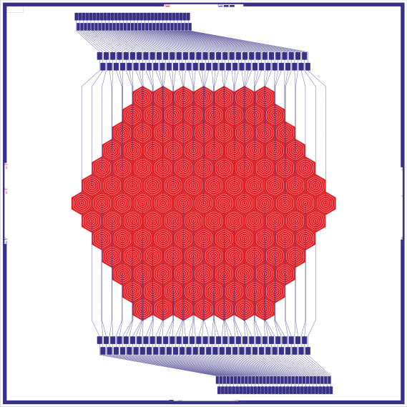
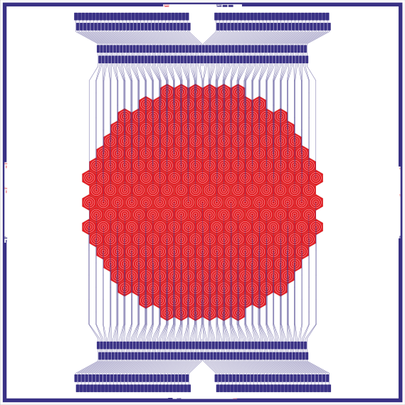
Option2: Full Frame Readout APS
full frame readout
1 amplifier channel / pixel
large hexagonal pixels, e.g.
800 µm / 127 cells
560 µm / 253 cells
two/four VERITAS readout ASICs
WFI electronics box
no SWITCHER
DePFET with internal storage
2 DePFETs / pixel
one collecting charge / other in readout mode
elimination of 'out-of-time' events
127
cells
253
cells
A. Bähr

Slide 21
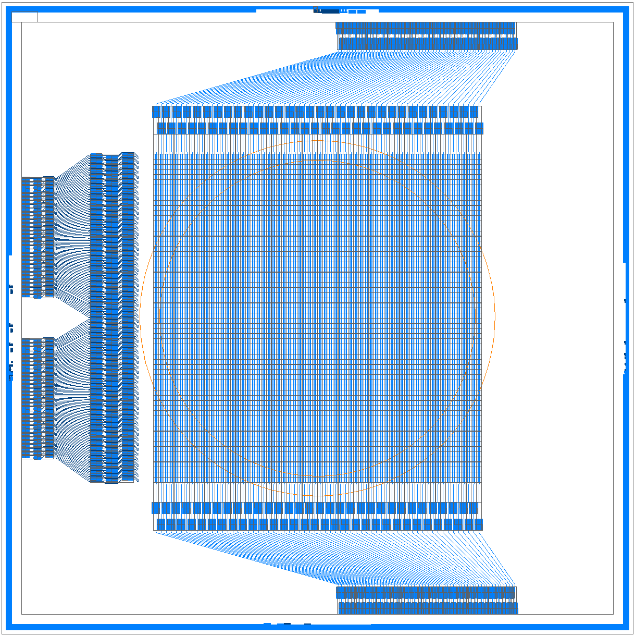
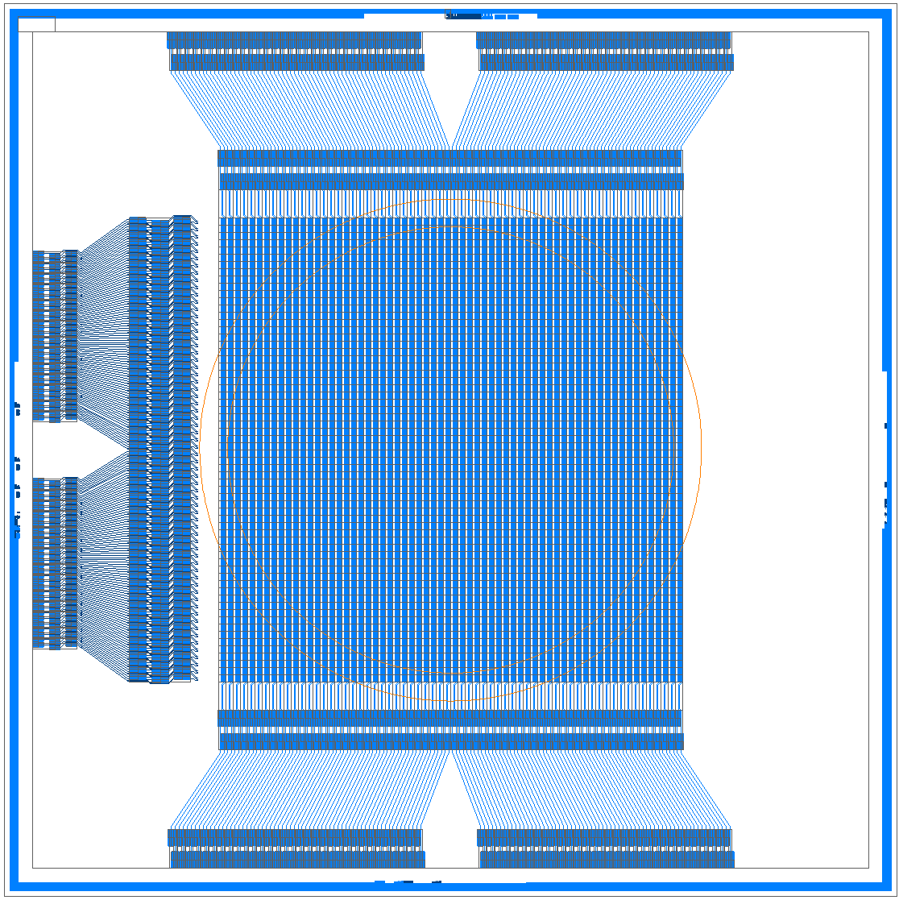
Option3: Split Frame Readout APS
'small large-area' WFI detector
format 64 x 64
pixel size 130 µm
split frame readout
 two 64 x 32 'hemispheres'
 two (half) SWITCHER control ASICs
 two readout ASICs
 frame time 32 x 2.5 µsec = 80 µsec
option:two-row parallel readout
 additional speed-up
 four readout ASICs
no specific production for high-rate detector
maximum of synergy with large WFI
64 x 64 APS
split frame readout
64 x 64 APS
two-row parallel
split frame readout

Slide 22
Summary
large-area WFI detector
samples of 1st production available in summer 16
large-scale devices
variations in layout, technology & readout mode
high-rate WFI detector
no specific activity
in parallel with large detector development

