Slide 1
DHH at DESY Test Beam 2016
Igor Konorov
TUM Physics Department E18
19-th DEPFET workshop
May 11-15 2016
Kloster Seeon
Overview:
DHH system overview
DHE/DHC functionality
Problems and fixes
Plans

Slide 2
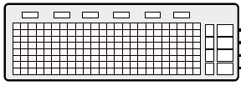
Simplified DHH system at DESY
Trigger
127MHz
FTSW
EPICS
DHE
ONSEN
DAQ
DHC
DHE
Bonn
DAQ
Complex system
Requires multiple tests for verification and debugging
We provide additional features for tests

Slide 3
ONSEN standalone tests
Trigger
127MHz
FTSW
EPICS
PC
DHE
ONSEN
DAQ
DHC
DHE
Bonn
DAQ
For every trigger DHC sends UDP packet with HLT information for ONSEN, standard firmware feature
DHC generates predefined hit pattern, special firmware

Slide 4
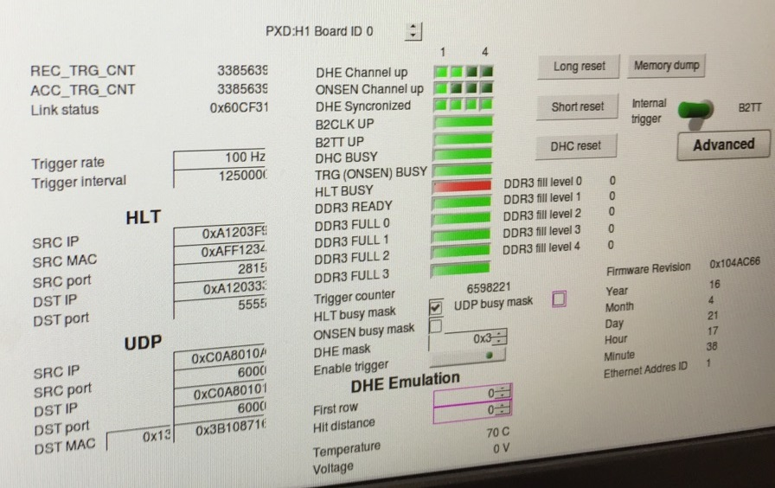
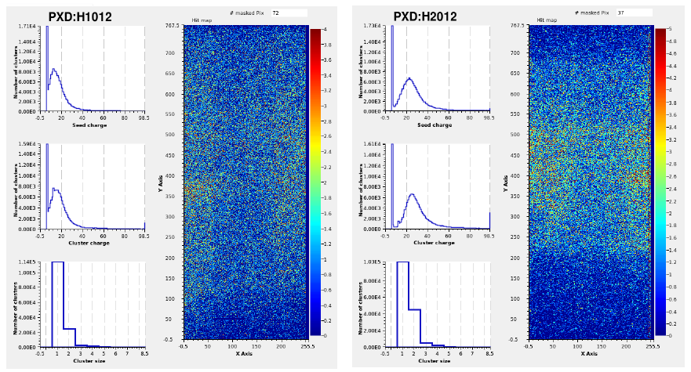
DHH control and monitoring
Trigger
127MHz
FTSW
EPICS
DHE
ONSEN
DAQ
DHC
DHE
Bonn
DAQ
Bonn DAQ - very important tool
Pedestal determination in local run mode
DQM during data taking
Generate log file of data consistency check

Slide 5
DHE data flow
No DDR memory
Simple event definition
DHP data frame defines start of event,
Timeout defines end of event
DHE data flow diagram
MX
DHE
DHP 0
FIFO
DHP 1
FIFO
Event
Builder
Aurora
DHC
DHP2
FIFO
DHP 3
FIFO

Slide 6
DHC data flow
DHC data flow diagram
MX
DHC
DHE 0
FIFO
256 MB
Trigger #
DHE 1
FIFO
256 MB
DHE2
FIFO
256 MB
Event
Builder
Aurora
ONSEN
DHE 3
FIFO
256 MB
FIFO
256 MB
UDP
Bonn DAQ
DHE 4
FIFO
256 MB
DHC event builder actions:
Trigger initiates generation of DHC Start Of Event frame
Reads DHE0 FIFO until DHE End Of Event frame
Reads DHE1 FIFO until DHE End Of Event frame
Generates DHC End Of Event frame

Slide 7
Readout stability
Setup was running at 65 MHz and 10m Infiniband cable
IB => DHE0 – DHP links unstable
OB => DHE1 – all 4 DHP links stable
Observed event number mismatch between DHE0 and DHE1 & DHC event numbers. DHE0 event number is always smaller
DHE0 was exchanged by another one
DHE0 - DHP links became more stably
System was running without loosing synchronization
There was no time to measure Bit Error Rate
Preliminary conclusion:
Links instability caused “extra event” in DHE and loss of synchronization at DHC event builder
Why links became more stable after exchanging DHE?

Slide 8
Summary of Observed DHH problems
☹ ☺
No memory dump support for pedestal determination
Limited DHE FPGA memory buffer, DDR buffer was not included in DHE yet
☹ ☺
Problem of handling big events
No FPGA logic to handle unforeseen data rate/event sizes
Limited buffer sizes
☹ ☺
Event number mismatch at DHC event builder
Unstable DHP links cause data errors and/or loss of link
No recovery logic neither in DHE nor in DHC to handle wrong Data Format
Other reasons ? To be investigated
☹
65MHz DHP clock instead of 76 MHz => Asynchronous operation

Slide 9
Observed DHH problems
☹ ☺
Bonn DAQ error logs: timeout error between frames within one event(>5ms)
DHH features multiple data buffers including DDR memory. DDR interface is optimized for bandwidth on expense of bigger latency

Slide 10
Improvement of DHH functionality
DHE: DDR memory for data buffering
Sharing detector data between overlapping events
DHE: DHP data consistency check and recovery logic
DHC: DHE data consistency check and automatic resynchronization
DHE: include programmable pixel remapping
DHE: include clustering algorithms
DHC: internal trigger generator for local runs

Slide 11
Conclusions
System was running stably with some problems
PXD is complex system
Such system requires availability of all components and significant time for debugging. Time was limited.
New diagnostic tools and information being included during system test but more is needed (ex.:event number mismatch)
Data consistency check and automatic resynchronization to be included in all steps of data processing
The DHH worked stably an no principle problems were observed

Slide 12
Instead of summary
DHE and DHC firmware still require a lot of development
We will try to work out a schedule to complete all developments by end of September

Slide 13
Hardware development plans
ATCA carrier card
If display port cable fulfils requirements present the final system layout to TB in June
Evaluation of new optical interfaces including irradiation test - June - July
Production of final ATCA carrier card for end of Septemebr

Slide 14
THANK YOU

