Slide 1
ysterious apping ess
M
Florian Lütticke
On behalf of the test beam crew

Slide 2
Overview
Mapping?
How to solve it

Slide 3
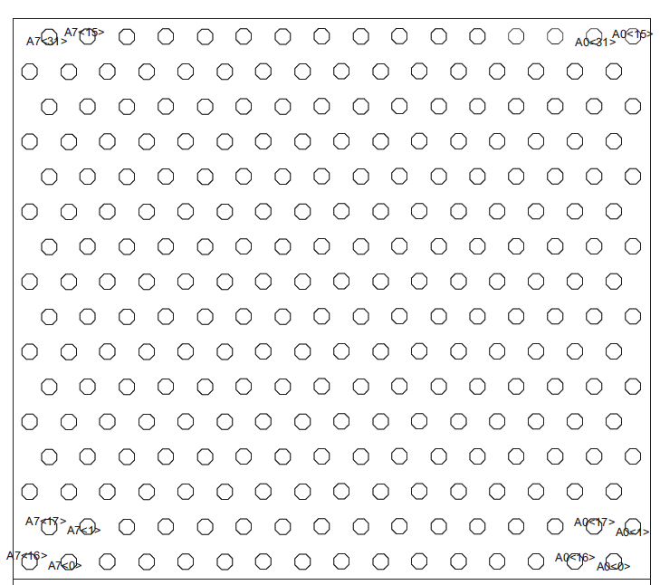
Reason for mapping
DCD has 8 Links with 32 ADCs
Ordered in 16*16 bump bonds
DHP assumes:
Col 0, Row 0 is ADC 0
Col 0, Row 1 is ADC 1
Col 0, Row 2 is ADC 2
Col 0, Row 3 is ADC 3
Col 1, Row 0 is ADC 4
Rows correct for Hybrid 6, DCD 1 & 3 on PXD9
Matrix fan-out assumed footprint of DCD but it is footprint on module! The 16 columns on DCD are swapped (like in Hybrid 6) - > mapping: col =col x-or 0x3C
PXD9 uses 250 of 256 ADCs. Do not connect ADC 250-255. Due to mirroring, now channels 10-15 are unconnected
ADC 255
ADC 15
ADC 14
ADC 10
ADC 2
ADC 1
ADC 0
Notes:
R_d = B -> D tau nu / B -> D l nu
R_d* = B -> D* tau nu / B -> D* l nu (4 sigma unterschied vom SM)

Slide 4
Reason for mapping
PXD9 uses 250 of 256 ADCs. 250 not divisible by 4 – one column is shared by 2 DCDs.
Everything is shifted by two ADCs for DHP and DCD 2
ADC 0 is Col x, Row 2
ADC 1 is Col x, Row 3
ADC 2 is Col x+1, Row 0
ADC 3 is Col x+1, Row 1
DCD does not connect to 64 full columns
Total column is not DHP column + 64* DHP ID (like it previously was)
We need to take everything into account:
Differences because of missing channels
The “easy” Hybrid 6 like mapping
Current solution: Software LUT
ADC 255
ADC 15
ADC 14
ADC 10
ADC 2
ADC 1
ADC 0
Notes:
R_d = B -> D tau nu / B -> D l nu
R_d* = B -> D* tau nu / B -> D* l nu (4 sigma unterschied vom SM)

Slide 5
DHP Data stream
DHP can address 64 columns and 1024 rows.
Two kind of data words:
Row header (one per double row), if there is a hit. Contains CM (common mode) and upper 9 bit of row
Hit Information (one per hit). Contains Column, value above threshold and lowest bit of row
Notes:
R_d = B -> D tau nu / B -> D l nu
R_d* = B -> D* tau nu / B -> D* l nu (4 sigma unterschied vom SM)

Slide 6
Solutions
Pure Software LUT
Cluster Format
Mapping of DHP data in ONSEN
Full mapping of DHP data in DHE/DHC
Partial mapping of DHP data in DHE/DHC
Discarded Ideas:
Build Matrix with 252 or 256 Columns
Redo Fanout on Matrix (DCD 2 &4: Different unconnected channels)
Mapping in DHPT
Build DCD and DHP with 250 channel
For simplicity, I will only show half a matrix (2 DCDs)
Notes:
R_d = B -> D tau nu / B -> D l nu
R_d* = B -> D* tau nu / B -> D* l nu (4 sigma unterschied vom SM)

Slide 7
Solutions
Pure Software LUT & bigger ROIs
Already implemented
Already worked
ROI size needs to be increased to get date from all gates and DCDs in the ROI
Less Data reduction
Calculate ADC (256*DHP + 4*DHP_Col + DHP_Row%4) and Gate (DHP_Row/4)
Map ADC to Drain line using mapping table
Calculate Row (4*Gate+Drain%4) and Col (Drain/4)
Cluster Format
DHE maps DHP data, sends it out in cluster format.
Very good solution
Original data lost
Cluster Format not implemented yet
Can ONSEN handle cluster format?
What happens to CM? Can ONSEN handle CM frames?
Can Clustering handle row IDs which are jumping? (2,3,0,1,6,7,4,5) instead of (0,1,2,3,4,5,6,7)?
Gate 6
Expanded
Gate 5
ROI
Gate 4
Gate 3
Gate 2
Gate 1
DCD 1
DCD 2
PXD9_IB_OF_inverse_mapping= [ 243, 242, 241, 240, 247, 246, 245, 244, 251, 250, 249, 248, 255, 254, 253, 252, 227, 226, 225, 224, 231, 230, 229, 228, 235, 234, 233, 232, 239, 238, 237, 236, 211, 210, 209, 208, 215, 214, 213, 212, 219, 218, 217, 216, 223, 222, 221, 220, 195, 194, 193, 192, 199, 198, 197, 196, 203, 202, 201, 200, 207, 206, 205, 204, 179, 178, 177, 176, 183, 182, 181, 180, 187, 186, 185, 184, 191, 190, 189, 188, 163, 162, 161, 160, 167, 166, 165, 164, 171, 170, 169, 168, 175, 174, 173, 172, 147, 146, 145, 144, 151, 150, 149, 148, 155, 154, 153, 152, 159, 158, 157, 156, 131, 130, 129, 128, 135, 134, 133, 132, 139, 138, 137, 136, 143, 142, 141, 140, 115, 114, 113, 112, 119, 118, 117, 116, 123, 122, 121, 120, 127, 126, 125, 124, 99, 98, 97, 96, 103, 102, 101, 100, 107, 106, 105, 104, 111, 110, 109, 108, 83, 82, 81, 80, 87, 86, 85, 84, 91, 90, 89, 88, 95, 94, 93, 92, 67, 66, 65, 64, 71, 70, 69, 68, 75, 74, 73, 72, 79, 78, 77, 76, 51, 50, 49, 48, 55, 54, 53, 52, 59, 58, 57, 56, 63, 62, 61, 60, 35, 34, 33, 32, 39, 38, 37, 36, 43, 42, 41, 40, 47, 46, 45, 44, 19, 18, 17, 16, 23, 22, 21, 20, 27, 26, 25, 24, 31, 30, 29, 28, 3, 2, 1, 0, 7, 6, 5, 4, 497, 496, 9, 8, 501, 500, 499, 498, 505, 504, 503, 502, 509, 508, 507, 506, 481, 480, 511, 510, 485, 484, 483, 482, 489, 488, 487, 486, 493, 492, 491, 490, 465, 464, 495, 494, 469, 468, 467, 466, 473, 472, 471, 470, 477, 476, 475, 474, 449, 448, 479, 478, 453, 452, 451, 450, 457, 456, 455, 454, 461, 460, 459, 458, 433, 432, 463, 462, 437, 436, 435, 434, 441, 440, 439, 438, 445, 444, 443, 442, 417, 416, 447, 446, 421, 420, 419, 418, 425, 424, 423, 422, 429, 428, 427, 426, 401, 400, 431, 430, 405, 404, 403, 402, 409, 408, 407, 406, 413, 412, 411, 410, 385, 384, 415, 414, 389, 388, 387, 386, 393, 392, 391, 390, 397, 396, 395, 394, 369, 368, 399, 398, 373, 372, 371, 370, 377, 376, 375, 374, 381, 380, 379, 378, 353, 352, 383, 382, 357, 356, 355, 354, 361, 360, 359, 358, 365, 364, 363, 362, 337, 336, 367, 366, 341, 340, 339, 338, 345, 344, 343, 342, 349, 348, 347, 346, 321, 320, 351, 350, 325, 324, 323, 322, 329, 328, 327, 326, 333, 332, 331, 330, 305, 304, 335, 334, 309, 308, 307, 306, 313, 312, 311, 310, 317, 316, 315, 314, 289, 288, 319, 318, 293, 292, 291, 290, 297, 296, 295, 294, 301, 300, 299, 298, 273, 272, 303, 302, 277, 276, 275, 274, 281, 280, 279, 278, 285, 284, 283, 282, 257, 256, 287, 286, 261, 260, 259, 258, 265, 264, 263, 262, 755, 754, 753, 752, 759, 758, 757, 756, 763, 762, 761, 760, 767, 766, 765, 764, 739, 738, 737, 736, 743, 742, 741, 740, 747, 746, 745, 744, 751, 750, 749, 748, 723, 722, 721, 720, 727, 726, 725, 724, 731, 730, 729, 728, 735, 734, 733, 732, 707, 706, 705, 704, 711, 710, 709, 708, 715, 714, 713, 712, 719, 718, 717, 716, 691, 690, 689, 688, 695, 694, 693, 692, 699, 698, 697, 696, 703, 702, 701, 700, 675, 674, 673, 672, 679, 678, 677, 676, 683, 682, 681, 680, 687, 686, 685, 684, 659, 658, 657, 656, 663, 662, 661, 660, 667, 666, 665, 664, 671, 670, 669, 668, 643, 642, 641, 640, 647, 646, 645, 644, 651, 650, 649, 648, 655, 654, 653, 652, 627, 626, 625, 624, 631, 630, 629, 628, 635, 634, 633, 632, 639, 638, 637, 636, 611, 610, 609, 608, 615, 614, 613, 612, 619, 618, 617, 616, 623, 622, 621, 620, 595, 594, 593, 592, 599, 598, 597, 596, 603, 602, 601, 600, 607, 606, 605, 604, 579, 578, 577, 576, 583, 582, 581, 580, 587, 586, 585, 584, 591, 590, 589, 588, 563, 562, 561, 560, 567, 566, 565, 564, 571, 570, 569, 568, 575, 574, 573, 572, 547, 546, 545, 544, 551, 550, 549, 548, 555, 554, 553, 552, 559, 558, 557, 556, 531, 530, 529, 528, 535, 534, 533, 532, 539, 538, 537, 536, 543, 542, 541, 540, 515, 514, 513, 512, 519, 518, 517, 516, 1009, 1008, 521, 520, 1013, 1012, 1011, 1010, 1017, 1016, 1015, 1014, 1021, 1020, 1019, 1018, 993, 992, 1023, 1022, 997, 996, 995, 994, 1001, 1000, 999, 998, 1005, 1004, 1003, 1002, 977, 976, 1007, 1006, 981, 980, 979, 978, 985, 984, 983, 982, 989, 988, 987, 986, 961, 960, 991, 990, 965, 964, 963, 962, 969, 968, 967, 966, 973, 972, 971, 970, 945, 944, 975, 974, 949, 948, 947, 946, 953, 952, 951, 950, 957, 956, 955, 954, 929, 928, 959, 958, 933, 932, 931, 930, 937, 936, 935, 934, 941, 940, 939, 938, 913, 912, 943, 942, 917, 916, 915, 914, 921, 920, 919, 918, 925, 924, 923, 922, 897, 896, 927, 926, 901, 900, 899, 898, 905, 904, 903, 902, 909, 908, 907, 906, 881, 880, 911, 910, 885, 884, 883, 882, 889, 888, 887, 886, 893, 892, 891, 890, 865, 864, 895, 894, 869, 868, 867, 866, 873, 872, 871, 870, 877, 876, 875, 874, 849, 848, 879, 878, 853, 852, 851, 850, 857, 856, 855, 854, 861, 860, 859, 858, 833, 832, 863, 862, 837, 836, 835, 834, 841, 840, 839, 838, 845, 844, 843, 842, 817, 816, 847, 846, 821, 820, 819, 818, 825, 824, 823, 822, 829, 828, 827, 826, 801, 800, 831, 830, 805, 804, 803, 802, 809, 808, 807, 806, 813, 812, 811, 810, 785, 784, 815, 814, 789, 788, 787, 786, 793, 792, 791, 790, 797, 796, 795, 794, 769, 768, 799, 798, 773, 772, 771, 770, 777, 776, 775, 774, 10, 11, 12, 13, 14, 15, 266, 267, 268, 269, 270, 271, 522, 523, 524, 525, 526, 527, 778, 779, 780, 781, 782, 783]
Notes:
R_d = B -> D tau nu / B -> D l nu
R_d* = B -> D* tau nu / B -> D* l nu (4 sigma unterschied vom SM)

Slide 8
Solutions
Mapping of DHP data in ONSEN
ONSEN does mapping for each pixel in data stream and keeps original data word if mapped pixel is in ROI
Original data stream is kept
Only modest changes needed
Offline mapping is still needed
Full mapping of DHP data in DHE/DHC
DHE maps DHP data, sends it out in DHP format.
Column 63 is in address range of DHP 1 but is read by DHP 2.
Needs to copy data from DHP 2 data stream to DHP1 data stream: Complicated!
What happens with CM? Additional row header?
Original data lost
What happens if one of the unconnected pixel fires?
Gate 6
ROI
Gate 5
Gate 4
Gate 3
Gate 2
Gate 1
DCD 1
DCD 2
Notes:
R_d = B -> D tau nu / B -> D l nu
R_d* = B -> D* tau nu / B -> D* l nu (4 sigma unterschied vom SM)

Slide 9
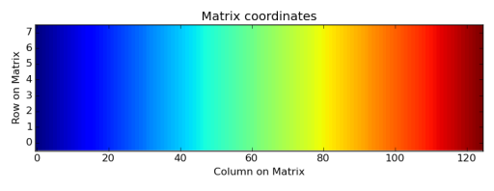
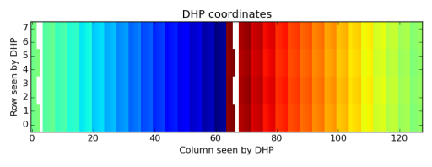
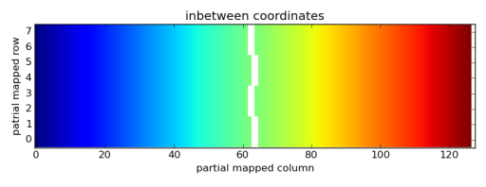
Solutions
Partial mapping of DHP data in DHE/DHC
Do a simple “premapping” on the DHE, so that data is mapped but there are still regions with unconnected channels
Can work word by word, no word dropped
Easy Operations: xor with constant, add one bit.
Either ONSEN adds 62/125/187 instead of 64/128/192 to columns OR : ROIs are enlarged to contain the unconnected channels (no extra data!)
New in-between format (but mapping from there is easy: 64<=col<128 ? Use col=col-2 etc.)
Changes needed in either for DHE and ONSEN or DHE and HLT/DATCON
Changes needed in unpacker
Only small/medium changes everywhere.
For DHE: First step to cluster format
if dhp%2==0:
c[row, 64*dhp + col_in_dhp ^ 0x3c]=b[row, 64*dhp + col_in_dhp ]
else:
c[row ^ 0x2, 64*dhp + (((col_in_dhp ^ 0x3c) + ((row & 2) >>1 )%64))] = b[row, 64*dhp + col_in_dhp ]
Notes:
R_d = B -> D tau nu / B -> D l nu
R_d* = B -> D* tau nu / B -> D* l nu (4 sigma unterschied vom SM)

Slide 10
Solutions
Which solution for
Lab tests
Software?
Next PXD only beam test
Next big beam test
Clusterformat?
Final Experiment
Clusterformat
Which backup solution?
Notes:
R_d = B -> D tau nu / B -> D l nu
R_d* = B -> D* tau nu / B -> D* l nu (4 sigma unterschied vom SM)

Slide 11
Pedestal Calculation
Raw Frames:
Take x raw frames (send memdump)
Calculate coarse pedestals
Using this, calculate CM (average, cut hits, average again)
Mask data around hits
Using CM and hit corrected data, calculate final pedestals
Upload
OR
Take many raw frames
Take mean
Upload
NEEDED for final experiment.
NOTE: DHP is capable of memdump
Zero Suppressed Data:
Reconfigure system (Switch Threshold to 0, CM correction off etc…)
Upload 0 to pedestal memory
Using short trigger width and artificial triggers, take matrix data silices
Puzzle them together, hope that you got data from all gates. Take mean as coarse pedestals
Using this, calculate CM (average, cut hits, average again)
Mask data around hits
Using CM and hit corrected data, calculate final pedestals
Upload
Reconfigure system
Not Possible during detector operation

