Slide 1
Sensor Performance During estbeam
Florian Lütticke
On behalf of the test beam crew

Slide 2
Overview
Row 0 Col 0
According to Belle Numbering scheme
SW1
SW6
IB
OB
Pedestals and Current
Signal
Row 0
Col 0
In this
talk
SW6
SW1
DHP1
DHP4
DHP1
DHP4

Slide 3
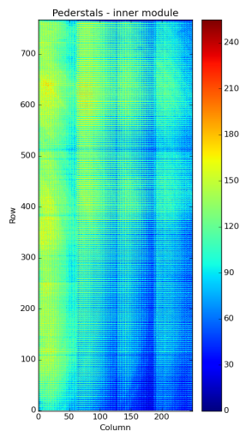
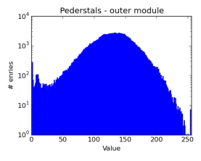
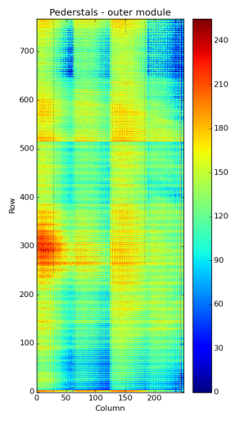
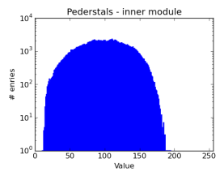
First runs
Gate On IB: -1.5V
Source: ~50 mA -> ~40-45uA/DEPFET
Rather homogeneous, Rings
Gate On IB: -1.27V/-1.33V
Source: ~50 mA -> ~40-45uA/DEPFET
Areas outside of dynamic range
Notes:
R_d = B -> D tau nu / B -> D l nu
R_d* = B -> D* tau nu / B -> D* l nu (4 sigma unterschied vom SM)

Slide 4
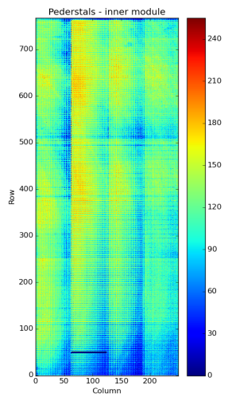
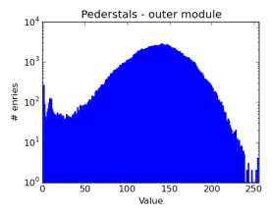
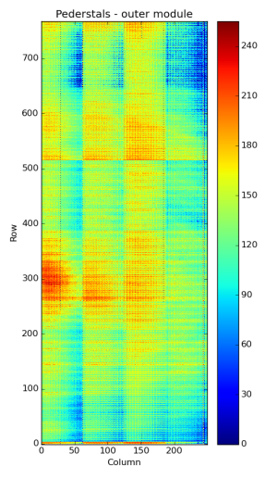
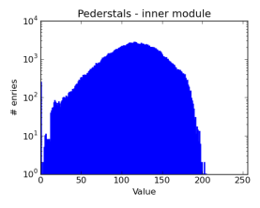
High Gate On @ IB
Gate On IB: -2V
Source: ~70 mA ->~60-65uA/DEPFET
Rather Homogeneous
Gate On IB: -1.27V/-1.33V
Source: ~50 mA->~40-45uA/DEPFET
Notes:
R_d = B -> D tau nu / B -> D l nu
R_d* = B -> D* tau nu / B -> D* l nu (4 sigma unterschied vom SM)

Slide 5
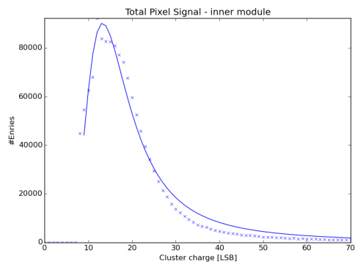
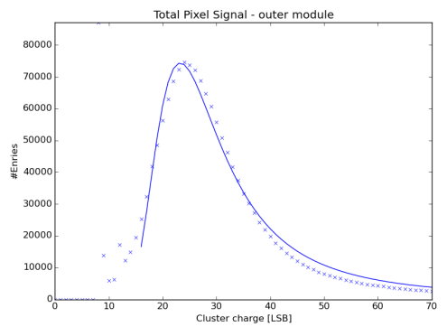
Cluster charge on both modules
Gate On IB: -1.5V
~40-45uA per DEPFET
MPV at ~15 LSB
Gate On IB: -1.27V/-1.33V
~40-45uA per DEPFET
MPV at ~24 LSB

Slide 6
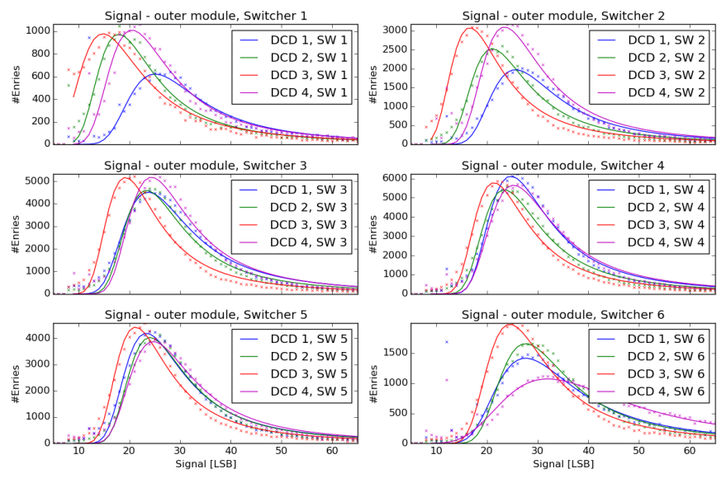
Signal for OB (aka Esperanza) ordered by Switcher
Notes:
R_d = B -> D tau nu / B -> D l nu
R_d* = B -> D* tau nu / B -> D* l nu (4 sigma unterschied vom SM)

Slide 7
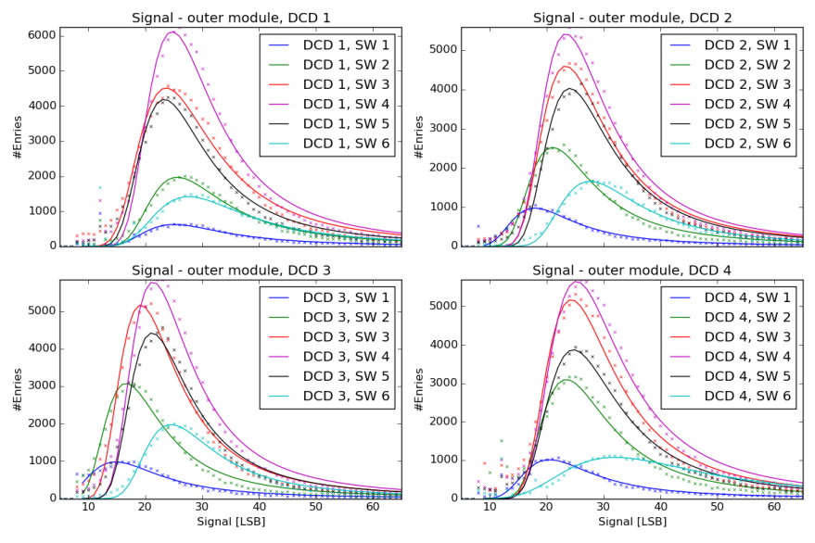
Signal for OB (aka Esperanza) ordered by DCD
Notes:
R_d = B -> D tau nu / B -> D l nu
R_d* = B -> D* tau nu / B -> D* l nu (4 sigma unterschied vom SM)

Slide 8
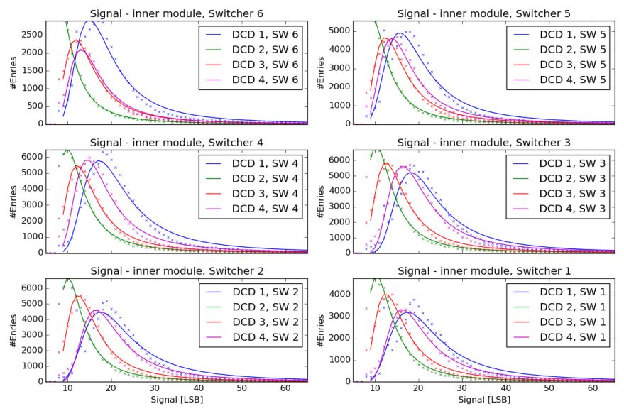
Signal for IB (aka Hopeless) ordered by Switcher
Notes:
R_d = B -> D tau nu / B -> D l nu
R_d* = B -> D* tau nu / B -> D* l nu (4 sigma unterschied vom SM)

Slide 9
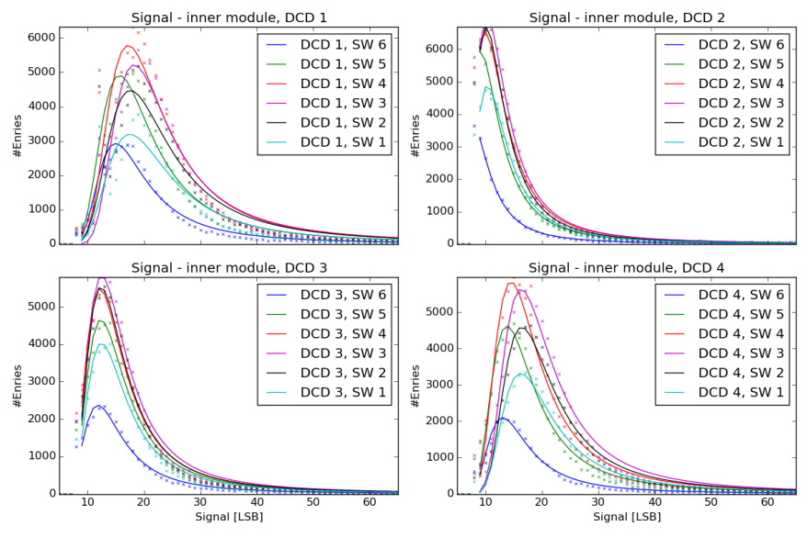
Signal for IB (aka Hopeless) ordered by DCD
Notes:
R_d = B -> D tau nu / B -> D l nu
R_d* = B -> D* tau nu / B -> D* l nu (4 sigma unterschied vom SM)

Slide 10
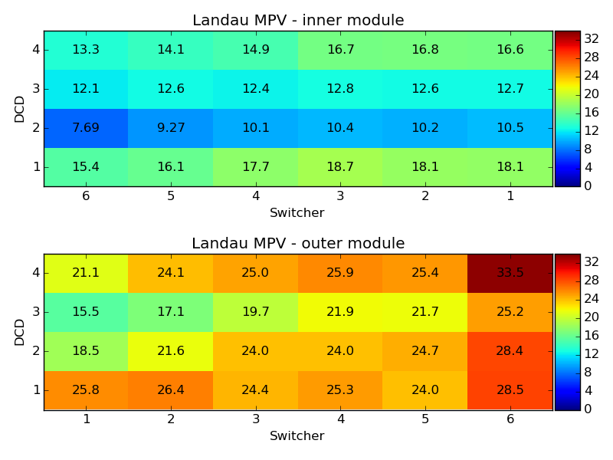
Landau MPV ordered by Switcher and DCD
IB
OB
Notes:
R_d = B -> D tau nu / B -> D l nu
R_d* = B -> D* tau nu / B -> D* l nu (4 sigma unterschied vom SM)

Slide 11
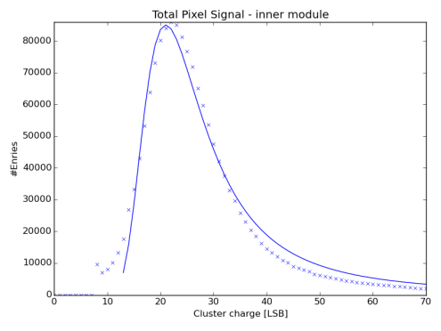
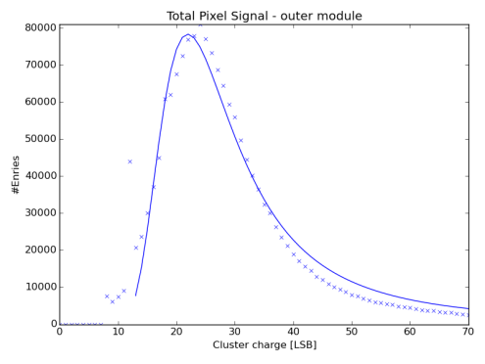
Increased DEPFET current on IB
Gate On IB: -2V
~60-65uA per DEPFET
MPV at ~21 LSB
Gate On IB: -1.27V/-1.33V
~40-45uA per DEPFET
MPV at ~24 LSB

Slide 12
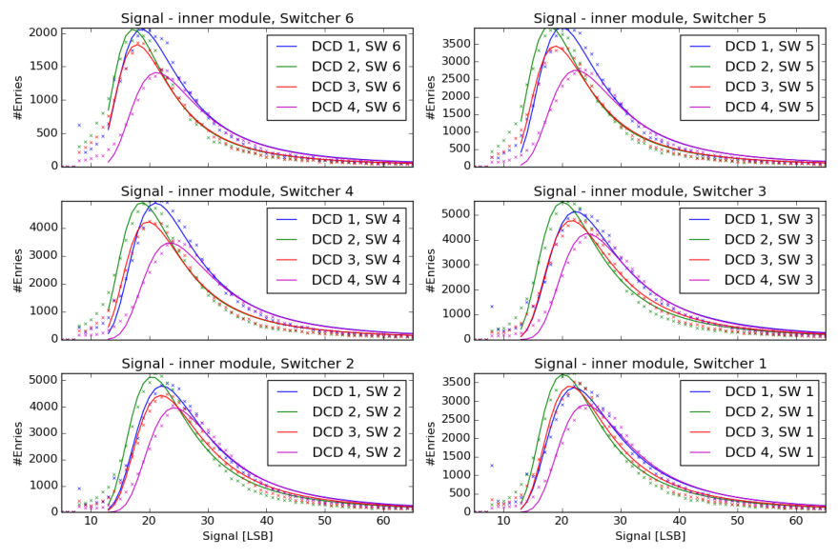
Signal for Hopeless ordered by Switcher @ GateOn -2V
Notes:
R_d = B -> D tau nu / B -> D l nu
R_d* = B -> D* tau nu / B -> D* l nu (4 sigma unterschied vom SM)

Slide 13
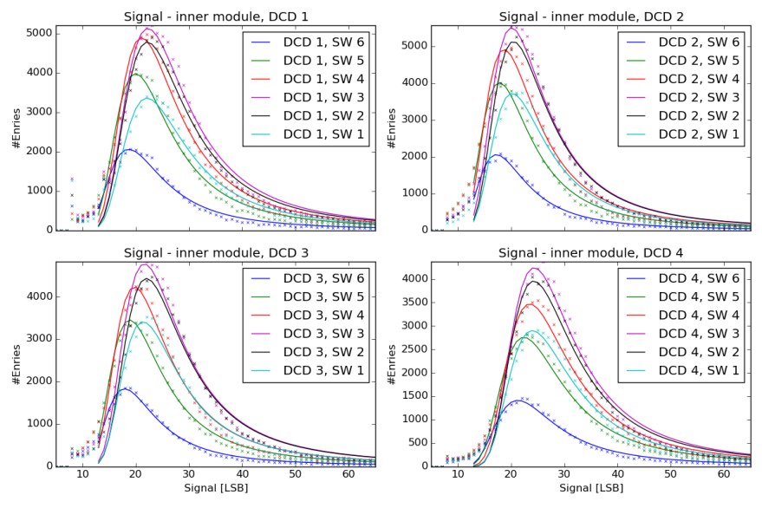
Signal for Hopeless ordered by DCD @ GateOn -2V
Notes:
R_d = B -> D tau nu / B -> D l nu
R_d* = B -> D* tau nu / B -> D* l nu (4 sigma unterschied vom SM)

Slide 14
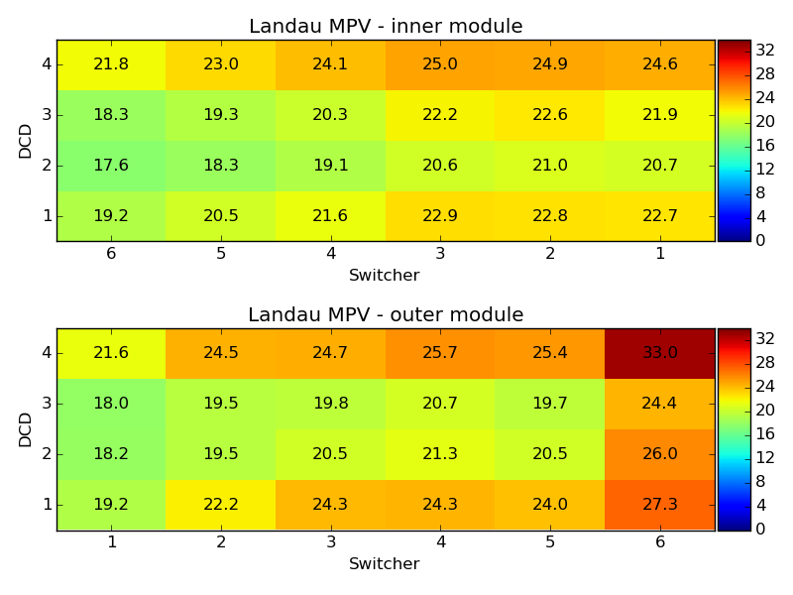
Landau MPV ordered by Switcher and DCD
IB
OB
Notes:
R_d = B -> D tau nu / B -> D l nu
R_d* = B -> D* tau nu / B -> D* l nu (4 sigma unterschied vom SM)

Slide 15
Outlook
More data needed (especially for Switcher 1,2 and 6 on Esperanza)
We need to start measurements (DCD) to see, if the effects are DCD related
We need to start measurements (Laser/Source) to get optimal operation voltages on the matrix (and on different positions on the matrix)
We need to seriously think about how we want to do this on 40 + X modules.
Irradiation: We know that at 2 Mrad DCD has some issues: Operation of a Matrix with this settings should be mandatory exercise
Notes:
R_d = B -> D tau nu / B -> D l nu
R_d* = B -> D* tau nu / B -> D* l nu (4 sigma unterschied vom SM)

