Slide 1




Yield measurements on PXD9-7 after 2nd metal
Paola Avella, Daniel Klose, Christian Koffmane, Jelena Ninković, Rainer H. Richter
for the MPP/HLL team

Slide 2


Outline & Motivation
1. Global tests on the modules to get info on:
      Diode integrity
      Shorts in the polylines
2. Tests of DEPFET transfer characteristics at the first gate row to
get info on:
      Shorts
      Opens
→ map of the fanout with precise localisation of faults
→ possibility of rework in faulty areas

Slide 3
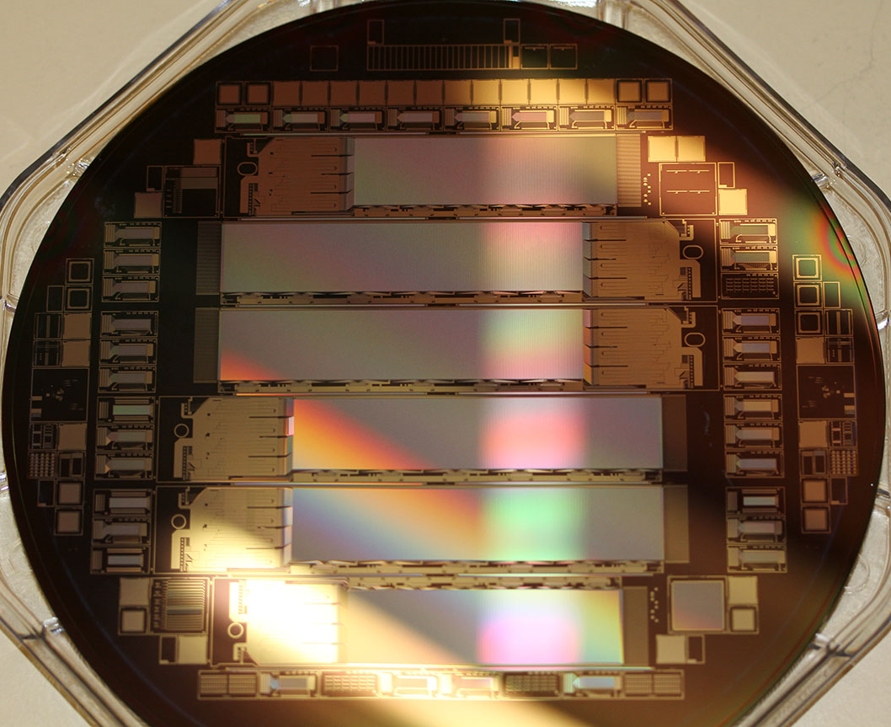
Wafer and chip layout
The batch of PXD9-7 wafers consists of four wafers:
All four wafers (W31, W37, W38 and W40) are currently undergoing further processing
IF
OF1
OF2
OB1
OB2
IB

Slide 4
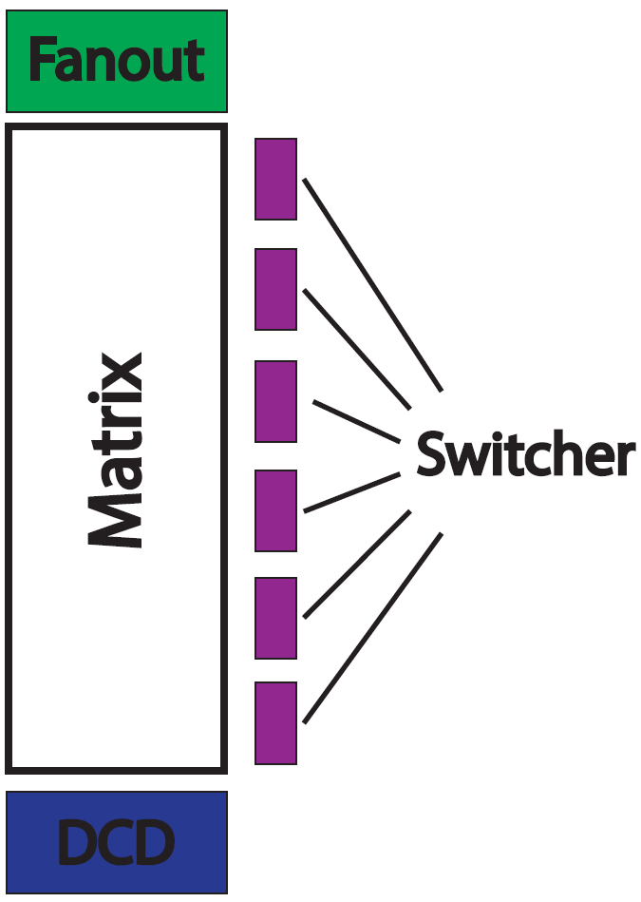
Wafer and chip layout
The batch of PXD9-7 wafers consists of four wafers:
All four wafers (W31, W37, W38 and W40) are currently undergoing further processing

Slide 5
Pretests – Clear vs Source
PXD 9-7 | W31 | W37 | W38 | W40
IF | ok | ok | ok | ok
OF1 | ok | ok | bad | ok
OF2 | ok | bad | bad | ok
OB1 | ok | ok | ok | ok
OB2 | ok | ok | bad | ok
IB | ok | ok | ok | ok
PXD 9-6 | W30 | W35 | W36
IF | ok | ok | ok
OF1 | ok | ok | ok
OF2 | ok | ok | ok
OB1 | ok | ok | bad
OB2 | ok | bad | ok
IB | ok | bad | ok
The All Clear and the Source testpad are connected to all pixels over bus structures.
All Clear and Source regions tested in reverse bias

Slide 6
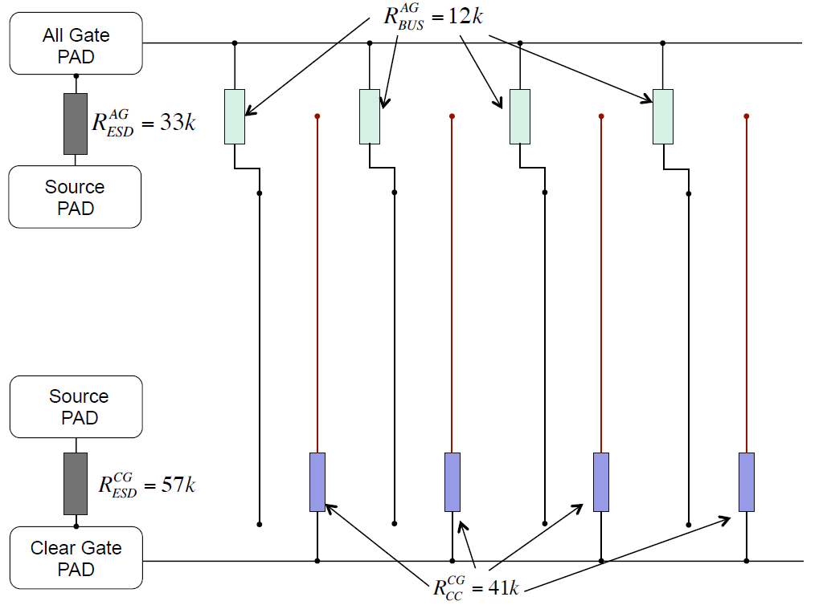
The poly1/poly2 electrical nets

Slide 7
The poly1/poly2 electrical nets

Slide 8
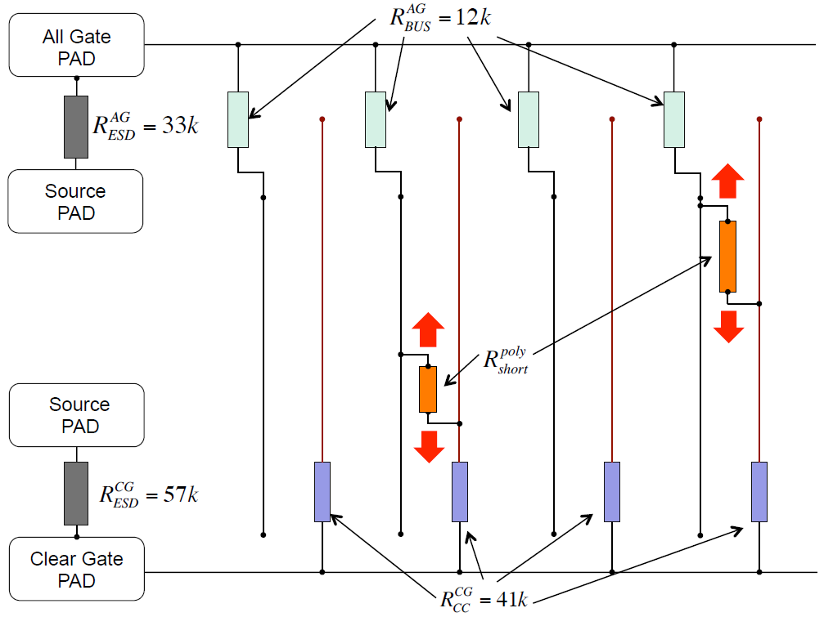
The poly1/poly2 electrical nets

Slide 9
Pretests – Shorts in Polylines
PXD 9-7 | W31 | W37 | W38 | W40
IF | 1-2 | 2+ | 1-2 | 0
OF1 | 1-3 | 2+ | 2+ | 1
OF2 | 1-2 | 2+ | 2+ | 1
OB1 | 1 | 2+ | 2+ | 0
OB2 | 1 | 1 | 2+ | 0
IB | 0 | 1-3 | 1-3 | 0
PXD 9-6 | W30 | W35 | W36
IF | 2 | 2+ | 1-3
OF1 | 0 | 1 | 1-2
OF2 | 1 | 1-2 | 1
OB1 | 2 | 0 | 1
OB2 | 1 | 1-2 | 1-2
IB | 2 | 0 | 1
Combined results of the pretests:
1. AllGate vs ClearGate
2. AllGate vs Source
3. ClearGate vs Source

Slide 10
Wafer and chip layout
The batch of PXD9-7 wafers consists of four wafers:
All four wafers (W31, W37, W38 and W40) are currently undergoing further processing
1st gaterow

Slide 11
Fan-out types
Type A: IF, OB1, OB2
Type B: IB, OF1, OF2
Clear Gate
Source
All Clear
All Clear
Drain pads
All Gates
All Gates
Drain pads
Source
Clear Gate
4
3
Static voltage
2
1
4
3
Static voltage
2
1
Configuration #1:
SMU2 = All Clear (15V – static voltage 1)
SMU3 = All Gates (2V – static voltage 2)
SMU4 = Clear Gate (5V – static voltage 3)
SMU5 = Source (0V – static voltage 4)
Configuration #2:
SMU2 = Source (0V – static voltage 1)
SMU3 = Clear Gate (5V – static voltage 2)
SMU4 = All Gates (2V – static voltage 3)
SMU5 = All Clear (15V – static voltage 4)
+ automatic probehead PH510 for the voltage sweep [-3 V to 2 V] at the external gate
Notes:
Current compliance and range for ALL the SMUs is 1 mA
7 SMUs are switched on ALMOST in parallel → total current expected in the source is still < 1 mA

Slide 12
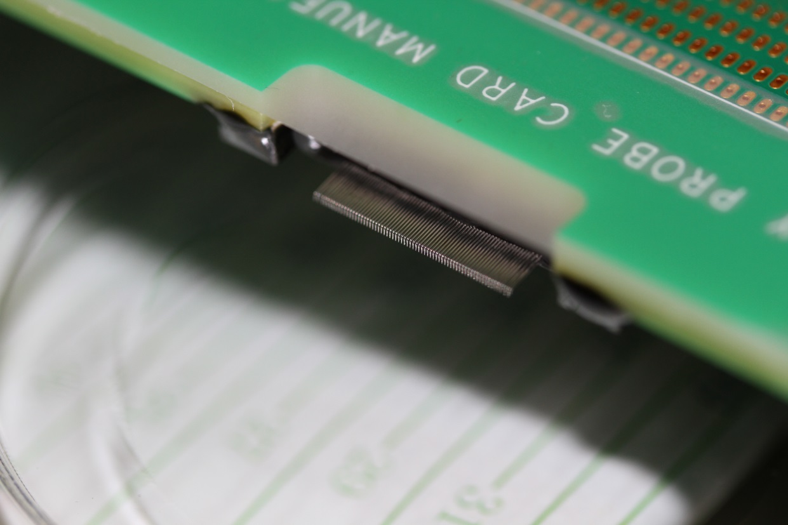
System description
Probe card with 134 needles in total, arranged in two rows. 126 needles for the drain lines and 4 needles per row for the static voltages.
Probe card is connected via two ribbon cables to a conversion board
Conversion board distributes the currents to the SMUs and the voltages to the probe card
The 126 drain lines are connected to 7 SMUs → 18 drain lines per SMU
The 4 static voltages are connected to 1 SMU each
1 SMU is used for the single needle for the gate rows.
➔ 12 SMUs in total
Notes:
Current compliance and range for ALL the SMUs is 1 mA
7 SMUs are switched on ALMOST in parallel → total current expected in the source is still < 1 mA

Slide 13
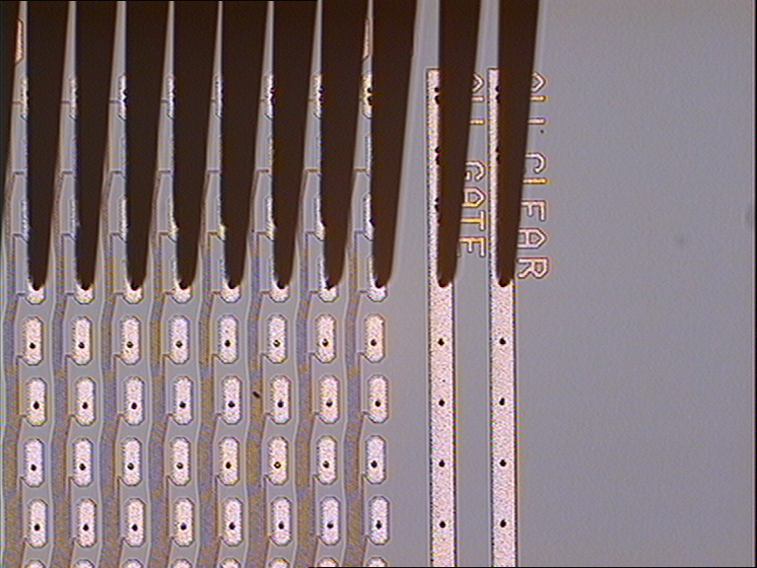
Drain Groups, mapping, probing

Slide 14
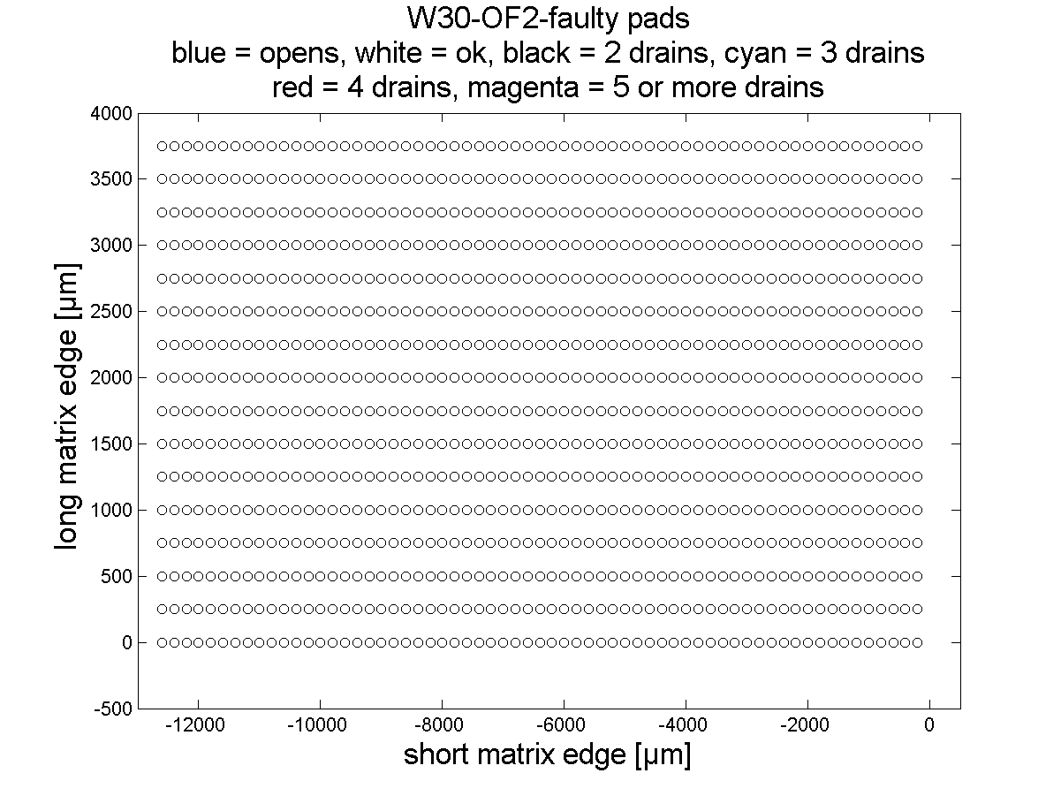
Drain Groups, mapping, probing
chuck
step #8
SMUb2
DG7 2612 #2
SMUa2
DG6 2612 #2
SMUb1
DG5 2612 #1
SMUa1
DG 4
2612 #1
SMU8
DG 3
4200
SMU7
DG 2
4200
SMU6
DG 1
4200
chuck
step #1

Slide 15
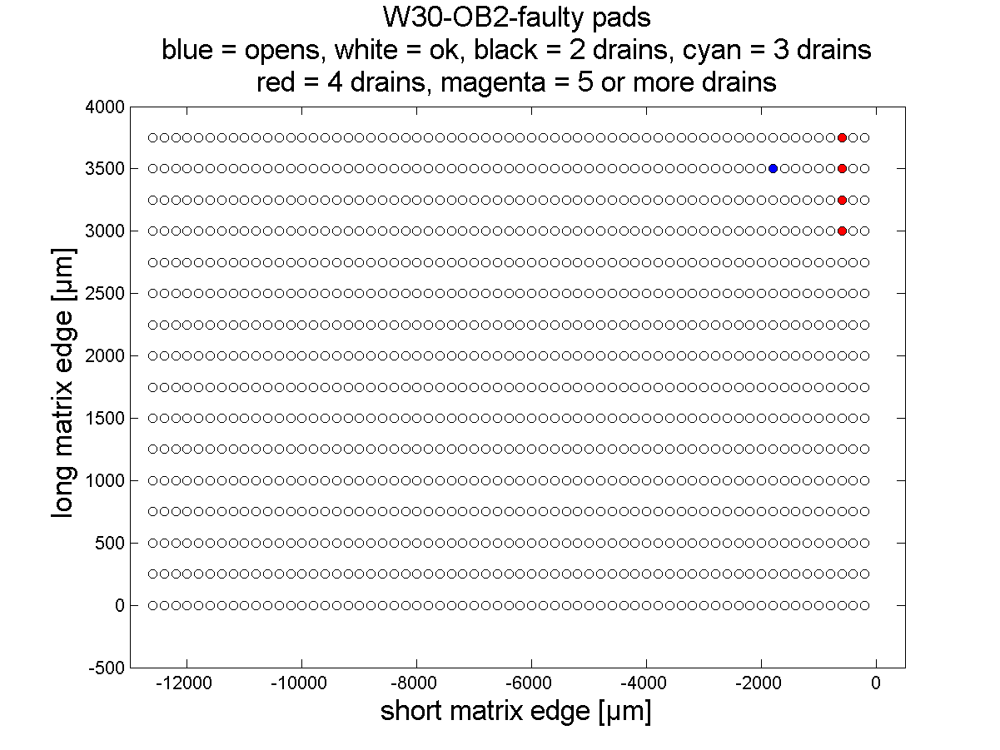
Example of the mapping

Slide 16
Opens & shorts
Opens | W31 | W37 | W38 | W40
IF | 0 | 0 | 0 | 0
OF1 | 0 | 1 | 0 | 0
OF2 | 0 | 0 | 0 | 0
OB1 | 0 | 0 | 1 | 0
OB2 | 0 | 0 | 3 | 1
Shorts | W31 | W37 | W38 | W40
IF | 1 + 1 D-S* | 0 | 1 strange | 0
OF1 | 0 | 1 strange | 0 | 0
OF2 | 0 | 0 | 0 | 1
OB1 | 1 G-D* | 0 | 4 D-S* | 0
OB2 | 0 | 0 | 0 | 0
* D-S: Drain to Source short, affecting one drain line
** G-D: Gate to Drain short, also affecting one drain line

Slide 17
PXD 9-7 estimated yield
- assuming successful repair
PXD 9-7 | W31 | W37 | W38 | W40
IF | 98.9 | 98.4 | 99.0 | 100.0
OF1 | 99.0 | 98.3 | 98.4 | 99.5
OF2 | 99.0 | 98.4 | 98.4 | 99.5
OB1 | 99.4 | 98.4 | 97.9 | 100.0
OB2 | 99.5 | 99.5 | 98.1 | 99.9
IB | 100.0 | 99.0 | 99.0 | 100.0
 |  |  | Percent
Total number of modules |  | 24
Prime grade (>=99%) |  | 15 | 62.50 %
Second grade |  | 5 | 20.83 %
No use |  | 4 | 16.67 %
Useful sensors |  | 20 | 83.33 %
PXD 9-6 | W30 | W35 | W36
IF | 73.4 | 98.4 | 99.0
OF1 | 100.0 | 98.4 | 99.0
OF2 | 99.5 | 99.0 | 99.5
OB1 | 97.7 | 99.4 | 98.4
OB2 | 99.5 | 97.4 | 99.0
IB | 97.9 | 100.0 | 99.5
 |  |  | Percent
Total number of modules |  | 18
Prime grade (>=99%) |  | 10 | 55.56 %
Second grade |  | 4 | 22.22 %
No use |  | 4 | 22.22 %
Useful sensors |  | 14 | 77.78 %

Slide 18
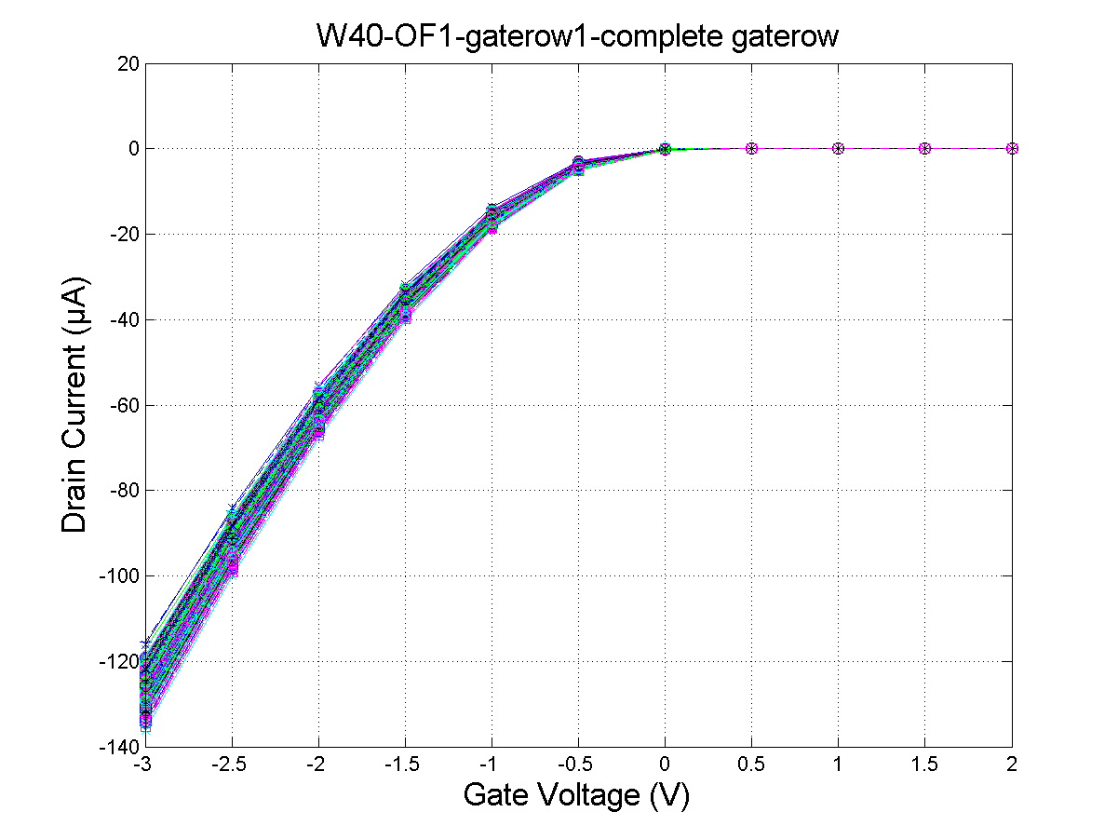
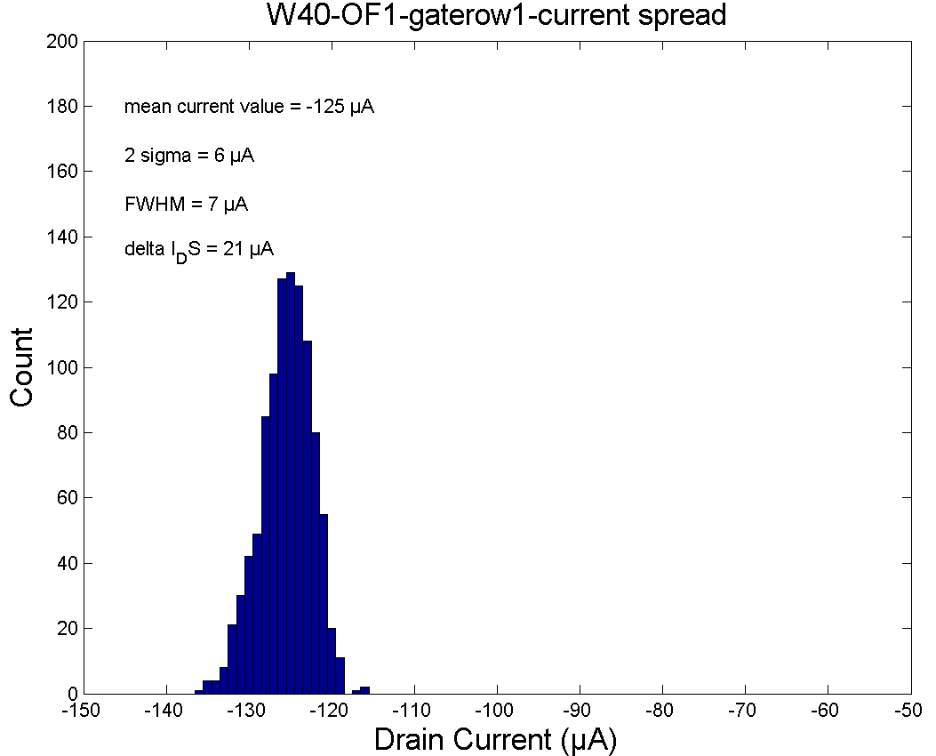
Pedestal – First gaterow

Slide 19
Pedestal – First gaterow
Average pedestal [- µA] | W31 | W37 | W38 | W40
IF | 110 | 122 | 125 | 125
OF1 | 111 | 126 | 118 | 125
OF2 | 106 | 120 | 118 | 120
OB1 | 100 | 115 | 115 | 118
OB2 | 99 | 117 | 125 | 118
PXD 9-6 | W30 | W35 | W36
IF | 106 | 130 | 122
OF1 | 106 | 122 | 123
OF2 | 102 | 114 | 117
OB1 | 99 | 114 | 111
OB2 | 104 | 114 | 110

Slide 20

Pedestal spread – First gaterow
ΔI [µA] | W31 | W37 | W38 | W40
IF | 16 | 27 | 26 | 29
OF1 | 22 | 24 | 23 | 21
OF2 | 21 | 20 | 23 | 18
OB1 | 17 | 22 | 19 | 22
OB2 | 18 | 24 | 22 | 21
PXD 9-6 | W30 | W35 | W36
IF | 16 | 27 | 26
OF1 | 22 | 24 | 23
OF2 | 21 | 20 | 23
OB1 | 17 | 22 | 19
OB2 | 18 | 24 | 22
Pedestal spread:
$∆I = I_{max}⁡– I_{min}$

Slide 21
Threshold– First gaterow
[V] | W31 | W37 | W38 | W40
IF | 0.005 | 0.087 | 0.095 | 0.078
OF1 | -0.016 | 0.083 | -0.012 | 0.085
OF2 | -0.078 | 0.042 | 0.005 | 0.050
OB1 | -0.127 | 0.010 | -0.015 | -0.009
OB2 | -0.146 | 0.023 | 0.813* | 0.014
Bad module!
Mean Threshold voltages for the first gate row
Spread of up to ±0.3 V for the individual drain line

Slide 22
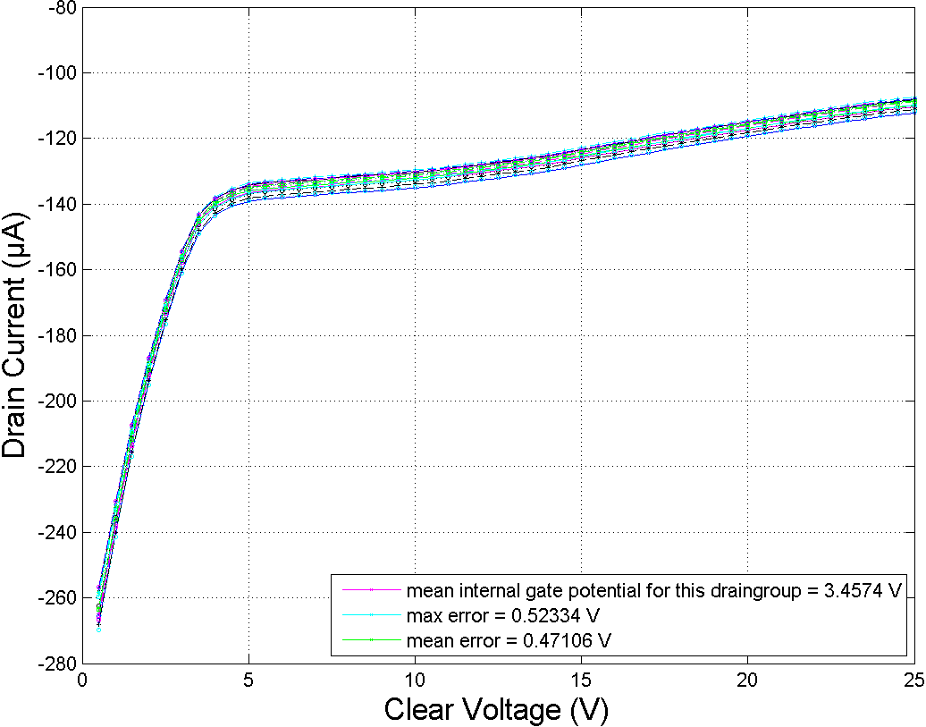
PXD9-6 W35-OF1 Internal Gate Potential
Internal gate potential of one gate row as a function of the clear voltage for 18 drains.
An average over the full gate row (1000 drains) gives:
Mean internal gate potential: 3.5 ± 0.5 V
Internal gate potential

Slide 23
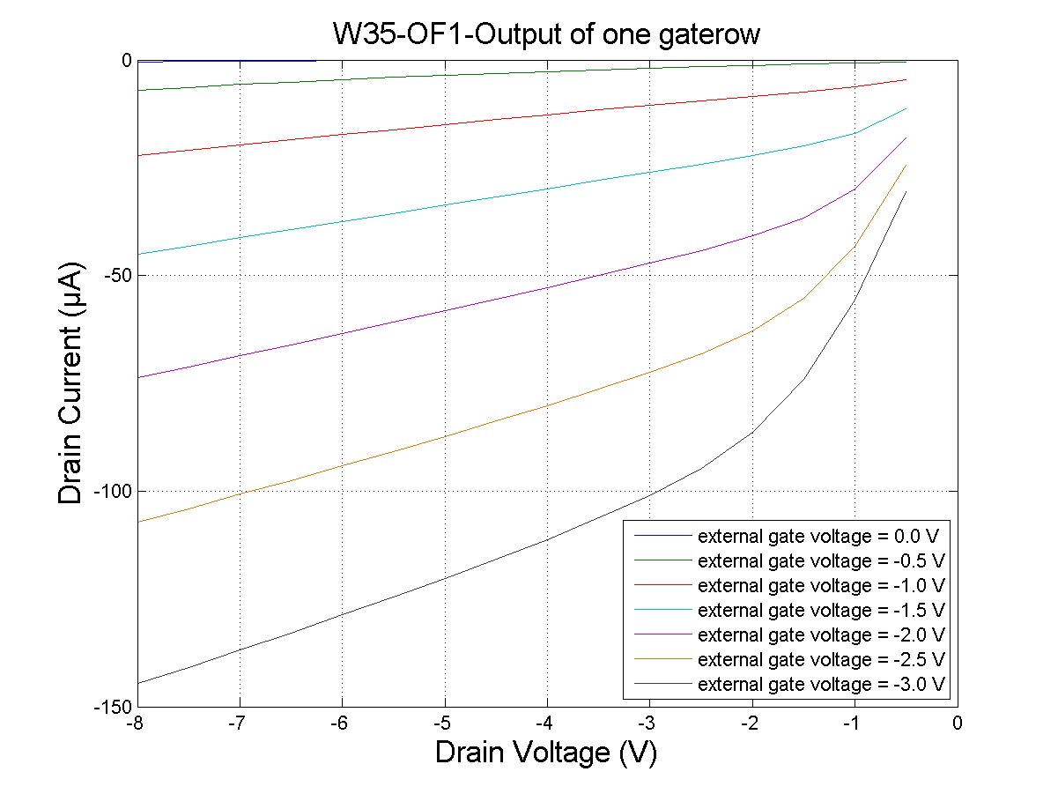
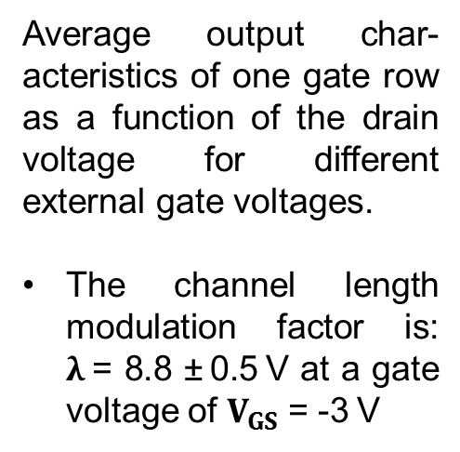
PXD9-6 W35-OF1 Output Characteristics
Average output char-acteristics of one gate row as a function of the drain voltage for different external gate voltages.
The channel length modulation factor is:
λ = 8.8 ± 0.5 V at a gate voltage of $V_{GS}$ = -3 V

Slide 24
Summary and future plans
  Introduction of a sense line for all four static voltages
Yield of the metal system is equal to the pilot run
Measurements of Internal Gate potential and Channel length modulation factor
for one module of the pilot run match the simulations
Wafers are currently further processed and repaired
Further tests on test structures after cutting
Thank you for your attention!

Slide 25
BACKUP SLIDES

Slide 26
System issues/failures
(from last SeeVogh meeting – 31.03.15)
Chuck not planar →
  Bad probing in the right hand side of the fan-out (source in conf #2) – (E/W tilt)
  Bad contacts (higher contact resistance ➔ smaller I_{ds}) for higher chuck steps (N/S tilt)
  NOW SOLVED:
    Chuck planarized
    Use of sense line at source contact (currently possible only for conf #2)
Electrical failures (due to contact problem in SMU2 preamp of Keithley 4200) →
  System freeze
  Bad characteristics due to wrong applied voltage (AC/conf #1 or S/conf #2 – critical)
  → Need investigation – currently on hold (temporary solution: SMU2 and SMU3 swapped)
Electrical failures (in Keithley 2612) →
  System freeze
  Possibly due to a timeout error in the communication between KITE (Keithley GUI) and the instruments:
    Software upgrade seems to solve the problem via the introduction of time delays (or settling time) and keeping the SMUs in the ON state for the whole duration of the measurement (under investigation!)
Software failures (fully understood) →
  KITE (DAQ software) crash
  System freeze if data folder remotely accessed

Slide 27
Yield considerations of the metal system
Yield (%)
 | W30 | W35 | W36
IF | 75.0 | 100.0 | 100.0
OF1 | 100.0 | 100.0 | 100.0
OF2 | 100.0 | 100.0 | 100.0
OB1 | 99.8 | 99.4 | 100.0
OB2 | 99.6 | 99.5 | 99.8
IB | 100.0 | 0 | 100.0
Yield calculated taking into account the following equation:
With D the total number of drain lines (1000) and D_{s} the number of drain lines involved in the short.
Rainer’s Yield Criteria
 | W30 | W35 | W36
IF | 3 | 0 | 0
OF1 | 0 | 0 | 0
OF2 | 0 | 0 | 0
OB1 | 1 | 1 | 0
OB2 | 1 | 5 | 1
IB | 0 | 4 | 0
Rainer’s criteria for yield calculation:
0: no faults
1: pixel or column* (drain line) level faults
2: row level faults
3: high impact faults
4: lethal faults
5: to be clarified
* Column level faults in Al2 can be repaired by rework (grade 1 → 0).

Slide 28
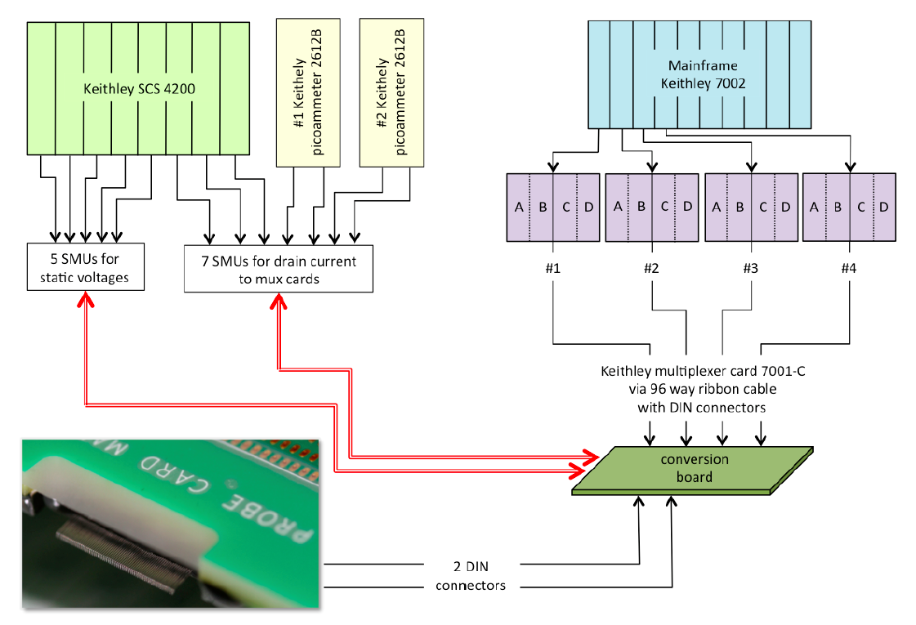
Switch system

Slide 29
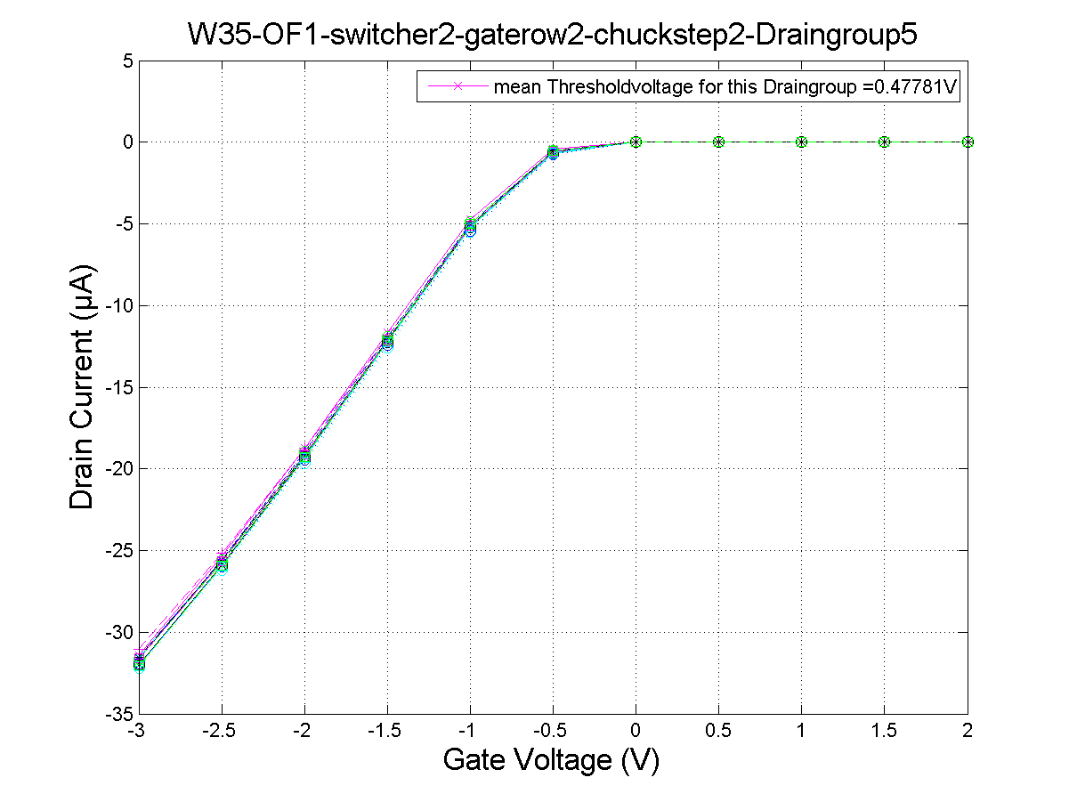
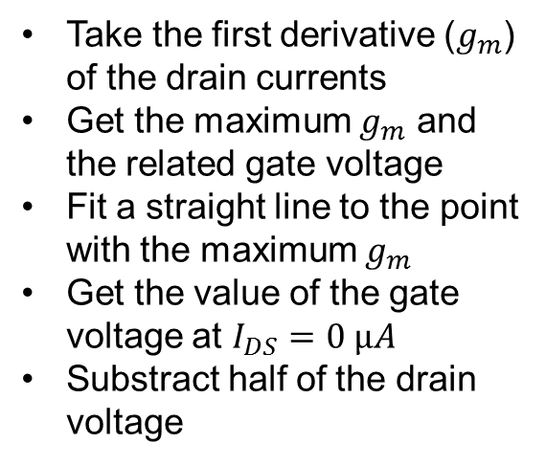
Threshold voltage – Linear ($V_{DS}=−0.5 V$)
Threshold calculation according to:
Dieter K. Schroder: Semiconductor material and device characterisation. Arizona State University (2006), p.223.
Take the first derivative ($g_{m}$) of the drain currents
Get the maximum $g_{m}$ and the related gate voltage
Fit a straight line to the point with the maximum $g_{m}$
Get the value of the gate voltage at $I_{DS}=0 µA$
Substract half of the drain voltage
Threshold voltage around -0.5V

Slide 30
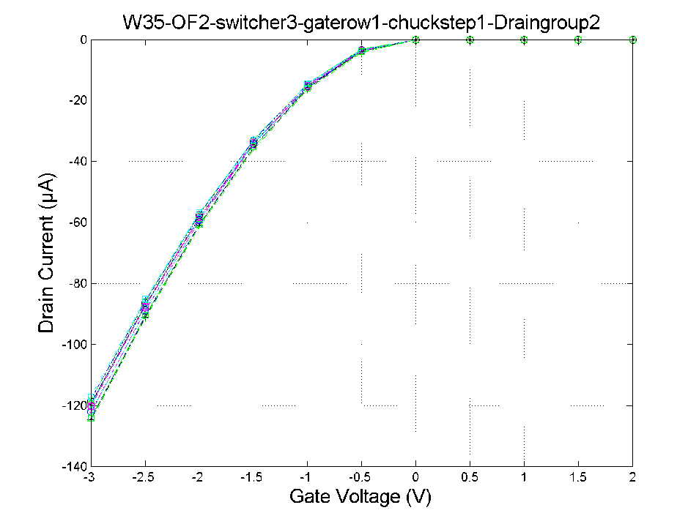
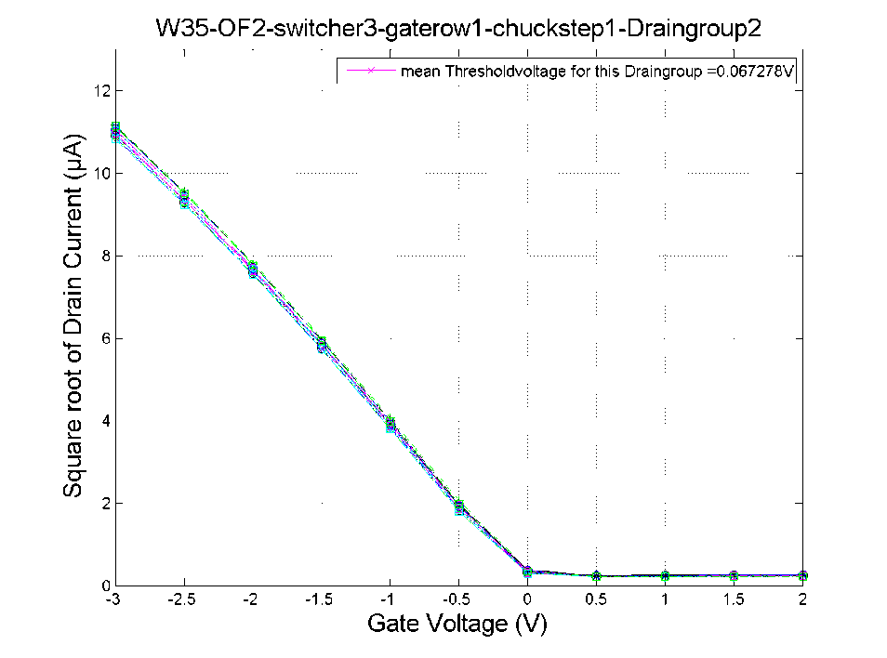
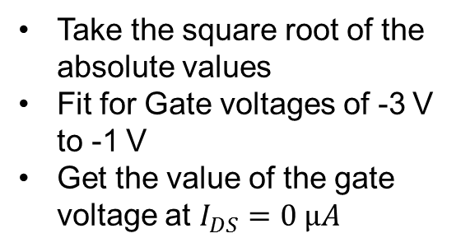
Threshold voltage – Saturation ($V_{DS}=−5 V$)
Threshold calculation according to:
Dieter K. Schroder: Semiconductor material and device characterisation. Arizona State University (2006), p.225.
Take the square root of the absolute values
Fit for Gate voltages of -3 V to -1 V
Get the value of the gate voltage at $I_{DS}=0 µA$
Threshold voltage mostly around +0.08V

