Slide 1
Status of ASICs

Slide 2
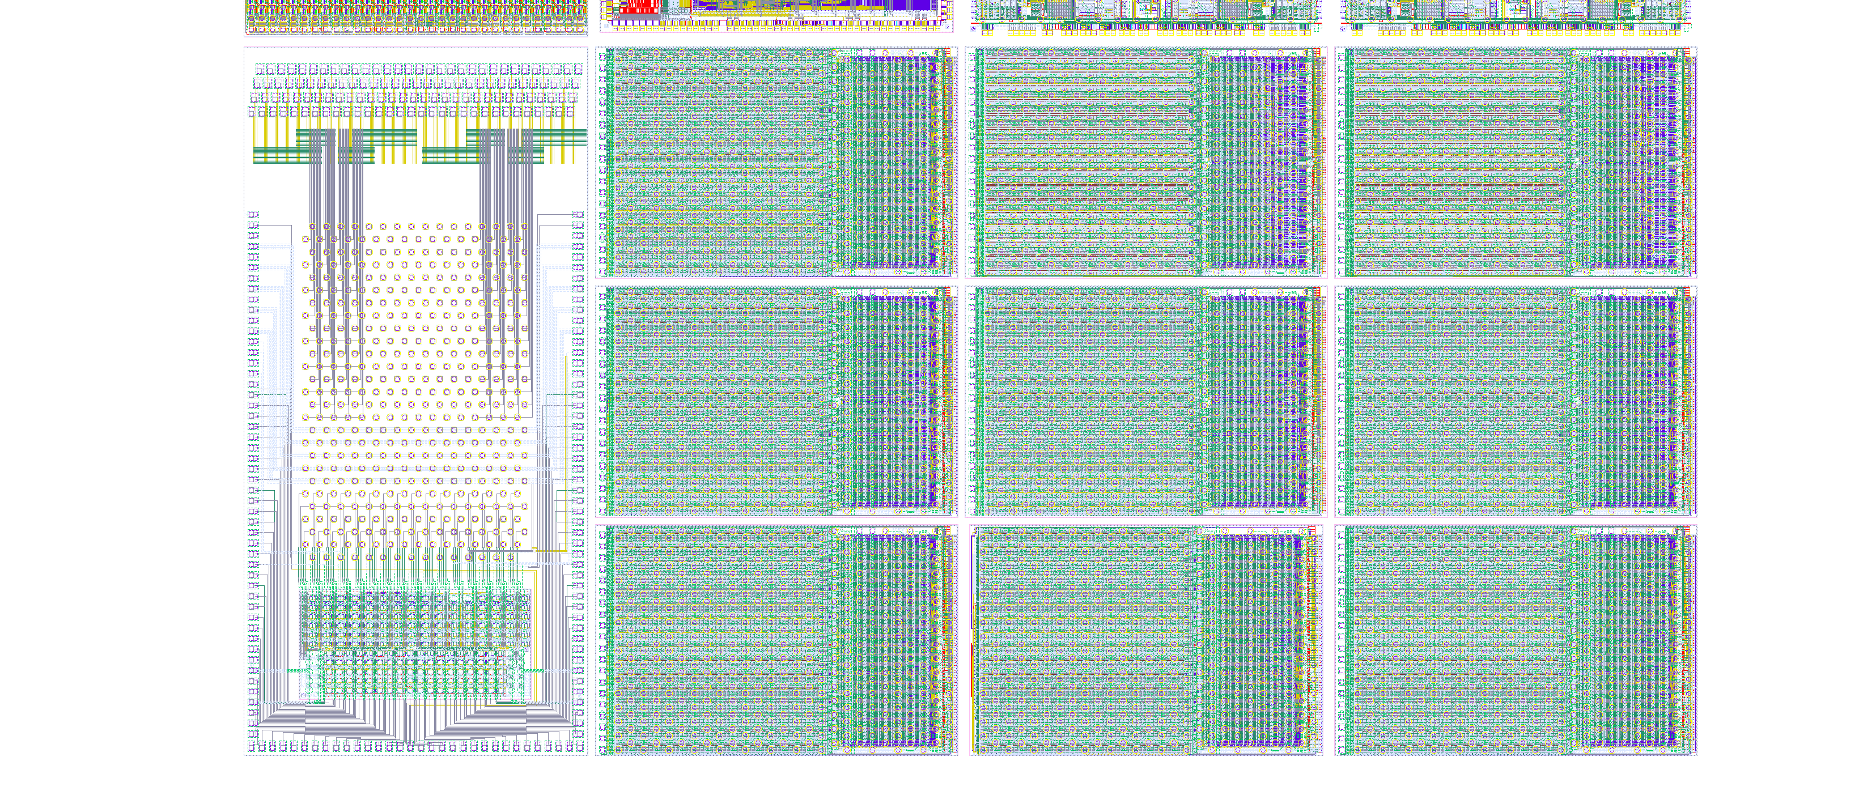
New DCD4.1 und DCD4.2
DCD engineering run in November 2015.

Slide 3
New DCD4.x
DCD digital driver strength can be optionally increased (from 1.3mA to 1.8mA)
Reference voltage can be increased by 30mV to cope with waveform asymmetry.
Gain setting by 20% lower (feedback resistors 13k, 19k, 26k – output resistor 15k)
DCD4.1 Added two antenna diodes/cell and dummy structures to improve the matching of transistors in ADC
DCD4.2 Changed layout to improve the matching
IPDAC range reduced by factor 2 to improve granularity of offset correction
DCDB4.2: New test-patterns for easier calculation of delay settings
DCDB4.2: Changed ID code
JTAG sampling CLK edge changed to be compatible with industry standard.
Test multiplexer has been added, it allows tests of all ADCs at full speed by contacting only 22 wire bond pads. The test pads do not contain bumps, standard needles can be used.
Test mux allows faster tests with probe cards. DCDB4.x chips can be tested at wafer (or at a diced wafer glued at UV foil) using standard needles => More reliable test contacts – less contacts needed, no need to contact bumps, no damage at bumps during testing.

Slide 4
New DCDE.x
DCD digital driver strength can be optionally increased (from 1.3mA to 1.8mA)
Reference voltage can be increased by 30mV to cope with waveform asymmetry.
Gain setting different than DCD (feedback resistors 1.5k, 3k, 15k – output resistor 15k)
Fixed pedestal current source (ISub) full range up to 1.6mA (DCD: 320 uA)
TIA can drain a current up to 800uA (DCD: 200uA)
Additional offset correction at input with one PMOS (EnLCap0)
DCDE.1 Added two antenna diodes/cell and dummy structures to improve the matching of transistors in ADC
DCDE.2 Changed layout to improve the matching
Increase IPDAC range
DCDBE.2: New test-patterns for easier calculation of delay settings
DCDBE.2: Changed ID code
JTAG sampling CLK edge changed to be compatible with industry standard.
Test multiplexer has been added, it allows tests of all ADCs at full speed by contacting only 22 wire bond pads. The test pads do not contain bumps, standard needles can be used.
Test mux allows faster tests with probe cards. DCDE.x chips can be tested at wafer (or at a diced wafer glued at UV foil) using standard needles => More reliable test contacts – less contacts needed, no need to contact bumps, no damage at bumps during testing.

Slide 5
DCD
Test systems
Two new DCD probe cards have been designed and produced (PTSL) – these cards should allow faster tests than the existing ones.
PC1 can contact all the digital outputs with bumps (the old probe card only half of outputs).
PC2 can contact the test pads using standard needles and tests DCDs at full speed
DCDnew/old
DCDnew/old
DCDnew

Slide 6
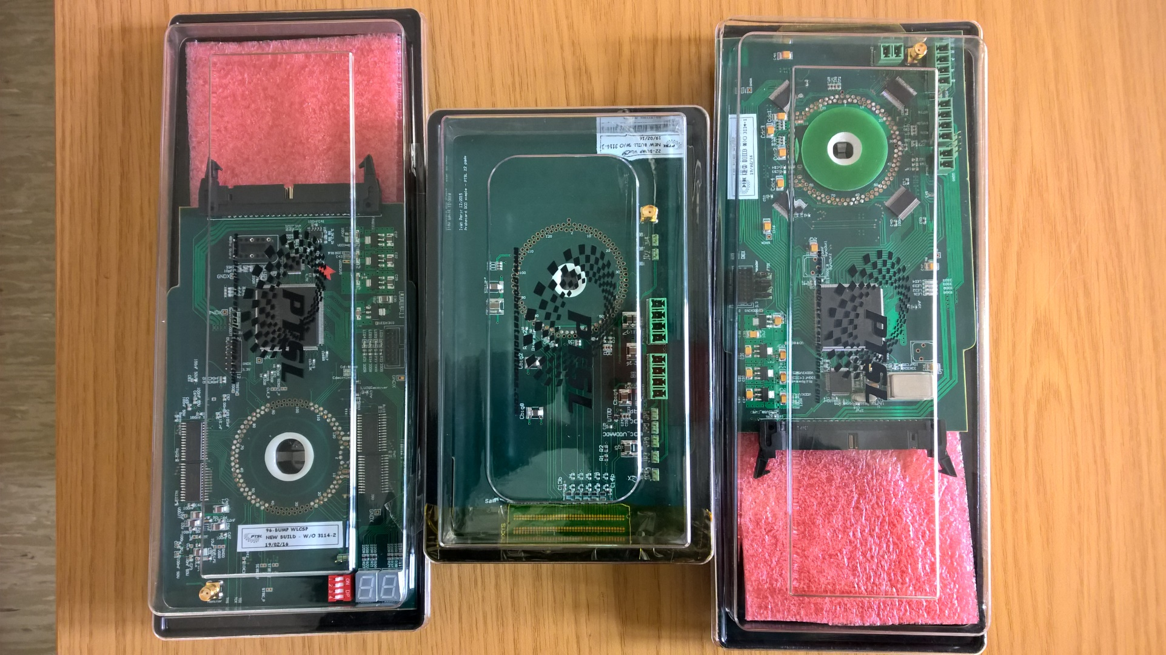
Probe Cards
…

Slide 7
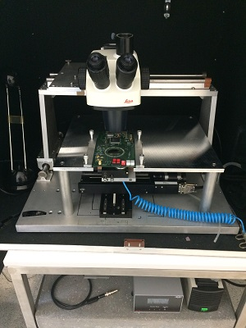
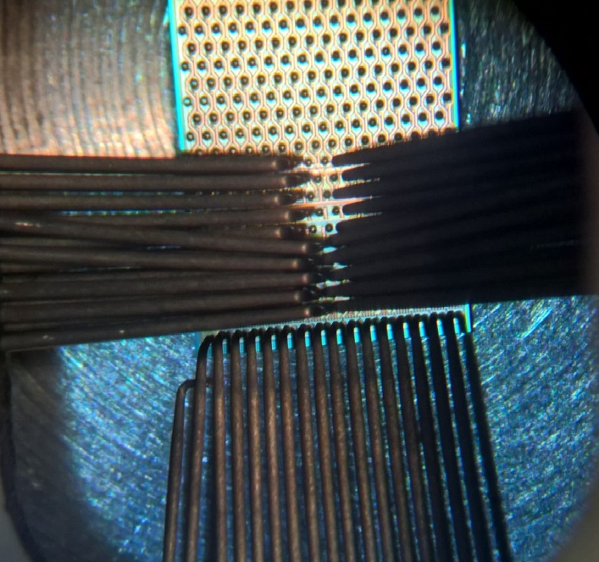
DCD
Small probe-station at KIT (IEKP) is currently being used
Automatic probe station is almost ready

Slide 8
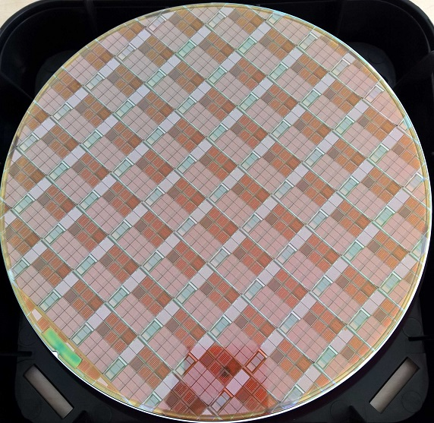
Wafer
…

Slide 9
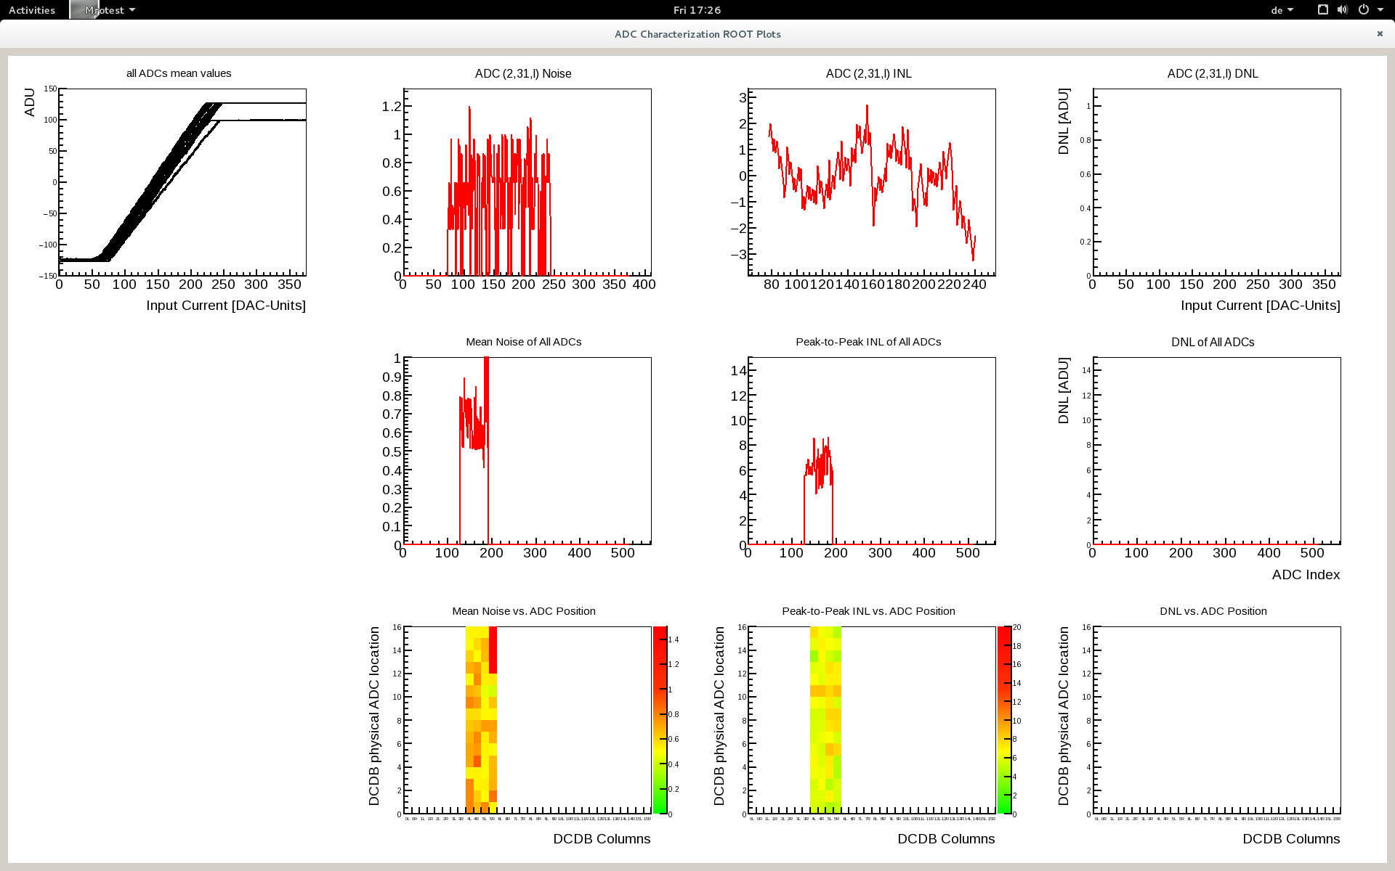
DCDB4.1 - Column 2
…
Low noise
Artefakt of the test system – happens also with old DCD
Uniform nonlinearity – no long codes

Slide 10
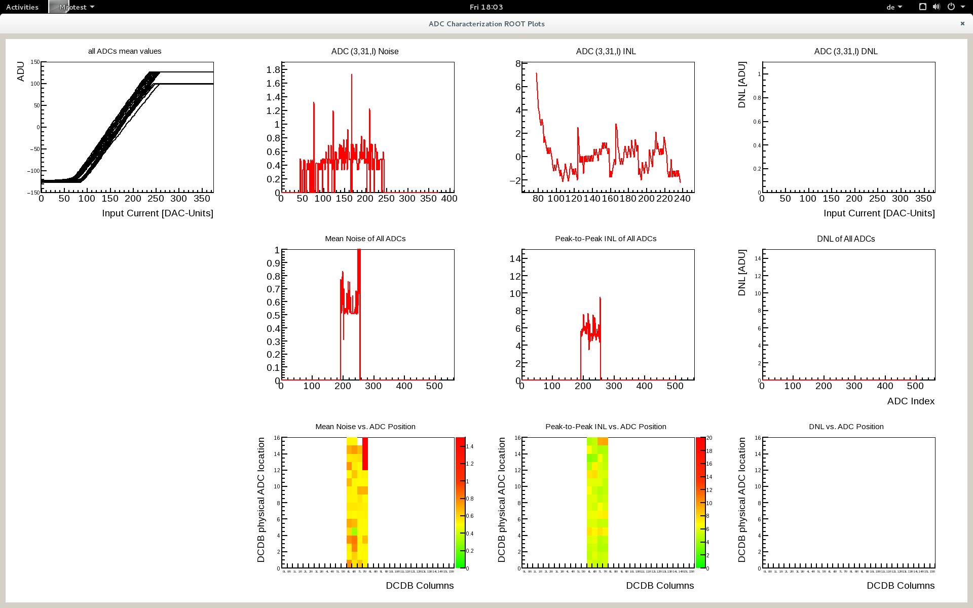
DCDB4.1 - Column 3
…

Slide 11
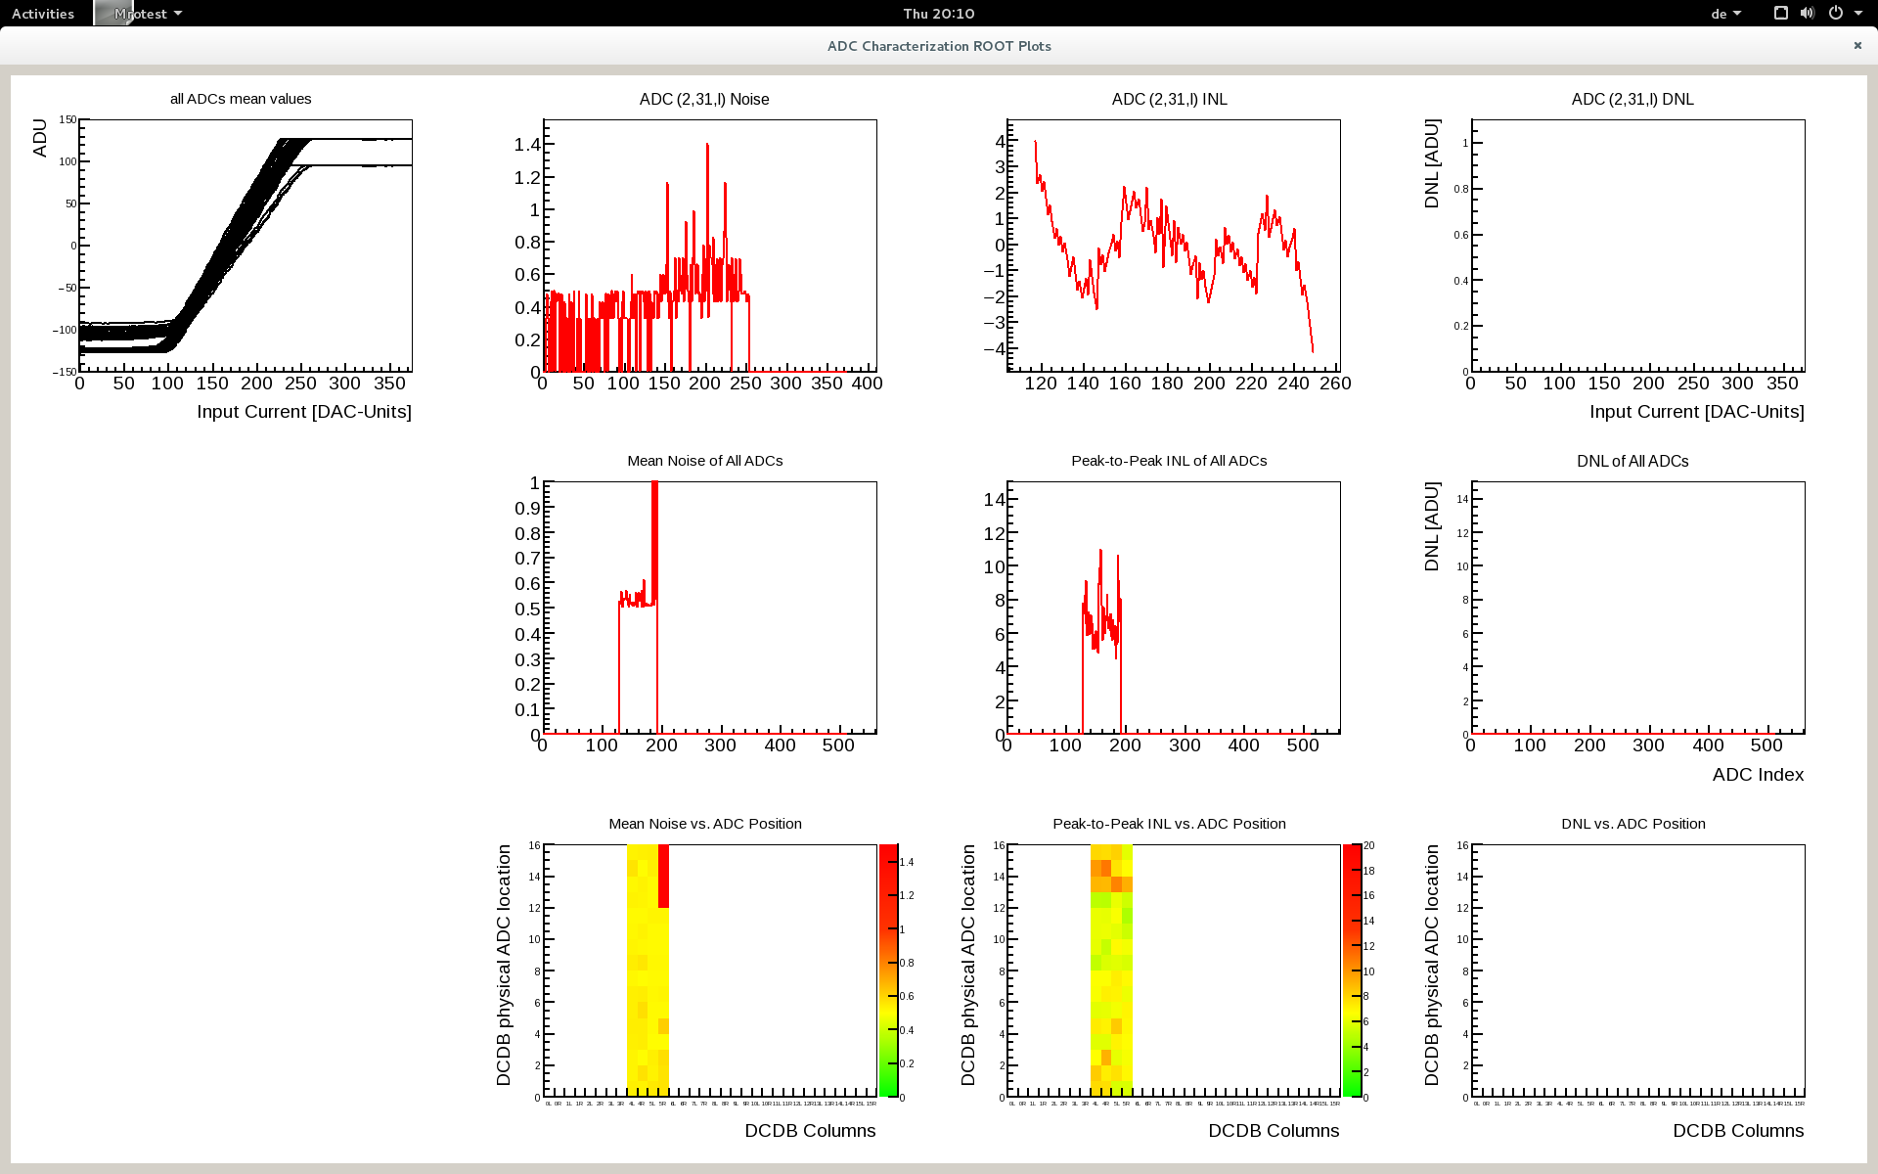
DCDB4.2 - Column 2
…
Start not from -127 – probably poor vdda connection

Slide 12
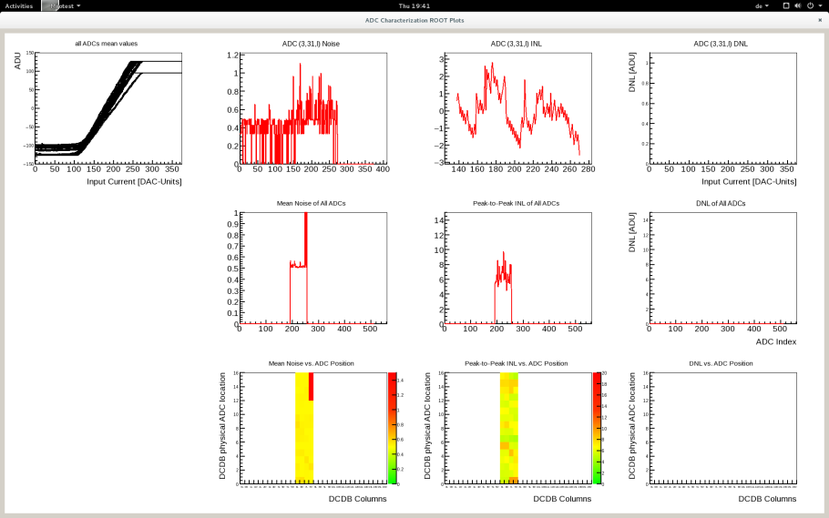
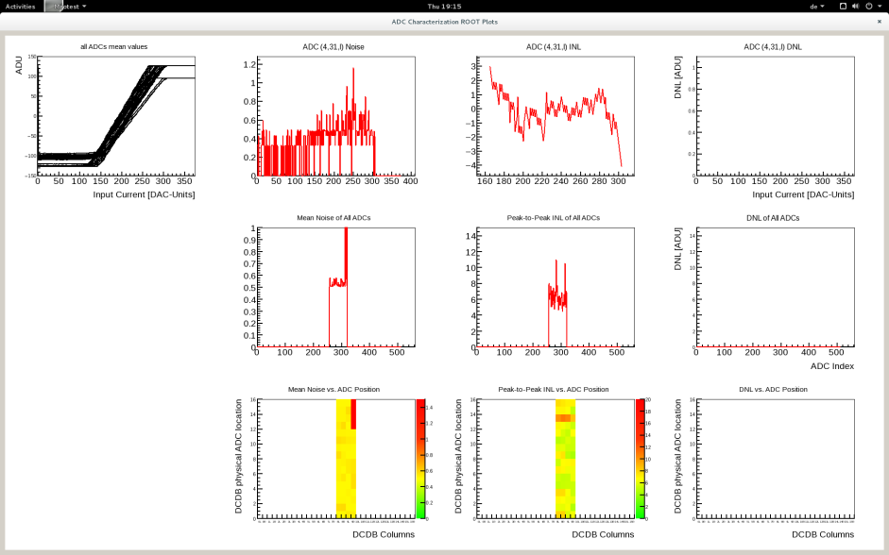
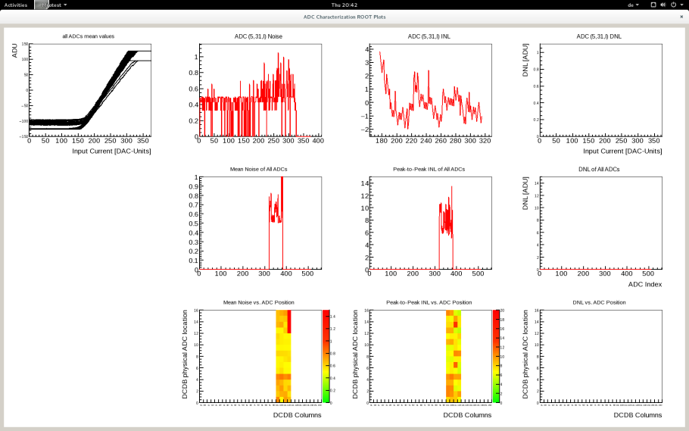
DCDB4.2 - Column 3,4,5
…

Slide 13
JTAG
…

Slide 14
Output Multiplexer
Strobe
TMS,TCK,TDI,TDO,TRST
BitCk/SyRes
Global Register
TestLd, EnTestSR, EnTestNeedle
Digital Part
If enTestSR
JTAG
TDI
TDO
Ck1=Strobe Ck2=TCK
TestLd
Ck1
BitCk/SyRes
Sample=TMS
EnNeedle
EnNeedle
If enTestSR
Strobe
BitCk/SyRes
&

Slide 15
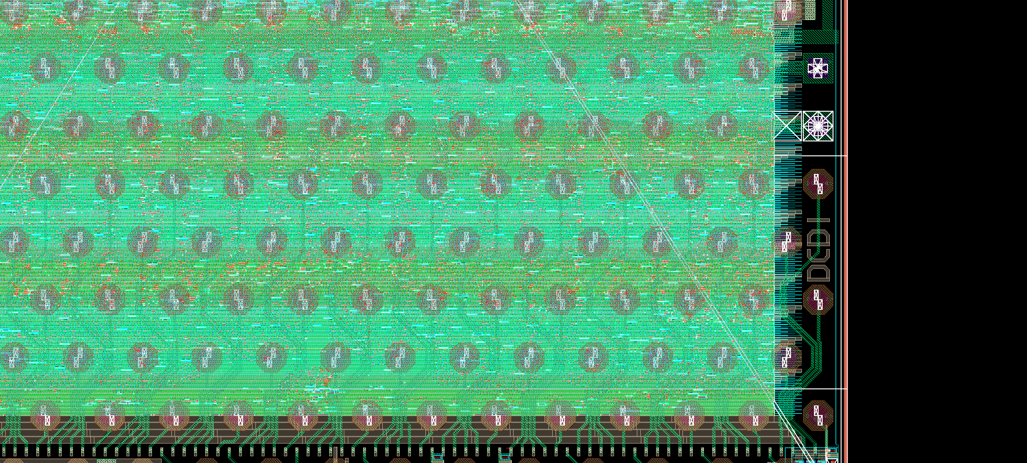
Chip Logo
Logo: DCDI; Chip DCDB4.1; Description: minimal fixes discussed in review, test mux
Logo: DCDIII; Chip DCDB4.2; Description: min fixes, new ADC layout, text mux, new digital part, new test patterns
Logo: DCDII; Chip DCDB4.3; Description: min fixes, new ADC layout

Slide 16
Measurements SwitcherBGv2

Slide 17
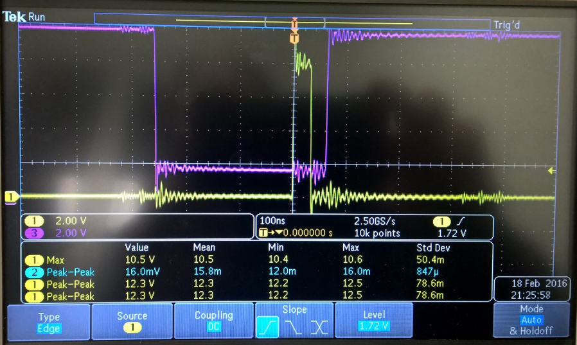
Switcher
The SwitcherBGv2 production version has been successfully tested
The chip has been wire bonded on PCB
Clear signal with ~ 100pF load – as expected
The chip is working well
Clear and gate signals, as expected

Slide 18
Gain Settings
…
19k
13k
26k
En120
En90
En60
En30
Rf
EnCap(0,2,3)
2x100f
60f
Cf
Cstability
Rs
out
15k

Slide 19
JTAG and slow controll
Pixel Register
PixelSel
P_Shift, P_Rb, P_Ld
PixelSel
ShiftDR, CaptureDR, UpdateDR
Address
Global Register
GlobalSel
G_Shift, G_Rb, G_Ld
Digital Block
GlobalSel
State M.
ShiftDR, CaptureDR, UpdateDR
TDO
PreLoad
TMS
CaptureIn
DO0(7:0),DI0(1:0),…,DI3(1:0),SYNC_RES,CLK,RetCLK,TestInjEn,DO4(7:0),…,DI7(1:0)
LatchOut
Data Register
In
Out
CaptureIn
ExtTest OR PreLoad
Cont. Signals
LatchOut
ShiftDR, CaptureDR, UpdateDR
ExtTest
Commands
Instruction Register
FF
Pads
ShiftIR
The other if not ShiftIR
ShiftIR, CaptureIR, UpdateIR
TDI
ID Register
FF
IDSel
ShiftDR&IDSel
FF
FF
Bypass

Slide 20
Conclusion
Measurement results (pilot module, EMCM) with old ASIC generation (DCDPip1.0, DHPT1.0, SWITCHERBG1.0) are good, the only relevant issue data communication DCD->DHP.
New generation of ASICs: Final SWICHERs and DCDs are produced
Enough DCDs for production available
Enough Switchers can be ordered
First tests prove that the DCD and Switchers is in a good shape
Two versions of DCD are tested – DCDB4.1 and DCDB4.2
It is unclear which DCD chip version behaves better
No missing codes seen, however the readout is at 50MHz
Still to do:
Tests with the new probe station and new probe cards
Tests with the output multiplexer and PC2
Tests of chips on hybrid systems
Tests of chips on modules, tests of chips on hybrid systems

