Slide 1
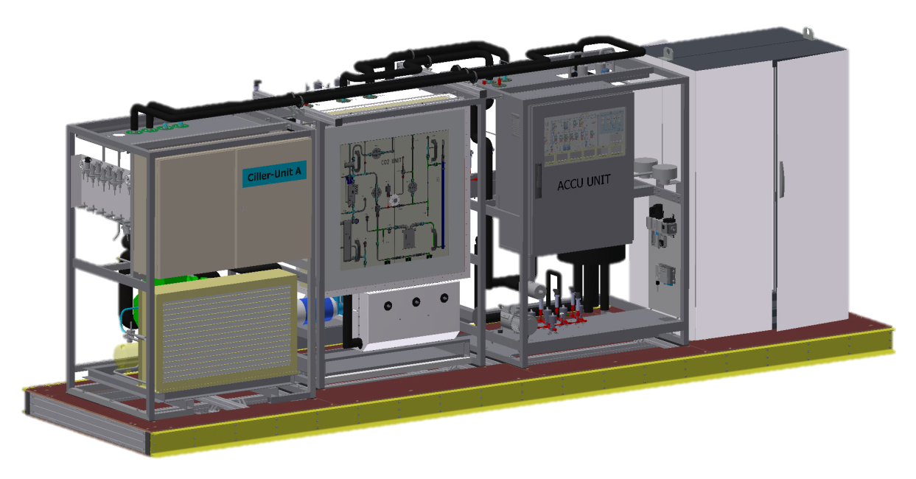
Gemba Summary
Visit at KEK by H.-G. Moser, R. Sedlmayer, and S. Vogt to prepare IBBelle commissioning (April 23-26)
Check location, service connections, logistics
Plan: Shipment (sea transport in summer) 6-8 weeks => arrival August/September
Commissioning: After October B2GM
Needed for Beast Phase II: April 2017

Slide 2
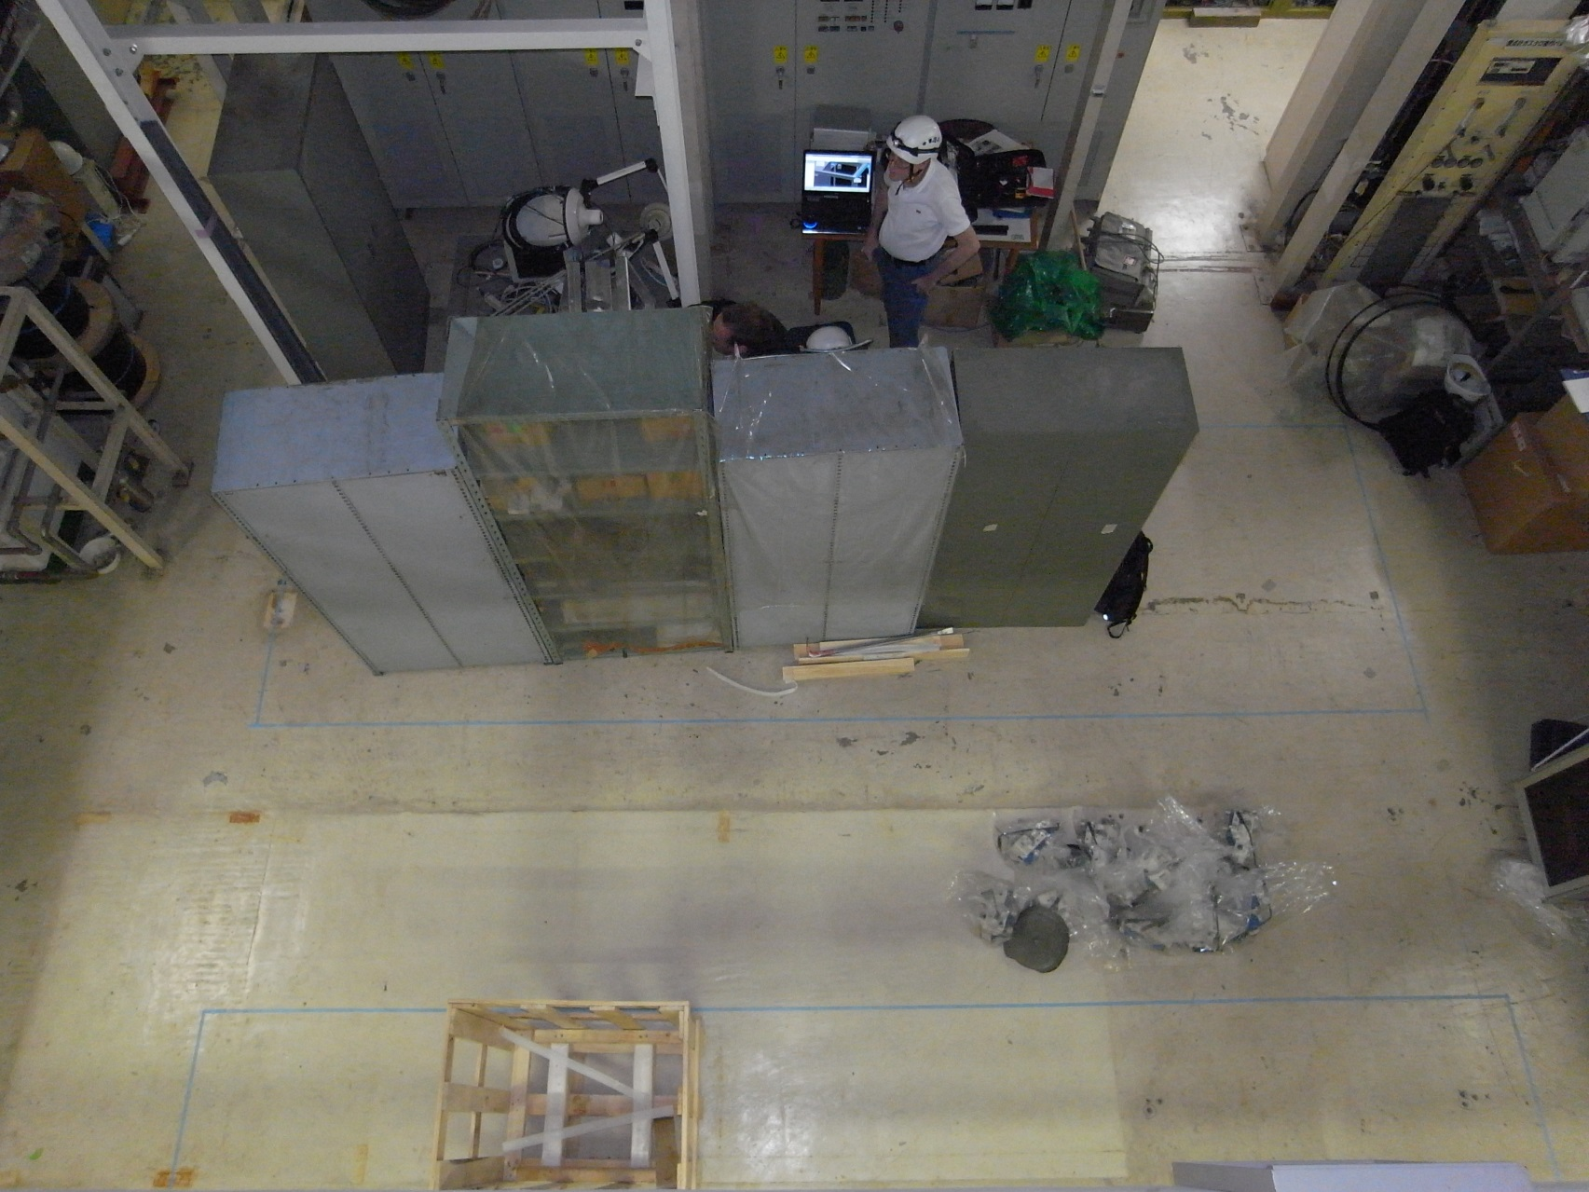
Location
Enough service space?
CO₂ line
UNIT A
Pump removal
UNIT B (laterl)
Room next to Tsukuba Hall in B1 level (used for solenoid)

Slide 3
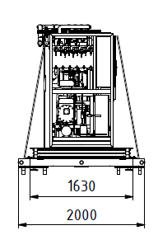
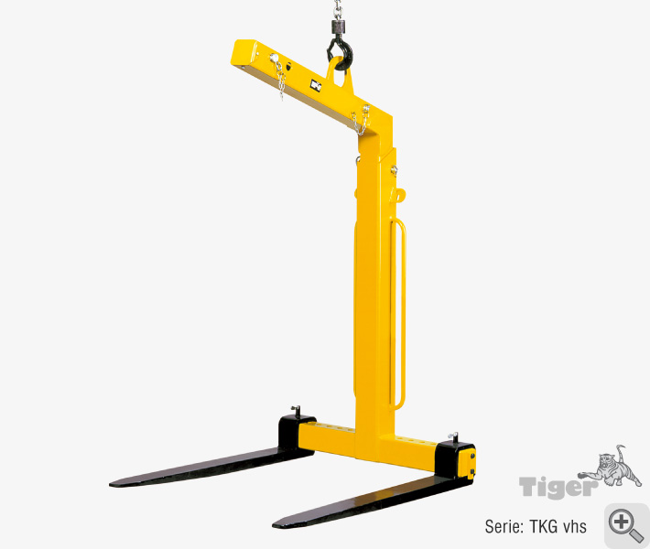
Requirements
60 cm free space around frame for access (open service doors).
Sufficient space for replacement of pumps (lift and crane access).
Short CO₂ transfer lines.
Possibility to fit second unit later without displacing the first one (clearance for crane operation).
Don’t obstruct escape doors.
Remove pump
2 m
60 cm
1 m
60 cm
Need fork for crane

Slide 4
Location at KEK
2.1 m
Unit B
Unit A
For solenoid
Clearance?
0.6 m
1.5 m
>0.6 m

Slide 5
Installation of B-Unit
For solenoid
0.6 m
1.5 m m
>0.6 m

Slide 6
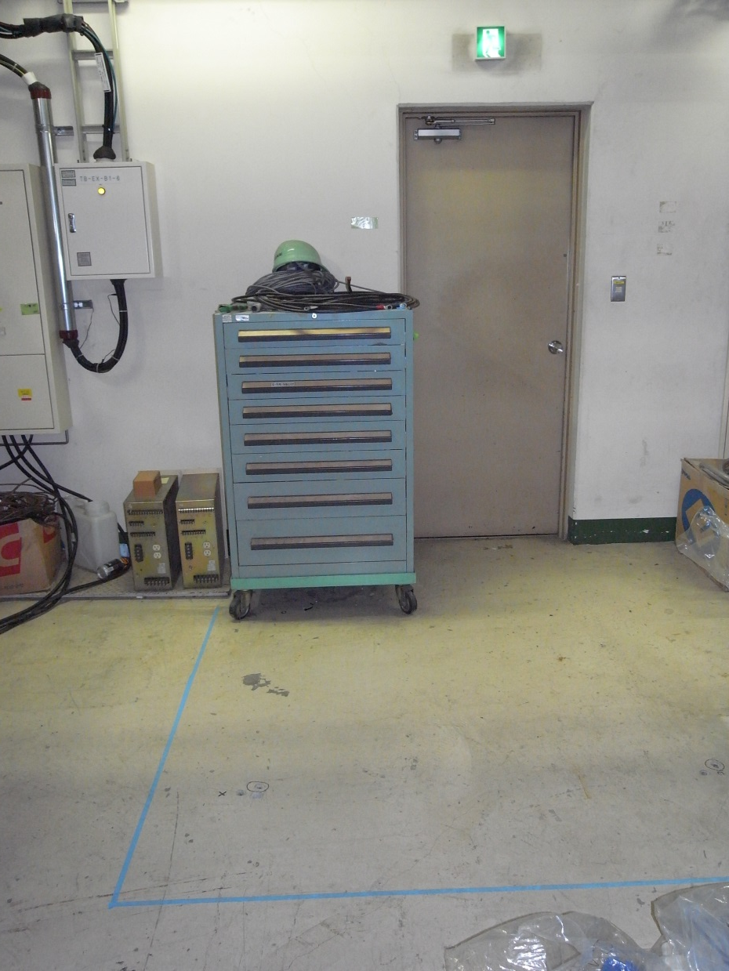
Escape Door
Escape door hidden behind unit B
60 cm clearance between wall and IBBelle frame
(+ 40 cm on frame)
In principle we can short Unit B by ~140 cm
(no accumulator needed)
Only partially hidden.
Is this acceptable ?
Seems to be ok….

Slide 7
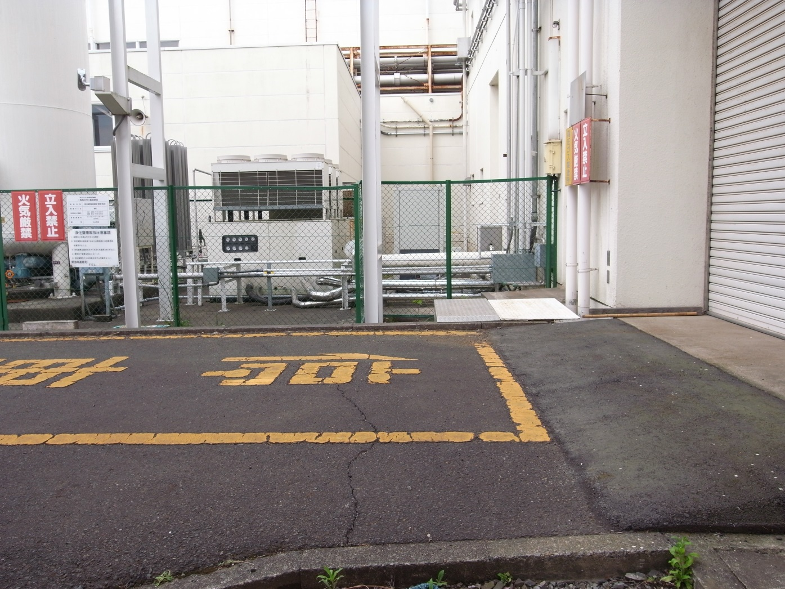
Ramp
In order to extract IBBelle the container has to be levelled and some steps filled
(slight ramp before gate)
Request to transport company(?)

Slide 8
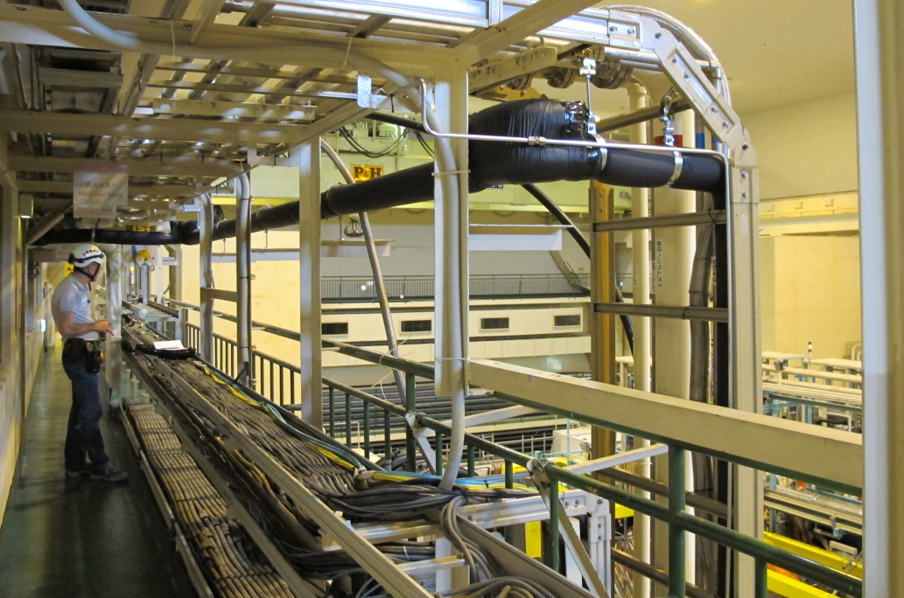
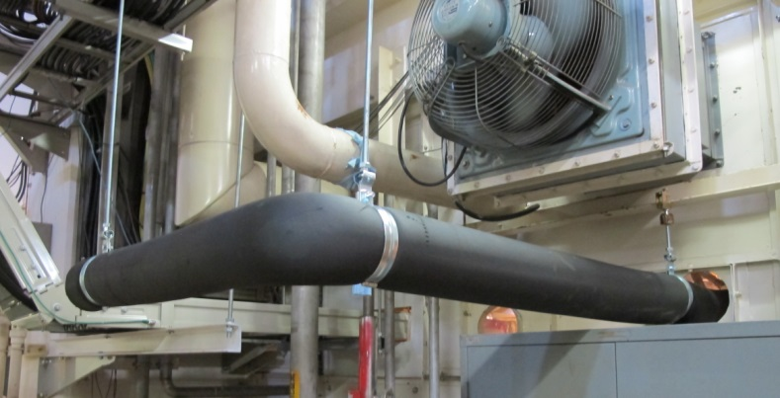
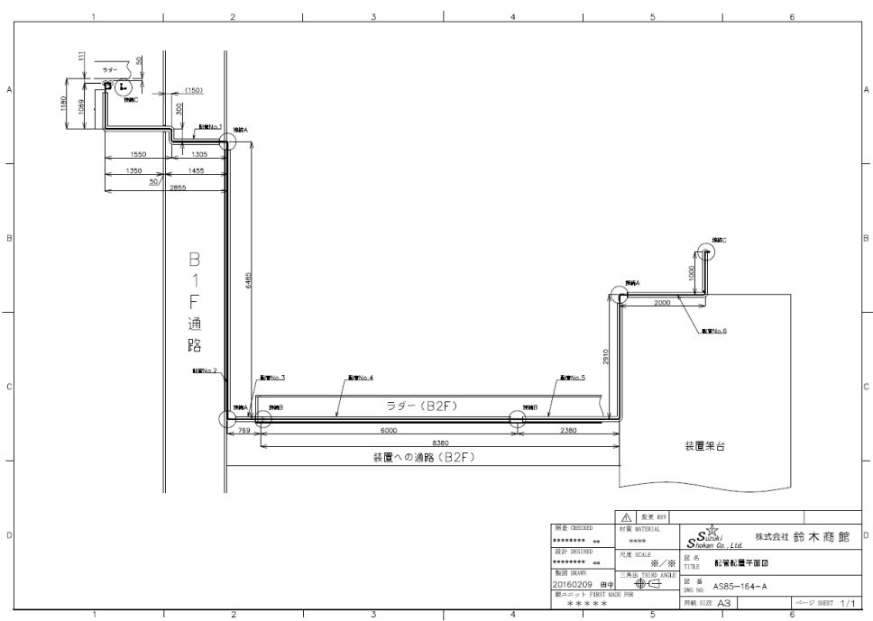
Long Transfer Line
At IBBelle Location
Along gallery (moveable)
Total length: 32 m (as expected)

Slide 9
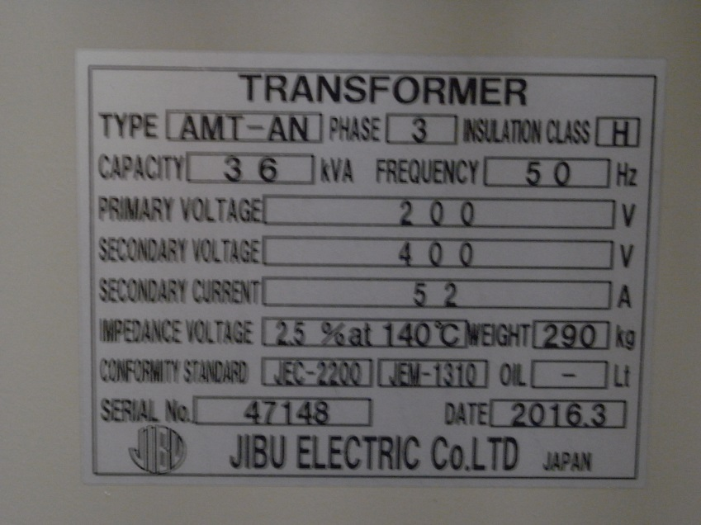
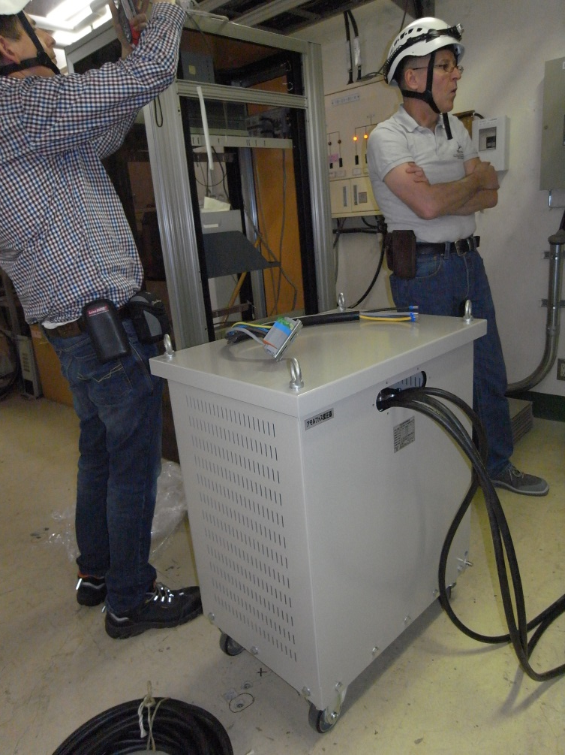
Transformer
Voltage too high (420V instead of 400V)
Might reduce lifetime of some components
Phase shifts between the lines were not correct!
Fixed?
Still confusing measurements
=> Need to verified

Slide 10
Other Services
Compressed air (6 bar, ok)
flexible tube (standard) will be provided by MPP
sample of connection pipe at KEK
Water pipe connection (25°C, 3 bar)
Flexible hose sufficient. Sample of connection type at KEK.
Network
Lan required, power for switch close to JB (Ito-san)
CO₂ connection IBBelle ⬄ transfer line ⬄ JB
VCR, 3/8 and 1/2 inch. Needs to be produced in Japan
CO₂ Connection JB <-> manifolds:
VCR, 3/8 and 1/2 inch. Needs to be produced in Japan. Need tray for tubes and cables (to give headroom).
Vacuum for Flex lines:
10⁻⁷ bar => ok
IBBelle shipment in summer. After locating it in B1 the exact pipe shapes and length can be defined. Time for production and installation: till October 2016

Slide 11
Other Requests
Monitoring of environment (humidity, temperature):
Dew point < 15°C.
R404a filling
By company. Quantity: 12 kg. Needed early October
CO2 filling:
by us or KEK group, need 3 bottles 50kg (with rising pipe) in B1
Unloading IBBelle from container:
need to level container

Slide 12
Tools needed
Crane tool: bar
Fork to lift pumps with the crane (only if unit B installed)
5 m x 2 m; 5 tons

Slide 13
Additional budget for IBBelle
Shuji Tanaka:
AC transformer (400V: 3phase with neutral line)
Water Cooling pipe
Vacuum pump for flex line
Transfer tube piping (also between junction box and manifold)
CO₂ monitor
Dew point sensor for IBBelle room

