Slide 1
FOS environmental monitor at the 2016 Test beam Kloster seeon, 20th Depfet Workshop
D. Moya, I. Vila, A. L. Virto., J.González
Instituto de Física de Cantabria (CSIC-UC)
G. Carrión, M. Frövel.
Instituto Nacional de Técnica Aeronautica (INTA)

Slide 2
Outline
Goals & Context
FBGs distribution.
Monitored Temperatures.
Humidity Sensor prototype.
Conclusions

Slide 3
Goals & Context.
Initial goal: temperature monitoring with acrylate coated fibers of the dry box atmosphere, cooling block and cooling outlets
First test of a FOS humidity sensor prototype able to operate under non-stable thermal conditions (“very first test”).
Issues encounter before and during the TB:
Ordered acrylate coated fibers did not arrive in time. Replaced by polyimide coated fibers (required humidity compensation).
Failure to compensate the temperature-induced bias in the humidity prototype

Slide 4
TB 2016: TB Fibers and FBGs
Fiber ID | FBG# | Coating | Tubing | Dominant Sensitivity | position
42 | 1 | polyimide | Teflon | Temperature (humidity?) | Environmental (F43,F54 ref sensor)
3 | 1 | polyimide | Metal tube | Temperature | Return pipe Temperature
4 | 1 | polyimide | Metal tube | Temperature | Cooling Block Temperature
1 | 1 | acrylate | Open metal tube | Temperature | Environmental (F2 ref sensor)
2 | 1 | polyimide | Open metal tube | Temperature + Humidity | environmental
43 | 2 | polyimide | none | Temperature + Humidity | environmental
54 | 4 | polyimide | none | Temperature + Humidity | Environmental
DAQ architecture and EPICS integration as in 2014 test beam

Slide 5
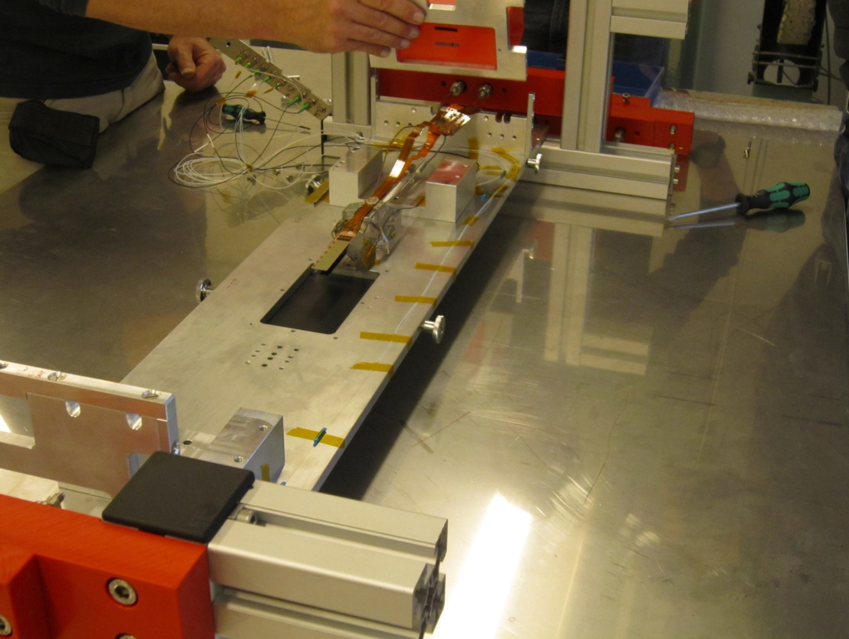
TB 2016: TB FBG Distribution
Fiber 3
Fiber 2 + 1
Fiber 43+42
Fiber 4
Fiber 54

Slide 6
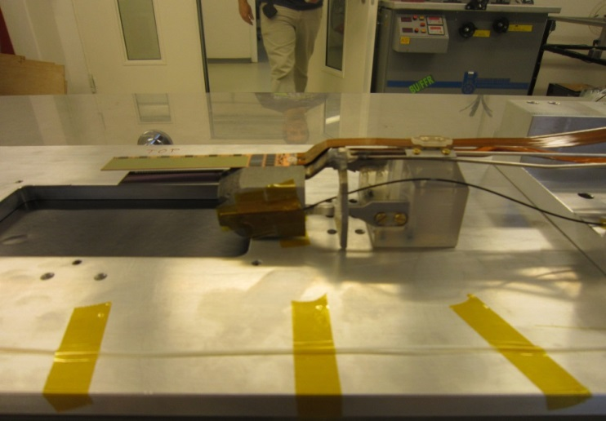
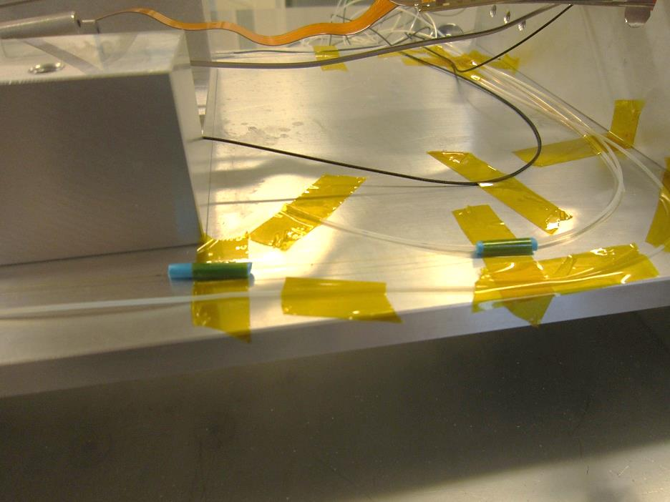
TB 2016: TB FBG Distribution
Fiber 2 (polyimide) + Fiber 1 (acrylate)
Fiber 4 (Temp. Ref.)
Fiber 42
(Temp. Ref.)
Fiber 3
(Temp. Ref.)
CO2 return pipe
Fiber 54
(Temp + RH%)
Fiber 43
(Temp + RH%)

Slide 7
2016 TB: Temperature measurements.
All the temperature measurements made under stable low-humidity conditions: data was not recorded either during the nitrogen injection or when the nitrogen flow ceased.
Teflon-encapsulated polyimide fiber showed a very slow (lasting several days) “drying drift” due to its very long latency on responding to the humidity changes (as expected).
Non-encapsulated polyimide fibers did not present any humidity-induced bias inside the low-humidity atmosphere (as expected since the FBG temperature calibration was done in dry atmosphere).

Slide 8
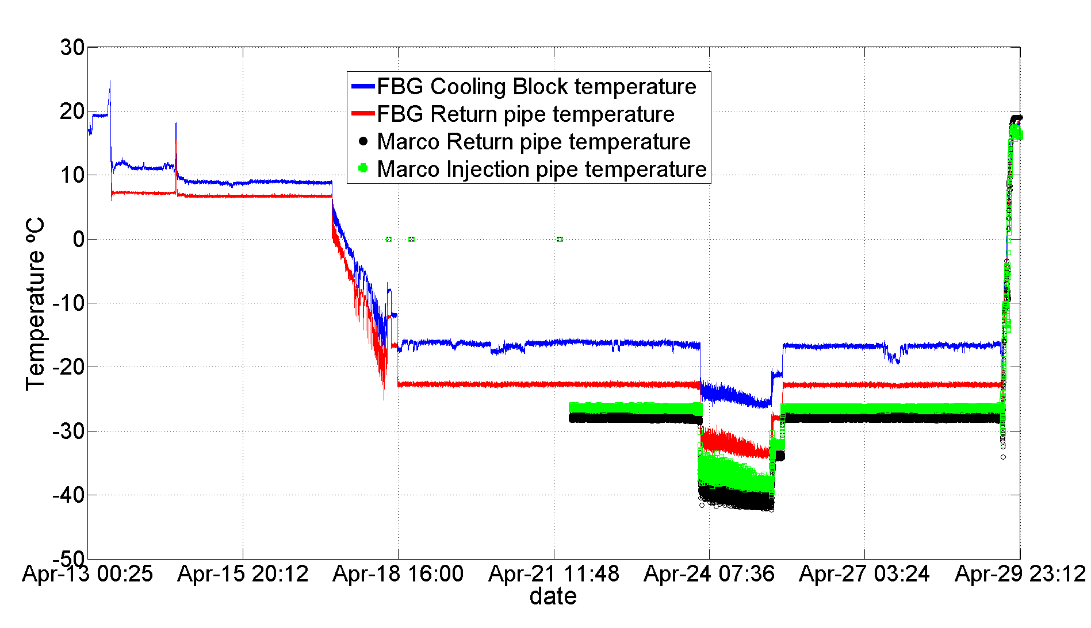
2016 common TB: Temperature measurements.
Cooling block and return pipe references sensors temperature matched temperature change observed by Marco (not Marco data available in epics until 21th of April)

Slide 9
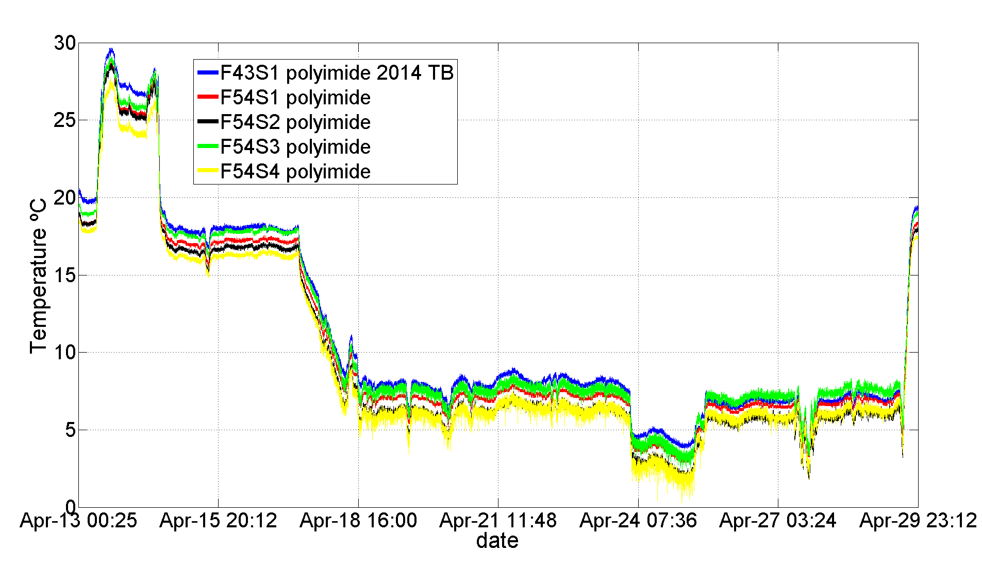
2016 common TB: Temperature measurements.
F54 and F43 followed each other in a quite accurate way (although they are positioned quite far one from the other).

Slide 10
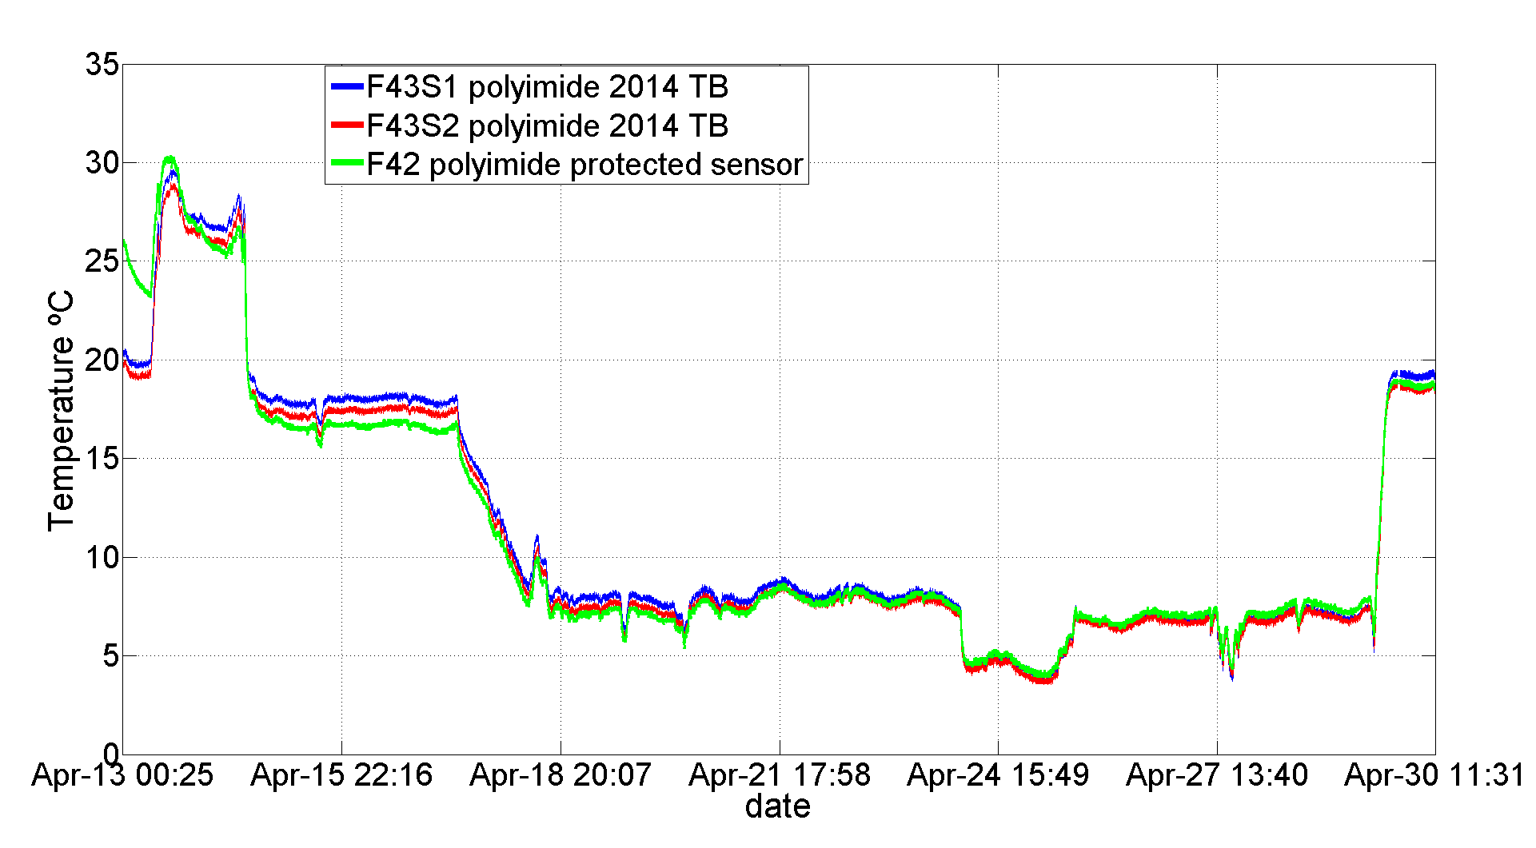
2016 common TB: Temperature measurements.
F42 was sensitive to humidity with days of latency (the offset was recalibrated with F43 measurement of the 23rd of April). After F42 stabilization all sensors measured near the same temperature.
Humidity stabilization

Slide 11
Humidity measurement approach
Sensing principle: Water molecules may swell the fiber coating expanding the inscribed FBG( material dependent effect)
Transductor implemention: closely packed acrylate coated (T) and polyimide coated (T+HR) FBGs. Compensate temperature induced bias of the polyimide FBG readout using the acrylate read-out.
Challenges to be address:
Strain-free packaging.
Residual humidity sensitivity of acrylate.
Latency (response stabilization)
Low sensitivity at low-humidity and saturation effects.

Slide 12
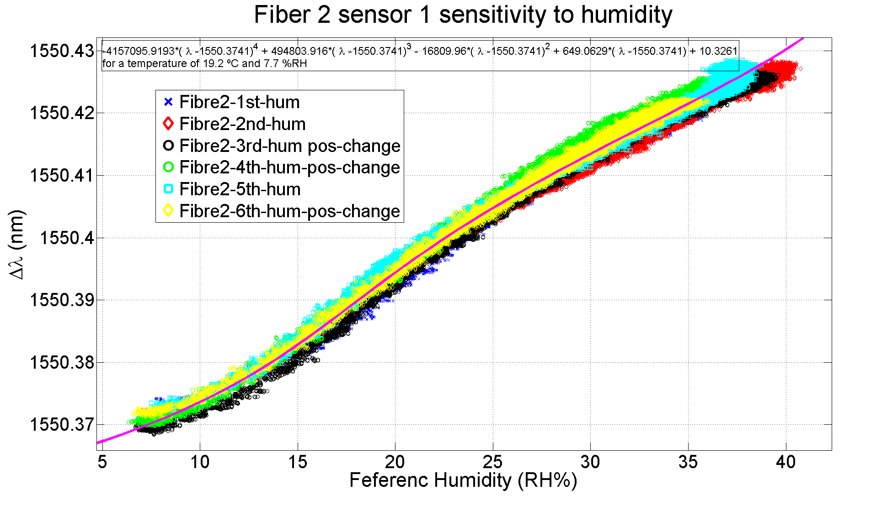
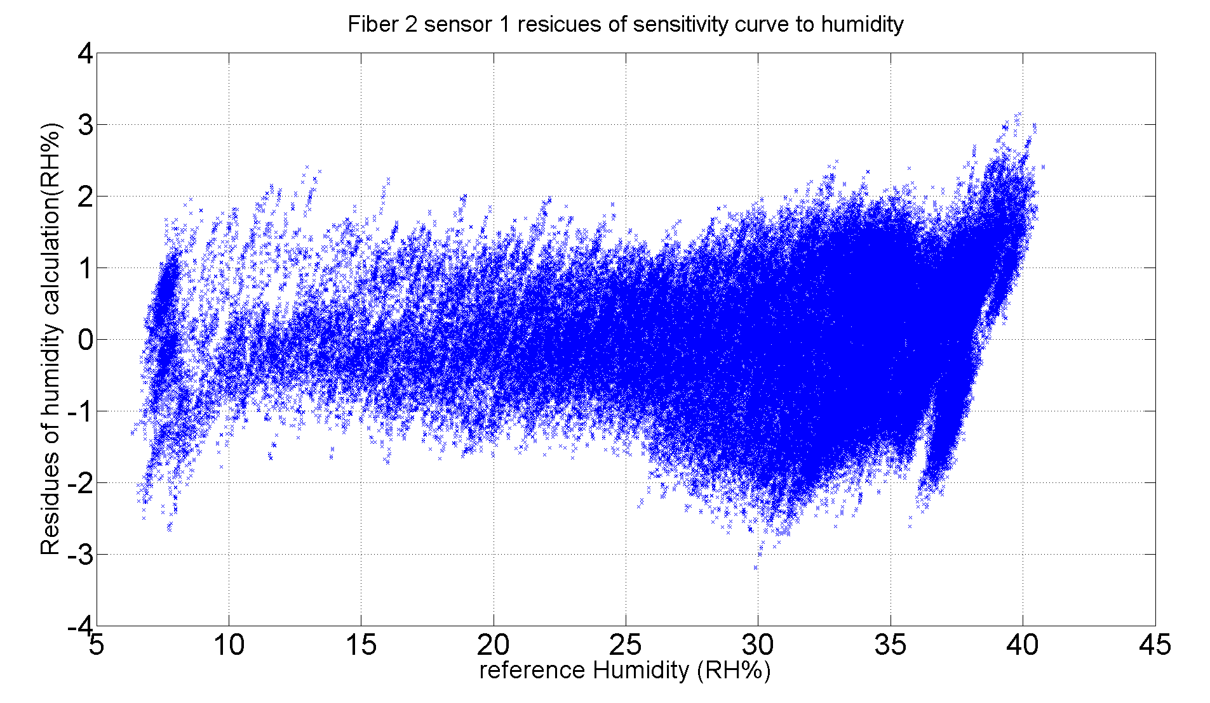
FBG-s Humidity calibration
Polyimide coated fibers where calibrated six times with a great repeatibility in the results and residues.

Slide 13
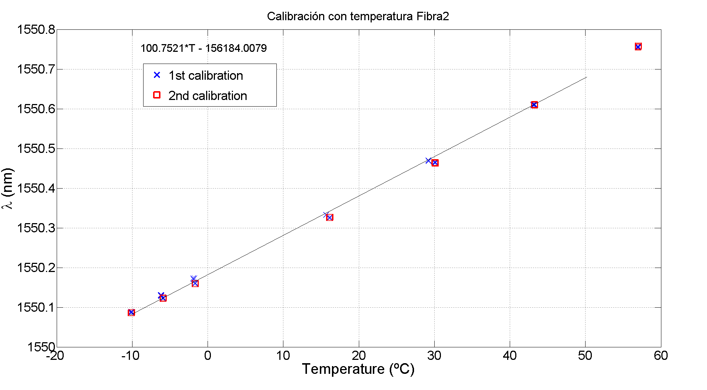
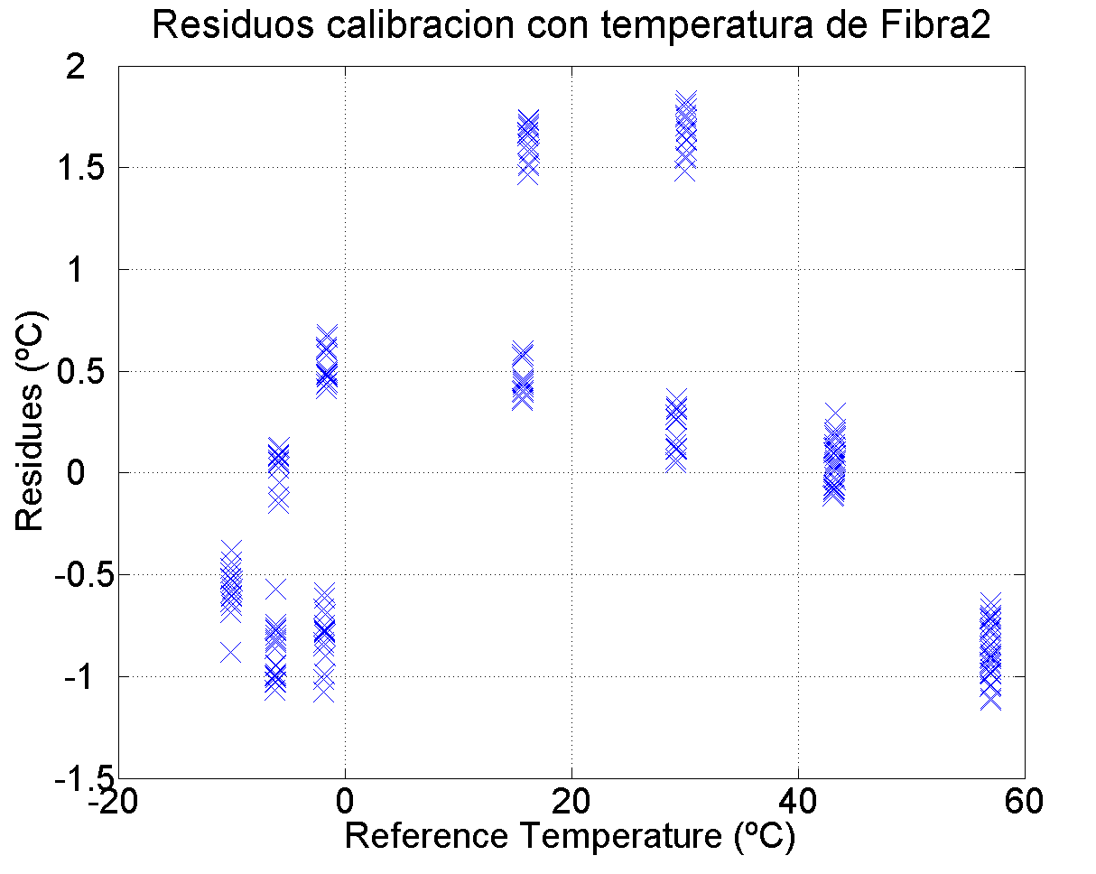
FBG-s Temperature calibration
The temperature calibration of the FBGs done under a low-humidity conditions.
During the test beam the F1 FBG to be used to compensate the temperature induced bias on the humidity measurement showed an apparent temperature a sensitive 20% smaller than the obtained during the calibration
Still unclear the origin of this discrepancy that prevented us to provide an accurate humidity determination.

Slide 14
Conclusions
Under stable humidity conditions polyimide coated fibers measured temperature accurately matching the test beam cooling and operating condition (reproducing 2014 Test beam measurements.)
Prototype humidity sensor did not work properly quite likely due to inaccurate temperature bias compensation
Dedicated test stand to characterize the humidity measurement sensor’s and calibration cross-check.

Slide 15
Backup

Slide 16
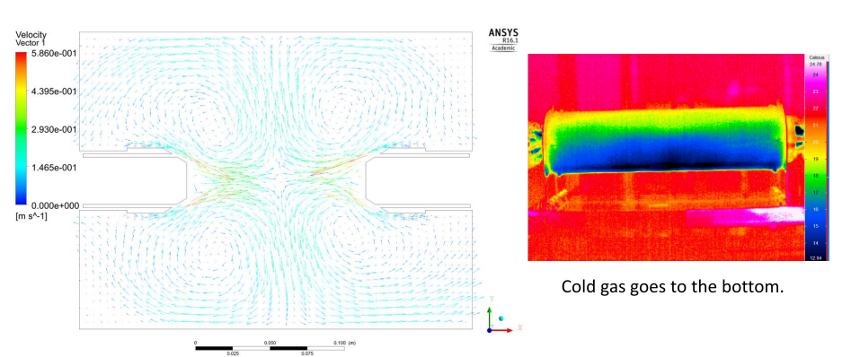
PXD Mockup: Operating Conditions
… Turbulent highly non-uniform regime inside the PXD envelope.
Temperature compensation of humidity fiber is not possible with the current FBG distribution.
Temperature readout accurate as long as temperature fibers F51, F52, F53 are operated long enough in a dry atmosphere.

Slide 17
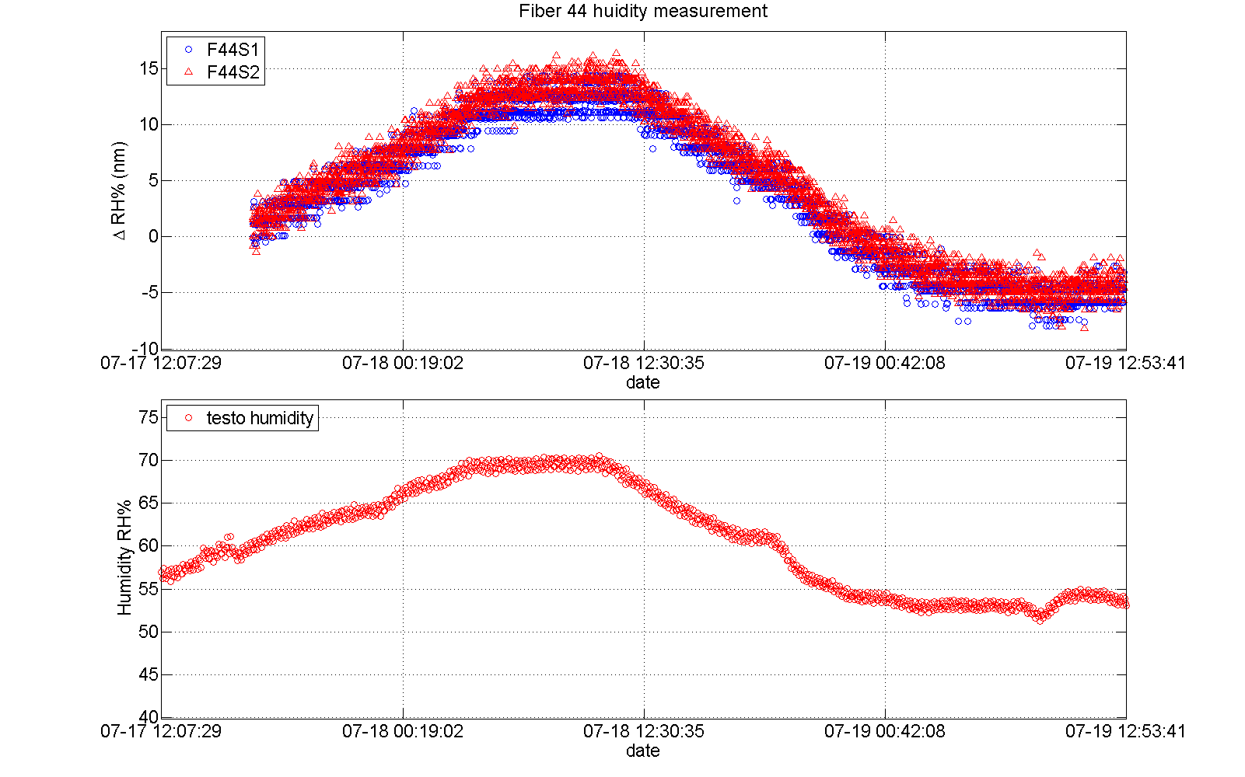
First results: Humidity Reference Fiber
Humidity reference sensor measures accurately Humidity change when the dry volume is open after temperature effect compensation
Under stable thermal conditions

Slide 18
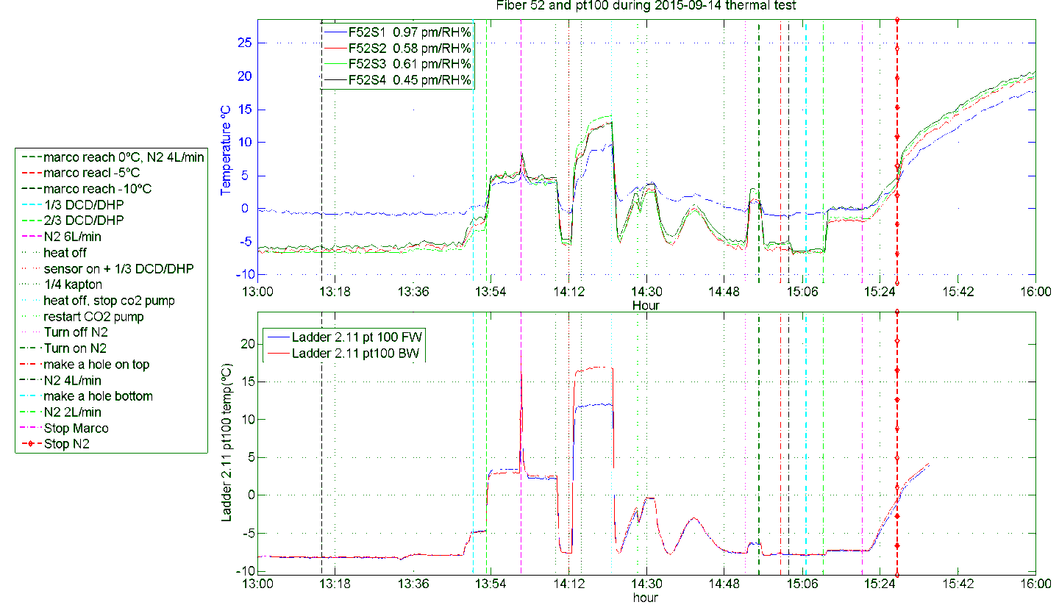
Mock-up: Temperature tests (N2 atmosphere for 3 days)
Comparison between Pt-100 in the ladder and FBG measurement
F52
F51
S2
S1
S2
S3
S4
N₂ off ?
FOS and pt100 very similar behavior.
S2-S4 sensing similar temperatures
S1 (outside the direct blow stream different behavior)
No effect of N₂ leaks
Sensitive to presence and flow of N₂
FBG sensors more sensitive to the N₂ temperature.
N₂ off
Kapton
N₂ 4→ 2 l/m
N₂ leak
N₂ OFF
N₂ 4→ 2 l/m

Slide 19
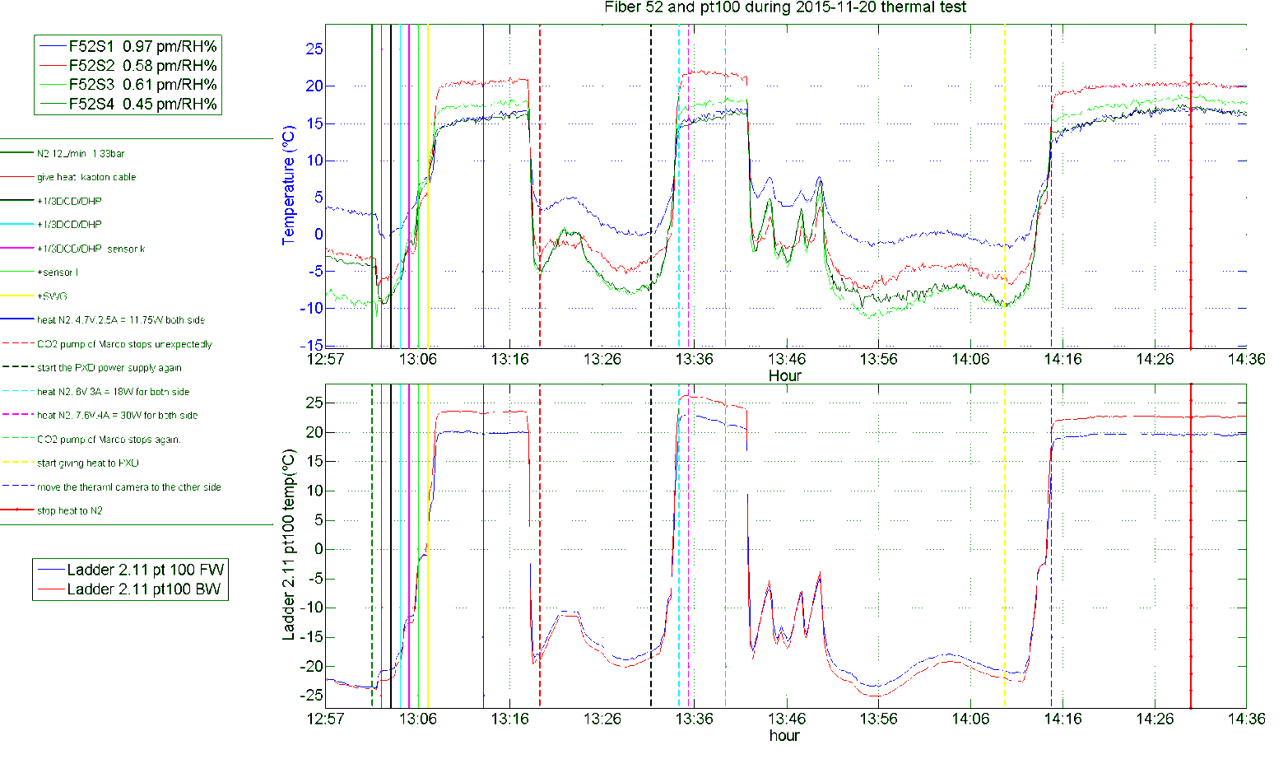
Mock-up: N₂ Injection at different temperatures
S1
S2
S3
S4
F52
F51
No Increase on the temperature is observed.
Is the N2 being really heated ?

Slide 20
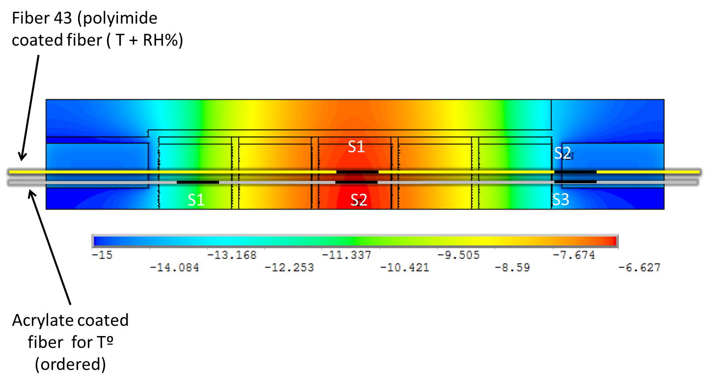
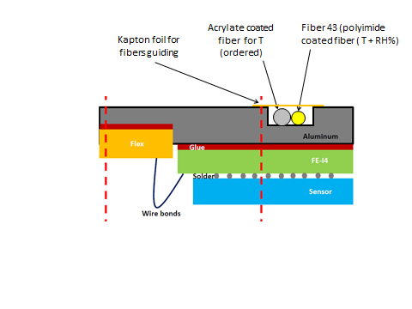
Test Beam and FANGS proposal
For April’s test beam we could re-use the current system used at DESY mock-up (already employed in January 2014 integrated test beam).
Additional fibers for FANGS ladders.

Slide 21
Conclusions
Under stable environmental conditions: accurate temperature and humidity measurement with fibers (reproducing January 2014 test beam)
Under mockup operating conditions: accurate temperature measurement mapping pt100 readouts with additional sensitivity on N2 atmosphere conditions.
Issues to be address:
The temperature compensation required for determining the humidity not possible (yet).
Residual FBG strains due to fiber fixing.
Proposal for a test beam and FANGS configuration.

Slide 22
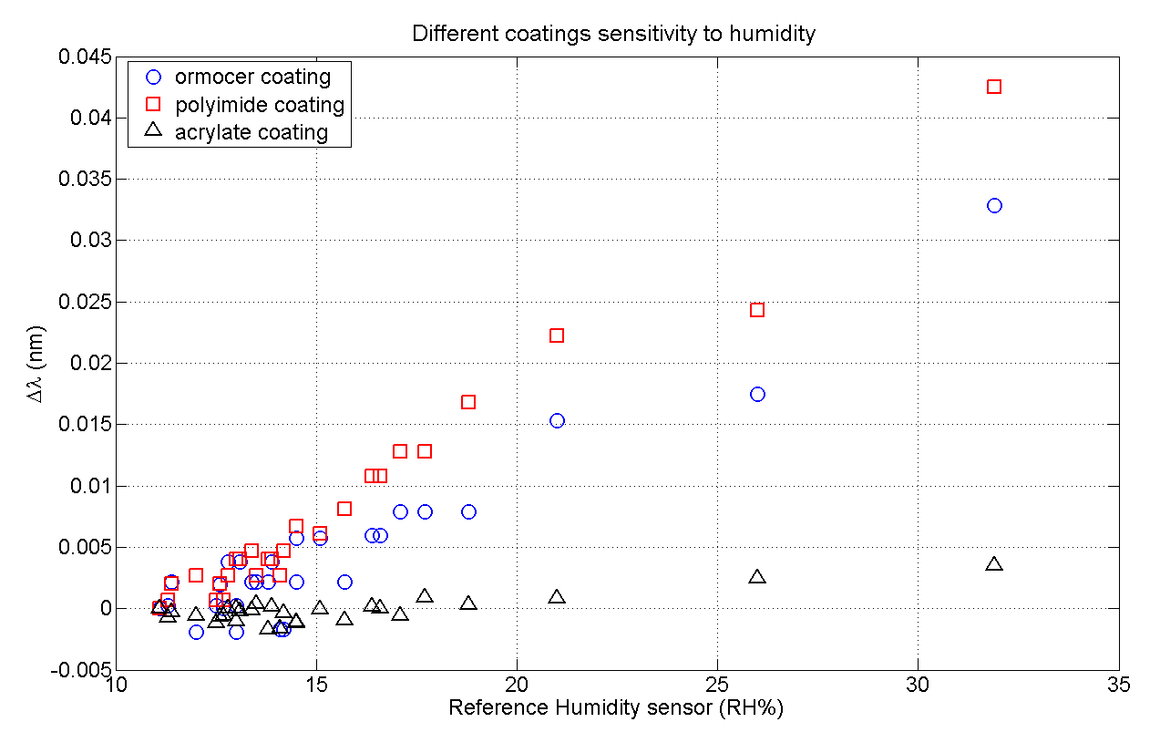
Coatings sensitivity to humidity

Slide 23
2016 Common TB: System description
The initial idea for the Test Beam:
Position Acrylate (very low sensitivity to humidity) sensors near polyimide sensors ( sensitive both to Temperature and humidity) for temperature compensation and monitor temperature and humidity at the same time.
Some problems:
Acrylate coated fibers didn´t arrive: Use as reference F42 (TB 2014) which was found to be sensitive to humidity with days of latency.
Fiber 1 and Fiber 2 seems not to measure same temperature ( Strain, different temperature?)
Humidity measurements will not be presented ( must be studied in more detail)

