Slide 1
Documentation
Transition to “Production Mode”
Please update docu and place it to Wiki
Sensors, ASICs, Assembly, backend electronics &DAQ
Schedule Module/Ladder
TB decision: go on with sensor prod? (!)

Slide 2
Module Assignment – PXD9-6 (Pilot)
 | W30 | W35 | W36
IF | 0 | 98.44 | 98.96
OF1 | Pilot module 0, H7 | 98.44 | 98.96
OF2 | Pilot module 0, broken | 98.96 | 99.48
OB1 | Pilot module 0 | DESY test 0 | 0
OB2 | Pilot module 0 | 0 | 98.96
IB | DESY test 0 | 0 | 99.48
Assemble remaining modules asap!
practice assembly
4 Modules for PF (OF) with Taiyo kapton from recent batch (are there enough)
IF and IB w/o kapton for Probe card qualification
Chipset: SWBv2.1, DCDB4, DHPT1.1

Slide 3
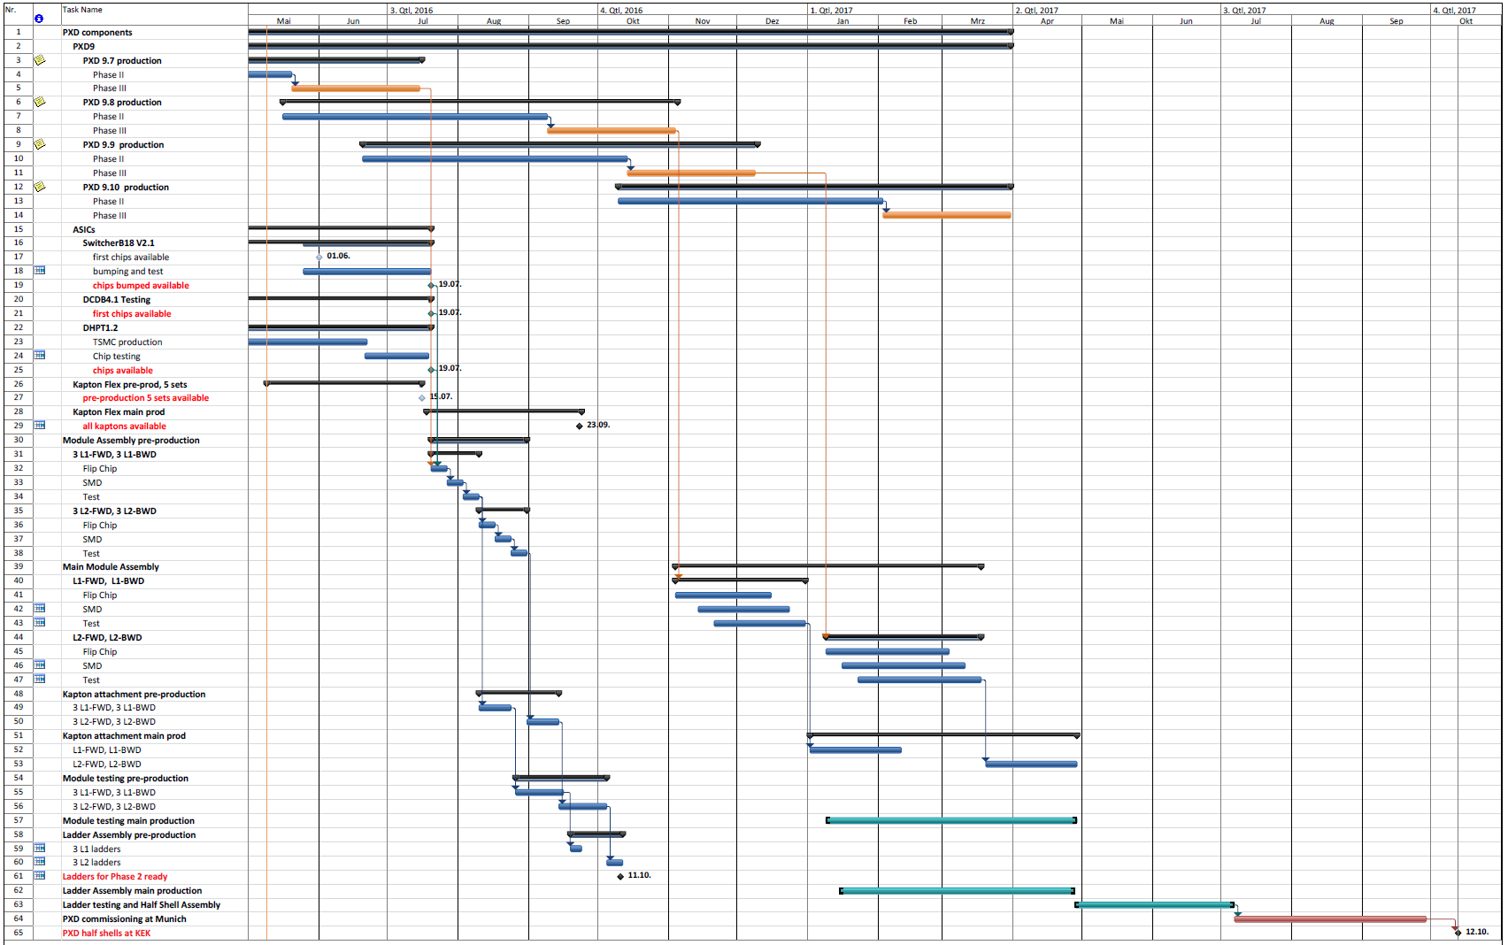
Updated schedule – creation of contingency

Slide 4
Updated schedule – creation of contingency
4 batches: PXD9-7 .. 10
PXD9-7 on schedule
4 wafers
almost PXD/2
For pre-production
PXD9-8 and PXD9-9
15 wafers for main
Incl. spares
PXD9-10
7 wafers
PF and emergency

Slide 5
Updated schedule – creation of contingency
SwitcherBv2.1
Pre-prod available
Partly bumped, tested
Re-order 500 more now
DCDB4.1
First tests okay
~ 450 chips available
12 weeks for more tests
DHPT1.2
In production at TSMC
Backup DHPT1.1
Test as soon as back
For pre-production
Order more autumn 16

Slide 6
Updated schedule – creation of contingency
Kapton
Qualify Kaupke company
5 sets Pre-prod ordered
8-10 w lead time
Main order asap

Slide 7
Updated schedule – creation of contingency
Module pre-production: July
3 L1 and 3 L2 ladders
Final chip set
Slowly step-by-step
FC, SMD, test
Repeat pilot with larger sample, practice ….

Slide 8
Updated schedule – creation of contingency
Ladder assembly
Kapton attach
Module testing
Ladder assembly
Phase 2 ladders mid. Oct.
Two spare ladders per layer

Slide 9
Updated schedule – creation of contingency
Main production, FC, SMD, test
Start w/ PXD9-8
Earlier w/ PXD9-7 rem.
4 modules/week
6 weeks L1 → 24 (16)
8 weeks L2 → 32 (24)
Kapton attach when L1 done
Can be earlier
Testing as soon as module available
Testing/ladder assembly interleaved

Slide 10
Updated schedule – creation of contingency
Ladder assembly, Ladder testing, half shell assembly
~25 weeks → contingency!!
PXD commissioning at MPP
3 months → contingency (??)
Shipment to KEK 1 week
PXD@KEK 12.10.2017

Slide 11
Summary
Gaining experience with gated mode operation
Weak points of module periphery of pilot run identified
More tests needed, optimize operation parameter of DCD
(very) first tests with analogue CM very promising ….
Can’t do much more with metal routing on module → go on with sensor production
Updated schedule presented
First batch sensor production on schedule, in spite delay due to gated mode tests
Second batch to start this week
Two phases of module/ladder production:
Pre-production for phase 2 and spares with fast feedback to IZM (flip-chip)
Main production in larger batches safes time, creates contingency ….

