Slide 1
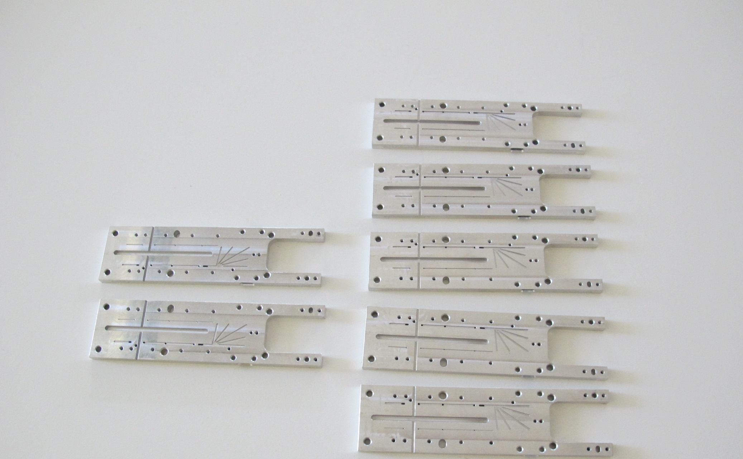
Module/Ladder Assembly
Receive module from HLL (after SMD assembly)
Kapton assembly (soldering, wire bonding)
Tests & characterisation
Glue two modules to a ladder
Test
Need jigs and tooling for each step
Module fixation for handling
Storage and transport
Tests (cooling)
Tooling

Slide 2
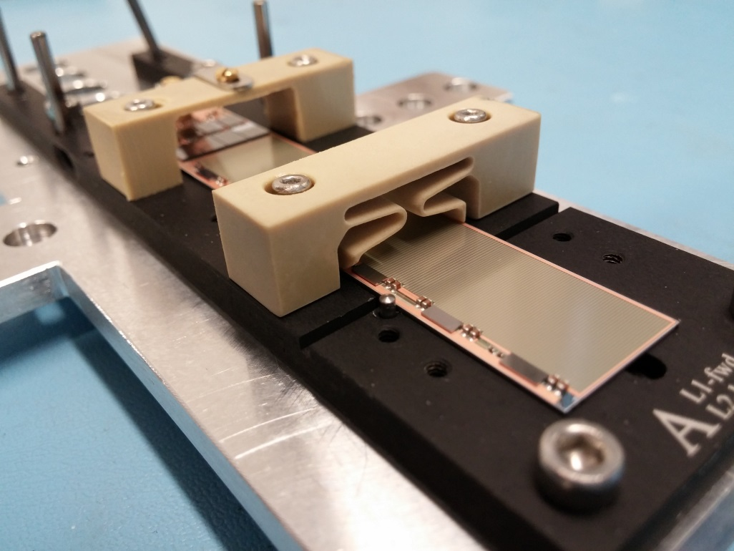
1st Step: Module
Base jig sensor
For transport and bonding
New clamps
Electrical insulation (Parylene)
Used for pilot modules
85 jigs in production

Slide 3
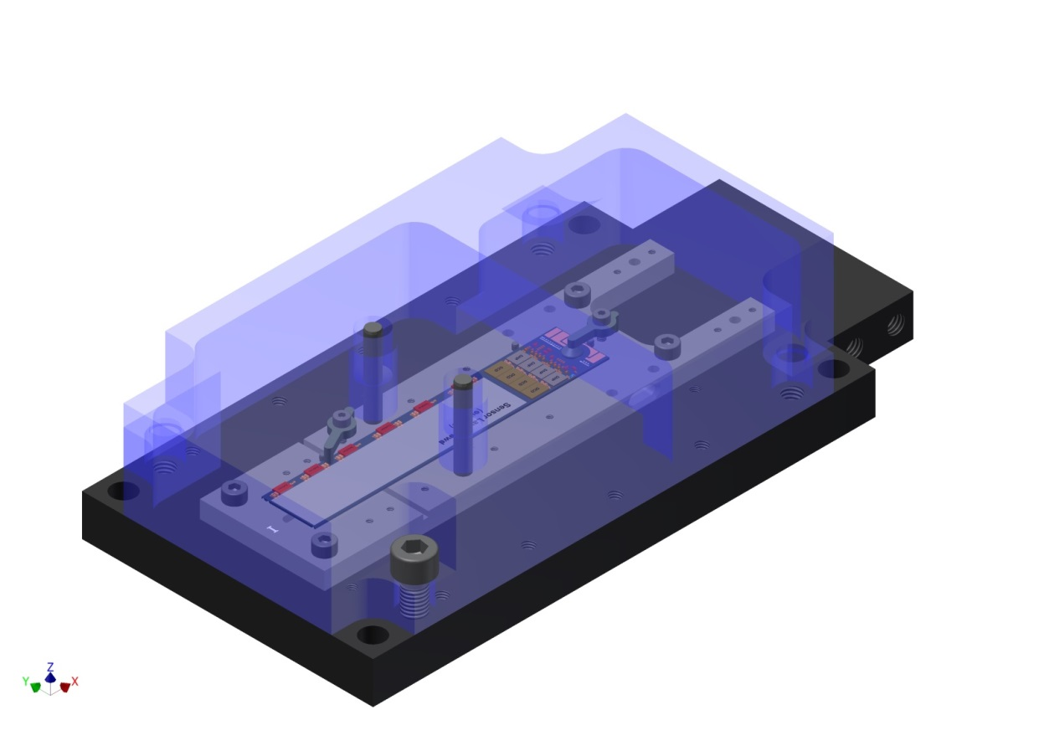
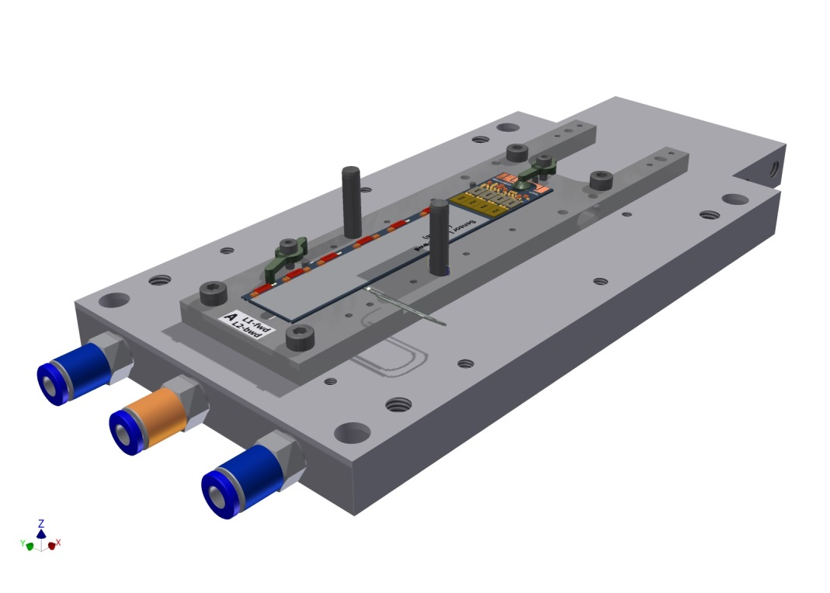
Transport cover
Cooling plate
(for tests)

Slide 4
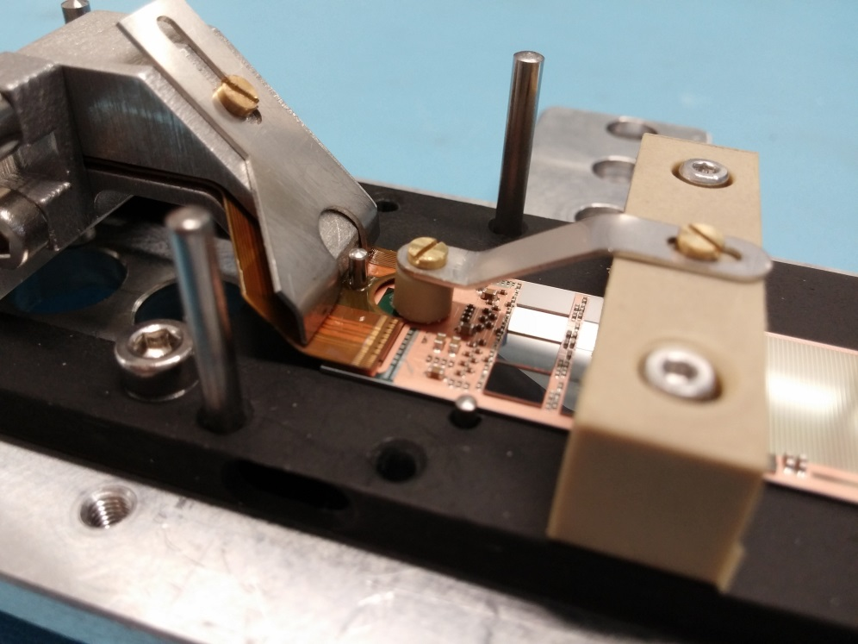
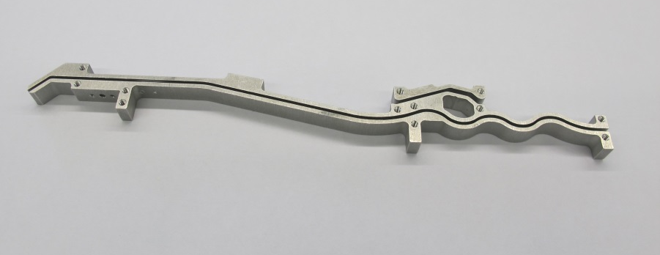
Kapton jig
shaped, to keep bending
Many improvments after prototyping
Special clamp to keep kapton flat during soldering
(& weight)

Slide 5
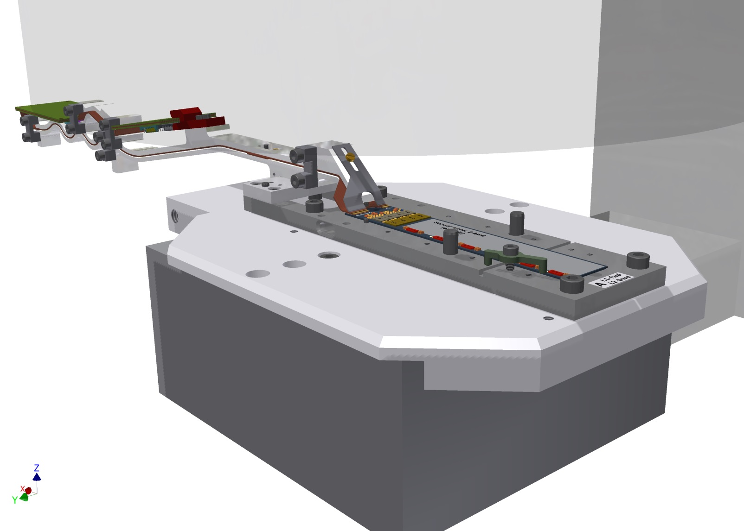
wire bonding

Slide 6
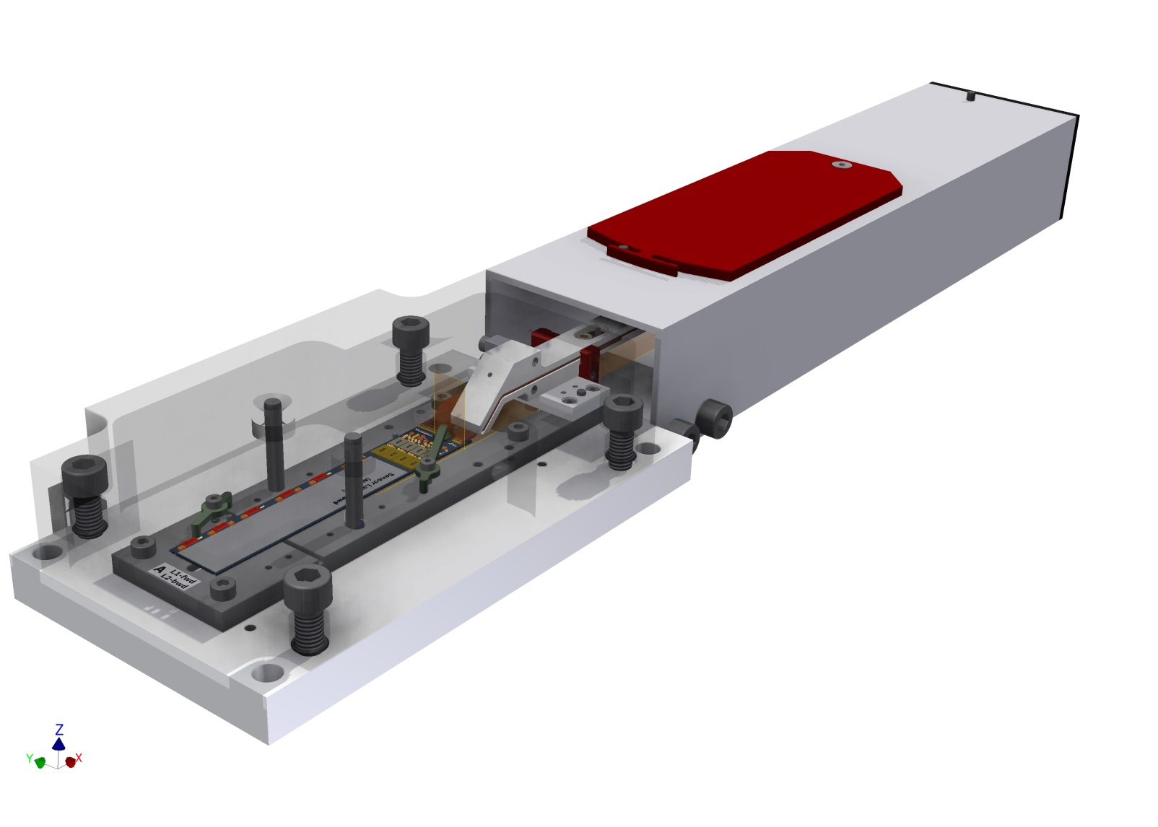
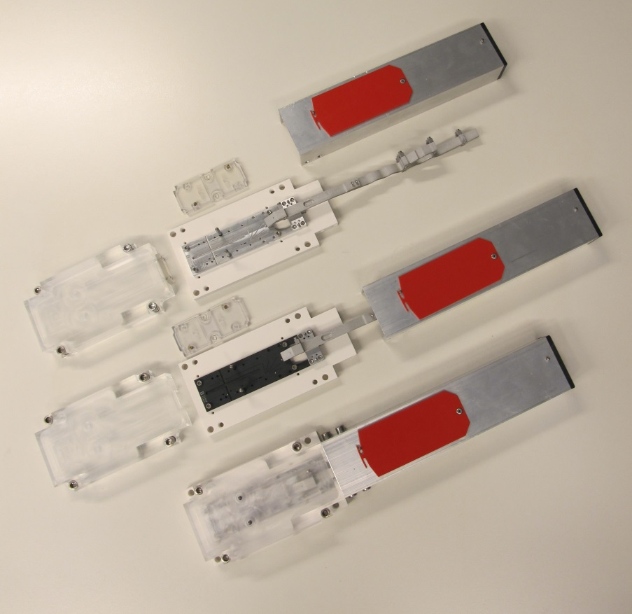
With protective cover for transport and storage

Slide 7
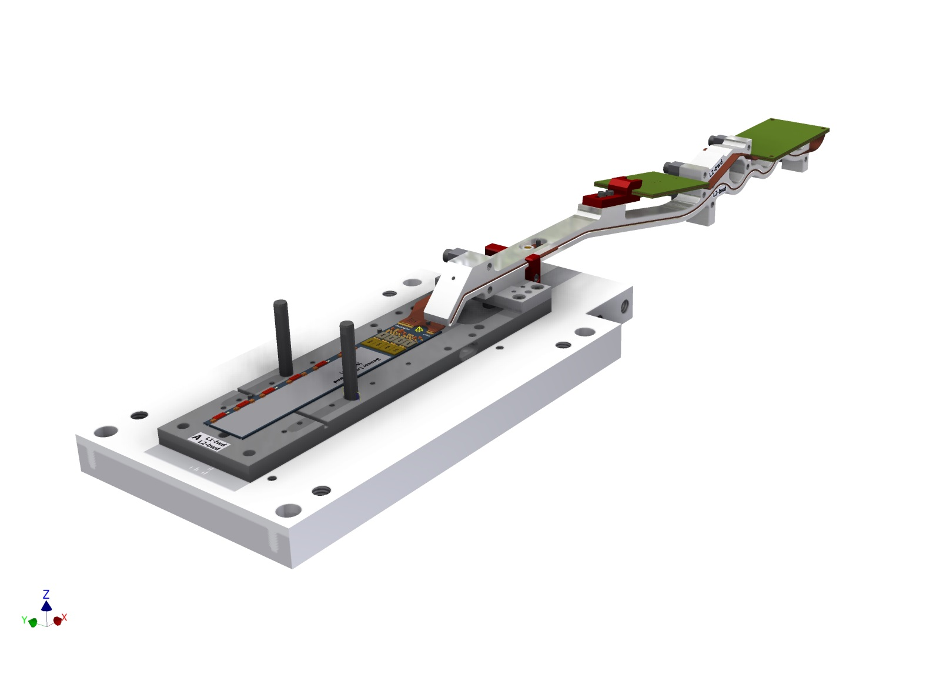
2nd Step: Ladder Gluing
Prepare for ladder gluing
open
Vacuum jig for turning and ladder gluing
Fits on top side (cut outs for switcher)
Mode from microporous plate (gentle vacuum on sensor top side)

Slide 8
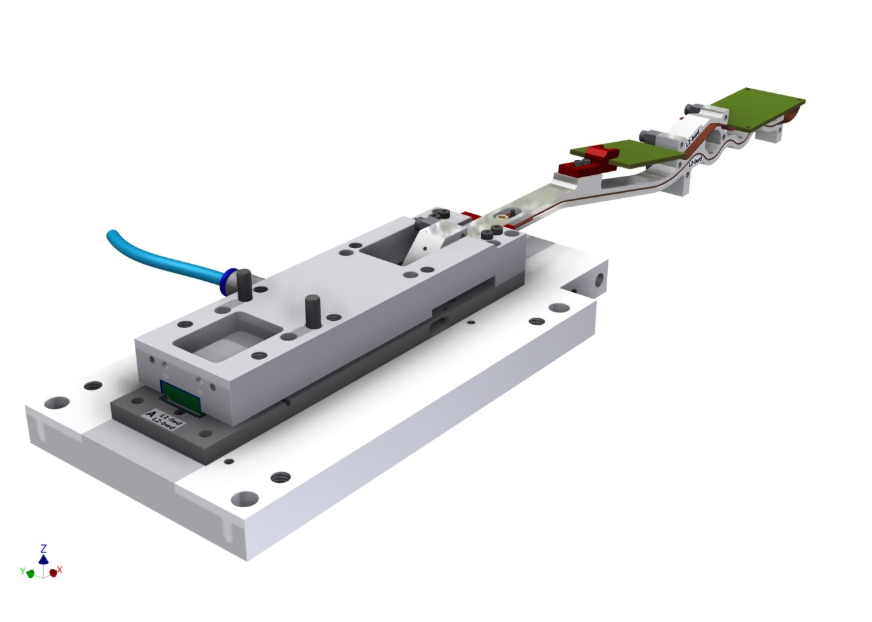
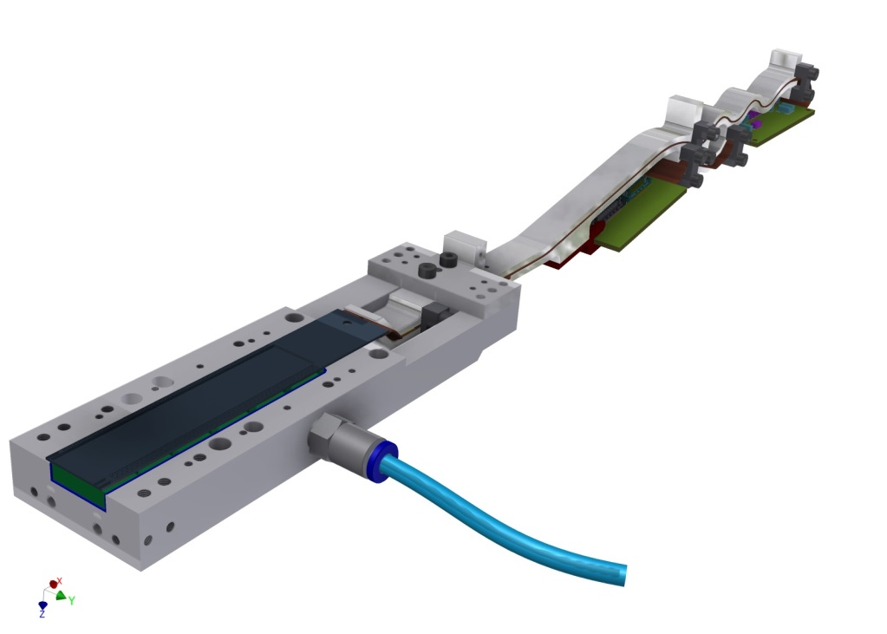
Vacuum jig on sensor
Connect kapton extension to vacuum jig
Disconnect base jig
Take off module and turn around

Slide 9
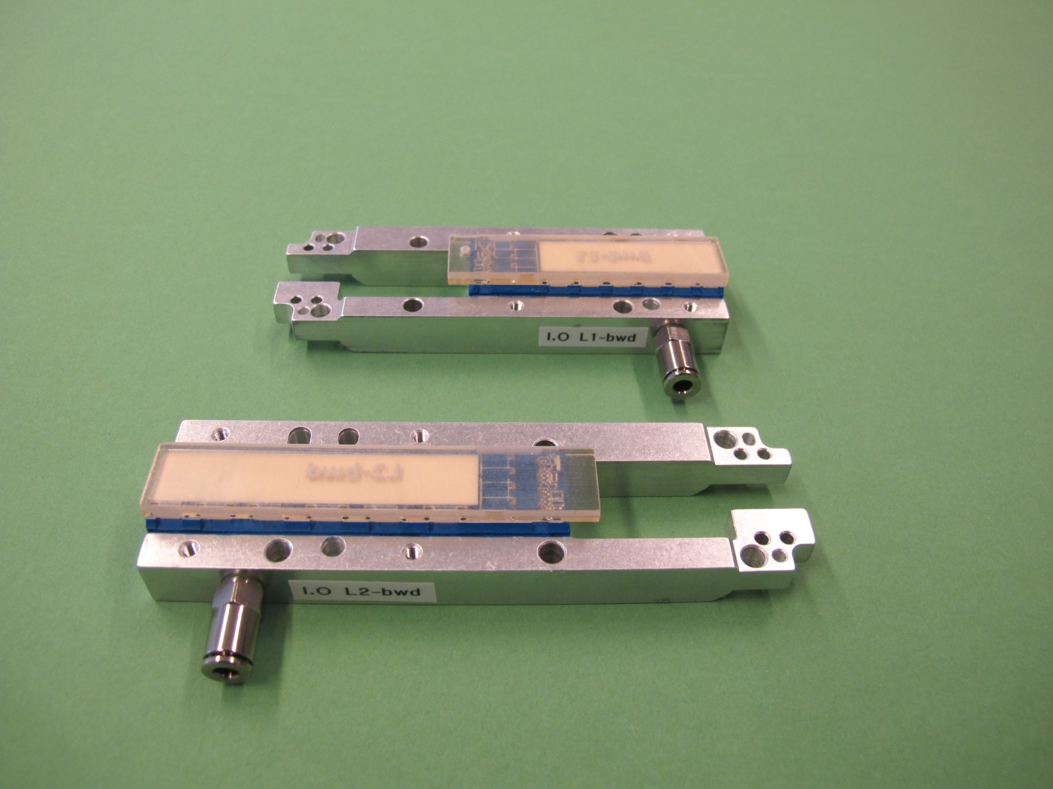
First set produced (here with transparent module dummies to check clearances)

Slide 10
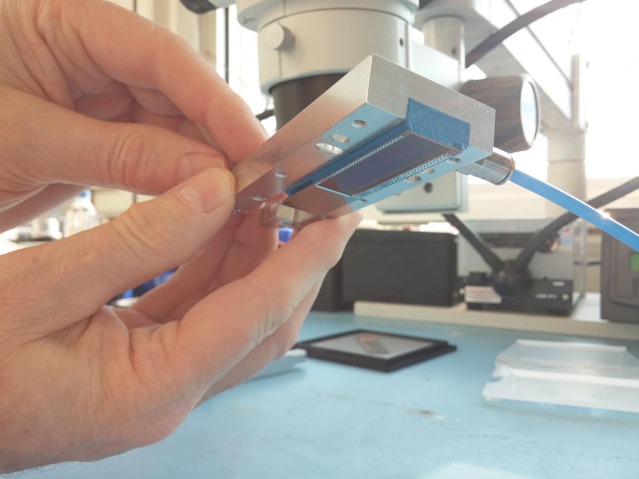
Lift off from base jig and turn over => safe!
In reality the modules is secured by kapton

Slide 11
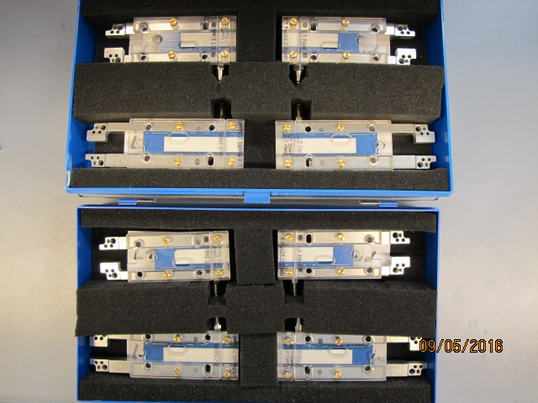
2 sets produced (2 inner and 2 outer)

Slide 12
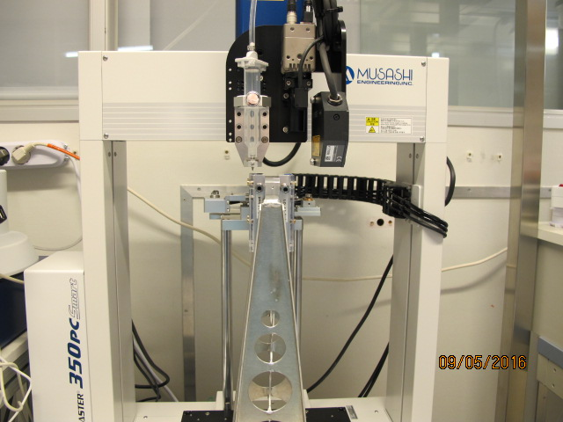
2 jigs with modules (L1fwd + L1bwd or L2fwd + L2bwd) are placed in a special holder
For glue dispensing

Slide 13
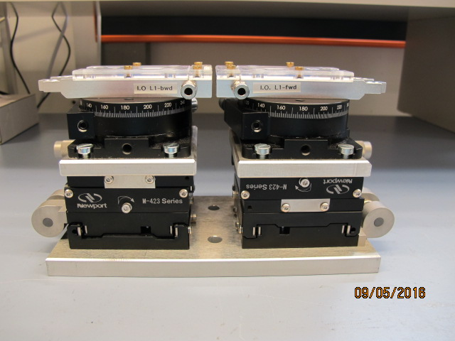
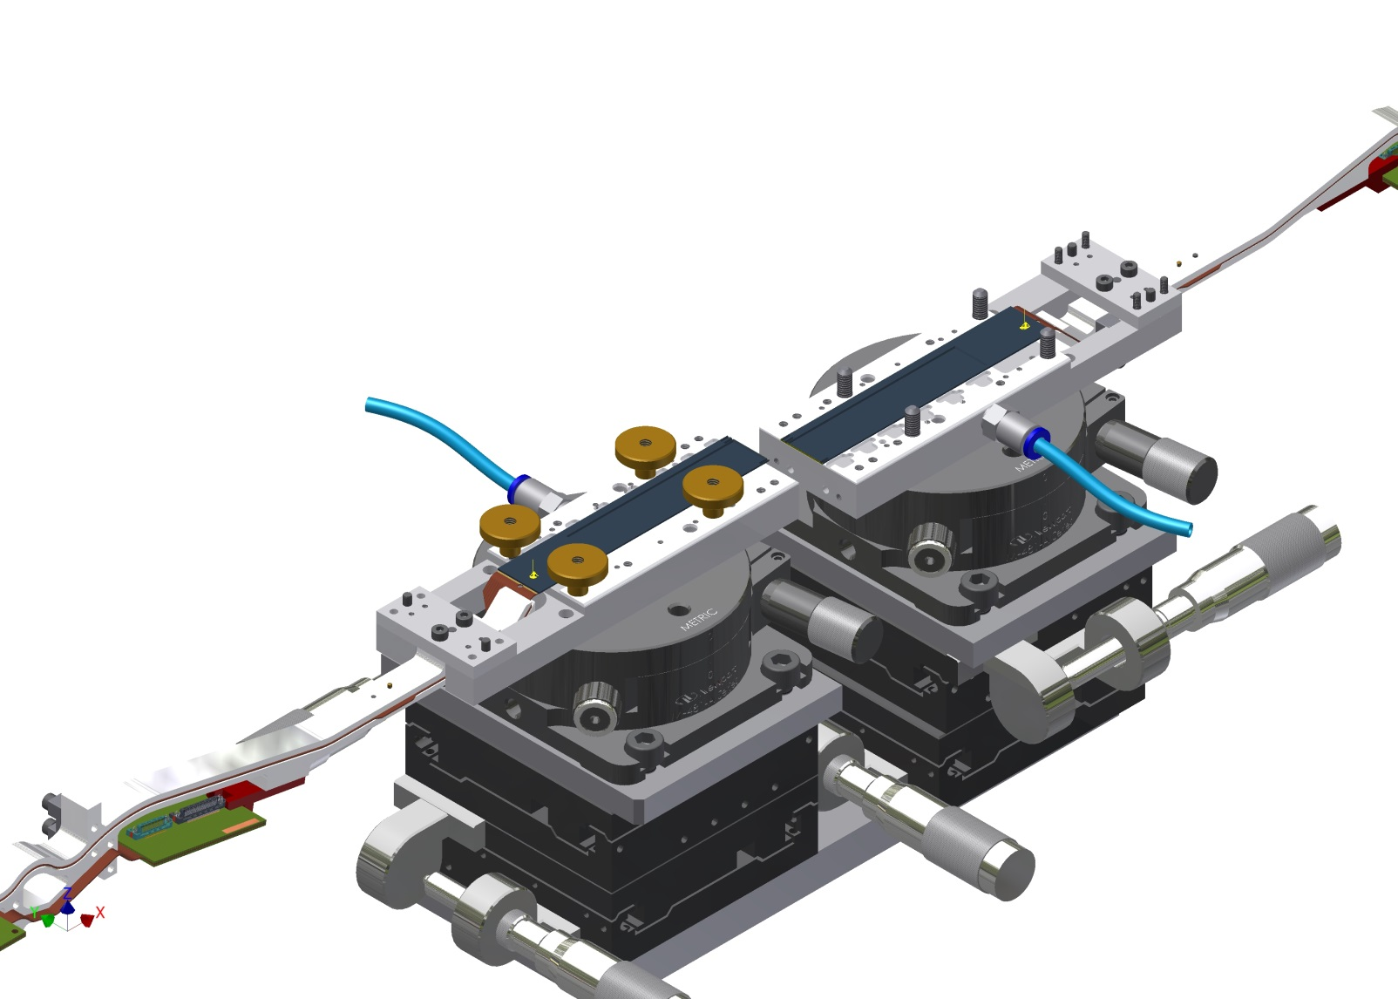
After dispensing: jigs are placed on an alignment stage for gluing
(using a CMM for alignment and to control width of glue joint

Slide 14
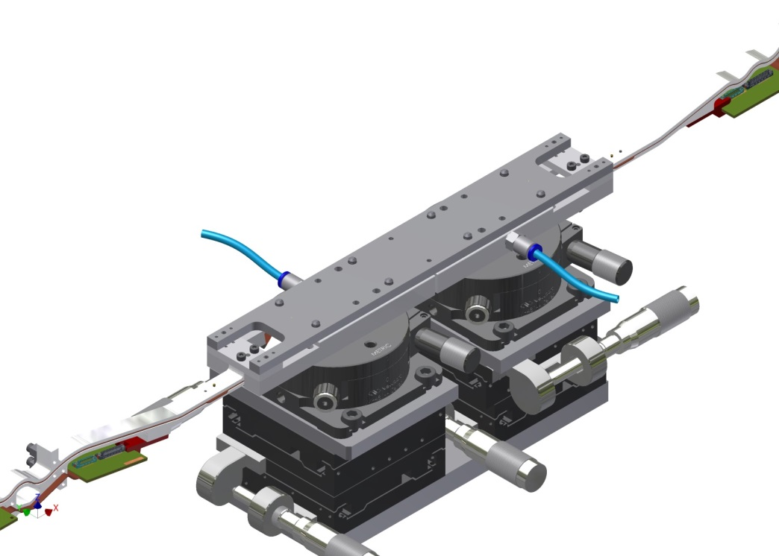
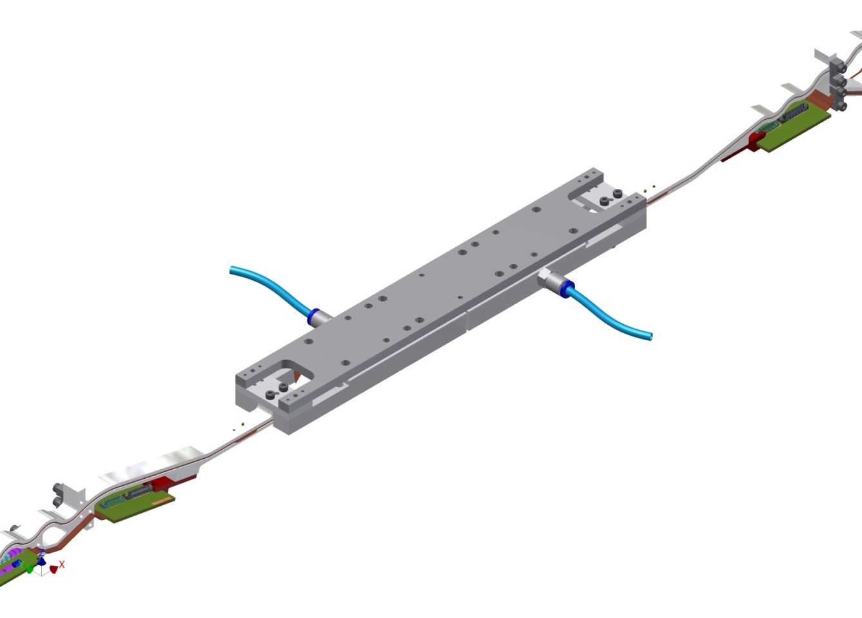
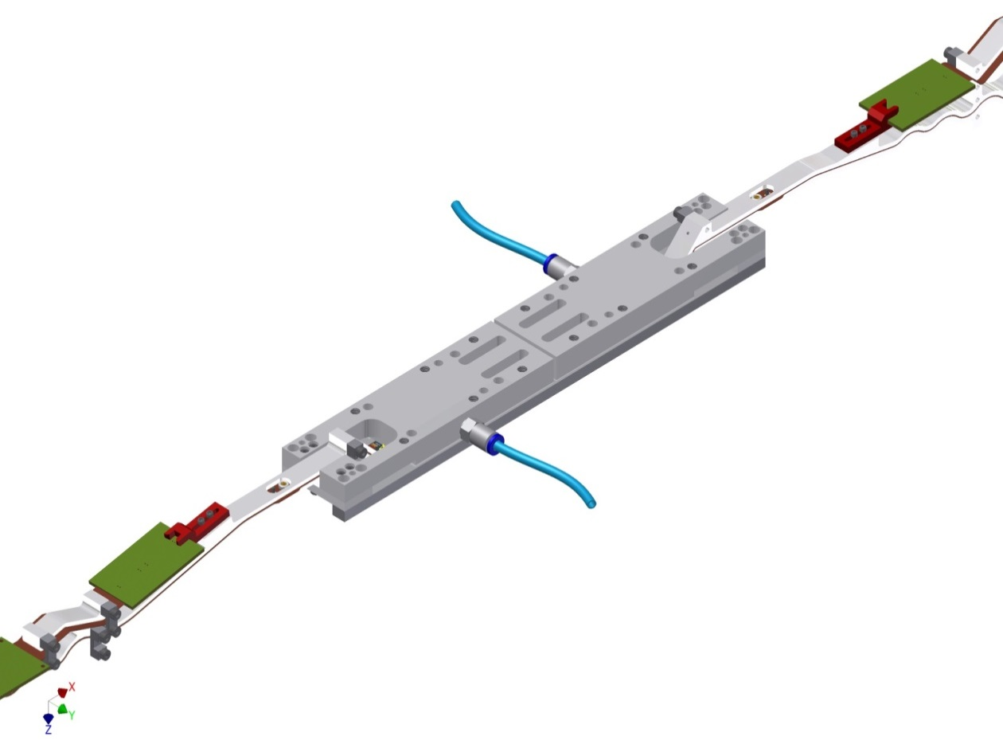
Add ladder jig
Take off from alignment stage
Turn over

Slide 15
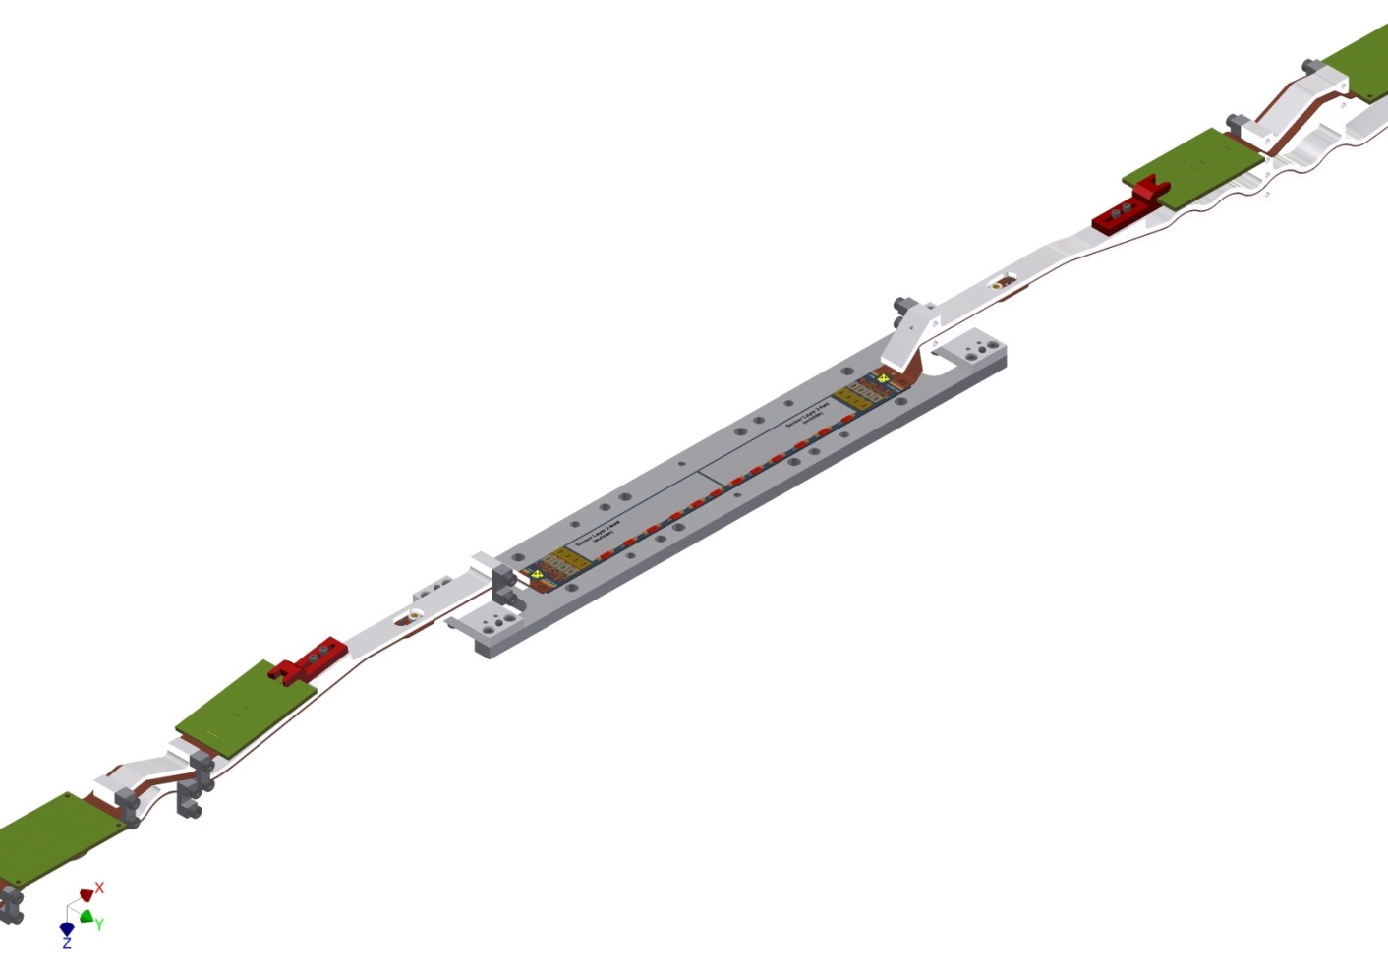
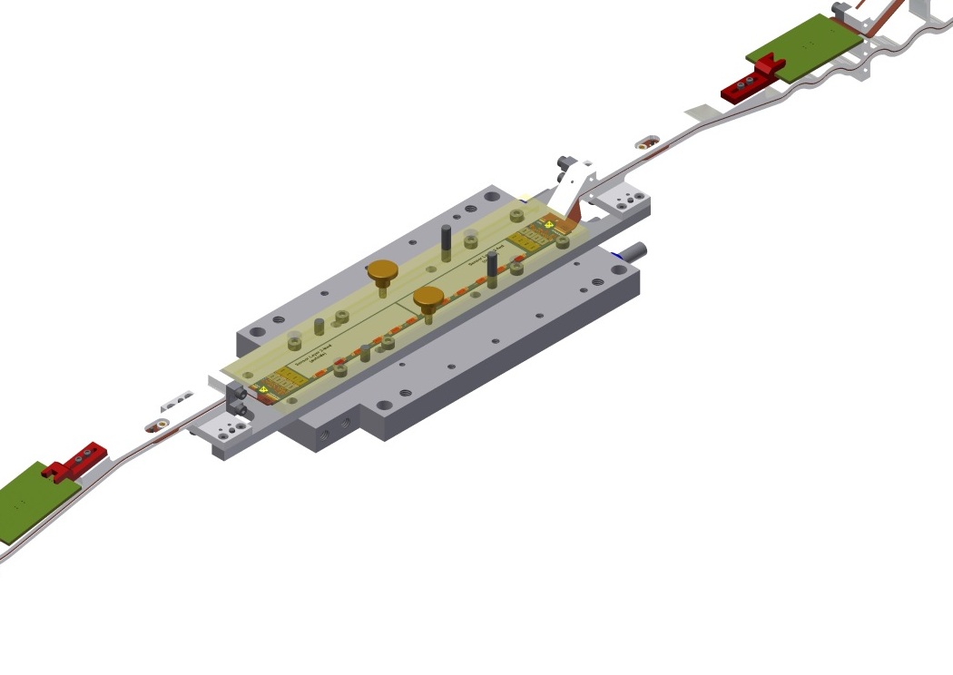
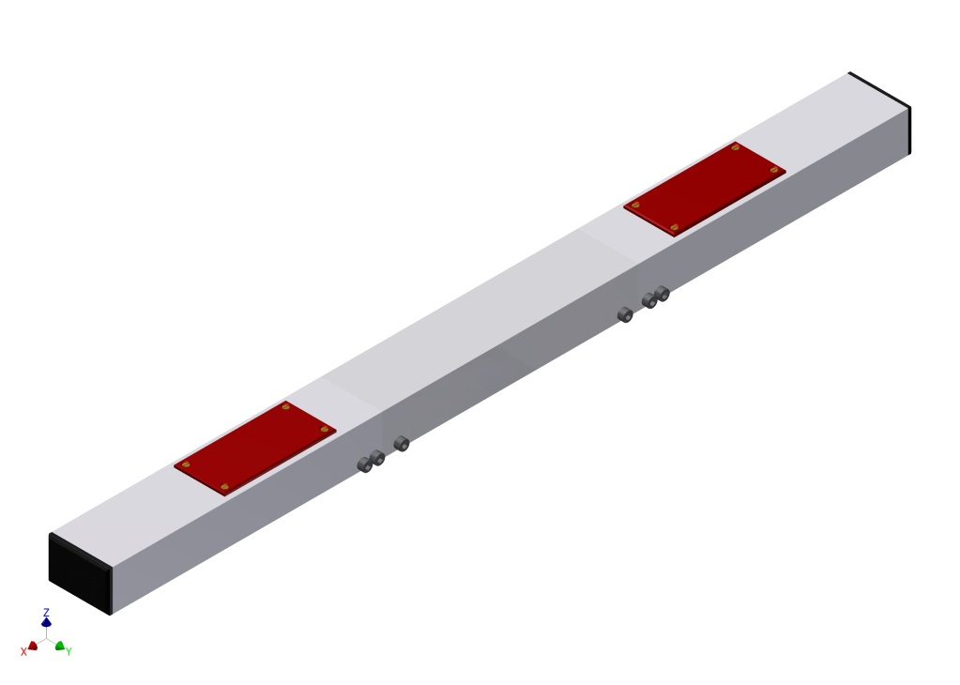
Remove gluing jigs
With base plate for tests (cooling)
Transport and storage

Slide 16
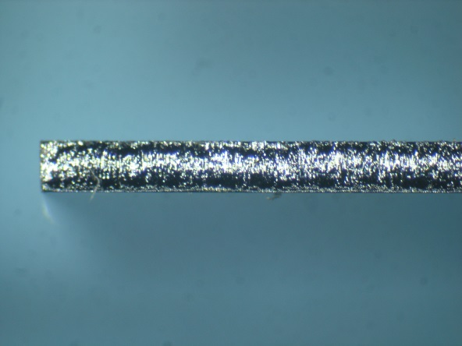
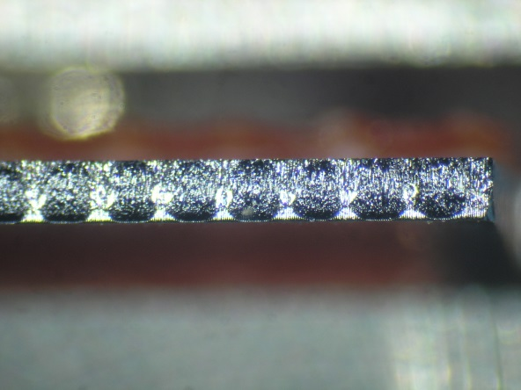
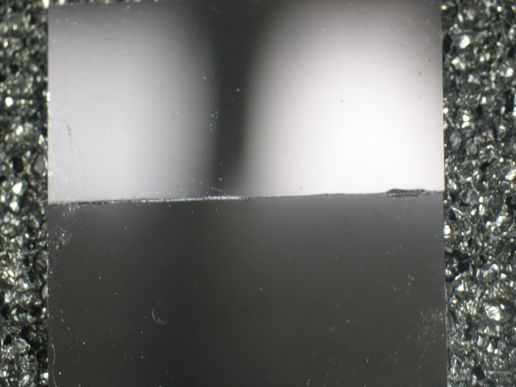
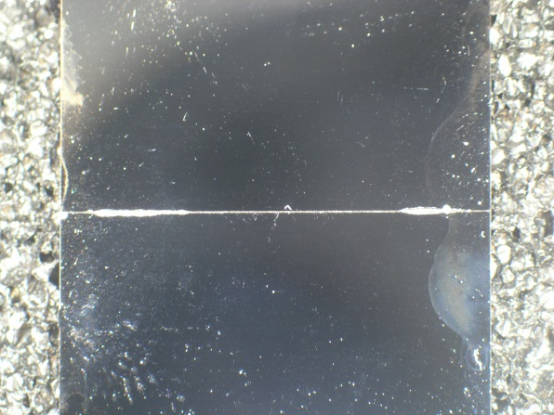
Gluing Tests
Musashi dispensor
Araldite 2011
200 Pa
5 mm/s (line)
Needle: 0.2 mm
Line dispensing
dots
First tests with manual alignment (no control of gap)
Some (very marginal) spill over (~100 µm width)
Very encouraging, to be optimized

Slide 17
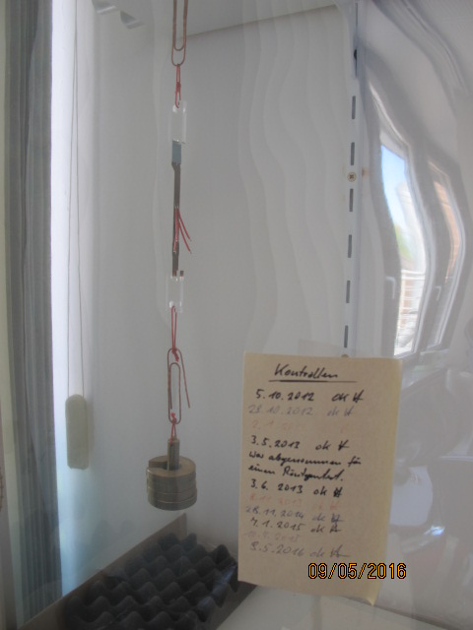
Summary
Module/Ladder assembly procedure defined
Tooling is designed and produced
Module assembly and transport jigs completed
Kapton jig produced
Successfully tested with pilot run modules
85 jig sets in production
Ladder gluing:
- Vacuum jigs produced (2 sets). Vacuum ok
Microdispenser with automatic alignment
Alignment stages (2 sets)
To do:
Continue gluing tests
- with gap control
- with CMM alignments
- add ceramic bars
- use realistic dummies
Furthermore: define test procedure and selection criteria
Test: strength of joint

