Slide 1
DHPT 1.2 Changes
T. Hemperek

Slide 2
Fixes
Mem dump issue when output at 800Mb/s and Clock Compensation
Internal system clock fixed phase relation to GCK (divided reset)
Double first word in gated mode
Change JATAG USERID
Gated mode without readout*

Slide 3
Further requests
Decoding synchronous commands using GCK clock instead of PLL divided
clock. Decoded commands shall be used for PLL divider phase alignment
No. But the phase will be fixed.
For gated mode operation include an option to jump from gate control
sequence back to main sequence to the point where it was interrupted
-> the synchronization with machine will be lost.
Control for Power On reset from the synchronous command interface
?
Configurable start row for the memory dump
If needed?
Use internal DHPT clock for UB ADC and not the TCK
I have no idea how this works -> UB
Configurable delays on DCD JTAG pins
DHPT ID in memory dump frames
OK

Slide 4
Status
I have re-run the DHPT10 flow that looks OK (the netlist are functionally equivalent -> Formality)
One can rather fast implement changes (Leo is also looking into simulation)
It takes about 48h to create digital layout
Itchi will help with LVS and final finishing (this takes about 1 week)

Slide 5
Backup

Slide 6
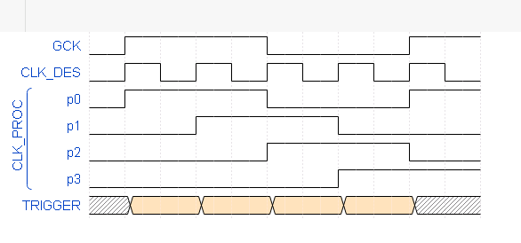
Synchronization
different startup conditions

Slide 7
Other solutions
PROGRAM.
DELAY
SYNC
Does not require changing/charactering PLL
Possibly need some calibration once (like DCD delays) to avoid hold/setup problems since the relationship between GCK and CLK_DES is unknown at this point

