Slide 1
HEC I chip design
Short summary
(J.Bán)

Slide 2
Technology
GaAs TriQuint QED-A 1um
(a commercial ion-implanted MESFET process)
MESFET transistors of types M, D, E available
FET types differ in channel doping level
(M-highest doping, E-lowest )
M,D depletion types; E enhancement type
(The design done in 1996)

Slide 3
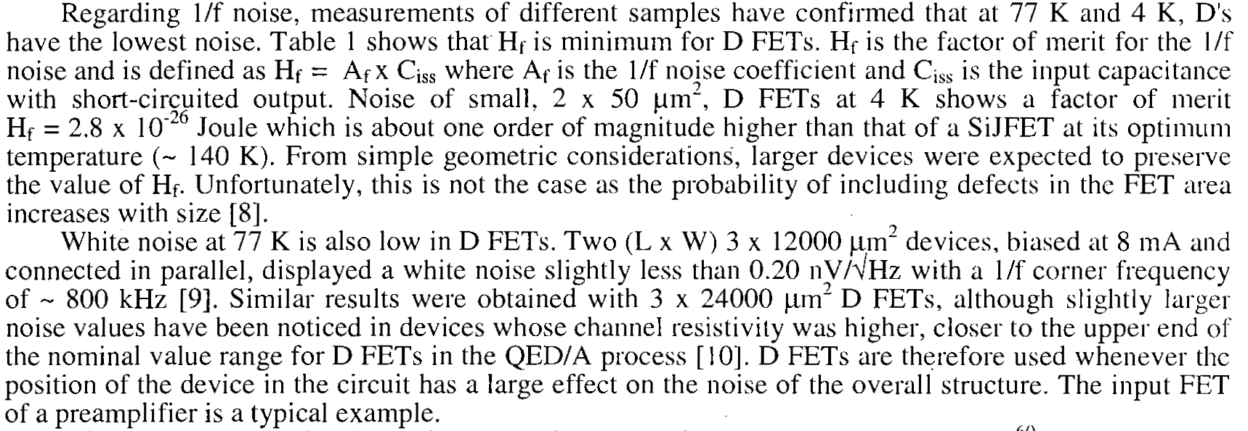
Technology

Slide 4
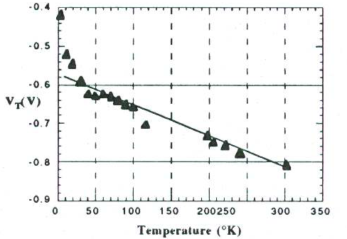
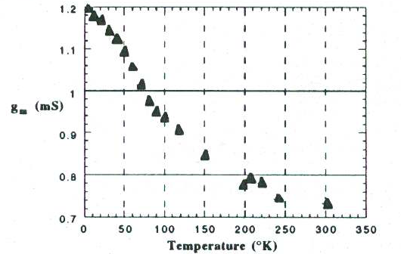
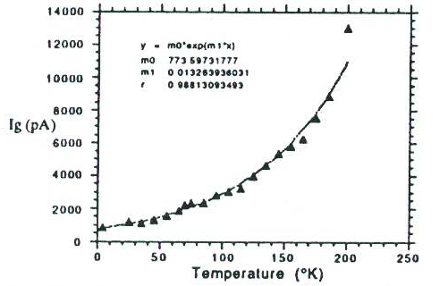

Slide 5
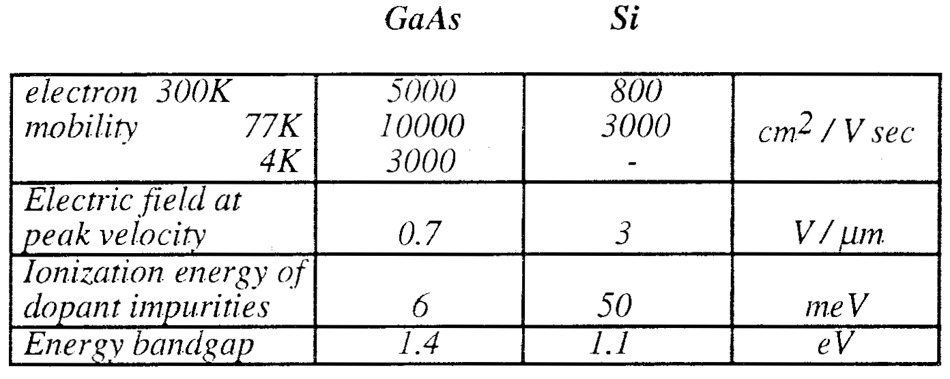

Slide 6
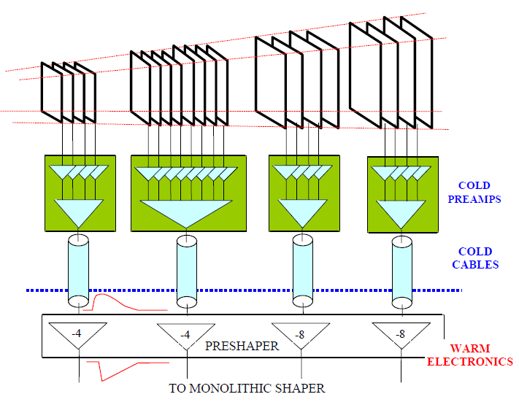
The need to sum-up pads with large capacitance led to “active pad” architecture.
The technology led to current sensitive amplifier.

Slide 7
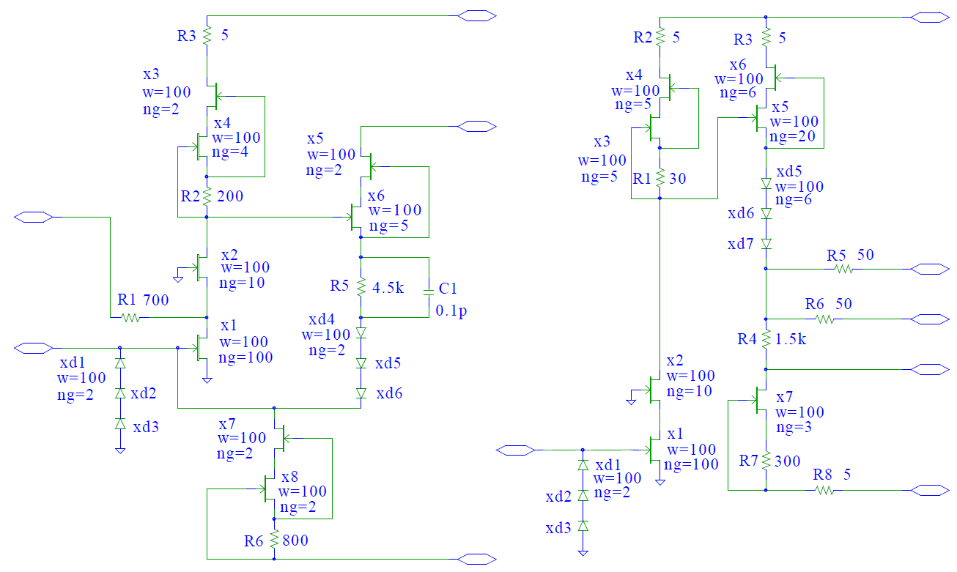
Circuit diagrams of the GaAs preamplifier (left) and driver (right).

Slide 8
Chip size 4*3mm
Function blocks 8 preamplifier channels
2 summing and driver channels
Power: separated groups 1: pa1, pa2, pa3, pa4;
2: pa5, pa6, pa7, pa8
3: dr1;
4: dr2;
Supply voltages +8V, +4V, -2V,

Slide 9
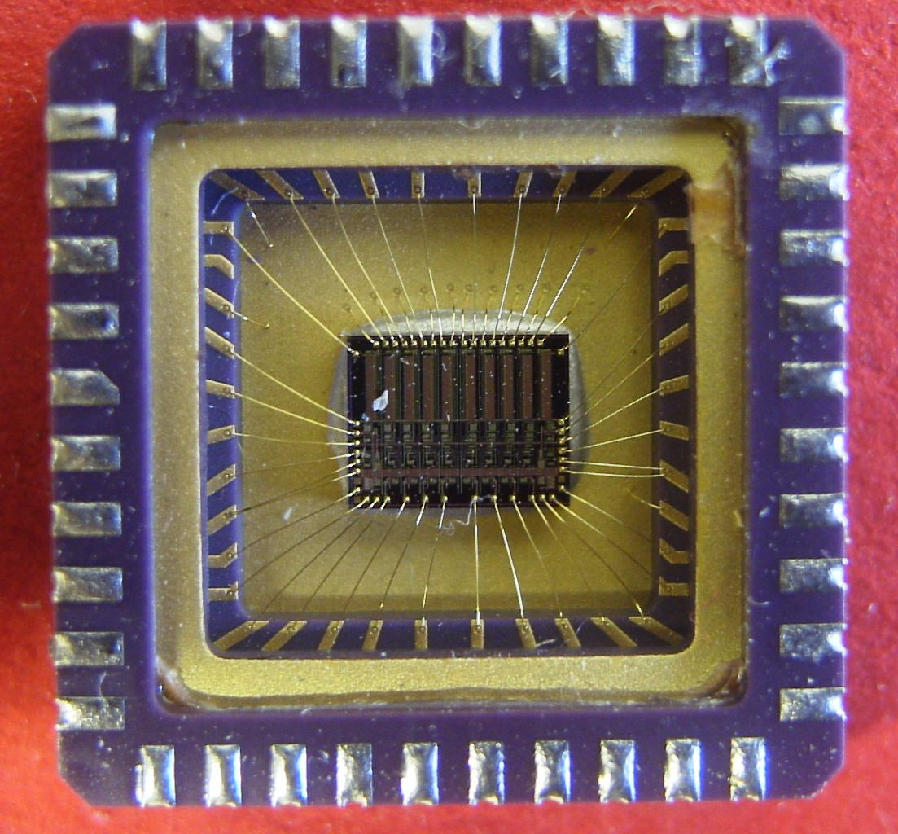
Chip BB96B photo

Slide 10
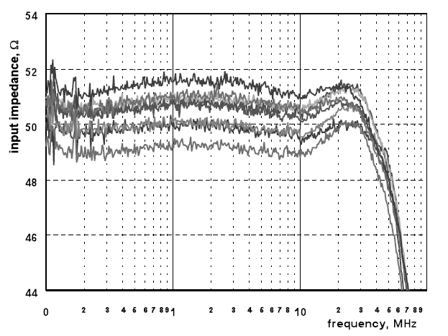
Absolute value of input impedance vs. frequency for three different GaAs chips.

Slide 11
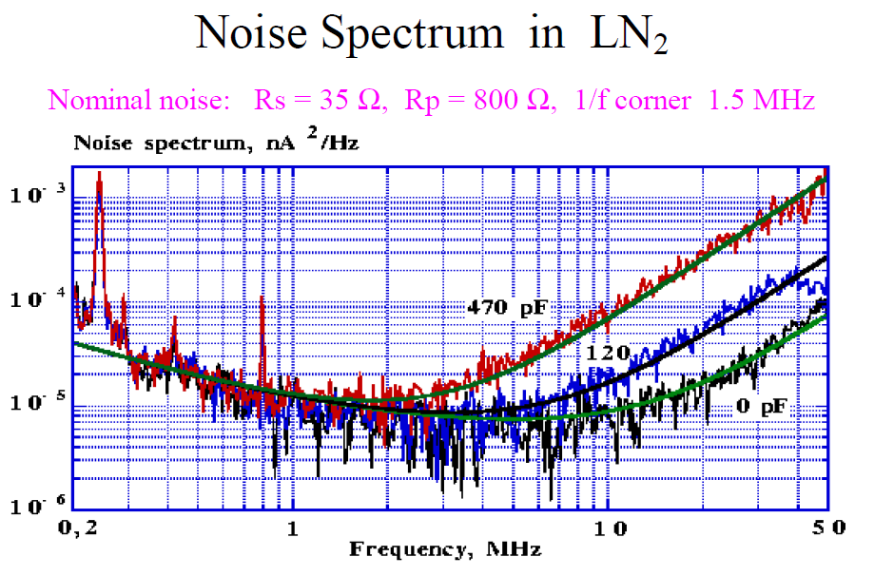

Slide 12
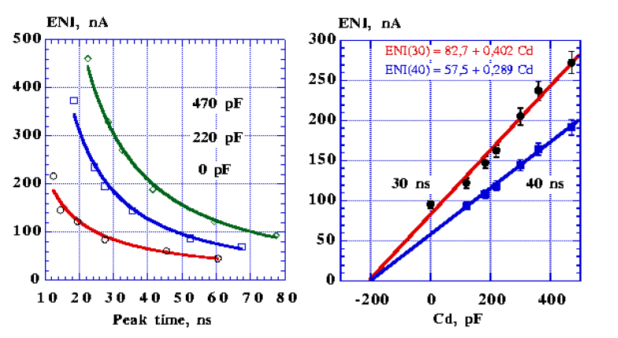
ENI versus peaking time (a) for three input
capacitors and versus detector capacitance for
fixed peaking times (b).

Slide 13
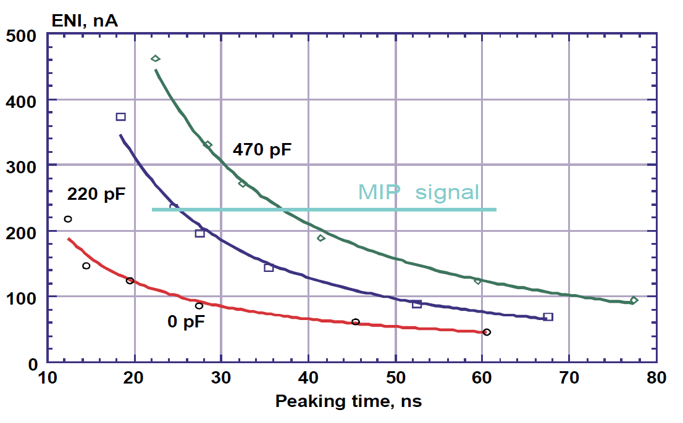

Slide 14
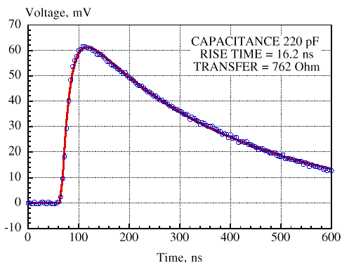
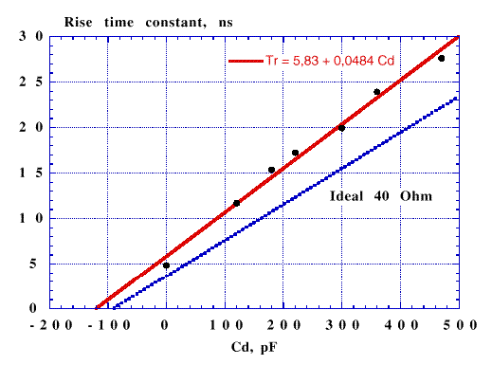
The real shape of the output signal is reasonably described by an integration time constant corresponding to a resistivity of 48.4 Ohm and an offset time of 5.83 ns.
Output signal shape (circles) fitted by two exponents (line).
Output signal rise time constant vs detector capacitance.

Slide 15
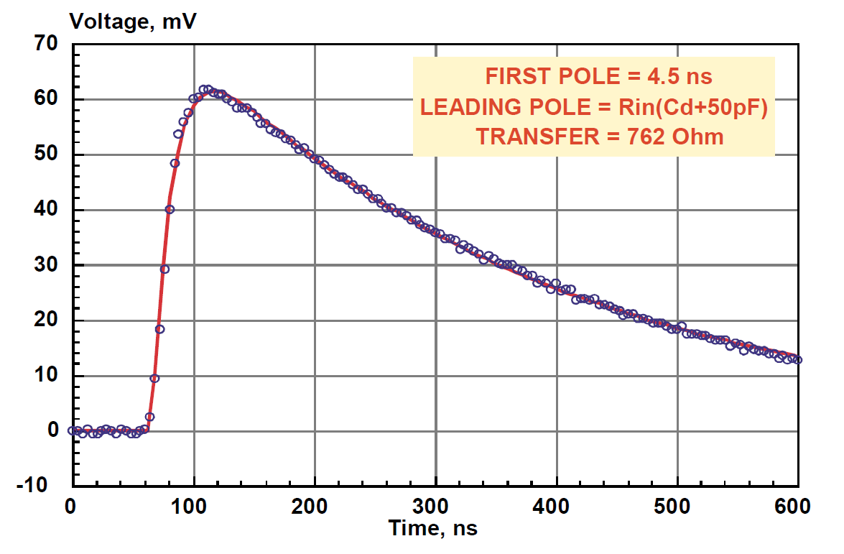

Slide 16
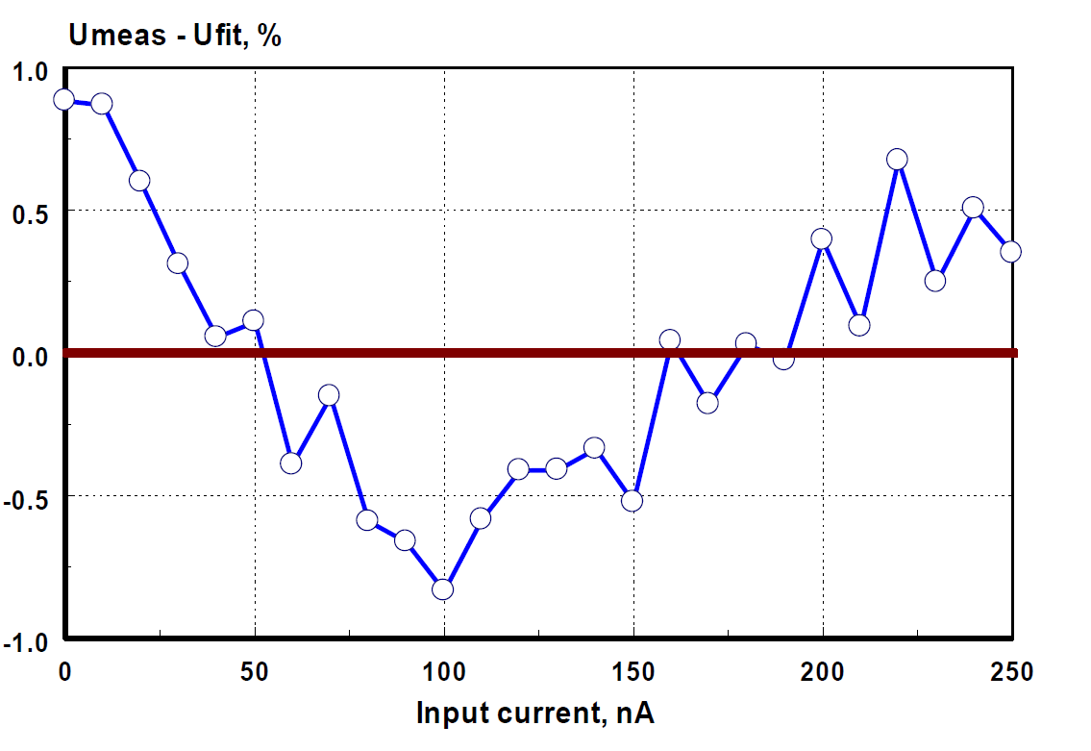
Typical linearity of the chip

Slide 17
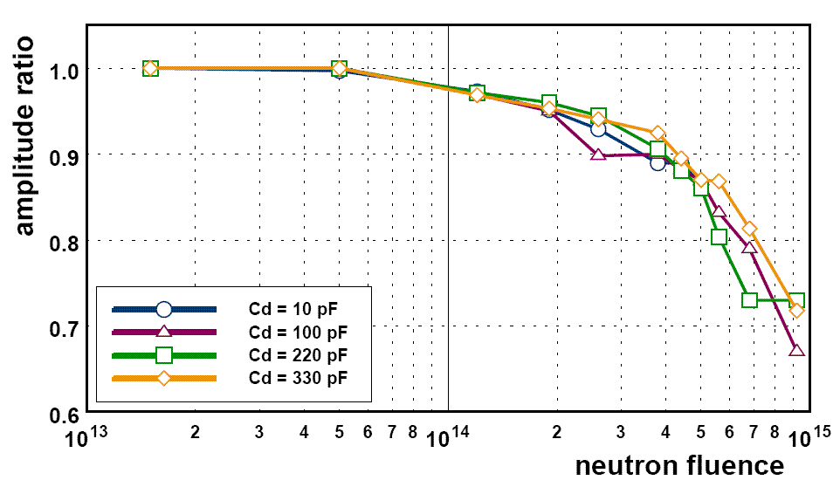
The chip shows a stable performance in terms of transfer function, peaking time, noise and linearity up to a high neutron fluence of 5 *10**14 n/cm2 independent detector capacitance. For neutron fluences beyond this value a clear deterioration of the transfer function and linearity has been observed. Under g-irradiation no damage of the performance has been seen up to an accumulated dose of 55 kGy.

Slide 18
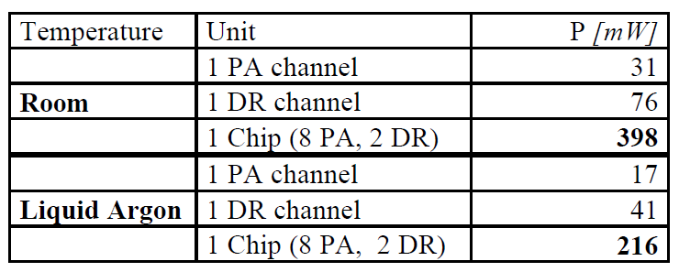
Power consumption at nominal power supply

Slide 19
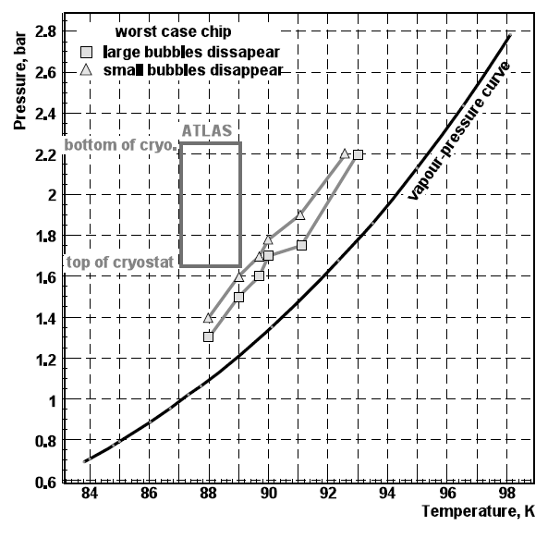

Slide 20
CONCLUSION
The HEC cold electronics has been designed (in 1996) to meet the requirements of operation for more than 10 years in low temperature, high rate and high radiation environment of Atlas (coming to operation in 2009).

