Slide 1

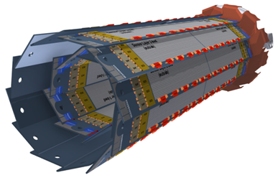
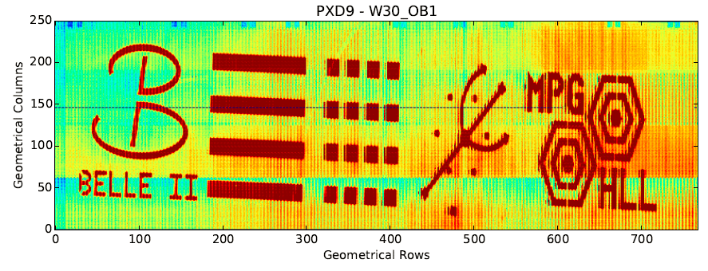

Characterization of Pilot Run Modules for the Belle II Pixel Detector
Felix Müller
Max-Planck-Institut für Physik
IMPRS Young Scientist Workshop
Ringberg Castle 2016, June 7, 2016

Slide 2
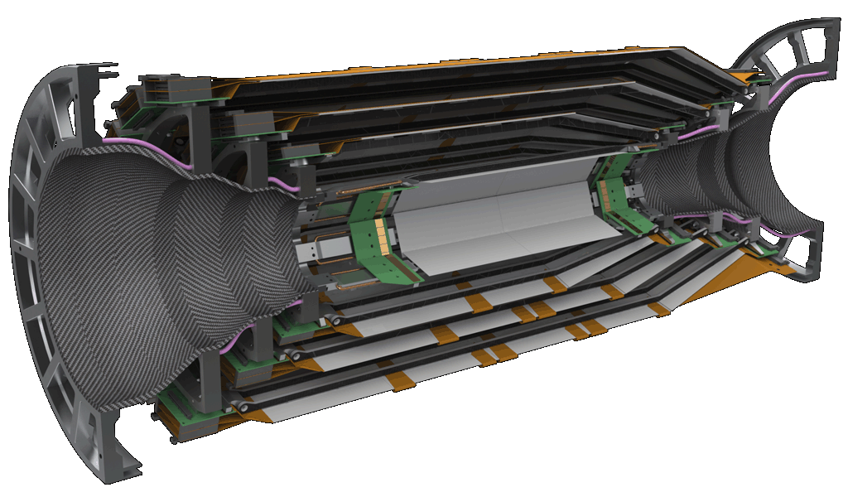
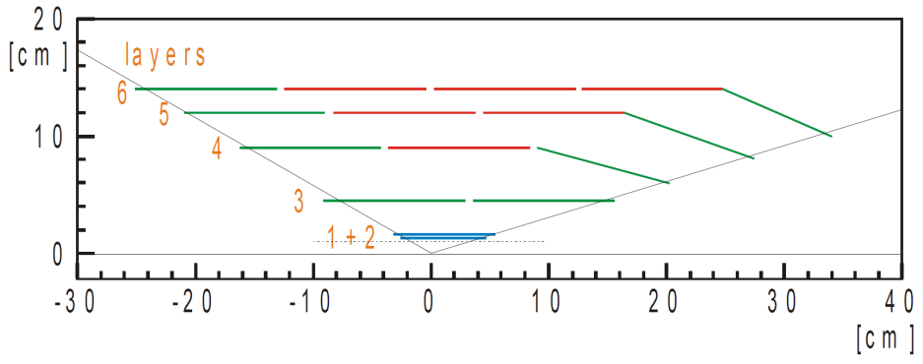
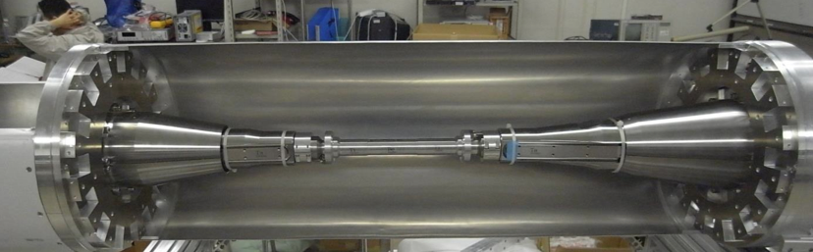
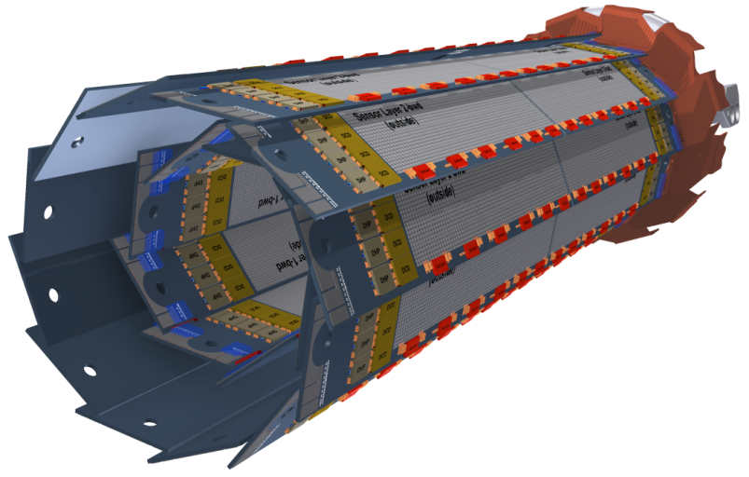
Belle II Vertex Detector
Silicon Vertex Detector (SVD)
4 layers of double sided silicon strip detector
R= 3.8 cm, 8.0 cm, 11.5 cm, 14 cm
Beam pipe: R=10mm
Pixel Detector (PXD)
2 layers of DEPFET pixels
R = 1.4 cm, 2.2 cm

Slide 3
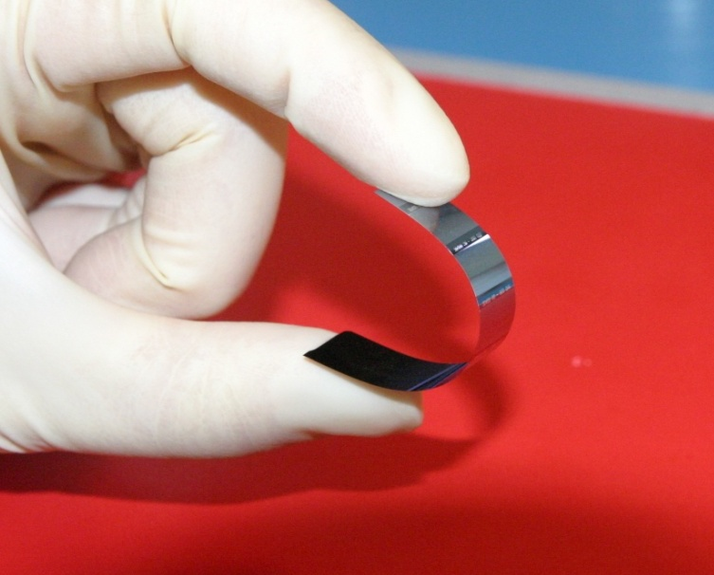
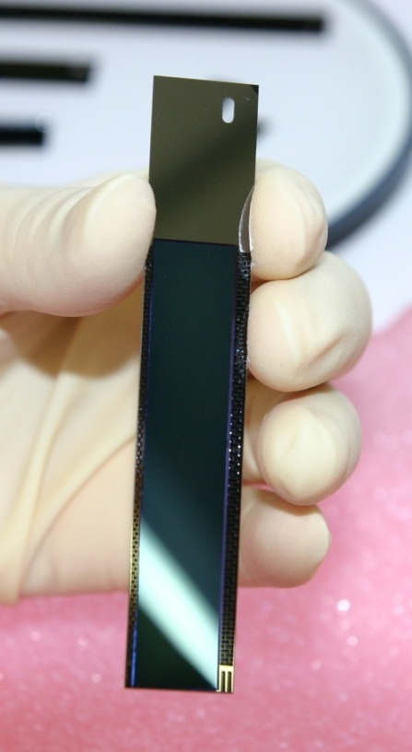
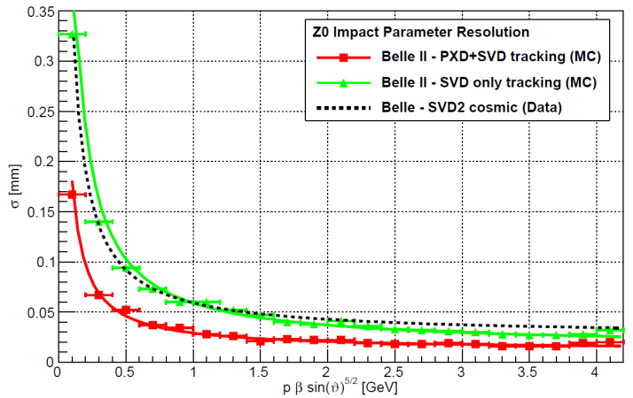
Belle II – PXD Requirements
Occupancy | ~ 1 %
Frame time | 20 µs (rolling shutter mode)
Momentum range | Low momentum (P_{t} > 50 MeV/c)
Acceptance | 17°-150°
Radiation | ~20 kGy/year, 1⋅10¹⁰ n/ab⁻¹cm²
Belle II is dominated by low momentum tracks (<P> = 500 MeV/c)
Modest intrinsic resolution (15 μm), dominated by multiple scattering → Moderate pixel size (50 x 75 μm²)
Lowest possible material budget (0.2% X₀/layer) [including ASICs]
Increase of background by factor 20-40: irreducible background by 2-photon QED process: Needs to cope with radiation damage, occupancy, fake hits and pile-up noise
100x higher trigger rate (30 kHz) compared to Belle
Silicon strip detector (SVD) close to beam pipe
excluded (too large occupancy): replace by PXD

Slide 4
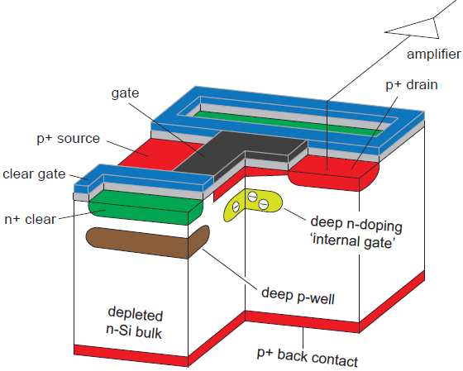
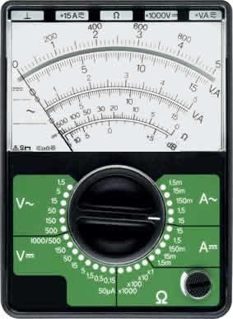
DEPFET (DEPleted p-channel Field Effect Transistor)
Turn on DEPFET
impinging
particle
Gate
source
Clear

Slide 5
DEPFET (DEPleted p-channel Field Effect Transistor)
A DEPFET is a MOSFET onto a sideward depleted silicon bulk
90 steps fabrication process
9 Implantations
19 Lithographies
2 Polysilicon layers
2 Aluminum layers
1 Copper layer
Back side processing
Clear
→ Low noise
→ Low power
→ High signal/noise-ratio
→ Non-destructive readout
internal amplification:
g_{q} ≈ 0.5 nA/e⁻

Slide 6
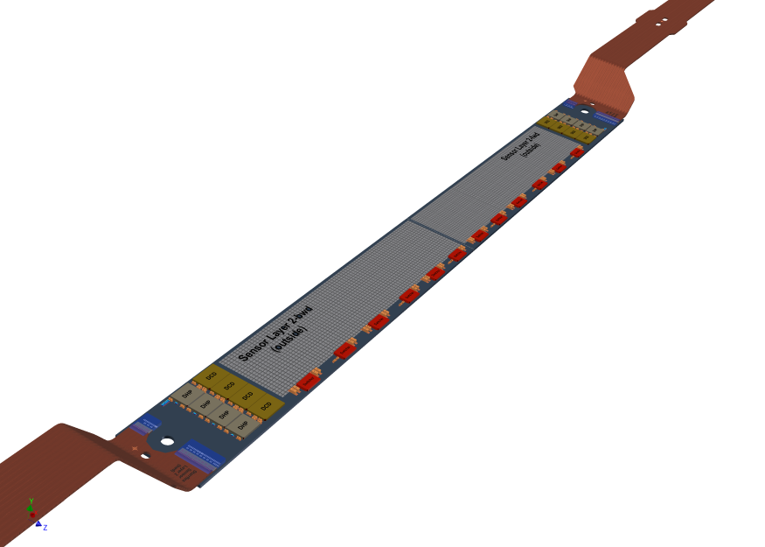

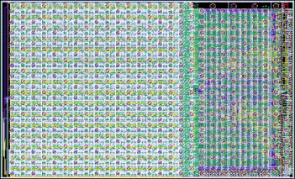
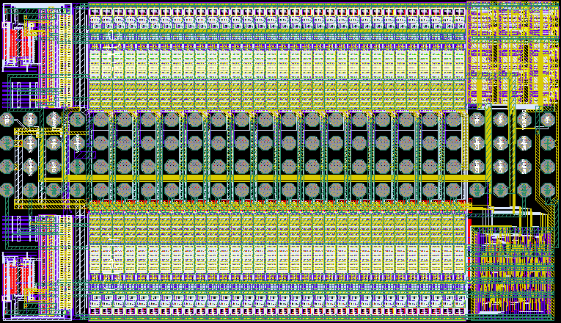
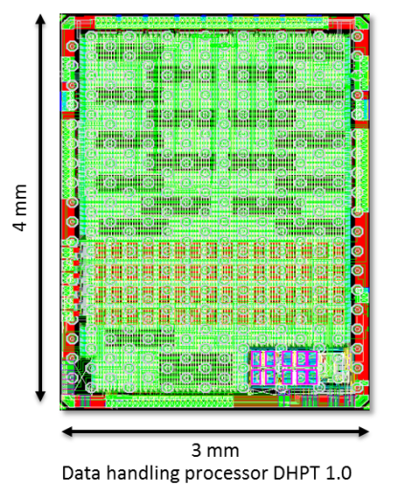
Control and readout electronics
Drain Current Digitizer (DCD)
8 bit ADCs
Compensates for pedestal variation
256 input channels (4 per module)
768x250 pixel x 2
DEPFET
SWITCHER
Fast voltage pulses up to 20 V
64 outputs gate and clear
192 electrical rows (6 per module)
Pixel i,j,v
Data Handling Processor (DHP)
Pedestal correction
Common mode correction
Data reduction (triggered readout and zero suppression)
Control of DCDs and Switcher
Kapton Flex cable
Power Supply
Data transmission
4 layers, 48 cm

Slide 7
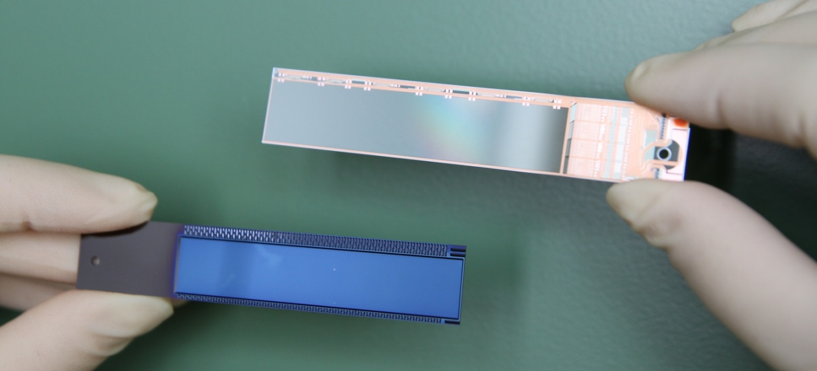
Additional steps in module production (1)
From Semiconductor Laboratory:
Silicon:
All implants
Metallization routings
Thinned to 75 µm
Missing:
Assembly of (control and readout) ASICs (@IZM, Berlin)
Assembly of passives (SMD components) (@ Semiconductor Laboratory)
Attachment of Kapton flex (data and power connection) (@ MPP)
End-on gluing of two modules to a self-supporting ladder (@ MPP)

Slide 8
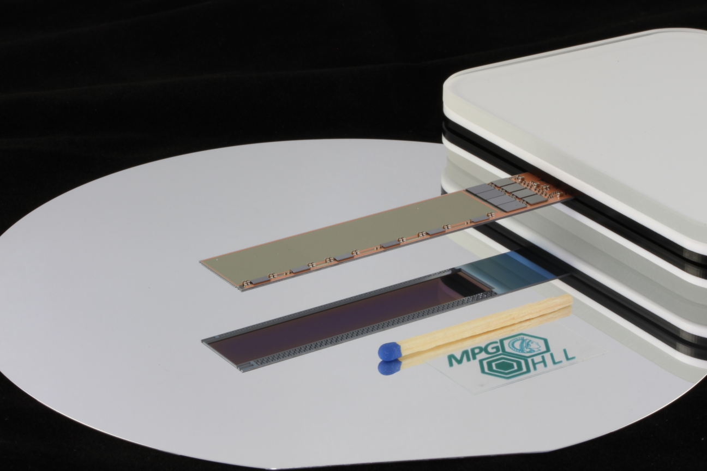
Additional steps in module production (2)
DCD
Drain
Current
Digitizer
DHP
Data
Handling
Processor
Switcher
DEPFETs
SMD
thinned area (75 µm)
Sensitive areas:
inner layer: ~ 45 x 13 mm²
outer layer: ~ 61 x 13 mm²
Module sizes:
inner layer: ~ 70 x 15 mm²
outer layer: ~ 85 x 15 mm²

Slide 9
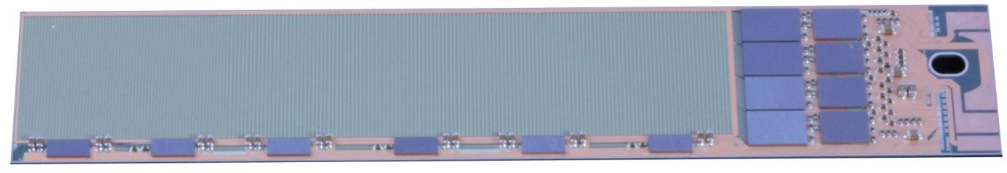
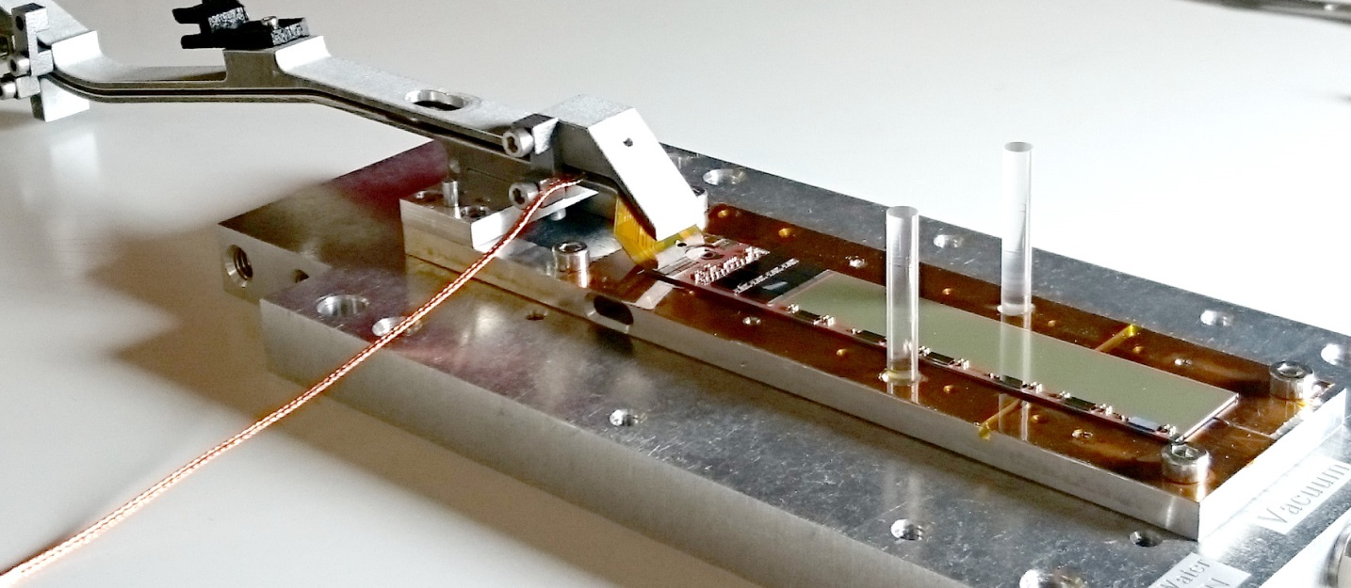
PXD9 Pilot Run
Drain
Current
Digitizer
Data
Handling
Processor
768 x 250 = 192.000
DEPFETs
Current
Switcher
Capacitors & Resistors
SMD 01005, 0201, 0402
careful handling of sensor required, protected by special jig (grounding, cooling, electrical insulation)

Slide 10
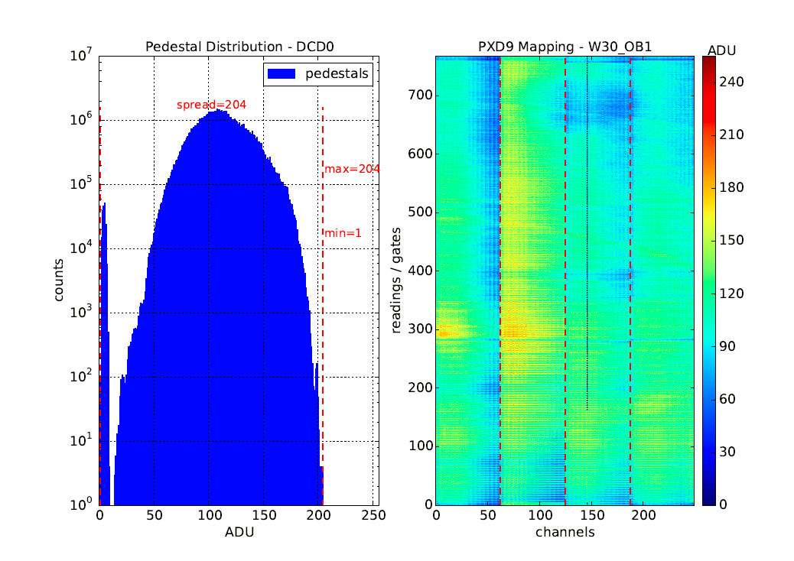
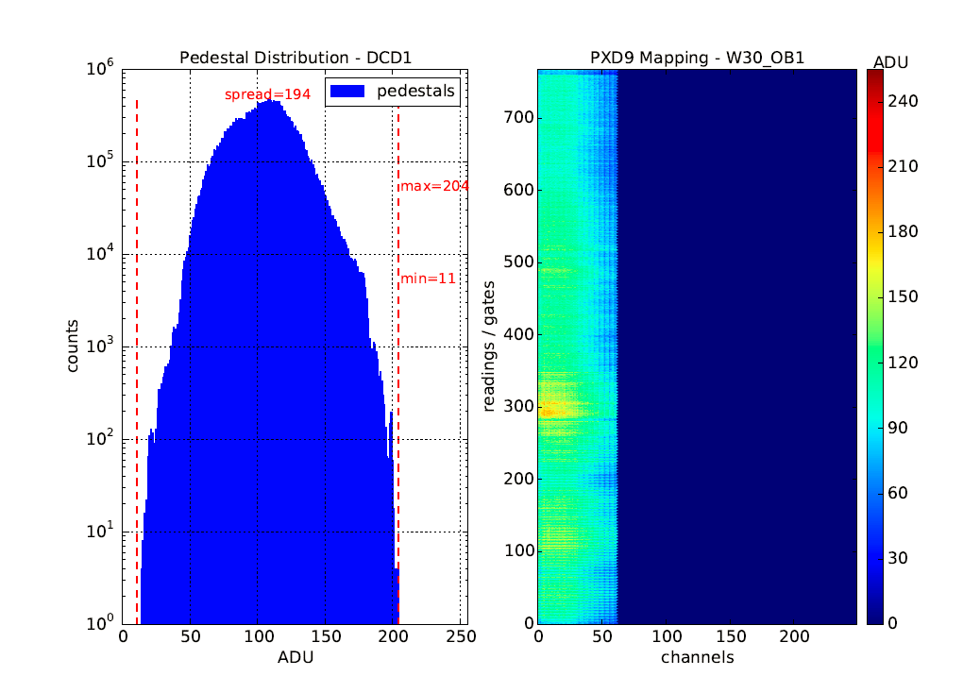
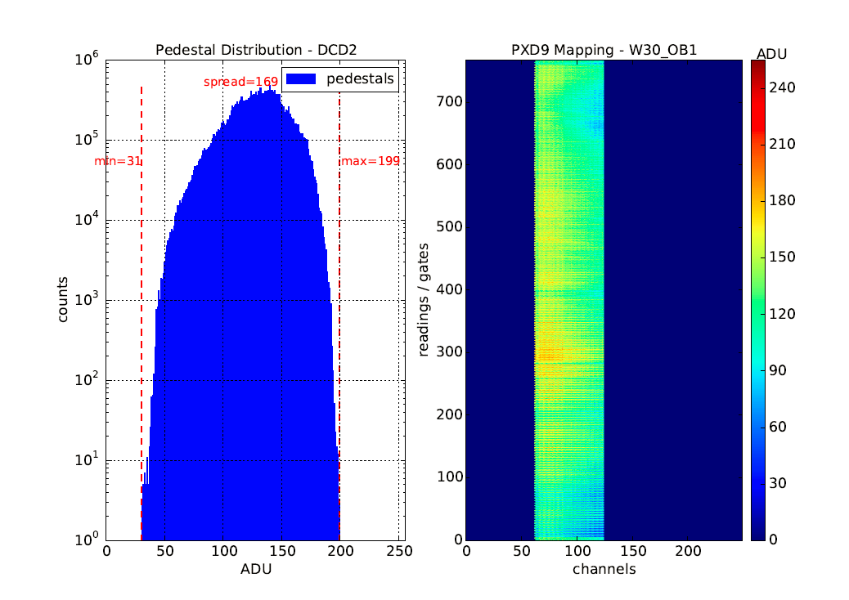
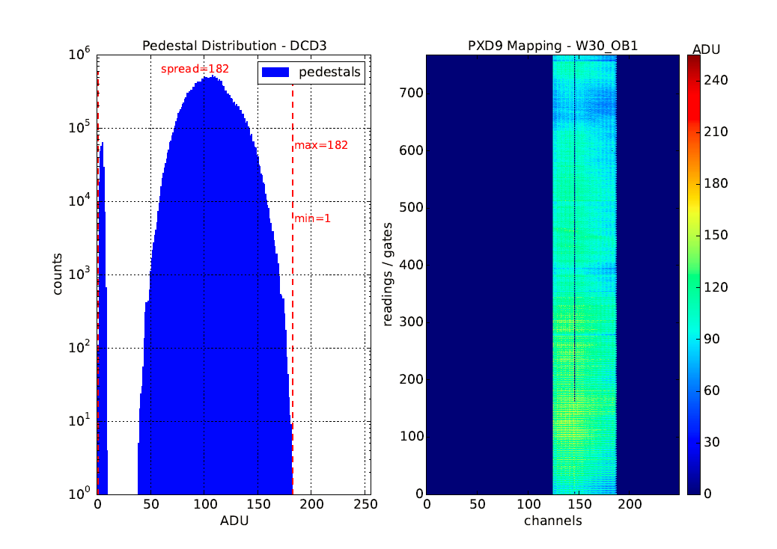
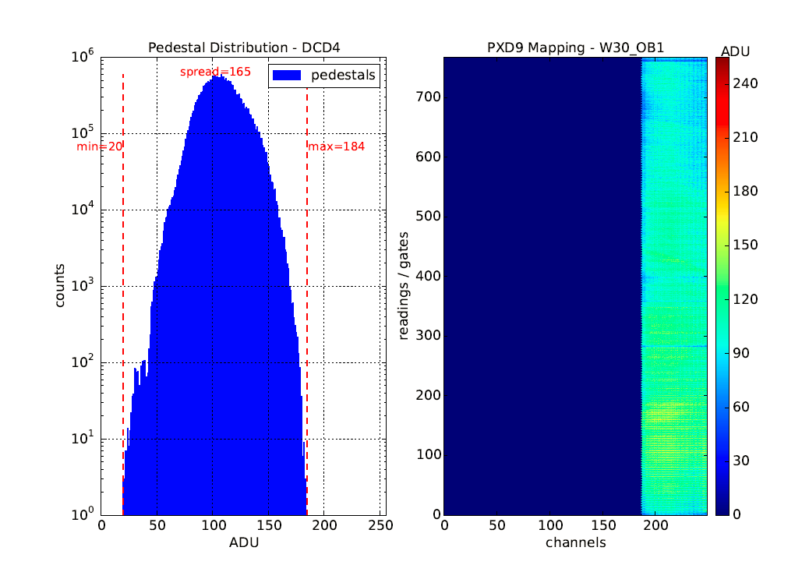
PXD9 – W30-OB1 – Pedestals

Slide 11
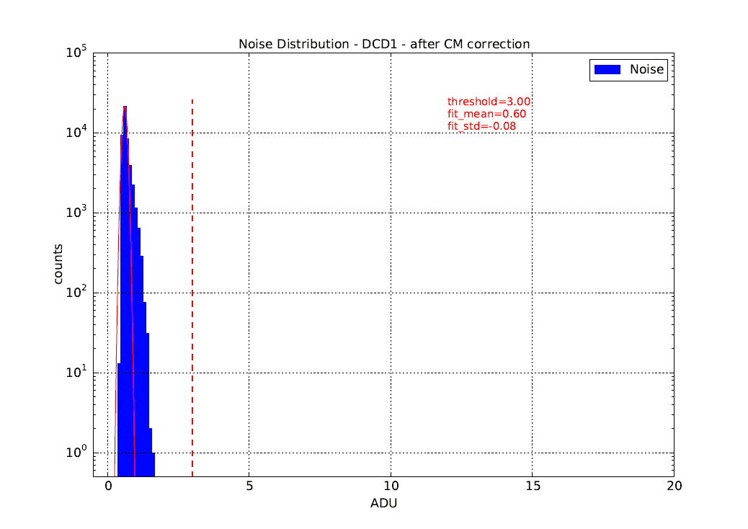
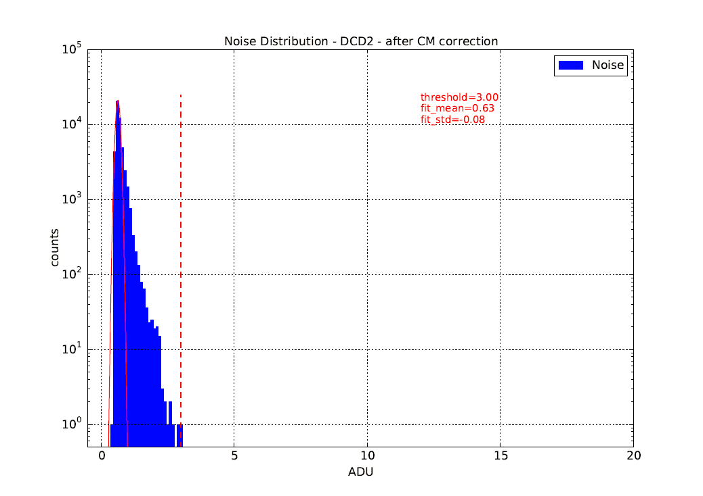
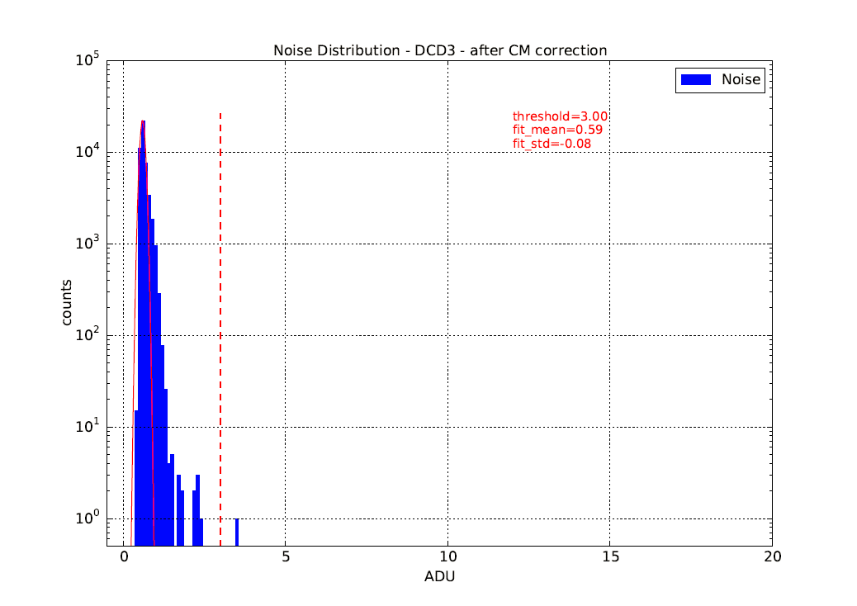

PXD9 – W30-OB1 – Noise
µ=0.60 ADU
µ=0.63 ADU
µ=0.59 ADU
µ=0.60 ADU

Slide 12
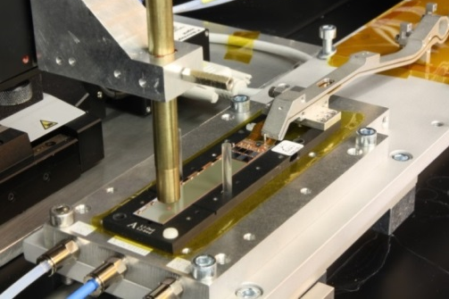
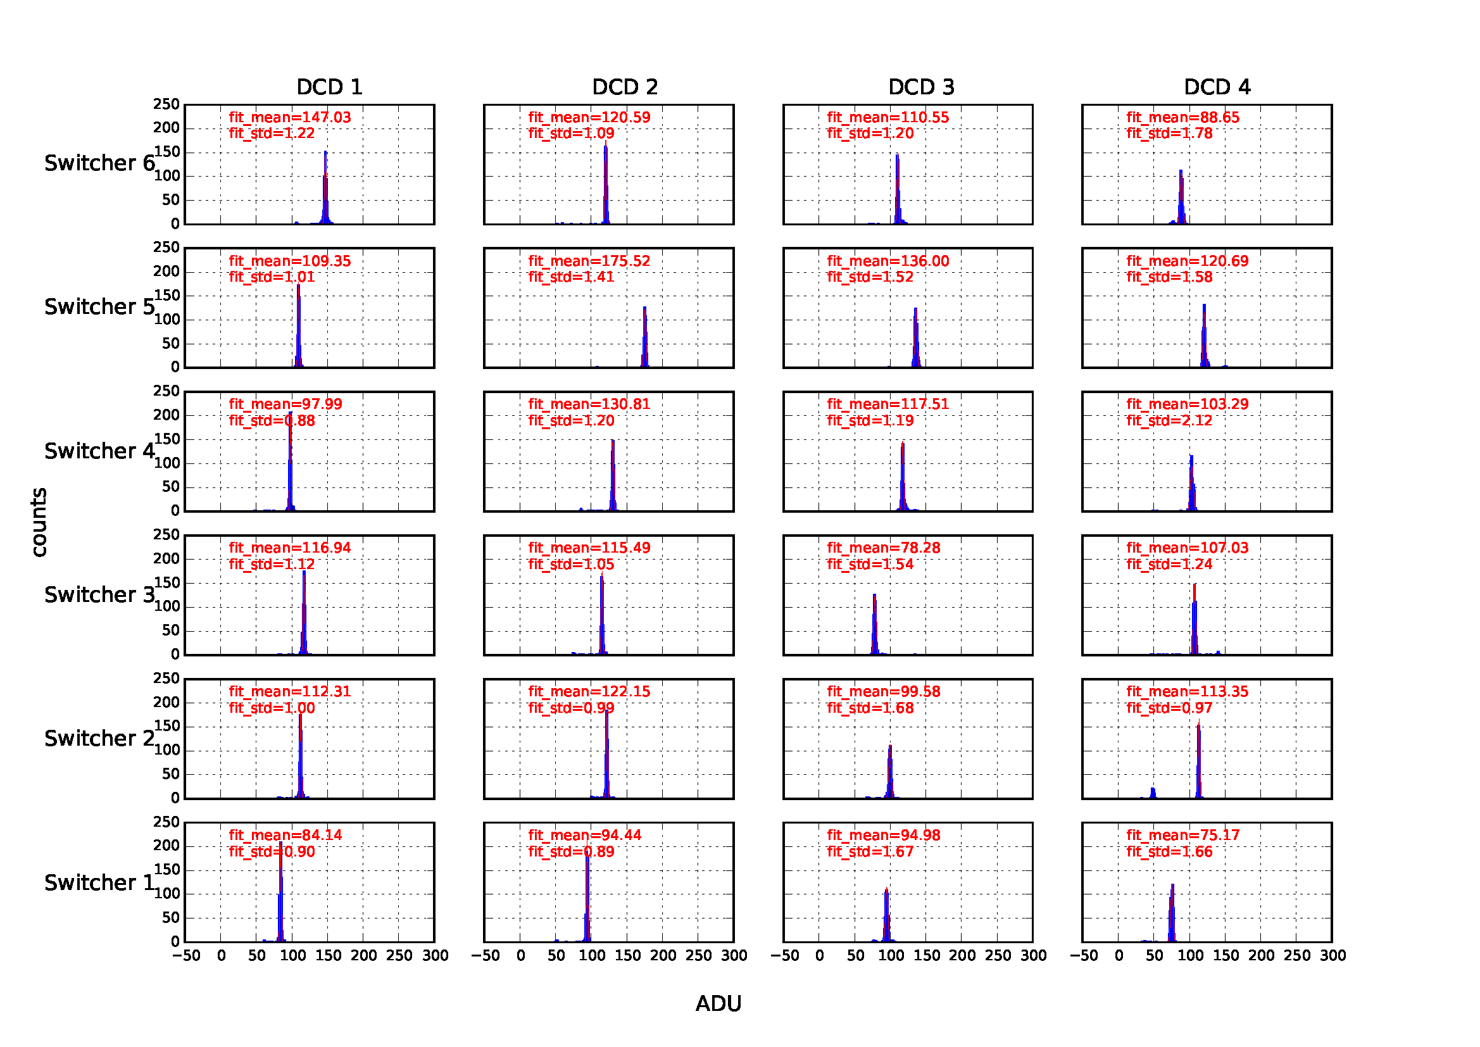
PXD9 – W30-OB1 – Laser scan
Laser signal ~2-4mip, read out at full speed with a noise of ~1.8 ADU (laser instability and system noise)
~105 ns/row, of which ~26ns are used for clear pulse (8 ticks of 32)

Slide 13
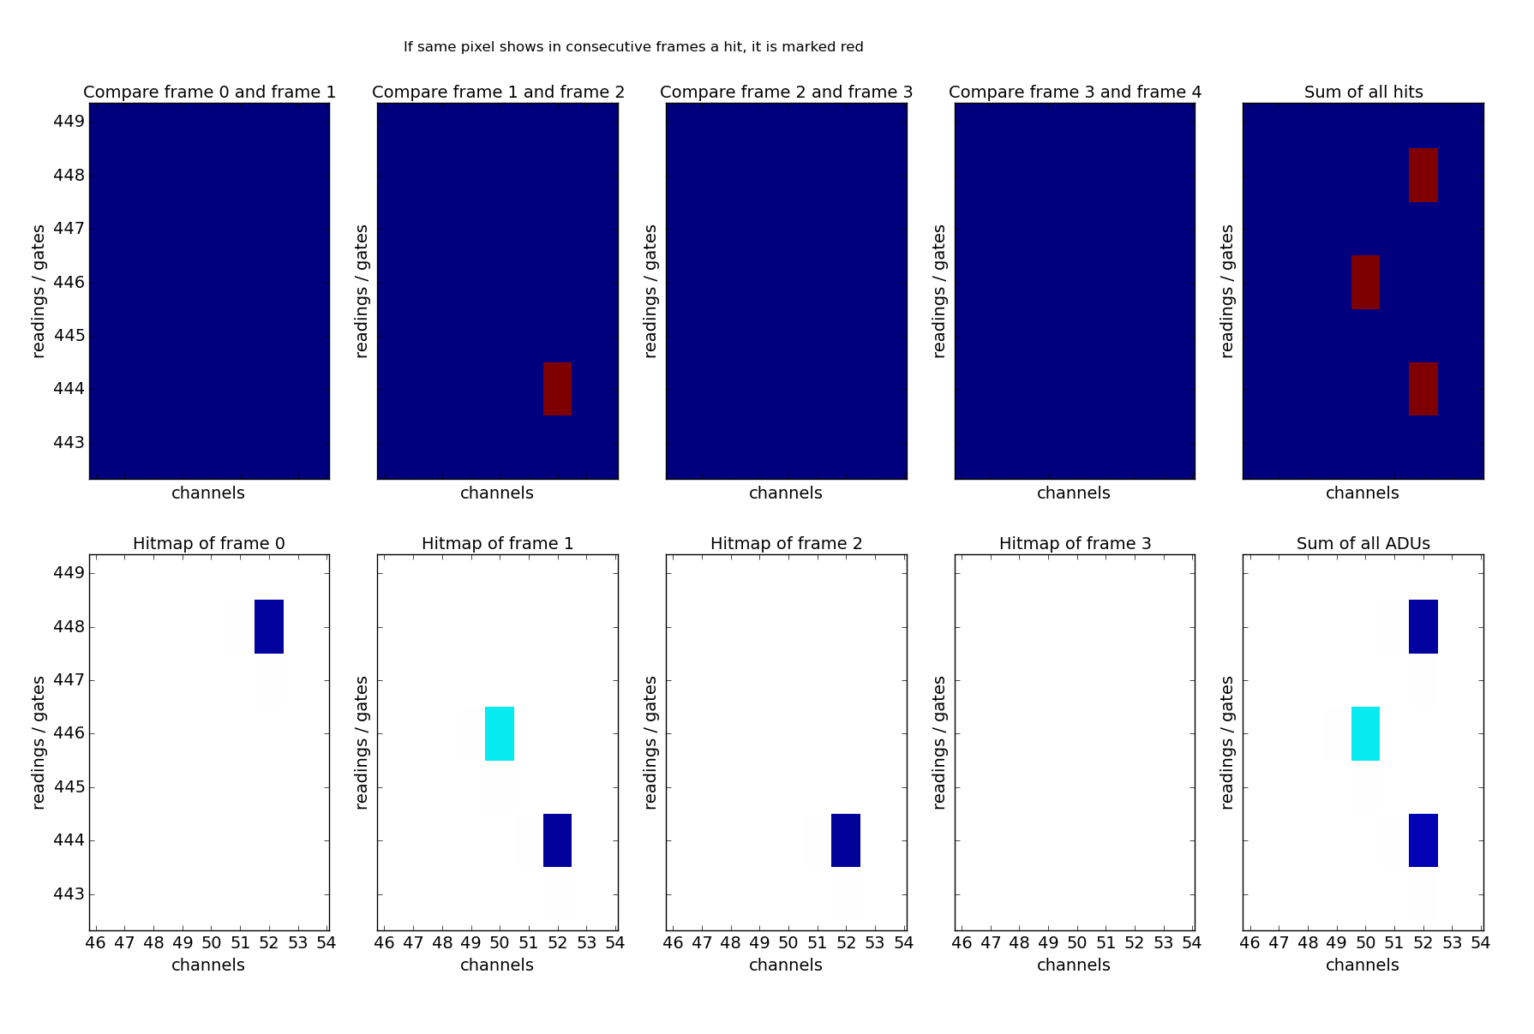
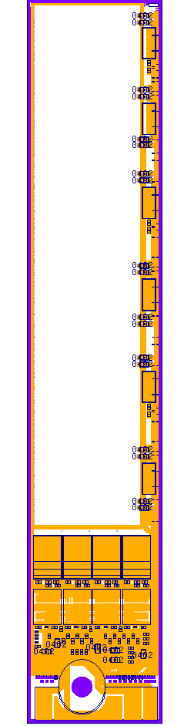
PXD9 – W30-1 – Clear behavior
Laser spot
91ADU
OB
Consecutive frames are readout
Timing of the laser set to have one laser pulse within 4 frames
Threshold of zero suppression is set to 5 ADU

Slide 14
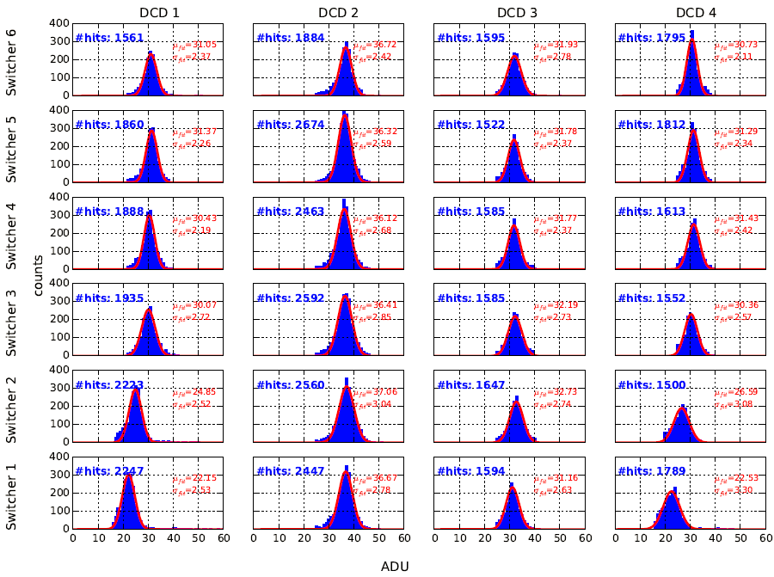
PXD9 – W30-OB1 – Source Measurement

Slide 15
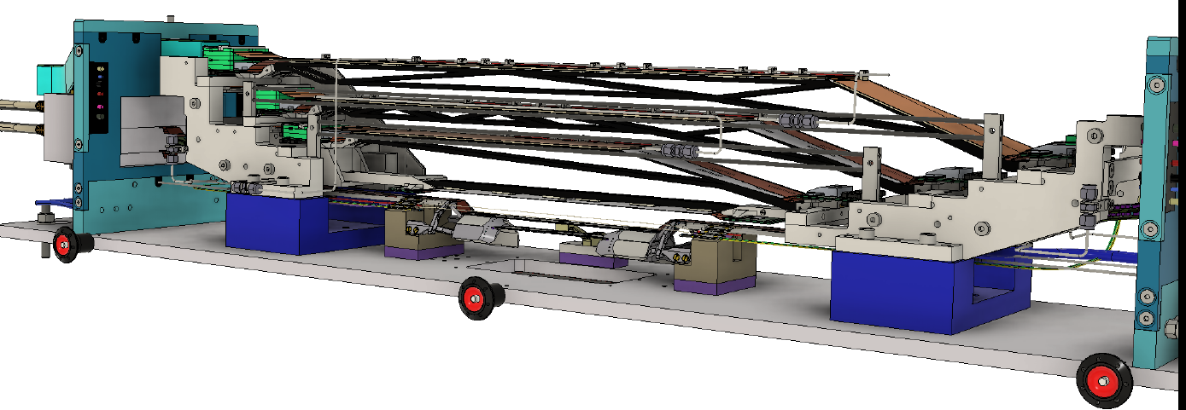
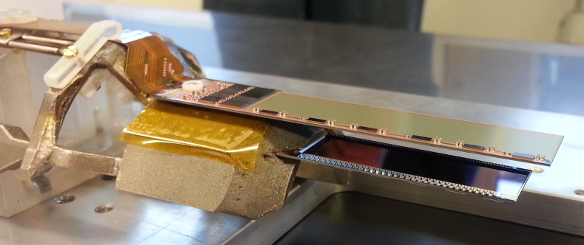
TestBeam April 2016 @ DESY (1)
66 registrants from 10 countries for beam test in April 16 at DESY
Complete system integration test (2 layers PXD, 4 layers SVD)
Layer 2
Cool block
(CO₂ pipes)
Layer 1

Slide 16
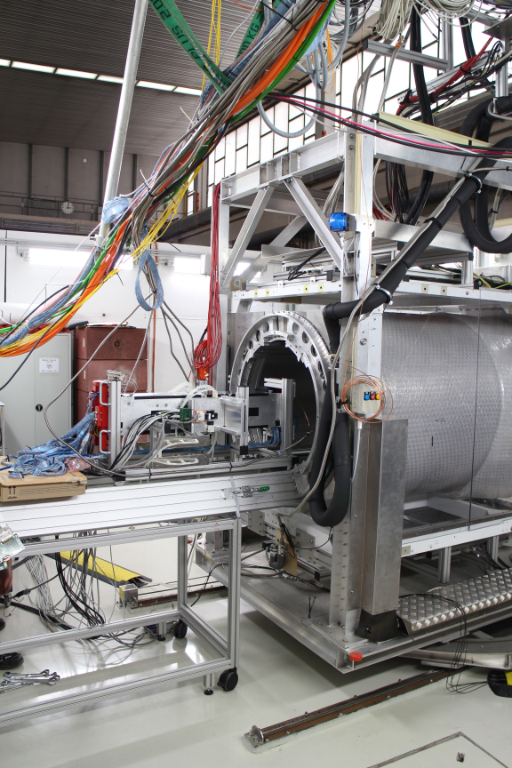
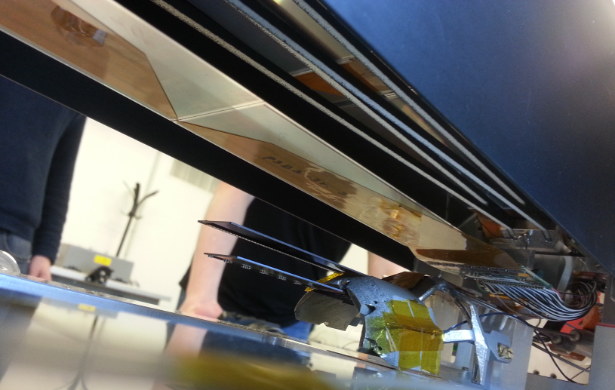
Test Beam April 2016 @ DESY (2)
1 T solenoid
6 GeV electrons
6 layers telescope,
4 layers SVD,
2 layers PXD
e⁻
SVD
e⁻
PXD

Slide 17
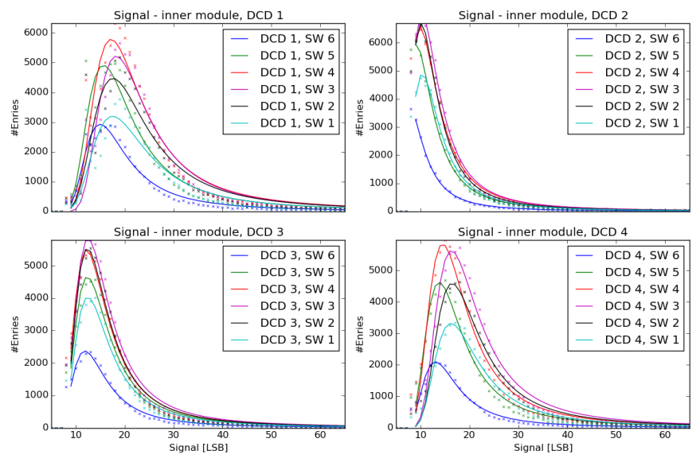
Preliminary TestBeam Analysis – Layer1 Module

Slide 18

Summary and Outlook
To fully exploit the high luminosity provided by SuperKEKB, a pixel detector close to the beam pipe is mandatory for the precise vertex reconstruction
PXD: Excellent spatial resolution of ~ 15 μm; occupancy ~ 1%, fast readout (50 kHz frame rate), huge number of pixels (~ 8 Mpix) => fits all the requirements for Belle II
Complex DEPFET technology; fully functional; successful demonstration in lab and beam tests
Thinning of sensitive area down to 50µm / 75 μm (0.2% X₀), minimizing multiple scattering;
Low power consumption ~ 18 W per ladder
ASICs and Sensors close to final version
Signal to Noise: ~ 40 (including noise from ASICs)
Many aspects not covered in this talk; though in development by the Collaboration
Shows a good clear performance over the entire sensitive area
Shows spectrum of all 24 DCD/Switcher regions with reduced speed
Outlook:
  Optimization of ASIC settings & Supply voltages
  Analysis of beam test data during the next weeks
  Further detector characterization & optimization

Slide 19
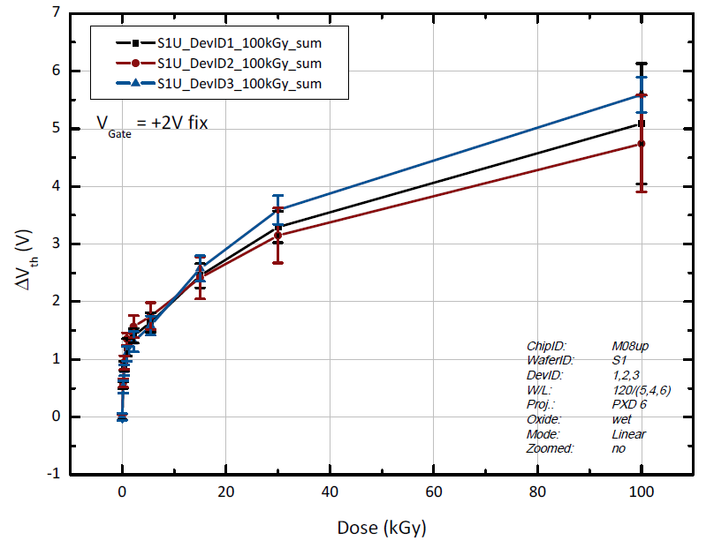
Radiation Tolerance
R&D since 2008:
Reduce t_{ox}
Optimize gate dielectric layer
ΔVt(10Mrad): ~15V → 3 V
The remaining small threshold
voltage shift can easily be
compensated by a shift of
the operating voltages
of the DEPFET!
→ Safe operation for about 10 years in Belle II

Slide 20
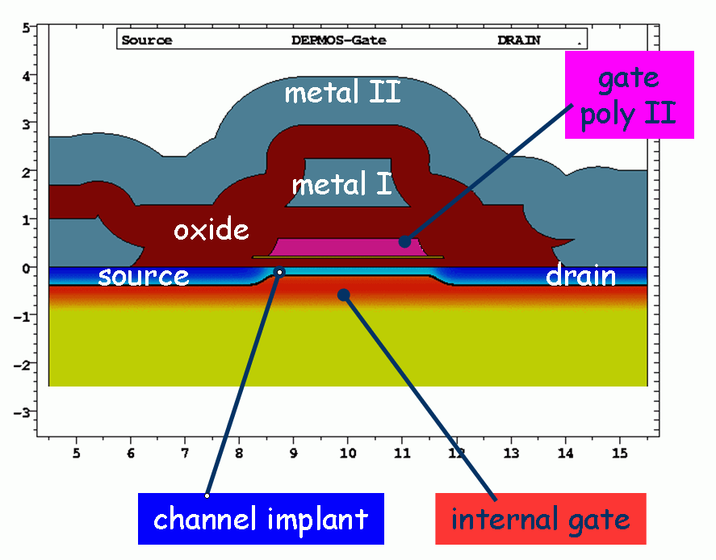
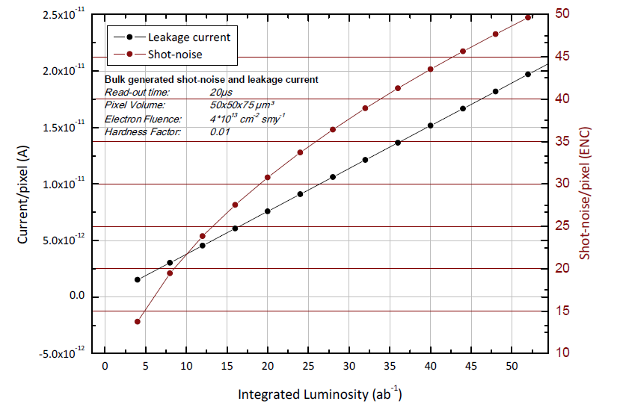
Radiation Tolerance
Gate Dielectrics: ~ 200nm
Radiation field at Belle II dominated by
~MeV electrons/positrons from QED beam background
Ionizing Radiation - Total Ionizing Dose (TID)
(~2Mrad/a at Belle II)
Positive fixed oxide positive charge → ∆V_{T}
interface trap density →
  reduced mobility (g_{m})
  higher 1/f noise
Non Ionizing Energy Loss (NIEL)
(10¹² n_{eq}/cm²/year at Belle II)
Leakage current increase → shot noise
Trapping not considered to be critical
Type inversion expected after 10¹⁴ n_{eq}/cm²

Slide 21
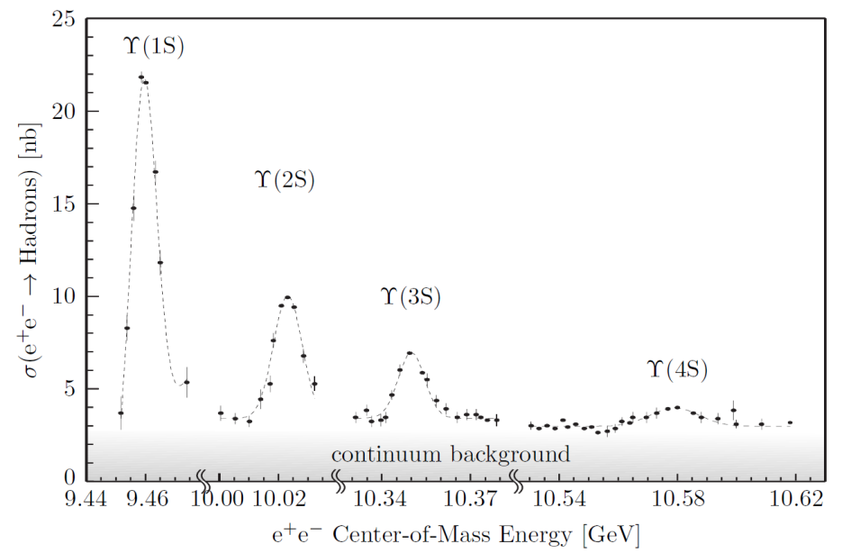
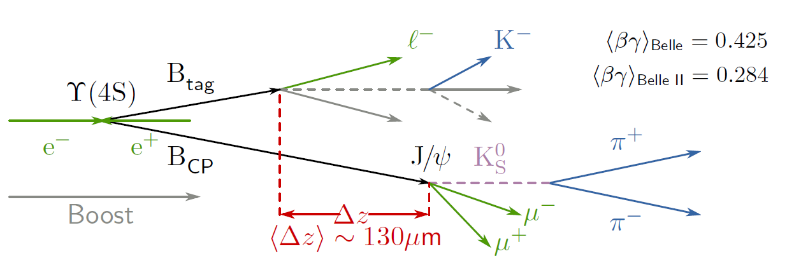

Time dependent measurements of CP violation
Y(4S) is the first resonance just above the BB production threshold
Only BB pairs are produced, and are quasi at rest in the Y(4S) frame
(Belle: ~200µm)

