Slide 1
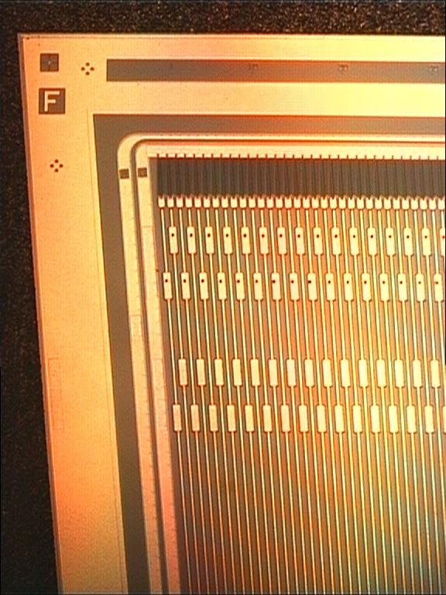
Silicon Detectors
The big success of silicon radiation detectors is based mainly on:
Large signal:
10⁶ electrons/cm (gas: 20-50 electrons/cm)
Fine pattering (photolithography):
=> excellent spatial resolution O(10 µm)
Good detection properties for light and soft x-rays
Well established production methods
(semiconductor industry)
- Good interfacing to electronics (integration)

Slide 2
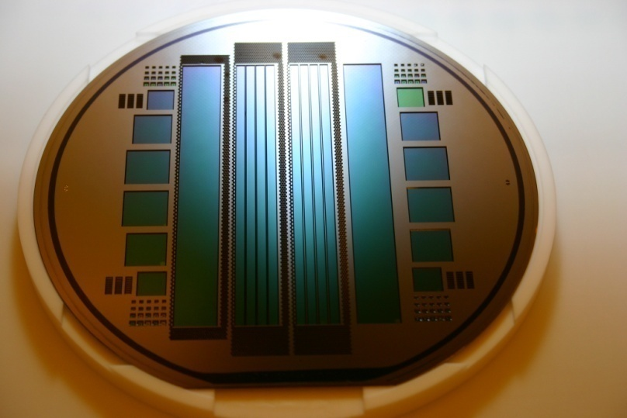
Silicon Detectors
First Lecture (1.7.16)
Semiconductor:
basic properties
pn junction,
leakage current
signal generation
charge transport
Interaction with radiation
Semiconductors: Si, GaAs, others
Second Lecture (4.7.16)
Fabrication of silicon detector
Silicon Detectors: Detector Types
Diodes
Strip Detectors,
Double Sided Strip Detectors
Pixel Detectors
Drift Detectors
CCDs
Silicon Photomultipliers
Radiation Damage
Silicon Detector Systems:
Front End Electronics
Noise
Integration
Active Pixel Sensors
CMOS Sensors
DEPFETs
Detector Systems

Slide 3


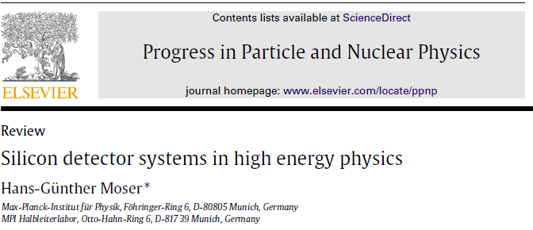
Literature

Slide 4
Band Model
Discrete energy levels of atoms develop into allowed energy bands and forbidden zones if ‘squeezed ‘ together in a solid state body
Conduction Band
Conduction Band
Conduction Band
E_{v}
Fermi Level
Valence Band
E_{g}
Fermi Level
E_{g}
Fermi Level
E_{c}
Valence Band
Valence Band
insulator
semiconductor
concuctor
k: Boltzmann constant
E_{f}: Fermi Level

Slide 5
Fermi-Statistics
F(E)
E/eV
E_{f}

Slide 6
For E>Ev
F(E)
T=300K
T=270K
E/eV

Slide 7
Intrinsic Semiconductors
Intrinsic Semiconductors: Si, Ge, D (Diamond), InSb, GaAs, InAs, CdS, CdTe…..
At T = 0°K: Half of the states occupied by electrons:
empty conduction band
full valence band
=> no conductivity
Silicon: band gap ~ 1 eV: thermal excitation at finite temperature
Intrinsic
n
Conduction Band
E_{c}
E_{g}
Fermi Level
E_{v}
Valence Band
p

Slide 8
Carrier Densities
Density of states (conduction band):
Electron density (conduction band)
Similar for holes (valence band)
N_{c} and N_{v} are the effective density of states at the conduction and valence band
Charge conservation and E_{g} = E_{c}-E_{v}:

Slide 9
Carrier Density
Charge conservation:
Law of mass action
(holds even if )

Slide 10
Doped Semiconductors
Si
Si
Si
Si
Si
Si
Intrinsic
Conduction Band
Si
Si
Si
Si
Si
Si
E_{g}
Fermi Level
Valence Band
Si
Si
Si
Si
Si
Si
Pure Silicon: all bonds saturated: intrinsic semiconductor
Free carriers only by thermal generation: high resistivity, large temperature dependence

Slide 11
Doped Semiconductors
Si
Si
Si
Si
Si
Si
n-doped
-
Conduction Band
-
-
-
-
-
-
-
-
Si
Si
Si
P
Si
Si
+
+
+
+
+
+
+
+
Valence Band
Si
Si
Si
Si
Si
Si
N-doped: an unbound electron of phosphorous atom can easily be ionised and act as free carrier. In the band model this is an donor ~45 meV below the conduction band.
At room temperature these states are ionized and the electrons move freely in the conduction band

Slide 12
Doped Semiconductors
Si
Si
Si
Si
Si
Si
p-doped
Conduction Band
Si
Si
Si
B
+
Si
Si
-
-
-
-
-
-
-
Valence Band
+
+
+
+
+
+
+
+
Si
Si
Si
Si
Si
Si
p-doped (e.g. Boron): missing bond acts effectively as positive charge (‘hole’)
In the band model this corresponds to an acceptor level ~45meV above the valence band
At room temperature these states are occupied and the corresponding holes in the valence band act as free carriers

Slide 13
Doping
Intrinsic
n-doped
p-doped
Conduction Band
Conduction Band
Conduction Band
-
-
-
-
-
-
-
-
E_{g}
Fermi Level
+
+
+
+
+
+
+
+
-
-
-
-
-
-
-
-
Valence Band
Valence Band
Valence Band
+
+
+
+
+
+
+
+
Si, Ge, GaAs, InSb..
Doped with
P, As, Sb
‘Donor’ N_{D}
ΔE~0.045eV
Doped with B
‘Acceptor’ N_{A}

Slide 14
Basics: the pn-junction
V_{bi}
Conduction Band
Conduction Band
-
-
-
-
-
-
-
-
-
-
-
-
-
-
-
-
-
p-doped
n-doped
+
+
+
+
+
+
+
+
Valence Band
+
+
+
+
+
+
+
+
Valence Band
d
At the junction: creation of a depleted region (space charge)

Slide 15
pn-junction forward biased
V_{bi}
Vext
Conduction Band
Conduction Band
-
-
-
-
-
-
-
-
n-doped
+
+
+
+
+
+
+
+
-
-
-
-
-
-
-
-
-
p-doped
Valence Band
+
+
+
+
+
+
+
+
+
Valence Band
d
Forward bias (positive voltage at p-region)
Depleted zone reduced => current increase
D: diffusion coefficient
τ: recombination lifetime

Slide 16
pn-junction: reverse biased
p-doped
V_{bi}
Conduction Band
-
-
-
-
-
-
-
-
-
-
-
Vext
Valence Band
+
+
+
+
+
+
+
+
n-doped
Conduction Band
-
-
-
-
-
-
-
v+
Valence Band
v+
v+
+
+
+
+
+v
+v
Reverse bias (positive at n region): increase of depleted zone
Current dominated by thermal generation current (leakage current)

Slide 17


pn-junction under bias
Applying a (reverse) voltage increases the
depleted region
Electric field:
2x10¹¹ cm⁻³
n
p
10¹³ cm⁻³
ε = ε₀ ε_{si} ~ 1 pF/cm
Potential:
Thickness of depleted region
Voltage to deplete a thickness D
dep

Slide 18
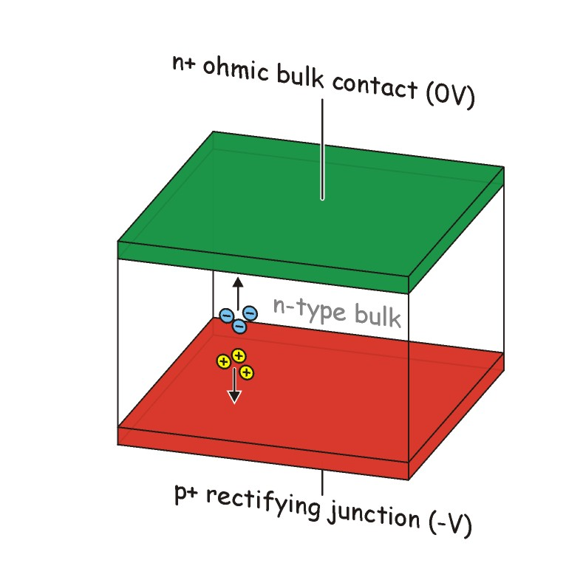
Depleted Diode: Current and Capacitance
No free charge carriers in depleted region
except:
Thermally generated current
Small leakage current
Capacitor (parallel plate):
Difference to a chamber: space charge!
=> can be used to shape field

Slide 19
Leakage Current
Shockely Read Hall
E_{g} > kT (T = 300K)
No generation or recombination at room temperature
However, generation and recombination possible due to mid-gap traps = recombination centres
Conduction Band
E_{g}
Fermi Level
x x x x x x
x
Valence Band
Leakage current level depends on impurity level
Rule of thumb: leakage current doubles each 6°C temperature rise

Slide 20
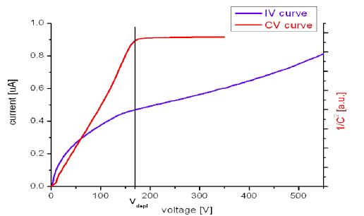
IV and CV characteristics
 | U < U_{dep} | U>U_{dep}
1/C² | ~U | const. (measures U_{dep})
I |  | ~const (+ surface contributions)

Slide 21
Examples
Doping concentration is related to the resistivity ρ and the carrier mobility μ
For silicon
1
2
3
4
5
1: extremely pure n-type silicon (hard to get)
2 fairly pure n-type material
3: note: for p-type material: μ_{h} = μ_{e}/3
4: irradiated material (LHC level: 10¹⁴ neutrons(1MeV)/cm²)
5 extremely irradiated (sLHC): 10¹⁶ neutrons(1MeV)/cm²)

Slide 22
Solid State Ionisation Chamber
Electrons & holes generated by ionising particles or photon conversions drift to the electrodes and induce a signal

Slide 23
Charge Transport
In the electric field the charge carries drift to the electrodes with a velocity
For not too large fields! At high fields (E_{sat}) the drift velocity saturates and becomes independent of the field (here Silicon):
Electrons drift three times faster than holes (in Si)
Saturation can happen in Si-sensors (thick, low resistivity)

Slide 24
Charge Collection time
For low fields (no saturation) the transition time to traverse a sensor of
thickness d is:
U_{dep}: Voltage to deplete the device with thickness d
ΔU: overvoltage (for ΔU = 0 the transition time becomes infinite)
(in practice: collection by diffusion)
e.g. 20kΟcm n-type, U_{dep}=15V, ΔU=5V, d=300 μm:
t_{trans}(e)=40ns t_{rans}(h)=120ns
Can be improved going to higher fields (low resisitivty material)
e.g. 2kOcm n-type, U_{dep}=150V, ΔU=10V, d=300 μm
t_{trans}(e)=2ns t_{rans}(h)=6ns

Slide 25
Charge Spread
a) Diffusion:
D=kT/μ
For detectors of d=300 μm: σ ~ 5-20 μm
b) Lorentz angle:
B
E
μ_{h}: Hall mobility differs from drift mobility
e: μ_{h} = 1670 cm²/Vs μ=1450 cm²/Vs
h: μ_{h} = 370 cm²/Vs μ=505 cm²/Vs
-> spreads charge over larger area
-> larger Lorentz angle for electrons (4.5 x)
~ 10° at 1T

Slide 26
Charge Collection
Does one need to collect the charges physically on the electrodes to detect a signal?
No!
Moving charges induce a current (S. Ramo, 1937)
E_{wi} is the weighting field, parameterizing the coupling of a charge to the electrode I
It depends only on the geometry of the electrodes, not on space charge, U_{bias} etc.
Set U_{wi} = 1 for the collecting electrode
U_{wi} = 0 for all other electrodes

Slide 27
Charge Collection
The induced charge of a carrier drifting from r(t₀) to r(t) is:
For an electron drifting from r₀ to the anode at r=d:
Q_{e} =
)]
0
And the hole drifting to r=0 (“backplane”)
Q_{h} =
The sum of the two contributions is q, independent of r
      Q = Q_{e} + Q_{h} = q
Both electrons and holes contribute, but with different magnitude

Slide 28
Planar Diode
A planar diode has a simple, linear weighing potential
(and a constant weighting field)
This is fo for a n in p device, the collecting electrode collects electrones!
n bulk
backplane
n/p junction
The contribution of electron and holes is proportional to their respective drift path,
That is, on average, equal.

Slide 29
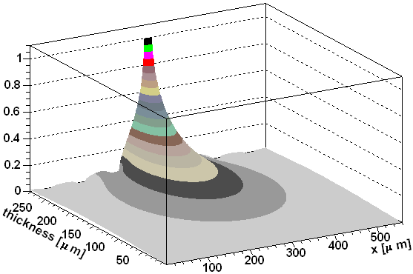
Segmented Device (Strip, Pixel)
The weighting potential gets strongly peaked at the collecting electrode
=> Signal contribution dominated by the region close to the electrode
n bulk
This is fo for a n in p device, the collecting electrode collects electrones!
backplane
n/p junction

Slide 30
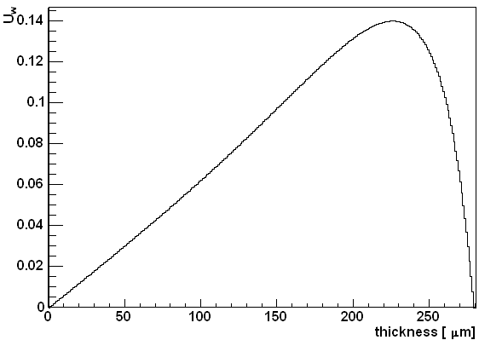
Consequences
Signal shape: fast component by electrodes followed by a slow component of the holes (slower drift)
Relative contribution of (slow) hole and (fast) electron signal depends on the distance to the electrode
Neighbour electrodes: U(r=0) = U(r=d) = 0
should not see a signal!
induced current is bipolar and integrates to 0
However: if the charge collection is incomplete (trapping, partial depletion)
Signal visible on neighbour electrodes
even with opposite polarity

Slide 31
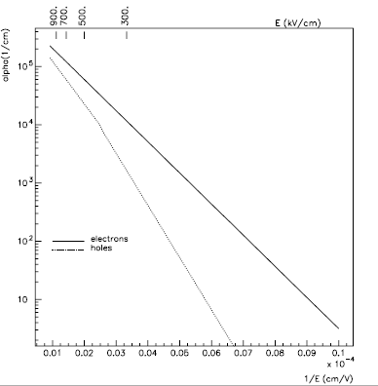
Impact Ionisation
In high electric fields electrons and holes acquire enough energy to create e-h pairs by impact ionisation
Electrons >~ 300 kV/cm
Holes >~ 400 kV/cm
300 kV/cm < E < 400 kV/cm
Only electrons ionize
Linear mode
Gain < 10
N(l) = exp(αl)
E ~ 400 kV/cm
Both electrons and (rarely) holes ionize
Still linear mode
Gain: 50 – 300
Excess noise: σ(N) = k N^{1/2}
h
h
h
h
h
h
h
h
h
h
h
h
h
h
h
h
h
h
h
h
h
h
h
h
h
h
h
h
h
h
h
h
h
h
h
h
h
h
h
h
h
h
h
h
h
h
h
h
h
h
h
h
h
h
h
h
h
h
h
h
h
h
h
h
h
h
h
h
h
h
h
h
h
h
h
h
h
h
h
h
h
h
h
h
h
h
h
h
h
h
h
h
h
h
h
h
h
h
h
h
h
h
h
h
h
h
h
h
h
h
h
h
h
h
h
h
h
h
h
h
h
h
h
h
h
h
h
h
h
h
h
h
h
h
h
h
h
h
h
h
h
h
h
h
h
h
h
h
h
h
h
h
h
h
h
h
h
h
h
h
h
h
h
h
h
h
h
h
h
h
h
h
h
h
h
h
h
h
h
h
h
h
h
h
h
h
h
h
h
h
h
h
h
h
h
h
h
h
h
h
h
h
h
h
h
h
h
h
h
h
h
h
h
h
h
h
h
h
h
h
h
h
h
h
h
h
h
h
h
h
h
h
h
h
h
h
h
h
h
h
h
h
h
h
h
h
h
h
h
h
h
h
h
h
h
h
h
h
h
h
h
h
h
h
h
h
h
h
h
h
h
h
h
h
h
h
h
h
h
h
h
h
h
h
h
h
h
h
h
h
h
h
h
h
h
h
h
h
h
h
h
h
h
h
h
h
h
h
h
h
h
h
h
h
h
h
h
h
h
h
h
h
h
h
h
h
h
h
h
h
h
h
h
h
h
h
h
h
h
h
h
h
h
h
h
h
h
h
h
h
h
h
h
h
h
h
h
h
h
h
h
h
h
h
h
h
h
d
e
e
e
t
t
e
e
e
e
e
e
e
e
e
e
e
e
e
e
e
e
e
e
e
e
e
e
e
e
e
e
e
e
e
e
e
e
e
e
e
e
e
e
e
e
e
e
e
e
e
e
e
e
e
e
e
e
e
e
e
e
e
e
e
t
e
e
e
e
e
e
e
e
e
e
e
e
e
e
e
e
e
e
e
e
e
e
e
e
e
e
e
e
e
e
e
e
e
e
e
e
e
e
e
e
e
e
e
e
e
e
e
e
e
e
e
e
e
e
e
e
e
e
e
e
e
e
e
e
e
e
e
e
e
e
e
e
e
e
e
e
e
e
e
e
e
e
e
e
e
e
e
e
e
e
e
e
e
e
e
e
e
e
e
e
e
e
e
e
e
e
e
e
e
e
e
e
e
e
e
e
e
e
e
e
e
e
e
e
e
e
e
e
e
e
e
e
e
e
e
e
e
e
e
e
e
e
e
e
e
e
e
e
e
e
e
e
e
e
e
e
e
e
e
e
e
e
e
e
e
e
e
e
e
e
e
e
e
e
e
e
e
e
e
e
e
e
e
e
e
e
e
e
e
e
e
e
e
e
e
e
e
e
e
e
e
e
e
e
e
e
e
e
e
e
e
e
e
e
e
e
e
e
e
e
e
e
e
e
e
e
e
e
e
e
e
e
e
e
e
e
e
e
e
e
e
e
e
e
e
e
e
e
e
e
e
e
e
e
e
e
e
e
e
e
e
e
e
e
e
e
e
e
e
e
e
e
e
e
e
e
e
e
e
e
e
e
e
e
e
e
e
e
e
e
e
e
e
e
e
e
e
e
e
e
e
e
e
e
e

Slide 32
Impact Ionisation
High electric fields must be avoided not to risk breakdown
On the other hand: a smart implementation of high field regions lead to sensors with intrinsic amplification
= > APD (avalanche photo diode)

Slide 33
Interaction of Radiation with Matter
Ionizing Radiation:
detection and tracking of charged particles
=> Bethe Bloch Formula
Non Ionizing Radiation
  Photons
  visible: Inter-band transitions: discussed later
  X-ray and gamma:
  Photo Effect
  Compton Effect
  Pair creation
  In the energy range useful for silicon detectors the photo effect dominates

Slide 34
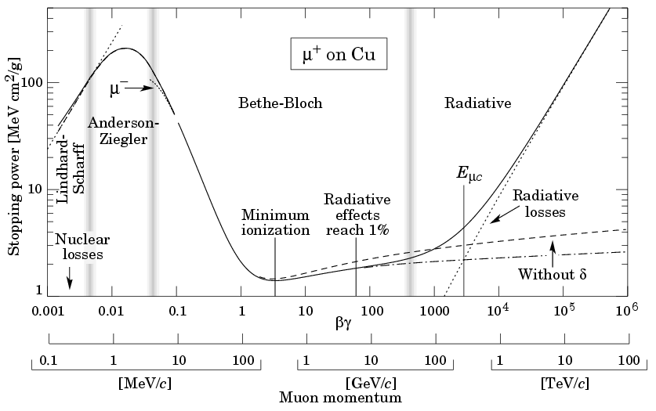
Ionisation
The average energy loss due to ionisation is given by the Bethe-Bloch formula:
(see PDG report p. 258 for the symbols…..)
MIP =
minimum
Ionizing
particle

Slide 35
Ionisation
Wide, asymmetric distribution (Landau)
High loss tail: contribution from δ-rays: energy not deposited near the track
(lost in thin or highly segmented devices)
More relevant: most probable energy loss
Rule of thumb:
~ 270 eV/μm for MIPs in Silicon
3.6 eV are needed to create an e/h pair:
75 e/h pairs/μm
However:
Most probable energy loss decreases
for thinner layers!

Slide 36
Energy Loss in Thin Detectors

Slide 37
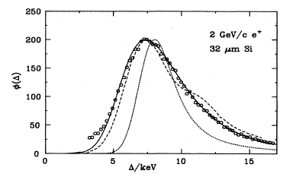
Thin Detectors
Energy lost in many collisions => statistical fluctuations
Thinner layers => less colllisons => larger fluctuations
Energy loss due to delta-rays which can escape
=> Energy loss spectrum shifted and wider than expected by Landau theory
Data
Landau
From H. Bichsel, Rev. Mod. Phys 60 (1988)

Slide 38
Signal Generation: Optical
Photo effect: possible if E_{γ} > E_{g} (=1.1 eV in Si)
Fine for visible light
Near infrared: Si becomes transparent for λ> 1100 nm
UV: light is absorbed in thin (un-depleted) surface layer for λ < 400nm

Slide 39
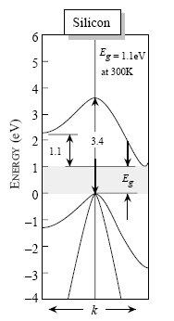

Light Absorption in Silicon
Si Band Structure

Slide 40
Photon Conversion Efficiency
Photon must be absorbed in the sensitive volume of the device
Problems:
Loss in insensitive surface layer (highly doped p or n implant to create junction)
depth typically O(100 nm)
Problem for short wavelengths
UV sensitive diodes need
extremely thin entrance windows
(special technology)
Photons of long wavelength traverse the sensitive volume
2 μm sensitive volume
10% conversion efficiency for λ=800 nm

Slide 41
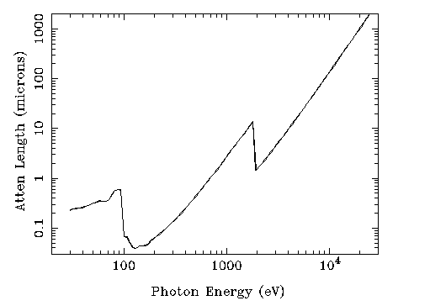
X-ray absorption in Si
Energetic x-rays generate several e/h pairs
Useful range: 100eV – 20 keV (for Si of 500 μm thickness)

Slide 42
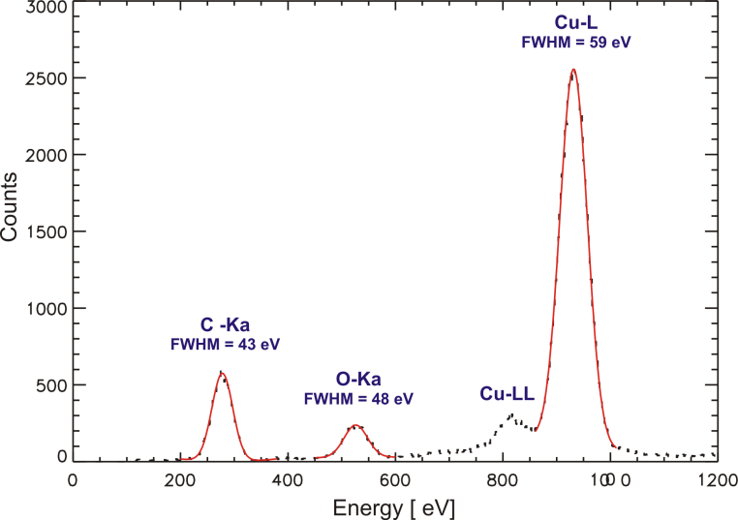
X-Ray Detection
On average: 3.6 eV needed to generate an e/h pair in Si
This is more then the band gap of 1.1 eV
some of the energy heats up the lattice (creates phonons)
Consequence: improved resolution:
Fano factor F=0.1 in Si (U. Fano, Phys Rev 72 (1947))
Si drift chamber
300µm

Slide 43
Which Semiconductor?
 | Si | Ge | GaAs | Diamond
Eg (eV) | 1.12 | 0.67 | 1.35 | 5.5
μ(e) (cm²/Vs) | 1450 | 3900 | 8800 | 1800
μ(h) (cm²/Vs) | 450 | 1900 | 320 | 1600
ε (pF/cm) | 11.9 | 16.2 | 12.9 | 5.7
ΔE(e/h) | 3.6 | 3.0 | 4.35 | 13
dE/dx (MeV/cm) | 3.2 | 7.1 | 5.6 | 6.1
ρ (g/cm³) | 2.33 | 5.3 | 5.32 | 3.5
X₀ (cm) | 9.4 | 2.3 |  | 12.15
Low Band gap => large signals
=> large leakage currents (cooling needed)
High mobility => fast signals
Low ε => low capacitance => low noise
Large X₀ => small multiple scattering
For a specific purpose there may be other important parameters:
Thermal conductivity, displacement energy,……

Slide 44
Why Silicon?
Except for: large volume detectors (spectrometers): Ge
Infrared sensors (InSb, HgCdTd..)
X-ray sensors (InAs)
Silicon is dominating the market for photo and tracking detectors
Why? In many respects other semiconductors are superior?
Sophisticated and readily available processing possibilities
Electronics industry uses silicon (CMOS)
Reason: “perfect” interface of SiO₂ and Si
basis for patterning, CMOS structures etc
Huge amount of knowledge how to process silicon
Processes and machinery readily available
Device and process simulation helps to design devices

Slide 45
End of Lecture I

Slide 46
Silicon Detectors
First Lecture
Semiconductor:
Basic properties
pn junction,
leakage current
signal generation
charge transport
Interaction with radiation
Semiconductors: Si, GaAs, others
Second Lecture
Fabrication
Silicon Detectors: Detector Types
Diodes
Strip Detectors,
Double Sided Strip Detectors
Pixel Detectors
Drift Detectors
CCDs
DEPFETs
Silicon Photomultipliers
Radiation Damage
Silicon Detector Systems:
Front End Electronics
Noise
Integration
Active Pixel Detectors
CMOS Sensors
DEPFETs
Full Detector Systems

Slide 47
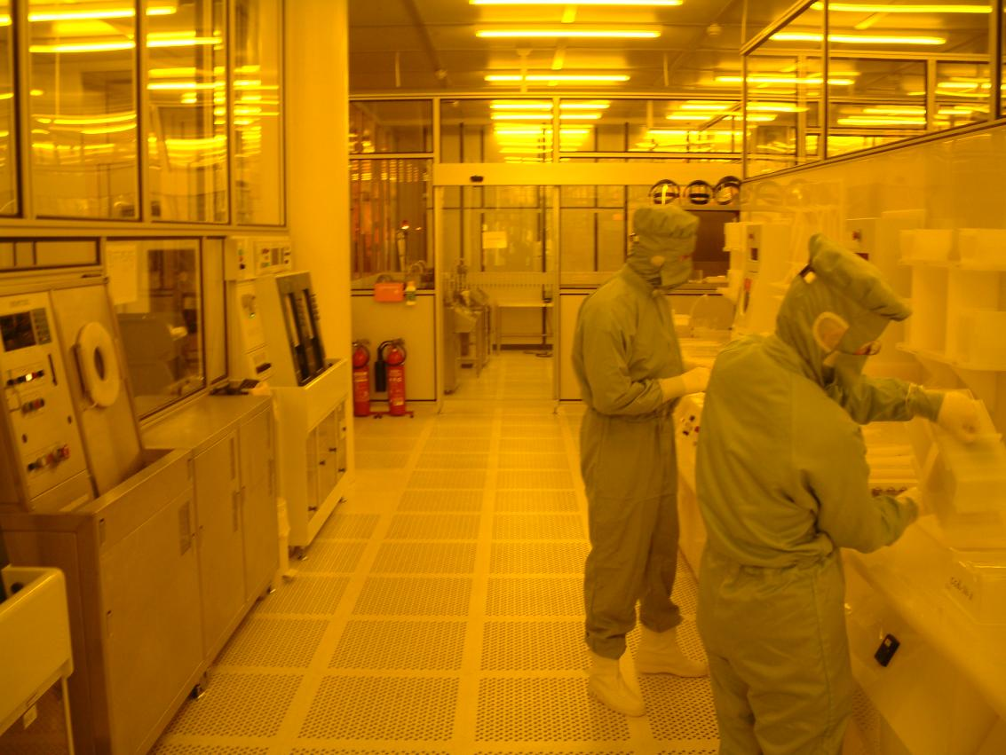
Fabrication
Fabrication of Silicon Detectors
Engineering!
Detailed knowledge of technology needed
Chemical etching
Energy/depth relation for implantations
Diffusion during thermal treatment
Optics
Technology widely used in semiconductor industry (much more advanced)
However: some details not disclosed
Cleanroom of the semiconductor laboratory of the Max-Planck Society (Munich)

Slide 48
Fabrication
Photolithography
Start with oxidised wafer
SiO2 (~100nm))
Si-bulk

Slide 49
Fabrication
Photolithography
Add a layer of photoresist
Photoresisist (~ µm)
SiO2 (~100nm))
SiO2 (~100nm))
Si-bulk
Si-bulk

Slide 50
Fabrication
Photolithography
Expose to light through a patterned glass mask (chromium)
Photoresist (~ µm)
SiO2 (~100nm))
SiO2 (~100nm))
Si-bulk
Si-bulk

Slide 51
Fabrication
Photolithography
Develop photoresist
Exposed regions are removed
SiO2 (~100nm))
SiO2 (~100nm))
Si-bulk
Si-bulk

Slide 52
Fabrication
Photolithography
Etch away SiO₂ (using HF)
Opening which can be used as a contact to the bulk
SiO2 (~100nm))
SiO2 (~100nm))
SiO2 (~100nm))
Si-bulk
Si-bulk
Si-bulk

Slide 53
Fabrication
Implant with an ion beam to dope the silicon
Phosphor: n doped
Boron: p doped
Energy of beam and thickness of resist has to be chosen that ions are 100% absorbed in photoresist
SiO2 (~100nm))
SiO2 (~100nm))
Si-bulk
Si-bulk

Slide 54
Fabrication
Result: diode (if p implanted in n-bulk) which can later be contacted by
metal to create a charge collecting sensor
SiO2 (~100nm))
SiO2 (~100nm))
Si-bulk
Si-bulk

Slide 55
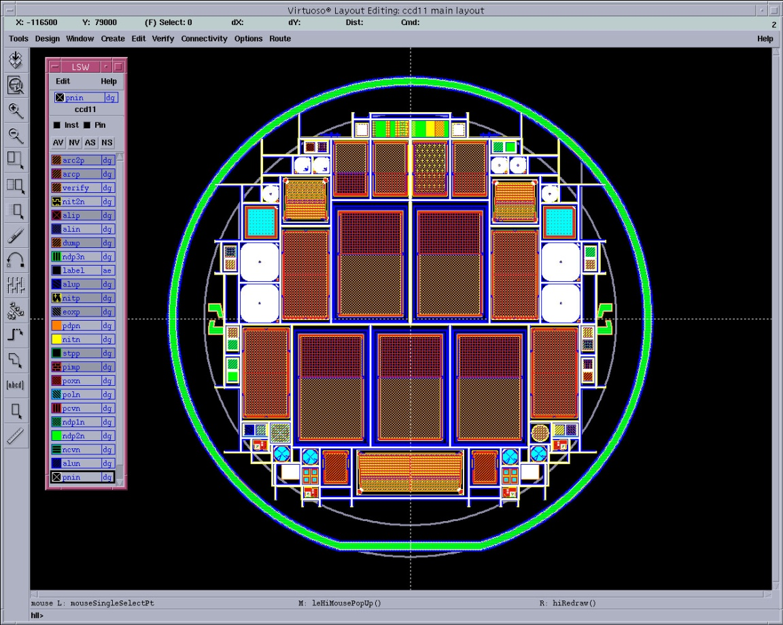
Layout
Si detectors are made of several structured layers
Silicon bulk with implantations
Oxide layers as insulation
Metal or polysilicon as contacts
Passivation layer
All these layers have to be designed and converted into photolithographic masks
55

Slide 56
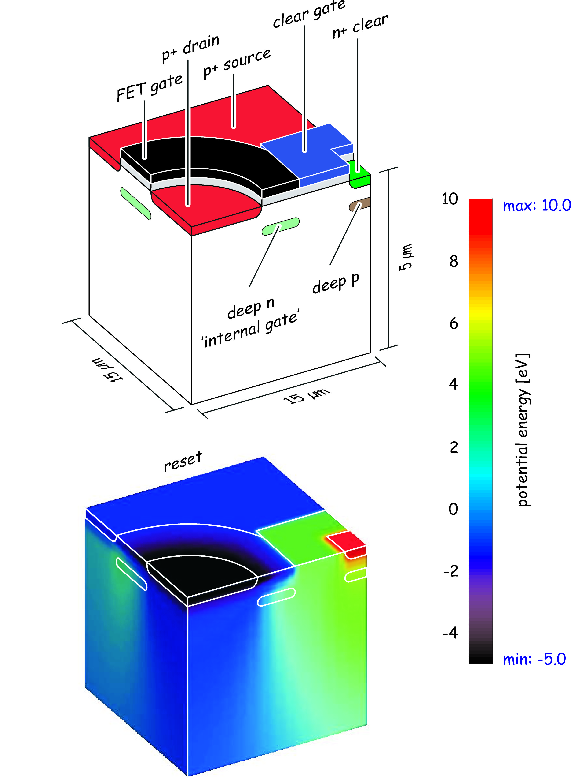
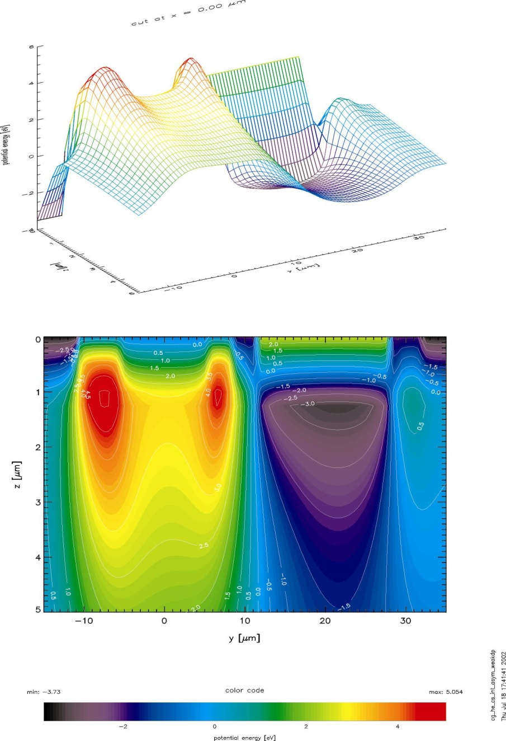
Device Simulation

Slide 57
Cleanroom
particle removal by a continuous filtered air stream (from ceiling to bottom).
clean processing by handling, clothing and separation from outside world.
clean process gases and chemicals.
supply of ultra-clean water.

Slide 58
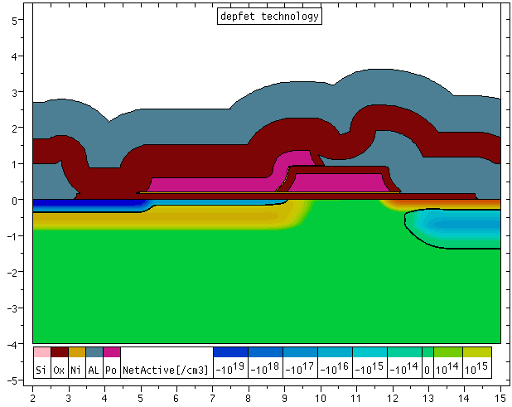
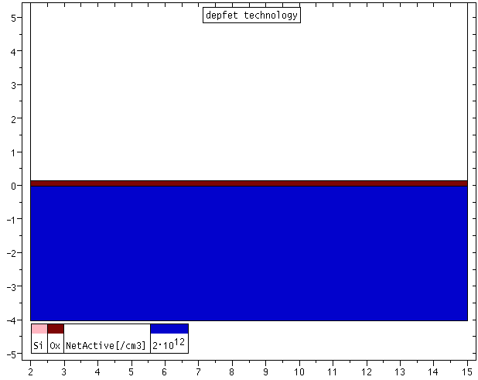
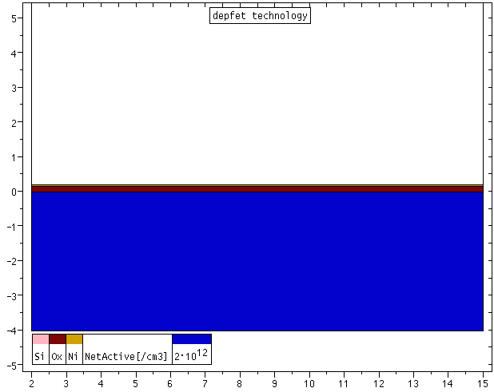
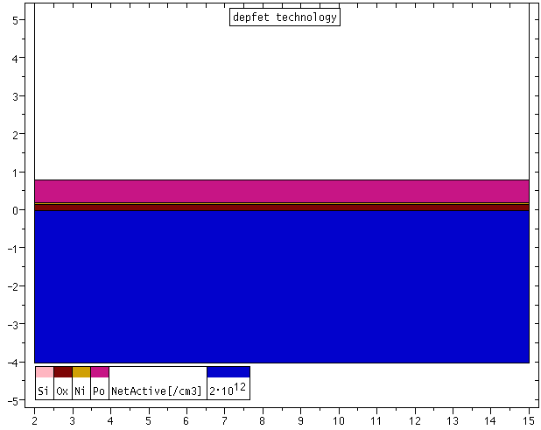

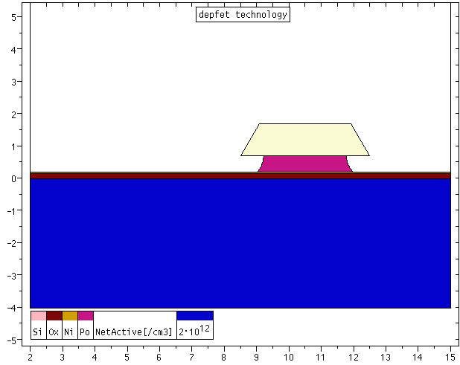
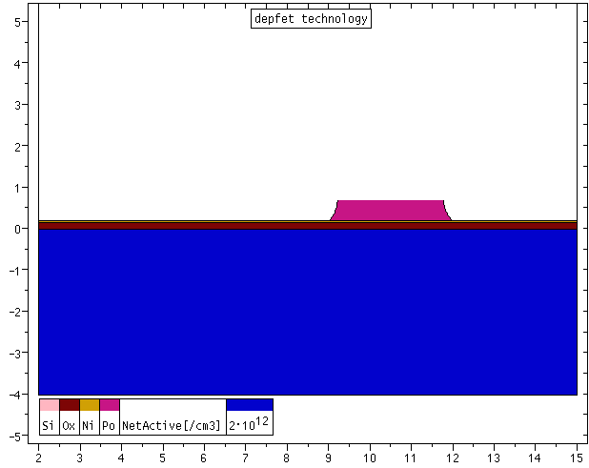
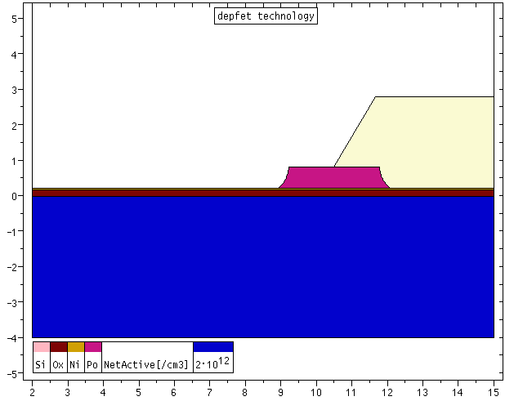
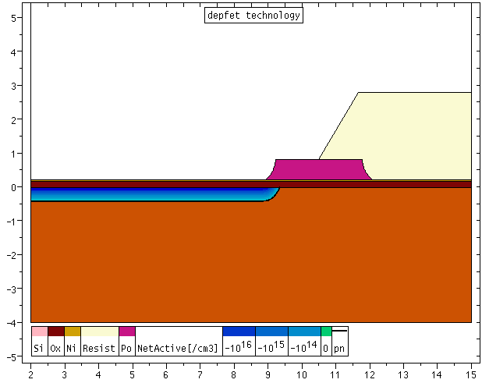
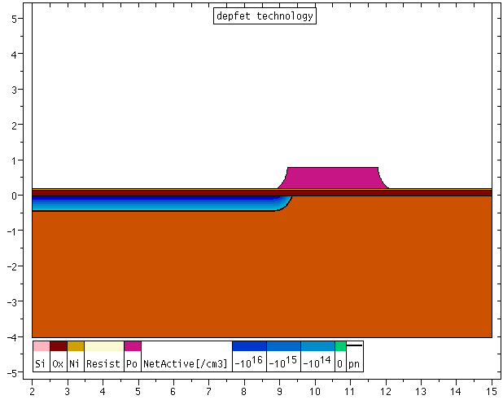

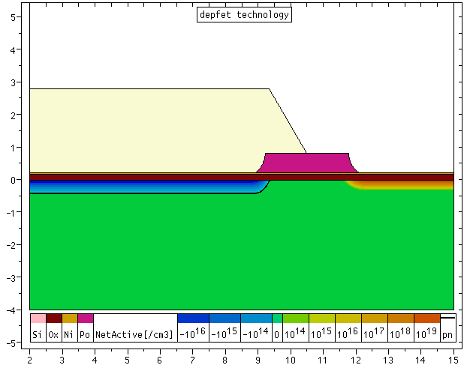
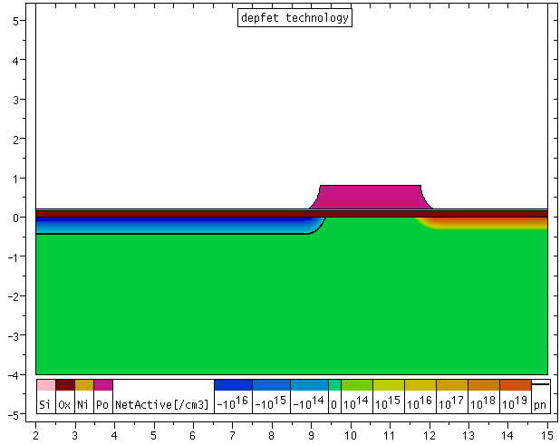
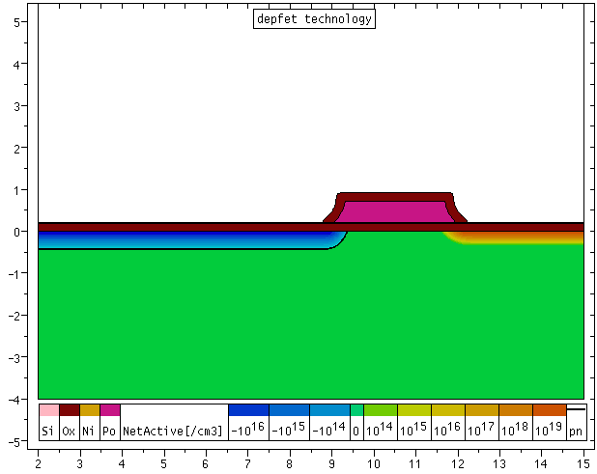
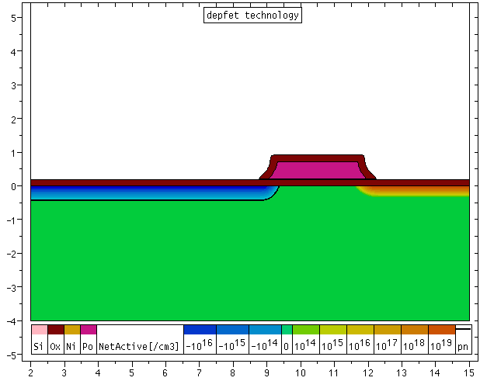
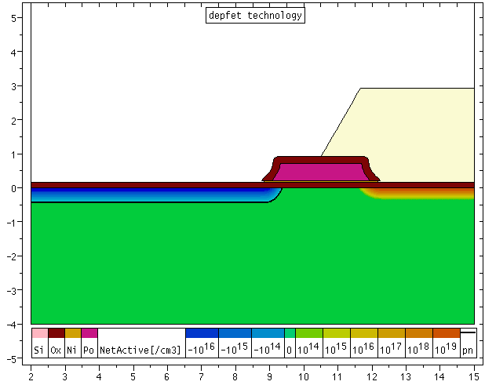
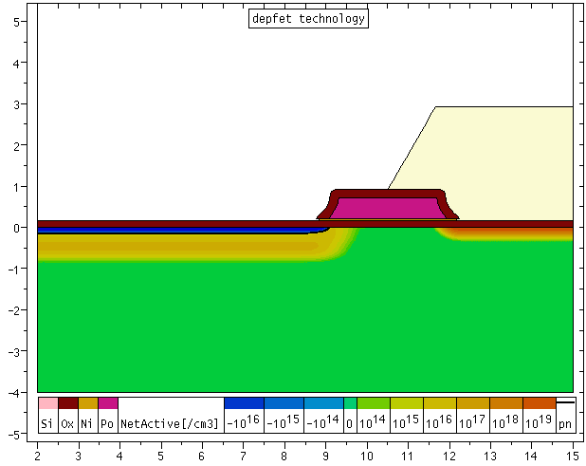
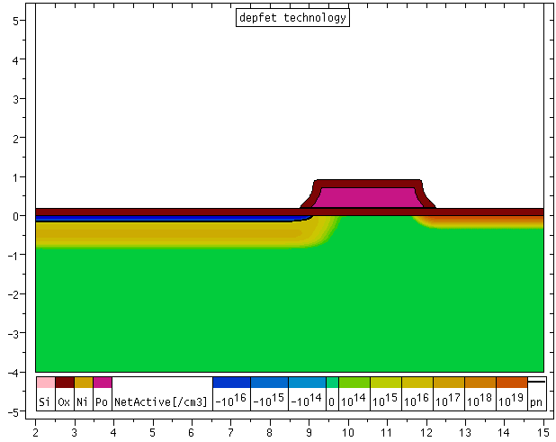
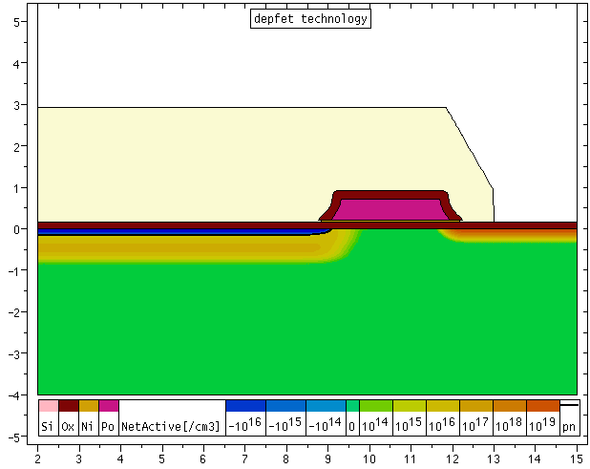
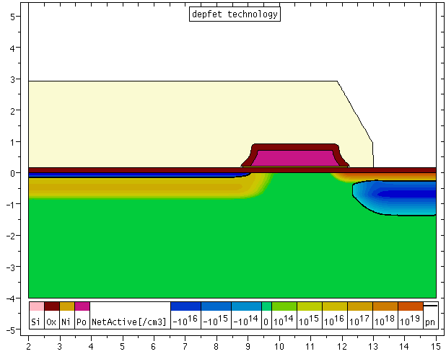
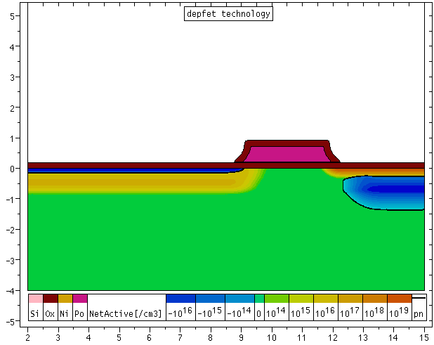
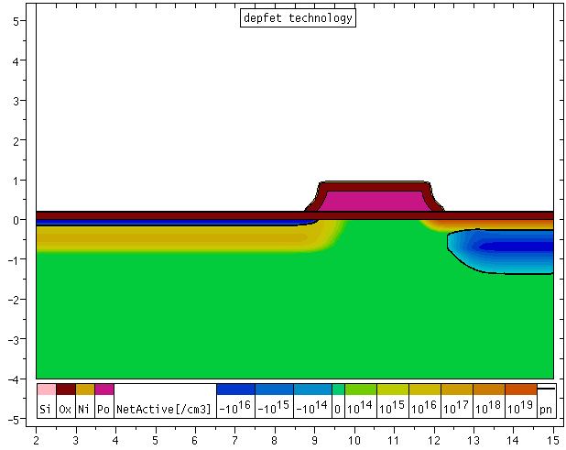
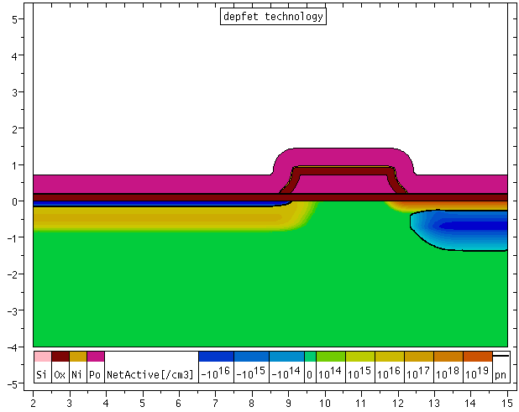
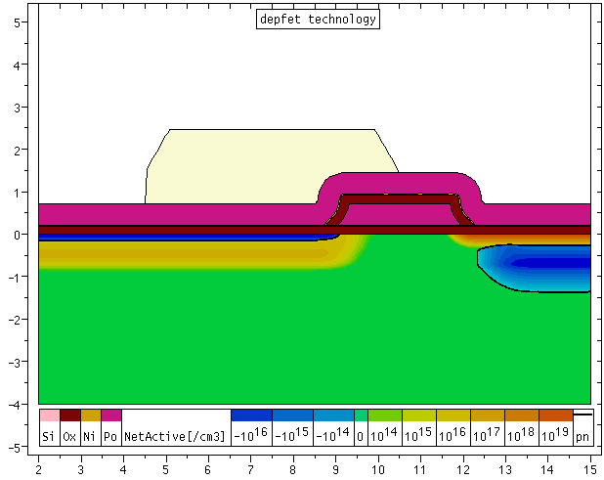
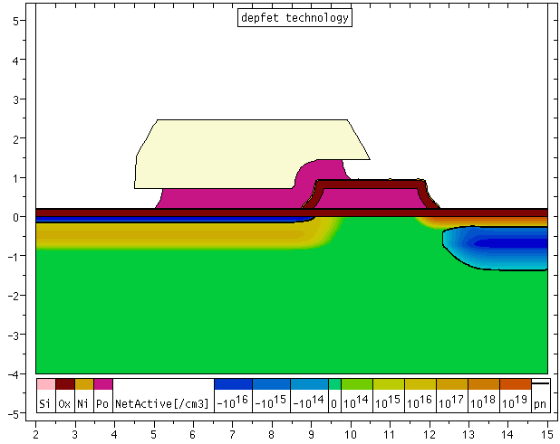
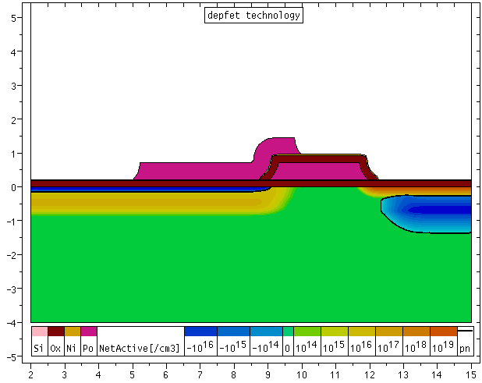
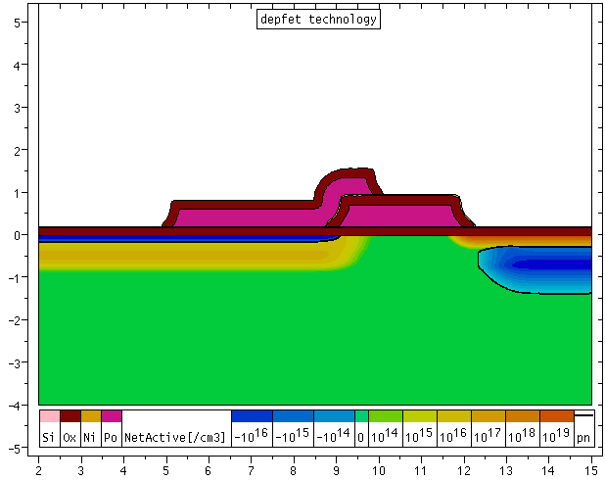

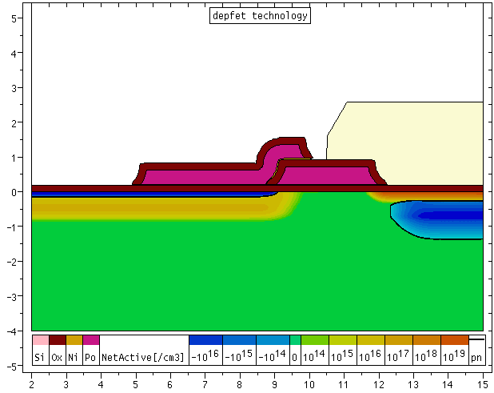
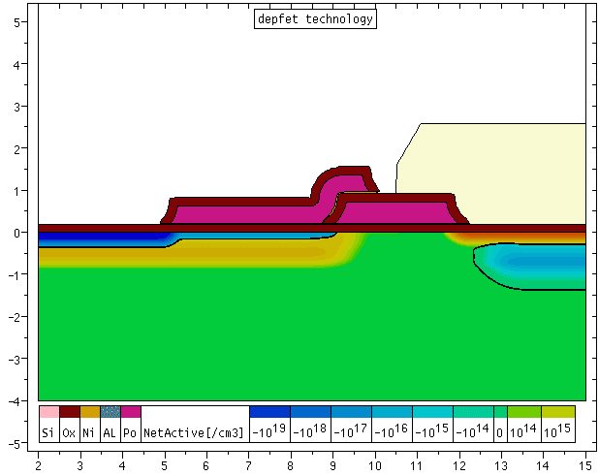
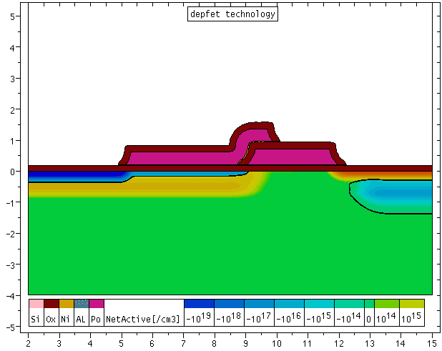
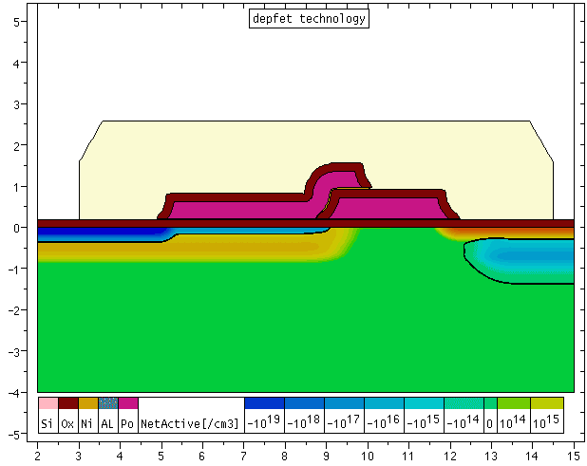
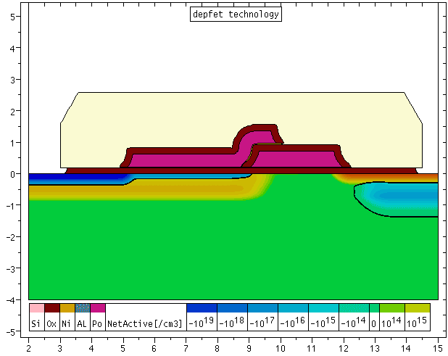
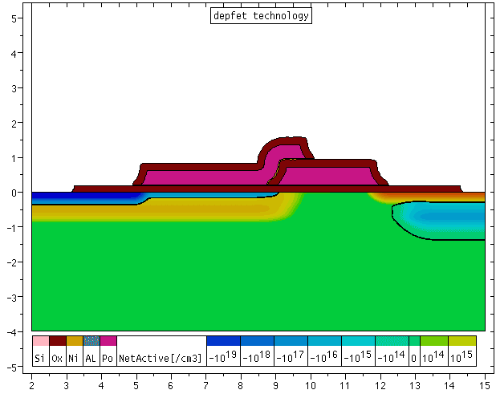
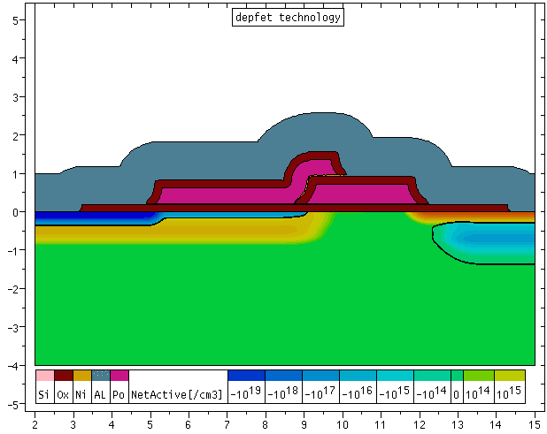
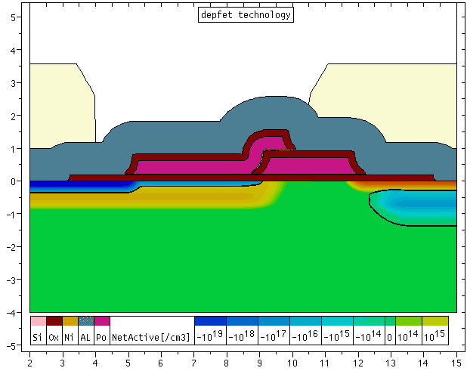


Process steps (DEPFET)
metal_2
oxide
polySi_2
polySi_1
metal_1
p+
n+
deep n
deep p
n bulk
Animation by P. Lechner

Slide 59
Basic Silicon Detector Types
Silicon sensors are made form Si-wafers:
Diameter thickness
4” (~10 cm) ~300 μm
6” (15 cm) ~500 μm
8” (20 cm) no high resistivity material available yet
thin, large area detectors
Photon detection (visible & near infrared)
Soft x-ray detection (spectroscopy & imaging)
Tracking of ionising particles (position sensitive)

Slide 60

Planar Diode
Mainly used as photodiode
Area ~ 1cm²
Rather large capacitance: 80 pF => 500 electrons noise (ENC)
Readout of scintillator crystals with high light yield (CsI(Tl), BGO)
Nuclear counter effect!

Slide 61


Strip Detectors
Position resolution (projective)
Typical pitch: p ~ (25 – 100) μm
Capacitance ~ 1pF/cm

Slide 62
Resolution
Binary readout: fixed threshold, yes/no information
charge contained in one cell (strip)
Analogue readout with charge division & weighting:
diffusion
Lorentz angle
Inclined tracks
Capacitive division
Attention: Landau fluctuations
Effective S/N > 14%
Typical: ~10 μm, but values around 1 μm have been achieved

Slide 63
Coupling/Bias
a) DC coupling: Bias mechanism can be part of external electronics
Simple, but amplifier has to absorb the leakage current
Bias resistor
Current sink
No leakage current flowing into amplifier
But many resistors needed (impossible for high density pixel sensors)
Quality problem
b) AC coupling: integrated bias mechanism
Integrated resistors: polysilicon
Punch through
Elegant solution: allows AC coupling without individual bias contacts

Slide 64

Double sided strip detector
2-dimensional resolution (projective => ambiguities)
Any stereo angle possible (trade resolution versus ambiguities)
Floating electronics or breakdown of decoupling capacitors
Routing of readout lines
Interstrip insulation at n-side

Slide 65
Interstrip Insulation
positive oxide charges attract electrons -> short between n-strips
a problem for n-strips in n-bulk (n-in-n)
and n-strips in p-bulk (n-in-p)
b) field plates (MOS structure in depletion mode)
c) p-stops
d) p-spray
Oxide charge density increases with radiation
Insulation structure impacts capacitance and breakdown behaviour

Slide 66

Pixel/pad detectors
real 2-dim resolution
works at highest track densities
small pixels sizes (50 x 50 μm²)
Low capacitance (~400 fF)
Challenge:
Connection to amplifier
Number of channels
Data rate

Slide 67




Sideward Depletion
Deplete large area detector from one small contact
=> Small capacitance
Symmetric bias
Asymmetric bias
Change shape of
potential

Slide 68


Silicon Drift Detector
True 2-dim information (segmented anode & drift time)
Needs high voltage across voltage divider
Good time resolution needed for resolution of drift (~7 μm/ns)
External t₀ needed: beam clock, scintillator trigger
Typical resolution: 20 μm (anode) 25 μm (drift) [STAR]
Low capacitance, low noise => measure dE/dx

Slide 69


Silicon Drift Detector
Simpler layout and production
Unstructured backside (optimal entrance window for x-rays)
Low capacitance (~ fF) for large area detector area (~ cm²)
Extremely low noise (3-6 e⁻ RMS)
Soft x-ray spectrometers (100eV–20keV)

Slide 70




CCD
Shift charge in potential pockets
Extremely low noise (~2 e⁻ rms)
X-ray imaging spectrometer
Large area possible (6x6 cm²)
Needs low temperature operation (100K)

Slide 71

Silicon Photomultiplier
Basic building block: avalanche photodiode operating in Geiger mode
The device is operated above the breakdown voltage
Photons are absorbed in depleted silicon, create e/h pairs
The electron (or hole) drifts into high field region.
Avalanche amplification (Geiger breakdown) occurs.
The signal size (“amplification”) is given by the overvoltage and the cell capacity Q = C x ΔU (~ 10⁶).
Passive quenching by integrated resistor (limits current)
Single SiPM cell: binary signal of fixed size!

Slide 72

Silicon Photomultiplier
Array of cells all connected to a single output:
Signal = Σ of cells fired
If probability to hit a single cell < 1 => Signal proportional to # photons
Pixel size: ~25 x 25 μm²
- ~100 x 100 μm²

Slide 73

Silicon Photomultiplier
Single & multiphoton peaks
“self calibrating” photon counter”
Dynamic range ~ number of pixel
Saturation for large signal: N = N_{pix} [1-exp(- εN_{ph}/N_{pix})]

Slide 74
Advantages
Simple, robust device
Photon counting capability
Insensitive to magnetic fields
Fast response (< 1 ns)
Large signal (only simple amplifier needed)
Good quantum efficiency (~ 40% @ 500 nm)
No damage by accidental light
Low operation voltage (40 – 70 V)

Slide 75

Cross talk
Hot carrier luminescence in avalanche:
~ 1 photon/10⁵ carries
(A. Lacaita, IEEE (1994))
Photons may trigger neighbour cells => > 1 pixel/photon
Typical values: 10% - 30%
Emission microscope picture
Trenches & Double junction
n+
p+
p⁻ epi
p+
n-substrate
Dark counts: Non-poisson distribution

Slide 76

Dark Rate
Thermally generated currents: Dark Rate
- Increases with overvoltage/gain (larger depleted area; tunneling)
- problem for large area devices (~50 MHz for 5x5 mm² at room temp.)
- cooling helps (but beware of afterpulsing due to trapping)
20.7 ⁰C
-50 ⁰C

Slide 77
Geiger efficiency of electrons and holes
Electrons have a higher probability to trigger an avalanche breakdown than holes
Efficiency depends on depth of photon conversion and hence on the wavelength
Solutions:
Increase overvoltage
Or:
- Ensure that only electrons trigger an avalanche
n+
p+
holes
el.
p+
n+
p⁻ epi
el.
n⁻ epi
holes
p-substrate
n-substrate
“standart”
inverted

Slide 78

Sensitivity at different wavelengths
Electrons trigger
Avalanche (p-subs.)
Holes trigger
Avalanche
(p-substrate)
Example:
p-substrate
holes
electrons
Thin entrance window needed
p-substrate: photons < 450 nm: only holes contribute
photons > 700 nm: lost in insensitive bulk
n-substrate: ok for short wavelengths,
hole efficiency dominates for λ > 500 nm

Slide 79
Spectral Response
IRST
p-substrate
Measurement: IRST
peak at ~ 550 nm
Inverted structure
(n-substrate):
better blue response
peak at 400 nm
However, sensitivity becomes poor above 500 nm
(only 2 μm drift region + hole sensitivity!)
Hamamatsu

Slide 80
Radiation Damage
Semiconductor sensors should detect radiation
Unfortunately radiation damages semiconductors
Two important damage types
Surface damage due to ionizing radiation
in Si: oxide charge up (positive), interface traps
main damage mechanism in CMOS electronics
Bulk damage: particle may displace nuclei from their lattice position
NIEL: non ionising energy loss
increase of leakage current
change of bulk properties (“type inversion”)
introduction of traps for charge carriers

Slide 81
Increase of leakage currents
G. Lindstroem et al, NIMA 466 (2001)
Annealing!

Slide 82
Type Inversion
- donor removal
- acceptor creation
=> type inversion (n -> p)
=> increase of depletion voltage
Parameters depend on material
Complex annealing!
G. Lindstroem et al, NIMA 466 (2001)

Slide 83
Detector Type
E
irradiation
E
p-in-n (“classic”)
Low cost
After type inversion:
Low CCE
Cannot operate partially depleted
p+
p+
n
p
n+
n+
n-in-n
Expensive (double sided processing)
After type inversion:
high CCE
Can operate partially depleted
E
E
n+
n+
n
p
p+
p+
n-in-p
Low cost
No type inversion
High CCE
Can operate partially depleted
E
E
n+
n+
p
p
p+
p+

Slide 84
Strip insulation
+ + + + + + + + + + + + + + + + + + + + + + +
SiO2: positive oxide charges
n+
- - - - - - - - - -
n+
- - - - - - - - - -
n+
N-strips shorted by accumulation layer
Electron accumulation layer
+ + + + + + + + + + + + + + + + + + + + + + +
Accumulation layer interrupted by p-stop
(or p-spray)
Problem: capacitance
high field
- - - - - - - - - -
- - - - - - - - - -
n+
p+
n+
p+
n+
Electron accumulation layer
n-in-n and n-in-p detectors need insulation structures (p-stop or p-spray)
Otherwise readout strips are shorted.
Fine tuning needed to adjust to changing conditions before and after irradiation.

Slide 85


Trapping in highly irradiated detectors
If l_{drift} = τ v_{drift} < d
Inefficient charge collection
Make v_{drift} high (saturation!)
Make d small
Electrons better than holes

Slide 86
Electric field and drift velocity
Is there an advantage of thin detectors compared to thick detectors operated partially depleted?
At the same voltage thin
(=over depleted) detectors have a higher electric field than thick (= partially depleted) detectors
Higher drift velocity
Better CCE
(however v_{drift} ~ v_{sat})
In addition the depleted volume of thick detectors is larger
Larger leakage currents
(shot noise, heat)
Additional volume does not give a signal (l_{drift}<z_{dep})
f = 5x10¹⁵ n/cm²
U_{op} = 200V
Simplified!

Slide 87
“3D” Detectors
Thin detector: high CCE but small signal
Idea (S. Parker):
collect charge horizontally to with narrowly space colums
- small drift distance: high CCE
- total detector thickness active

Slide 88
“3D” Detectors
Processing: using RIE etching holes with ~ 1/20 aspect ratio can be etched into silicon (“Bosch process”)
Filled with doped polysilicon these holes act as charge collecting electrodes.
Complex and expensive technology -> several variants

Slide 89
Signal Amplification
Silicon sensors generate small signals (~ 24000 e- /MIP in 300 µm => 3.8 fC)
Need amplifiers to generate a detectable signal
Charge Sensitive Amplifier followed by shaper (RCCR)
CSA: output proportional integrated charge Q: U = C_{f} x Q
Shaper: Band-path to filter out high and low frequency noise

Slide 90
Signal Amplifiction
I_{s}: Signal (current source)
C_{d}: detector capacitance
C_{f}: feedback capacitor of CSA (U = C * Q_{s})
Reset: = clears signal after t = R C_{f}
Shaper: high and low pass RC filter

Slide 91



Noise Soures
Serial noise: voltage fluctuations
Parallel noise: current fluctuations
Noise of input FET of amplifier
First term: Channel noise which depends on Transconductance q_{m} of the FET:
µ: mobility of carriers
C_{ox}: oxide sheet resistance of FET
W: gate width
L: gate length
I_{D}: drain current

Slide 92
Noise Sources
Noise of input FET of amplifier
Second term is 1/f noise:
Due to trapping and de-trapping of charges
Approx. Proportional to 1/f
Depends on transistor parameter W and L and C_{ox}
and a process dependent factor K_{f}
(~10⁻³¹C²/cm²)

Slide 93


Noise Sources
Shot noise to leakage current I_{leak}
Thermal noise from bias resistor R:
Serial noise: voltage fluctuations (channel noise and 1/f noise)
Parallel noise: current fluctuations (shot noise and bias resistor thermal noise)

Slide 94




Filtering
The power spectrum has to be convoluted by the response function of the shaper
With the response function of the RCCR shaper:
For serial noise : with C_{t} the total capacitance of the shaper
For parallel noise:

Slide 95

Evaluation
Channel noise
1/f noise
Shot noise
Bias noise

Slide 96
Noise Sources
Summing up all noise sources in quadrature and normalizing to units of elementary charge (q):
Thermal noise input FET: ~ C/τ^{1/2}
1/f noise: ~ FET parameters, independent of τ
Shot noise: ~ (I_{leak} τ)^{1/2}
Bias noise: ~ (1/R τ)^{1/2}

Slide 97

Typical behaviour

Slide 98

Notes
Noise depends crucially on C, τ, I_{leak}, R and FET technology
Noise can be minimized by an appropriate choice of τ
Good practice:
reduce C (small pixels, narrow strips)
choose large bias resistor
best FET technology (good g_{m}, low 1/f)
keep leakage current under control (cooling)
fast detectors (small t) need high g_{m}:
=> large I_{D}, high power!
More sophisticated filtering techniques are possible. 1/f noise can be reduced by
‘correlated double sampling’

Slide 99
Examples
 | Area | Capaci tance | gm | current | Shaping | Channel noise | Shot noise | Bias resistor | total
Diode | 1 x 1 cm² | 33pF | 800 µS | 40 nA | 1 µs | 760 e | 250 e | 800 e | 1125 e
Strip | 12 cm x 25 µm | 15 pF | 800 µS | 2.0 µA | 25 ns | 2160 e | 280 e | 125 e | 2190 e
Pixel | 50µm x 400µm | 400fF | 800µS | 2.5 nA | 25 ns | 58 e | 10 e | - | 60 e
The leakage currents for strip and pixel assume irradiation damaged sensors (LHC)
Typical signal of a 300µm thick sensors for a MIP : 24000 e

Slide 100


ASICs
Application Specific Integrated Circuit
Became available in the mid 80s
=> Integrate many (~100) amplifier channels in a cm² chip
~1cm
1984: Microplex (NMOS)
1988: CAMEX64 (CMOS)
Noise low enough to get S/N > 10 for 12 cm long strips
=> (small) vertex detectors in colliding beam experiments

Slide 101

Interconnection
Connection of sensors to ASIC using wirebonds
ASICs (hopefully) outside acceptance
Thin wire (17 μm diameter)
Simple pitch: 50 μm ok
Staggering and multiple loops:
` 12.5 μm possible (4x)

Slide 102


Pixel Detector Electronics
Face to face interconnection: ASIC - Sensor
Pitch: 50 μm

Slide 103

3D Interconnection
Basic Problem:
How to integrate good sensors and good electronic circuits?
3D Interconnection:
Two or more layers (=“tiers”) of thinned semiconductor devices interconnected to form a “monolithic” circuit.
Different layers can be made in different technology
(BiCMOS, deep sub-μ CMOS, SiGe,…..).
3D is driven by industry:
  Reduces R,L and C.
  Improves speed.
  Reduces interconnect power, x-talk.
  Reduces chip size.
  Each layer can be optimized individually.
Si pixel sensor
Better: slides from vertex2012
BiCMOS analogue
CMOS digital

Slide 104


Advantages for Module Design
Contact pixels through vias:
-> 4-side buttable.
-> No “cantilever” needed.
Larger module with minimal dead space.
Less support structures & services.
Substantial material savings.
Large pitch of I/O connections allows use of large diameter/low aspect ration vias
=> Rather mature technology, several vendors

Slide 105
New Concepts
Integration of sensor (Si) and electronics (Si)

Slide 106
CMOS Sensors
CMOS Sensors are used as optical sensors e.g. in digital cameras
Replacing CCDs
Advantage:
Combine sensor, amplifier and processing on one chip
Cheap (CMOS)

Slide 107
CMOS Sensors: MAPS
Modification to use as particle tracker
R. Turchetta (2000)
n-well used for signal collection
only p-well possible for FET (NMOS)
no PMOS transistors (only in periphery)
Charge collection by diffusion in thin epi-layer (slow, small signal)
Successful prototypes
(MIMOSA series, Strasbourg)
S/N: >20/1, Resolution < 2 μm
Only small (cm²) chips possible (stepping)
Evolution: triple well technologies
Many activities: France, UK, US, Italy
(MAPS, CAPS, FAPS…..)

Slide 108
Multiple Well Technologies
N-well imbedding PMOS transistor acts as parasitic charge collection node
=> Reduced charge collection efficiency
n
n
p
p
n
p
n
n
p
p
Another p-well surrounding the n-well suppresses this parasitic charge loss.
=> Full efficiency and full CMOS
n
p

Slide 109
Summary: Integration

Slide 110



The DEPFET active pixel sensor
Depleted Field EffectTransistor
Each pixel is a p-channel FET on a completely depleted bulk
A deep n-implant creates a potential minimum for electrons under the gate (“internal gate”)
Signal electrons accumulate in the internal gate and modulate the transistor current (g_{q} ~ 400 pA/e⁻)
Accumulated charge can be removed by a clear contact (“reset”)
Fully depleted:
large signal, fast signal collection
Low capacitance,
internal amplification: => low noise
High S/N even for thin sensors
Rolling shutter mode (column parallel) for matrix operation
100 ns readout/pixel 20
=> Low power (only few lines powered)
source
top gate
drain
clear
bulk
p+
n+
p+
n+
n+
p
-
-
-
-
-
n
-
internal gate
+
-
+
-
+
+
n
-
-
p+

Slide 111
Matrix operation
Charge collection in "OFF" state of the transistor
Select one row via external gates and measure pedestal + signal current
Reset that row and measure pedestal currents …..
Only one single row active at a time and dissipating power
However, sensor is sensitive even if DEPFET is OFF!

Slide 112
How does it work?
FET in saturation:
W
L
Gate-oxide; C=C_{ox} W L
I_{d}: source-drain current
C_{ox}: sheet capacitance of gate oxide
µ: mobility (p-channel: holes)
V_{g}: gate voltage
V_{th}: threshold voltage
Gate
d
P-channel
Source
Internal
gate
Drain
Transconductance:
Conversion factor:
A charge q in the internal gate influences a mirror charge αq in the channel
(α <1, for stray capacitance)
This mirror charge is compensated by a change of the gate voltage:
ΔV = α q / C = α q / (C_{ox} W L)
112

Slide 113

Gain and Noise
Measurements in good agreement
Typical values:
g_{q} ~ 400 pA/e (for L = 6 µm)
Could be pushed up to 1 nA/e
1.6 e ENC at τ=10 μs
40 e ENC at τ=20ns (50MHz)

Slide 114
Detector Systems

Slide 115
Tracking Detectors
Several (N) layers of segmented sensors within a B-field
Measure by ionisation (of gas or silicon)
Curvature k = 1/R measures the momentum
σ
p_{T} in GeV/c
B in T
R in m
L
Resolution:
Good resolution
Large B
Large L and N (expensive)
Good position resolution
For N equally spaced layers with equal position resolution σ

Slide 116



Impact Parameter
At very high energies (LHC) the decay tracks from the B become very collimated and the decay vertex becomes difficult to reconstruct.
A better parameter is the impact parameter
By how much misses track (i) the primary vertex
(lab frame)
(rest frame)
On average (spherical decay) = <d> = cτ ∼ 450 µm (independent of the boost)
Again: a good detector has to measure a fraction of this: σ = O(10µm)

Slide 117
What has/will be achieved
Material (scattering)
Resolution
Distance to IP
How to improve impact parameter resolution?
Small pixels
Close to the beam
Low material budget
Layer layout (lever arm)
Good S/N

Slide 118
Some History
~1980: NA11/NA32
First silicon strip detector operating in a particle physics experiment!

Slide 119

History
ALEPH Experiment
LEP/CERN, 1989 – 1995
First double sided silicon strip detector operation in a colliding beam experiment
Major contributions to B-physics
Evidence for B_{s}, Λ_{b}
Individual lifetimes of all B⁰, B⁺, B_{s}, Λ_{b}
Time dependence of B⁰ oscillations

Slide 120


ATLAS and ATLAS Inner Detector
ID length: 7 m
ID diameter: 2m

Slide 121
The ATLAS Inner Detector
Three subdetectors using different technologies to match the requirements of granularity and radiation tolerance
Sub-
Detector r(cm) element size resolution hits/track channels
Pixel 5-12.5 50μm x400μm 12μm x 60μm 3 93x10⁶
(Silicon) (3D)
SCT 30-52 80μm x 12cm 16μm x 580μm 4 6x10⁶
(Silicon Strip) (stereo)
TRT 56-107 4 mm x 74cm 170μm 36 0.4x10⁶
(Straw Tubes) (projective)

Slide 122

Pixel Detector Module
Sensor:
  250 μm thick n-on-n sensor
  47232 (328 x 144) pixels
  Typical pixel size 50 x 400 μm²
  (50 x 600 μm² pixels in gaps between FE chips)
  Bias voltage 150 – 600 V
Readout:
  16 FE chips, 2880 pixels each
  Zero suppression in the FE chip, MCC builds module event
  Pulse height measured by means of Time over Threshold
  Data transfer 40 – 160 MHz depending on layer

Slide 123

Semiconductor Tracker (SCT)
4 barrel layers, 9 disks per end-cap
4088 modules, 6.3M channels (61 m²)
Intrinsic Resolution = 17 μm / 580 μm (Rϕ/z)
Operational T = -8ºC to ~5ºC
C₃F₈ Evaporative Cooling, in common with Pixel detector

Slide 124

SCT Modules
Basic Concept (Endcap)
4 Si-strip detectors in 2 planes (40 mrad stereo)
-Mechanical carrier made from Thermal Pyrolytic Graphite (C_{k}>1700 W/m/°K) and AlN
-Flex Hybrid (Kapton) on carbon substrate with ASIC readout electronics
-Glas pitch adaptors for mechanical/electrical connection detector-electronics (heat barrier)
strip direction
strip direction

Slide 125

SCT Silicon Detectors
Radiation tolerant up to 3x10¹⁴ p/cm²
p-on-n single sided detectors
285 micron 2-8 kOhm
4“ substrate
Barrel: 64x64 mm²
Forward: wedge shaped (5 shapes)
768 readout strips with ca 80 μm pitch
No intermediate strips
AC coupled strips
Polysilicon or implanted bias resistors
Multi guardring structure to ensure stability up to 500 V
Ca. 20000 needed
Produced by Hamamatsu and CIS

Slide 126

Belle II
CsI(Tl) EM calorimeter:
waveform sampling
electronics, pure CsI
for end-caps
7.4 m
RPC µ & K_{L} counter:
scintillator + Si-PM
for end-caps
4 layers DS Si Vertex
Detector →
2 layers PXD (DEPFET),
4 layers DSSD
5.0 m
Time-of-Flight, Aerogel
Cherenkov Counter →
Time-of-Propagation counter
(barrel),
prox. focusing Aerogel RICH
(forward)
Central Drift Chamber:
smaller cell size,
long lever arm

Slide 127
Requirements for the Belle II detector
Critical issues at L= 8 x 10³⁵/cm²/sec
4 Higher background ( ×10-20)
4 Higher event rate ( ×10)
4 Special features required
radiation damage and occupancy
fake hits and pile-up noise in the EM Calorimeter
- higher rate trigger, DAQ and computing
- γβ reduced by a factor of 2: compensated by improved vertexing
Result: significant upgrade

Slide 128


Silicon Tracking System @ Belle II
SVD: 4 layer Si strip detector (DSSD)
(R = 3.8, 8.0, 11.5, 14.0 cm)
PXD: 2 layer Si pixel detector (DEPFET technology)
(R = 1.4, 2.2 cm)
monolithic sensor
thickness 75 µm (!),
pixel size 50 x 55 µm² to 50 x 85µm² (depending on layer and z)
Significant improvement in z-vertex resolution
σ [µm]
PXD
PXD+SVD
100
Belle
50
30μm
20
Belle II
15μm
0
0.4
0.8
1.2
1.6
2.0
pβsin(θ) [GeV/c]

Slide 129
How does this compare?
Material (scattering)
Resolution
Distance to IP
Belle II almost reaches
ILC performance
(note p < 2 GeV/c² at Belle)
Belle II

Slide 130

Sensor Module/Ladder

Slide 131




ASICs for control and readout
Switcher
Control of gate and clear
32 x 2 channels
Switches up to 30V
AMS 0.18 µm HV technology
Tested up to 36 Mrad
DCDB
Amplification and digitization of DEPFET signals
256 input channels
8-bit ADC per channel
92 ns sampling time
UMC 180nm
Rad hard design
DHP
Signal processor
Common mode correction
Pedestal subtraction
0-supression
Timing and trigger control
TSMC 65nm
Rad hard design

Slide 132



Sensor Thinning
?
Need thin (50µm-75µm) self supporting all silicon module
Process backside
e.g. structured implant
Wafer bonding
SOI process
Thinning of top wafer (CMP)
Processing
etching of handle wafer (structured)
Cut through the matrix
450μm
50μm
diodes and large mechanical samples
Belle II module

Slide 133

Prototype at a beam test
Strip detector
2nd layer PXD
1st layer PXD
Cooling block

Slide 134

All-silicon module – material budget (single layer)
 | Belle II
Frame thickness | 525 µm
Sensitive layer | 75 µm
Switcher thickness | 500µm
Cu layer | only on periphery
Total | 0.21 %X0

Slide 135

Injection Noise & Gating
Sensor filled with hits from freshly injected bunches => ~ 20% dead time
Gating : Sensor is made blind for a short time during high background (noisy bunch)
Signals detected in the clean period before are preserved
Simulations, lab tests with lasers and particle beams demonstrate feasibility of gating

Slide 136


Gated Operation
In normal clear operation
the gate is pulsed negatively
(repells electrons)
The clear is pulsed positively
(attracts electrons from internal gate and bulk underneath)
In gated mode the gate is
not pulsed,
Remains attractive for electrons
The clear is pulsed positively,
Attracte electrons fro, bulk underneath

Slide 137


Electron drift directions
Normal operation:
Signal charge drifts into internal gate
Gated Mode
Charges from background drift directly to clear gate
Signal already stored in internal gate is protected

Slide 138

Tests with laser
Protection of signal
No clear
Rejection of background
clear
E. Prinker

Slide 139
More DEPFETs
Like gating other interesting detectors can be constructed based on DEPFETs

Slide 140


Repetitive Readout
repetitive
non destructive
readout
Multiple measurement of signal charge reduces 1/f noise
rms noise < 0.25 e
counts individual signal electrons!

Slide 141
End of 2nd Lecture

Slide 142
Punch through biassing
Vpunch through (V-)
Matrix (not connected)
Vbulk (0V)
p contact
n+ ohmic contact
75µm
n bulk
Backside (not directly accessible)
Illustrations by Rainer Richter, MPG HLL

Slide 143
Punch Through Characteristic I-V curve

Slide 144
Punch Through Characteristic [I]
Vpunch through
Vbulk
Phase 1
Depletion expands
Depletion region expanding from punchthrough contact into the bulk
(small volume -> small leakage current)

Slide 145
Punch Through Characteristic [II]
Vpunch through
Vbulk
Backside reached
Interface current
bulk current
Depletion region reaches backside
(sudden increase of leakage current due surface generation at backside)

Slide 146
Punch Through Characteristic [III]
Vpunch through
Vbulk
entire bulk gets depleted
Interface current
bulk current
Depletion region expands from the entire backside implant into the bulk
(small increase of current due to volume increase)

Slide 147
Punch Through Characteristic [IV]
Interface and surface currents
Vpunch through
Vbulk
Active generation centers
Interface current
bulk current
generation states are getting activated generation current at upper surface

Slide 148
Punch Through Characteristic [V]
Interface and surface currents
Vpunch through
Vbulk
Generation current saturates
Interface current
bulk current
All generation states are activated generation current saturates

