Slide 1

10 th VXD Belle II Workshop
Santander-SPAIN, 14-16 September 2016
PXD9 EMI STUDY
M.Iglesias, I.Echeverria ,Fernando Arteche ,Philipp Leitl, Felix Müller and Hans-Günther Mosser,

Slide 2
OUTLINE
1.Introduction
2. RF susceptibility test
  Test Set-up
3. Susceptibility test to noise on power cables
  Test results
  Loss of communication link
4. Susceptibility test to beam pipe radiation noise
  Test results
5. Conclusions
6. Acknowledgements
10 th VXD Belle II Workshop
14-16 September 2016, Santander, Spain
2 de 29

Slide 3
1. Introduction
During the last years ITAINNOVA has been carrying out a project in order to characterize the EM environment of PXD sub-detector.
The project has been divided into four working packages
  Grounding and shielding strategy for PXD
  Conducted and Radiated Noise emissions test.
    PS units & FEE
  Noise propagation issues in power cables
  Immunity issues of PXD system.
10 th VXD Belle II Workshop
14-16 September 2016, Santander, Spain
3 de 29

Slide 4
1. Introduction
Two kind of noises may disturb the performance of FEE:
  Thermal noise dominant effect (by design)
  EM external noise (via power lines, FEE-det, etc)
EM noise contribution to detector defines noise floor.
  Detector immunity
The immunity of the system is defined mainly by the sensitivity of the FEE
It can be characterized via:
  Signal circuit analysis
  Susceptibility test on prototypes
10 th VXD Belle II Workshop
14-16 September 2016, Santander, Spain
4 de 29

Slide 5
2. RF susceptibility test
The main goal of the RF susceptibility test is to define the immunity of the FEE to RF conducted disturbances
  Identify critical elements in prototypes that reduce the FEE performance.
  Fix the noise level required for the power supplies units
  Fix the ambient noise level compatible with PXD
The idea of the test is to inject a perturbing signal to the FEE and evaluate the performance of PXD (each pixel)
This is the first time that this kind of test has been performed in a Pixel detector
Several test configurations have been studied:
  Power cables & Beam pipe radiation
10 th VXD Belle II Workshop
14-16 September 2016, Santander, Spain
5 de 29

Slide 6
2. RF susceptibility test
The EMI test has been performed during two weeks at ITAINNOVA EMC Lab in Zaragoza
  Long sessions (10-11 hours per day)
We have performed close to 1000 runs
We have generated more than 500 files
  5GB of processed data
  More than 60 GB of raw data
  Analysis is on going – It takes time ( 1000 run /500 files)
Today , we only present a general overview of the test campaign.
  The detailed analysis have just started
10 th VXD Belle II Workshop
14-16 September 2016, Santander, Spain
6 de 29

Slide 7
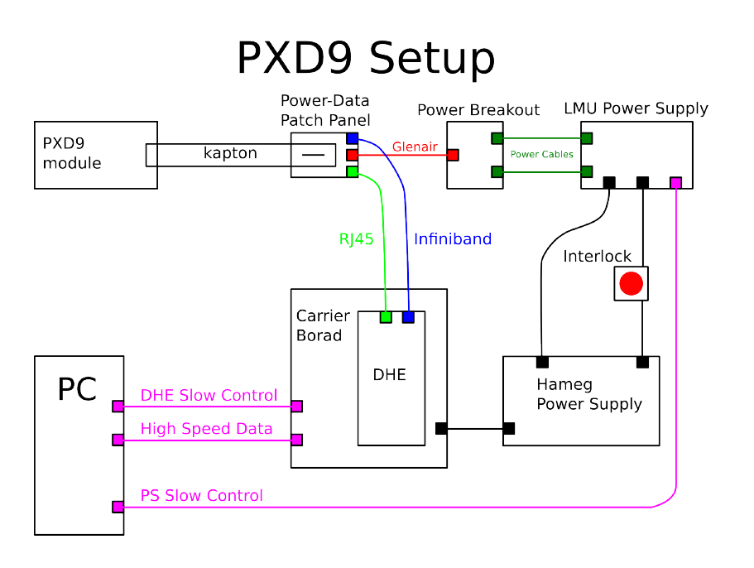
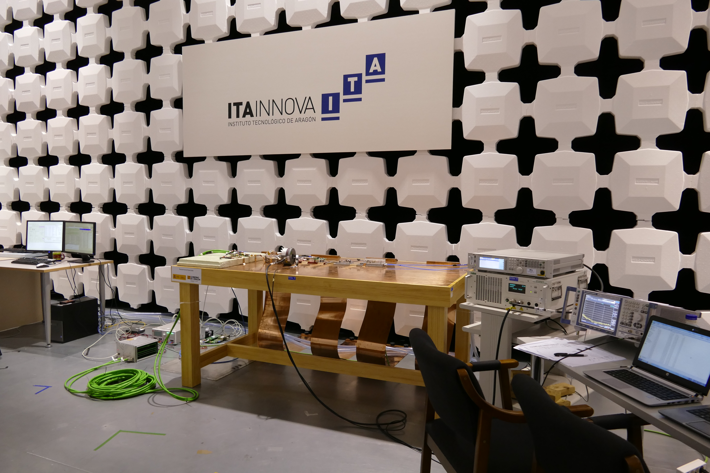
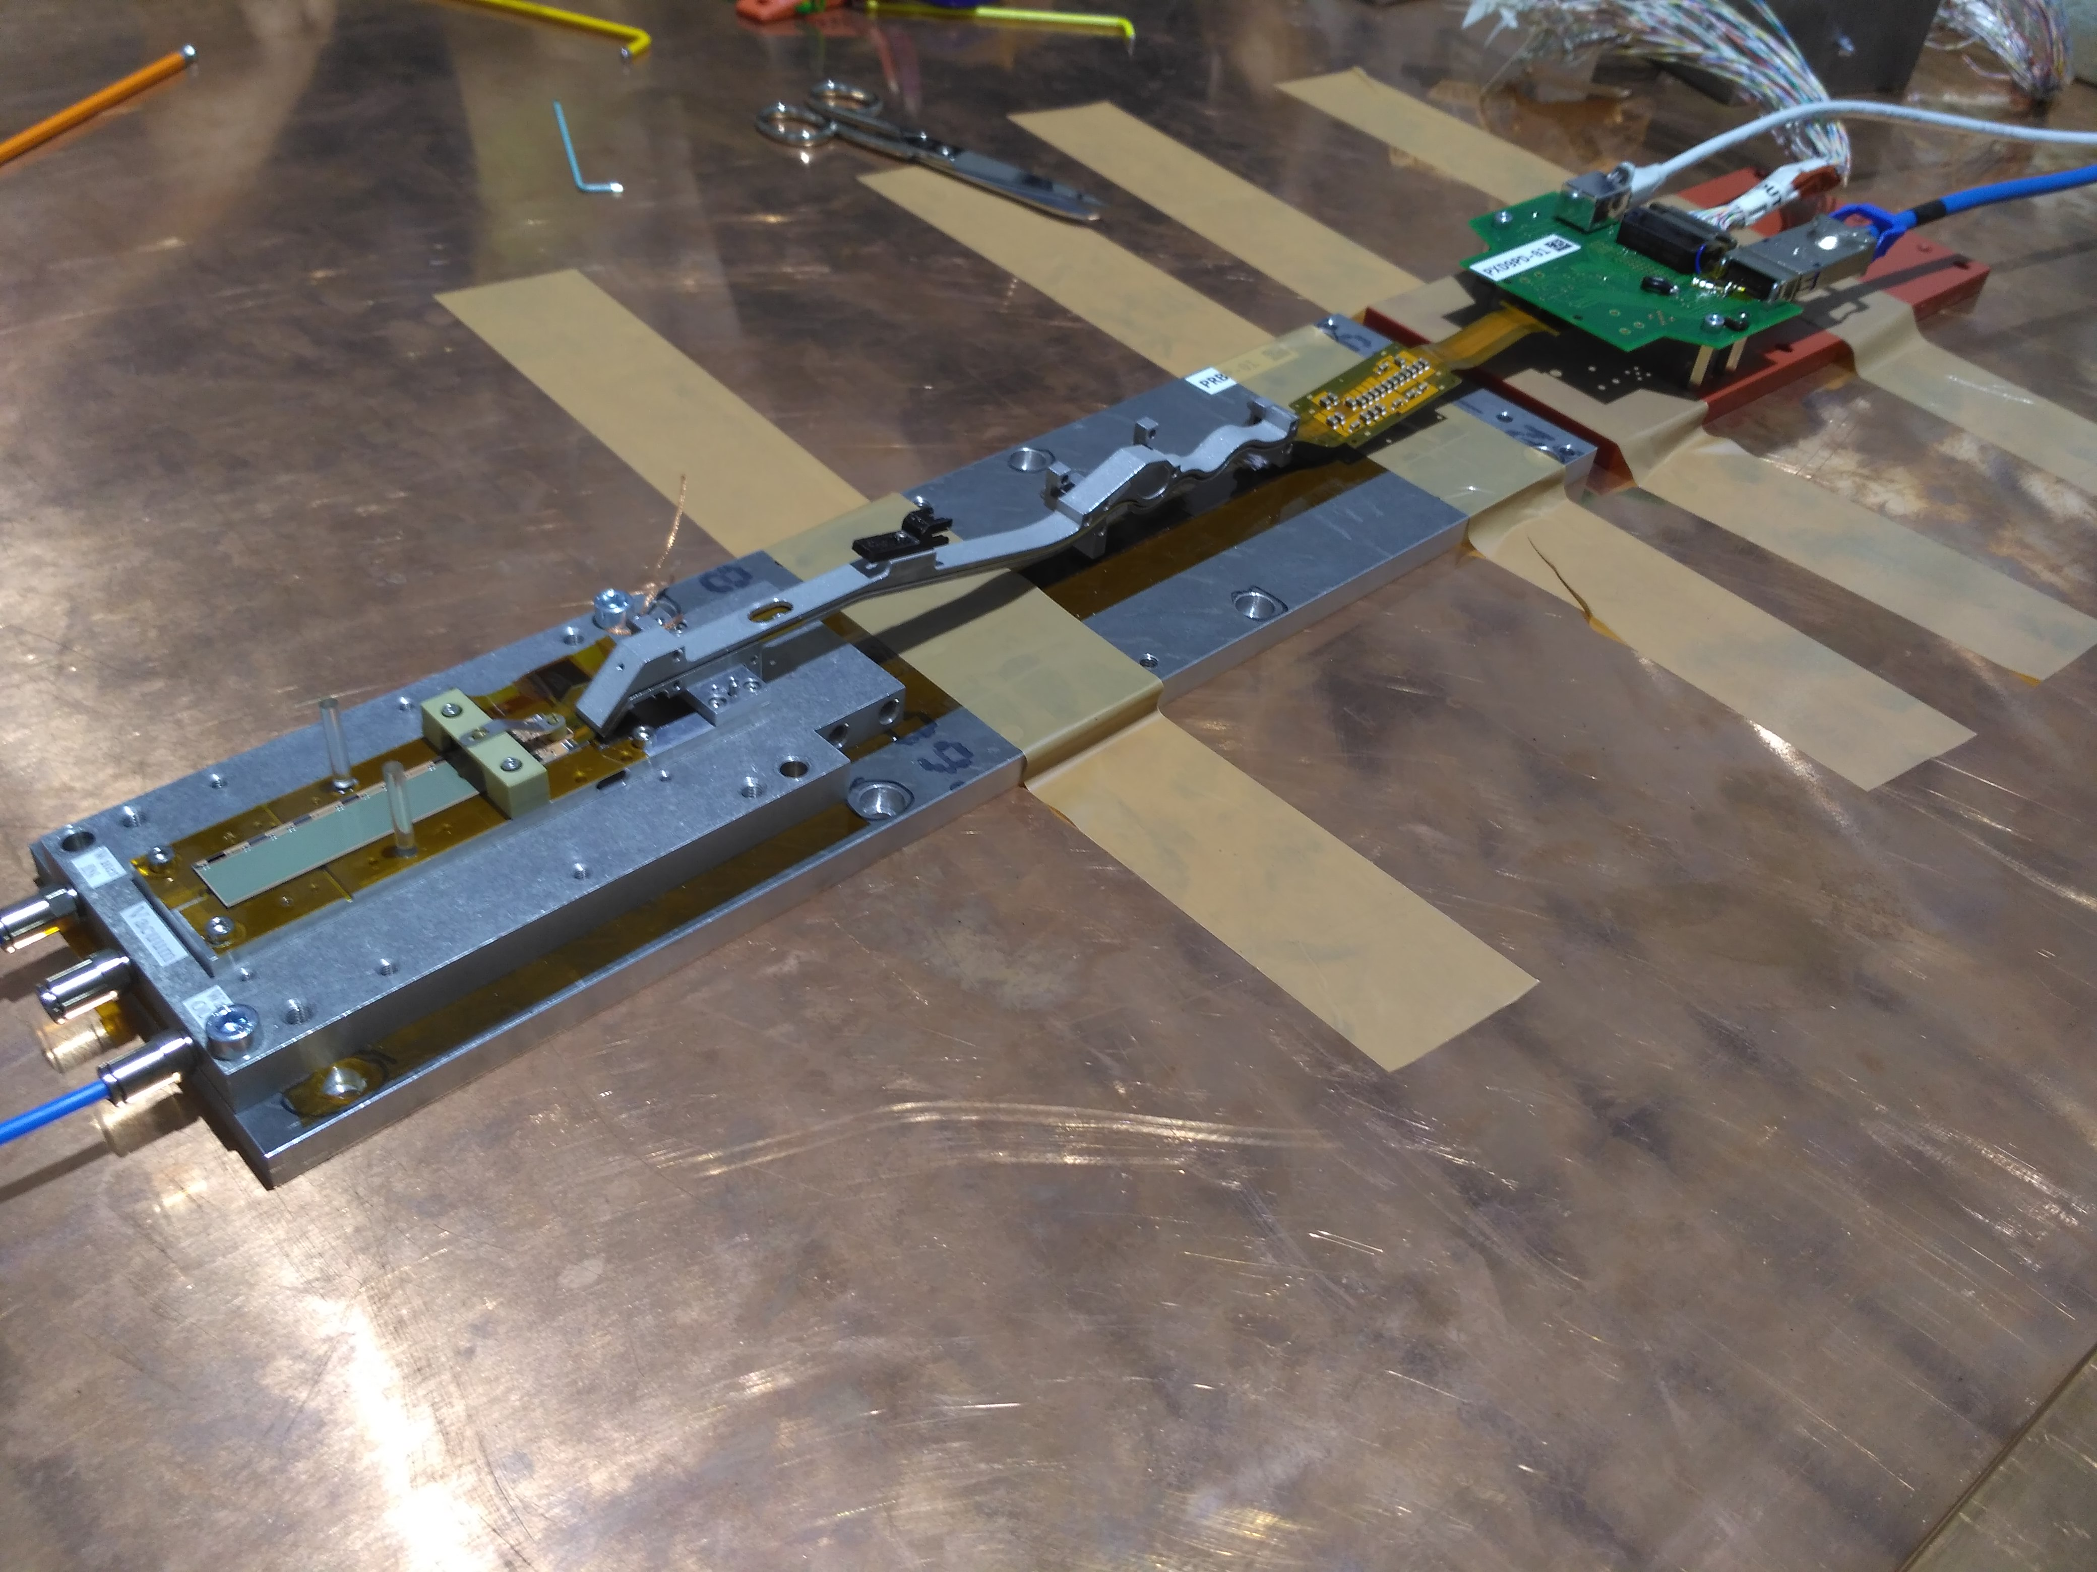
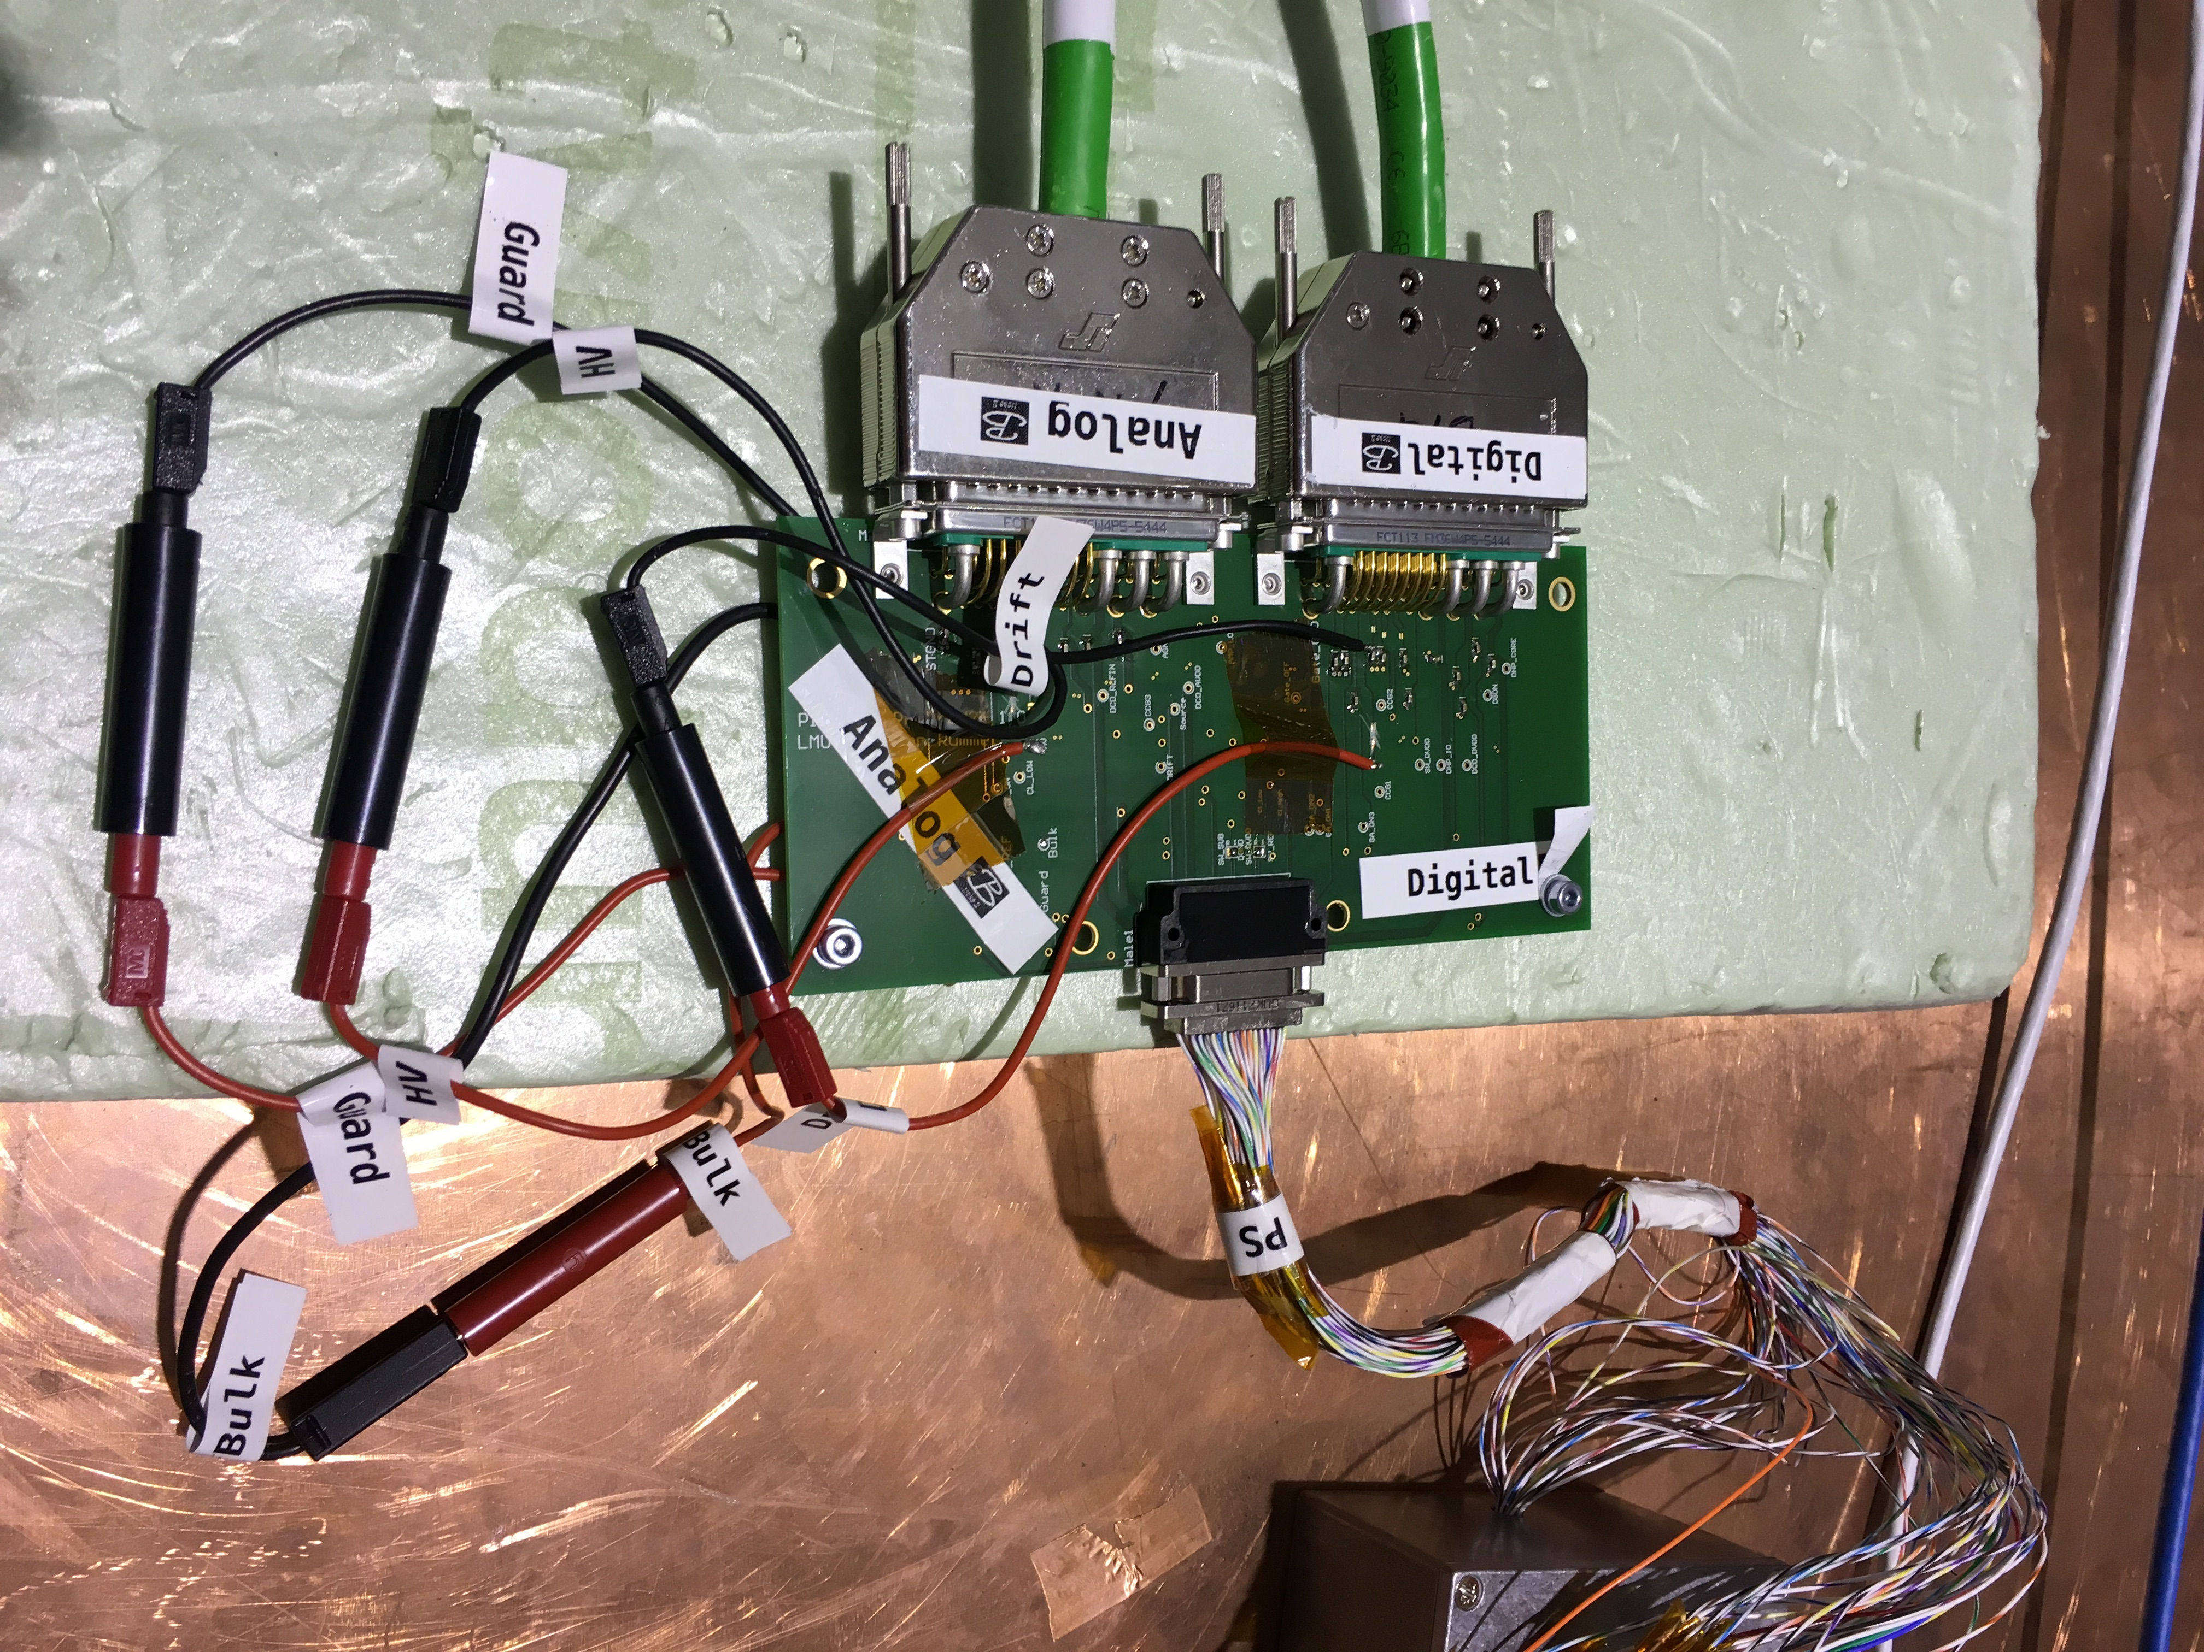
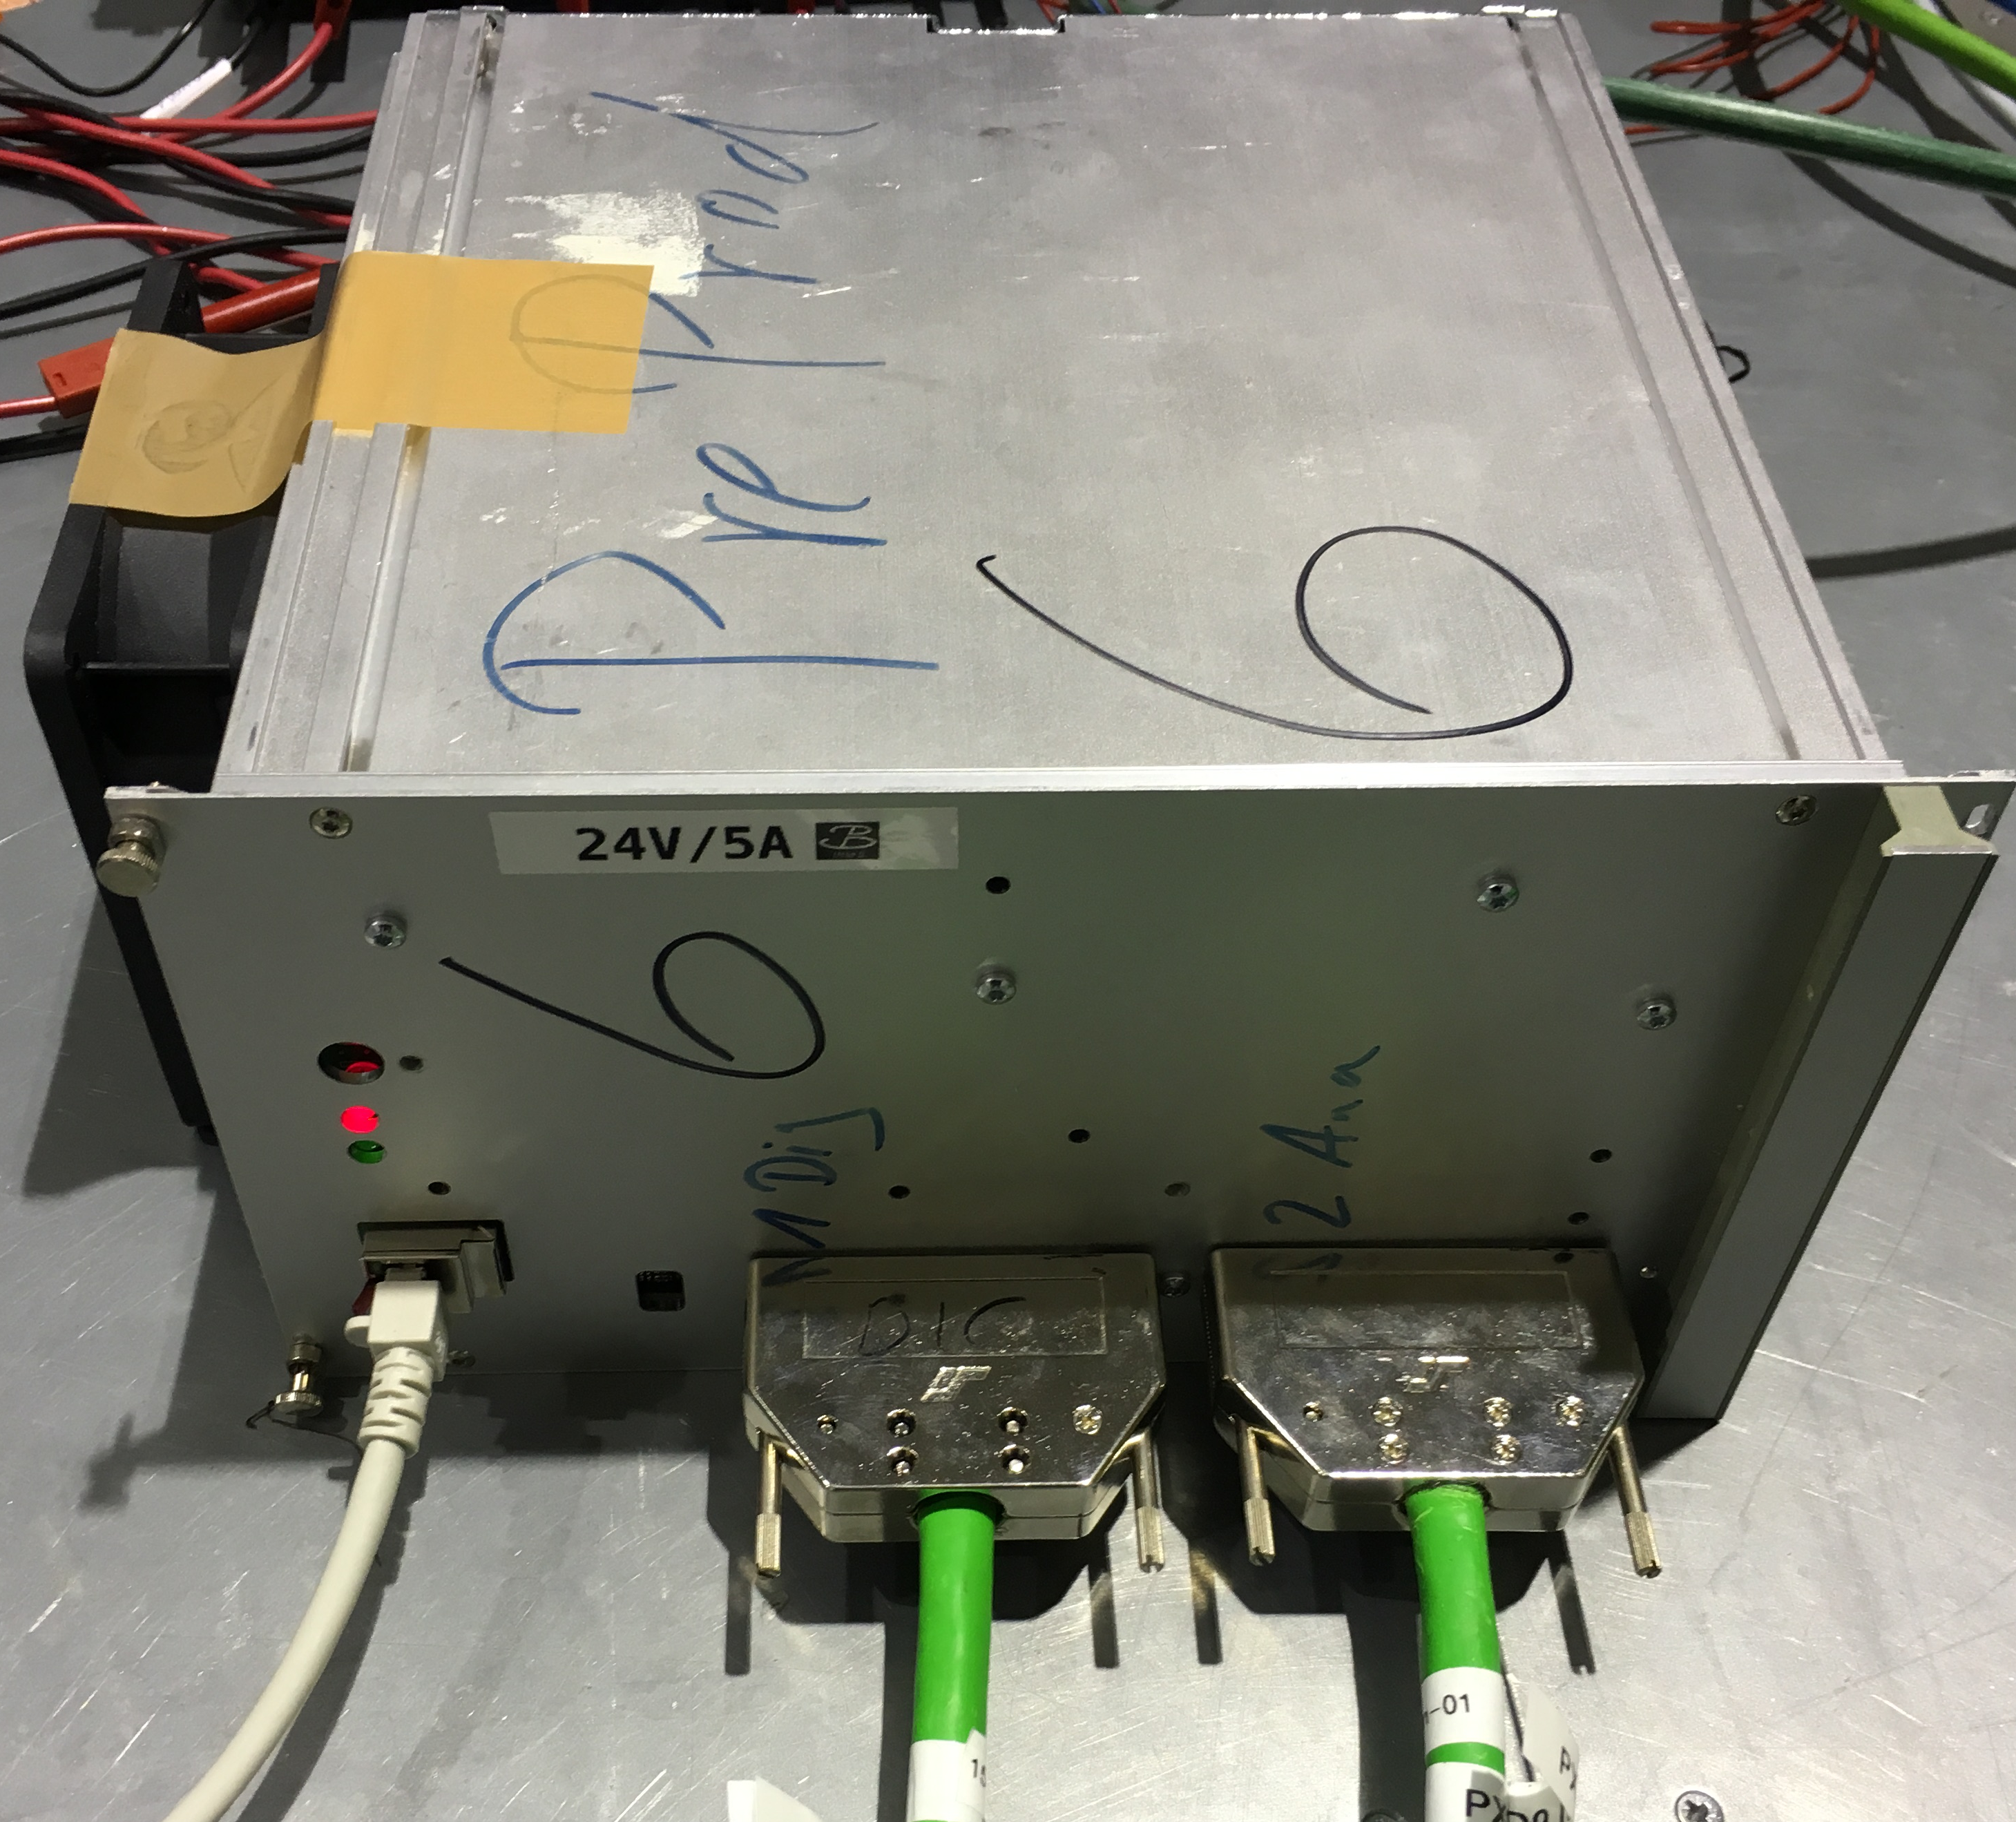
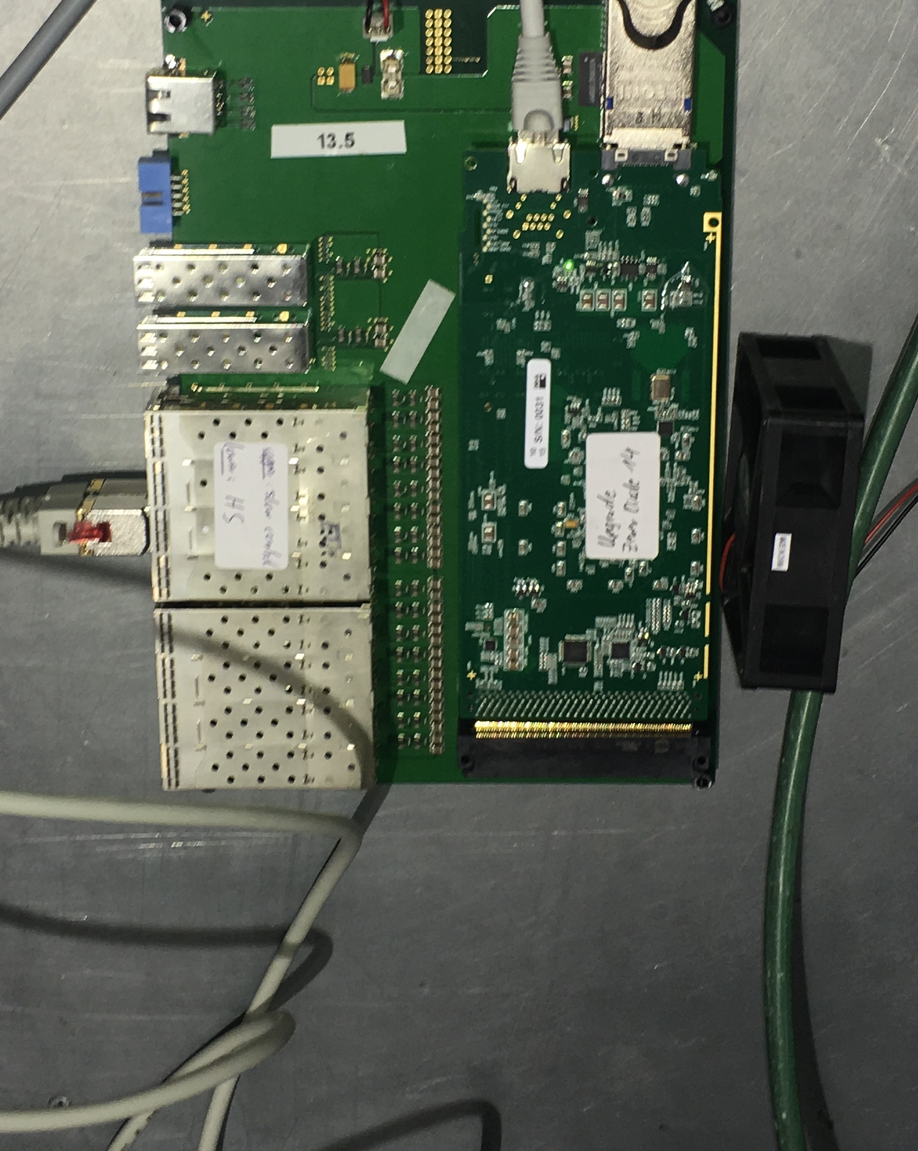
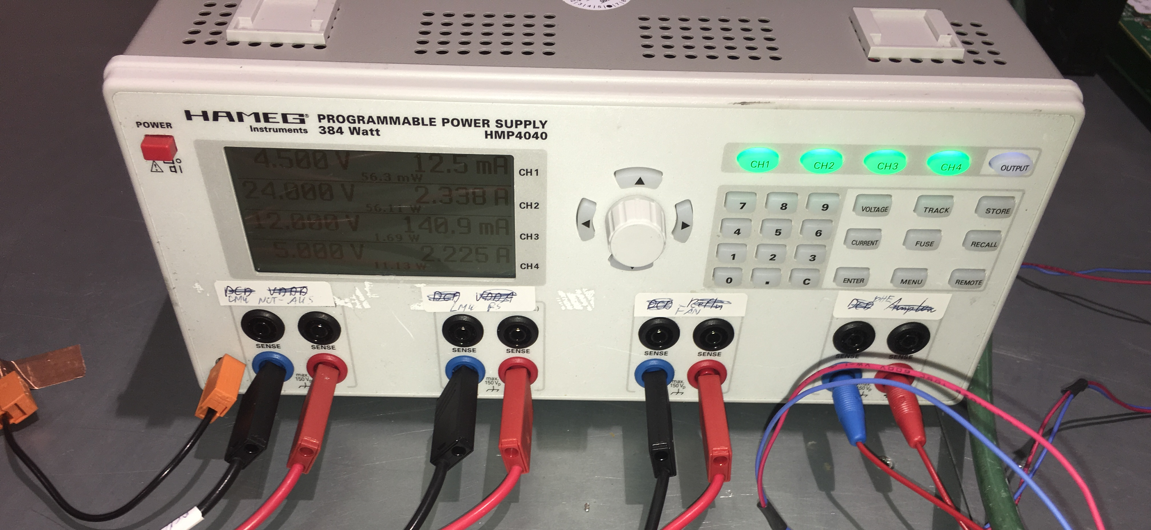
2.1 RF susceptibility test: Test Set-up
1 2 3 4 5
7
6
1
- 2
3
4
5
7
1
2
6 DC/DC
6
EMC UNIT- PXD9
POWER
CABLES
EMC TEST SETUP CLOSE TO FINAL CONFIGURATION:
  NO DOCK-BOX for DHE&CARRIER BOARD (7), and POWER BREAKOUT (4)
  NOT THE FINAL PATCH PANEL (3)
10 th VXD Belle II Workshop
14-16 September 2016, Santander, Spain
7 de 29

Slide 8
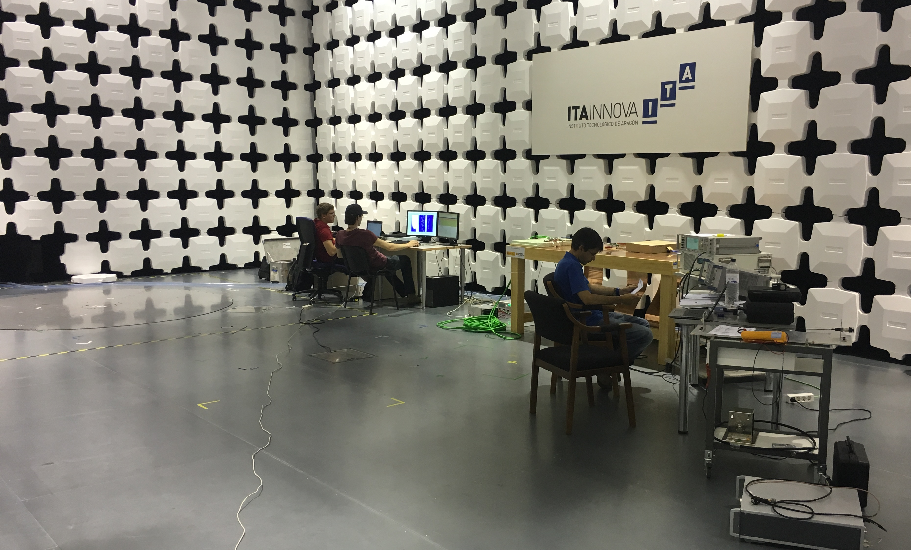
2.1 RF susceptibility test: Test Set-up
D.U.T
TEST MONITORING
POWER
SUPPLIES
EMC EQUIPMENTS
10 th VXD Belle II Workshop
14-16 September 2016, Santander, Spain
8 de 29

Slide 9
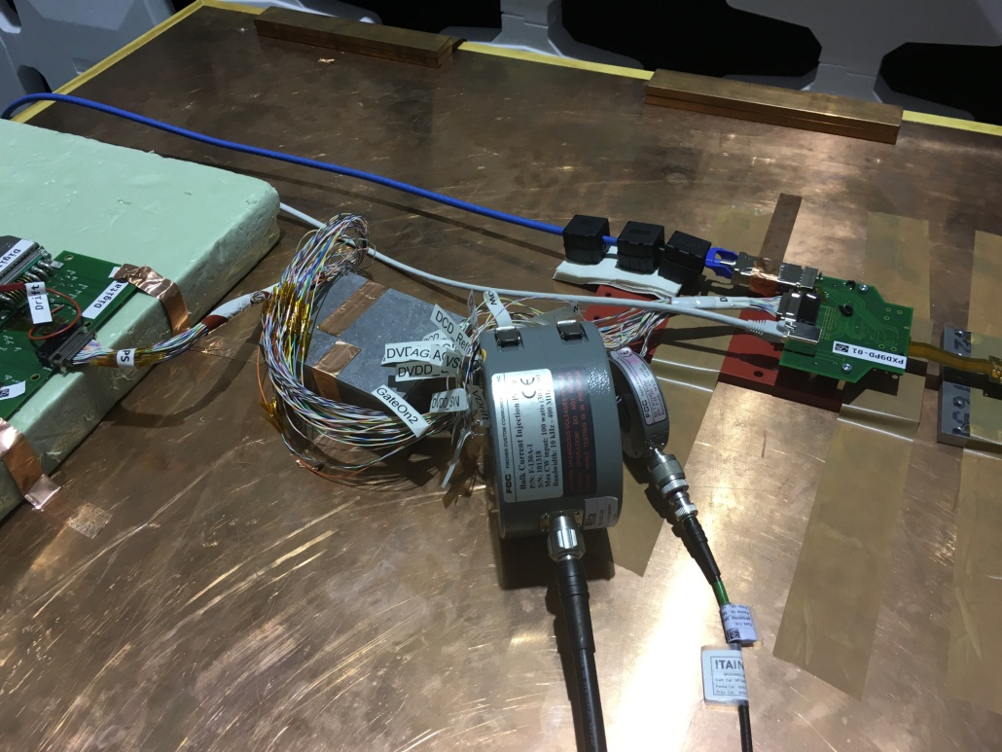
2.1 RF susceptibility test: Test Set-up
BCI PROBE
CDN
RF PROBE
SCHEMATIC OF THE INJECTION SETUP – From 100kHz up to 400 MHz.
Injection system
RF AMPLIFIER (160 W) [10 kHz-400 MHz] - RF GENERATOR [10 kHz-2 GHz] - BCI PROBE: [10 kHz-400 MHz]
Measurement system
SPECTRUM ANALYZER ( 20 Hz-3 GHz) - RF PROBE: [10 kHz-500 MHz]
10 th VXD Belle II Workshop
14-16 September 2016, Santander, Spain
9 de 29

Slide 10
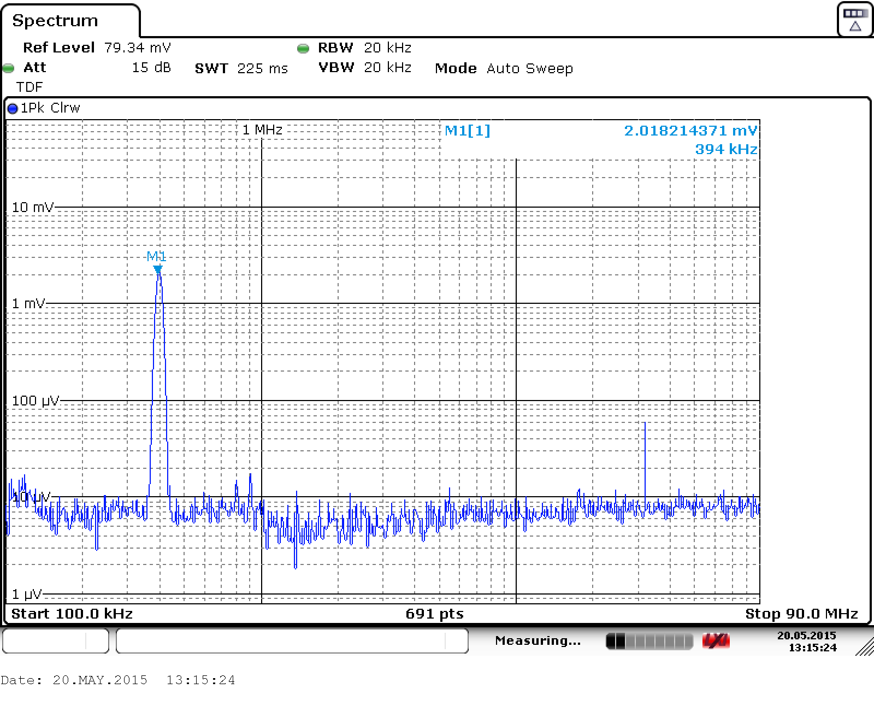
2.1 RF susceptibility test: Test Set-up
32 dB=Factor 40
BACKGROUND SIGNAL
Noise injection – HF current probes
  High ratio – perturbing / background signal
10 th VXD Belle II Workshop
14-16 September 2016, Santander, Spain
10 de 29

Slide 11
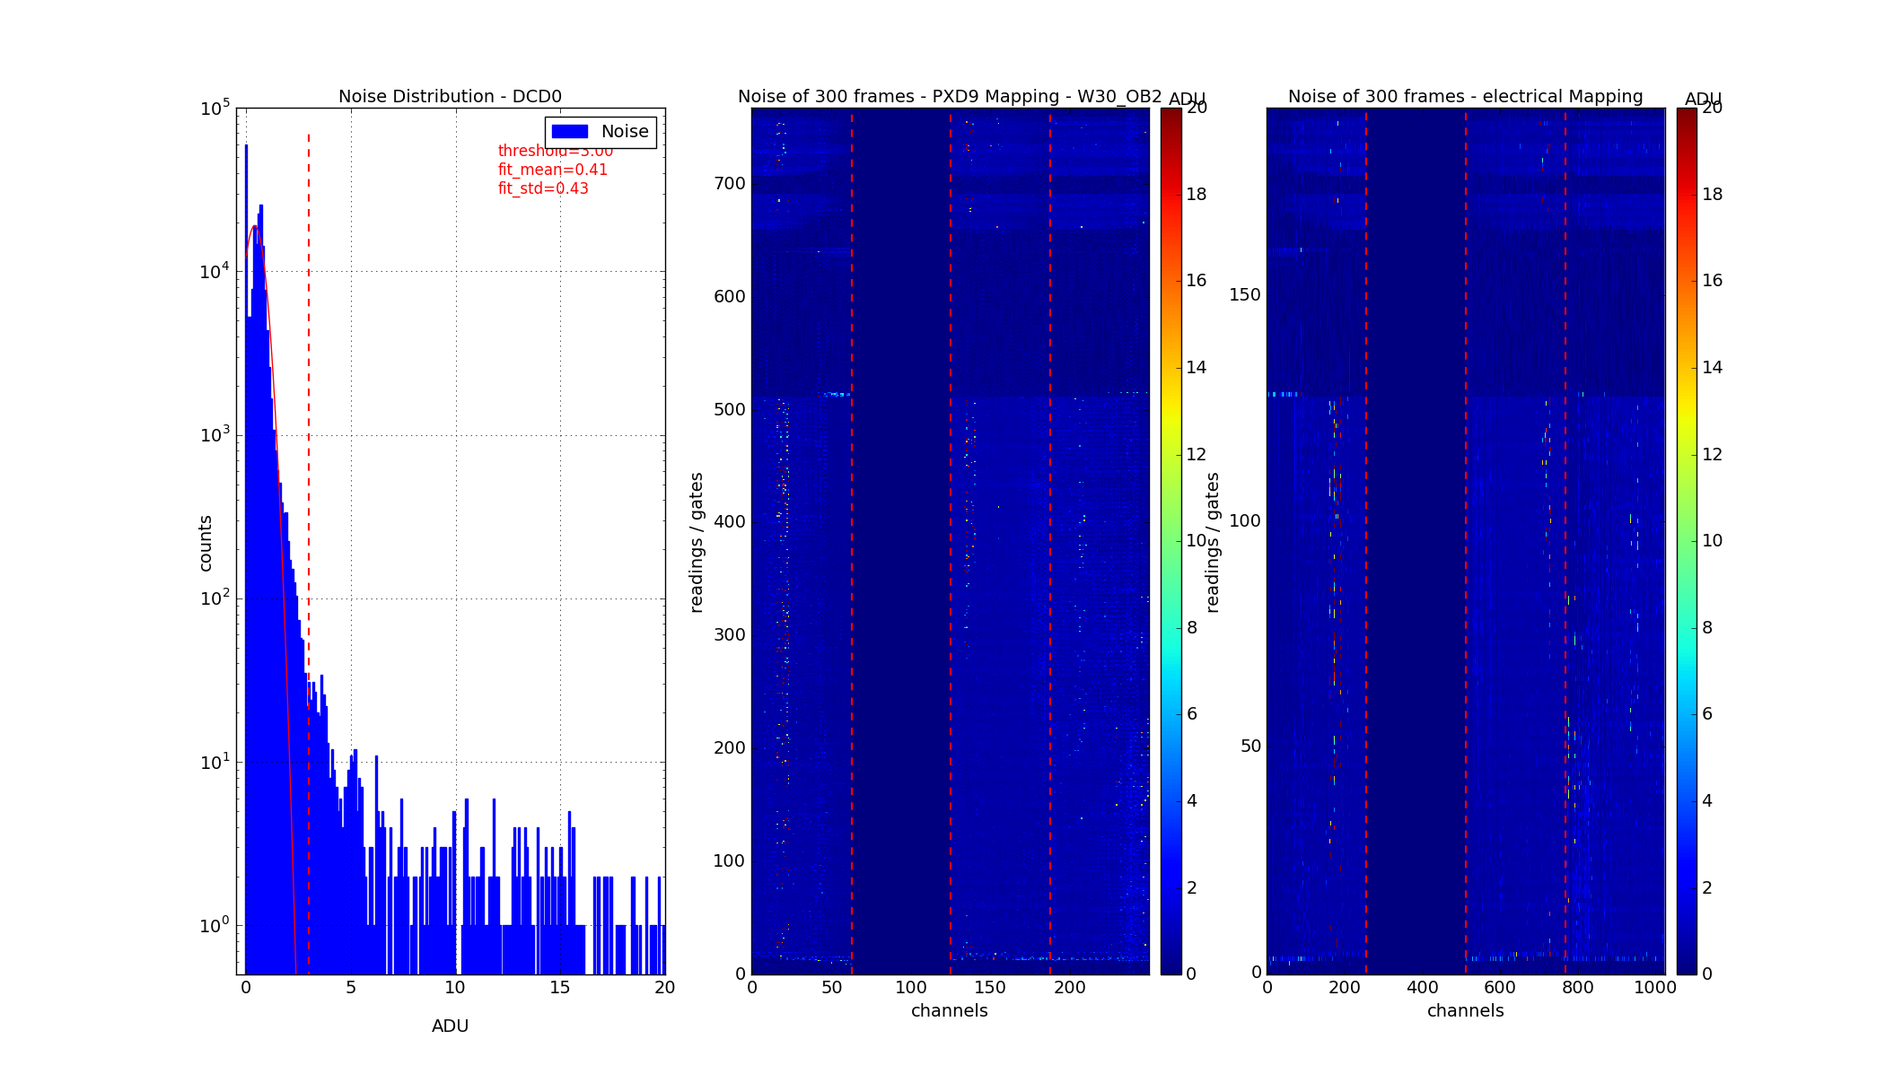
2.1 RF susceptibility test: Test Set-up
  The Performance of the PXD system has been evaluated via RMS value of each pixel
  PHYSICAL MAPPING: Pixel distribution directly on the sensor→768x256
  ELECTRICAL MAPPING: Electrical connection representation of the pixels with the readout.→192 x 1000
    Y Axis: 192 gates controlled by 6 switchers
    X Axis: 1000 drains connected to the 4 DCD
  NOISE DISTRIBUTION: Number of counts for each pixel value (Analogue to Digital Units). The histogram is obtained based on 300 events
NOISE DISTRIBUTION
PHYSICAL MAPPING
ELECTRICAL MAPPING
10 th VXD Belle II Workshop
14-16 September 2016, Santander, Spain
11 de 29

Slide 12
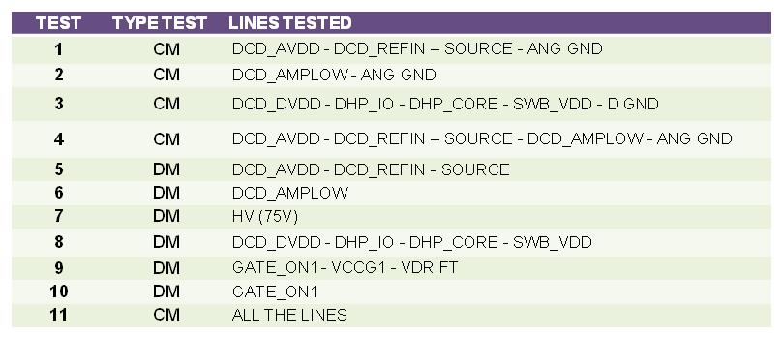
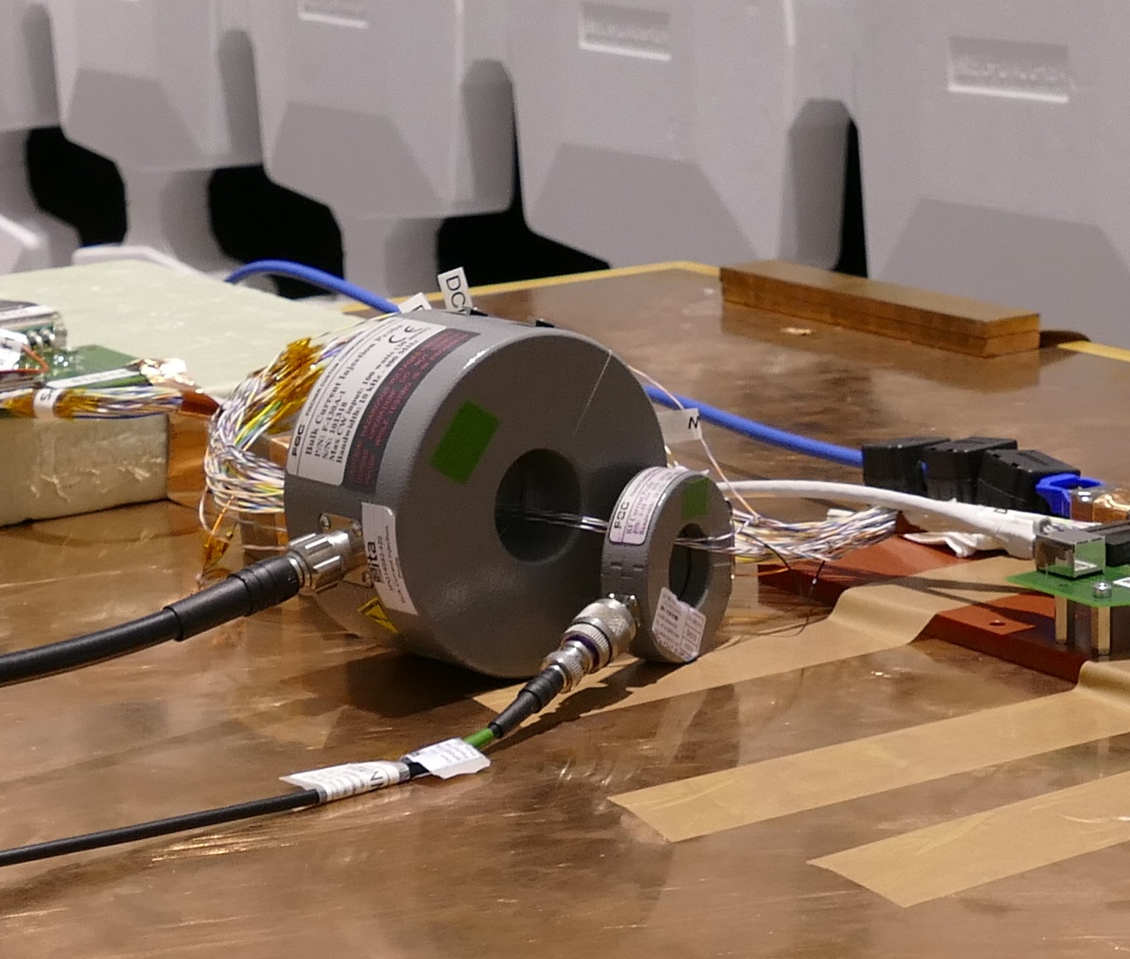
3. Susceptibility test to noise on power cables
Perturbing current is injected into PXD power cables (PS)
  Several amplitudes & frequencies ( up to 400 MHz)
It is equivalent to CM and DM noise coming through power lines (complementary test)
  PS noise (CM & DM)
  External coupling
11 groups of lines have been characterized
10 th VXD Belle II Workshop
14-16 September 2016, Santander, Spain
12 de 29

Slide 13
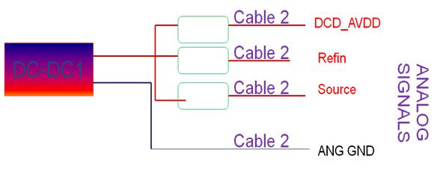
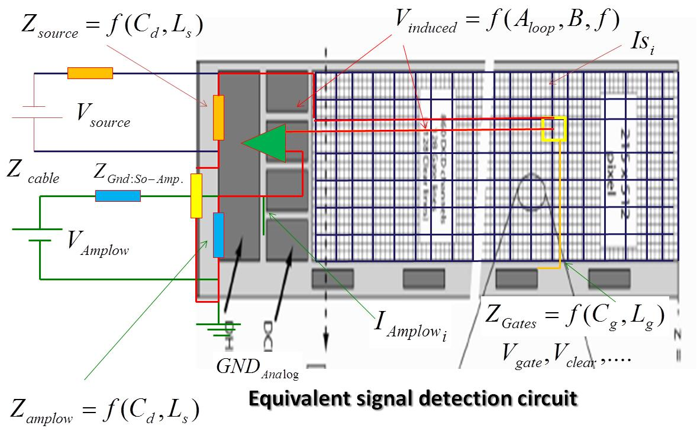
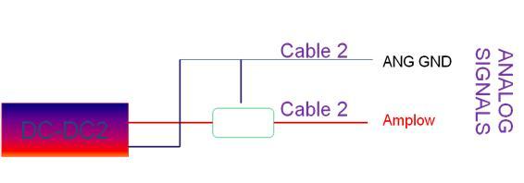
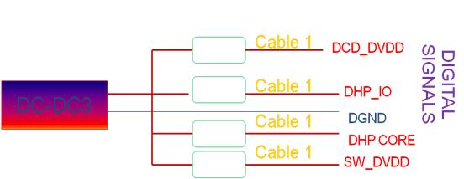
3. Susceptibility test to noise on power cables
A group of lines have been selected based on :
  Previous emission tests
    Emission and immunity tests are complementary
  Analysis of signal circuit - Critical lines
DCDC1
DCDC2
DCDC3
10 th VXD Belle II Workshop
14-16 September 2016, Santander, Spain
13 de 29

Slide 14
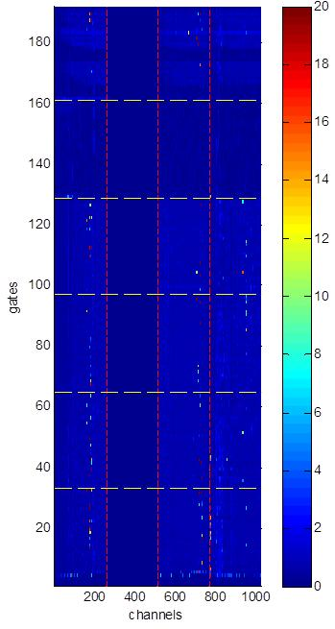
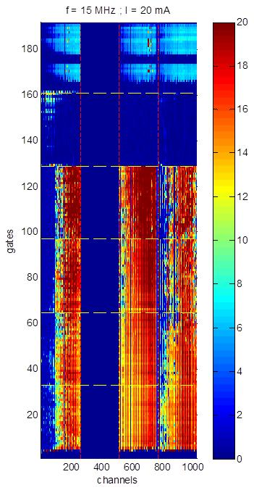
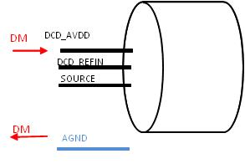
3.1 Susceptibility test to noise on power cables: Results
DM TEST DC-DC1
No noise
DM DC-DC1 | DCD_AVDD
 | DCD_REFIN
 | SOURCE
Noise does not distribute equally in all pixels
10 th VXD Belle II Workshop
14-16 September 2016, Santander, Spain
14 de 29

Slide 15
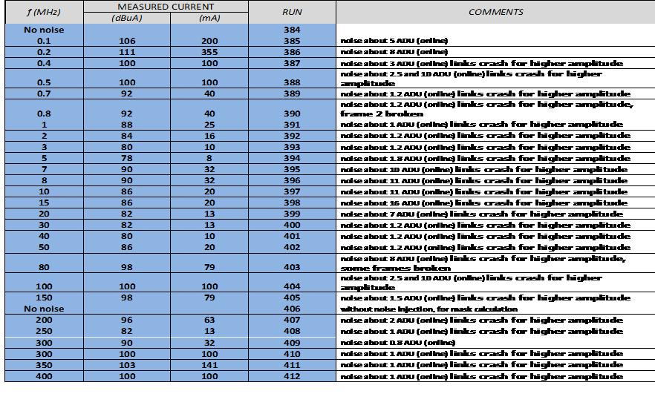
3.1 Susceptibility test to noise on power cables: Results
10 th VXD Belle II Workshop
14-16 September 2016, Santander, Spain
15 de 29

Slide 16
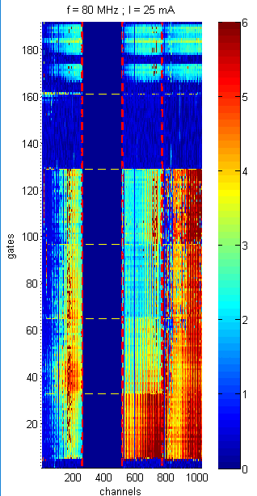
3.1 Susceptibility test to noise on power cables: Results
CM TEST DC-DC1
CM DC-DC1 | DCD_AVDD
 | DCD_REFIN
 | SOURCE
Noise does not distribute equally in all pixels
  Different distribution
10 th VXD Belle II Workshop
14-16 September 2016, Santander, Spain
16 de 29

Slide 17
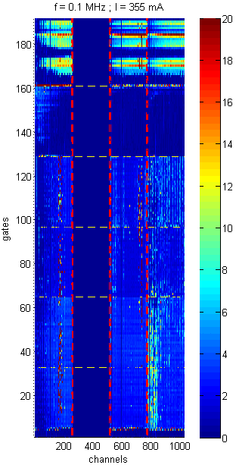
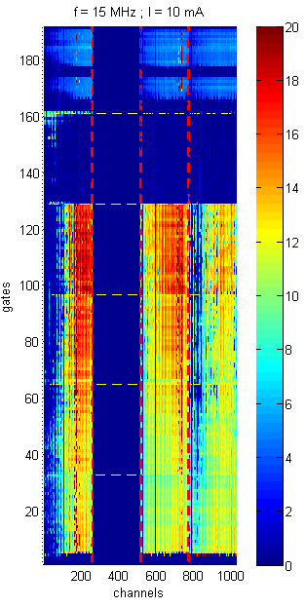
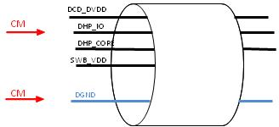
3.1 Susceptibility test to noise on power cables: Results
CM TEST DC-DC3
CM DC-DC3 | DCD_DVDD
 | DHP_IO
 | DHP_CORE
 | SW_DVDD
Noise does not distribute equally in all pixels
  It depends on frequency
10 th VXD Belle II Workshop
14-16 September 2016, Santander, Spain
17 de 29

Slide 18
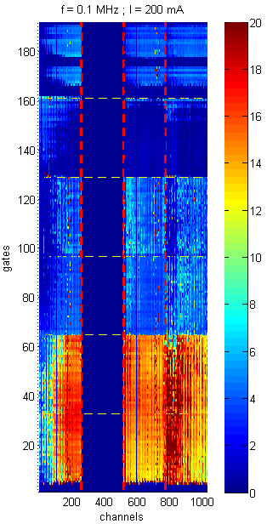
3.1 Susceptibility test to noise on power cables: Results
DM TEST DC-DC6
GATE_ON1
D
M
CCG1
DRIFT
D
M
ST
GND
DM DC-DC6 | GATE ON1
 | CCG1
 | VDRIFT
Noise does not distribute equally in all pixels
10 th VXD Belle II Workshop
14-16 September 2016, Santander, Spain
18 de 29

Slide 19
3.2 Susceptibility test to noise on power cables: Loss of communication link
During the test campaign it has been observed that in some cases there has been a loss of the communication link in the PXD system.
It depends on the noise injected.
  ON / OFF – There is a clear threshold
It has been observed in all lines.
  Limit was different
A special test was performed in the most sensitive groups of lines in order to define the link susceptibility curve.
At specific frequencies the perturbing current is increased until communication link fails.
10 th VXD Belle II Workshop
14-16 September 2016, Santander, Spain
19 de 29

Slide 20
3.2 Susceptibility test to noise on power cables: Loss of communication link
f (MHz) | MEASURED CURRENT |  | SYSTEM FAIL?
 | (dBuA) | (mA)
No noise
0.1 | 112 | 398 | NO
0.2 | 112 | 398 | NO
0.4 | 112 | 398 | NO
0.5 | 111 | 355 | YES
0.7 | 112 | 398 | NO
0.8 | 112 | 398 | NO
1 | 109 | 282 | YES
2 | 100 | 100 | YES
3 | 94 | 50 | YES
5 | 92 | 40 | YES
7 | 96 | 63 | YES
8 | 96 | 63 | YES
10 | 98 | 79 | YES
15 | 94 | 50 | YES
20 | 93 | 45 | YES
30 | 89 | 28 | YES
40 | 85 | 18 | YES
50 | 92 | 40 | YES
80 | 92 | 40 | YES
100 | 88 | 25 | YES
150 | 90 | 32 | YES
200 | 94 | 50 | YES
250 | 78 | 8 | YES
300 | 93 | 45 | YES
350 | 99 | 89 | YES
400 | 99 | 89 | YES
Most sensitive line Susceptibility curve- AMPLOW line
10 th VXD Belle II Workshop
14-16 September 2016, Santander, Spain
20 de 29

Slide 21
4. Susceptibility test to beam pipe radiation noise
The PXD is going to be placed very close to the beam pipe
The beam pipe may radiate noise
  PXD is not a PCB with a nice ground plane ( there are traces)
Beam pipe is part of the accelerator and it may have noise currents in the external face of the pipe (H field)
  Pumps
  Auxiliary electronics (BM)
  Power converters
This noise does not come from the beam
  The EM wave associated to the beam is very well confined (skin-depth)
10 th VXD Belle II Workshop
14-16 September 2016, Santander, Spain
21 de 29

Slide 22
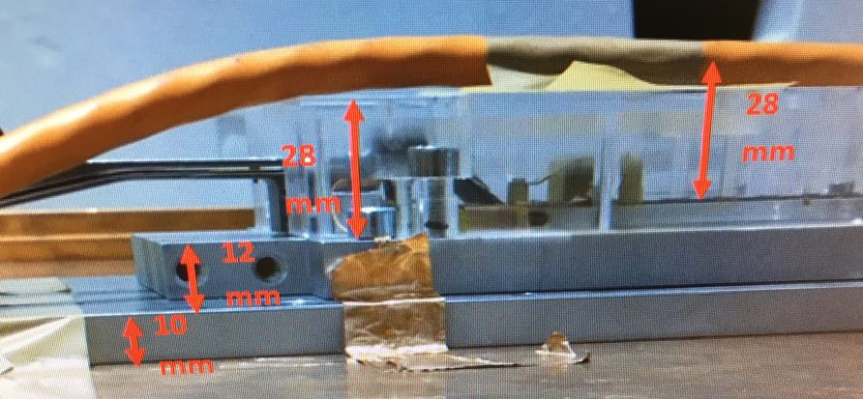
4. Susceptibility test to beam pipe radiation noise
In order to emulate this noise, a special test set-up has been prepared.
A noise current has been injected in an external cable
  Noise current has returned via cooper plane.
This current creates a magnetic field similar to the one radiated by noise current running through the external face of the beam pipe
Susceptibility to beam pipe emissions
10 th VXD Belle II Workshop
14-16 September 2016, Santander, Spain
22 de 29

Slide 23
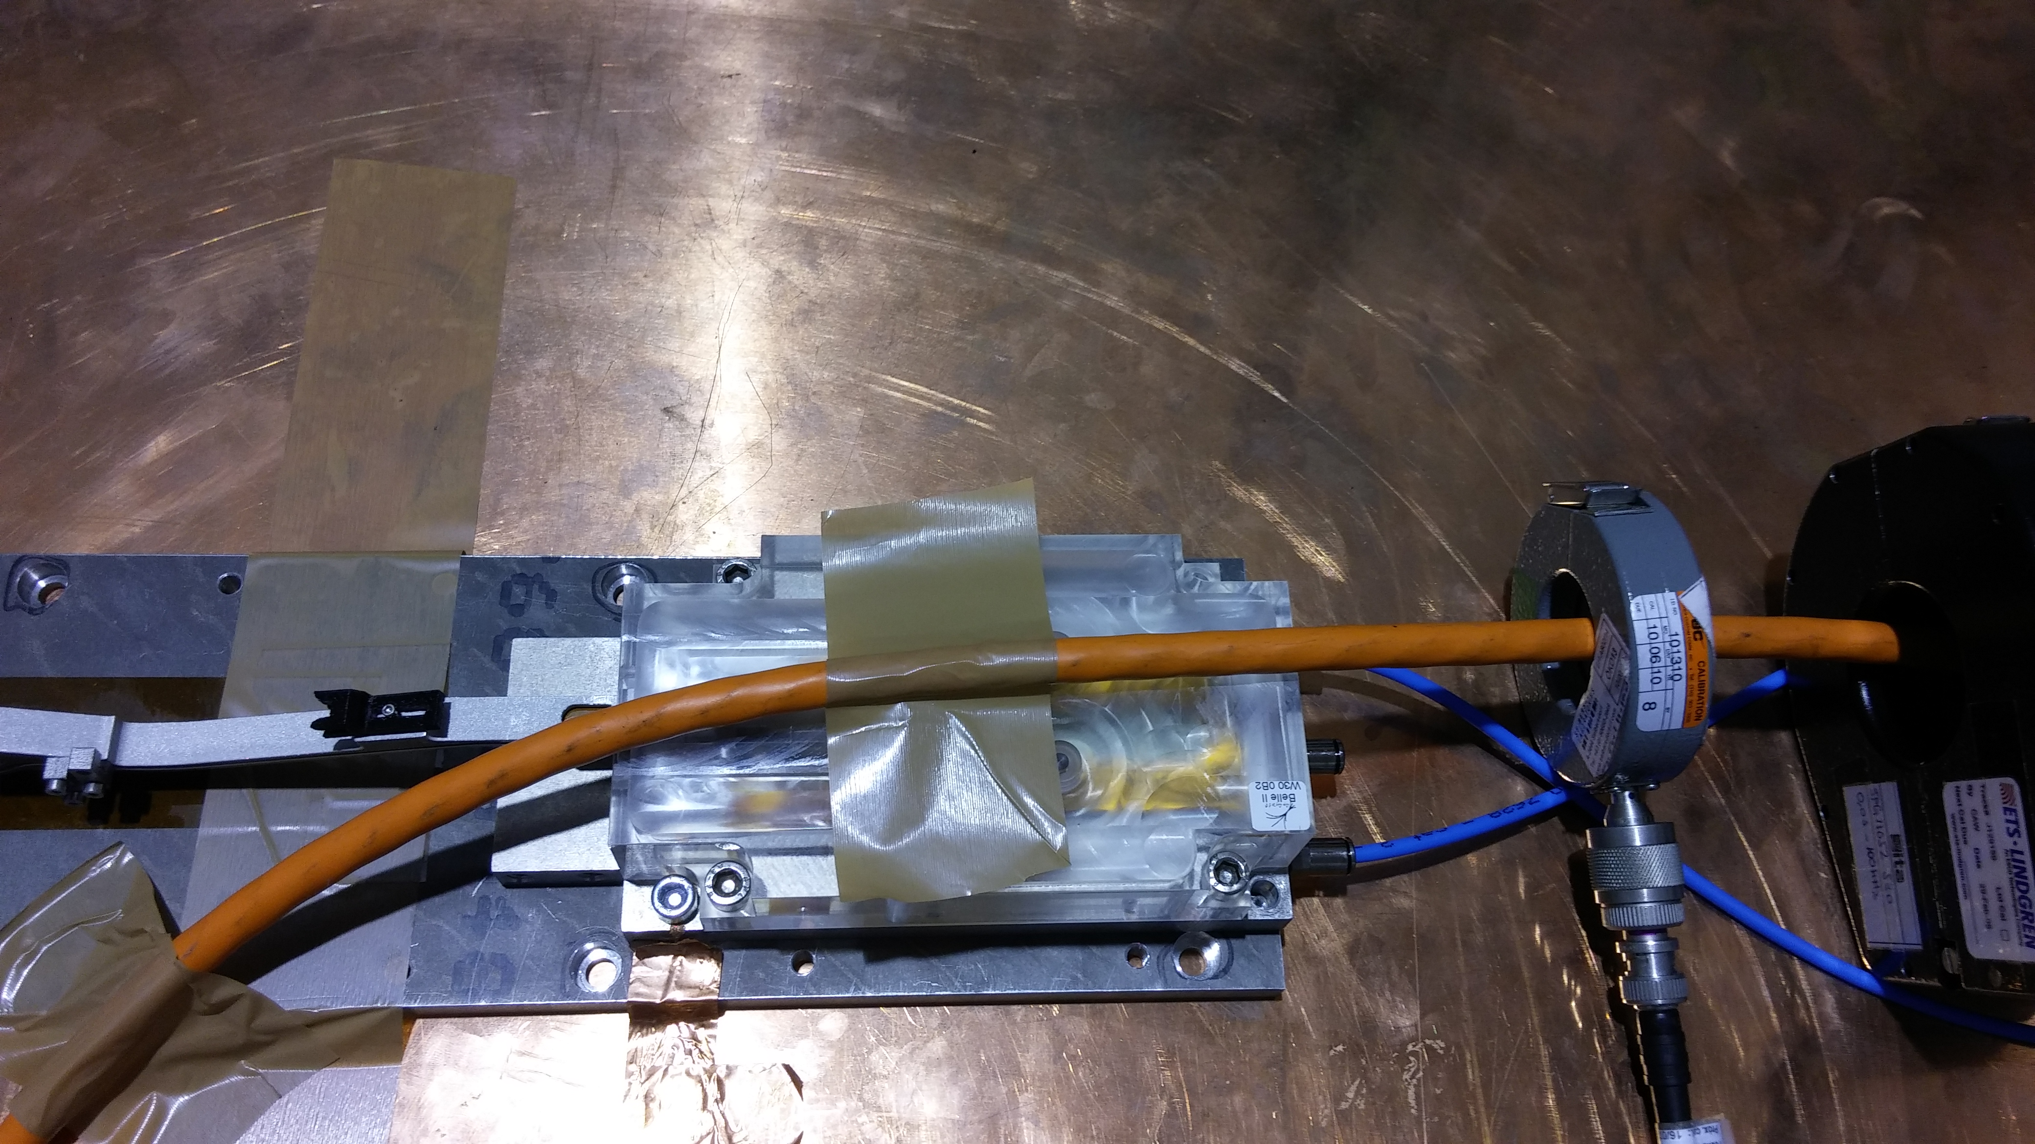
4.1 Susceptibility test to beam pipe radiation noise: Test results
Tests have been performed between 400 kHz up to 400 MHz
  At some frequencies 32mA are enough to disturb the system (at others 1 A is required)
10 th VXD Belle II Workshop
14-16 September 2016, Santander, Spain
23 de 29

Slide 24
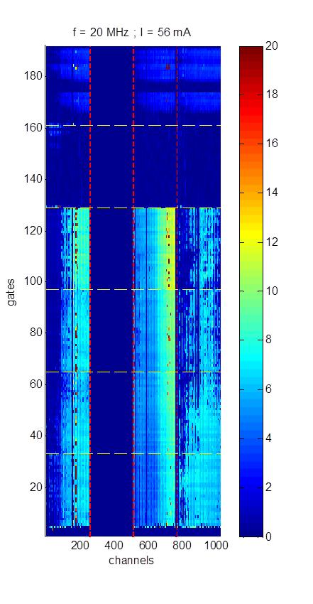

4.1 Susceptibility test to beam pipe radiation noise: Test results
No noise
10 th VXD Belle II Workshop
14-16 September 2016, Santander, Spain
24 de 29

Slide 25
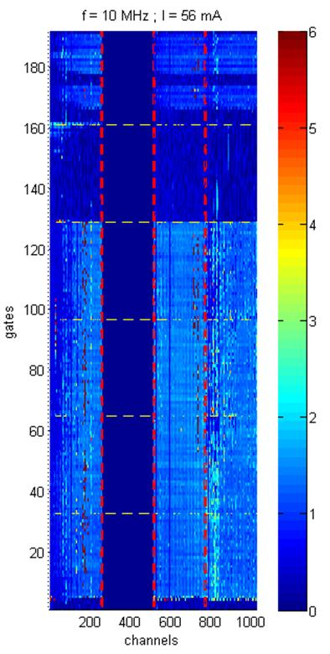
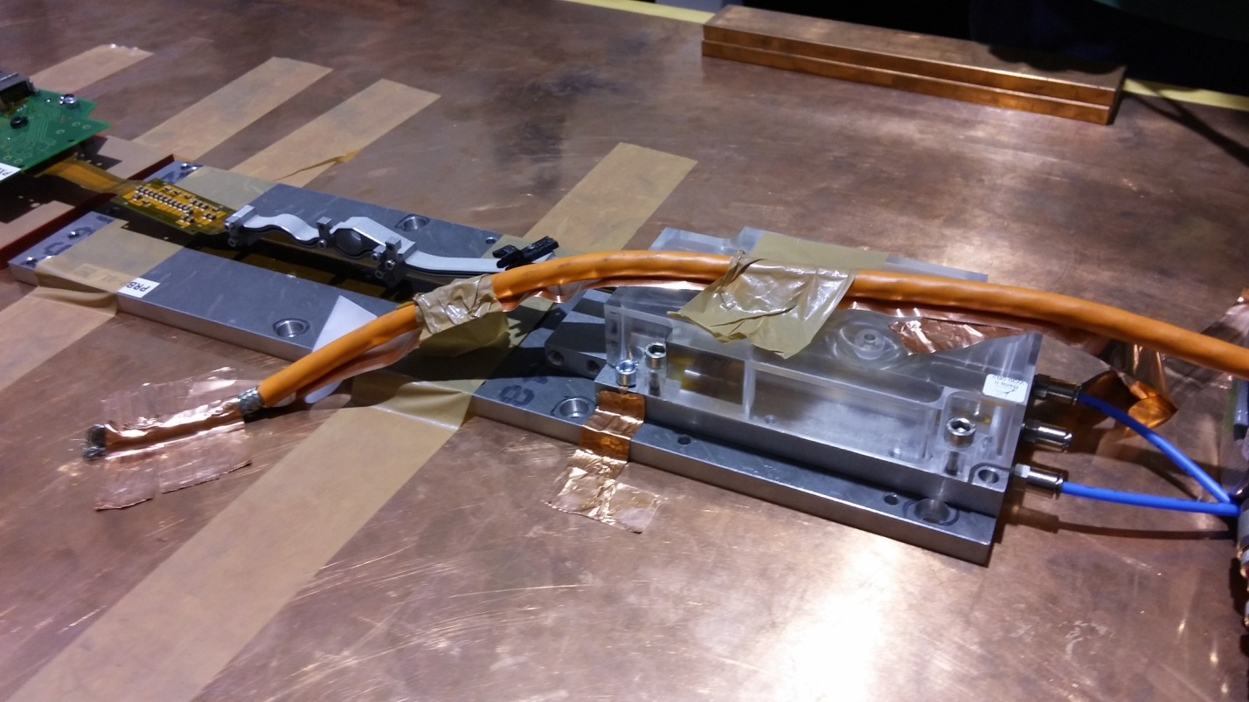
4.1 Susceptibility test to beam pipe radiation noise: Test results
Several configurations have been tested in order to analyze this effect in detail
  A cooper tape has been placed underneath
    Noise disappear
10 th VXD Belle II Workshop
14-16 September 2016, Santander, Spain
25 de 29

Slide 26
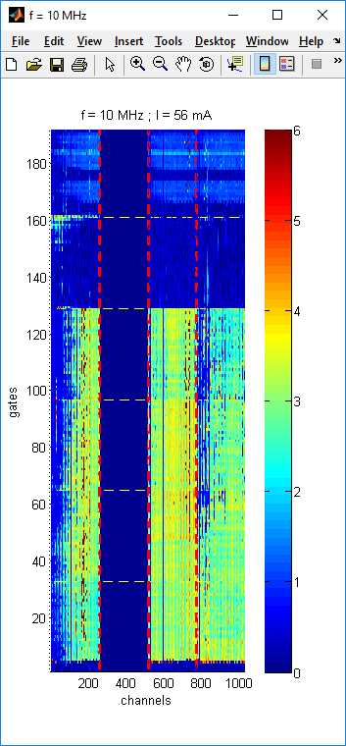
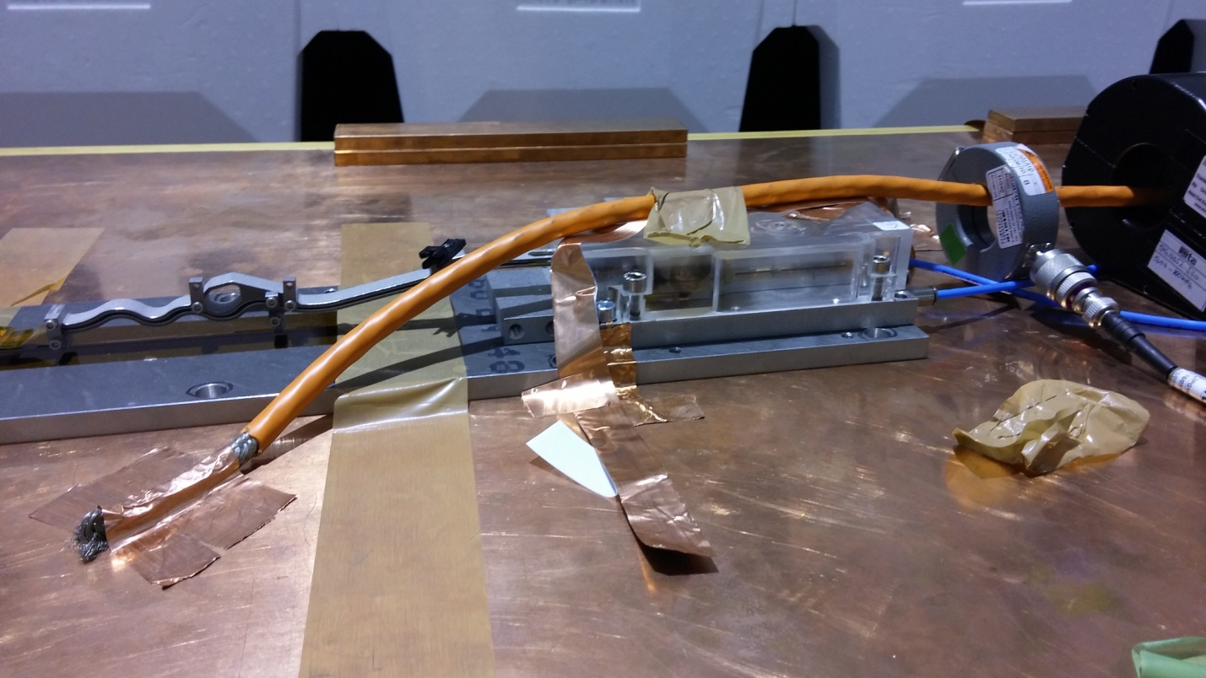
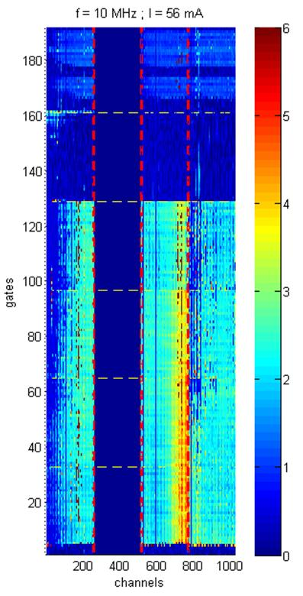
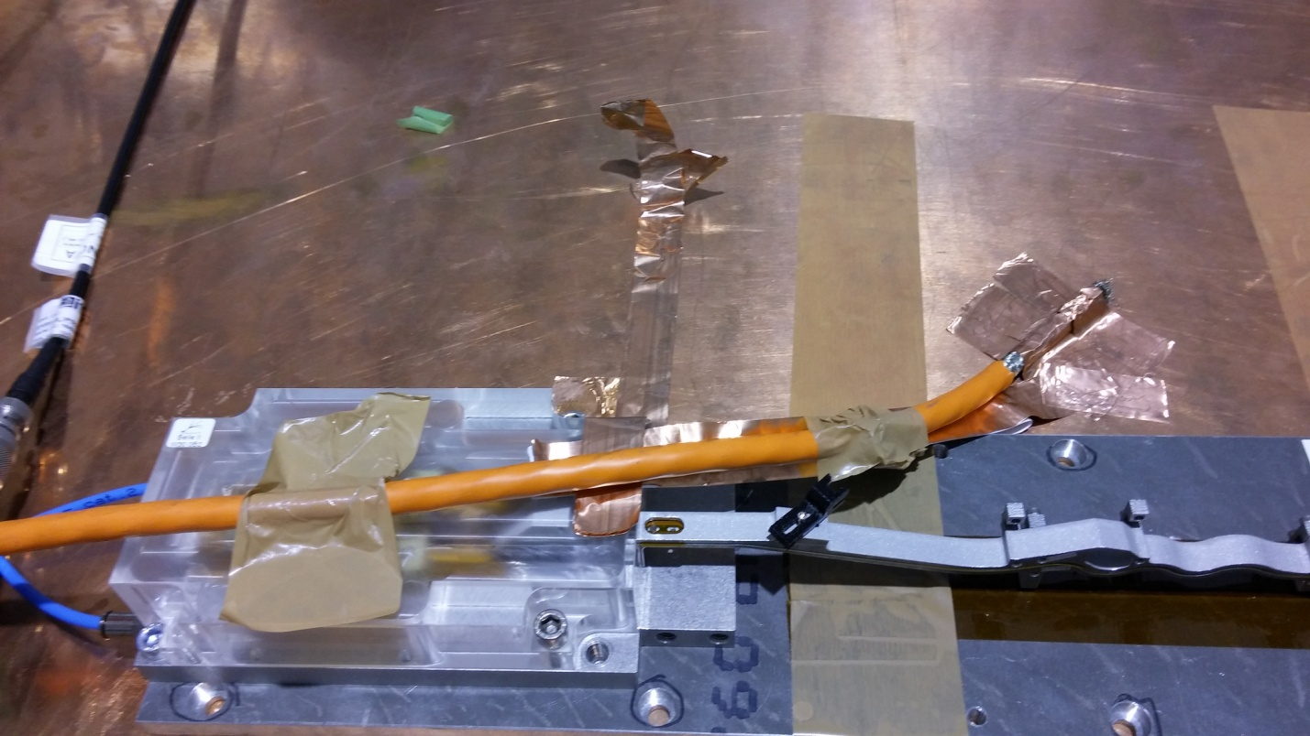
4.1 Susceptibility test to beam pipe radiation noise: Test results
It seems kapton area is more susceptible than sensor area.
10 th VXD Belle II Workshop
14-16 September 2016, Santander, Spain
26 de 29

Slide 27
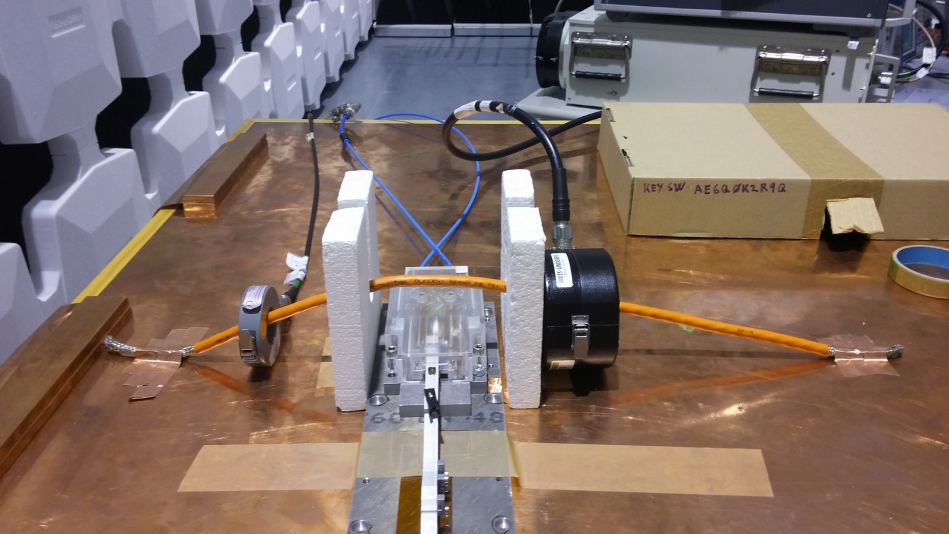
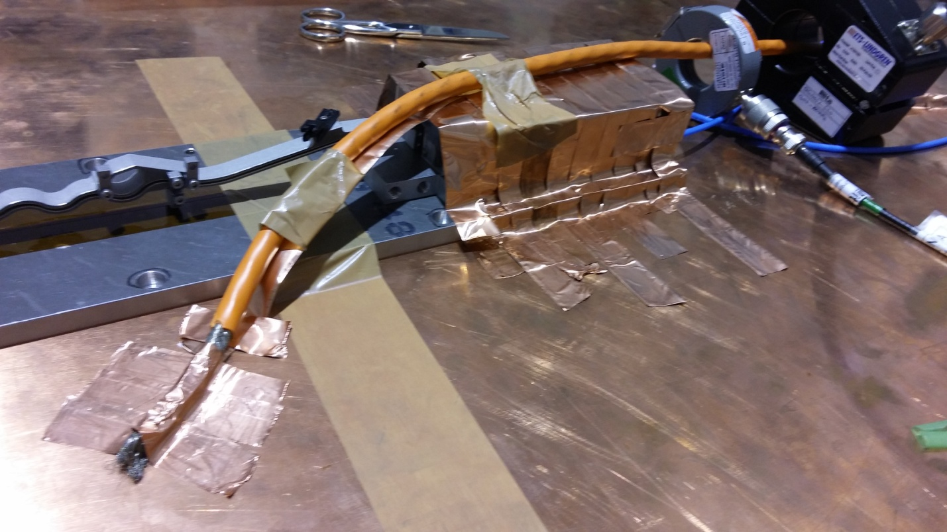
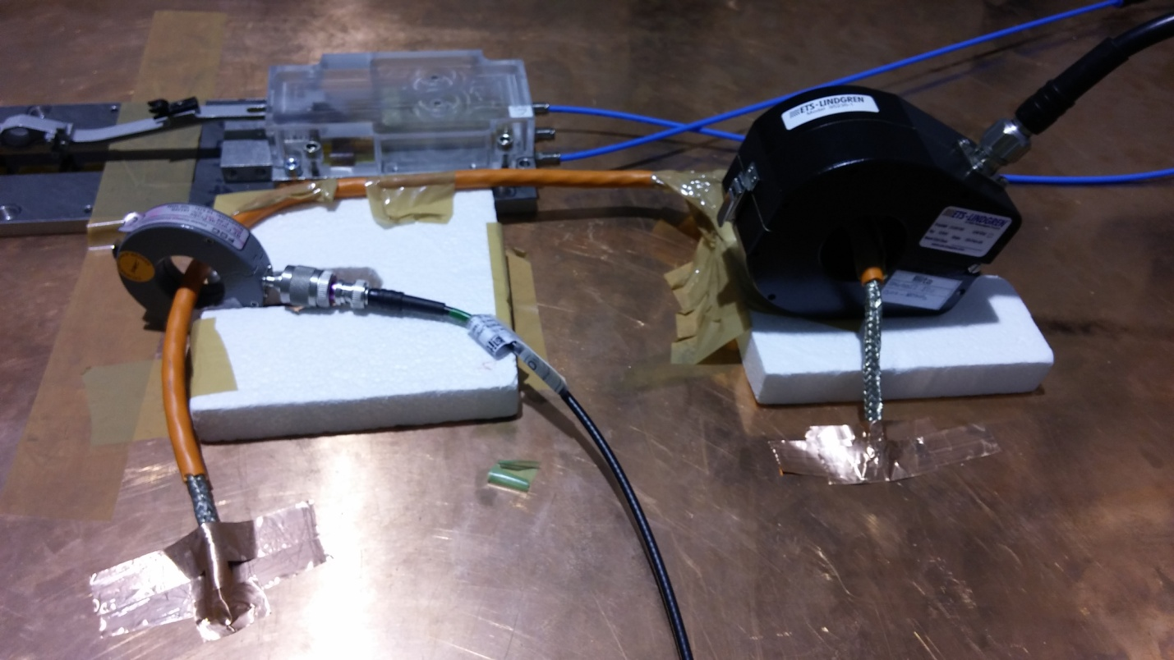
4.1 Susceptibility test to beam pipe radiation noise: Test results
Other topologies that have showed less noise .
PERPENDICULAR
SHIELDING
PARALLEL
10 th VXD Belle II Workshop
14-16 September 2016, Santander, Spain
27 de 29

Slide 28
5. CONCLUSIONS
A general overview of the EMC test campaign has been presented
  It has been focused on the susceptibility test
Several tests have been performed ( 1000 runs)
  Susceptibility to power lines noise
    CM &DM – 11 configurations
  Susceptibility to beam pipe radiation
We have just started to analyze the data but we have already seen interesting results
  It confirms that these tests are very useful
Future plans:
  It is planned to calculate the TF of each tested topology
10 th VXD Belle II Workshop
14-16 September 2016, Santander, Spain
28 de 29

Slide 29
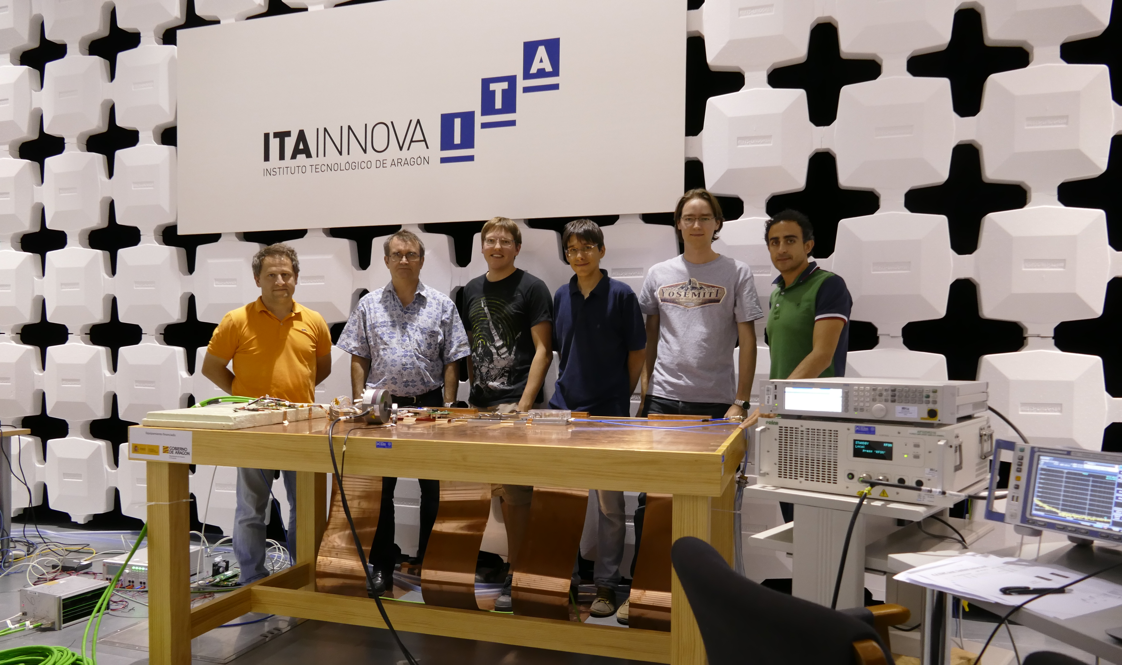
6. Acknowledgements
We would like to thank to all PXD community (Christian Kiesling, Laci Andricek, etc) to make this test campaign possible and specially Christian Koffmane (HLL-MPG) and Carlos Mariñas (UniBonn ) for the fruitful discussions during the test preparation.
10 th VXD Belle II Workshop
14-16 September 2016, Santander, Spain
29 de 29

