Slide 1
SVD DAQ status
-inputs for BPAC-
Katsuro Nakamura
Sep. 14, 2016
10th VXD Workshop

Slide 2
Specification of SVD DAQ

Slide 3
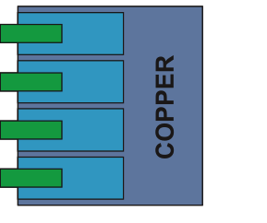
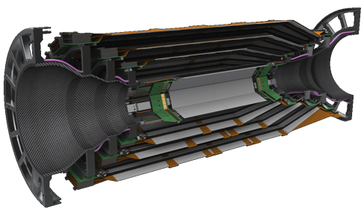
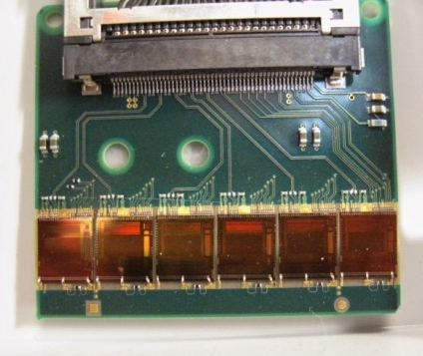
SVD Readout System Overview
(phase-3)
Interaction Region
Dock Area
Top of the Belle II detector
E-hat 2F
~2m
copper
cables
Junction
boards
( signal
repeater )
~10m
copper
cables
FADC x48
COPPER
Belle II SVD
data flow
HSLB
flash ADC
zero-sup.
data format
FTB x48
basf2
DAQ
belle2link
data
format
B2L
control signals
Aurora
1748
APV25’s
Aurora link
PXD system
clock,
trigger,
reset …
VME
backplane
belle2tt
DATCON
PXD RoI
Buffer x4
clock,
trigger,
reset …
FADC-Ctrl
copper
cables
APV25 chips
FADC control
APV Trig. Gen.
B2TT decoder
belle2tt
clock,
trigger,
reset …
FTSW
SVD readout system
SVD readout system is
driven by 32MHz clock.

Slide 4

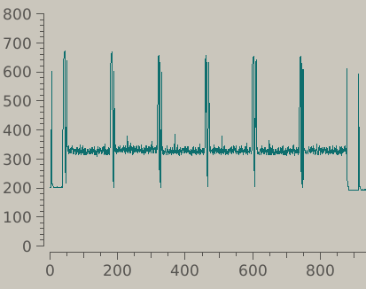
APV25 and Requirement on Triggers
APV25 chip
  Front-end electronics with 128 analog input channels for DSSD signal readout
  Short shaping time: 50 nsec
  → Suitable for high occupancy in Belle II SVD
We will use 6- or 3-samples per a trigger
  6-samples: good peak finding
  3-samples: smaller event size
Requirements on triggers from APV25
  Maximum average trigger rate:
    38kHz (6-samples), 76kHz (3-samples)
      cf. max. trigger rate in Belle II is 30kHz
  Minimum trigger interval: (3 clocks/3-samples)
    189nsec (6-samples), 94nsec (3-samples)
  Maximum trigger latency:
    5.03 usec (available pipe-line size of 160 samples)
APV25 chip
output from APV25
(6 samples/trigger)
ADC
1 sample
a particle hit
clock tick (32MHz)

Slide 5
Requirement on Belle II trigger latency
Maximum acceptable APV25 latency: 5.030usec
  Trigger propagation from collisions to trigger arrival to the APV25 chip
  We have to think 3 components in the trigger propagation time
    Path-1. Collision – trigger arrival on FTSW (master)
    Path-2. Trigger arrival on FTSW (master) – trigger arrival on FADC system
    Path-3. Trigger arrival on FADC system – trigger arrival on APV25 chip
  Propagation times on path-2 and path-3 are determined mainly by hardware specification.
Path-3: (SVD FADC system): 230nsec trigger propagation in the final setup (from KEK measurement)
Path-2 (Trigger distribution in FTSWs): 350nsec (from Nakao-san’s measurement)
Path-1 (Trigger generation): must be less than 4.45usec
  4.45 usec = 5.03 usec – 0.35 usec – 0.23 usec

Slide 6
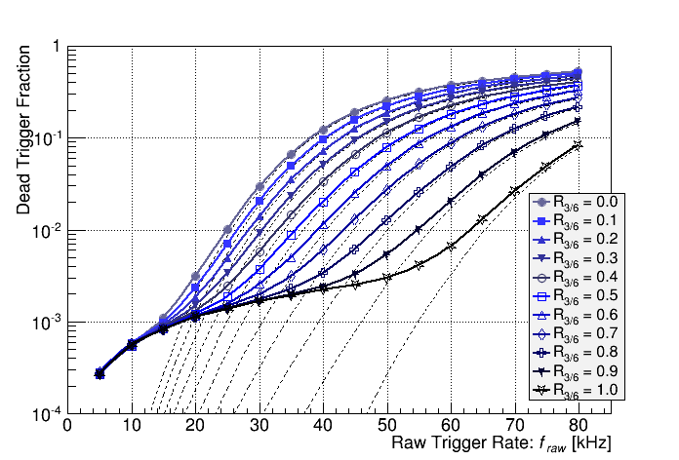
Simulated Trigger Dead Time from SVD
(w/ APV25 FIFO emulator)
Trigger dead time vs. Raw trigger rate (Simulation)
shown at
TRG/DAQ workshop 2014
Belle II designed
max. trigger rate
only 6-samples
R_{3/6}: fraction of
mixed 3-samples mode
only 3-samples
threshold: 26 samples
no trigger/busy propagation
trigger interval: 190nsec (24 clocks)
Trigger dead time at 30 kHz trigger is 3%.
Furthermore, the trigger dead time can be decreased by switching btw. 3-/6-samples event-by-event according to trigger timing resolution.
If we can increase R_{3/6} to more than 0.7, 50 kHz trigger is also acceptable.

Slide 7
SVD Data Format
Brief descriptions
Main purposes
Raw mode | Raw signal shape from APV25 output | SVD local data taking. (check of raw APV signal shape)
Transparent mode | DSSD hit information w/o zero-suppression | Debugging purpose. (check of noise distribution)
Zero-suppression mode | DSSD hit information w/ zero-suppression | For physics data taking. Reasonable data size
Zero-suppression + hit-time mode | Future data mode for further data size reduction. (not present yet) | For physics data taking. Reasonable data size
We have 4 data modes.
Zero-suppression (+ hit-time) mode is for physics data taking.
  Raw mode: SVD internal data taking for noise, calibration, clock timing scan, etc.
  Transparent mode: confirmation for noise distribution and common-mode correction.

Slide 8
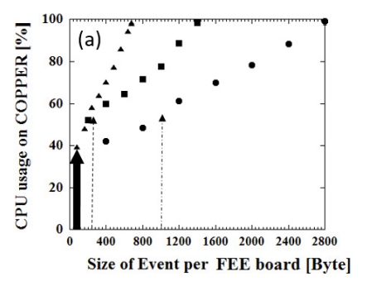
SVD Event Size
Zero-suppression mode:
  The event size depends on the occupancy and the number of APV25 chips (= N) on the FADC.
  FTB header (2 words) + FADC header (1 word) + APV header (N words) + DSSD hit data (occupancy*128*1(3-samples) or 2(6-samples) words) + FADC trailer (1 word) + FTB trailer (1 word)
    = 5 + (occ.*128 + 1)*N words (in 3-samples/trigger)
    = 5 + (occ.*256 + 1)*N words (in 6-samples/trigger)
  cf. 1 word = 4 Byte
  1% occupancy creates ~176 words (704 Byte) data for N=48 APV25s, 6 samples
Transparent mode:
  data size: 5 + 65*sample*N words
    → 18725 words (74.9kB) for N=48 and 6 samples.
  In small trigger rate, this data size can also be taken with Belle II DAQ.
Expected COPPER CPU usage
(in 30 kHz trigger rate ?)
SVD
Plot is made by Yamada-san
The numbers of data sizes in this slide are sums of FADC+FTB data, but without B2L data.

Slide 9
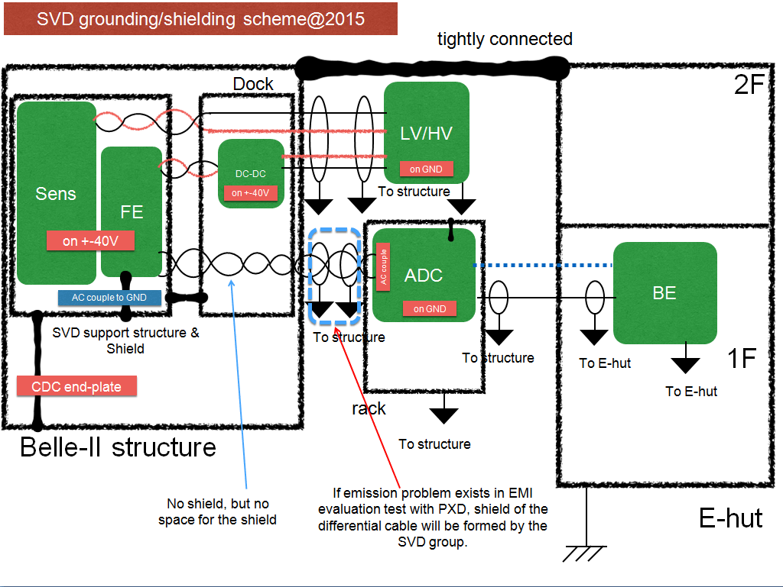
SVD Grounding Scheme
Baseline of SVD grounding scheme is already finalized and agreed with the Belle II grounding group.

Slide 10
Development Status/Schedule
(Hardware, Firmware, and Slow Control)

Slide 11
Summary of SVD-DAQ Development Status
All the data process and link communication work excellently. The data from SVD are acquired very stably in up to 1kHz triggers.
  Successfully confirmed in the several beam tests.
But, still further developments are necessary before physics data taking for:
  improvement on noise performance,
  capability for high trigger rate,
  data-corruption detection in firmware.
    We have to detect SEU on APV25.

Slide 12
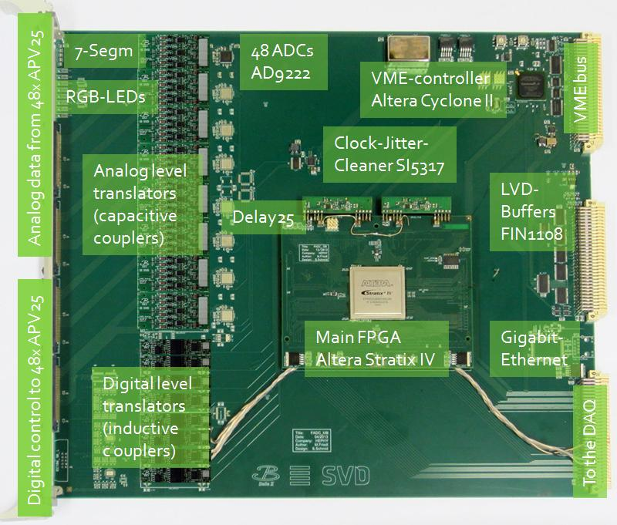
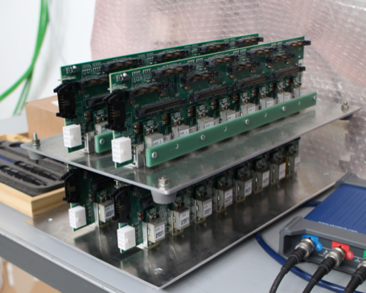
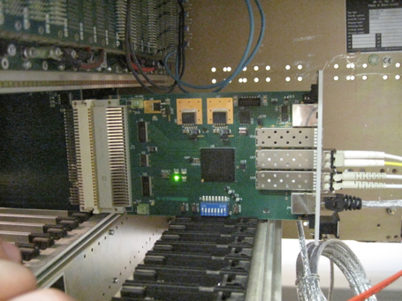
Electronics Preparation Status
FADC board (48 boards for phase-3)
  Ver.3 board: Produced and tested at the last DESY beam test. Good performance of data readout was confirmed on DESY beam test. Especially, stabilities of FPGA configuration and VME access are excellently improved.
  Ver.4 board (for phase-3): Final version of FADC board, in which noise performance will be improved. Schematic drawing work has been started at HEPHY. The first samples will be ready by Mar. 2017.
    The performance will be tested with a permanent DAQ setup in DESY.
Junction board (48 boards for phase-3)
  Board for FADC Ver.3: Produced and tested at the DESY beam test. Working good.
  Board for FADC Ver.4 (for phase-3): Modification on schematics has been done. Once cross-check is completed, we will order PCBs.
FADC-Ctrl board (1 board for phase-3)
  Ver.2 board (for phase-3): Produced and tested at the DESY beam test.
FTB board (48 boards for phase-3)
  Ver.3 board (for phase-3): well tested and mass-production has been completed already.
FADC board
Junction board
FTB board

Slide 13
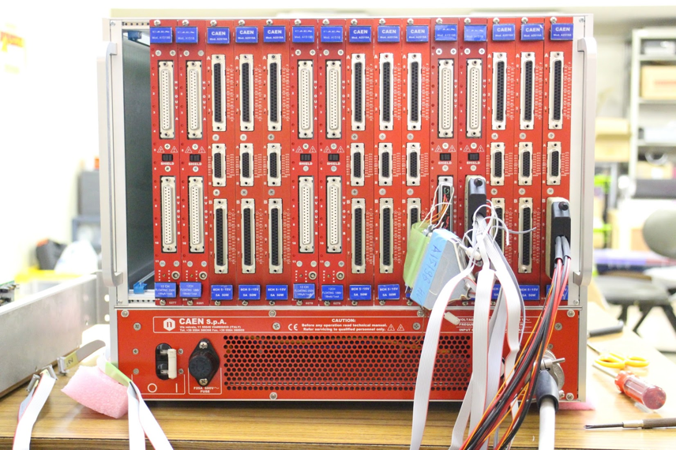
Power Supply Preparation Status
For SVD HV and LV, CAEN modules are employed.
  Crate: SY4527 (Universal multichannel PS system, can be controlled with EPICS)
  HV: A1519B (250V, 1mA, floating 12ch)
  LV: A2519A (15V, 5A, 50W, floating 8ch)
  Separation voltage: A1510 (100V, 10mA, floating 12ch)
All the necessary modules are already procured by PISA.
CAEN HV/LV power supply modules
Excellent performance of these modules was confirmed at the last beam test (Apr. 2016).
  Although an A1510 module didn’t work due to a hardware problem, other modules excellently worked without any suspicious noise.
Control with EPICS is working well.

Slide 14
Patch Panel for Power Supply and Issue of Separation Voltage Polarity
To be updated according to Francesco’s talk.

Slide 15
Firmware Preparation Status
Basically, minimum set of firmwares for data taking are already prepared.
  They work good in the previous DESY beam test.
However, still some necessary functions for the physics run are missing and further development are required.

Slide 16
Remaining Tasks in Firmware Development
High priority: (necessary for physics run)
APV pipe-line address emulator (in FADC-Ctrl)
  the event order mismatch on FADC can be detected.
APV FIFO emulator (in master FTSW)
  prevents APV FIFO full which causes data corruption.
Improvement on common-mode correction (CMC) function. (in FADC)
  Currently 128-strips wise, but will be changed to 32-strips wise for more accurate common-mode noise reduction.
GbE data link for SVD local data taking (in FADC)
  For faster local data taking.
Remote FPGA configuration through VME access (in FADC)
Improvement on data format of FTB-DATCON link (in FTB)
  in order to increase the data size of the clock counter (currently 24-bits).
Middle priority: (not mandatory, but better to have )
Fake-hit filter (in FADC)
Zero-suppressed + Hit timing extraction mode (in FADC)
  The last data format for further data size suppression.
Function of event-by-event switching btw. 3- and 6-samples depending on trigger types. (in FADC-Ctrl + FADC)
  Necessary only for operation with about 30kHz or higher trigger rate.
New FTB data format (in FTB)
  w/ more useful information.

Slide 17
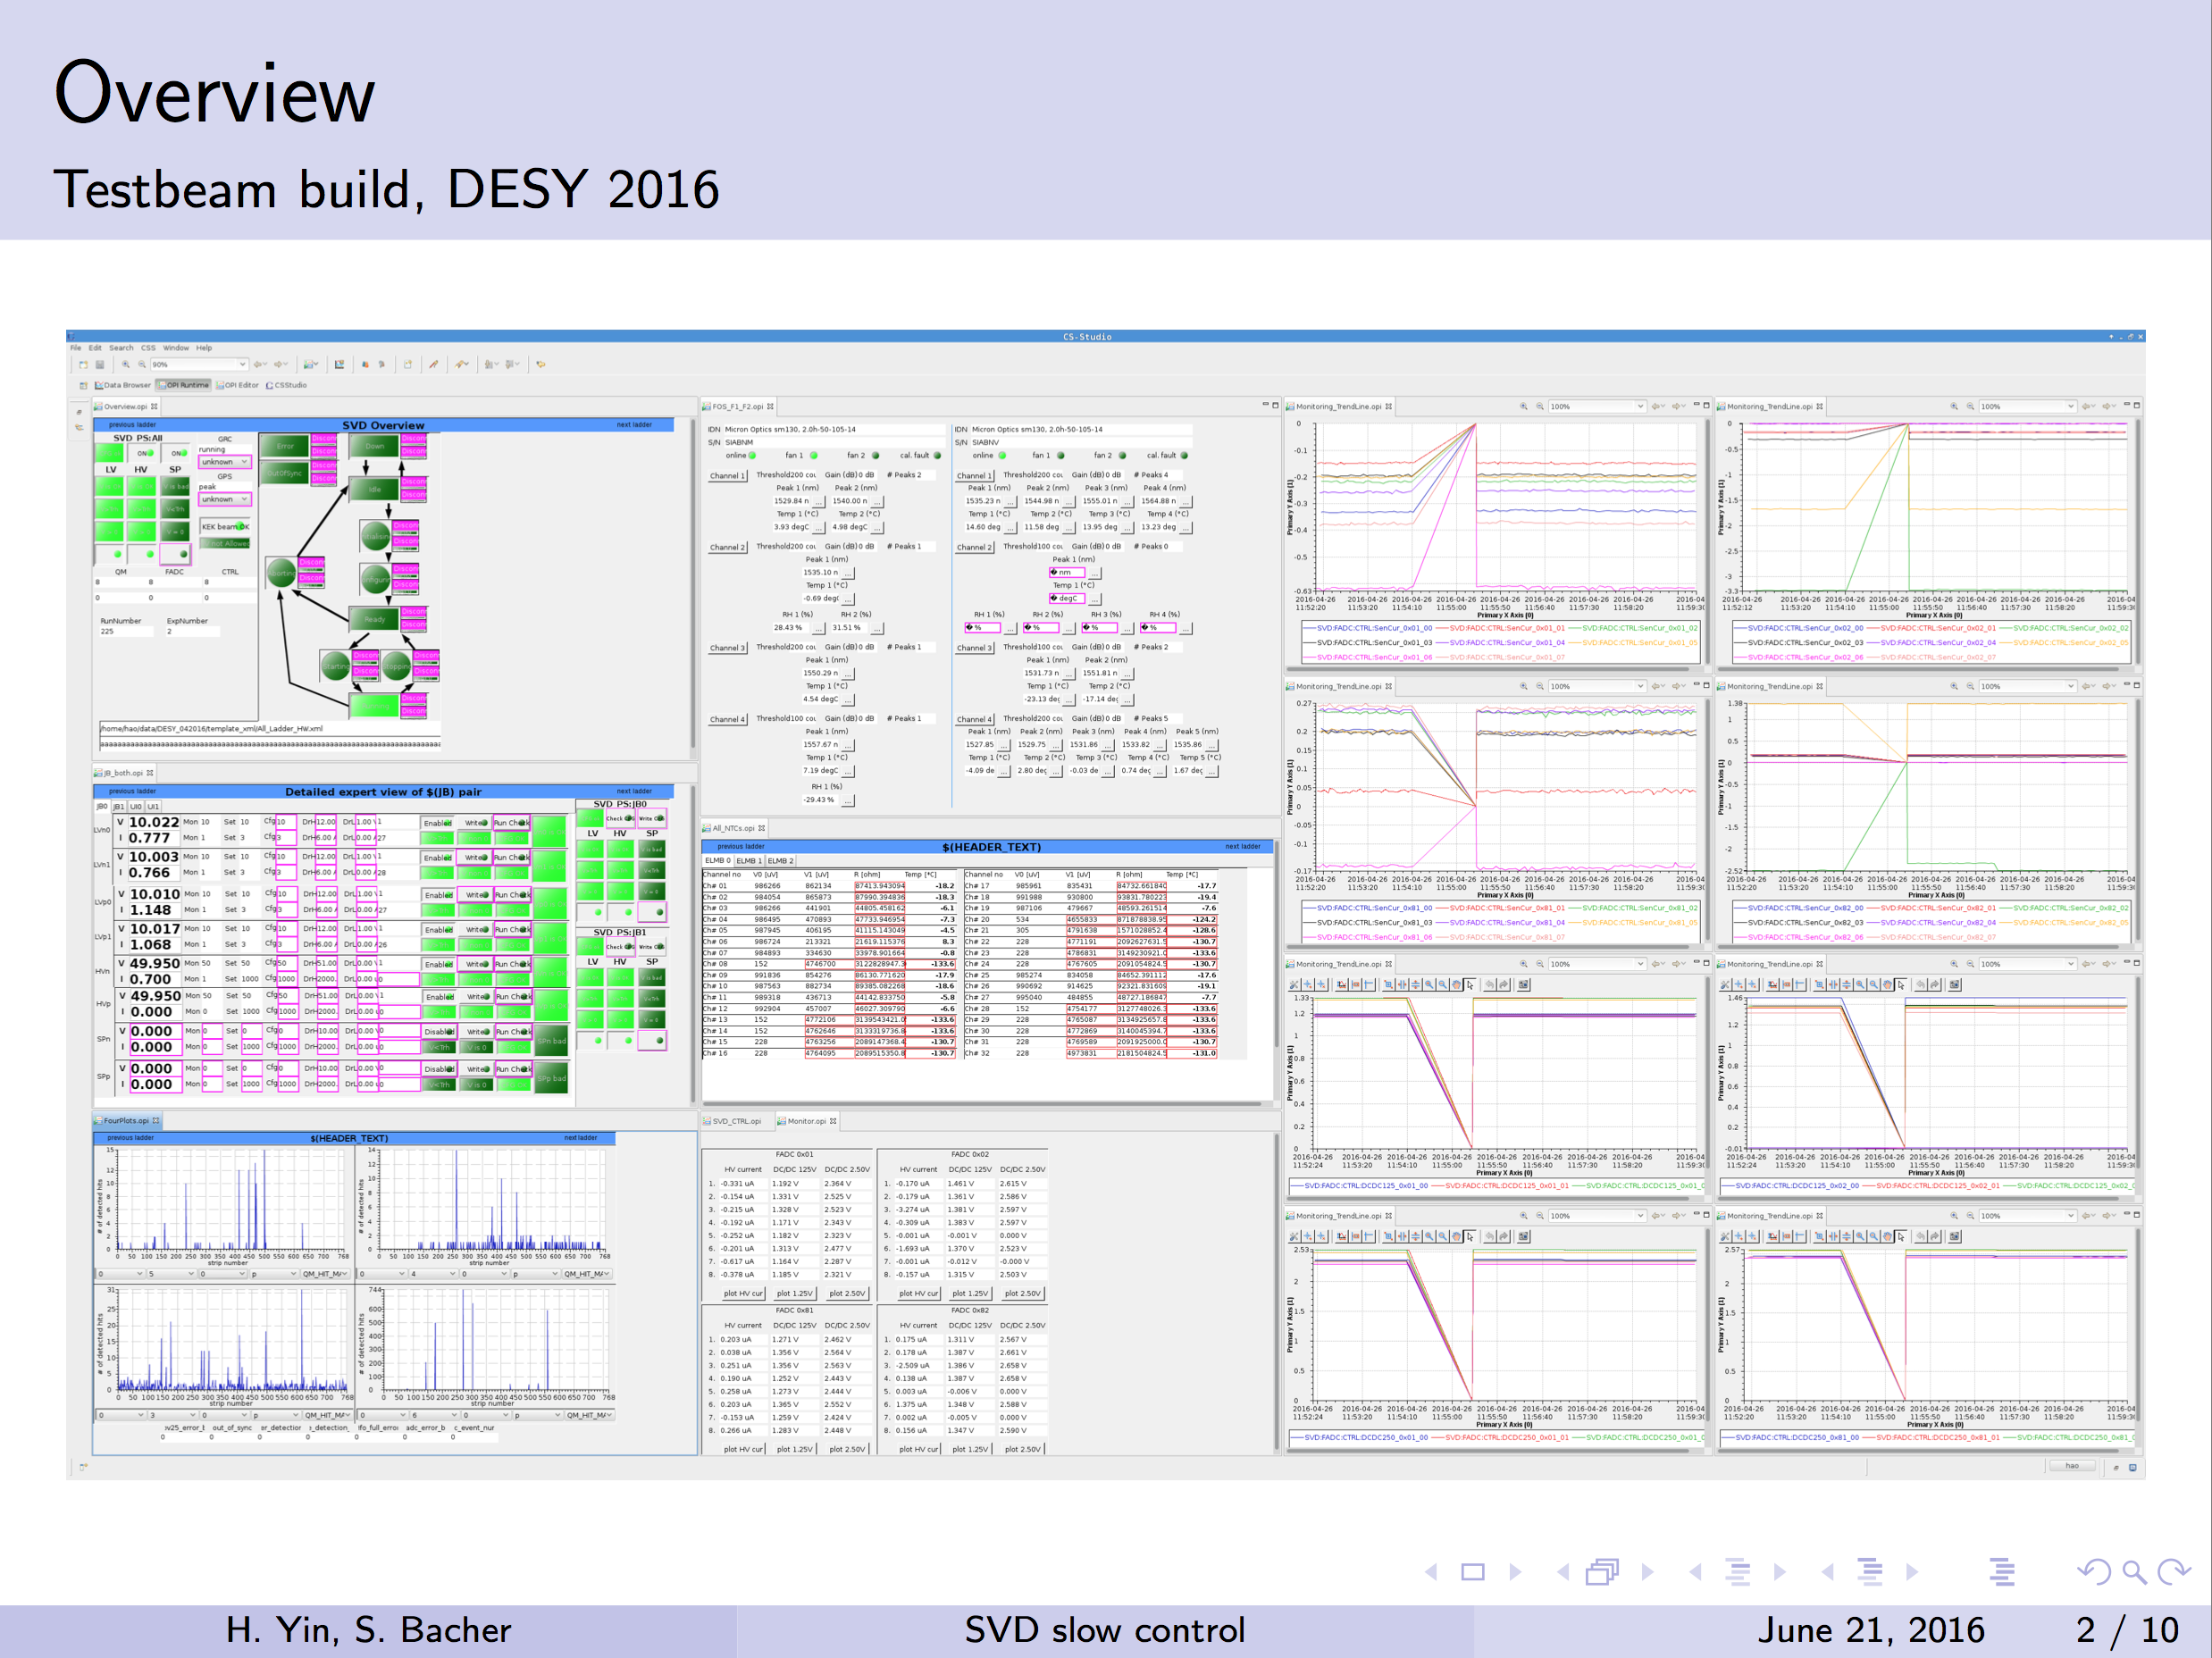
SVD slow control (achievements)
from H. Yin slides, Jun 21 B2GM
Necessary GUI frameworks (FADC system controller, Power supply controller, On-line data monitor) and gateway for NSM2 were prepared for the last beam test (Apr. 2016). They all worked good.

Slide 18
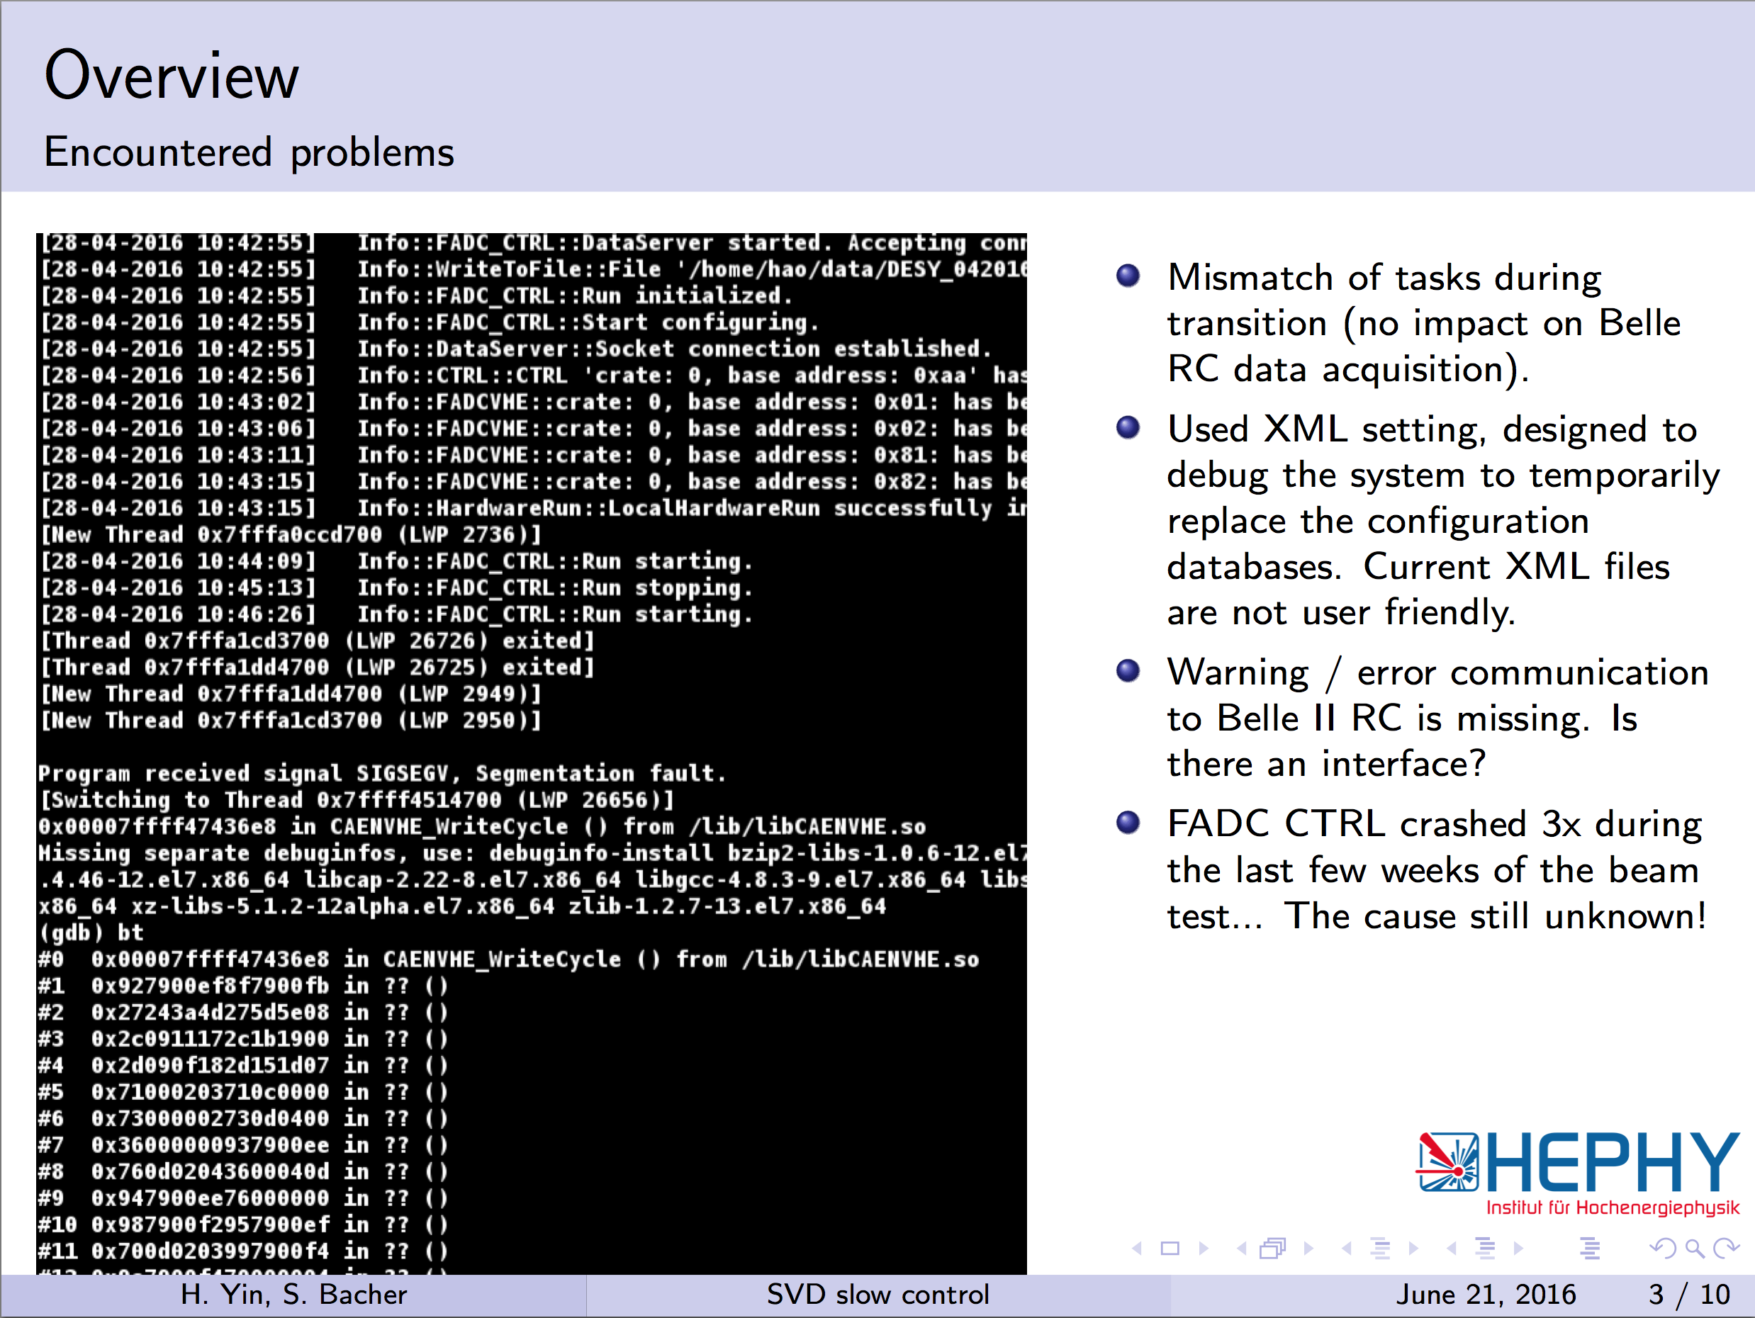
SVD slow control (items to be developed)
from H. Yin slides, Jun 21 B2GM

Slide 19
Manpower for SVD-DAQ Development
Hardware development
  FADC board, FADC-Ctrl, Junction board
    M. Friedl (HEPHY), R. Thalmeier (HEPHY)
  FTB board
    W. Ostrowicz (Krakow), Z. Natkaniec (Krakow)
Firmware development
  FADC board
    R. Thalmeier (HEPHY), K. Nakamura (KEK)
  FADC-Ctrl board
    K. Nakamura (KEK)
  FTB board
    W. Ostrowicz (Krakow), K. Nakamura (KEK)
Slow Control development
  FADC system controller, Data quality monitor
    H. Yin (HEPHY), C. Irmler (HEPHY)
  Power supply controller, Monitor controller
    S. Bacher (Krakow)
  Database, Network
    Persons from PISA and Trieste

Slide 20
Global Schedule
Dec. 2016: 3rd DESY beam test campaign
  We will use FADC ver.3 boards for this beam test.
End of Feb. 2017: Start SVD ladder mount
  We will use FADC ver.2 boards for electrical test during the ladder mount.
Jan. 2017: FADC ver.4/Junction boards test production
Mar. 2017: Test of FADC ver.4 in HEPHY and DESY
  Noise performance will be tested with permanent setup at DESY
Apr. 2017: Decision whether ver.3 or ver.4
May.-Jul. 2017: FADC ver.4/Junction board mass production
From the end of 2017:
  Phase-2: A partial VXD system will be installed for phase-2 commissioning.
  Cosmic-ray commissioning: In parallel to phase-2, full VXD will be assembled and tested with
  Full sets of FADC system and power supply are necessary by this point.
From the end of 2018: Phase-3 experiment
  Full VXD installation and operation
PS schedule must be included here.

Slide 21
Performance Study
(Results from Beam Test at DESY)

Slide 22
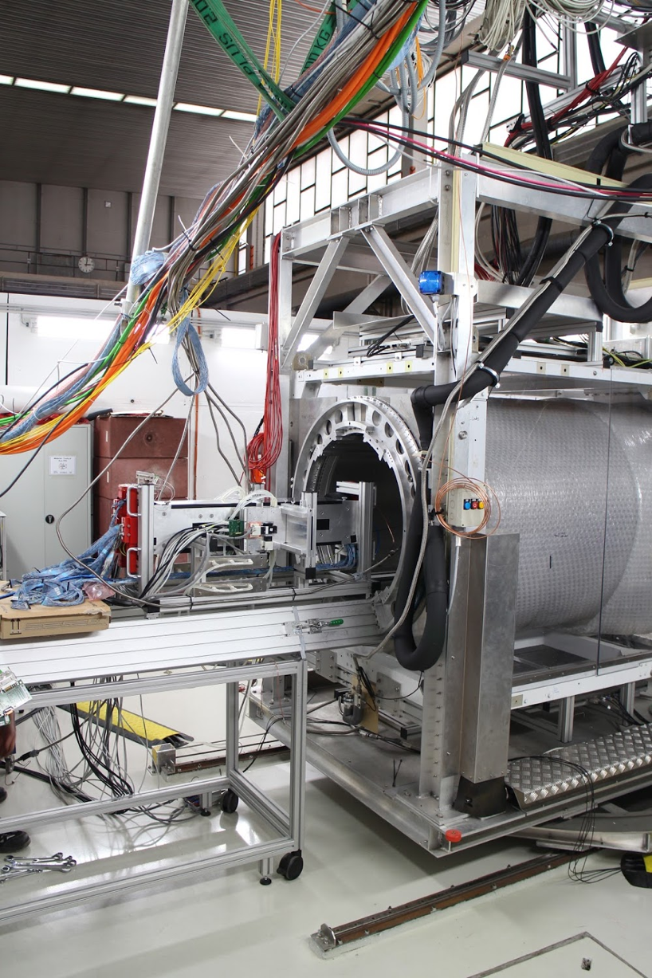
VXD Beam Test Campaign
Beam test with PXD + SVD system
e- beam with momentum of 2-5 GeV/c
Full readout DAQ chain
1T B-field in PCMAG
Nominal trigger rate: ~500Hz
PCMAG
(Solenoid
magnet)
PXD+SVD
(phase-2 setup)
insert PXD+SVD
into PCMAG
for experiment
e- beam

Slide 23
History of DESY VXD BT campaign
Jan. 2014: 1st DESY BT campaign
  PXD: sensor in pilot production
  SVD: prototype DSSD module
  We successfully confirmed VXD-DAQ concept.
Apr. 2016: 2nd DESY BT campaign
  PXD: Final DEPFET sensors with prototype ASICs. Only BWD sensors were installed.
  SVD: Final ladders (but class-B = lower grade)
  Geometrical setup is same as phase-2 VXD.

Slide 24
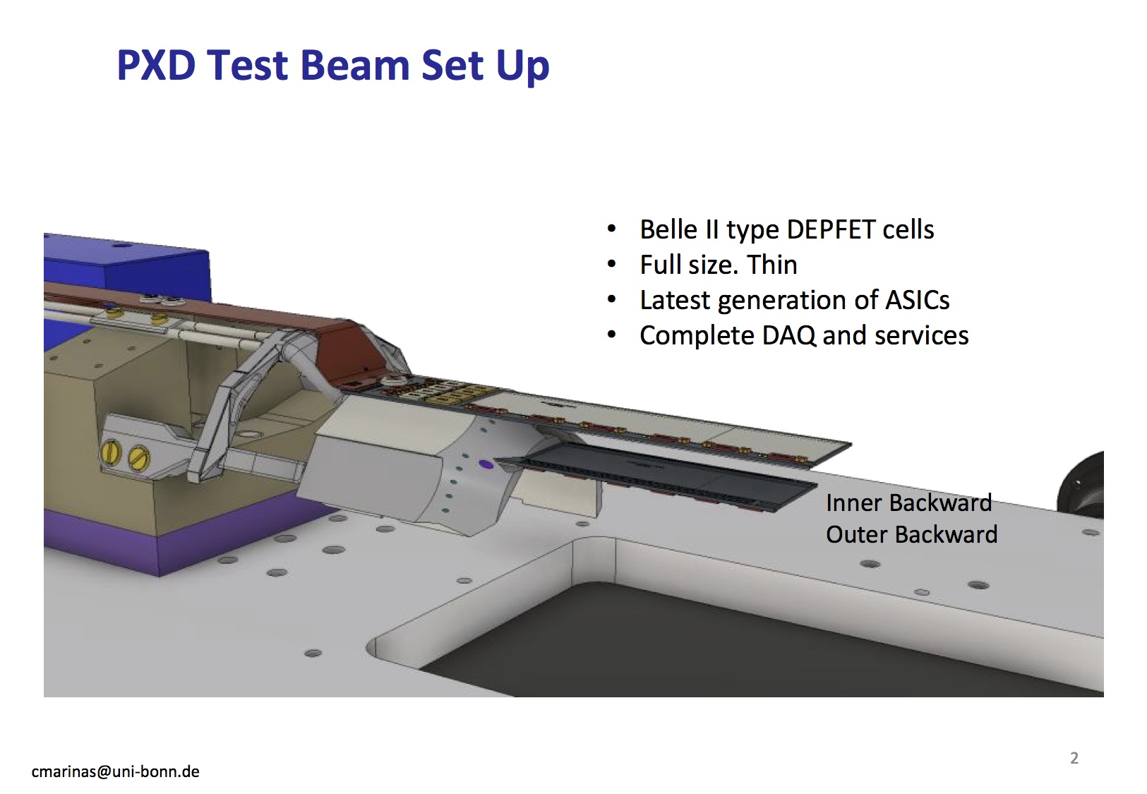

Slide 25
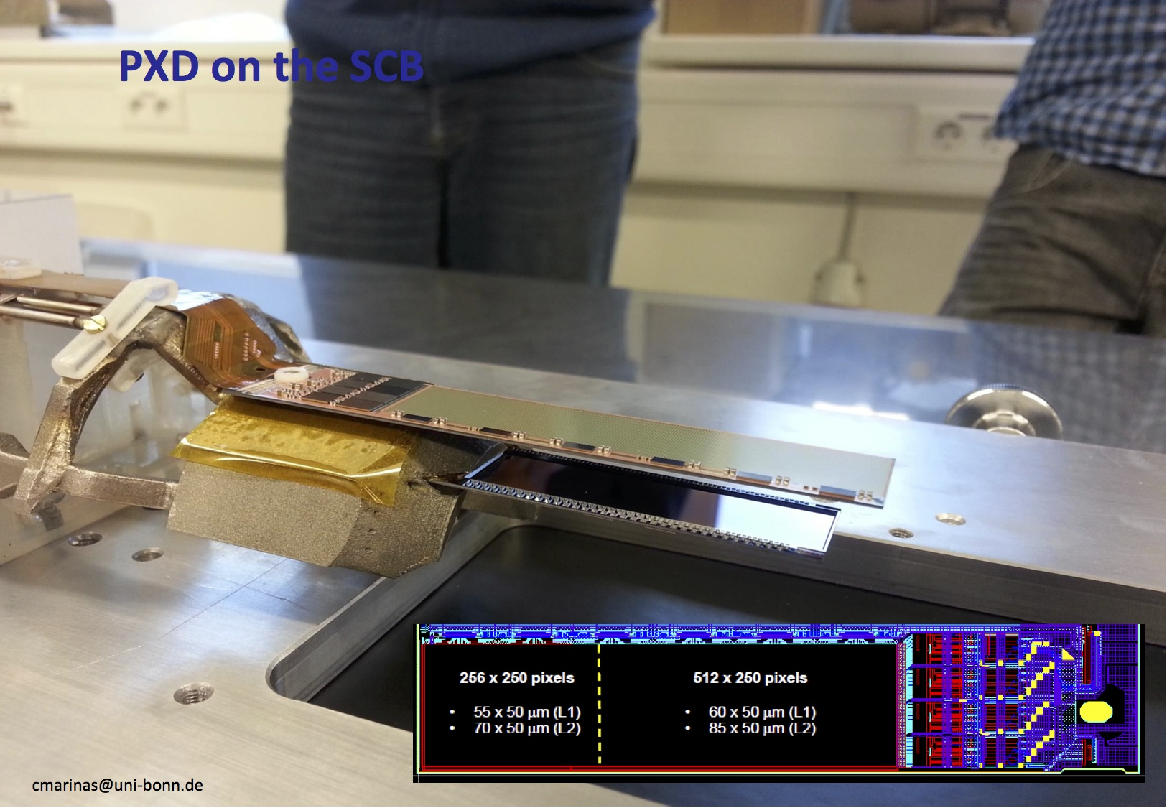

Slide 26
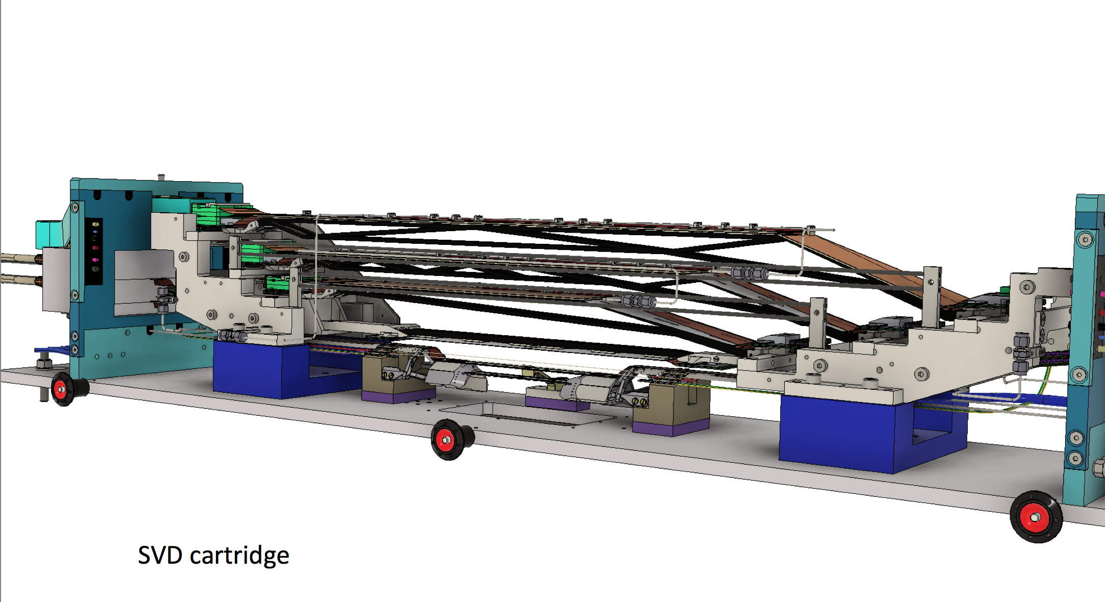
SVD setup in DESY BT campaign (1)
Same setup as phase-2
One SVD ladder in each layer
Total 4 SVD ladders

Slide 27
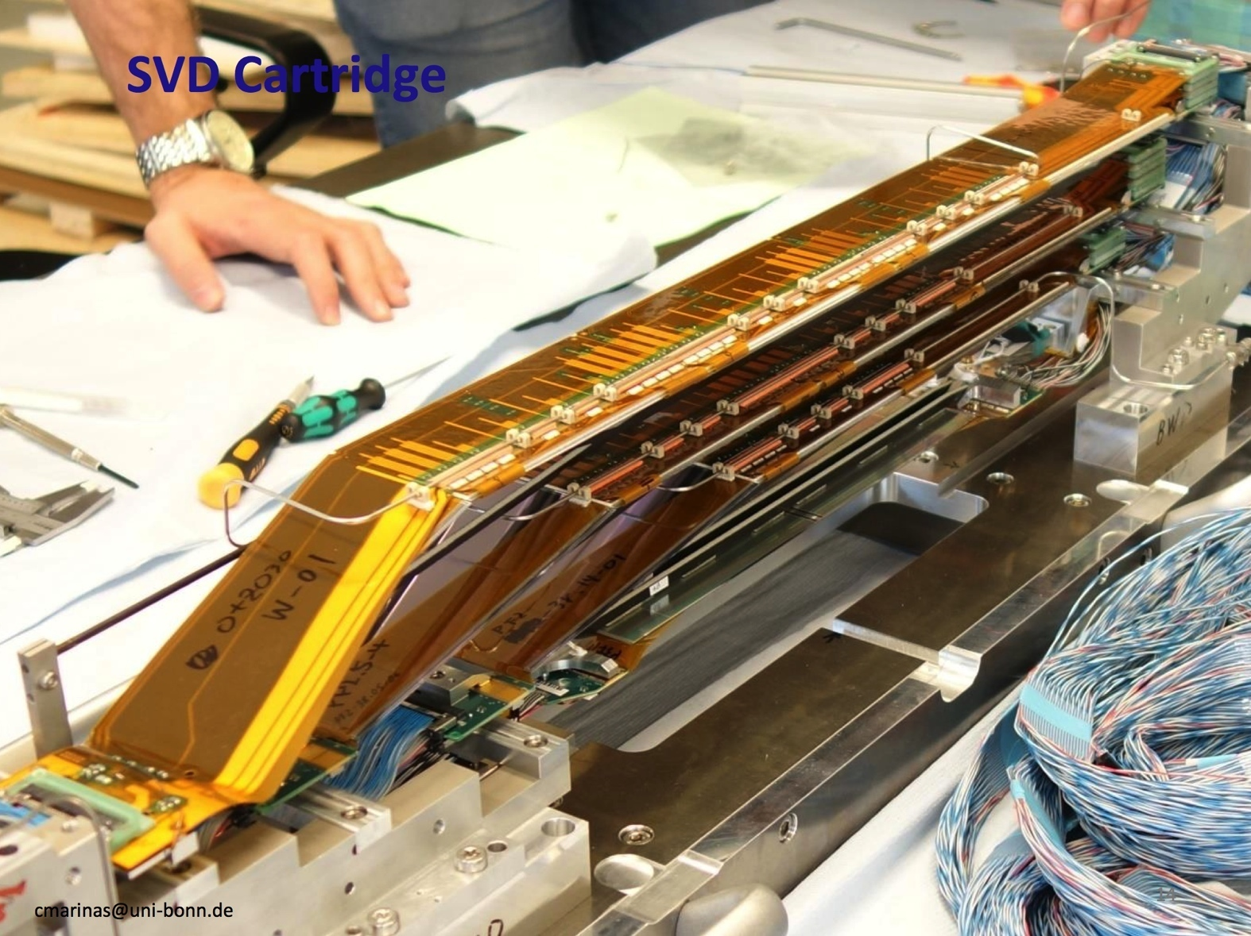
SVD setup in DESY BT campaign (2)

Slide 28
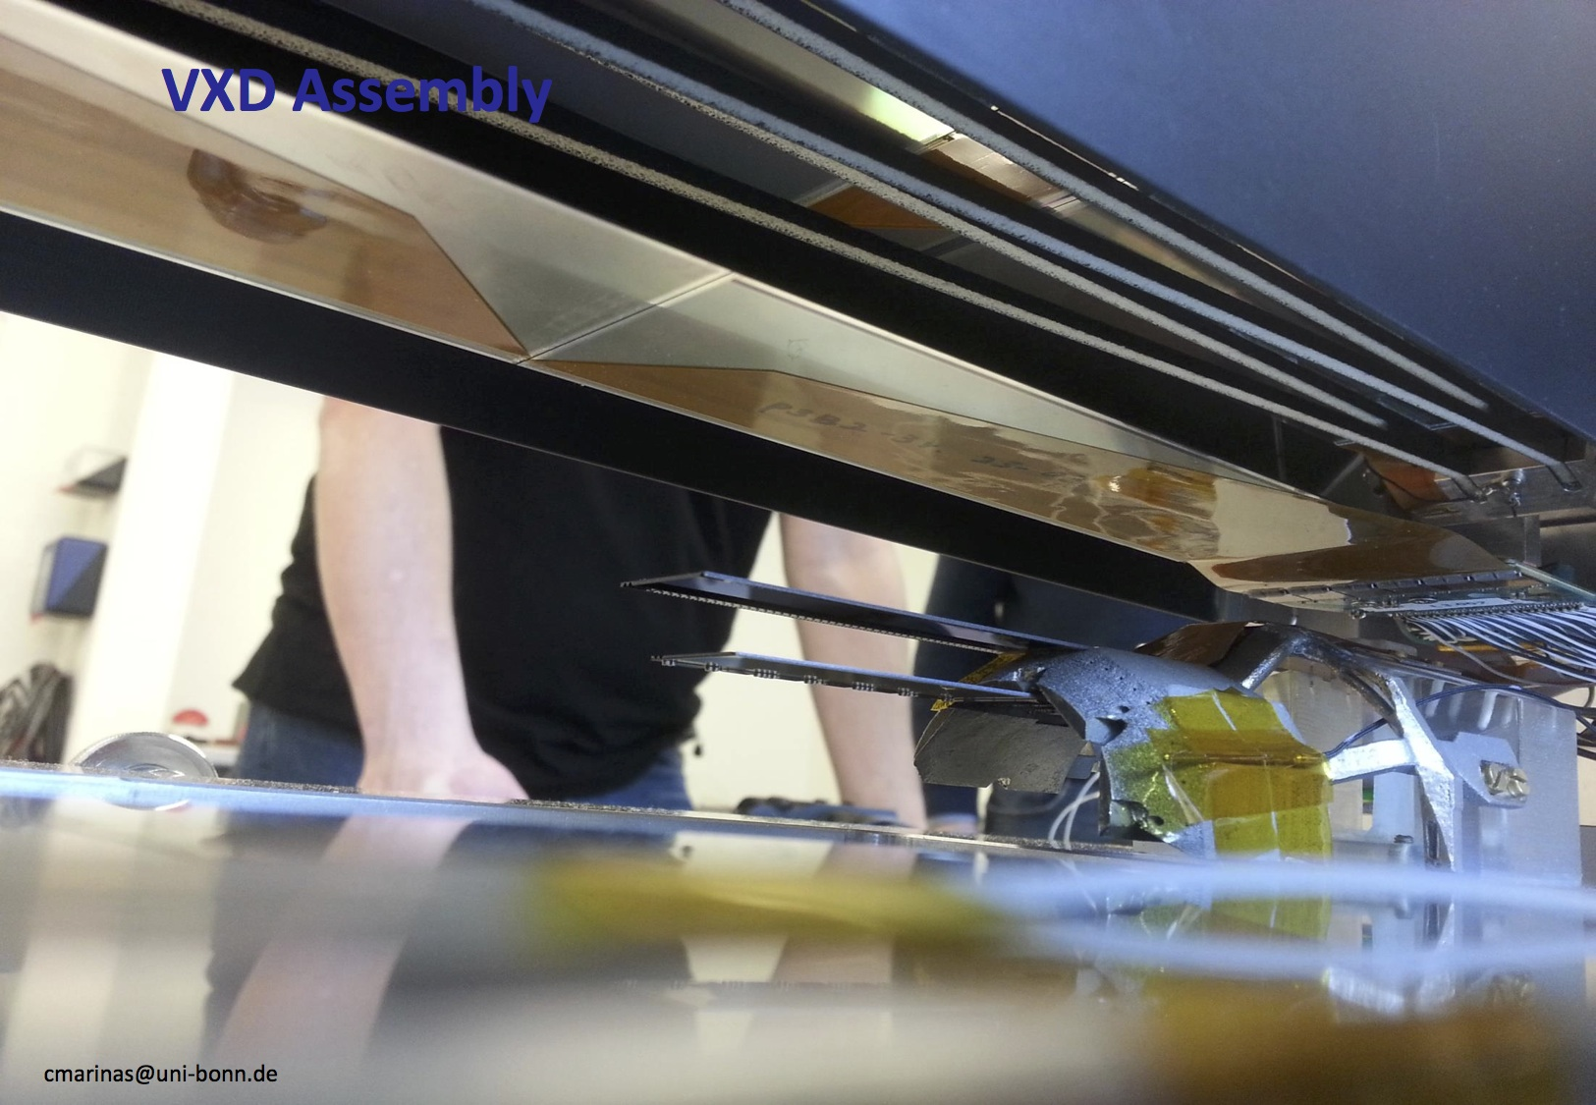

Slide 29
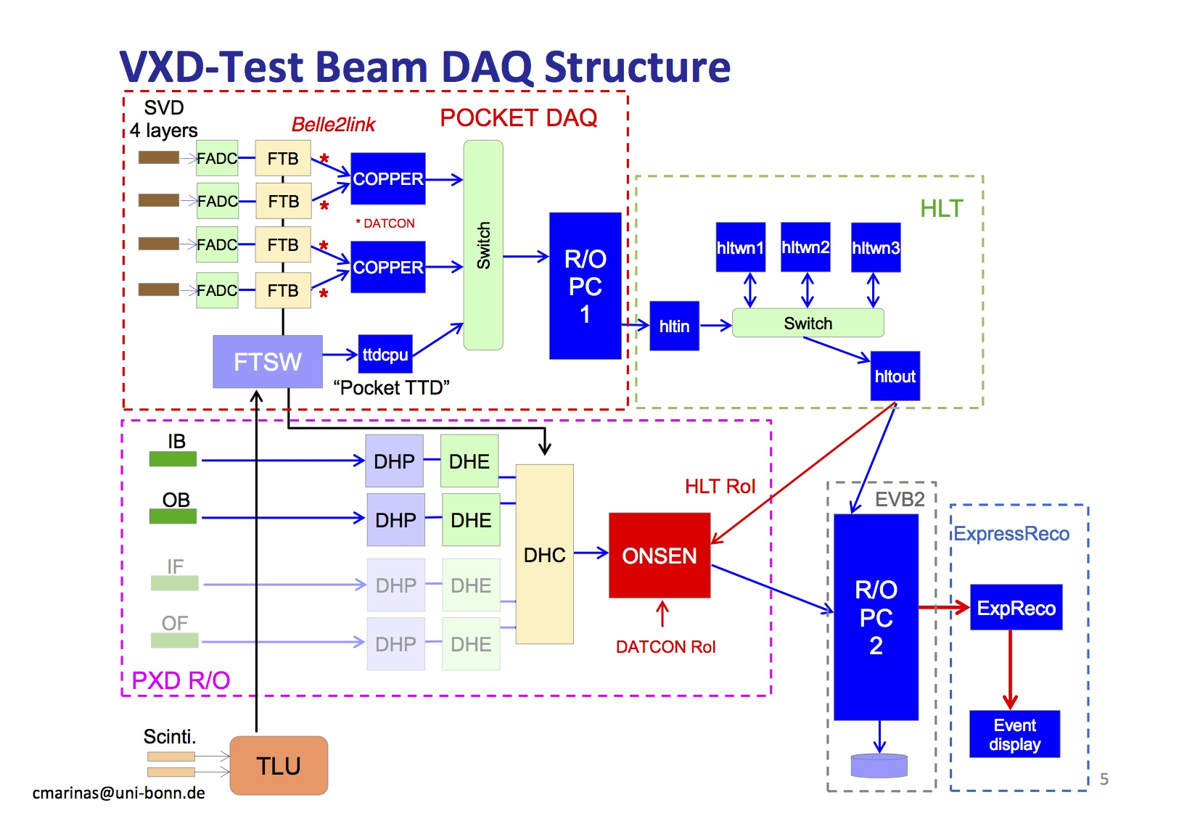
DAQ setup in DESY BT campaign

Slide 30
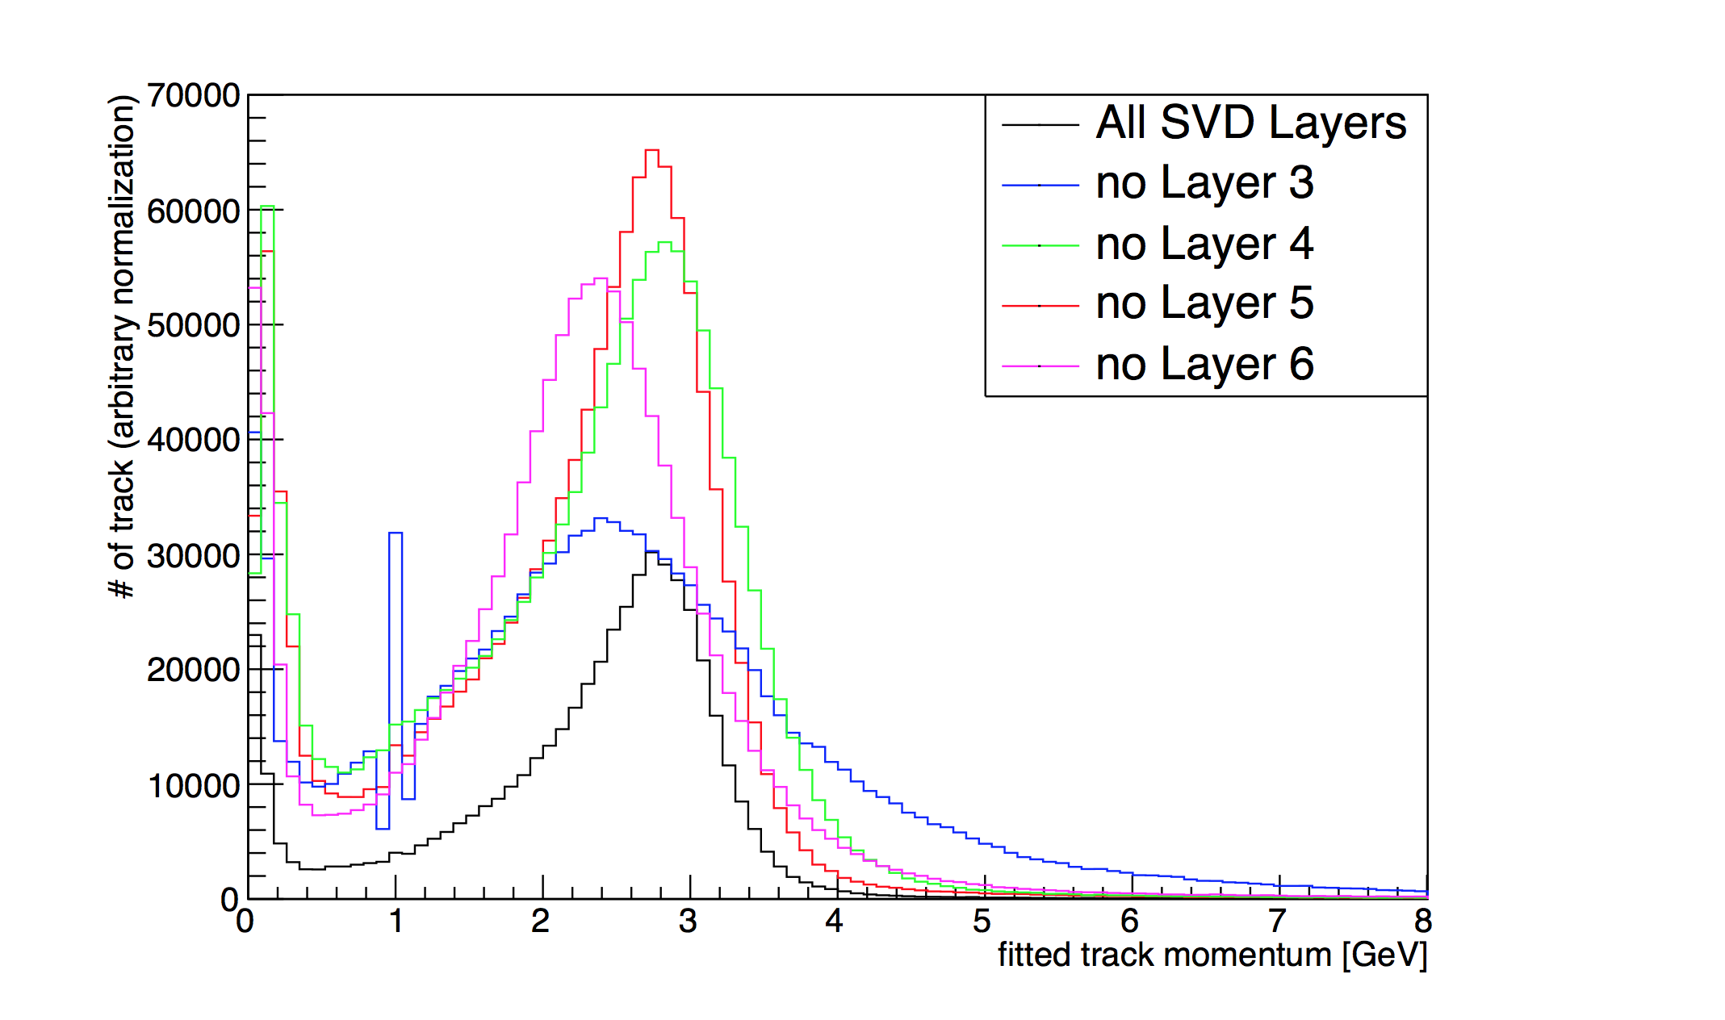
Measured momentum distribution in SVD
from T. Luck slides, Jun 21 B2GM
what is
this strange
peak?

Slide 31
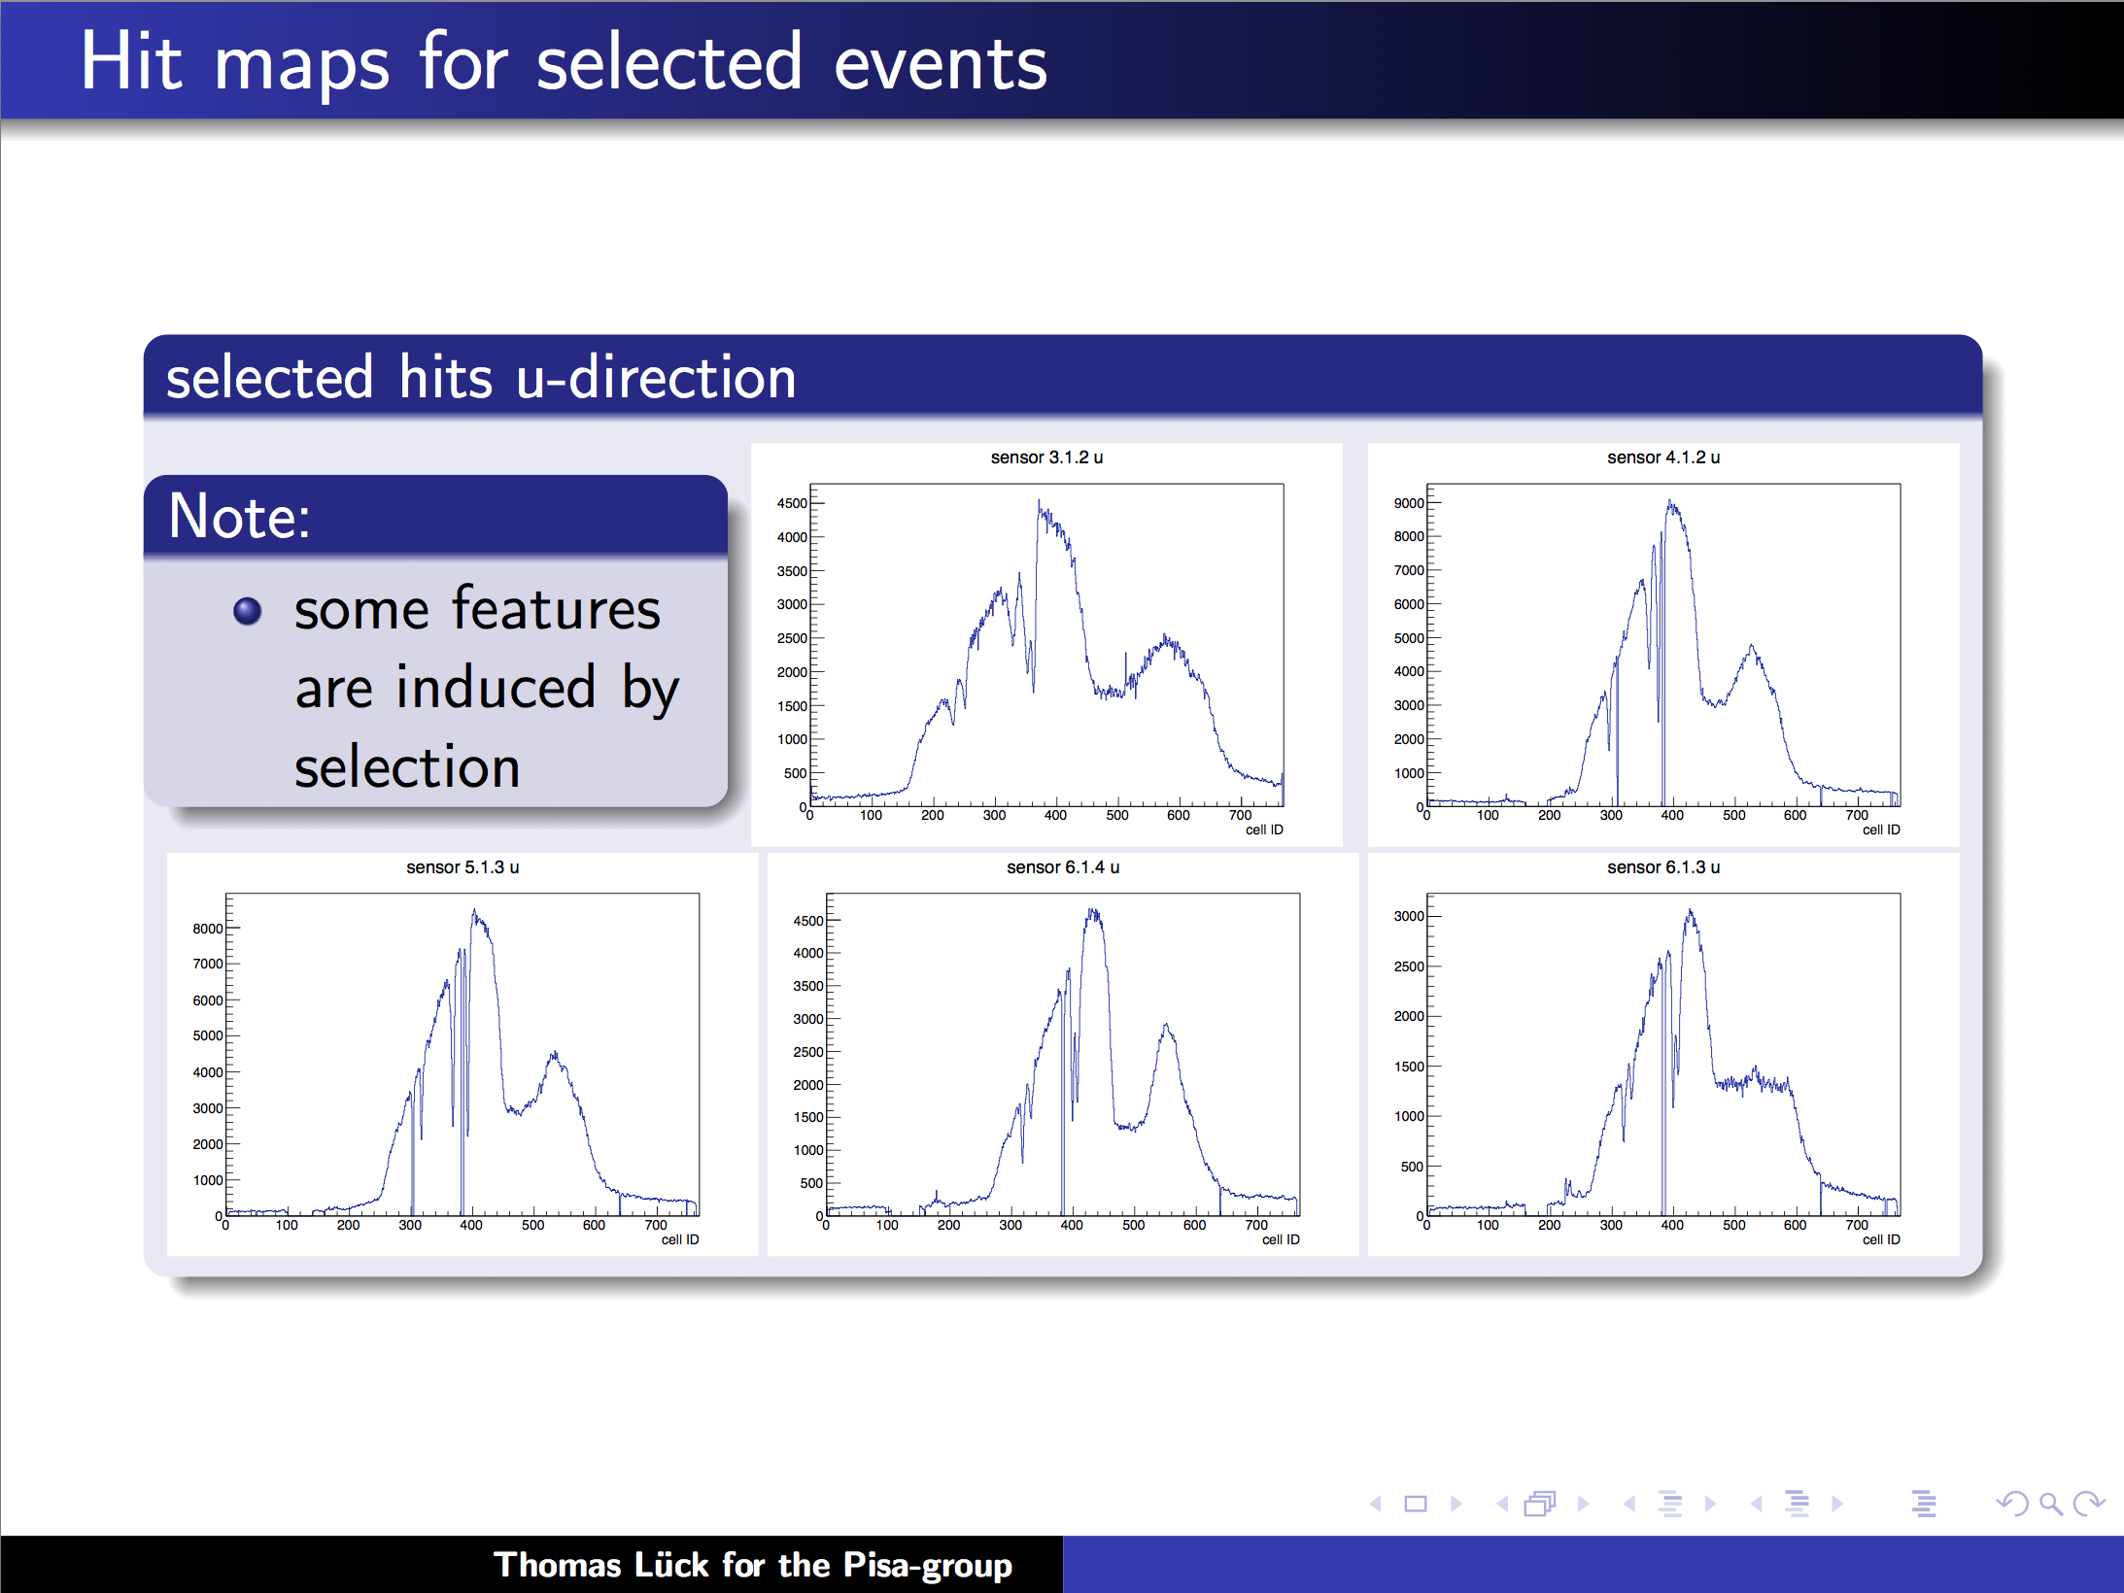
SVD hit maps (φ-direction = p-side)
from T. Luck slides, Jun 21 B2GM

Slide 32
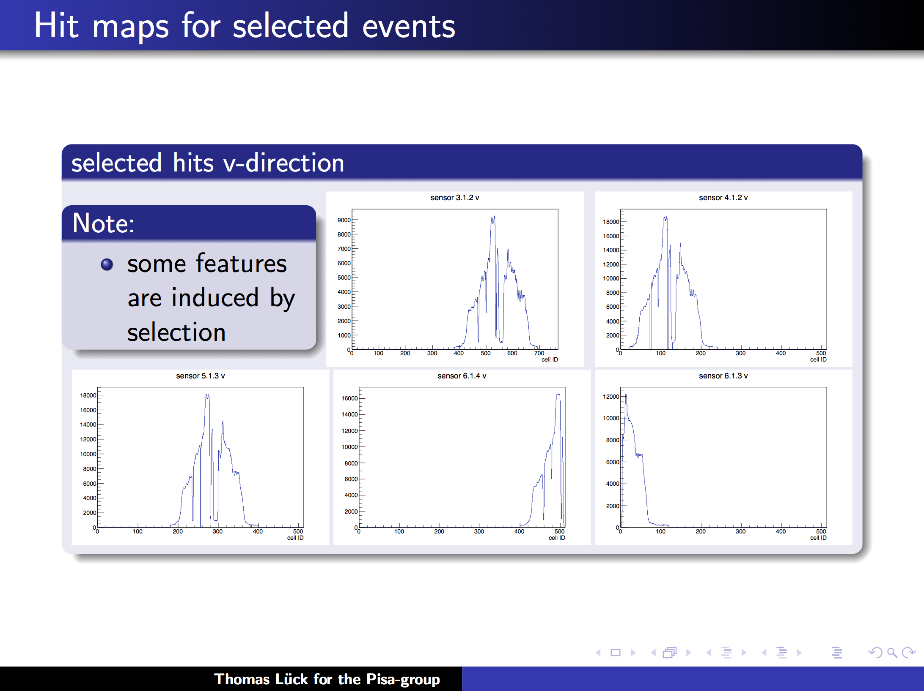
SVD hit maps (z-direction = n-side)
from T. Luck slides, Jun 21 B2GM

Slide 33
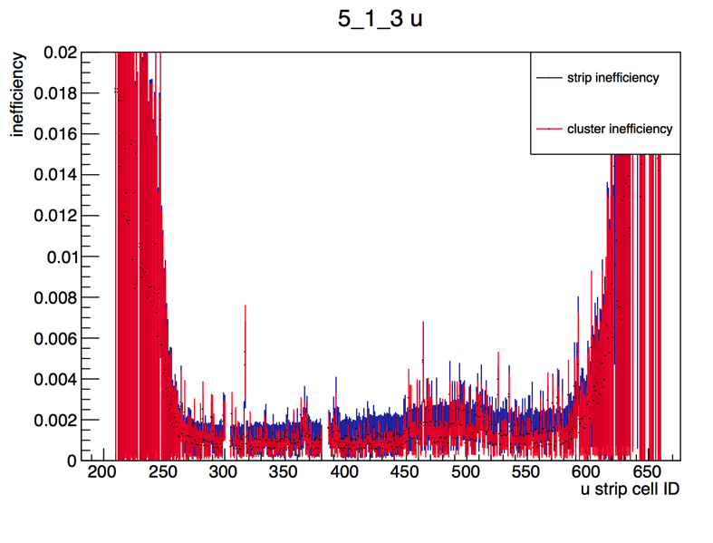
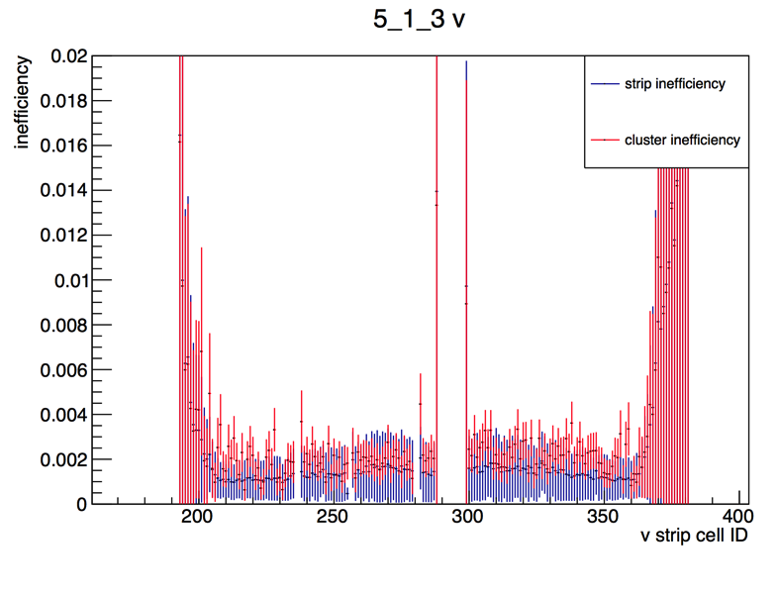
SVD hit/cluster inefficiency (1 - efficiency)
Sensor (5.1.3) in L5 ladder (p-side)
Sensor (5.1.3) in L5 ladder (n-side)
from T. Luck slides, Jun 21 B2GM
Very high efficiency, > 99%
Some inefficiencies by known defects, new defects and selection

Slide 34
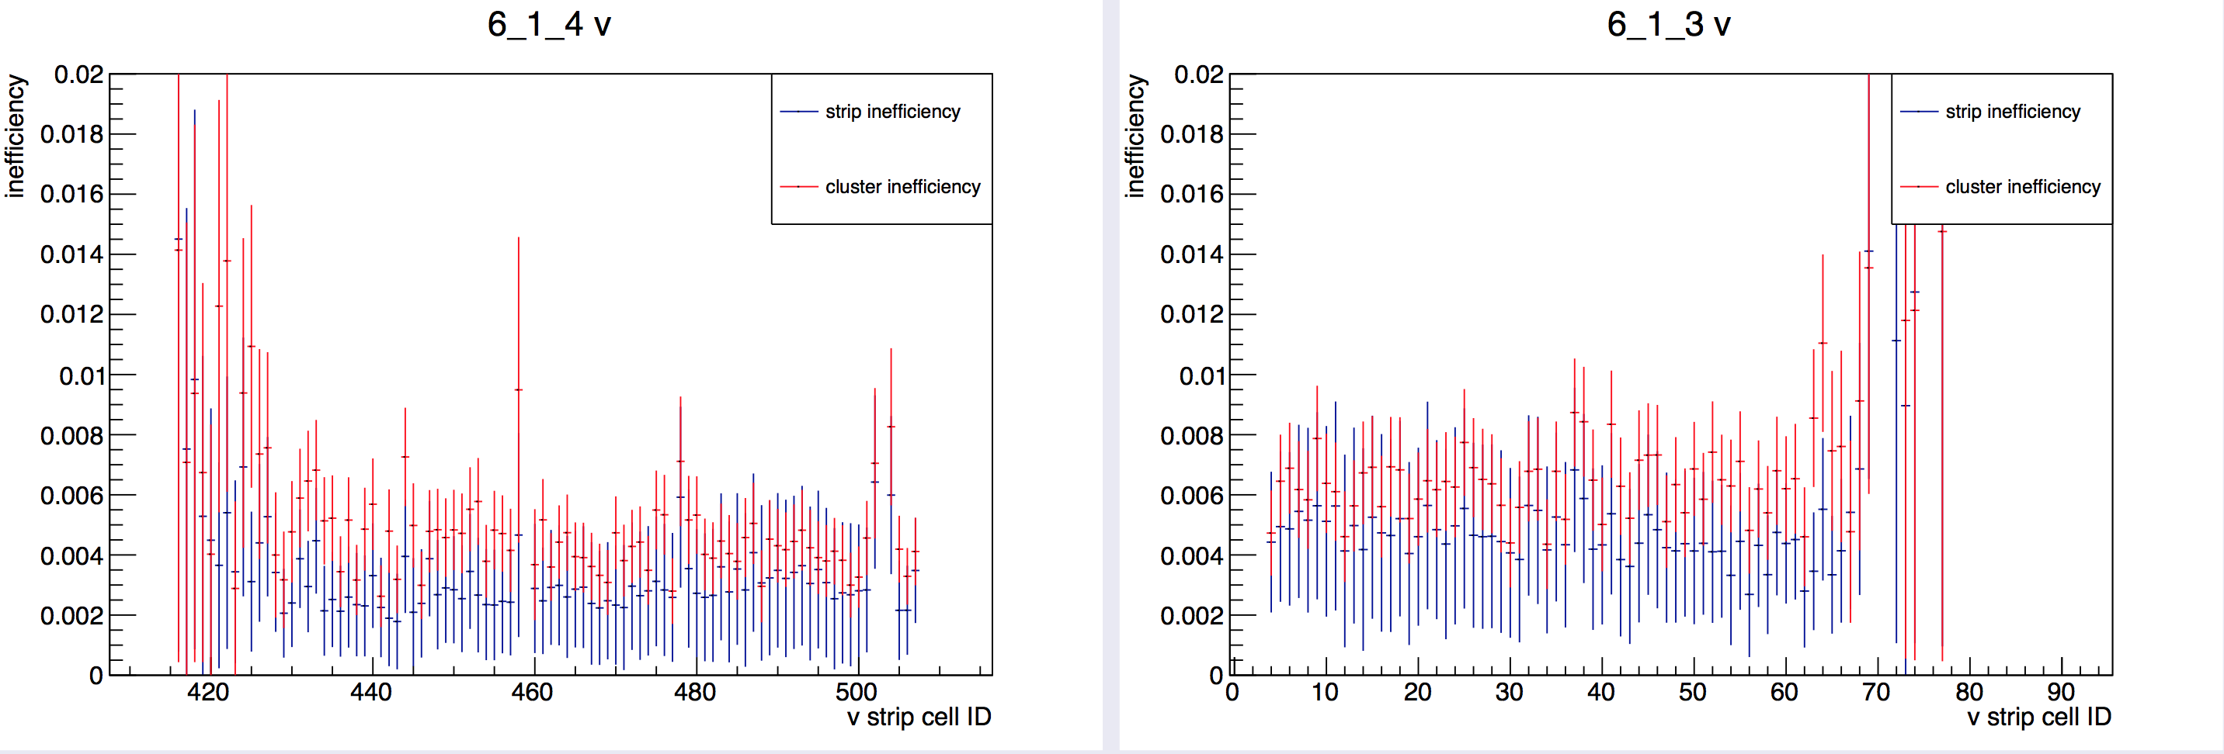
Fiducial acceptance of SVD ladders
Sensor (6.1.4) in L6 ladder (n-side)
Sensor (6.1.3) in L6 ladder (n-side)
neighboring
each other
In total 16 strips were
out of fiducial region
At the boundary of sensors in L6, we had in total 16 hot strips.
This loose 16/520 = 3% of the sensor acceptance.
  Can they be improved or would this be the final specification? Or is this due to class-B sensor, but I don’t think so?
Considering very good fraction of sensor healthy strips, bonding yield, ORIGAMI quality, and hit efficiency, this acceptance loss would be the biggest component of SVD inefficiency.

Slide 35
Future Study Items and 3rd Beam Test
Short study time for attack to the SVD noise issue (see details later slides)
  Most likely, the biggest noise source seems a water chiller beside PCMAG.
  We have to study how this affects our data qualities.
SVD internal event number mismatch
  We understand the reason. Due to an issue in process of trigger number decoding from FTSW signals (in FADC-Ctrl)
Data format in FTB-DATCON
  must be revised by the next BT campaign.
Further development is necessary for SVD slow control
  Database is still missing. System should be more stable.
Data taking with high rate triggers (around 30kHz)
  So far, we haven’t confirm the feasibility for such high rate DAQ.
  Development of a firmware, “APV25 FIFO emulator”, is necessary in order to avoid APV25 FIFO full.
Acceptance of SVD sensors
  Hit efficiencies on sensors are measured. We should also check the acceptance of fiducial regions in sensors.
For above studies, we will have 3rd beam test at DESY on this Dec. This is the final chance of the beam test before the full commissioning at KEK.

Slide 36
SVD Noise Study

Slide 37
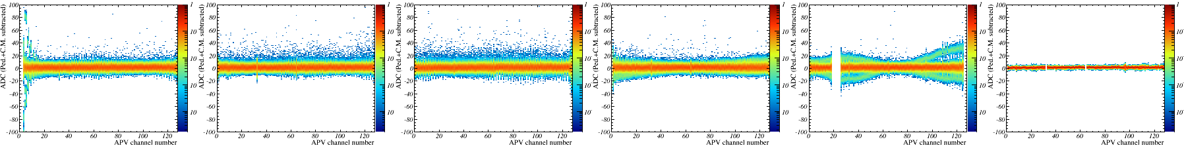
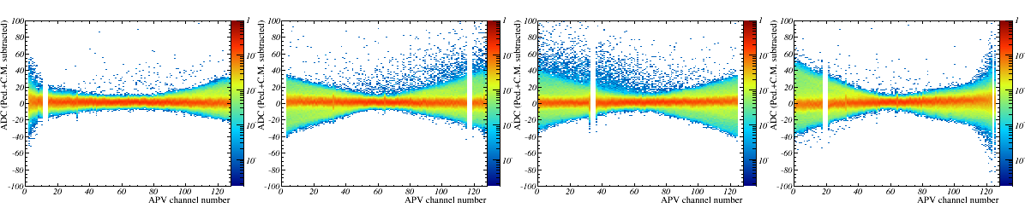
Strange Noise Observed in 1st Beam Test (Jan. 2014)
L5 p-side
Corrected ADC distribution
sensor is
not connected
APV1
APV2
APV3
APV4
APV5
APV6
L3 n-side
Corrected ADC distribution
APV1
APV2
APV3
APV4
We observed problematic noise in several APV25s.

Slide 38
Noise Test in 2nd DESY Beam Test
Strange noise was present again in this time also.
  Most probably the same noise as the 1st beam test.
  Noticeable at the DAQ data
However, in contrast to the 1st beam test, this time we were mostly immune against it because of our new grounding concept including the increased (10nF→100nF) grounding capacitors on Hybrids.

Slide 39
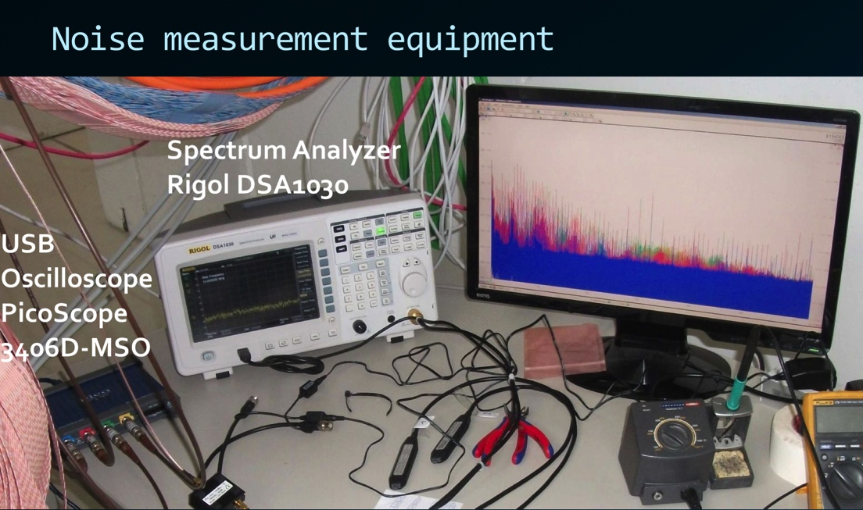
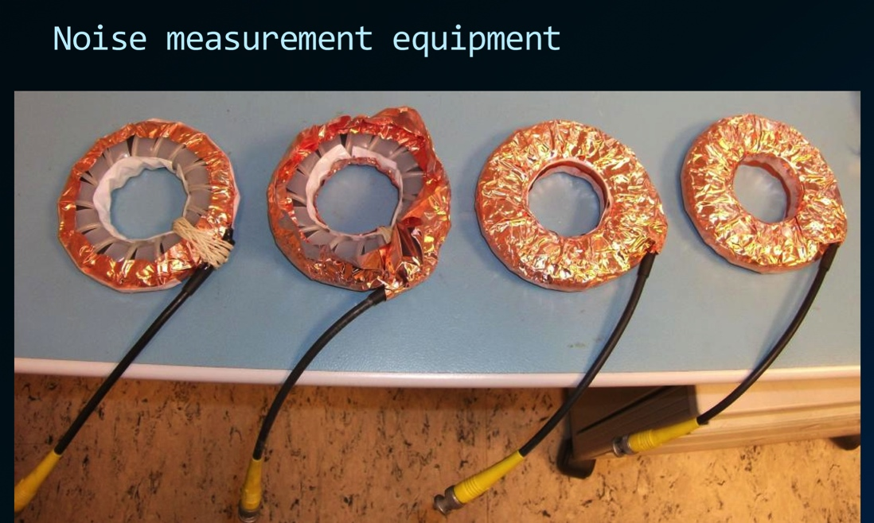
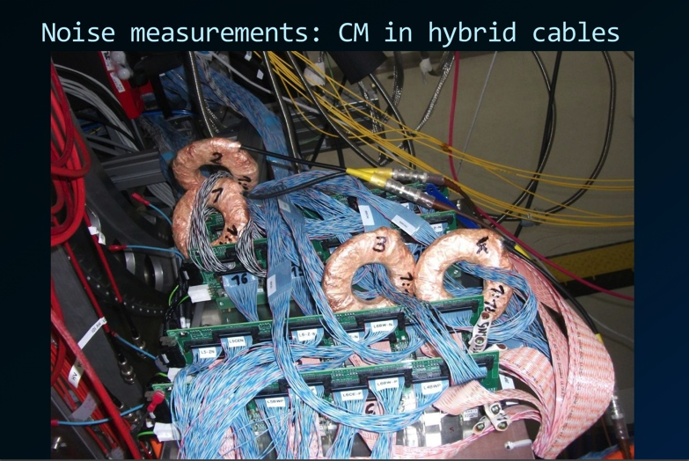
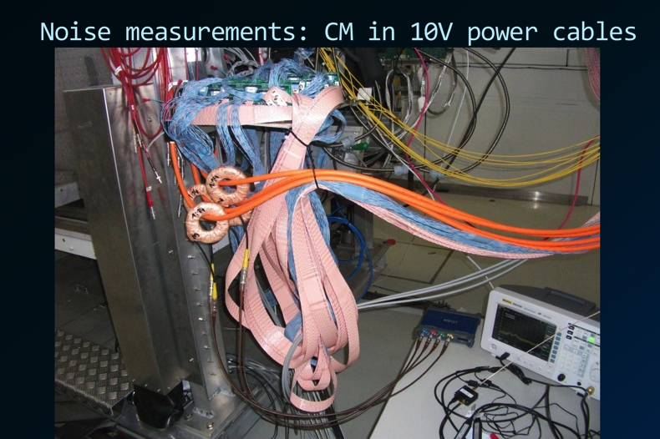
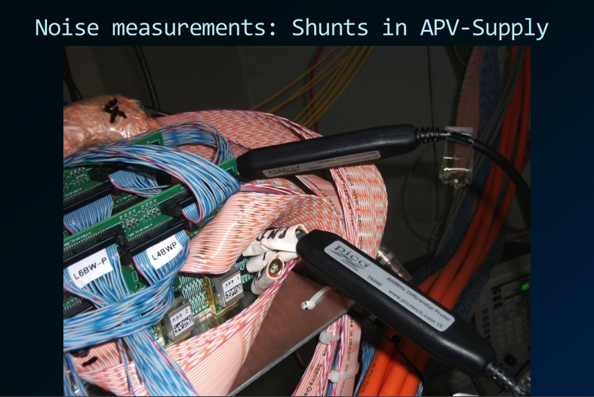
Noise Study Setup

Slide 40
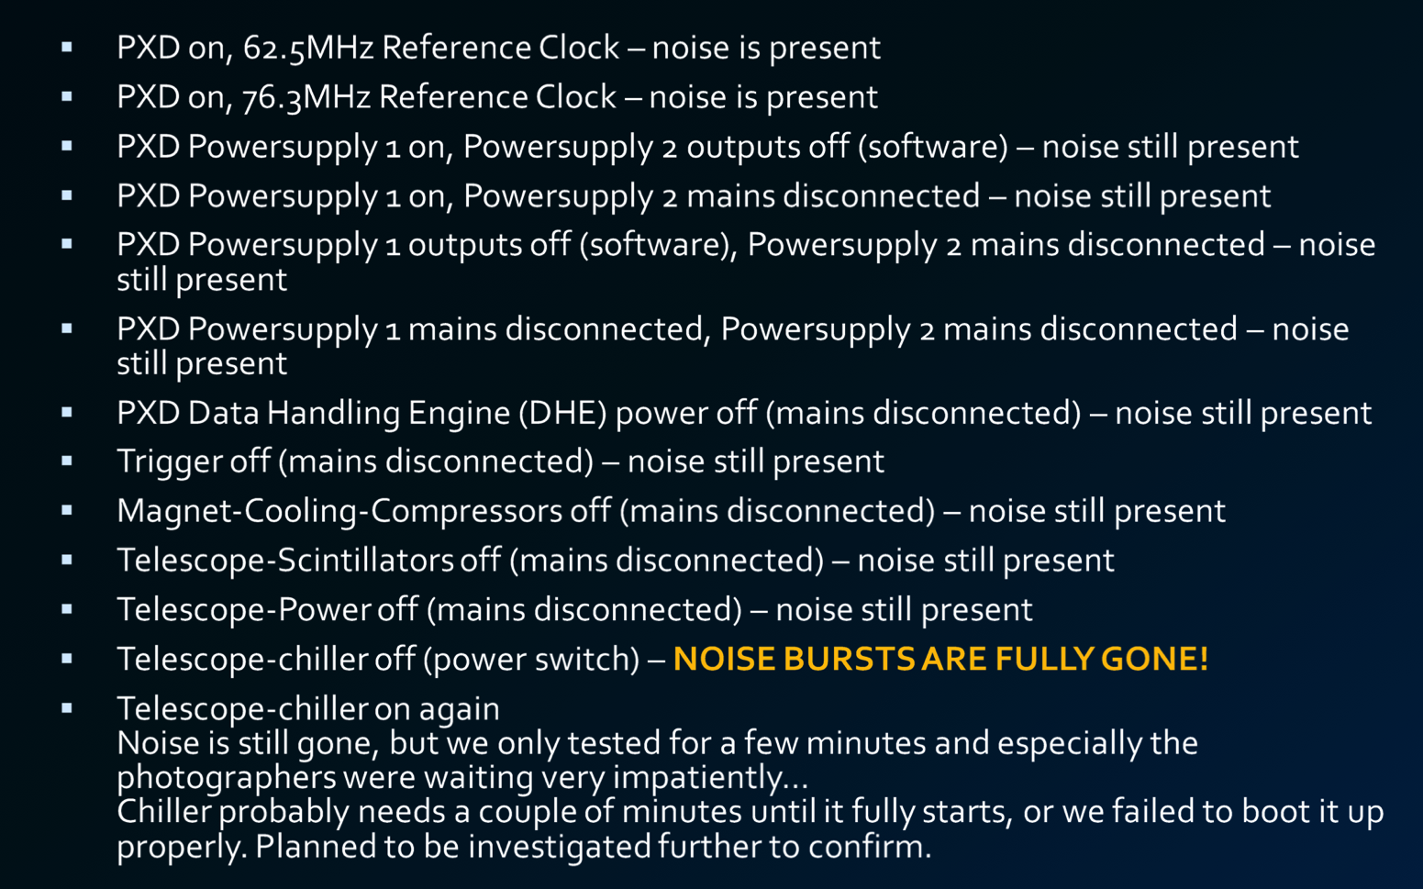
Noise Study Results
We almost identified the source of the noise (chiller beside PCMAG), but the time was not enough to investigate it further more.

Slide 41
Prospect of Noise Study
What kinds of studies are necessary further more?
What should be confirmed before phase-3 and phase-2.
  It would be difficult what kind of noise can happen on the final experiment…
  Noise in phase-3 must be checked in phase-2.
  Then, what should be checked before phase-2?
Results of emission and immunity test for FADC system
  should be shown on a grounding meeting during B2GM.

Slide 42
Summary

Slide 43
Summary
The specification of SVD-DAQ is already well established and well confirmed in beam tests.
  SVD data can be taken stably with this system.
  Excellent performance was shown in the tests.
However, still developments in hardware, firmware, and software are remaining for physics operation.
  New version of FADC and junction boards.
  Several firmware developments are necessary.
  Slow control software should be stabilized.
We almost figure out the source of the noise issue on the DESY beam test.
  We have to discuss how to proceed for further studies.

Slide 44
backup slides from here
Thanks!

Slide 45
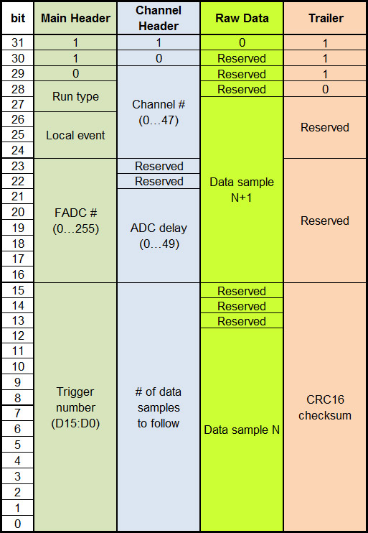
Data Format: Raw Mode
Run type
  00…raw
  01…transparent
  10…zero-suppressed
  11…zero-suppressed + hit time finding
Event type
  000…TTD event
  100…local software trigger
  101…local intcal

Slide 46
Raw Mode Example
One data frame consists of
  1 Main Header
  1 Channel Header per active APV25 input (up to 48)
  X/2 words for raw data for each active APV25
    X…number of ADC samples (written in channel header)
  1 Trailer
Main Header
Channel Header 0
Raw data of channel 0
Channel Header 1
Raw data of
channel 1
Channel Header 2
Raw data…
Trailer

Slide 47
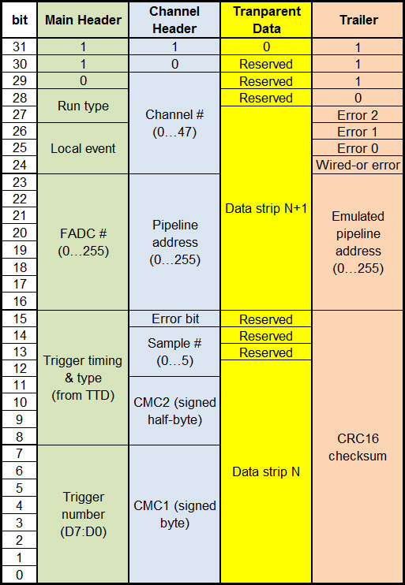
Data Format: Transparent Mode
Error bit
  Extracted from APV25 header
Wired-or error
  OR of all APV25 error bits
Error 0, 1, 2
  indicators for abnormal conditions

Slide 48
Transparent Mode Example
One data frame consists of
  1 Main Header
  1 Channel Header per active APV25 input (up to 48)
  64 words for raw strip data for each active APV25 and sample
  1 Trailer
Main Header
Channel Header 0,
sample 0
Transparent strip data
of channel 0, sample 0
Channel Header 0,
sample 1
Transp. data
channel 0,
sample 1
Channel Header 0,
sample 2
Transp.
strip
data…
Trailer

Slide 49
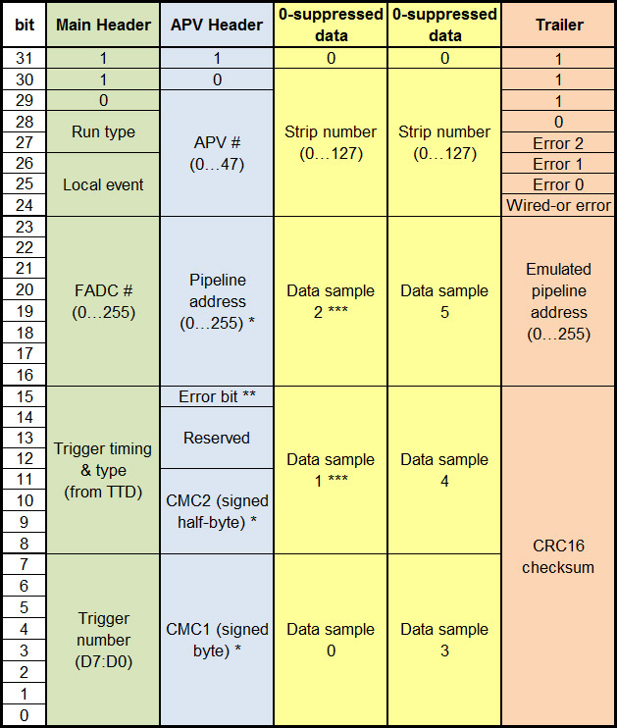
Data Format: Zero-suppressed Mode
Remarks
  * of first sample
  ** wired-or of all samples
  *** only if >1 samples
Second yellow block only appears if 6 samples are read out

Slide 50
Zero-suppressed Mode Example
One data frame consists of
  1 Main Header
  1 Channel Header per active APV25 input (=up to 48)
  2N data words with N hit strips (in case of 6 samples)
    No data words if no hits found
  1 Trailer
Main Header
Channel Header 0
One hit
(6 data
samples)
Channel Header 1
Channel Header 2
Channel Header 3
Two hits
(6 data samples each)
Channel Header 4
Hits…
Trailer

Slide 51
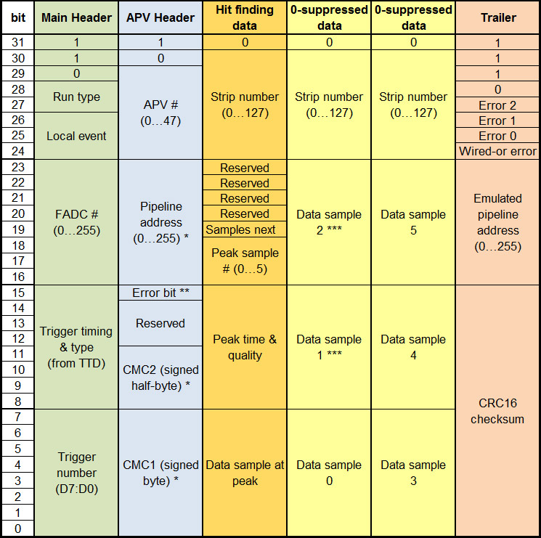
Data Format: Zero-suppressed + Hit Time
Normally, only peak sample and peak time is sent (orange)
Yellow sample data word(s) only appears if hit time cannot be found reliably
  E.g. double-peak due to pile-up
  “Samples Next” = 1 in such a case
(Only if 6 samples)

Slide 52
Zero-suppressed + Hit Time Example
One data frame consists of
  1 Main Header
  1 Channel Header per active APV25 input (=up to 48)
  N data words with N hit strips
  + 2 data words per bad hit (no timing found)
  1 Trailer
Main Header
Channel Header 0
One
good
hit
Channel Header 1
Channel Header 2
Two
good
hits
Channel Header 3
One bad hit followed by 6 data samples
Channel Header 4
Hits…
Trailer

Slide 53
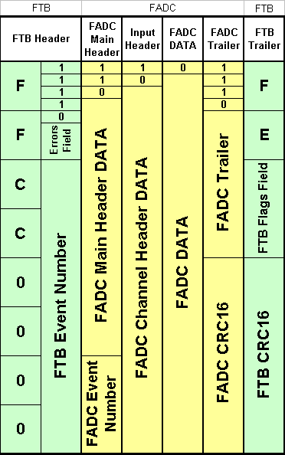
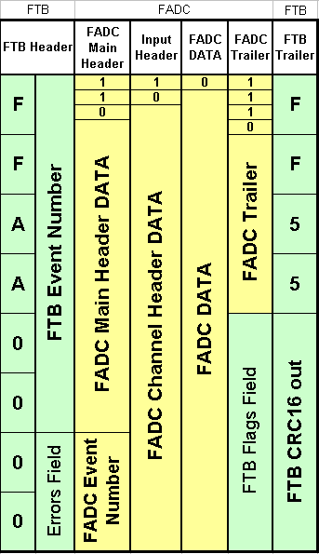
FTB - Changes in Hardware and Firmware. Recent status.
Current FTB data format @ Sep. 2016
Future FTB data format
20.01.2014 wacek ostrowicz 6/12

Slide 54
Outcomes from DESY beam test
(Study of SVD event order)

Slide 55
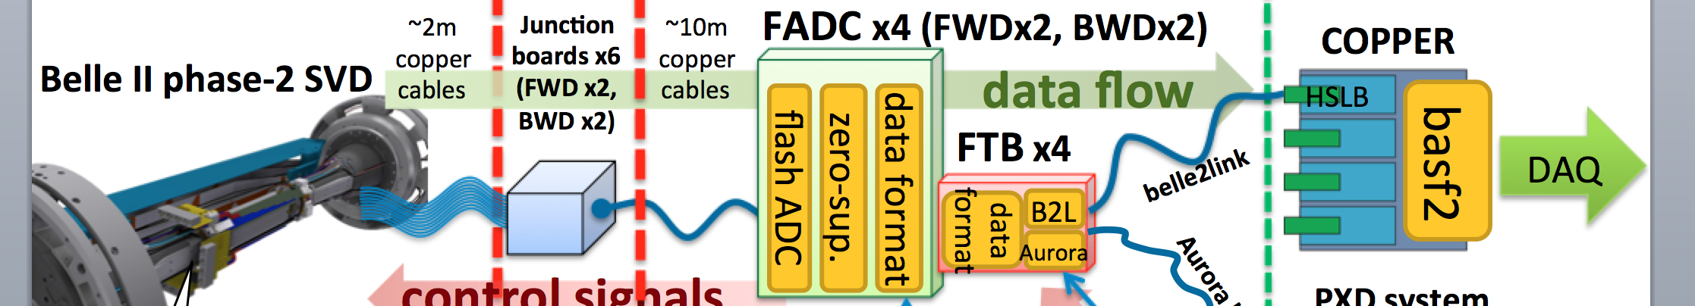
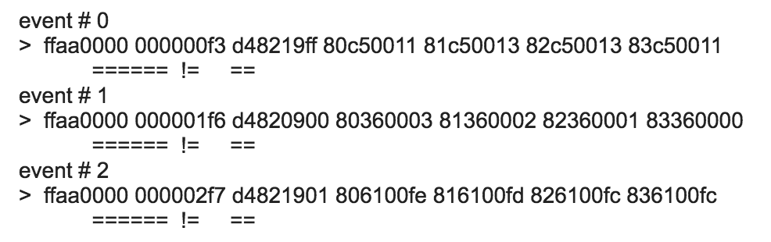
SVD event number in DESY BT
B2L event num.
FTB event num. (24-bit)
hit data
FADC event num. (8-bit)
The FTB number is consistent with B2L number.
FADC number is always B2L number – 1, but we know the cause of the problem and we are sure this doesn’t cause the observed VXD event mixing.

Slide 56
But, is the event order in FADC really correct?
signal from APV chip
FADC
numbers show actual event order
(not written on data)
n
event numbers
APV25
Failure in
event
ordering
(just possibility)
n+2
n+1
n
n+2
n+1
n
n+1
n+2
n
n+1
numbers show actual event order
(not written on data)
APV25 data
but without event number
n+2
pipeline process
Event number looks good,
but actual event order is wrong!
event numbers
n+2
n+1
n
FADC/FTB event numbers
are added here
Nakao-san pointed out a possibility that event mixing can happen even in SVD even we see good event numbers.
  Because APV25 data do not contain event number.
This possibility has not been checked yet.
We should check it by comparing APV25 pipeline address (= PLA) and FTSW clock counter value.
  Very roughly speaking, the APV25 PLA is compatible with the clock counter.

Slide 57
PLA simulation method
What is recorded on the stored data?
  Observed PLAs on all APV25
  Event number
  127MHz Clock counter from FTSW
  (Fine trigger timing on FADC system)
Basically, using PLA value in event n-1 and difference of FTSW clock counter values between events n-1 and n, we can expect PLA value in event n.
  However, exact expectation requires detailed understanding of APV25 data process, e.g. necessary process time for 1-event output.
In the last DESY beam test, FTSW applied a trigger veto for about 300usec or 100usec after every trigger accept due to an issue on PXD data taking.
  300usec is enough time to finish readout of all 6 samples in APV25 (6 samples x 140 clocks/sample x 31nsec/clock = 26usec).
→ Always, next trigger comes after APV25 finishes to output the current event data.
This makes the expectation of PLA behavior rather easier. We can assume a fixed number of skipped cells for the completion of the 1-event output.

Slide 58
PLA distribution
All the data in run153
All the PLA values shown here are gray-decoded ones.
I realized that PLA values range not from 0 to 191, but from 32 to 223.
The distribution looks reasonably uniform within statistics.

Slide 59
Observed vs. Expected PLA
The first 200 events in run153
Mainly, expected PLA values are consistent with observed PLA values.
  Also I checked all the data in run153 other than above 200 events, but didn’t see any inconsistency from the expected values.
We can conclude SVD event order was NOT mixed up at all.

Slide 60
Observed PLA – Expected PLA
The first 200 events in run153
1 clock mismatches in PLA
BUT, we see 1 clock mismatches between the observation and expectation in a fraction of about 10%.
So far I don’t know the cause of the problem, but it is not related to the VXD event order mismatch problem.
  This will be studied further more to develop PLA emulator firmware.

