Slide 1
Phase-2 VXD+BEAST2 Rack Location, Cable Routing, and Cable Specification
Katsuro Nakamura
Sep. 15, 2016
10th VXD workshop

Slide 2
Detectors and Representative Persons
sensor | contact p. | number | location | DAQ | unique measurement | Tasks/ Priority
Belle II PXD | C. Marinas | 2 ladders | VXD | Belle II / VXD EPICS | in-situ occupancy, full Belle II tracking, vertexing | 1,2 (4)
Belle II SVD | K. Nakamura | 4 ladders | VXD | Belle II / VXD EPICS
diamond sensors | L. Vitale | 8 diamonds | VXD | VXD EPICS & BEAST EPICS | ionizing dose in VXD → BEAM abort | 1,2 (4)
FANGS “LHC style” silicon pixel sensors | C. Marinas | 3 arms 15 chips | VXD | BEAST EPICS | MIPs & x-rays > 10 keV @ 40 MHz → Synchrotron x-ray spectrum | 1,2,4
CLAWS Scintillators w/ SiPMTs | F. Simon | 2 ladders | VXD | BEAST EPICS | X-rays or track counting w/ 1-ns timing → injection background | 1,2 (4)
PLUME “ILC style” silicon pixels sensor | I. Ripp-Baudot | 2 ladders | VXD | BEAST EPICS | Two-sided silicon pixels → tracklets w/ pointing | 1,2 (4)
Micro-TPC nuclear recoil detectors | S. Vahsen | 8 | VXD dock | BEAST EPICS | fast neutrons: rate, directional & spectral information | 4
He-3 tube neutron detectors | S. De Jong | 4 | VXD dock | BEAST EPICS | thermal neutrons: rate | 4
Scintillators + PIN diodes | H. Nakayama K. Nakamura | 40+40 | around QCS | BEAST EPICS | X-ray and total loss distribution versus position, → collimator adjustment | 3
LYSO | A. Fodor | 4+4 crystals | ECL endcap shield | ??? | X-rays in outer detector volume | ?

Slide 3
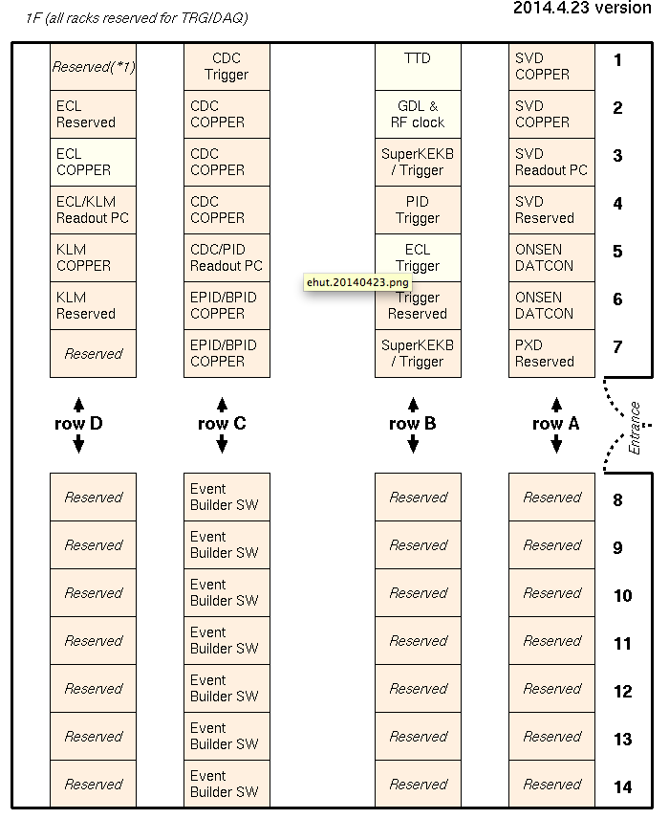
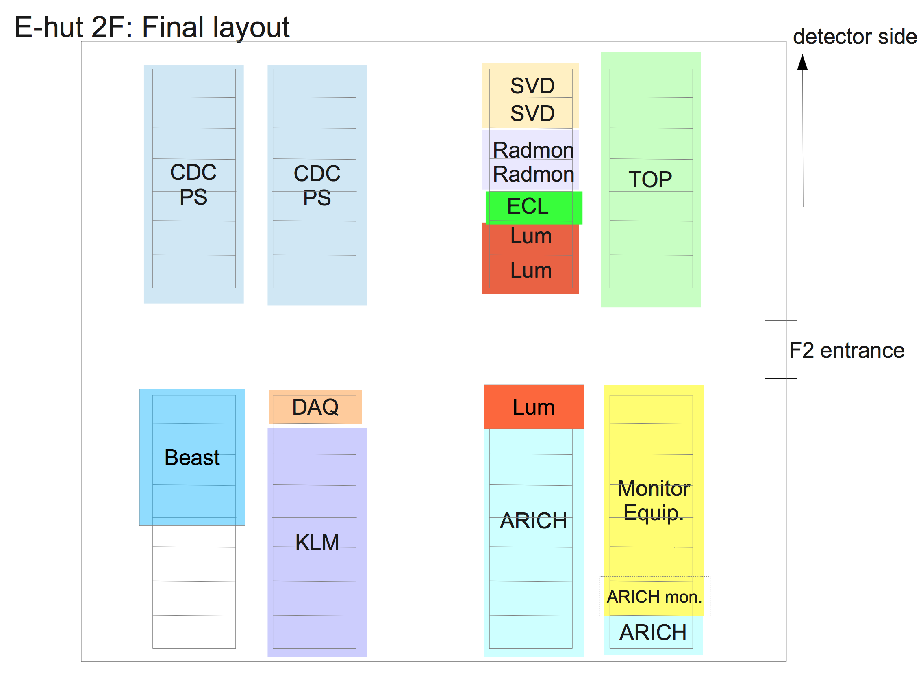
BEAST2 DAQ racks in E-hut
from Itoh-san’s slides (Jun. 22, 2016)
2F
VXD monitor
PXD/SVD
BEAST2
racks
(4 racks)

Slide 4
Space allocation in BEAST racks
1U=44.45mm
570mm
H-11
H-10
H-9
H-8
top
BEAST
shared area for
big heat dissipating
components
(e.g. PCs)
30U = 1334mm
CLAWS
(15U = 667mm)
PLUME
(24U = 1067mm)
FANGS
(15U = 667mm)
total 1500mm height (33U)
He3
(15U = 667mm)
u-TPC
(15U = 667mm)
3U Breaker
(100V 20A x 8)
3U Breaker
(100V 20A x 8)
3U Breaker
(100V 20A x 8)
3U Breaker
(100V 20A x 8)
total must be less than 100A
total must be less than 100A
total must be less than 100A
total must be less than 100A
bottom

Slide 5
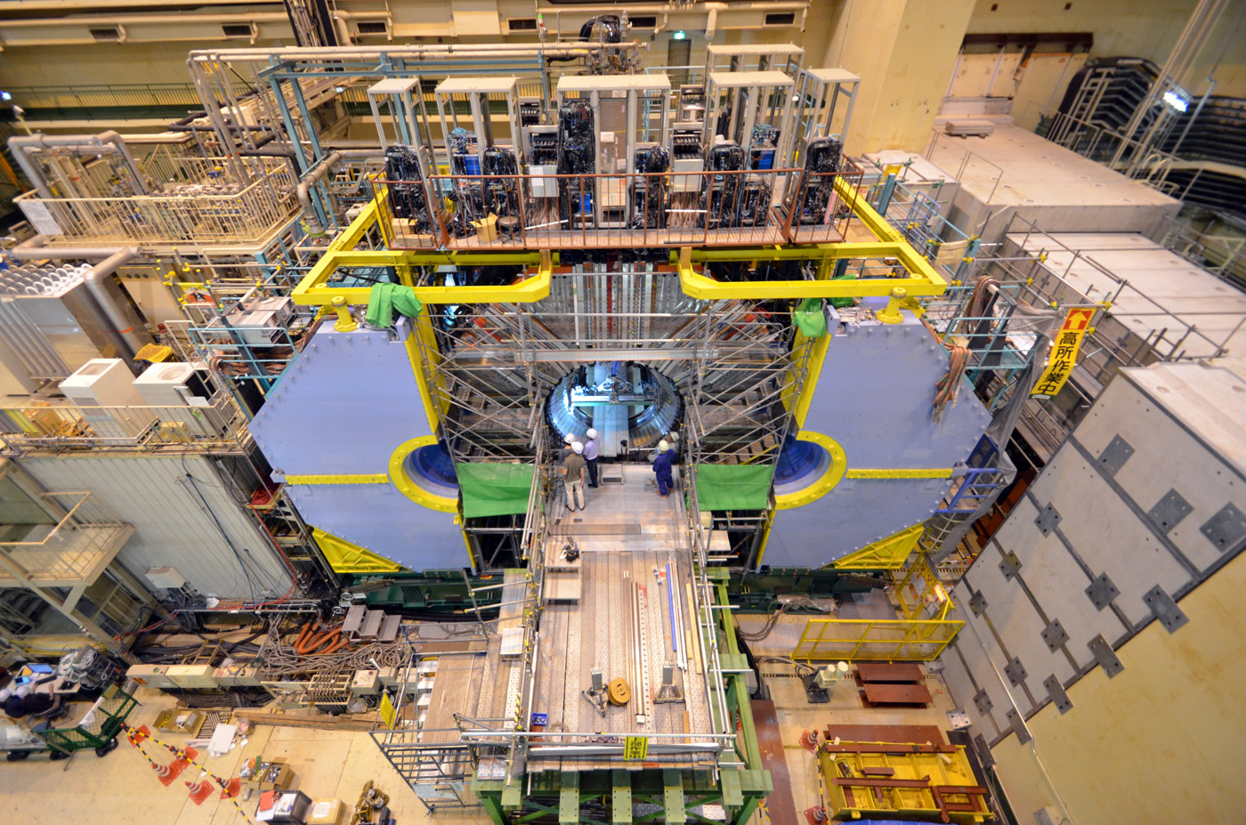
Other BEAST Spaces in VXD Racks
(FWD) PLUME:
3U module will be sit in FWD SVD FADC crate (11U) location.
(BWD) TPC:
13U modules (LV, DAQ, PC) in BWD SVD space will be used by TPC.
FWD/BWD VXD rack
650
FWD VXD rack
BWD VXD rack
650

Slide 6
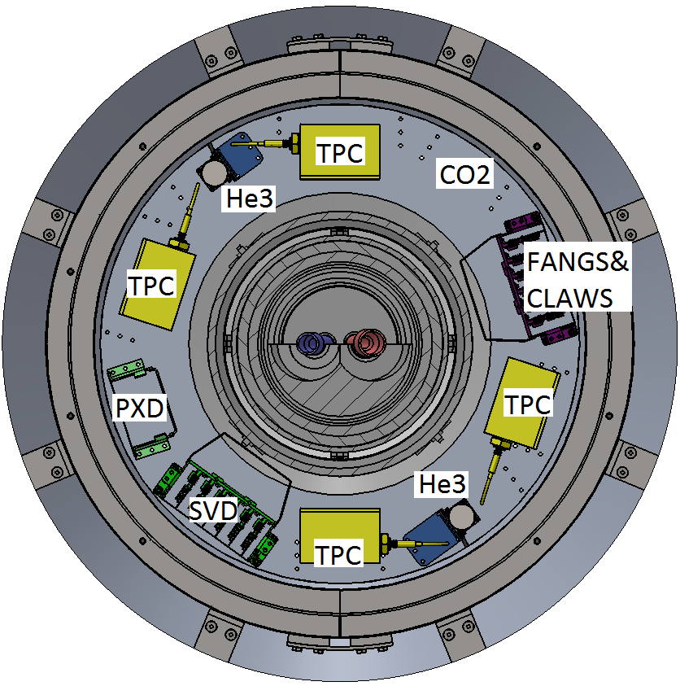
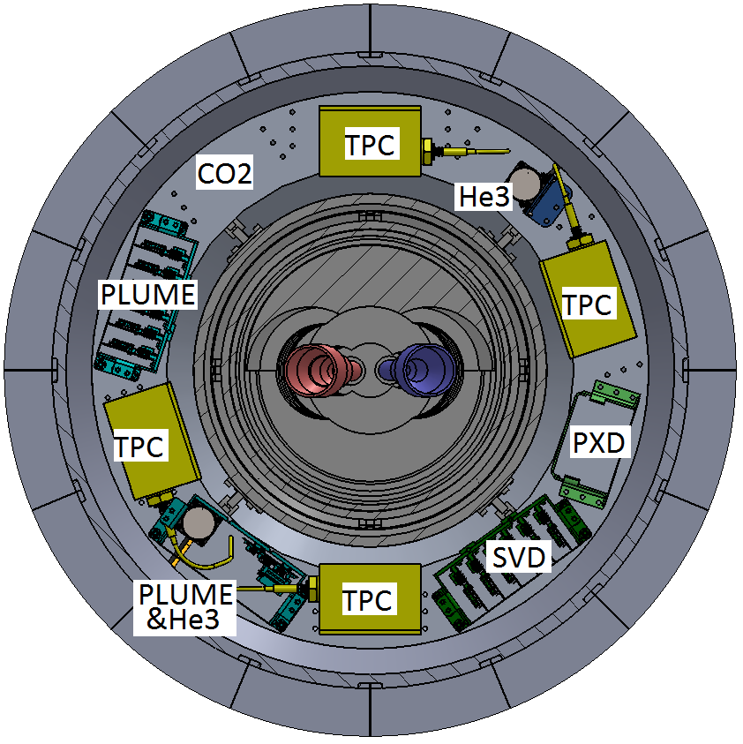
BEAST2 phase-2 dock boxes
BWD
FWD
CO2 dock box design will
be prepared by Tscharlie
③
③
④
②
②
④
①
⑤
⑤
①
⑩
⑥
⑥
⑩
⑨
⑦
⑦
⑨
⑧
⑧
PLUME and He3
sit together.
PXD, CO2 box designs are to be updated.
Interference between gap sensors and RVC side-bumps is to be checked.

Slide 7
Cabling Work
We have to install all the necessary VXD+BEAST2 cables and pipes before start of phase-2.
The cabling and piping will be done by ourselves.
Detailed cabling route and cable specification must be shown in outer-detector meeting before this work.
I will show our plan on the meeting in October or November, considering a possibility of VXD+BEAST cable installation in Jan. 2017.

Slide 8
Requirement of Flammability
Request from Adachi-san
(Feb. 24, 2015)
This boarder is
the requirement
from Adachi-san
FD = KEK facility division
Adachi-san is requesting flammability grade of UL VW-1 or higher
for all the cables.
LSZH is also acceptable.

Slide 9
Requirement of Halogen-Freeness
SVD in the last Belle experiment had an accident due to PVC (including halogen) in 2005
http://belle.kek.jp/secured/bgmpdf/2005/1115/Ushiroda.pdf
belle.kek.jp password is required.
Connectors were burnt! Very serious.
We would forbidden any non halogen-free material in VXD volume and dock area.
Please specify all materials of your connectors and cables.
Produced Chlorine/hydrochloric acid gasses corrode surrounding materials.

Slide 10
Confirmation of Flammability and Halogen Contamination
The good flammability and halogen-freeness are confirmed on the most of the cables to be installed.
But the following items are not yet:
PLUME data cables (VHDCI cable)
Halogen contamination
TPC both HV cables
Flammability + Halogen contamination
He3 HV cable
Flammability + Halogen contamination
They must be solved before the installation.
Although the cable replacement requires a big modification of the system, but especially halogen-free is important for safe operation of VXD+BEAST.

Slide 11
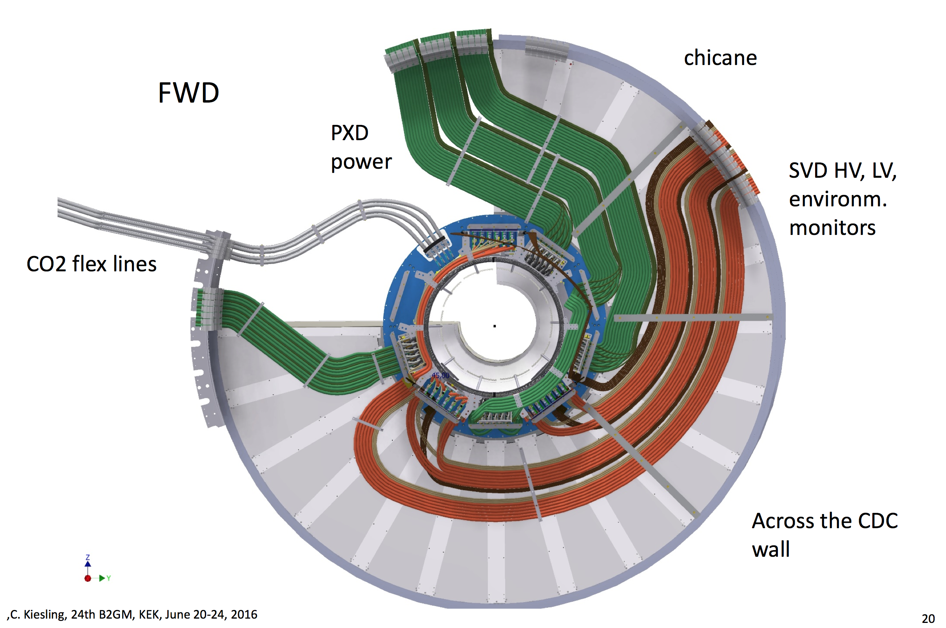
Constraint on cabling
Phase-3 cable route on CDC wall
CO2 pipe, which will be routed before our installation, is rather thick and other cables cannot cross the pipe in the CDC wall region.
Thick power cables of SVD and PXD.
Maybe no problem, but we should keep it in our mind.

Slide 12
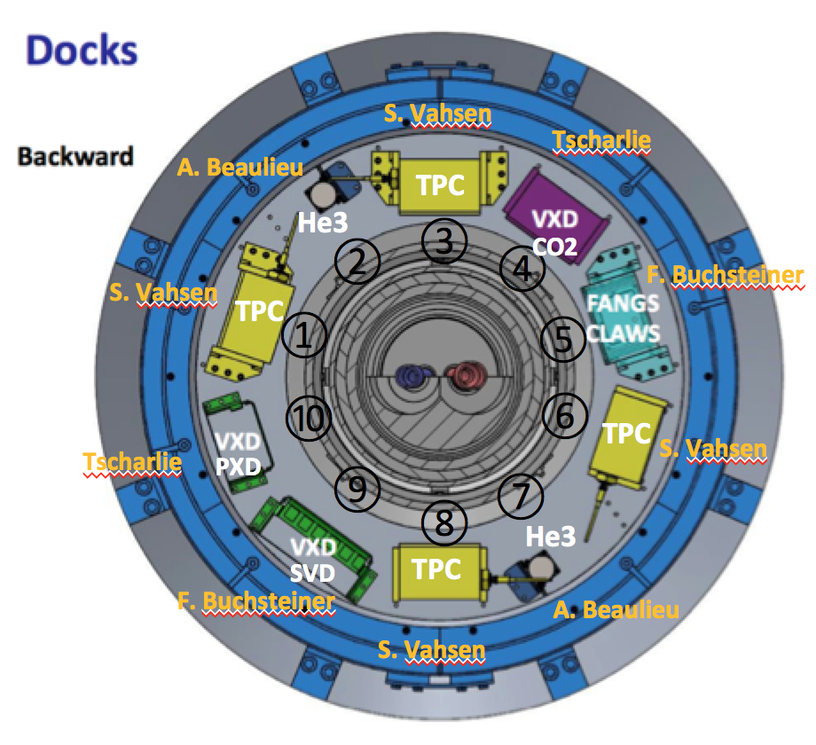
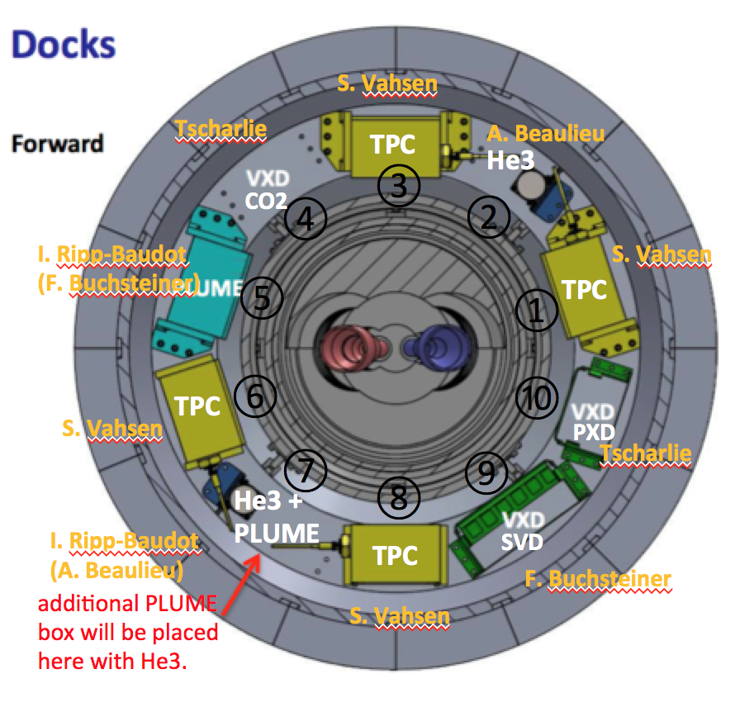
cable paths on CDC wall
He3,TPC
PXD power
He3, TPC
PLUME
SVD power
BWD
FWD
PXD power
CO2
CO2
SVD power
FANGS
CLAWS
→ E-hut
E-hut ←
PXD and SVD signal cables will go to top.
FANGS and CLAWS go to horizontal.
PLUME, TPC, and He3 go to top as well.
Maybe PLUME cable goes behind CO2 dock box? (shorter path)

Slide 13
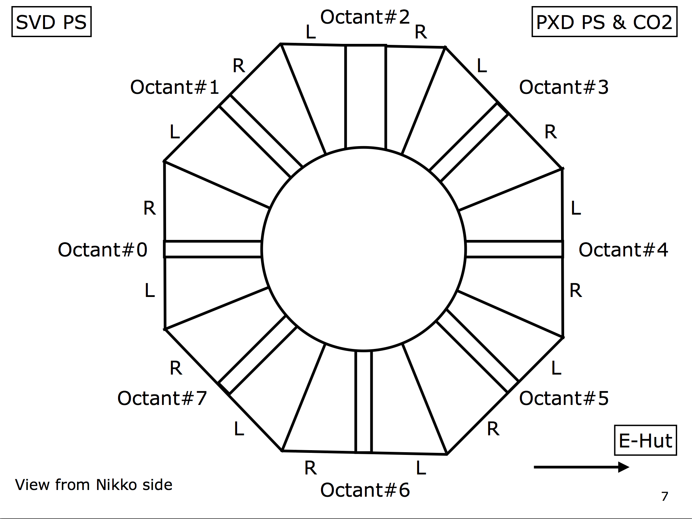
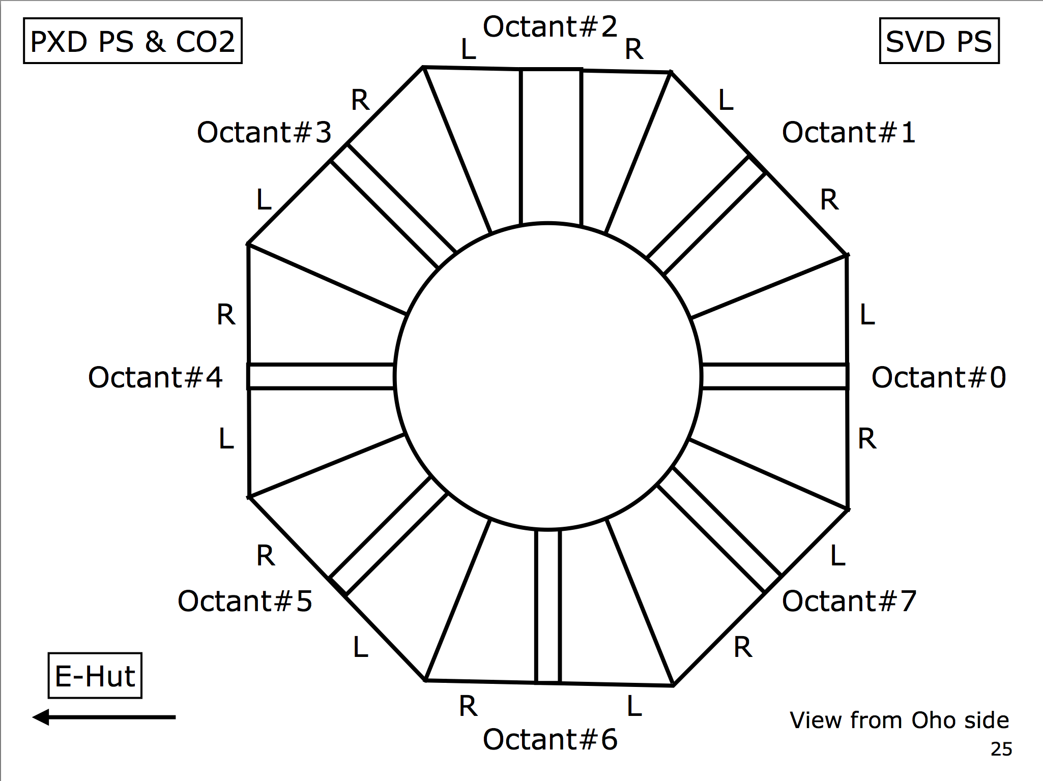
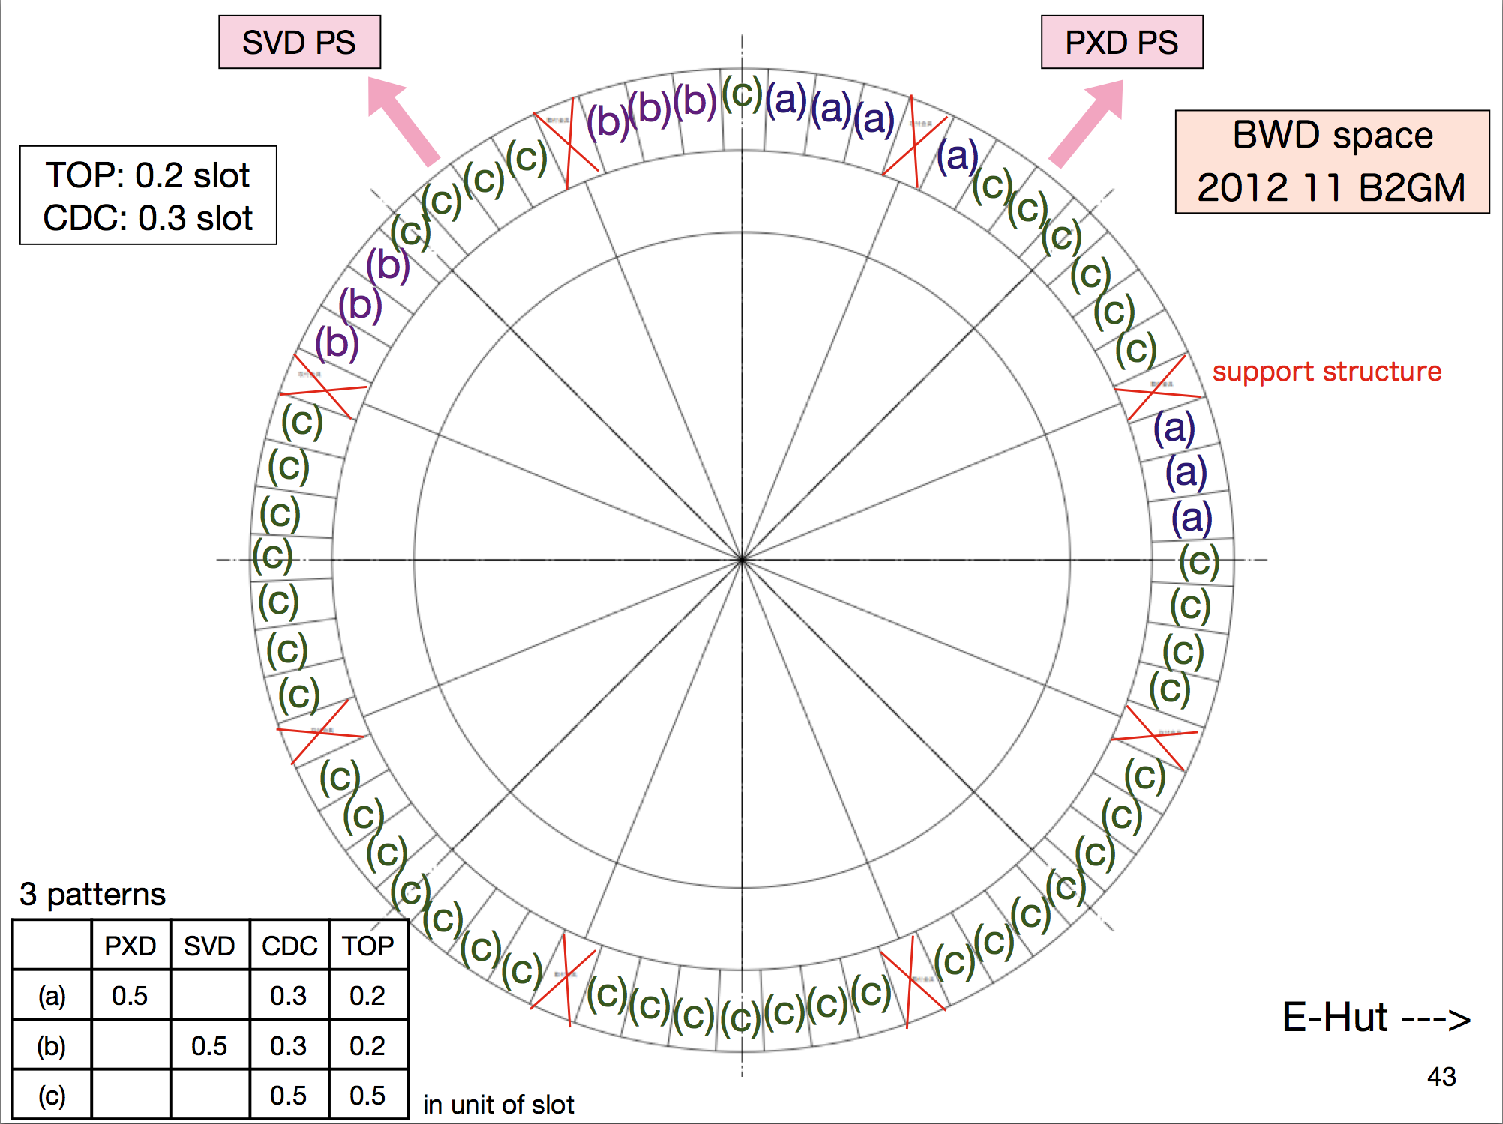
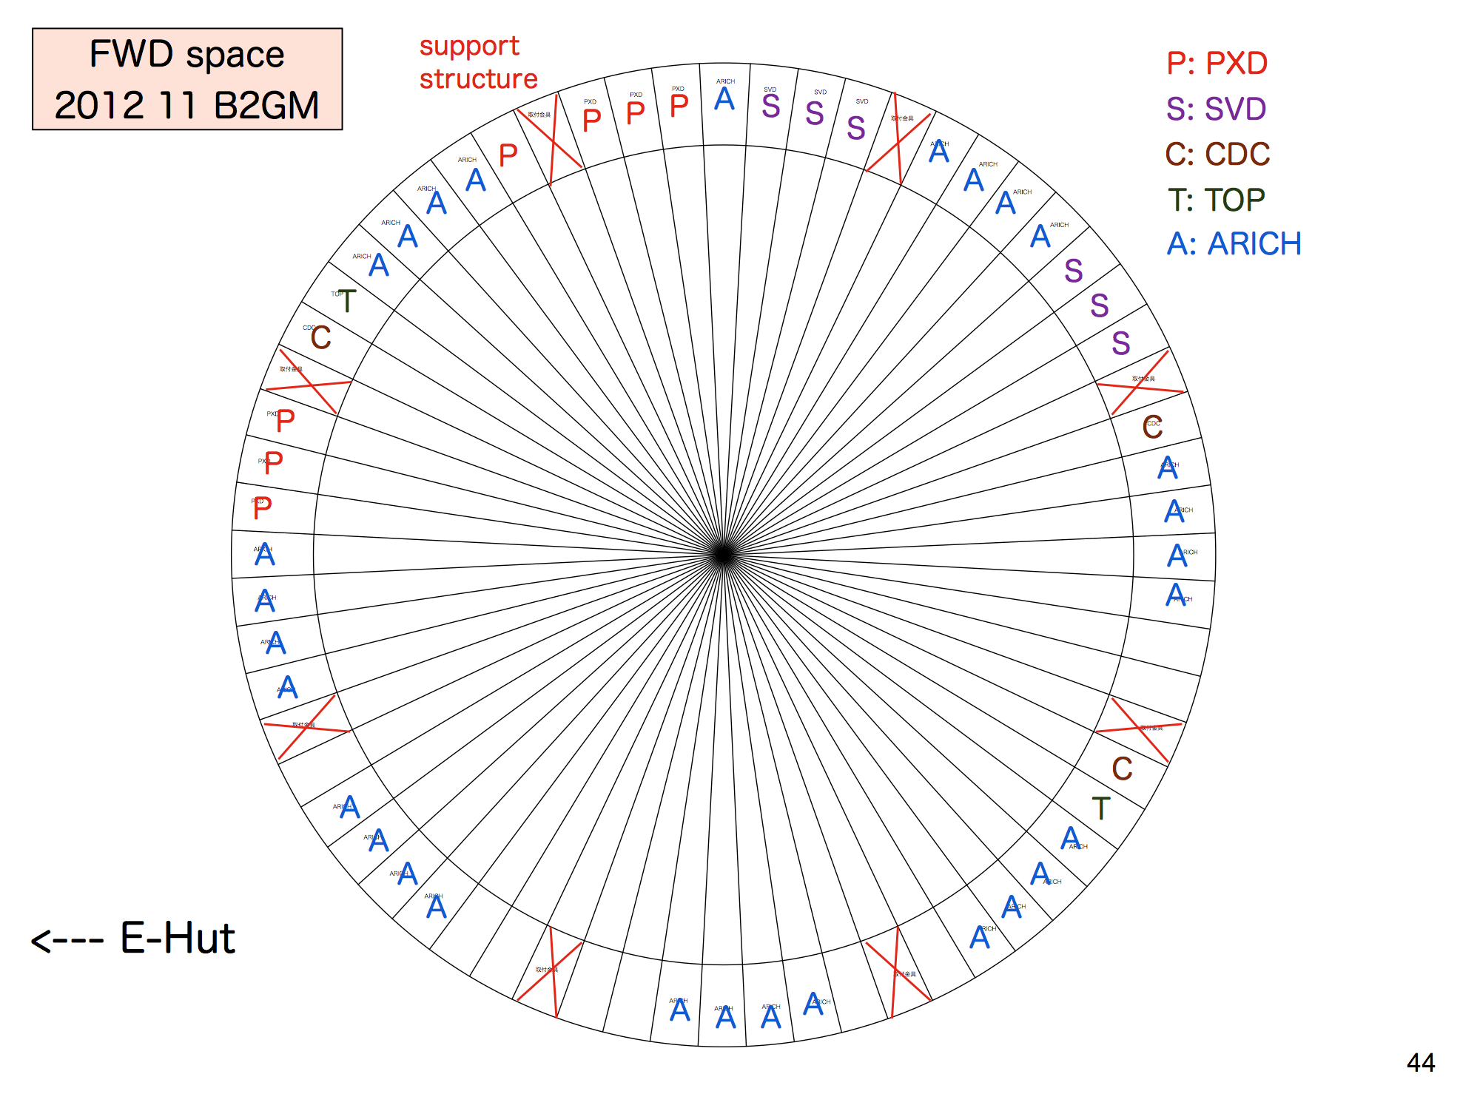
Available KLM/ECL Slot
BWD
FWD
SVD data
PXD data
He3,TPC
SVD data
PXD data
He3,TPC
PXD power
PLUME
SVD power
PXD power
SVD power
KLM
CO2
CO2
FANGS
CLAWS
ECL

Slide 14
Scintillator + PIN diodes (H. Nakayama)
Preliminary
Scintillator:
2-core cables x 20
(φ1.7mm)
PIN diode:
RG-174U (φ2.5mm)
x 20
+ pairs(φ2mm) x 20
Scintillator:
2-core cables x 20
(φ1.7mm)
PIN diode:
RG-174U (φ2.5mm)
x 20
+ pairs(φ2mm) x 20
- 40 sensors in total (10 z positions x 4 phi directions)
- Put scintillator (10mm t), PIN diode and thermal sensor at each position

Slide 15
Summary
Rack space, space allocation, cable/pipe routing:
Already determined.
Dock space:
Remaining check-point is interference between TPC and RVC side-bumps.
Cable specification:
Flammability and halogen contamination must be confirmed and solved for some cables.

Slide 16
backup

Slide 17
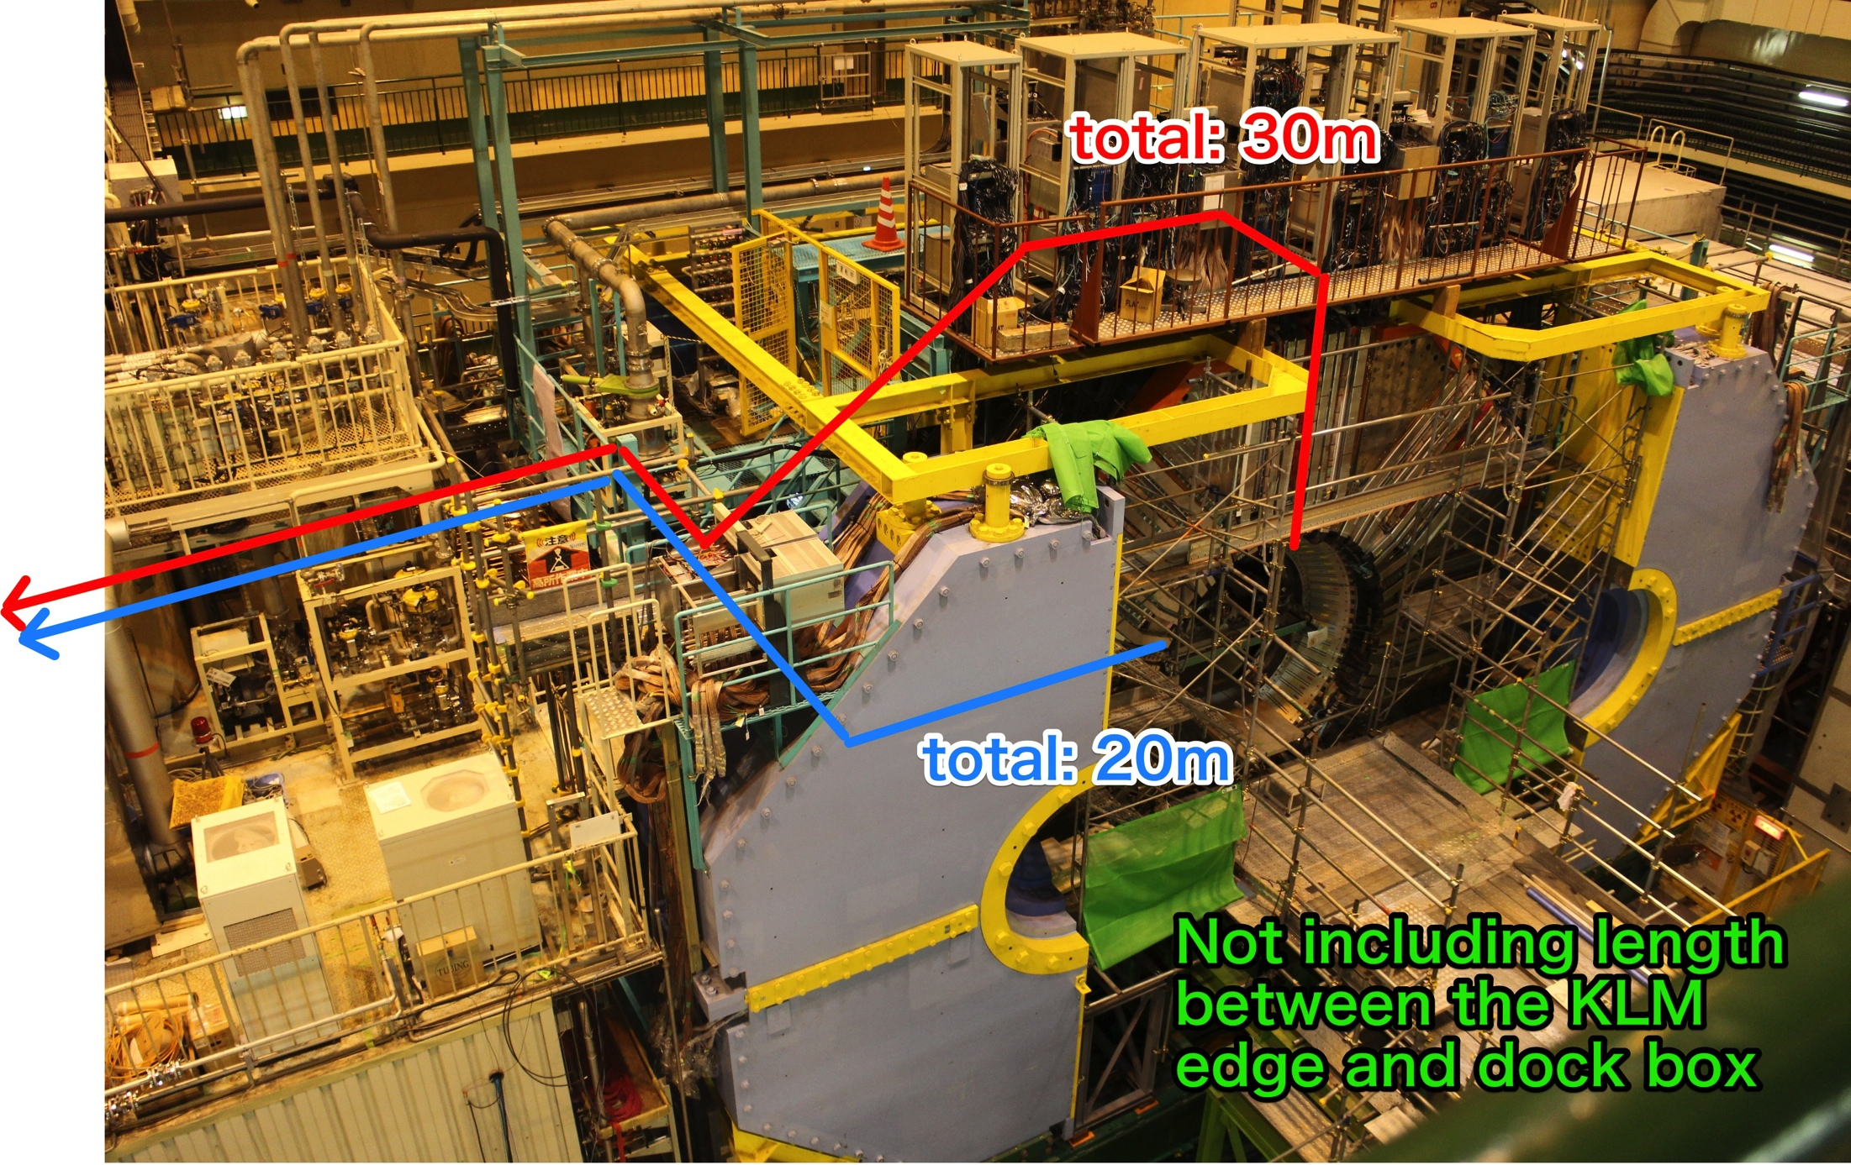
Cable path and length (from KLM edge to BEAST2 racks in E-hat)
Vertical
Horizontal
KLM edge
E-hut 2F
(The end point is the bottom of rack H-11, the farthest point in our racks)
FWD
Vertical path: 30m
Horizontal path: 22m
BWD
Vertical path: ~30m
Horizontal path: 17m
FANGS and CLAWS prefer this option
We have to add length between KLM edge and dockbox to above values! (~4-7m)

Slide 18
PXD (C. Marnas)
Please send me the PXD cable list !

Slide 19
PXD Cables (C. Marinas)
Data cables (IR - Dock):
type: “Infiniband Cable” 10GBaseCX4 (Meritec)
(diameter 9.4 mm) 69.4mm2
Flammability: LSZH
Halogen free: yes
Data cables (Dock – Top of Belle):
type: optical cable
Flammability: LSZH
Halogen free: yes
Power cables (Dock – PS):
type: nonstandard (application specific from “SAB Brockskes”)
(diameter 12.6mm) 124.7mm2
Flammability: DIN VDE 0472 part 815 and IEC 60754
Halogen free: yes (DIN VDE 0472 part 815 and IEC 60754)

Slide 20
SVD (K. Nakamura)
10x flat, ???mm², 2.5m
FADC
system
(2 FADC
boards)
FWD
VXD rack
dock box
#9
(2 junction
boards)
6x flat, ???mm², 10m
Layer-3
data/power
data
Layer-4
total: 309.8mm²
Layer-5
Layer-6
2x HV, 32.2 mm², 17m
HV power
SVD PS
2x LV, 122.7mm², 17m
LV power
total: 309.8mm²
18x flat, ???mm², 2.5m
dock box
#9
(4 junction
boards)
10x flat, ???mm², 10m
FADC
system
(4 FADC
boards)
BWD
VXD rack
Layer-3
data/power
Layer-4
data
Layer-5
total: 619.6mm²
Layer-6
4x HV, 32.2mm², 17m
HV power
SVD PS
4x LV, 122.7mm², 17m
LV power
total: 619.6mm²
CO2 tubes are not shown in this diagram.

Slide 21
SVD Cables (K. Nakamura)
Hybrid cables: 10 (FWD) + 18 (BWD)
type: 3M 79992-25P-270A (obsolete, but was in stock at CERN store)
32 x 1 mm2
Flammability: no information, but CERN is quite strict with those things
Halogen free: yes
FADC cables: 6 (FWD) + 10 (BWD)
type: Amphenol 125-3097-998
44 x 1 mm2
Flammability: UL AWM Style 20744, CSA AWM
Halogen free: yes
HV cables: 2 (FWD) + 4 (BWD)
type: HF659/10 (3M)
32.2 mm2
Flammability: UL VW-1, CSA FT-1
Halogen free: yes
LV cables: 2 (FWD) + 4 (BWD)
type: LEHC 002054 (Leoni)
122.7 mm2
Flammability: UL VW-1, CSA FT-1, IEC 60332-1-2
Halogen free: yes

Slide 22
FANGS (C. Marinas)
Side of Belle II
Octant #4
Rack
(H-8)
module 1
12x CAT7, 33.2mm², 2m
dock box
#5
12x CAT7, 33.2mm², 20m
data
module 2
30x Cu wire, 7.07mm², 2m
30x Cu wire, 7.07mm², 20m
power
module 3
total: 610.2mm²,
total: 610.2mm²,

Slide 23
FANGS Cables (C. Marinas)
Data cables : 12
cable type: CAT7
33.2mm2
Flammability grade: LSZH
Halogen-free: yes
Power cables : 30
cable type: BS EN 50525-3-41 (Pro-Power)
7.07mm2
Flammability grade: LSZH
Halogen-free: yes

Slide 24
FANGS Grounding (C. Marinas)

Slide 25
CLAWS (F. Simon)
Side of Belle II
Octant #4
Rack
(H-10)
16x coax, 1.8mm², 2m
dock box
#5
16x RG-174, 5.7mm², 20m
module 1
data
data
4x twist pair, 9.6mm², 2m
4x twisted pair, 2x2.5mm², 20m
module 2
power
power
total: 111mm²

Slide 26
CLAWS Cables (F. Simon)
Data cables (IR – Dockbox): 16
PEEK LSZH cable
0.78 mm2
Flammability grade: LSZH
Halogen-free: yes
Data cables (Dockbox – E-hut) : 16
cable type: RG-174
5.7 mm2
Flammability grade: LSZH
Halogen-free: yes
Power cables (1) : 4
cable type: TBC
56.7mm2
Flammability grade: LSZH
Halogen-free: yes
Power cables (2) : 2
cable type: TBC
28.26mm2
Flammability grade: LSZH
Halogen-free: yes

Slide 27
CLAWS Grounding (F. Simon)
Grounding of CLAWS setup via our cables connected to PSU

Slide 28
PLUME (I. Ripp-Baudot)
IR
Dock Space
Top of Belle II
E-hat 2F
Octant #2
dock box
#7
132 mm² (GND)
Rack
(H-9)
2x 34 mm² (LV)
132 mm² (LV)
Ladder 1
2x 78 mm² (LV)
AUX1
51 mm² (LV)
2x 78 mm² (VHDCI)
Buffer/
repeater
2x 78 mm² (VHDCI)
2x 78 mm²
(VHDCI)
FWD
51 mm²
FWD
132 mm² (LV)
dock box
#5
90 mm² (GND)
2x 34 mm² (LV)
Ladder 2
35 mm² (LV)
Buffer/
repeater
51 mm² (LV)
2x 78 mm² (VHDCI)
2x 78 mm² (VHDCI)
2x 78 mm²
(VHDCI)
Buffer/
repeater
51 mm²
L1/L2 PP
28 mm² (CAT6)
2x 28 mm² (CAT6)
The module will sit on
SVD 9U crate space.
(This will be free during phase-2)
total: 476mm²,
total: 913mm²,
25m
2m
10m
BWD
Space TBD
Based on PLUME_cables_in_Beast-Phase2_2016-02-29.doc circulated in early March 2016

Slide 29
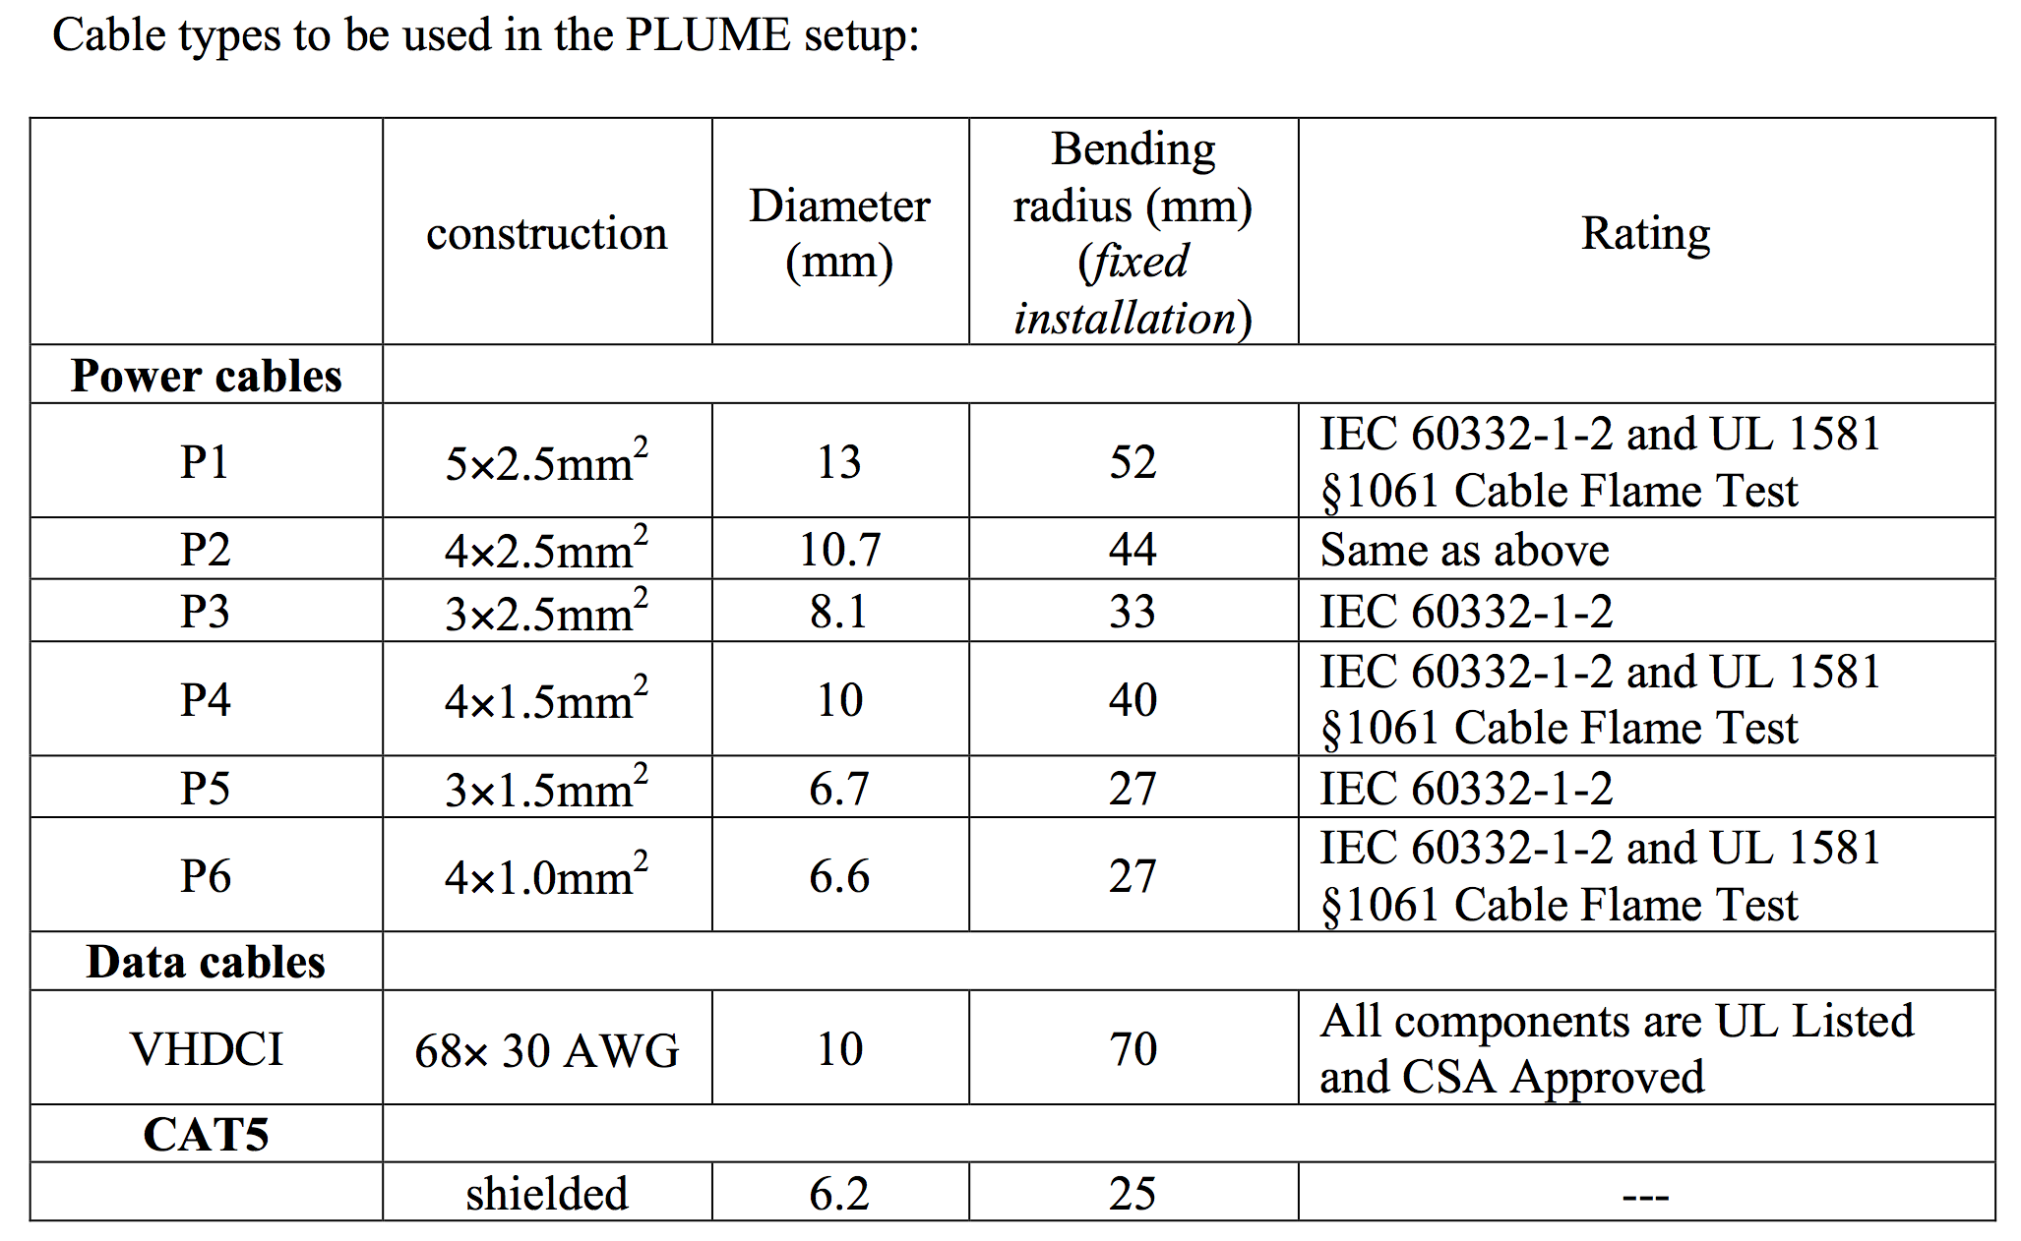
PLUME Cables (I. Ripp-Baudot)
See here for the details
All the cables has enough flammability.
Cables other than VHDCI are halogen-free, but VHDCI is not.
This must be solved.

Slide 30
PLUME Grounding (I. Ripp-Baudot)

Slide 31
VXD Monitor (L. Vitale)
NOT Top of Belle II
diamond 1
8x coax, 2.01mm²,
dock box
#9
8x coax, 2.01mm²,
diamond 2
dock box
AH501
diamond 3
dock box
diamond 4
dock box
4x diamond
20x twist pairs, ???mm²,
20x twist pairs, ???mm²,
NTCs
dock box
#9
same route as phase-3
NTC
measurement
2x SS, 33.18mm²,
dock box
#4
2x Cu, ???mm²,
sniffing pipe
Interlogater
diamond 5
8x coax, 2.01mm²,
dock box
#9
8x coax, 2.01mm²,
diamond 6
dock box
diamond 7
dock box
diamond 8
dock box
4x diamond
Dew point
measurement
28x twist pairs, ???mm²,
28x twist pairs, ???mm²,
NTCs
dock box
#9
(3+2+3)x fiber, 0.79mm²,
(3+2+3)x fiber, 0.79mm²,
FOSs
dock box
#9
Interlock
3: SVD ladders, 2: outer cover
3: FANGS
3: SVD ladders, 2: outer cover, 3: FANGS
2x SS, 33.18mm²,
dock box
#4
2x Cu, ???mm²,
same route as phase-3
sniffing pipe
Rack
(F-1,2,3,4)

Slide 32
VXD Monitor Cables (L. Vitale)
Diamond cables (IR - Dock) : 8 (FWD) + 8 (BWD)
cable type: coaxial cables (SUCOFORM_47_CU_LSFH from Huber+Suhner)
(diameter 1.7mm) 2.3 mm2
Flammability grade: LSZH
Halogen-free: yes
Diamond cables (Dock – E-hut) : 8 (FWD) + 8 (BWD)
cable type: coaxial cables (S_04162-B60 from Huber+Suhner)
(diameter 5.5mm) 23.8 mm2
Flammability grade: LSZH
Halogen-free: yes
NTC cables : 20 (FWD) + 28 (BWD)
cable type: twist cables (3M 79992-17P-270A CERN store, SCEM code 04.21.334.5)
21.5 x 0.7 mm2
Flammability grade: as from CERN regulations IS23
Halogen-free: as from CERN regulations IS23
FOS fiber cables: 8 (BWD)
cable type: fiber (SM-28C, acrylate coating)
(diameter 0.9mm) 0.6 mm2
Flammability grade: LSZH (UL 94V-0)
Halogen-free: yes

Slide 33
micro-TPC (S. Vahsen)
(HV) 2x ???, 41mm², 35m
TPC
dock box #1
(LV) 2x CAT7, 21mm², 35m
(gas) 2x SS tube, 20mm², ???m
Better to use
Cu tubes???
(HV) 2x ???, 41mm², 35m
TPC
dock box #3
(LV) 2x CAT7, 21mm², 35m
(gas) 2x SS tube, 20mm², ???m
(HV) 2x ???, 41mm², 35m
TPC
dock box #6
(LV) 2x CAT7 21mm², 35m
(gas) 2x SS tube, 20mm², ???m
(HV) 2x ???, 41mm², 35m
TPC
dock box #8
(LV) 2x CAT7 21mm², 35m
(gas) 2x SS tube, 20mm², ???m
Rack
(H-8)
Total: 656mm²,
(HV) 2x ???, 41mm², 35m
VXD rack
(BWD)
13U space
TPC
dock box #1
(LV) 2x CAT7, 21mm², 35m
(gas) 2x SS tube, 20mm², ???m
(HV) 2x ???, 41mm², 35m
TPC
dock box #3
(LV) 2x CAT7, 21mm², 35m
(gas) 2x SS tube, 20mm², ???m
(HV) 2x ???, 41mm², 35m
TPC
dock box #6
(LV) 2x CAT7, 21mm², 35m
(gas) 2x SS tube, 20mm², ???m
(HV) 2x ???, 41mm², 35m
TPC
dock box #8
(LV) 2x CAT7, 21mm², 35m
(gas) 2x SS tube, 20mm², ???m
Total: 656mm²,
gas supply
Top of E-hut

Slide 34
micro-TPC Cables (S. Vahsen)
8kV/3kV HV cables: 8 (FWD) + 8 (BWD) (requesting another 16 (FWD) + 16 (BWD) )
cable type: TBC
21.2 mm2
Flammability grade: TBC
Halogen-free: TBC
LV cables : 8 (FWD) + 8 (BWD)
cable type: CAT7
40.7 mm2
Flammability grade: LSZH
Halogen-free: yes
requesting another coaxial cables: 4 (FWD) + 4 (BWD)
cable type: RG-58
21.2 mm2
Flammability grade: TBC
Halogen-free: TBC

Slide 35
micro-TPC Grounding (S. Vahsen)
Please let us know the information!

Slide 36
He3 (S. De Jong)
He3
dock box #2
(HV) 1x Belden 9209, 28mm², 39m
(LV) 1x CAT6, 21mm², 39m
He3
dock box #7
(HV) 1x Belden 9209, 28mm², 39m
(LV) 1x CAT6, 21mm², 39m
Total: 99.0 mm²,
Rack
(H-10)
He3
dock box #2
(HV) 1x Belden 9209, 28mm², 39m
(LV) 1x CAT6, 21mm², 39m
He3
dock box #7
(HV) 1x Belden 9209, 28mm², 39m
(LV) 1x Belden 9209, 21mm², 39m
Total: 99.0 mm²,

Slide 37
He3 Cables (S. De Jong)
Belden 9209 HV cables: 4 (39m)
28.3 mm2 (6mm diameter) (But still looking for other solution)
Flammability: TBC
Halogen free: yes (PE insulator)
(Bending radius: 2.5 inch.)
CAT6 cables: 4 (39m)
21.2 mm2 (5.2mm diameter)
Flammability: LSZH
Halogen free: yes

Slide 38
He3 Grounding (S. De Jong)
Simple solution: electrically isolate He3tube supports from the rest of the structure
But they will try some combinations for grounding at He3 commissioning.

