Slide 1
Export of PXD Parts
So far we have experience with:
Transport of small items as hand luggage (be aware of security check).
Air freight of bulky components.
See freight of (very) large and heavy components.
Taxes: like in Markus’ talk.
Temporary import is complicated, for items of low values it is cheaper to pay the taxes .
Donation: we do it for IBBelle, let’s see in October whether it works.
- Donation letter.
- Proforma invoice.
- start well in advance.

Slide 2
Costs: Air Freight/Sea Freight
Air freight: Fast, takes about 1 week
Costs: depends on weight:
610 kg: ~ 4000€ (sea freight for return: 2000€)
135 kg: ~ 840€
=> 6 €/kg
Sea freight: ~40 days
IBBelle: 40’ high cube container, 3.5t (total)
ITG/K Line Logistics
Container rent, Pick up in Munich -> Hamburg: 1190€
Shipment to Tokyo: 1740€
Tokyo port -> KEK 1880€
4810€
Handling at KEK will lead to additional costs:
lowering IBBelle from truck into hall: 3800€

Slide 3
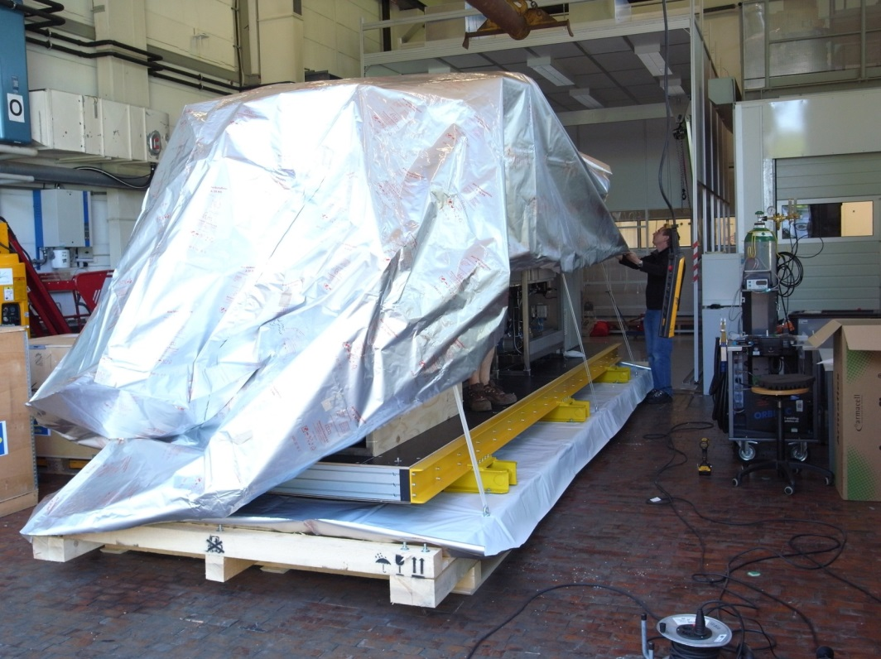
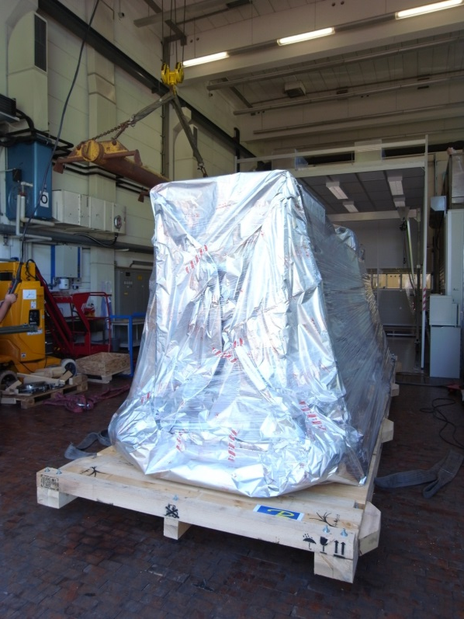
Packaging:
Sea transport: 80°C on deck, 100% humidity in load
to avoid corrosion: seal in special foil, fill with desiccant
done by specialised company (1800€, including pallet and container stacking.
Air freight: some freighters have no air conditioning (-40°C)
=> similar protection recommended

