Slide 1
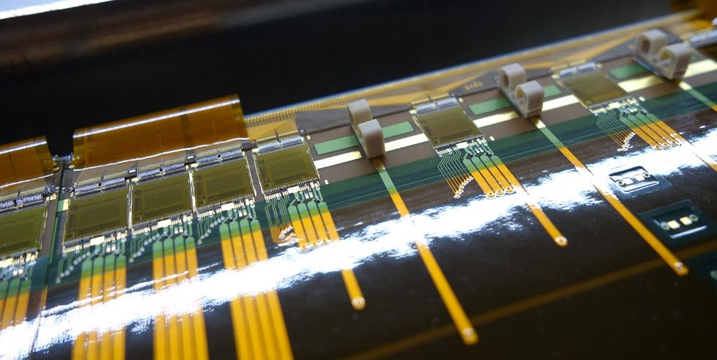
SVD Slow Control Overview and Network
10th VXD Workshop, Santander, Spain

Slide 2
Introduction
Overview about SVD SC system
Names and purpose of subsystems and IOCs
First draft of network and server configurations
Intended as starting point for discussion
Manpower

Slide 3
SVD Slow Control System Overview

Slide 4
FADC related IOCs (1)
FADC CTRL:
IOC to configure and control FADC and FADC-Ctrl boards
HW interfaces:
CAEN VME controller
High speed Ethernet to FADC spydaq network
SVDQM:
Low level quality monitoring (down to APV level)
Analysis of local run data
Requires high processing power
Where to store data → local? KEKCC?
HW interface: none
Receives FADC spy data via dedicated local socket
Strongly coupled IOCs → can run on same server

Slide 5
FADC related IOCs (2)
FADC CM:
FADC crate monitoring (CM)
Voltages, currents, fan speed, temperatures, etc.
Protocol: SMP
HW interface: Ethernet
SVD CTRL:
Interface to Belle II RC
Controls SVD state machine
HW interface: Ethernet (EPICS)
Can share server with FADC Ctrl and SVDQM

Slide 6
Power Supply IOCs
SVD_PS:
To configure and control of CAEN power supplies
Monitoring of voltages and currents
Implementation of Belle II PS state machine
CAEN PS crate monitoring
HW interface: Ethernet, anything else?
SVD_PSPP:
IOC to configure and control PS patch panels
Vsep polarity inversion
Further “intelligent” functionality?
HW interface: Ethernet?
Ethernet only? → Can run on any IOC server
Could share server with environmental monitoring system

Slide 7
Environmental Monitoring IOCs (1)
NTC:
NTC sensors IOC
Dedicated interface board required for server?
HW interface: CANbus, Ethernet?
FOS:
Fiber optics sensor (FOS) IOC
Same system as PXD but dedicated HW
Common IOC with PXD?
HW interface: Ethernet?

Slide 8
Environmental Monitoring IOCs (2)
HUM:
Humidity monitoring
Common VXD system
HW interface: Ethernet? / other?
RAD:
Radiation monitoring, diamonds
Common VXD system
HW interface: Ethernet? / other?

Slide 9
Other IOCs / Systems
SVD CA gw
Separates belle2epics and SVD epics
Reduce the amount of process variables (PVs) transmitted to belle2epics
Do we need this CA gateway or can we just connect the two epics networks?
If yes, which process variables (PVs) shall be forwarded to belle2epics?
SVD archiver
Archiver for all relevant SVD PVs
Can we use the same archiver as PXD?
Answer from M. Ritzert: rather no
If yes, do we need to connect pxd epics with svd epics?
Directly or via CA gateway?

Slide 10
Databases
Need to interface with several databases
Configuration DB
Condition DB
Archiver
Error and alarm logging
other?
At the moment nobody concentrates on this!
Currently we use XML files for configuration

Slide 11
Responsibilities and Manpower
Number of person working on SC is low
Hao Yin
SVD CTRL, FADC CTRL, SVDQM, FADC CM
incl. CSS for these modules
Good progress since beam test → see Hao’s presentation
Szymon Bacher
SVD_PS, NTC
HUM?, RAD?, SVD_PSPP?
Not so much progress since test beam
Christian Irmler (partly ~10%, still busy with ladder assembly)
SC group management
Server and Network configuration

Slide 12
Poorly Covered Tasks
The following tasks and subsystems are not or just poorly covered
FOS
Same system as PXD, but can we also share IOC?
Suppose we can use same IOC, but should run on SVD server
Need to implement SVD specific CSS
Coordination of SC activities → SC group management
So far, partly done by myself
Will be busy with L5 assembly until summer 2017
Databases, archiver, gateways, system and network architecture

Slide 13
Network Configuration (Draft)
First draft, assuming that IOCs are distributed among 2 servers
One for FADC related IOCs and a second for the rest (PS, environment, etc.)
To be discussed
Remote connection to our machines via bdaq and access gateway

Slide 14
SVD Networks
svd epics
Local SVD EPICS network → all SVD PVs
Connection to b2epics: directly or via CA gateway?
Dedicated server or VM for CA gateway?
svd management
Remote access to our servers and devices
Used for management and configuration purposes (ssh)
FADC spydaq
High speed network for GB links of FADC boards
Two switches at each FADC rack (FW and BW)
Several optical links between switches and E-hut
DAQ network for local runs and spy data

Slide 15
Belle II Networks
bdaq
Belle 2 DAQ network
Used to access DAQ servers
Remote connection to our machines via bdaq?
b2epis
Belle 2 epics network
How to connect?
Directly or via CA GW?

Slide 16
SVD SC/RC Computing HW
How many servers do we need?
Need to ensure failsafe operation over several years
So far we have purchased 1 server for FADC system
Is this sufficient? → Not yet clear.
Need to define computing infrastructure
Can / shall we use virtualization
Dedicated VM for each IOC or group of IOCs
Ideal for IOCs, which do not require special HW interface
Allows to implement nice load balancing and error handling, e.g. if one server fails another can take over IOCs
Need to verify compatibility with HW interfaces
Probably requires to duplicate some HW interfaces

Slide 17
Summary
Number and tasks of SVD SC sub-systems well defined
Manpower is marginal
Some tasks are not well covered, e.g. databases, management
Need to define / assign work packages and schedule
Computing and network infrastructure
First ideas exist, but nothing decided
Many questions open?

